Slide 1
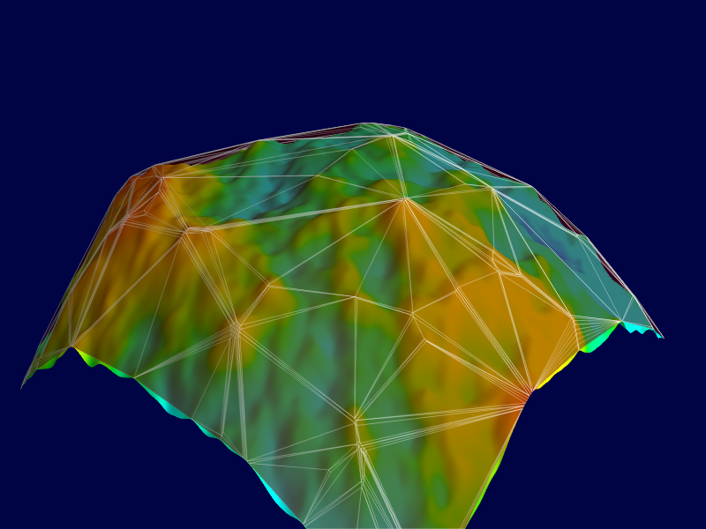
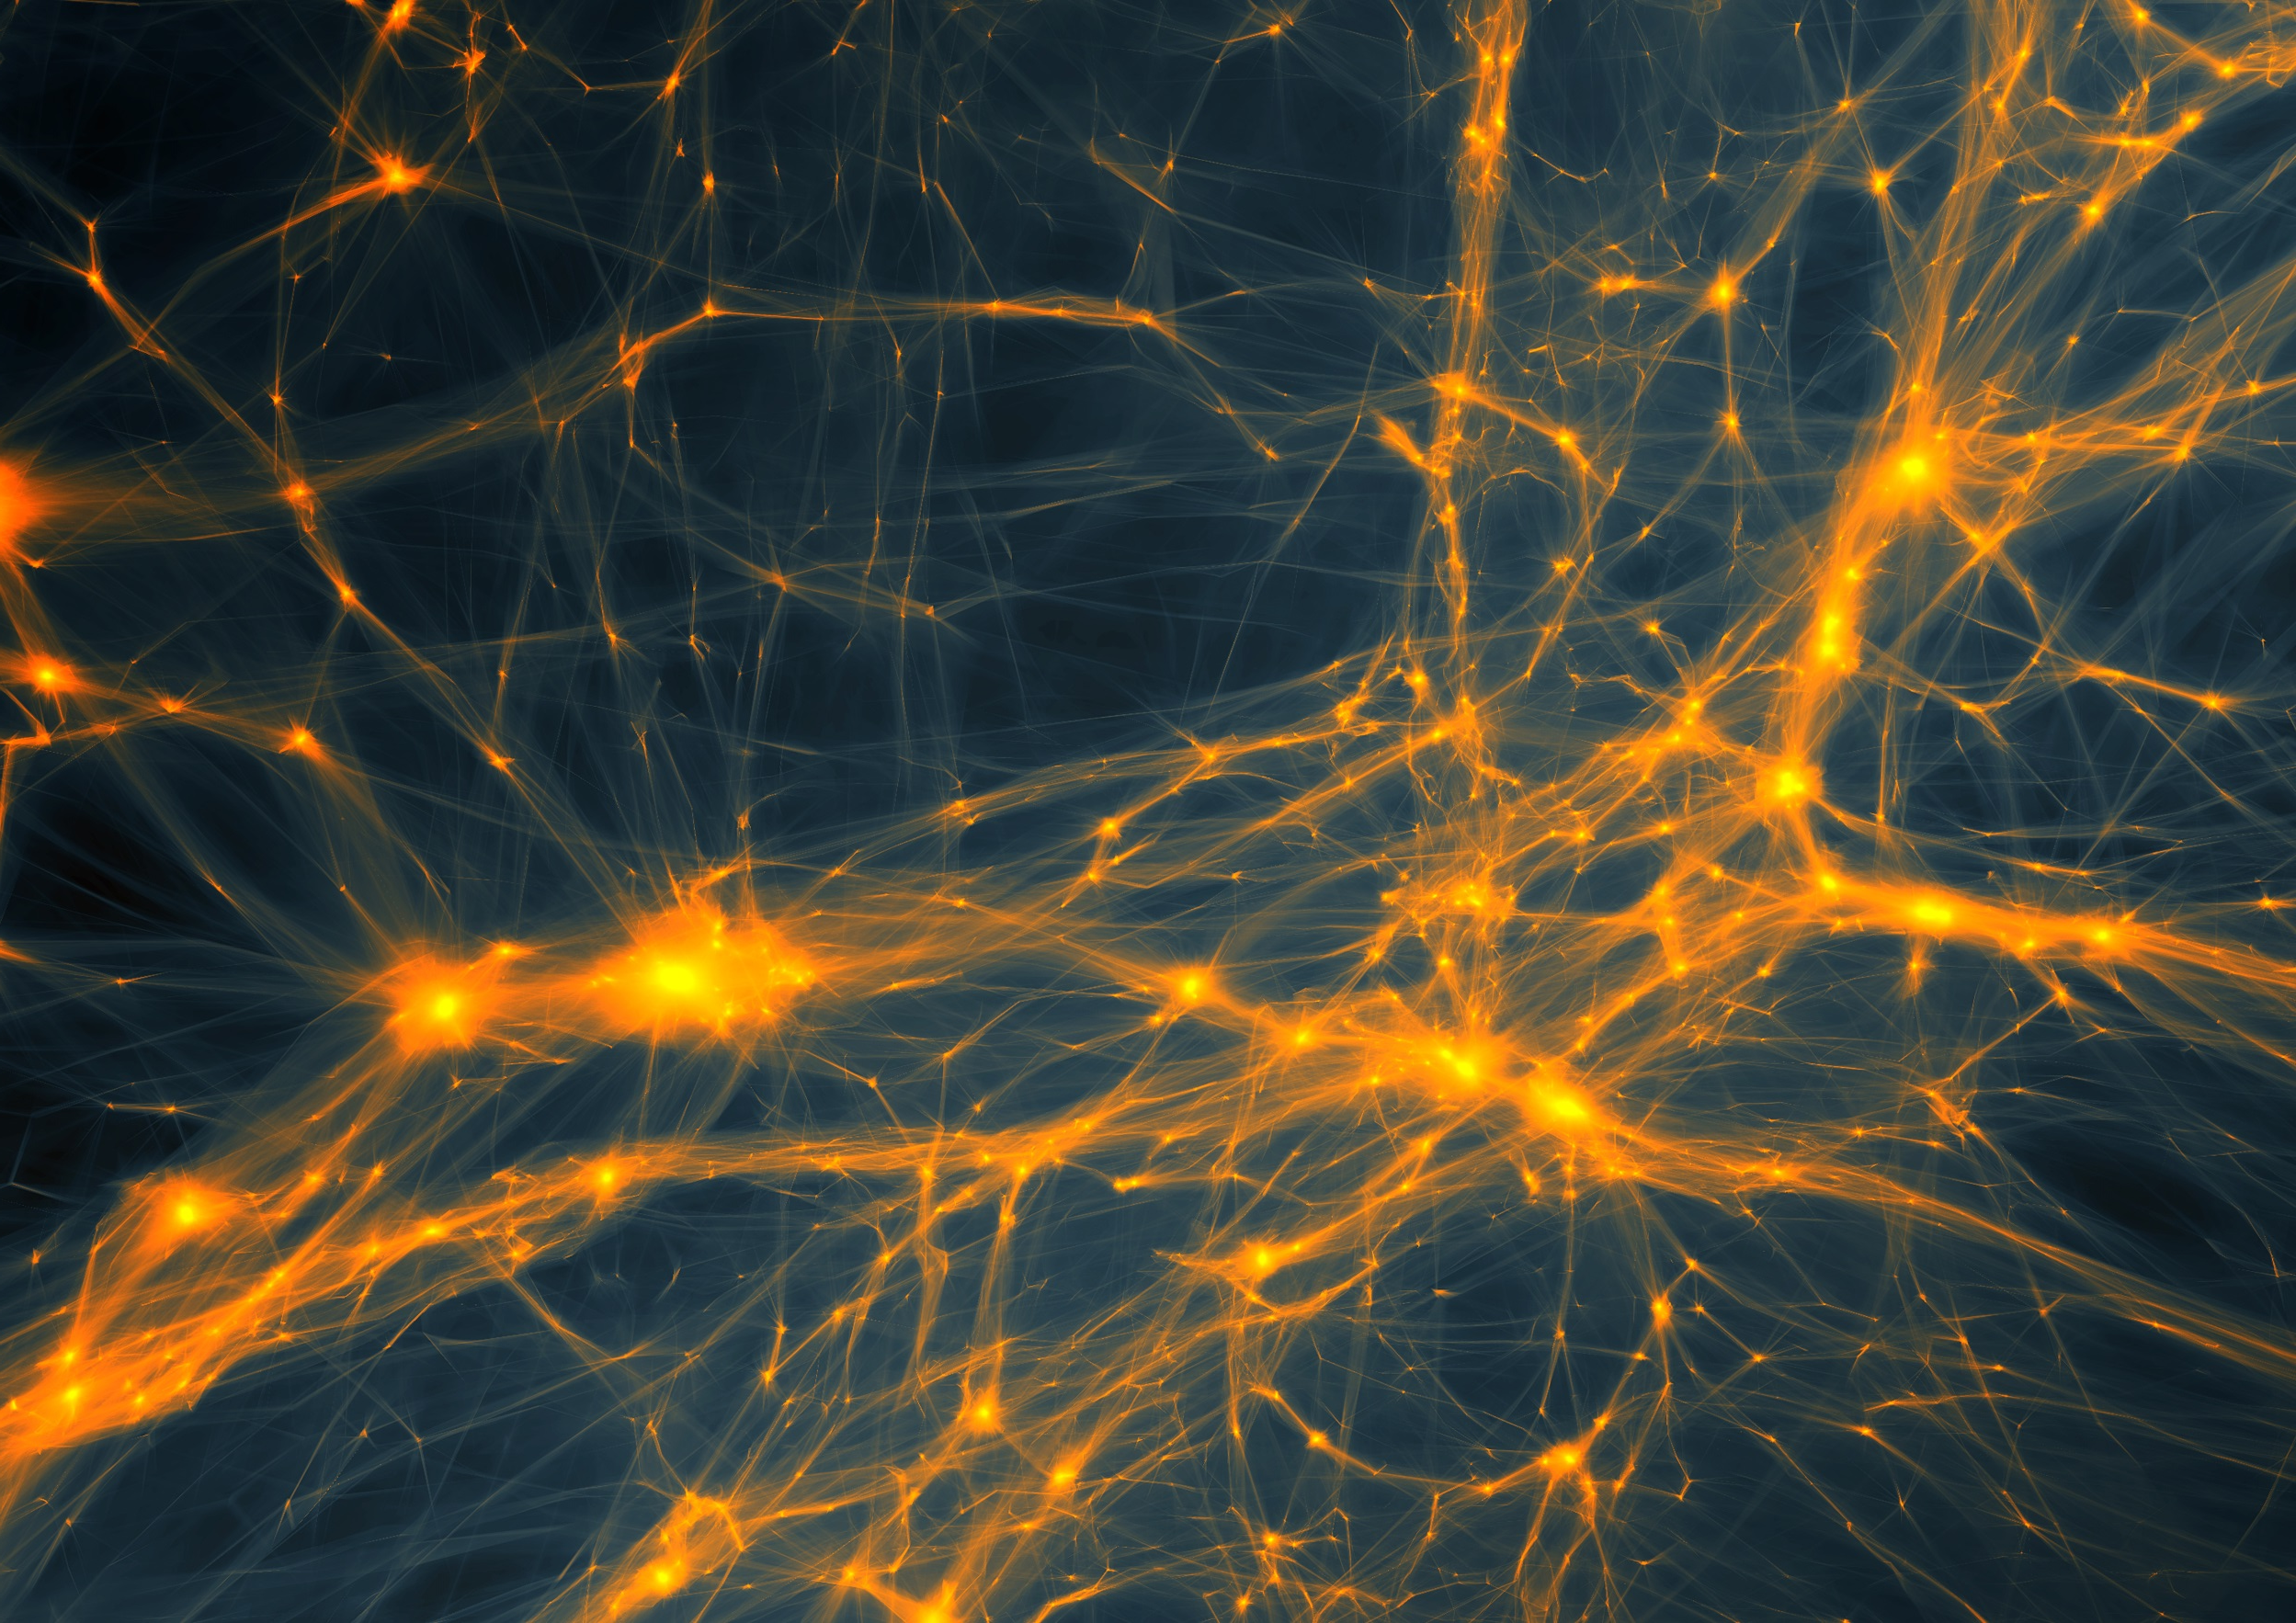
Cosmic Structure:
Lecture 9
Observational Probes
&
Surveys
Rien van de Weijgaert,
Cosmic Structure Formation, Oct. 2018

Slide 2
Galaxy & Cluster Distribution

Slide 3
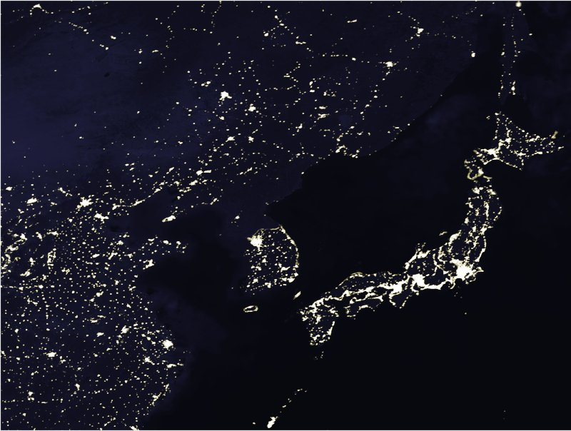
Map of the Universe
How to map the structures and
patterns in the Universe ?
Use galaxies as beacons
Map of
Galaxy positions
Tracing of structures from
distribution of galaxies

Slide 4
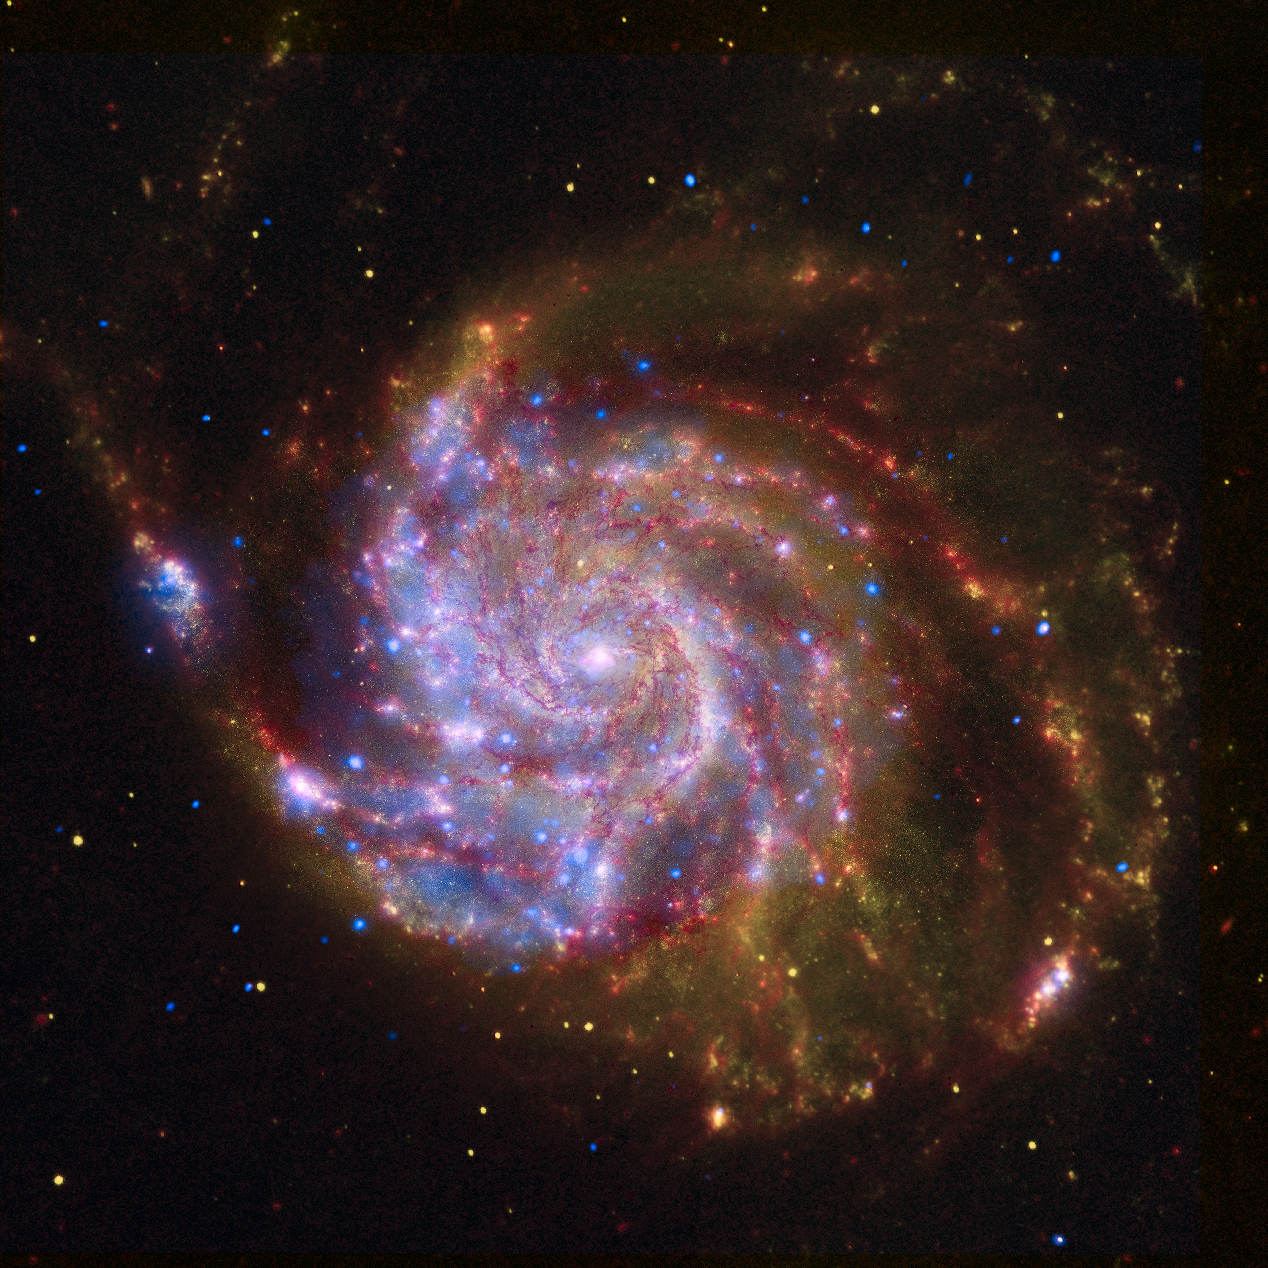
… Galaxies …

Slide 5
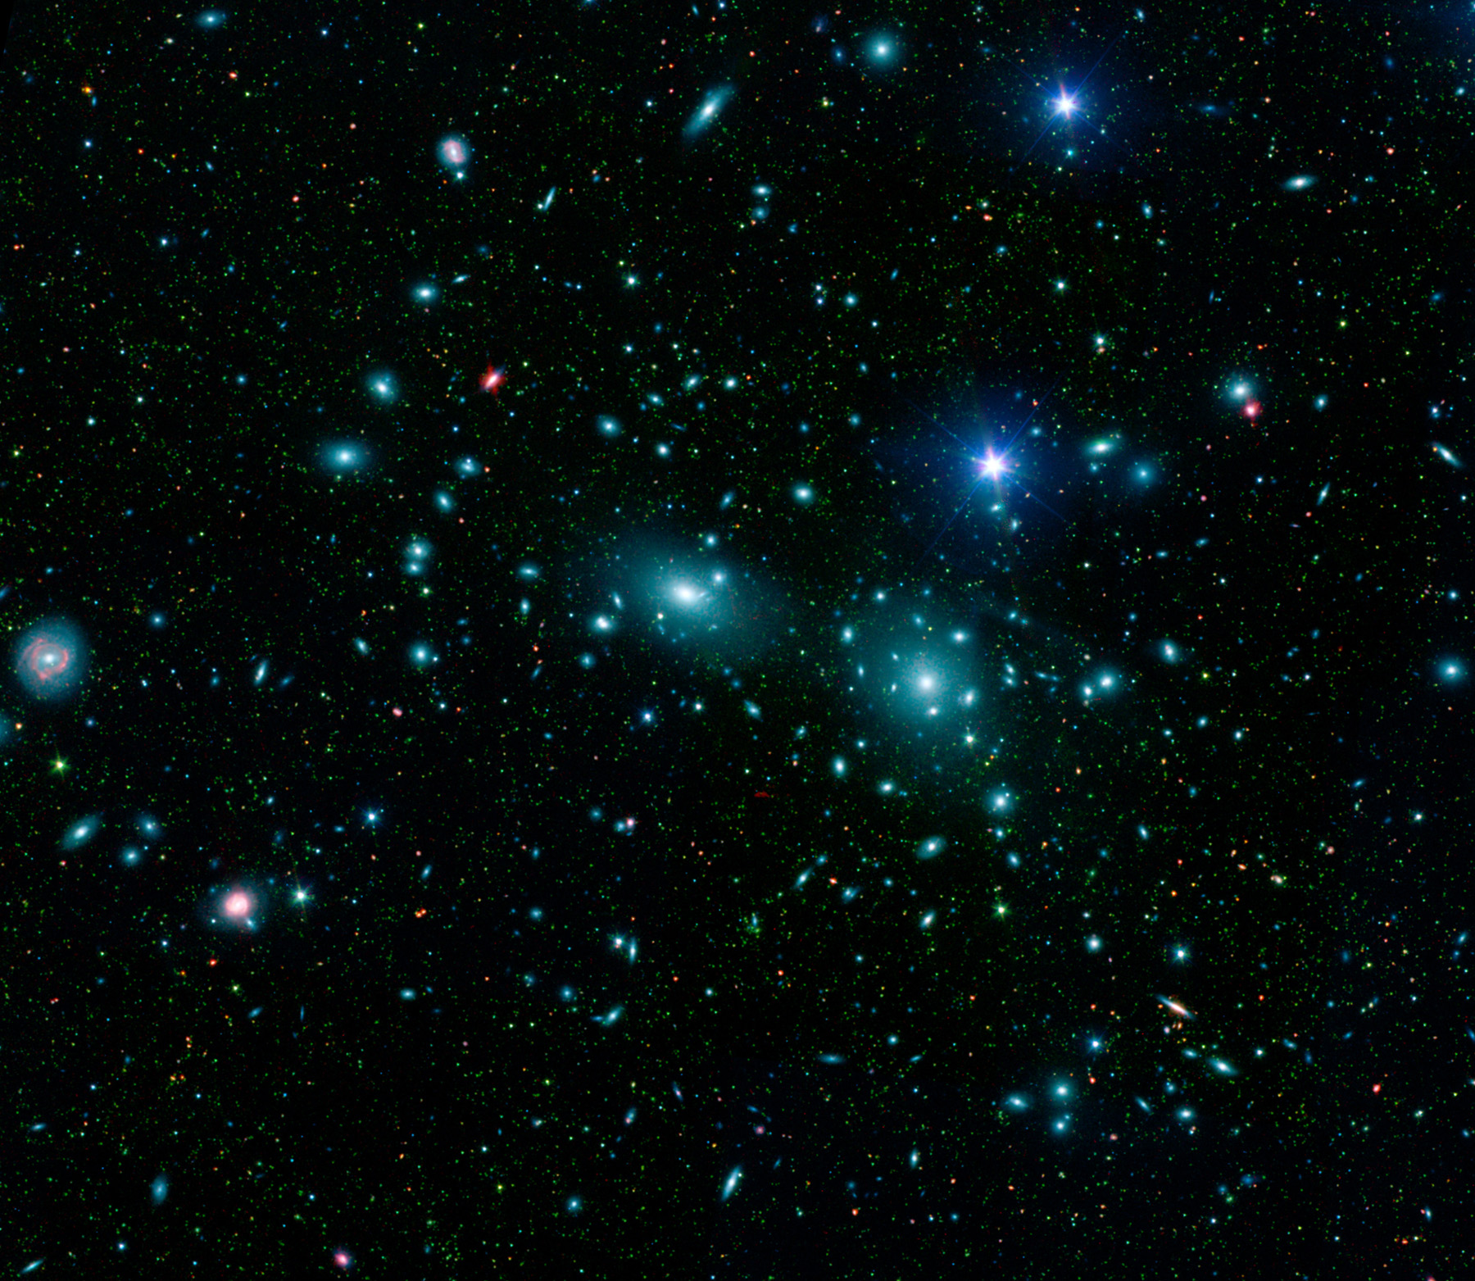
Clusters of Galaxies
Coma Cluster

Slide 6
Galaxy Surveys:
Luminosity Function
&
Survey Depth

Slide 7
Galaxy Surveys
Galaxies , Groups, Clusters & Superclusters:
Tracers of Structure in the Universe
discrete tracers of underlying density field:
Fair or Biased Tracer ?

Slide 8
Galaxy Surveys
Ideal Sample:
- all sample points have exactly the same properties
over complete “survey volume”
However …
galaxies have different luminosities, sizes, etc.:
- systematic influence on distribution as function of
depth
- do galaxy properties depend on environment ?

Slide 9
Galaxy Surveys
Various selection criteria:
+ magnitude-limited
+ angular diameter – limited
Galaxy distribution as tracer cosmic structure:
+ requirement to understand selection (r,,,,T):
sampling rate of galaxies at
distance r
sky position ,
frequency 
galaxy type T
Most convenient and best controlled:
+ selection on basis luminosity/brightness

Slide 10
Luminosity Function
Large variety of galaxies
- ranging from dwarfs to giant ellipticals
- large range of luminosity/brightness
Luminosity distribution:
number density of galaxies with luminosity
PS. Luminosity distribution may depend on various
galaxy properties, such as morphological type

Slide 11
Schechter Luminosity Function
Very good approximate expression for the
galaxy luminosity distribution:
Schechter Luminosity Function:
Parameterized by 3 parameters:
* : normalization density parameter
L* : characteristic luminosity
 : faint-end slope

Slide 12
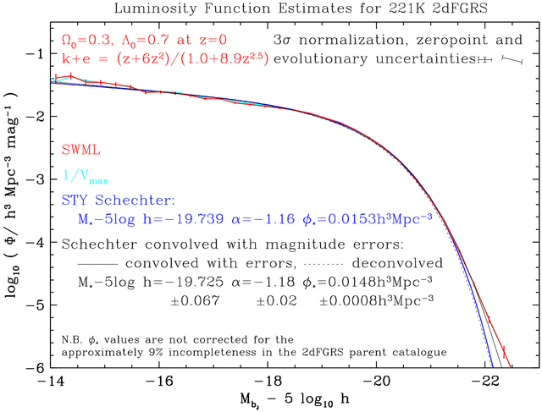
Schechter Function

Slide 13
Schechter Luminosity Function
Mean space density gal’s:
- Gamma function:
- Notice: divergent if <-1
(infinite contribution faint gal’s)
Mean Luminosity (from cosmic volume)
- divergent only if <-2

Slide 14
Schechter Luminosity Function
2dFGRs luminosity function:
Faint Galaxies dominate number density !!!!!
Bright Galaxies determine the luminosity (stars)
in a cosmic volume !!!!!

Slide 15
Survey Depth
Most galaxy surveys defined by
apparent magnitude limit m_{lim}
All galaxies having an apparent brightness higher
than that corresponding to m_{lim} are included in
survey
Depends on
- intrinsic brightness/absolute magnitude M
- (luminosity) distance d_{L}
(- k-correction: shift galaxy spectrum as function redshift z)
Absolute Magnitude Apparent Magnitude

Slide 16
Survey Depth
For a survey with magnitude limit m_{lim}:
At distance d_{L} (Mpc) one can see galaxies
brighter than:
Survey Depth d_{sur}:
distance out to which one can see an
M galaxy:

Slide 17
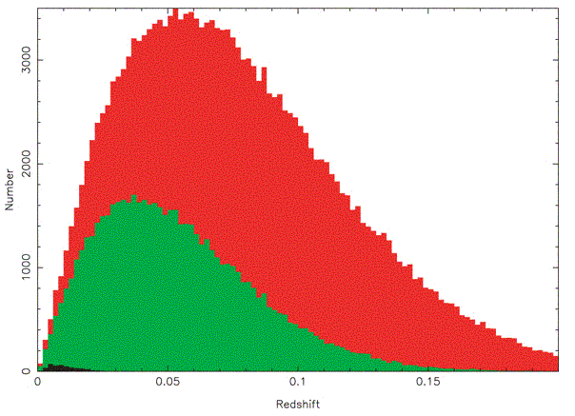
Survey Depth
Depth Survey
Increasing number
of galaxies because
of
increasing volume:
N(z) dz  z² dz
Diminishing number
as only galaxies
brighter than M can
be seen:
sampling the exponential fall-off
of Schechter function
Redshift z

Slide 18
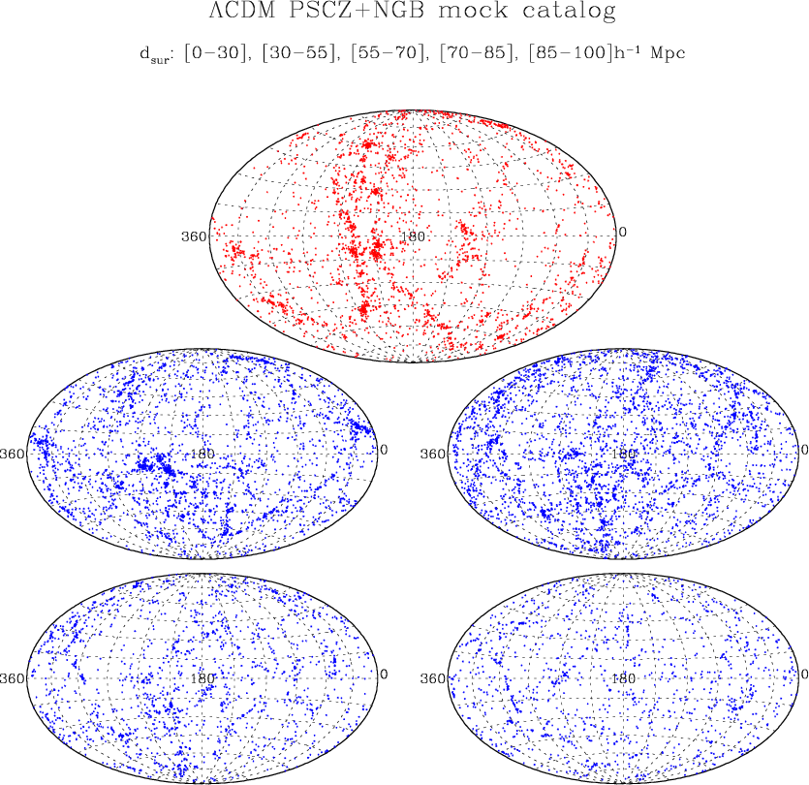
Survey Depth
Theoretical Example:
Galaxies in PSCz
catalogue, at
different depths

Slide 19
Galaxy Sky Maps

Slide 20
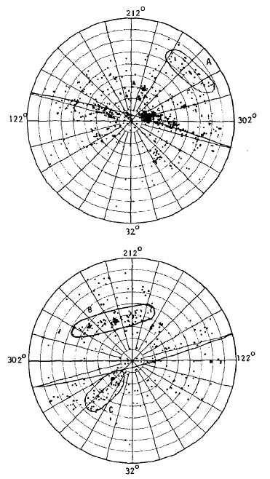
Shapley-Ames
Shapley-Ames catalog (1932) of nearby galaxies:
All-sky survey of galaxies to m=18.3
δ > -23º
● numerous concentrations:
groups and clusters (incl. Virgo cluster)
● asymmetry between north and south:
many more galaxies on northern sky
● conspicuous concentration along a line
running through richest nearby cluster,
the Virgo cluster:
● The Supergalactic Plane
(first identified by de Vaucouleurs:
the plane of our own Local Supercluster)

Slide 21
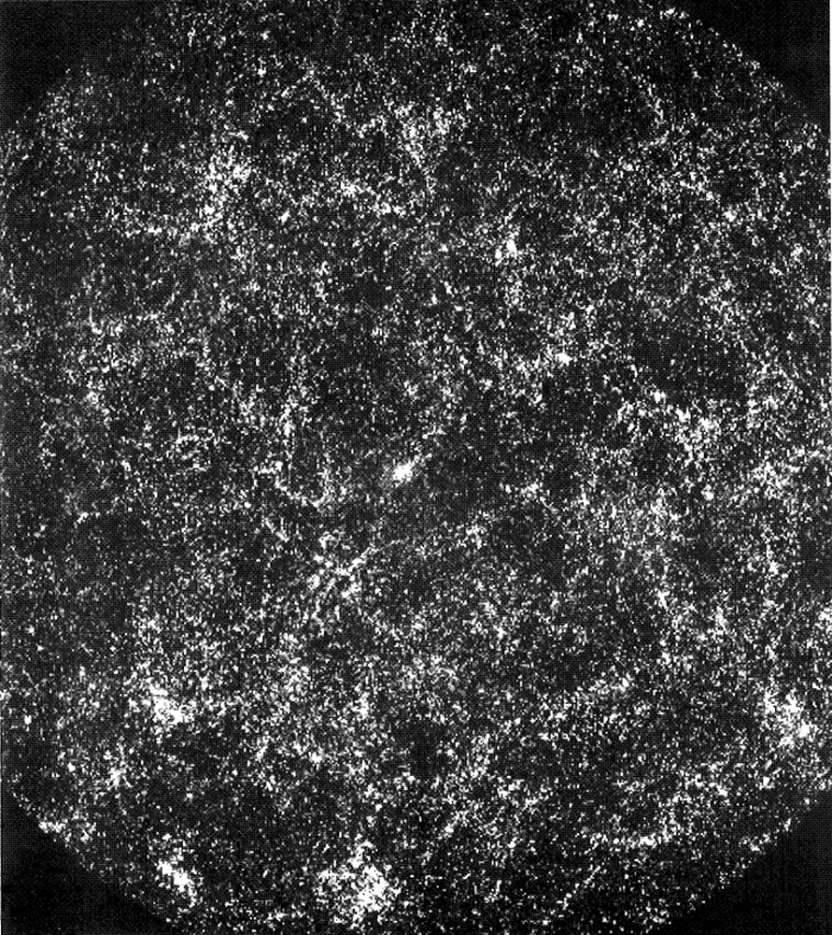
A million galaxies
Shane-Wirtanen map:
On the basis of the Shane-Wirtanen counts,
P.J.E. Peebles produced a map of the sky distribution of 1 million galaxies on the sky:
● Clearly visible are clusters
● hint of filamentary LSS features, embedding clusters

Slide 22
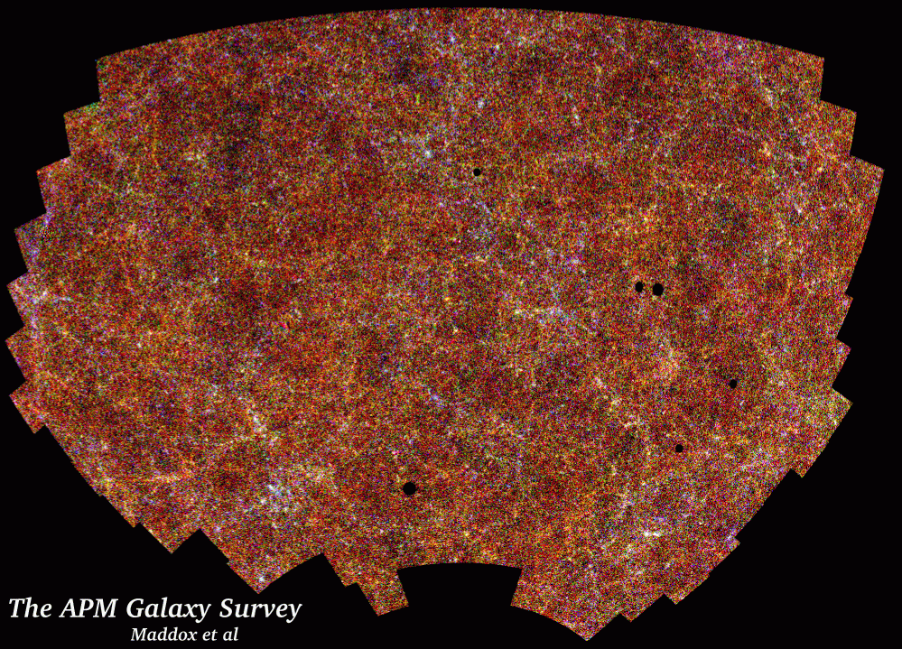
APM Galaxy Survey
Sky map:
2 x 10⁶ galaxies
17 < m < 20.5
Uniformly defined
• Sky region:
4300 sq. deg.
185 UK Schmidt plates,
6º x 6º
● Large inhomogeneities,
hints of weblike patterns,
with clusters at
densest regions.
S. Maddox, G. Efstathiou,
W. Sutherland, D. Loveday

Slide 23
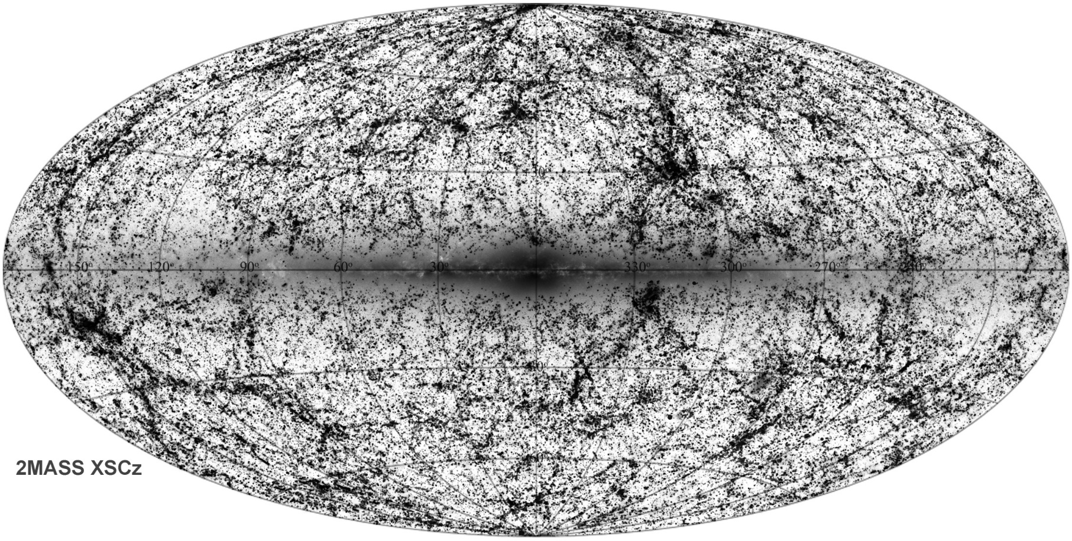
2MASS Cosmic Web
2MASS all-sky survey:
• ground-based near-infrared
survey whole sky,
J(1.2 m), H(1.6 m), K(2.2 m)
● 2MASS extended source catalog (XSC):
1.5 million galaxies
● unbiased sample nearby galaxies
● photometric redshifts:
depth in 2MASS maps,
• “cosmic web” of (nearby) superclusters
spanning the entire sky.
courtesy: T. Jarrett
Looking around us we already see the unmistakable signatures of an intriguing
weblike matter distribution in our immediate Cosmic Vicinity.

Slide 24
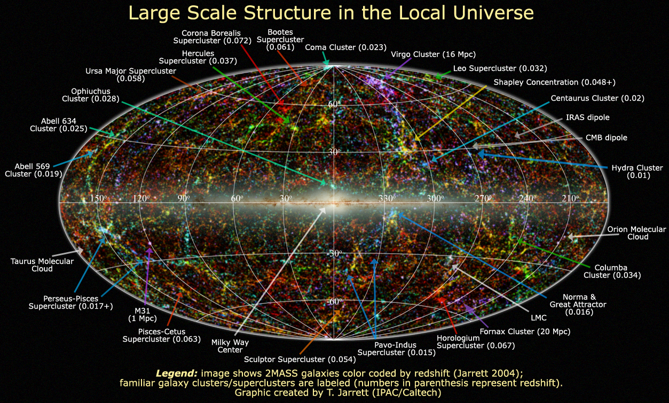


Slide 25
Galaxy Redshift Surveys

Slide 26
Galaxy Redshift Surveys
For obtaining 3D maps of the galaxy distribution:
measure spatial location of galaxies:
- position on the sky (,)
- distance r
Determination real distance r of galaxy very
cumbersome, reasonably accurate estimates only
for nearby gal’s …
• Common approximate method:
exploit Hubble expansion of the Universe

Slide 27
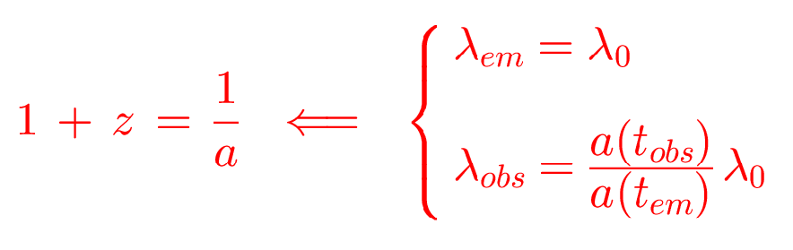
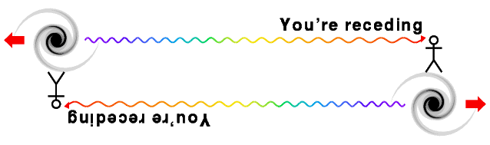
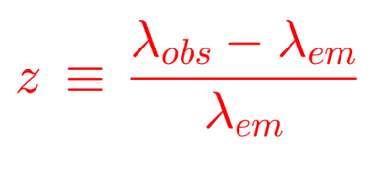
Galaxy Redshift Surveys

Slide 28
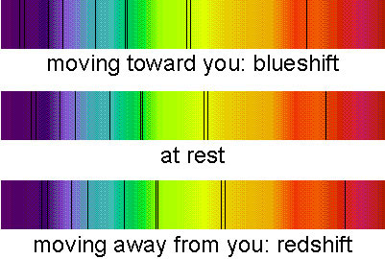
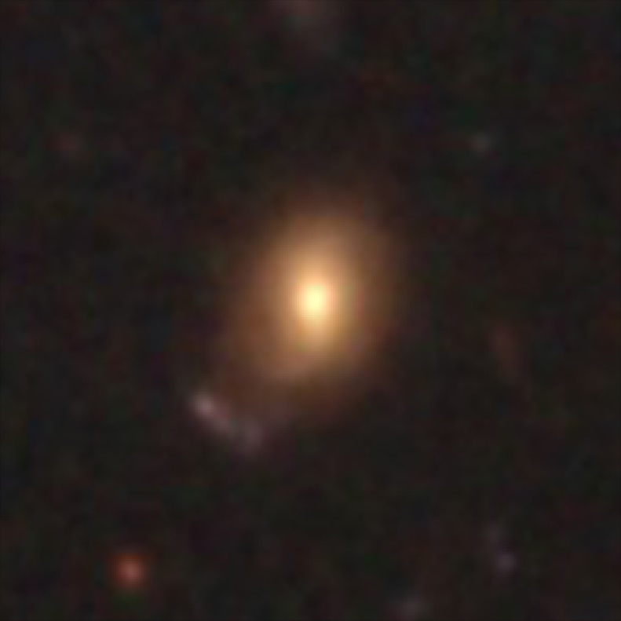
Redshifted Galaxy

Slide 29
Galaxy Redshift Surveys
Hubble Expansion:
(z  1)
galaxy at distance r
has redshift z
(c: vel. light; H: Hubble constant)
Redshift of galaxies can be much more easily
determined than distance:
Galaxy Spectrum

Slide 30
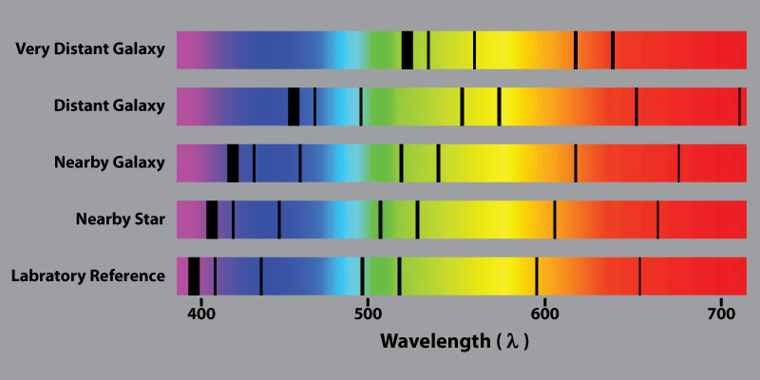
Hubble Expansion & Galaxy Redshift
The Hubble law tells us that the further a galaxy is, the more redshifted it is.
Moreover, because this a linear relation, we can even estimate distances to galaxies once we know
the value of the Hubble constant !

Slide 31
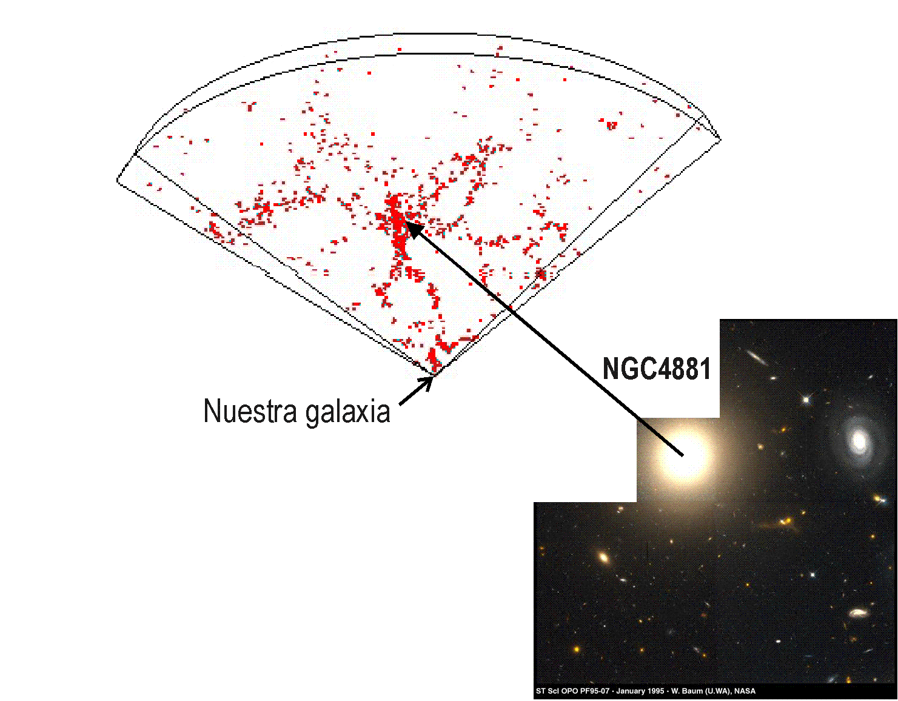
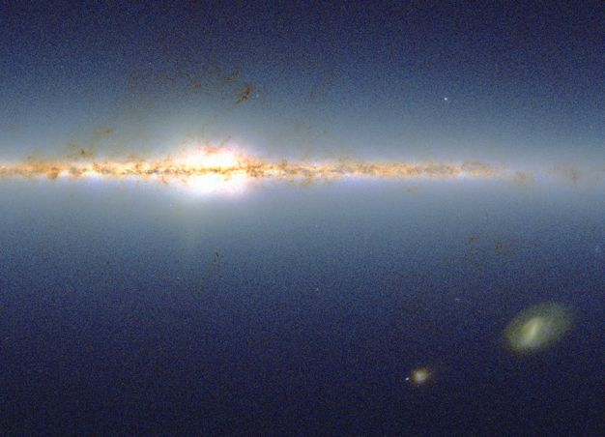
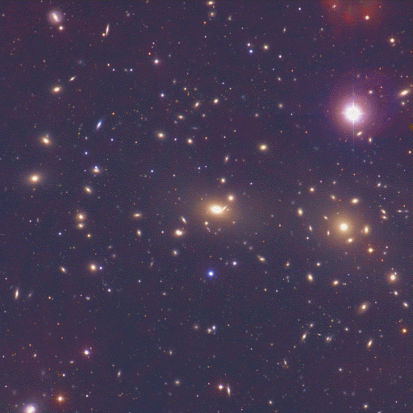
Mapping the Universe
Coma Cluster
Our own Galaxy
de Lapparent, Geller, and Huchra (1986), ApJ, 302, L1

Slide 32
Galaxy Surveys:
Overview & Developments

Slide 33
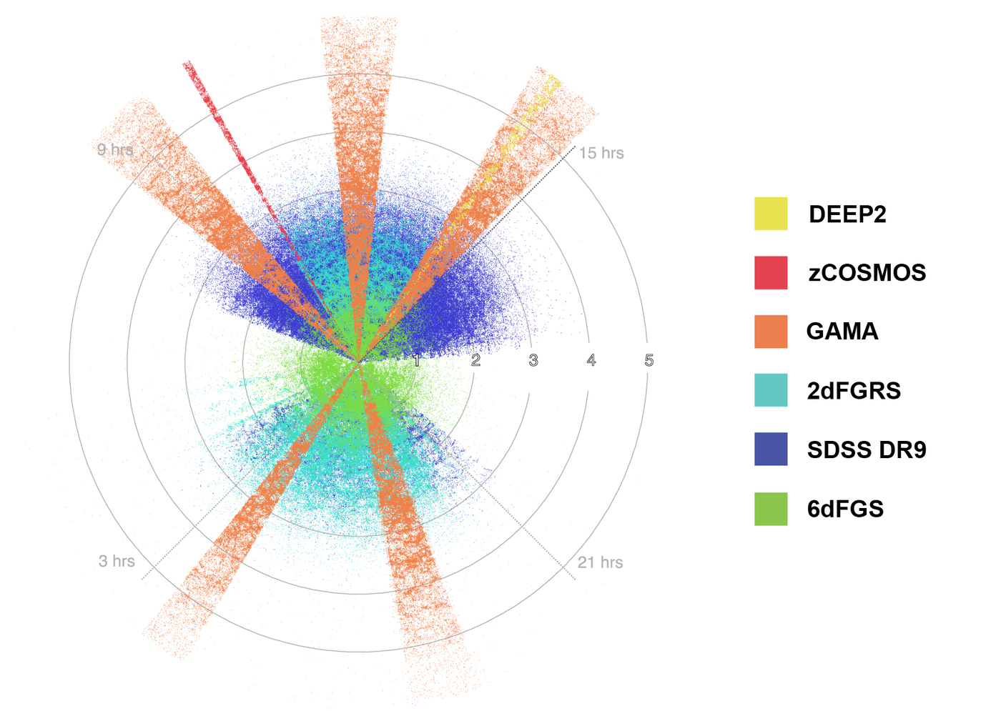

Slide 34
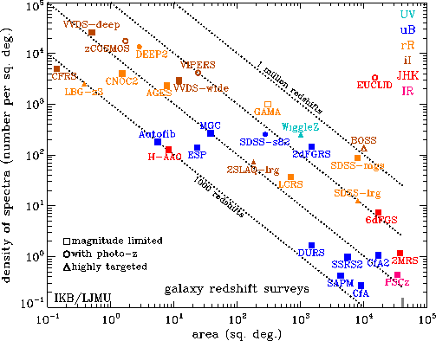
Galaxy Redshift Surveys:
some statistics
Comparing
Galaxy/Cluster
Redshift Surveys
Angular number density
vs.
Sky area

Slide 35
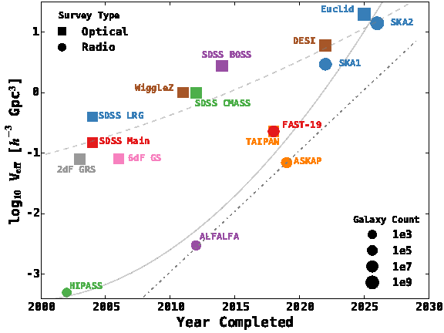
Galaxy Redshift Surveys:
some statistics
Comparing
Optical & Radio
surveys
Year completion
Vs.
Effective survey volume

Slide 36
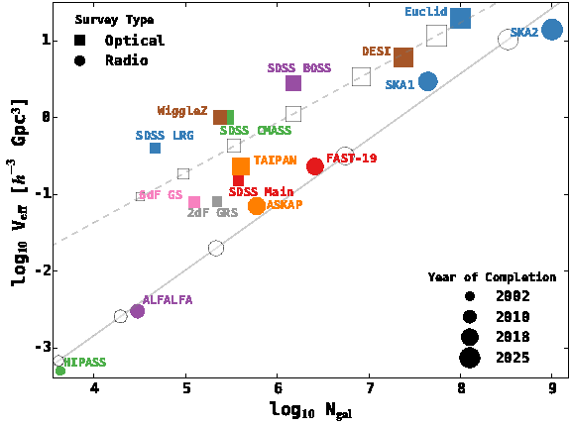
Galaxy Redshift Surveys:
some statistics
Comparing
Optical & Radio
surveys
Number survey galaxies
vs.
Effective survey volume

Slide 37
Galaxy Surveys:
Redshift Space Distortions

Slide 38
Redshift Space Distortions
When measuring the redshift of galaxies,you do only approximately
determine its distance.
• In reality, galaxies do not exactly follow the Hubble flow.
• In addition to the cosmological flow, there are locally induced velocity
components in a galaxy’s motion, their peculiar velocity
• Because it is very hard to disentangle the real distance term r and the
peculiar velocity term,
• As a result, maps on the basis of galaxy redshift do not reflect the galaxy’s true
spatial distribution,
• they involve a distortion, the RSD or redshift space distortion.

Slide 39
Redshift Distortions
In reality, galaxies do not exactly follow the
Hubble flow:
In addition to the cosmological flow, there are
locally induced velocity components in a galaxy’s
motion:
the galaxy’s peculiar velocity v_{pec}
As a result, maps on the basis of galaxy z do not
reflect the galaxies’ true spatial distribution

Slide 40
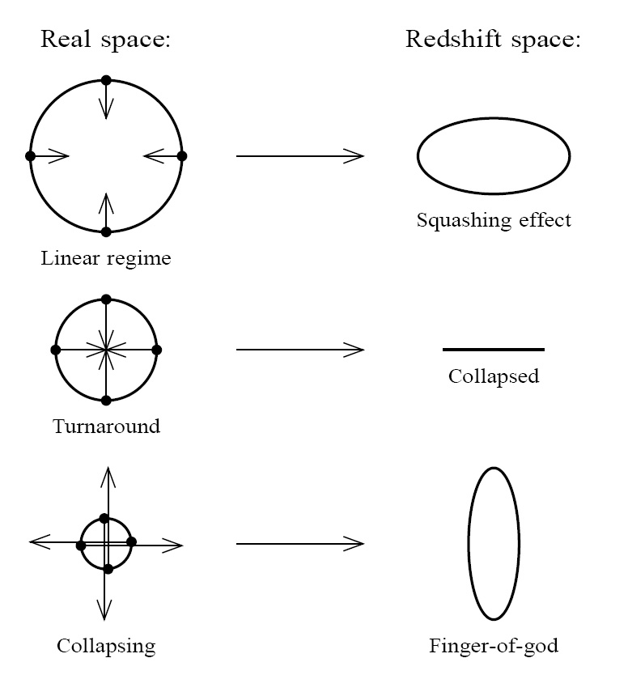
Redshift Distortions
Origin of peculiar velocities:
three regimes
• very high-density virialized
cluster (core) regions:
“thermal” motion in cluster,
up to > 1000 km/s
“Fingers of God”
• collapsing overdensity
(forming cluster):
inflow/infall velocity
• Large scales:
(linear, quasi-linear) cosmic flow,
manifestation of structure growth

Slide 41
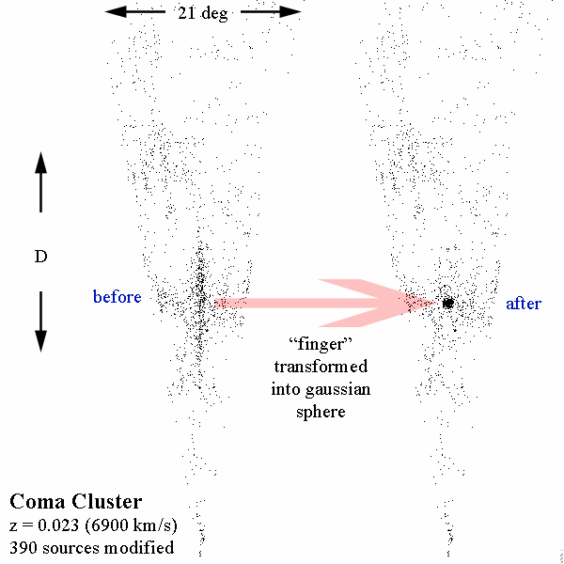
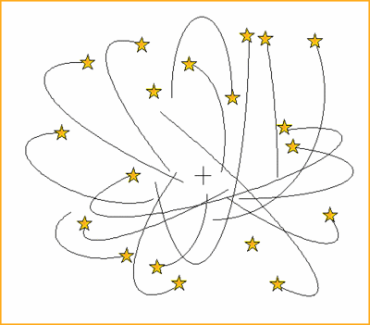
Fingers of God
Galaxy velocity
component along
line of sight

Slide 42
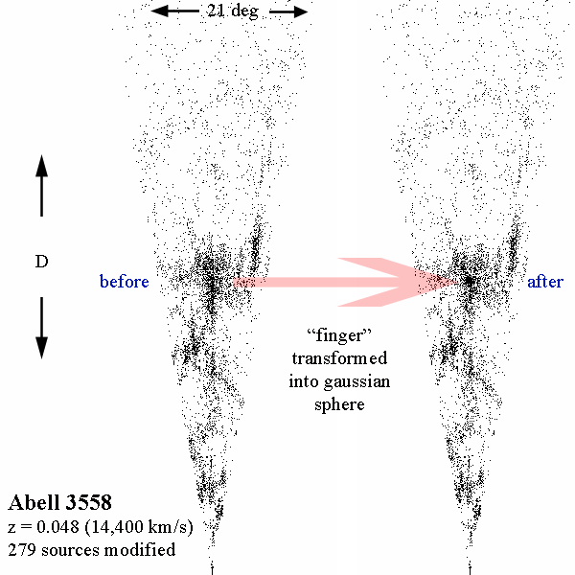

Fingers of God
Clusters of galaxies:
Mass: 10¹⁴-10¹⁵ M•
Radius: ~ 1.5 Mpc
Overdensity  ~ 1000
Thermal velocity: ~ 1000 km/s
Internal cluster galaxy velocities
visible in projection along line of sight
“Finger of God”

Slide 43
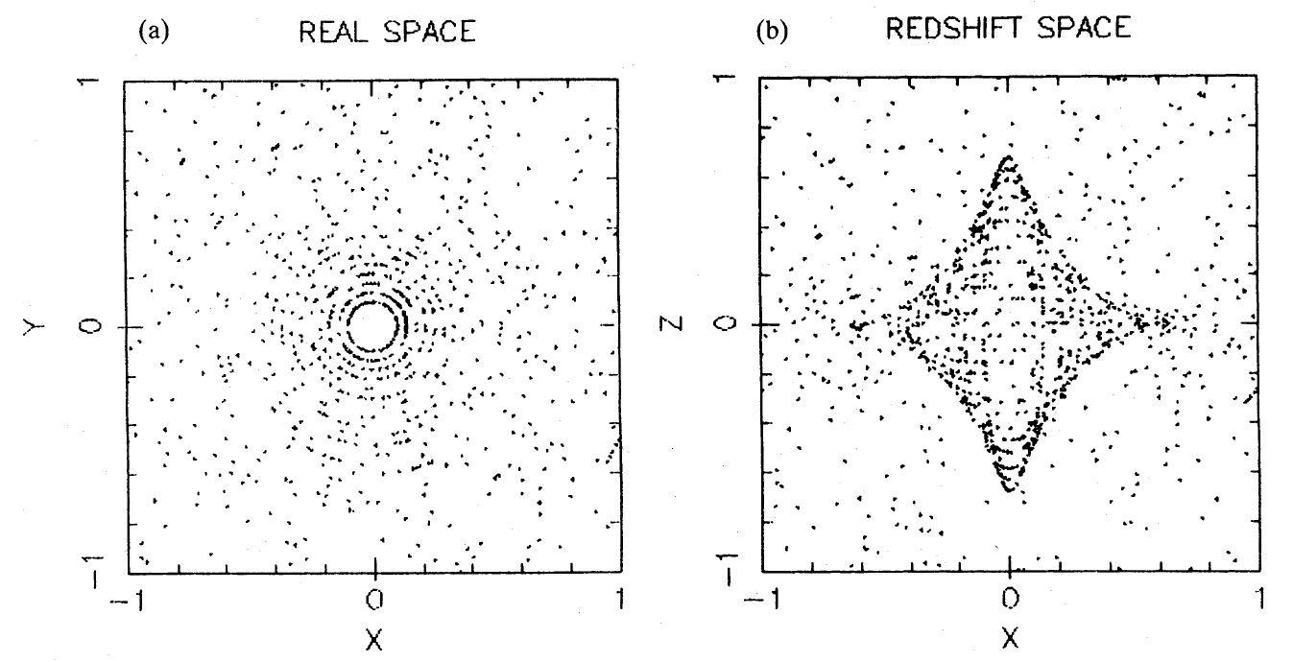
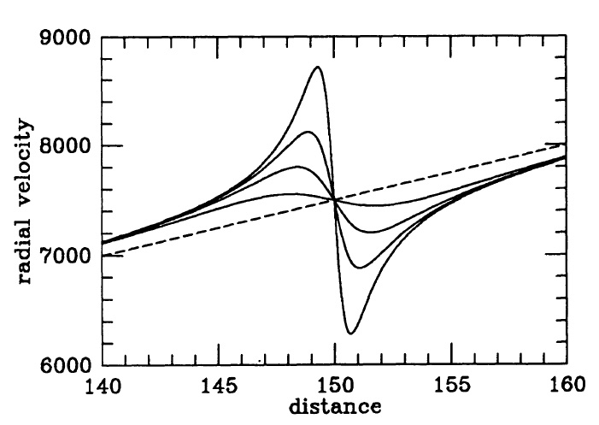
Nonlinear Infall Pattern
Cluster Infall:
Matter in surroundings falling
in onto cluster:
• infall velocities up to 1000 km/s
radially declining :
• velocities decrease as distance
to cluster centre increases
• projected radial velocity
function of angle & distance
wrt. cluster centre.
• triple-value region redshift space:
- within turnaround radius,
a particular redshift z
may correspond to 3 spatial
positions

Slide 44
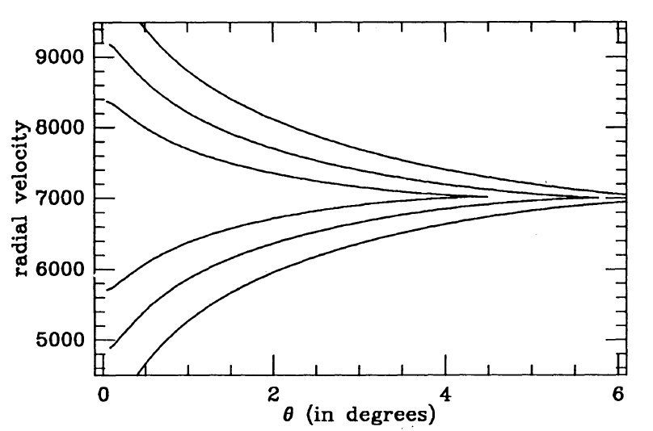
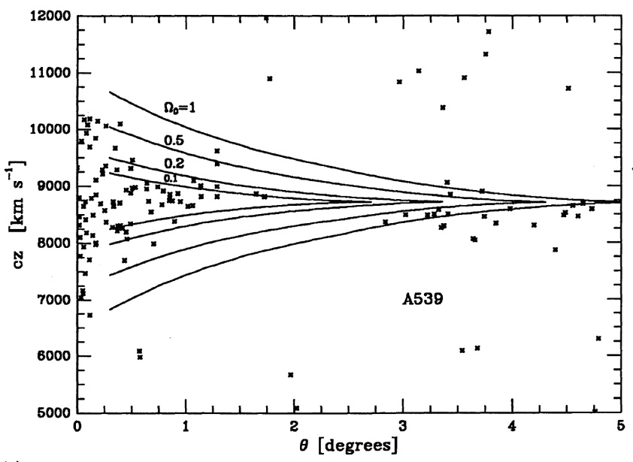
Nonlinear Infall Pattern
Cluster Caustics:
Three-value region cluster infall:
Projection onto restricted cone-shaped
redshift space regions around clusters
Enclosed within caustic surfaces
Position caustics dependent on Ω_{m}

Slide 45
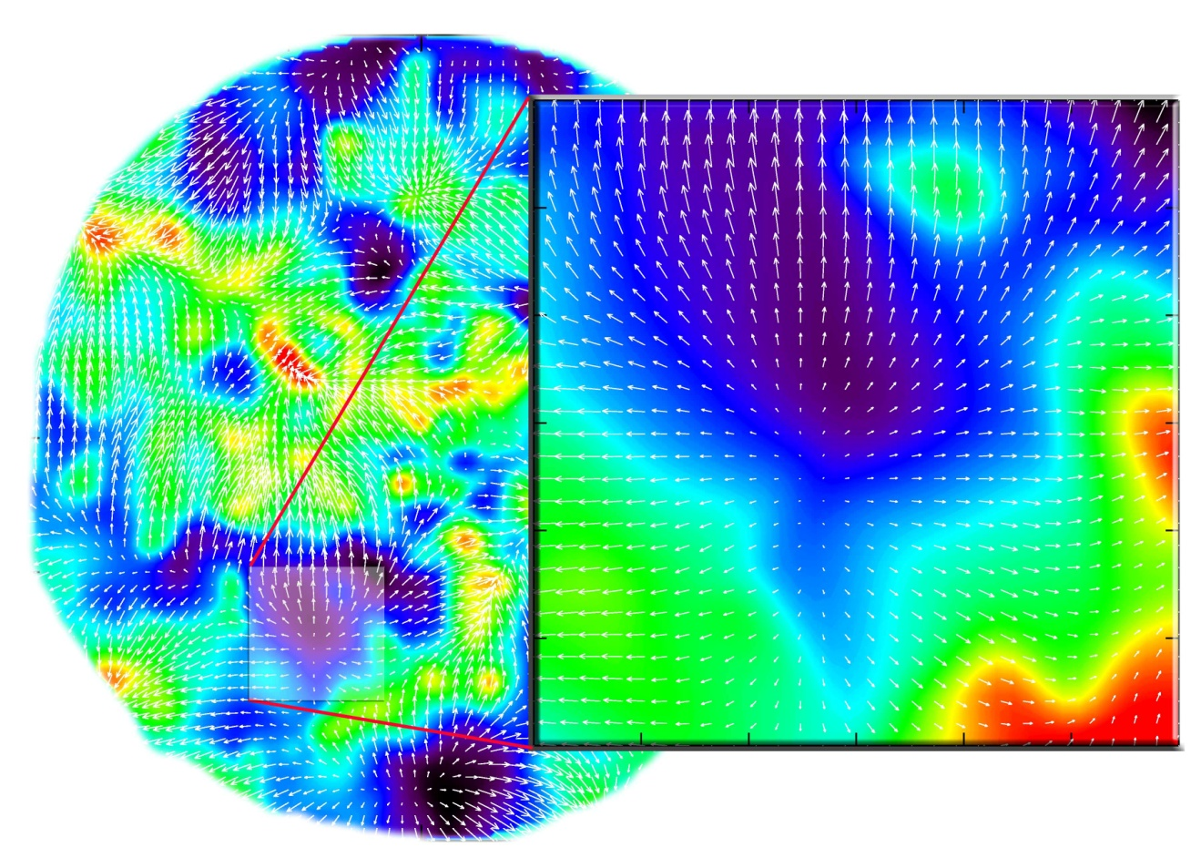
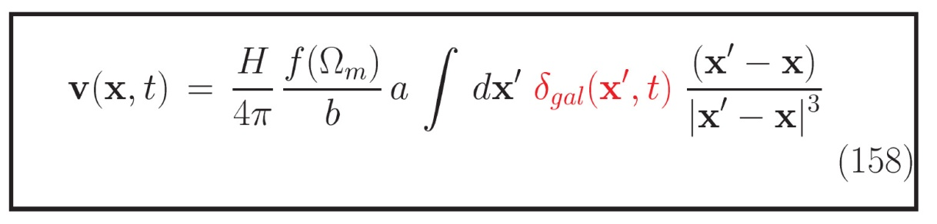
Large Scale Flows
Large-Scale Flows:
• On large (Mpc) scales,
structure formation
still in linear regime
• Structure buildup
accompanied
by displacement of matter:
- Cosmic flows
• Directly related to
cosmic matter distribution
• In principle possible to
correct for this distortion,
ie. to invert the mapping
from real to redshift space
• Condition:
entire mass distribution
within volume should
be mapped

Slide 46
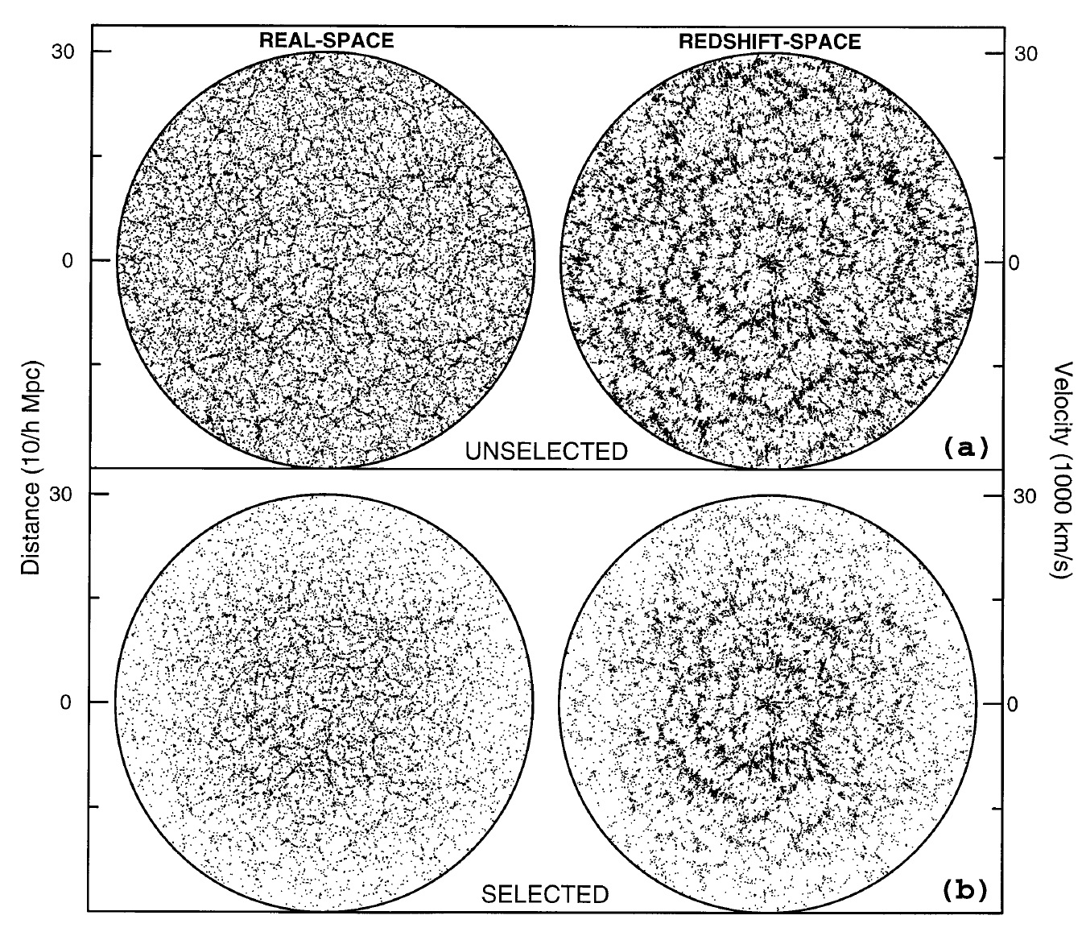
Large Scale Flows
Large-Scale Flows:
The induced large scale
peculiar velocities translate
into extra contributions to
the redshift of the galaxies
Compare
“real space” structure vs.
“redshift space” structure

Slide 47
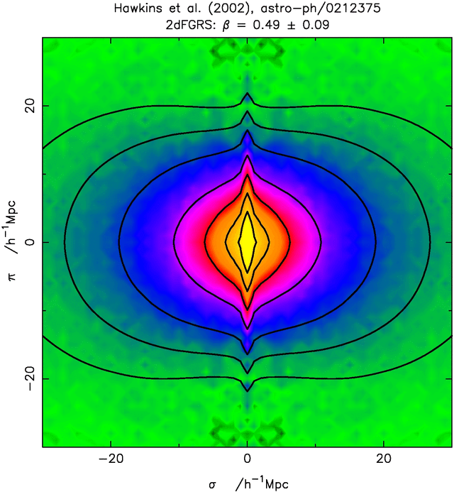
the Web: Migration Flows
Large scale flows lead to redshift distortions:
cz = H r + v_{pec}
These flows are part of the assembly of large scale structures, and reach largest values as matter is transported along the filaments into the clusters.
When mapping the galaxy distribution in redshift space, this induces a distortion:
● Flattening along z as matter flows into
Megaparsec features (v < 600 km/s).
● Extension due to thermal motions
inside cluster (v ~ 1000 km/s):
“Fingers of God”
“Finger of God”
Megaparsec flows

Slide 48
Galaxy Surveys:
Magnitude vs. Volume-Limited

Slide 49
Magnitude vs. Volume limited Surveys
Two different sampling approaches for analysis spatial structure from galaxy redshift catalogue:
Volume-limited surveys:
- uniform spatial coverage, including all galaxies within volume to depth d_{s}
- all galaxies with an absolute brightness > survey limit M_{s}
- diminishing sampling density & spatial resolution
as one wishes to include larger volume (excluding all galaxies M>M_{s})
Magnitude-limited survey
- include all galaxies with apparent magnitude brighter than m_{s}
- assures optimal use of spatial galaxy catalogue
- at the price of an non-uniform spatial coverage &
diminishing resolution towards higher depths

Slide 50
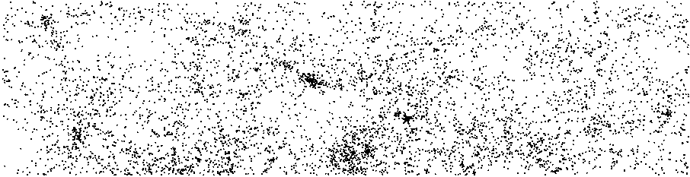
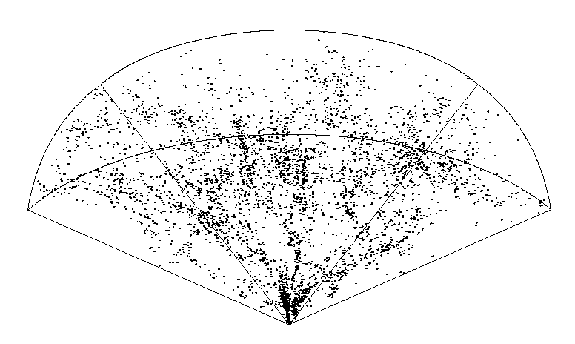
44.5º
8.5º
16 h
8h
The CfA2
redshift survey
(Northern Hemisphere)
101 Mpc/h
Redshift:
v = c z ~ H r + v_{pec}
A magnitude-limited sample,
m < 15.5
N = 4933 galaxies
Figure courtesy: V. Martinez

Slide 51
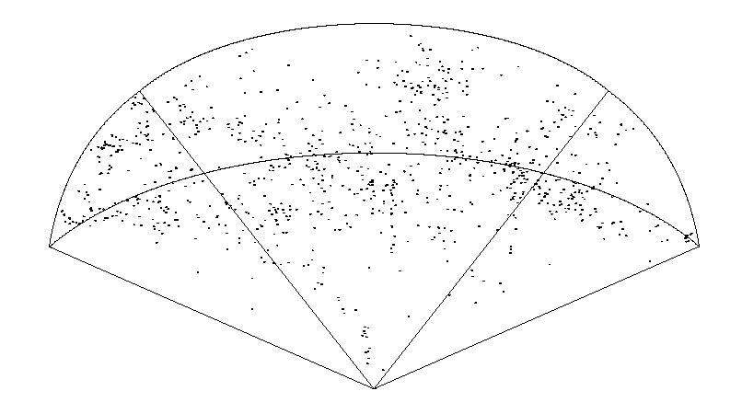
44.5º
8.5º
16 h
8h
The CfA2
redshift survey
(Northern Hemisphere)
101 Mpc/h
A volume-limited sample,
M < 15.5 – 5log(D(z)) – 25 – Kz
N = 905 galaxies

Slide 52
Galaxy Surveys:
Photometric Surveys

Slide 53
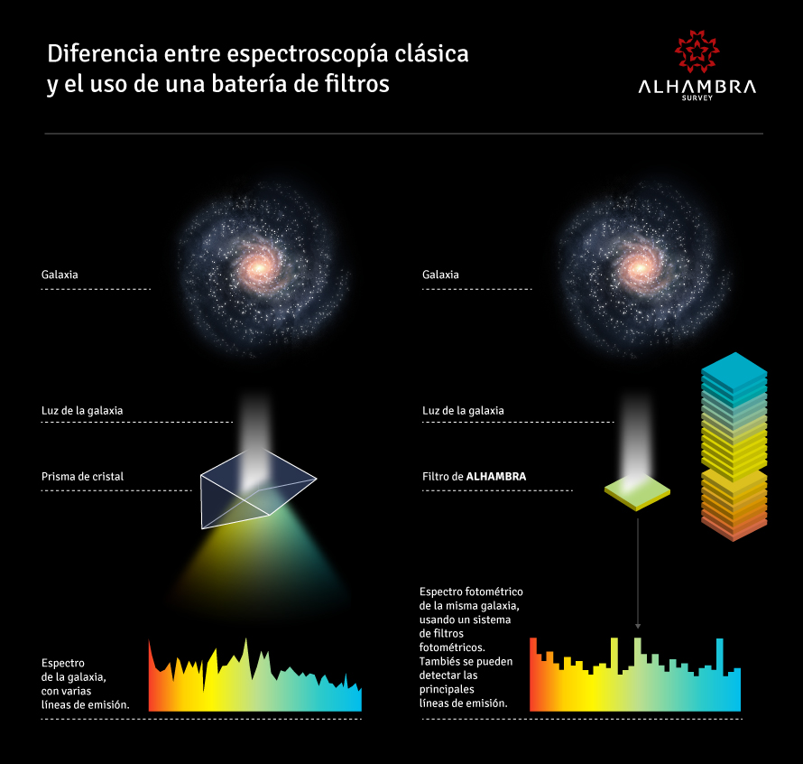
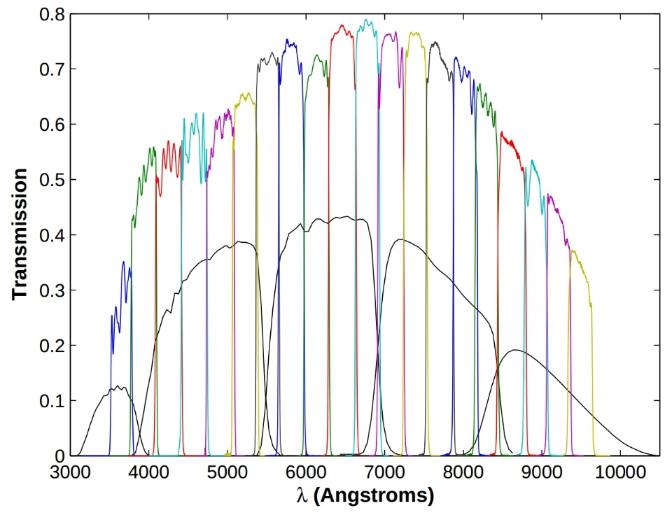
Photometric Redshifts
Instead of measuring the electromagnetic spectrum of the galaxies in
a survey, one may get a good estimate of the redshift on the basis of the
photometry and colours of the objects.
Alhambra photoz survey:
filter bank:
20 contiguous, equal width, bands

Slide 54
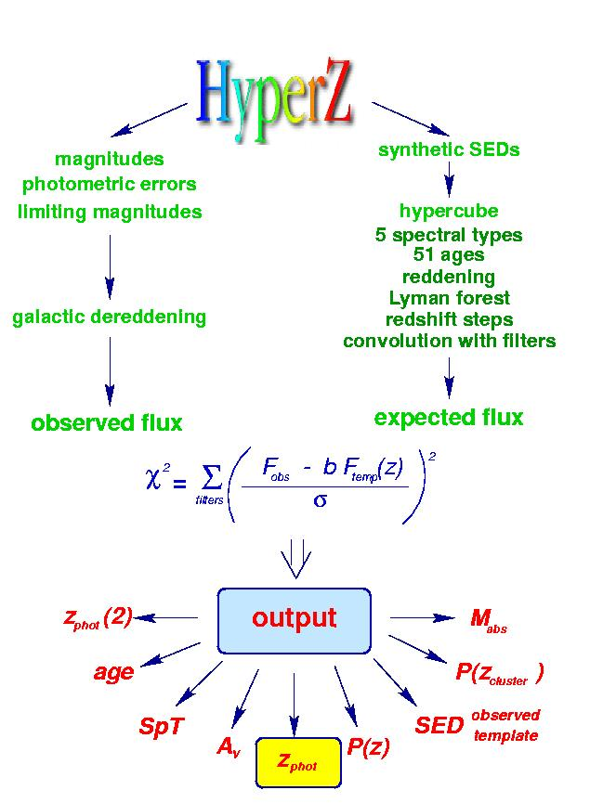
Photometric Redshifts
Practical Implementation:
• Photometric redshifts
determined by fitting to
standard SED
(SED: spectral energy distribution)
• Taking into account:
- spectral type
- reddening
- Lyman forest (high z!)
- filters
• Accuracy (typical):
- z ~ 0.1
widely used Hyperz package

Slide 55
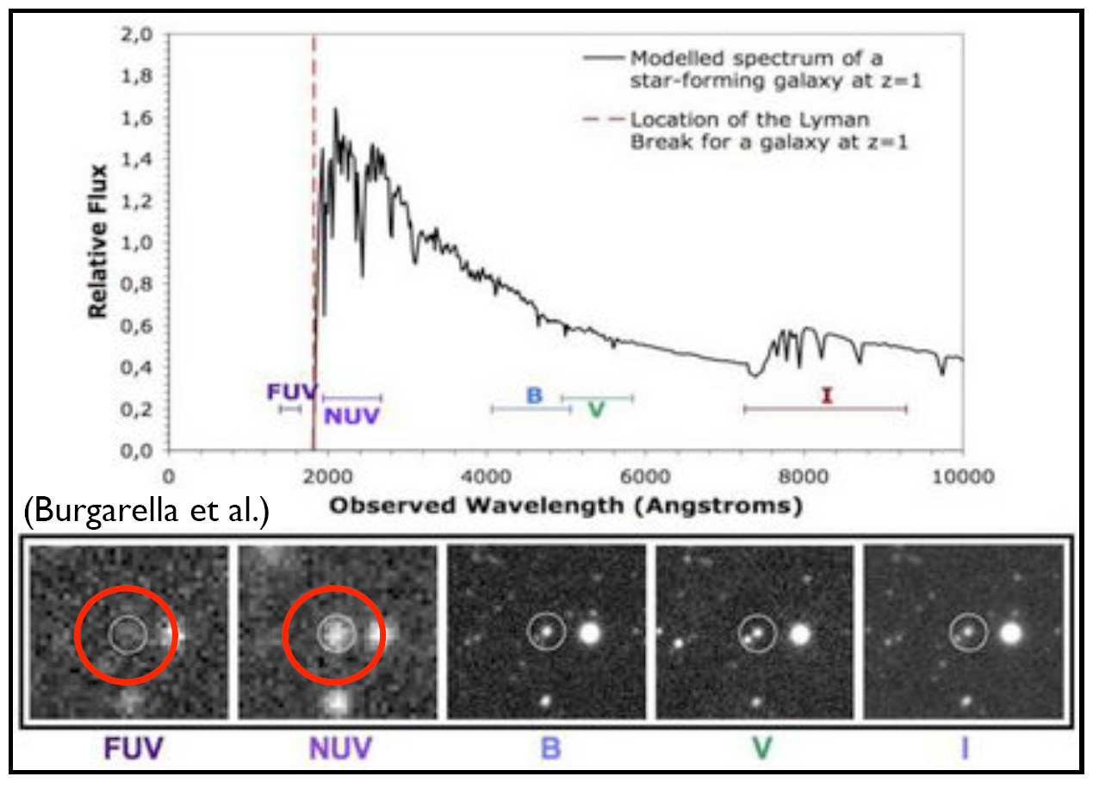
Photometric Redshifts
Photometric Redshifts
Technique widely
used for identifying
high z objects
For example,
Lyman break results
in
FUV-NUV dropouts
(1400-1800 A)
for z ~ 0.5-1.0
Below the Lyman break at 912 A, hydrogen absorbs galaxy light
•

Slide 56
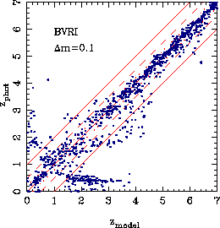
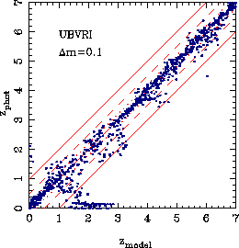
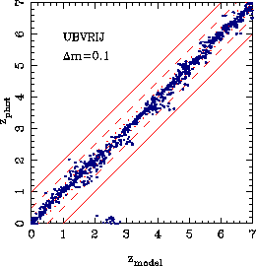
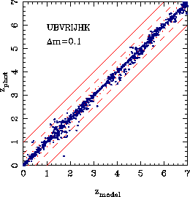
Photometric Redshifts
Photometric Redshifts:
• Accuracy (typical):
- z ~ 0.1
• Accuracy higher as
more bands are used
• Bands to be chosen to
take into account
spectral characteristics/
features
• eg. low z: UV still
weak point

Slide 57
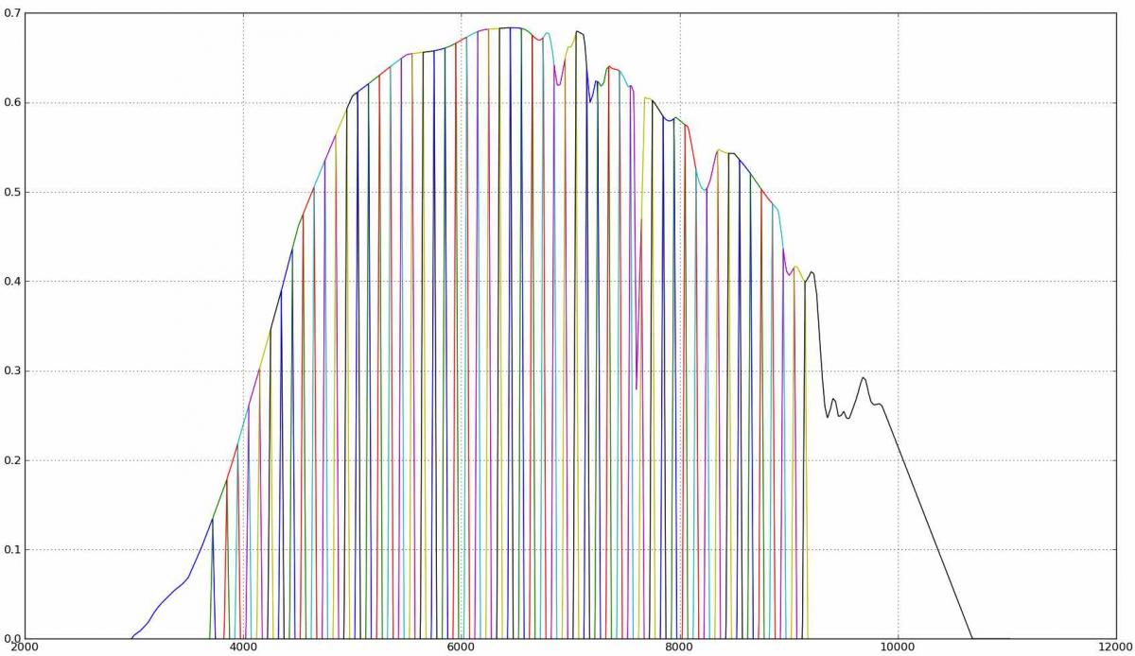
J-Pas survey
J-PAS survey:
56 narrow band filters
2.5 m. telescope, 7º field of view (OAJ, Javalambre, Spain):
8000 deg2
accurate redshifts
out to z~1
14 million red, luminous
galaxies

Slide 58
Galaxy Surveys:
Survey Geometry

Slide 59

Survey Geometry
Practical Limitations
- Limited telescope time
- Limited detector sensitivity
• How to optimally sample
structure in Universe ?
• Devise survey geometry that
reveals optimal amount of
Information on question at hand:
- Patterns galaxy distribution
-Distribution high-density peaks
- Density Field
Sky Location
2-D LCRS survey slices

Slide 60
Survey Geometry
Survey Geometry:
•Slice Surveys:
- thin stripe on sky
- very sensitive to reveal
patterns galaxy distribution
• Pencil-beam surveys
- very narrow region on sky
- very deep
- strategy to probe largest
structures
- structure at high z (early times)
Sky Location
2-D LCRS survey slices

Slide 61

Survey Geometries
Examples of
Slice Redshift Surveys:
From
CfA2 -2dFGRS - SDSS
widely used Hyperz package

Slide 62

Survey Geometry
Survey Geometry:
•Sparse Sample:
- sampling density field
- on scales >
intergalaxy distance
• Full-sky surveys
- necessary to probe
dynamics cosmic regions

Slide 63
Galaxy Surveys:
SDSS
Sloan Digital Sky Survey

Slide 64
SDSS survey
Largest and most systematic (digital !) sky survey in
history of astronomy.
Images sky in 5 photometric bands !!!!
Down to apparent magnitude r~23.1
Covers ~ 25% of the sky: 8452 sq. deg.
With 2dFGRS, the SDSS has produced the most
extensive map of the spatial structure of our cosmic neighbourhood.
Million galaxies subsequently selected for measuring redshift z:
electromagnetic spectrum
Total:
sky survey: 10⁸ stars, 10⁸ galaxies, 10⁵ quasars
spectroscopy: 10⁶ galaxies, 10⁵ quasars, 10⁵ stars

Slide 65

SDSS survey
• Imaging:
230 million objects
• Spectroscopic (Redshift) survey:
magnitude limit:
galaxies: (Petrosian) r < 17.7
quasars i < 19.1 / i < 20.2 (z > 2.3)
objects: 928,567 galaxies
109,862 quasars z < 2.3
8,802 quasars z > 2.3

Slide 66

SDSS Galaxy Survey
Distribution of galaxies in the nearby Universe:
weblike filigree of galaxies,
pervasive network of filaments

Slide 67


SDSS survey
Specially dedicated
2.5m wide-angle telescope
Apache Point Observatory (New Mexico)

Slide 68

SDSS survey
Aims to sample 25% of the sky:
DR7 - 8423 sq. deg.
Photometric system 5 filters:
● m_{lim}
u 354 nm 24.4
g 476 nm 25.3
r 628 nm 25.1
i 769 nm 24.4
z 925 nm 22.9
Driftscan mode
- 5 filters:
- 30 CCD chips, 5 rows of 6
- S/N ~ 5
- CCD chip: 2048x2048 pixels
120 Mbyte
Spectroscopy
- up to 640 (fibers) per recording
- per night 6-9 recordings

Slide 69

SDSS survey
Aims to sample 25% of the sky:
DR7 - 8423 sq. deg.
Photometric system 5 filters:
● m_{lim}
u 354 nm 24.4
g 476 nm 25.3
r 628 nm 25.1
i 769 nm 24.4
z 925 nm 22.9
Driftscan mode
- 5 filters:
- 30 CCD chips, 5 rows of 6
- S/N ~ 5
- CCD chip: 2048x2048 pixels
120 Mbyte
Spectroscopy
- up to 640 (fibers) per recording
- per night 6-9 recordings

Slide 70

SDSS survey

Slide 71



SDSS survey
5-color
Camera
30 CCD
chips
Fiber
Spectrograph

Slide 72



SDSS survey
SDSS Legacy
Imaging Sky Coverage:
8423 sq. deg.
SDSS region, Galactic coordinates
compare to 2MRS surey
SDSS Legacy
Spectral Sky Coverage:
8032 sq. deg.

Slide 73


SDSS Galaxy Survey
KIAS VAGC:
value added galaxy catalog:
sky coverage completeness - not that uniform

Slide 74


Mapping the Galaxy Distribution

Slide 75
Cosmic Web

Slide 76


Cosmic Web:
Stickman & Discovery
deLapparent, Geller & Huchra, 1986:
“a slice of the Universe”
Voids appear to be an integral part of
a complex weblike arrangement of
galaxies

Slide 77


2dFGRS Galaxy Survey
map 2dFGRS,
clearly visible weblike network
with the advent of large galaxy redshift surveys
– LCRS, 2dFGRS, SDSS, 2MRS –
voids have been recognized as one of the quintessential components of the Cosmic Web

Slide 78

2dFGRS Galaxy Survey
map 2dFGRS, clearly visible
weblike network
(Schaap et al. 2007)
map SDSS, clearly visible underdensities (Platen et al. 2010)
with the advent of large galaxy redshift surveys
– LCRS, 2dFGRS, SDSS, 2MRS –
voids have been recognized as one of the quintessential components of the Cosmic Web

Slide 79


SDSS Galaxy Survey
map SDSS, clearly visible underdensities (Platen et al. 2010)
map SDSS, clearly visible underdensities (Platen et al. 2010)
with the advent of large galaxy redshift surveys
– LCRS, 2dFGRS, SDSS, 2MRS –
voids have been recognized as one of the quintessential components of the Cosmic Web

Slide 80

2MASS: the Local Cosmic Web
Looking around us we already see the unmistakable signatures of an intriguing foamlike matter distribution in our immediate Cosmic Vicinity.

Slide 81

local Cosmic Web: 2MRS
most detailed reconstruction of the
local dark matter
Cosmic Web
Courtesy: Francisco Kitaura

Slide 82

GAMA/WISE:
Cosmic Web z=0.3
GAMA/WISE
Intermediate redshift
z=0.3
(Jarrett et al. 2017)
GAMA/WISE:
galaxy populations in
different parts/regions of
the Cosmic Web
bright, early-type galaxies
in dense nodes
late-type disk galaxies
lowest clustering level
(filaments & voids)

Slide 83
High z Universe

Slide 84

Cosmic Web at High z

Slide 85

Cosmic Web at High z
Deep pencil beam survey (Broadhurst et al):
A semi-regular pattern of redshift spikes along line of sight, indicating the passage of l.o.s. through sheets, filaments and clusters. Suggestions for a characteristic scale of ~120h⁻¹ Mpc should be ascribed to the 1-D character of the redshift skewer through 3-D structure.

Slide 86


VIPERS: Cosmic Web at High z
VIPERS
deep redshift survey,
z=0.4-1.2
(Guzzo et al. 2014-)
map SDSS, clearly visible underdensities (Platen et al. 2010)
recent galaxy surveys out to high cosmic depths
- eg. DEEP, VIPERS -
establish that the Cosmic Web pervades entire Universe (up to z~5 at least)

Slide 87

Cosmic Web at High z
Subaru:
Ly emitters at z=3 (Ouchi et al. 2005)

Slide 88
Filaments

Slide 89

Pisces-Perseus Supercluster

Slide 90

Walls and Filaments
Pisces-Perseus Chain Sky
21 cm line redshift survey (Giovanelli, Haynes et al. 19 Redshift

Slide 91

Pisces-Perseus Chain
Canonic example of a strongly flattened supercluster consisting of
● sheet-like central region, dense filamentary boundary ridge
● Relative proximity (d ~ 55h⁻¹ Mpc),
● Characteristic & salient filamentary morphology,
● Favourable orientation.
Northern boundary: ridge south-westward of Perseus cluster (A426)
Dimensions Ridge: 5h⁻¹ Mpc wide
50h⁻¹ Mpc length; possible 140h⁻¹ Mpc extension
Along Ridge: high density clusters, incl. A462, A347, A262

Slide 92

Pisces-Perseus Supercluster
Hidding 2015

Slide 93

Pisces-Perseus Supercluster
Hidding 2015

Slide 94

galaxy
filament projection
survey galaxy
Additional Analysis Step:
projection of filament galaxies
to Medial Axis of Nexus/MMF filaments

Slide 95


Dark Matter
Cosmic Web
A222-A223
Dietrich et al. 2013

Slide 96
Walls

Slide 97

Sloan Great Wall
Platen 2009
Largest Structure
Local Universe
~ 300 x 150 Mpc

Slide 98


Slide 99


Coma Great Wall
Sloan Great Wall
Platen 2009

Slide 100
Voids

Slide 101



z
Zeldovich, Einasto & Shandarin 1982:
First linking of observationally visible
void regions and the theory of
cosmic structure formation.
Coma
Virgo
y
x

Slide 102


Bootes Void
Kirshner, Oemler, Schectman, Schechter (KOSS) 1981, 1987
the canonical void
Bootes Void
d~50h⁻¹ Mpc

Slide 103
Voids & the Cosmic Web
deLapparent, Geller & Huchra, 1986:
“a slice of the Universe”
Voids appear to be an integral part of
a complex weblike arrangement of
galaxies

Slide 104


local Cosmic Web: Local Void
Karachentsev etal.
LV catalog:
galaxies within 10 Mpc reveal
beautifully the magnificent
Local Void – Tully Void
Adhesion-KIGEN reconstruction
Hidding, vdW, Kitaura & Hess 2015

Slide 105

2MRS Local Universe …
2MRS survey sky map
Hidding 2015
Depth: ~50 Mpc

Slide 106

SDSS Galaxy Survey
Bootes void substructure (Platen 2009)
map SDSS, clearly visible underdensities (Platen et al. 2010)
map SDSS, clearly visible underdensities (Platen et al. 2010)
with the advent of large galaxy redshift surveys
– LCRS, 2dFGRS, SDSS, 2MRS –
voids have been recognized as one of the quintessential components of the Cosmic Web

Slide 107


SDSS Void Sample
Sutter et al. 2013
SDSS void sample
Void size distribution
Void identification by ZOBOV/VIDE

Slide 108

Voids & Clusters
Einasto, Saar et al. (1990s)
- Superclustering in Abell/APM clusters catalog
- Finding of characteristic scale ~140 Mpc,
corresponding to large voids in the cluster
distribution
Reflex II cluster catalogy (Bohringer et al.)
reveals same population of voids in cluster distribution
(see talk by Collins).

Slide 109


Cosmic Web Tomography
Lyα survey CLAMATO
Mapping the Lyα forest in a densely sampled set of quasar spectra over sky region
1-D skewers through the gaseous Universe
Reconstruction full 3-D cosmic web, when skewers within correlation scale from each other
First systematic survey: CLAMATO (Lee et al.): identification Lya forest void population
KG Lee et al..

Slide 110

(Super)voids & ISW
Granett et al. 2009
identification of (LRG) supercluster & supervoid
ISW imprint on CMB

Slide 111
Clusters

Slide 112

Clusters of Galaxies
Courtesy:
O. Lopez-Cruz
Coma Cluster

Slide 113

Studying Clusters
Includes many different aspects of these versatile astrophysical laboratories:
• Optical/Infrared/Ultraviolet
- Galaxy Population:
spatial distribution, kinematics, galaxy morphology
• X-ray observations
- (hot, ionized) intracluster gas
- distribution (density, temperature): cluster mass
- abundances heavy elements (enrichment)
• Sunyaev-Zel’dovich effect:
- “cluster shadows” in cosmic microwave background radiation
- CMB microwave wavelength region
- intracluster gas (pressure)
- peculiar motion cluster (kinematic SZ)
• Gravitational Lensing
- mainly optical, also radio, submm, …
- strong lensing (arcs, rings), weak lensing (sheared images)
- dark matter mass
- dark matter distribution
• Radio wavelengths
- radio halos, radio relics
- synchroton radiation in shocked, hot, ionized intracluster plasma

Slide 114

Virgo Cluster

Slide 115
Clusters of Galaxies
Coma Cluster

Slide 116
Clusters of Galaxies
Clusters not only contain galaxies:
in fact, galaxies & stars are a minor component:
I. Clusters are Halos of Dark Matter:
M_{DM}/M_{total} ~ 82%
II. Clusters are Hot Balls of (highly ionized) Gas
M_{ICM}/M_{total} ~ 16-17 %
III. Galaxies are mainly raisins in a sea of
dark matter & hot gas
M_{stars}/M_{total} ~ 2%

Slide 117

Clusters of Galaxies:
X-ray intracluster gas
Baryonic matter in clusters is not only confined to galaxies:
~ 2 to 5 times more baryonic mass in the form of a diffuse hot X-ray emitting
Intracluster Gas,
trapped and heated to a temperature of the order of
T ~ 10⁸ K
by the gravitational potential of the cluster.
At such high temperatures, this gas is a fully ionized plasma, producing powerful X-ray emission, bremsstrahlung radiation induced by the electron-ion interactions.
M51
ROSAT X-ray image Coma Cluster

Slide 118


Slide 119

Cluster Mass:
X-ray intracluster gas
Hydrostatic Equilibrium:
M51
Determination Mass from X-ray observations:
assumption:
Isothermal: T(r)=T_{o}
density profile:
X-ray emission Bremsstrahlung: L(r) ~ ρ(r)²
ROSAT X-ray image Coma Cluster

Slide 120


Clusters of Galaxies:
Gravitational Lenses
Courtesy:
T. Broadhurst et al.
A highly promising method to determine the amount and distribution of
matter in the Universe
looks at the way it affects
the trajectories of photons
According to
Einstein’s theory of
General Relativity,
gravitational potential wells will bend and focus light. Dark matter concentrations act as a
Gravitational Lens
A1689

Slide 121

Clusters:
Gravitational Lensing
Geometry of Gravitational Lenses

Slide 122

Gravitational Lensing:
Einstein Ring

Slide 123

Gravitational Telescopes:
Weak vs. Strong Lensing
Two kinds of lensing:
• Strong Lensing:
❑ < _{E}
- nonlinear distortions
- multiple image
Weak Lensing:
❑ > _{E}
- linear distortions
- sheared images
Cluster Mass determination:
Weak Lensing: Linear Inversion Distortion Field
Strong Lensing: Complex Modeling density distribution.
non-trivial

Slide 124



Weak Gravitational Lensing
Lensed Galaxies
Unlensed
Shear map +
Projected Mass

Slide 125

Weak Gravitational Lensing:
MS1054
z=0.83:
one of the highest known z clusters
Weak Lensing study by
  Clowe et al. Keck
  Hoekstra et al. HST

Slide 126

Clusters of Galaxies:
Dark Matter Map
A highly promising method to determine the amount and distribution of
matter in the Universe
looks at the way it affects
the trajectories of photons.
According to
Einstein’s theory of
General Relativity,
gravitational potential wells will bend and focus light. Dark matter concentrations act as a
Gravitational Lens.
Cl0024

Slide 127
Clusters and Superclusters

Slide 128
Voids & Clusters
Einasto, Saar et al. (1990s)
- Superclustering in Abell/APM clusters catalog
- Finding of characteristic scale ~140 Mpc,
corresponding to large voids in the cluster
distribution
Reflex II cluster catalogy (Bohringer et al.)
reveals same population of voids in cluster distribution.

Slide 129


Slide 130
Cosmic Web:
Alignments

Slide 131

Spinning the Galaxies

Slide 132

Spinning the Galaxies
Spinning up
a collapsing protogalaxy
by Tidal Torques

Slide 133


Spinning the Galaxies
Connection
Galaxy Spin
Cosmic Web
Spinning the Galaxies:
Tidal Forces that also
Shape Cosmic Web

Slide 134

❑
Aragon-Calvo et al. 2007
Hahn et al. 2007
parallel
parallel
perpendicular

Slide 135

Filament-Halo alignments
Ganeshaiah et al. 2018

Slide 136


Spin-Flip:
mass dependent alignments
Ganeshaiah et al. 2018

Slide 137



SDSS:
Galaxy-Filament alignment
Aragon-Calvo et al. 2010
also see alignment studies by:
Plionis et al. 1996
Flin, Biernacka et al.
Tempel & Libeskind 2014

Slide 138
Cosmic Web:
Dark Matter & Grav. Lensing

Slide 139

Tidal Shaping of the Cosmic Web
Aragon-Calvo et al. 2010
also see alignment studies by:
Plionis et al. 1996
Flin, Biernacka et al.
Tempel & Libeskind 2014
Tidal Forces
shape the Cosmic Web
Rieder & vdW 2018

Slide 140

Dark Matter Cosmic Web
Lensing of background light by dark matter distribution

Slide 141

Galaxy Clusters
CL0024+17:
(Jee et al., 2007)
mapping the dark matter
content of
cosmic mass distribution
via
weak gravitational lensing

Slide 142
Dark Matter
Cosmic Web
A222-A223
Dietrich et al. 2013

Slide 143


Dark Matter
Cosmic Web
MACSJ0171.5+3745
Ebeling et al. 2012

Slide 144


Slide 145

Dark Energy Survey (DES)
Map of (projected) (dark) matter density:
Determined from lensing deformation 28 million galaxies
Red-yellow: overdense
Blue-white: underdense
Clearly visible: the weblike arrangement of dark matter

Slide 146

Dark Energy Survey (DES)
Map of
(projected) (dark) matter density:
For reference, elements of the
Cosmic Web:
Identification 2 clusters
Reveals filamentary extensions
Also noticeable is a void region

Slide 147
Cosmic Web:
Gas

Slide 148

Illustris Simulation:
Cosmic Web
Dark Matter - Gas - Galaxies

Slide 149

Gaseous
the Gaseous Cosmic Web
Evolution of the gaseous Cosmic Web:
Gas falls into the potential wells (mainly determined by dark matter web)
Gas heats up: - extremely hot in cluster nodes (hard Xray emitting gas)
- warm/hot gas in filamentary extensions (WHIM)

Slide 150

Gaseous
the Gaseous Cosmic Web
Gaseous Cosmic Web:
Detection via:
Lyα absorption (Lyα forest)
- neutral hydrogen (cloud)
- mostly at high redshift
- absorption against quasar los.
- possible use as tomographic tool
2) WHIM
- warm-hot intergalactic medium
- soft Xray emission of hot gas (10⁵ K)
very hard to see
- absorption lines Xray band (eg. OVI)
3) Sunyaev-Zeldovich scattering filaments
- inverse Compton scattering
CMB photons against hot electrons
in ICM/IGM
- has been seen in Planck (80 filam.)

Slide 151



The Gaseous Cosmic Web:
Lyα forest
Lyα transition:
absorption line by
neutral hydrogen
intervening
hydrogen gas

Slide 152

Lyα forest: piercing the Cosmic Web

Slide 153

Cosmic Web Tomography
Lyα survey CLAMATO
Mapping the Lyα forest in a densely sampled set of quasar spectra over sky region
1-D skewers through the gaseous Universe
Reconstruction full 3-D cosmic web, when skewers within correlation scale from each other
First systematic survey: CLAMATO (Lee et al.)
KG Lee et al..

Slide 154

The Gaseous Cosmic Web:
Intergalactic Hydrogen Lanes
J. Cramer

Slide 155



Gaseous
The Gaseous Cosmic Web:
Sunyaev-Zeldovich
ALMA image:
Suny-Zeld. Cluster trough
Sunyaev-Zeldovich
Inverse Compton scattering
of CMB photons:
hot intervening gas:
frequency dependent signature:
Absorption
Emission

Slide 156

Gaseous
The Gaseous Cosmic Web:
Sunyaev-Zeldovich
Sunyaev-Zeldovich
detection of
Inter-cluster bridge/filament
in between clusters
A401 and A399
ESA/Planck collaboration

Slide 157
Cosmic Web:
Cosmic Migration Flows

Slide 158
Large Scale Flows
Large-Scale Flows:
Structure buildup
accompanied
by displacement of matter:
- Cosmic flows
On large (Mpc) scales,
structure formation
still in linear regime
Directly related to
cosmic matter distribution
Note:
redshift space distortion
cz = Hr + v_{pec}
In principle possible to
correct for this distortion,
ie. to invert the mapping
from real to redshift space
Condition:
entire mass distribution
within volume should be mapped

Slide 159

Flow in the Cosmic Web

Slide 160

Cosmic Web Flowlines:
Stokes: flow field components
Divergence dominant in voids
Shear dominant along filaments
Vorticity: only in high-density
multistream regions

Slide 161




Supergalactic Plane
mean KIGEN - adhesion reconstruction
Hidding, Kitaura, vdW & Hess 2016/2017

Slide 162


Slide 163

Push of the Local Void
Sculptor Void
Tully et al. 2008:
Local Void pushes with ~260 km/s against our local neighbourhood

Slide 164


CosmicFlows-2
Sculptor Void
Courtois et al. 2013
Local void expansion in Cosmicflows-2

Slide 165

Laniakea

Slide 166


Laniakea
Laniakea:
Watershed basin
Velocity potential
around Great Attractor

Slide 167


CosmicFlows-3
Cosmic Web morphology:
velocity shear based
V-web identification
flow pattern in cosmic web
(Pomarede et al. 2017)

