Slide 1
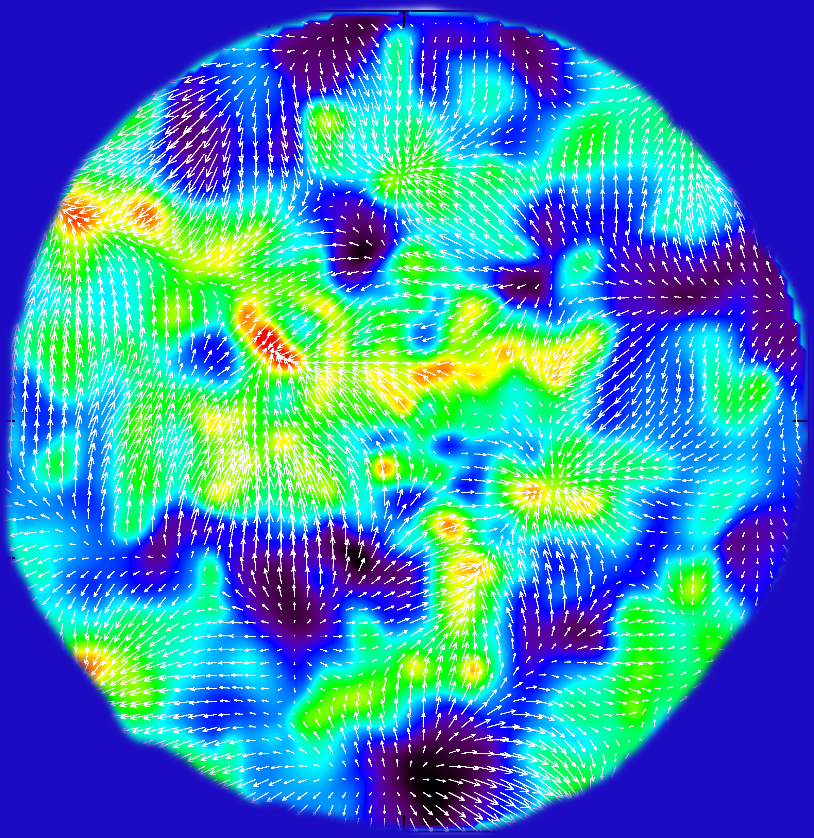
Lecture course
University Groningen
Sept. 2018-Oct 2018
Cosmic Flows

Slide 2
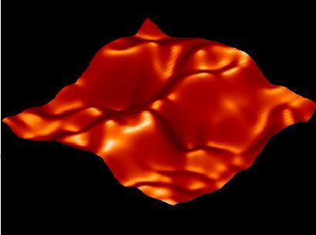
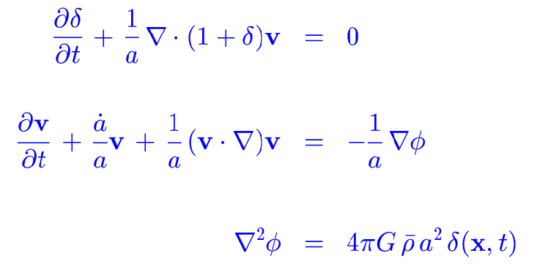
Gravitational Instability

Slide 3
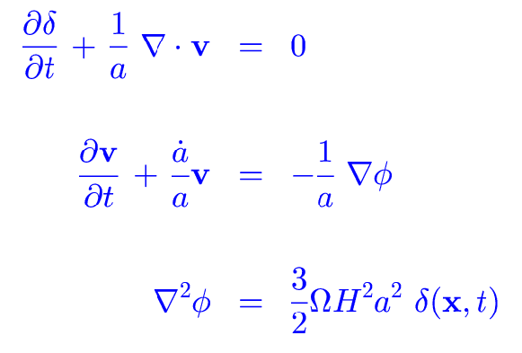
Gravitational Instability

Slide 4
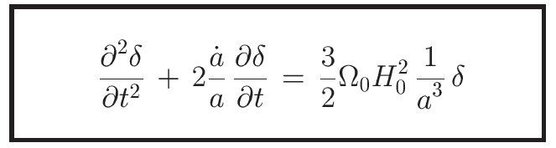
Gravitational Instability
The linear system of structure growth equations can be written in terms of a second order differential equation,

Slide 5
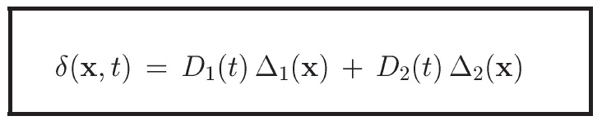
Gravitational Instability
… whose two solutions are separable in time and space, leading to a universal “density growth factor” D(t),
“Growing Mode”
“Decaying Mode”

Slide 6
Linear Density Growth
… whose two solutions are separable in time and space, leading to a universal “density growth factor” D(t),
“Growing Mode”
“Decaying Mode”

Slide 7
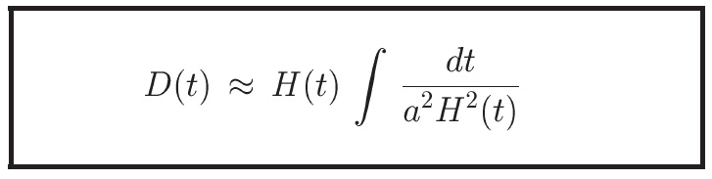
Linear Density Growth
… The universal “density growth factor” D(t) can be computed for any cosmology through the integral

Slide 8
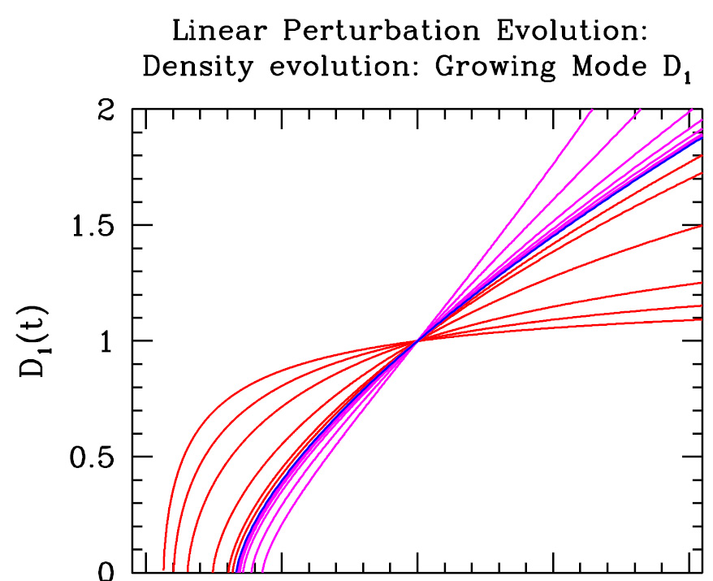
Linear Density Growth

Slide 9
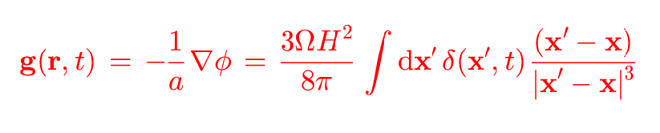
Gravitational Instability
GRAVITY PERTURBATIONS

Slide 10
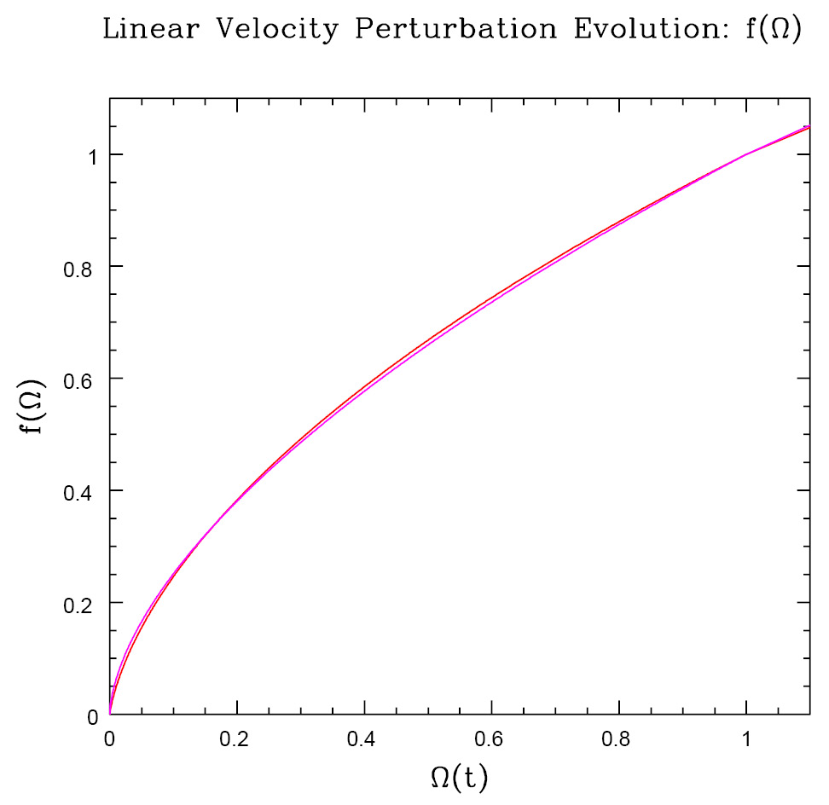
Velocity Perturbations

Slide 11
Measuring
Distances

Slide 12
Distance & Velocity
Measurements
To measure peculiar velocities of galaxies, one needs to know their
real distance r:
• ie. the distance independent of redshift, ie. of the use of the Hubble relation:
• to determine the (radial component) of the peculair velocity, one would need
to measure independently the distance r.
• Determining reliable distances directly is still one of the main challenges
of observational cosmology.

Slide 13
Distance & Velocity
Measurements
• Determining reliable distances directly is still one of the main challenges
of observational cosmology.
• In practice, one makes use of galaxy scaling relations, which relates an
observable intrinsic characteristic of a galaxy – such as velocity dispersion or
rotation velocity – with an observable distance dependent characteristic whose
intrinsic value is physically related to the intrinsic characteristic.
• The 2 main examples are the Tully-Fisher (TF) relation – for late-type galaxies –
and the Faber-Jackson (FJ) relation – for early-type galaxies. Both are relations
based on the dynamics of galaxies, relating the mass M of the galaxy to their rotation
velocity (TF) or velocity dispersion (FJ) of galaxies.
• Main obstacle: accuracy/measurement errors of peculiar velocities still only
20%, at best 10%

Slide 14
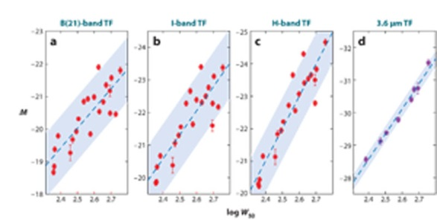
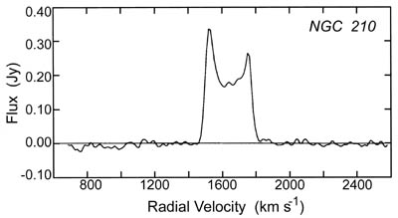
Tully-Fisher
Spiral galaxies:
relation between rotation velocity v
(measured by HI velocity width)
and absolute luminosity L of galaxy
L ∝ v⁴
Measure rotation velocity v
from linewidth 21cm line of galaxy:
TF → L
Measure apparent magnitude,
ie. apparent luminosity l:
• Distance r:

Slide 15
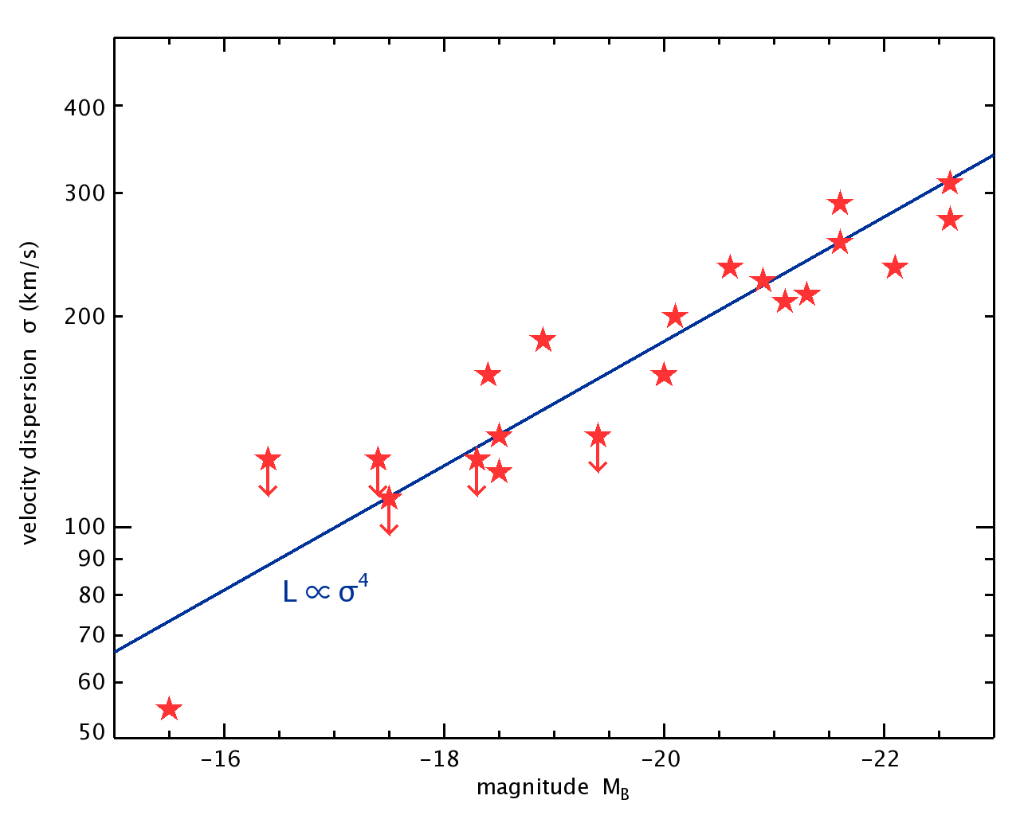
Faber-Jackson
Early-type galaxies:
relation between
velocity dispersion σ_{v}
Luminosity L of galaxy
L ∝ σ_{v} ⁴
Measure velocity dispersion σ_{v}
of galaxy:
FJ → L
Measure apparent magnitude,
ie. apparent luminosity l:
• Distance r:
The FJ relation is a projection of a higher
dimensional relation, the Fundamental Plane (FP)
The FP relates, for E and SO galaxies, the
surface brightness I_{e}, effective radius R_{e} &
velocity dispersion σ_{v} of a galaxy
The FP is a reflection of the virial equilibrium of such a galaxy

Slide 16
Peculiar Velocities
Local Universe

Slide 17
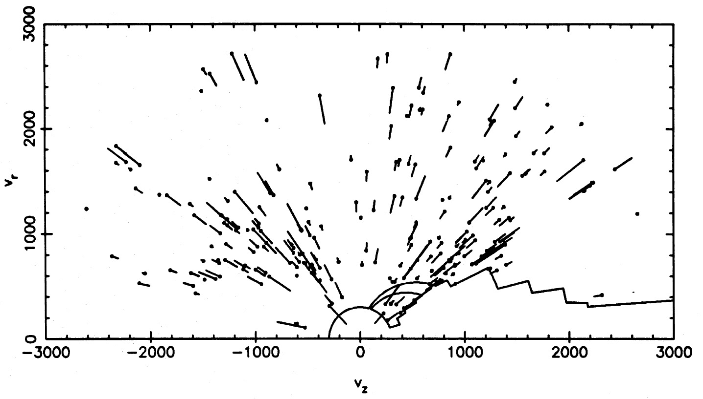
Local Supercluster flow
Lilje, Yahil & Jones 1986

Slide 18
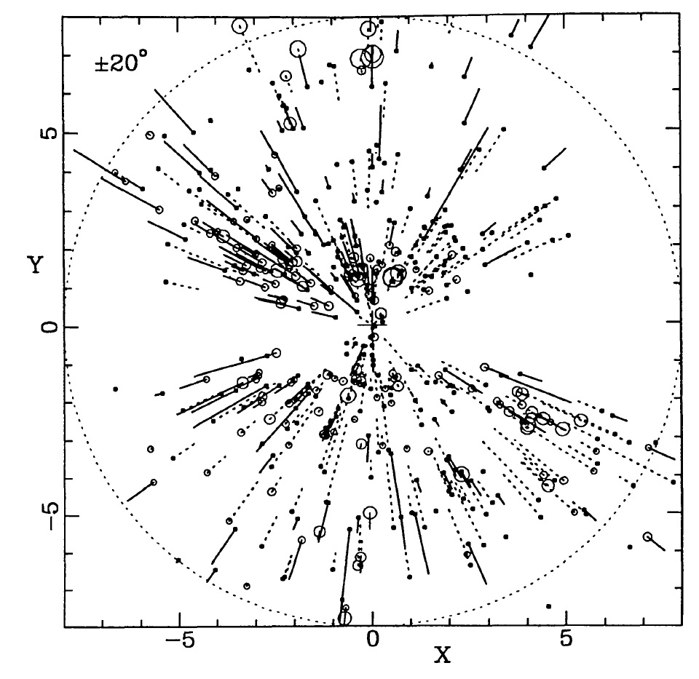
Mark III
Peculiar velocities
Local Universe
Willick, Strauss et al.
First flow maps:
7 Samurai

Slide 19
POTENT
velocity reconstruction
mass density distribution
Surveys of galaxy peculiar velocities only give a sample of RADIAL velocities of galaxies,
• irregularly sample – at discrete galaxy locations – in sample volume
• Bertschinger & Dekel (1989++) proposed a beautiful idea to convert this into a map of
the mass distribution in this volume.
• Their method, POTENT, is based on the realization that the flow on large scales is a
a potential flow, so that once can compute the velocity potential Φ_{v}:
From this one can then simply
get the FULL 3-D velocity flow:

Slide 20
POTENT
velocity reconstruction
mass density distribution
Surveys of galaxy peculiar velocities only give a sample of RADIAL velocities of galaxies,
• irregularly sample – at discrete galaxy locations – in sample volume
• Bertschinger & Dekel (1989++) proposed a beautiful idea to convert this into a map of
the mass distribution in this volume.
• Their method, POTENT, is based on the realization that the flow on large scales is a
a potential flow, so that once can compute the velocity potential Φ_{v}:
From this one can then simply
get the FULL 3-D velocity flow:
The density field δ(r) then simply
follows from the linear continuity eqn.

Slide 21
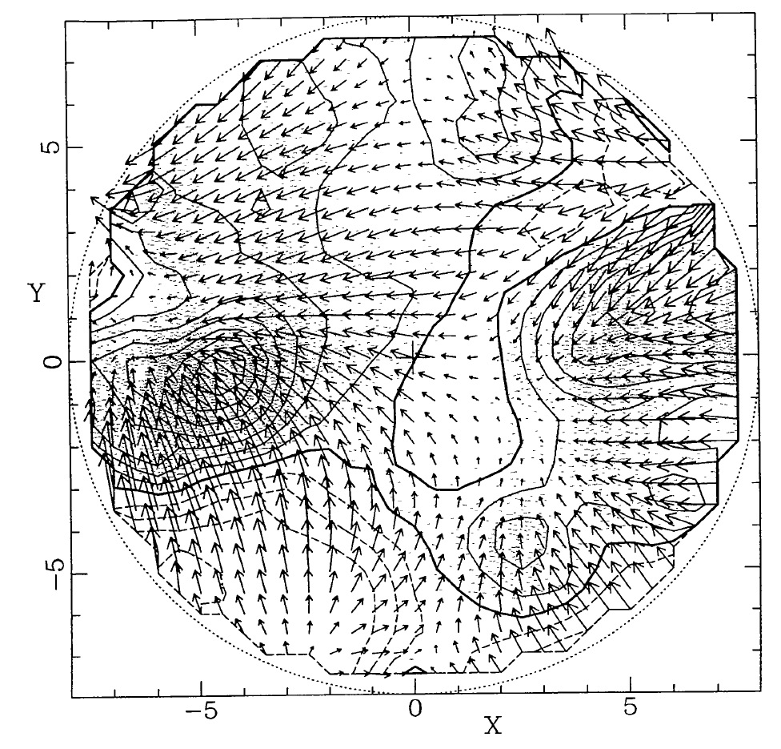
POTENT map
Mass distribution
Local Universe
Bertschinger,
Dekel, et al.

Slide 22
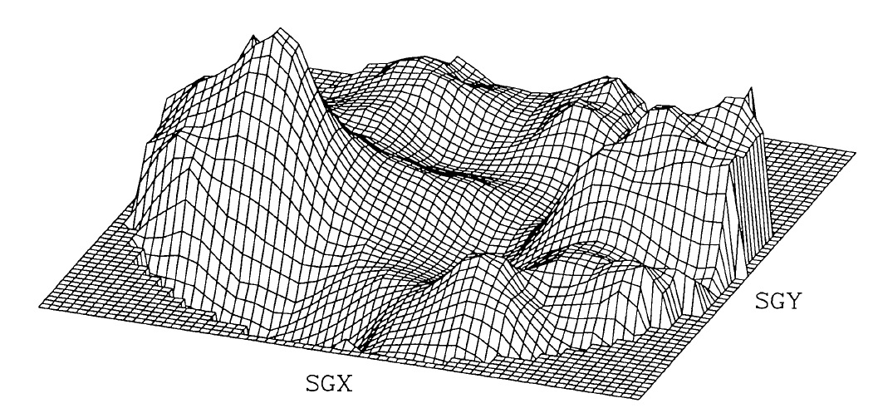
POTENT map
Mass distribution Local Universe
Bertschinger, Dekel, et al.
Great Attractor
Galaxy

Slide 23
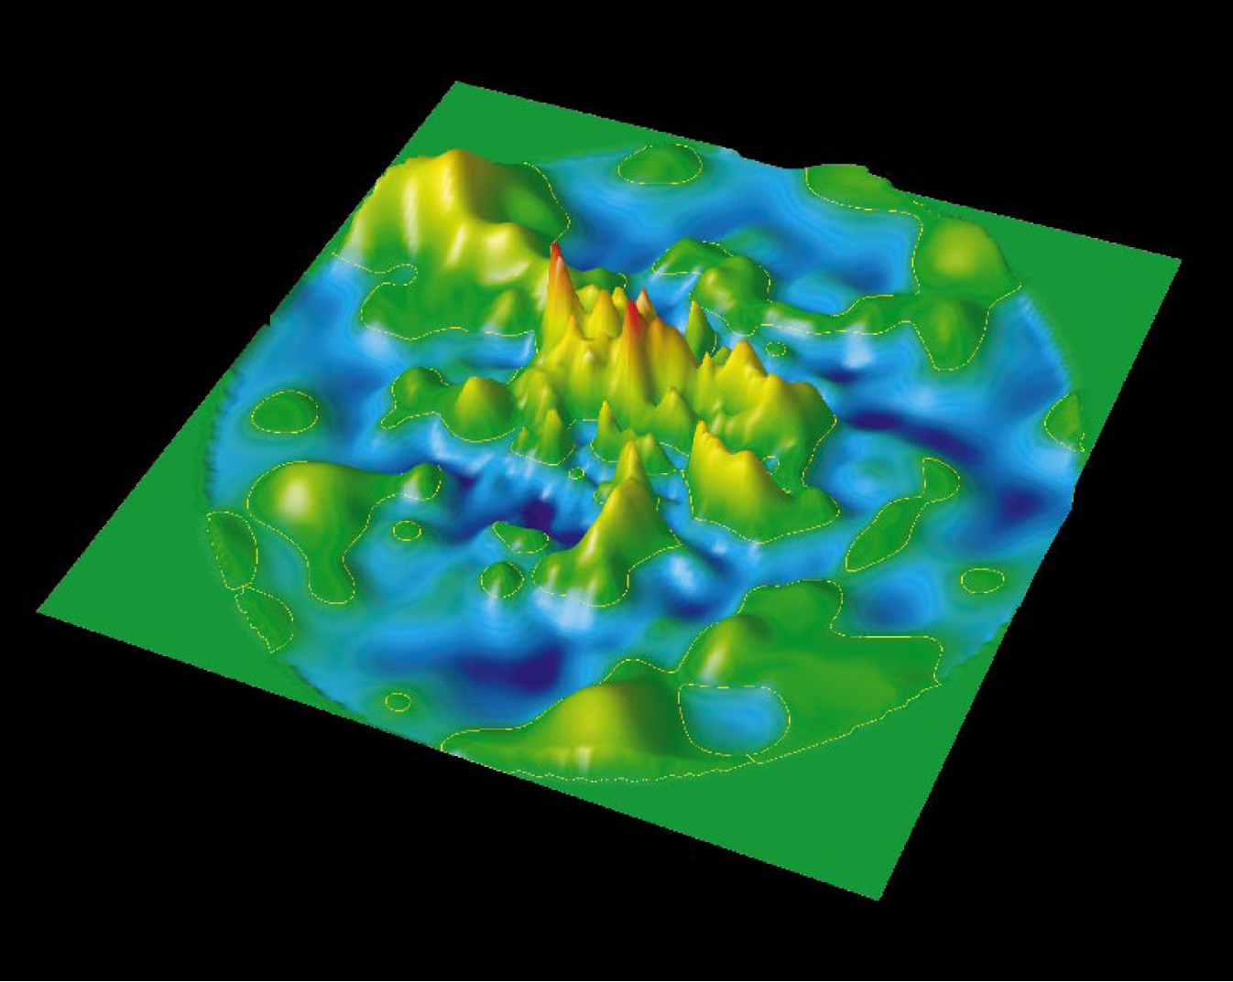
Local Universe
Mass Distribution
PSCz
(Branchini et al.)

Slide 24
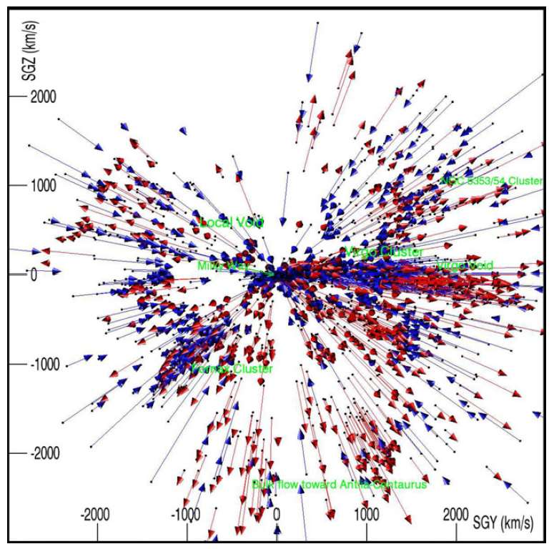
Cosmicflows
Cosmicflows survey
peculiar velocities
Local Universe:
Tully & Courtois
Cosmicflows-2 2013
Cosmicflows-3 2017

Slide 25
the Great Attractor

Slide 26
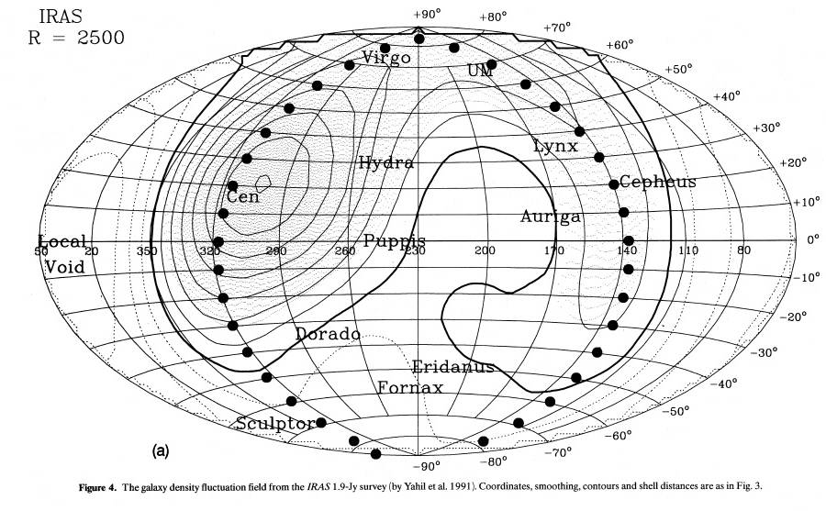

Slide 27
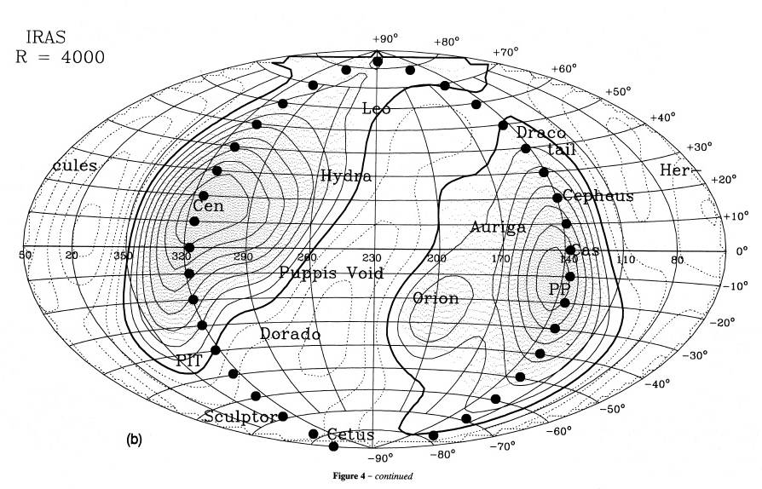

Slide 28
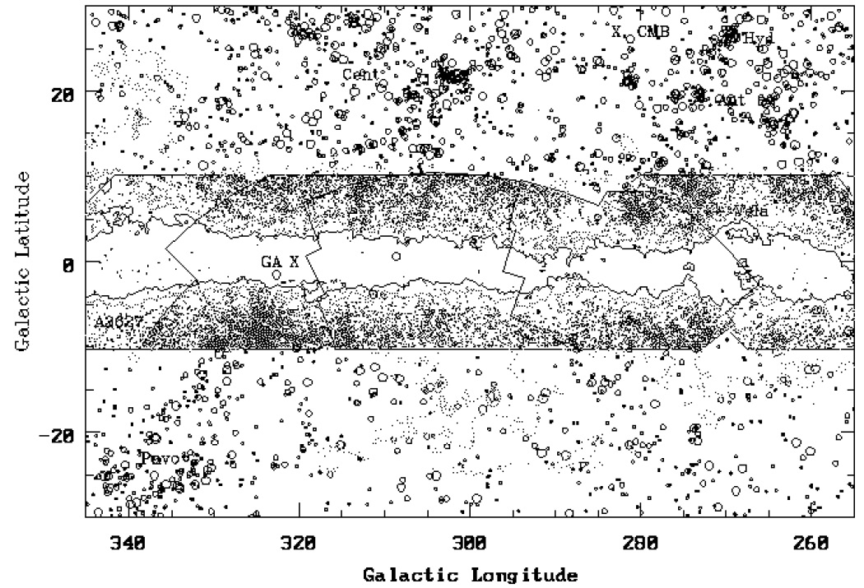

Slide 29
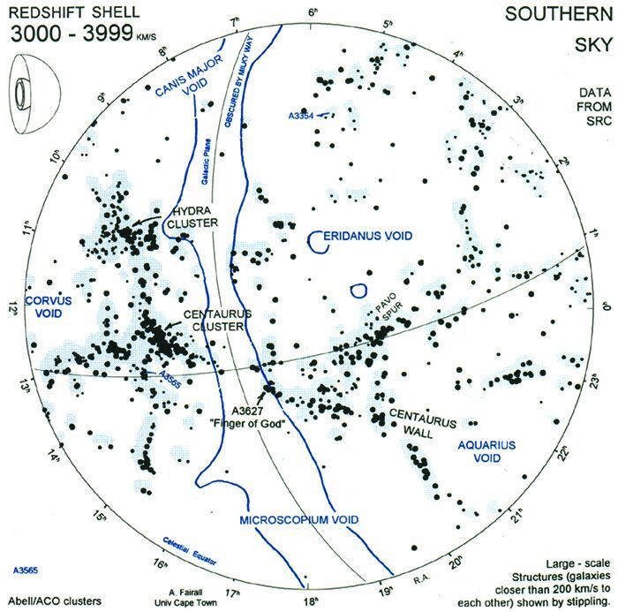
Tony Fairall’s
nearby LSS map:
cz=3000-3999 km/s
clear views of
Great Attractor:
Norma Cluster/
A3627

Slide 30
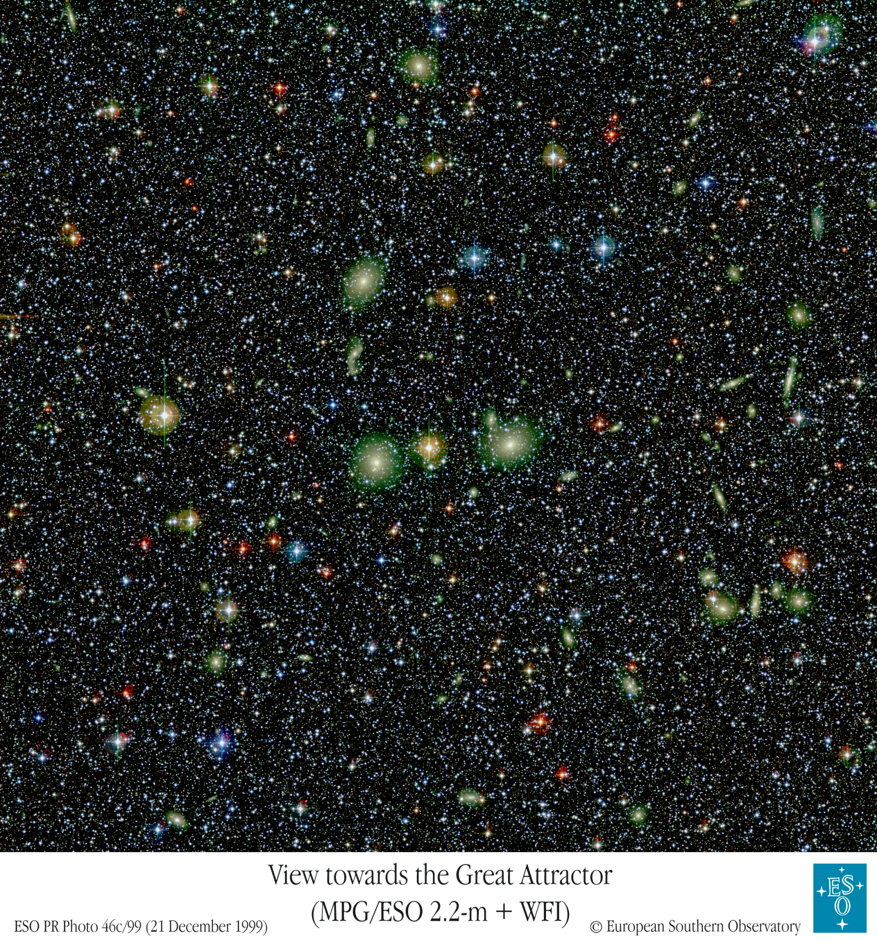

Slide 31
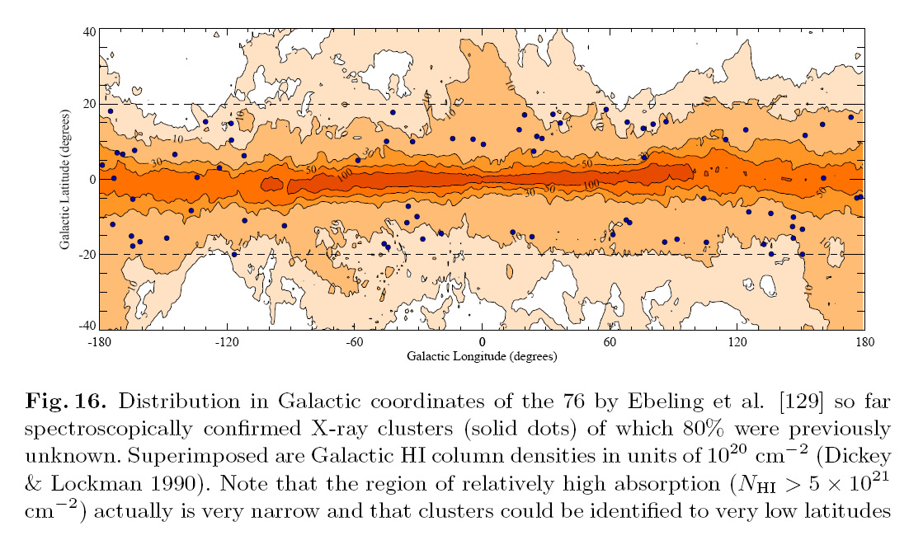

Slide 32
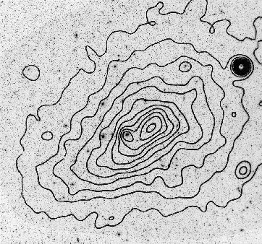

Slide 33
PSCz:
Cosmic Migration Flows
Local Universe

Slide 34
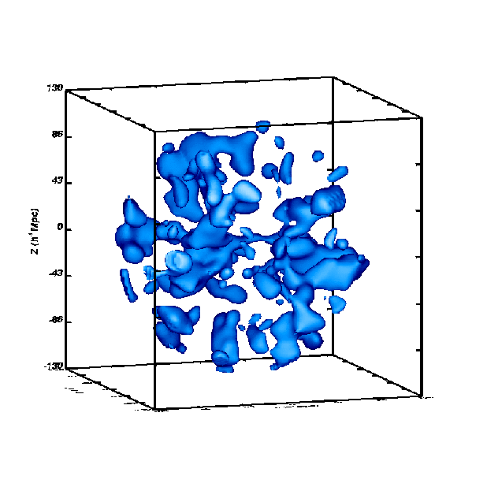

Slide 35

Velocity
Field

Slide 36
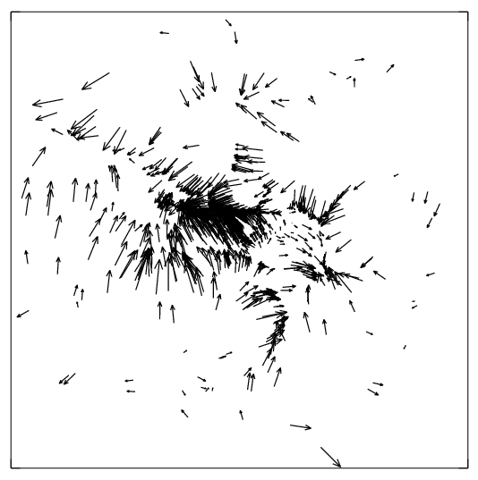

Slide 37
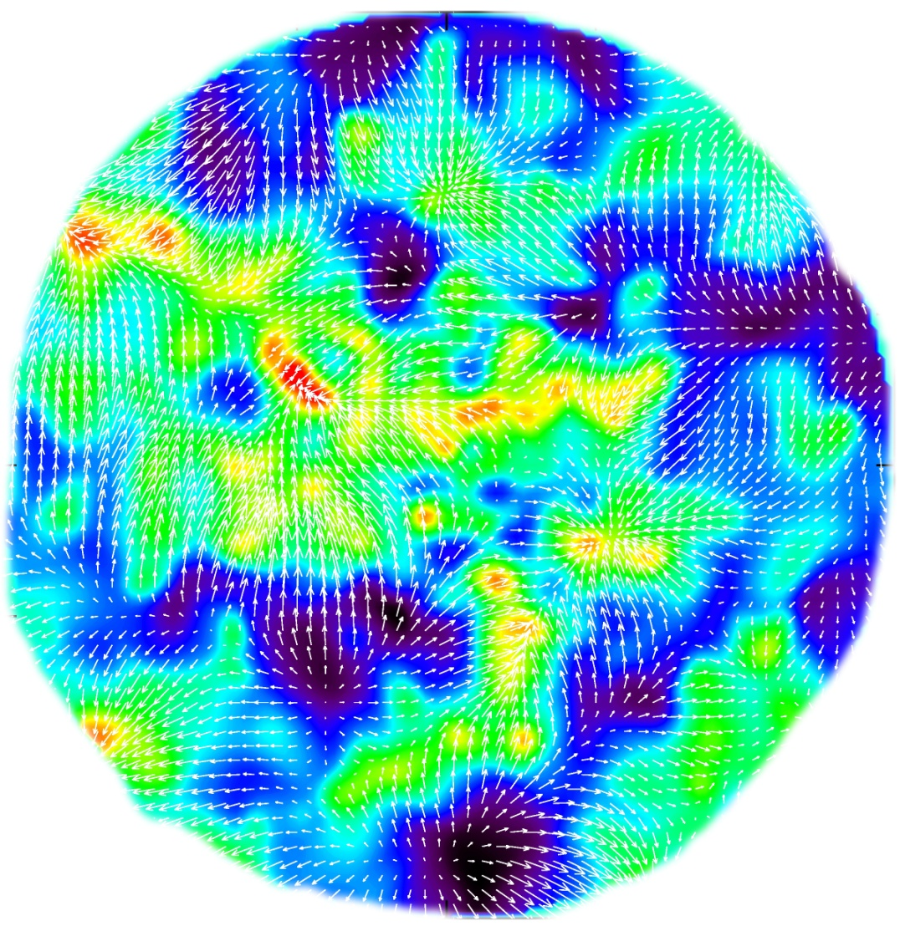
PSCz
Flow Field
Flow throughout the volume
restored (assuming no shell-crossing)
Restored velocities volume-weighted
Shot-noise suppressed
PSCz, velocity+density field

Slide 38
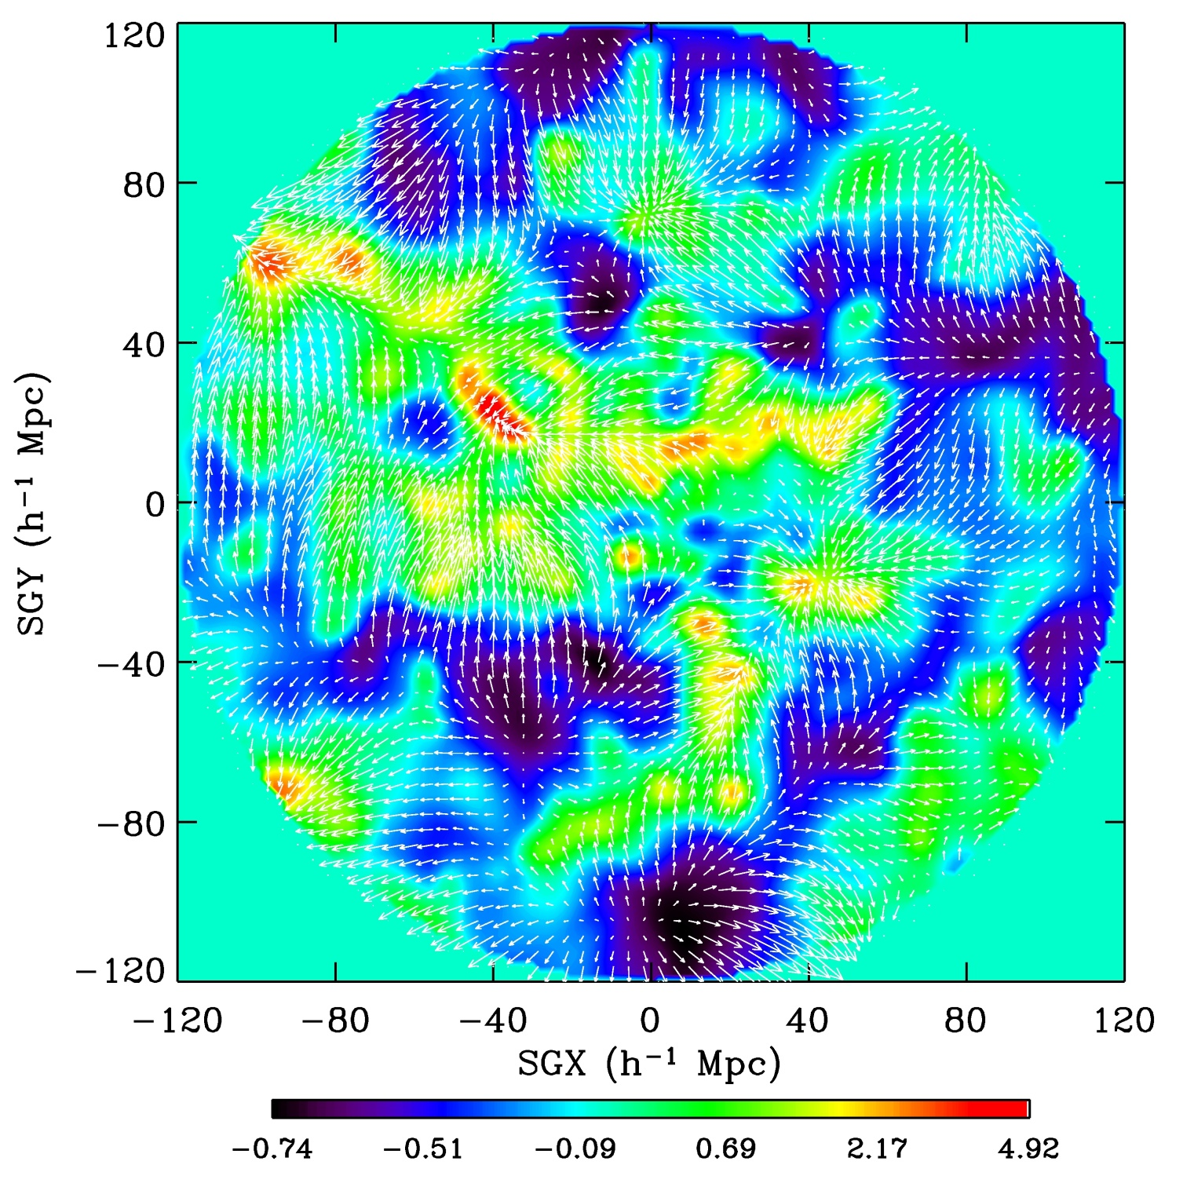

Slide 39
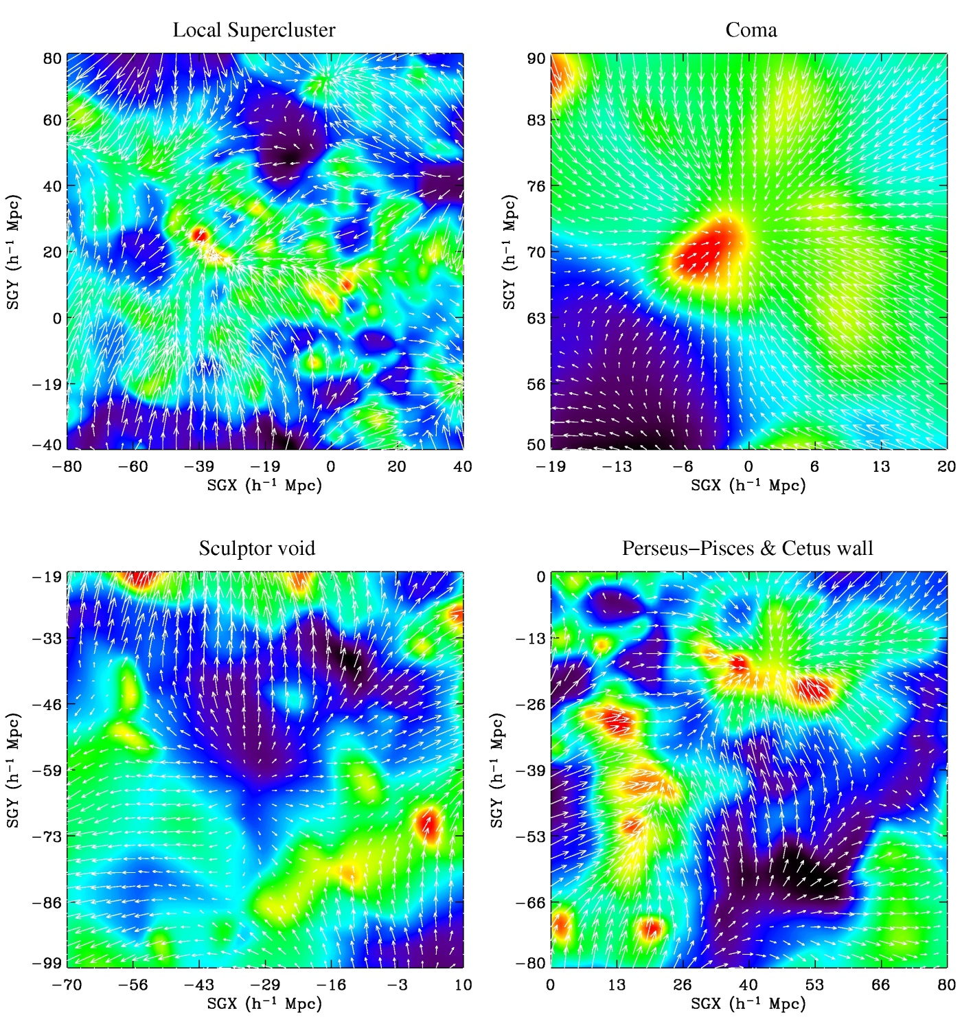

Slide 40
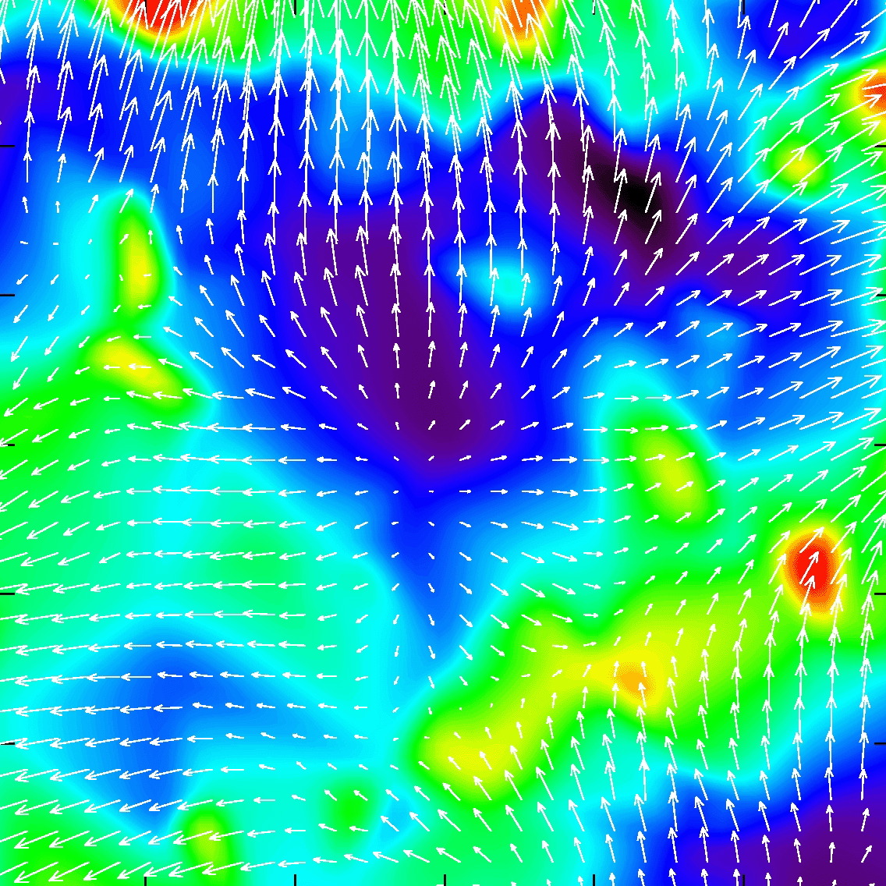

Slide 41
Cosmic Web:
Cosmic Migration Flows

Slide 42
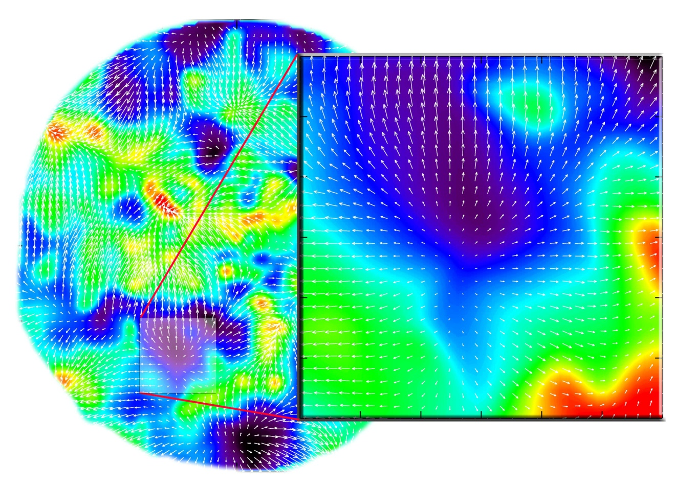
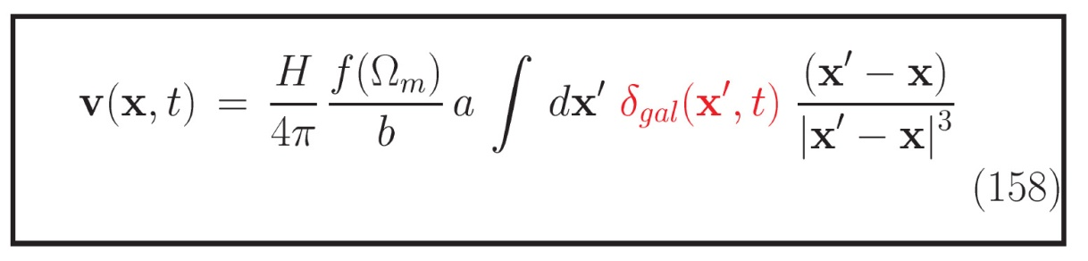
Large Scale Flows
Large-Scale Flows:
Structure buildup
accompanied
by displacement of matter:
- Cosmic flows
On large (Mpc) scales,
structure formation
still in linear regime
Directly related to
cosmic matter distribution
Note:
redshift space distortion
cz = Hr + v_{pec}
In principle possible to
correct for this distortion,
ie. to invert the mapping
from real to redshift space
Condition:
entire mass distribution
within volume should be mapped

Slide 43
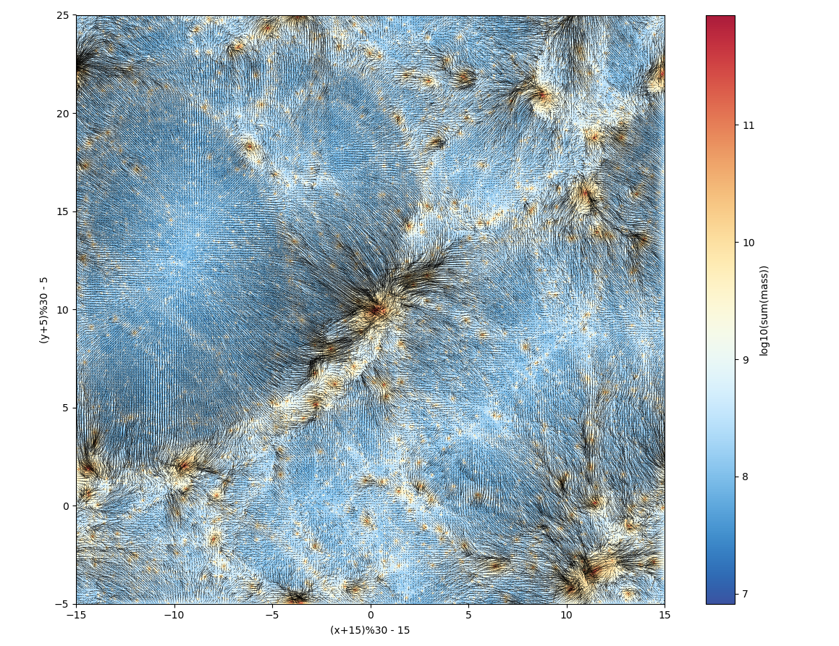
Flow in the Cosmic Web

Slide 44
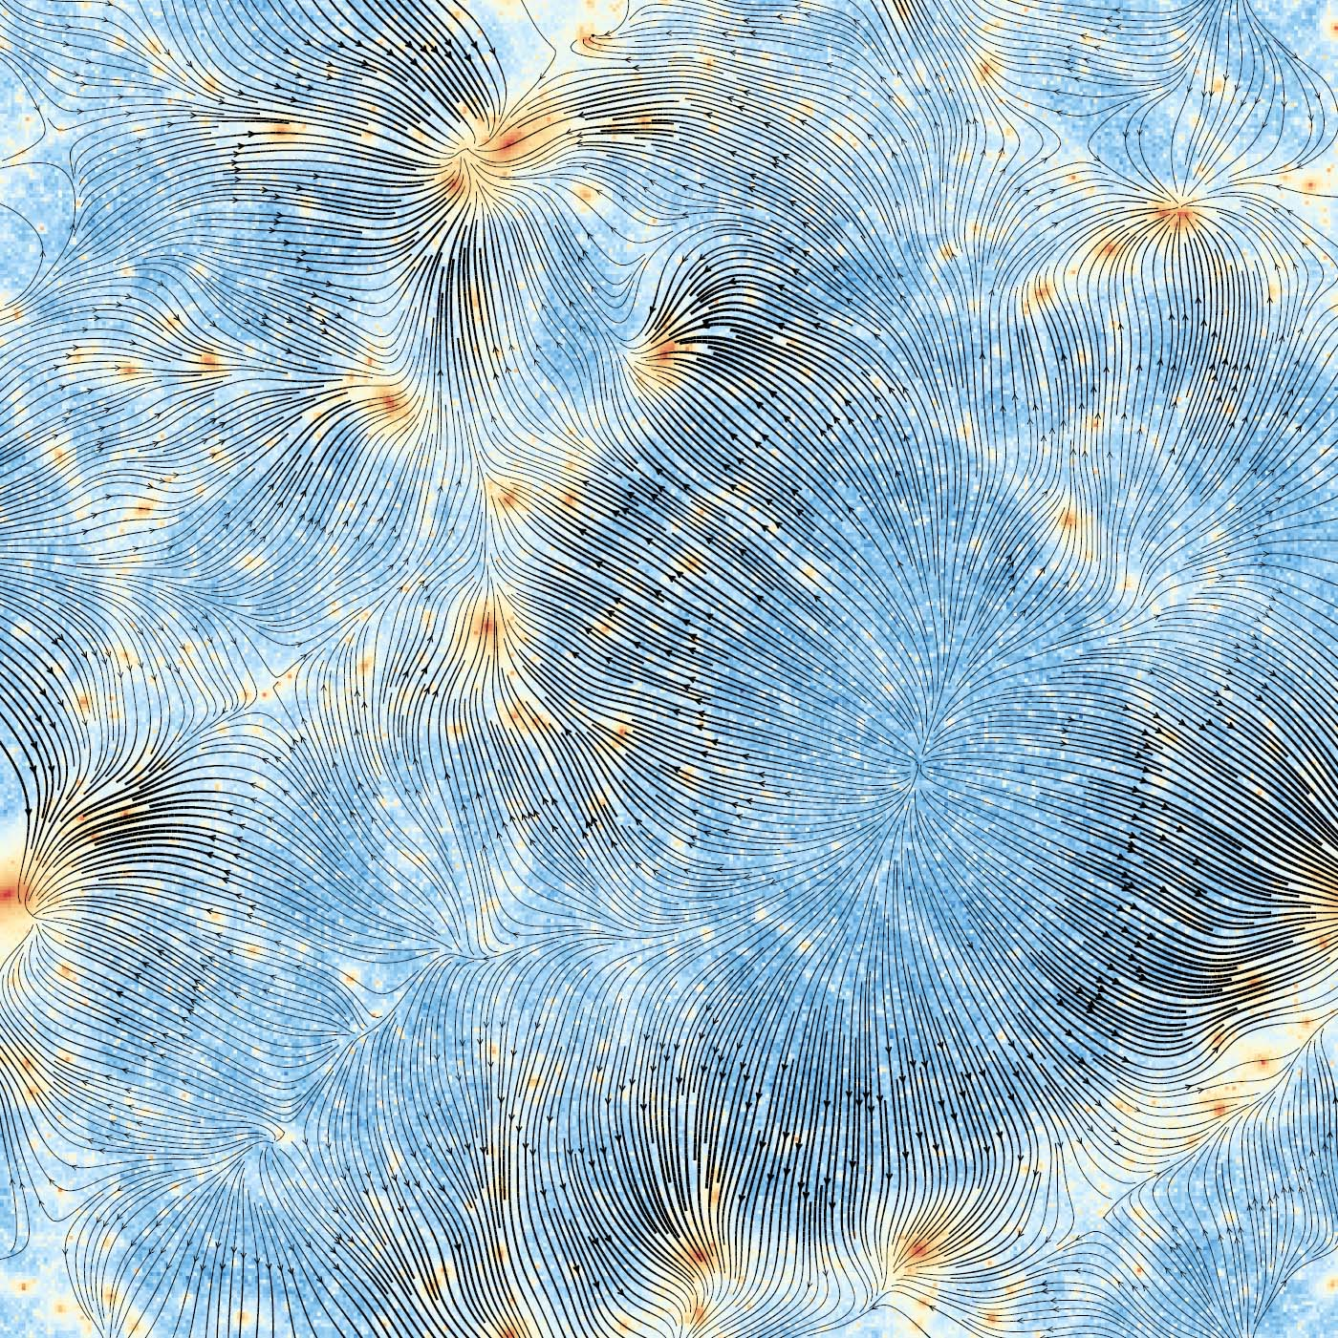
Cosmic Web Flowlines:
Stokes: flow field components
Divergence dominant in voids
Shear dominant along filaments
Vorticity: only in high-density
multistream regions

Slide 45
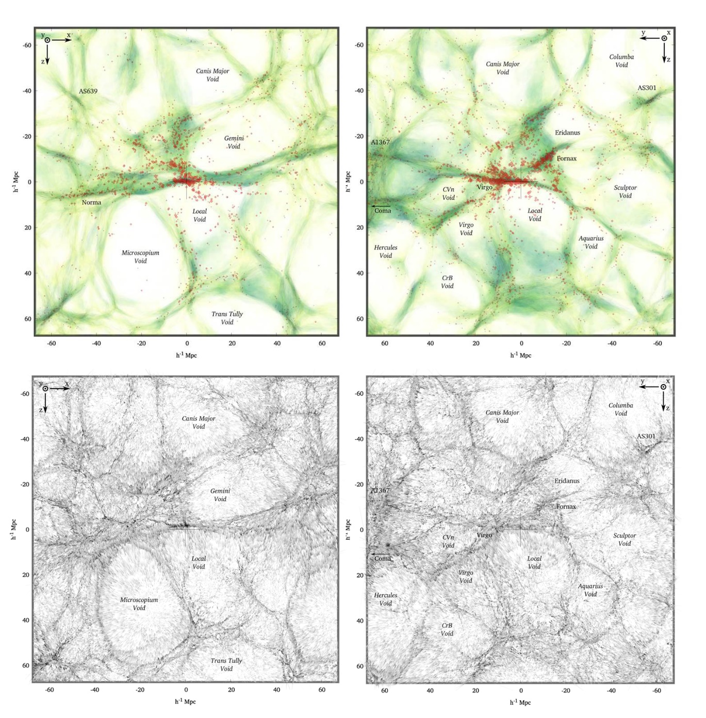
2MRS Local Universe
KIGEN-adhesion
reconstruction 2MRS
Hidding, vdW, Kitaura & Hess 2018

Slide 46
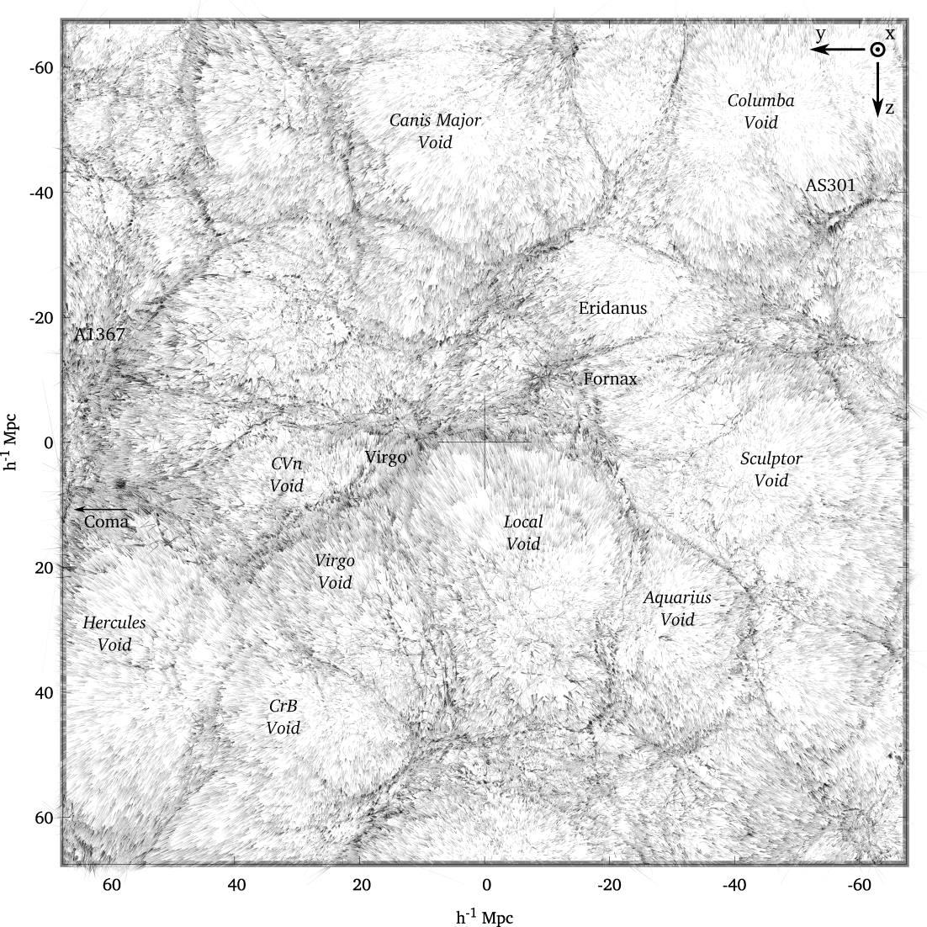
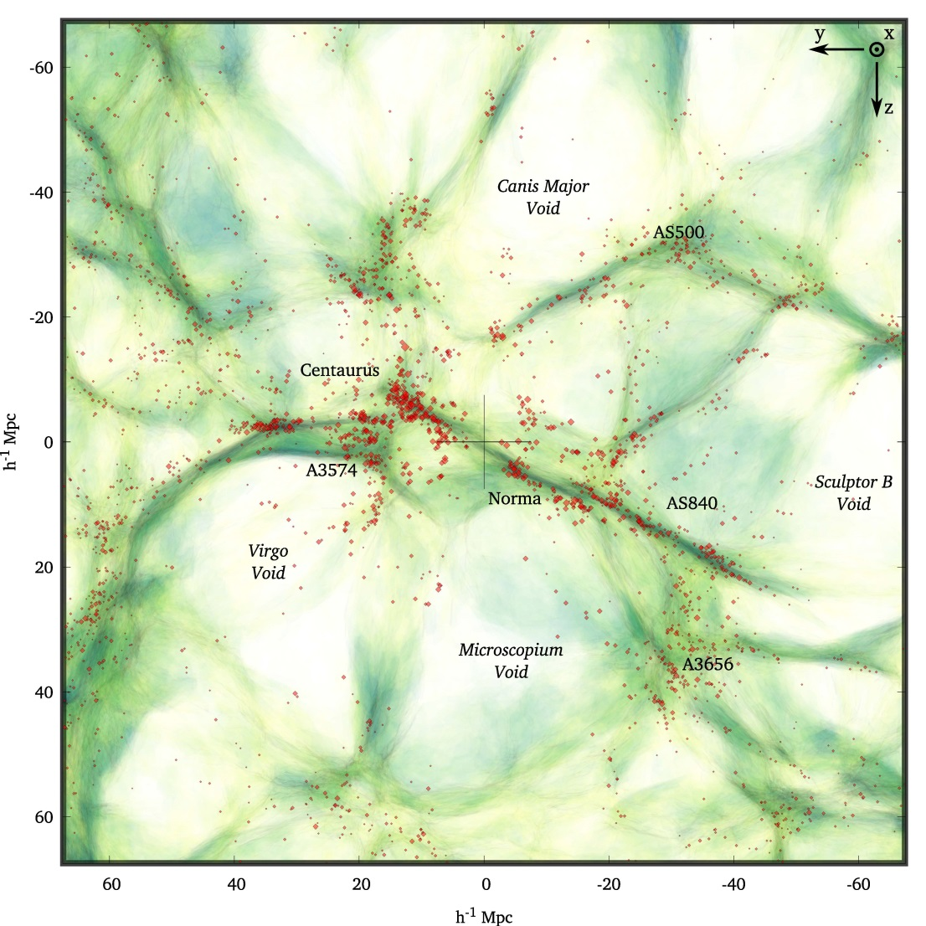
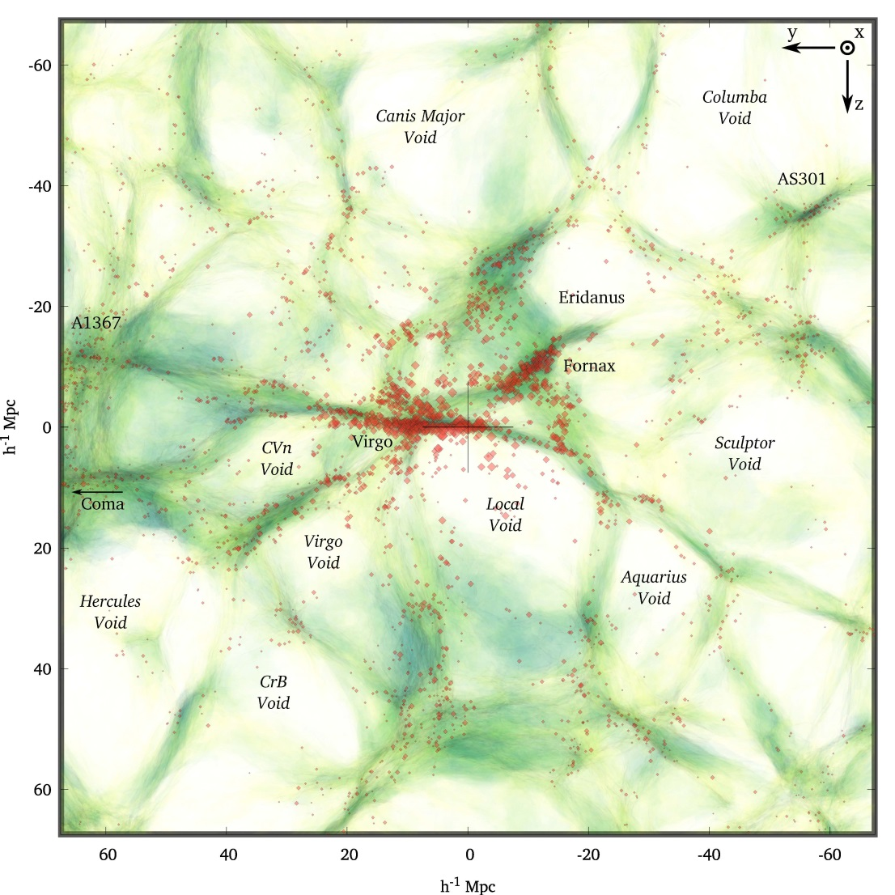
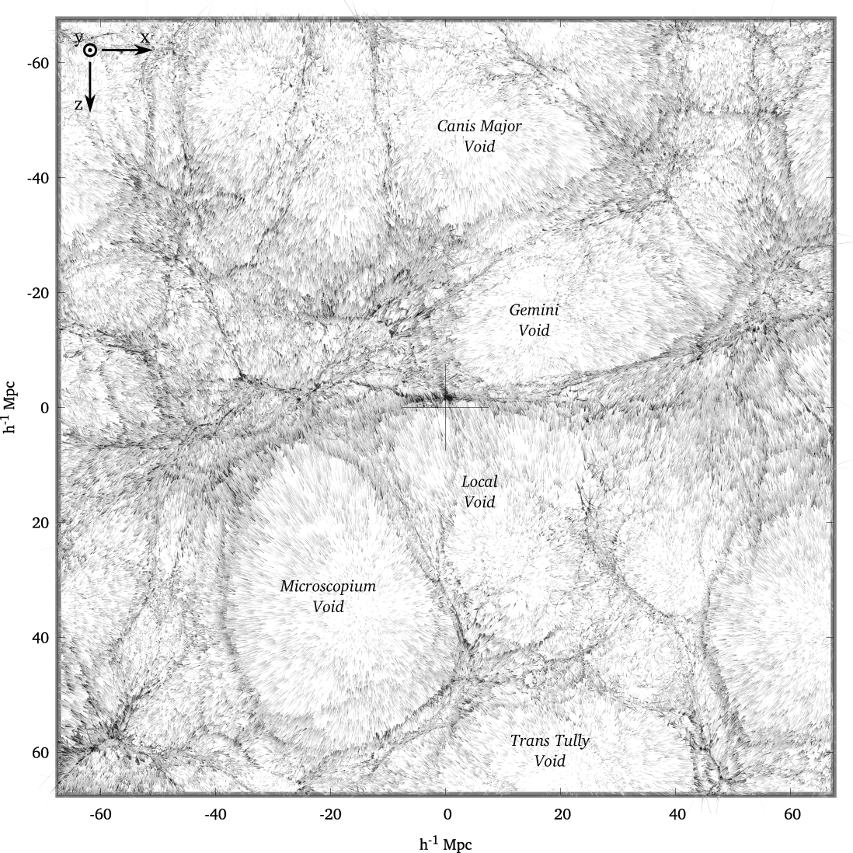
Supergalactic Plane
mean KIGEN - adhesion reconstruction
Hidding, Kitaura, vdW & Hess 2016/2017

Slide 48
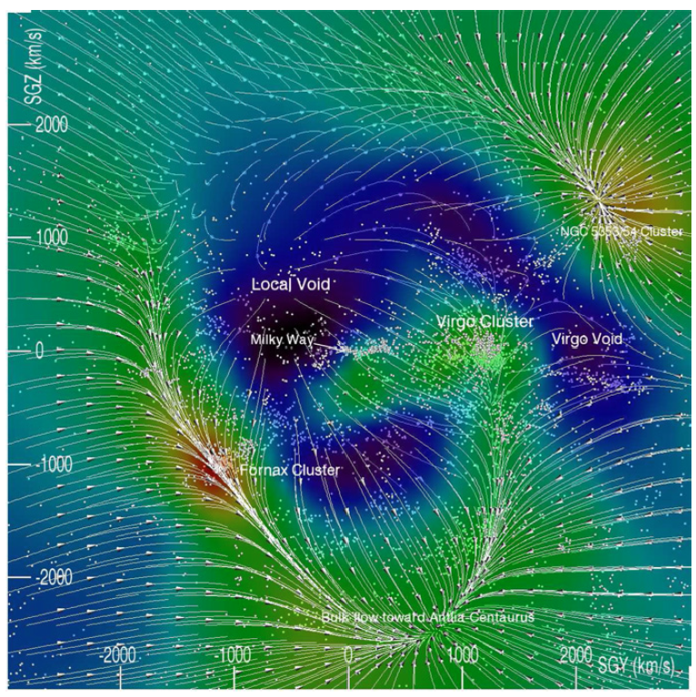
CosmicFlows-2
Sculptor Void
Courtois et al. 2013
Local void expansion in Cosmicflows-2

Slide 49
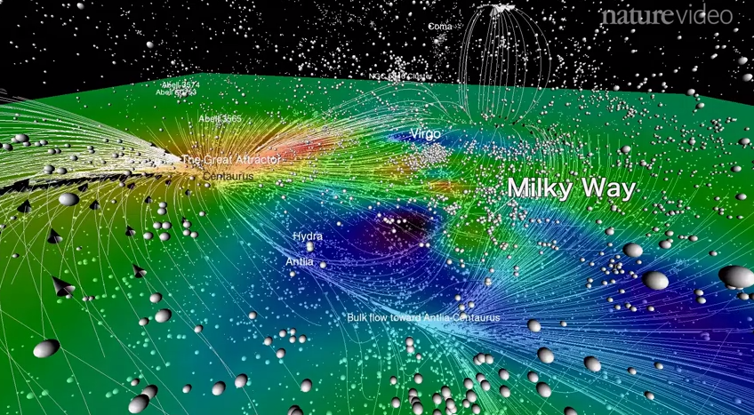
Laniakea

Slide 50
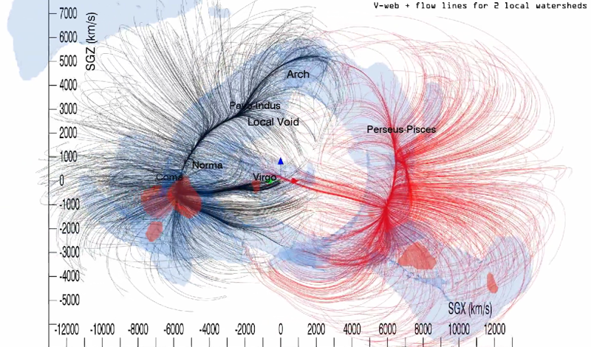
Laniakea

Slide 51
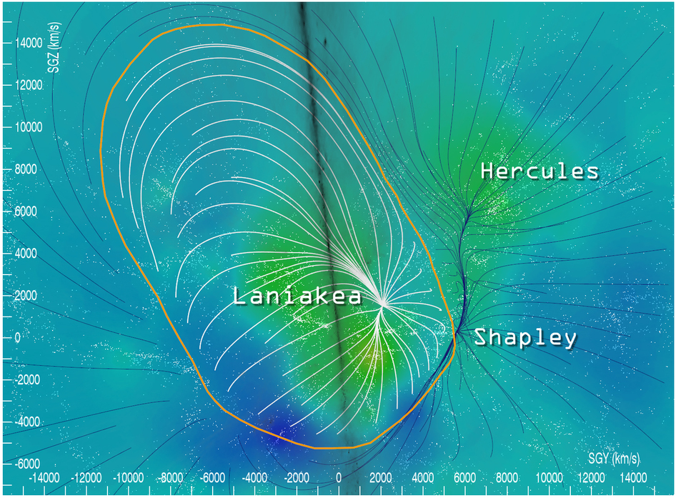
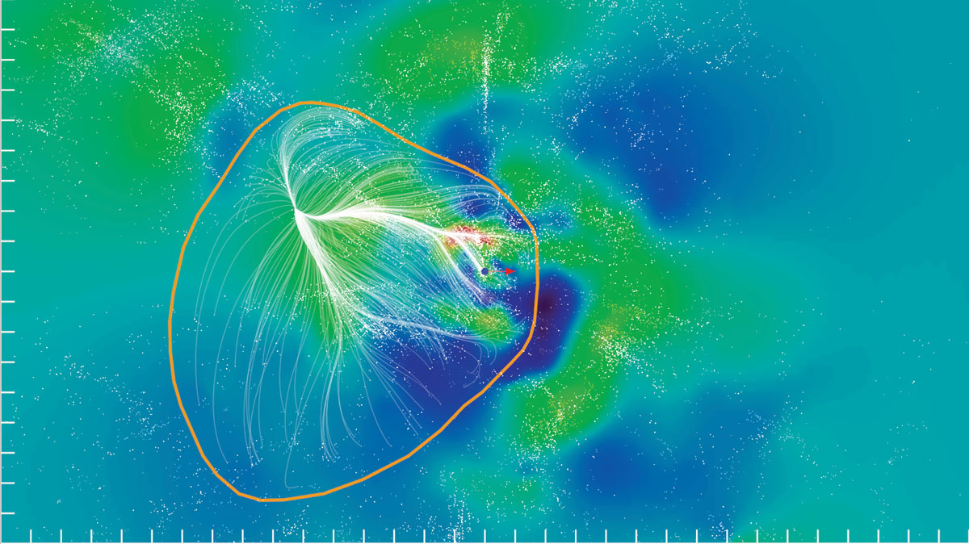
Laniakea

Slide 52
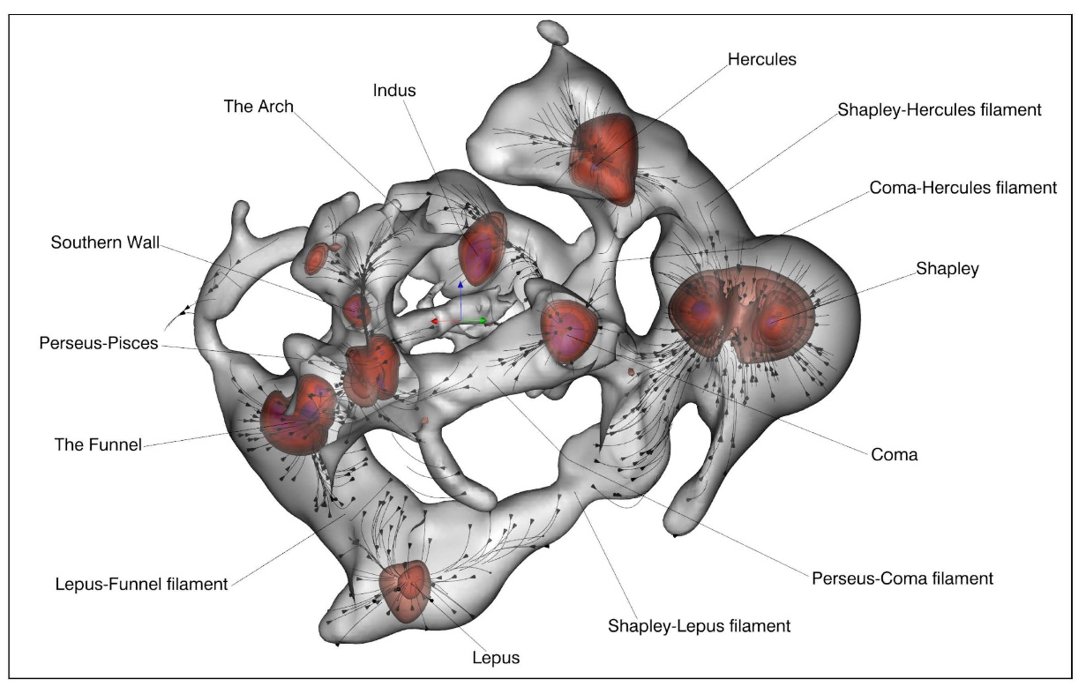
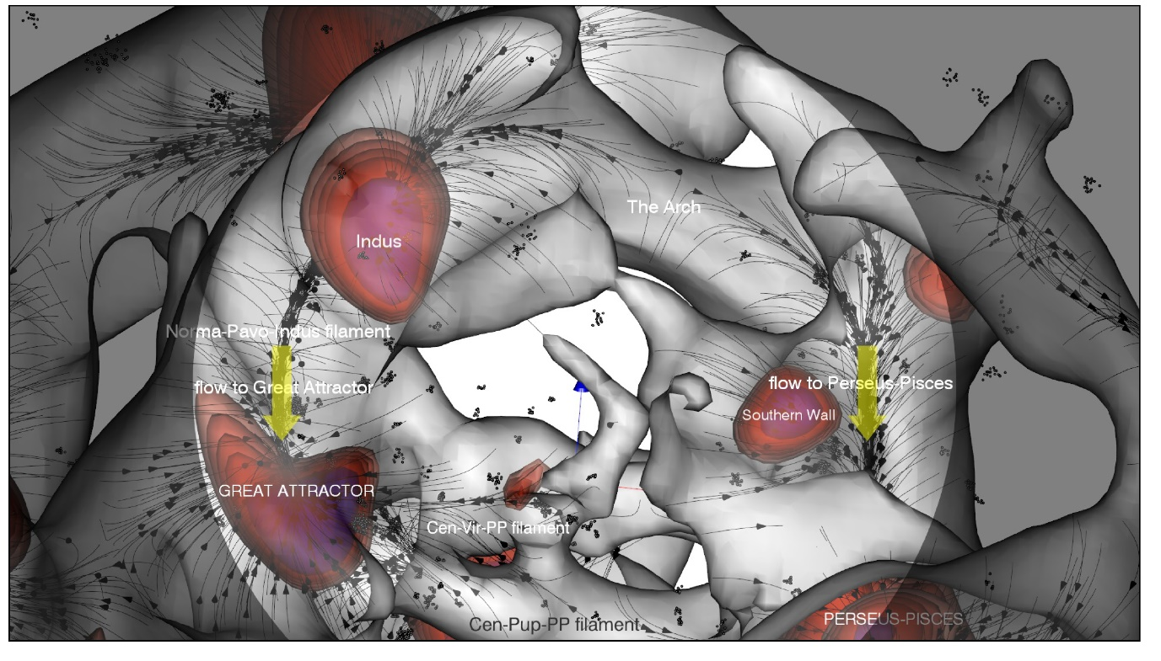
CosmicFlows-3
Cosmic Web morphology:
velocity shear based
V-web identification
flow pattern in cosmic web
(Pomarede et al. 2017)

Slide 53
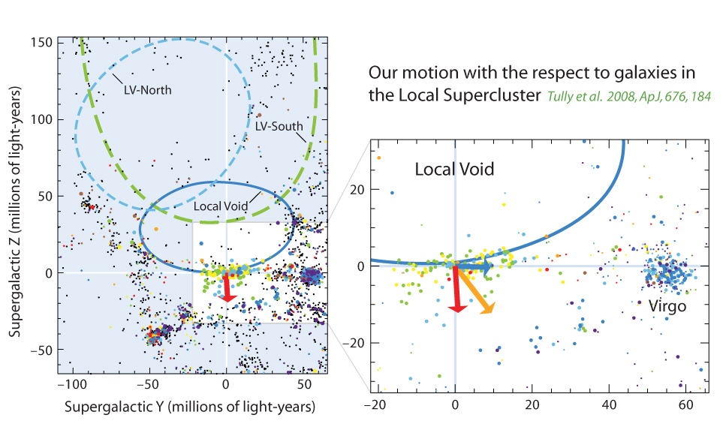
Push of the Local Void
Sculptor Void
Tully et al. 2008:
Local Void pushes with ~260 km/s against our local neighbourhood

Slide 54
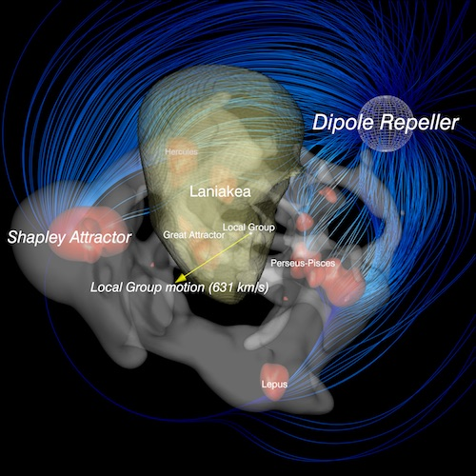
Void Dipole Repeller
Cosmicflows-3 Cosmic Web
morphology Local Universe
(Pomarede et al. 2017)
Void Dipole Repeller
dominant dynamical
Presence Local Universe
(Tully et al. 2017)

Slide 55
Cosmic Dipoles:
Motion of the Milky Way

Slide 56

The CMB Dipole
T= 3.36 mK v_{LG}= 627 +/- 22 km/s
(l,b)=(264.3º,48.1º) (l,b)=(276º,30º)

Slide 57



Slide 58

PSCz dipole

Slide 59


Slide 60



Slide 61
2MASS survey
2MASS all-sky survey:
ground-based near-infrared survey whole sky,
J(1.2 m), H(1.6 m), K(2.2 m)
● 2MASS extended source catalog (XSC):
1.5 million galaxies
● unbiased sample nearby galaxies
● photometric redshifts:
depth in 2MASS maps,
“cosmic web” of (nearby) superclusters spanning the entire sky.
courtesy: T. Jarrett

Slide 62

2MASS Cosmic Web
Looking around us we already see the unmistakable signatures of an intriguing foamlike matter distribution in our immediate Cosmic Vicinity.

Slide 63

Identity of Local Structures along local Cosmic Web.

Slide 64


Slide 65

2MASS dipole

Slide 66


