Slide 1
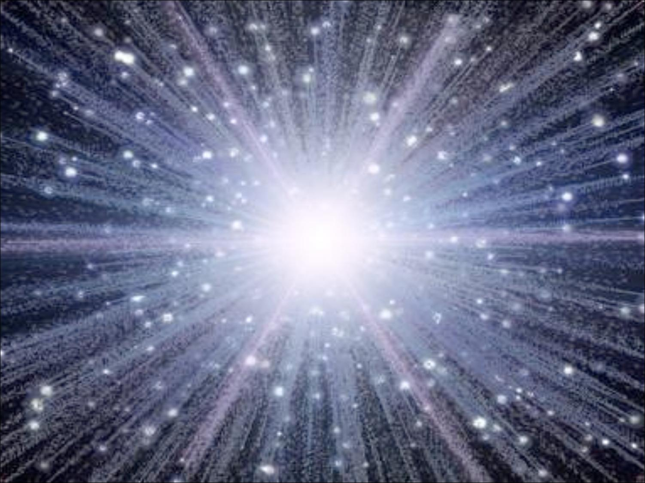
Cosmology
13.8 Gyrs of Big Bang History

Slide 2
Gravity
Ruler of the Universe

Slide 3
Four Fundamental Forces of Nature
Strong Nuclear Force
Responsible for holding particles together inside the nucleus.
The nuclear strong force carrier particle is called the gluon.
The nuclear strong interaction has a range of 10⁻¹⁵ m (diameter of a proton).
Electromagnetic Force
Responsible for electric and magnetic interactions, and determines structure of
atoms and molecules.
The electromagnetic force carrier particle is the photon (quantum of light)
The electromagnetic interaction range is infinite.
Weak Force
Responsible for (beta) radioactivity.
The weak force carrier particles are called weak gauge bosons (Z,W⁺,W⁻).
The nuclear weak interaction has a range of 10⁻¹⁷ m (1% of proton diameter).
Gravity
Responsible for the attraction between masses. Although the gravitational force carrier
The hypothetical (carrier) particle is the graviton.
The gravitational interaction range is infinite.
By far the weakest force of nature.

Slide 4
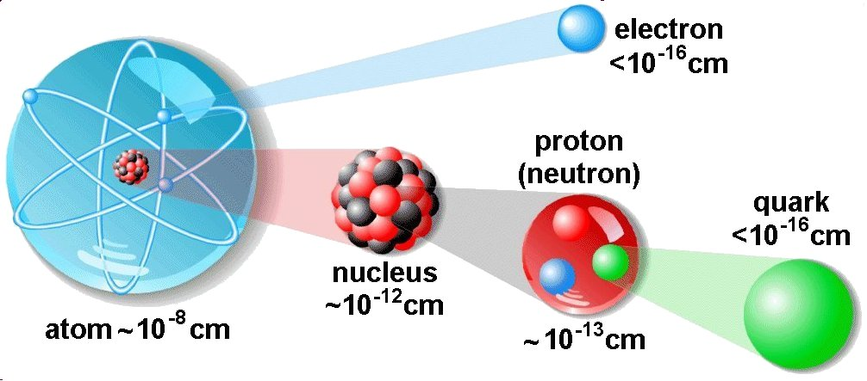
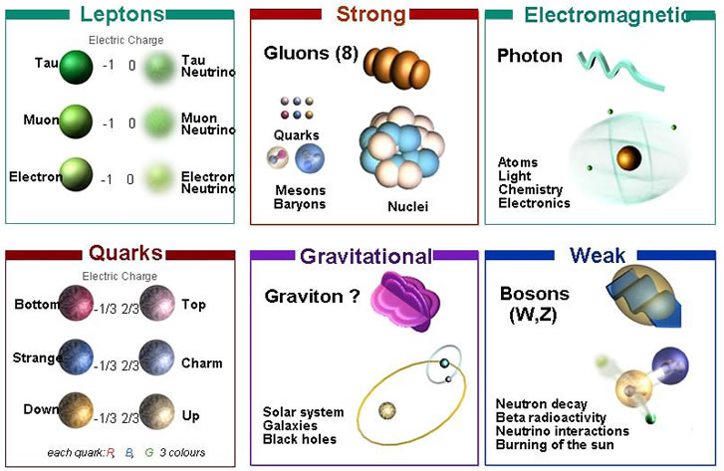
Four Fundamental
Forces of Nature

Slide 5
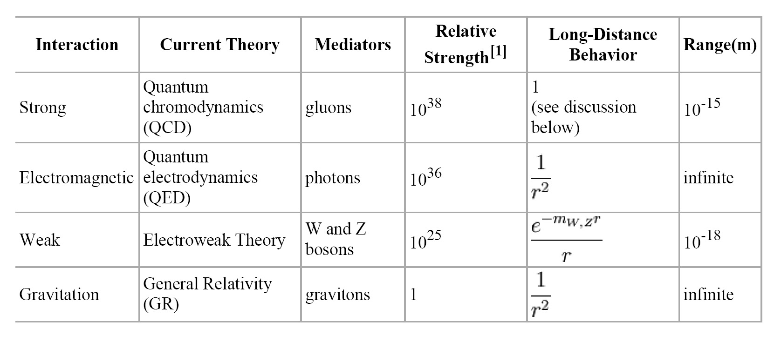
The weakest force, by far, rules the Universe …
Gravity has dominated its evolution, and determines its fate …

Slide 6
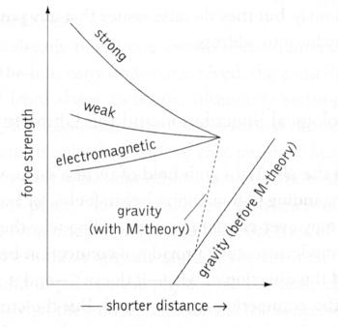
Grand Unified Theories (GUT)
Grand Unified Theories
* describe how
• Strong
• Weak
• Electromagnetic
Forces are manifestations of the same
underlying GUT force …
* This implies the strength of the forces to
diverge from their uniform GUT strength
* Interesting to see whether gravity at some
very early instant unifies
with these forces ???

Slide 7
Newton’s Static Universe

Slide 8
The Unchanging Universe
• In two thousand years of astronomy,
no one ever guessed that the universe might be expanding.
• To ancient Greek astronomers and philosophers,
the universe was seen as the embodiment of perfection,
the heavens were truly heavenly:
– unchanging, permanent, and geometrically perfect.
• In the early 1600s, Isaac Newton developed his law of gravity,
showing that motion in the heavens obeyed the same laws
as motion on Earth.

Slide 9
Newton's Universe
• However, Newton ran into trouble when he tried to apply
his theory of gravity to the entire universe.
• Since gravity is always attractive,
his law predicted that all the matter in the universe should
eventually clump into one big ball.
• Newton knew this was not the case, and assumed that
the universe had to be static
• So he conjectured that:
the Creator placed the stars such that they were
``at immense distances from one another.’’

Slide 10
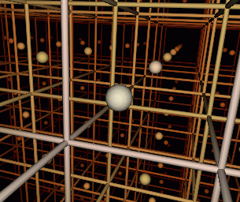
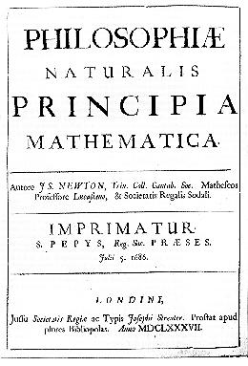
Renaissance of Western Science
In footsteps of Copernicus, Galilei & Kepler,
Isaac Newton (1687) in his Principia
formulated a comprehensive model of the
world. Cosmologically, it meant
absolute and uniform time
space & time independent of matter
dynamics: - action at distance
- instantaneous
Universe edgeless, centerless & infinite
Cosmological Principle:
Universe looks the same at every
place in space, every moment in time
absolute, static & infinite space

Slide 11
Einstein’s
Dynamic & Geometric Universe

Slide 12
Einstein’s Universe
In 1915,
Albert Einstein completed his General Theory of Relativity.
• General Relativity is a “metric theory’’:
gravity is a manifestation of the geometry, curvature, of space-time.
• Revolutionized our thinking about the nature of space & time:
- no longer Newton’s static and rigid background,
- a dynamic medium, intimately coupled to
the universe’s content of matter and energy.
• All phrased into perhaps
the most beautiful and impressive scientific equation
known to humankind, a triumph of human genius,
Einstein Field Equations

Slide 13
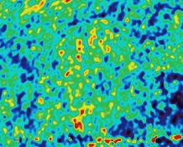
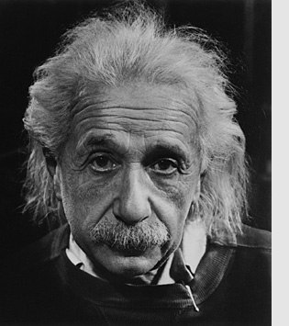
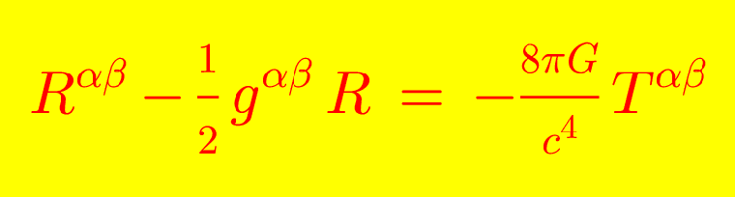
… Spacetime becomes a dynamic continuum,
integral part of the structure of the cosmos …
curved spacetime becomes force of gravity
… its geometry rules the world,
the world rules its geometry…

Slide 14
Albert Einstein
Albert Einstein
(1879-1955; Ulm-Princeton)
father of
General Relativity (1915),
opening the way towards
Physical Cosmology
The supreme task of the physicist is to arrive at those universal elementary laws from which the cosmos can be built up by pure deduction.
(Albert Einstein, 1954)

Slide 15
General Relativity:
Einstein Field Equations

Slide 16
Einstein Field Equation
Metric tensor:
Energy-Momentum tensor:

Slide 17
Einstein Field Equation
Einstein Tensor:
Einstein Tensor only rank 2 tensor for which this holds:

Slide 18
Einstein Field Equation
also:
Freedom to add a multiple of
metric tensor to Einstein tensor:
: Cosmological Constant

Slide 19
Einstein Field Equation
Dark Energy

Slide 20
Einstein Field Equation

Slide 21
Curved Space:
Cosmological Principle
Friedmann-Robertson Metric

Slide 22
General Relativity
A crucial aspect of any particular configuration is the geometry of
spacetime: because Einstein’s General Relativity is a metric
theory, knowledge of the geometry is essential.
Einstein Field Equations are notoriously complex, essentially
10 equations. Solving them for general situations is almost
impossible.
However, there are some special circumstances that do allow a
full solution. The simplest one is also the one that describes
our Universe. It is encapsulated in the
Cosmological Principle
On the basis of this principle, we can constrain the geometry
of the Universe and hence find its dynamical evolution.

Slide 23
Cosmological Principle: the Universe Simple & Smooth
“God is an infinite sphere whose centre is
everywhere and its circumference nowhere”
Empedocles, 5th cent BC
Cosmological Principle:
Describes the symmetries in global appearance of the Universe:
● Homogeneous
● Isotropic
● Universality
● Uniformly Expanding
The Universe is the same everywhere:
- physical quantities (density, T,p,…)
The Universe looks the same in every direction
Physical Laws same everywhere
The Universe “grows” with same rate in
- every direction
- at every location
”all places in the Universe are alike’’
Einstein, 1931

Slide 24
Geometry of the Universe
Fundamental Tenet
of (Non-Euclidian = Riemannian) Geometry
There exist no more than THREE uniform spaces:
1) Euclidian (flat) Geometry Euclides
2) Hyperbolic Geometry Gauß, Lobachevski, Bolyai
3) Spherical Geometry Riemann
uniform=
homogeneous & isotropic
(cosmological principle)

Slide 25
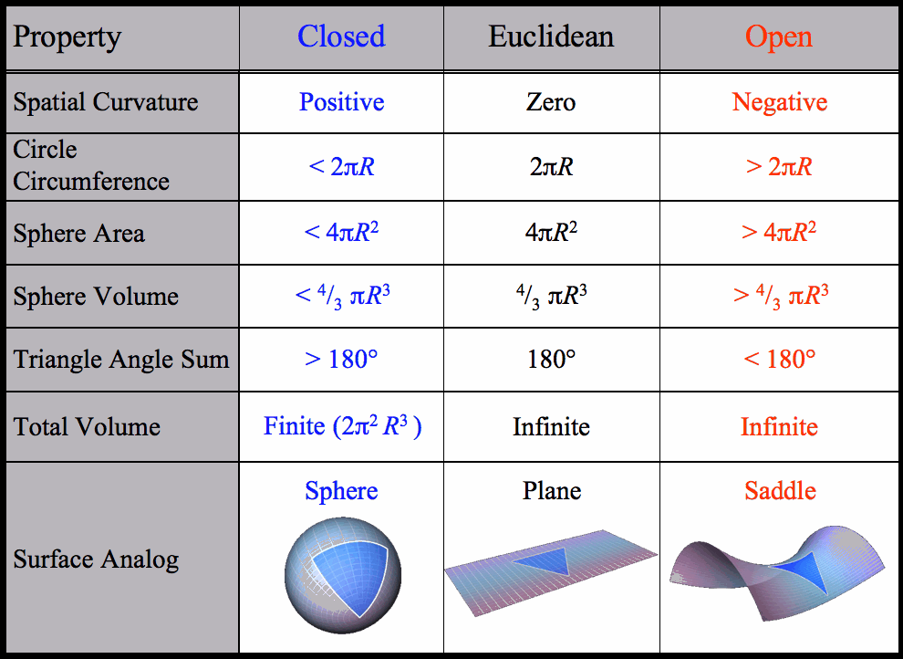

Slide 26
Robertson-Walker Metric
Distances in a uniformly curved spacetime is specified in terms of the
Robertson-Walker metric. The spacetime distance of a point at coordinate
(r,,) is:
where the function S_{k}(r/R_{c})
specifies the effect of curvature
on the distances between
points in spacetime

Slide 27
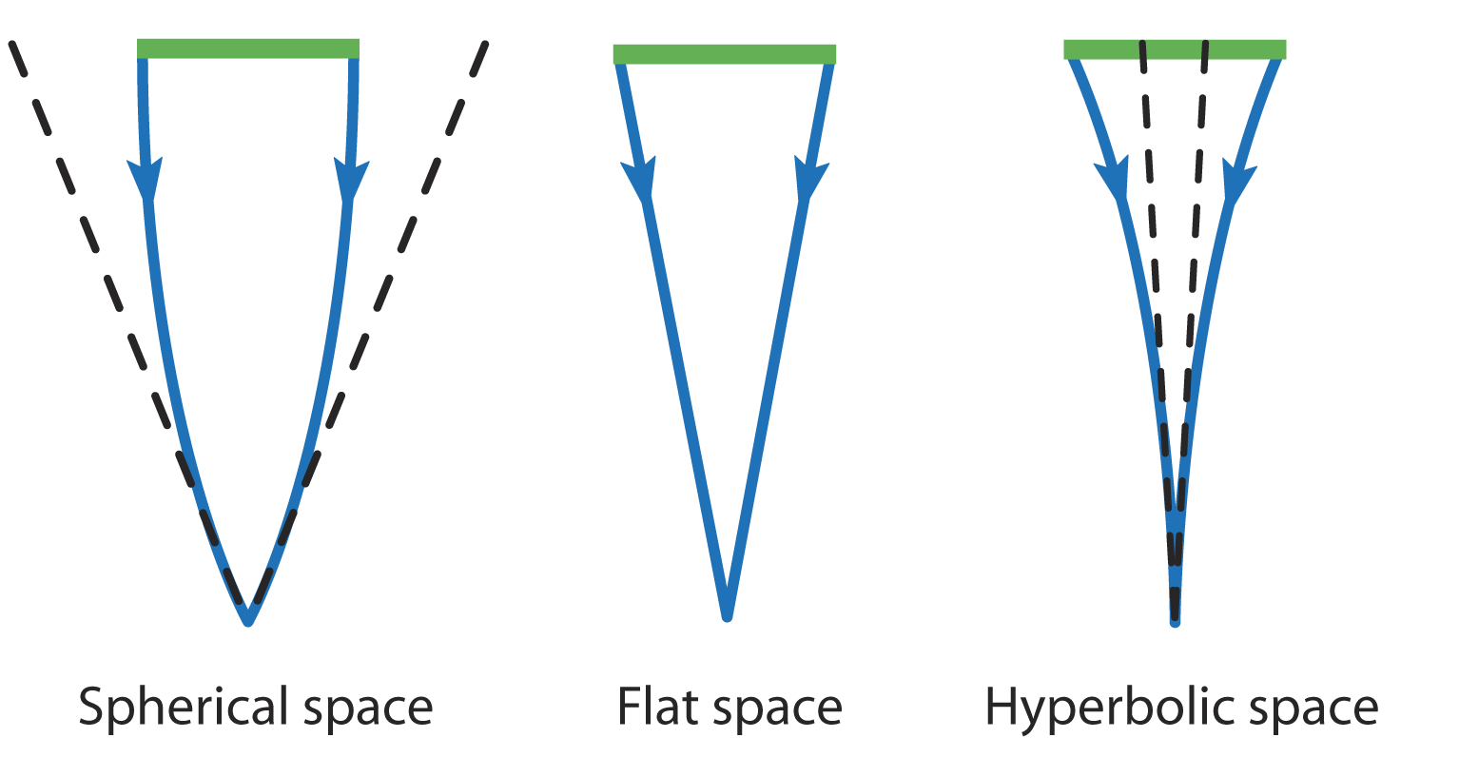

Slide 28
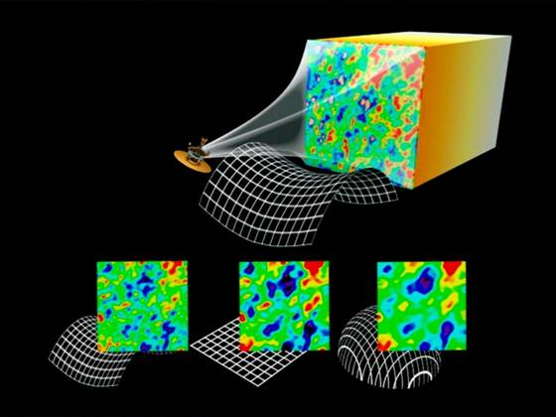

Slide 29
Friedmann-Robertson-Walker-Lemaitre
(FRLW)
Universe

Slide 30
Einstein Field Equation

Slide 31
Einstein Field Equation

Slide 32
Friedmann-Robertson-Walker-Lemaitre
Universe

Slide 33
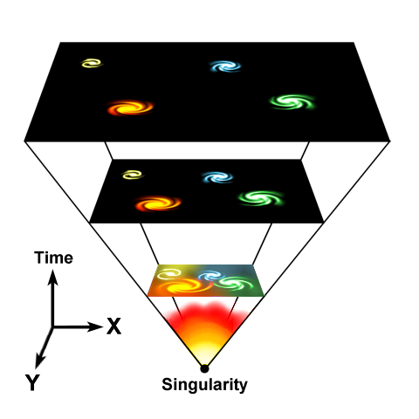


Cosmic Expansion Factor
Cosmic Expansion is a
uniform expansion of
space

Slide 34
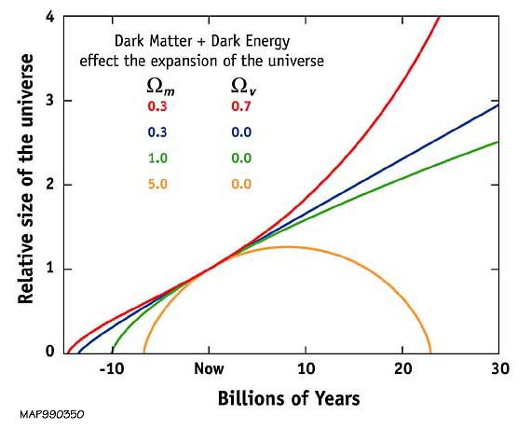
Our Universe ?
Einstein-de Sitter
Universe ?

Slide 35
Friedmann-Robertson-Walker-Lemaitre Universe
pressure
cosmological
constant
density
curvature term

Slide 36
Friedmann-Robertson-Walker-Lemaitre
Universe
Because of General Relativity, the evolution of the Universe is
fully determined by four factors:
• density
• pressure
• curvature
: present curvature radius
• cosmological constant
• Density & Pressure: - in relativity, energy & momentum need to be
seen as one physical quantity (four-vector)
- pressure = momentum flux
• Curvature: - gravity is a manifestation of geometry spacetime
Cosmological Constant: - free parameter in General Relativity
- Einstein’s “biggest blunder”
- mysteriously, since 1998 we know it dominates
the Universe

Slide 37
Friedmann-Robertson-Walker-Lemaitre
Universe
Relativistic Cosmology
Newtonian Cosmology
Curvature
Cosmological Constant
Pressure
Energy

Slide 38
Cosmological Constant
&
FRW equations

Slide 39
Friedmann-Robertson-Walker-Lemaitre Universe

Slide 40

Dark Energy & Energy Density

Slide 41
Friedmann-Robertson-Walker-Lemaitre Universe

Slide 42
Cosmic Constituents

Slide 43
Cosmic Constituents
The total energy content of Universe made up by various constituents, principal ones:
matter
_{b}
baryonic matter
_{m}
_{DM}
dark matter
radiation

photons
_{tot}
_{rad}

neutrino’s
_{v}
dark/
vacuum energy
In addition, contributions by - gravitational waves
- magnetic fields,
- cosmic rays …
Poor constraints on their contribution: henceforth we will not take them into account !

Slide 44
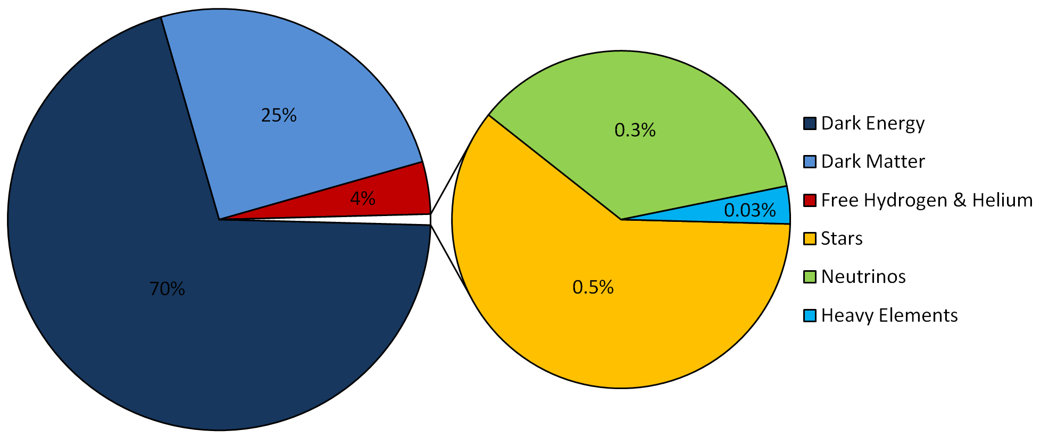
LCDM Cosmology
Concordance cosmology
- model that fits the majority of cosmological observations
- universe dominated by Dark Matter and Dark Energy
LCDM composition today …

Slide 45
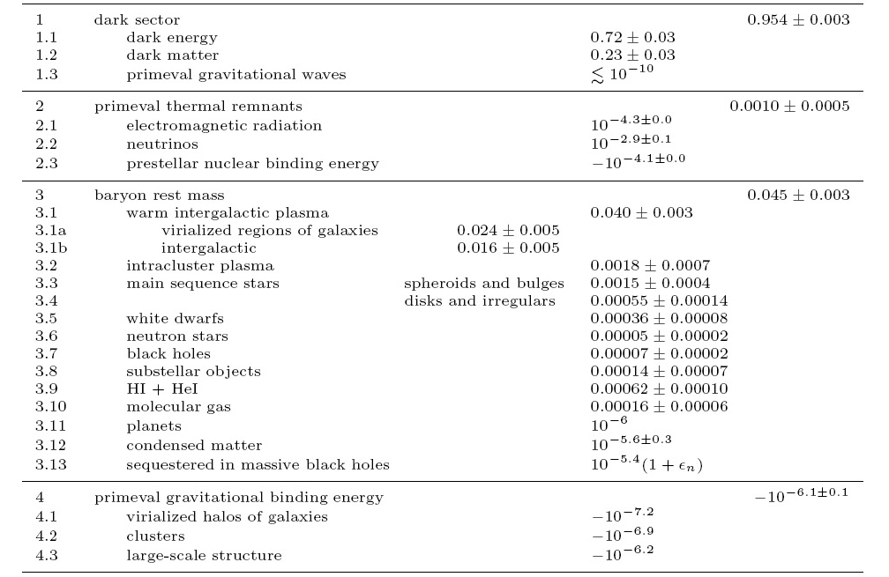
Cosmic Energy Inventory
Fukugita & Peebles 2004

Slide 46
Cosmic Constituents:
Evolving Energy Density

Slide 47
FRW Energy Equation
To infer the evolving energy density (t) of each cosmic component, we refer to
the cosmic energy equation. This equation can be directly inferred from the FRW equations
The equation forms a direct expression of the adiabatic expansion of the Universe,
ie.
Internal energy
Expanding volume

Slide 48
FRW Energy Equation
To infer (t) from the energy equation, we need to know the pressure p(t) for
that particular medium/ingredient of the Universe.
To infer p(t), we need to know the nature of the medium, which provides
us with the equation of state,

Slide 49
Cosmic Constituents:
Evolution of Energy Density
Matter:
• Radiation:
• Dark Energy:

Slide 50
Dark Energy:
Equation of State

Slide 51
Einstein Field Equation
curvature side
energy-momentum side

Slide 52
Equation of State
restframe
restframe:

Slide 53
Equation of State

Slide 54
Dynamics
Relativistic Poisson Equation:
Repulsion !!!

Slide 55
Dark Energy & Cosmic Acceleration
Nature Dark Energy:
(Parameterized) Equation of State
Cosmic Acceleration:
Gravitational Repulsion:

Slide 56
Dark Energy & Cosmic Acceleration
DE equation of State
Cosmological Constant:
-1/3 > w > -1:
decreases with time
Phantom Energy:
increases with time

Slide 57
Dynamic Dark Energy
DE equation of State
Dynamically evolving dark energy,
parameterization:

Slide 58
Critical Density & Omega

Slide 59
FRW Dynamics
Critical Density:
- For a Universe with ☹=0
- Given a particular expansion rate H(t)
Density corresponding to a
flat Universe (k=0)

Slide 60
FRW Dynamics
In a FRW Universe,
densities are in the order of the critical density,

Slide 61
FRW Dynamics
In a matter-dominated Universe,
the evolution and fate of the Universe entirely determined
by the (energy) density in units of critical density:
Arguably,  is the most important parameter of cosmology !!!
Present-day
Cosmic Density:

Slide 62
FRW Dynamics
The individual contributions to the energy density of
the Universe can be figured into the  parameter:
- radiation
- matter
- dark energy/
cosmological constant

Slide 63
Critical Density
There is a 1-1 relation between the total energy content
of the Universe and its curvature. From FRW equations:

Slide 64
FRW Universe: Curvature
There is a 1-1 relation between the total energy content
of the Universe and its curvature. From FRW equations:

Slide 65
Radiation, Matter & Dark Energy
The individual contributions to the energy density of
the Universe can be figured into the  parameter:
- radiation
- matter
- dark energy/
cosmological constant

Slide 66
Hubble Expansion

Slide 67
Hubble Expansion
Cosmic Expansion is a uniform expansion of space
Objects do not move themselves:
they are like beacons tied to a uniformly expanding sheet:

Slide 68
Hubble Expansion
Cosmic Expansion is a uniform expansion of space
Objects do not move themselves:
they are like beacons tied to a uniformly expanding sheet:
Comoving Position
Hubble Parameter:
Hubble “constant”:
H₀H(t=t₀)
Comoving Position

Slide 69
Hubble Parameter
For a long time, the correct value of the Hubble constant H₀
was a major unsettled issue:
H₀ = 50 km s⁻¹ Mpc⁻¹ H₀ = 100 km s⁻¹ Mpc⁻¹
This meant distances and timescales in the Universe had to
deal with uncertainties of a factor 2 !!!
Following major programs, such as Hubble Key Project, the
Supernova key projects and the WMAP CMB measurements,

Slide 70
Hubble Time

Slide 71
Hubble Distance
Just as the Hubble time sets a natural time scale for the universe,
one may also infer a natural distance scale of the universe, the
Hubble Distance

Slide 72
Acceleration Parameter

Slide 73
FRW Dynamics:
Cosmic Acceleration
Cosmic acceleration quantified
by means of dimensionless deceleration parameter q(t):
Examples:

Slide 74
Dynamics
FRW Universe

Slide 75
General Solution
Expanding FRW Universe
From the FRW equations:
Expansion history Universe

Slide 76
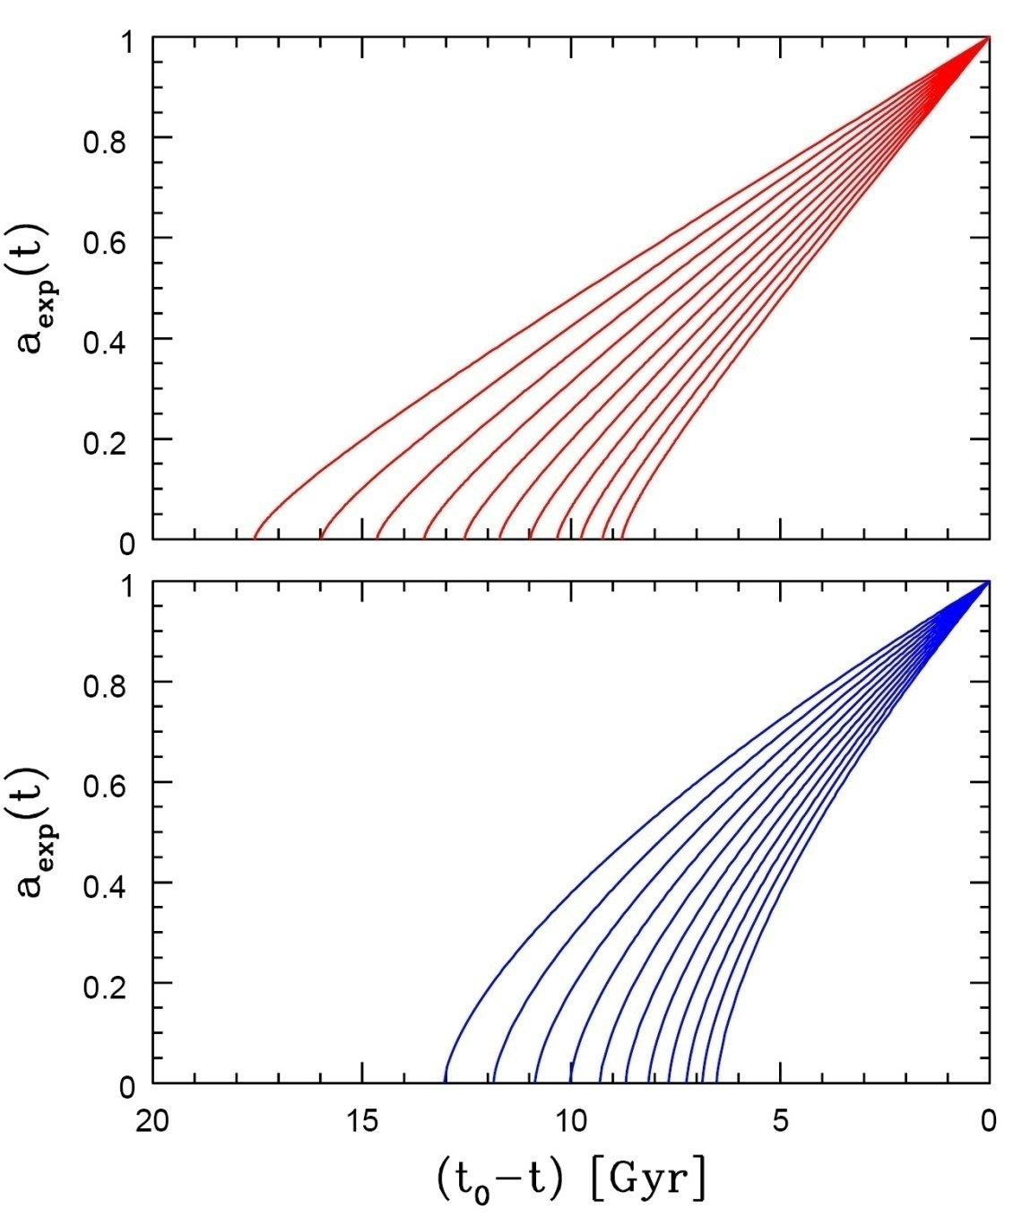
Age of the Universe
Age of a FRW universe at
Expansion factor a(t)
Matter-dominated
Hubble time
Matter-dominated

Slide 77
Specific Solutions
FRW Universe
While general solutions to the FRW equations is only possible
by numerical integration, analytical solutions may be found for particular classes of cosmologies:
Single-component Universes:
- empty Universe
- flat Universes, with only radiation, matter or
dark energy
Matter-dominated Universes
Matter+Dark Energy flat Universe

Slide 78
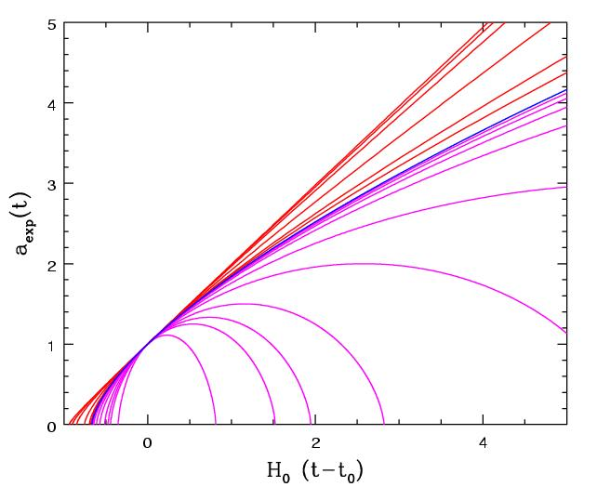
Matter-Dominated Universes
Assume radiation contribution is negligible:
Zero cosmological constant:
Matter-dominated, including curvature

Slide 79
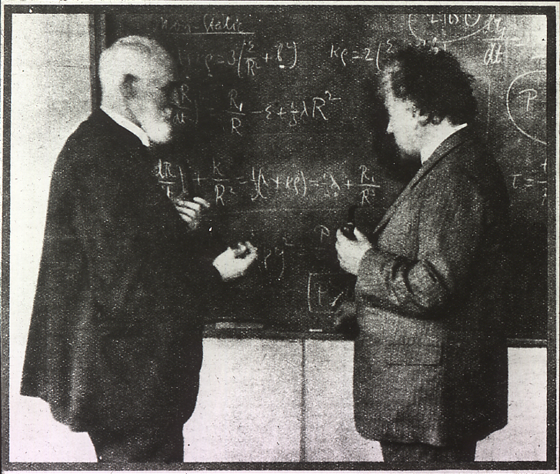
Einstein-de Sitter Universe
FRW:
Albert Einstein and Willem de Sitter discussing the Universe. In 1932 they published a paper together on the Einstein-de Sitter universe, which is a model with flat geometry containing matter as the only significant substance.
Age
EdS Universe:

Slide 80
Free Expanding "Milne" Universe
Empty space is curved
FRW:
Age
Empty Universe:

Slide 81
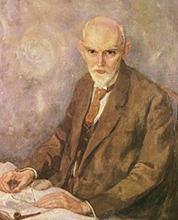
De Sitter Expansion
FRW:
Willem de Sitter (1872-1934; Sneek-Leiden)
director Leiden Observatory
alma mater: Groningen University
Age
De Sitter Universe: infinitely old

Slide 82
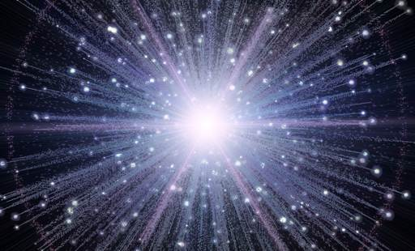
Expansion
Radiation-dominated Universe
In the very early Universe, the energy density is completely dominated by radiation. The dynamics of the very early Universe is therefore fully determined by the evolution of the radiation energy density:
FRW:
Age
Radiation
Universe:

Slide 83
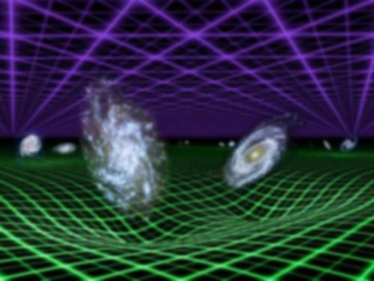
General Flat FRW Universe
FRW:

Slide 84
Cosmological Transitions

Slide 85
Dynamical Transitions
Because radiation, matter, dark energy (and curvature) of the Universe evolve differently as the Universe expands, at different epochs the energy density of the Universe is alternately dominated by these different ingredients.
As the Universe is dominated by either radiation, matter, curvature or
dark energy, the cosmic expansion a(t) proceeds differently.
We therefore recognize the following epochs:
• radiation-dominated era
• matter-dominated era
• curvature-dominated expansion
• dark energy dominated epoch
The different cosmic expansions at these eras have a huge effect on relevant physical processes

Slide 86
Dynamical Transitions
• Radiation Density Evolution
• Matter Density Evolution
• Curvature Evolution
Dark Energy
(Cosmological Constant)
Evolution

Slide 87
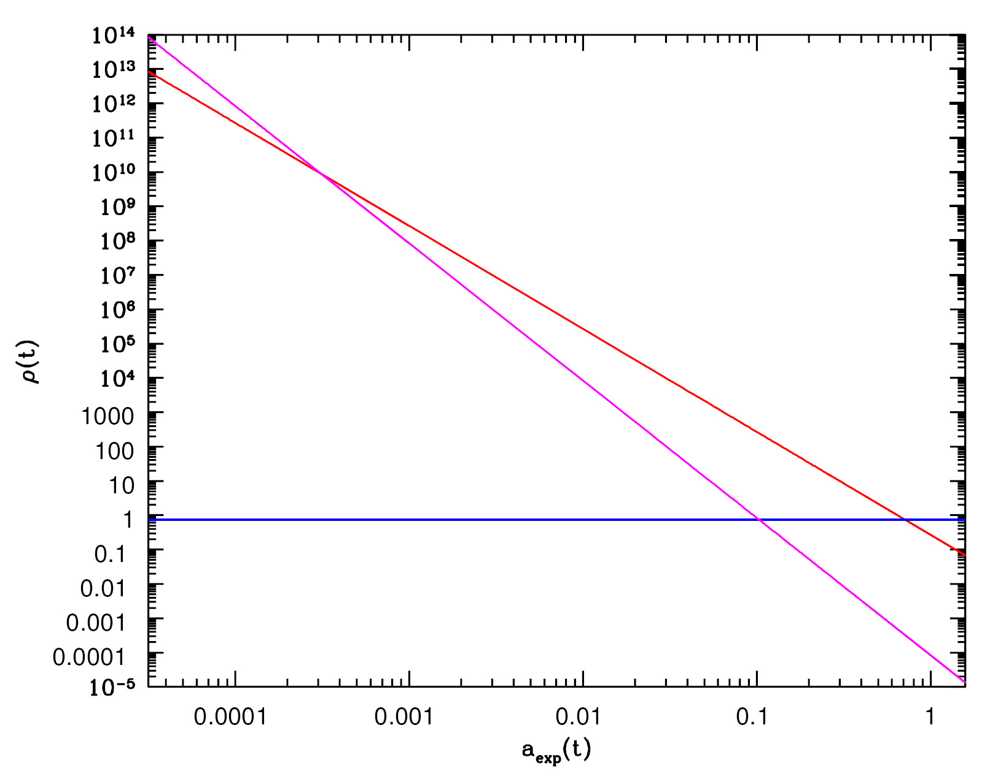
matter
Density Evolution Cosmic Components
radiation
dark energy

Slide 88
Matter-Dark Energy
Transition
matter
Radiation-Matter transition
radiation
dark energy

Slide 89
Radiation-Matter
Transition
• Radiation Density Evolution
• Matter Density Evolution
Radiation energy density decreases more rapidly than matter density:
this implies radiation to have had a higher energy density before a
particular cosmic time:
Radiation
dominance
Matter
dominance

Slide 90
Matter-Dark Energy
Transition
• Matter Density Evolution
• Dark Energy Density Evolution
While matter density decreases due to the expansion of the Universe,
the cosmological constant represents a small, yet constant, energy density.
As a result, it will represent a higher density after
Matter
dominance
Dark energy
dominance

Slide 91
Matter-Dark Energy
Transition
Note: a more appropriate characteristic transition
is that at which the deceleration turns into
acceleration:
Flat
Universe

Slide 92
Evolution
Cosmological Density Parameter
Limiting ourselves to a flat Universe
(and discarding the contribution by and evolution of curvature):
to appreciate the dominance of radiation, matter and dark energy in the subsequent cosmological eras, it is most illuminating to look at the evolution
of the cosmological density parameter of these cosmological components:
e.g.

Slide 93
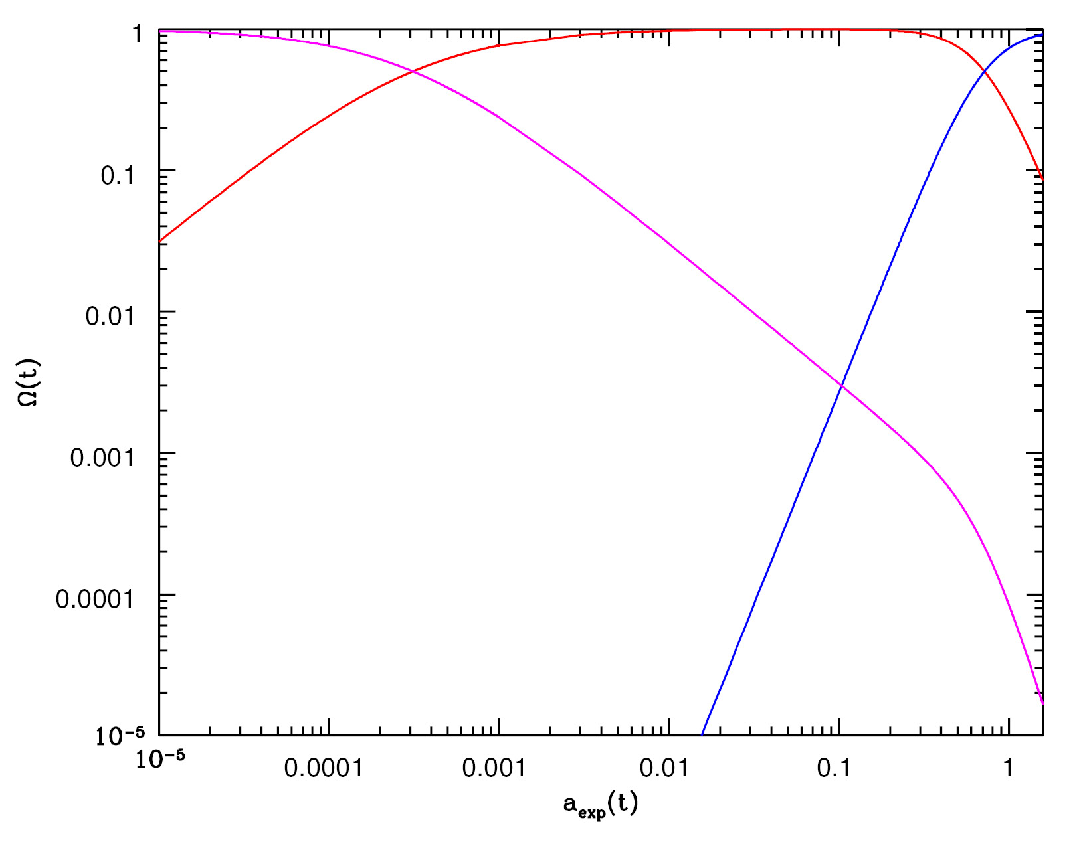
matter
radiation
Evolution Cosmic Density Parameter 
radiation, matter, dark energy
(in concordance Universe)
dark energy

Slide 94
matter
radiation
dark energy

Slide 95
matter
radiation
Matter-
Dark Energy
Transition
Radiation-Matter transition
dark energy

Slide 96
Concordance Universe

Slide 97
Concordance Universe Parameters
Hubble Parameter
Age of the Universe
Temperature CMB
Matter | Baryonic Matter Dark Matter
Radiation | Photons (CMB) Neutrinos (Cosmic)
Dark Energy
Total

Slide 98
LCDM Cosmology
Concordance cosmology
- model that fits the majority of cosmological observations
- universe dominated by Dark Matter and Dark Energy
LCDM composition today …

Slide 99
Concordance Expansion
transition epoch:
matter-dominate to
☹ dominated
a_{m☹}0.75

Slide 100
Concordance Expansion
We can recognize two extreme regimes:
• very early times
matter dominates the expansion, and : Einstein-de Sitter expansion,
very late times
matter has diluted to oblivion, and : de Sitter expansion driven by
dark energy

Slide 101
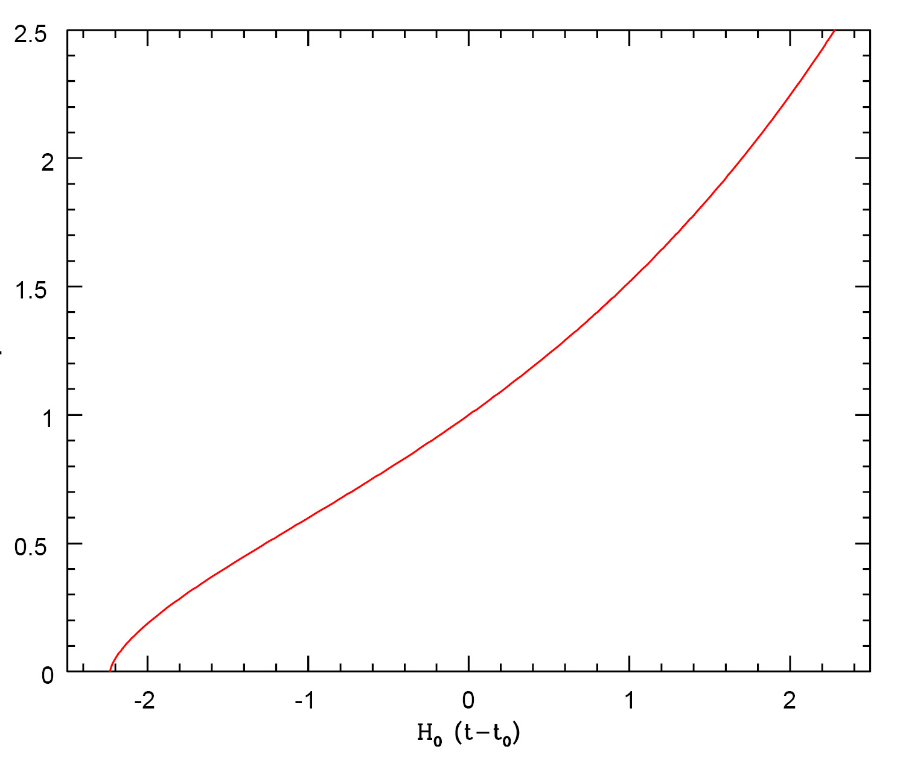
Concordance Expansion

Slide 102
Concordance Expansion
expansion like
De Sitter expansion
acceleration
past
future
expansion like
EdS universe
today
deceleration

Slide 103
Matter-Dark Energy
Transition
Note: a more appropriate characteristic transition
is that at which the deceleration turns into
acceleration:
Flat
Universe

Slide 104
Key Epochs Concordance Universe
Radiation-Matter Equality
Recombination/ Decoupling
Reionization | Optical Depth Redshift
Matter-Dark Energy Transition | Acceleration Energy
Today

Slide 105
Observational Cosmology
in
FRW Universe

Slide 106
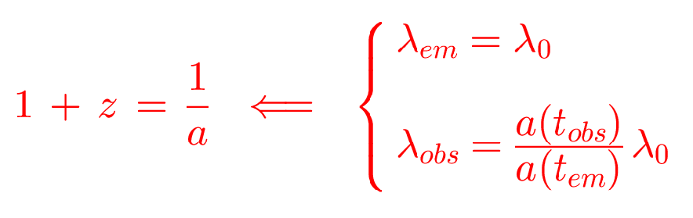
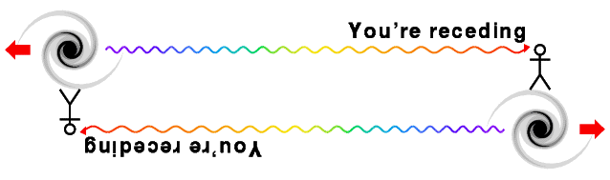
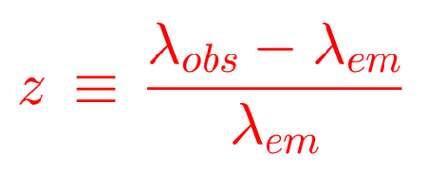
Cosmic Redshift

Slide 107
RW Distance Measure
In an (expanding) space with Robertson-Walker metric,
there are several definitions for distance, dependent on how you measure it.
They all involve the central distance function, the RW Distance Measure,

Slide 108
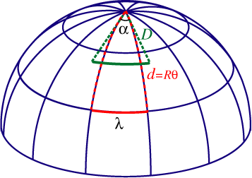
Angular Diameter Distance
Imagine an object of proper size d, at redshift z, its angular size  is given by
Angular Diameter distance:

Slide 109
Luminosity Distance
Imagine an object of luminosity L(_{e}), at redshift z, its flux density at observed frequency _{o} is
Luminosity distance:

Slide 110
FRW Redshift-Distance
Observing in a FRW Universe, we locate galaxies in terms of their redshift z. To
connect this to their true physical distance, we need to know what the coordinate distance r of an object with redshift z,
In a FRW Universe, the dependence of the Hubble expansion rate H(z) at any
redshift z depends on the content of matter, dark energy and radiation, as well
ss its curvature. This leads to the following explicit expression for the
redshift-distance relation,

Slide 111
Matter-Dominated FRW Universe
Observing in a FRW Universe, we locate galaxies in terms of their redshift z. To
connect this to their true physical distance, we need to know what the coordinate distance r of an object with redshift z,
In a FRW Universe, the dependence of the Hubble expansion rate H(z) at any
redshift z depends on the content of matter, dark energy and radiation, as well
ss its curvature. This leads to the following explicit expression for the
redshift-distance relation,
in a matter-dominated Universe, the redshift-distance relation is
from which one may find that

Slide 112
Mattig’s Formula
The integral expression
can be evaluated by using the substitution:
This leads to Mattig’s formula:
This is one of the very most important and most useful equations
in observational cosmology.

Slide 113
Mattig’s Formula
In a low-density Universe, it is better to use the following version:
For a Universe with a cosmological constant, there is not an easily
tractable analytical expression (a Mattig’s formula). The comoving
Distance r has to be found through a numerical evaluation of the fundamental dr/dz expression.

Slide 114
Distance-Redshift Relation, 2nd order
For all general FRW Universe, the
second-order distance-redshift relation is identical,
only depending on the deceleration parameter q₀:
q₀ can be related to ₀ once the equation of state is known.

Slide 115
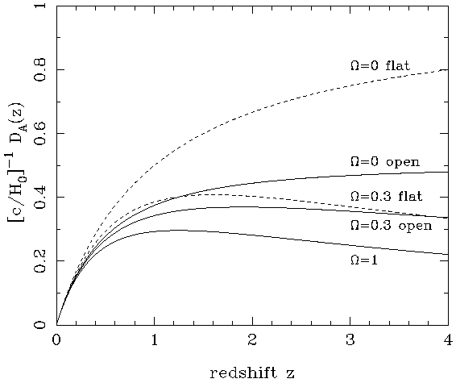
Angular Diameter Distance
matter-dominated FRW Universe
In a matter-dominated Universe, the angular diameter distance as function of redshift is given by:

Slide 116
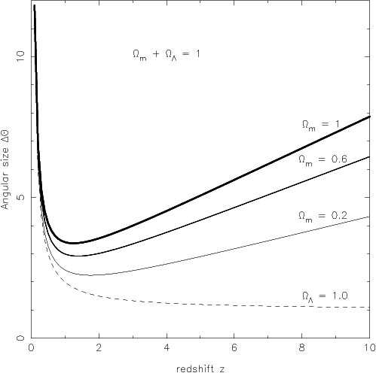
Angular Size - Redshift
FRW Universe
The angular size (z) of an object of physical size  at a redshift z displays an interesting
behaviour. In most FRW universes is has a
minimum at a medium range redshift –
z=1.25 in an _{m}=1 EdS universe – and increases
again at higher redshifts.
In a matter-dominated Universe, the angular diameter distance as function of redshift is given by:

Slide 117
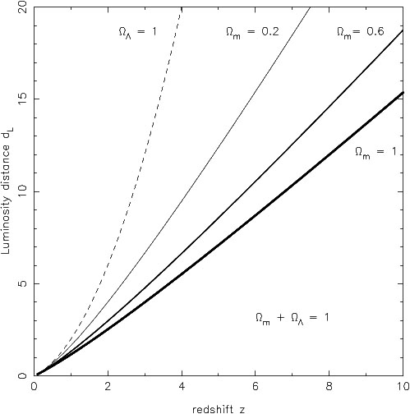
Luminosity Distance
matter-dominated FRW Universe
In a matter-dominated Universe, the luminosity distance as function of redshift is given by:

Slide 118
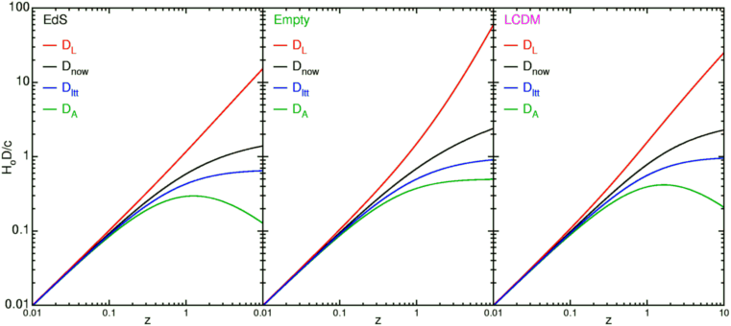
FRW Universe Distances
summary

Slide 119
FRW
Thermodynamics

Slide 120
FRW Dynamics
To find solutions a(t) for the expansion history of the Universe, for a particular FRW Universe ,
one needs to know how the
density (t) and pressure p(t) evolve as function of a(t)
FRW equations are implicitly equivalent to a third Einstein equation, the
energy equation,

Slide 121
FRW Dynamics:
Adiabatic Cosmic Expansion
Important observation:
the energy equation,
is equivalent to stating that the change in internal energy
of a specific co-expanding volume V(t) of the Universe, is due to work by pressure:
Friedmann-Robertson-Walker-Lemaitre expansion of the Universe is
Adiabatic Expansion

Slide 122
FRW Dynamics:
Thermal Evolution
Adiabatic Expansion of the Universe:
• Implication for Thermal History
• Temperature Evolution of cosmic components
For a medium with adiabatic index :
Radiation (Photons)
Monatomic Gas
(hydrogen)

Slide 123
FRW Dynamics:
Thermal Evolution
Adiabatic Expansion of the Universe:
• Implication for Thermal History
• Temperature Evolution of cosmic components
For a medium with adiabatic index :
Radiation (Photons)
Monatomic Gas
(hydrogen)

Slide 124
Radiation
&
Matter

Slide 125
Cosmic Radiation
The Universe is filled with thermal radiation, the photons that were created in
The Big Bang and that we now observe as the Cosmic Microwave Background (CMB).
The CMB photons represent the most abundant species in the Universe, by far !
The CMB radiation field is PERFECTLY thermalized, with their energy distribution representing the most perfect blackbody spectrum we know in nature. The energy density u(T) is therefore given by the Planck spectral distribution,
At present, the temperature T of the cosmic radiation field is known to impressive
precision,

Slide 126
Cosmic Radiation
With the energy density u(T) of CMB photons with energy h given, we know the
number density n(T) of such photons:
The total number density n(T) of photons in the Universe can be assessed by
integrating the number density n(T) of photons with frequency  over all
frequencies,

Slide 127
Baryon-Photon Ratio
Having determined the number density of photons, we may compare this with the
number density of baryons, n_{b}(T). That is, we wish to know the
PHOTON-BARYON ratio,
The baryon number density is inferred from the baryon mass density.
here, for simplicity, we have assumed that baryons (protons and neutrons) have
the same mass, the proton mass m_{p}  1.672  10⁻²⁴ g. At present we therefore find
We know that
_{b}0.044 and h0.72:

Slide 128
Baryon-Photon Ratio
From simple thermodynamic arguments, we find that the number of photons is
vastly larger than that of baryons in the Universe.
In this, the Universe is a unique physical system, with tremendous repercussions for the thermal history of the Universe. We may in fact easily find that the cosmic photon-baryon ratio remains constant during the expansion of the Universe,

Slide 129
Entropy of the Universe
The photon-baryon ratio in the Universe remains constant during the expansion
of the Universe, and has the large value of
This quantity is one of the key parameters of the Big Bang. The baryon-photon
ratio quantifies the ENTROPY of the Universe, and it remains to be explained why
the Universe has produced such a system of extremely large entropy !!!!!
The key to this lies in the very earliest instants of our Universe !

Slide 130
Hot Big Bang
Key Observations

Slide 131
Big Bang Evidence
Olber’s paradox:
the night sky is dark
finite age Universe (13.7 Gyr)
Hubble Expansion
uniform expansion, with
expansion velocity ~ distance: v = H r
Explanation Helium Abundance 24%:
light chemical elements formed (H, He, Li, …)
after ~3 minutes …
The Cosmic Microwave Background Radiation:
the 2.725K radiation blanket, remnant left over
hot ionized plasma neutral universe
(379,000 years after Big Bang)
Distant, deep Universe indeed looks different …

Slide 132
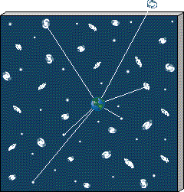
1. Olber’s Paradox
In an infinitely large, old and unchanging
Universe each line of sight would hit a star:
Sky would be as bright as surface of star:
Night sky as bright as
Solar Surface, yet
the night sky is dark
finite age of Universe (13.7 Gyr)

Slide 133
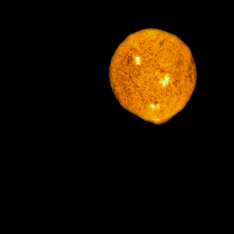
1. Paradox van Olbers
In an infinitely large, old and unchanging
Universe each line of sight would hit a star:
Sky would be as bright as surface of star:
Night sky as bright as
Solar Surface, yet
the night sky is dark
finite age of Universe (13.8 Gyr)

Slide 134
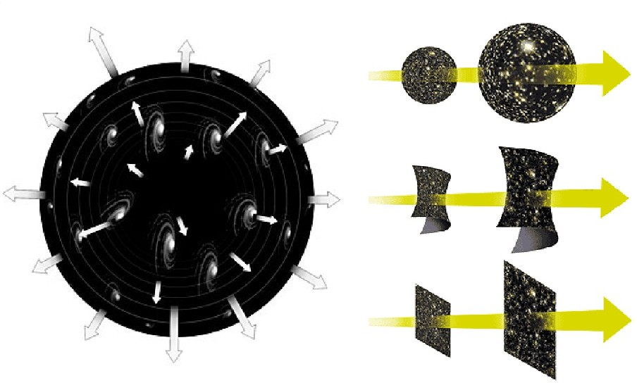
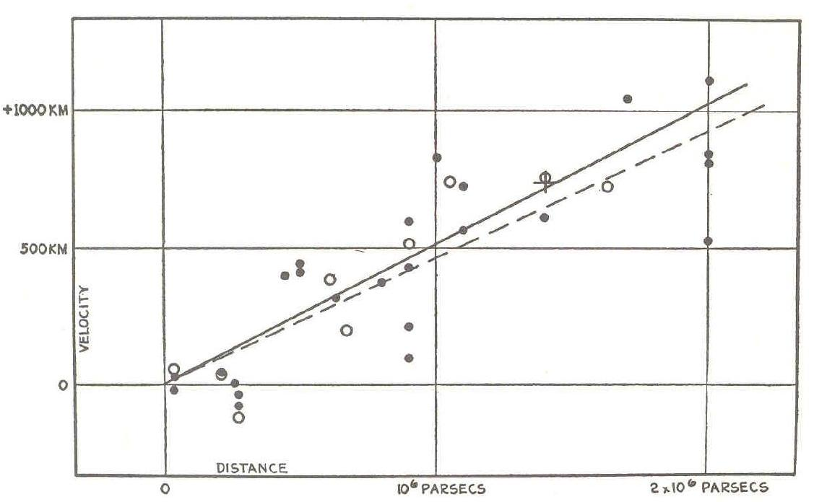
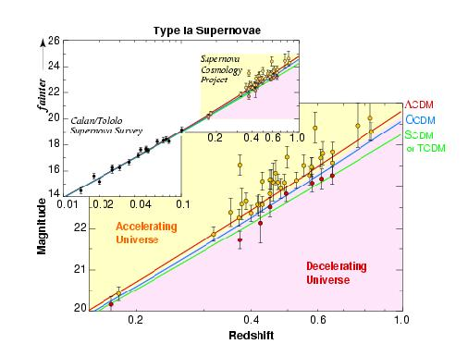
2. Hubble Expansion
Hubble Diagram:
Hubble 1929: Universe expands !!!!
Supernova Cosmic Expansion
Projects (1998) is accelerating

Slide 135
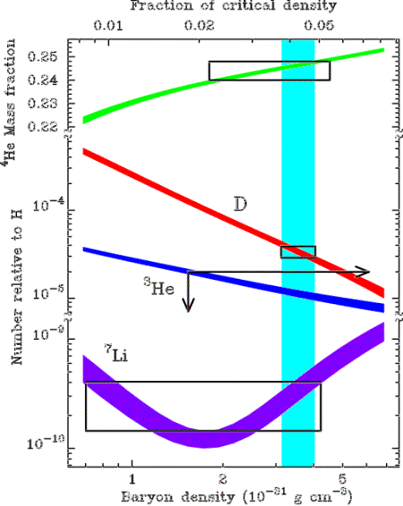
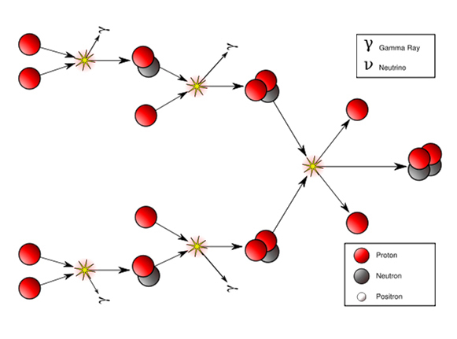
3. Light Element Abundance
Mass Fraction Light Elements
24% ⁴He nuclei
traces D, ³He, ⁷Li nuclei
75% H nuclei (protons)
Between 1-200 seconds after Big Bang,
temperature dropped to 10⁹ K:
Fusion protons & neutrons
into light atomic nuclei

Slide 136
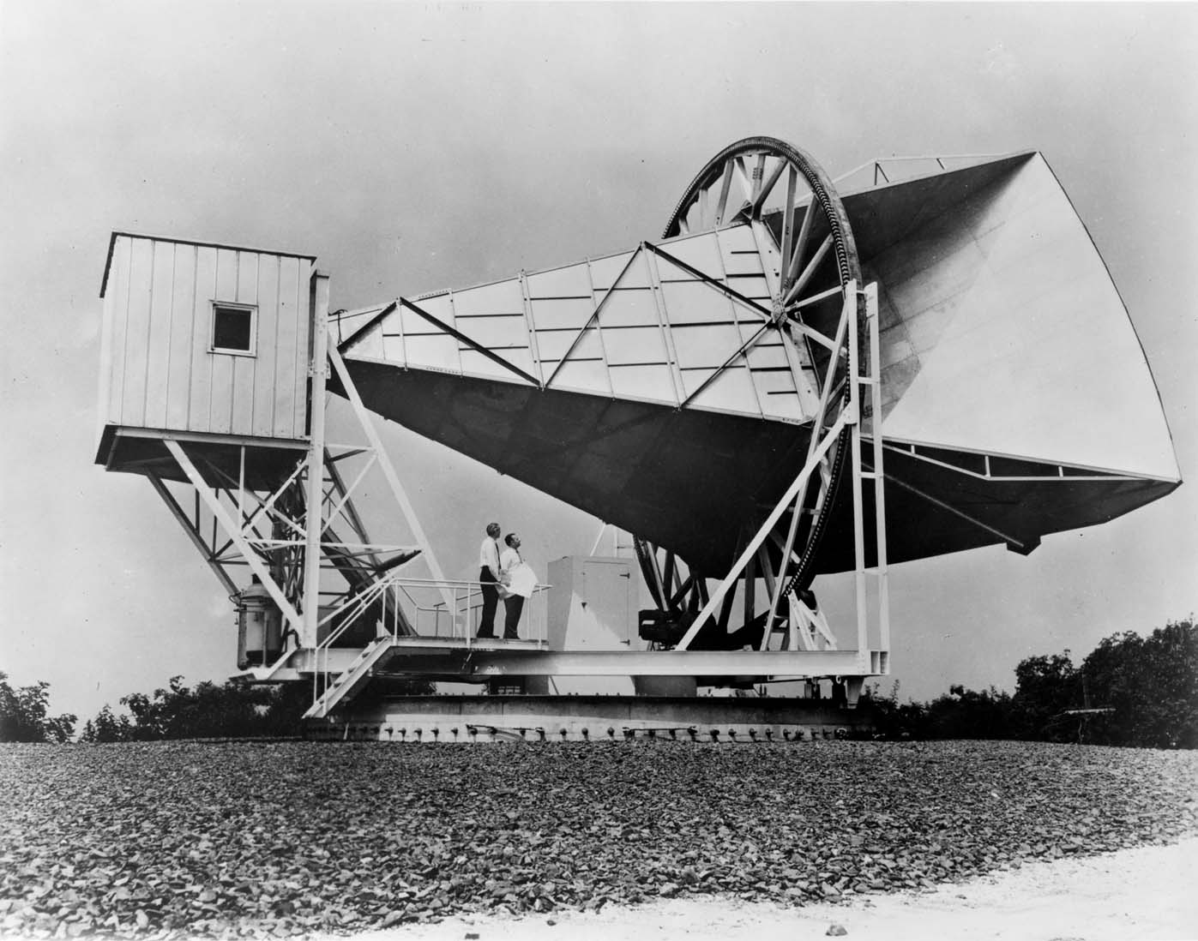
4. Cosmic Microwave Background

Slide 137
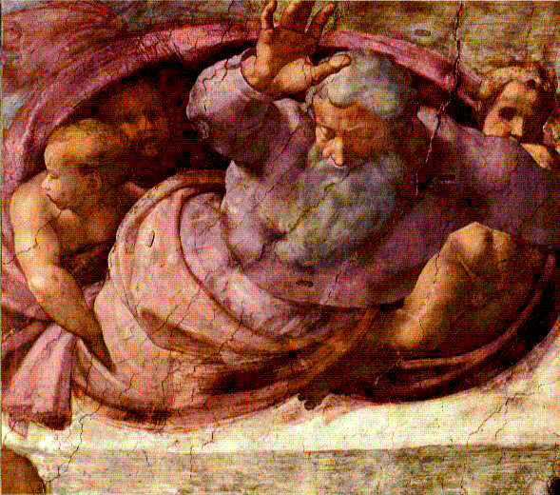
And there was light...

Slide 138
4. Cosmic Microwave Background
Thermal Background Radiation Field
T=2.725 K
Discovery Penzias & Wilson (1965)
Nobelprize Physics 1978
Echo of the Big Bang:
perfect thermal nature can
only be understood when
Universe went through
very hot and dense phase:
• Ultimate proof Hot Big Bang !!!!!
T ~ 3000 K
z_{dec}=1089 (Δz_{dec}=195); t_{dec}=379.000 yrs

Slide 139
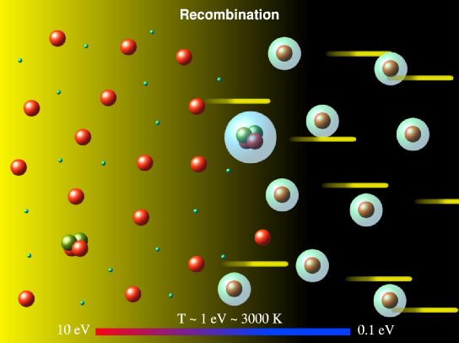
Recombination & Decoupling
protonen & electronen
waterstofatomen
lichtdeeltjes/fotonen

Slide 140
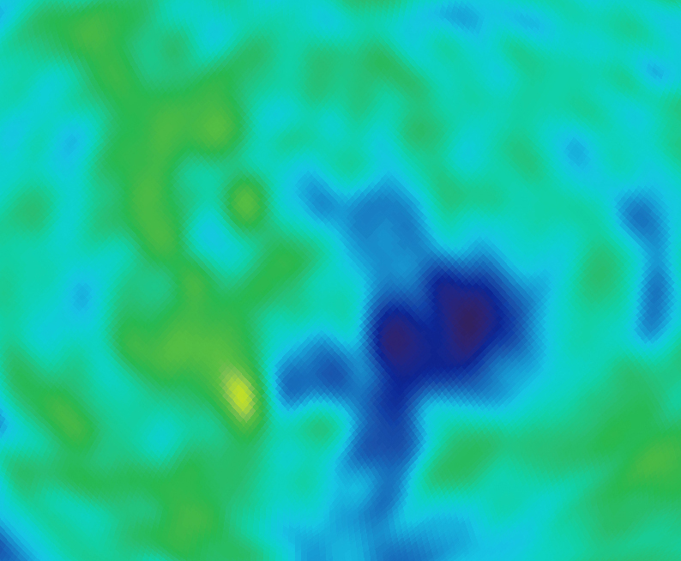
Cosmic Light (CMB): the facts
Ontdekt in 1965 door Penzias & Wilson,
Nobelprijs 1978 !!!!!
Kosmisch Licht dat het gehele heelal uniform vult
Temperatuur: T_{γ}=2.725 K
Fotonen veruit het meest voorkomende deeltje in de natuur:
n_{γ} ~ 415 cm⁻³
Per atoom in het Heelal: n_{γ}/n _{B} ~ 1.9 x 10⁹
Ultieme Bewijs van de Big Bang !!!!!!!!!!!!!!!!!!!

Slide 141
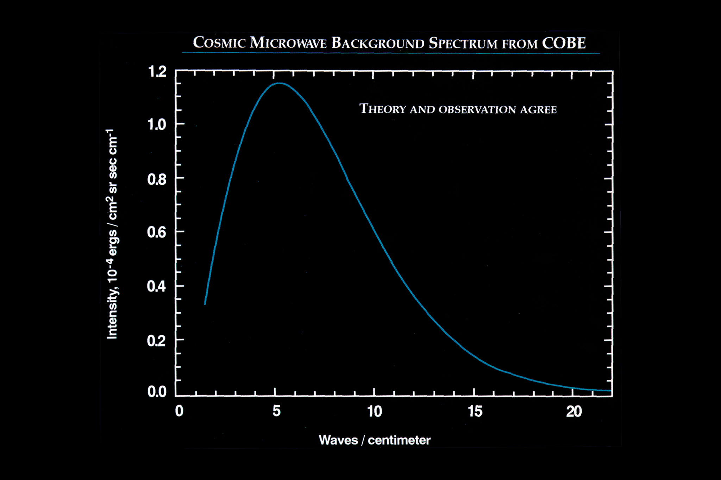
CMB Radiation Field
Blackbody Radiation
• COBE-DIRBE:
temperature, blackbody
T = 2.725 K
John Mather
Nobelprize physics 2006
• Most accurately measured
Black Body Spectrum
Ever !!!!!

Slide 142
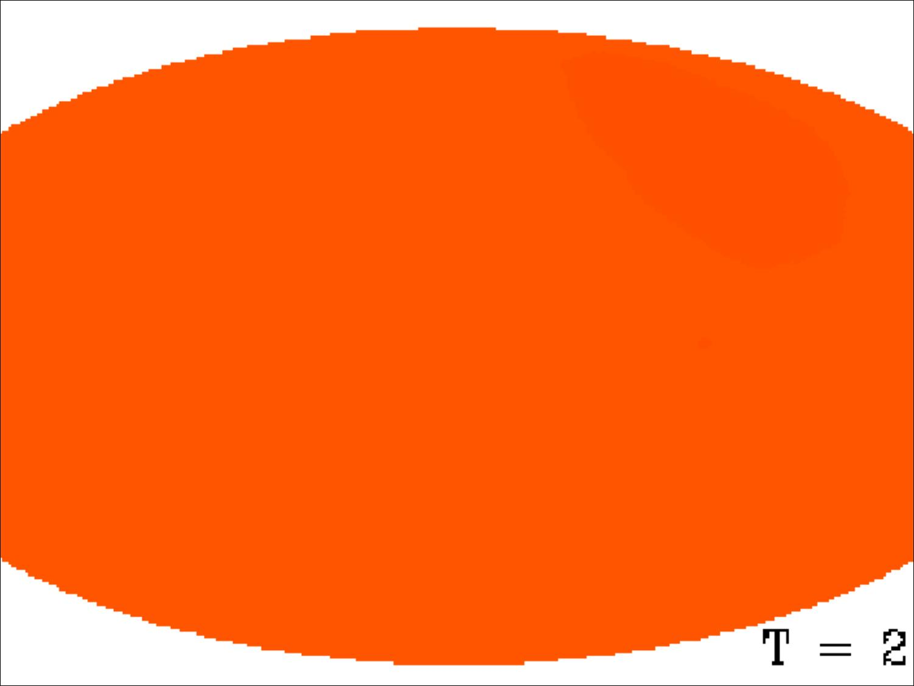

CMB Photons
Note:
far from being an exotic faraway phenomenon, realize that the CMB nowadays is counting for approximately 1% of the noise on your tv set …
Courtesy: W. Hu

Slide 143
Cosmic Light (CMB): most abundant species
By far,
the most abundant particle species
in the Universe
n_{γ}/n _{B} ~ 1.9 billion

Slide 144
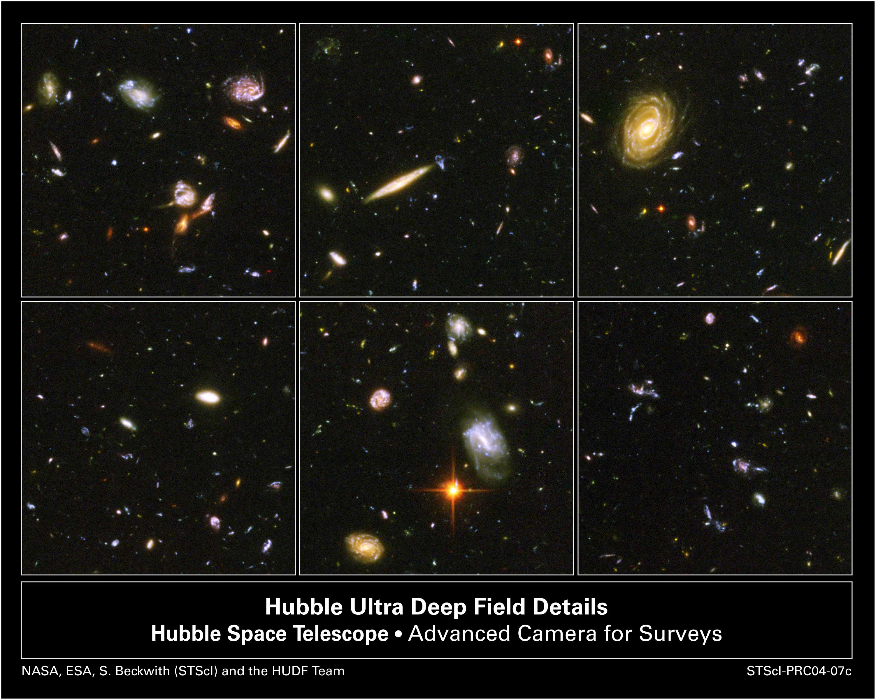
5. Changing Universe
The appearance of the Universe does change when looking deeper into the Universe:
Depth=Time
Galaxies in Hubble Ultra Deep Field

Slide 145
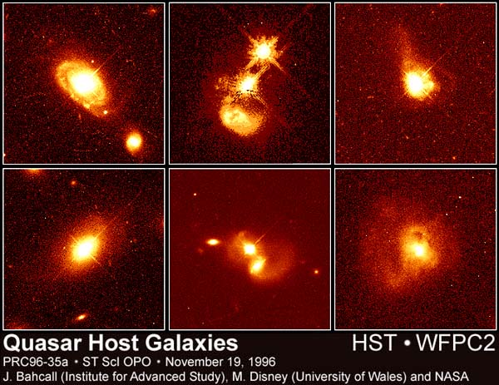
5. Changing Universe
The appearance of the Universe does change when looking deeper into the Universe:
Depth=Time
Quasars
(very high z)

Slide 146
How Much ?
Cosmic Curvature

Slide 147
FRW Universe: Curvature
There is a 1-1 relation between the total energy content
of the Universe and its curvature. From FRW equations:

Slide 148
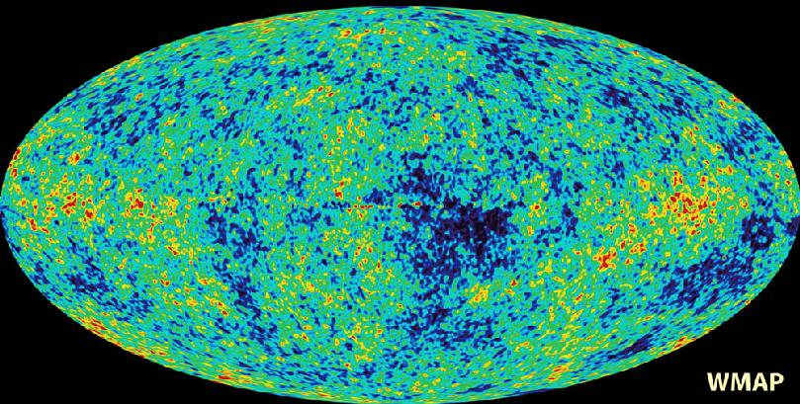
Cosmic Microwave Background
Map of the Universe at Recombination Epoch (WMAP, 2003):
• 379,000 years after Big Bang
• Subhorizon perturbations: primordial sound waves
• ∆T/T < 10-5

Slide 149
Measuring Curvature
Measuring the Geometry of the Universe:
• Object with known physical size,
at large cosmological distance
● Measure angular extent on sky
● Comparison yields light path,
and from this the curvature of space
W. Hu
In a FRW Universe:
lightpaths described by
Robertson-Walker metric
Geometry of Space

Slide 150
Measuring Curvature
• Object with known physical size,
at large cosmological distance:
• Sound Waves in the Early Universe !!!!
W. Hu
In a FRW Universe:
lightpaths described by
Robertson-Walker metric
Temperature Fluctuations
CMB

Slide 151


Music of the Spheres
● small ripples in
primordial matter & photon distribution
● gravity:
- compression primordial photon gas
- photon pressure resists
● compressions and rarefactions
in photon gas: sound waves
● sound waves not heard, but seen:
- compressions: (photon) T higher
- rarefactions: lower
● fundamental mode sound spectrum
- size of “instrument”:
- (sound) horizon size last scattering
● Observed, angular size: θ~1º
- exact scale maximum compression, the
“cosmic fundamental mode of music”
W. Hu

Slide 152


The Cosmic Tonal Ladder
The WMAP CMB temperature
power spectrum
Cosmic sound horizon
The Cosmic Microwave Background Temperature Anisotropies:
Universe is almost perfectly flat

Slide 153

The WMAP CMB temperature
power spectrum

Slide 154


Angular CMB temperature fluctuations
CMB: Universe almost perfectly Flat !

Slide 155
Cosmic Constraints

Slide 156

_{m} vs. ☹
SCP Union2 constraints (2010)
on values of matter density _{m}
dark energy density ☹

Slide 157
Standard Big Bang:
what it cannot explain

Slide 158
Flatness Problem
the Universe is remarkably flat, and was even (much)
flatter in the past
Horizon Problem
the Universe is nearly perfectly isotropic and
homogeneous, much more so in the past
Monopole Problem:
There are hardly any magnetic monopoles in
our Universe
Fluctuations, seeds of structure
Structure in the Universe: origin

Slide 159
Flatness Problem

Slide 160
Flatness Problem
FRW Dynamical Evolution:
Going back in time, we find that the Universe was much flatter than it is at the
present.
Reversely, that means that any small deviation from flatness in the early Universe would have been strongly amplified nowadays …
We would therefore expect to live in a Universe that would either be almost
=0 or ;
Yet, we find ourselves to live in a Universe that is almost perfectly flat … _{tot}1
How can this be ?

Slide 161
Evolution 
From the FRW equations, one can infer that the evolution of  goes like
(for simplicity, assume matter-dominated Universe),
These equations directly show that
implying that the early Universe was very
nearly flat …

Slide 162

Flatness Evolution
• At radiation-matter equiv.
• Big Bang nucleosynthesis
a_{nuc}3.610⁻⁸
• Planck time

Slide 163
Horizon Problem

Slide 164
Cosmic Horizons
Light travel in an expanding Universe:
• Robertson-Walker metric:
• Light:
Horizon distance in comoving space
Horizon distance in physical space
Horizon of the Universe:
distance that light travelled since the Big Bang

Slide 165
Cosmic Horizons
In an Einstein-de Sitter Universe
Horizon distance in physical space
Horizon of the Universe:
distance that light travelled since the Big Bang

Slide 166
Cosmic Horizons
In an Einstein-de Sitter Universe
Horizon distance in physical space
The horizon distance at
recombination/decoupling
(CMB),
angular size on the sky:
Horizon of the Universe:
distance that light travelled since the Big Bang

Slide 167
Cosmic Horizons
The horizon distance at
recombination/decoupling
(CMB),
angular size on the sky:
Large angular scales:
NOT in physical contact
Small angular scales:
In physical (thus, also thermal) contact
Horizon of the Universe:
distance that light travelled since the Big Bang

Slide 168

Cosmic Microwave Background
Size Horizon Recombination
COBE measured fluctuations: > 7º
Size Horizon at Recombination spans angle ~ 1º
How can it be that regions totally out of thermal contact have the same temperature ?

Slide 169
Cosmic Microwave Background
Size Horizon Recombination
COBE measured fluctuations: > 7º
Size Horizon at Recombination spans angle ~ 1º
COBE proved that superhorizon fluctuations do exist: prediction Inflation !!!!!

Slide 170

Horizon Problem
The horizon distance at
recombination/decoupling
(CMB),
angular size on the sky:
Angular scales:
How can it be that regions that were
never in thermal still have almost
exactly the same temperature T~2.725 K
Horizon of the Universe:
distance that light travelled since the Big Bang

Slide 171
Structure Problem

Slide 172

Millennium Simulation

Slide 173

Millennium Simulation

Slide 174
The Universe should be
Uniform: homogeneous & isotropic
Where does all structure in the Universe
come from ?

Slide 175
Monopole Problem

Slide 176
Inflationary Universe

Slide 177

10⁻³⁶ sec after Big Bang:
Inflation of the Universe

Slide 178

FRW Big Bang extended:
Inflationary Universe
Essential
Ingredient/Extension
Standard Cosmology
Inflationary Universe
Phase transition
Early Universe
- GUT transition :
t ~ 10⁻³⁶ sec ??
- (false) vacuum potential
induces exponential
(de Sitter) expansion
Universe blows up by factor
N > 10⁶⁰
As time evolves and the Universe expands, due to the decreasing temperature, the potential V() of the Universe goes down and culminates in a broken symmetry

Slide 179


Cosmic Inflation
~ 10⁻³⁶ sec. after Big Bang:
Universe expands exponentially:
factor 10⁶⁰ in 10⁻³⁴ sec
Size current visible Heelal:
begin inflation: 10⁻¹⁵ size atoom
end inflation: diameter dime

Slide 180

FRW Big Bang extended:
Inflationary Universe
Essential
Ingredient/Extension
Standard Cosmology
Inflationary Universe
Phase transition
Early Universe
- GUT transition :
t ~ 10⁻³⁶ sec ??
- (false) vacuum potential
induces exponential
(de Sitter) expansion
Universe blows up by factor
N > 10⁶⁰
Inflation explains the horizon problem in a natural fashion:
a region that initially was much smaller than the pre-inflation horizon,
rapidly blew to a superhorizon size: any region on the CMB sky was in
thermal contact before inflation !

Slide 181

FRW Big Bang extended:
Inflationary Universe
Essential
Ingredient/Extension
Standard Cosmology
Inflationary Universe
Phase transition
Early Universe
- GUT transition :
t ~ 10⁻³⁶ sec ??
- (false) vacuum potential
induces exponential
(de Sitter) expansion
Universe blows up by factor
N > 10⁶⁰
Fluctuation Generation during Inflation:
Quantum fluctuations around the potential get magnified to
macroscopic scales.

Slide 182

Propelling Inflation: Inflaton

Slide 183

Inflatie & Multiverse

Slide 184

FRW Big Bang extended:
Inflationary Universe
Inflationary Universe
Explains:
Horizon Problem
Flatness Problem
Monopole Problem
And …
Origin of Structure
Towards the end of inflation, the Universe converts the
tremendous amount of vacuum energy that drives inflation
into a surge of newly created radiation and particles (“latent heat”).
This is the Reheating Phase of inflation.

Slide 185


Slide 186


Slide 187
Cosmic Future
&
Cosmic Horizons

Slide 188

Cosmic Horizons
Particle Horizon of the Universe:
distance that light travelled since the Big Bang

Slide 189
Cosmic Horizons
Fundamental Concept for our understanding of the physics of the Universe:
Physical processes are limited to the region of space with which we are
or have ever been in physical contact.
What is the region of space with which we are in contact ?
Region with whom we have been able to exchange photons
(photons: fastest moving particles)
From which distance have we received light.
Complication: - light is moving in an expanding and curved space
- fighting its way against an expanding background
This is called the
Horizon of the Universe
:

Slide 190
Cosmic Particle Horizon
Light travel in an expanding Universe:
• Robertson-Walker metric:
• Light:
Horizon distance in comoving space
Horizon distance in physical space
Particle Horizon of the Universe:
distance that light travelled since the Big Bang

Slide 191
Cosmic Particle Horizon
Particle Horizon of the Universe:
distance that light travelled since the Big Bang
Horizon distance in comoving space
Horizon distance in physical space
In a spatially flat Universe, the horizon distance has a finite value for w>-1/3

Slide 192
Cosmic Particle Horizon
Particle Horizon of the Universe:
distance that light travelled since the Big Bang
In a spatially flat Universe, the horizon distance has a finite value for w>-1/3
flat, matter-dominated universe
flat, radiation-dominated universe

Slide 193
Infinite Particle Horizon
Particle Horizon of the Universe:
distance that light travelled since the Big Bang
In a spatially flat Universe, the horizon distance is infinite for w<-11/3
In such a universe, all of space is causally connected to observer:
In such a universe, you could see every point in space.

Slide 194
Cosmic Event Horizon
Light travel in an expanding Universe:
• Robertson-Walker metric:
• Light:
Event Horizon distance in
comoving space
Event Horizon distance in
physical space
Event Horizon of the Universe:
the distance over which one may still communicate …

Slide 195
Cosmic Event Horizon
Event Horizon of the Universe:
distance light may still travel in Universe.
Event Horizon distance comoving space
Event Horizon distance physical space
In a spatially flat Universe, the event horizon is:

Slide 196
Cosmic Event Horizon
Event Horizon of the Universe:
distance light may still travel in Universe.
In a spatially flat Universe, the event horizon is:
shrinking event horizon:

Slide 197


Slide 198


Cosmic Fate
100 Gigayears:
the end of Cosmology

