Slide 1
(Gaussian) Random Fields

Slide 2
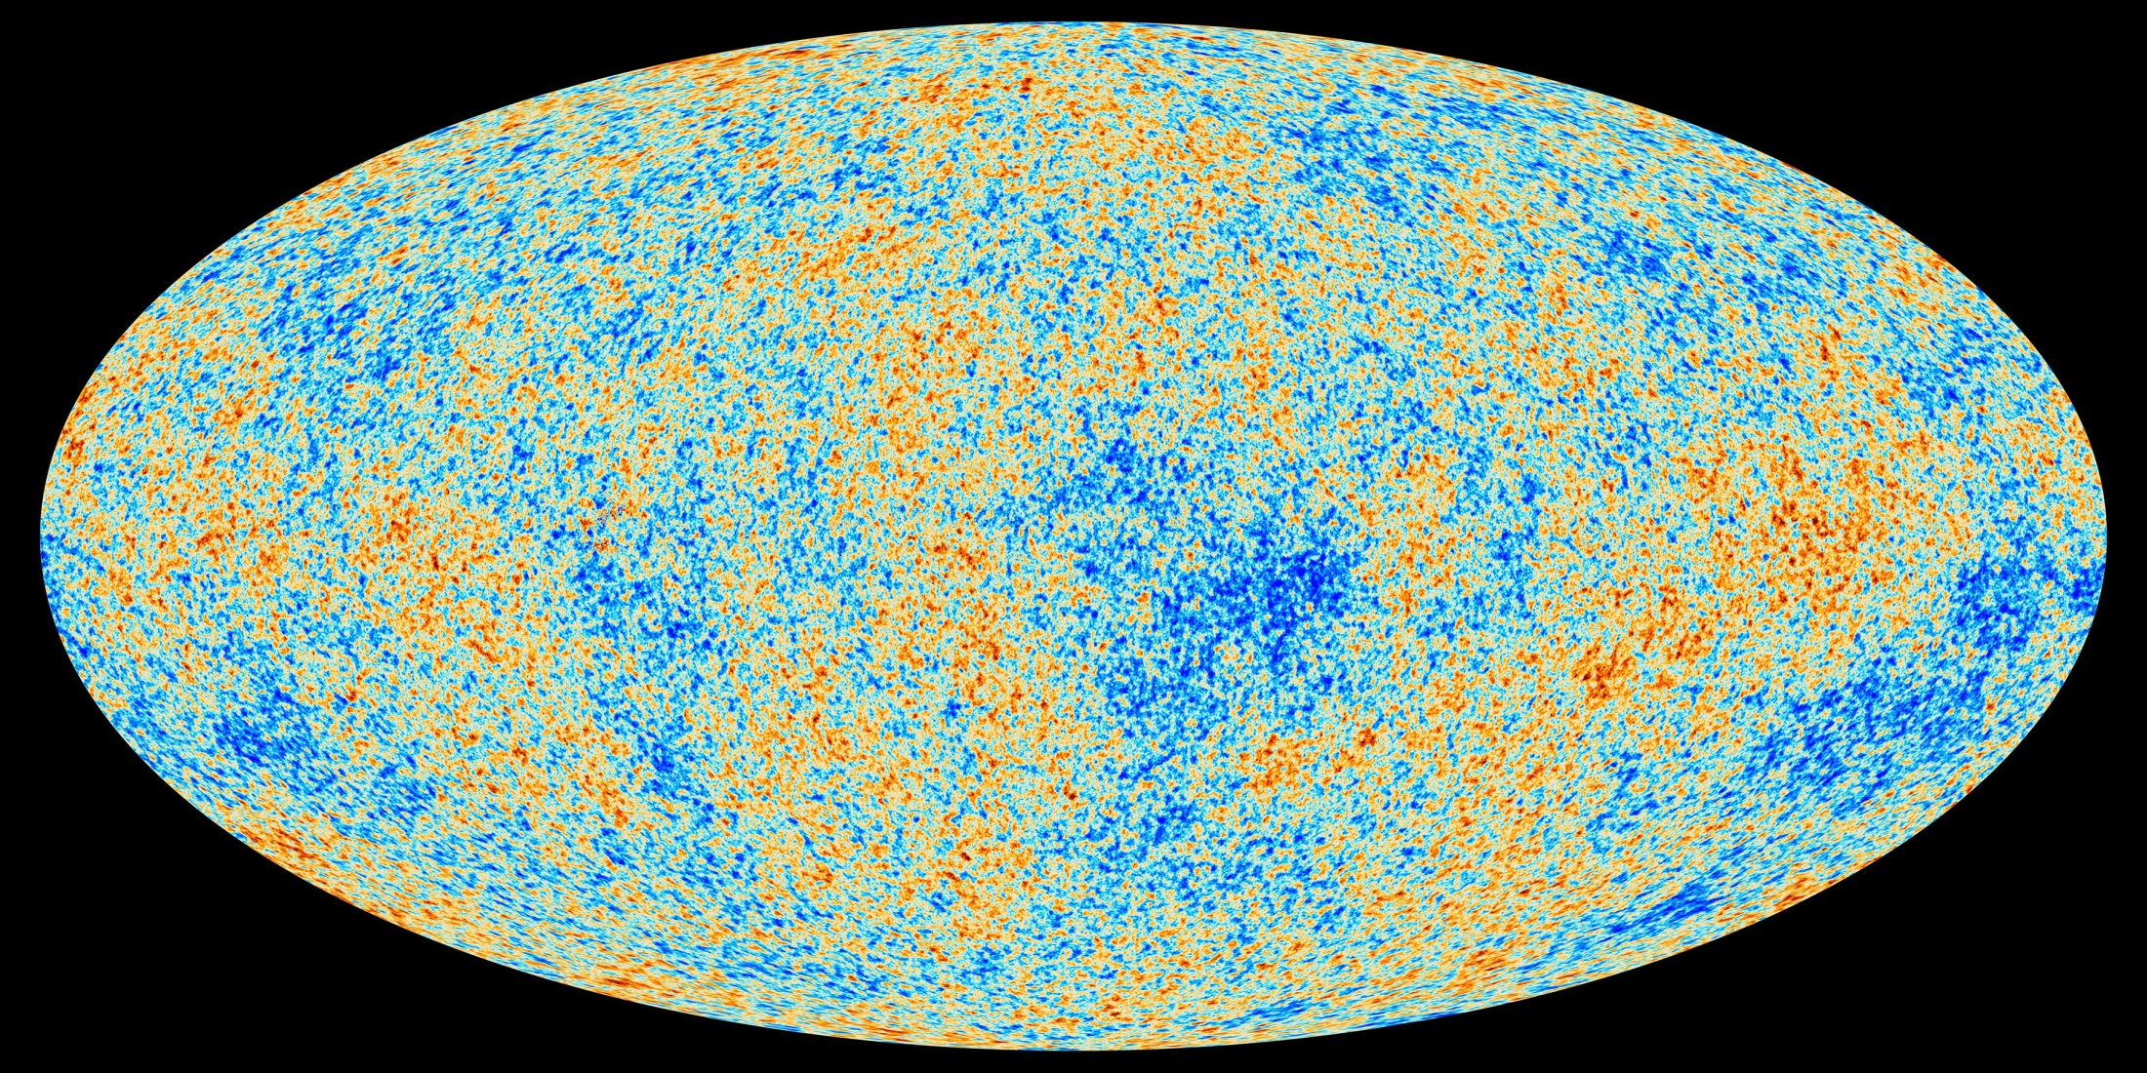
Echo of the Big Bang:
Cosmic Microwave Background
Planck (2013)
Earliest view of the Universe: 379000 yrs. after Big Bang, 13.8 Gyr ago.

Slide 3
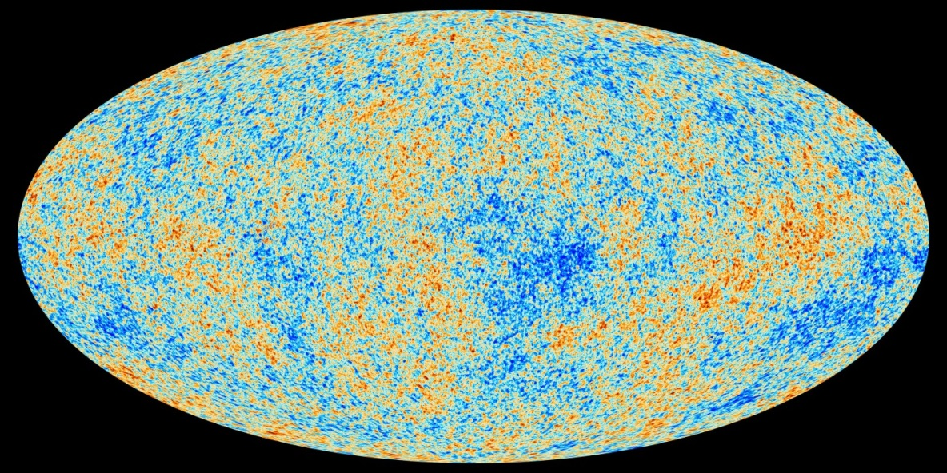
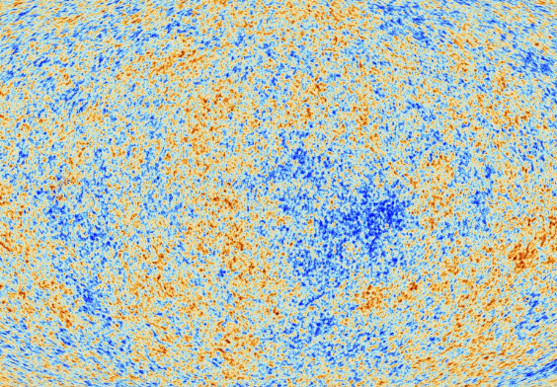
CMB Temperature Perturbations
Cosmic Structure at Edge Visible Universe
Planck (2013)
CMB temperature map:
Fluctuation Field
(almost)
perfectly Gaussian
Origin:
inflationary era,
t = 10⁻³⁶ sec.

Slide 4
Gaussian Random Field

Slide 5
Gaussian Random Field: Multiscale Structure

Slide 6
Gaussian Random Field: Density

Slide 7
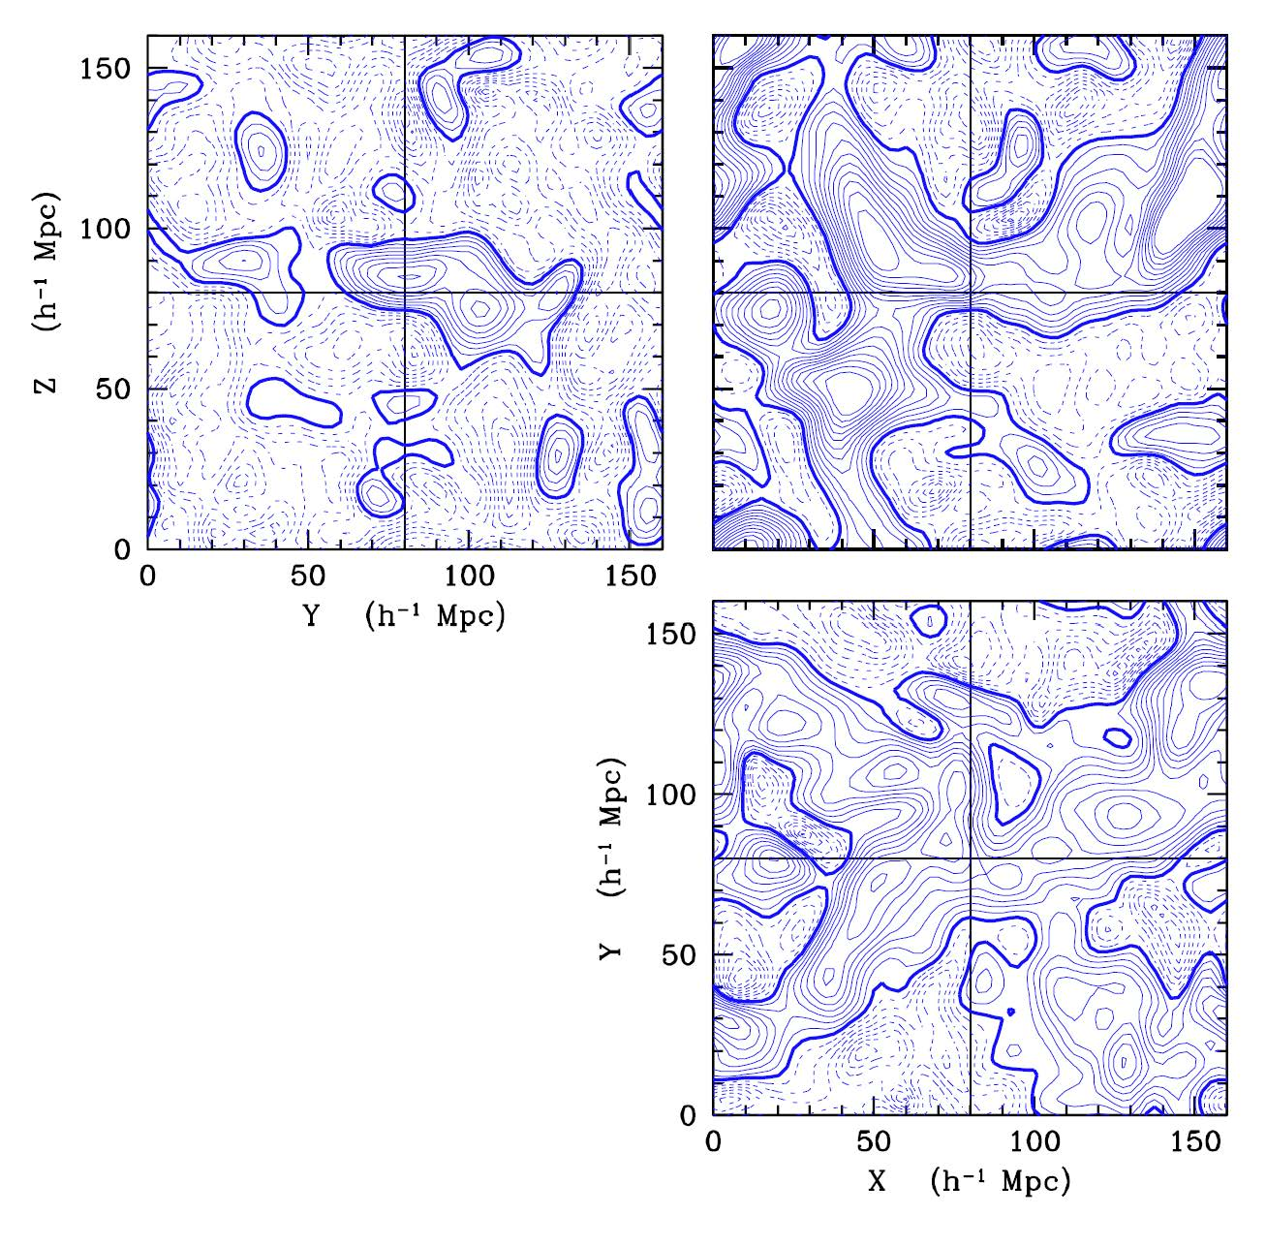
Gaussian Random Field: Gravity

Slide 8
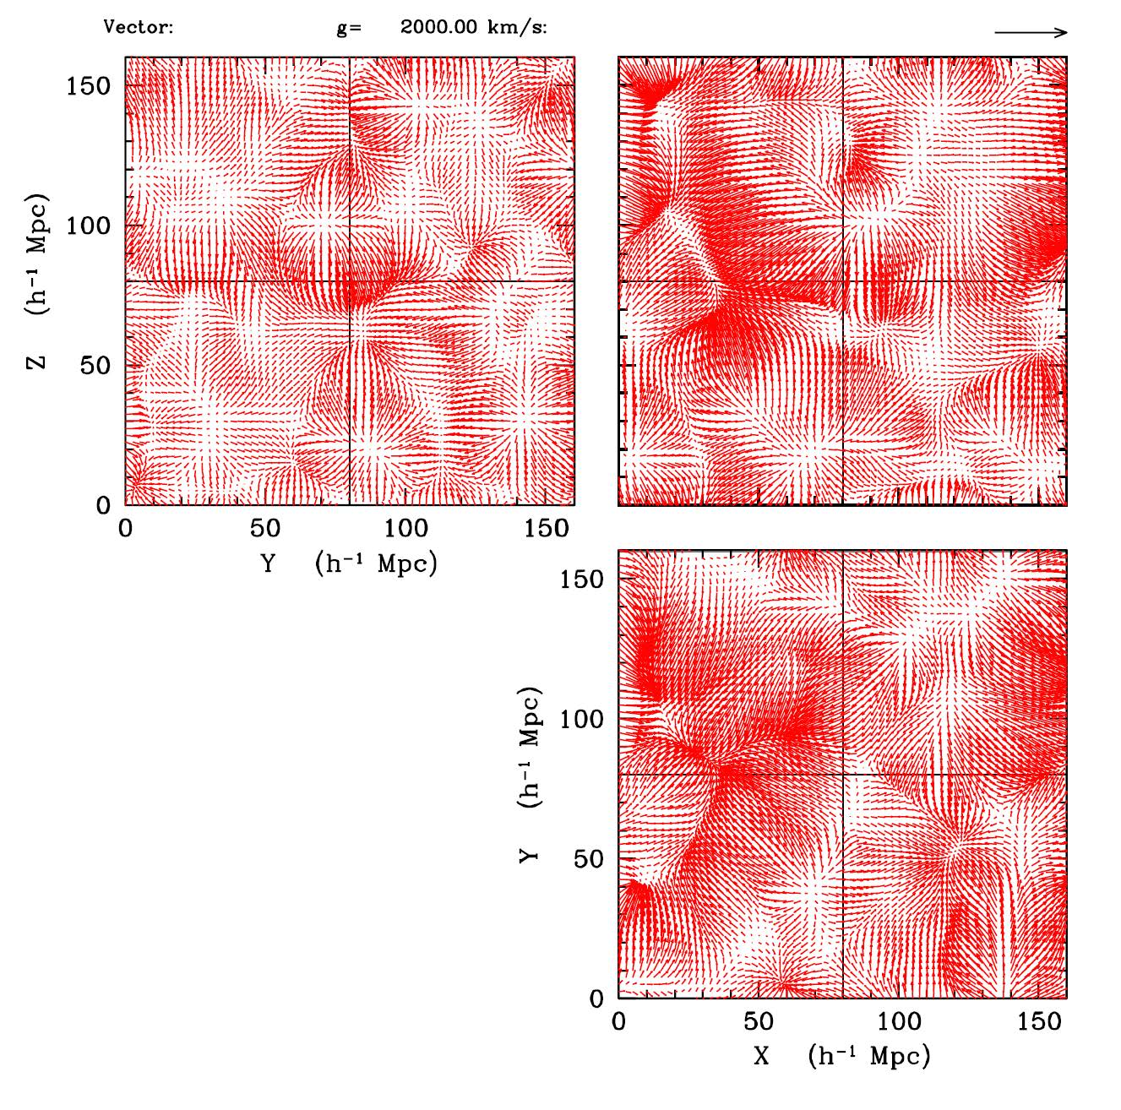
Gaussian Random Field: Gravity Vectors

Slide 9
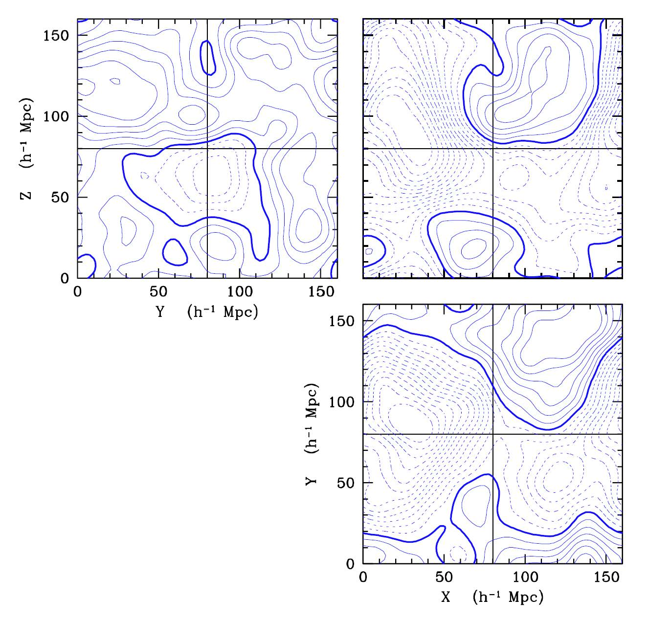
Gaussian Random Field: Potential

Slide 10
Power Spectrum

Slide 11
Power Spectrum
The key characteristic of Gaussian fields is that their structure is
FULLY, COMPLETELY and EXCLUSIVELY determined by the
second order moment of the Gaussian distribution.
P(k) specifies the relative contribution of different scales to the density
fluctuation field. It entails a wealth of cosmological information.

Slide 12
Power Spectrum
P(k) specifies the relative contribution of different scales to the density
fluctuation field. It entails a wealth of cosmological information.
Formal definition:

Slide 13
Power Spectrum – Correlation Function
Gaussian random field fully described by 2nd order moment:
in Fourier space: power spectrum
in Configuration (spatial) space: 2-pt correlation function

Slide 14
Primordial Gaussian Field
Key aspects of Gaussian fields:
solely & uniquely dependent on 2nd order moment
all Fourier modes mutually independent &
Gaussian distributed

Slide 15
Power Spectrum
P(k) specifies the relative contribution of different scales to the density
fluctuation field. It entails a wealth of cosmological information.
Power Law Power Spectrum:
as index n lower, density field increasingly dominated by large scale modes.
For an arbitrary spectrum,

Slide 17
Power Spectrum Physical & Observed

Slide 18
CDM Power Spectrum P(k)

Slide 19
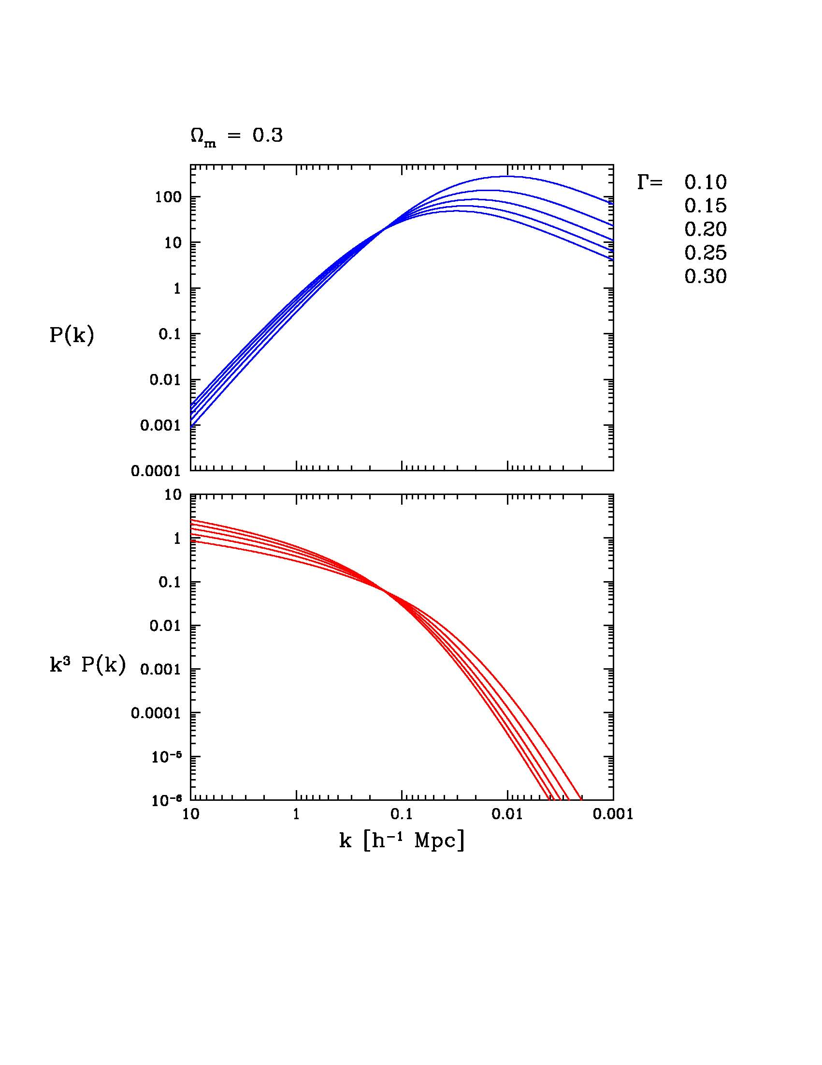
Power Spectrum P(k)

Slide 24
Phases & Patterns

Slide 25
Random Field Phases
When a field is a Random Gaussian Field, its phases (k) are uniformly
distributed over the interval [0,2]:
As a result of nonlinear gravitational evolution, we see the phases acquire a
distinct non-uniform distribution.

Slide 27
Power Spectrum: Pattern Information & Phases

Slide 28
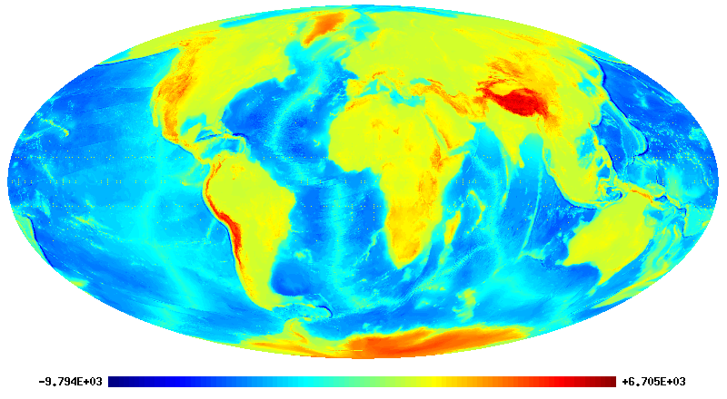

Slide 29
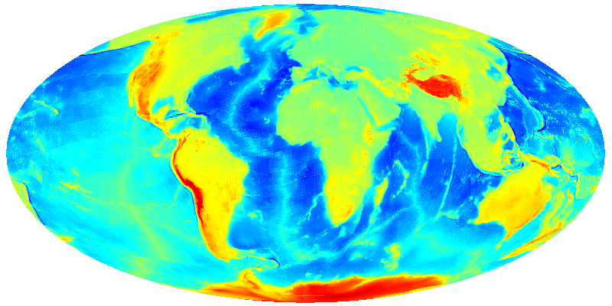

Slide 30
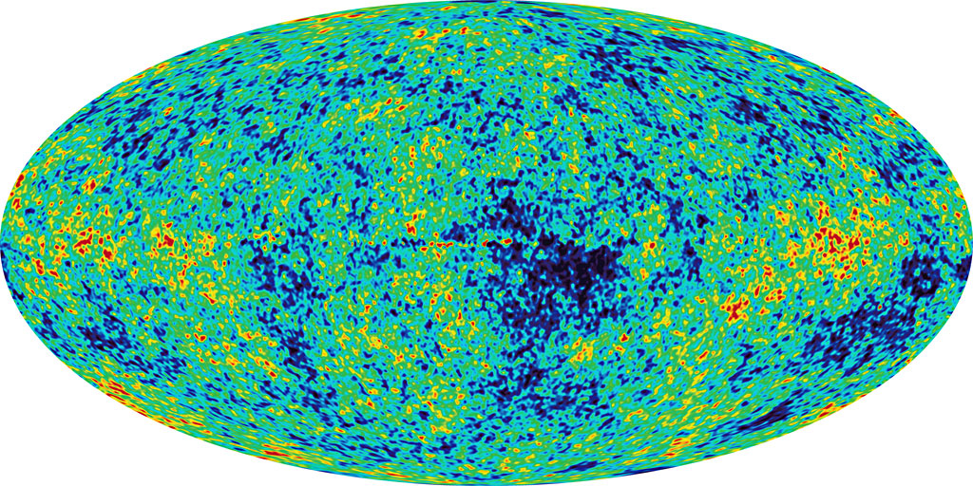

Slide 31
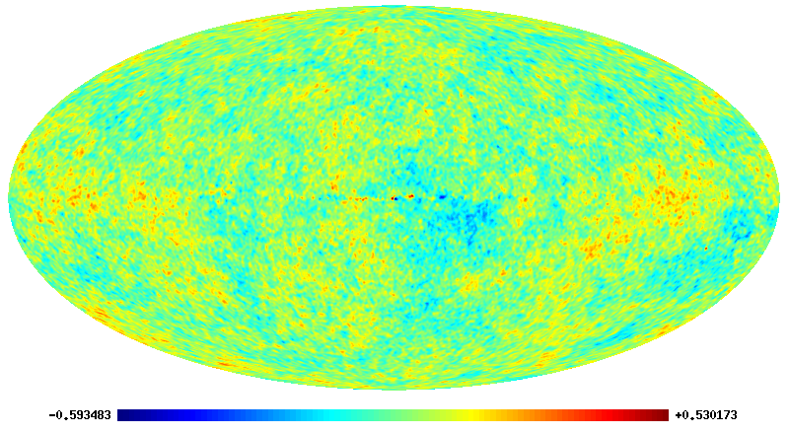

Slide 32
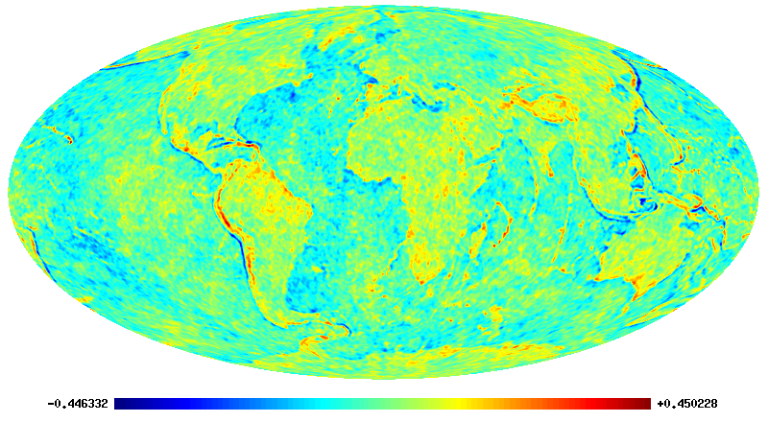

Slide 33
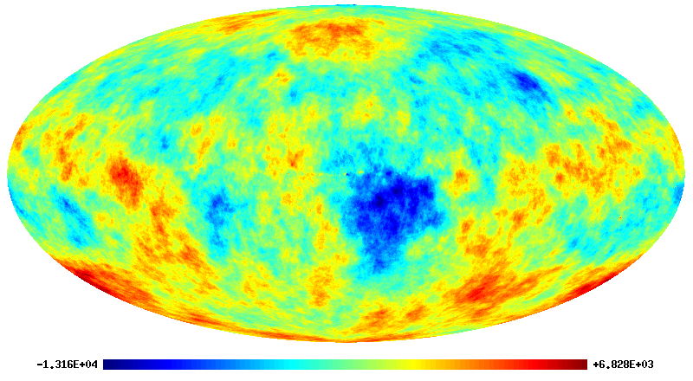

Slide 34
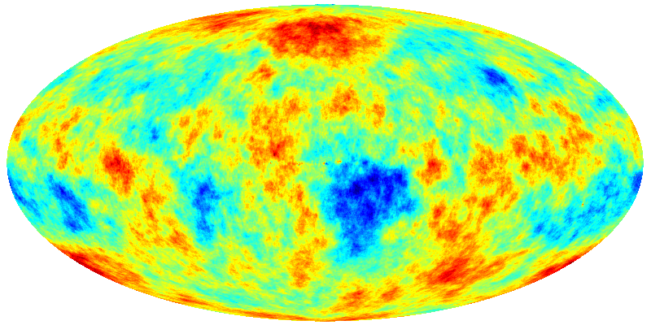

Slide 35
Ergodic Theorem

Slide 36
Statistical Cosmological Principle
Cosmological Principle:
Universe is Isotropic and Homogeneous
Homogeneous & Isotropic Random Field :
Homogenous
Isotropic
Within Universe one particular realization :
Observations: only spatial distribution in that one particular
Theory:

Slide 37
Ergodic Theorem
Spatial Averages
Ensemble Averages over one realization
of random field
Basis for statistical analysis cosmological large scale structure
In statistical mechanics Ergodic Hypothesis usually refers to time evolution
of system, in cosmological applications to spatial distribution at one fixed time

Slide 38
Ergodic Theorem
Validity Ergodic Theorem:
Proven for Gaussian random fields with continuous power spectrum
Requirement:
spatial correlations decay sufficiently rapidly with separation
such that
many statistically independent volumes in one realization
All information present in complete distribution function available from single sample over all space

Slide 39
Fair Sample Hypothesis
Statistical Cosmological Principle
+
Weak cosmological principle
(small fluctuations initially and today over Hubble scale)
+
Ergodic Hypothesis
fair sample hypothesis
(Peebles 1980)

