Slide 1
Lecture course CSF2014
University Groningen
Nov . 2014-Jan 2015
Measures of
Cosmic Structure

Slide 2
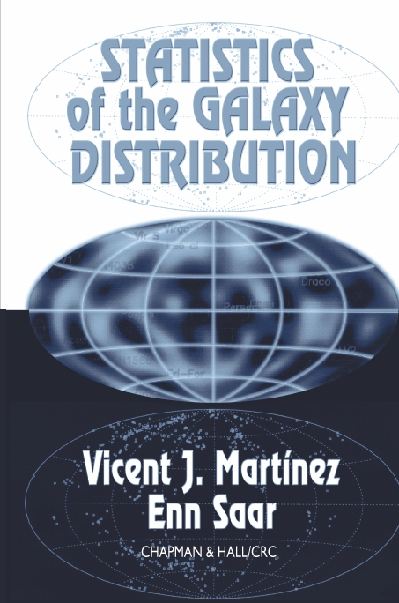
If you want to know more...
Standard
Reference:
Martinez & Saar

Slide 3
Ergodic Theorem

Slide 4
Statistical Cosmological Principle
Cosmological Principle:
Universe is Isotropic and Homogeneous
Homogeneous & Isotropic Random Field :
Homogenous
Isotropic
Within Universe one particular realization :
Observations: only spatial distribution in that one particular
Theory:

Slide 5
Ergodic Theorem
Spatial Averages
Ensemble Averages over one realization
of random field
Basis for statistical analysis cosmological large scale structure
In statistical mechanics Ergodic Hypothesis usually refers to time evolution
of system, in cosmological applications to spatial distribution at one fixed time

Slide 6
Ergodic Theorem
Validity Ergodic Theorem:
Proven for Gaussian random fields with continuous power spectrum
Requirement:
spatial correlations decay sufficiently rapidly with separation
such that
many statistically independent volumes in one realization
All information present in complete distribution function available from single sample over all space

Slide 7
Fair Sample Hypothesis
Statistical Cosmological Principle
+
Weak cosmological principle
(small fluctuations initially and today over Hubble scale)
+
Ergodic Hypothesis
fair sample hypothesis
(Peebles 1980)

Slide 8
Discrete e.g. Continuous

Slide 9
Discrete & Continuous
Distributions
How to relate discrete and continuous distributions:
Define number density for a point process:
Dirac Delta function
ensemble average

Slide 10
Correlation Functions

Slide 11
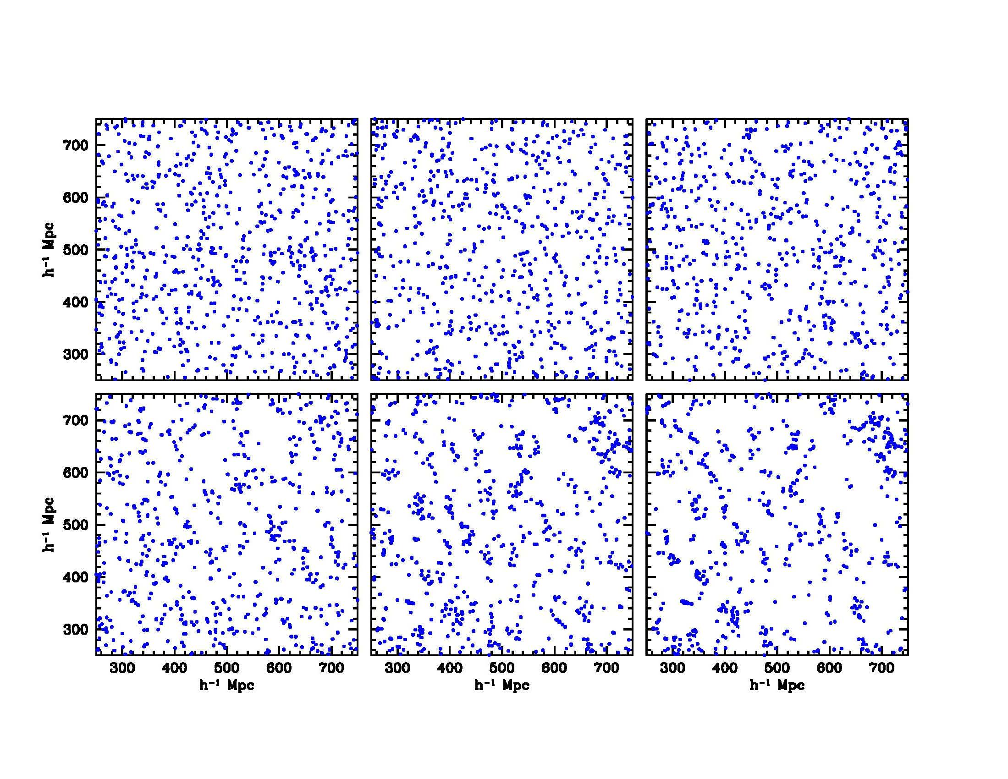

Correlation Functions
Joint probability that
in each one of
the two infinitesimal volumes
dV₁ & dV₂,
at distance r,
lies a galaxy
Infinitesimal Definition Two-Point Correlation Function:
mean density

Slide 12
Correlation Functions
In case of
Homogeneous & Isotropic
point process
then
only dependent on
Infinitesimal Definition Two-Point Correlation Function:
mean density

Slide 13
Correlation Functions
Discrete Continuous
Two-point correlation function Autocorrelation function
probability for 2 points in
dV₁ and dV₂

Slide 14

Correlation Functions
Gaussian (primordial and large-scale) density field:
Autocorrelation function (r) Fourier transform power spectrum P(k)
Autocorrelation function completely specifies statistical properties
of field
First order measure of deviations from uniformity
Nonlinear objects (halos):
(r) measure of density profile
Large Scales:
related to dynamics of structure formation via e.g.
cosmic virial theorem

Slide 15
Correlation Functions: related measures
Other measures related to :
Second-order intensity
Pair correlation function
Conditional density

Slide 16
Correlation Functions: related measures
Volume averaged correlation function

Slide 17
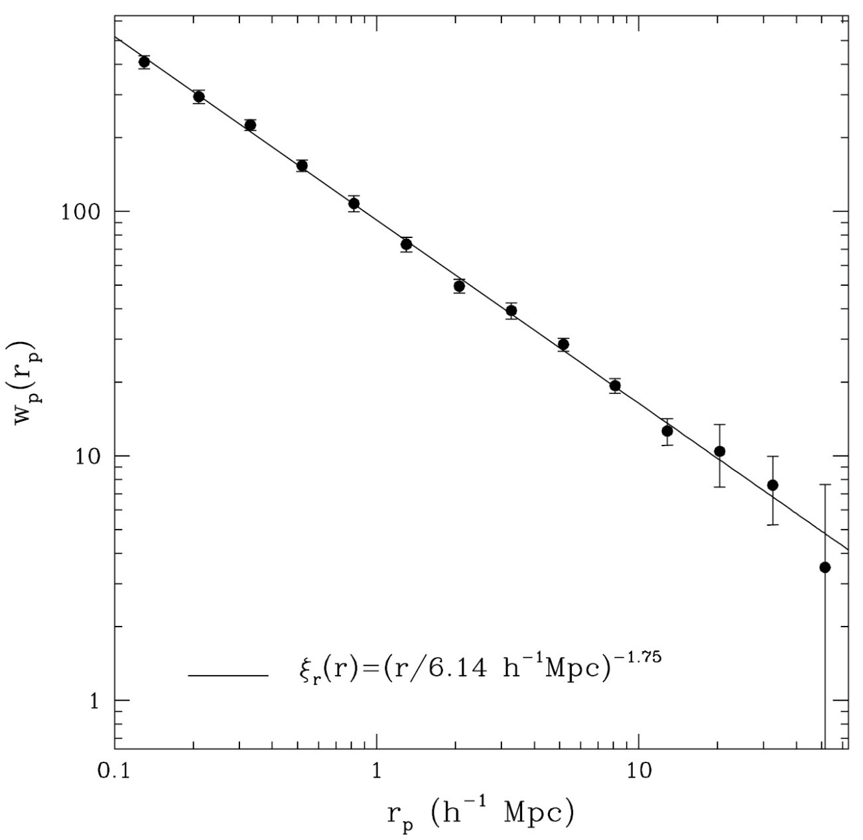
Power-law Correlations
Totsuji & Kihara 1969
Peebles 1975, 1980, …

Slide 18
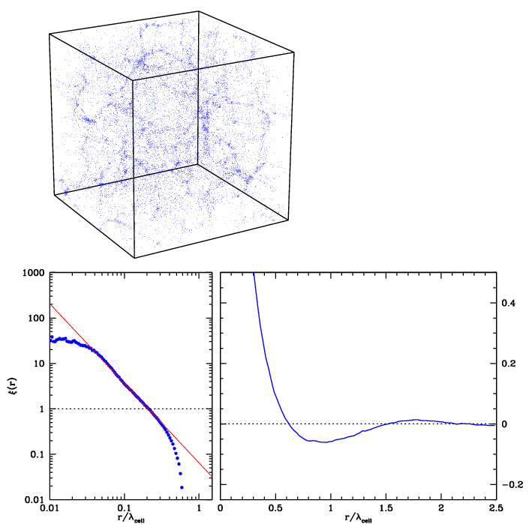



Correlation Functions
Clustering length/
“Correlation” length
Coherence length

Slide 19
Correlation Function
Estimators

Slide 20
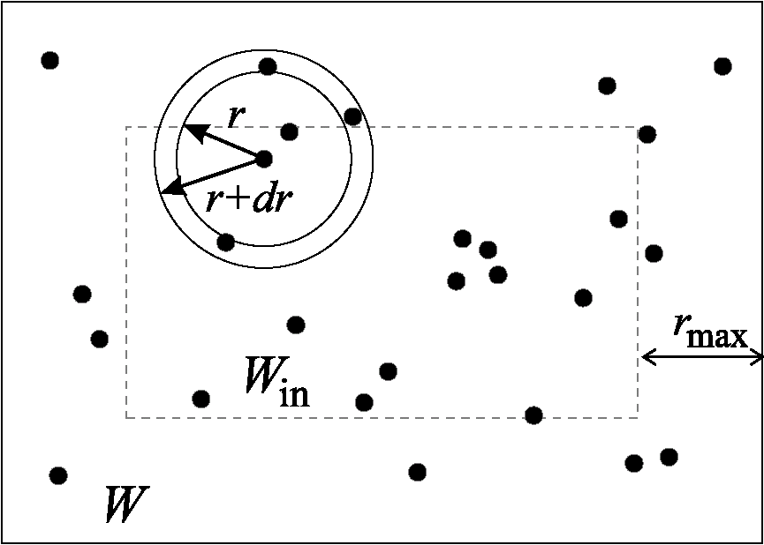
Minimal Estimator
For galaxies close to the boundary
the number of neighbours is
Underestimated. One way to overcome this problem is to consider
as centers for counting neighbours
only galaxies lying within an inner
window W_{in}
V_{sh} is the volume of the shell of
width dr

Slide 21
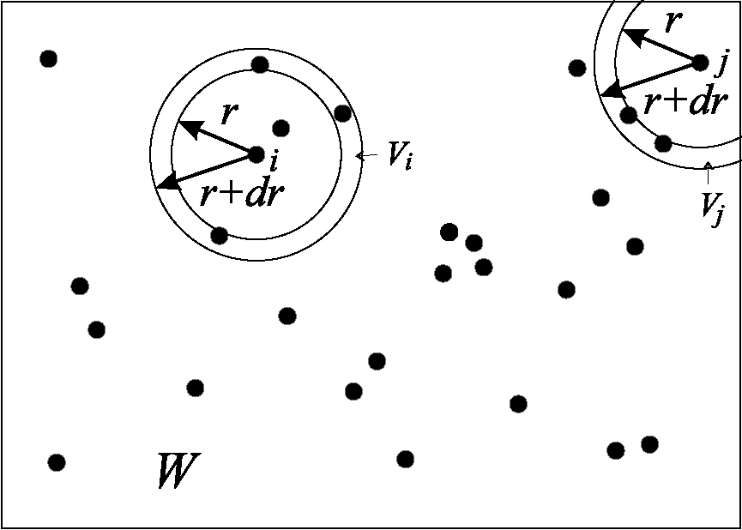
Edge-Corrected Estimator
N_{i}(r): number of neighours at distance
in the interval [r,r+dr] from galaxy I
V_{i}: volume of the intersection of the
shell with W
W: when W a cube, an analytic
expression for V_{i} can be found
in Baddely et al. (1993).

Slide 22
Estimators Redshift Surveys
In redshift surveys, galaxies are not sampled uniformly over the survey volume
Depth selection:
in magnitude-limited surveys, the sampling density decreases as function of
distance
Survey Geometry
boundaries of survey often nontrivially defined:
- slice surveys
- non-uniform sky coverage
etc.
Clustering in survey compared with sample of Poisson distributed points,
following the same sampling behaviour in depth and survey geometry
Difference in clustering between
data sample (D) and Poisson sample (R)
genuine clustering

Slide 23
Estimators Redshift Surveys
Clustering in survey compared with sample of Poisson distributed points,
following the same sampling behaviour in depth and survey geometry
Difference in clustering between
data sample (D) and Poisson sample (R)
genuine clustering
Davis-Peebles
(1983)
Hamilton
(1993)
Landy-Szalay
(1993)

Slide 24
Angular
Two-point Correlation Function

Slide 25
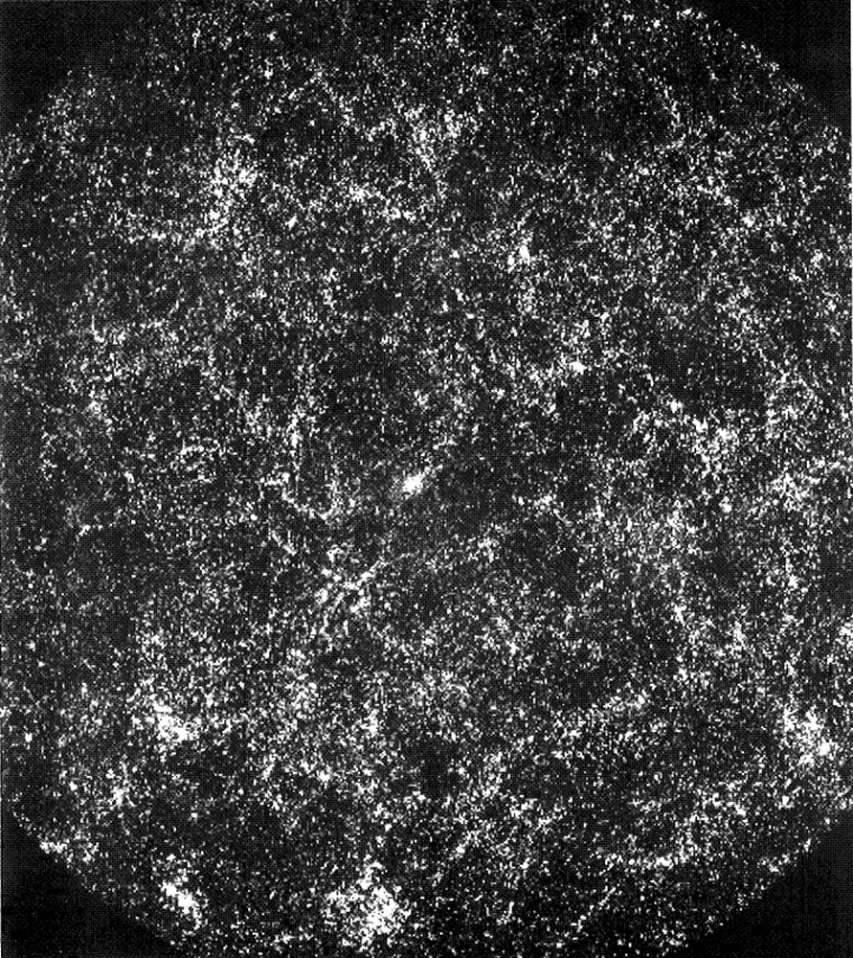
Nonlinear Descriptions
Angular Correlation Function
Galaxy sky distribution:
Galaxies clustered,
a projected expression of the
true 3-D clustering
Probability to find a galaxy near
another galaxy higher than
average (Poisson) probability
• Quantitatively expressed by
2-pt correlation function w():
Excess probability of finding
2 gal’s at angular distance 

Slide 26
Nonlinear Descriptions
Angular & Spatial Clustering
Two-point angular correlation function is the “projection” of
Limber’s Equation:
p(x): survey selection function

Slide 27
Nonlinear Descriptions
Limber Equation

Slide 28
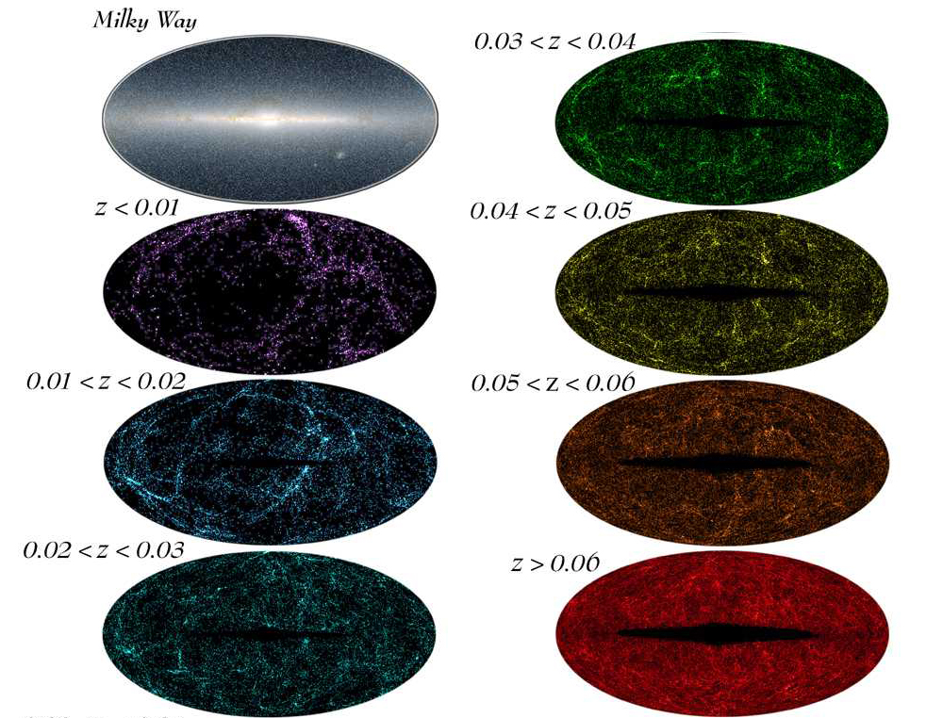

Slide 29
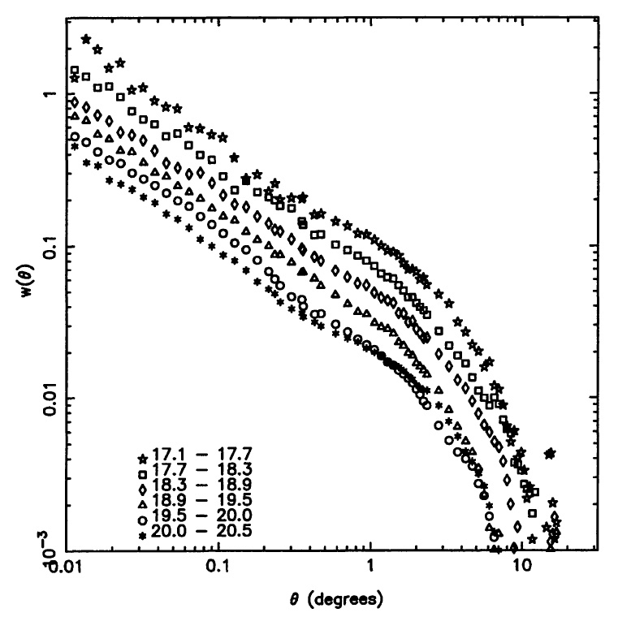
Nonlinear Descriptions
Angular Clustering Scaling
Two-point correlation function:
• small angles: power-law
• large angles 0
ie. to homogeneity
APM survey

Slide 30
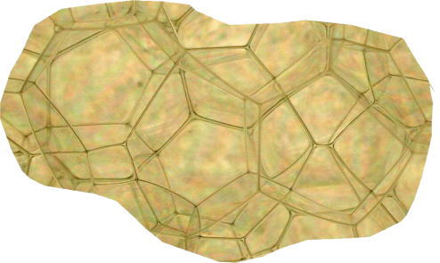
Nonlinear Descriptions
Angular Clustering Scaling
APM survey
Angular size structures smaller when more distant
Projection of more layers leads to
decreasing amplitude w()

Slide 31
Nonlinear Descriptions
Angular Clustering Scaling
Angular size structures smaller when more distant
APM survey
Projection of
more layers
leads to
decreasing
amplitude w()

Slide 32
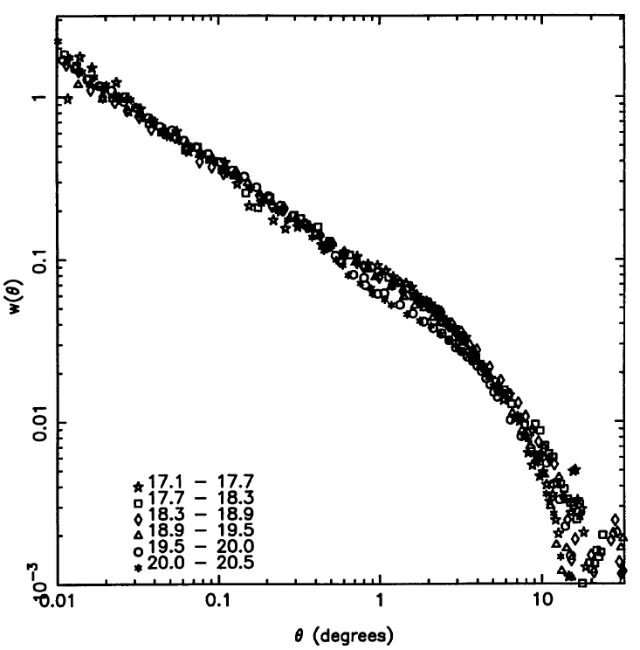
Nonlinear Descriptions
Angular Clustering Scaling
Angular size structures smaller when more distant
APM survey
Projection of
more layers
leads to
decreasing
amplitude w()

Slide 33
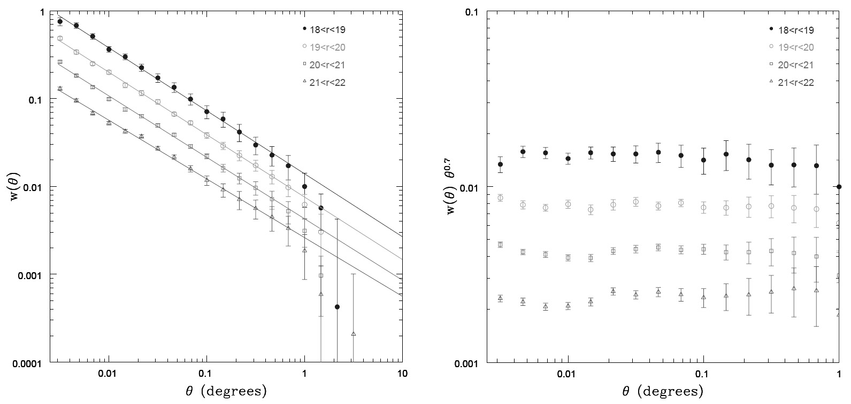
Nonlinear Descriptions
Angular Clustering Scaling
The angular scaling of w() is found back to even fainter magnitudes in the
SDSS survey (m=22)
Clear evidence that there are no significant large structures on scales > 100-200 Mpc

Slide 34
Correlation Functions:
Redshift Space

Slide 35
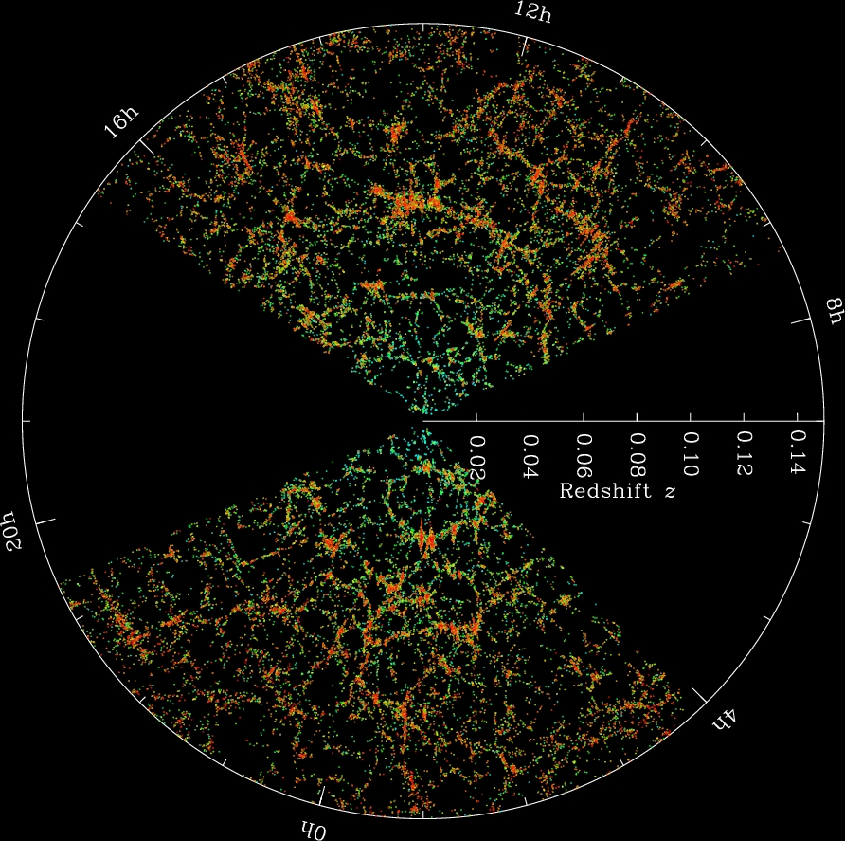

Slide 36
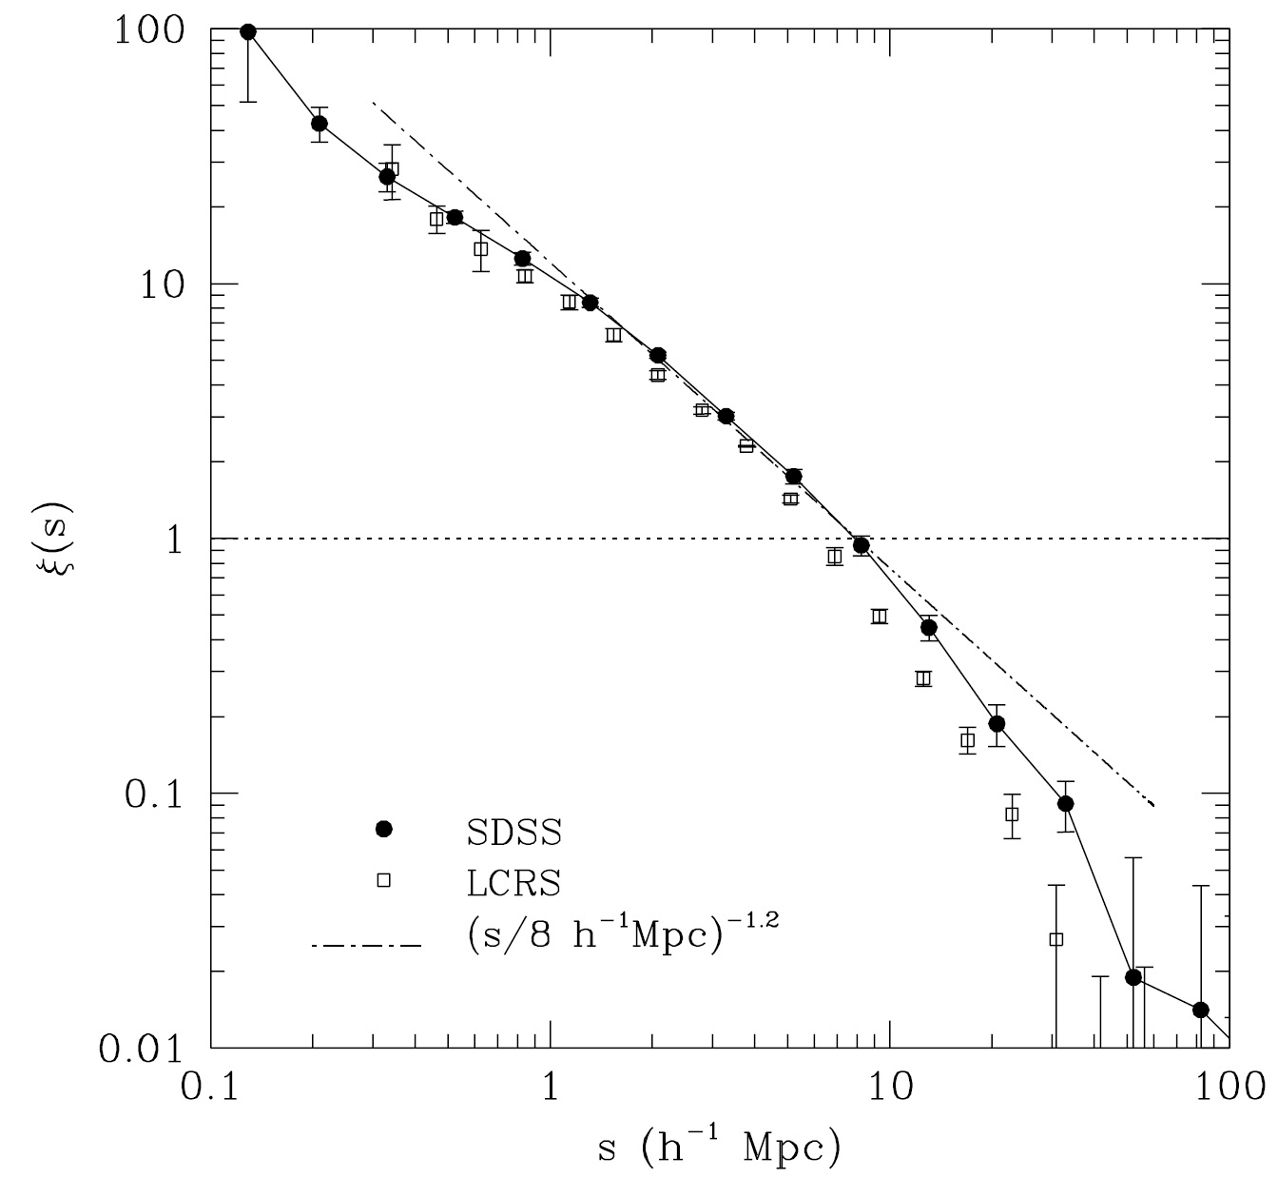

Slide 37
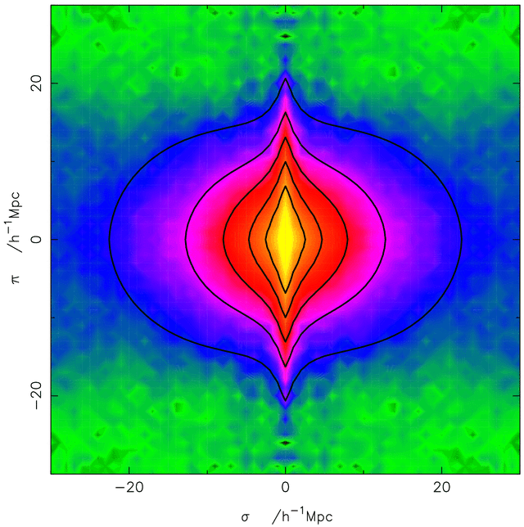
sky-redshift space
2-pt correlation function (,)
Correlation function determined
in sky-redshift space:
sky position:
redshift coordinate:
Close distances:
distortion due to non-linear
Finger of God
Large distances:
distortions due to large-scale
flows

Slide 38
Redshift Space Distortions
Correlation Function
On average, gets amplified
wrt.
Linear perturbation theory
(Kaiser 1987):
Large distances:
distortions due to large-scale
flows

Slide 39
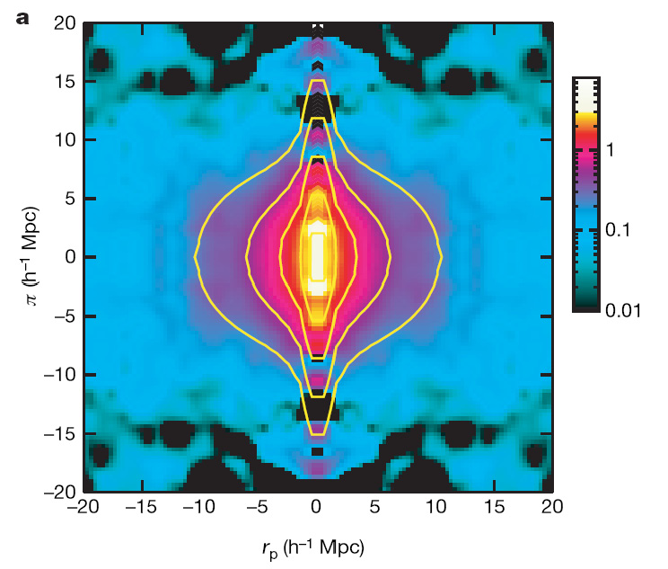
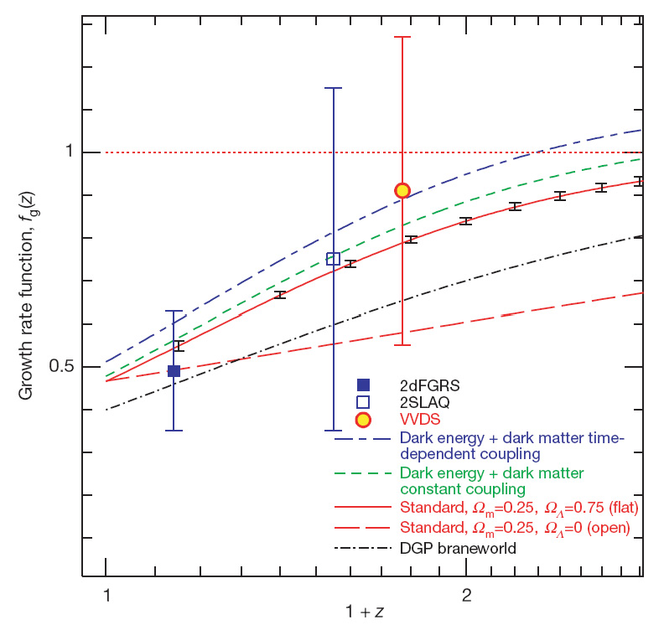
Evolution Growth Rate
Linder 2008
Guzzo et al. 2008
Peebles growth rate factor

Slide 40
Measurement
Spatial 2pt-Correlation Function

Slide 41
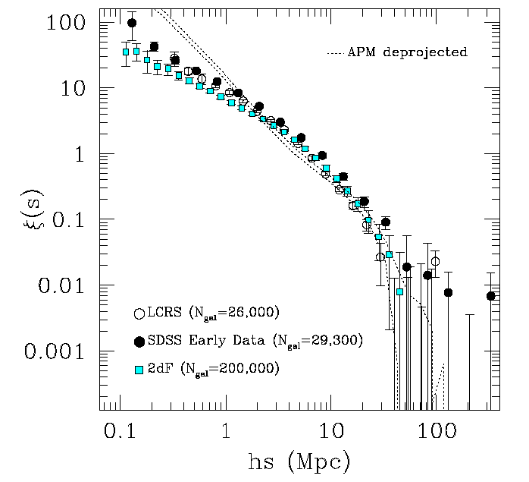
Deprojected Spatial Correlations
2pt correlation function
not an ideal power-law:
Halo Model:
Two-point correlation function
combination of
1) small-scale correlations,
due to galaxies inside
one dark matter halo
large scale correlations
between dark matter halos

Slide 42
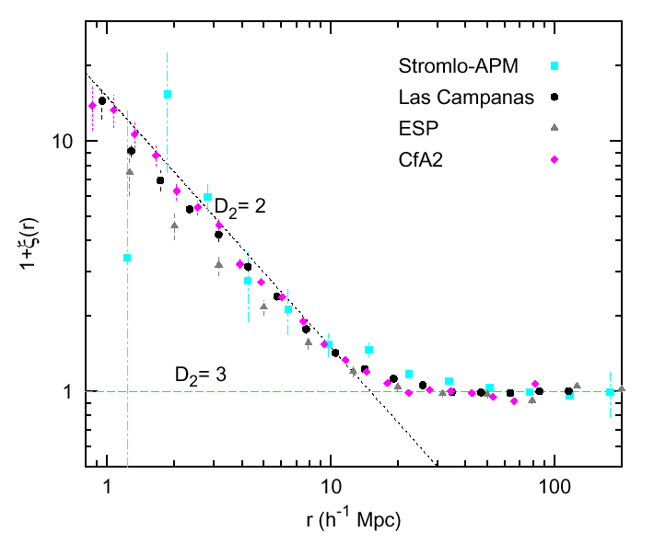
Convergence to Homogeneity
(3)
The correlation function g(r)=1+ξ(r)
Stromlo-APM, Las Campanas,
CfA2, ESP redshift surveys.
The fractal behavior at small
scales dissapears at larger
distances, providing evidence
for a gradual transition to
homogeneity.
Plot from Martínez, 1999, Science, 284, 445.
Loveday et al., 1995, ApJ, 442, 457
Tucker et al., 1997, MNRAS, 285, L5
Guzzo et al., 2000, AA, 355, 1

Slide 43
Luminosity Dependence
Correlation Functions

Slide 44
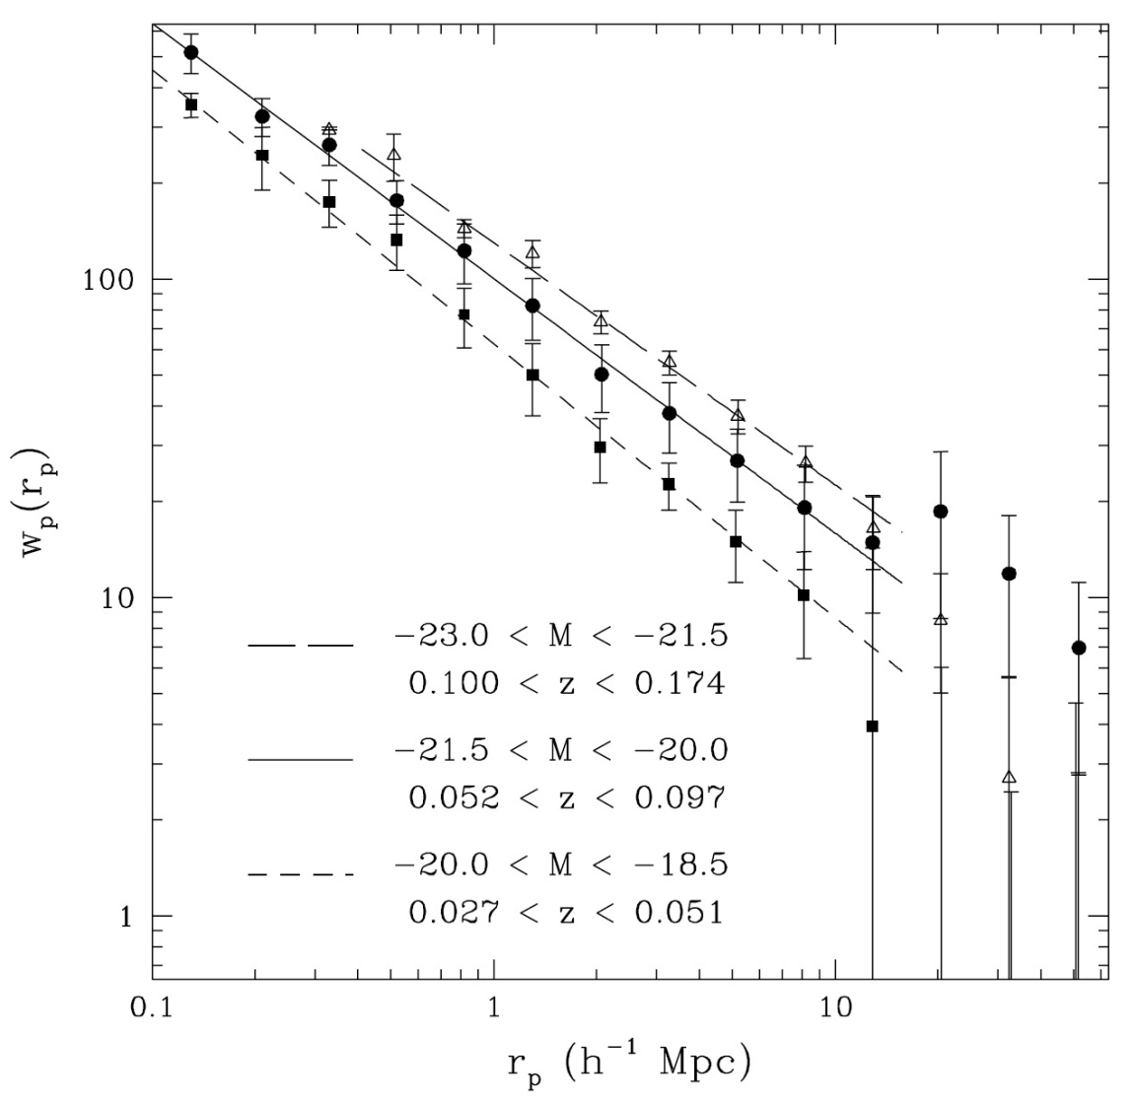
Galaxy Luminosity Dependence
SDSS
correlation function
for galaxies in different
luminosity bins

Slide 45
Spatial Structure &
Correlation Functions

Slide 46
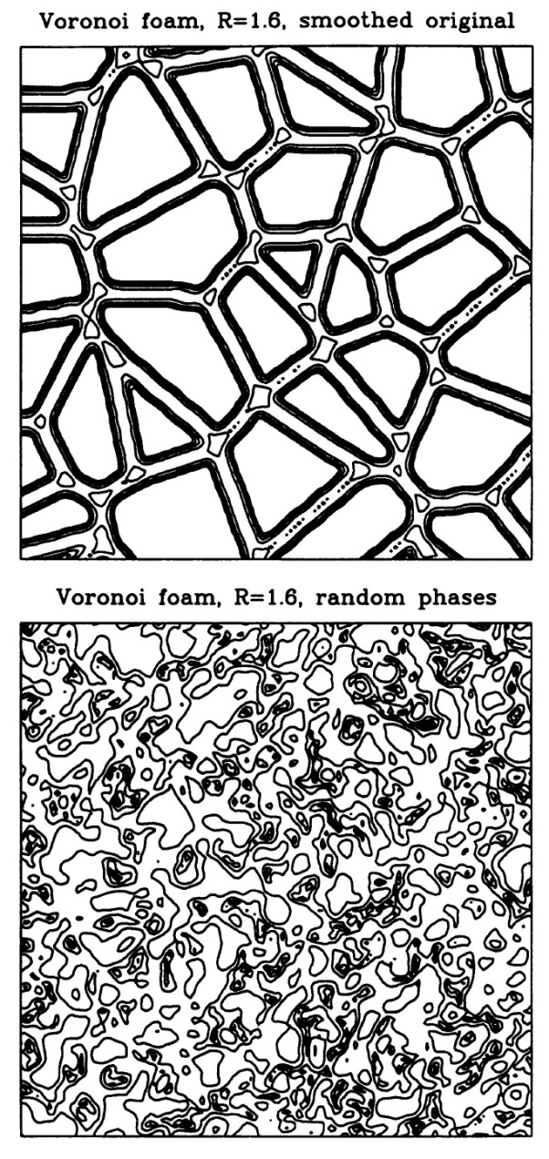
Structural Insensitivity
2-pt correlation function is
highly insensitive to the geometry & morphology
of weblike patterns:
compare 2 distributions with same
(r), cq. P(k),
but totally different phase distribution
In practice, some sensitivity in terms of distinction
Field, Filamentary, Wall-like and Cluster-dominated
distributions:
because of different fractal dimensions

Slide 47
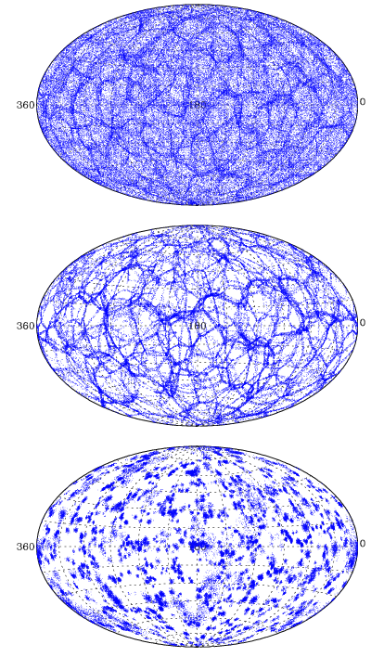
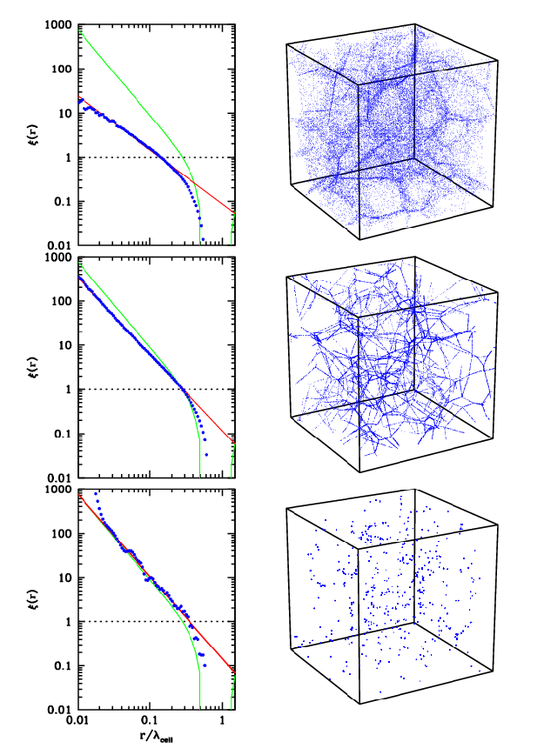
Structural Sensitivity
Wall-dominated
Filamentary
Cluster-like

Slide 48
Cluster
Correlation Functions

Slide 49
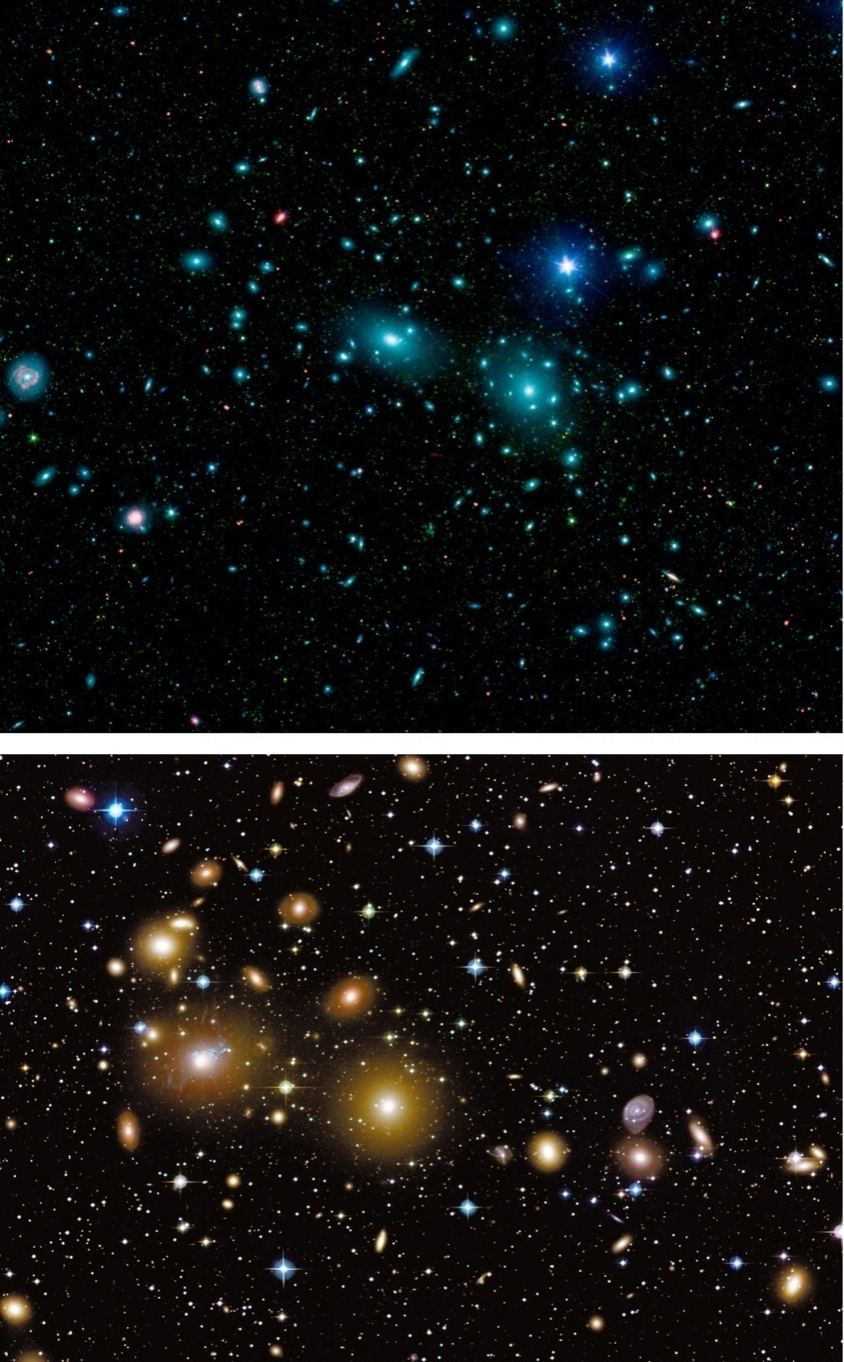
Clusters of Galaxies
Coma Cluster
Perseus Cluster

Slide 50
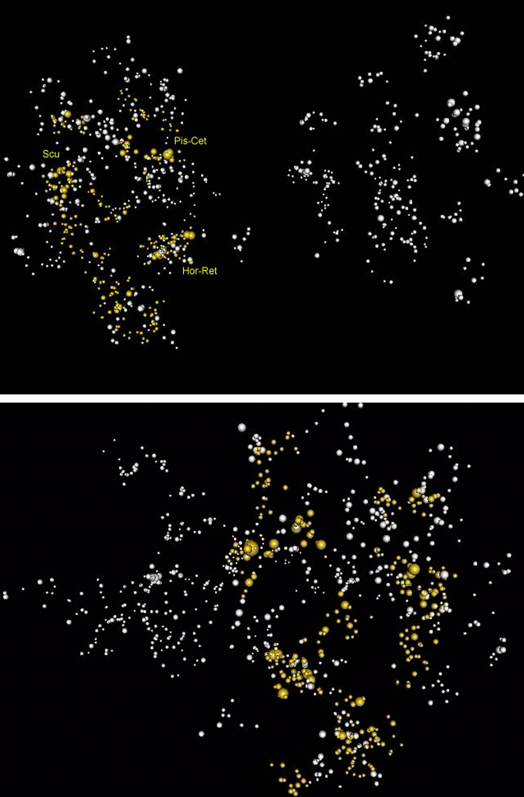
Clustering
of
Clusters
Clusters cluster much more strongly
than galaxies:
clustering defines superclusters !
also power-law 2-pt correlation fct.
same power law slope 1.8
much higher correlation length r₀ :
r₀ ~ 15-25 h⁻¹ Mpc

Slide 51
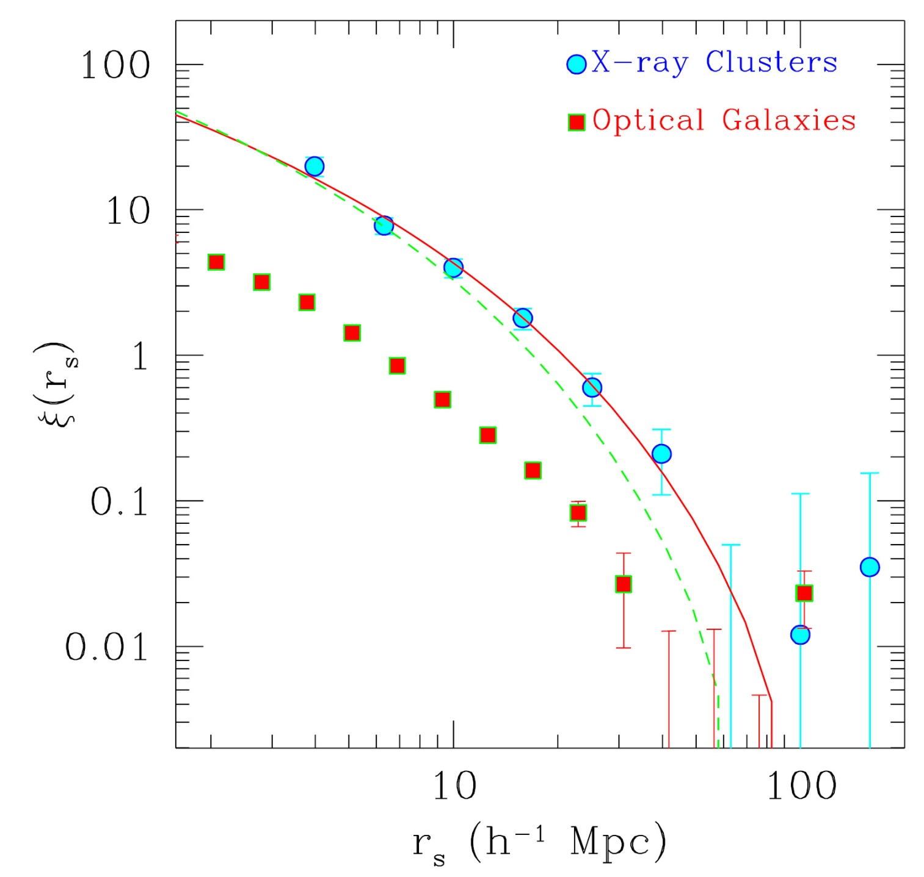

Slide 52
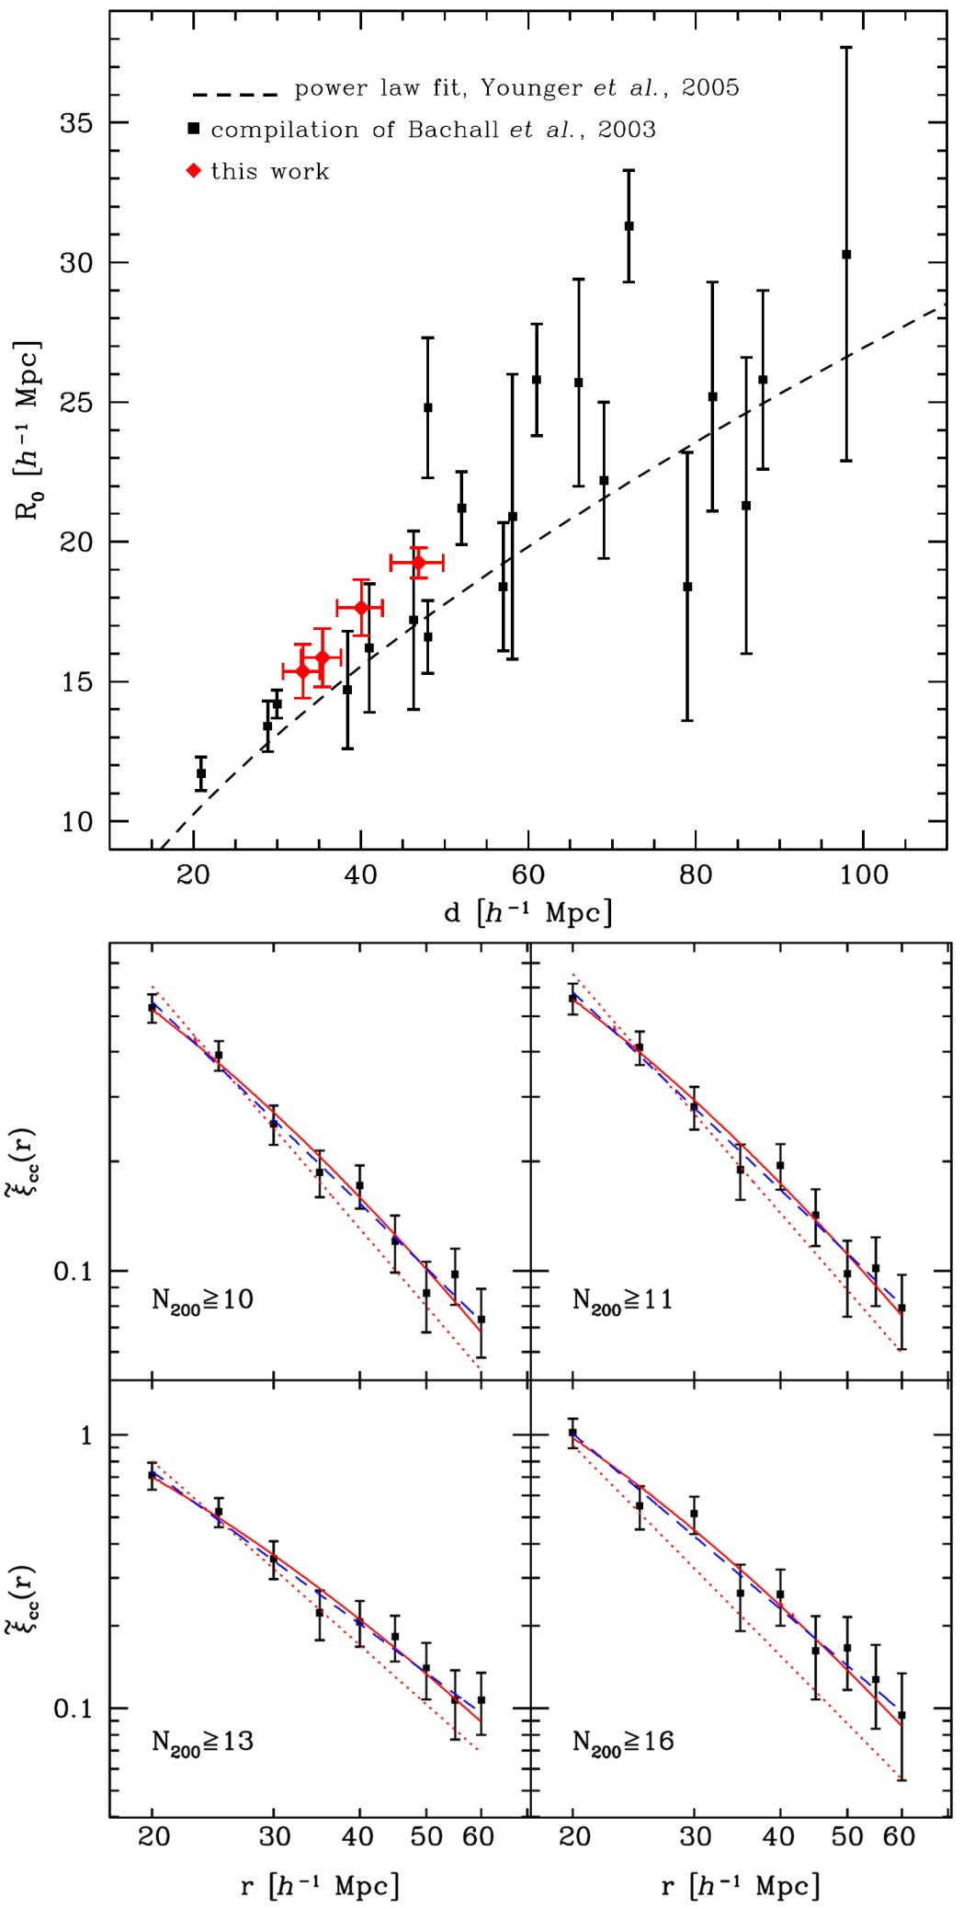
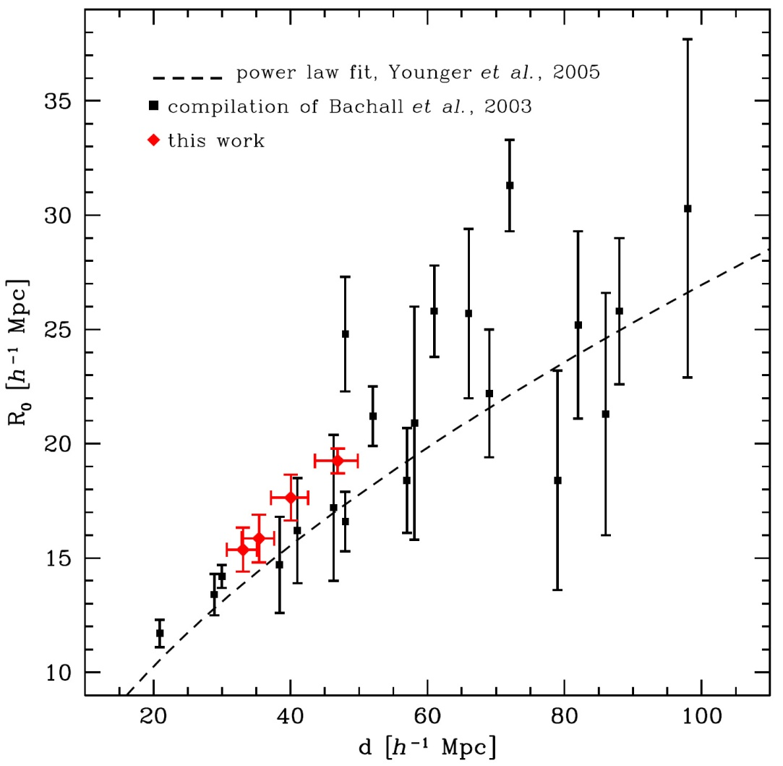
Richness-Dependent Cluster Correlations
More massive clusters are
systematically more strongly
clustered than lower mass ones.

Slide 53


Richness-Dependent Cluster Correlations
More massive clusters are more
systematically more strongly
clustered than lower mass ones:
simple model:
Szalay & Schramm 1985

Slide 54
Scaling of
Cluster Correlation Functions: a geometric model

Slide 55
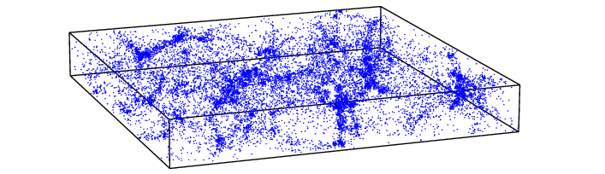
Voronoi Models:
Templates for the Cosmic Web
filament
void
cluster
wall

Slide 56
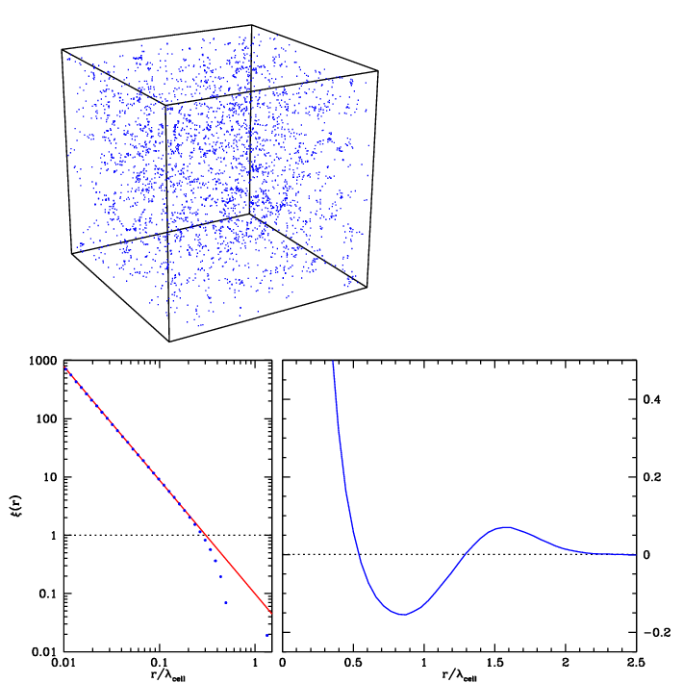


Perfect
Power-law clustering
Voronoi vertices

Slide 57
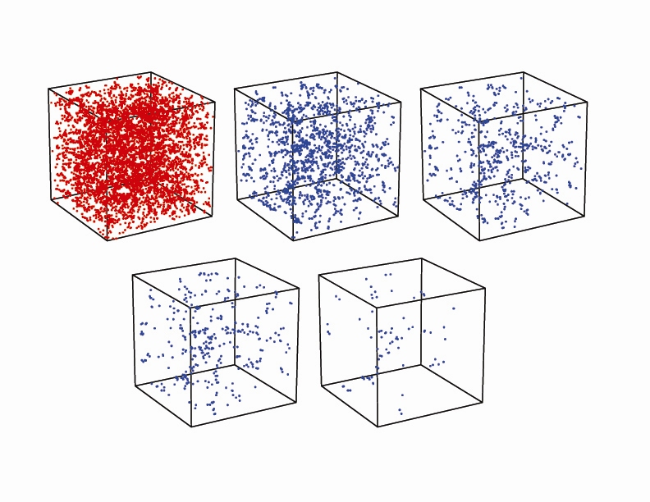

Slide 59
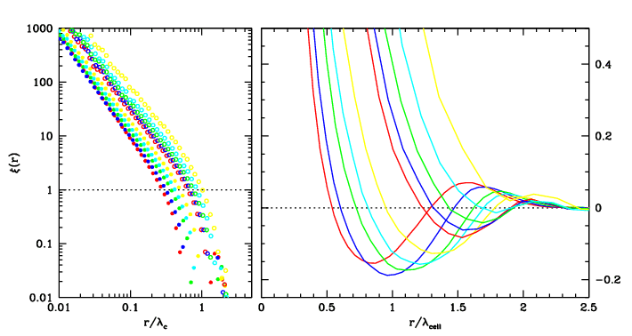
Self-similar Clustering
As function of mass, the correlation length r₀ and coherence length r_{a}
increase unanimously.

Slide 60
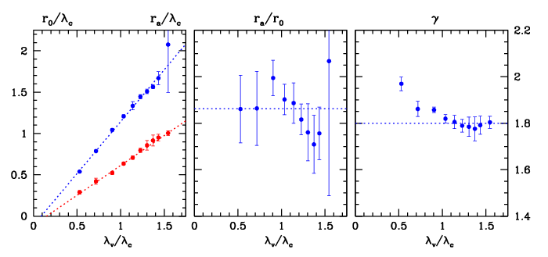
Self-similar Clustering
As function of mass, the correlation length r₀ and coherence length r_{a}
increase unanimously.

Slide 61
Higher Order
Correlation Functions:

Slide 62
N-point correlation functions
N-point correlation function
Probability function of finding an n-tuplet of galaxies in
n specified volumes dV₁, dV₂, …, dV_{n}

Slide 63
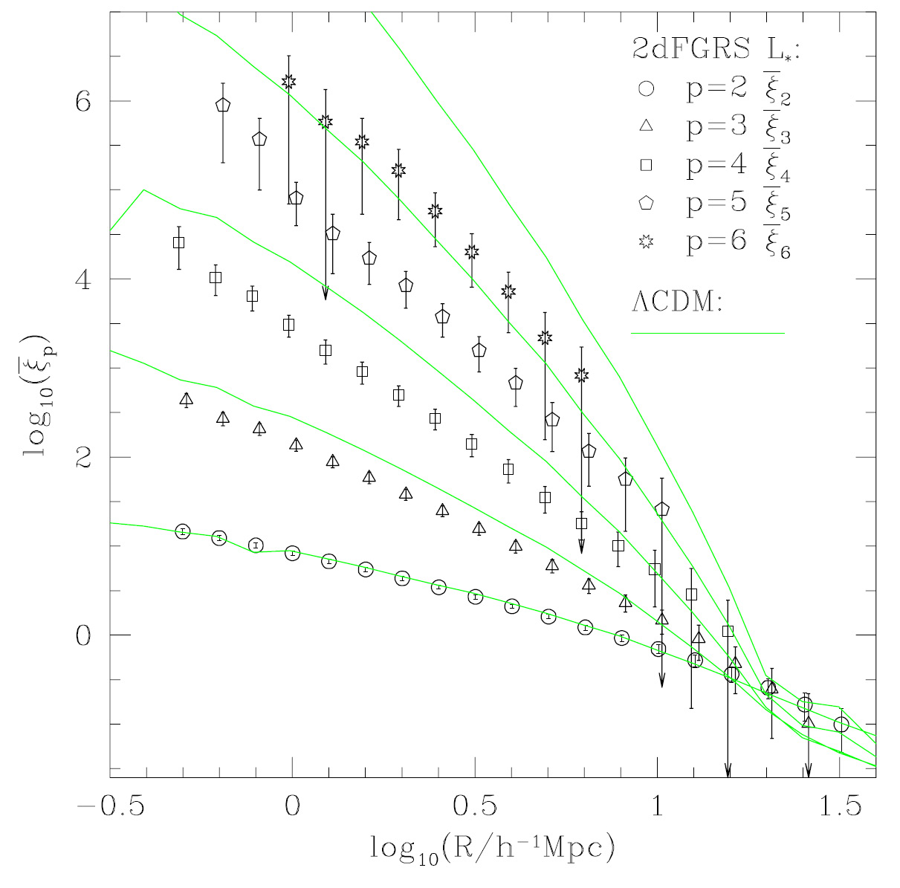

Slide 64
3-point correlation functions
3-point correlation function

Slide 65
3-point correlation functions
3-point correlation function
reduced 3-point correlation function
excess correlation over that described by the 2-pt contributions
  0: non-Gaussian density field
Hierarchical ansatz (Groth & Peebles 1977)

Slide 66
Power Spectrum

Slide 67
Power Spectrum
Directly measuring clustering in
Fourier space:
- More intuitive physically:
separating processes on different scales
- Theoretical model predictions are made
in terms of power spectrum
- Amplitudes for different wavenumbers are
statistically orthogonal

Slide 68
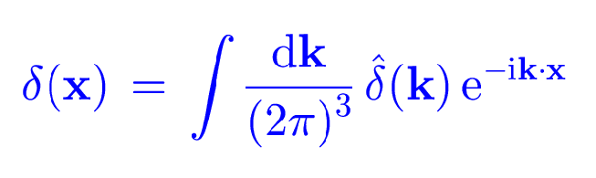
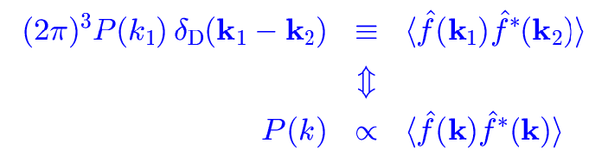
Power Spectrum P(k)

Slide 69
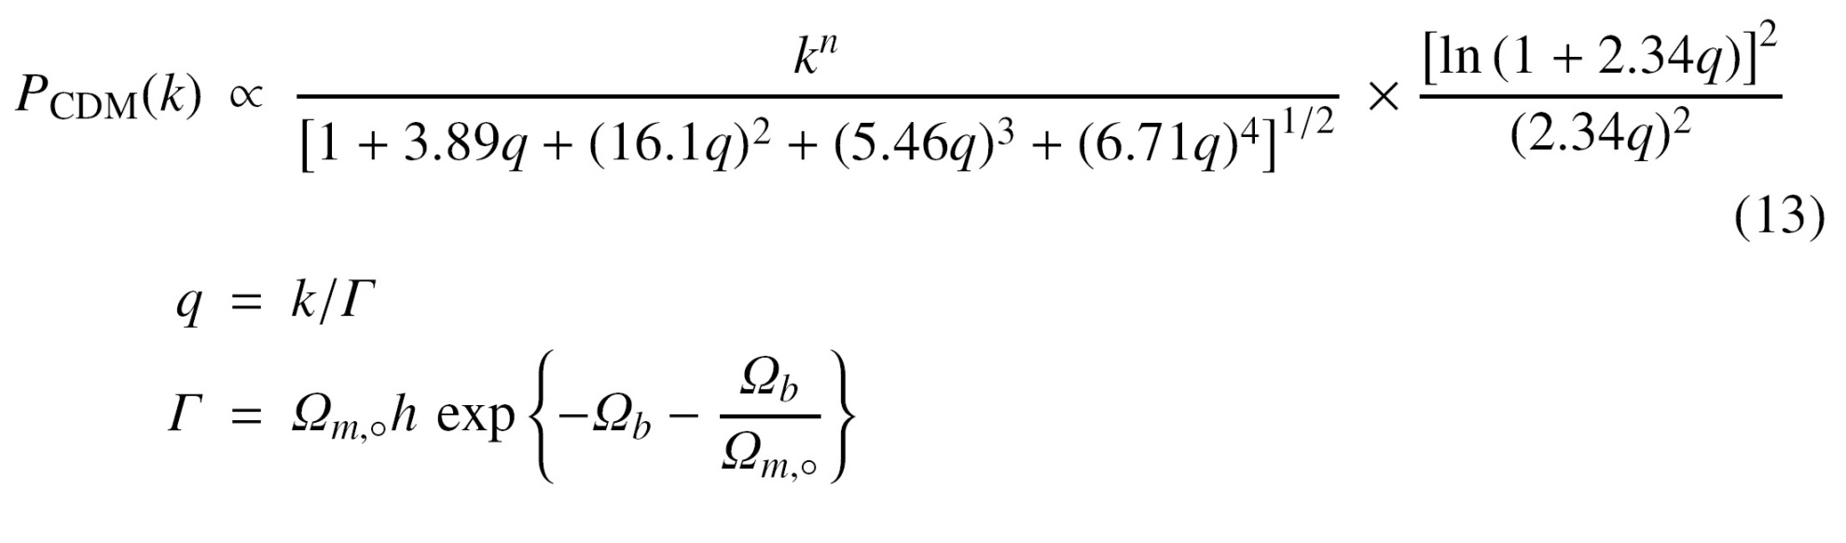
CDM Power Spectrum P(k)

Slide 70
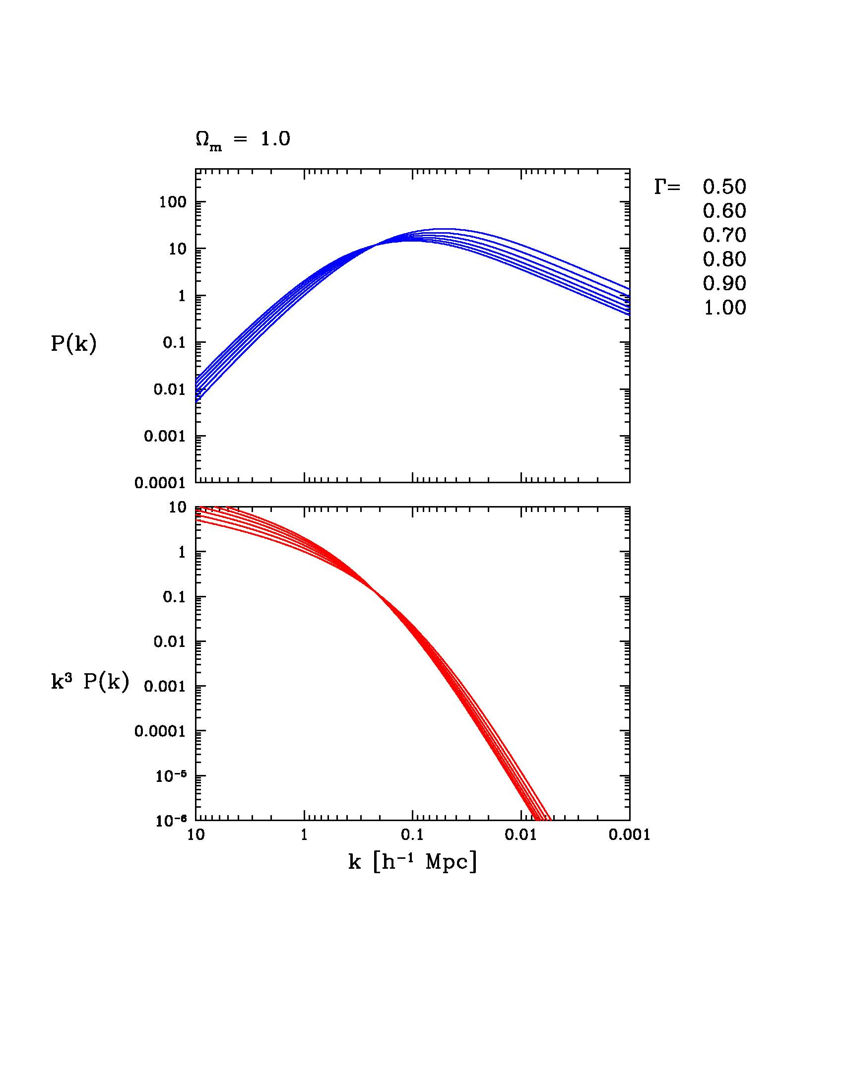
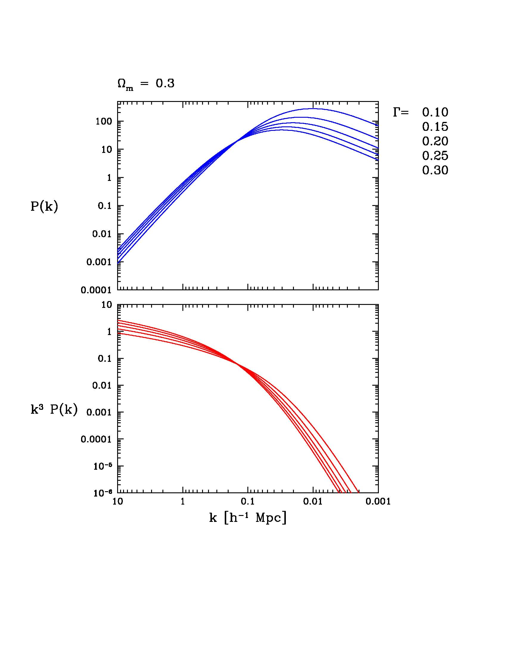
Power Spectrum P(k)

Slide 71
Power Spectrum - Correlation Function
Isotropy:
Delta-power

Slide 72
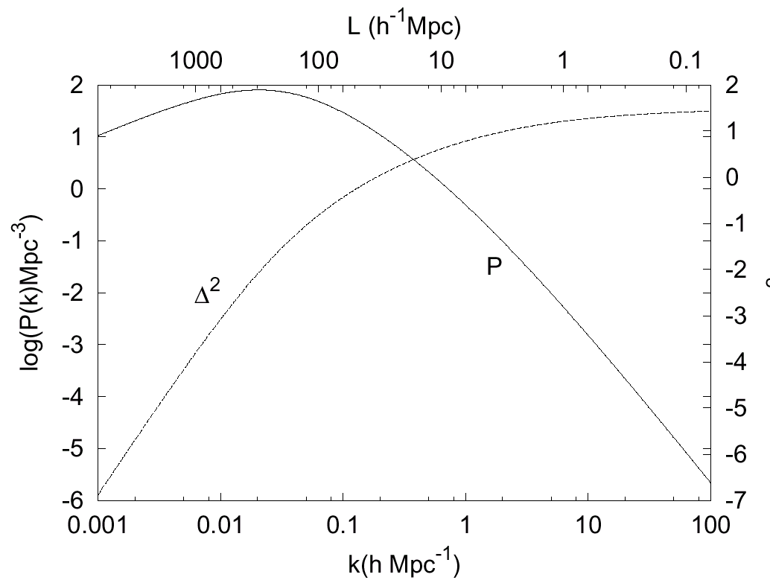

Slide 73
Estimators of P(k)
Power Spectrum Estimators
Direct estimator
Pixelization and maximum likelihood
Karhunen-Loèwe (signal-to-noise) transform
Quadratic compression
Bayesian
Multiresolution decomposition
Tegmark, Hamilton, Strauss, Vogeley, and Szalay, (1998), Measuring the galaxy power spectrum with future redshift surveys, ApJ, 499, 555

Slide 74
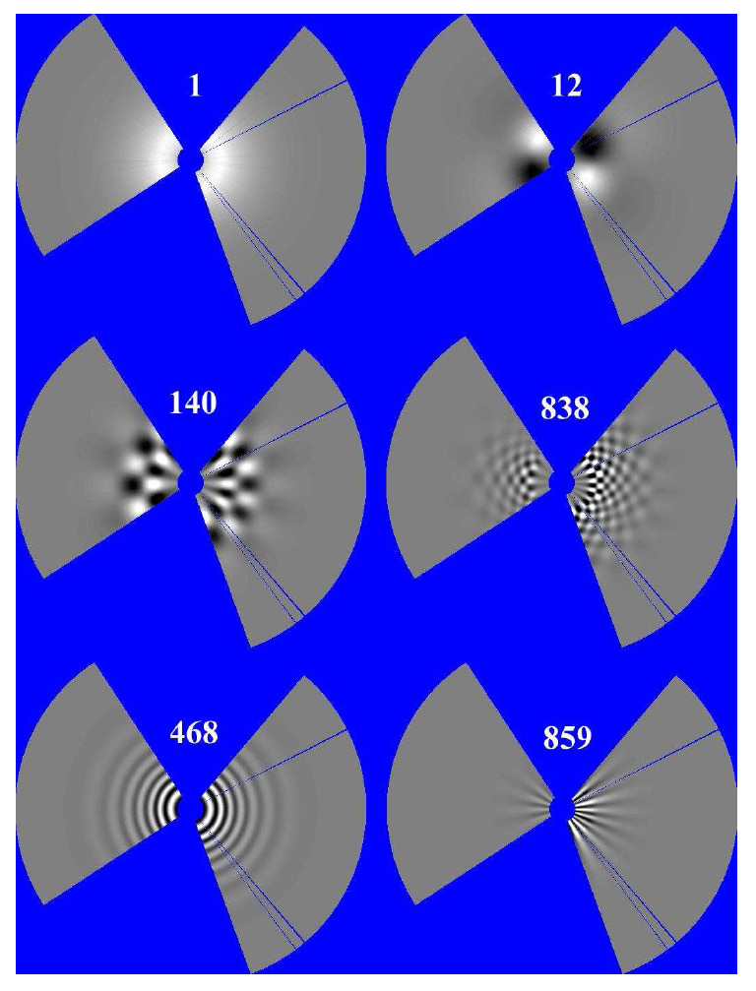
Karhunen-Loeve
Decomposition in series of
orthogonal
signal-noise eigenfunctions
Vogeley & Szalay 1995

Slide 75
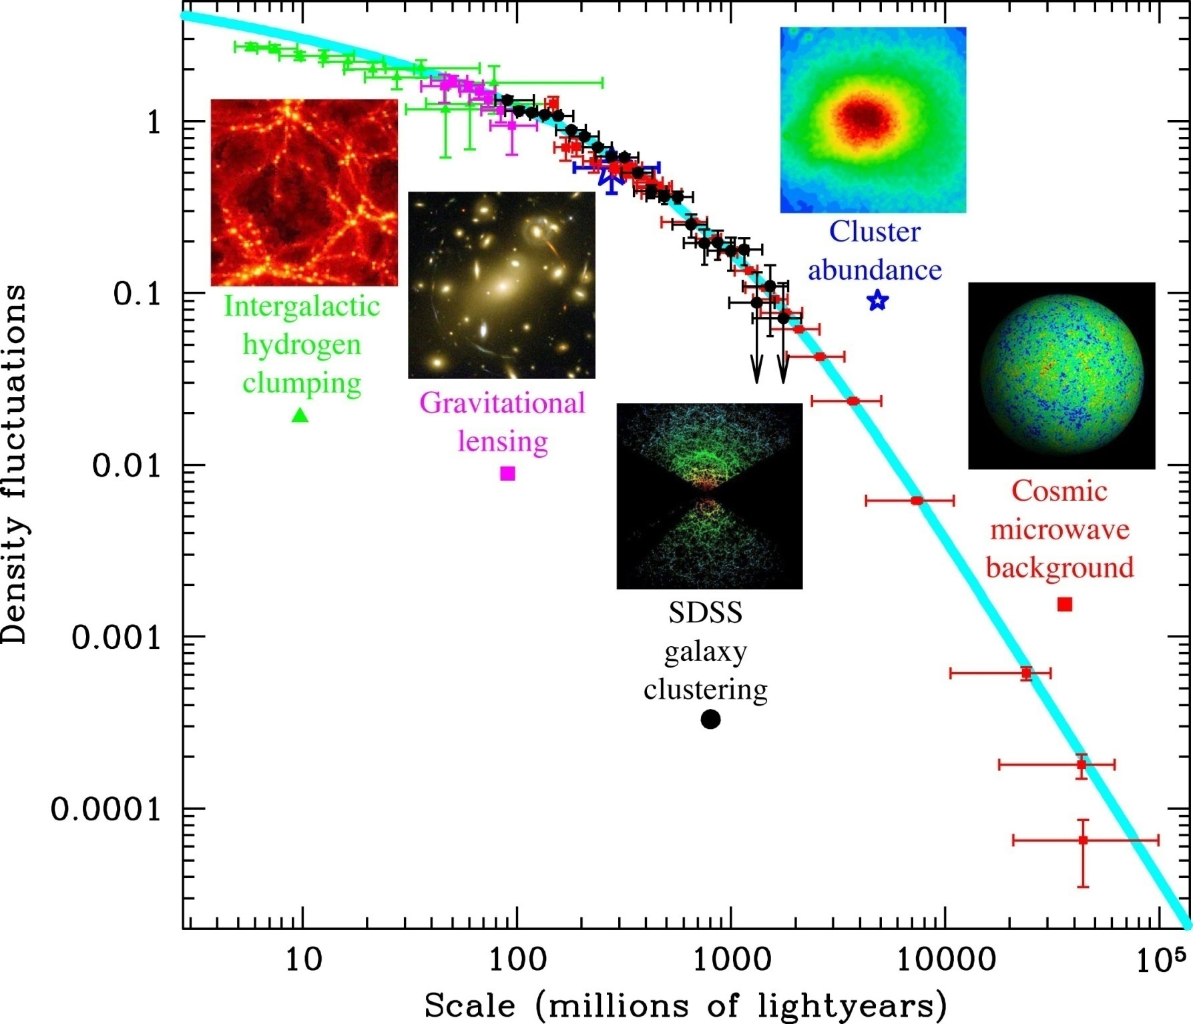

Slide 76
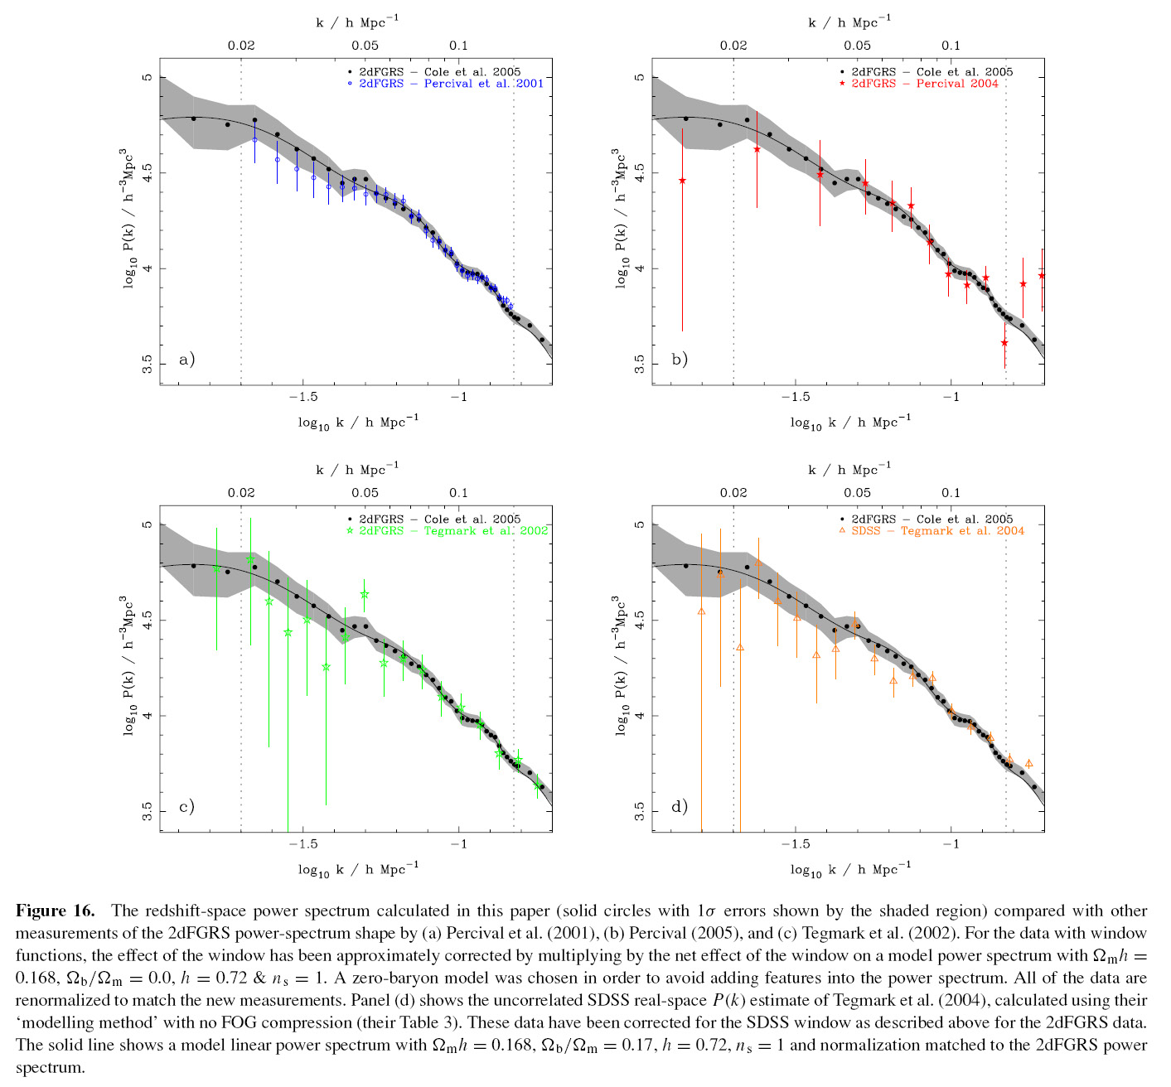

Slide 77
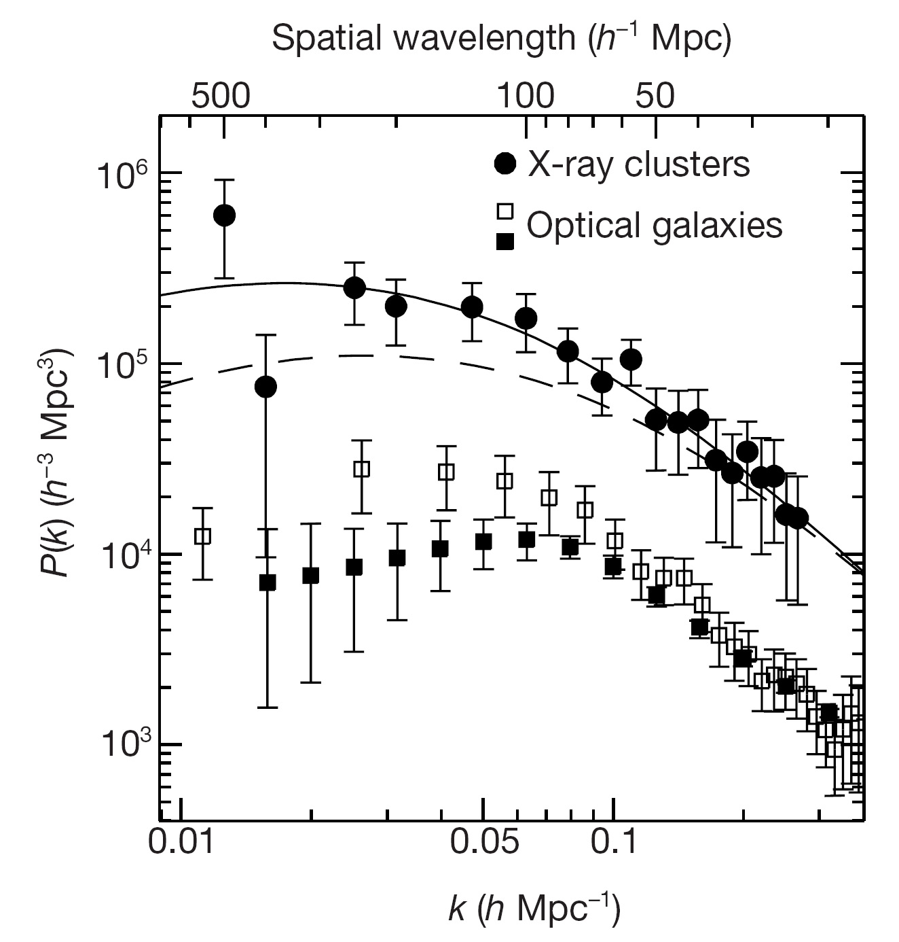

Slide 78
Baryonic Acoustic
Oscillations

Slide 79
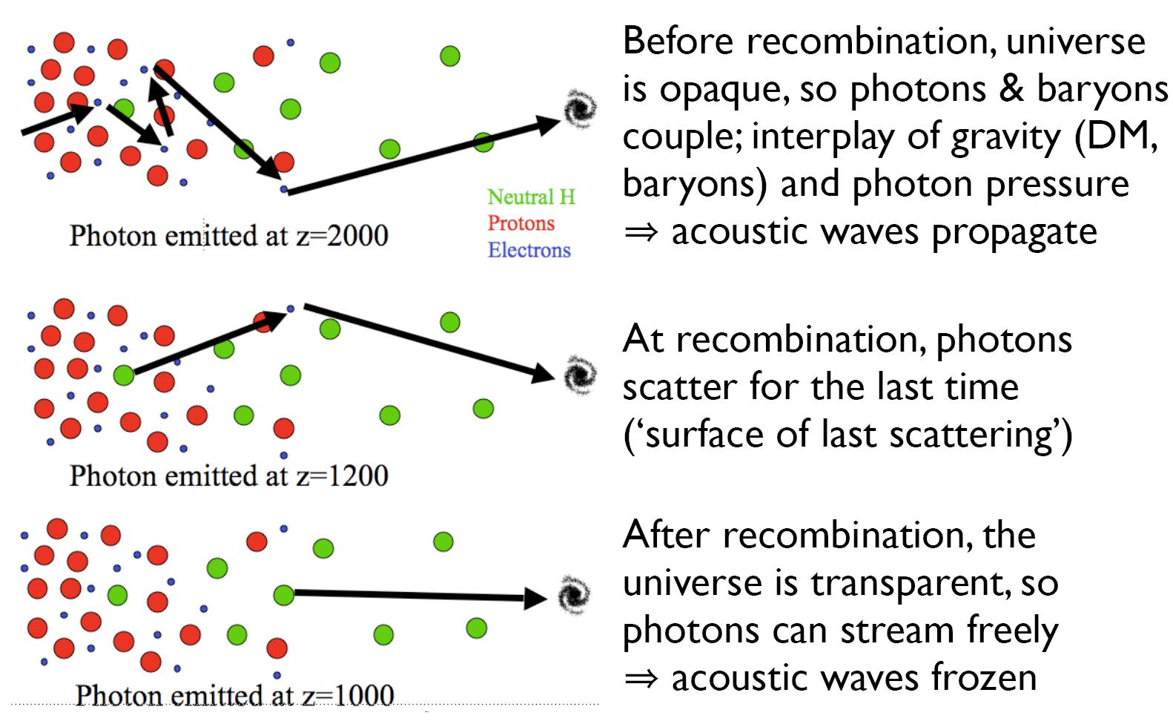
BAO

Slide 80
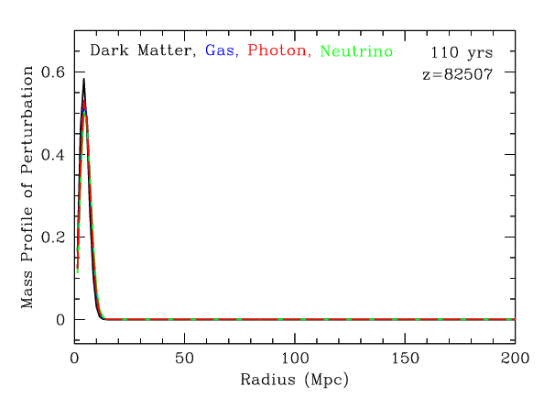
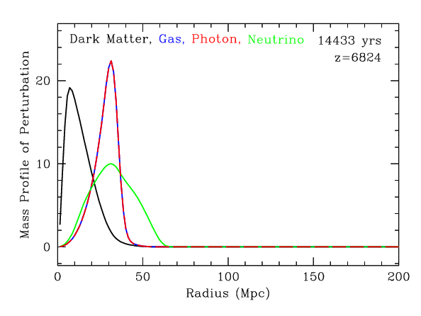
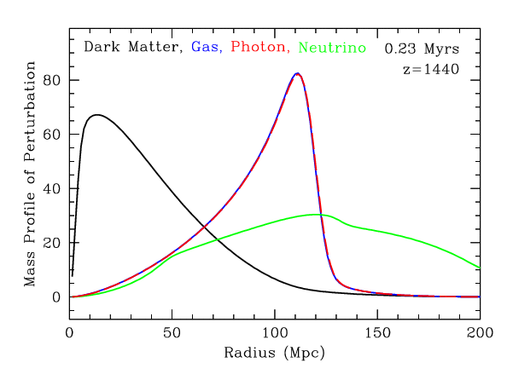
BAO

Slide 81
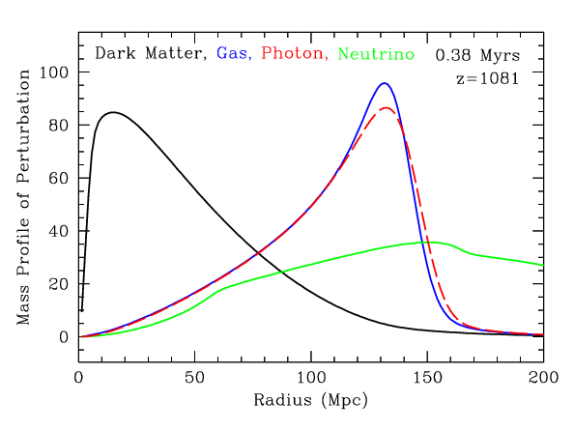
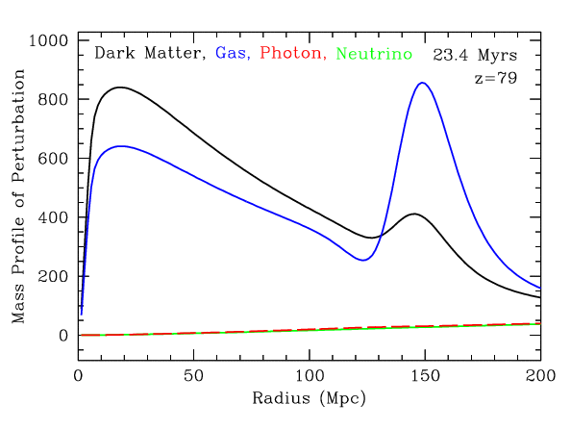
BAO

Slide 82

Measuring BAO

Slide 83


BAO as cosmological tools
Until recombination, the sound wave travels a distance of:
This distance can be accurately determined from the CMB power spectrum, and was found to be 147±2 Mpc.

Slide 84


Cosmic Constraints
LSS Clustering
SDSS DR7 LRG sample
Clustering, Reid et al. 2010

Slide 85
Topological Analysis of the Cosmic Web

Slide 86
Cosmic Structure Analysis
To assess the
key aspects of the
nonlinear cosmic matter and galaxy distribution:
● multiscale character hierarchical structure formation
● weblike network anisotropic collapse
● volume dominance voids asymmetry overdense vs. underdense
Many statistical measures: clustering measures (correlation functions)
density distribution functions
Topological Characteristic of network: genus statistics
Geometric Characteristics: Minkowski functionals

Slide 87



Slide 88


Why is the topology study useful?
1. Direct intuitive meanings
- characterize the LSS as a quantitative measure with a physical interpretation attached
2. Easy to measure
- global genus topology from integration of local curvature:
According to the Gauss-Bonnet theorem the integrated Gaussian curvature of a surface is related with its topological genus by

Slide 89




Intrinsic topology
does not change by trivial change in the shape of structure
or by trivial coordinate transformation, which result in monotonic
expansion/contraction, distortion, rotation ...

Slide 90



II. Introductory theory of topology statistics
Measures of intrinsic topology - Minkowski Functionals
3D
1. 3d genus (Euler characteristic) 2. mean curvature 3. contour surface area 4. volume fraction
3d galaxy redshift survey data, 3d HI map
2D
1. 2d genus (Euler characteristic) 2. contour length 3. area fraction
CMB temp./polarization, 2d galaxy surveys
1D
1. level crossings 2. length fraction
Lyα clouds, deep HI surveys, pencil beam galaxy surveys
II. Introductory theory of topology statistics
1. Measures of intrinsic topology
2. Definitions of MFs
3. Gaussian formulae

Slide 91


Topological definition of the genus, G=-V₃
Genus = # of holes in iso-density contour surfaces - # of isolated regions
[ex. G(sphere)=-1, G(torus)=0, G(two tori)=+1 ]
The topological genus is related with the integrated Gaussian curvature of a surface by (Gauss-Bonnet theorem )
: 2 holes – 1 body = +1

Slide 92
Gauss – Bonnet Theorem
For a surface with c components, the genus G specifies  handles on
surface, and is related to the Euler characteristic () via:
where, according to the Gauss-Bonnet theorem, the Euler-Poincare
characteristic is given by the surface integral over the Gaussian curvature

Slide 93

The usefulness of Euler
The mean value of χ can be calculated analytically for Gaussian random fields (test of GRF hypothesis?)
In 3D the mean level is characterised by g>0 (a sponge)
In 2D the mean level has χ=0.
There is no 2D equivalent of a sponge!

Slide 94
Topology of the
Primordial Gaussian Field

Slide 95

Edge of the Visible Universe
Earliest View
of our Cosmos:
the Universe
379,000 years
after the Big Bang
Perfect
Gaussian Field
Origin: Inflation,
t =10⁻³⁶ sec
WMAP
CMB
temperature map
Cosmic Microwave Background

Slide 96

Primordial Gaussian Field

Slide 97


Slide 98

Gaussian Random Fields:
Genus
Genus Gaussian Field, the “cosmological” way :

Slide 99
Topology of non-Gaussian Fields

Slide 100

Analytic formulae for the genus in weakly nonlinear regime due to gravitational evolution are known too (Matsubara 1994). So the non-Gaussianity due to non-linear gravitational evolution can be separated, and the primordial topology can be better explored.
G=-V₃

Slide 101


Moore et al. (1992): The topology of the QDOT IRAS redshift survey
The amplitude of the genus curves on large (21Mpc/h) scales is inconsistent with the predictions of a constant-bias SCDM model, and the shape of the best-fit PS from genus analysis is n=-1
* IRAS QDOT: 2163 redshifts out to $z=0.07$, randomly sampled at a rate of 1/6
from IRAS PSC (f_60μm > 0.6Jy), |b|>10

Slide 102

Vogeley et al. (94): Topology Analysis of the CfA Redshift Survey
Genus on R_{G} = 4.2 ~ 14 Mpc/h. Statistics derived from the genus curve
Amplitude drop relative to the fields with the same PS due to phase correlation on scales <10Mpc/h → amplitude of the genus curve is not a good measure of n.
The amplitude of the genus curves on large scales is inconsistent with the predictions of a constant bias SCDM, but consistent with a LCDM with Ωh=0.24 and Ω_{Λ}=0.6 and an OCDM with Ω h=0.2.
* CfA2: ~12000 galaxies with m_B < 15.5$.

Slide 103


Slide 104




Genus Non-Gaussian Fields
Clusters Bubbles
(Weinberg, Gott & Melott 1987)

Slide 105
Minkowski Functionals

Slide 106
Minkowski Functionals
Complete quantitative characterization of local geometry and
morphology of isodensity surfaces in terms of
Minkowski Functionals
Minkowski Functionals (defined by isodensity surface):
- Volume
- Surface area
- Integrated mean curvature
- Integrated Intrinsic curvature
Euler Characteristic

Slide 107



Minkowski Functionals:
Non-Gaussianity Measure
Theoretical predictions for Gaussian fields are known.
(Schmalzing & Buchert 1997)

Slide 108

Minkowski functionals
In R³ four functionals:
volume V
surface area A
integral mean curvature H
Euler-Poincare characteristic 
These are the Minkowski Functionals
Kerscher & Martínez (1998),
Bull. Int. Statist. Inst. 57-2, 363

Slide 109
Homology Analysis of the Cosmic Web

Slide 110
Cosmic Structure Topology
Complete quantitative characterization of homology in terms of
Betti Numbers
Betti number _{k}: - rank of homology groups Hp of manifold
- number of k-dimensional holes of an
object or shape
3-D object, e.g. density superlevel set:
₀: -  independent components
₁: -  independent tunnels
₂: -  independent enclosed voids

Slide 111
Geometry & Topology
Complete quantitative characterization of homology in terms of
Betti Numbers
Complete quantitative characterization of local geometry in terms of
Minkowski Functionals
Minkowski Functionals:
- Volume
- Surface area
- Integrated mean curvature
- Genus/Euler Characteristic

Slide 112
Genus, Euler & Betti
 Euler – Poincare formula
Relationship between Betti Numbers & Euler Characteristic :

Slide 113
Genus, Euler & Betti
 Euler – Poincare formula
Relationship between Betti Numbers & Euler Characteristic .
3-D manifold :
2-D boundary manifold :

Slide 114
Genus, Euler & Betti
For a surface with c components, the genus G specifies  handles on
surface, and is related to the Euler characteristic () via:
where, according to the Gauss-Bonnet theorem
 Euler characteristic 3-D manifold  & 2-D boundary manifold :

Slide 115

Gaussian Random Fields:
Betti Numbers
In a Gaussian field:
# tunnels dominant at intermediate density levels, when superlevel domain spongelike
overlap between ₀ and ₂ at =0, domain punctured by clumps with cavities
# clumps/islands reaches maximum at , # cavities/voids at

Slide 116


Gaussian Random Fields:
Betti Numbers
Distinct sensitivity of Betti curves on
power spectrum P(k):
unlike genus (only amplitude P(k) sensitive)

Slide 117

Gaussian Random Fields:
Correlation Betti Numbers

Slide 118


Gaussian Random Fields:
Betti Numbers

Slide 119
Homology of the Cosmic Web

Slide 120

Homology of evolving LCDM cosmology
₀
₁
₂

Slide 121

Betti₂: evolving void populations

Slide 122

LCDM vs. SUGRA

Slide 123

Homology sensitivity LCDM vs. Quintessence
₀
₁
₂

Slide 124
Persistence

Slide 125

Persistence: search for topological reality
Concept introduced by Edelsbrunner:
Reality of features (eg. voids) determined on the basis of -interval between
“birth” and “death” of features

Slide 126

Persistent Homology
Persistent Homology describes the homological features which persist
as a single parameter changes

Slide 127

Persistent LCDM Cosmic Web
Death

Birth 

Slide 128
Minimal Spanning Tree

Slide 129


Slide 130
Morse Theory

Slide 131

Density Field Flow Lines

Slide 132

Density Field Flow Lines
Density Field:
Flow Lines

Slide 133
Density Field Flow Lines
Critical Points:
- Maxima
- Minima
- Saddle Points (of various signature)

Slide 134


Density Field
Critical Points:
Ridges:
Connections
Saddle-Maxima

Slide 135

Integral Lines & Field Ridges:
Singularities

Slide 136



Slide 138

Cluster Node
Void Basins
Filamentary Ridge

Slide 139
Maximum
Minimum
Saddle
Filamentary Ridge

