Slide 1
Lecture course LSS2014 University Groningen Nov. 2014-Jan. 2015
Gaussian
Random Fields

Slide 2
Power Spectrum

Slide 3
Power Spectrum P(k)

Slide 4
CDM Power Spectrum P(k)

Slide 5
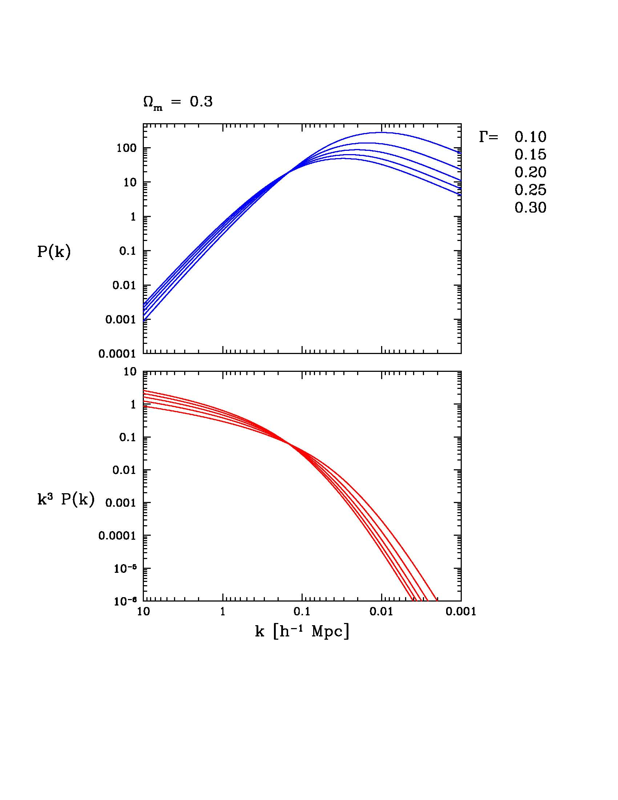
Power Spectrum P(k)

Slide 6
Power Spectrum - Correlation Function
Isotropy:
Delta-power

Slide 7
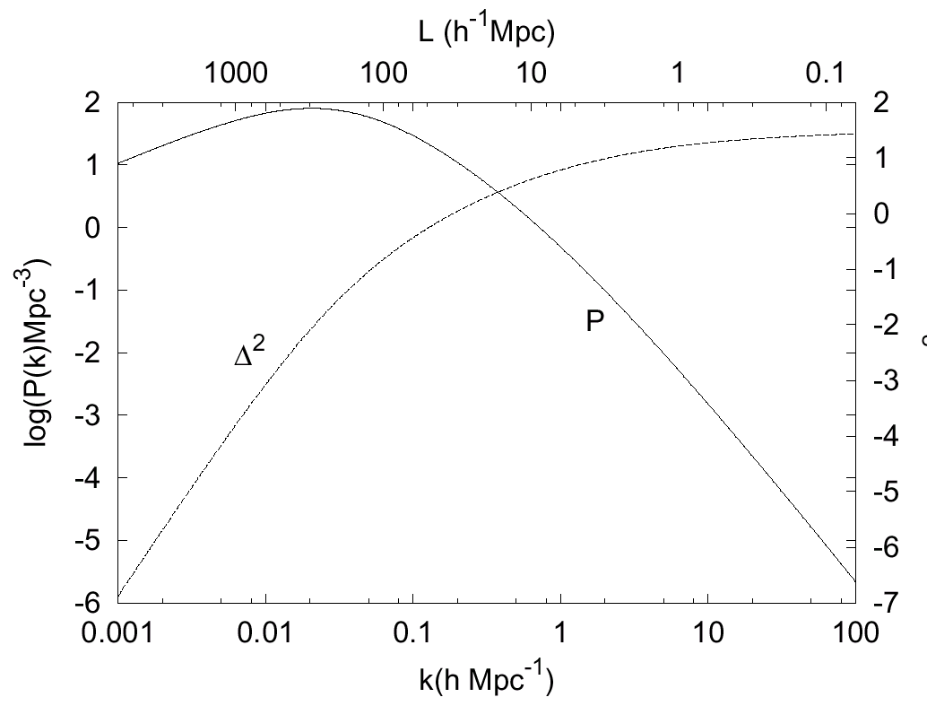

Slide 8
Field Realizations

Slide 13
Power Spectrum Phases & Pattern Information

Slide 14
Random Field Phases
When a field is a Random Gaussian Field, its phases (k) are uniformly
distributed over the interval [0,2]:
As a result of nonlinear gravitational evolution, we see the phases acquire a
distinct non-uniform distribution.

Slide 16
Power Spectrum: Pattern Information & Phases

Slide 17
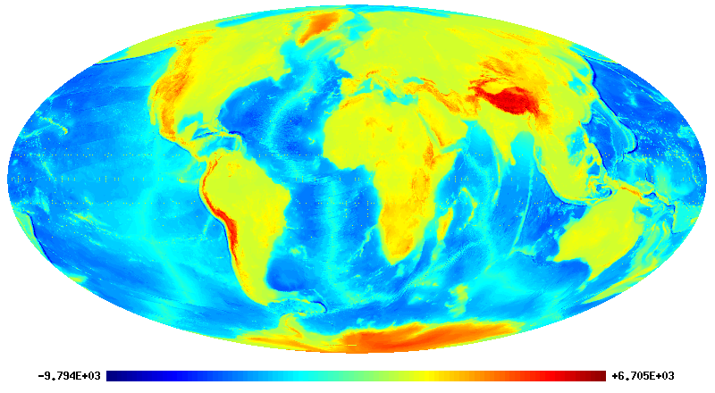

Slide 18
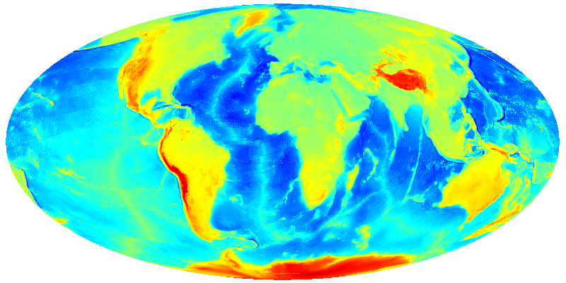

Slide 19
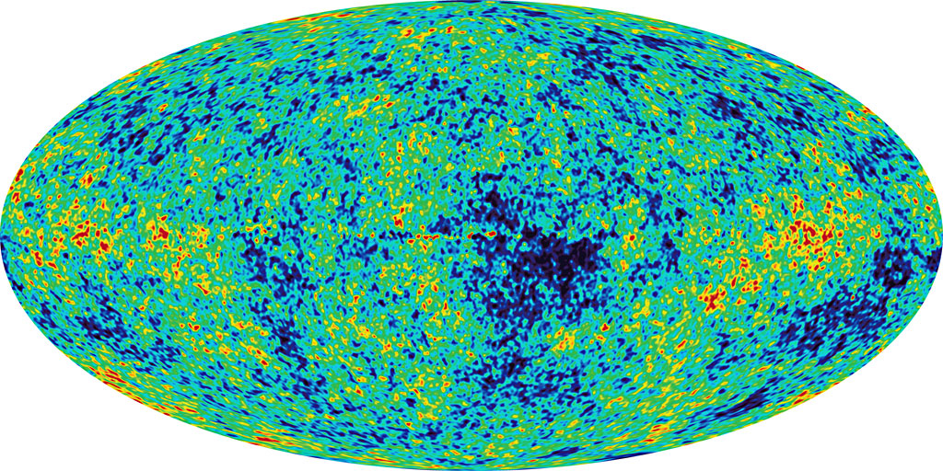

Slide 20
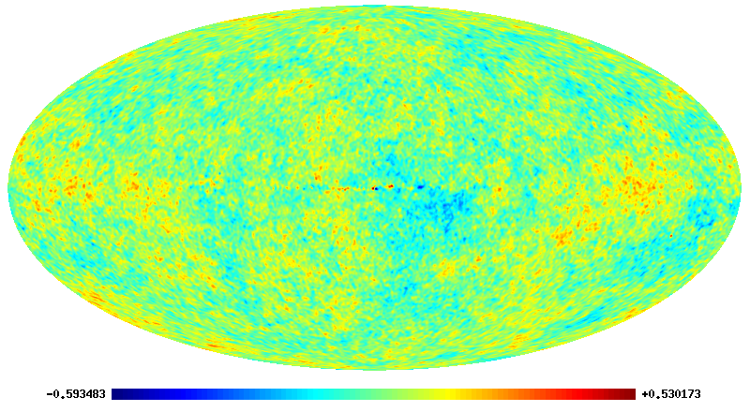

Slide 21
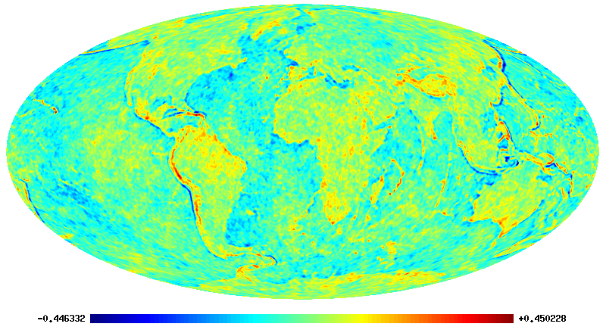

Slide 22
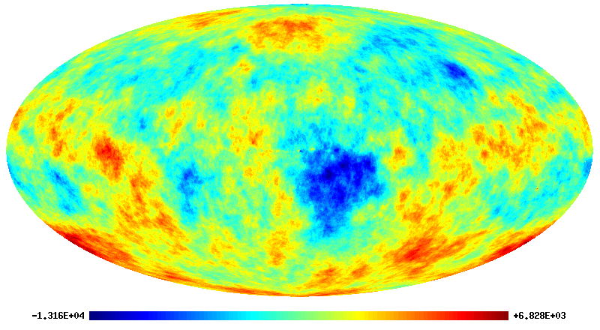

Slide 23
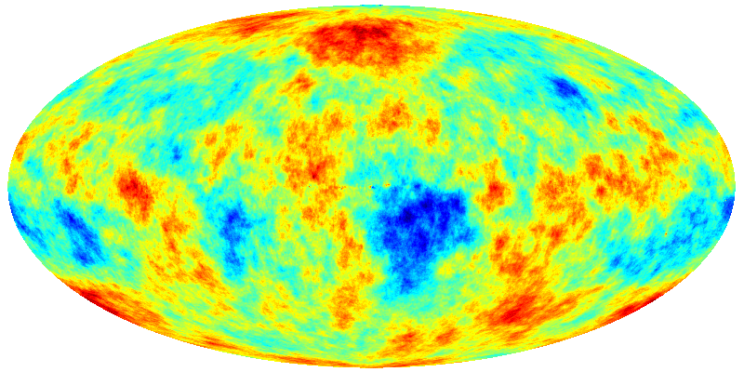

Slide 24
Power Spectrum Measurement

Slide 26
CDM Power Spectrum P(k)

Slide 30
Ergodic Theorem

Slide 31
Statistical Cosmological Principle
Cosmological Principle:
Universe is Isotropic and Homogeneous
Homogeneous & Isotropic Random Field :
Homogenous
Isotropic
Within Universe one particular realization :
Observations: only spatial distribution in that one particular
Theory:

Slide 32
Ergodic Theorem
Spatial Averages
Ensemble Averages over one realization
of random field
Basis for statistical analysis cosmological large scale structure
In statistical mechanics Ergodic Hypothesis usually refers to time evolution
of system, in cosmological applications to spatial distribution at one fixed time

Slide 33
Ergodic Theorem
Validity Ergodic Theorem:
Proven for Gaussian random fields with continuous power spectrum
Requirement:
spatial correlations decay sufficiently rapidly with separation
such that
many statistically independent volumes in one realization
All information present in complete distribution function available from single sample over all space

Slide 34
Fair Sample Hypothesis
Statistical Cosmological Principle
+
Weak cosmological principle
(small fluctuations initially and today over Hubble scale)
+
Ergodic Hypothesis
fair sample hypothesis
(Peebles 1980)

