Slide 1
the Zel’dovich Formalism

Slide 2
Yakov Borisovich Zel’dovich

Slide 3
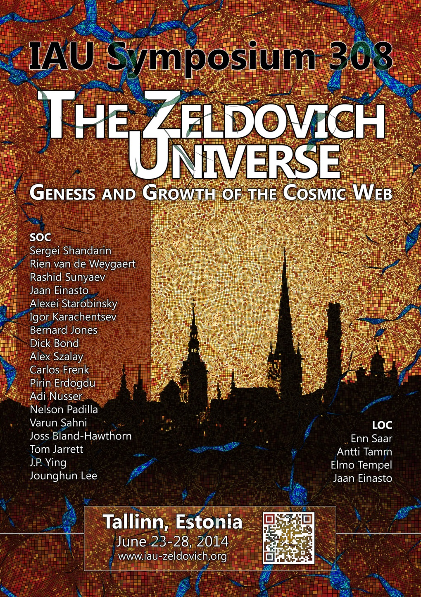

Slide 4
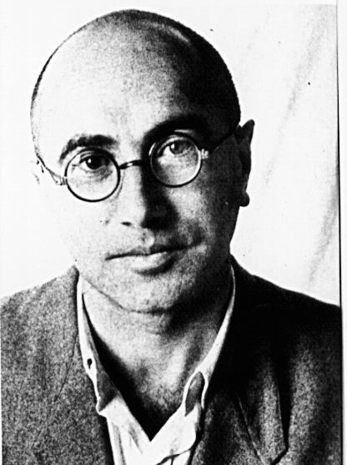
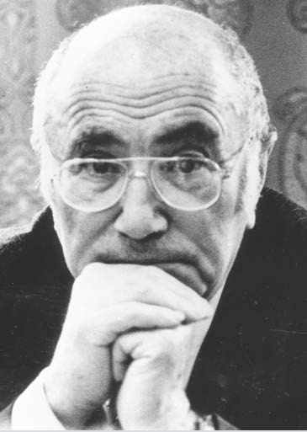
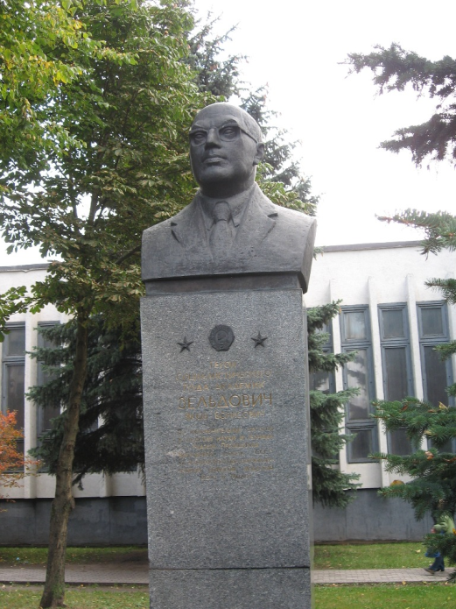
Yakov Borisovich Zel’dovich
Minsk, 1914- Moscow, 1987
stamp Zeldovich,
Russia 2014
monument Zeldovich,
Minsk, Belorussia

Slide 5
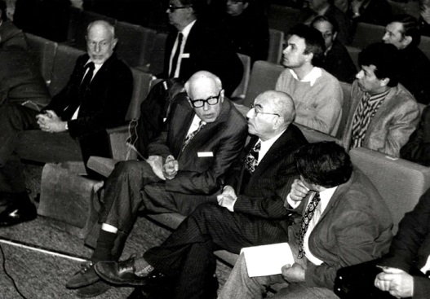
Zel’dovich & pope John Paul II
Zel’dovich & Andrei Sacharov

Slide 6
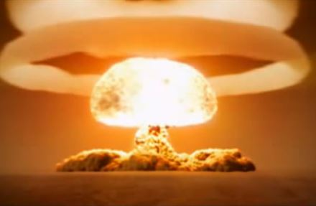
Zeldovich & Raizer
standard book on shock waves ...

Slide 7
Yakov Borisovich Zel’dovich

Slide 8
Zel’dovich Approximation

Slide 9
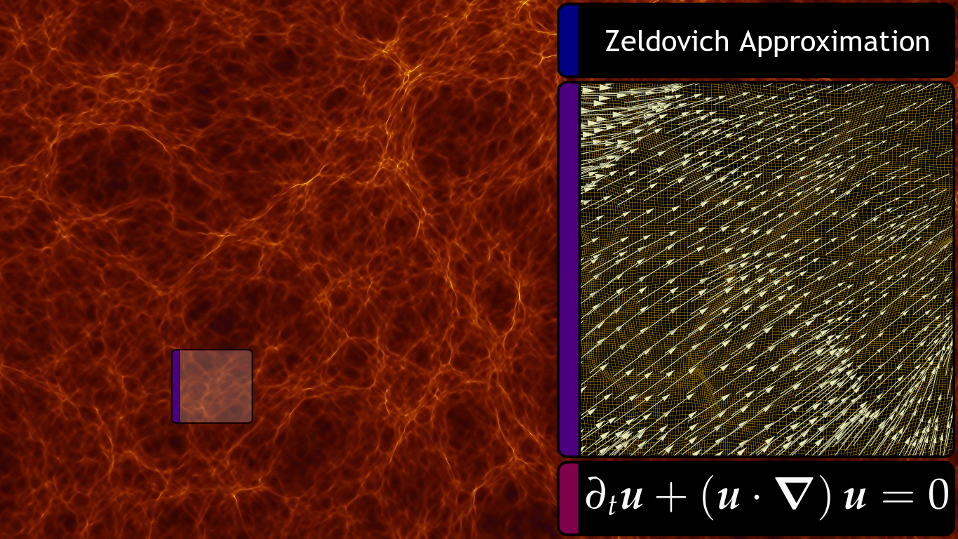
Zel’dovich Approximation

Slide 10
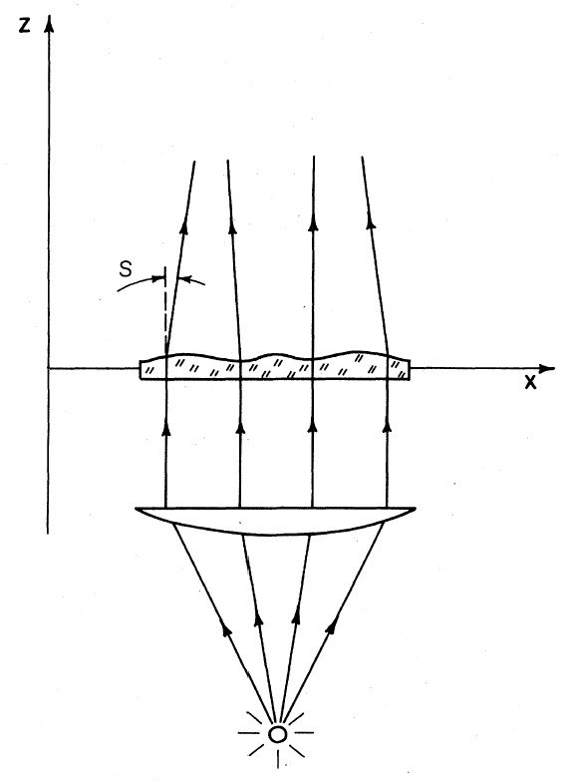
Zel’dovich Formalism: Streaming & Caustics
Illustration of the formation of caustics due to streaming paths of light through deforming medium

Slide 12
Zel’dovich Approximation
structure of the cosmic web determined by the
spatial field of eigenvalues

Slide 13
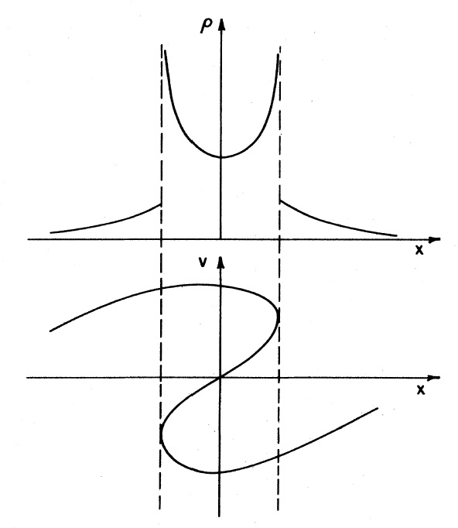
Zel’dovich Formalism: Density Evolution
Density Profile through pancake, at moment of formation and shortly thereafter (multistream)

Slide 14
Singularities & Catastrophes
Zeldovich
deformation eigenvalue
landscape
Hidding, Shandarin & vdW 2014

Slide 16
Zel’dovich Formalism
Illustration:
Caustic formation of weblike matter distribution according to the Zel’dovich formalism.
From: Buchert 1989

Slide 17
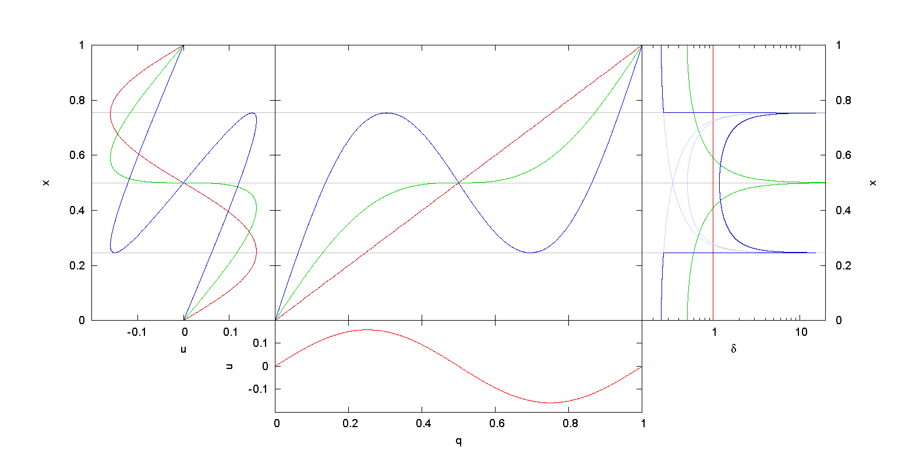

Slide 18
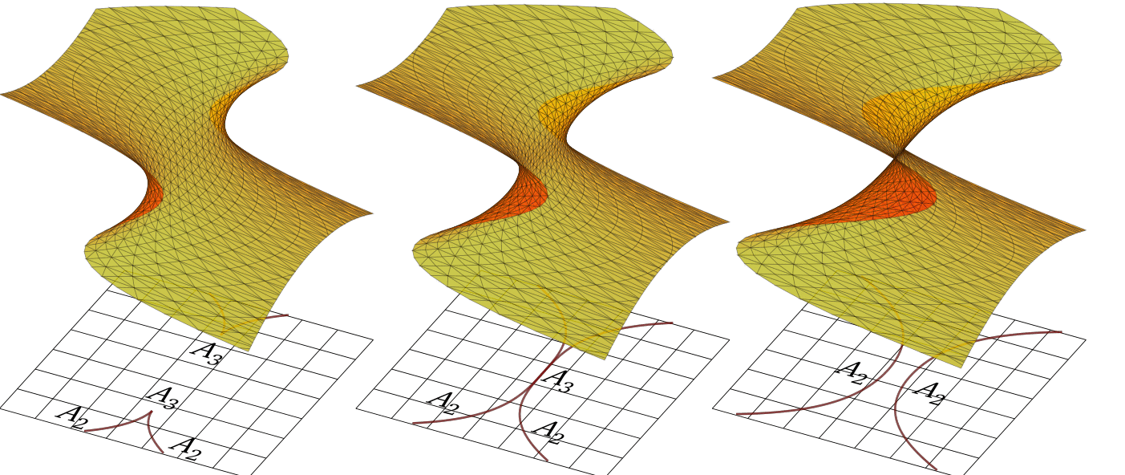

Slide 19
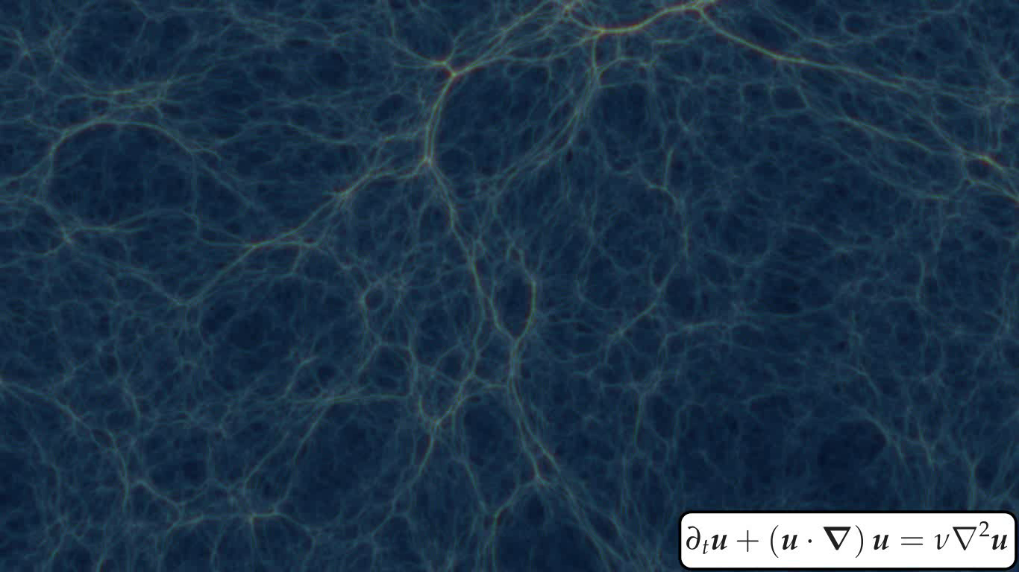
Adhesion Approximation
Burger’’s Equation

Slide 20
Adhesion Approximation
Gurbatov, Saichev & Shandarin 1987
Hidding 2012

Slide 21
Velocity & Gravity Potential

Slide 22
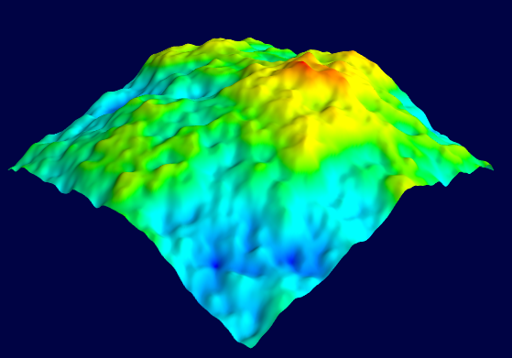
Burger’s Equation: Hopf Solution
Hidding 2012/2014

Slide 23
Burger’s Equation: Hopf Solution

Slide 24
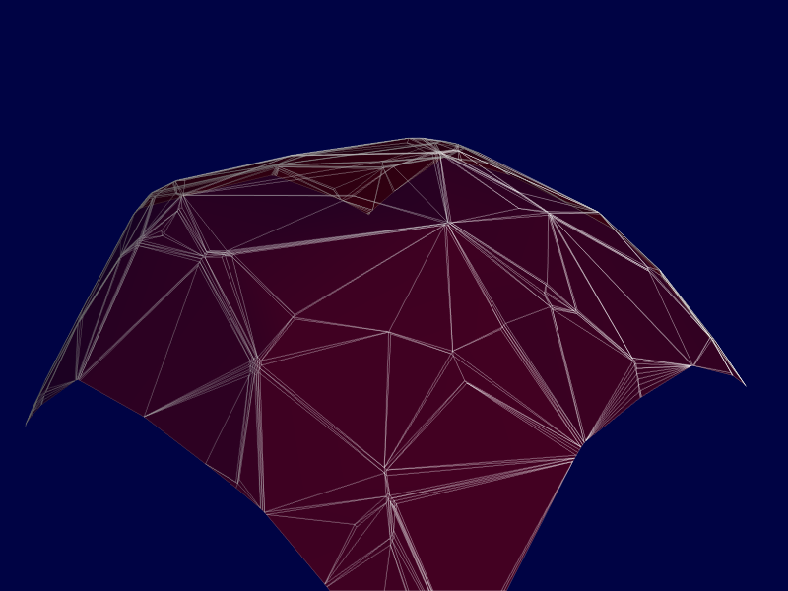
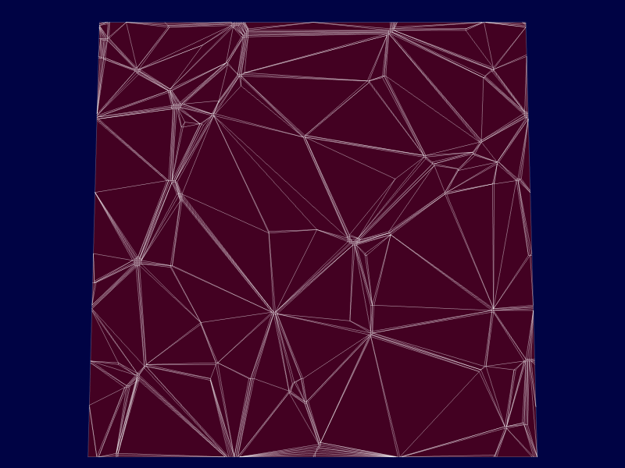
Hidding 2012/2014
Convex Hull
quadratically lifted potential field
Delaunay tessellation
generated by maxima potential field

Slide 25
s
Eulerian – Lagrangian
Voronoi - Delaunay

Slide 26
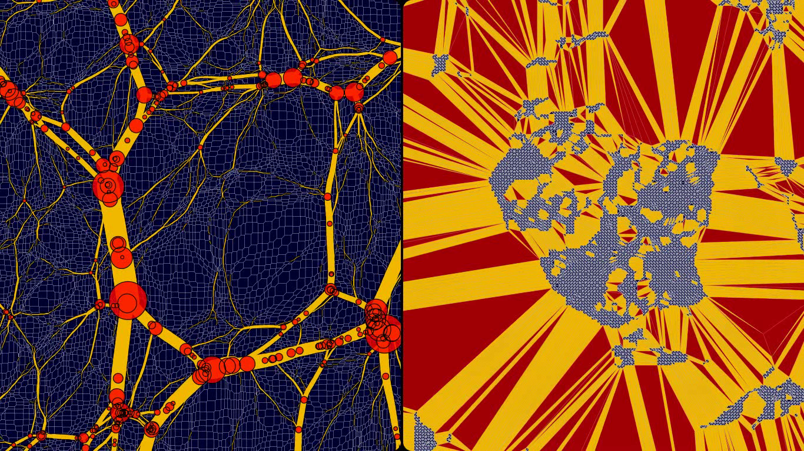
Eulerian – Lagrangian
Voronoi - Delaunay

Slide 27
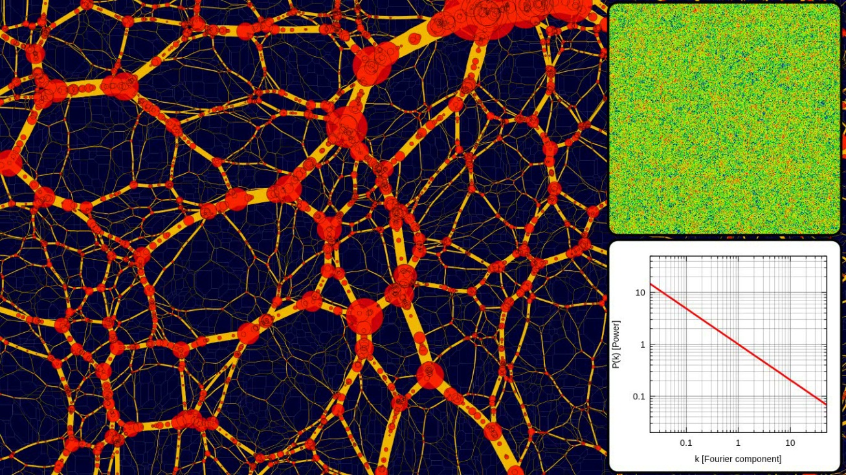
Cosmological Sensitivity
the morphology of the weblike network is
highly sensitive to the underlying cosmology
P(k)k^{-1.5}
Hidding 2012/2014
P(k)k^{-2.0}

Slide 28
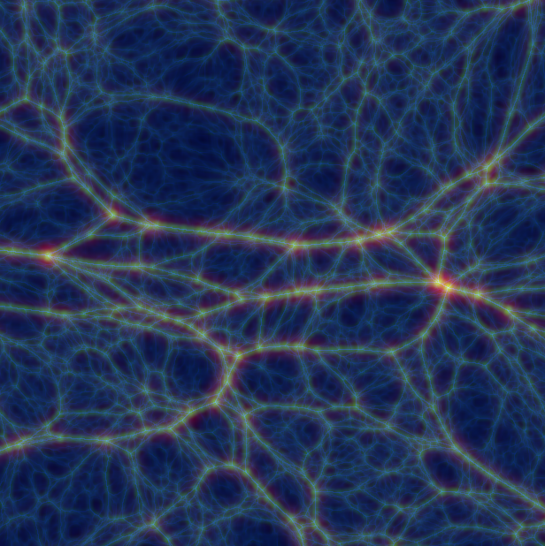
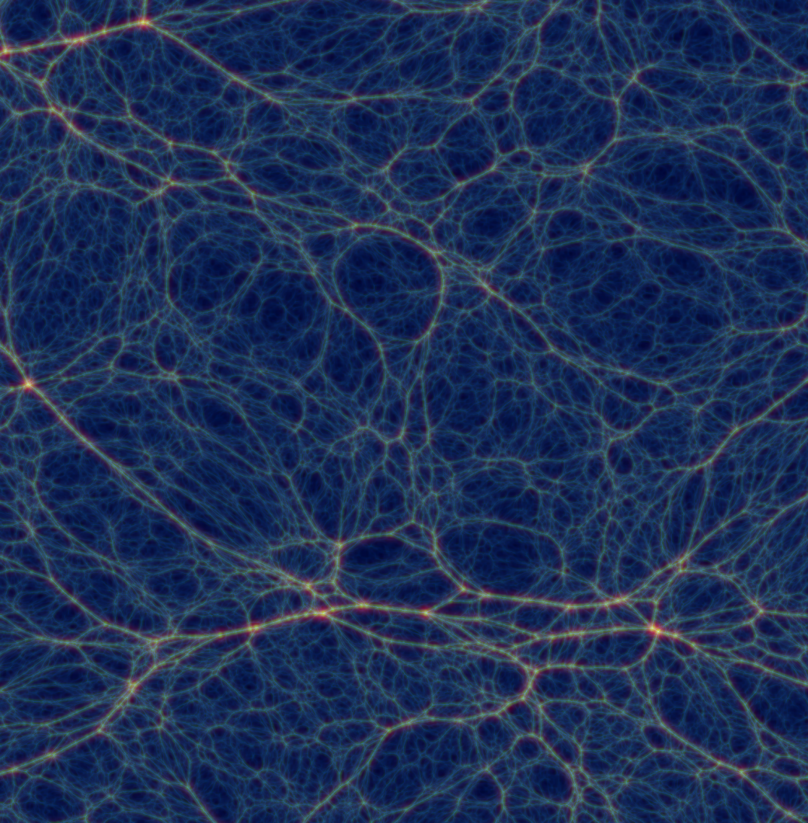
Hierarchical Clustering:
P(k)  k^{-1.5}

Slide 29
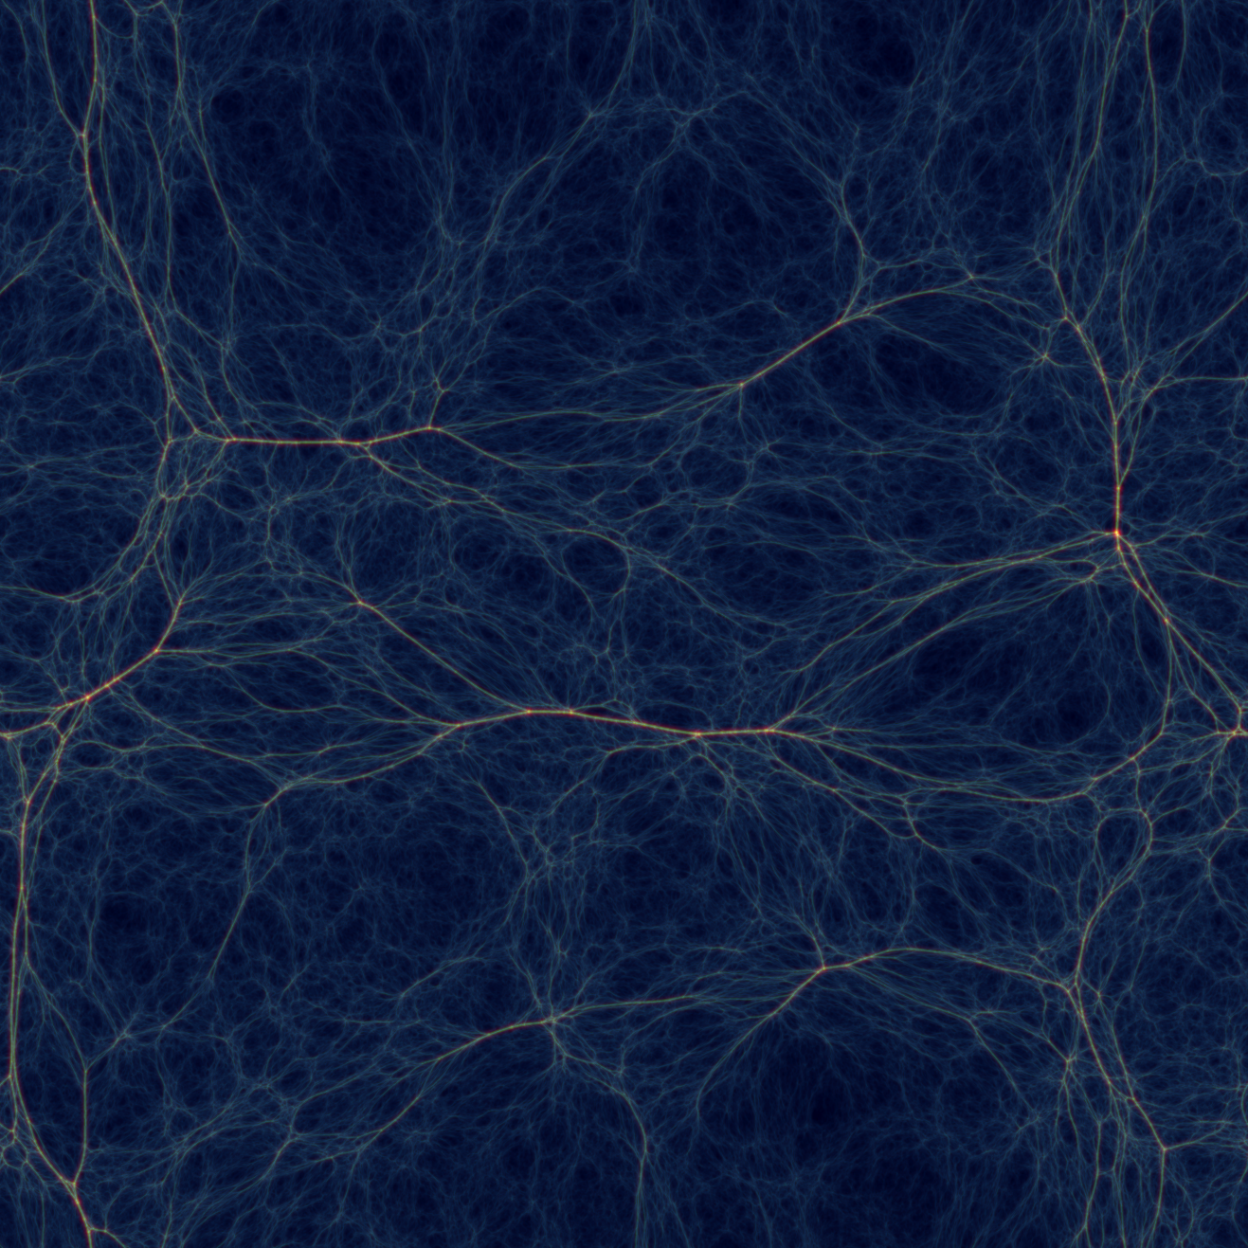
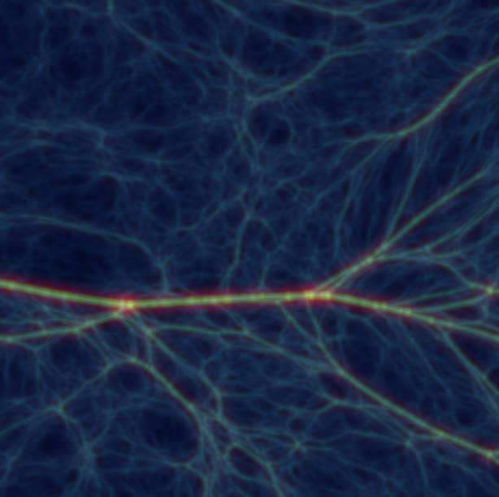
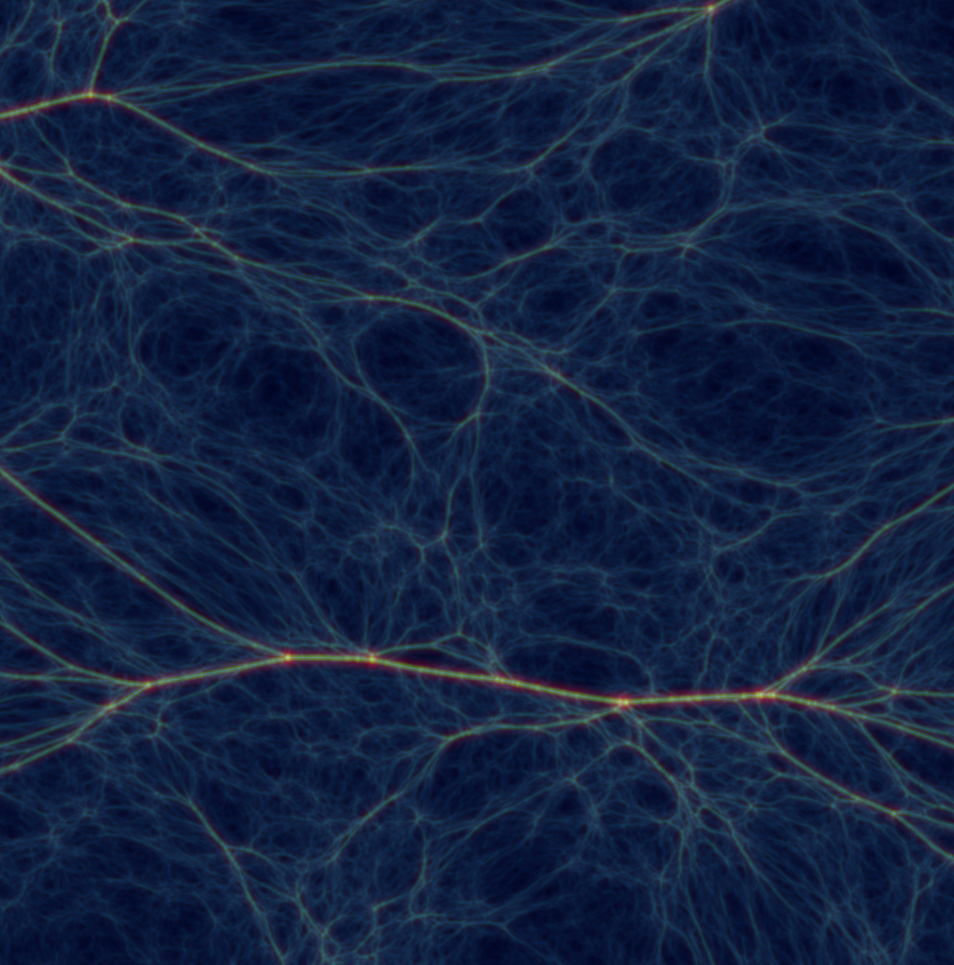
Hierarchical Clustering:
P(k)  k^{-2.0}

Slide 30
the Spherical Model

Slide 31
Spherical Model
The spherical model (Gunn & Gott 1972) describes the evolution of a
spherical mass distribution. It forms THE reference point for all further
evaluations of structure formation.
● Because of Birkhoff’s theorem we may see the evolution of each
individual mass shell as due only to the integrated mass distribution within
its radius.
● As long as two mass shells are not crossing – e.g. due to the faster infall
of an outer shell into an overdensity -- the motion of a shell – with radius
r -- is simply that of an individual spherical shell attracted by a point mass
M(r), with M(r) the integrated mass within radius r.
● Perhaps not surprisingly, the equations of motion for the mass shells are
the same as that of Friedmann-Robertson-Walker universes for an
equivalent density parameter (r).
● These equations of motion for each mass shell can be solved analytically for any
decently behaving mass profile (i.e. the mass profile should be sufficiently
centrally concentrated to prevent shell crossing).
● The spherical model is equally valid for overdensities as well as for
underdensities.

Slide 32
Spherical Model
Contraction/Expansion of a shell with initial (Lagrangian) radius r_{i} is described by a scale factor R(t,r_{i}), such that the radius r(t,r_{i}) at time t is given by:

Slide 33
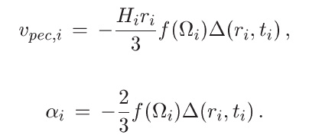
Spherical Model
The motion is fully determined by the average mass density ∆(r,t) within a radius r,
and by the the peculiar velocity v_{pec,i} of the shell. For this we usually take the peculiar velocity predicted by linear theory for the growing mode.
It is convenient to describe the density perturbation with respect to a EdS Universe, in terms of ∆_{i} and the velocity perturbation with respect to the Hubble expansion in terms of parameter α_{i} .

Slide 34
Spherical Model
The solutions for the scale factor of overdense/underdense shells can be written in the same parameterized form, by means of shell angle Θ, as we know from the solutions for FRW universes,
with time dependence specified by

Slide 35
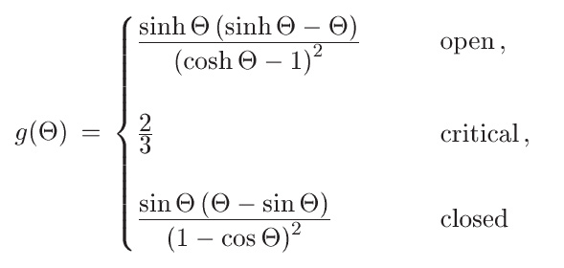
Spherical Model
The corresponding peculiar velocity of the shell
can be inferred from
with

Slide 36
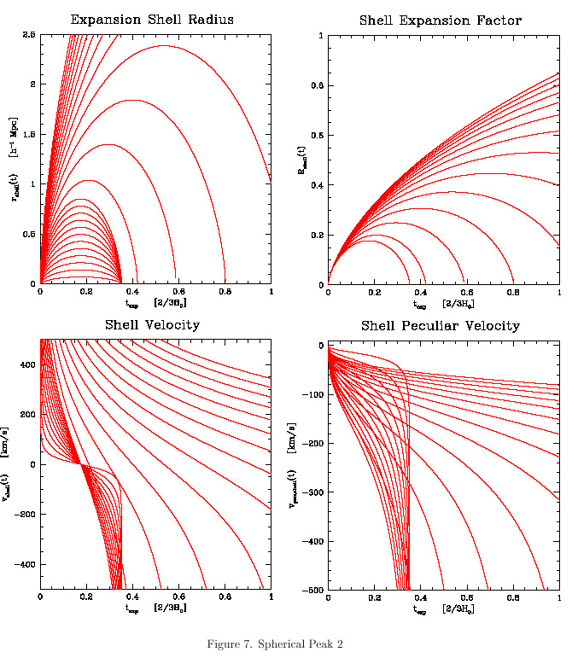
Evolution Spherical Tophat Halo

Slide 37
Evolution Spherical Tophat Halo

Slide 38
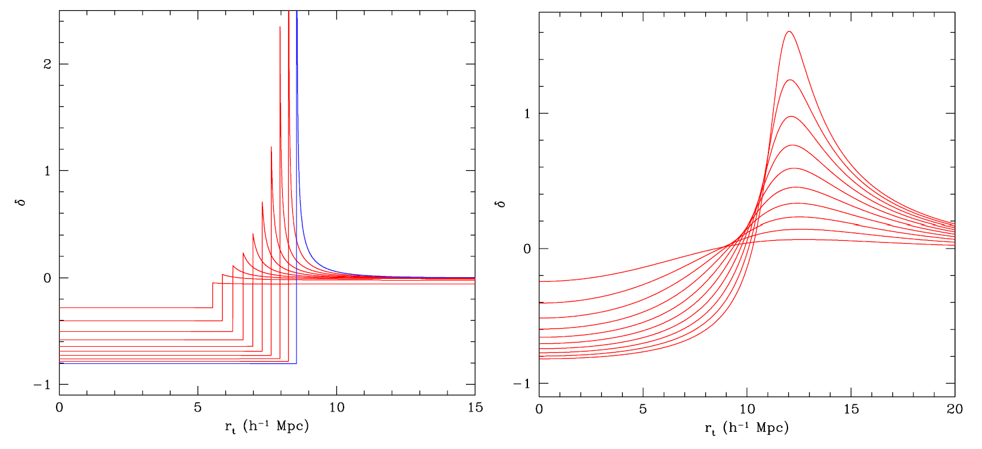
Spherical Void Evolution

Slide 39
Spherical Model
Having determined the evolution of the radius and velocity of each spherical shell of the density perturbation, we may then proceed to derive the corresponding evolution of the density profile of the shell. Here we limit ourselves to the integrated density profile ∆(r,t),
whose solution can be specified in terms of a density function f(θ),

Slide 40
Spherical Model
whose solution can be specified in terms of a density function f(θ),
At maximum expansion of an overdense shell, Θ=π, defining the turnaround radius of the matter concentration, we thus find that the integrated overdensity of the shell is
~ 5.6

Slide 41
Spherical Model
In the “imaginary” situation in which the overdensity would have continued to evolve linearly, it would have reached an overdensity dictated by the linear growth factor D(t) for the corresponding background Universe. For the situation of an Einstein-de Sitter Universe, with
a mass overdensity reaches its turnaround at a linear overdensity
The consequences of this finding are truely wonderful: the cosmologist may resort to the primordial density field, search for the peaks in this Gaussian field, and assuming they are spherical (which they are not at all), and identify the ones that reach turnaround at some redshift z. Even more useful is the equivalent case for final collapse.

Slide 42
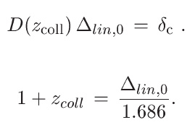
Spherical Model
Collapse, ie. ∆=∞, happens when the density fluctuation would have reached a linear overdensity of
The fact that this is a universal value, valid for any (spherical) density peak, makes it into one of the most crucial numbers in the theory of structure formation. We may thus find the collapse redshifts z_{coll} for any primordial density peak,

Slide 43
the Ellipsoidal Model

Slide 44
Homogeneous Ellipsoids

Slide 45
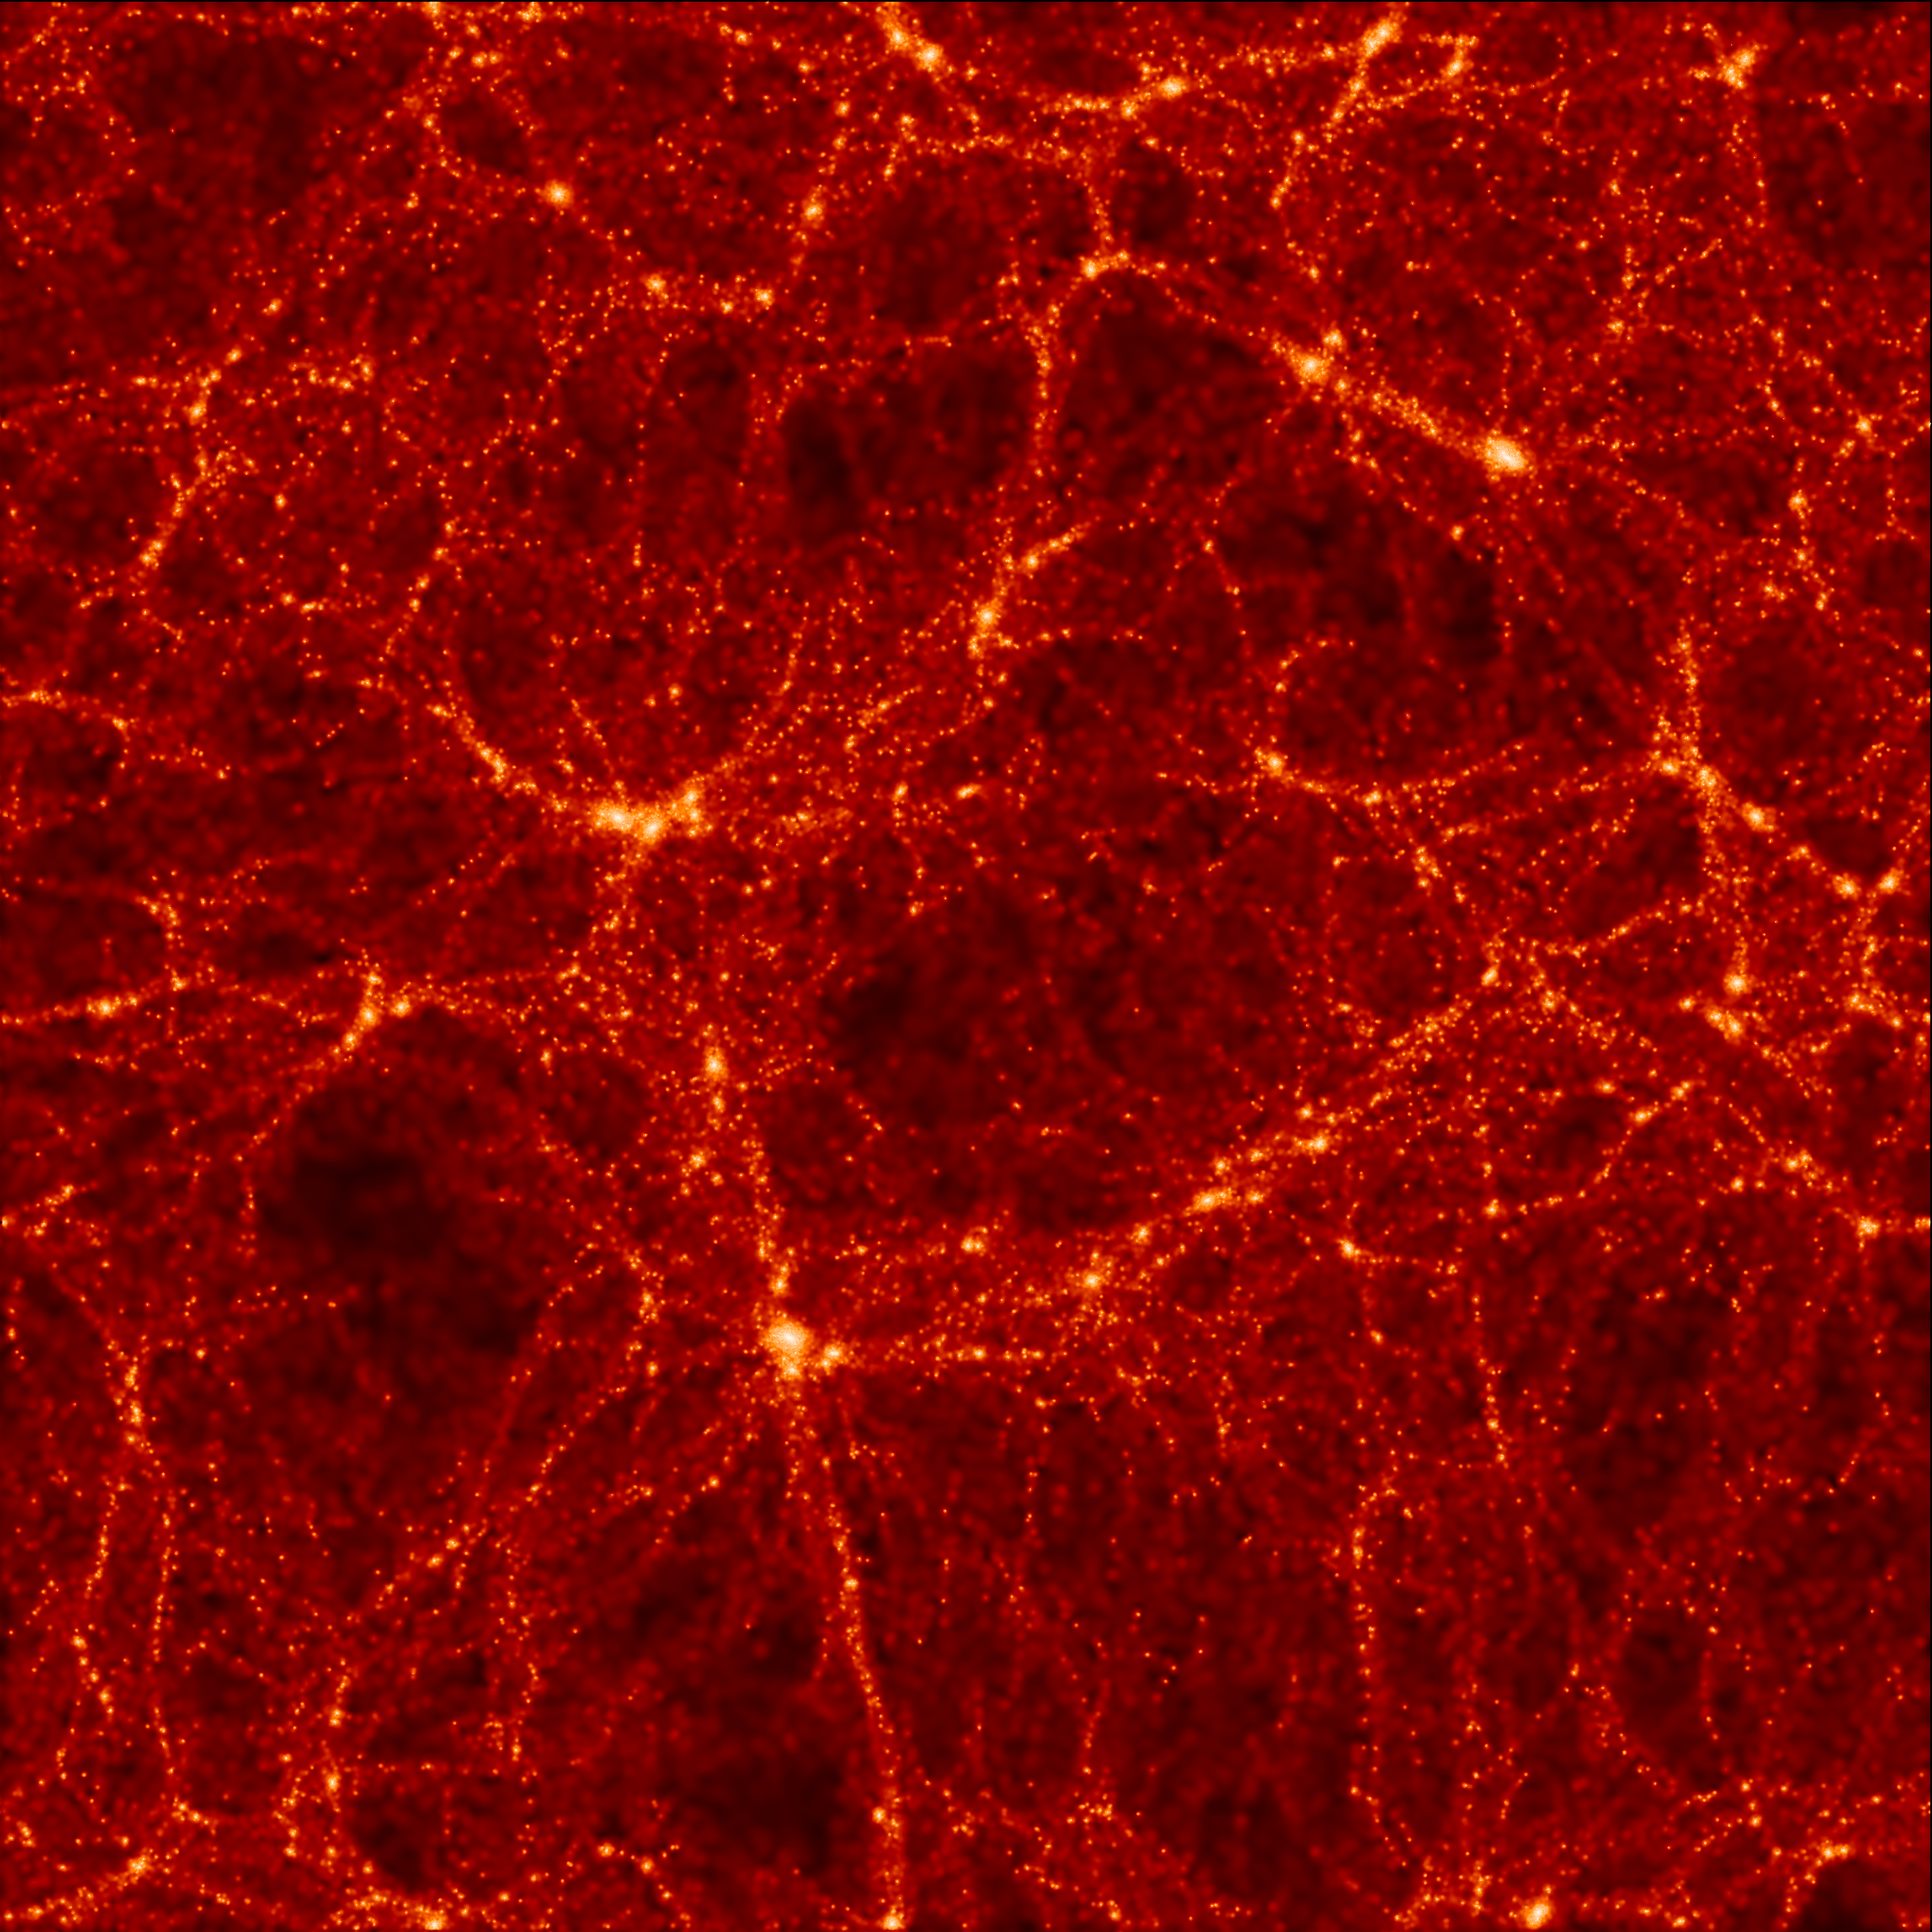
Homogeneous Ellipsoids

Slide 46
Homogeneous Ellipsoids

Slide 47
Homogeneous Ellipsoids

Slide 48
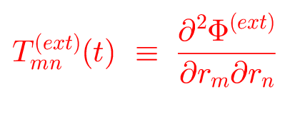
Homogeneous Ellipsoids

Slide 49
Homogeneous Ellipsoids

Slide 50
Homogeneous Ellipsoids

Slide 51
Homogeneous Ellipsoids

Slide 52
Homogeneous Ellipsoids

Slide 53
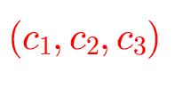
Homogeneous Ellipsoids

Slide 54
Homogeneous Ellipsoids

Slide 55
Homogeneous Ellipsoids

Slide 56
Homogeneous Ellipsoids

Slide 57
Homogeneous Ellipsoids

Slide 58
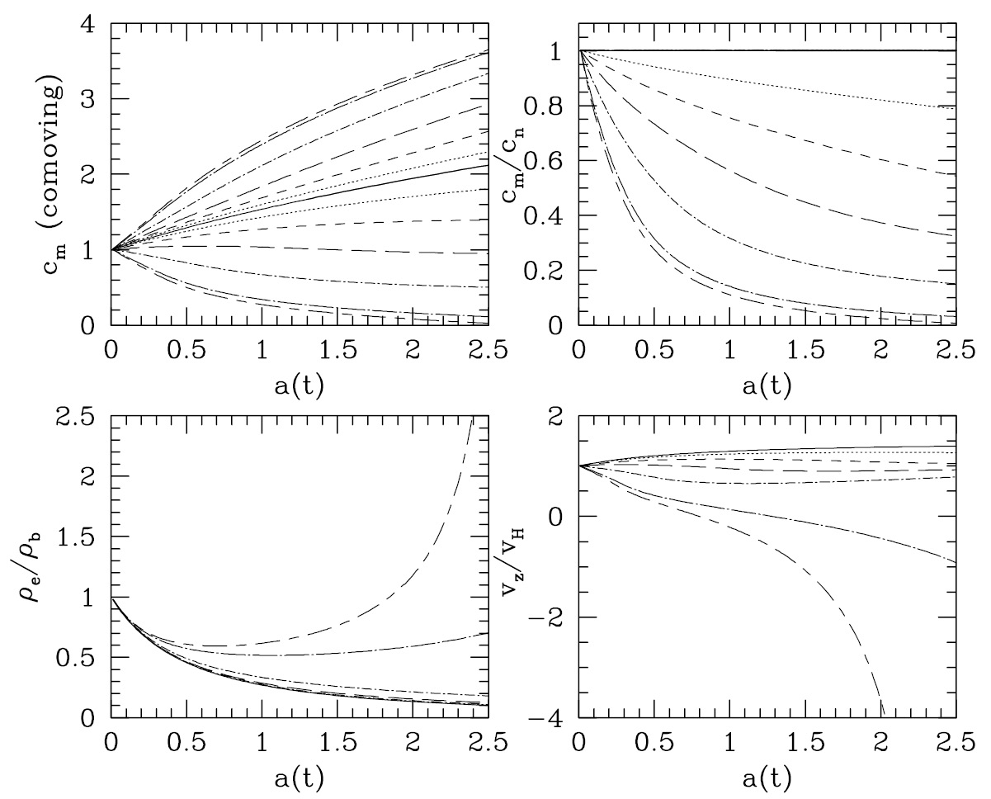
Homogeneous Ellipsoids

