Slide 1
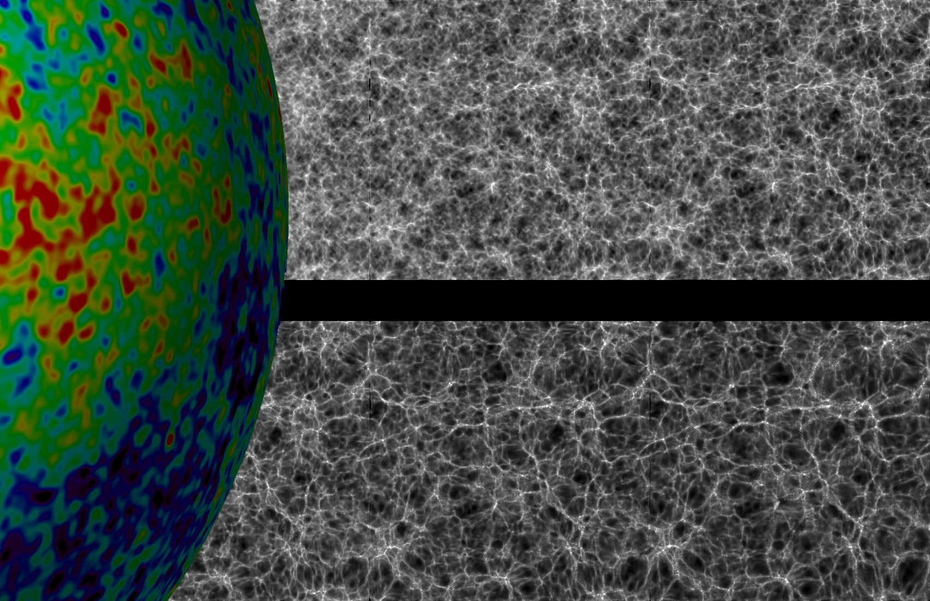
Large Scale Structure
of the Universe
Galaxy Surveys

Slide 2
Galaxy Surveys:
Luminosity
Function

Slide 3
Galaxy Surveys
Galaxies , Groups, Clusters & Superclusters:
Tracers of Structure in the Universe
discrete tracers of underlying density field:
Fair or Biased Tracer ?

Slide 4
Galaxy Surveys
Ideal Sample:
- all sample points have exactly the same properties
over complete “survey volume”
However …
galaxies have different luminosities, sizes, etc.:
- systematic influence on distribution as function of
depth
- do galaxy properties depend on environment ?

Slide 5
Galaxy Surveys
Various selection criteria:
+ magnitude-limited
+ angular diameter – limited
Galaxy distribution as tracer cosmic structure:
+ requirement to understand selection (r,,,,T):
sampling rate of galaxies at
distance r
sky position ,
frequency 
galaxy type T
Most convenient and best controlled:
+ selection on basis luminosity/brightness

Slide 6
Luminosity Function
Large variety of galaxies
- ranging from dwarfs to giant ellipticals
- large range of luminosity/brightness
Luminosity distribution:
number density of galaxies with luminosity
PS. Luminosity distribution may depend on various
galaxy properties, such as morphological type

Slide 7
Schechter Luminosity Function
Very good approximate expression for the
galaxy luminosity distribution:
Schechter Luminosity Function:
Parameterized by 3 parameters:
* : normalization density parameter
L* : characteristic luminosity
 : faint-end slope

Slide 8
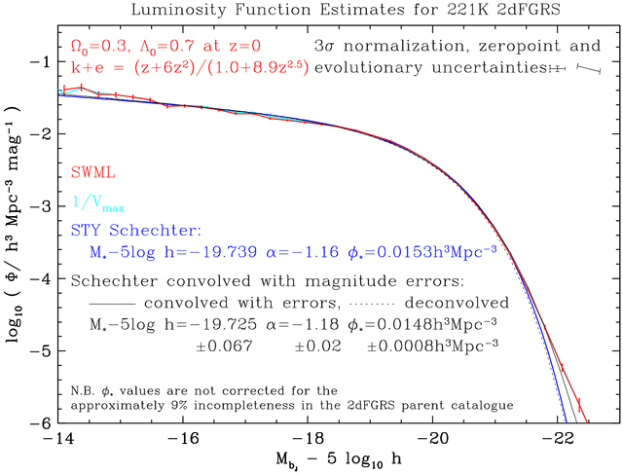
Schechter Function

Slide 9
Schechter Luminosity Function
Mean space density gal’s:
- Gamma function:
- Notice: divergent if <-1
(infinite contribution faint gal’s)
Mean Luminosity (from cosmic volume)
- divergent only if <-2

Slide 10
Schechter Luminosity Function
2dFGRs luminosity function:
Faint Galaxies dominate number density !!!!!
Bright Galaxies determine the luminosity (stars)
in a cosmic volume !!!!!

Slide 11
Survey Depth
Most galaxy surveys defined by
apparent magnitude limit m_{lim}
All galaxies having an apparent brightness higher
than that corresponding to m_{lim} are included in
survey
Depends on
- intrinsic brightness/absolute magnitude M
- (luminosity) distance d_{L}
(- k-correction: shift galaxy spectrum as function redshift z)
Absolute Magnitude Apparent Magnitude

Slide 12
Survey Depth
For a survey with magnitude limit m_{lim}:
At distance d_{L} (Mpc) one can see galaxies
brighter than:
Survey Depth d_{sur}:
distance out to which one can see an
M galaxy:

Slide 13
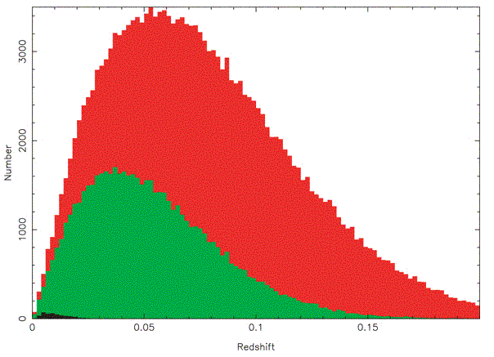
Survey Depth
Depth Survey
Increasing number
of galaxies because
of
increasing volume:
N(z) dz  z² dz
Diminishing number
as only galaxies
brighter than M can
be seen:
sampling the exponential fall-off
of Schechter function
Redshift z

Slide 14
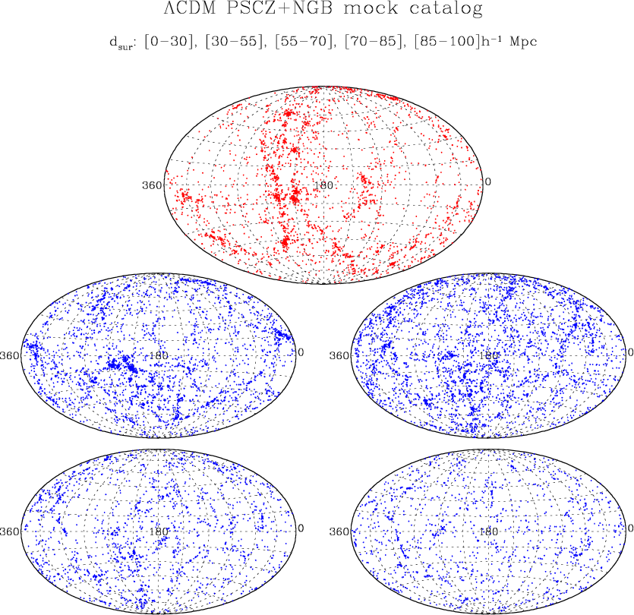
Survey Depth
Theoretical Example:
Galaxies in PSCz
catalogue, at
different depths

Slide 15
Sky Maps: world all around us

Slide 16
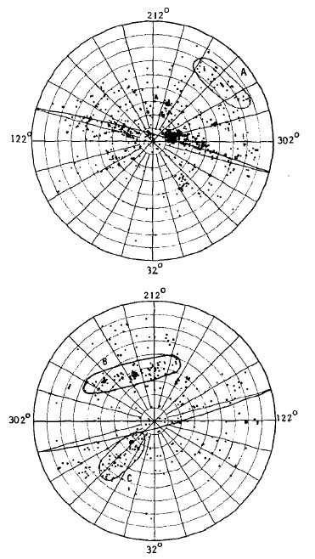
Early Views
Shapley-Ames catalog (1932) of nearby galaxies:
All-sky survey of galaxies to m=18.3
δ > -23º
● numerous concentrations:
groups and clusters (incl. Virgo cluster)
● asymmetry between north and south:
many more galaxies on northern sky
● conspicuous concentration along a line
running through richest nearby cluster,
the Virgo cluster:
● The Supergalactic Plane
(first identified by de Vaucouleurs:
the plane of our own Local Supercluster)

Slide 17
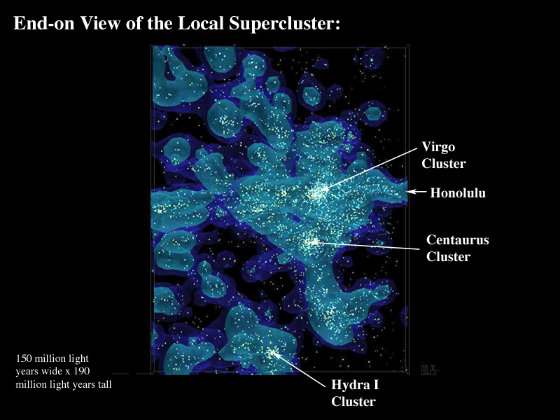
The Local Supercluster
Our Local Group finds itself
located at the outer region of
a large supercluster region,
● the “Local Supercluster”,
● a large flattened mass
concentration ~ 10 h⁻¹ Mpc
in size,
● centered on one rich
cluster, the Virgo cluster
Planet Earth
Courtesy: B. Tully

Slide 18
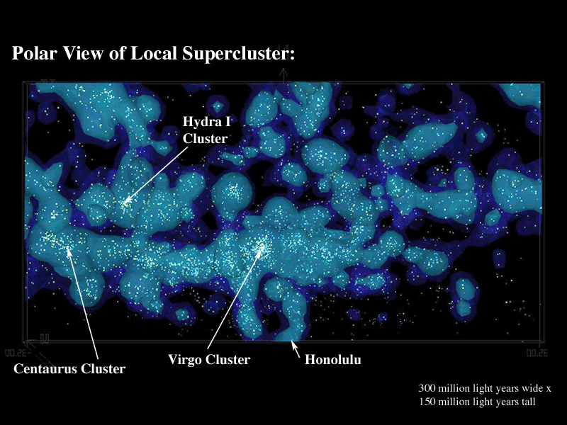
The Local Supercluster
Our Local Group finds itself
located at the outer region of
a large supercluster region,
● the “Local Supercluster”,
● a large flattened mass
concentration ~ 10 h⁻¹ Mpc
in size,
● centered on one rich
cluster, the Virgo cluster
Planet Earth
Courtesy: B. Tully

Slide 19
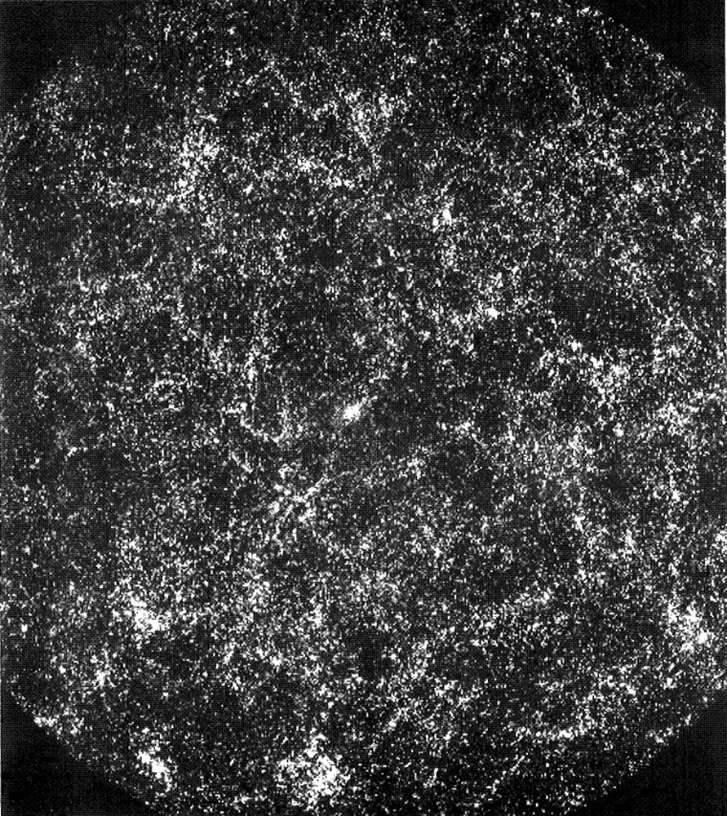
A million galaxies
Shane-Wirtanen map:
On the basis of the Shane-Wirtanen counts, P.J.E. Peebles produced a map of the sky distribution of 1 million galaxies on the sky:
● Clearly visible are clusters
● hint of filamentary LSS features, embedding clusters

Slide 20
APM survey
Sky map:
2 x 10⁶ galaxies
17 < m < 20.5
Uniformly defined
Sky region: 4300 sq. deg.
185 UK Schmidt plates, 6º x 6º
● Large inhomogeneities, hints of weblike patterns, with clusters at densest regions.
courtesy: S. Maddox, G. Efstathiou,
W. Sutherland, D. Loveday

Slide 21
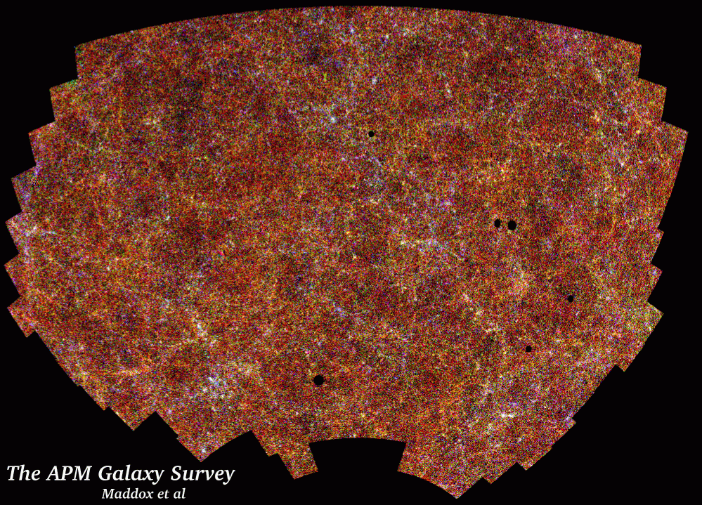

Slide 22
Maps of the
Local Universe

Slide 23
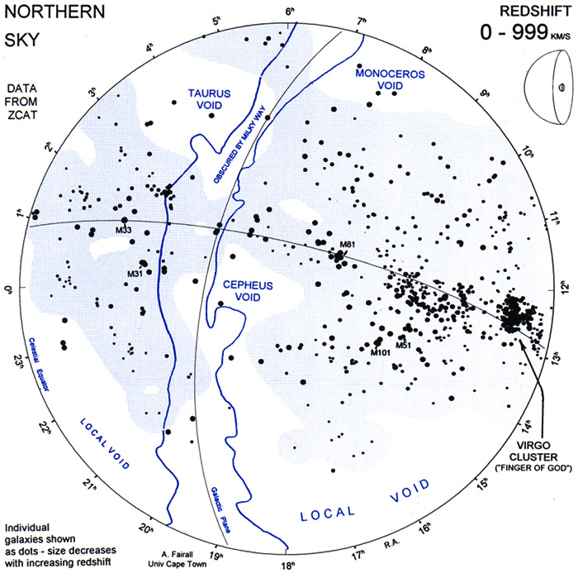
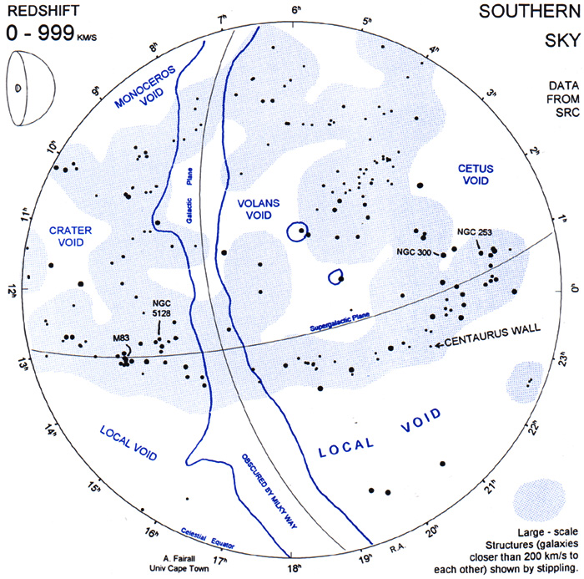
Local Views
Tony Fairall’s nearby LSS map: Local Supercluster clearly visible at v < 999 km/s

Slide 24
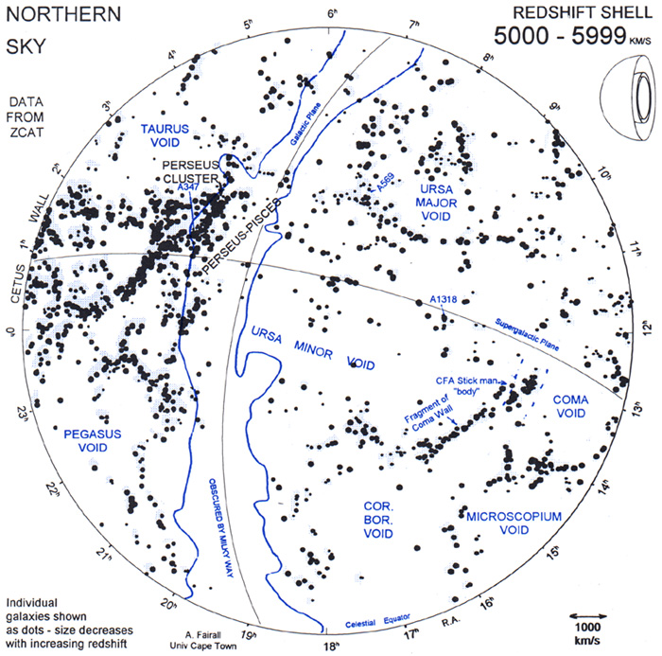
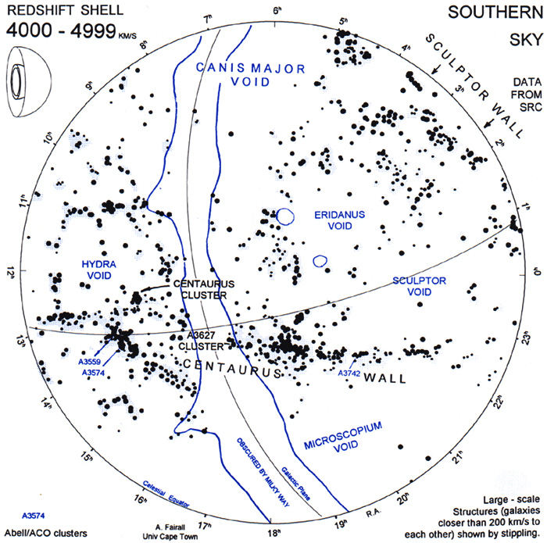
Local Views: Moving into Foam
Tony Fairall’s nearby LSS map: at cz=5000-5999 km/s clear views of
local cosmic web

Slide 25
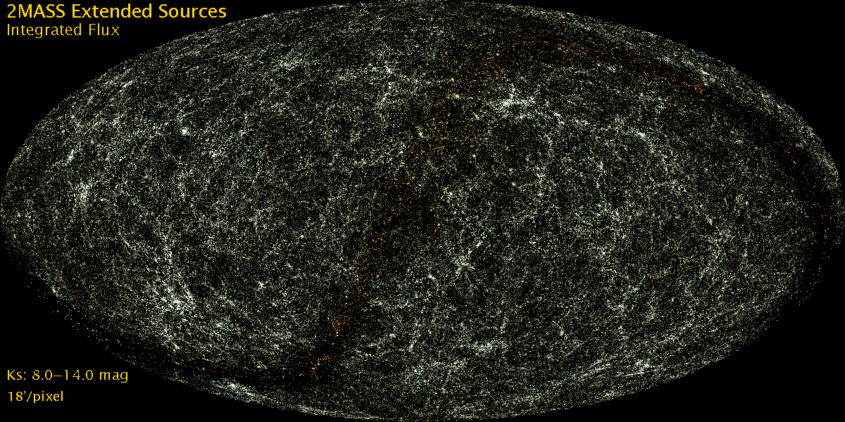
The Cosmic Web
Looking around us we already see the unmistakable signatures of an intriguing foamlike matter distribution in our immediate Cosmic Vicinity.

Slide 26
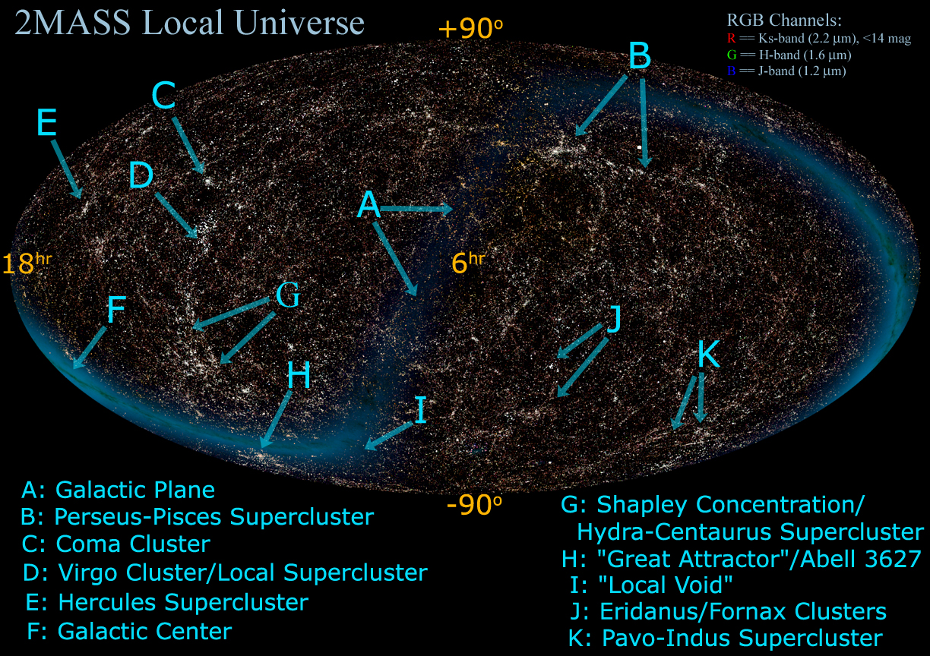
Identity of Local Structures along local Cosmic Web.

Slide 27
2MASS survey
2MASS all-sky survey:
ground-based near-infrared survey whole sky,
J(1.2 m), H(1.6 m), K(2.2 m)
● 2MASS extended source catalog (XSC):
1.5 million galaxies
● unbiased sample nearby galaxies
● photometric redshifts: depth in 2MASS maps, “cosmic web” of (nearby) superclusters spanning the entire sky.
courtesy: T. Jarrett

Slide 28
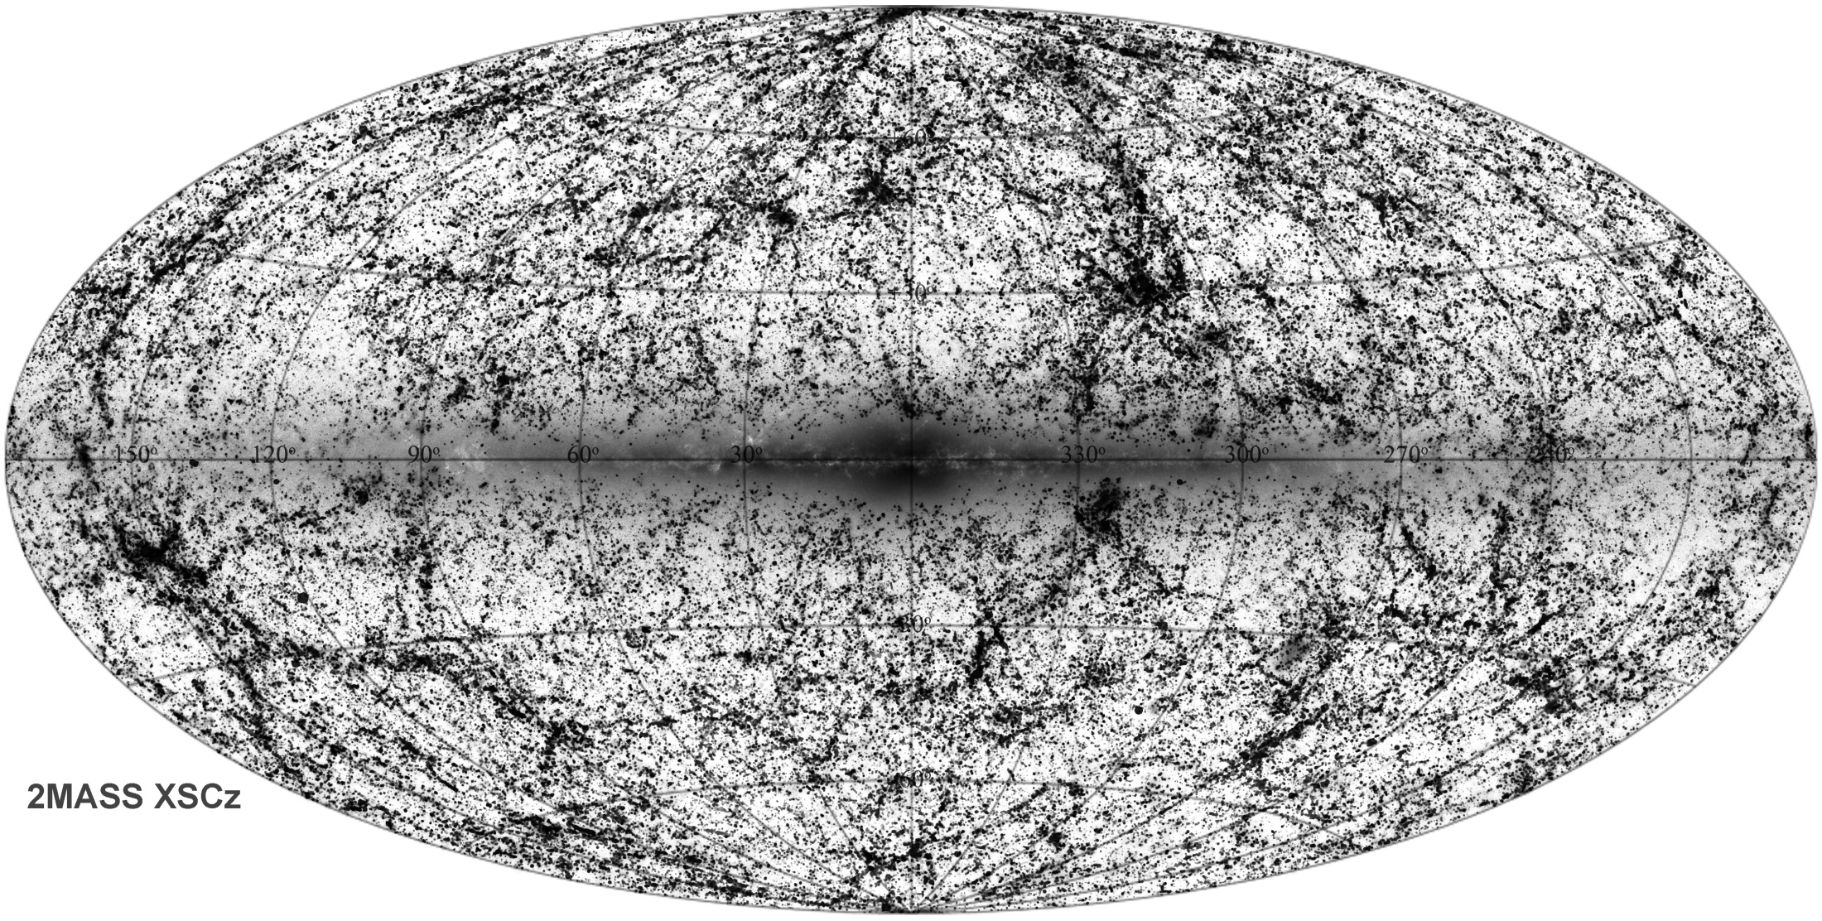
2MASS Cosmic Web
Looking around us we already see the unmistakable signatures of an intriguing
weblike matter distribution in our immediate Cosmic Vicinity.

Slide 29
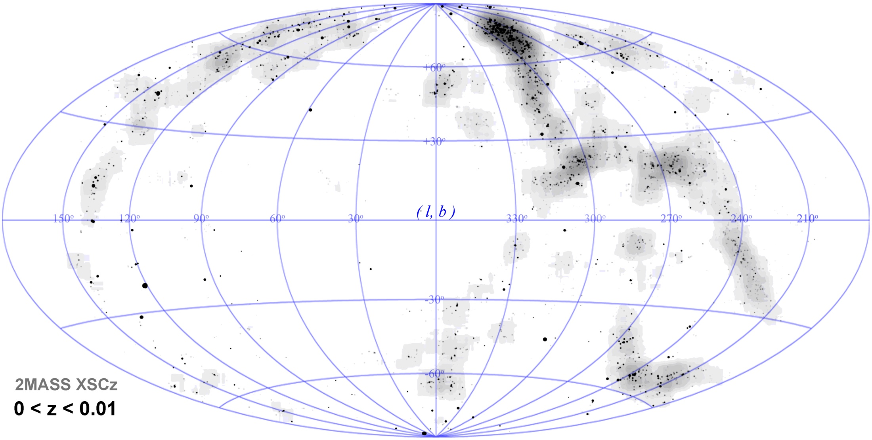
2MASS Cosmic Web
Looking around us we already see the unmistakable signatures of an intriguing
weblike matter distribution in our immediate Cosmic Vicinity.

Slide 30
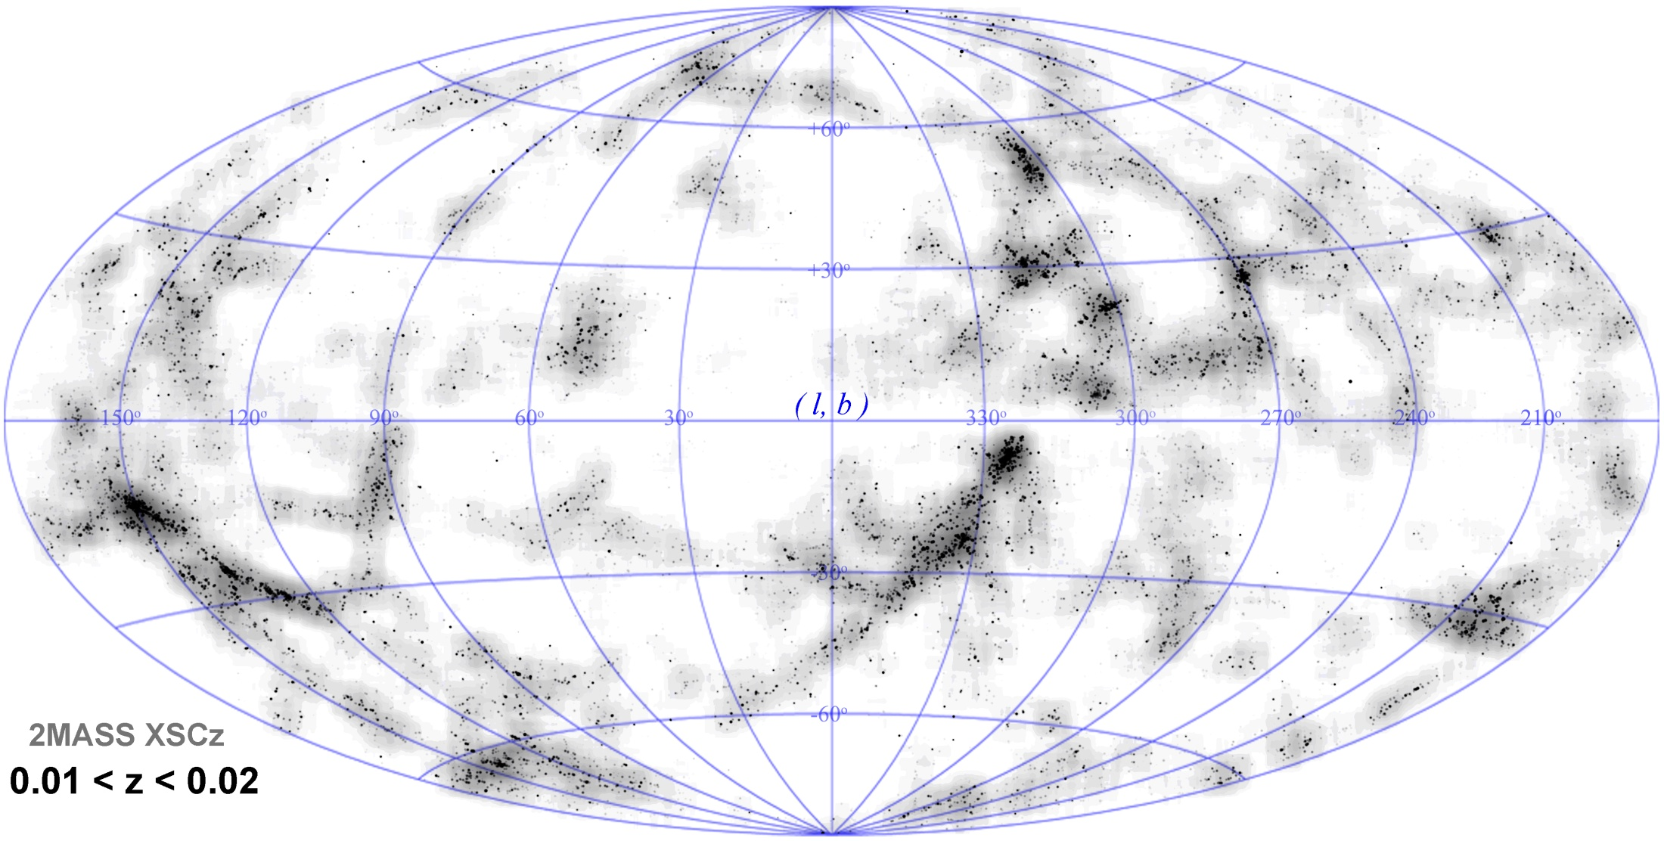
2MASS Cosmic Web
Looking around us we already see the unmistakable signatures of an intriguing
weblike matter distribution in our immediate Cosmic Vicinity.

Slide 31
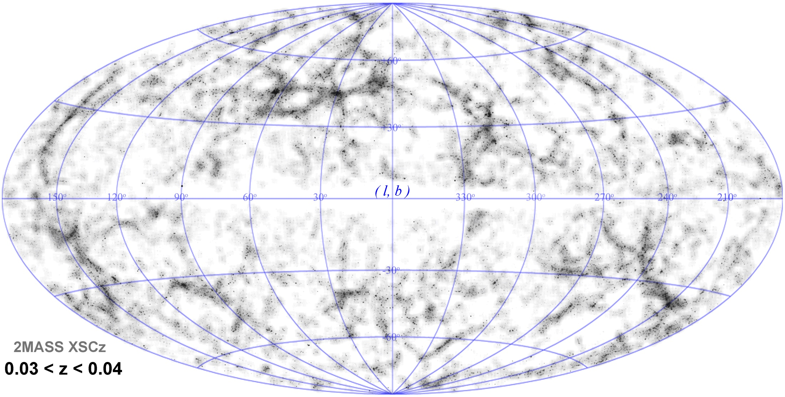
2MASS Cosmic Web
Looking around us we already see the unmistakable signatures of an intriguing
weblike matter distribution in our immediate Cosmic Vicinity.

Slide 32
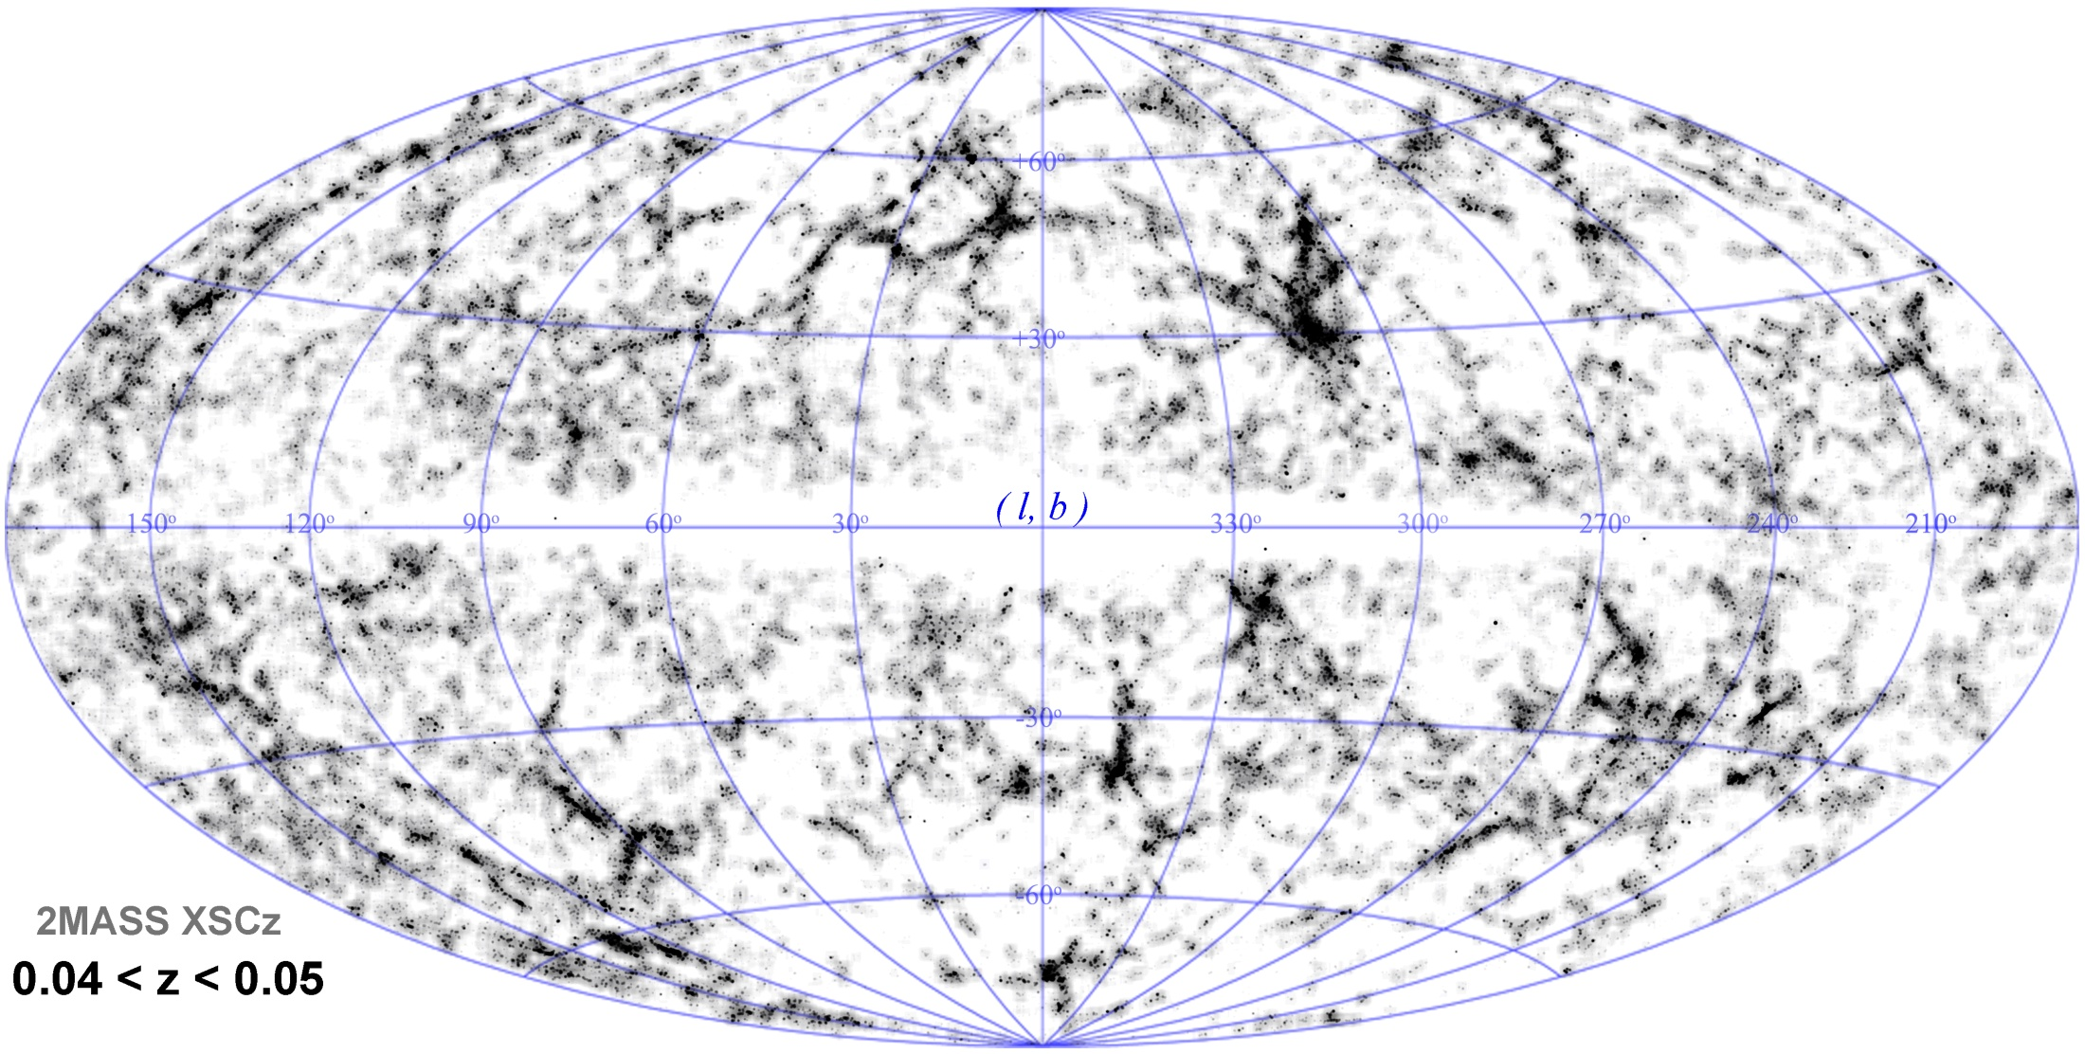
2MASS Cosmic Web
Looking around us we already see the unmistakable signatures of an intriguing
weblike matter distribution in our immediate Cosmic Vicinity.

Slide 33
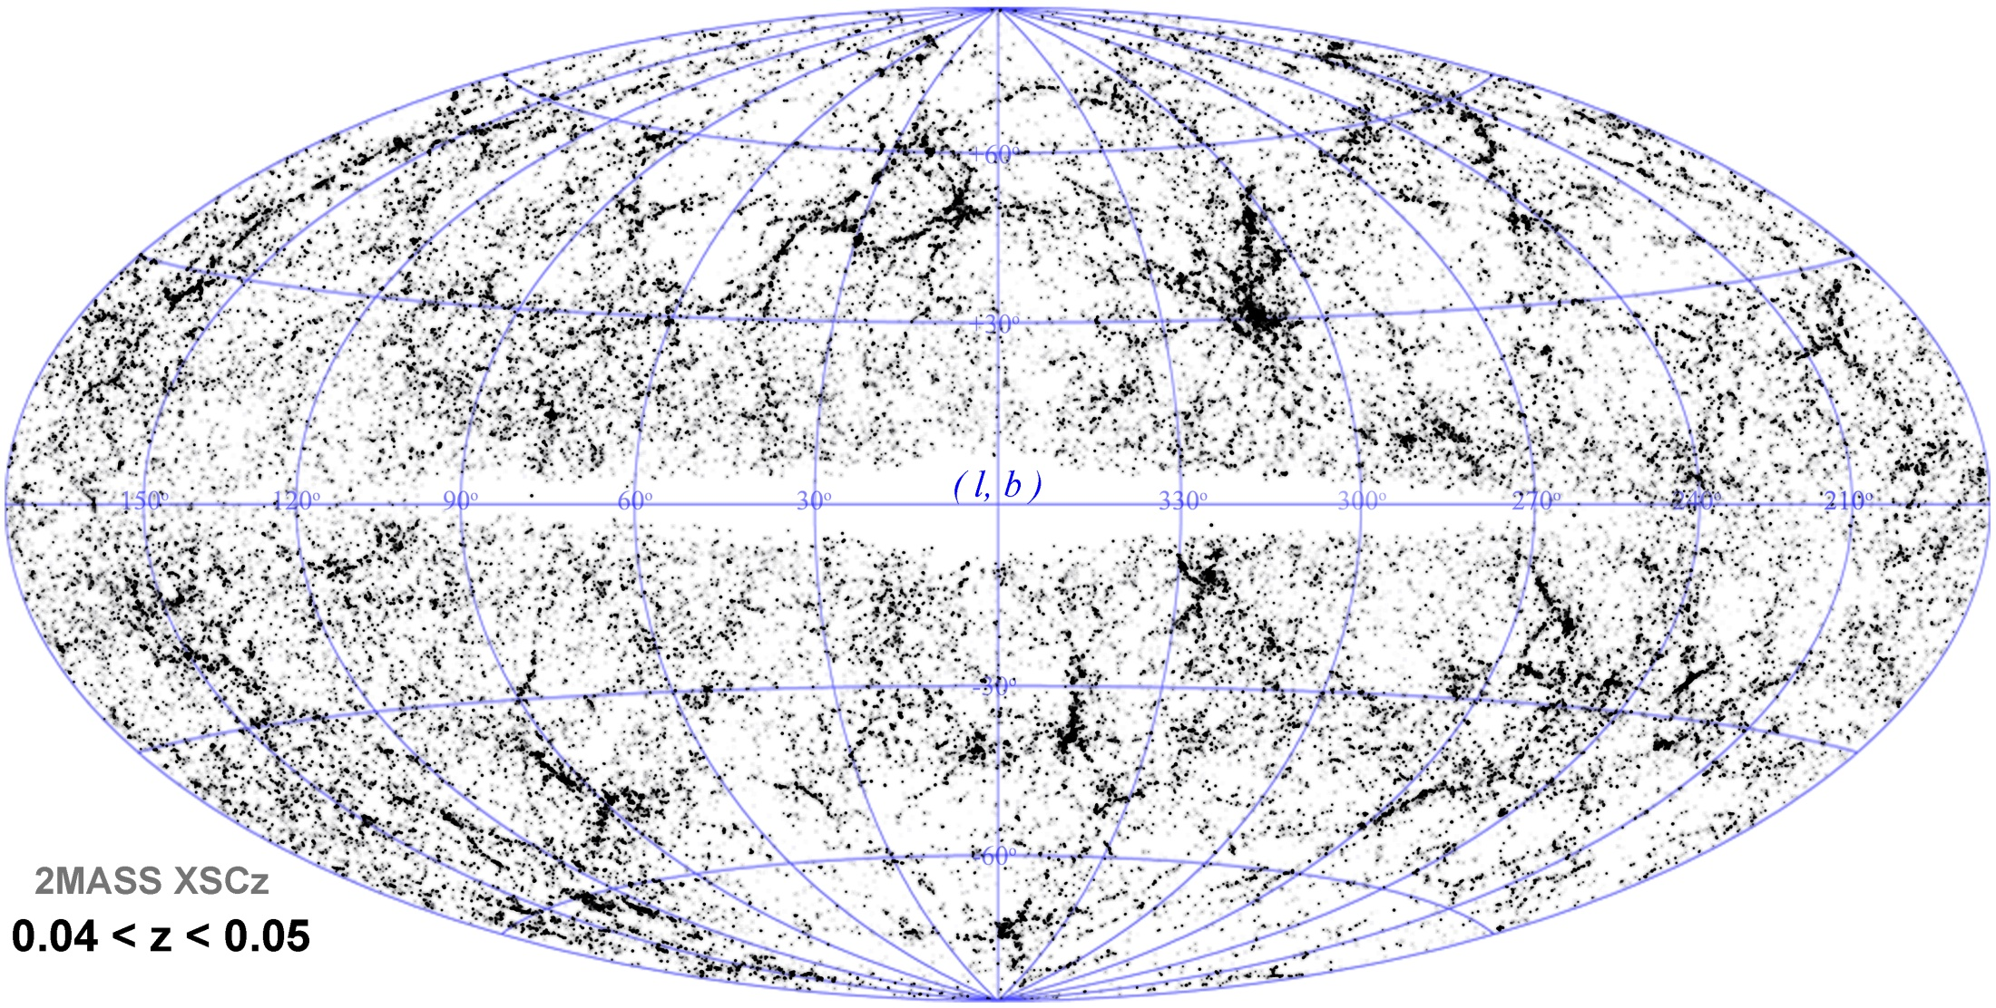
2MASS Cosmic Web
Looking around us we already see the unmistakable signatures of an intriguing
weblike matter distribution in our immediate Cosmic Vicinity.

Slide 34
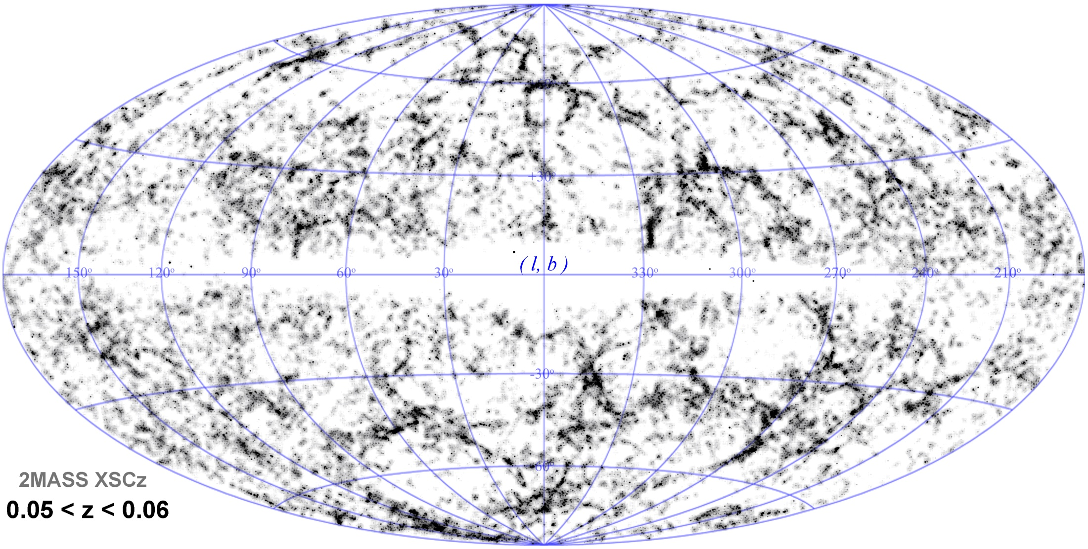
2MASS Cosmic Web
Looking around us we already see the unmistakable signatures of an intriguing
weblike matter distribution in our immediate Cosmic Vicinity.

Slide 35
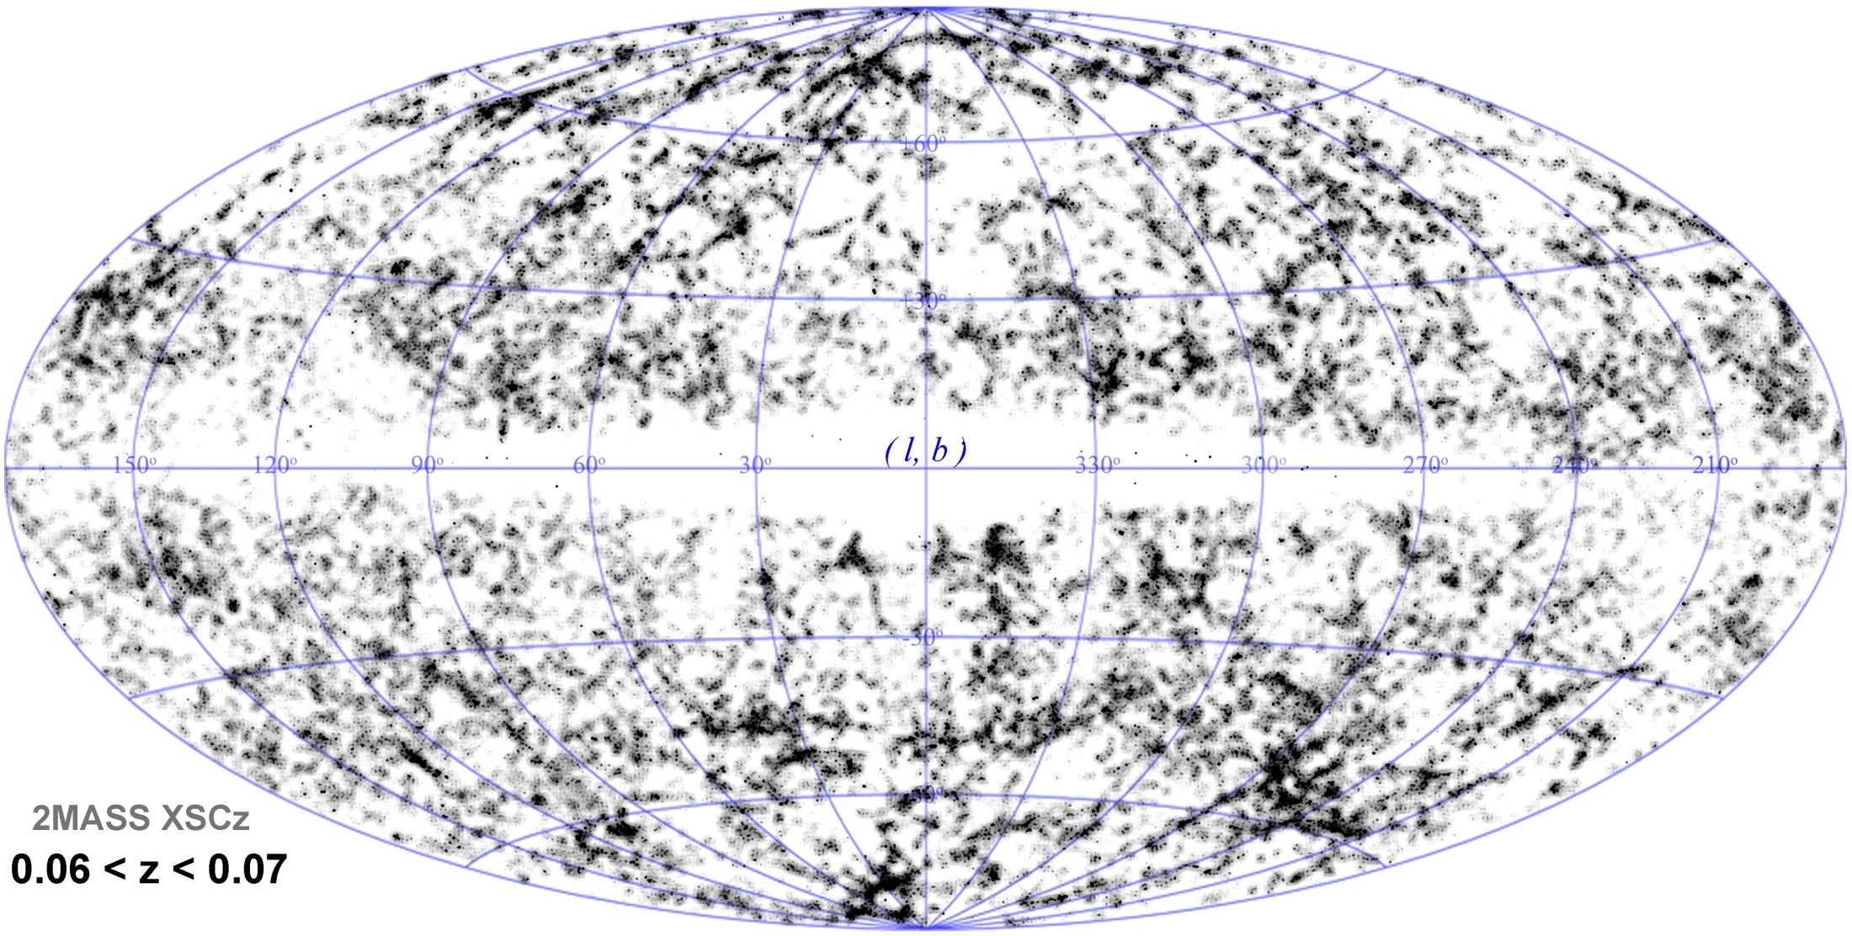
2MASS Cosmic Web
Looking around us we already see the unmistakable signatures of an intriguing
weblike matter distribution in our immediate Cosmic Vicinity.

Slide 36
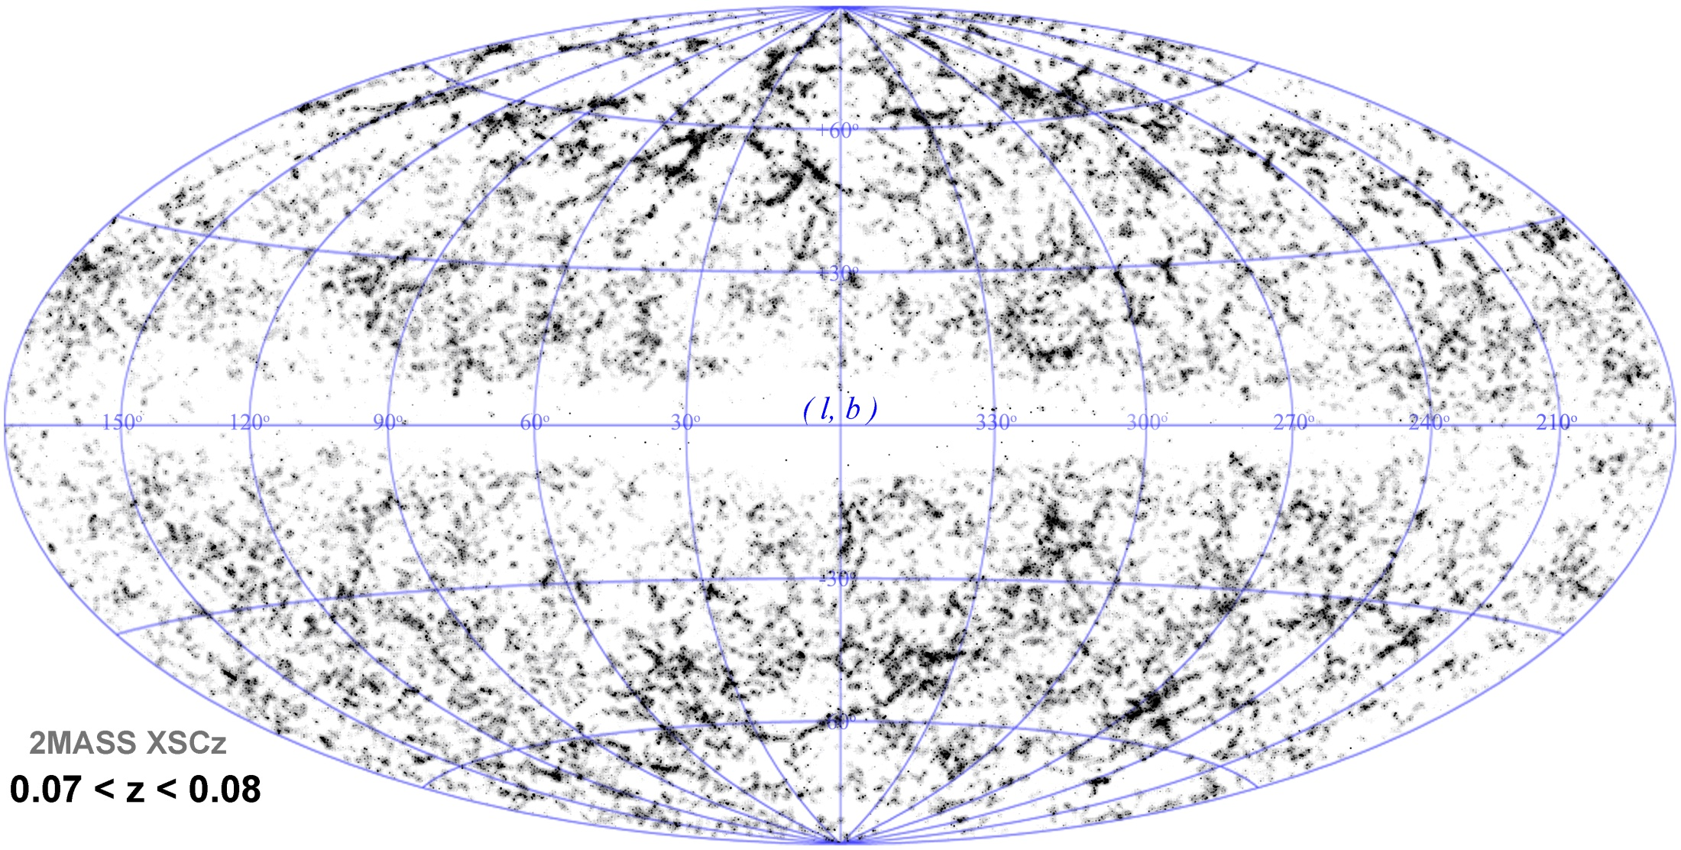
2MASS Cosmic Web
Looking around us we already see the unmistakable signatures of an intriguing
weblike matter distribution in our immediate Cosmic Vicinity.

Slide 37
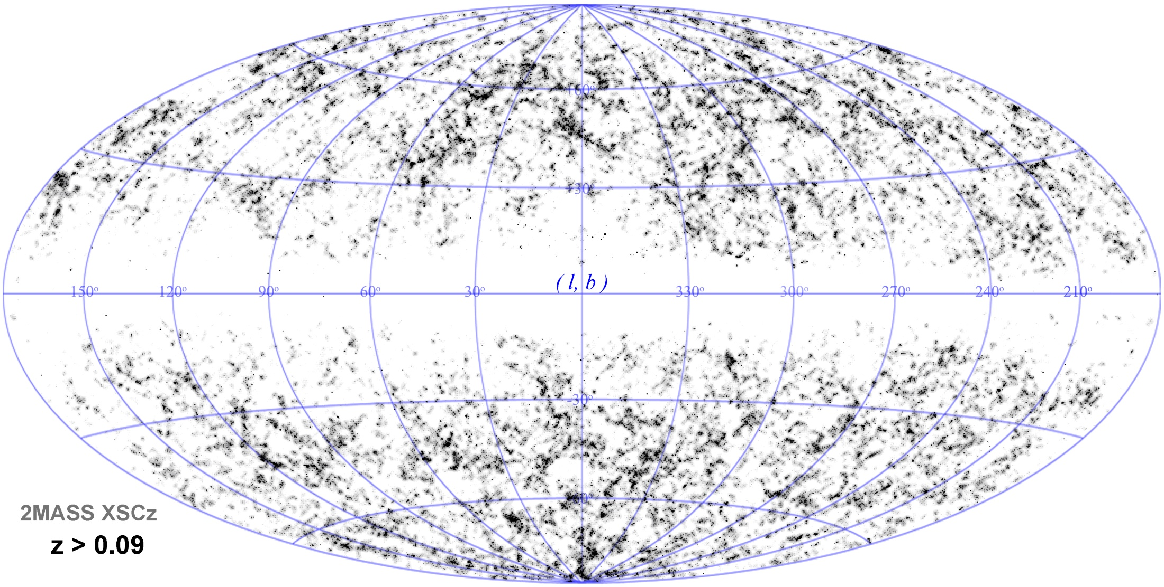
2MASS Cosmic Web
Looking around us we already see the unmistakable signatures of an intriguing
weblike matter distribution in our immediate Cosmic Vicinity.

Slide 38
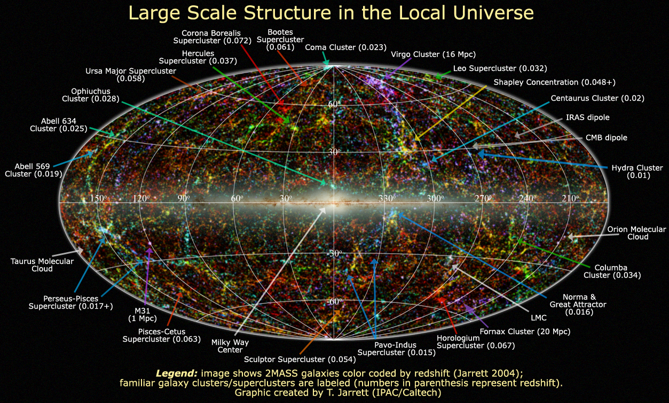

Slide 39
Galaxy
Redshift Surveys

Slide 40
Galaxy Redshift Surveys
For obtaining 3D maps of the galaxy distribution:
measure spatial location of galaxies:
- position on the sky (,)
- distance r
Determination real distance r of galaxy very
cumbersome, reasonably accurate estimates only
for nearby gal’s …
• Common approximate method:
exploit Hubble expansion of the Universe

Slide 41
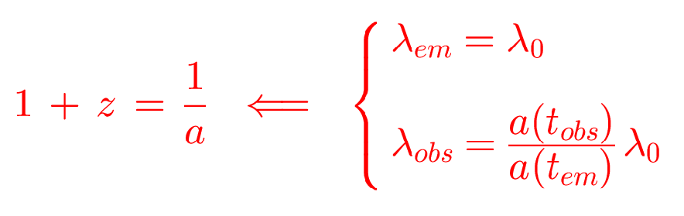
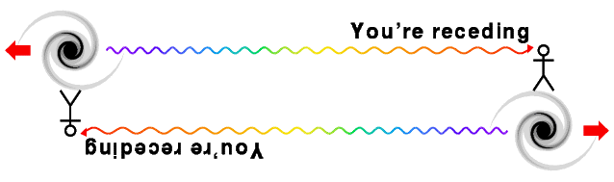
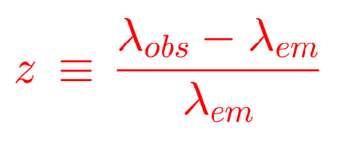
Galaxy Redshift Surveys

Slide 42
Galaxy Redshift Surveys
Hubble Expansion:
(z  1)
galaxy at distance r
has redshift z
(c: vel. light; H: Hubble constant)
Redshift of galaxies can be much more easily
determined than distance:
Galaxy Spectrum

Slide 43
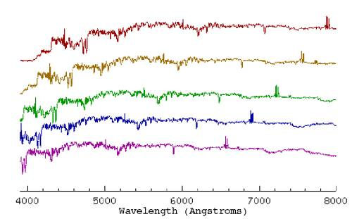
Galaxy Redshift Surveys
Examples of redshifted galaxy spectra

Slide 44
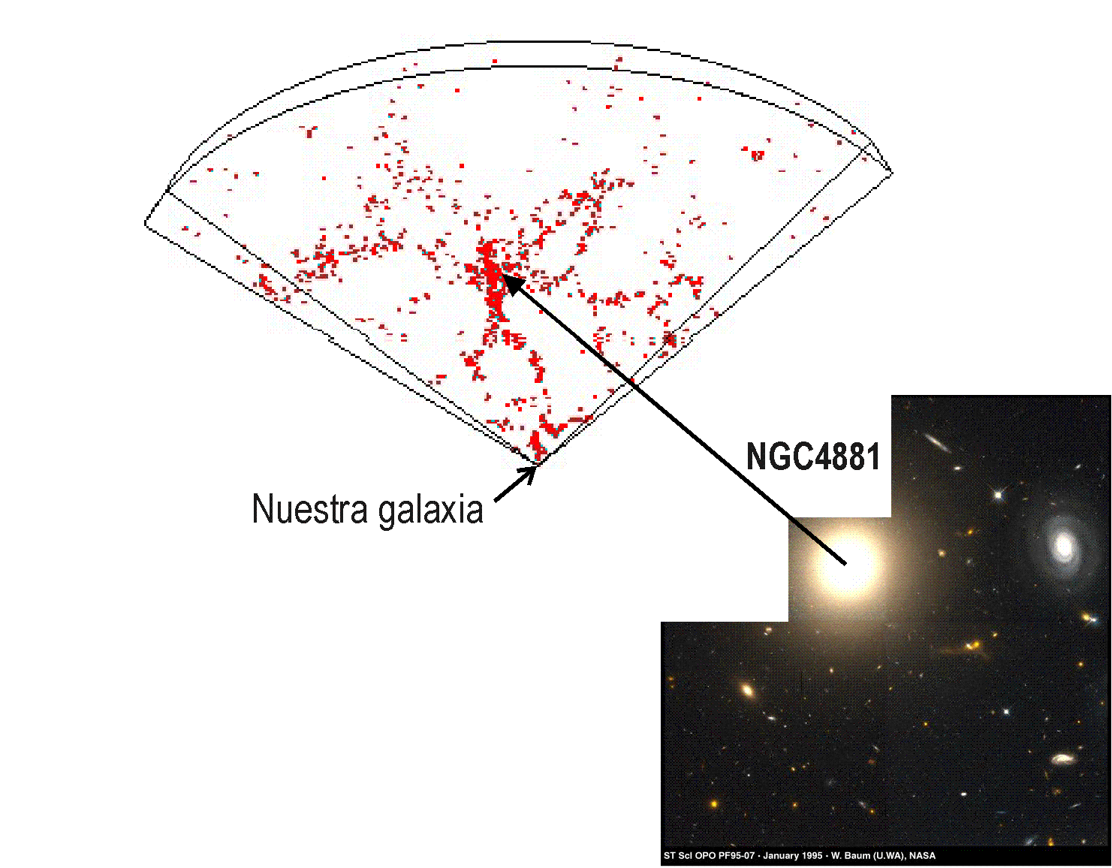
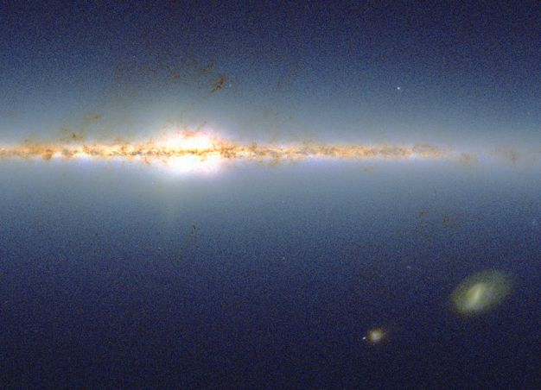
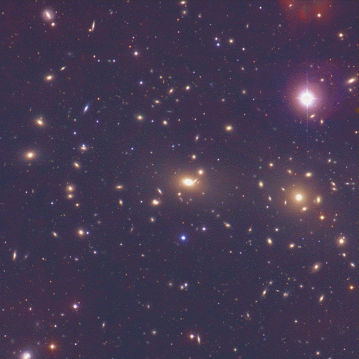
Mapping the Universe
Coma Cluster
Our own Galaxy
de Lapparent, Geller, and Huchra (1986), ApJ, 302, L1

Slide 45
Redshift Space Distortions

Slide 46
Redshift Distortions
In reality, galaxies do not exactly follow the
Hubble flow:
In addition to the cosmological flow, there are
locally induced velocity components in a galaxy’s
motion:
the galaxy’s peculiar velocity v_{pec}
As a result, maps on the basis of galaxy z do not
reflect the galaxies’ true spatial distribution

Slide 47
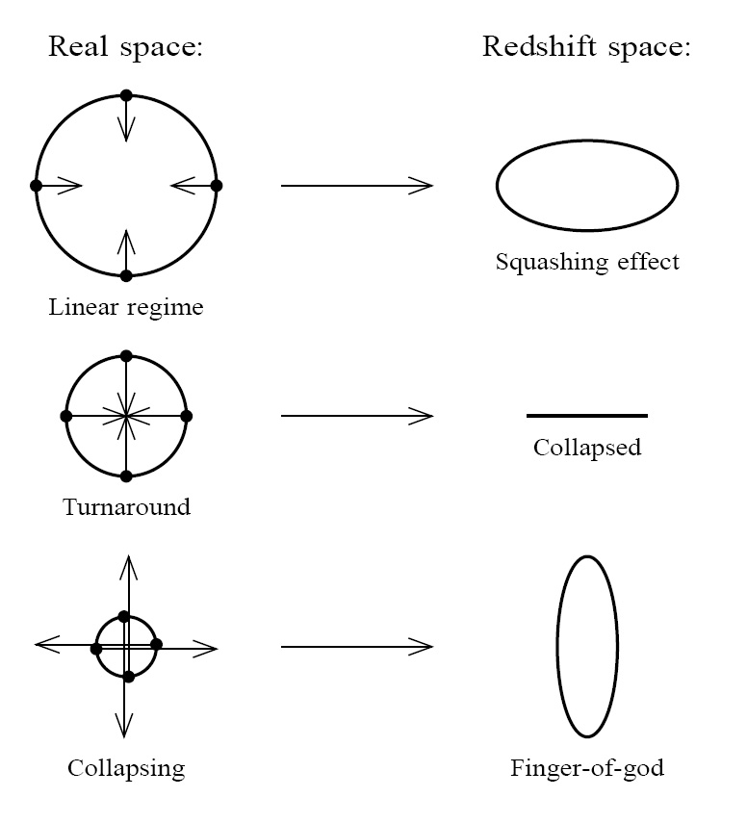
Redshift Distortions
Origin of peculiar velocities:
three regimes
• very high-density virialized
cluster (core) regions:
“thermal” motion in cluster,
up to > 1000 km/s
“Fingers of God”
• collapsing overdensity
(forming cluster):
inflow/infall velocity
• Large scales:
(linear, quasi-linear) cosmic flow,
manifestation of structure growth

Slide 48
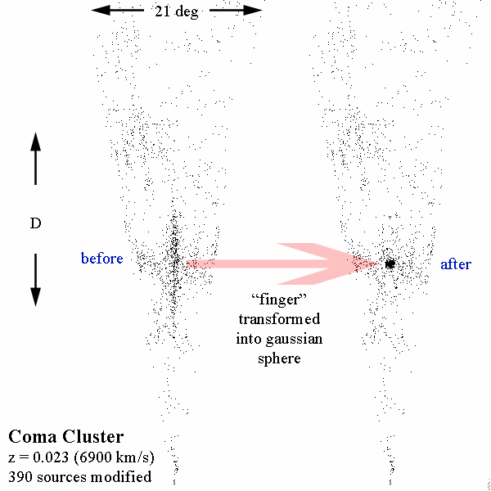
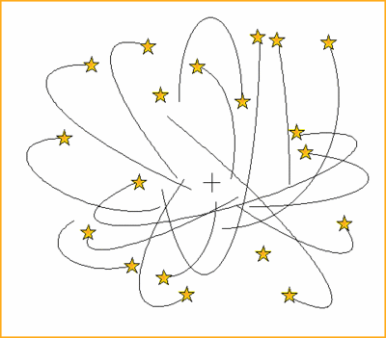
Fingers of God
Galaxy velocity
component along
line of sight

Slide 49
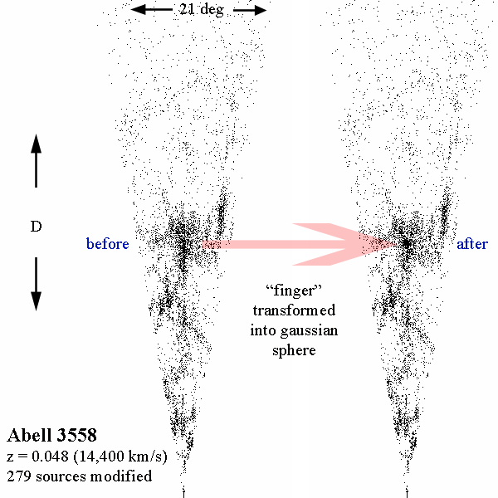

Fingers of God
Clusters of galaxies:
Mass: 10¹⁴-10¹⁵ M•
Radius: ~ 1.5 Mpc
Overdensity  ~ 1000
Thermal velocity: ~ 1000 km/s
Internal cluster galaxy velocities
visible in projection along line of sight
“Finger of God”

Slide 50
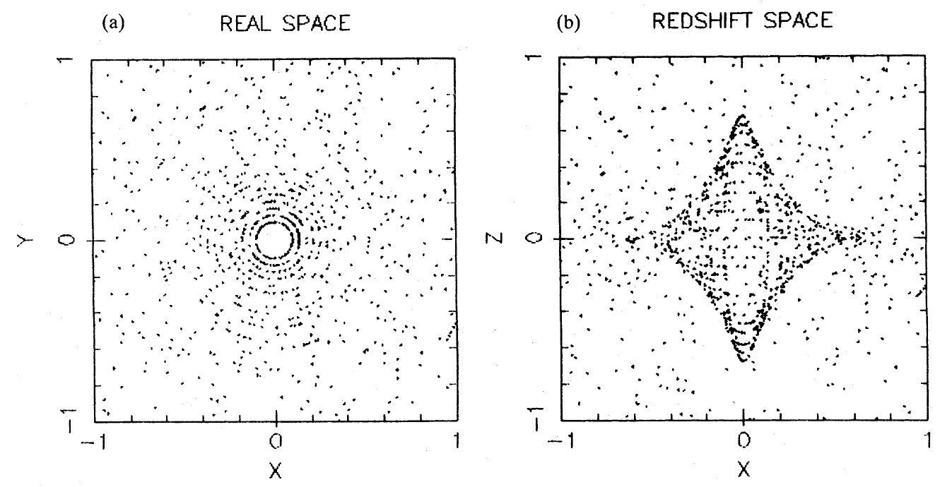
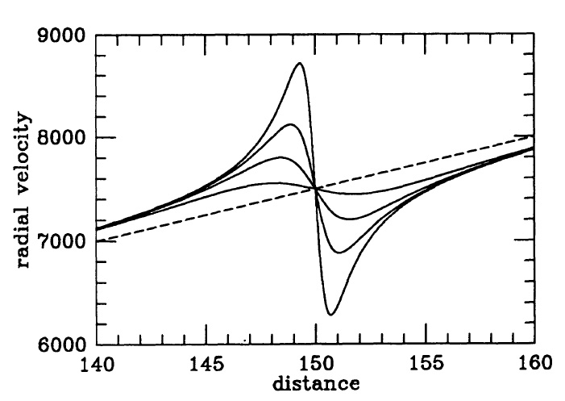
Nonlinear Infall Pattern
Cluster Infall:
Matter in surroundings falling
in onto cluster:
• infall velocities up to 1000 km/s
radially declining :
• velocities decrease as distance
to cluster centre increases
• projected radial velocity
function of angle & distance
wrt. cluster centre.
• triple-value region redshift space:
- within turnaround radius,
a particular redshift z
may correspond to 3 spatial
positions

Slide 51
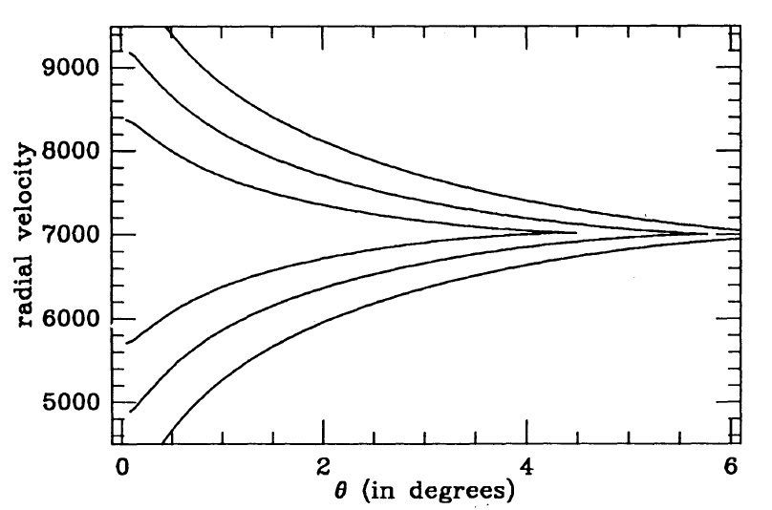
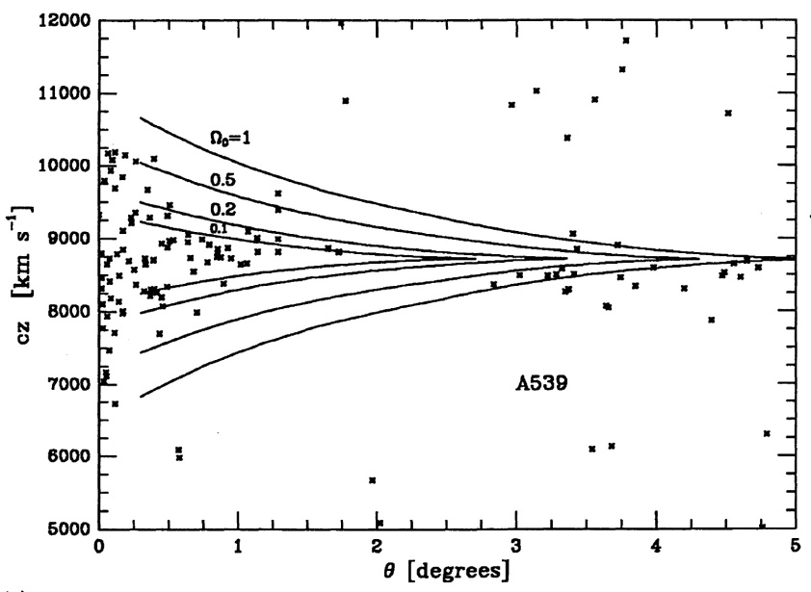
Nonlinear Infall Pattern
Cluster Caustics:
Three-value region cluster infall:
Projection onto restricted cone-shaped
redshift space regions around clusters
Enclosed within caustic surfaces
Position caustics dependent on Ω_{m}

Slide 52
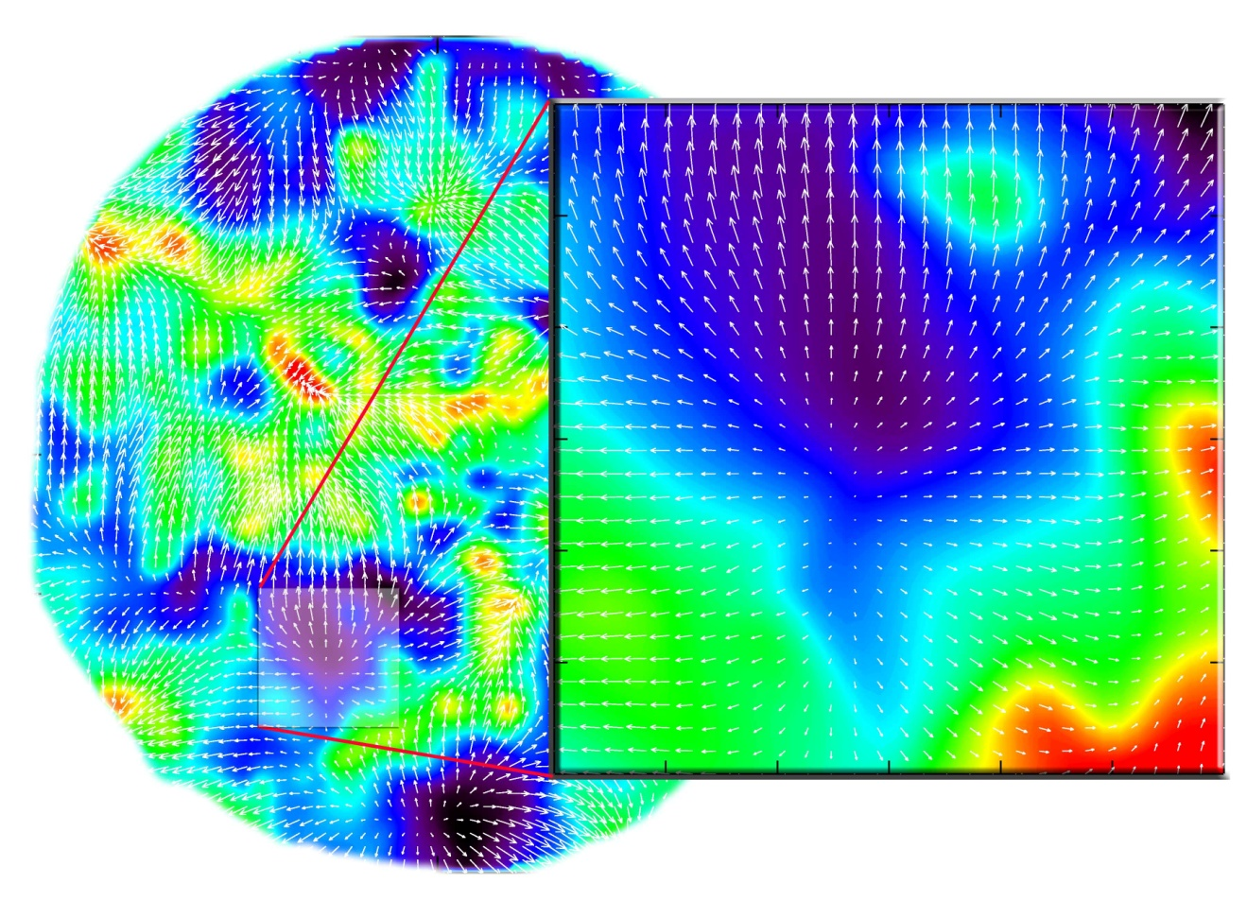
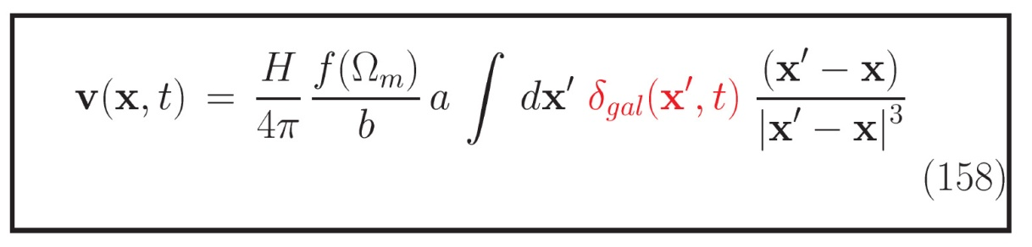
Large Scale Flows
Large-Scale Flows:
• On large (Mpc) scales,
structure formation
still in linear regime
• Structure buildup
accompanied
by displacement of matter:
- Cosmic flows
• Directly related to
cosmic matter distribution
• In principle possible to
correct for this distortion,
ie. to invert the mapping
from real to redshift space
• Condition:
entire mass distribution
within volume should
be mapped

Slide 53
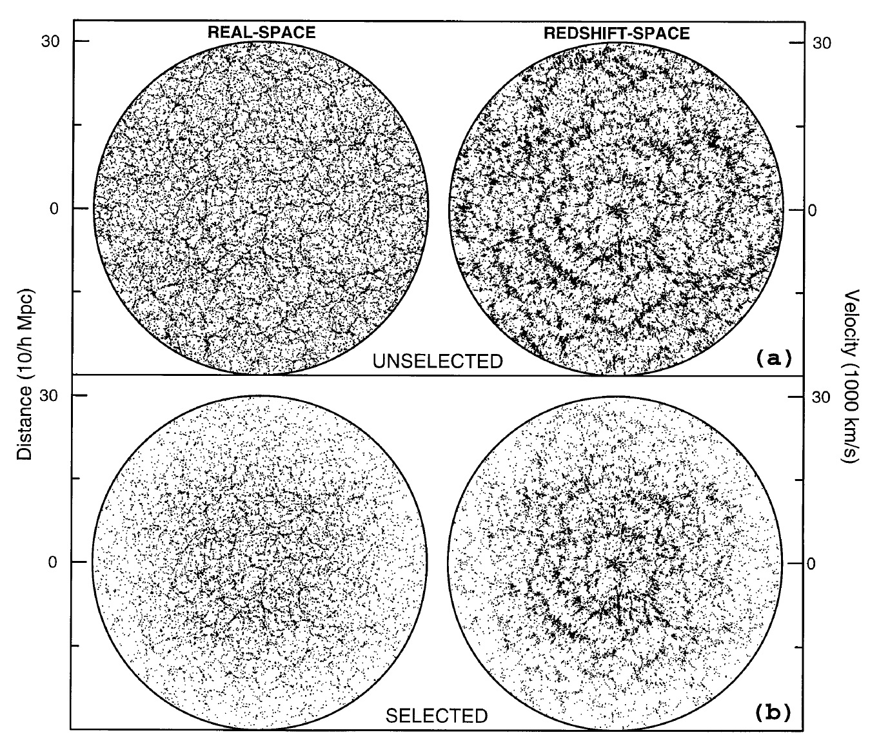
Large Scale Flows
Large-Scale Flows:
The induced large scale
peculiar velocities translate
into extra contributions to
the redshift of the galaxies
Compare
“real space” structure vs.
“redshift space” structure

Slide 54
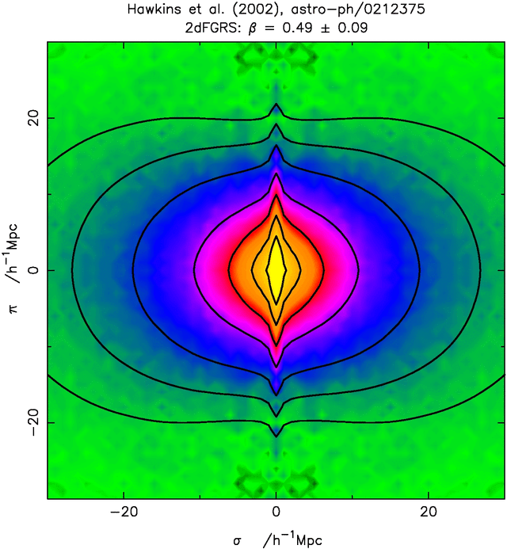
the Web: Migration Flows
Large scale flows lead to redshift distortions:
cz = H r + v_{pec}
These flows are part of the assembly of large scale structures, and reach largest values as matter is transported along the filaments into the clusters.
When mapping the galaxy distribution in redshift space, this induces a distortion:
● Flattening along z as matter flows into
Megaparsec features (v < 600 km/s).
● Extension due to thermal motions
inside cluster (v ~ 1000 km/s):
“Fingers of God”
“Finger of God”
Megaparsec flows

Slide 55
Magnitude vs. Volume Limited

Slide 56
Magnitude vs. Volume limited Surveys
Two different sampling approaches for analysis spatial structure from galaxy redshift catalogue:
Volume-limited surveys:
- uniform spatial coverage, including all galaxies within volume to depth d_{s}
- all galaxies with an absolute brightness > survey limit M_{s}
- diminishing sampling density & spatial resolution
as one wishes to include larger volume (excluding all galaxies M>M_{s})
Magnitude-limited survey
- include all galaxies with apparent magnitude brighter than m_{s}
- assures optimal use of spatial galaxy catalogue
- at the price of an non-uniform spatial coverage &
diminishing resolution towards higher depths

Slide 57
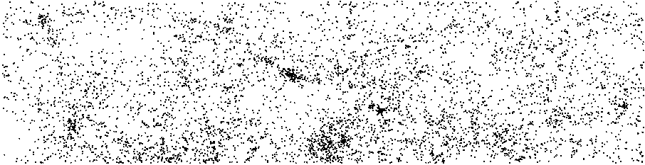
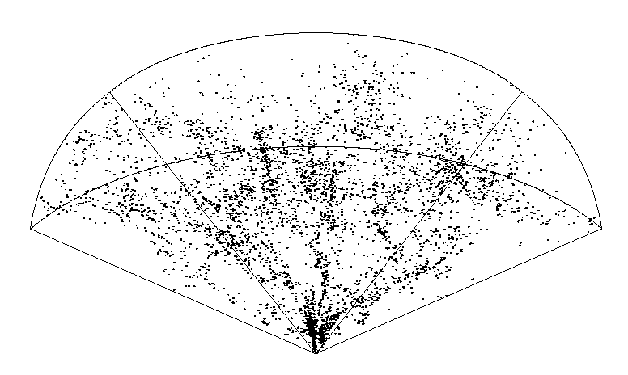
44.5º
8.5º
16 h
8h
The CfA2
redshift survey
(Northern Hemisphere)
101 Mpc/h
Redshift:
v = c z ~ H r + v_{pec}
A magnitude-limited sample,
m < 15.5
N = 4933 galaxies
Figure courtesy: V. Martinez

Slide 58
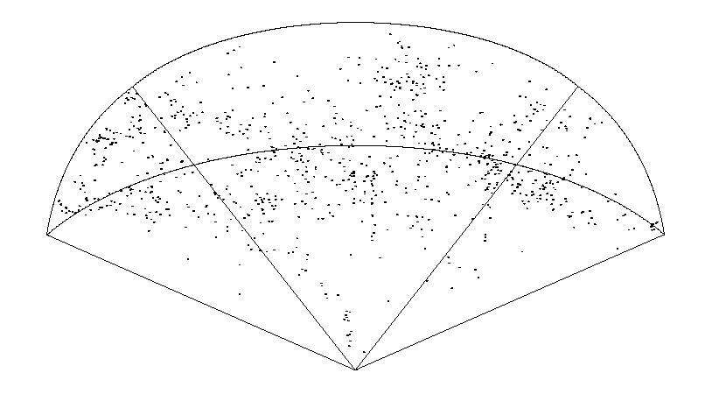
44.5º
8.5º
16 h
8h
The CfA2
redshift survey
(Northern Hemisphere)
101 Mpc/h
A volume-limited sample,
M < 15.5 – 5log(D(z)) – 25 – Kz
N = 905 galaxies

Slide 59
Photometric Redshifts

Slide 60
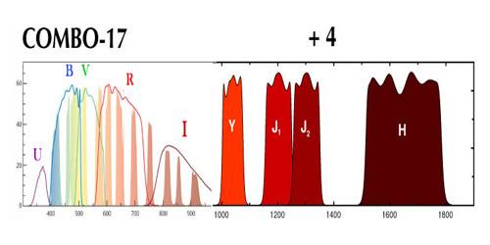
Photometric Redshifts
Instead of measuring the electromagnetic spectrum of the galaxies in
a survey, one may get a good estimate of the redshift on the basis of the
photometry and colours of the objects.
Accuracy of the photometric redshifts becomes better as more bands are
used.
Examples of photometric redshift surveys:
- 2MASS
- COMBO-17
- Wigglez

Slide 61
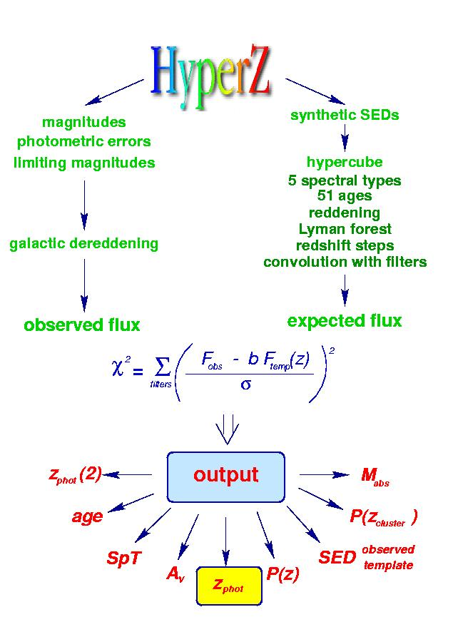
Photometric Redshifts
Practical Implementation:
• Photometric redshifts
determined by fitting to
standard SED
(SED: spectral energy distribution)
• Taking into account:
- spectral type
- reddening
- Lyman forest (high z!)
- filters
• Accuracy (typical):
- z ~ 0.1
widely used Hyperz package

Slide 62

Photometric Redshifts
Photometric Redshifts
Technique widely
used for identifying
high z objects
For example,
Lyman break results
in
FUV-NUV dropouts
(1400-1800 A)
for z ~ 0.5-1.0
Below the Lyman break at 912 A, hydrogen absorbs galaxy light
•

Slide 63




Photometric Redshifts
Photometric Redshifts:
• Accuracy (typical):
- z ~ 0.1
• Accuracy higher as
more bands are used
• Bands to be chosen to
take into account
spectral characteristics/
features
• eg. low z: UV still
weak point

Slide 64
Survey Geometry

Slide 65

Survey Geometry
Practical Limitations
- Limited telescope time
- Limited detector sensitivity
• How to optimally sample
structure in Universe ?
• Devise survey geometry that
reveals optimal amount of
Information on question at hand:
- Patterns galaxy distribution
-Distribution high-density peaks
- Density Field
Sky Location
2-D LCRS survey slices

Slide 66
Survey Geometry
Survey Geometry:
•Slice Surveys:
- thin stripe on sky
- very sensitive to reveal
patterns galaxy distribution
• Pencil-beam surveys
- very narrow region on sky
- very deep
- strategy to probe largest
structures
- structure at high z (early times)
Sky Location
2-D LCRS survey slices

Slide 67

Survey Geometries
Examples of
Slice Redshift Surveys:
From
CfA2 -2dFGRS - SDSS
widely used Hyperz package

Slide 68

Survey Geometry
Survey Geometry:
•Sparse Sample:
- sampling density field
- on scales >
intergalaxy distance
• Full-sky surveys
- necessary to probe
dynamics cosmic regions

Slide 69
Galaxy
Redshift Surveys:
Overview

Slide 70

Comparing
Galaxy/Cluster
Redshift Surveys
“Sensitivity”
vs.
Extent

Slide 71



The largest structures in LCRS are much smaller than
the survey size
LCRS
“ The beginning of the end” or “the end of greatness” ...R. Kirshner

Slide 72

2dF
Galaxy
Redshift Survey

Slide 73


Slide 74


Slide 75

2dF Galaxy Redshift Survey
final release
221414 galaxies
(from Colless et al. 2003)

Slide 76


Slide 77

SDSS
Galaxy
Redshift Survey

Slide 78
SDSS survey
Largest and most systematic (digital !) sky survey in
history of astronomy.
Images sky in 5 photometric bands !!!!
Down to apparent magnitude r~23.1
Covers ~ 25% of the sky: 8452 sq. deg.
With 2dFGRS, the SDSS has produced the most
extensive map of the spatial structure of our cosmic neighbourhood.
Million galaxies subsequently selected for measuring redshift z:
electromagnetic spectrum
Total:
sky survey: 10⁸ stars, 10⁸ galaxies, 10⁵ quasars
spectroscopy: 10⁶ galaxies, 10⁵ quasars, 10⁵ stars

Slide 79


SDSS survey
Specially dedicated
2.5m wide-angle telescope
Apache Point Observatory (New Mexico)

Slide 80

SDSS survey
Aims to sample 25% of the sky:
DR7 - 8423 sq. deg.
Photometric system 5 filters:
● m_{lim}
u 354 nm 24.4
g 476 nm 25.3
r 628 nm 25.1
i 769 nm 24.4
z 925 nm 22.9
Driftscan mode
- 5 filters:
- 30 CCD chips, 5 rows of 6
- S/N ~ 5
- CCD chip: 2048x2048 pixels
120 Mbyte
Spectroscopy
- up to 640 (fibers) per recording
- per night 6-9 recordings

Slide 81

SDSS survey
Aims to sample 25% of the sky:
DR7 - 8423 sq. deg.
Photometric system 5 filters:
● m_{lim}
u 354 nm 24.4
g 476 nm 25.3
r 628 nm 25.1
i 769 nm 24.4
z 925 nm 22.9
Driftscan mode
- 5 filters:
- 30 CCD chips, 5 rows of 6
- S/N ~ 5
- CCD chip: 2048x2048 pixels
120 Mbyte
Spectroscopy
- up to 640 (fibers) per recording
- per night 6-9 recordings

Slide 82



SDSS survey
5-color
Camera
30 CCD
chips
Fiber
Spectrograph

Slide 83


SDSS survey
SDSS Data Release 7 (2008):
SDSS Legacy Imaging Sky Coverage:
8423 sq. deg.
SDSS Legacy Spectral Sky Coverage:
8032 sq. deg.

Slide 84


SDSS survey
SDSS Data Release 1-7 (2000-2008)
SDSS Legacy Imaging Sky Coverage:
8423 sq. deg.
SDSS Legacy Spectral Sky Coverage:
8032 sq. deg.

Slide 85

SDSS Galaxy Survey
KIAS VAGC:
value added galaxy catalog
Distribution of galaxies in the nearby Universe:
weblike filigree of galaxies,
pervasive network of filaments

Slide 86

SDSS Galactic region
comparison 2MASS

Slide 87

SDSS Galaxy Survey
Distribution of galaxies in the nearby Universe:
weblike filigree of galaxies,
pervasive network of filaments

Slide 88

SDSS Galaxy Survey
Distribution of galaxies in the nearby Universe:
weblike filigree of galaxies,
pervasive network of filaments

Slide 89

SDSS survey
• Imaging:
230 million objects
• Spectroscopic (Redshift) survey:
magnitude limit:
galaxies: (Petrosian) r < 17.7
quasars i < 19.1 / i < 20.2 (z > 2.3)
objects: 928,567 galaxies
109,862 quasars z < 2.3
8,802 quasars z > 2.3

Slide 90

SDSS survey

Slide 91

Mapping the Galaxy Distribution

Slide 92


Slide 93


Slide 94


Slide 95

Clusters

Slide 96

Clusters of Galaxies
Assemblies of up to 1000’s of galaxies within
a radius of only
R ~ 1.5-2h⁻¹ Mpc,
Total masses:
M ~ 10¹⁴ M•
Representing overdensities of ~1000
Galaxy move around with velocities
v~ 1000 km/s
They are the most massive, and most recently,
fully collapsed structures in our Universe.

Slide 97

Clusters of Galaxies
Courtesy:
O. Lopez-Cruz
Coma Cluster

Slide 98

Studying Clusters
Includes many different aspects of these versatile astrophysical laboratories:
• Optical/Infrared/Ultraviolet
- Galaxy Population:
spatial distribution, kinematics, galaxy morphology
• X-ray observations
- (hot, ionized) intracluster gas
- distribution (density, temperature): cluster mass
- abundances heavy elements (enrichment)
• Sunyaev-Zel’dovich effect:
- “cluster shadows” in cosmic microwave background radiation
- CMB microwave wavelength region
- intracluster gas (pressure)
- peculiar motion cluster (kinematic SZ)
• Gravitational Lensing
- mainly optical, also radio, submm, …
- strong lensing (arcs, rings), weak lensing (sheared images)
- dark matter mass
- dark matter distribution
• Radio wavelengths
- radio halos, radio relics
- synchroton radiation in shocked, hot, ionized intracluster plasma

Slide 99

Virgo Cluster

Slide 100

Clusters of Galaxies
Coma Cluster

Slide 101
Clusters of Galaxies
Clusters not only contain galaxies:
in fact, galaxies & stars are a minor component:
I. Clusters are Halos of Dark Matter:
M_{DM}/M_{total} ~ 82%
II. Clusters are Hot Balls of (highly ionized) Gas
M_{ICM}/M_{total} ~ 16-17 %
III. Galaxies are mainly raisins in a sea of
dark matter & hot gas
M_{stars}/M_{total} ~ 2%

Slide 102

Clusters of Galaxies:
X-ray intracluster gas
Baryonic matter in clusters is not only confined to galaxies:
~ 2 to 5 times more baryonic mass in the form of a diffuse hot X-ray emitting
Intracluster Gas,
trapped and heated to a temperature of the order of
T ~ 10⁸ K
by the gravitational potential of the cluster.
At such high temperatures, this gas is a fully ionized plasma, producing powerful X-ray emission, bremsstrahlung radiation induced by the electron-ion interactions.
M51
ROSAT X-ray image Coma Cluster

Slide 103


Slide 104

Cluster Mass:
X-ray intracluster gas
Hydrostatic Equilibrium:
M51
Determination Mass from X-ray observations:
assumption:
Isothermal: T(r)=T_{o}
density profile:
X-ray emission Bremsstrahlung: L(r) ~ ρ(r)²
ROSAT X-ray image Coma Cluster

Slide 105


Clusters of Galaxies:
Gravitational Lenses
Courtesy:
T. Broadhurst et al.
A highly promising method to determine the amount and distribution of
matter in the Universe
looks at the way it affects
the trajectories of photons
According to
Einstein’s theory of
General Relativity,
gravitational potential wells will bend and focus light. Dark matter concentrations act as a
Gravitational Lens
A1689

Slide 106

Clusters:
Gravitational Lensing
Geometry of Gravitational Lenses

Slide 107

Gravitational Lensing:
Einstein Ring

Slide 108

Gravitational Telescopes:
Weak vs. Strong Lensing
Two kinds of lensing:
• Strong Lensing:
❑ < _{E}
- nonlinear distortions
- multiple image
Weak Lensing:
❑ > _{E}
- linear distortions
- sheared images
Cluster Mass determination:
Weak Lensing: Linear Inversion Distortion Field
Strong Lensing: Complex Modeling density distribution.
non-trivial

Slide 109



Weak Gravitational Lensing
Lensed Galaxies
Unlensed
Shear map +
Projected Mass

Slide 110

Weak Gravitational Lensing:
MS1054
z=0.83:
one of the highest known z clusters
Weak Lensing study by
  Clowe et al. Keck
  Hoekstra et al. HST

Slide 111

Clusters of Galaxies:
Dark Matter Map
A highly promising method to determine the amount and distribution of
matter in the Universe
looks at the way it affects
the trajectories of photons.
According to
Einstein’s theory of
General Relativity,
gravitational potential wells will bend and focus light. Dark matter concentrations act as a
Gravitational Lens.
Cl0024

Slide 112
Superclusters

Slide 113


Superclusters
Large groups of clusters & galaxies (1-dozens)
M ~ 10¹⁵-10¹⁶ M_{o}
L ~ few-100 Mpc
irregular shaped
mild overdensity ~few

Slide 114


Superclusters:
Einasto et al. sample
X-ray clusters (yellow) and
Abell clusters (white)
superclusters are not isolated single objects,
but integral components in the pervasive
Cosmic Web

Slide 115


Slide 116
Cosmic Web

Slide 117
Voids

Slide 118



z
Zeldovich, Einasto & Shandarin 1982:
First linking of observationally visible
void regions and the theory of
cosmic structure formation.
Coma
Virgo
y
x

Slide 119

First Voids
Gregory & Thompson 1978:
redshift survey of Coma/A1367 supercluster region revealed existence of large
near-empty regions of space.

Slide 120


Bootes Void
Kirshner, Oemler, Schectman, Schechter (KOSS) 1981, 1987
the canonical void
Bootes Void
d~50h⁻¹ Mpc

Slide 121
Bootes Void
The Bootes Void.
Bootes void as revealed by the galaxy number space density in a sequence of five different recession velocity intervals in the direction of the Bootes constellation on the sky.
The lowest contour represents a density equal to 0.7 of the cosmic mean, each higher contour represents a factor 2 increase in density. Velocity ranges (km/s):
(a) 7,000-12,000 (b) 12,000-17,000 (c) 17,000-23,000
(d) 23,000-29,000 (e) 29,000-39,000
Frame (b) clearly reveals a large void in the galaxy distribution, which turns out to be roughly spherical in outline.
From: Kirshner et al. (1987)

Slide 122

Voids & the Cosmic Web
deLapparent, Geller & Huchra, 1986:
“a slice of the Universe”
Voids appear to be an integral part of
a complex weblike arrangement of
galaxies

Slide 123

local Cosmic Web: Local Void
Karachentsev etal.
LV catalog:
galaxies within 10 Mpc reveal
beautifully the magnificent
Local Void – Tully Void

Slide 124

Fairall Void Catalogue
6dF based
catalogue
of 526
visually identified
voids.

Slide 125

Bootes Void: Substructure
Platen et al. 2009

Slide 126

Voids & Clusters
Einasto, Saar et al. (1990s)
- Superclustering in Abell/APM clusters catalog
- Finding of characteristic scale ~140 Mpc,
corresponding to large voids in the cluster
distribution
Reflex II cluster catalogy (Bohringer et al.)
reveals same population of voids in cluster distribution
(see talk by Collins).

Slide 127


Voids & the Gaseous Web
Tejos et al. 2012:
HI Ly absorption systems clearly
delineate voids

Slide 128

Voids exert a repulsing dynamical influence over their surroundings.
Sculptor Void
PSCz: DTFE density & velocity field
(Romano-Diaz & vdW 2007)

Slide 129

Push of the Local Void
Sculptor Void
Tully et al. 2008:
Local Void pushes with ~260 km/s against our local neighbourhood

Slide 130

Void Dynamics: Local Void

Slide 131
Voids:
Identification & Catalogues
Voids are not easily defined
not as cleanly & objectively identifiable objects as clusters
range of criteria & identifiers,
often conflicting see Colberg et al. 2008
increased interest due to cosmological/dark energy
information contained in voids
Catalogues:
- Fairall 2006 by eye
- Pan et al. 2012 Hoyle-Vogeley algorithm
- Sutter et al. 2012 Watershed/ZOBOV multiscale

Slide 132

SDSS Voids

Slide 133


SDSS Multiscale Watershed Void Catalog
Sutter et al. 2012

Slide 134


Supervoids ???
Survey possible supervoids by
Granett et al.
Claim: supervoid in
NVVS radio galaxy distribution
(Rudnick et al. 2007)
Possible link with cold spot WMAP: ISW ?

Slide 135
Filaments

Slide 136

Nexus Filaments
Nexus identification of filaments (blue)
Identification on the basis of 6 different
physical characteristics of the cosmic mass
distribution:
Density - Velocity Divergence
Tidal field - Velocity Shear
Log(density) - Nexus+
from: Cautun et al. 2013

Slide 137




Slide 138


Pisces-Perseus Chain
21 cm line redshift survey,
Giovanelli & Haynes

Slide 139
Pisces-Perseus Chain
Canonic example of a strongly flattened supercluster consisting of
● sheet-like central region, dense filamentary boundary ridge
● Relative proximity (d ~ 55h⁻¹ Mpc),
● Characteristic & salient filamentary morphology,
● Favourable orientation.
Northern boundary: ridge south-westward of Perseus cluster (A426)
Dimensions Ridge: 5h⁻¹ Mpc wide
50h⁻¹ Mpc length; possible 140h⁻¹ Mpc extension
Along Ridge: high density clusters, incl. A462, A347, A262

Slide 140

Walls and Filaments
Pisces-Perseus Chain Sky
21 cm line redshift survey (Giovanelli, Haynes et al. 19 Redshift

Slide 141



Spine of the Cosmic Web

Slide 142

galaxy
filament projection
survey galaxy
Additional Analysis Step:
projection of filament galaxies
to Medial Axis of Nexus/MMF filaments

Slide 143
Walls - Sheets

Slide 144

Nexus:
Walls &
Filaments
Cautun et al. 2012

Slide 145



Slide 146


Slide 147

Largest Structure
Local Universe
~ 300 x 150 Mpc
Sloan Great Wall

Slide 148

Nexus:
Multiscale Morphology
Identification
Cosmic Web Elements
Walls
Cautun et al. 2012

Slide 149
Cluster Nodes

Slide 150

Cluster Nodes
Cosmic Web Theory (Bond et al. 1996):
Clusters are the nodes that weave the cosmic tapestry:
Tidal (gravitational) force field generated by clusters responsible for anisotropic collapse into filaments and walls.

Slide 151


Cluster Nodes

Slide 152
Cluster Nodes

Slide 153
Cluster Nodes

Slide 154




Millennium II

Slide 155


Slide 156
Cluster Nodes & the Web
Pisces-Perseus Chain; 21 cm line redshift survey,
Giovanelli & Haynes

Slide 157

Cluster Nodes & the Web
Perseus Cluster (A426)
Pisces-Perseus Chain; 21 cm line redshift survey,
Giovanelli & Haynes

Slide 158
Cluster Nodes & the Web
Perseus Cluster (A426)
Pisces-Perseus Chain; 21 cm line redshift survey,
Giovanelli & Haynes

Slide 159
Cosmic Web:
Gas

Slide 160

Local
Universe:
Constrained
Simulation
Gas Distribution courtesy:
Klaus Dolag

Slide 161

The Gastrophysical Web
Gas in the Cosmic Web:
(up to 90% of baryons outside galaxies and clusters)
- Neutral HI gas, seen in absorption: Lyα forest
Warm/Hot Intergalactic Medium: photoionized 10⁴ K gas
shock-heated 10⁶ K gas (X-ray)
Courtesy:
Virgo/V. Springel

Slide 162

The Gastrophysical Web
The Lyα forest:
HI gas in the intergalactic medium closely traces the density fluctuations in the dark matter distribution.
QSO absorption lines arise due to the line of sight intersection by the neutral hydrogen component
Low column density absorption lines associated with sheets and filaments in the “Cosmic Web”
Courtesy: Cen & Ostriker

Slide 163

Gaseous
the Gaseous Cosmic Web

Slide 164

Gaseous
the Gaseous Cosmic Web
SZ detection of
Inter-cluster bridge/filament
in between clusters
A401 and A399
ESA/Planck collaboration

Slide 165


Dark Matter
Cosmic Web
A222-A223
Dietrich et al. 2013

Slide 166
Cosmic Web:
in depth

Slide 167

Far Away,
Long Ago
Various surveys are attempting to trace the large scale structure out to large cosmic depths/redshifts.
● Is cosmic web truly universal
● What about the scales of the web
(characteristic, largest structures, …)
● Evolution of Megaparsec scale
matter distribution.
Simulation of VIRMOS redshift
survey, web out to large redshift

Slide 168

Far Away, Long Ago
Various surveys are attempting to trace the large scale structure out to large cosmic depths/redshifts.
● Is cosmic web truly universal
● What about the scales of the web
(characteristic, largest structures, …)
● Evolution of Megaparsec scale
matter distribution.
Subaru Survey: Amazing prominent large scale distribution of Lyα emitting galaxies.
A filament at redshift z~3 ?

Slide 169

Far Away, Long Ago
Various surveys are attempting to trace the large scale structure out to large cosmic depths/redshifts.
● Is cosmic web truly universal ?
● What about the scales of the web
(characteristic, largest structures, …)
● Evolution of Megaparsec scale
matter distribution.
Ebeling et al. (2004):
A filamentary structure in between two rich clusters.

Slide 170

Far Away, Long Ago
Deep pencil beam survey (Broadhurst et al):
A semi-regular pattern of redshift spikes along line of sight, indicating the passage of l.o.s. through sheets, filaments and clusters. Suggestions for a characteristic scale of ~120h⁻¹ Mpc should be ascribed to the 1-D character of the redshift skewer through 3-D structure.

