Slide 1
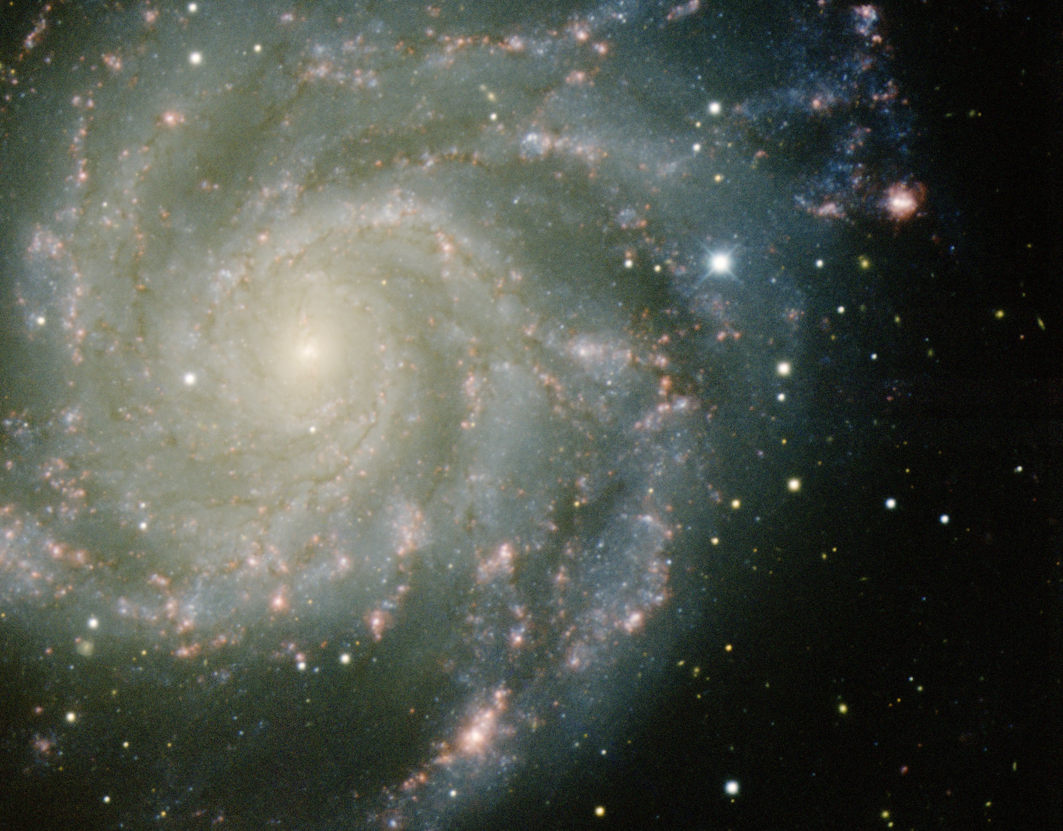
Dark Energy
Probes of Dark Energy

Slide 2
Probes Dark Energy
Supernovae Ia
probing luminosity distance – redshift relation
Clusters of Galaxies
number counts N(z),
# formed clusters of galaxies as function of z sensitive to w & w’
Cosmic Shear/Weak Lensing
measures angular diameter distance-redshift relation, in combination with structure
growth
• Baryonic Oscillations (BAO)
cosmic yardstick, curvature: residual imprint in galaxy distribution
acoustic oscillations primordial baryon-photon plasma
Integrated Sachs Wolfe (ISW)
imprint foreground large scale structure on CMB,
via evolving potential perturbations
Clustering
clustering correlation function/power spectrum,
directly probing cosmological scenario, BAO wiggles
Growth of clustering:
evolving growth rate f(Omega,z), probed via influence of
redshift distortions on correlation functions
Voids:
evolving void shapes,
probing tidal force field generated by large scale mass distribution
Morphology and Topology
sensitivity of topology, measured by homology (Betti numbers)

Slide 3
Dark Energy Probes: Comparison
Method | Strengths | Weaknesses | Systematics
Weak Lensing | Structure Growth + Geometric Statistical Power | CDM assumption | Image quality Photo-z
Supernovae SNIa | Purely Geometric Mature | Standard Candle assumption | Evolution Dust
BAO (Baryonic Acoustic Oscillation) | Largely Geometric Low systematics | Large samples required | Bias Nonlinearity
Cluster Population N(z) | Structure Growth + Geometric Xray+SZ+optical | CDM assumption | Determining mass Selection function

Slide 4
Standard Candle
&
Cosmic Distances

Slide 5
Robertson-Walker Metric
Distances in a uniformly curved spacetime is specified in terms of the
Robertson-Walker metric. The spacetime distance of a point at coordinate
(r,,) is:
where the function S_{k}(r/R_{c})
specifies the effect of curvature
on the distances between
points in spacetime

Slide 6
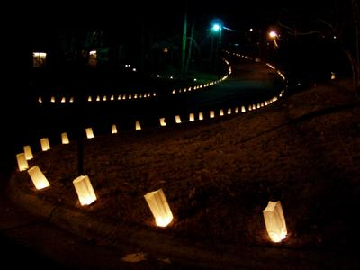
Cosmic Distance Measurements
Luminosity Distance:
use of “Standard Candles”

Slide 7
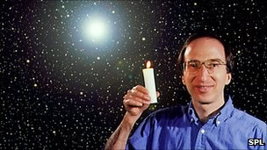
Standard Candles in Cosmology

Slide 8
Luminosity Distance
Definition cosmological luminosity distance:
for a source with INTRINSIC luminosity L
OBSERVED brightness l
In a Robertson-Walker geometry, luminosity distance is
where D(z) is the cosmological distance measure

Slide 9
Luminosity Distance
Cosmological distance measure:
with curvature term S_{k}(x)=sin(x), x, or sinh(x)
Comoving radial distance r(z) at redshift z

Slide 10
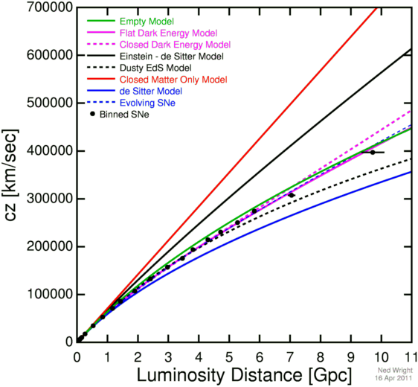
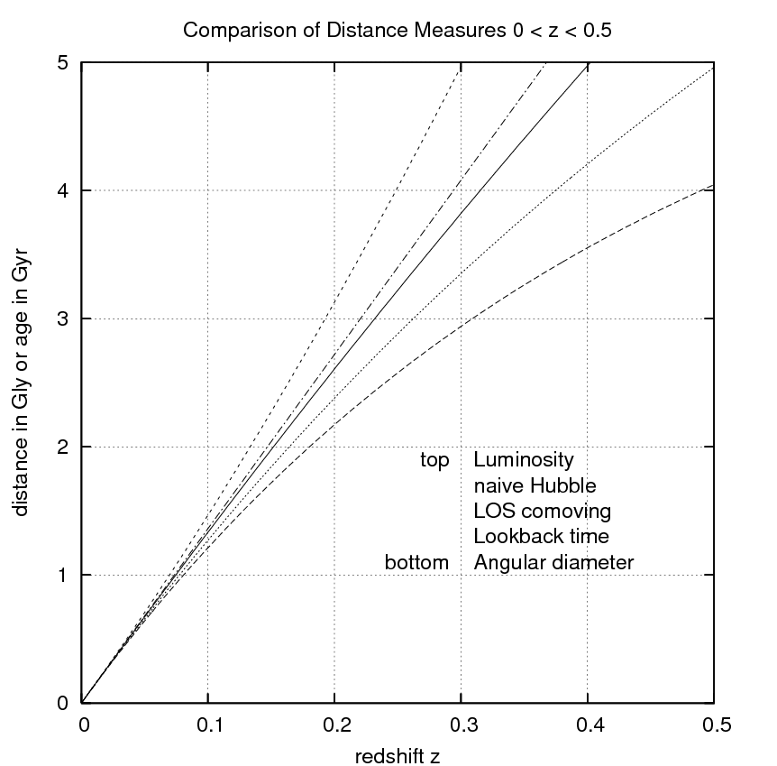
Luminosity Distance
Luminosity Distance at low redshift:
with first term the linear
Hubble expansion term
second term the first
accelerarion/deceleration term:

Slide 11
Type Ia Supernovae

Slide 12
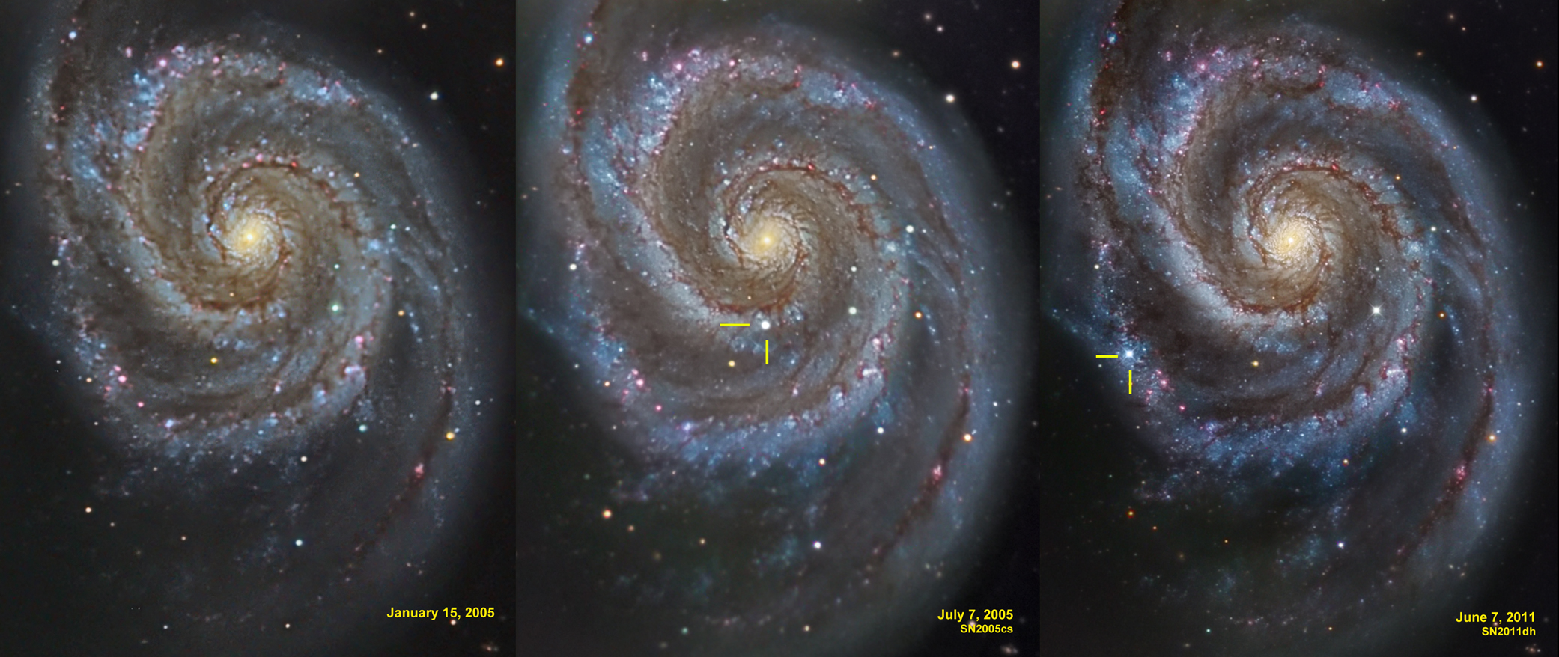
Supernova Explosion & Host Galaxy
M51 supernovae

Slide 13
Supernovae
Supernovae:
gigantic stellar explosions
within few months more radiation than Sun over entire lifetime
shockwaves 5,000-30,000 km/s
enrichment interstellar medium
triggers star formation in surrounding ISM
Supernovae, 4 types
(spectral absorption lines):
SN II
SN Ia - no hydrogen
SN Ib
SN Ic - no helium

Slide 14
Type Ia Supernova Explosion

Slide 15
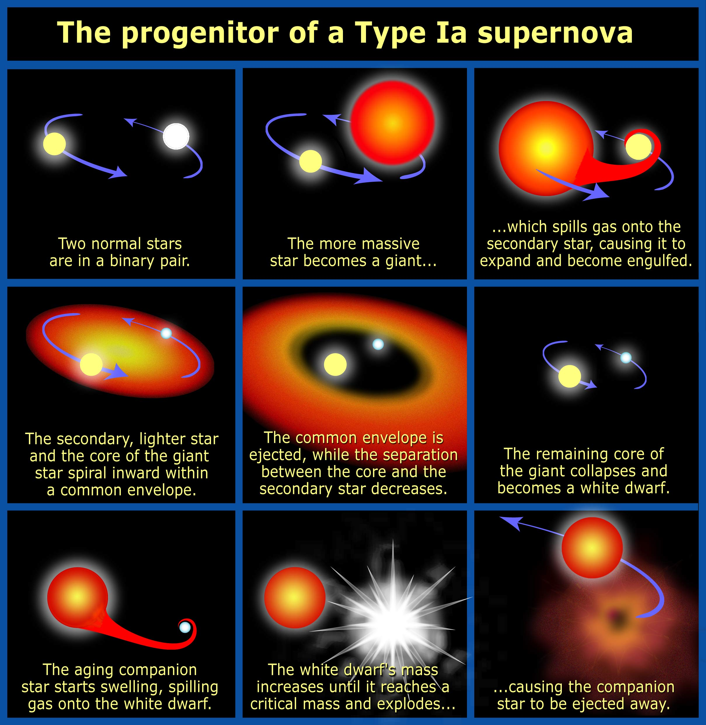

Slide 16
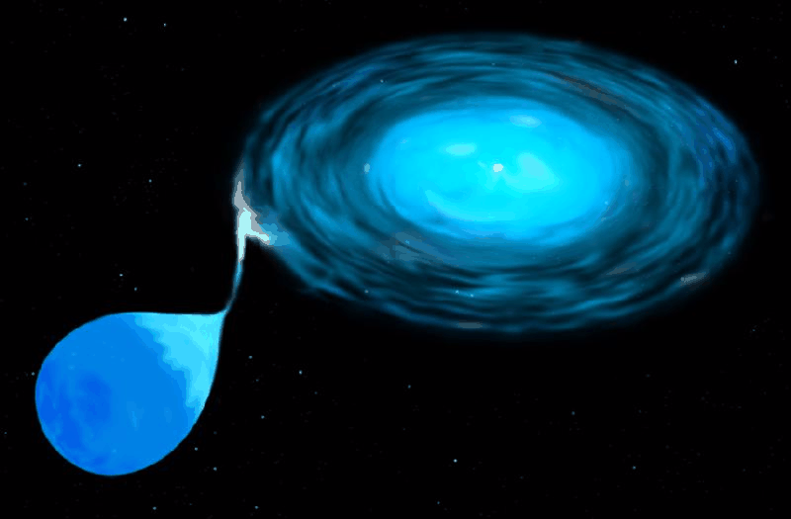
Type Ia Supernova
Amongst the most energetic explosions in our Universe:
E ~ 10⁵⁴ ergs
During explosion the star is as bright as entire galaxy ! (ie. 10¹¹ stars)
Violent explosion Carbon-Oxygen white dwarfs:
Embedded in binary, mass accretion from companion star
When nearing Chandrasekhar Limit (1.38 M•), electron degeneracy pressure
can no longer sustain star.
while contracting under its weight, carbon fusion sets in, powering a
catastrophic deflagration or detonation wave,
leading to a violent explosion, ripping apart entire star
Because exploding stars have nearly uniform progenitor (~1.38 M• white dwarf),
their luminosity is almost the same: M ~ -19.3
Standard Candle

Slide 17
SN1006
Supernova SN1006:
brightest stellar event recorded in history

Slide 18
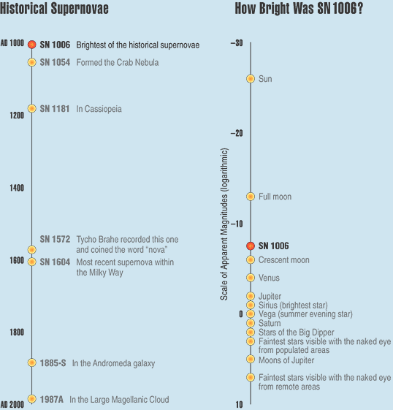
SN1006
Supernova SN1006:
- brightness: m = -7.5
distance: d=2.2 kpc
recorded: China, Egypt, Iraq, Japan,
Switzerland, North America
Supernova SN1006:
brightest stellar event recorded in history

Slide 19
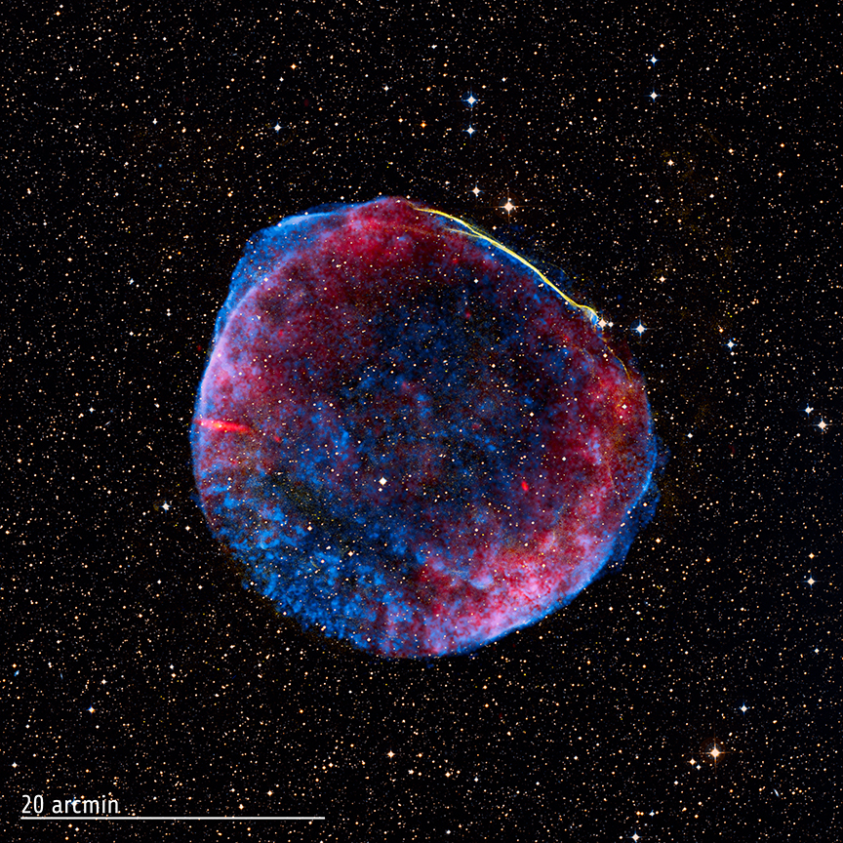
SN1006
Supernova SN1006:
- brightness: m = -7.5
distance: d=2.2 kpc
recorded: China, Egypt, Iraq, Japan,
Switzerland, North America
present-day
Supernova Remnant
Supernova SN1006:
brightest stellar event recorded in history

Slide 20
White Dwarfs

Slide 21
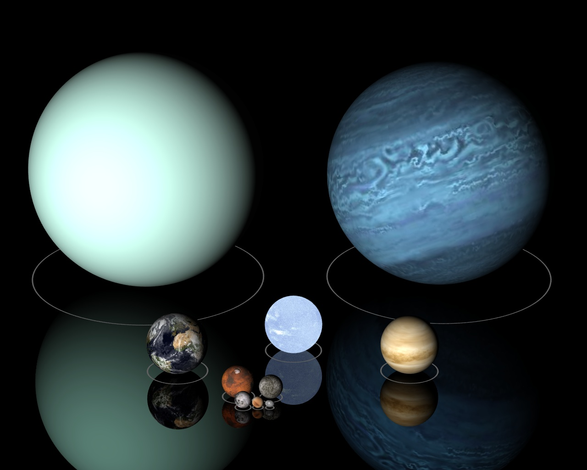
Low Mass Stars
Sirius B

Slide 22
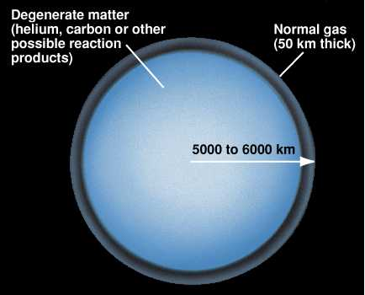
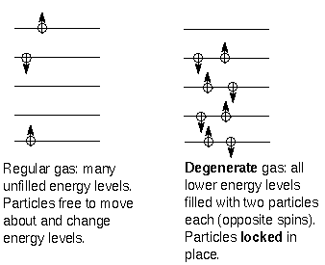

Slide 23
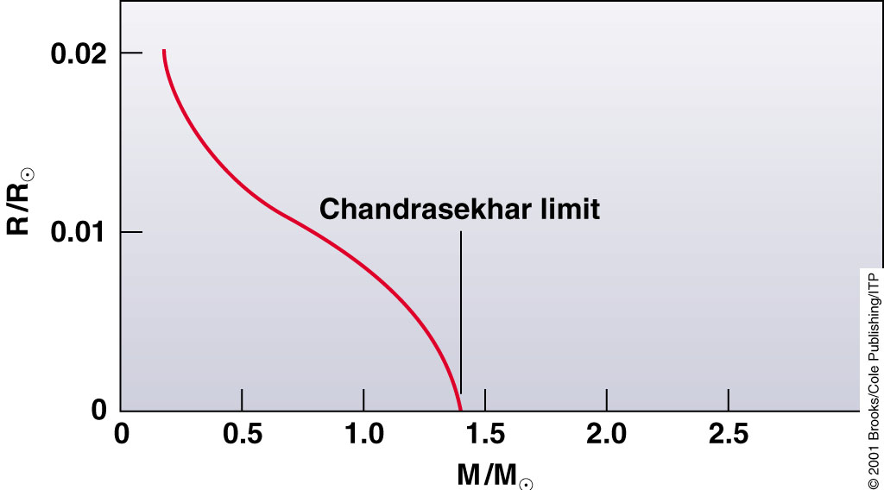
Chandrasekhar Mass Limit
What is the maximum mass that can be supported by
the dense compact material of a white dwarf star?

Slide 24
Supernova Lightcurves

Slide 25
SN 2007uy
Supernova SN 2007uy in NGC2770
while fading, another supernova, SN2008D, went off in same galaxy

Slide 26
Supernova Lightcurve & Spectrum

Slide 27
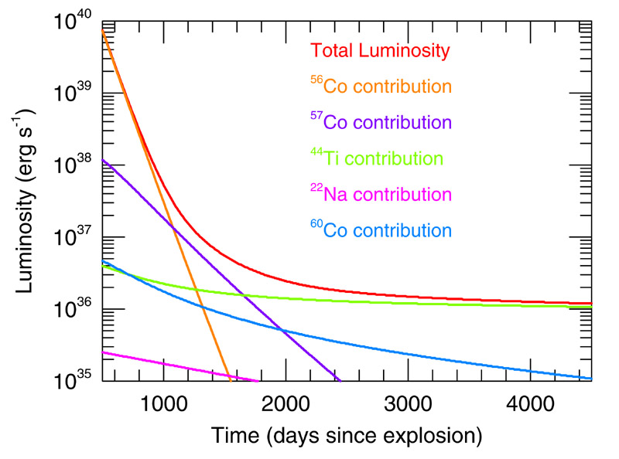
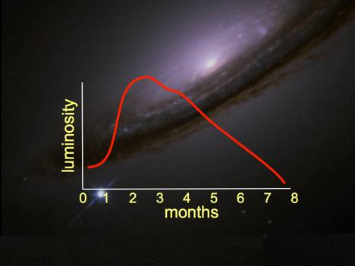
Supernova Lightcurve
Type Ia supernovae follow a characteristic light curve
—the graph of luminosity as a function of time—after the explosion.
This luminosity is generated by the radioactive decay of Nickel-56 through Cobalt-56 to Iron-56.
Maximum absolute magnitude of about -19.3.

Slide 28
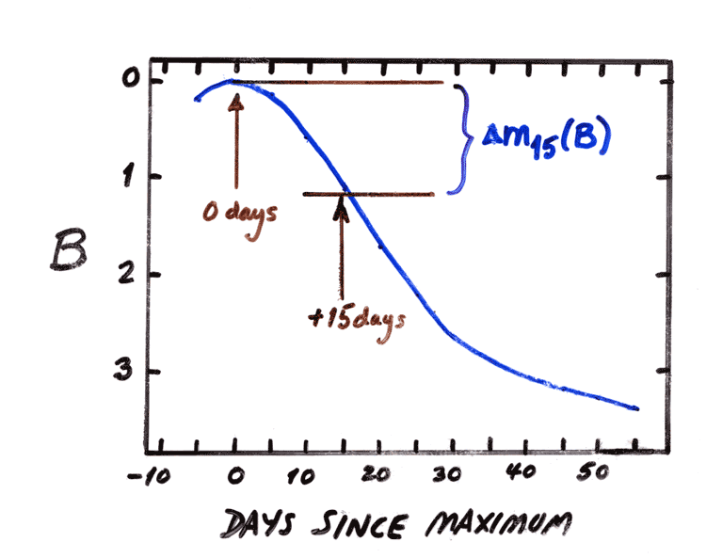
the Phillips Relation
Relationship between
peak luminosity of a Type Ia supernova
speed of luminosity evolution after maximum light.
Mark Phillips (1993):
on the basis of Calan/Tololo Supernova Survey
the faster a supernova fades after peak,
the fainter its intrinsic peak luminosity
reduces scatter in Hubble diagram to <0.2 mag
heuristic relationship, as yet not theoretically “understood”

Slide 29
Supernova Teams:
Practical Aspects

Slide 30
Supernova Cosmology Project
Success of Supernova Projects built on 3 major developments:
the introduction in the 1980s of large mosaic charge-coupled device (CCD) cameras
on 4-meter class telescopes:
- systematic search of thousands of galaxies over large area of sky for
rare supernova events
dramatic increase in computing power in the 1980s:
- enabling vast amount of data processing for automated search of supernovae
amongst the huge number of galaxies monitored
Supernovae Ia as standard candles
- Calan/Tololo Supernova Search: accurate light curves & spectra
- Phillips relation
High-z Supernova Search Team

Slide 31
Supernova Cosmology Project
diligently monitoring millions
of galaxies, in search for that
one explosion …
High-z Supernova Search Team

Slide 32
Supernova Cosmology Project
Challenges to be dealt with by Supernova Teams:
Huge logistic (and political) issue of assuring vast amounts of (strongly contested)
observing time on a range of telescopes (incl. 4-m ones for probing high-z universe)
Dealing with a range of astronomical effects
that would render any subtle cosmological signature insignificant:
- Influence of dust: affecting brightness of supernovae
- Abundance effects: poorly understood influence of
heavy chemical elements on supernova lightcurves
- ….
Results put under heavy scrutiny through large range of tests dealing with
each imaginable pitfall and artefact
Absolutely crucial that two competing teams reached same conclusion independently !!!!
High-z Supernova Search Team

Slide 33
Cosmic Acceleration

Slide 34
Cosmic Acceleration
Hubble Diagram high-z SNIa
• distance vs. redshift z
m-M vs. redshift z
• determine:
- absolute brightness of supernova Ia
- from dimming rate (Phillips relation)
• measure:
- apparent brightness of explosion
• translates into:
- luminosity distance of supernova
- dependent on acceleration parm. q

Slide 35
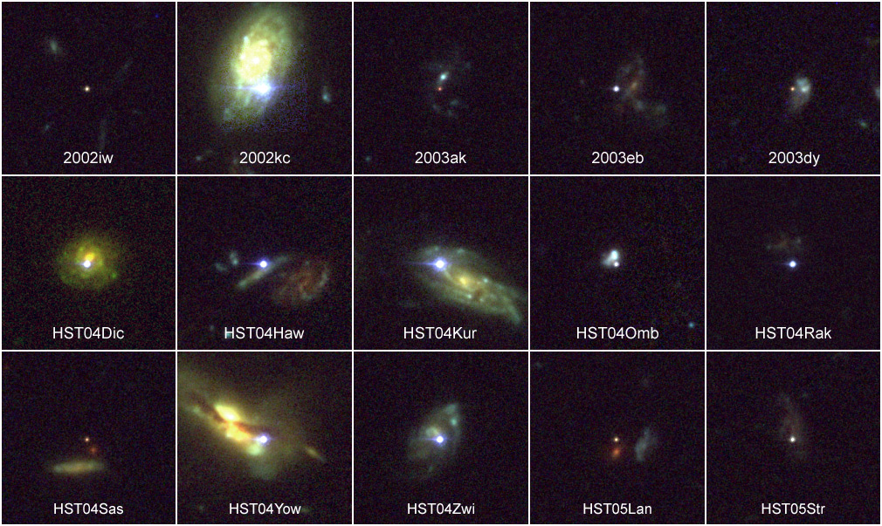
High-z SNIa: sample

Slide 36
Cosmic Acceleration
Hubble Diagram high-z SNIa
• distance vs. redshift z
m-M vs. redshift z
• determine:
- absolute brightness of supernova Ia
- from dimming rate (Phillips relation)
• measure:
- apparent brightness of explosion
• translates into:
- luminosity distance of supernova
- dependent on acceleration parm. q

Slide 37
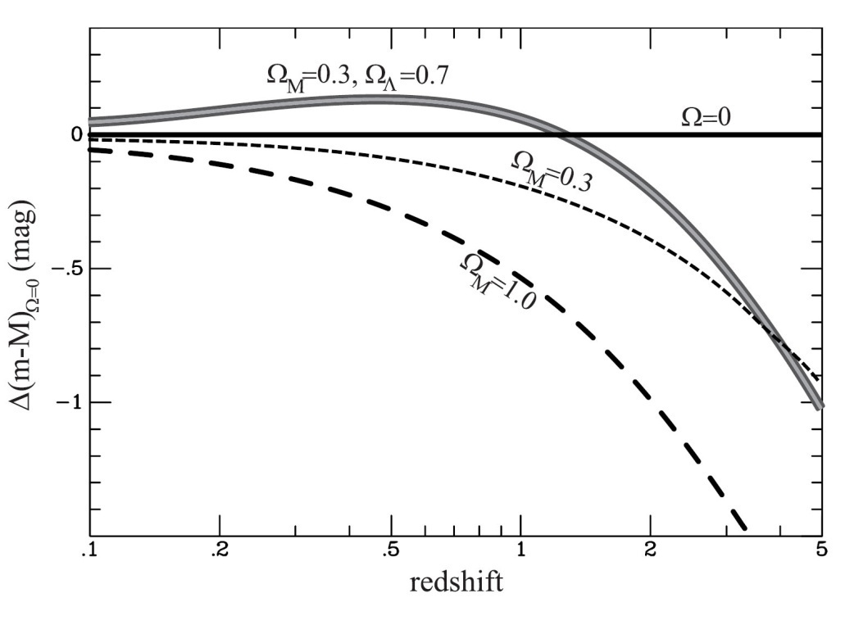
Cosmic Acceleration
Relative Hubble Diagram
∆(m-M) vs. Redshift z
with Hubble diagram for empty Universe
Ω_{m}=0.0, Ω_{Λ}=0.0
as reference.
Acceleration of the Universe:

Slide 38
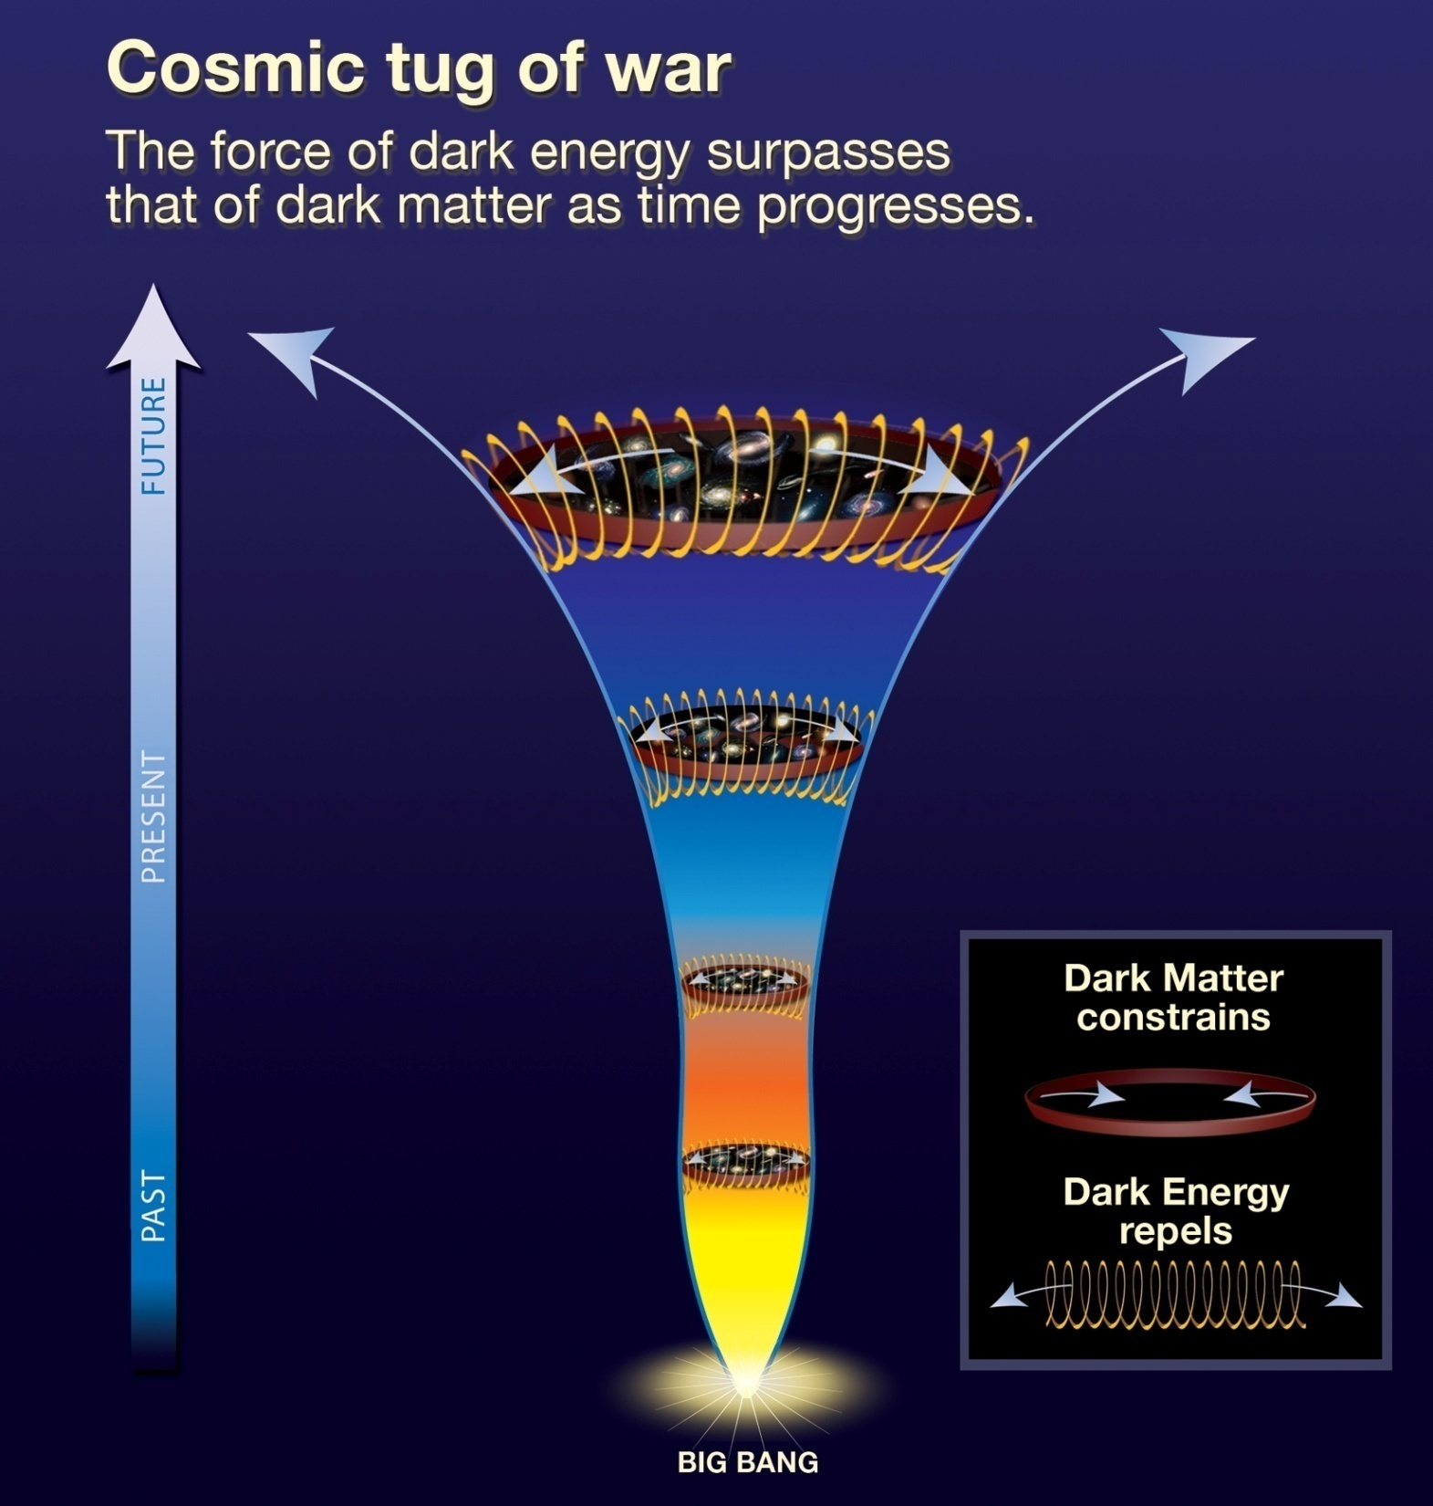
Present:
ACCELERATION
Past:
DECELERATION

Slide 40
Cosmic Deceleration
Before current Dark Energy epoch
• Universe dominated by matter:
Decelerating Expansion
Observable in SNIa at very high z:
z > 0.73
Cosmic deceleration:
SNIa brighter
Cosmic acceleration:
SNIa fainter

Slide 41
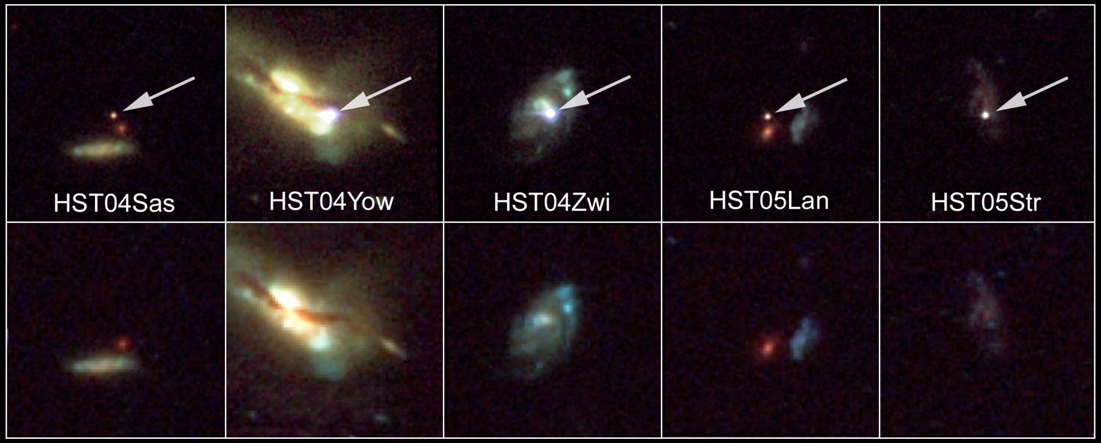
Beyond Acceleration: SNe Ia at z > 0.7
Five high-z SNIa, images HST-ACS camera
SNIa and host galaxies lower panel: before
top panel: after explosion)

Slide 42
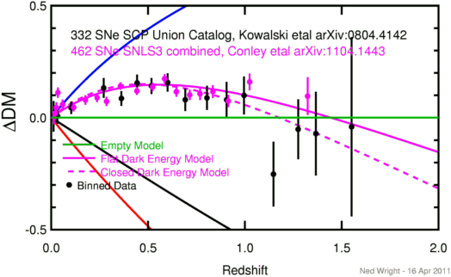
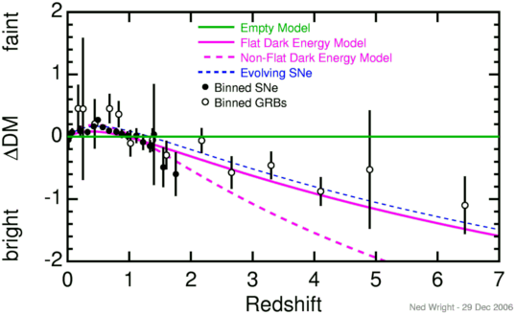
Cosmic Deceleration
Before current Dark Energy epoch
• Universe dominated by matter:
Decelerating Expansion
Observable in SNIa at very high z:
z > 0.73

Slide 43
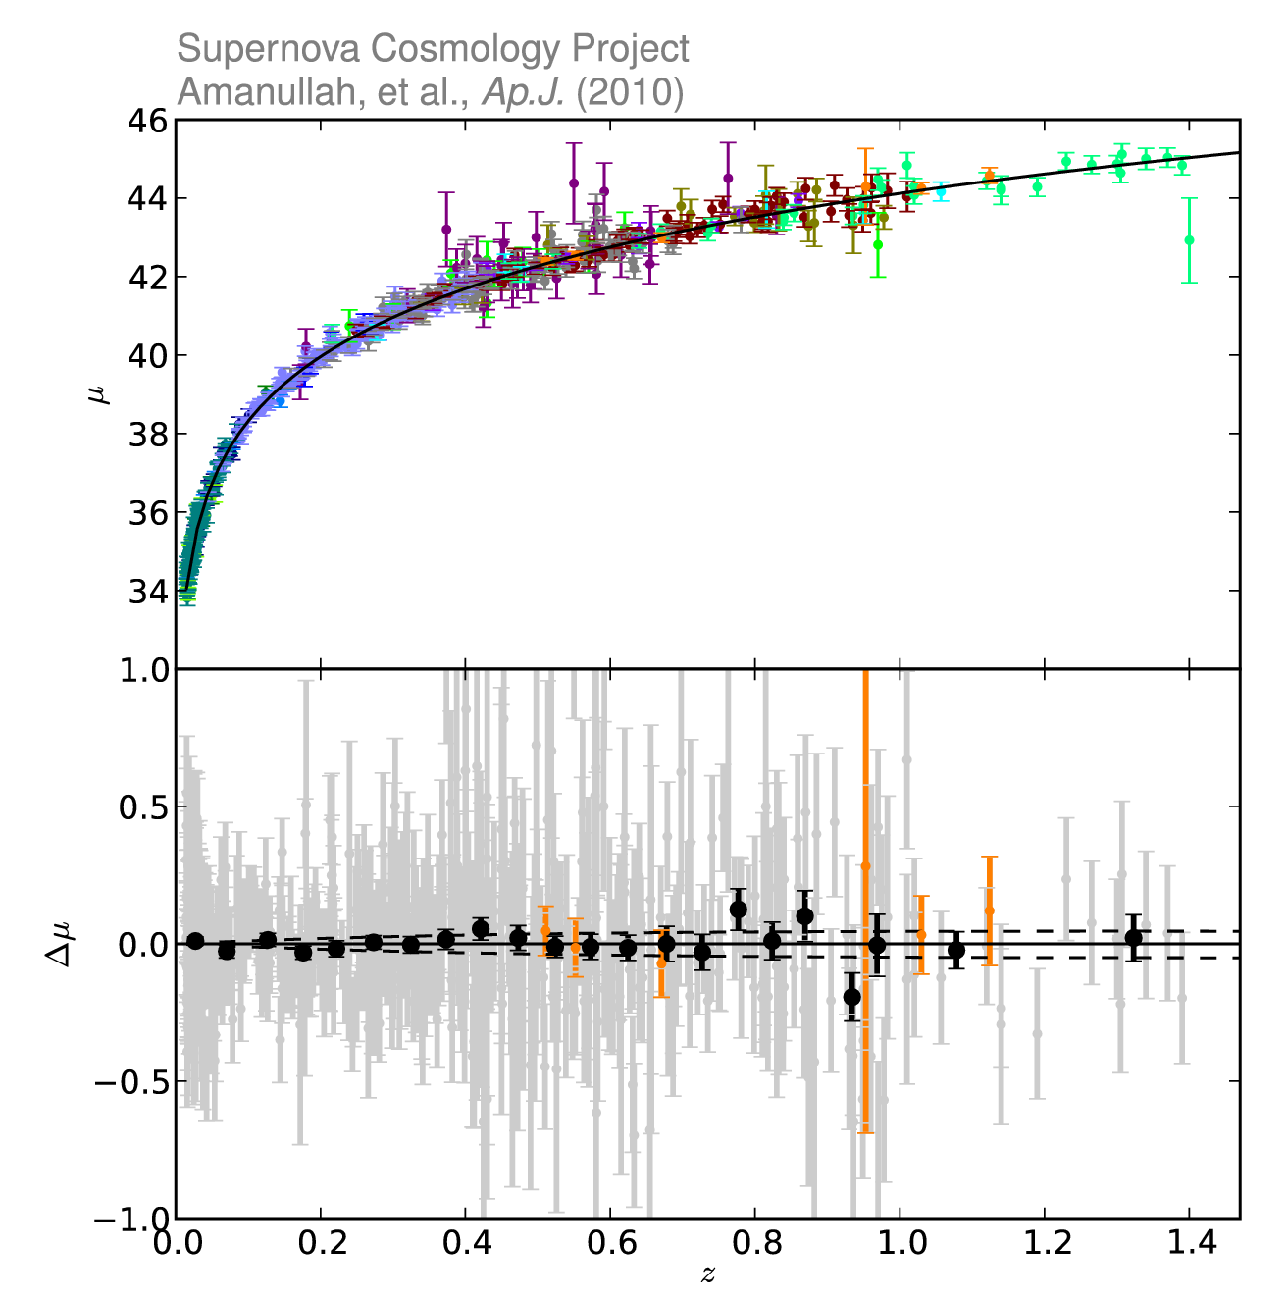
Union2: state-of-the-art SNIa compilation
SCP Union2.1 SN Ia compilation:
719 SNe, 17 datasets
(557 used)
6 z>1 SN Ia
Amanullah et al. 2010

Slide 44
Cosmic Curvature

Slide 45
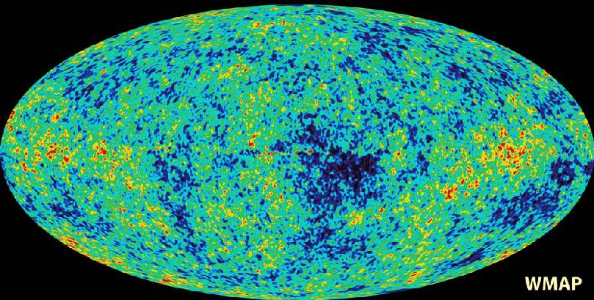
Cosmic Microwave Background
Map of the Universe at Recombination Epoch (WMAP, 2003):
• 379,000 years after Big Bang
• Subhorizon perturbations: primordial sound waves
• ∆T/T < 10-5

Slide 46
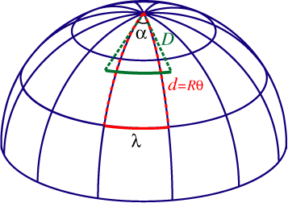
Measuring Curvature
Measuring the Geometry of the Universe:
• Object with known physical size,
at large cosmological distance
● Measure angular extent on sky
● Comparison yields light path,
and from this the curvature of space
W. Hu
In a FRW Universe:
lightpaths described by
Robertson-Walker metric
Geometry of Space

Slide 47
Measuring Curvature
• Object with known physical size,
at large cosmological distance:
• Sound Waves in the Early Universe !!!!
W. Hu
In a FRW Universe:
lightpaths described by
Robertson-Walker metric
Temperature Fluctuations
CMB

Slide 48
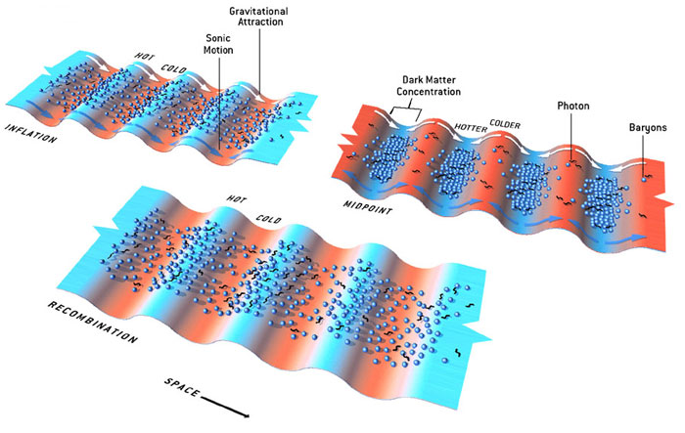
Fluctuations-Origin

Slide 49
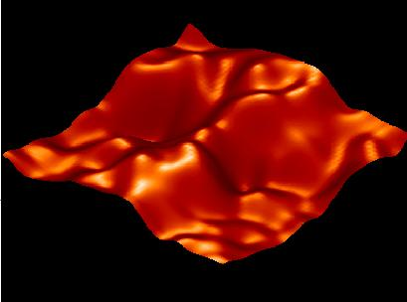
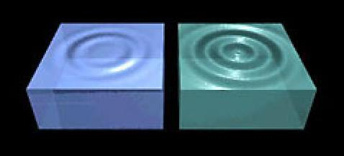
Music of the Spheres
● small ripples in
primordial matter & photon distribution
● gravity:
- compression primordial photon gas
- photon pressure resists
● compressions and rarefactions
in photon gas: sound waves
● sound waves not heard, but seen:
- compressions: (photon) T higher
- rarefactions: lower
● fundamental mode sound spectrum
- size of “instrument”:
- (sound) horizon size last scattering
● Observed, angular size: θ~1º
- exact scale maximum compression, the
“cosmic fundamental mode of music”
W. Hu

Slide 50
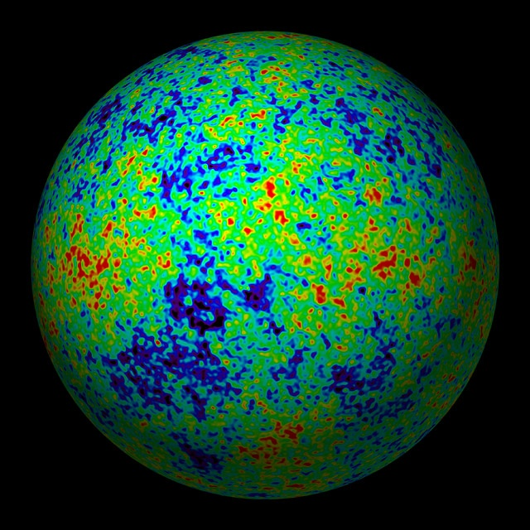
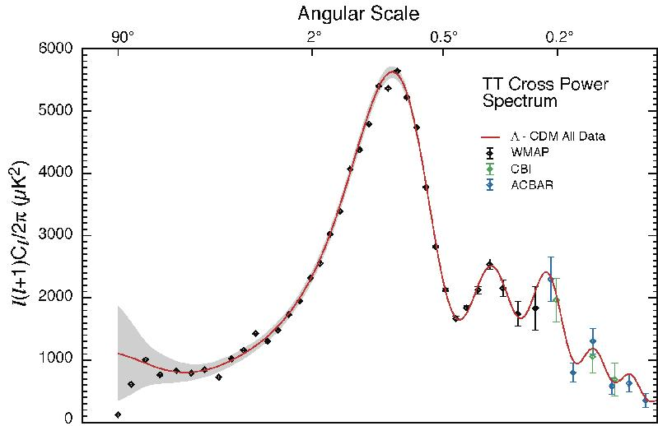
The Cosmic Tonal Ladder
The WMAP CMB temperature
power spectrum
Cosmic sound horizon
The Cosmic Microwave Background Temperature Anisotropies:
Universe is almost perfectly flat

Slide 51
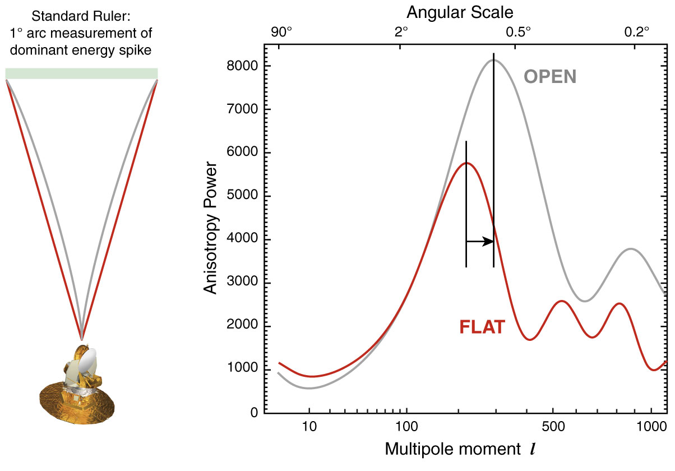
The WMAP CMB temperature
power spectrum

Slide 52
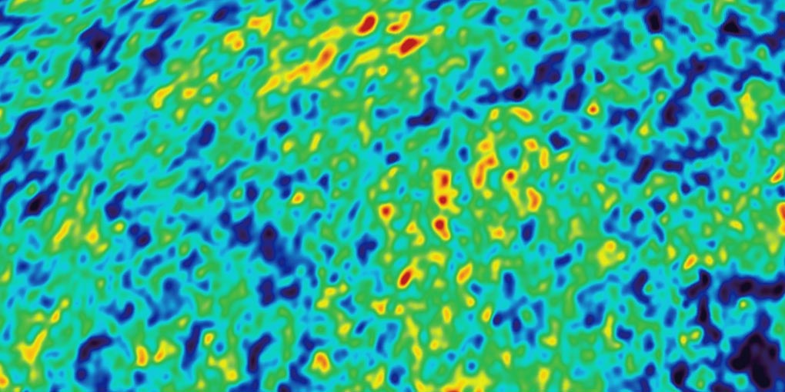
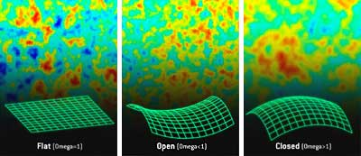
Angular CMB temperature fluctuations
CMB: Universe almost perfectly Flat !

Slide 53
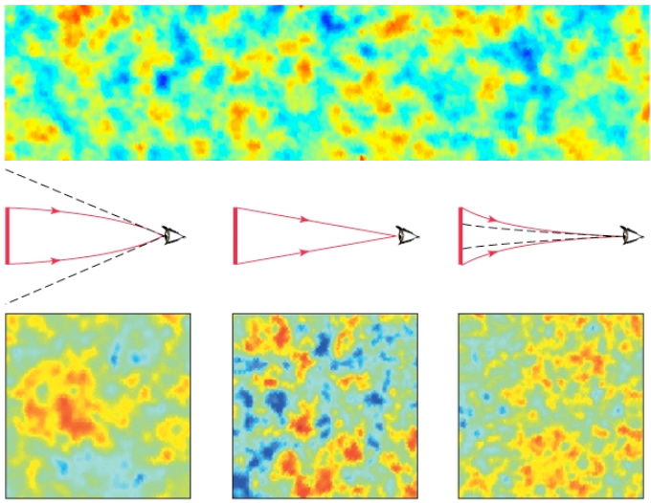
Flat universe from CMB
First peak: flat universe
We know the redshift and the time it took for the light to reach us: from this we know the length of the legs of the triangle and the angle at which we are measuring and the sound horizon.
Closed: hot spots appear larger
Flat: appear as big as they are
Open: spots appear smaller

Slide 54
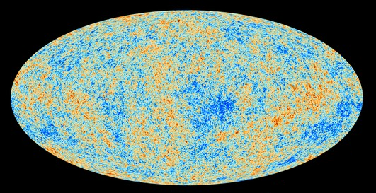
CMB, l up to 2500

Slide 55
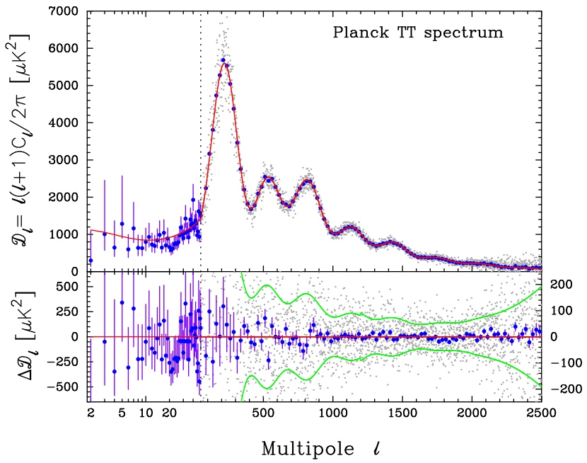
CMB - Fluctuations

Slide 56
Probes
Combined

Slide 57
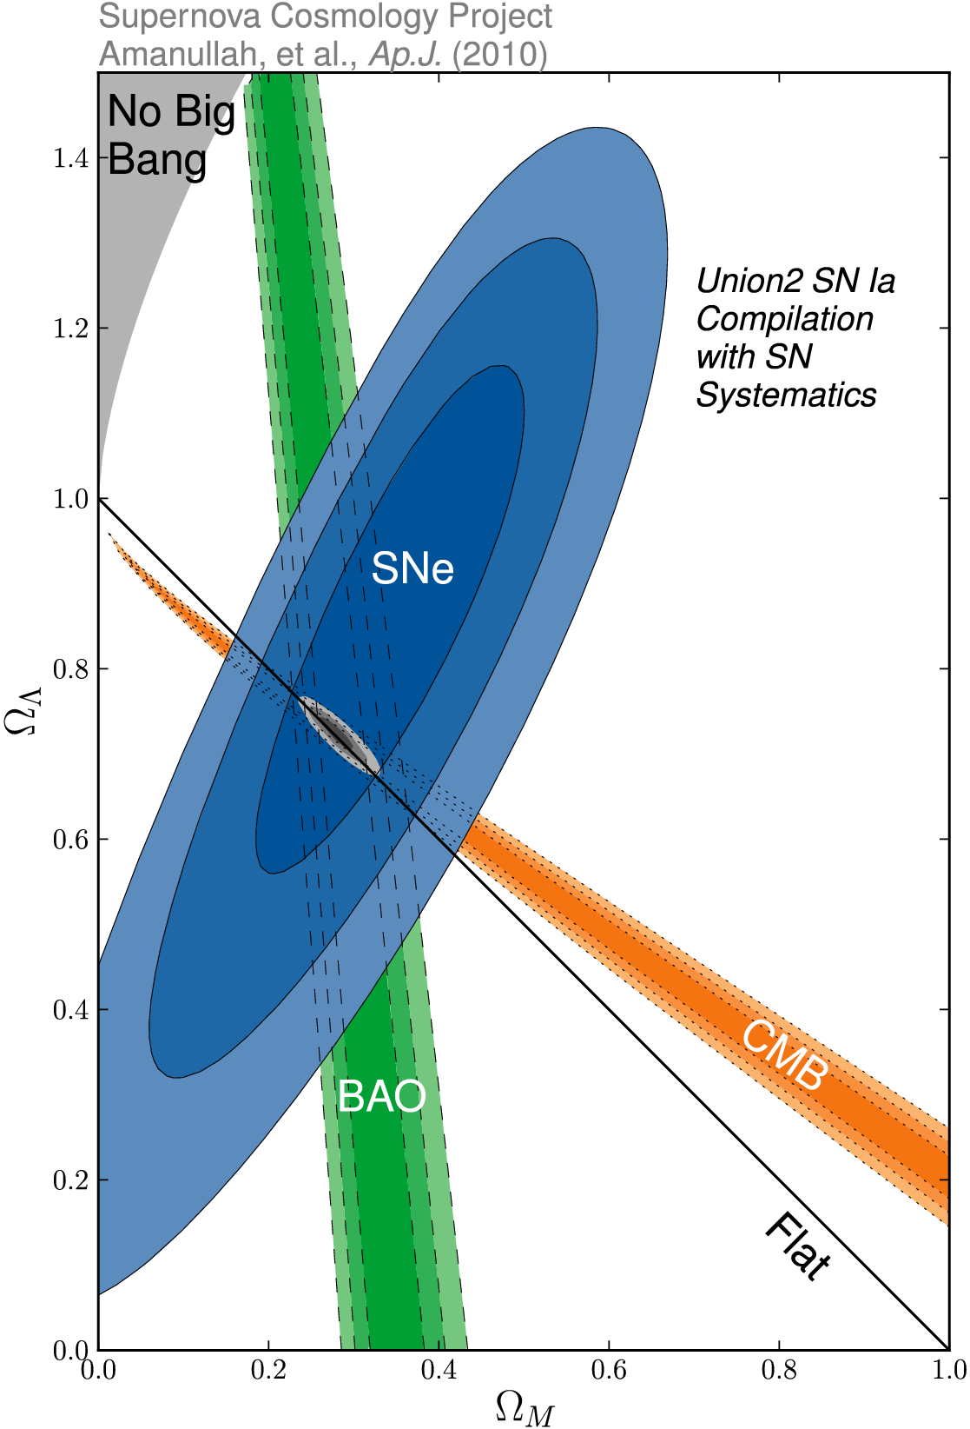
_{m} vs. ☹
SCP Union2 constraints (2010)
on values of matter density _{m}
dark energy density ☹

Slide 58
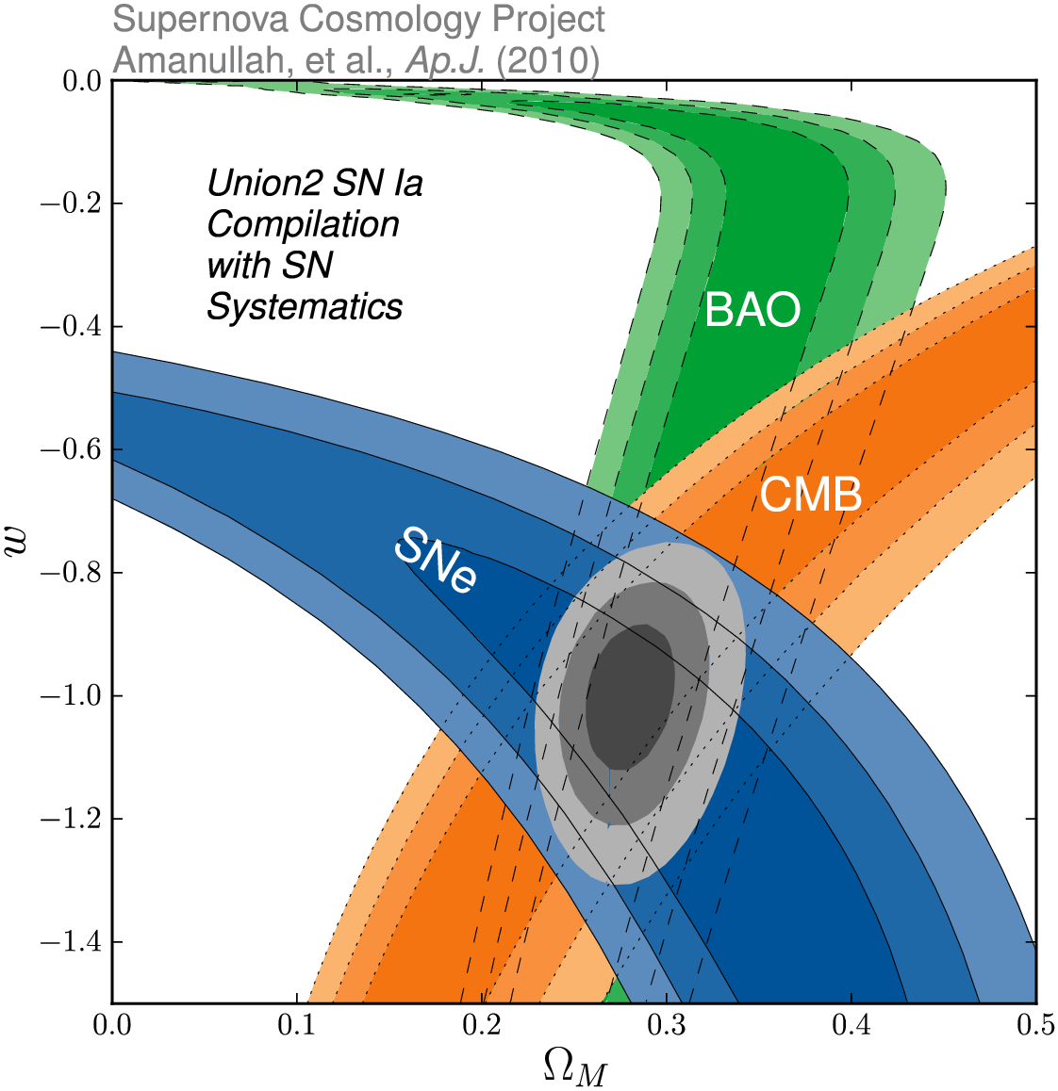
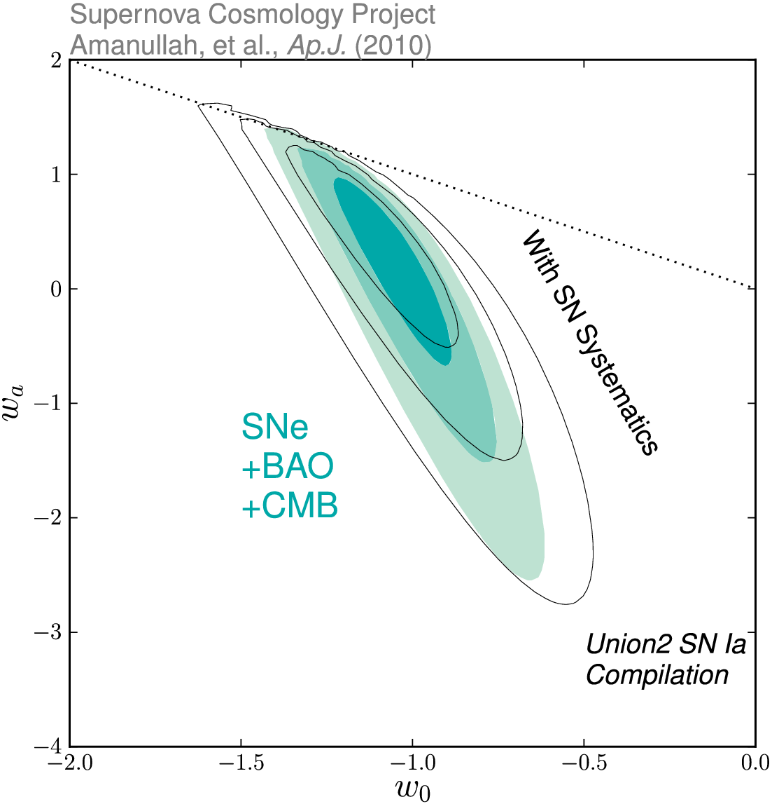
Dark Energy Eqn.State
on dynamical evolution dark energy:
eqn. state parameters w₀
w_{a}
SCP Union2 constraints (2010)
on values of matter density _{m}
dark energy eqn. state w

Slide 59
BAO:
Baryonic Acoustic
Oscillations

Slide 60
What are BAO?
Sound waves traveling in the primordial plasma.
The resonant wavelengths are selected by the time when recombination takes place.
Signature of these waves in the matter distribution in the present universe.

Slide 61
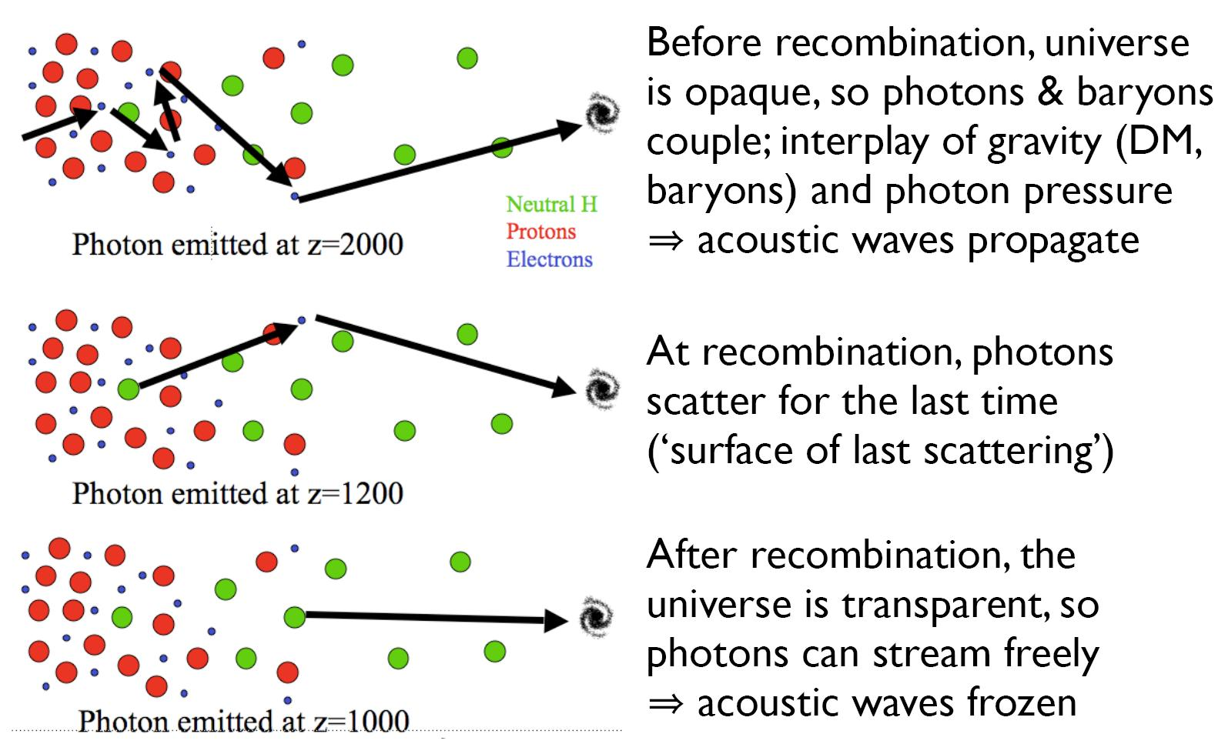
BAO explained

Slide 62
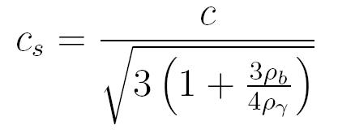
BAO explained
The early universe is a hot plasma in which baryonic matter and radiation are tightly coupled.
The density is not uniform, but there are small variations that oscillate due to gravity and radiation pressure.
The waves stop propagating at recombination, since the photons stop interacting with baryons.

Slide 63
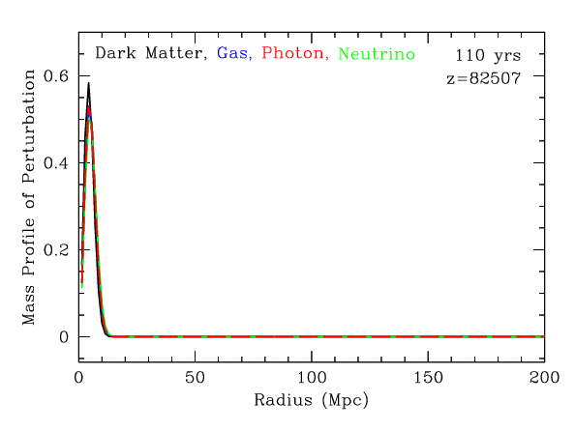
BAO explained

Slide 64
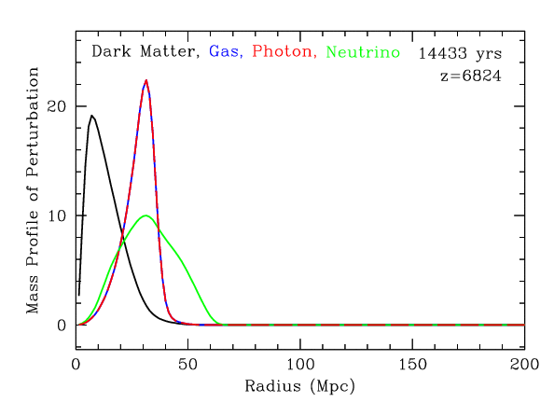
BAO explained

Slide 65
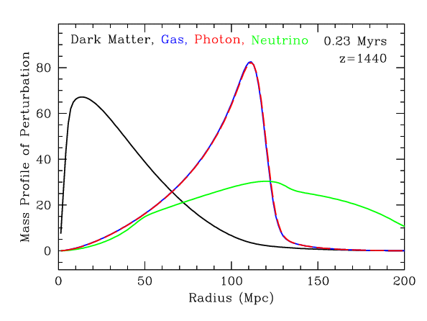
BAO explained

Slide 66
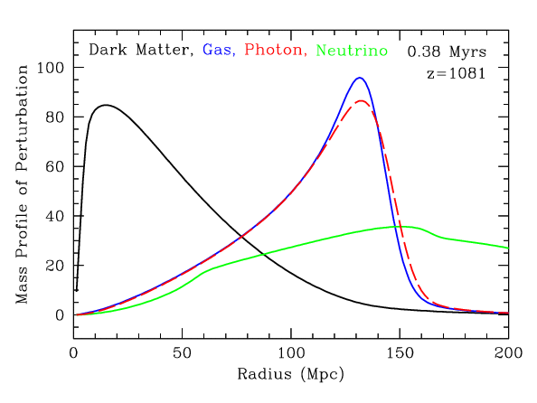
BAO explained

Slide 67
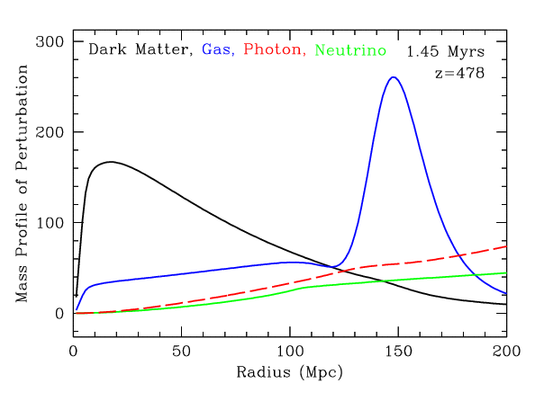
BAO explained

Slide 68
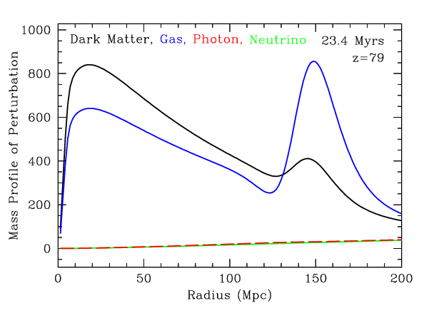
BAO explained

Slide 69
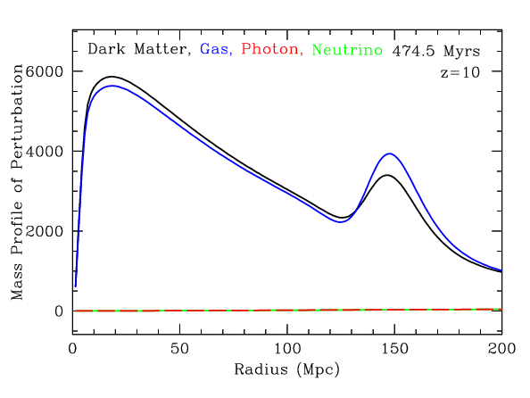
BAO explained

Slide 70
BAO explained

Slide 71
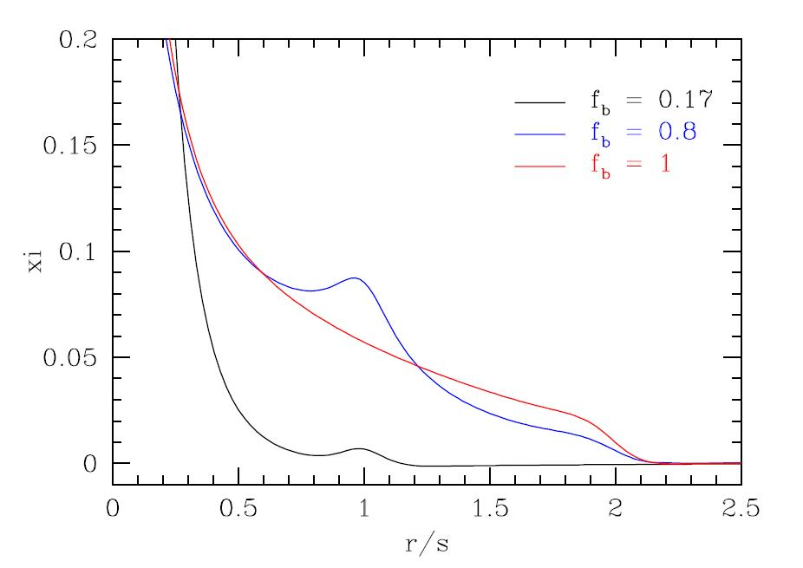
BAO explained

Slide 72
BAO as cosmological tools
Until recombination, the sound wave travels a distance of:
This distance can be accurately determined from the CMB power spectrum, and was found to be 147±2 Mpc.

Slide 73
BAO as cosmological tools
If we know the radius rs, than we can compute both the Hubble factor H(z) and the angular distance DA(z):

Slide 74
Measuring BAO

Slide 75
Measuring BAO

Slide 76
Measuring BAO

Slide 77
Measuring BAO
SDSS galaxies

Slide 78
Measuring BAO
Must use statistical tools to find the acoustic peak!
In the CMB, the acoustic peak if found by computing the power spectrum of the temperature fluctuations across the sky. This determines the distance rs traveled by the sound waves until recombination.
In the baryon distribution, the acoustic peak is computed from the 2-point correlation function or the power spectrum. (The 2-point correlation function quantifies the excess of clustering on a given scale relative to a uniform distribution of matter with the same mean density.)

Slide 79
Measuring BAO

Slide 80
SDSS results
Green, red and blue: increasing Ωm h^2 from 0.12 to 0.14
Magenta: Only CDM
Eisenstein et al. 2005

Slide 81
2dFGRS results
Cole et al. 2005

Slide 82
BAO Results
Kowalski et. al. 2008
w = -1
Flat universe
Jarosik et. al. 2010 –WMAP7

Slide 83
Structure
Growth Factor

Slide 84
Large Scale Flows
Large-Scale Flows:
• On large (Mpc) scales,
structure formation
still in linear regime
• Structure buildup
accompanied
by displacement of matter:
- Cosmic flows
• Directly related to
cosmic matter distribution

Slide 85
Redshift Distortions
Origin of peculiar velocities:
three regimes
• very high-density virialized
cluster (core) regions:
“thermal” motion in cluster,
up to > 1000 km/s
“Fingers of God”
• collapsing overdensity
(forming cluster):
inflow/infall velocity
• Large scales:
(linear, quasi-linear) cosmic flow,
manifestation of structure growth

Slide 88
sky-redshift space 2-pt correlation function (,)
Correlation function determined
in sky-redshift space:
sky position:
redshift coordinate:
Close distances:
distortion due to non-linear
Finger of God
Large distances:
distortions due to large-scale
flows

Slide 89
Redshift Space Distortions Correlation Function
On average, gets amplified
wrt.
Linear perturbation theory
(Kaiser 1987):
Large distances:
distortions due to large-scale
flows

Slide 90
Evolution Growth Rate
Linder 2008
Guzzo et al. 2008
Peebles growth rate factor

Slide 91
ISW:
Integrated
Sachs Wolfe Effect

Slide 92
Dark Energy: ISW
Dark Energy modifies evolution
potential wells

Slide 93
Dark Energy: ISW
Dark Energy modifies evolution
potential wells

Slide 94
Dark Energy & CMB: ISW
The WMAP CMB temperature
power spectrum
Dark Energy modifies evolution
potential wells

Slide 95
ISW & identified voids/clusters
Granett et al. (2008-…)
- LRG distribution vs. predicted ISW signal
identification (super)voids & (super)clusters
correlation with WMAP

Slide 96
Dark Energy: ISW
Dark Energy modifies evolution
potential wells

Slide 97
Cosmic Voids:
Shape of Voids

Slide 98
Cosmic Voids

Slide 99
Evolving Void Shapes
Evolution of void shape
sensitive probe of dark energy:
Park & Lee 2007
Lavaux & Wandelt 2010

Slide 100
Evolving Void Shapes
Measuring void shape by WVF
Bos et al. 2011:
Trend of evolving void shape
as function of dark energy eqn.state confirmed.

Slide 101
Future Experiments

Slide 102
Euclid
Euclid:
father of geometry
ESA
Cosmic Vision
2020-2025
1.2 m Korsch telescope
visible light:
m=24.5 CCD imaging
IR (Y,J,H) band photometer
spectrometer 108 bright gals
15,000 sq. deg. survey
40 sq. deg. deep survey
Combination:
- DUNE grav. Lensing
- SPACE BAO

Slide 103
Euclid
ESA
Cosmic Vision
2020-2025
1.2 m Korsch telescope
visible light:
m=24.5 CCD imaging
IR (Y,J,H) band photometer
spectrometer 108 bright gals
15,000 sq. deg. survey
40 sq. deg. deep survey
Combination:
- DUNE grav. Lensing
- SPACE BAO

Slide 104
LSST:
Large Synoptic Survey Telescope
8.4 m primary mirror
widefield survey telescope
El Penon, Chile
2682 m. mountain
start operation: 2015
3.5 deg. angle of view
3.2 Gigapixel prime focus
digital camera
200,000 images per year
30 Tbyte per night
partial funding Bill Gates

Slide 105
Summary

Slide 106
Take-Home Facts
Strong evidence Accelerated Expansion
- since supernova discovery, 100s SNIa observed over broader range redshifts
- based solely upon supernova Hubble diagram, independent of General Relativity,
very strong evidence expansion Universe accelerated recently
2. Dark energy as cause cosmic acceleration
- within general relativity, accelerated expansion cannot be explained by any known
form of matter or energy
- it can be accommodated by a nearly smooth form of energy with large negative pressure,
Dark Energy, that accounts for about 73% of the universe.
Independent evidence dark energy
- Cosmic Microwave Background and Large Scale Structure data provide independent evidence,
within context of CDM model of structure formation, that the universe is filled with a smooth
medium accounting for 73% of the total energy content of the universe.
- that came to dominate the dynamics of the universe once all observed structure had formed

Slide 107
Take-Home Facts
Vacuum energy as dark energy
- simplest explanation for dark energy is the energy associated with the vacuum
- mathematically equivalent to a cosmological constant
- However, most straightforward calculations of vacuum energy density from zero-point
energies of all quantum fields lead to estimates which are a bit too large,
in the order of ~10¹²⁰
5. Dark theories of Dark Energy
- There is no compelling theory of dark energy
- Beyond vacuum energy, man intriguing ideas: light scalar fields, additional spatial dimensions, etc.
- Many models involve time-varying dark energy
6. New Gravitational Theories ?
- alternatively, cosmic acceleration could be a manifestaation of gravitational physics beyond
General Relativity
- however, as yet there is no self-consistent model for new gravitational physics that is
consistent with large body of data that constrains theories of graavity.

Slide 108
Take-Home Facts
7. Dark destiny
8. At the nexus of many physical mysteries
9. Two big questions
a) Is dark energy something different than vacuum energy
b) Does General Relativity self-consistently describe cosmic acceleration ?
10. Probing Dark Energy

