Slide 1
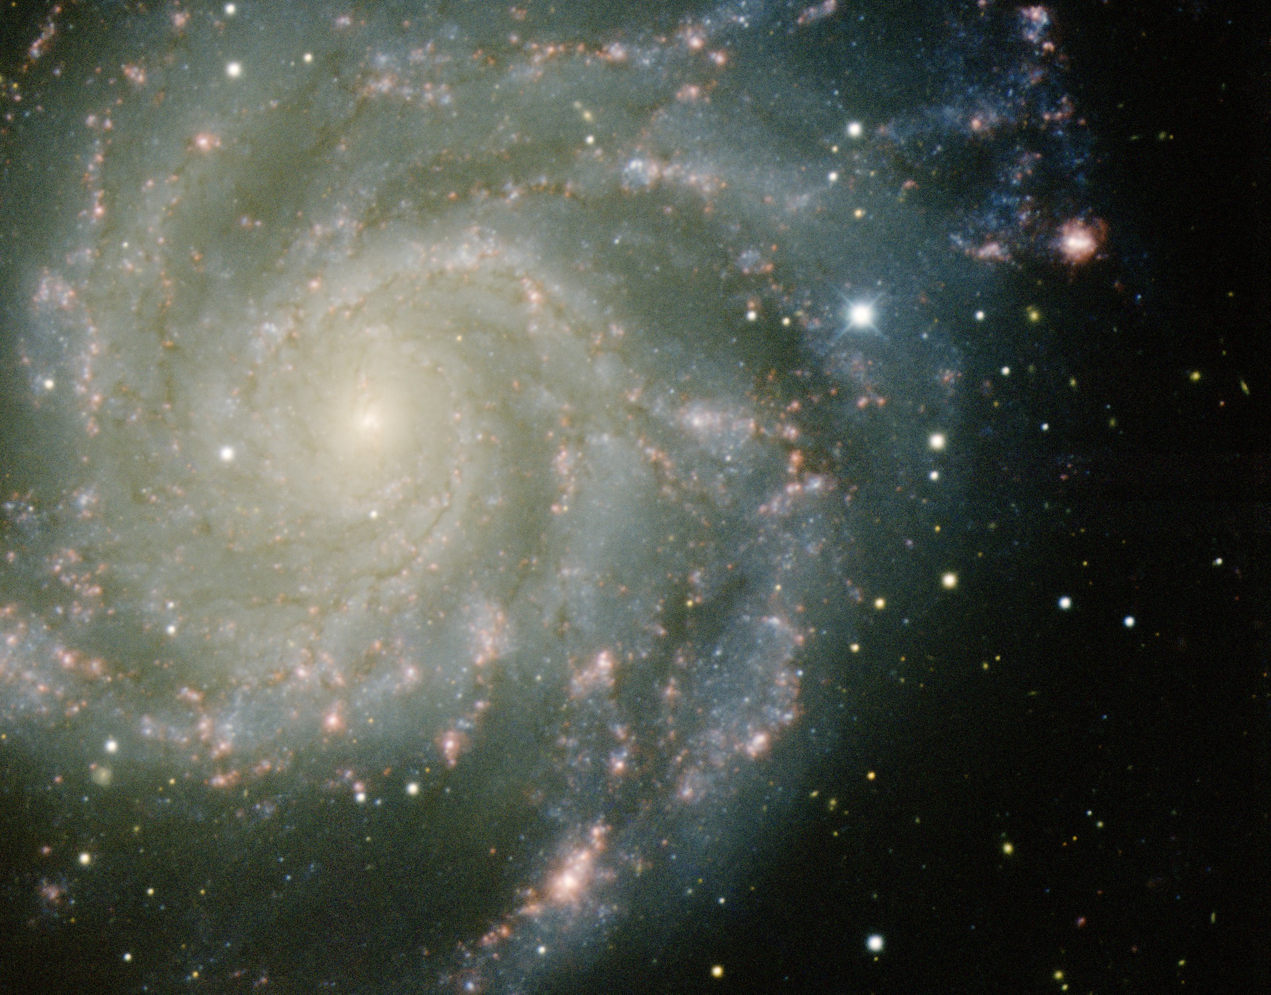
Dark Energy
Caput Lecture Series
Groningen University
November 2013 - January 2014

Slide 2
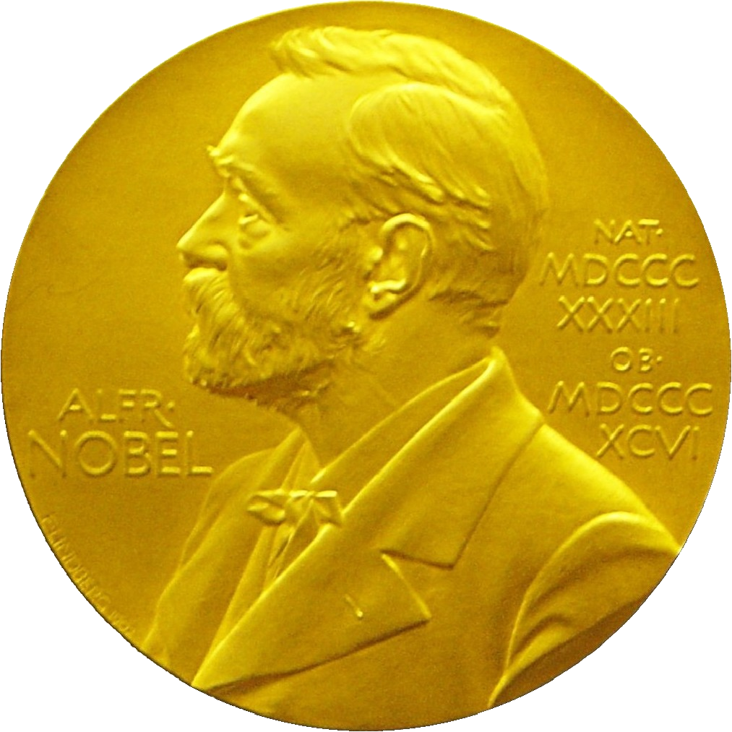
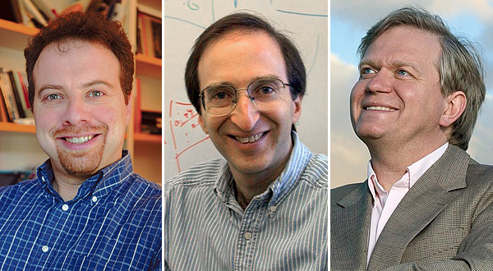
Nobel Prize Laureates
Adam Riess
Saul Perlmutter
Brian Schmidt

Slide 3
Nobel Prize Physics 2011
“the most startling discovery in physics since
I have been in the field.”
E. Witten
“I was shocked by my discovery, I just
assumed we made a mistake"
Brian Schmidt

Slide 4
the Supernova Teams

Slide 5
Supernova Cosmology Project
High-z Supernova Search Team

Slide 6
Supernova Cosmology Project
SCP:
Saul Perlmutter Lawrence Berkeley National Laboratory
~ 31 members, Australia, Chile, France, Spain, Sweden, UK, USA
R. Ellis, A. Filippenko, I. Hook, M. Irwin, P. Ruiz-Lapuente, …
HZST:
Brian Schmidt ANU, Mount Stromlo Observatory, Australia
Adam Riess JHU, STScI (1998: Harvard)
20 members, Australia, Chile, Europe, USA
A. Filippenko, M. Hamuy, R. Kirshner, B. Leibundgut, M. Phillips, J. Tonry …
High-z Supernova Search Team

Slide 7
Supernova Cosmology Project
Riess et al., 1998, Astronomical Journal, 116, 1009
subm. March 13, 1998; accepted May 1998
5822 citations (16/11/11)
Perlmutter et al. , 1999, Astrophysical Journal, 517, 565
5916 citations (16/11/11)
High-z Supernova Search Team

Slide 8
Supernova Cosmology Project
2006: Shaw Prize
2007: Gruber Cosmology Prize
2011: Nobel Prize
Jim Peebles, Gruber Prize 2007 ceremony:
“first, for solving the mass density of the Universe
secondly, for solving the age crisis”
High-z Supernova Search Team

Slide 9
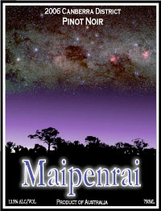
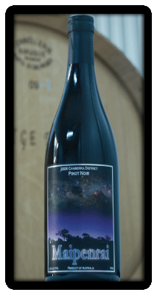
“I was shocked by my discovery, I just
assumed we made a mistake"
Brian Schmidt

Slide 10
Einstein’s Blunder

Slide 11
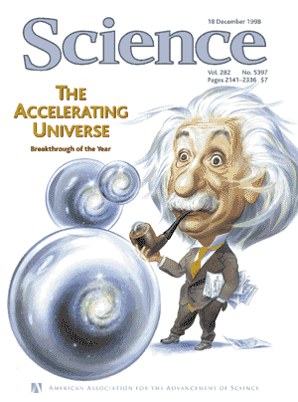
Science Magazine 1998
Science
Breakthrough of the Year
1998

Slide 12
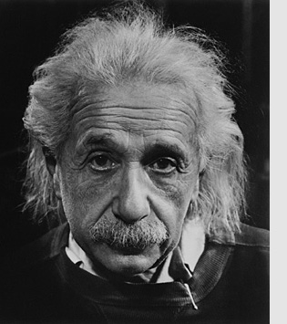
☹
Einstein’s Biggest Blunder

Slide 13
Cosmic Expansion

Slide 14
Friedmann-Robertson-Walker
Universe:
the Big Bang Universe

Slide 15
Einstein Field Equation

Slide 16
Einstein Field Equation
curvature side
energy-momentum side

Slide 17
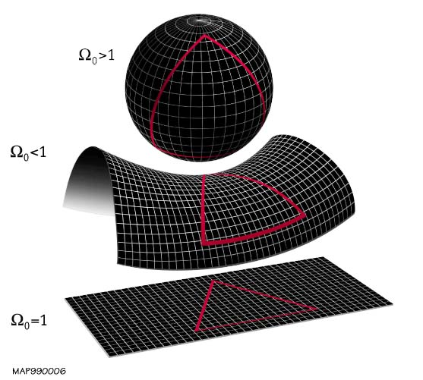
Uniformly Curved Space
K=+1
K= -1
K=0

Slide 18
Friedmann-Robertson-Walker-Lemaitre Universe

Slide 19
Friedmann-Robertson-Walker-Lemaitre Universe
pressure
cosmological
constant
density
curvature term

Slide 20
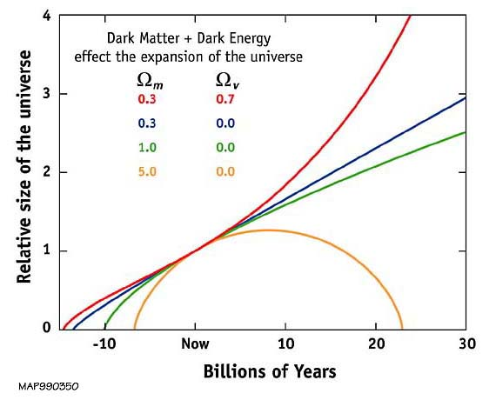
Our Universe ?
Einstein-de Sitter
Universe ?

Slide 21
Hubble Expansion
Edwin Hubble
(1889-1953)
v = H r
Hubble Expansion

Slide 22
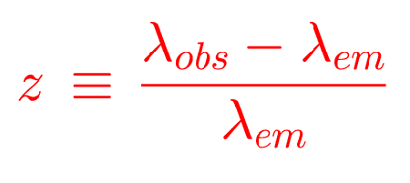
Cosmic Redshift

Slide 23
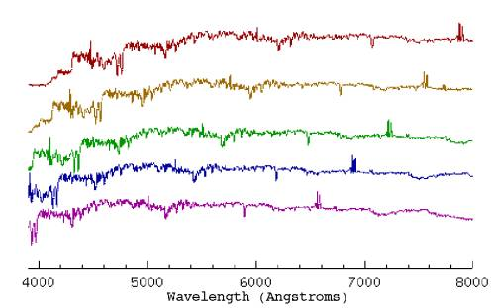
Redshift & Galaxy Spectra
Examples of redshifted galaxy spectra

Slide 25
FRW Dynamics
The individual contributions to the energy density of
the Universe can be figured into the  parameter:
- radiation
- matter
- dark energy/
cosmological constant

Slide 26
FRW Universe: Curvature
There is a 1-1 relation between the total energy content
of the Universe and its curvature. From FRW equations:

Slide 27
FRW Dynamics: Cosmic Acceleration
Cosmic acceleration quantified
by means of dimensionless deceleration parameter q(t):
Examples:

Slide 28
How Much ?
Cosmic Curvature

Slide 29
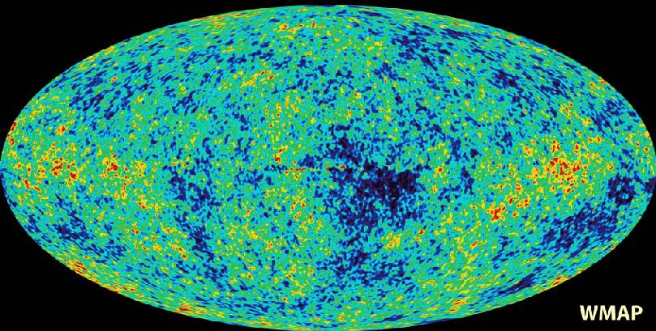
Cosmic Microwave Background
Map of the Universe at Recombination Epoch (WMAP, 2003):
• 379,000 years after Big Bang
• Subhorizon perturbations: primordial sound waves
• ∆T/T < 10-5

Slide 30
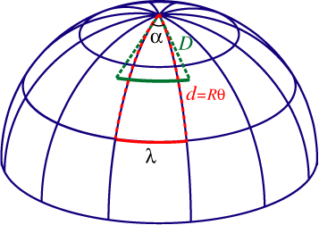
Measuring Curvature
Measuring the Geometry of the Universe:
• Object with known physical size,
at large cosmological distance
● Measure angular extent on sky
● Comparison yields light path,
and from this the curvature of space
W. Hu
In a FRW Universe:
lightpaths described by
Robertson-Walker metric
Geometry of Space

Slide 31
Measuring Curvature
• Object with known physical size,
at large cosmological distance:
• Sound Waves in the Early Universe !!!!
W. Hu
In a FRW Universe:
lightpaths described by
Robertson-Walker metric
Temperature Fluctuations
CMB

Slide 32
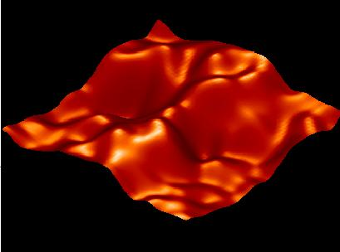
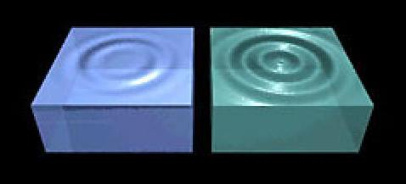
Music of the Spheres
● small ripples in
primordial matter & photon distribution
● gravity:
- compression primordial photon gas
- photon pressure resists
● compressions and rarefactions
in photon gas: sound waves
● sound waves not heard, but seen:
- compressions: (photon) T higher
- rarefactions: lower
● fundamental mode sound spectrum
- size of “instrument”:
- (sound) horizon size last scattering
● Observed, angular size: θ~1º
- exact scale maximum compression, the
“cosmic fundamental mode of music”
W. Hu

Slide 33
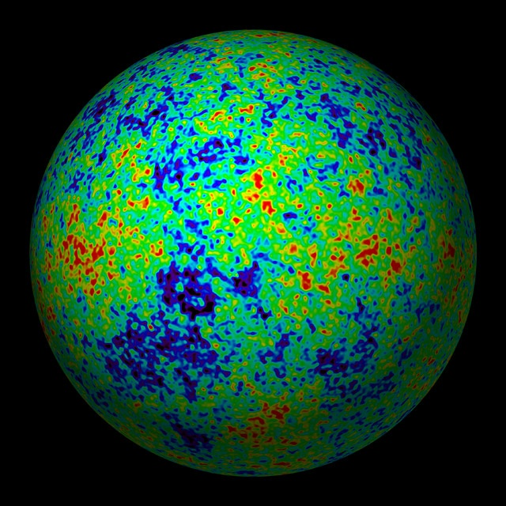
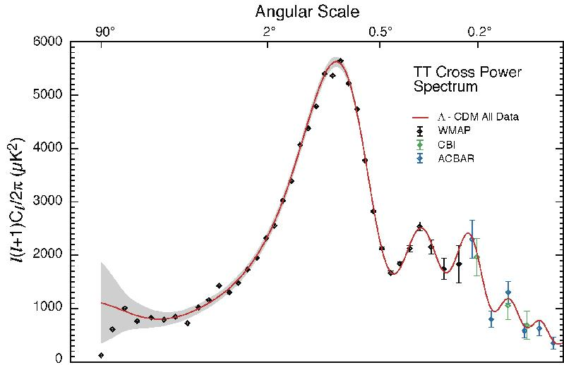
The Cosmic Tonal Ladder
The WMAP CMB temperature
power spectrum
Cosmic sound horizon
The Cosmic Microwave Background Temperature Anisotropies:
Universe is almost perfectly flat

Slide 34
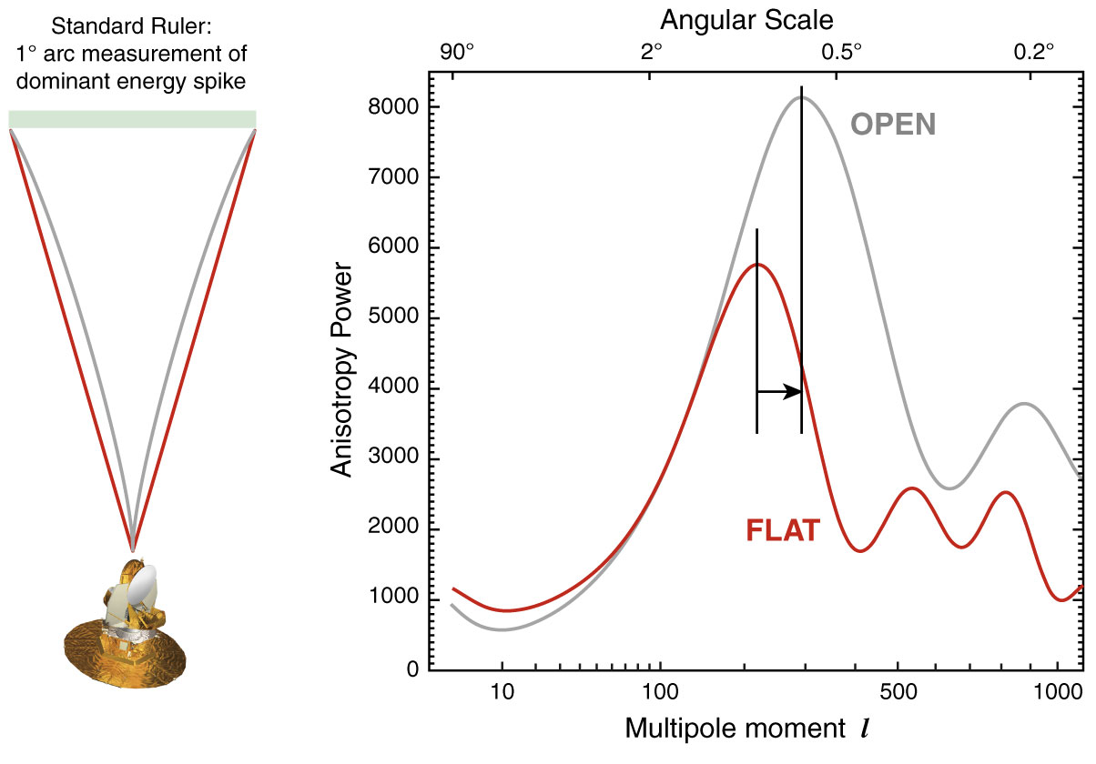
The WMAP CMB temperature
power spectrum

Slide 35
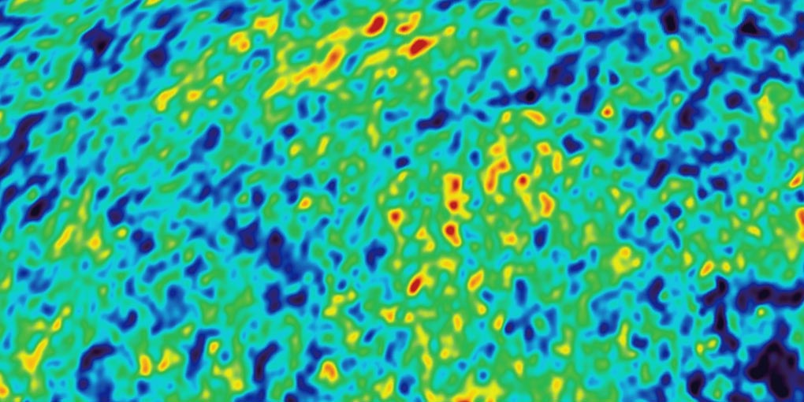
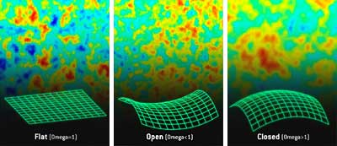
Angular CMB temperature fluctuations
CMB: Universe almost perfectly Flat !

Slide 36
Cosmic Constraints

Slide 37
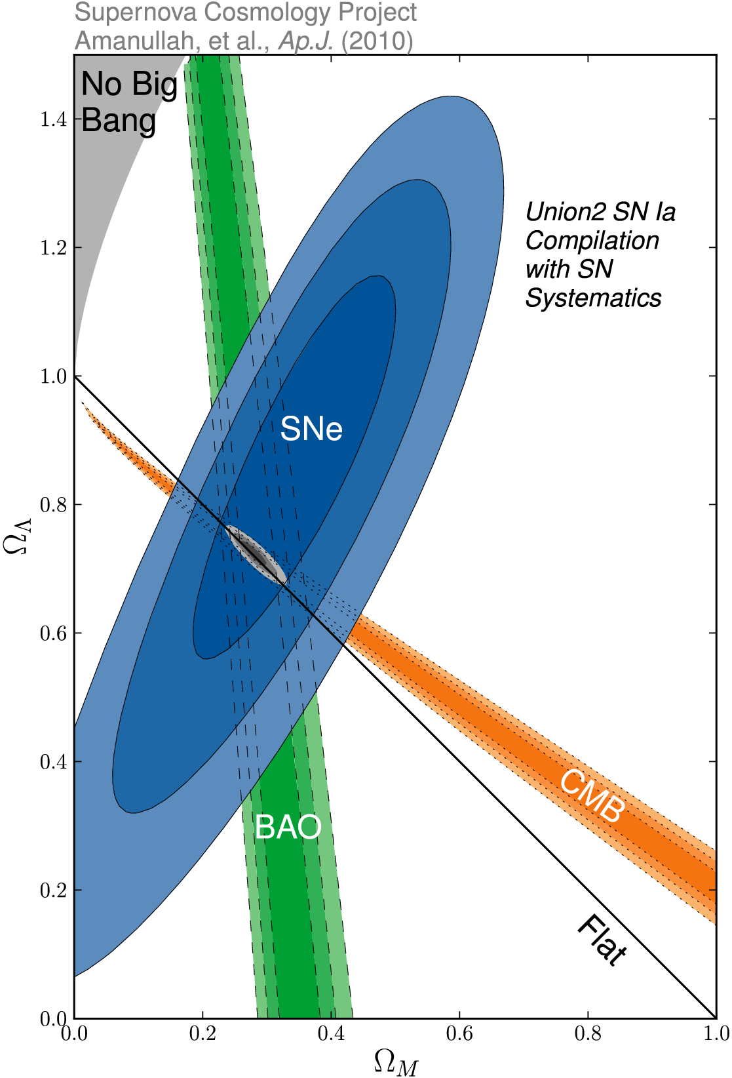
_{m} vs. ☹
SCP Union2 constraints (2010)
on values of matter density _{m}
dark energy density ☹

Slide 38
Concordance Universe

Slide 39
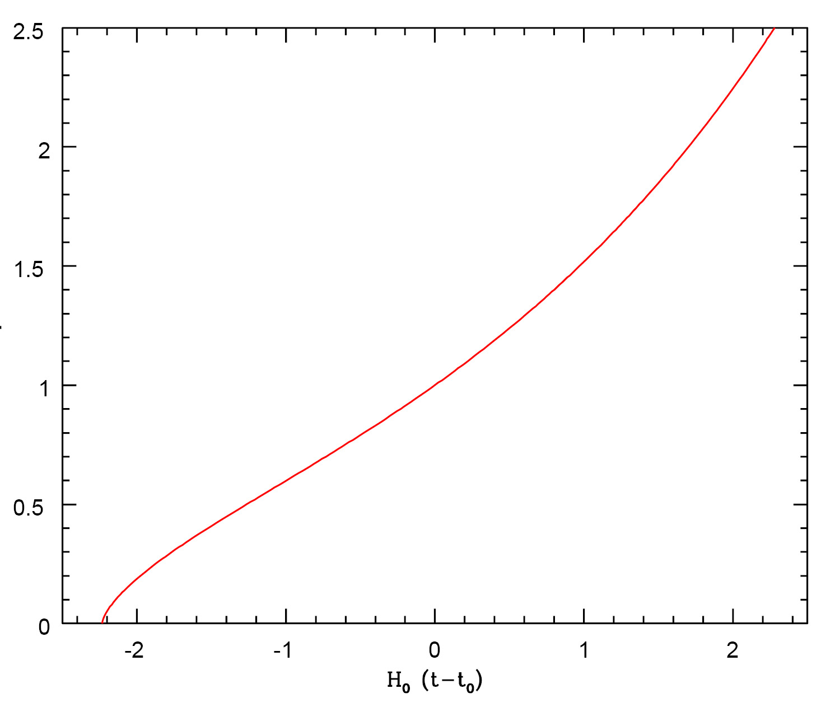
Concordance Expansion
expansion like
De Sitter expansion
acceleration
past
future
expansion like
EdS universe
today
deceleration

Slide 41
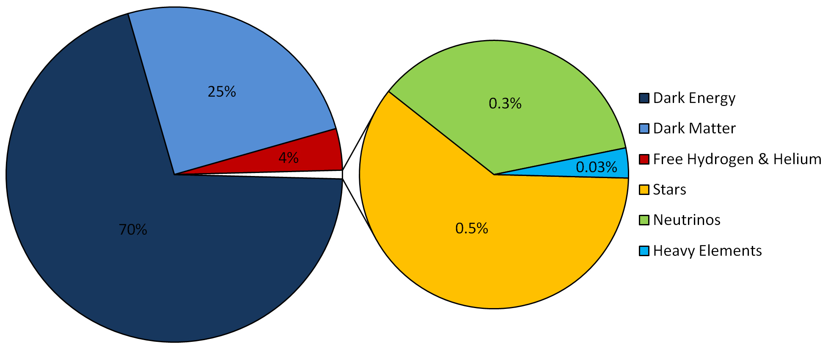
LCDM Cosmology
Concordance cosmology
- model that fits the majority of cosmological observations
- universe dominated by Dark Matter and Dark Energy
LCDM composition today …

Slide 42
Matter-Dark Energy
Transition
Note: a more appropriate characteristic transition
is that at which the deceleration turns into
acceleration:
Flat
Universe

Slide 43
Matter-Dark Energy
Transition
matter
Radiation-Matter transition
radiation
dark energy

Slide 44
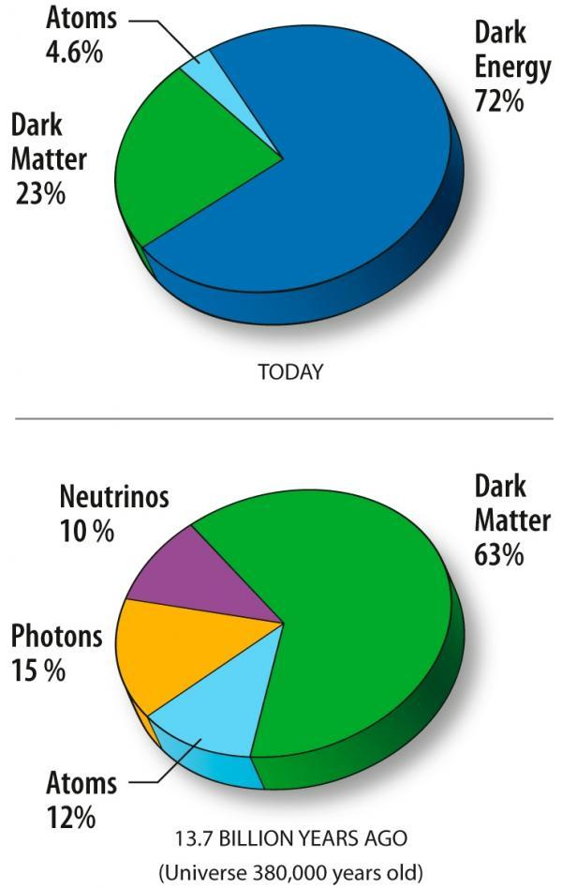
LCDM Cosmology
- with an evolving mixture of
Dark Matter and Dark Energy
Universe today
Universe at recombination

Slide 45
matter
radiation
Matter-
Dark Energy
Transition
Radiation-Matter transition
dark energy

Slide 46
1990s:
the Brewing Crisis

Slide 47
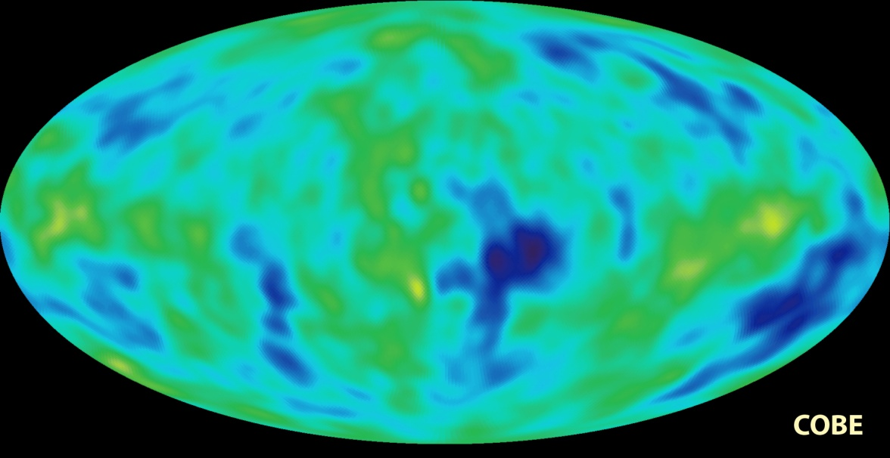
Standard Cosmology ~ 1990
FRW Universe
augmented by Inflation
- solved 4 fine-runing problems
- accelerated expansion by
factor 10⁶⁰
~ 10⁻³⁶-10⁻³⁴ sec after Big Bang
- firm prediction:
Universe flat: k=0, _{tot}=1
Universe dominated by Dark Matter:
- necessary to explain structure growth from primordial
fluctuations, which COBE in 1992 had detected at 10⁻⁵ level
- would have to make up 96% of matter density Universe
- SCDM: “standard Cold Dark Matter”, _{m}=1.0
Succesfully explained large range of astronomical observations
(or was made to explain these: “bias”)

Slide 48
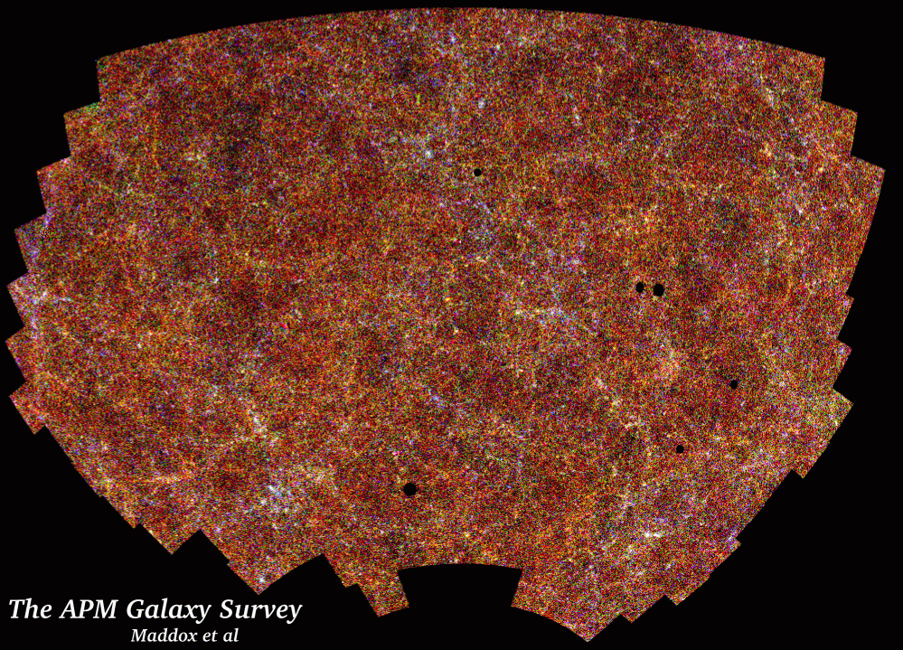
Galaxy Clustering
Clustering of galaxies in the plate-scanned
APM sky galaxy survey (2 million gals):
angular 2pt correlation function
Efstathiou, Sutherland & Maddox, 1990
Nature, 348, 705
APM
SCDM
_{m}=1.0
“It is argued here that the success of the cosmological cold dark matter (CDM) model can be retained and the new observations of very large scale cosmological structures can be accommodated in a spatially flat cosmology in which as much as 80 percent of the critical density is provided by a positive cosmological constant. In such a universe, expansion was dominated by CDM until a recent epoch, but is now governed by the cosmological constant.”
“the Cosmological Constant and Cold Dark Matter”

Slide 49
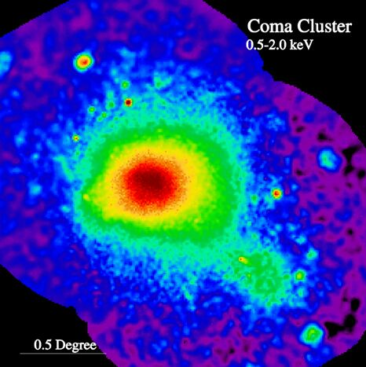
Cluster Baryon fraction
X-ray intracluster gas:
Mass determination via
hydrostatic equilibrium
fraction mass in baryons (White et al.)
f_{baryon} ~ 1/6-1/7
But,
- if representative for Universe, AND
- _{m}=1.0
- conflict with baryon density
suggested by Big Bang nucleosynthesis:
_{b}=0.04
Many other indications find
_{m}=0.3
APM
SCDM
_{m}=1.0
ROSAT X-ray image Coma Cluster

Slide 50
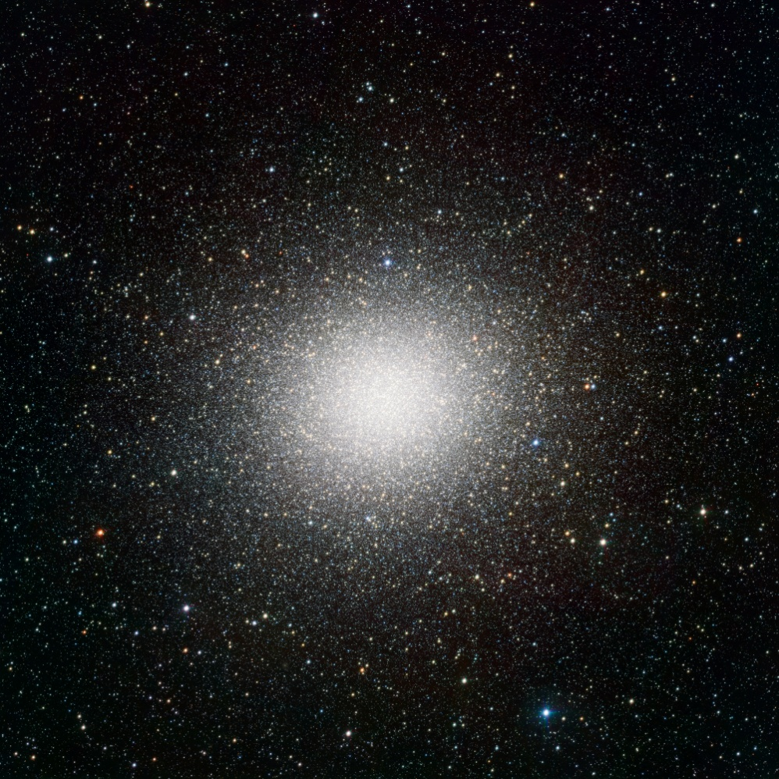
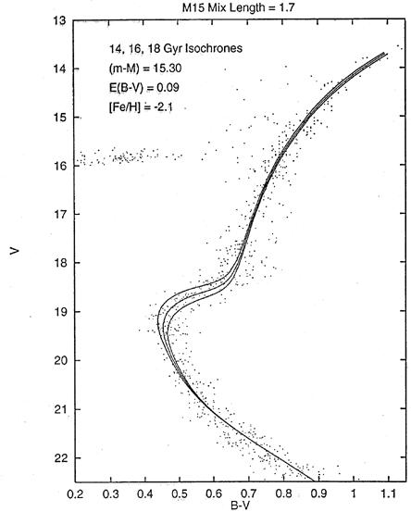
Cosmic Age Crisis
estimated age of the oldest stars in Universe
far in excess of estimated
age of matter-dominated FRW Universe:
Globular cluster stars: 13-15 Gyr
Universe: 10-12 Gyr
Globular Clusters
Roughly spherical assemblies of 100,000-200,000 stars
Radius ~ 20-50 pc: extremely high star density
Globulars are very old, amongst oldest objects in local Universe
Stars formed around same time: old, red, population
Colour-magnitude diagram characteristic:
accurate age determination on the basis of stellar evolution theories.
APM
Typical
1980-1990s isochrone fit
Omega Centauri

Slide 51
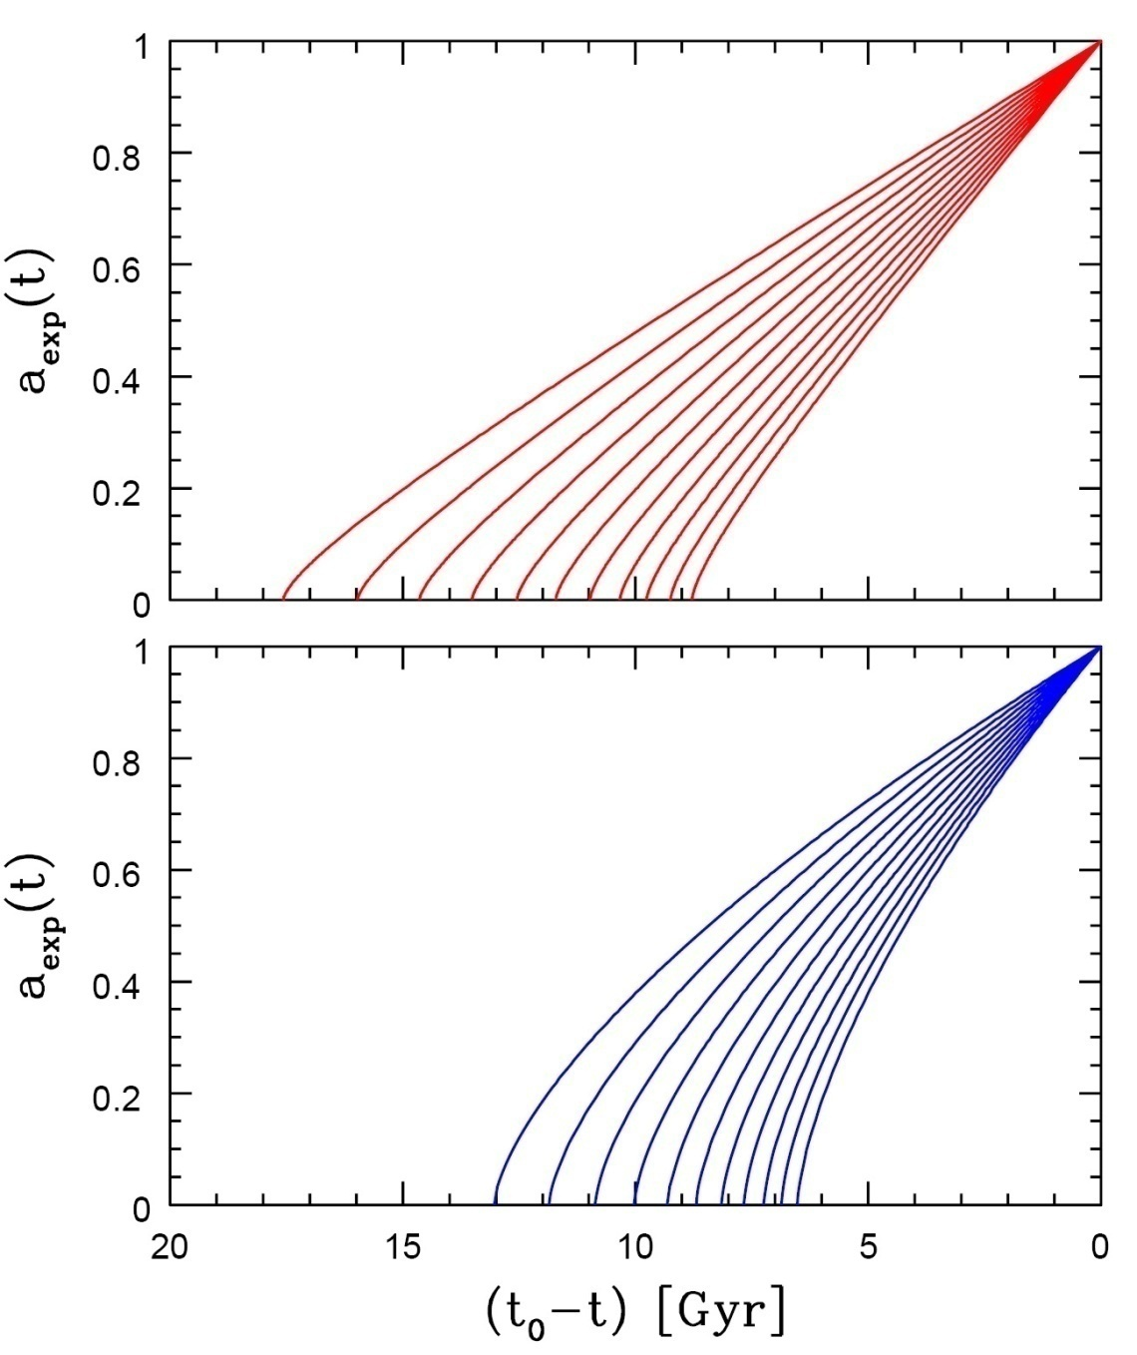
Age of the Universe
Age of a FRW universe at
Expansion factor a(t)
Matter-dominated
Hubble time
Matter-dominated

Slide 52
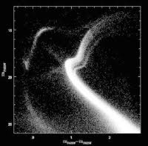
Cosmic Age Crisis
estimated age of the oldest stars in Universe
far in excess of estimated
age of matter-dominated FRW Universe:
Globular cluster stars: 13-15 Gyr
Universe: 10-12 Gyr
Globular Clusters
Roughly spherical assemblies of 100,000-200,000 stars
Radius ~ 20-50 pc: extremely high star density
Globulars are very old, amongst oldest objects in local Universe
Stars formed around same time: old, red, population
Colour-magnitude diagram characteristic:
accurate age determination on the basis of stellar evolution theories.
APM
Typical
21st century
colour-magnitude
diagram:
multiple populations
in
Omega Centauri
Omega Centauri

Slide 53
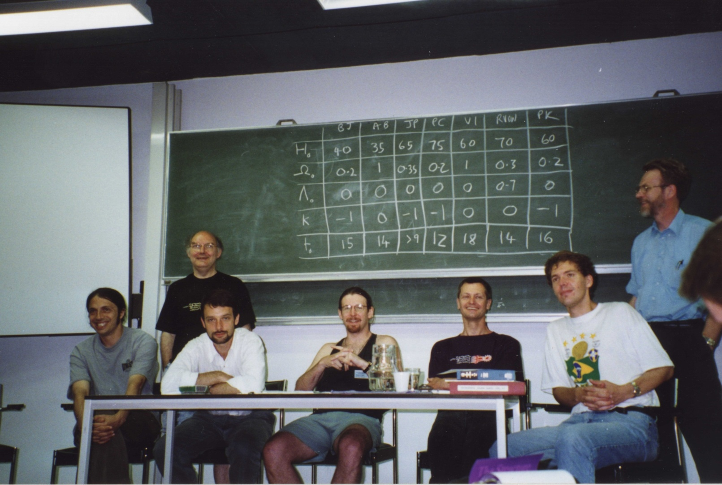
1995: Cosmic Confusion
EADN Summerschool, July 1995, Leiden
Bernard Jones (BJ)
Vincent Icke (VI)
Peter Katgert (PK)
Alain Blanchard (AB)
John Peacock (JP)
Rien van de Weijgaert (RVDW)
Peter Coles (PC)
“Rien, be real … “
John Peacock

Slide 54
the Source:
Dark Energy

Slide 55
Dark Energy & Cosmic Acceleration
Nature Dark Energy:
(Parameterized) Equation of State
Cosmic Acceleration:
Gravitational Repulsion:

Slide 56
Dark Energy: Identity & Nature
Huge and ever growing
list of suggestions on
identity & nature of Dark Energy:
Cosmological Constant
Cosmic Backreaction
(inhomogeneities)
Modified Gravity
Quintessence,
in a variety of flavours
Phantom Energy
Chameleon Energy
Chaplygin gas
Agegraphic DE
….
Dark Energy = Vacuum Energy
Ya. Zel’dovich - 1960s
S. Weinberg - 1989
Cosmological Constant to be
identified with zero-point
vacuum energy ?
minor problem:
1st order estimate
off by 120 orders magnitude:
~ 10¹²⁰

Slide 57
Galaxy Clustering

Slide 58
Dark Energy & Cosmic Acceleration
DE equation of State
Cosmological Constant:
-1/3 > w > -1:
decreases with time
Phantom Energy:
increases with time

Slide 59
Phantom Energy:
De Big Rip ?

Slide 60
Dynamic Dark Energy
DE equation of State
Dynamically evolving dark energy,
parameterization:

Slide 61
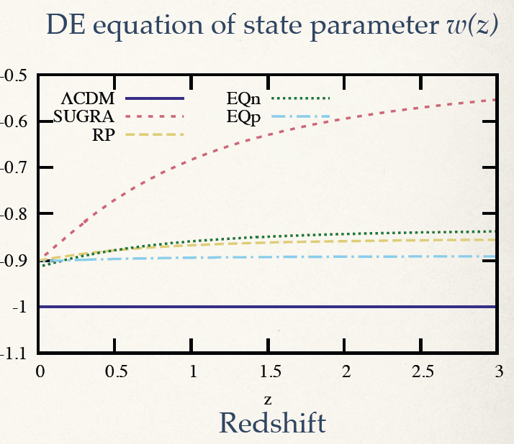
DE Equation of State

Slide 63
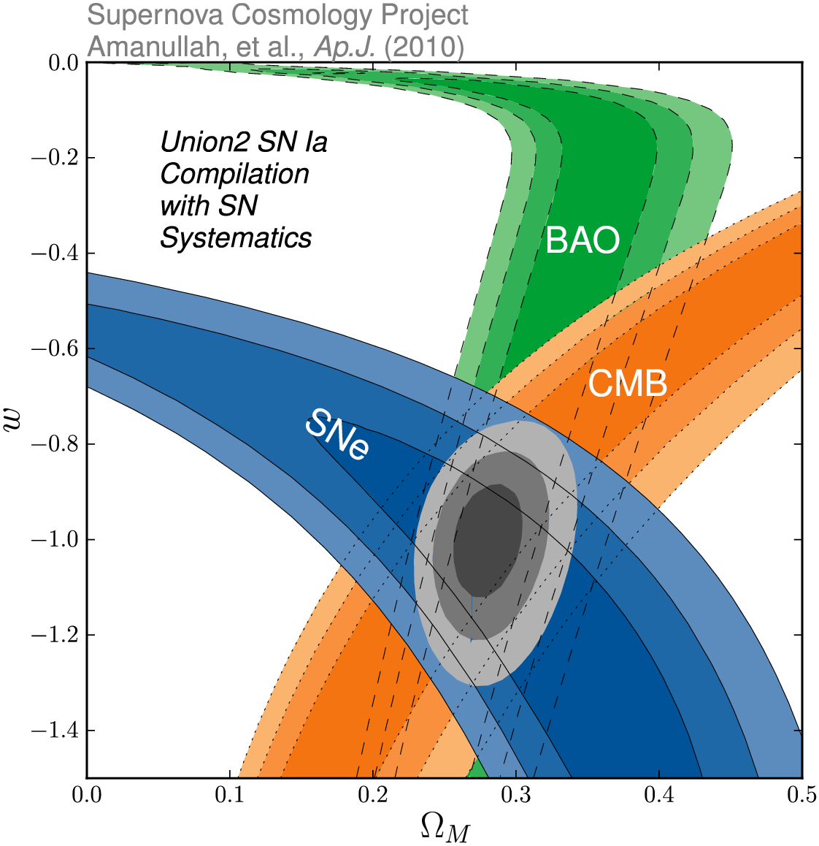
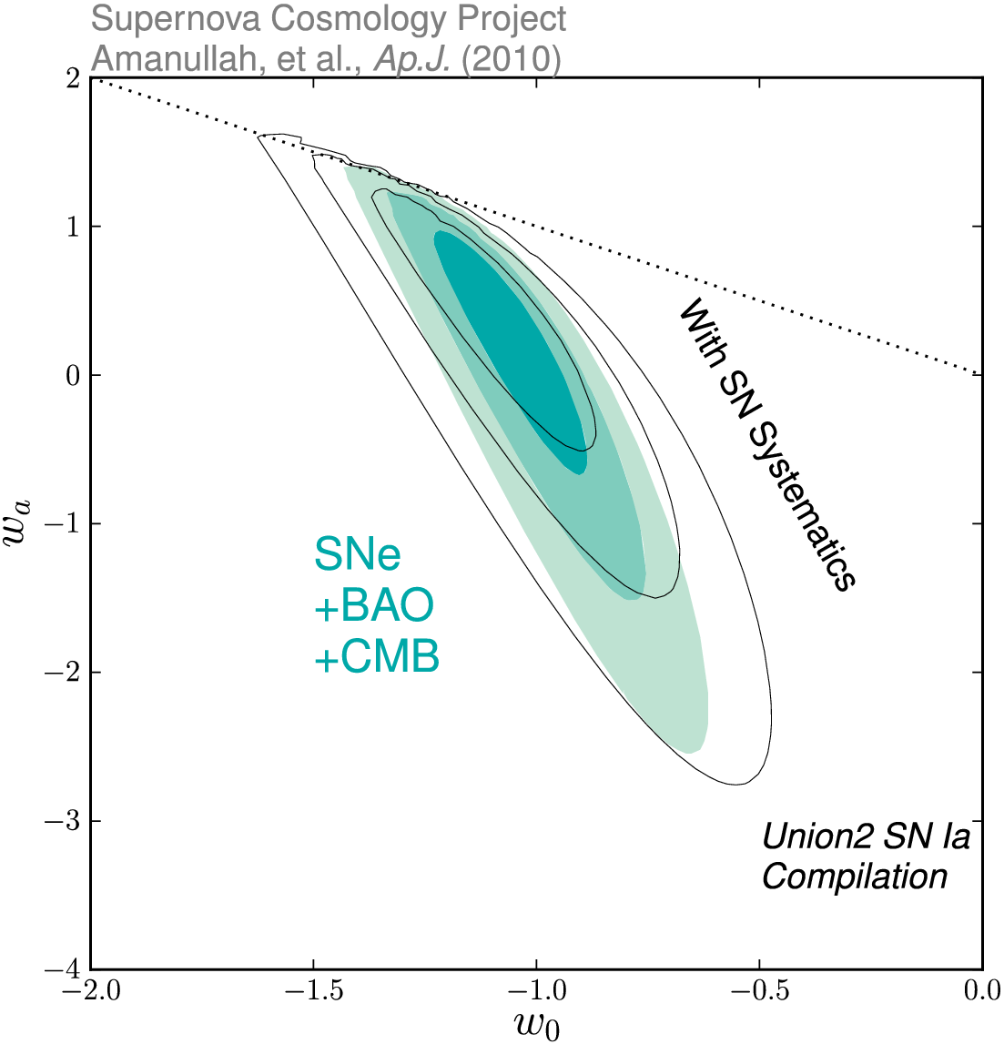
Dark Energy Eqn.State
on dynamical evolution dark energy:
eqn. state parameters w₀
w_{a}
SCP Union2 constraints (2010)
on values of matter density _{m}
dark energy eqn. state w

Slide 64
Take-Home Facts
Strong evidence Accelerated Expansion
- since supernova discovery, 100s SNIa observed over broader range redshifts
- based solely upon supernova Hubble diagram, independent of General Relativity,
very strong evidence expansion Universe accelerated recently
2. Dark energy as cause cosmic acceleration
- within general relativity, accelerated expansion cannot be explained by any known
form of matter or energy
- it can be accommodated by a nearly smooth form of energy with large negative pressure,
Dark Energy, that accounts for about 73% of the universe.
Independent evidence dark energy
- Cosmic Microwave Background and Large Scale Structure data provide independent evidence,
within context of CDM model of structure formation, that the universe is filled with a smooth
medium accounting for 73% of the total energy content of the universe.
- that came to dominate the dynamics of the universe once all observed structure had formed

Slide 65
Take-Home Facts
Vacuum energy as dark energy
- simplest explanation for dark energy is the energy associated with the vacuum
- mathematically equivalent to a cosmological constant
- However, most straightforward calculations of vacuum energy density from zero-point
energies of all quantum fields lead to estimates which are a bit too large,
in the order of ~10¹²⁰
5. Dark theories of Dark Energy
- There is no compelling theory of dark energy
- Beyond vacuum energy, man intriguing ideas: light scalar fields, additional spatial dimensions, etc.
- Many models involve time-varying dark energy
6. New Gravitational Theories ?
- alternatively, cosmic acceleration could be a manifestaation of gravitational physics beyond
General Relativity
- however, as yet there is no self-consistent model for new gravitational physics that is
consistent with large body of data that constrains theories of graavity.

Slide 66
Cosmic Future

Slide 67
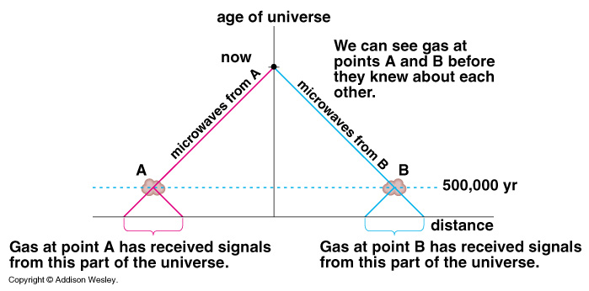
Cosmic Horizons
Particle Horizon of the Universe:
distance that light travelled since the Big Bang

Slide 68
Cosmic Particle Horizon
Light travel in an expanding Universe:
• Robertson-Walker metric:
• Light:
Horizon distance in comoving space
Horizon distance in physical space
Particle Horizon of the Universe:
distance that light travelled since the Big Bang

Slide 69
Cosmic Event Horizon
Light travel in an expanding Universe:
• Robertson-Walker metric:
• Light:
Event Horizon distance in
comoving space
Event Horizon distance in
physical space
Event Horizon of the Universe:
the distance over which one may still communicate …

Slide 71
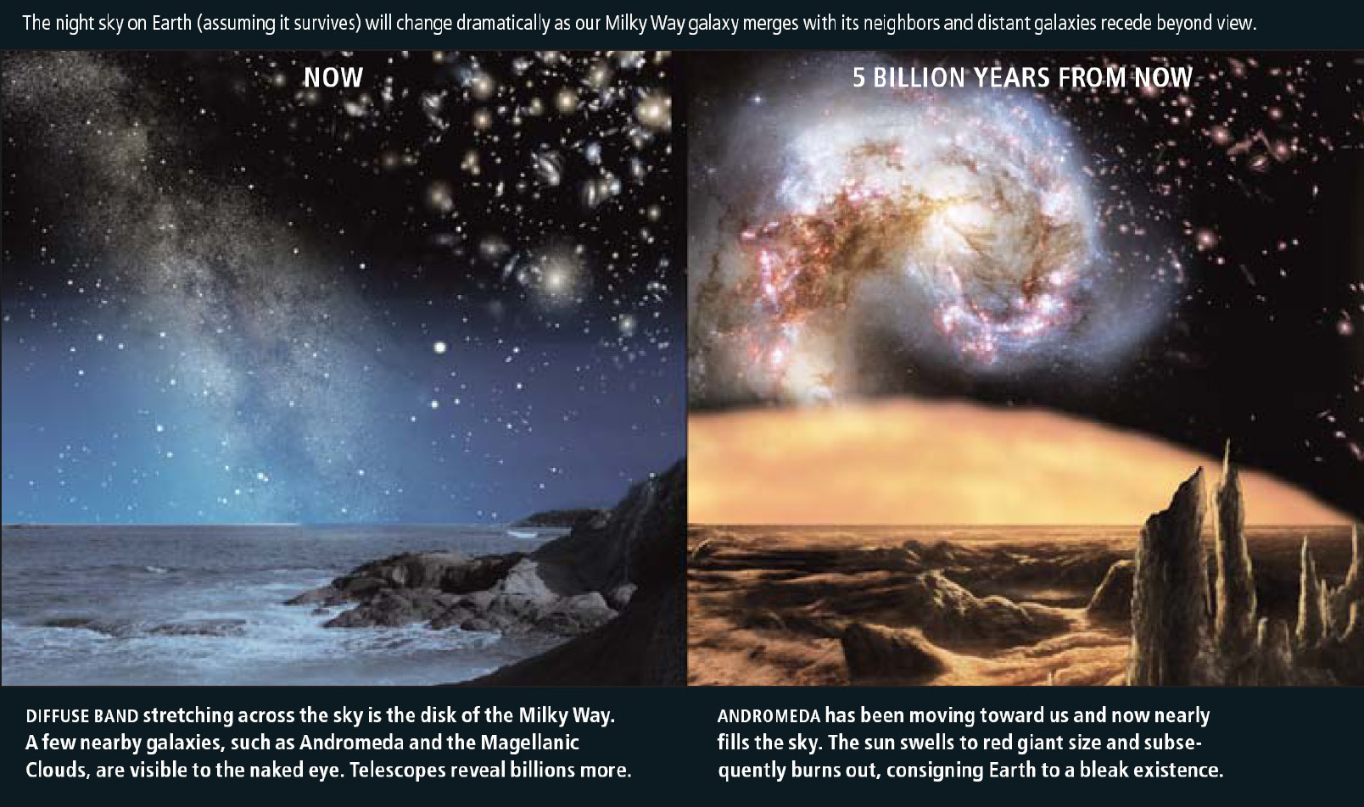
Cosmic Fate
100 Gigayears:
the end of Cosmology

Slide 72
Dark Energy:
Probes

Slide 73
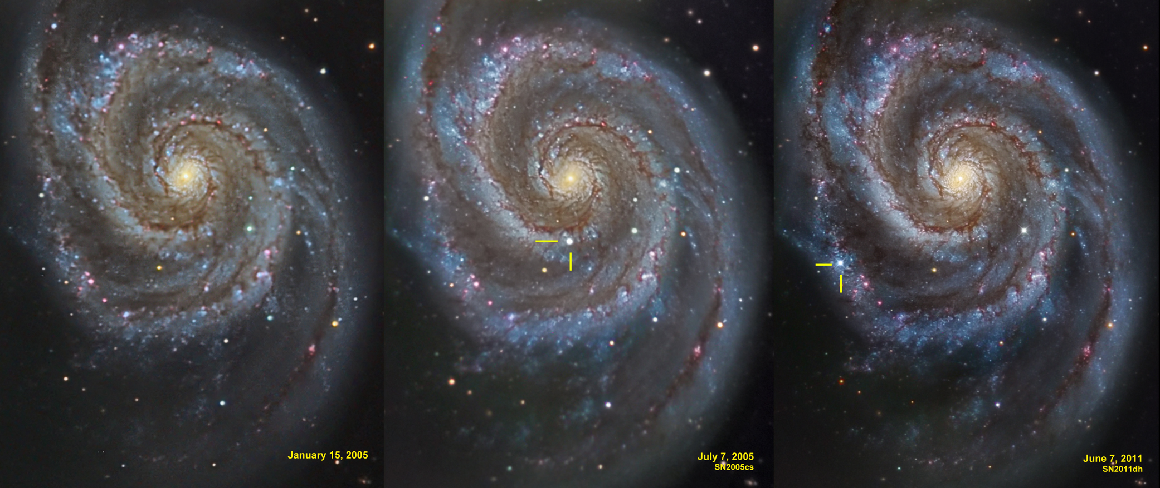
Supernovae Ia
M51 supernovae

Slide 74
Probes DE: additional
• Clusters of Galaxies
number counts N(z),
# formed clusters of galaxies as function of z sensitive to w & w’
• Baryonic Oscillations (BAO)
cosmic yardstick, curvature: residual imprint in galaxy distribution
acoustic oscillations primordial baryon-photon plasma
Integrated Sachs Wolfe (ISW)
imprint foreground large scale structure on CMB,
via evolving potential perturbations
Clustering
clustering correlation function/power spectrum,
directly probing cosmological scenario, BAO wiggles
Growth of clustering:
evolving growth rate f(Omega,z), probed via influence of
redshift distortions on correlation functions
Voids:
evolving void shapes,
probing tidal force field generated by large scale mass distribution
Morphology and Topology
sensitivity of topology, measured by homology (Betti numbers)

Slide 75
Dark Energy Probes: Comparison
Method | Strengths | Weaknesses | Systematics
Weak Lensing | Structure Growth + Geometric Statistical Power | CDM assumption | Image quality Photo-z
Supernovae SNIa | Purely Geometric Mature | Standard Candle assumption | Evolution Dust
BAO (Baryonic Acoustic Oscillation) | Largely Geometric Low systematics | Large samples required | Bias Nonlinearity
Cluster Population N(z) | Structure Growth + Geometric Xray+SZ+optical | CDM assumption | Determining mass Selection function

Slide 76
Standard Candle
&
Cosmic Distances

Slide 77
Robertson-Walker Metric
Distances in a uniformly curved spacetime is specified in terms of the
Robertson-Walker metric. The spacetime distance of a point at coordinate
(r,,) is:
where the function S_{k}(r/R_{c})
specifies the effect of curvature
on the distances between
points in spacetime

Slide 78
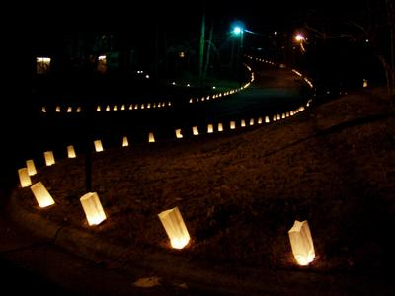
Cosmic Distance Measurements
Luminosity Distance:
use of “Standard Candles”

Slide 79
Luminosity Distance
Definition cosmological luminosity distance:
for a source with INTRINSIC luminosity L
OBSERVED brightness l
In a Robertson-Walker geometry, luminosity distance is
where D(z) is the cosmological distance measure

Slide 80
Luminosity Distance
Cosmological distance measure:
with curvature term S_{k}(x)=sin(x), x, or sinh(x)
Comoving radial distance r(z) at redshift z

Slide 81
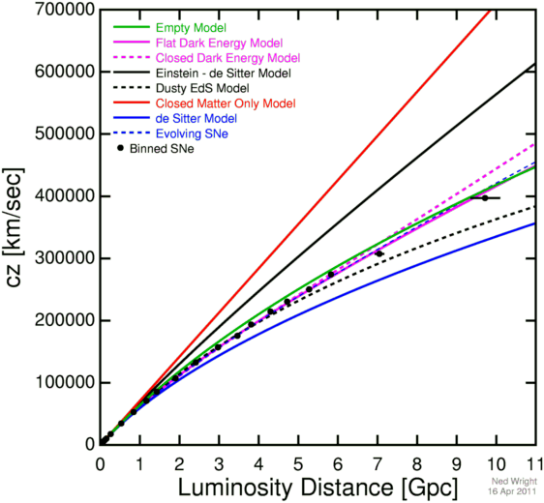
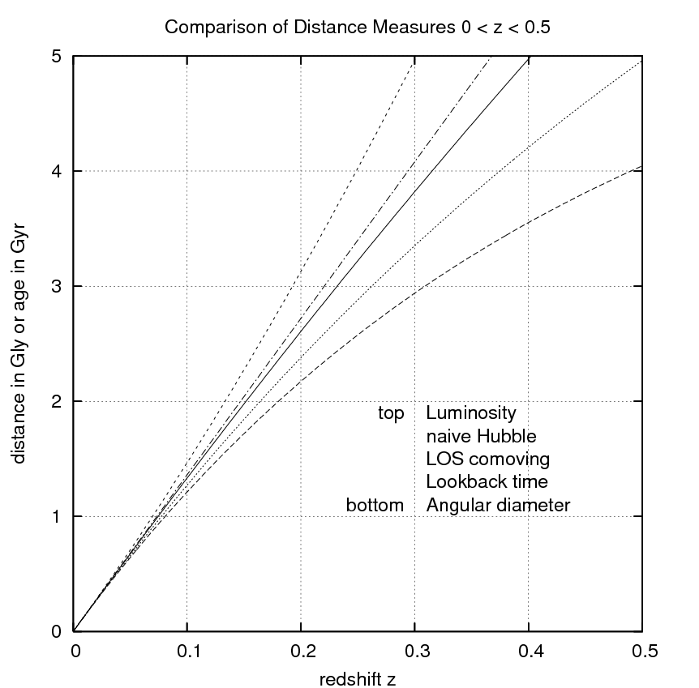
Luminosity Distance
Luminosity Distance at low redshift:
with first term the linear
Hubble expansion term
second term the first
accelerarion/deceleration term:

Slide 82
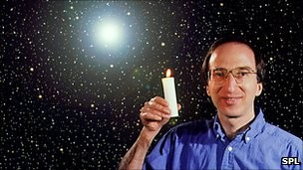
Standard Candles in Cosmology

Slide 83
Type Ia Supernovae

Slide 84
Supernovae
Supernovae:
gigantic stellar explosions
within few months more radiation than Sun over entire lifetime
shockwaves 5,000-30,000 km/s
enrichment interstellar medium
triggers star formation in surrounding ISM
Supernovae, 4 types
(spectral absorption lines):
SN II
SN Ia - no hydrogen
SN Ib
SN Ic - no helium

Slide 85
Type Ia Supernova Explosion

Slide 86
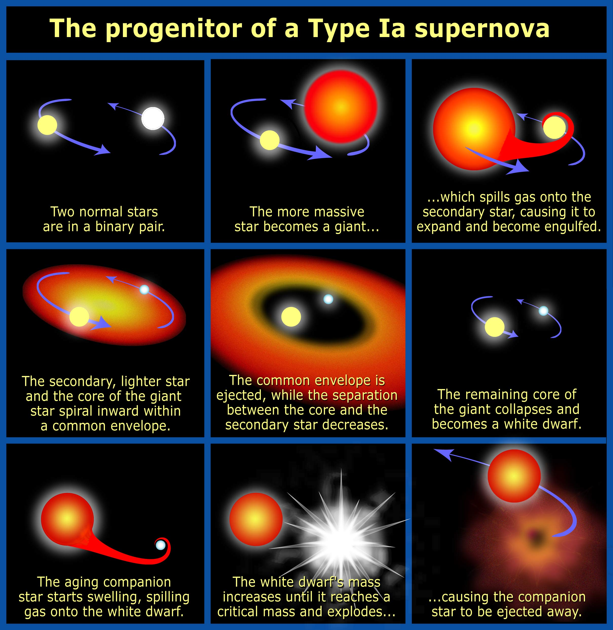

Slide 87
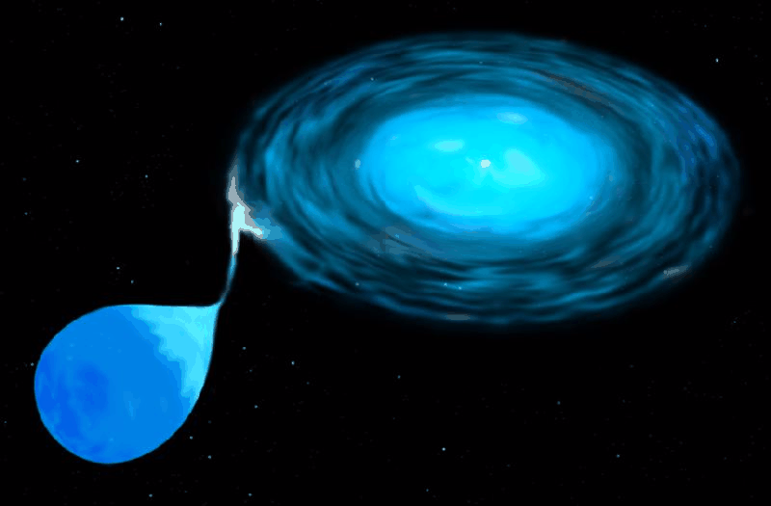
Type Ia Supernova
Amongst the most energetic explosions in our Universe:
E ~ 10⁵⁴ ergs
During explosion the star is as bright as entire galaxy ! (ie. 10¹¹ stars)
Violent explosion Carbon-Oxygen white dwarfs:
Embedded in binary, mass accretion from companion star
When nearing Chandrasekhar Limit (1.38 M•), electron degeneracy pressure
can no longer sustain star.
while contracting under its weight, carbon fusion sets in, powering a
catastrophic deflagration or detonation wave,
leading to a violent explosion, ripping apart entire star
Because exploding stars have nearly uniform progenitor (~1.38 M• white dwarf),
their luminosity is almost the same: M ~ -19.3
Standard Candle

Slide 88
Supernova Explosion & Host Galaxy
M51 supernovae

Slide 89
SN1006
Supernova SN1006:
brightest stellar event recorded in history

Slide 90
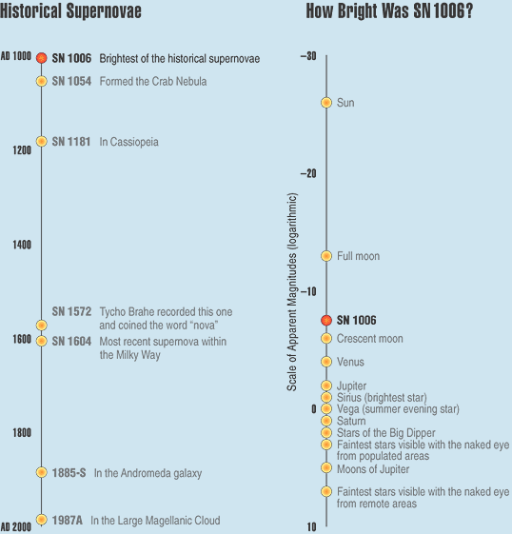
SN1006
Supernova SN1006:
- brightness: m = -7.5
distance: d=2.2 kpc
recorded: China, Egypt, Iraq, Japan,
Switzerland, North America
Supernova SN1006:
brightest stellar event recorded in history

Slide 91
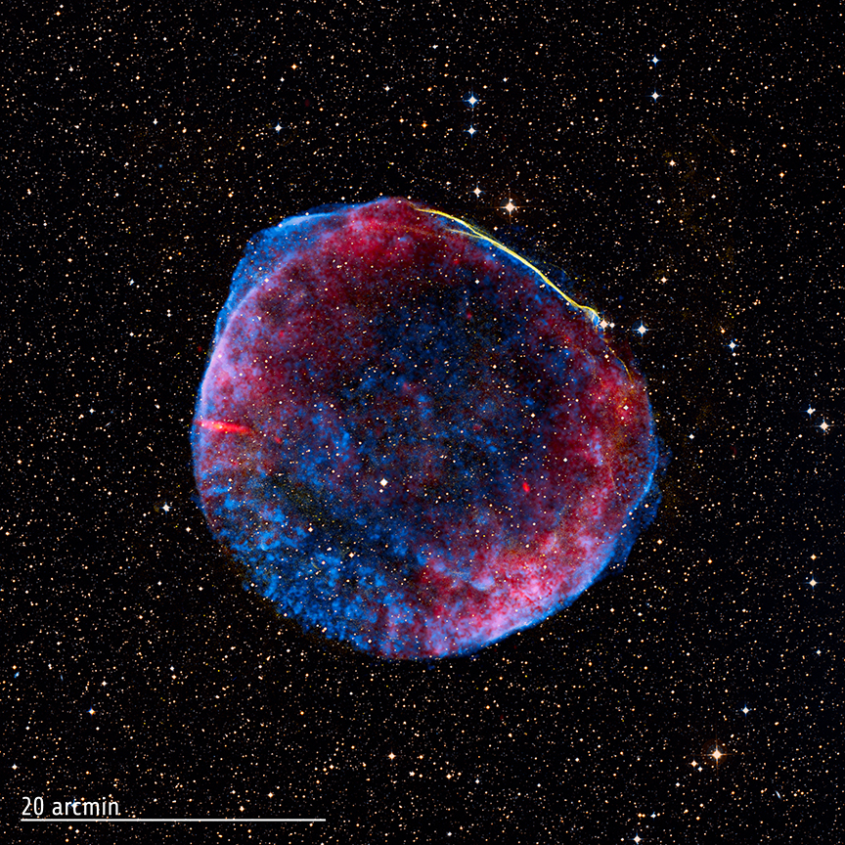
SN1006
Supernova SN1006:
- brightness: m = -7.5
distance: d=2.2 kpc
recorded: China, Egypt, Iraq, Japan,
Switzerland, North America
present-day
Supernova Remnant
Supernova SN1006:
brightest stellar event recorded in history

Slide 92
White Dwarfs

Slide 93
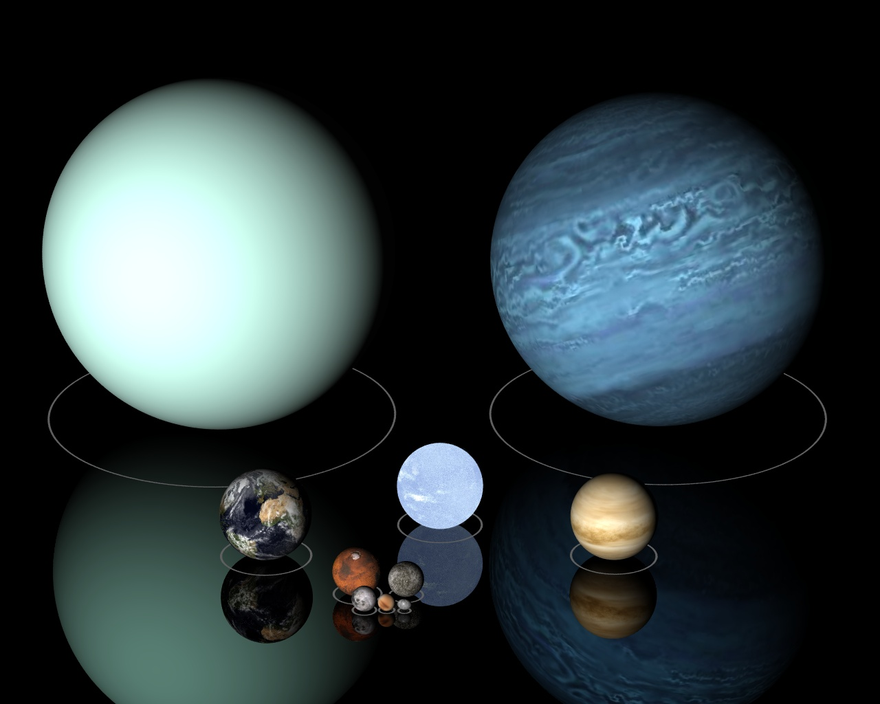
Low Mass Stars
Sirius B

Slide 94
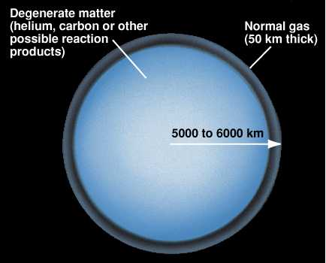
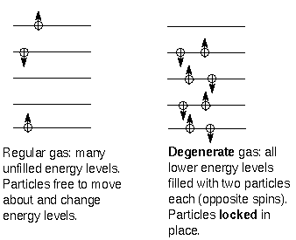

Slide 95
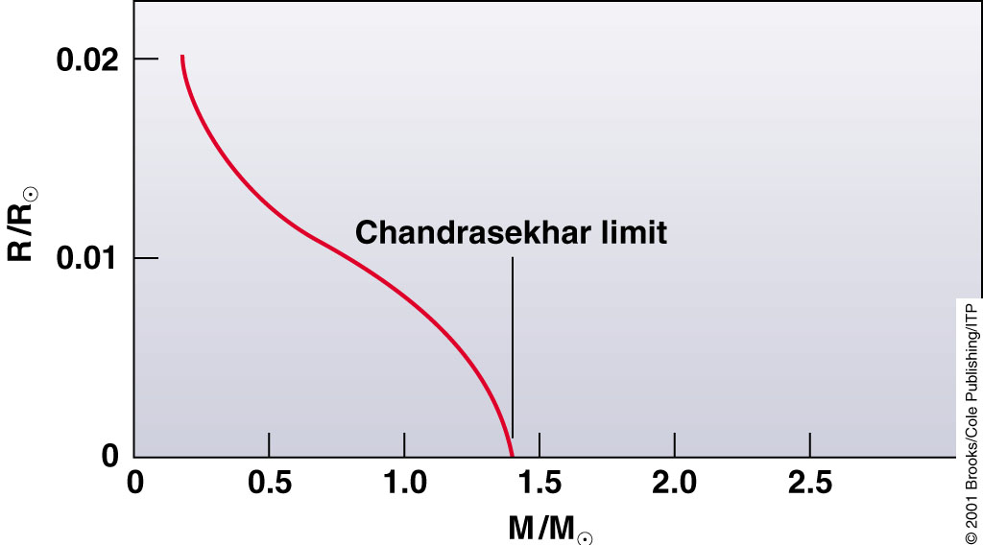
Chandrasekhar Mass Limit
What is the maximum mass that can be supported by
the dense compact material of a white dwarf star?

Slide 96
Supernova Lightcurves

Slide 97
SN 2007uy
Supernova SN 2007uy in NGC2770
while fading, another supernova, SN2008D, went off in same galaxy

Slide 98
Supernova Lightcurve & Spectrum

Slide 99
Supernova Lightcurve
Type Ia supernovae follow a characteristic light curve
—the graph of luminosity as a function of time—after the explosion.
This luminosity is generated by the radioactive decay of Nickel-56 through Cobalt-56 to Iron-56.
Maximum absolute magnitude of about -19.3.

Slide 100
the Phillips Relation
Relationship between
peak luminosity of a Type Ia supernova
speed of luminosity evolution after maximum light.
Mark Phillips (1993):
on the basis of Calan/Tololo Supernova Survey
the faster a supernova fades after peak,
the fainter its intrinsic peak luminosity
reduces scatter in Hubble diagram to <0.2 mag
heuristic relationship, as yet not theoretically “understood”

Slide 101
Supernova Teams:
Practical Aspects

Slide 102
Supernova Cosmology Project
Success of Supernova Projects built on 3 major developments:
the introduction in the 1980s of large mosaic charge-coupled device (CCD) cameras
on 4-meter class telescopes:
- systematic search of thousands of galaxies over large area of sky for
rare supernova events
dramatic increase in computing power in the 1980s:
- enabling vast amount of data processing for automated search of supernovae
amongst the huge number of galaxies monitored
Supernovae Ia as standard candles
- Calan/Tololo Supernova Search: accurate light curves & spectra
- Phillips relation
High-z Supernova Search Team

Slide 103
Supernova Cosmology Project
diligently monitoring millions
of galaxies, in search for that
one explosion …
High-z Supernova Search Team

Slide 104
Supernova Cosmology Project
Challenges to be dealt with by Supernova Teams:
Huge logistic (and political) issue of assuring vast amounts of (strongly contested)
observing time on a range of telescopes (incl. 4-m ones for probing high-z universe)
Dealing with a range of astronomical effects
that would render any subtle cosmological signature insignificant:
- Influence of dust: affecting brightness of supernovae
- Abundance effects: poorly understood influence of
heavy chemical elements on supernova lightcurves
- ….
Results put under heavy scrutiny through large range of tests dealing with
each imaginable pitfall and artefact
Absolutely crucial that two competing teams reached same conclusion independently !!!!
High-z Supernova Search Team

Slide 105
Cosmic Acceleration

Slide 106
Cosmic Acceleration
Hubble Diagram high-z SNIa
• distance vs. redshift z
m-M vs. redshift z
• determine:
- absolute brightness of supernova Ia
- from dimming rate (Phillips relation)
• measure:
- apparent brightness of explosion
• translates into:
- luminosity distance of supernova
- dependent on acceleration parm. q

Slide 107
High-z SNIa: sample

Slide 108
Cosmic Acceleration
Hubble Diagram high-z SNIa
• distance vs. redshift z
m-M vs. redshift z
• determine:
- absolute brightness of supernova Ia
- from dimming rate (Phillips relation)
• measure:
- apparent brightness of explosion
• translates into:
- luminosity distance of supernova
- dependent on acceleration parm. q

Slide 109
Cosmic Acceleration
Relative Hubble Diagram
∆(m-M) vs. Redshift z
with Hubble diagram for empty Universe
Ω_{m}=0.0, Ω_{Λ}=0.0
as reference.
Acceleration of the Universe:

Slide 110
Present:
ACCELERATION
Past:
DECELERATION

Slide 112
Cosmic Deceleration
Before current Dark Energy epoch
• Universe dominated by matter:
Decelerating Expansion
Observable in SNIa at very high z:
z > 0.73
Cosmic deceleration:
SNIa brighter
Cosmic acceleration:
SNIa fainter

Slide 113
Beyond Acceleration: SNe Ia at z > 0.7
Five high-z SNIa, images HST-ACS camera
SNIa and host galaxies lower panel: before
top panel: after explosion)

Slide 114
Cosmic Deceleration
Before current Dark Energy epoch
• Universe dominated by matter:
Decelerating Expansion
Observable in SNIa at very high z:
z > 0.73

Slide 115
Union2: state-of-the-art SNIa compilation
SCP Union2.1 SN Ia compilation:
719 SNe, 17 datasets
(557 used)
6 z>1 SN Ia
Amanullah et al. 2010

Slide 116
Clustering

Slide 117
Cosmic Constraints LSS Clustering
SDSS DR7 LRG sample
Clustering, Reid et al. 2010

Slide 118
Structure
Growth Factor

Slide 119
Large Scale Flows
Large-Scale Flows:
• On large (Mpc) scales,
structure formation
still in linear regime
• Structure buildup
accompanied
by displacement of matter:
- Cosmic flows
• Directly related to
cosmic matter distribution

Slide 120
Redshift Distortions
Origin of peculiar velocities:
three regimes
• very high-density virialized
cluster (core) regions:
“thermal” motion in cluster,
up to > 1000 km/s
“Fingers of God”
• collapsing overdensity
(forming cluster):
inflow/infall velocity
• Large scales:
(linear, quasi-linear) cosmic flow,
manifestation of structure growth

Slide 121
sky-redshift space 2-pt correlation function (,)
Correlation function determined
in sky-redshift space:
sky position:
redshift coordinate:
Close distances:
distortion due to non-linear
Finger of God
Large distances:
distortions due to large-scale
flows

Slide 122
Redshift Space Distortions Correlation Function
On average, gets amplified
wrt.
Linear perturbation theory
(Kaiser 1987):
Large distances:
distortions due to large-scale
flows

Slide 123
Evolution Growth Rate
Linder 2008
Guzzo et al. 2008
Peebles growth rate factor

Slide 124
Galaxy & Cluster
Clustering

Slide 125
Cosmic Constraints LSS Clustering
SDSS DR7 LRG sample
Clustering, Reid et al. 2010

Slide 126
Structure
Growth Factor

Slide 127
Large Scale Flows
Large-Scale Flows:
• On large (Mpc) scales,
structure formation
still in linear regime
• Structure buildup
accompanied
by displacement of matter:
- Cosmic flows
• Directly related to
cosmic matter distribution

Slide 128
Redshift Distortions
Origin of peculiar velocities:
three regimes
• very high-density virialized
cluster (core) regions:
“thermal” motion in cluster,
up to > 1000 km/s
“Fingers of God”
• collapsing overdensity
(forming cluster):
inflow/infall velocity
• Large scales:
(linear, quasi-linear) cosmic flow,
manifestation of structure growth

Slide 129
sky-redshift space 2-pt correlation function (,)
Correlation function determined
in sky-redshift space:
sky position:
redshift coordinate:
Close distances:
distortion due to non-linear
Finger of God
Large distances:
distortions due to large-scale
flows

Slide 130
Redshift Space Distortions Correlation Function
On average, gets amplified
wrt.
Linear perturbation theory
(Kaiser 1987):
Large distances:
distortions due to large-scale
flows

Slide 131
Evolution Growth Rate
Linder 2008
Guzzo et al. 2008
Peebles growth rate factor

Slide 132
BAO:
Baryonic Acoustic
Oscillations

Slide 133
BAO

Slide 134
BAO as cosmological tools
Until recombination, the sound wave travels a distance of:
This distance can be accurately determined from the CMB power spectrum, and was found to be 147±2 Mpc.

Slide 135
Measuring BAO

Slide 136
Measuring BAO

Slide 137
ISW:
Integrated
Sachs Wolfe Effect

Slide 138
Dark Energy & CMB: ISW
The WMAP CMB temperature
power spectrum
Dark Energy modifies evolution
potential wells

Slide 139
Dark Energy: ISW
Dark Energy modifies evolution
potential wells

Slide 140
ISW & identified voids/clusters
Granett et al. (2008-…)
- LRG distribution vs. predicted ISW signal
identification (super)voids & (super)clusters
correlation with WMAP

Slide 141
Dark Energy: ISW
Dark Energy modifies evolution
potential wells

Slide 142
Cosmic Voids:
Shape of Voids

Slide 143
Cosmic Voids

Slide 144
Evolving Void Shapes
Evolution of void shape
sensitive probe of dark energy:
Park & Lee 2007
Lavaux & Wandelt 2010

Slide 145
Evolving Void Shapes
Measuring void shape by WVF
Bos et al. 2011:
Trend of evolving void shape
as function of dark energy eqn.state confirmed.

Slide 146
Future Experiments

Slide 147
Euclid
Euclid:
father of geometry
ESA
Cosmic Vision
2020-2025
1.2 m Korsch telescope
visible light:
m=24.5 CCD imaging
IR (Y,J,H) band photometer
spectrometer 108 bright gals
15,000 sq. deg. survey
40 sq. deg. deep survey
Combination:
- DUNE grav. Lensing
- SPACE BAO

Slide 148
Euclid
ESA
Cosmic Vision
2020-2025
1.2 m Korsch telescope
visible light:
m=24.5 CCD imaging
IR (Y,J,H) band photometer
spectrometer 108 bright gals
15,000 sq. deg. survey
40 sq. deg. deep survey
Combination:
- DUNE grav. Lensing
- SPACE BAO

Slide 149
LSST:
Large Synoptic Survey Telescope
8.4 m primary mirror
widefield survey telescope
El Penon, Chile
2682 m. mountain
start operation: 2015
3.5 deg. angle of view
3.2 Gigapixel prime focus
digital camera
200,000 images per year
30 Tbyte per night
partial funding Bill Gates

Slide 150
Summary

Slide 151
Take-Home Facts
Strong evidence Accelerated Expansion
- since supernova discovery, 100s SNIa observed over broader range redshifts
- based solely upon supernova Hubble diagram, independent of General Relativity,
very strong evidence expansion Universe accelerated recently
2. Dark energy as cause cosmic acceleration
- within general relativity, accelerated expansion cannot be explained by any known
form of matter or energy
- it can be accommodated by a nearly smooth form of energy with large negative pressure,
Dark Energy, that accounts for about 73% of the universe.
Independent evidence dark energy
- Cosmic Microwave Background and Large Scale Structure data provide independent evidence,
within context of CDM model of structure formation, that the universe is filled with a smooth
medium accounting for 73% of the total energy content of the universe.
- that came to dominate the dynamics of the universe once all observed structure had formed

Slide 152
Take-Home Facts
Vacuum energy as dark energy
- simplest explanation for dark energy is the energy associated with the vacuum
- mathematically equivalent to a cosmological constant
- However, most straightforward calculations of vacuum energy density from zero-point
energies of all quantum fields lead to estimates which are a bit too large,
in the order of ~10¹²⁰
5. Dark theories of Dark Energy
- There is no compelling theory of dark energy
- Beyond vacuum energy, man intriguing ideas: light scalar fields, additional spatial dimensions, etc.
- Many models involve time-varying dark energy
6. New Gravitational Theories ?
- alternatively, cosmic acceleration could be a manifestaation of gravitational physics beyond
General Relativity
- however, as yet there is no self-consistent model for new gravitational physics that is
consistent with large body of data that constrains theories of graavity.

Slide 153
Take-Home Facts
7. Dark destiny
8. At the nexus of many physical mysteries
9. Two big questions
a) Is dark energy something different than vacuum energy
b) Does General Relativity self-consistently describe cosmic acceleration ?
10. Probing Dark Energy

Slide 154
Oct 5, 2011:
“We Are Sold out
We were down to our last few cases before the announcement of Maipenrai's Brian Schmidt winning the Nobel Prize, and what remained has literally gone in 60 seconds.
Stay tuned for our next release in December of the 2009 Maipenrai Pinot Noir.”

