Slide 1
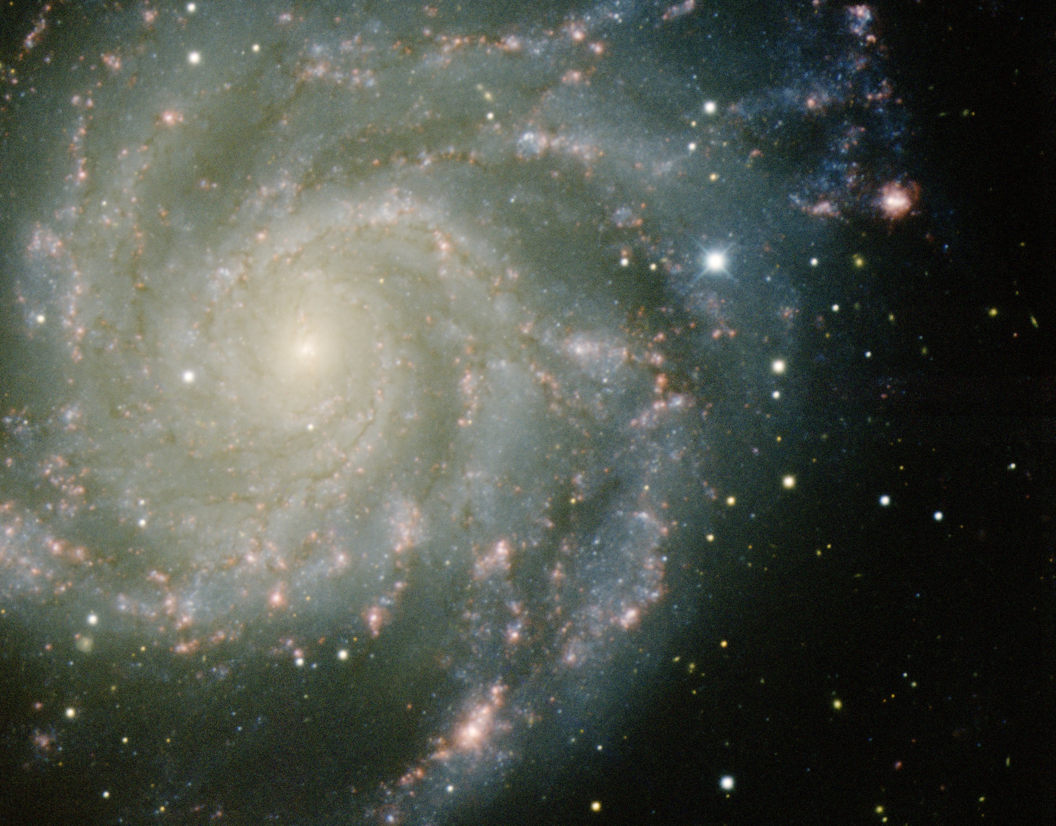
Dark Energy
the FRW Universe

Slide 2
General Relativity:
Einstein Field Equations

Slide 3
Einstein Field Equation
Metric tensor:
Energy-Momentum tensor:

Slide 4
Einstein Field Equation
Einstein Tensor:
Einstein Tensor only rank 2 tensor for which this holds:

Slide 5
Einstein Field Equation
also:
Freedom to add a multiple of
metric tensor to Einstein tensor:
: Cosmological Constant

Slide 6
Einstein Field Equation
Dark Energy

Slide 7
Einstein Field Equation

Slide 8
Einstein Field Equation
curvature side
energy-momentum side

Slide 9
Equation of State
restframe
restframe:

Slide 10
Equation of State

Slide 11
Dynamics
Relativistic Poisson Equation:
Repulsion !!!

Slide 12
Curved Space:
Friedmann-Robertson Metric

Slide 13
Cosmological Principle: the Universe Simple & Smooth
“God is an infinite sphere whose centre is
everywhere and its circumference nowhere”
Empedocles, 5th cent BC
Cosmological Principle:
Describes the symmetries in global appearance of the Universe:
● Homogeneous
● Isotropic
● Universality
● Uniformly Expanding
The Universe is the same everywhere:
- physical quantities (density, T,p,…)
The Universe looks the same in every direction
Physical Laws same everywhere
The Universe “grows” with same rate in
- every direction
- at every location
”all places in the Universe are alike’’
Einstein, 1931

Slide 15
Robertson-Walker Metric
Distances in a uniformly curved spacetime is specified in terms of the
Robertson-Walker metric. The spacetime distance of a point at coordinate
(r,,) is:
where the function S_{k}(r/R_{c})
specifies the effect of curvature
on the distances between
points in spacetime

Slide 18
Friedmann-Robertson-Walker
Universe

Slide 19
Einstein Field Equation

Slide 20
Einstein Field Equation

Slide 21
Friedmann-Robertson-Walker-Lemaitre Universe

Slide 22
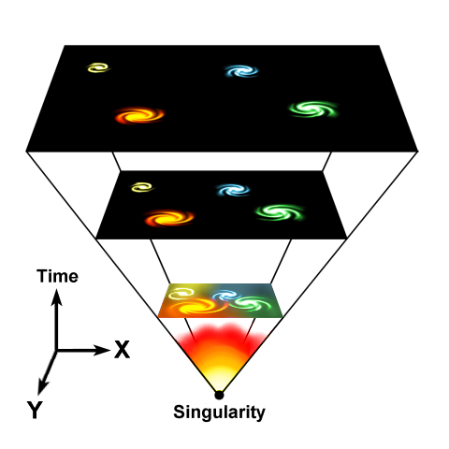
Cosmic Expansion Factor
Cosmic Expansion is a
uniform expansion of
space

Slide 23
Friedmann-Robertson-Walker-Lemaitre Universe
pressure
cosmological
constant
density
curvature term

Slide 24
Friedmann-Robertson-Walker-Lemaitre Universe
Because of General Relativity, the evolution of the Universe is
determined by four factors:
• density
• pressure
• curvature
: present curvature radius
• cosmological constant
• Density & Pressure: - in relativity, energy & momentum need to be
seen as one physical quantity (four-vector)
- pressure = momentum flux
• Curvature: - gravity is a manifestation of geometry spacetime
Cosmological Constant: - free parameter in General Relativity
- Einstein’s “biggest blunder”
- mysteriously, since 1998 we know it dominates
the Universe

Slide 25
Cosmological Constant
&
FRW equations

Slide 26
Friedmann-Robertson-Walker-Lemaitre Universe

Slide 27
Dark Energy & Energy Density

Slide 28
Friedmann-Robertson-Walker-Lemaitre Universe

Slide 29
Cosmic Constituents

Slide 30
Cosmic Constituents
The total energy content of Universe made up by various constituents, principal ones:
matter
_{b}
baryonic matter
_{m}
_{DM}
dark matter
radiation

photons
_{tot}
_{rad}

neutrino’s
_{v}
dark/ vacuum energy
In addition, contributions by - gravitational waves
- magnetic fields,
- cosmic rays …
Poor constraints on their contribution: henceforth we will not take them into account !

Slide 31
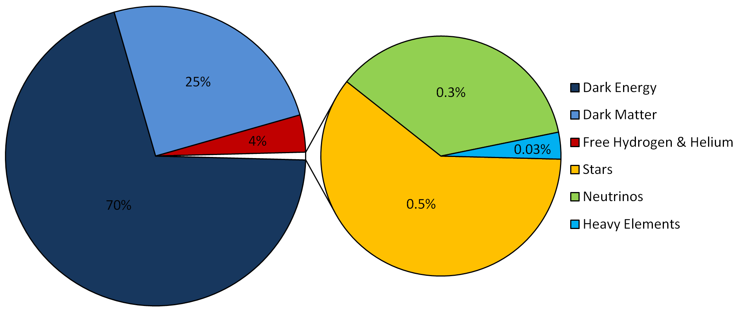
LCDM Cosmology
Concordance cosmology
- model that fits the majority of cosmological observations
- universe dominated by Dark Matter and Dark Energy
LCDM composition today …

Slide 32
Cosmic Energy Inventory
Fukugita & Peebles 2004

Slide 33
Cosmic Constituents:
Evolving Energy Density

Slide 34
FRW Energy Equation
To infer the evolving energy density (t) of each cosmic component, we refer to
the cosmic energy equation. This equation can be directly inferred from the FRW equations
The equation forms a direct expression of the adiabatic expansion of the Universe,
ie.
Internal energy
Expanding volume

Slide 35
FRW Energy Equation
To infer (t) from the energy equation, we need to know the pressure p(t) for
that particular medium/ingredient of the Universe.
To infer p(t), we need to know the nature of the medium, which provides
us with the equation of state,

Slide 36
Cosmic Constituents: Evolution of Energy Density
Matter:
• Radiation:
• Dark Energy:

Slide 37
Dark Energy:
Equation of State

Slide 38
Dark Energy & Cosmic Acceleration
Nature Dark Energy:
(Parameterized) Equation of State
Cosmic Acceleration:
Gravitational Repulsion:

Slide 39
Dark Energy & Cosmic Acceleration
DE equation of State
Cosmological Constant:
-1/3 > w > -1:
decreases with time
Phantom Energy:
increases with time

Slide 40
Dynamic Dark Energy
DE equation of State
Dynamically evolving dark energy,
parameterization:

Slide 41
Critical Density & Omega

Slide 42
FRW Dynamics
Critical Density:
- For a Universe with ☹=0
- Given a particular expansion rate H(t)
Density corresponding to a
flat Universe (k=0)

Slide 43
FRW Dynamics
In a FRW Universe,
densities are in the order of the critical density,

Slide 44
FRW Dynamics
In a matter-dominated Universe,
the evolution and fate of the Universe entirely determined
by the (energy) density in units of critical density:
Arguably,  is the most important parameter of cosmology !!!
Present-day
Cosmic Density:

Slide 45
FRW Dynamics
The individual contributions to the energy density of
the Universe can be figured into the  parameter:
- radiation
- matter
- dark energy/
cosmological constant

Slide 46
Critical Density
There is a 1-1 relation between the total energy content
of the Universe and its curvature. From FRW equations:

Slide 47
FRW Universe: Curvature
There is a 1-1 relation between the total energy content
of the Universe and its curvature. From FRW equations:

Slide 48
Radiation, Matter & Dark Energy
The individual contributions to the energy density of
the Universe can be figured into the  parameter:
- radiation
- matter
- dark energy/
cosmological constant

Slide 49
Hubble Expansion

Slide 50
Hubble Expansion
Cosmic Expansion is a uniform expansion of space
Objects do not move themselves:
they are like beacons tied to a uniformly expanding sheet:

Slide 51
Hubble Expansion
Cosmic Expansion is a uniform expansion of space
Objects do not move themselves:
they are like beacons tied to a uniformly expanding sheet:
Comoving Position
Hubble Parameter:
Hubble “constant”:
H₀H(t=t₀)
Comoving Position

Slide 52
Hubble Parameter
For a long time, the correct value of the Hubble constant H₀
was a major unsettled issue:
H₀ = 50 km s⁻¹ Mpc⁻¹ H₀ = 100 km s⁻¹ Mpc⁻¹
This meant distances and timescales in the Universe had to
deal with uncertainties of a factor 2 !!!
Following major programs, such as Hubble Key Project, the
Supernova key projects and the WMAP CMB measurements,

Slide 53
Hubble Time

Slide 54
Hubble Distance
Just as the Hubble time sets a natural time scale for the universe,
one may also infer a natural distance scale of the universe, the
Hubble Distance

Slide 55
Acceleration Parameter

Slide 56
FRW Dynamics: Cosmic Acceleration
Cosmic acceleration quantified
by means of dimensionless deceleration parameter q(t):
Examples:

Slide 57
Dynamics
FRW Universe

Slide 58
General Solution Expanding FRW Universe
From the FRW equations:
Expansion history Universe

Slide 59
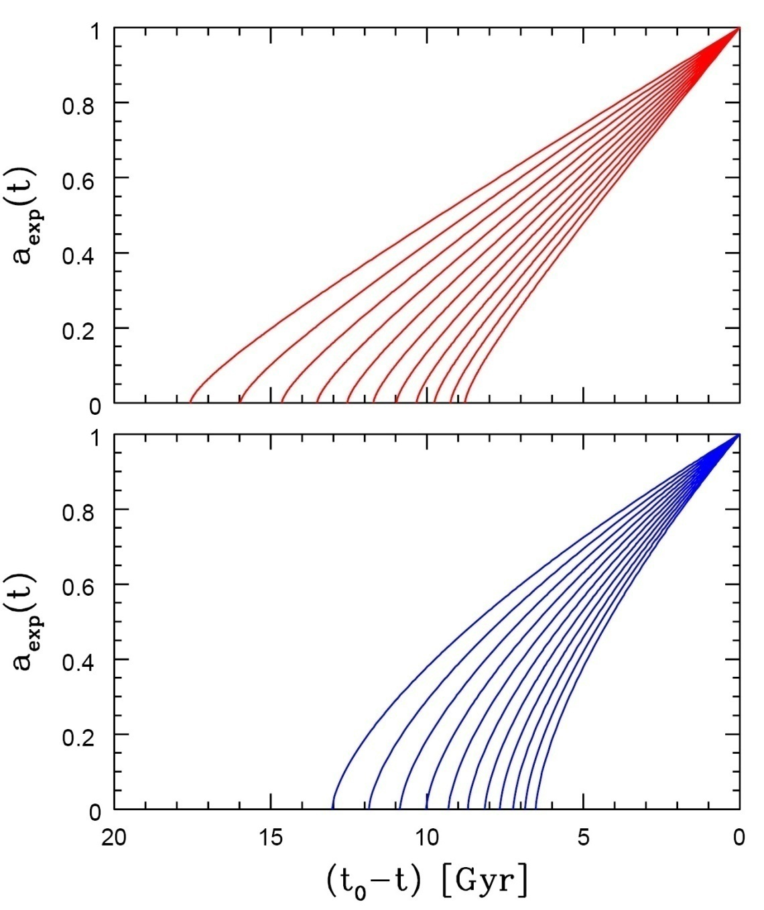
Age of the Universe
Age of a FRW universe at
Expansion factor a(t)
Matter-dominated
Hubble time
Matter-dominated

Slide 60
Specific Solutions FRW Universe
While general solutions to the FRW equations is only possible
by numerical integration, analytical solutions may be found for particular classes of cosmologies:
Single-component Universes:
- empty Universe
- flat Universes, with only radiation, matter or
dark energy
Matter-dominated Universes
Matter+Dark Energy flat Universe

Slide 61
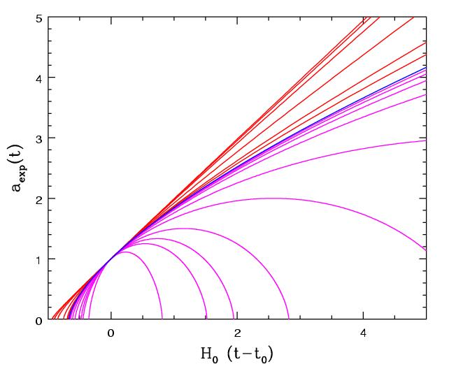
Matter-Dominated Universes
Assume radiation contribution is negligible:
Zero cosmological constant:
Matter-dominated, including curvature

Slide 62
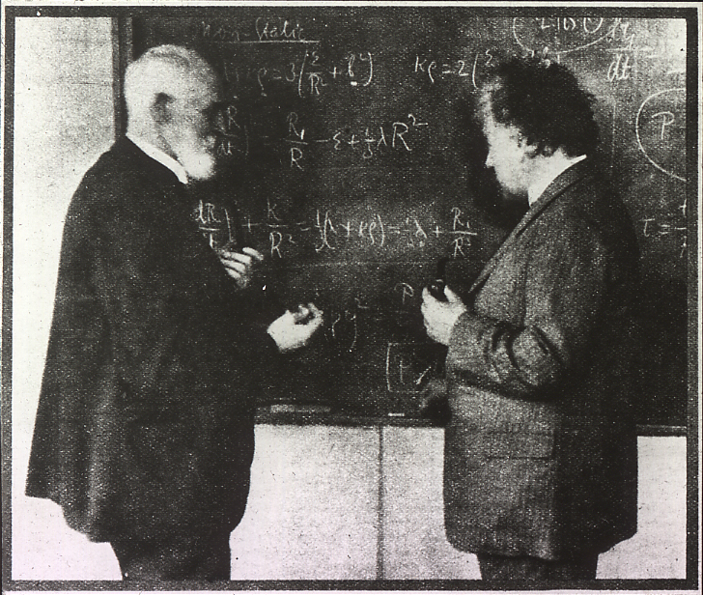
Einstein-de Sitter Universe
FRW:
Albert Einstein and Willem de Sitter discussing the Universe. In 1932 they published a paper together on the Einstein-de Sitter universe, which is a model with flat geometry containing matter as the only significant substance.
Age
EdS Universe:

Slide 63
Free Expanding "Milne" Universe
Empty space is curved
FRW:
Age
Empty Universe:

Slide 64
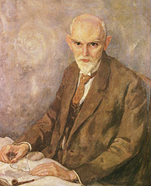
De Sitter Expansion
FRW:
Willem de Sitter (1872-1934; Sneek-Leiden)
director Leiden Observatory
alma mater: Groningen University
Age
De Sitter Universe: infinitely old

Slide 65
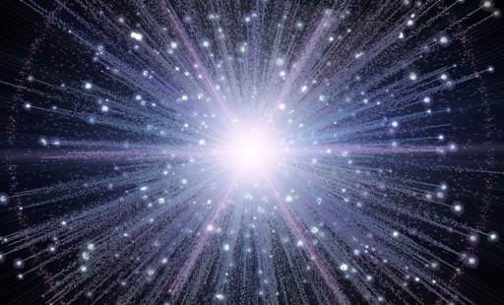
Expansion Radiation-dominated Universe
In the very early Universe, the energy density is completely dominated by radiation. The dynamics of the very early Universe is therefore fully determined by the evolution of the radiation energy density:
FRW:
Age
Radiation
Universe:

Slide 66
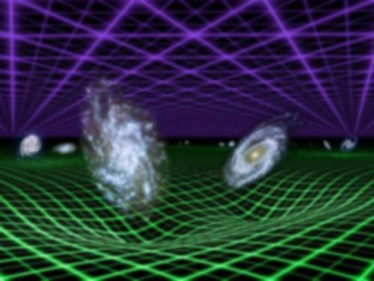
General Flat FRW Universe
FRW:

Slide 67
Observational Cosmology
in
FRW Universe

Slide 68
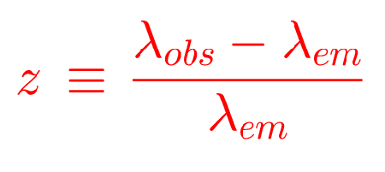
Cosmic Redshift

Slide 69
RW Distance Measure
In an (expanding) space with Robertson-Walker metric,
there are several definitions for distance, dependent on how you measure it.
They all involve the central distance function, the RW Distance Measure,

Slide 70
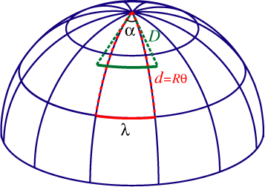
Angular Diameter Distance
Imagine an object of proper size d, at redshift z, its angular size  is given by
Angular Diameter distance:

Slide 71
Luminosity Distance
Imagine an object of luminosity L(_{e}), at redshift z, its flux density at observed frequency _{o} is
Luminosity distance:

Slide 72
FRW Redshift-Distance
Observing in a FRW Universe, we locate galaxies in terms of their redshift z. To
connect this to their true physical distance, we need to know what the coordinate distance r of an object with redshift z,
In a FRW Universe, the dependence of the Hubble expansion rate H(z) at any
redshift z depends on the content of matter, dark energy and radiation, as well
ss its curvature. This leads to the following explicit expression for the
redshift-distance relation,

Slide 73
Matter-Dominated FRW Universe
Observing in a FRW Universe, we locate galaxies in terms of their redshift z. To
connect this to their true physical distance, we need to know what the coordinate distance r of an object with redshift z,
In a FRW Universe, the dependence of the Hubble expansion rate H(z) at any
redshift z depends on the content of matter, dark energy and radiation, as well
ss its curvature. This leads to the following explicit expression for the
redshift-distance relation,
in a matter-dominated Universe, the redshift-distance relation is
from which one may find that

Slide 74
Mattig’s Formula
The integral expression
can be evaluated by using the substitution:
This leads to Mattig’s formula:
This is one of the very most important and most useful equations
in observational cosmology.

Slide 75
Mattig’s Formula
In a low-density Universe, it is better to use the following version:
For a Universe with a cosmological constant, there is not an easily
tractable analytical expression (a Mattig’s formula). The comoving
Distance r has to be found through a numerical evaluation of the fundamental dr/dz expression.

Slide 76
Distance-Redshift Relation, 2nd order
For all general FRW Universe, the
second-order distance-redshift relation is identical,
only depending on the deceleration parameter q₀:
q₀ can be related to ₀ once the equation of state is known.

Slide 77
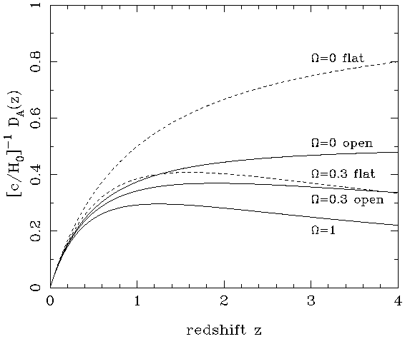
Angular Diameter Distance
matter-dominated FRW Universe
In a matter-dominated Universe, the angular diameter distance as function of redshift is given by:

Slide 78
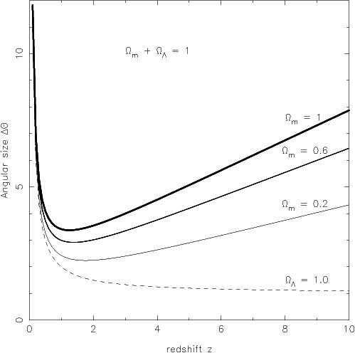
Angular Size - Redshift
FRW Universe
The angular size (z) of an object of physical size  at a redshift z displays an interesting
behaviour. In most FRW universes is has a
minimum at a medium range redshift –
z=1.25 in an _{m}=1 EdS universe – and increases
again at higher redshifts.
In a matter-dominated Universe, the angular diameter distance as function of redshift is given by:

Slide 79
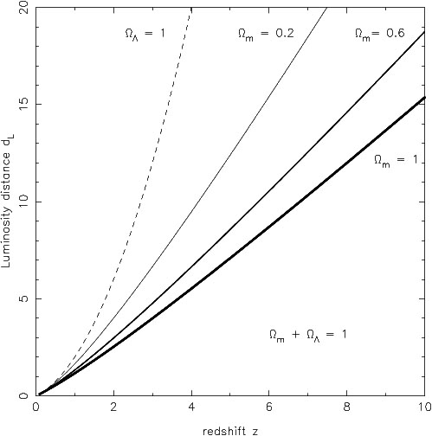
Luminosity Distance
matter-dominated FRW Universe
In a matter-dominated Universe, the luminosity distance as function of redshift is given by:

Slide 80
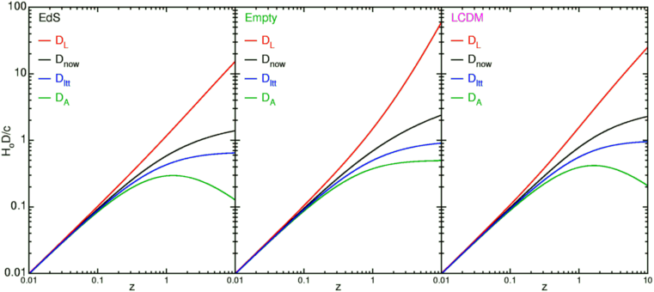
FRW Universe Distances
summary

Slide 81
How Much ?
Cosmic Curvature

Slide 82
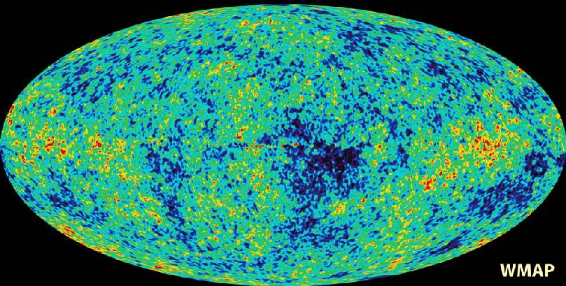
Cosmic Microwave Background
Map of the Universe at Recombination Epoch (WMAP, 2003):
• 379,000 years after Big Bang
• Subhorizon perturbations: primordial sound waves
• ∆T/T < 10-5

Slide 83
Measuring Curvature
Measuring the Geometry of the Universe:
• Object with known physical size,
at large cosmological distance
● Measure angular extent on sky
● Comparison yields light path,
and from this the curvature of space
W. Hu
In a FRW Universe:
lightpaths described by
Robertson-Walker metric
Geometry of Space

Slide 84
Measuring Curvature
• Object with known physical size,
at large cosmological distance:
• Sound Waves in the Early Universe !!!!
W. Hu
In a FRW Universe:
lightpaths described by
Robertson-Walker metric
Temperature Fluctuations
CMB

Slide 85
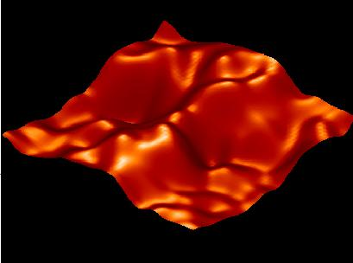
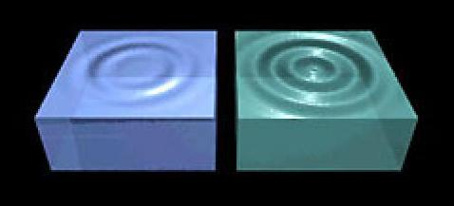
Music of the Spheres
● small ripples in
primordial matter & photon distribution
● gravity:
- compression primordial photon gas
- photon pressure resists
● compressions and rarefactions
in photon gas: sound waves
● sound waves not heard, but seen:
- compressions: (photon) T higher
- rarefactions: lower
● fundamental mode sound spectrum
- size of “instrument”:
- (sound) horizon size last scattering
● Observed, angular size: θ~1º
- exact scale maximum compression, the
“cosmic fundamental mode of music”
W. Hu

Slide 86
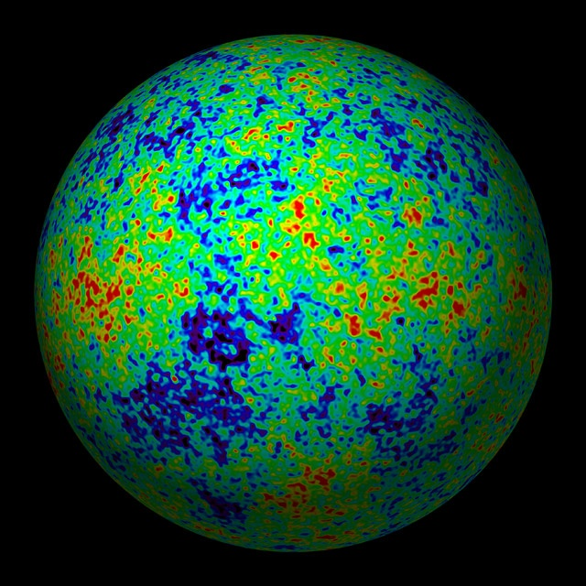
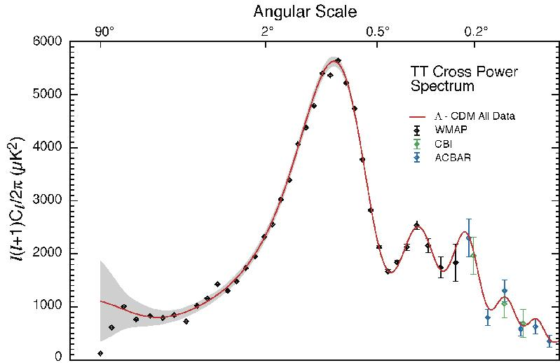
The Cosmic Tonal Ladder
The WMAP CMB temperature
power spectrum
Cosmic sound horizon
The Cosmic Microwave Background Temperature Anisotropies:
Universe is almost perfectly flat

Slide 87
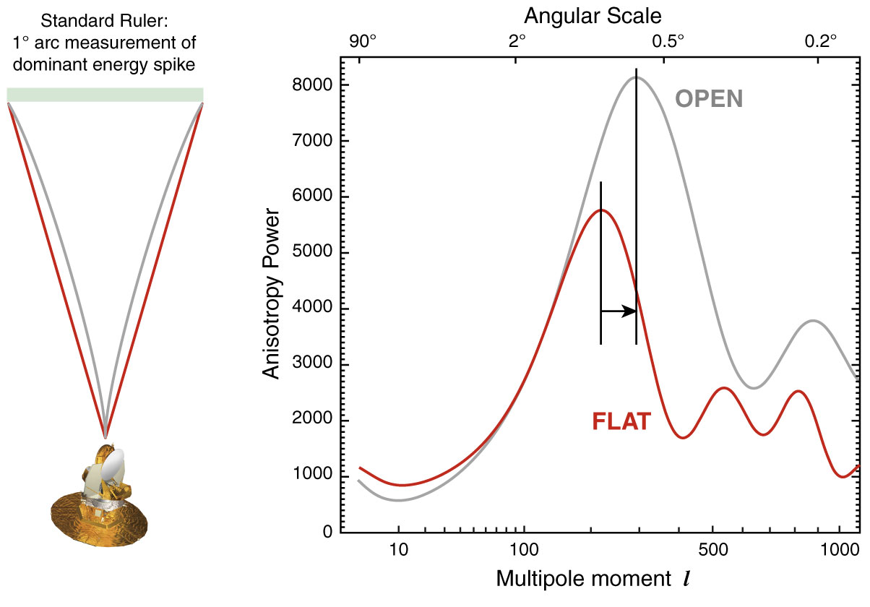
The WMAP CMB temperature
power spectrum

Slide 88
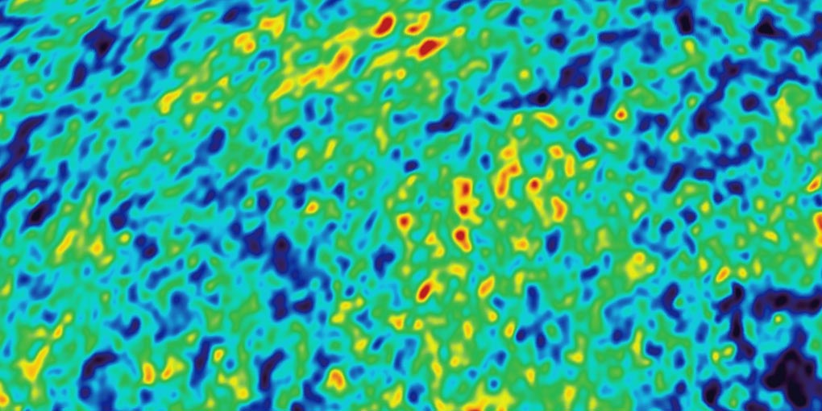
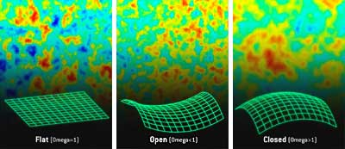
Angular CMB temperature fluctuations
CMB: Universe almost perfectly Flat !

Slide 89
Cosmic Constraints

Slide 90
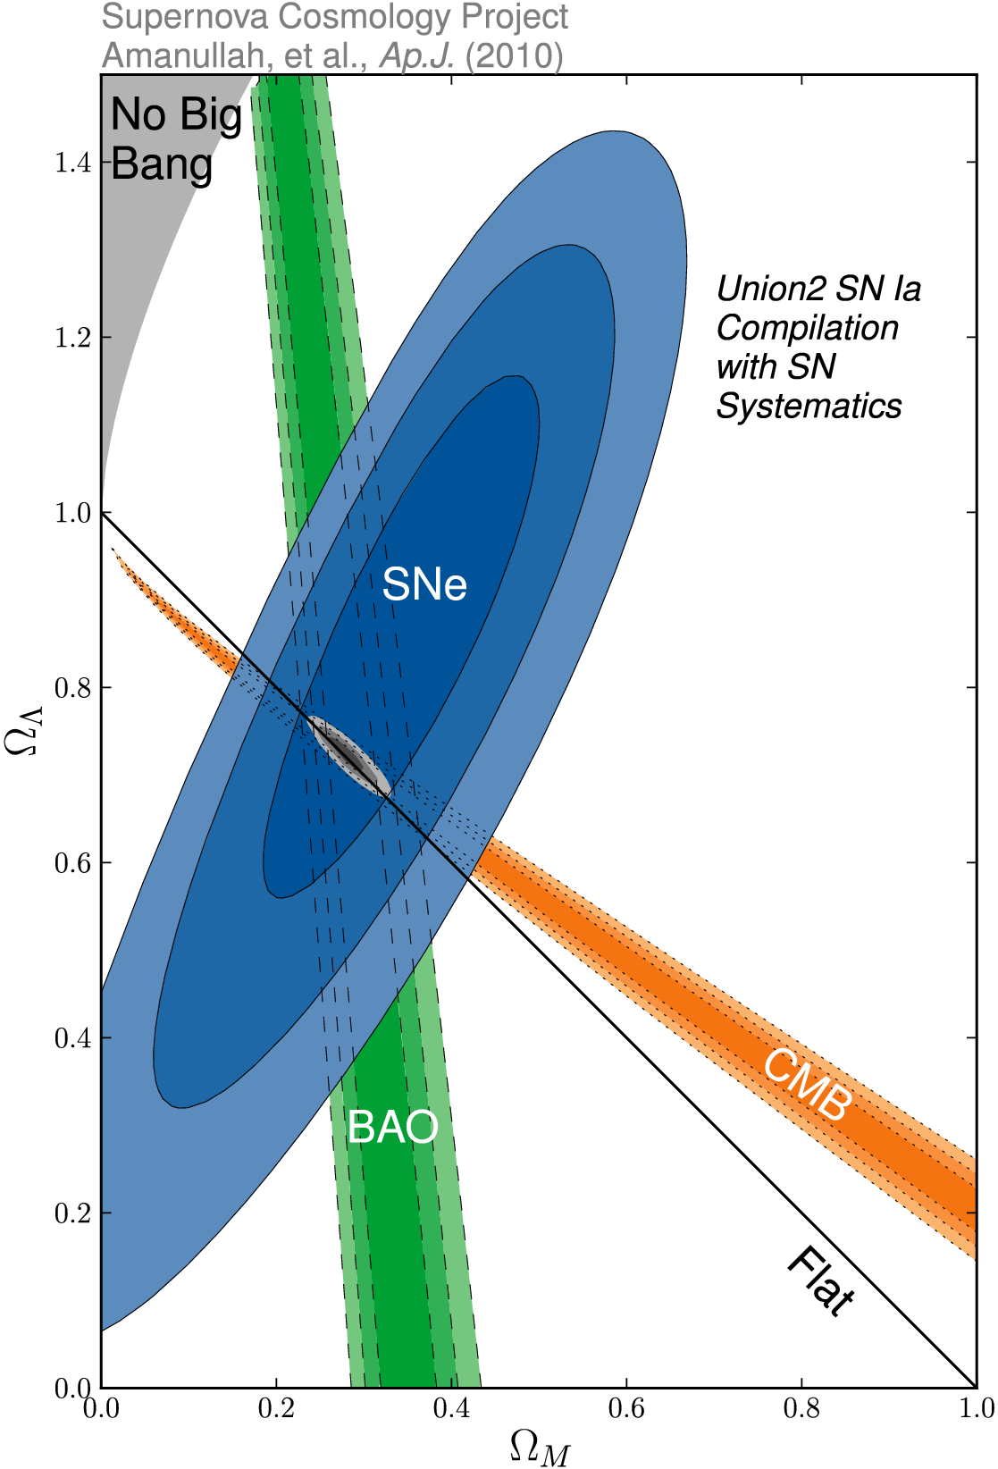
_{m} vs. ☹
SCP Union2 constraints (2010)
on values of matter density _{m}
dark energy density ☹

Slide 91
Concordance Universe

Slide 92
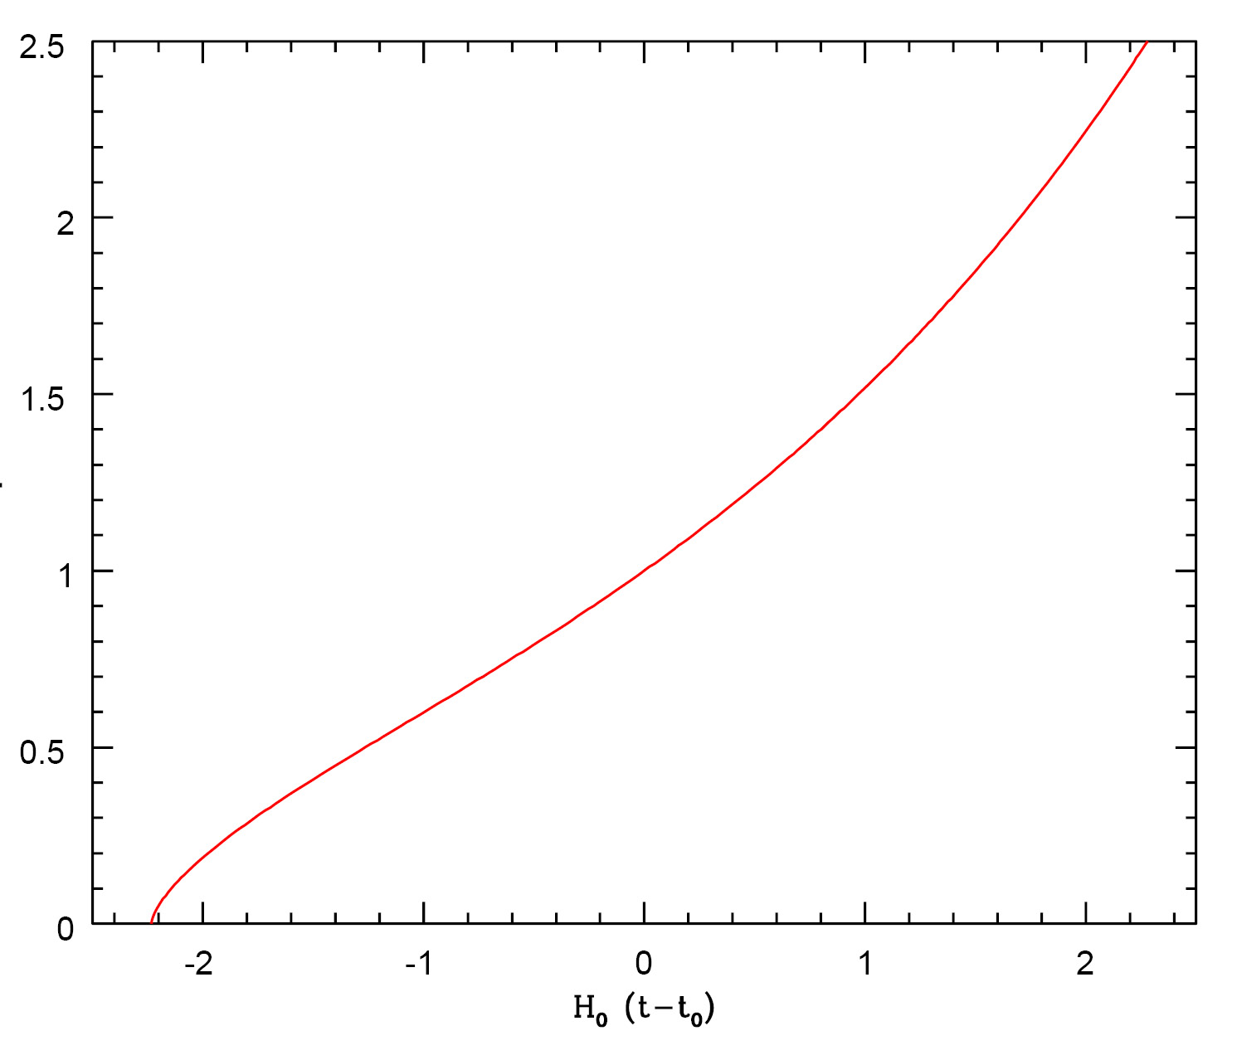
Concordance Expansion
expansion like
De Sitter expansion
acceleration
past
future
expansion like
EdS universe
today
deceleration

Slide 94
LCDM Cosmology
Concordance cosmology
- model that fits the majority of cosmological observations
- universe dominated by Dark Matter and Dark Energy
LCDM composition today …

Slide 95
Matter-Dark Energy
Transition
Note: a more appropriate characteristic transition
is that at which the deceleration turns into
acceleration:
Flat
Universe

Slide 96
Cosmic Future

Slide 97
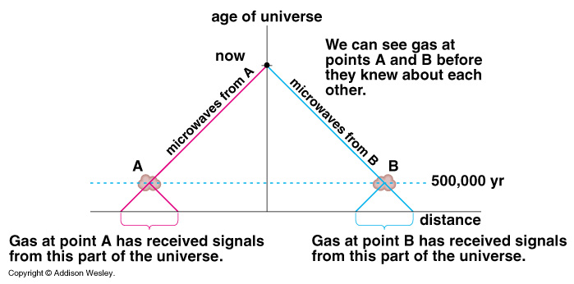
Cosmic Horizons
Particle Horizon of the Universe:
distance that light travelled since the Big Bang

Slide 98
Cosmic Particle Horizon
Light travel in an expanding Universe:
• Robertson-Walker metric:
• Light:
Horizon distance in comoving space
Horizon distance in physical space
Particle Horizon of the Universe:
distance that light travelled since the Big Bang

Slide 99
Cosmic Particle Horizon
Particle Horizon of the Universe:
distance that light travelled since the Big Bang
Horizon distance in comoving space
Horizon distance in physical space
In a spatially flat Universe, the horizon distance has a finite value for w>-1/3

Slide 100
Cosmic Particle Horizon
Particle Horizon of the Universe:
distance that light travelled since the Big Bang
In a spatially flat Universe, the horizon distance has a finite value for w>-1/3
flat, matter-dominated universe
flat, radiation-dominated universe

Slide 101
Infinite Particle Horizon
Particle Horizon of the Universe:
distance that light travelled since the Big Bang
In a spatially flat Universe, the horizon distance is infinite for w<-11/3
In such a universe, all of space is causally connected to observer:
In such a universe, you could see every point in space.

Slide 102
Cosmic Event Horizon
Light travel in an expanding Universe:
• Robertson-Walker metric:
• Light:
Event Horizon distance in
comoving space
Event Horizon distance in
physical space
Event Horizon of the Universe:
the distance over which one may still communicate …

Slide 103
Cosmic Event Horizon
Event Horizon of the Universe:
distance light may still travel in Universe.
Event Horizon distance comoving space
Event Horizon distance physical space
In a spatially flat Universe, the event horizon is:

Slide 104
Cosmic Event Horizon
Event Horizon of the Universe:
distance light may still travel in Universe.
In a spatially flat Universe, the event horizon is:
shrinking event horizon:

Slide 106
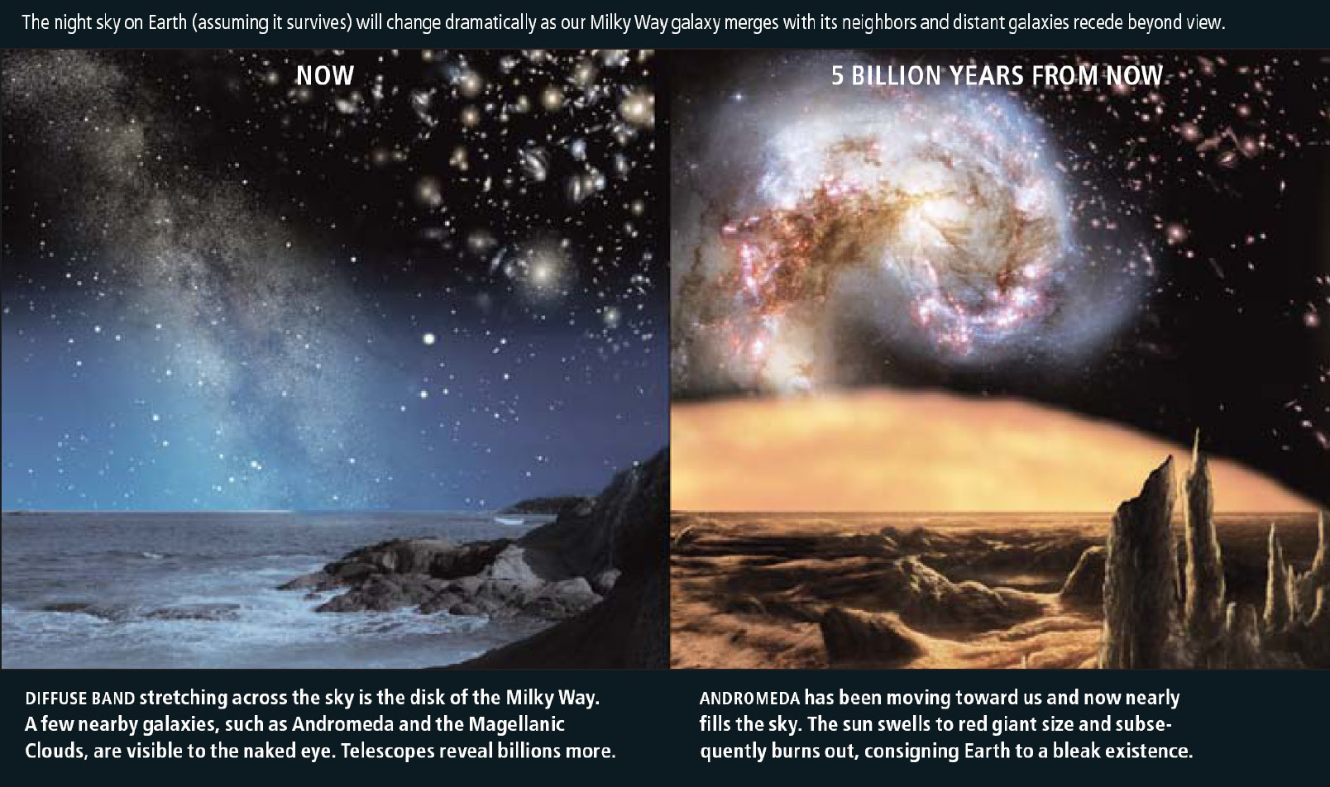
Cosmic Fate
100 Gigayears:
the end of Cosmology

