Slide 1
Cosmology,
lect. 8
Inflationary Universe

Slide 2
Standard Big Bang:
what it cannot explain …

Slide 3
Flatness Problem
the Universe is remarkably flat, and was even (much)
flatter in the past
Horizon Problem
the Universe is nearly perfectly isotropic and
homogeneous, much more so in the past
Monopole Problem:
There are hardly any magnetic monopoles in
our Universe
Fluctuations, seeds of structure
Structure in the Universe: origin

Slide 4
Flatness Problem

Slide 5
Flatness Problem
FRW Dynamical Evolution:
Going back in time, we find that the Universe was much flatter than it is at the
present.
Reversely, that means that any small deviation from flatness in the early Universe would have been strongly amplified nowadays …
We would therefore expect to live in a Universe that would either be almost
=0 or ;
Yet, we find ourselves to live in a Universe that is almost perfectly flat … _{tot}1
How can this be ?

Slide 6
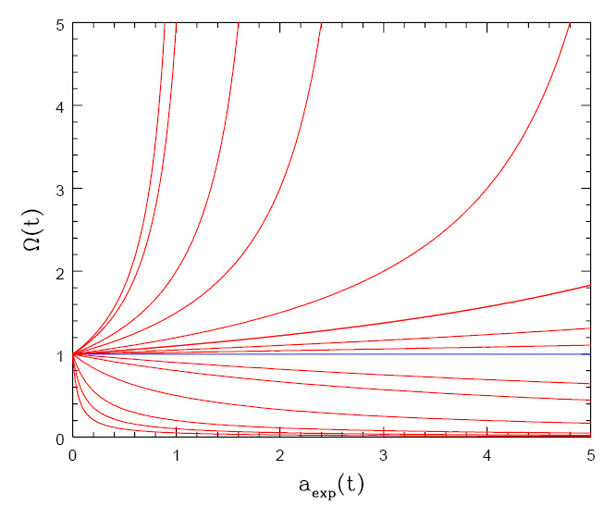
Flatness Evolution
• At radiation-matter equiv.
• Big Bang nucleosynthesis
a_{nuc}3.610⁻⁸
• Planck time

Slide 7
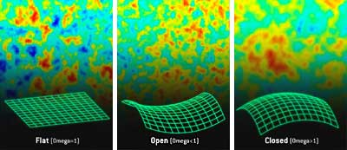
Angular CMB temperature fluctuations
CMB: Universe almost perfectly Flat !

Slide 8
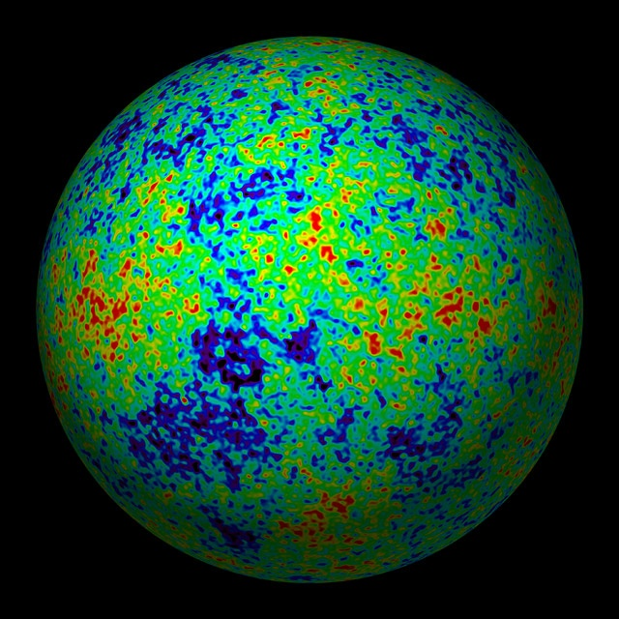
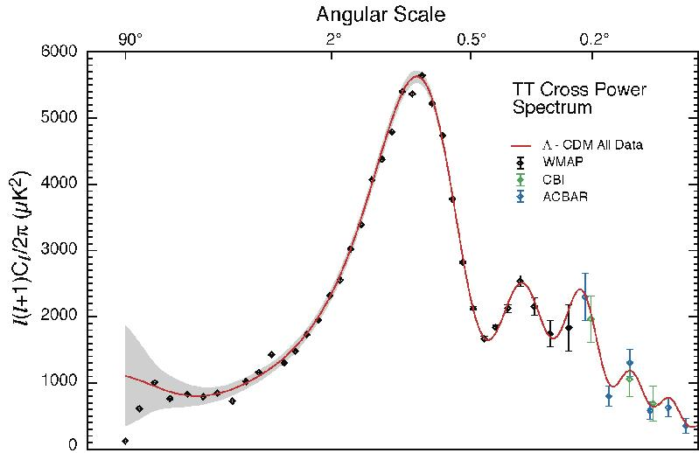
The Cosmic Tonal Ladder
The WMAP CMB temperature
power spectrum
Cosmic sound horizon
The Cosmic Microwave Background Temperature Anisotropies:
Universe is almost perfectly flat

Slide 9
Horizon Problem

Slide 10
Cosmic Horizons
Fundamental Concept for our understanding of the physics of the Universe:
Physical processes are limited to the region of space with which we are
or have ever been in physical contact.
What is the region of space with which we are in contact ?
Region with whom we have been able to exchange photons
(photons: fastest moving particles)
From which distance have we received light.
Complication: - light is moving in an expanding and curved space
- fighting its way against an expanding background
This is called the
Horizon of the Universe
:

Slide 11
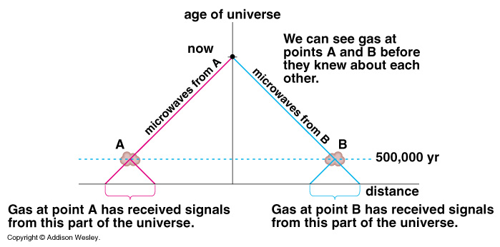
Cosmic Horizons
Horizon of the Universe:
distance that light travelled since the Big Bang

Slide 12
Cosmic Horizons
In an Einstein-de Sitter Universe
Horizon distance in physical space
Horizon of the Universe:
distance that light travelled since the Big Bang

Slide 13
Cosmic Horizons
The horizon distance at recombination/decoupling
(ie. time at which Cosmic Microwave Background is coming from)
angular size on the sky:
Large angular scales:
NOT in physical contact
Small angular scales:
In physical (thus, also thermal) contact
Horizon of the Universe:
distance that light travelled since the Big Bang

Slide 14
Cosmic Microwave Background
Size Horizon Recombination
COBE measured fluctuations: > 7º
Size Horizon at Recombination spans angle ~ 1º
How can it be that regions totally out of thermal contact have the same temperature ?

Slide 15
Cosmic Microwave Background
Size Horizon Recombination
COBE measured fluctuations: > 7º
Size Horizon at Recombination spans angle ~ 1º
COBE proved that superhorizon fluctuations do exist: prediction Inflation !!!!!

Slide 16
Structure Problem

Slide 17
Primordial Noise: Seeds of Cosmic Structure

Slide 18
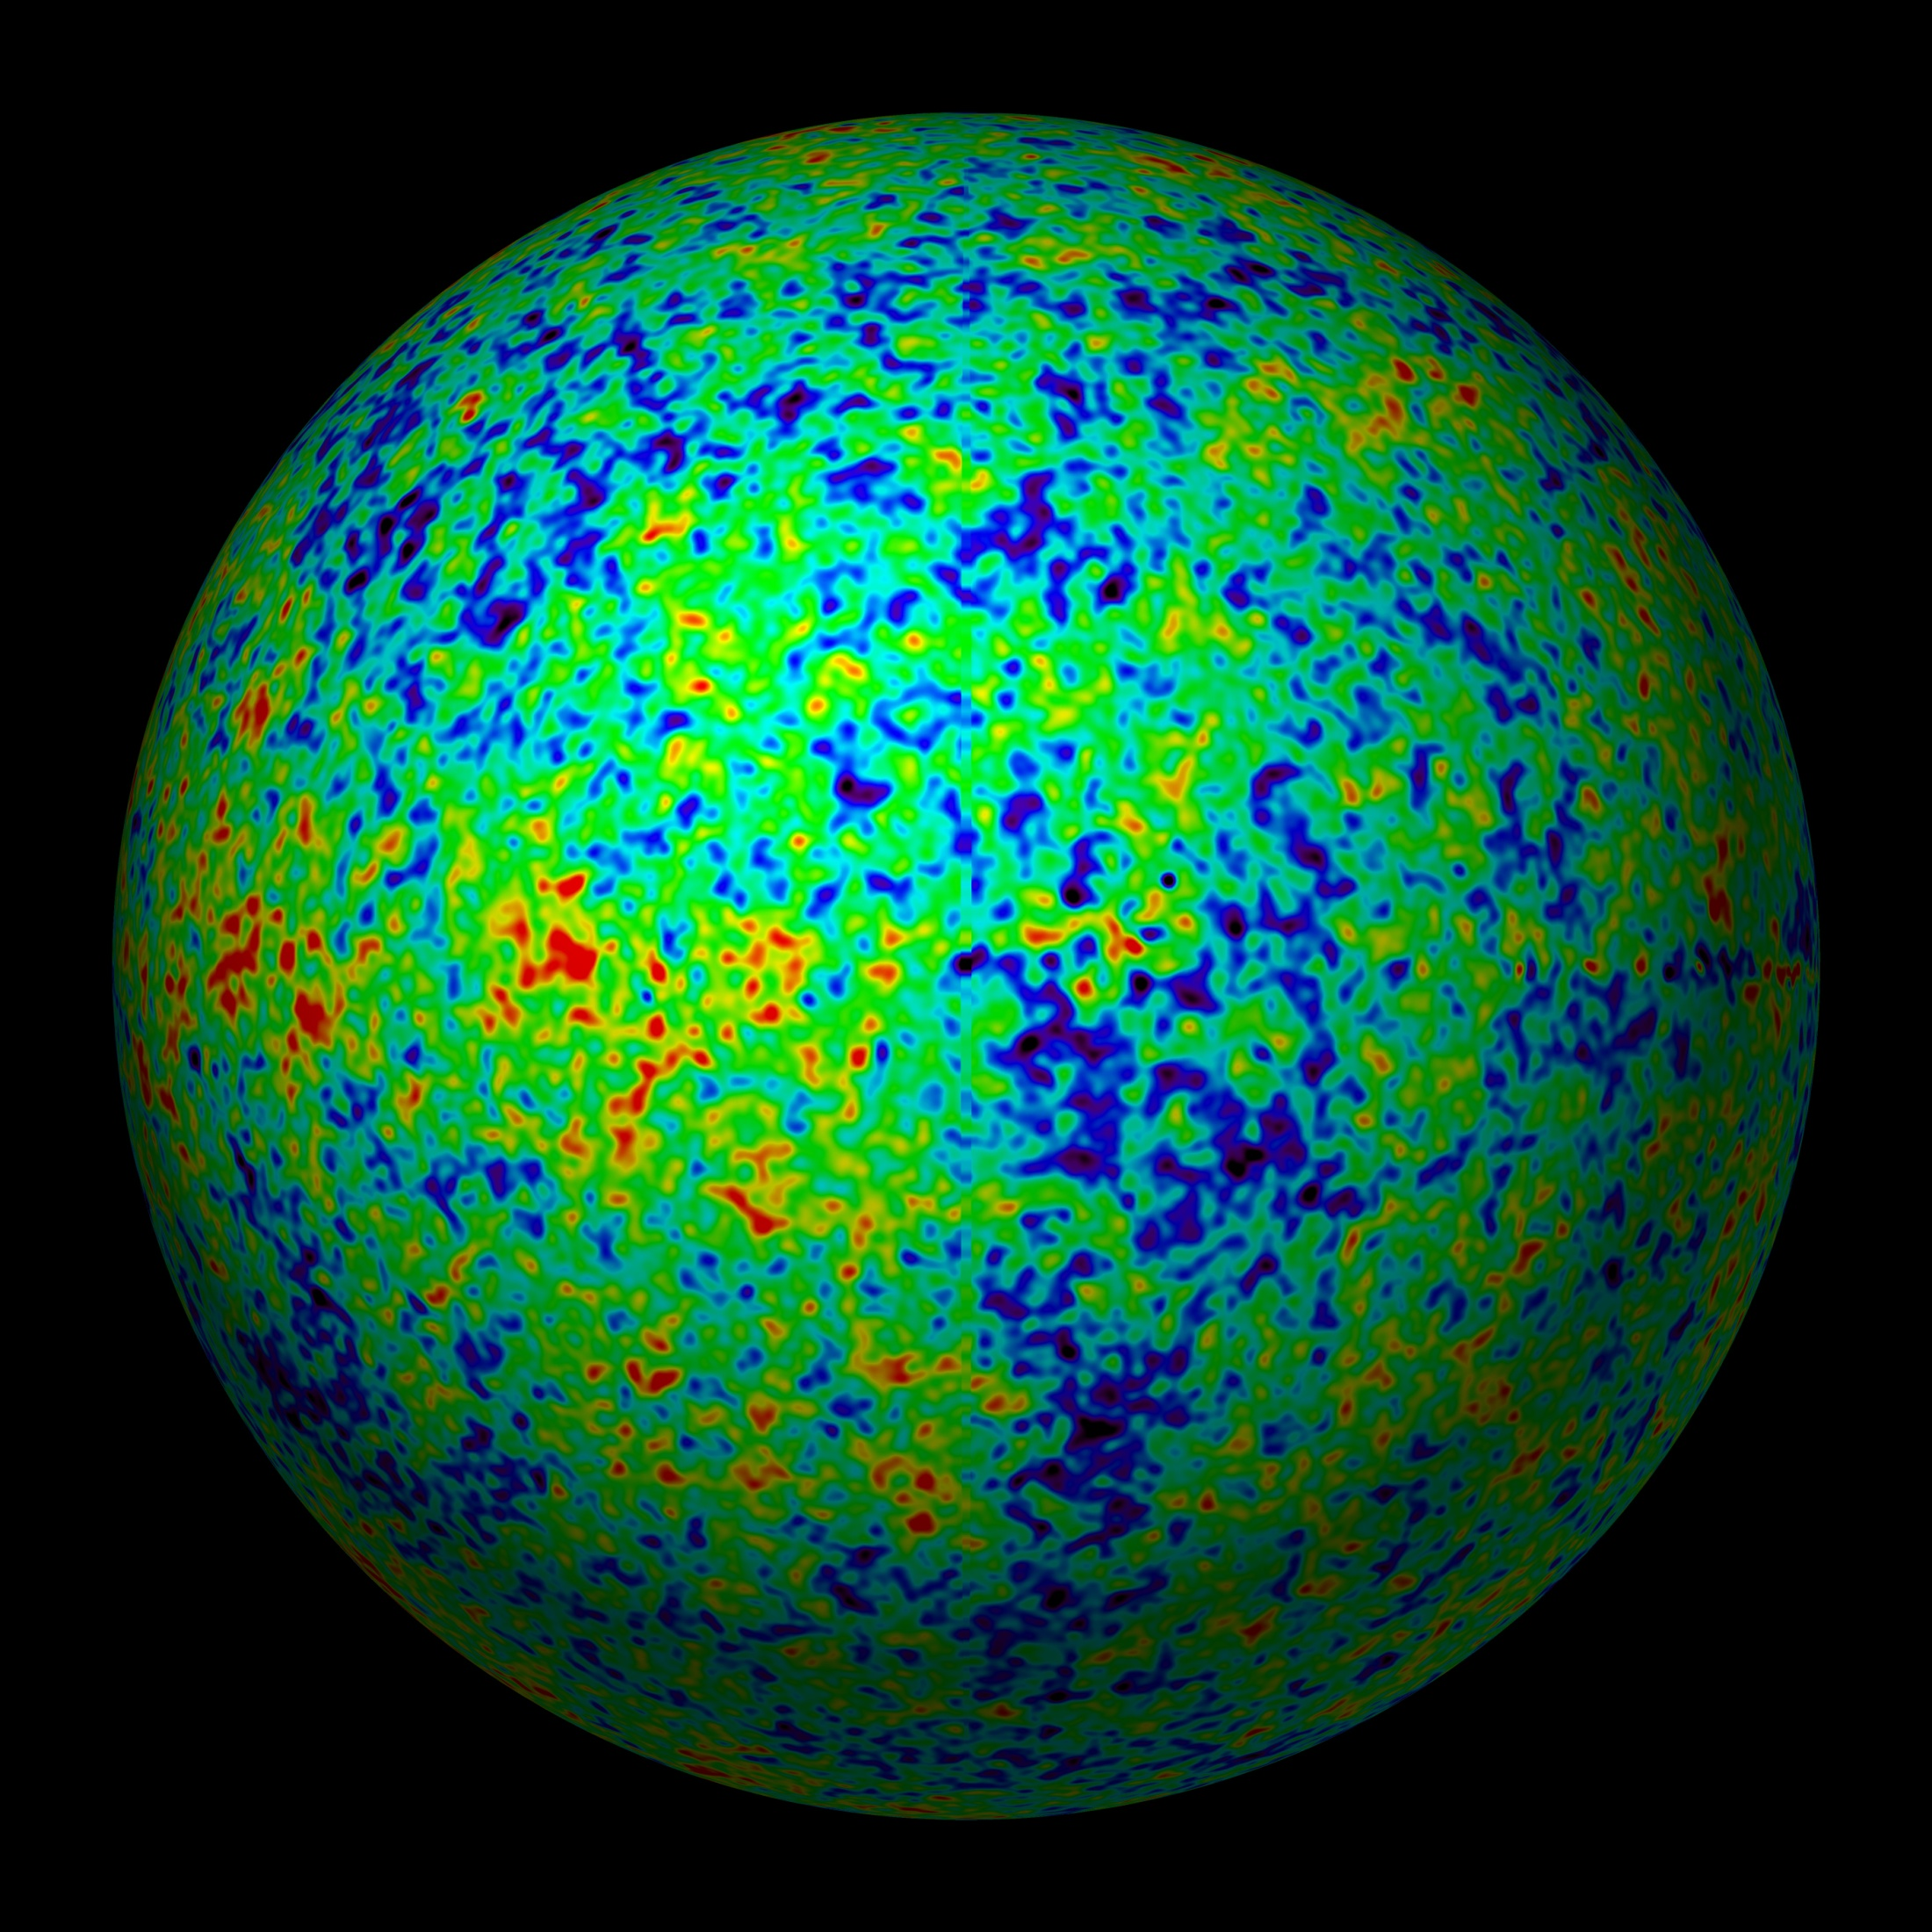
Universe at
379000 years:
almost featureless

Slide 19
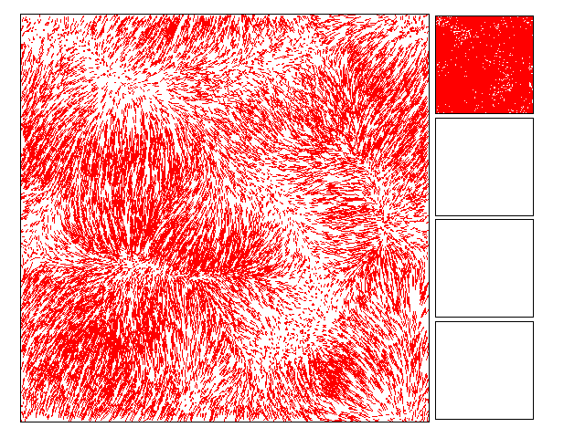
The Universe should be
Uniform: homogeneous & isotropic
Migration Streams of
matter induced by gravity
resulting from small perturbations

Slide 20
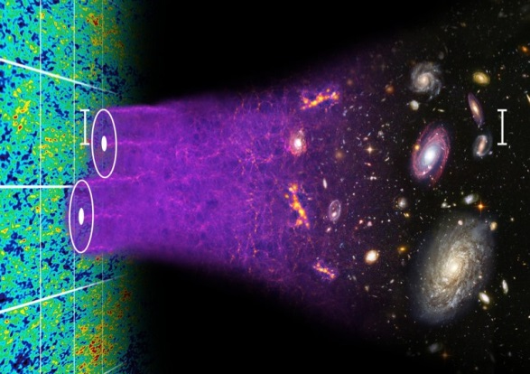
Formation Cosmic Structures

Slide 21
Cosmic Structure Formation
Formation
Cosmic Web:
simulation
sequence
(cold)
dark matter
(courtesy:
Virgo/V. Springel).

Slide 22
Millennium
Nbody simulation
time
resolution
Springel 2005

Slide 23
Illustris Simulation:
Cosmic Web
Dark Matter - Gas - Galaxies

Slide 24
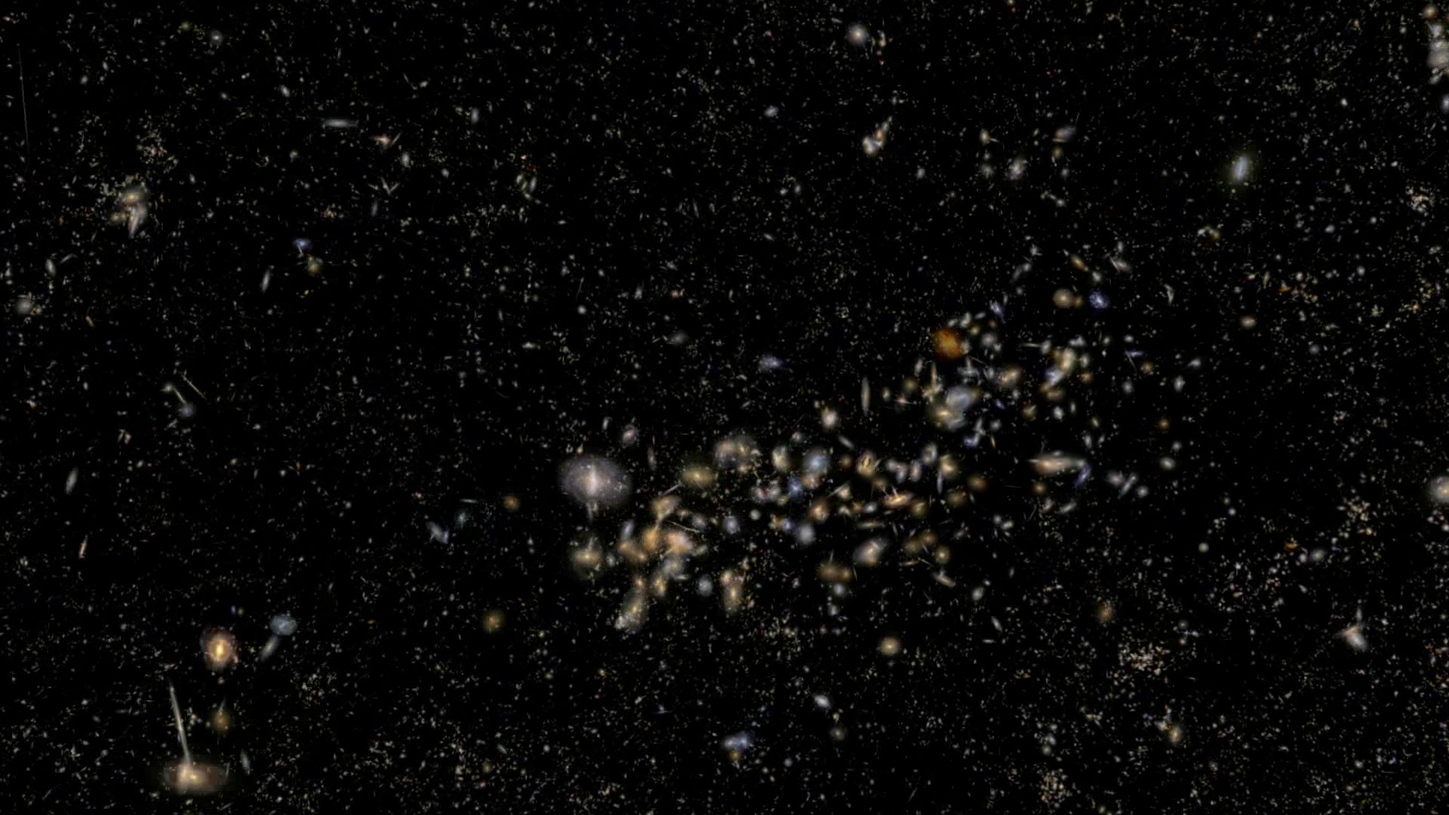
Universe at 13.8 Gyrs:
rich & complex structure

Slide 25
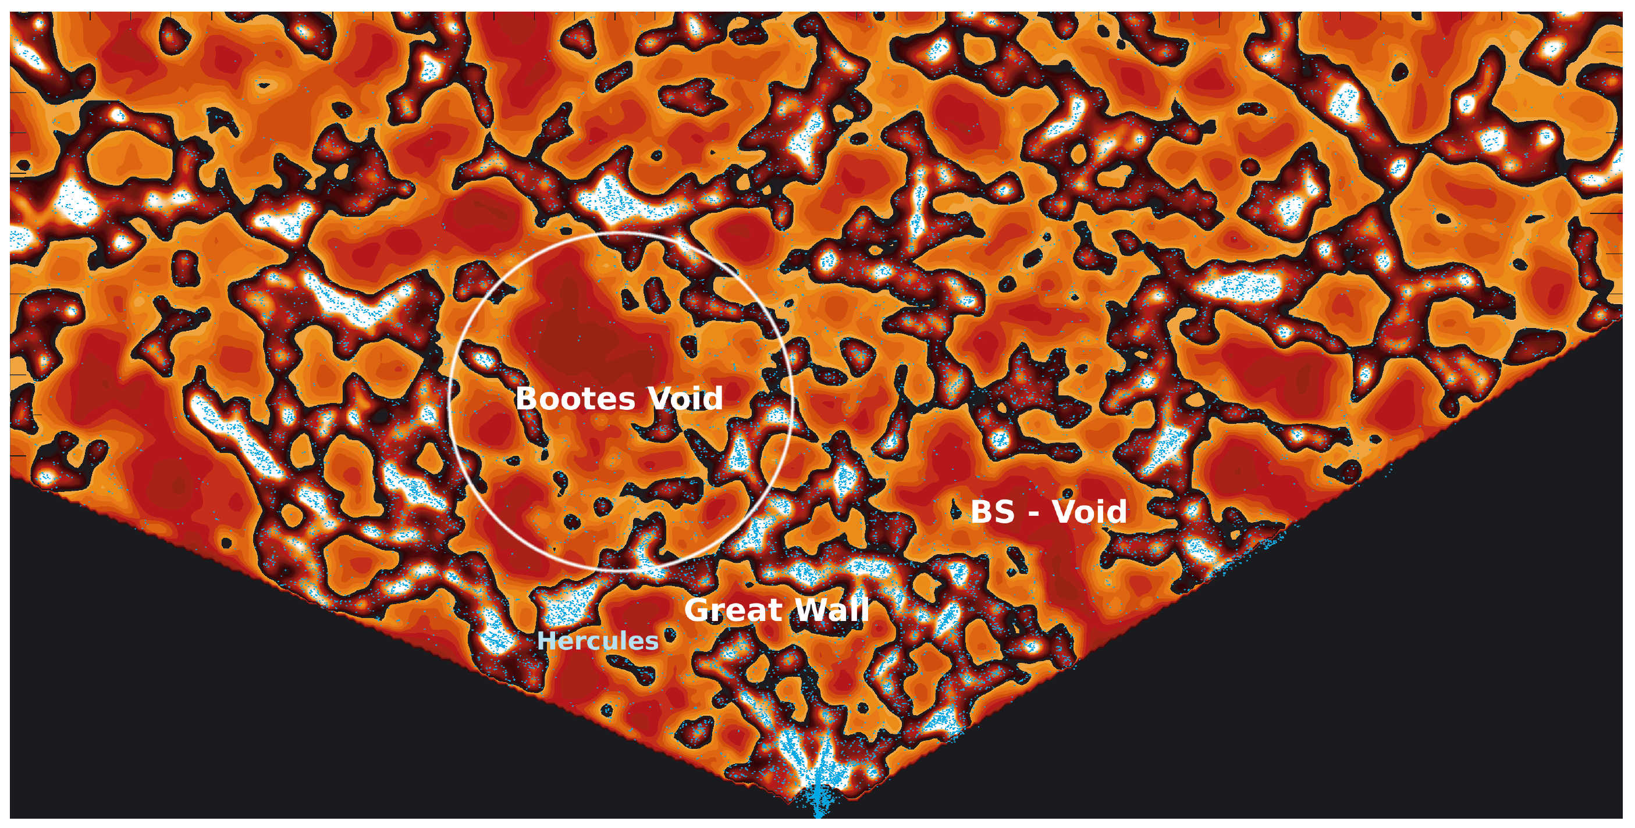
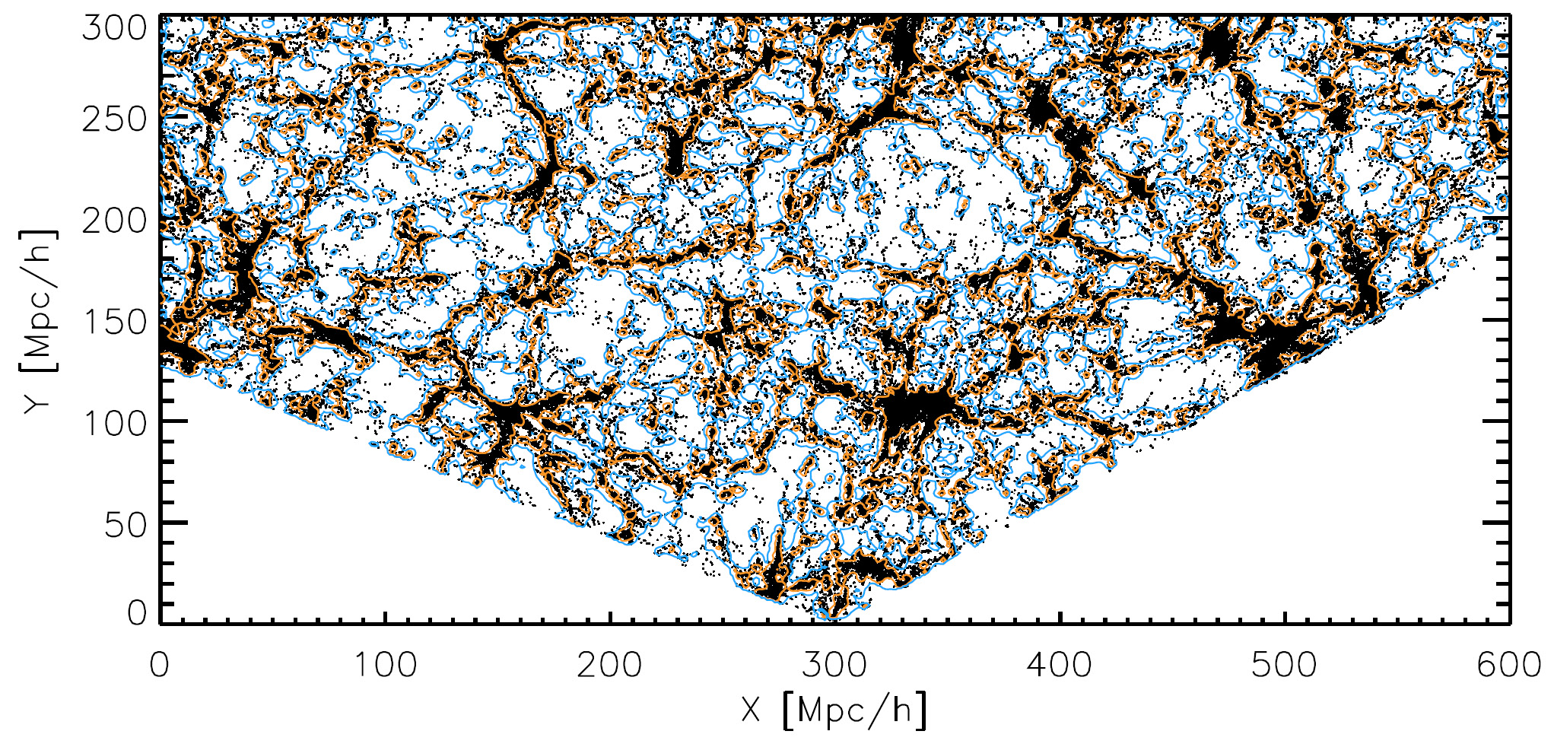
SDSS Galaxy Survey
map SDSS, clearly visible underdensities (Platen et al. 2010)
map SDSS, clearly visible underdensities (Platen et al. 2010)
with the advent of large galaxy redshift surveys
– LCRS, 2dFGRS, SDSS, 2MRS –
voids have been recognized as one of the quintessential components of the Cosmic Web

Slide 26
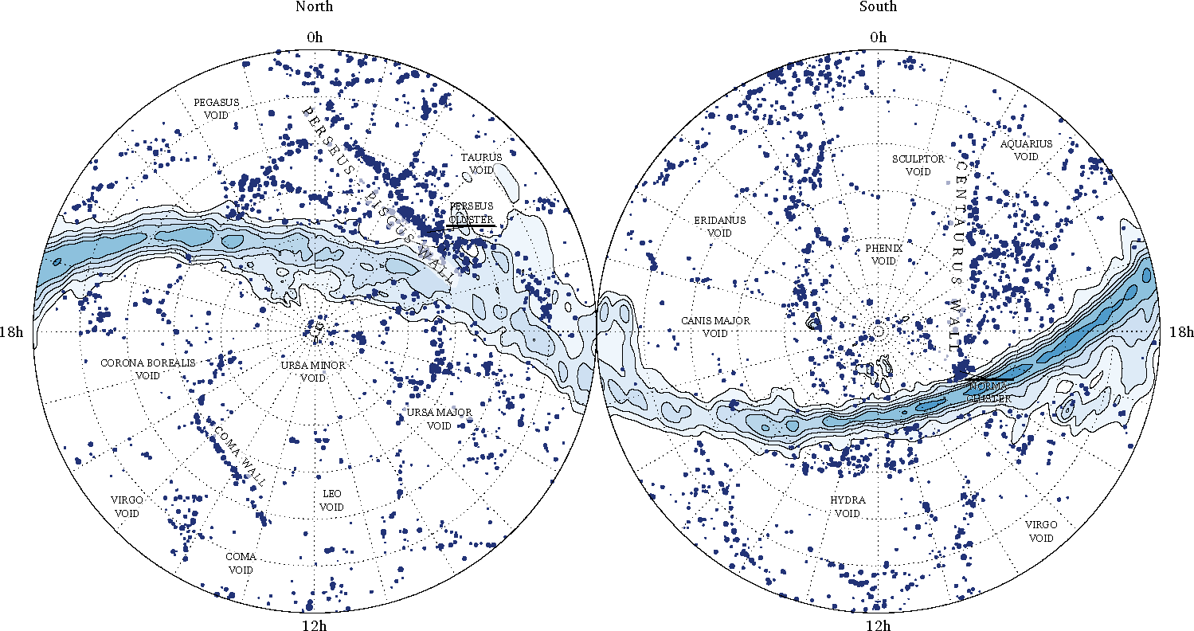
local Cosmic Web: 2MRS
cz=5,000-6,000 km/s
Courtesy: Johan Hidding

Slide 27
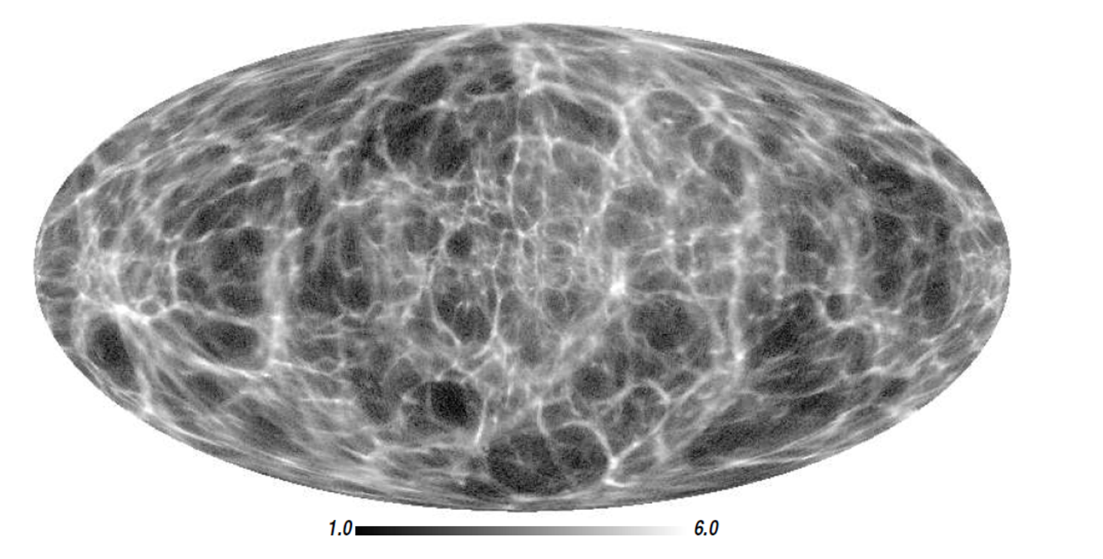
local Cosmic Web: 2MRS
most detailed reconstruction of the
local dark matter
Cosmic Web
Courtesy: Francisco Kitaura

Slide 28
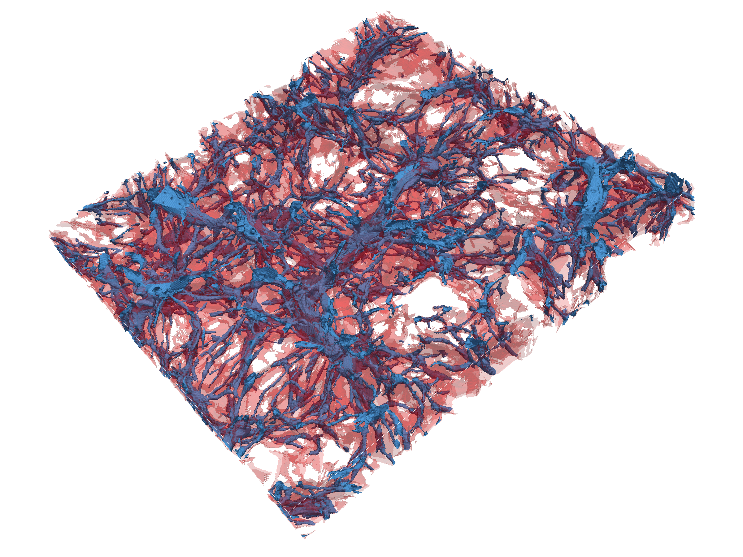
Nexus+ tracing of filaments:
inherent multiscale
character of filamentary web
Hidding, Cautun, vdW 2015

Slide 29
Horizon Problem

Slide 30
Cosmic Horizons
Fundamental Concept for our understanding of the physics of the Universe:
Physical processes are limited to the region of space with which we are
or have ever been in physical contact.
What is the region of space with which we are in contact ?
Region with whom we have been able to exchange photons
(photons: fastest moving particles)
From which distance have we received light.
Complication: - light is moving in an expanding and curved space
- fighting its way against an expanding background
This is called the
Horizon of the Universe
:

Slide 31
Cosmic Horizon
(Particle) Horizon of the Universe:
distance that light travelled since Big Bang

Slide 32
Probleem van Kosmische Horizon
Size Horizon Recombination
COBE metingen CMB temperatuur fluctuaties: > 7º
Schaal Horizon Zichtbare Heelal 379000 jr. na Big Bang: ~ 1º
Temperatuur hetzelfde over gehele hemel,
maar hoe kan dat zonder ooit in thermisch contact te zijn geweest?

Slide 33
INFLATION

Slide 34
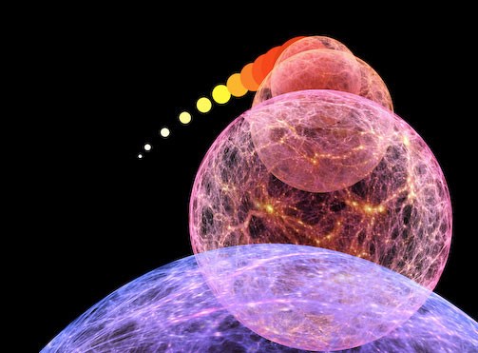
10⁻³⁶ sec after Big Bang: Inflation of the Universe

Slide 36
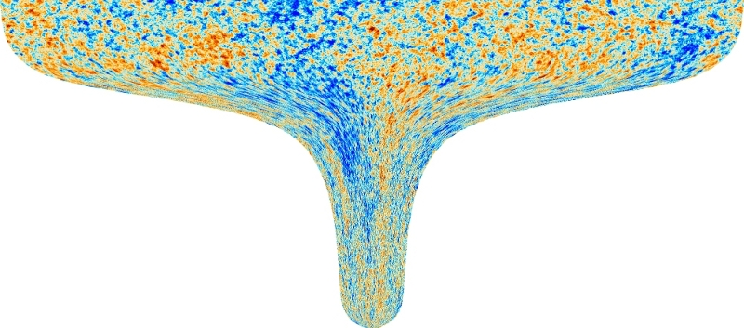
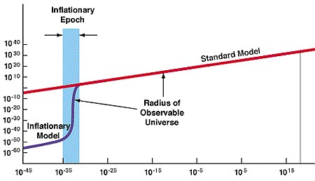
Kosmische Inflatie
~ 10⁻³⁶ sec. na Big Bang:
Heelal dijt exponentieel uit:
factor 10⁶⁰ in 10⁻³⁴ sec
Afmeting huidige zichtbare Heelal:
begin inflatie: 10⁻¹⁵ afmeting atoom
eind inflatie: diameter van stuiver

Slide 38
Propelling Inflation: Inflaton

Slide 39
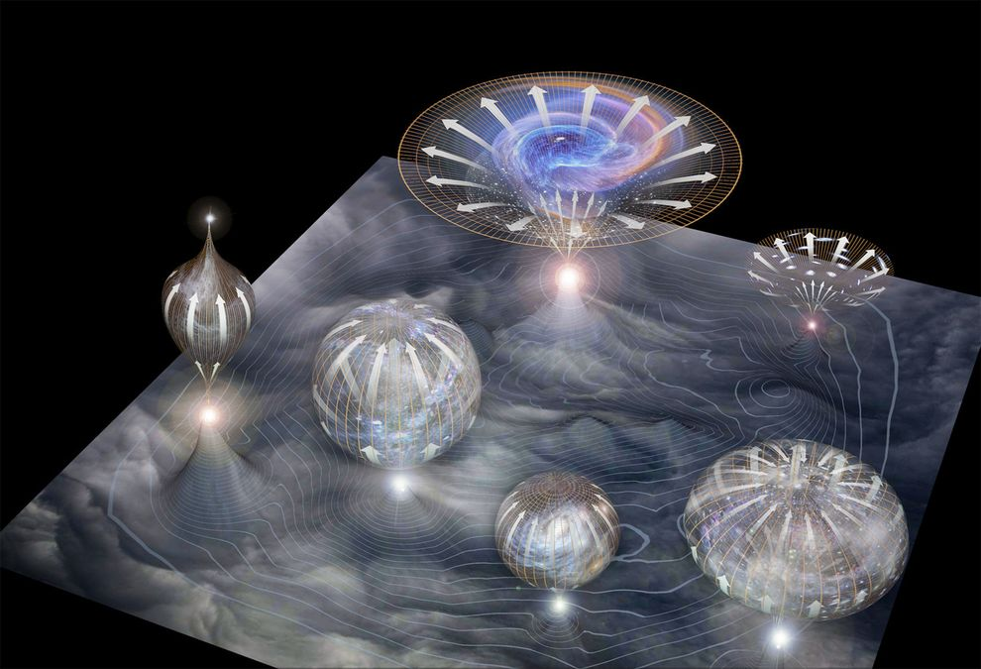
Inflatie & Multiverse

