Slide 1
Cosmology,
lect. 7
Thermal History

Slide 2
FRW
Thermodynamics

Slide 3
FRW Dynamics
To find solutions a(t) for the expansion history of the Universe, for a particular FRW Universe ,
one needs to know how the
density ρ(t) and pressure p(t) evolve as function of a(t)
FRW equations are implicitly equivalent to a third Einstein equation, the
energy equation,

Slide 4
FRW Dynamics:
Adiabatic Cosmic Expansion
Important observation:
the energy equation,
is equivalent to stating that the change in internal energy
of a specific co-expanding volume V(t) of the Universe, is due to work by pressure:
Friedmann-Robertson-Walker-Lemaitre expansion of the Universe is
Adiabatic Expansion

Slide 5
FRW Dynamics:
Thermal Evolution
Adiabatic Expansion of the Universe:
• Implication for Thermal History
• Temperature Evolution of cosmic components
For a medium with adiabatic index γ:
Radiation (Photons)
Monatomic Gas
(hydrogen)

Slide 6
Radiation
&
Matter

Slide 7
Cosmic Radiation
The Universe is filled with thermal radiation, the photons that were created in
The Big Bang and that we now observe as the Cosmic Microwave Background (CMB).
The CMB photons represent the most abundant species in the Universe, by far !
The CMB radiation field is PERFECTLY thermalized, with their energy distribution representing the most perfect blackbody spectrum we know in nature. The energy density u(T) is therefore given by the Planck spectral distribution,
At present, the temperature T of the cosmic radiation field is known to impressive
precision,

Slide 8
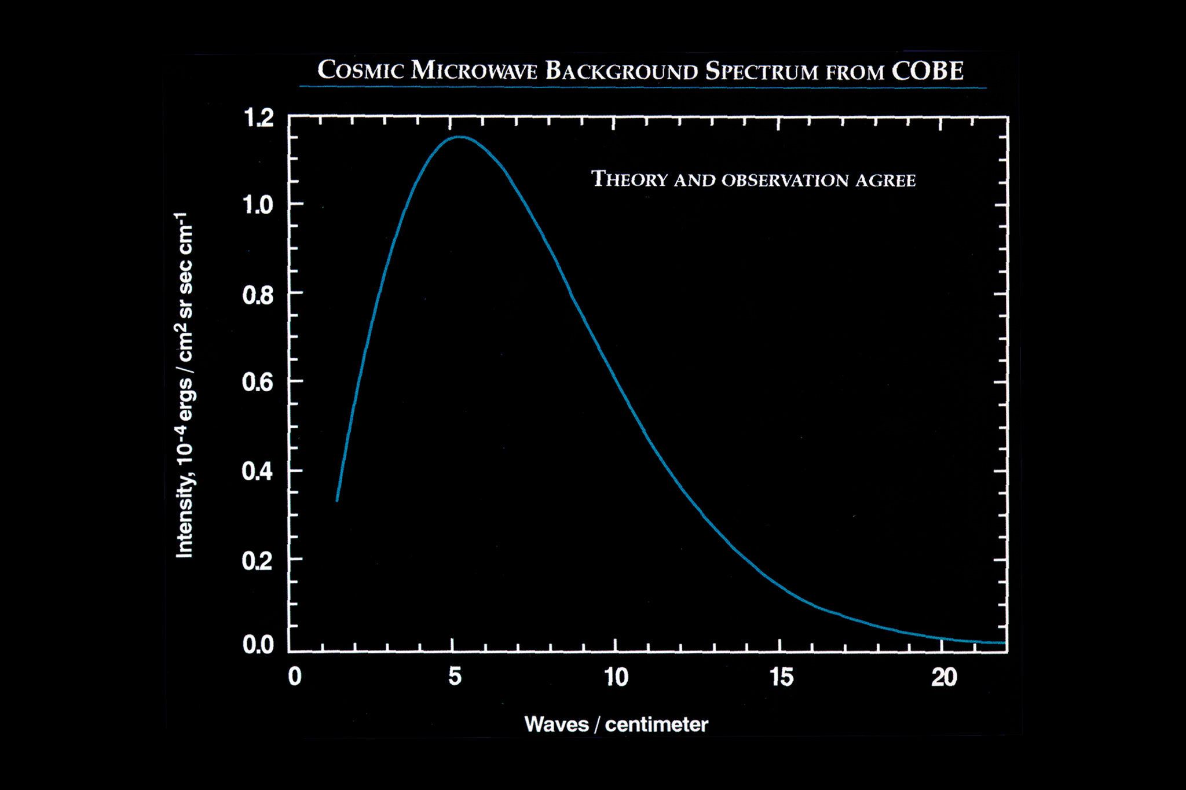
CMB Radiation Field Blackbody Radiation
• COBE-DIRBE:
temperature, blackbody
T = 2.725 K
John Mather
Nobelprize physics 2006
• Most accurately measured
Black Body Spectrum
Ever !!!!!

Slide 9
Cosmic Radiation
With the energy density u_{ν}(T) of CMB photons with energy hν given, we know the
number density n_{ν}(T) of such photons:
The total number density n_{γ}(T) of photons in the Universe can be assessed by
integrating the number density n_{γ}(T) of photons with frequency ν over all
frequencies,

Slide 10
Baryon-Photon Ratio
Having determined the number density of photons, we may compare this with the
number density of baryons, n_{b}(T). That is, we wish to know the
PHOTON-BARYON ratio,
The baryon number density is inferred from the baryon mass density.
here, for simplicity, we have assumed that baryons (protons and neutrons) have
the same mass, the proton mass m_{p} ~ 1.672 x 10⁻²⁴ g. At present we therefore find
We know that
Ω_{b}~0.044 and h~0.72:

Slide 11
Baryon-Photon Ratio
From simple thermodynamic arguments, we find that the number of photons is
vastly larger than that of baryons in the Universe.
In this, the Universe is a unique physical system, with tremendous repercussions for the thermal history of the Universe. We may in fact easily find that the cosmic photon-baryon ratio remains constant during the expansion of the Universe,

Slide 12
Entropy of the Universe
The photon-baryon ratio in the Universe remains constant during the expansion
of the Universe, and has the large value of
This quantity is one of the key parameters of the Big Bang. The baryon-photon
ratio quantifies the ENTROPY of the Universe, and it remains to be explained why
the Universe has produced such a system of extremely large entropy !!!!!
The key to this lies in the very earliest instants of our Universe !

Slide 13
Cosmic Light (CMB): most abundant species
By far,
the most abundant particle species
in the Universe
n_{γ}/n _{B} ~ 1.9 billion

Slide 14
Hot Big Bang:
Thermal History

Slide 15
Adiabatic Expansion
The Universe of Einstein, Friedmann & Lemaitre
expands adiabatically
Energy of the expansion of the Universe corresponds to the decrease in the energy of its constituents
The Universe COOLS as a result of its expansion !

Slide 16
Equilibrium Processes
Throughout most of the universe’s history (i.e. in the early universe),
various species of particles keep in (local) thermal equilibrium
via interaction processes:
Equilibrium as long as the interaction rate Γ_{int} in
the cosmos’ thermal bath, leading to N_{int} interactions in time t,
is much larger than the expansion rate of the Universe,
the Hubble parameter H(t):

Slide 17
Reconstruction
Thermal History Timeline
Strategy:
To work out the thermal history of the Universe, one has to evaluate at each cosmic time which physical processes are still in equilibrium.
Once this no longer is the case, a physically significant transition has taken place.
Dependent on whether one wants a crude impression or an accurately and detailed worked out description, one may follow two approaches:
Crudely:
Assess transitions of particles out of equilibrium, when they decouple from
thermal bath. Usually, on crude argument:
Strictly:
evolve particle distributions by integrating the Boltzmann equation

Slide 18
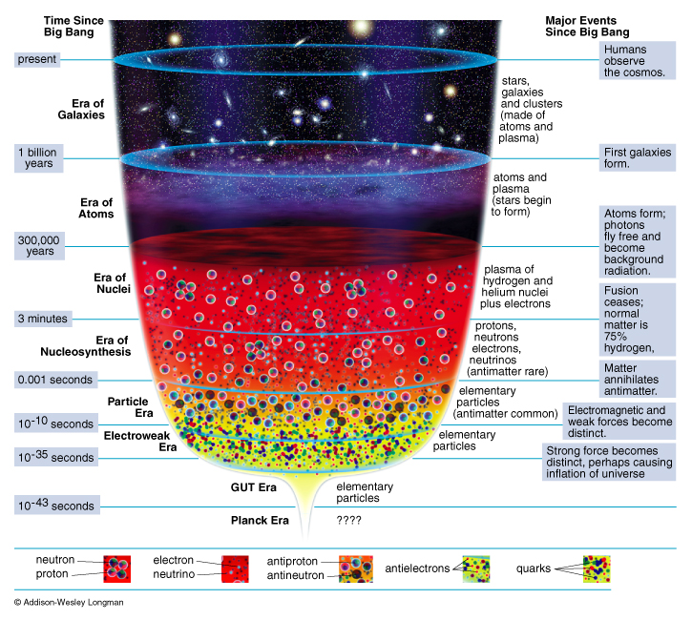
Adiabatic Expansion
reconstruction
Thermal History
of the Universe

Slide 19
Thermal History: Interactions
Particle interactions are mediated by gauge bosons:
• photons for the electromagnetic force,
• W bosons for weak interactions,
• gluons for the strong force.
The strength of the interaction is set by the coupling constant,
leading to the following dependence of the interaction rate Γ, on temperature T:
mediated by massless gauge boson (photon):
(ii) mediated by massive gauge boson (W^{+/-} ,Z⁰)

Slide 20
Hot Big Bang
Eras

Slide 21
Cosmic Epochs
Planck Epoch t < 10⁻⁴³ sec
Phase Transition Era 10⁻⁴³ sec < t < 10⁵sec
Hadron Era t ~10⁻⁵ sec
Lepton Era 10⁻⁵ sec < t < 1 min
Radiation Era 1 min < t <379,000 yrs
Post-Recombination Era t > 379,000 yrs
GUT transition
electroweak transition
quark-hadron transition
muon annihilation
neutrino decoupling
electron-positron annihilation
primordial nucleosynthesis
radiation-matter equivalence
recombination & decoupling
Structure & Galaxy formation
Dark Ages
Reionization
Matter-Dark Energy transition

Slide 22
History of the Universe in Four Episodes: I
On the basis of the
1) complexity of the involved physics
2) our knowledge of the physical processes
we may broadly distinguish four cosmic episodes:
(I)
Origin universe
???
t < 10⁻⁴³ sec
fundamental physics:
totally unknown
Planck Era

Slide 23
History of the Universe in Four Episodes: II
(II)
_{tot:}
curvature/
flatness
_{b} (n_{b}/n)
`exotic’
dark matter
primordial
fluctuations
10⁻⁴³ < t < 10⁻³ sec
fundamental physics:
poorly known
speculative
VERY early universe

Slide 24
History of the Universe in Four Episodes: III
(III)
primordial
nucleo-
synthesis
blackbody
radiation:
CMB
10⁻³ < t < 10¹³ sec
Standard
Hot Big Bang
Fireball
fundamental microphysics:
known very well

Slide 25
History of the Universe in Four Episodes: IV
(IV)
t > 10¹³ sec
structure
formation:
stars,
galaxies
clusters
…
Post
(Re)Combination
universe
complex macrophysics:
Fundamentals known
complex interplay

Slide 26
Origins:
the Planck Epoch

Slide 27
Thermal History: Episode by Episode
Planck Epoch
t < 10⁻⁴³ sec
In principle, temperature T should rise to infinity as we probe earlier and earlier into the universe’s history:
However, at that time the energy of the particles starts to reach values where quantum gravity effects become dominant. In other words, the de Broglie wavelength of the particles become comparable to their own Schwarzschild radius.

Slide 28
Thermal History: Planck Epoch
Once the de Broglie wavelength is smaller than the corresponding Schwarzschild radius, the particle has essentially become a “quantum black hole”:
de Broglie wavelength:
≤
Schwarzschild radius:
These two mass scales define the epoch of quantum cosmology, in which the purely deterministic metric description of gravity by the theory of relativity needs to be augmented by a theory incorporating quantum effects: quantum gravity.

Slide 29
Thermal History: Planck Epoch
On the basis of the expressions of the de Broglie wavelength and the Schwarzschild radius we may infer the typical mass scale, length scale and timescale for this epoch of quantum cosmology:
Planck Mass
Planck Length
Planck Time
Because our physics cannot yet handle quantum black holes, i.e. because we do not have any viable theory of quantum gravity we cannot answer sensibly questions on what happened before the Planck time. In other words, we are not able to probe the ultimate cosmic singularity … some ideas of how things may have been do exist …

Slide 30
Statistical Equilibrium

Slide 31
Maxwell-Boltzmann
Non-relativistic medium
For statistical equilibrium, the Maxwell-Boltzmann distribution specifies for a temperature T, the density of particles:
- number density n_{i}
- particles with mass m_{i}
- statistical weight g_{i}
- chemical potential μ_{i}

Slide 32
Echo of the Big Bang:
Recombination,
Decoupling,
Last Scattering

Slide 33
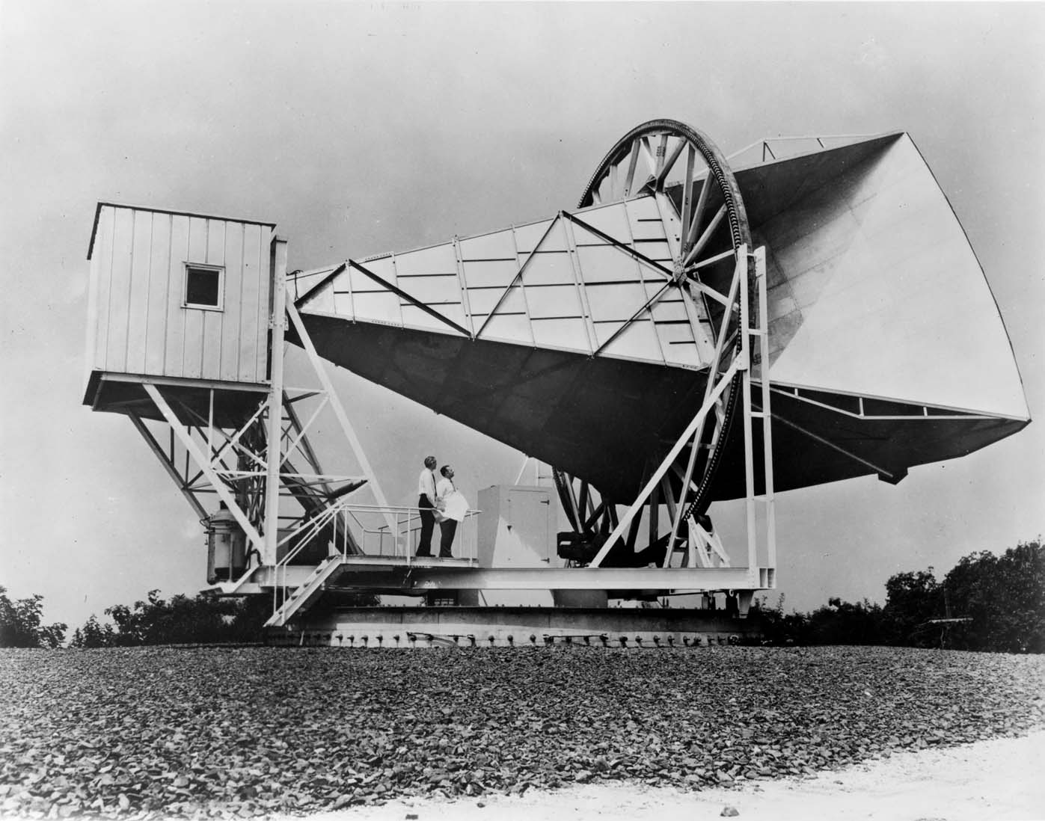
CMB Discovery: Penzias & Wilson

Slide 34
Cosmic Light (CMB): the facts
Discovered serendipitously in 1965 Penzias & Wilson,
Nobelprize 1978 !!!!!
Cosmic Licht that fills up the Universe uniformly
Temperature: T_{γ}=2.725 K
(CMB) photons most abundant particle in the Universe:
n_{γ} ~ 415 cm⁻³
Per atom in the Universe: n_{γ}/n _{B} ~ 1.9 x 10⁹
Ultimate evidence of the Big Bang !!!!!!!!!!!!!!!!!!!

Slide 35
Recombination & Decoupling
protonen & electronen
waterstofatomen
lichtdeeltjes/fotonen

Slide 36
the Cosmic TV Show
Note:
far from being an exotic faraway phenomenon, realize that the CMB nowadays is counting for approximately 1% of the noise on your (camping) tv set …
!!!! Live broadcast from the Big Bang !!!!
Courtesy: W. Hu

Slide 37
Recombination & Decoupling
T ~ 3000 K
z_{dec}=1089 (Δz_{dec}=195); t_{dec}=379.000 yrs
Before the “Recombination Epoch
Radiation and Matter are tightly coupled through Thomson scattering.
The events surrounding “recombination” exist of THREE major
(coupled, yet different) processes:
• Recombination protons & electrons combine to H atoms
• Decoupling photons & baryonic matter no longer interact
• Last scattering meaning, photons have a last kick and go …

Slide 38
Recombination & Decoupling
T ~ 3000 K
z_{dec}=1089 (Δz_{dec}=195); t_{dec}=379.000 yrs
Before this time, radiation and matter are tightly coupled through
Thomson scattering:
Because of the continuing scattering of photons, the universe is a “fog”.
A radical change of this situation occurs once the temperature starts to drop below T~3000 K. and electrons. Thermodynamically it becomes favorable to form neutral (hydrogen) atoms H (because the photons can no longer destory the atoms):
This transition is usually marked by the word “recombination”, somewhat of a misnomer, as of course hydrogen atoms combine just for the first time in cosmic history. It marks a radical transition point in the universe’s history.

Slide 39
Recombination - Saha
Recombination Process:
Statistical Equilibrium sets the density of
electrons, protons and hydrogen atoms involved in the recombination process:

Slide 40
Recombination - Saha
Recombination Process:
Taking along that for the chemical potentials
we find for the relation between the number densities

Slide 41
Recombination - Saha
Recombination Process:
- mass electron small:
- binding energy hydrogen atom:
- weights g_{i}:
results in the Saha Equation,
which specifies the shifting ionization state as a function of
shifting temperature T

Slide 42
Recombination - Ionization
Recombination Process:
Photon number density in blackbody bath temperature T:
Ionization fraction x:
Baryon-photon ratio η:
Proton number density at T:
which specifies the shifting ionization state as a function of
shifting temperature T

Slide 43
Recombination: Ionization Evolution (Saha)

Slide 44
Recombination - Ionization
Recombination Process:
Relation between temperature T and ionization fraction X:
Moment of recombination:
which specifies the shifting ionization state as a function of
shifting temperature T

Slide 45
Standard theory of H recombination (Peebles 1968, Zel’dovich et al 1968)
Recombination Process
not entirely trivial:
• ground state could be
reached via Lya transition (2P-1S)
DOES NOT WORK !!!!!
large abundance Lya Ionization
•Recombination in parts:
forbidden transition =2-photon emission:
2S – 1S
•Takes 8.23 s⁻¹
much slower than ‘direct’, and thus
recombination occurs late …
at T ~ 3000 K
H⁺ + e⁻
radiative recombination
+ photoionization
3s
3p
3d
2s
2p
2γ
Lyman-α
resonance
escape
1s

Slide 46
Decoupling
Decoupling:
Thomson scattering:
Elastic scattering of photons off electrons
Cross-section:
Mean free path:
Interaction rate:

Slide 47
Decoupling - Primordial Plasma
Decoupling:
Thomson scattering:
Fully ionized plasma:
Interaction rate:

Slide 48
Decoupling - Primordial Plasma
Decoupling:
Thomson scattering:
Fully ionized plasma:
Interaction rate - Hubble expansion rate:
If fully ionized: decoupling at
radiation-dominated phase

Slide 49
Decoupling - Recombination
Decoupling:
Thomson scattering:
While plasma undergoes recombination,
number density electrons n_{e} decreases,
substantially altering interaction rate:

Slide 50
Decoupling - Recombination
Decoupling:
Thomson scattering:
Interaction rate vs. Hubble expansion rate:
Decoupling when
Saha equation value X(z):

Slide 51
Last Scattering
Thomson scattering:
Probability scattering in time interval dt:
Expected number of scatterings since time t
when CMB photon seen at t0,
This is Optical Depth !
Decoupling when
Saha equation value X(z):

Slide 52
Last Scattering
Thomson scattering:
Last Scattering Epoch:
time t for which
Last scattering epoch:

Slide 54
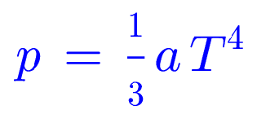
Recombination & Decoupling
In summary, the recombination transition and the related decoupling of matter and radiation defines one of the most crucial events in cosmology. In a rather sudden transition, the universe changes from
Before z_{dec}, z>z_{dec}
universe fully ionized
photons incessantly scattered
pressure dominated by
radiation:
After z_{dec}, z<z_{dec}
universe practically neutral
photons propagate freely
pressure only by
baryons:
(photon pressure negligible)

Slide 55
Origin CMB Photons
!
!
Important Issues:
When were the CMB photons produced ?
How did they become a blackbody/thermal
radiation field
At which time were they scattered for the last time
(in other words, what are we looking at ?)

Slide 56
Origin CMB Photons
!
T < 10⁹ K
t ~ 1 min, z ~ 10⁹
!
Origin CMB photons:
most were produced when
electrons & positrons annihilated each other
(a few perhaps even at reheating phase inflation)

Slide 57
CMB thermalization
At the onset certainly not thermally distributed energies
Photons keep on being scattered back and forth until z ~ 1089, the epoch
of recombination.
• Thermal equilibrium (blackbody spectrum) of photons reached within
2 months after their creation
Blackbody Spectrum produced through three scattering processes
● Compton scattering
● Free-free scattering
● Double Compton scattering

Slide 58
CMB Thermalization
• Thermalization through three scattering processes
● Compton scattering + dominant energy redistribution
● Free-free scattering + creates new photons to
● Double Compton scattering adjust spectrum to Planck
While Compton scattering manages to redistribute the energy of the
photons, it cannot adjust the number of photons. Free-free scattering
and Double Compton scattering manage to do so …
But …
only before z < 10⁵ , after that the interaction times too long ….

Slide 59
CMB Thermalization
• Following this thermalization, a perfect blackbody photon spectrum
has emerged:
• This is the ULTIMATE proof of the HOT BIG BANG
• Note: after z ~ 10⁵ till recombination, the interaction between electrons and
photons exclusively by Thomson Scattering
!

Slide 60
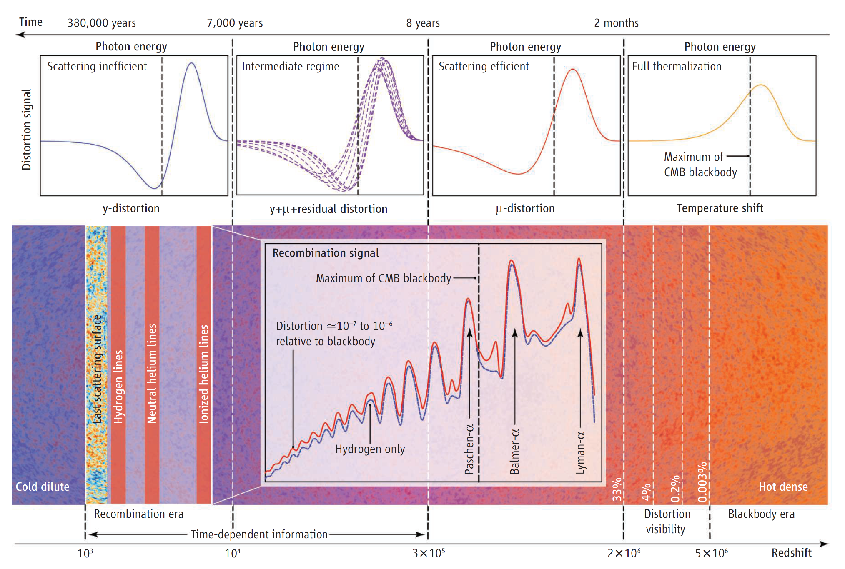
CMB hermalization
Chluba & Silk 2015

Slide 61
First Three Minutes:
Big Bang Nucleosynthesis

Slide 62
Photon Energy Early Universe
Radiation-dominated phase:

Slide 63
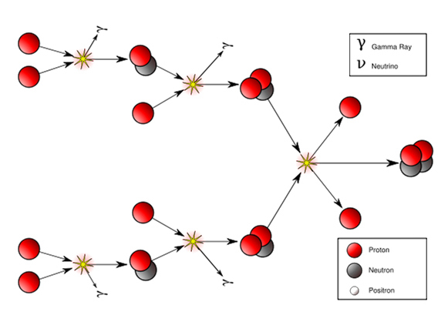
Big Bang Nucleosynthesis
Mass Fraction Light Elements
24% ⁴He nuclei
traces D, ³He, ⁷Li nuclei
75% H nuclei (protons)
p/n ~1/7: 1 min na BB
Between 1-200 seconds after Big Bang,
temperature dropped to 10⁹ K:
Fusion protons & neutrons
into light atomic nuclei

Slide 64
Neutron-Proton –
before Neutrino Decoupling
Before Neutrino Decoupling:
equilibrium between protons & neutrons through 2 weak interactions:P
we find for the relation between the number densities

Slide 65
Neutron-Proton - Saha

Slide 66
Deuterium-Neutron - Saha

Slide 67
Big Bang Reaction Network

Slide 68
Nucleus Binding Energies

Slide 71
Helium Abundance – Neutrino’s

