Slide 1
Cosmology,
lect. 6a
Dark Energy

Slide 2
General Relativity:
Einstein Field Equations

Slide 3
Einstein Field Equation
Metric tensor:
Energy-Momentum tensor:

Slide 4
Einstein Field Equation
Einstein Tensor:
Einstein Tensor only rank 2 tensor for which this holds:

Slide 5
Einstein Field Equation
also:
Freedom to add a multiple of
metric tensor to Einstein tensor:
: Cosmological Constant

Slide 6
Einstein Field Equation
Dark Energy

Slide 7
Einstein Field Equation

Slide 8
Einstein Field Equation
curvature side
energy-momentum side

Slide 9
Equation of State
restframe
restframe:

Slide 10
Equation of State

Slide 11
Dynamics
Relativistic Poisson Equation:
Repulsion !!!

Slide 12
the Source:
Dark Energy

Slide 13
Dark Energy & Cosmic Acceleration
Nature Dark Energy:
(Parameterized) Equation of State
Cosmic Acceleration:
Gravitational Repulsion:

Slide 14
Dark Energy: Identity & Nature
Huge and ever growing
list of suggestions on
identity & nature of Dark Energy:
Cosmological Constant
Cosmic Backreaction
(inhomogeneities)
Modified Gravity
Quintessence,
in a variety of flavours
Phantom Energy
Chameleon Energy
Chaplygin gas
Agegraphic DE
….
Dark Energy = Vacuum Energy
Ya. Zel’dovich - 1960s
S. Weinberg - 1989
Cosmological Constant to be
identified with zero-point
vacuum energy ?
minor problem:
1st order estimate
off by 120 orders magnitude:
~ 10¹²⁰

Slide 15
Galaxy Clustering

Slide 16
Dark Energy & Cosmic Acceleration
DE equation of State
Cosmological Constant:
-1/3 > w > -1:
decreases with time
Phantom Energy:
increases with time

Slide 17
Phantom Energy:
De Big Rip ?

Slide 18
Dynamic Dark Energy
DE equation of State
Dynamically evolving dark energy,
parameterization:

Slide 19
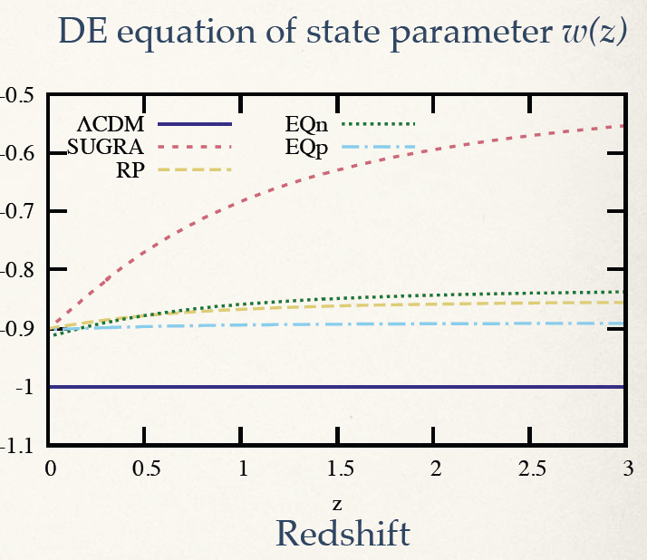
DE Equation of State

Slide 21
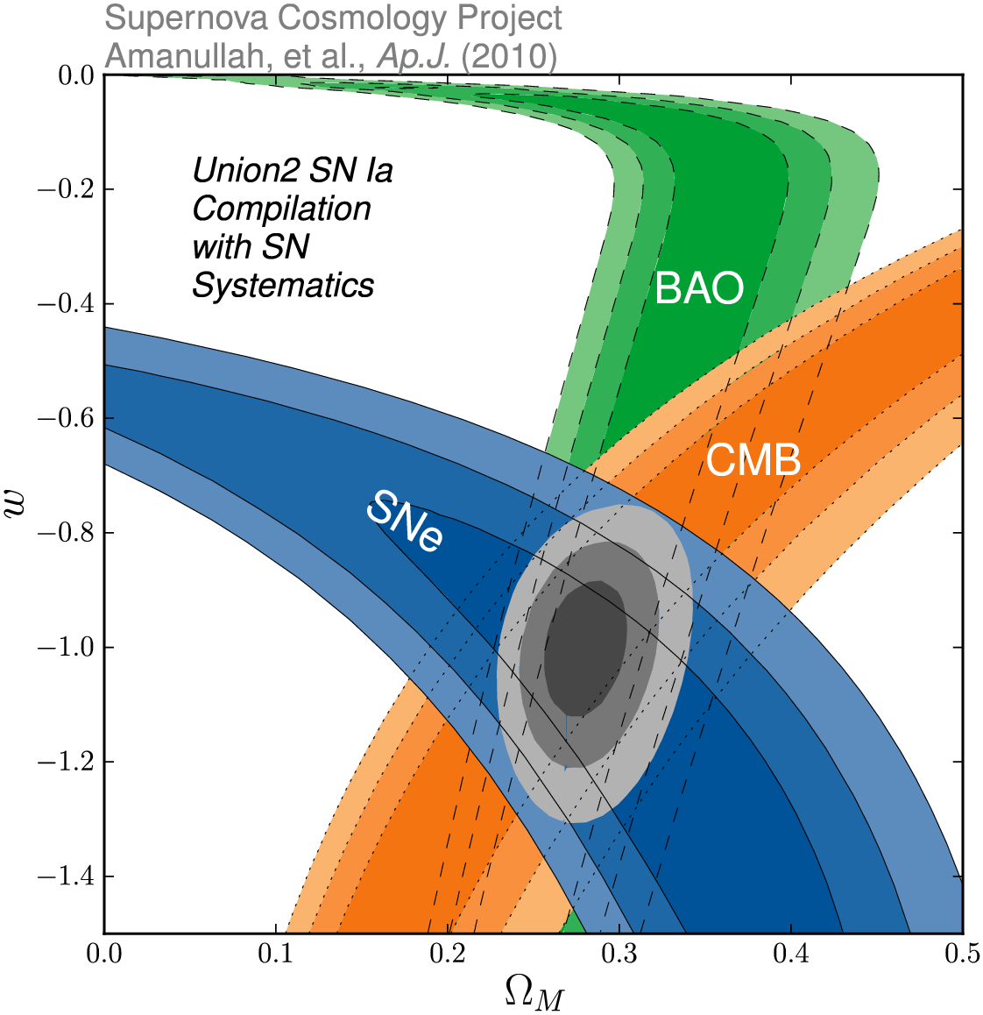
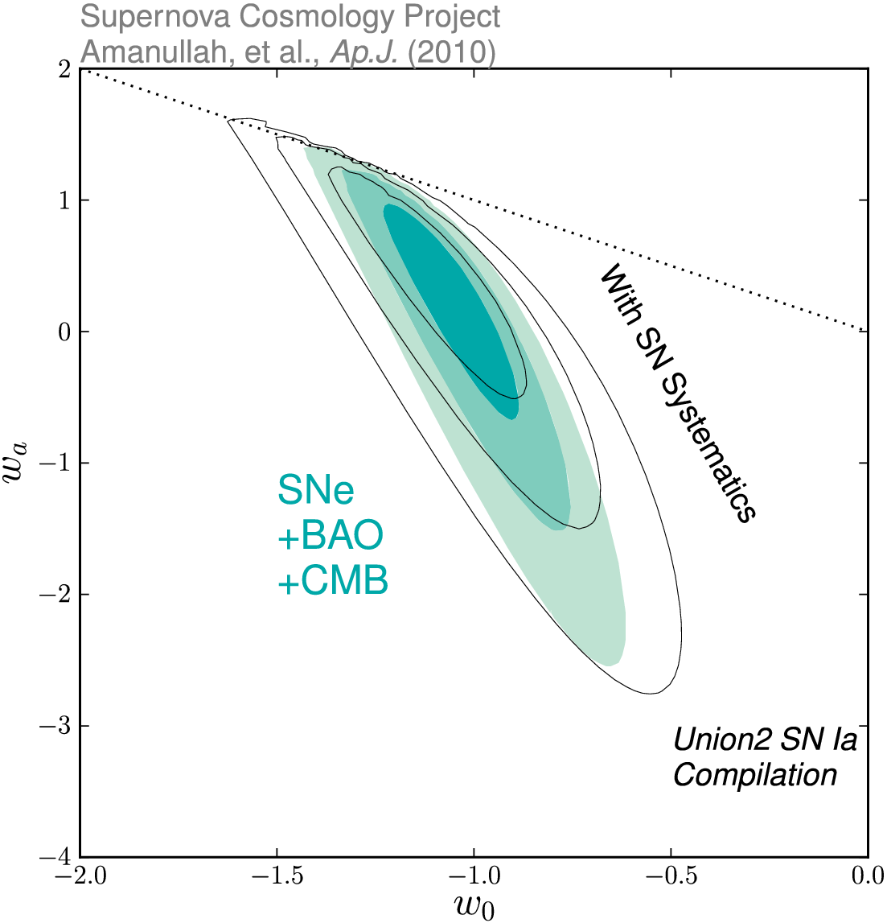
Dark Energy Eqn.State
on dynamical evolution dark energy:
eqn. state parameters w₀
w_{a}
SCP Union2 constraints (2010)
on values of matter density Ω_{m}
dark energy eqn. state w

Slide 22
Take-Home Facts
Strong evidence Accelerated Expansion
- since supernova discovery, 100s SNIa observed over broader range redshifts
- based solely upon supernova Hubble diagram, independent of General Relativity,
very strong evidence expansion Universe accelerated recently
2. Dark energy as cause cosmic acceleration
- within general relativity, accelerated expansion cannot be explained by any known
form of matter or energy
- it can be accommodated by a nearly smooth form of energy with large negative pressure,
Dark Energy, that accounts for about 73% of the universe.
Independent evidence dark energy
- Cosmic Microwave Background and Large Scale Structure data provide independent evidence,
within context of CDM model of structure formation, that the universe is filled with a smooth
medium accounting for 73% of the total energy content of the universe.
- that came to dominate the dynamics of the universe once all observed structure had formed

Slide 23
Take-Home Facts
Vacuum energy as dark energy
- simplest explanation for dark energy is the energy associated with the vacuum
- mathematically equivalent to a cosmological constant
- However, most straightforward calculations of vacuum energy density from zero-point
energies of all quantum fields lead to estimates which are a bit too large,
in the order of ~10¹²⁰
5. Dark theories of Dark Energy
- There is no compelling theory of dark energy
- Beyond vacuum energy, man intriguing ideas: light scalar fields, additional spatial dimensions, etc.
- Many models involve time-varying dark energy
6. New Gravitational Theories ?
- alternatively, cosmic acceleration could be a manifestaation of gravitational physics beyond
General Relativity
- however, as yet there is no self-consistent model for new gravitational physics that is
consistent with large body of data that constrains theories of graavity.

Slide 24
Cosmic Future

Slide 25
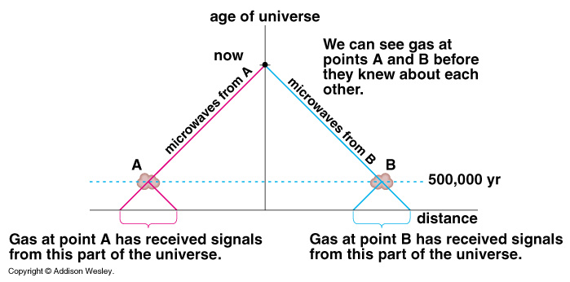
Cosmic Horizons
Particle Horizon of the Universe:
distance that light travelled since the Big Bang

Slide 26
Cosmic Particle Horizon
Light travel in an expanding Universe:
• Robertson-Walker metric:
• Light:
Horizon distance in comoving space
Horizon distance in physical space
Particle Horizon of the Universe:
distance that light travelled since the Big Bang

Slide 27
Cosmic Event Horizon
Light travel in an expanding Universe:
• Robertson-Walker metric:
• Light:
Event Horizon distance in
comoving space
Event Horizon distance in
physical space
Event Horizon of the Universe:
the distance over which one may still communicate …

Slide 29
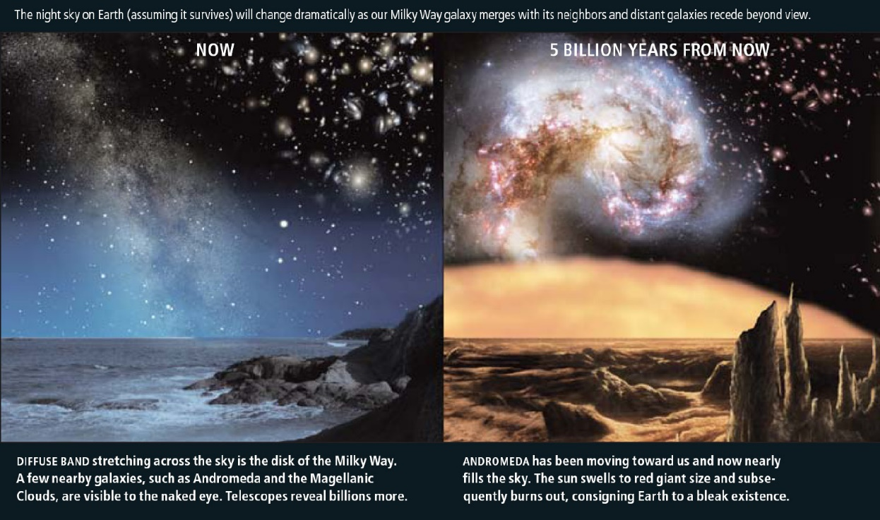
Cosmic Fate
100 Gigayears:
the end of Cosmology

Slide 30
1990s:
the Brewing Crisis

Slide 31
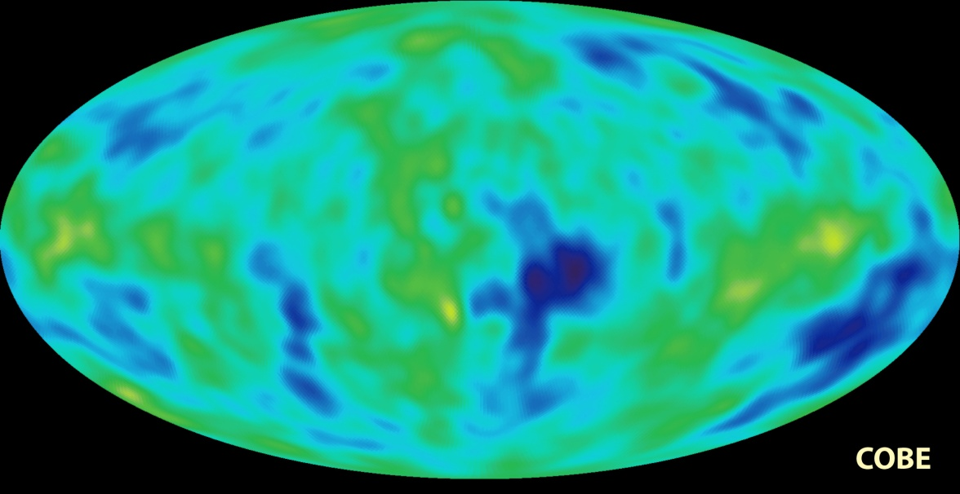
Standard Cosmology ~ 1990
FRW Universe
augmented by Inflation
- solved 4 fine-runing problems
- accelerated expansion by
factor 10⁶⁰
~ 10⁻³⁶-10⁻³⁴ sec after Big Bang
- firm prediction:
Universe flat: k=0, _{tot}=1
Universe dominated by Dark Matter:
- necessary to explain structure growth from primordial
fluctuations, which COBE in 1992 had detected at 10⁻⁵ level
- would have to make up 96% of matter density Universe
- SCDM: “standard Cold Dark Matter”, _{m}=1.0
Succesfully explained large range of astronomical observations
(or was made to explain these: “bias”)

Slide 32
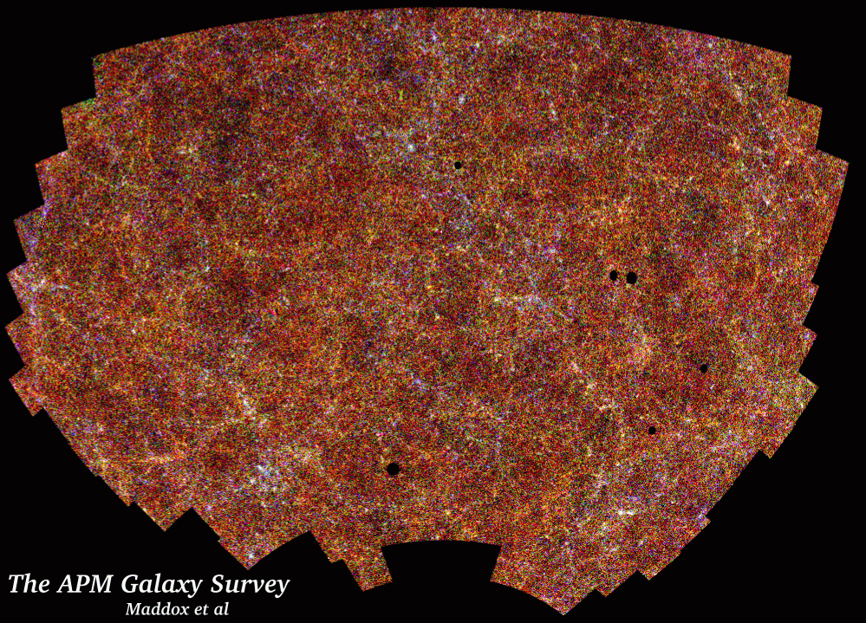
Galaxy Clustering
Clustering of galaxies in the plate-scanned
APM sky galaxy survey (2 million gals):
angular 2pt correlation function
Efstathiou, Sutherland & Maddox, 1990
Nature, 348, 705
APM
SCDM
_{m}=1.0
“It is argued here that the success of the cosmological cold dark matter (CDM) model can be retained and the new observations of very large scale cosmological structures can be accommodated in a spatially flat cosmology in which as much as 80 percent of the critical density is provided by a positive cosmological constant. In such a universe, expansion was dominated by CDM until a recent epoch, but is now governed by the cosmological constant.”
“the Cosmological Constant and Cold Dark Matter”

Slide 33
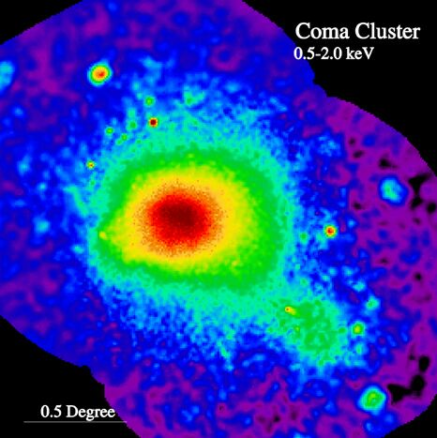
Cluster Baryon fraction
X-ray intracluster gas:
Mass determination via
hydrostatic equilibrium
fraction mass in baryons (White et al.)
f_{baryon} ~ 1/6-1/7
But,
- if representative for Universe, AND
- _{m}=1.0
- conflict with baryon density
suggested by Big Bang nucleosynthesis:
_{b}=0.04
Many other indications find
_{m}=0.3
APM
SCDM
_{m}=1.0
ROSAT X-ray image Coma Cluster

Slide 34
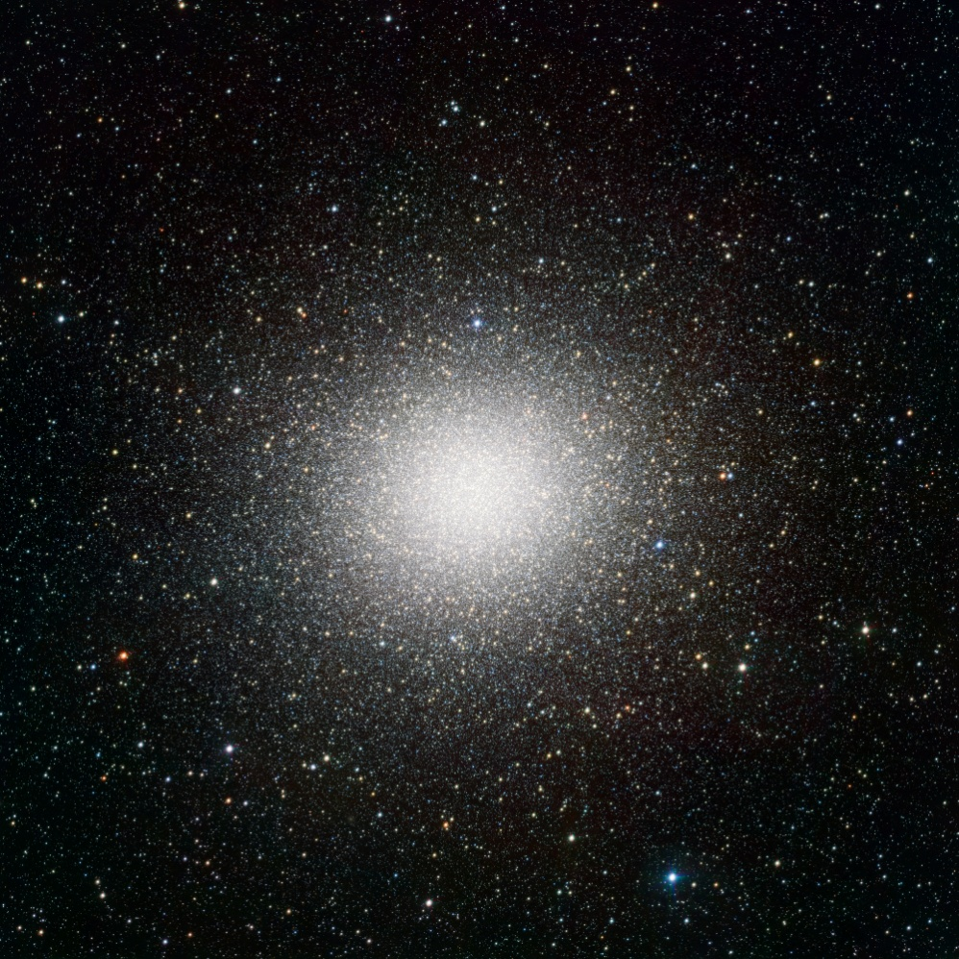
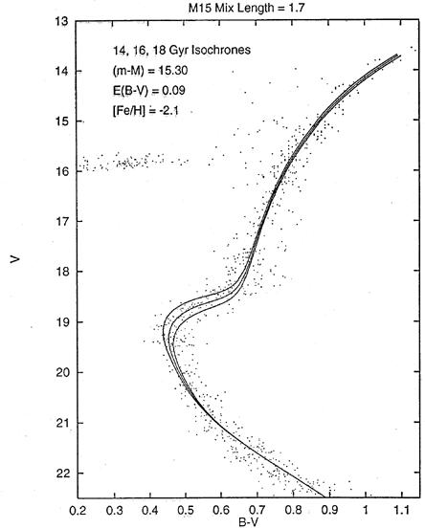
Cosmic Age Crisis
estimated age of the oldest stars in Universe
far in excess of estimated
age of matter-dominated FRW Universe:
Globular cluster stars: 13-15 Gyr
Universe: 10-12 Gyr
Globular Clusters
Roughly spherical assemblies of 100,000-200,000 stars
Radius ~ 20-50 pc: extremely high star density
Globulars are very old, amongst oldest objects in local Universe
Stars formed around same time: old, red, population
Colour-magnitude diagram characteristic:
accurate age determination on the basis of stellar evolution theories.
APM
Typical
1980-1990s isochrone fit
Omega Centauri

Slide 35
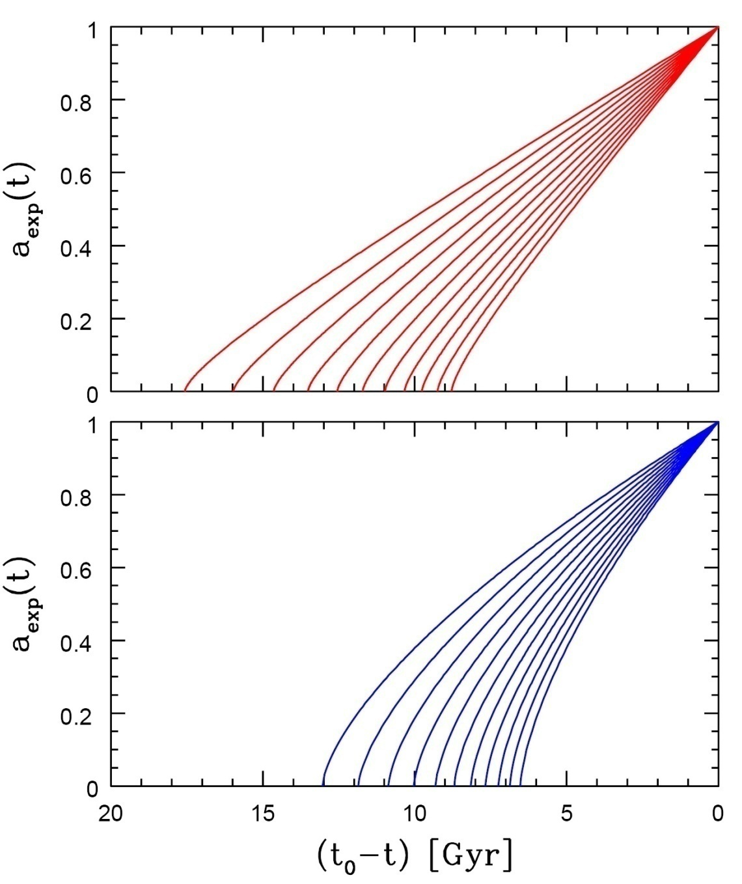
Age of the Universe
Age of a FRW universe at
Expansion factor a(t)
Matter-dominated
Hubble time
Matter-dominated

Slide 36
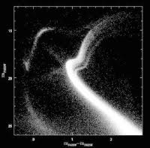
Cosmic Age Crisis
estimated age of the oldest stars in Universe
far in excess of estimated
age of matter-dominated FRW Universe:
Globular cluster stars: 13-15 Gyr
Universe: 10-12 Gyr
Globular Clusters
Roughly spherical assemblies of 100,000-200,000 stars
Radius ~ 20-50 pc: extremely high star density
Globulars are very old, amongst oldest objects in local Universe
Stars formed around same time: old, red, population
Colour-magnitude diagram characteristic:
accurate age determination on the basis of stellar evolution theories.
APM
Typical
21st century
colour-magnitude
diagram:
multiple populations
in
Omega Centauri
Omega Centauri

Slide 37
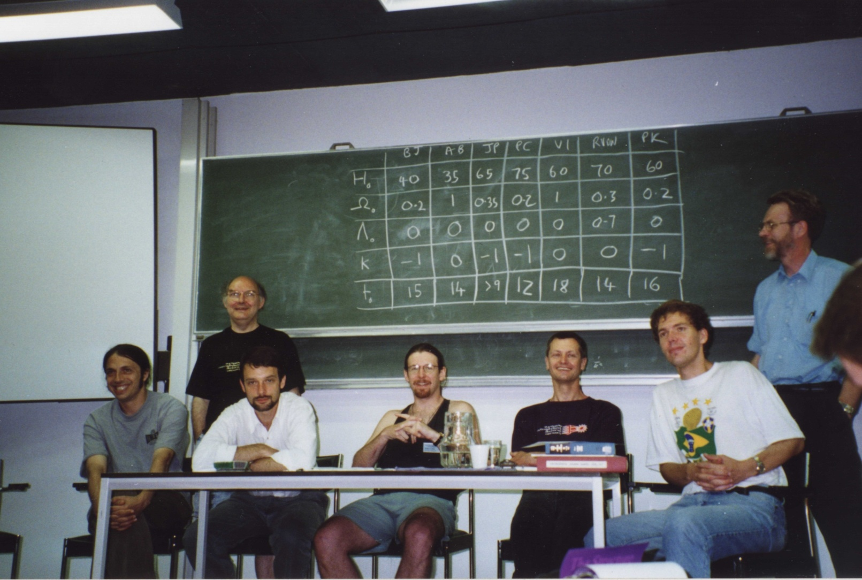
1995: Cosmic Confusion
EADN Summerschool, July 1995, Leiden
Bernard Jones (BJ)
Vincent Icke (VI)
Peter Katgert (PK)
Alain Blanchard (AB)
John Peacock (JP)
Rien van de Weijgaert (RVDW)
Peter Coles (PC)
“Rien, be real … “
John Peacock

Slide 38
Dark Energy:
Probes

Slide 39
Probes DE: additional
• Clusters of Galaxies
number counts N(z),
# formed clusters of galaxies as function of z sensitive to w & w’
• Baryonic Oscillations (BAO)
cosmic yardstick, curvature: residual imprint in galaxy distribution
acoustic oscillations primordial baryon-photon plasma
Integrated Sachs Wolfe (ISW)
imprint foreground large scale structure on CMB,
via evolving potential perturbations
Clustering
clustering correlation function/power spectrum,
directly probing cosmological scenario, BAO wiggles
Growth of clustering:
evolving growth rate f(Omega,z), probed via influence of
redshift distortions on correlation functions
Voids:
evolving void shapes,
probing tidal force field generated by large scale mass distribution
Morphology and Topology
sensitivity of topology, measured by homology (Betti numbers)

Slide 40
Dark Energy Probes: Comparison
Method | Strengths | Weaknesses | Systematics
Weak Lensing | Structure Growth + Geometric Statistical Power | CDM assumption | Image quality Photo-z
Supernovae SNIa | Purely Geometric Mature | Standard Candle assumption | Evolution Dust
BAO (Baryonic Acoustic Oscillation) | Largely Geometric Low systematics | Large samples required | Bias Nonlinearity
Cluster Population N(z) | Structure Growth + Geometric Xray+SZ+optical | CDM assumption | Determining mass Selection function

Slide 41
Type Ia Supernovae

Slide 42
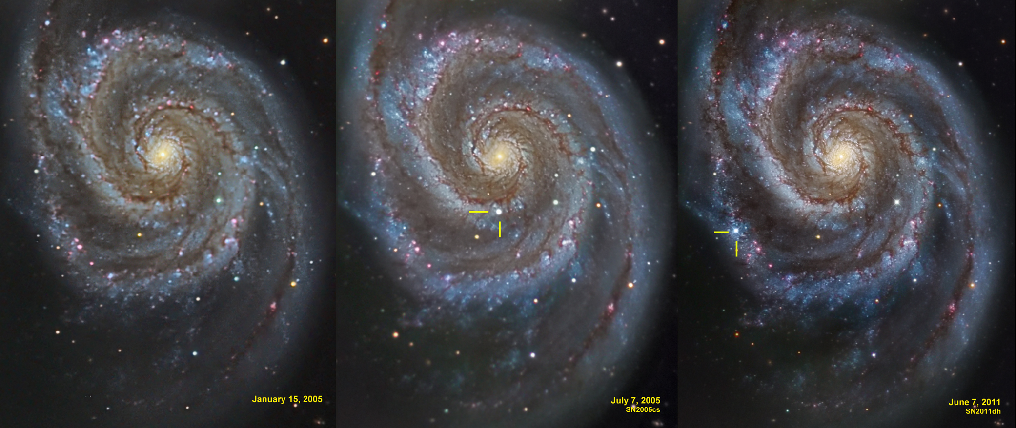
Supernova Explosion & Host Galaxy
M51 supernovae

Slide 43
Type Ia Supernova Explosion

Slide 44
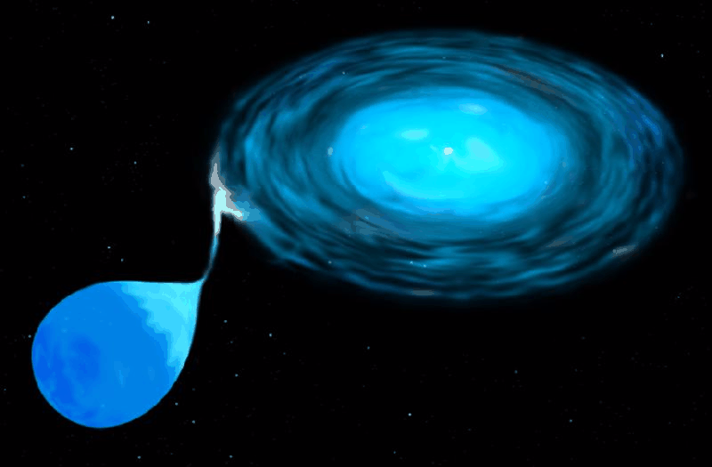
Type Ia Supernova
Amongst the most energetic explosions in our Universe:
E ~ 10⁵⁴ ergs
During explosion the star is as bright as entire galaxy ! (ie. 10¹¹ stars)
• Violent explosion Carbon-Oxygen white dwarfs:
• Embedded in binary, mass accretion from companion star
• When nearing Chandrasekhar Limit (1.38 M•), electron degeneracy pressure
can no longer sustain star.
• while contracting under its weight, carbon fusion sets in, powering a
catastrophic deflagration or detonation wave,
• leading to a violent explosion, ripping apart entire star
• Because exploding stars have nearly uniform progenitor (~1.38 M• white dwarf),
their luminosity is almost the same: M ~ -19.3
Standard Candle

Slide 45
SN1006
Supernova SN1006:
brightest stellar event recorded in history

Slide 46
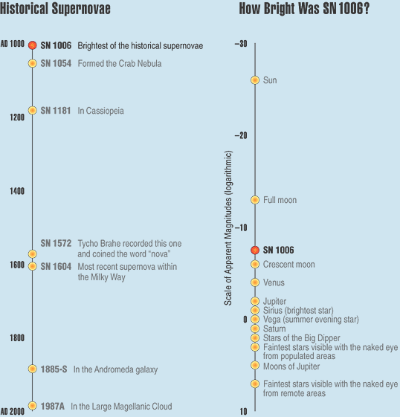
SN1006
Supernova SN1006:
- brightness: m = -7.5
distance: d=2.2 kpc
recorded: China, Egypt, Iraq, Japan,
Switzerland, North America
Supernova SN1006:
brightest stellar event recorded in history

Slide 47
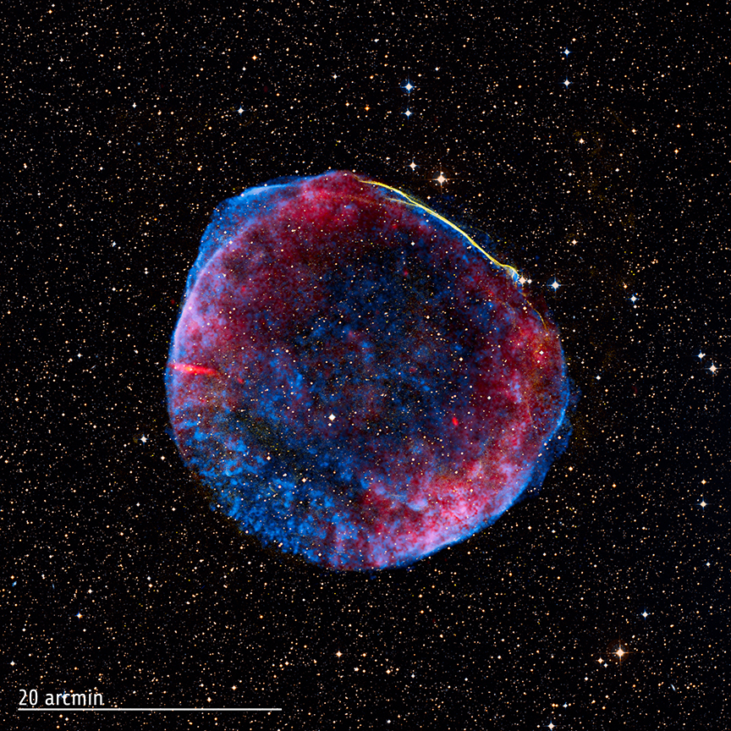
SN1006
Supernova SN1006:
- brightness: m = -7.5
distance: d=2.2 kpc
recorded: China, Egypt, Iraq, Japan,
Switzerland, North America
present-day
Supernova Remnant
Supernova SN1006:
brightest stellar event recorded in history

Slide 48
White Dwarfs

Slide 49
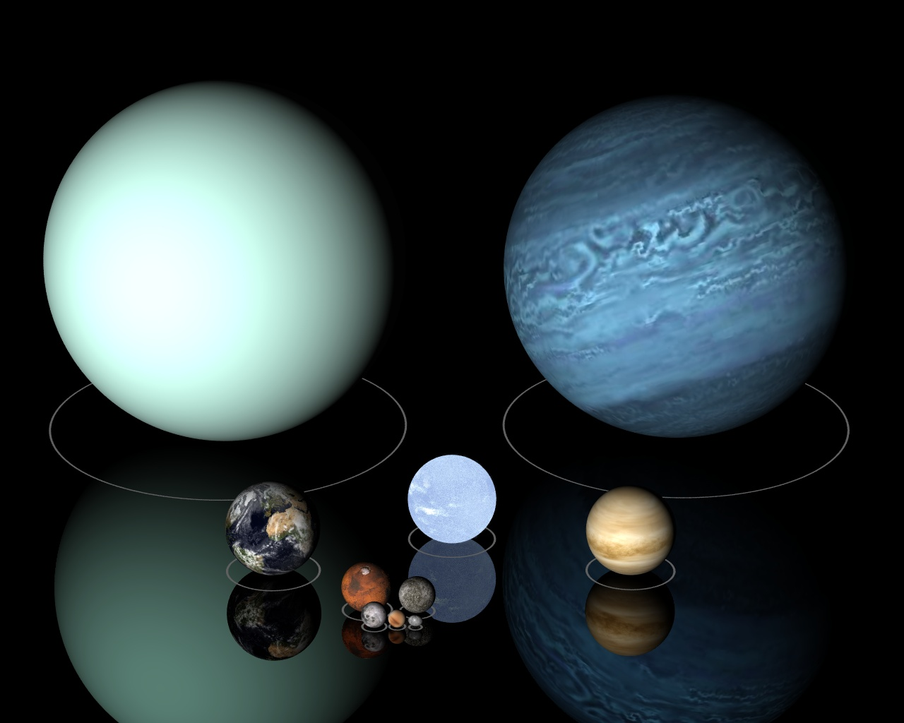
Low Mass Stars
Sirius B

Slide 50
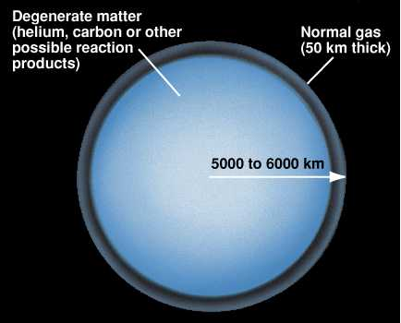
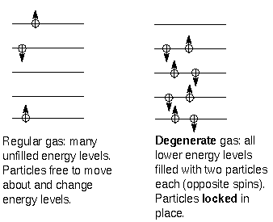

Slide 51
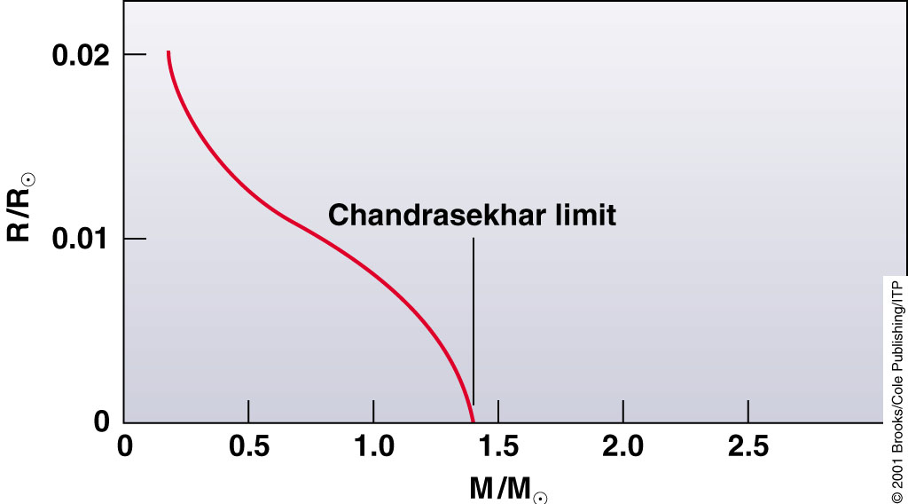
Chandrasekhar Mass Limit
What is the maximum mass that can be supported by
the dense compact material of a white dwarf star?

Slide 52
Supernova Lightcurves

Slide 53
SN 2007uy
Supernova SN 2007uy in NGC2770
while fading, another supernova, SN2008D, went off in same galaxy

Slide 54
Supernova Lightcurve & Spectrum

Slide 55
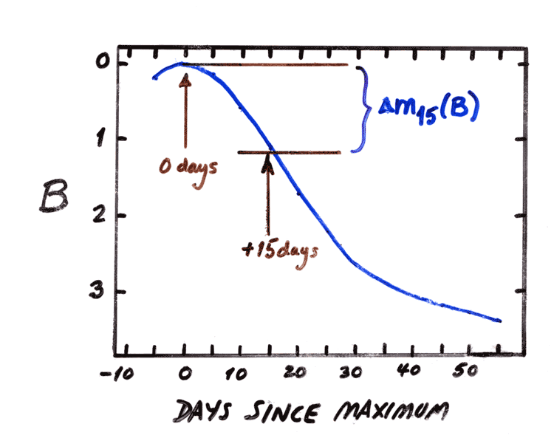
the Phillips Relation
Relationship between
peak luminosity of a Type Ia supernova
speed of luminosity evolution after maximum light.
Mark Phillips (1993):
on the basis of Calan/Tololo Supernova Survey
the faster a supernova fades after peak,
the fainter its intrinsic peak luminosity
reduces scatter in Hubble diagram to <0.2 mag
heuristic relationship, as yet not theoretically “understood”

Slide 56
Supernova Cosmology Project
High-z Supernova Search Team

Slide 57
Supernova Cosmology Project
diligently monitoring millions
of galaxies, in search for that
one explosion …
High-z Supernova Search Team

Slide 58
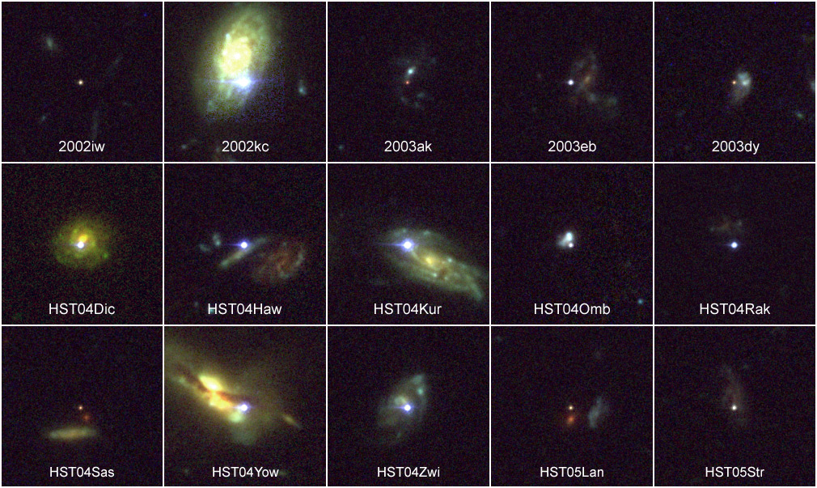
High-z SNIa: sample

Slide 59
Cosmic Acceleration
&
Cosmic Density

Slide 60
Cosmic Acceleration
Hubble Diagram high-z SNIa
• distance vs. redshift z
m-M vs. redshift z
• determine:
- absolute brightness of supernova Ia
- from dimming rate (Phillips relation)
• measure:
- apparent brightness of explosion
• translates into:
- luminosity distance of supernova
- dependent on acceleration parm. q

Slide 61
Luminosity Distance
For all general FRW Universe, the
second-order luminosity distance-redshift relation,
only depends on the deceleration parameter q₀:
q₀ can be related to Ω₀ once the equation of state is known.

Slide 62
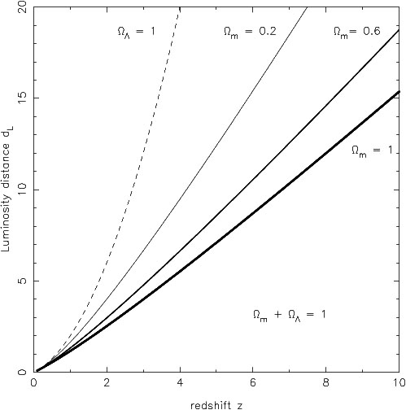
Luminosity Distance
matter-dominated FRW Universe
In a matter-dominated Universe, the luminosity distance as function of redshift is given by:

Slide 63
Cosmic Acceleration
Hubble Diagram high-z SNIa
distance vs. redshift z
m-M vs. redshift z
• determine:
- absolute brightness of supernova Ia
- from dimming rate (Phillips relation)
• measure:
- apparent brightness of explosion
• translates into:
- luminosity distance of supernova
- dependent on acceleration parm. q

Slide 64
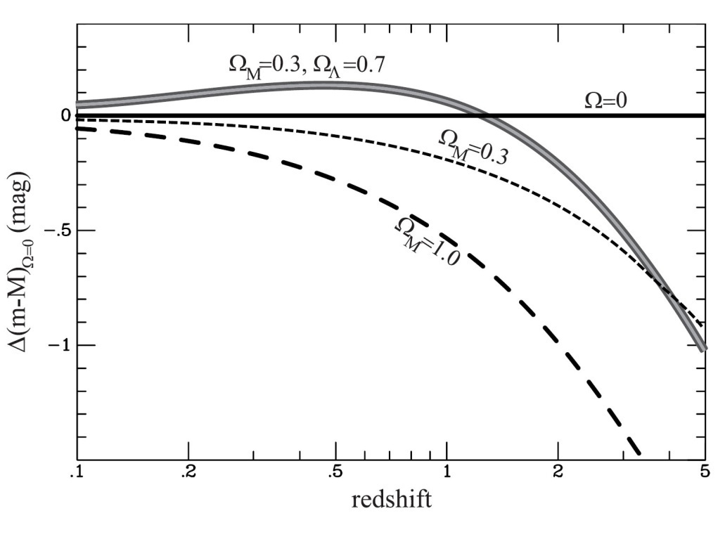
Cosmic Acceleration
Relative Hubble Diagram
∆(m-M) vs. Redshift z
with Hubble diagram for empty Universe
Ω_{m}=0.0, Ω_{Λ}=0.0
as reference.
Acceleration of the Universe:

Slide 65
Cosmic Deceleration
Before current Dark Energy epoch
• Universe dominated by matter:
Decelerating Expansion
Observable in SNIa at very high z:
z > 0.73
Cosmic deceleration:
SNIa brighter
Cosmic acceleration:
SNIa fainter

Slide 66
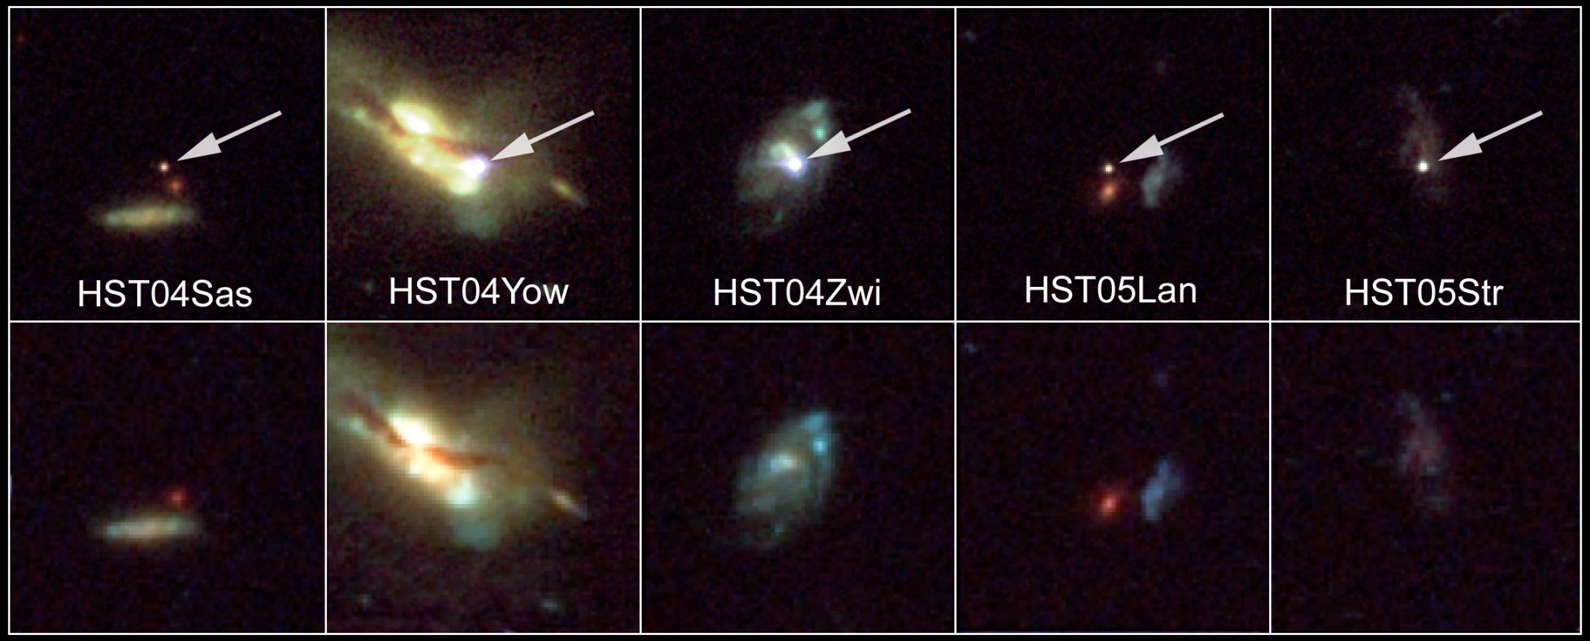
Beyond Acceleration: SNe Ia at z > 0.7
Five high-z SNIa, images HST-ACS camera
SNIa and host galaxies lower panel: before
top panel: after explosion)

Slide 67
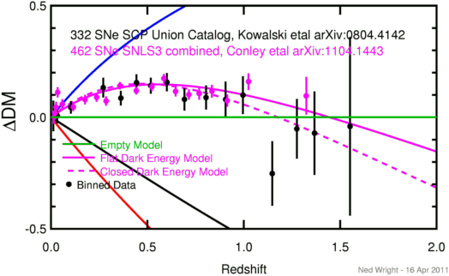
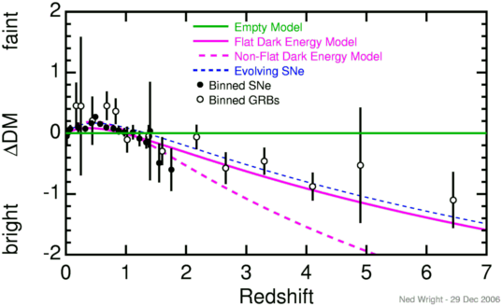
Cosmic Deceleration
Before current Dark Energy epoch
• Universe dominated by matter:
Decelerating Expansion
(“Einstein-de Sitter phase”)
• Observable in SNIa at very high z:
z > 0.73

Slide 68
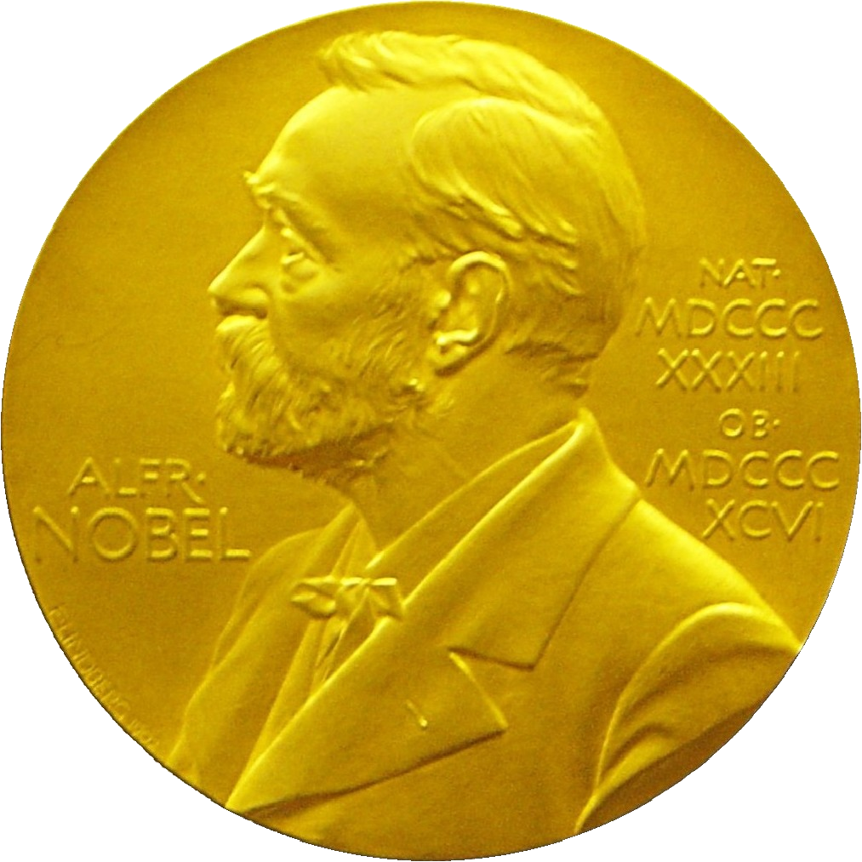
Nobel Prize Laureates
Adam Riess
Saul Perlmutter
Brian Schmidt

Slide 69
Cosmic Curvature
Measured

Slide 70
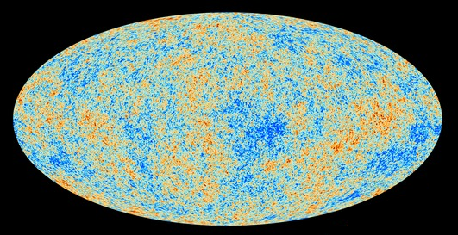
Cosmic Microwave Background
Map of the Universe at Recombination Epoch (Planck, 2013):
• 379,000 years after Big Bang
• Subhorizon perturbations: primordial sound waves
• ∆T/T < 10-5

Slide 71
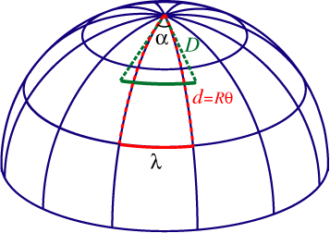
Measuring Curvature
Measuring the Geometry of the Universe:
• Object with known physical size,
at large cosmological distance
● Measure angular extent on sky
● Comparison yields light path,
and from this the curvature of space
W. Hu
FRW Universe:
lightpaths described by Robertson-Walker metric
Here: angular diameter distance D_{A}:
Geometry of Space

Slide 72
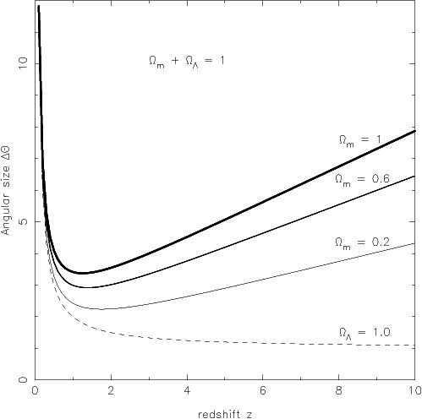
Angular Size - Redshift
FRW Universe
The angular size (z) of an object of physical size  at a redshift z displays an interesting
behaviour. In most FRW universes is has a
minimum at a medium range redshift –
z=1.25 in an Ω_{m}=1 EdS universe – and increases
again at higher redshifts.
In a matter-dominated Universe, the angular diameter distance as function of redshift is given by:

Slide 73
Measuring Curvature
• Object with known physical size,
at large cosmological distance:
• Sound Waves in the Early Universe !!!!
W. Hu
FRW Universe:
lightpaths described by Robertson-Walker metric
Here: angular diameter distance D_{A}:
Temperature Fluctuations
CMB

Slide 74
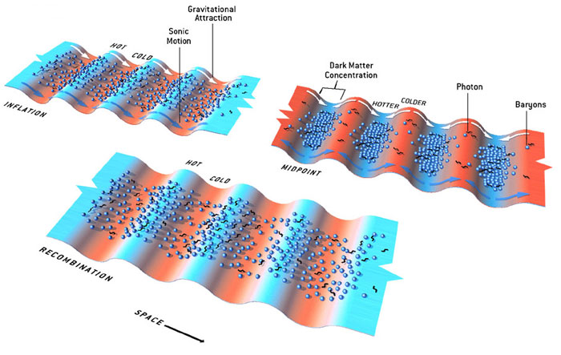
Fluctuations-Origin

Slide 75
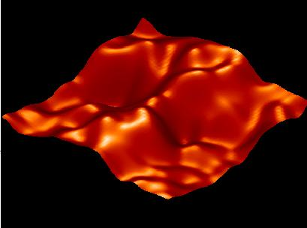
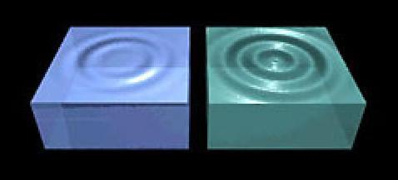
Music of the Spheres
● small ripples in
primordial matter & photon distribution
● gravity:
- compression primordial photon gas
- photon pressure resists
● compressions and rarefactions
in photon gas: sound waves
● sound waves not heard, but seen:
- compressions: (photon) T higher
- rarefactions: lower
● fundamental mode sound spectrum
- size of “instrument”:
- (sound) horizon size last scattering
● Observed, angular size: θ~1º
- exact scale maximum compression, the
“cosmic fundamental mode of music”
W. Hu

Slide 76
Cosmic Microwave Background
Size Horizon Recombination
COBE measured fluctuations: > 7º
Size Horizon at Recombination spans angle ~ 1º
COBE proved that superhorizon fluctuations do exist: prediction Inflation !!!!!

Slide 77
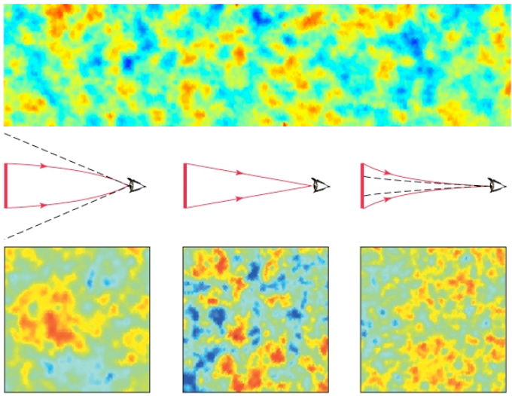
Flat universe from CMB
First peak: flat universe
We know the redshift and the time it took for the light to reach us:
from this we know the
- length of the legs of the
triangle
- the angle at which we are
measuring the sound horizon.
Closed:
hot spots
appear larger
Flat:
appear as big as they are
Open:
spots appear smaller

Slide 78
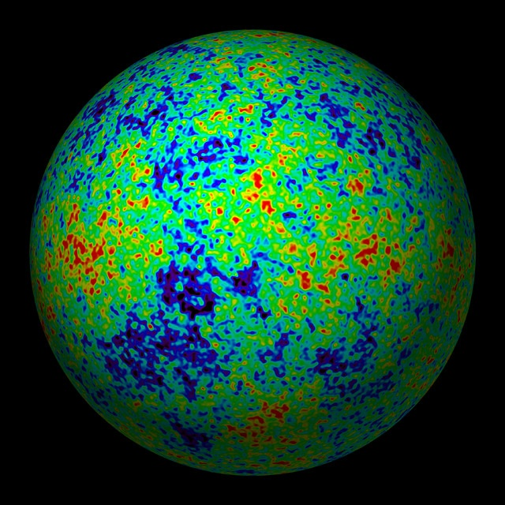
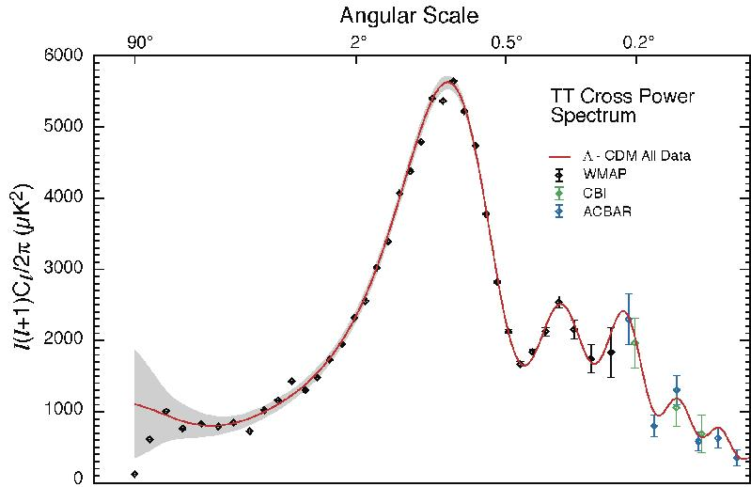
The Cosmic Tonal Ladder
The WMAP CMB temperature
power spectrum
Cosmic sound horizon
The Cosmic Microwave Background Temperature Anisotropies:
Universe is almost perfectly FLAT !!!!

Slide 79
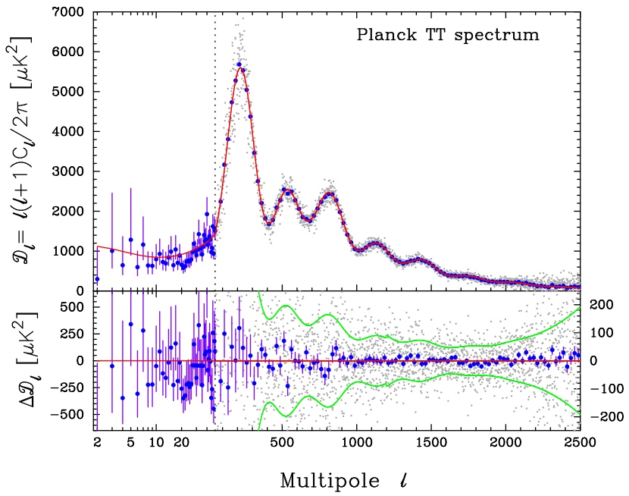
Planck CMB Temperature Fluctuations

Slide 80
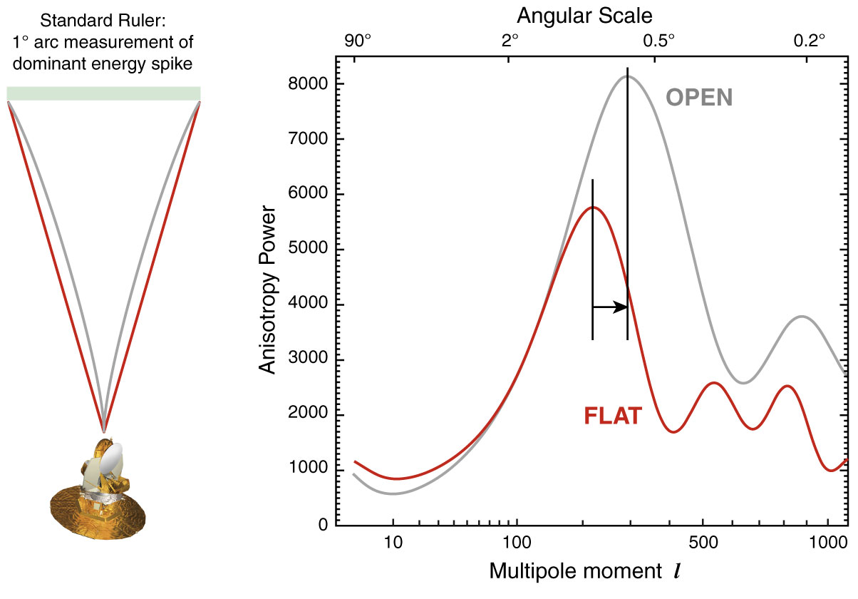
The WMAP CMB temperature
power spectrum

Slide 81
FRW Universe: Curvature
There is a 1-1 relation between the total energy content
of the Universe and its curvature. From FRW equations:

Slide 82
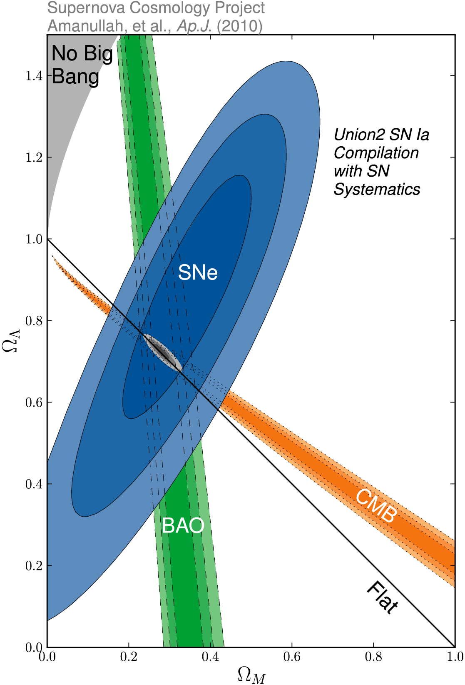
Cosmic Curvature
&
Cosmic Density
SCP Union2 constraints (2010)
on values of matter density Ω_{m}
dark energy density Ω_{Λ}

