Slide 1
Cosmology,
lect. 6
Universe Measured

Slide 2
Galaxies & the Cosmos:
Distances & Motions

Slide 3
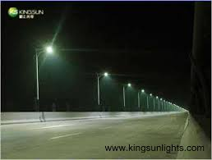
Distance Measurement
Given the vast distances in the Universe, it is impossible to measure distances directly.
Hence, we need to develop indirect methods that allow us to infer
reliable estimates of the distances of objects.
One of the most practical means is based on the comparison between
- observed brightness of an object
(apparent brightness)
- intrinsic brightness of an object
(absolute brightness)
Compare this with distance of streetlights :

Slide 4
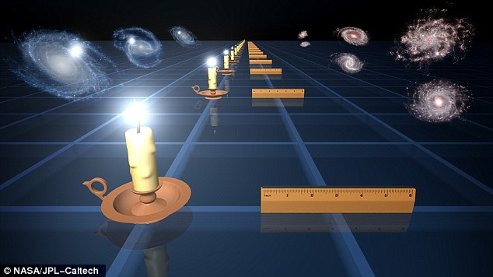
Standard Candles
To determine distances in the Universe, astronomers identify objects
of which they know the intrinsic brightness: standard candles.

Slide 5
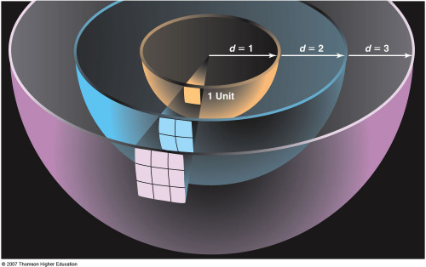
Standard Candles
To determine distances in the Universe, astronomers identify objects
of which they know the intrinsic brightness:
Standard Candles
Knowing the intrinsic luminosity/brightness L_{abs} of a star/object,
and measuring its apparent brightness, or flux S (light through per unit area),
the distance D_{L} may simply be inferred from

Slide 6
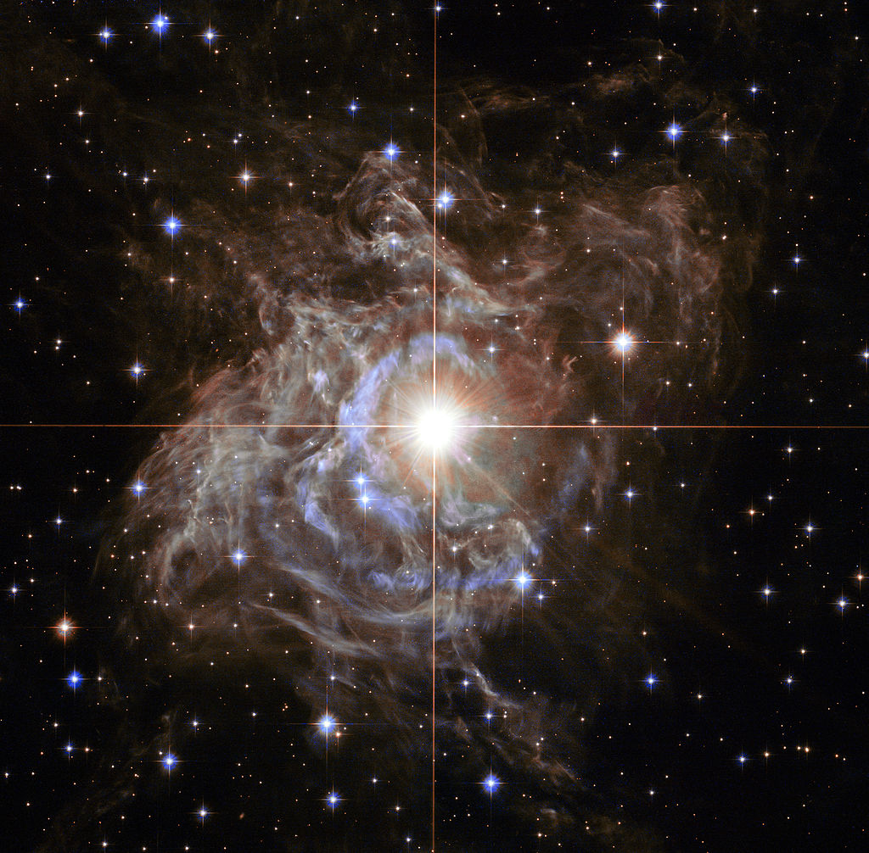
Cepheids: Period-Luminosity
To be able to determine cosmological distances, the reference Standard Candles
need to be very bright objects/stars, whose intrinsic luminosity has been
determined to high precision.
It was Henrietta Swan Leavitt (1868-1921) who
discovered that a particular type of variable stars,
the Cepheid stars,
- whose brightness varies as a result of their
weeks long rhythmic pulsations –
have a characteristic relation between
- the period of their variation/pulsation
- their intrinsic brightness
- the socalled Period-Luminosity relation
As individual Cepheid stars are very bright
- up to 100,000 times the Sun’s luminosity,
with masses in the order of 4-20 M• -
they can be identified in other galaxies
and the distance to those galaxies determined.

Slide 7
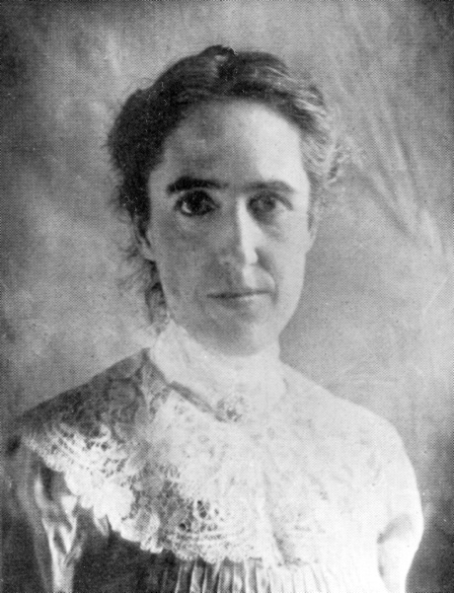
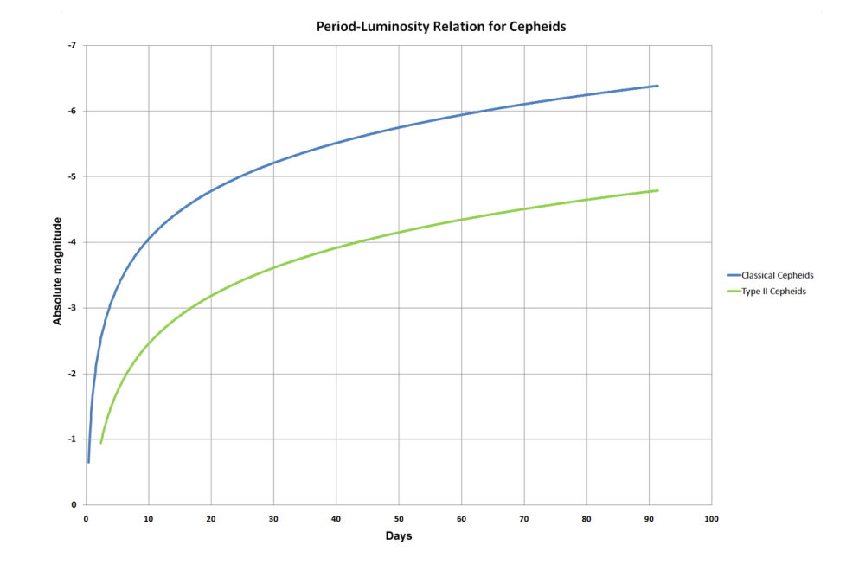
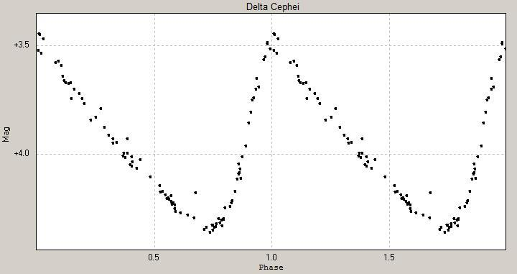
Henrietta Leavitt (1868-1921)
Henrietta Swan-Leavitt started working in 1893 at
Harvard College Observatory as one of the women human computers
hired by Edward Pickering to measure and catalog brightness of
stars on photographic plates.
In this time, she made the fundamental discovery of the
period-luminosity relation of Cepheid stars.
During her lifetime she hardly got recognition for this discovery,
which is one of astronomy’s most significant ones as it allowed
the measurement of extragalactic distances.
Edwin Hubble used this relation to establish the distances to
nearby galaxies and discover the expansion of the Universe.

Slide 8
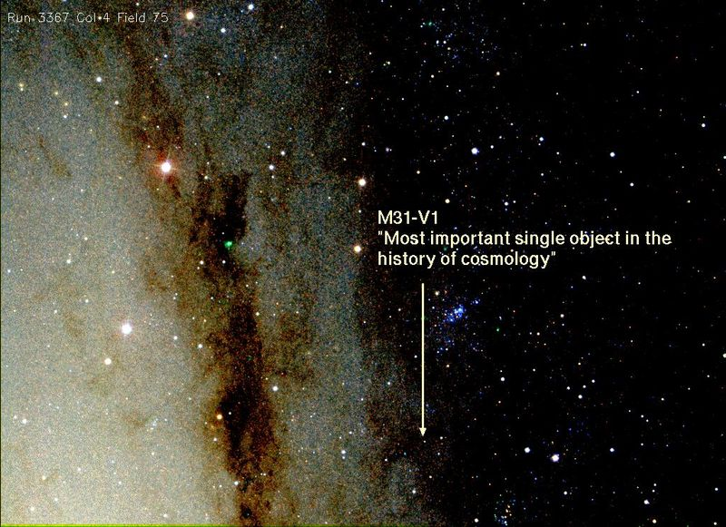
Andromeda-V1

Slide 9
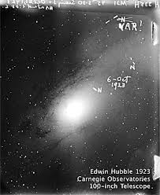
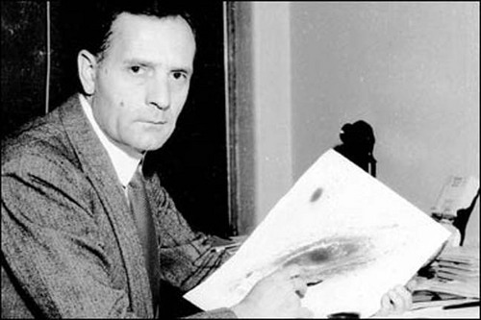
Andromeda-V1: the object that changed the Universe
October 6, 1923:
Edwin Hubble 45 minute exposure of
the Andromeda galaxy M31 with the
100 inch Hooker telescope at Mount Wilson
Identifies 3 stars as N, thinking they are Novae
Comparison with earlier plates of same region,
he realizes one is a variable: VAR !
And that it is a Cepheid variable, enabling the
determination of the distance to M31
finding it is ~ 1 million lightyears
Virtually overnight,
our perception of the Universe, and cosmic distances,
changed radically !

Slide 10
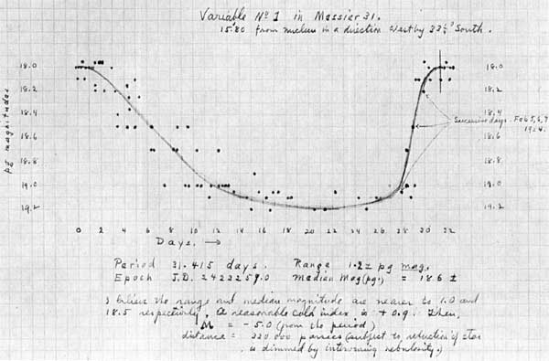
Andromeda-V1: the object that changed the Universe
October 6, 1923:
Edwin Hubble 45 minute exposure of
the Andromeda galaxy M31 with the
100 inch Hooker telescope at Mount Wilson
Identifies 3 stars as N, thinking they are Novae
Comparison with earlier plates of same region,
he realizes one is a variable: VAR !
And that it is a Cepheid variable, enabling the
determination of the distance to M31
finding it is ~ 1 million lightyears
Virtually overnight,
our perception of the Universe,
- of cosmic scales and distances -
changed in a radical and revolutionary way !

Slide 11
Andromeda-V1

Slide 12
Andromeda-V1
In 2010, the
Hubble Space Telescope
followed M31-V1 again.

Slide 13
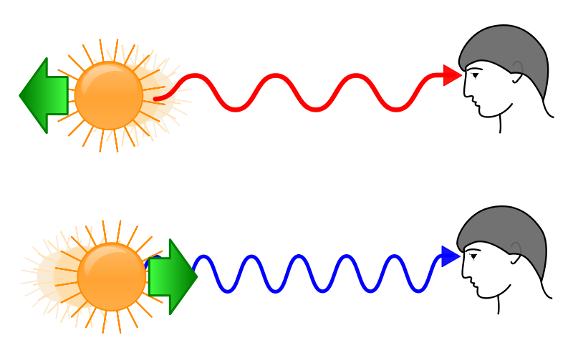
Galaxy Velocities: Redshift
Velocity measurement:
redshift/blueshift of radiation emitted by a source (galaxy, star)
Comparable to Doppler shift:
the wavelength of radiation emitted by a source
changes as it has a velocity towards or away from us:
towards us:
- towards shorter wavelength/higher frequency
- towards blue
away from us:
- towards larger wavelength/lower frequence
- towards red

Slide 14
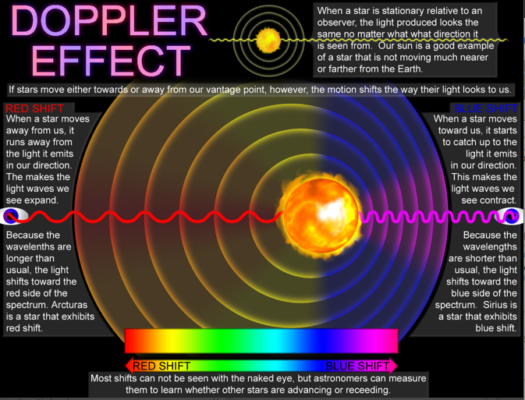

Slide 15
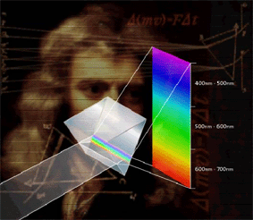
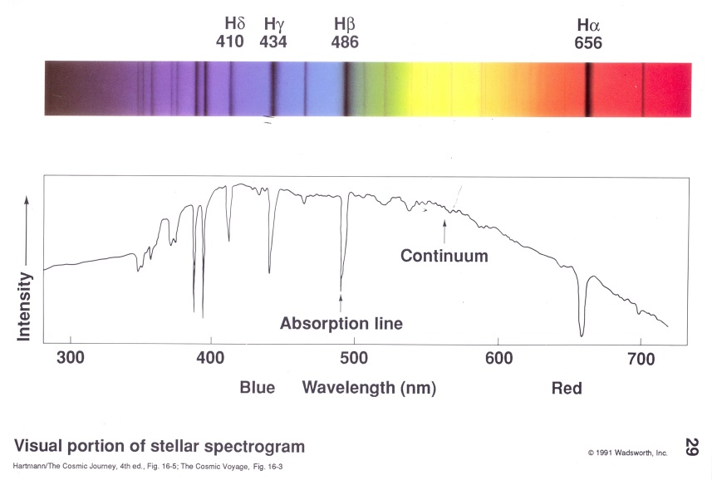
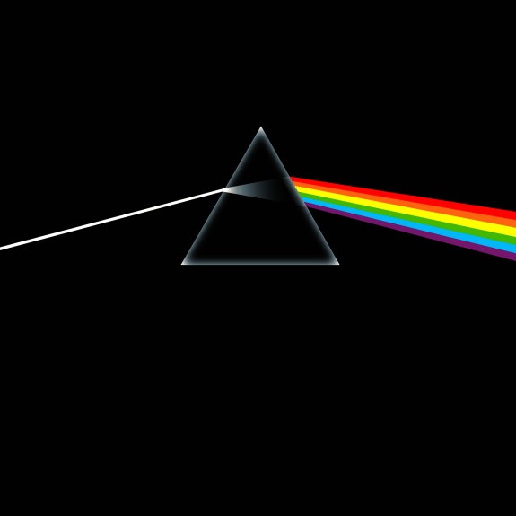
Stellar Spectra & Spectral Lines
Look at the spectrum of the light emitted by a galaxy:
Spectrum: energy distribution of light
red: lower energy
blue: higher energy
Example: use prism to dissect light
In the spectrum of stars, you see a large number of lines:
- light/photons of specific energy/frequencies absorbed
by atoms & molecules in the atmospheres of stars
- the frequencies of these spectral lines are fixed,
by the quantum laws
governing the structure and dynamics of atoms

Slide 16
Solar Spectrum
Notice the signatures/absorption lines of atoms (and molecules) in the atmosphere of the Sun

Slide 17
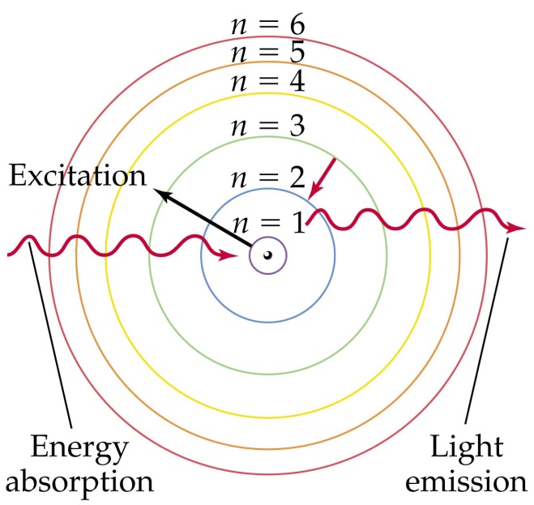
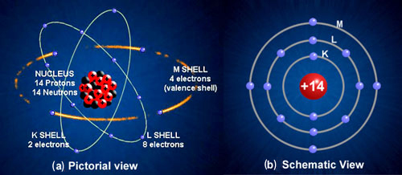
Atoms & Spectral Lines
The energy of a photon is directly proportional to
- directly proporotional to its frequency (ie. colour) 
- inversely proportional to its wavelength 
in this: c - velocity of light; h – Planck constant
The energy transitions go along with
towards higher level:
absorption of photon with
that specific energy
towards lower level:
emission of photon with
that specific energy
Energy of photon = frequency light

Slide 18
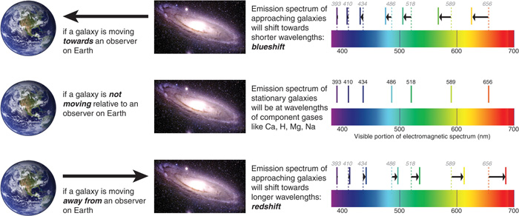
Galaxy Spectra & Cosmic Redshift
Galaxy spectra:
- the combined light of 100s billions of stars
- absorption lines mark the frequencies at which the
atmospheres of the stars in the galaxy have absorbed
light emitted by the stars
Galaxy redshift determination:
- identify (well-known and strong) spectral lines
- compare to rest wavelength, then determine z
- light/photons of specific energy/frequencies absorbed

Slide 19
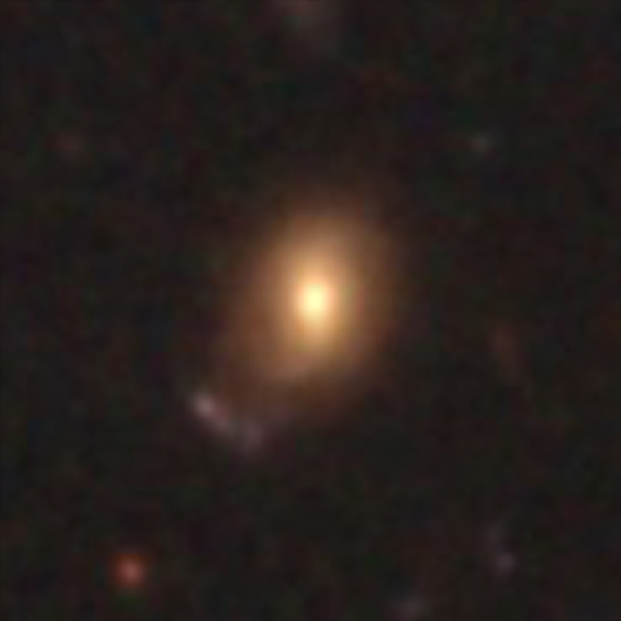
Redshifted Galaxy

Slide 20
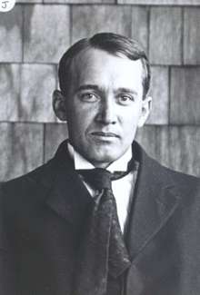
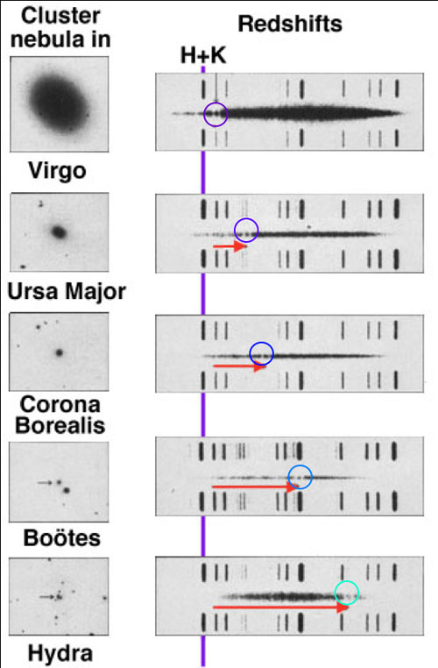
Slipher & Galaxy Redshifts
Vesto Slipher
(1875-1969)
US astronomer who was the first
to measure redshifts of galaxies
For a major part of his career
he was director of
Lowell Observatory,
Flagstaff, Arizona, USA
1913: Slipher finds that the spectrum of M31 is shifted to
blue, corresponding to a velocity of ~ 300 km/s
Note: and, indeed, M31 is belonging with our Galaxy
to a dense group of galaxies, the Local Group,
and is moving towards us.
M31 and the Galaxy will collide in 4.5 billion years
1914: additional redshifts of 14 spirals,
some blueshifted (approaching),
some redshifted (moving away)

Slide 21
Slipher & Galaxy Redshifts
Vesto Slipher
(1875-1969)
US astronomer who was the first
to measure redshifts of galaxies
For a major part of his career
he was director of
Lowell Observatory,
Flagstaff, Arizona, USA
1917: Slipher measures more galaxy redshifts:
- more and more galaxies are redshifted
- proportion of redshifted galaxies such that it is no
longer in accordance with random galaxy motions
AND
- redshift on average larger as
galaxy is smaller (ie. seems further away) !!!!!
Is there a physical relationship between
Radial Velocity and Distance of a galaxy ???

Slide 22
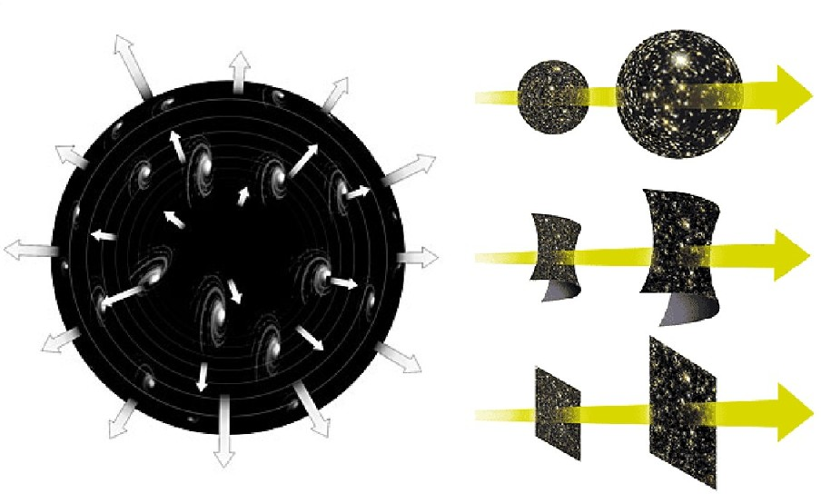
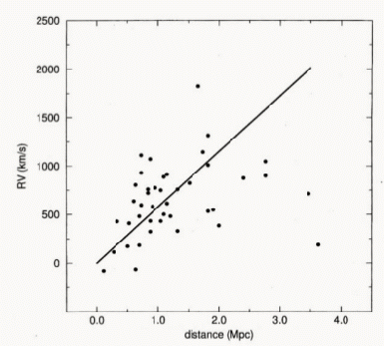
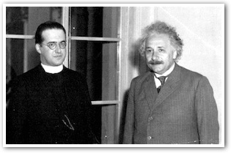
Cosmic Expansion: first indications
1925: Lundmark, Swedish astronomer (1889-1958)
- radial velocity 44 galaxies
- rough distance estimates,
comparing distances and brightnesses
- comparing to M31, estimated to be at 650,000 ly
(in fact ~2,000,000 ly).
Lundmark concluded that there may be a relationship
between galactic redshift and distance,
but “not a very definitive one”
1927:
Georges Lemaitre
(1894-1966)
Belgian priest
One of few who by
1920s understood
General Relativity,
Predicted linear
relationship
redshift – distance
and ... inferred it from data
Block 2011

Slide 23
Lemaitre Expansion ?
Georges Lemaitre (1894-1966)
On the basis of the General Theory of Relativity,
Lemaitre derived the equations describing the expansion of the
Universe:
Friedmann-Robertson-Walker-Lemaitre equations
He then went on to show that this predicted a linear
relation between redshift/recession velocity and distance.
In a remarkable paper, in an “obscure” French-language journal,
1927, Annales de la Societe Scientifique de Bruxelles, A47, 49
he then used redshifts and distances of 42 galaxies to show
that it seems indeed there is such a relation, and inferred the
slope of the relation, now known as the “”Hubble constant”
He assumed that the absolute brightness of galaxies can be
used as standard candle, and thus inferred distances on the
basis of galaxy brightnesses.
Strangely enough, when the paper got later translated into
English, the passage in which the expansion constant was
determined got omitted.
Had Hubble tried to cover up the earlier finding of expansion
by Lemaitre ? A few years it was found Lemaitre himself who
had tranlated the paper.
Note: the scatter of the distance estimates on the basis
of intrinsic brightness has a large scatter.. Significance of
result was not very strong.

Slide 24
Hubble Expansion – Hubble Law
Finally, the ultimate evidence for an expanding Universe follows in 1929,
when Edwin Hubble (1889-1953) describes his finding of a
linear recession velocity – distance relation
This relation is now known as the Hubble Law.
A relation between distance and radial velocity among extragalactic nebulae
E. Hubble, Proc. Nat. Acad. Sciences, 1929, 15, 168-173
Note: Hubble himself never grasped that this was the evidence for an
expanding Universe as described by the Friedmann-Lemaitre equations,
ie. as implied by Einstein’s theory of General Relativity.
Hubble constant
specifies expanssion rate of the Universe

Slide 25
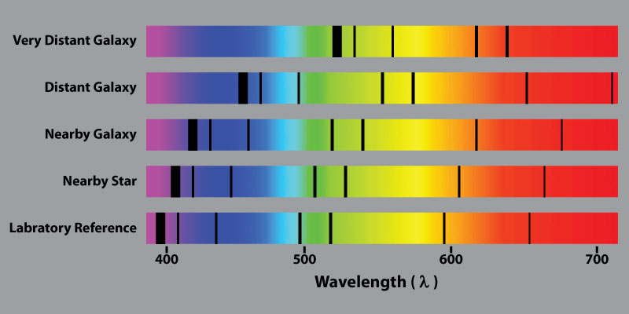
Hubble Expansion & Galaxy Redshift
The Hubble law tells us that the further a galaxy is, the more redshifted it is.
Moreover, because this a linear relation, we can even estimate distances to galaxies once we know
the value of the Hubble constant !

Slide 26
Hubble Expansion
Edwin Hubble
(1889-1953)
v = H r
Hubble Expansion

Slide 27
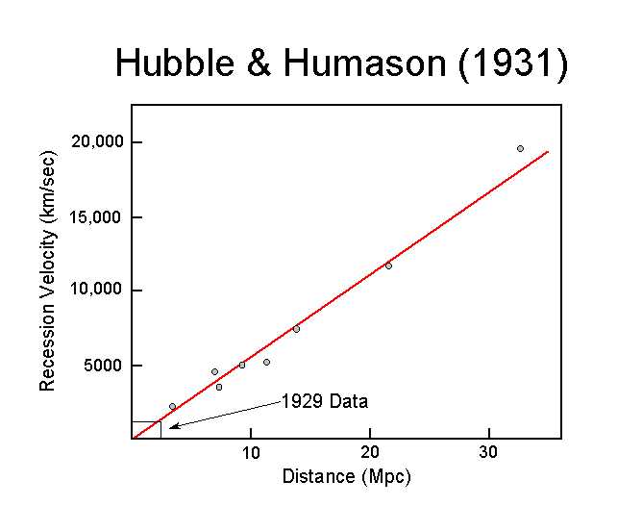
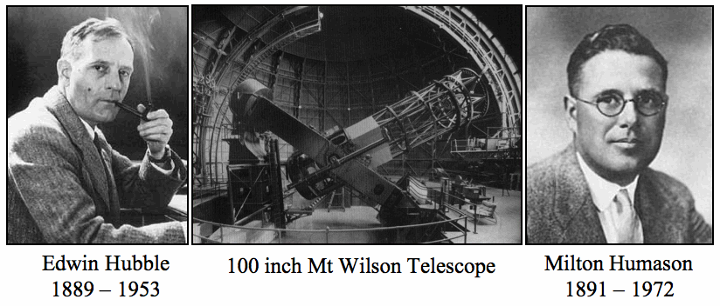
Hubble – Humason (1931)
It was in the additional publication by Hubble & Humason (1931) that the linear Hubble relation was firmly established to far larger depths into the Universe:
Hubble, Humason, 1931, Astrophys. J., 74, 43
Humason (1891-1972) assisted Hubble, and did most of the work on
world’s most powerful telescope at the time, the 100 inch Mt. Wilson telescope.
Humason did not have a PhD, left school at 14, and was hired as janitor at Mt. Wilson Observatory.
His role in the discovery of the expansion of the Universe was seminal.

Slide 28
Cosmic Acceleration

Slide 29
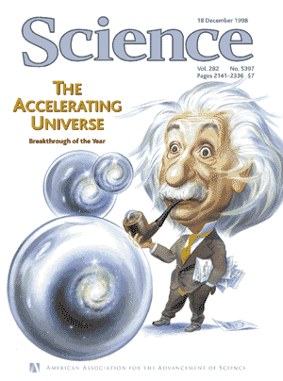
Science Magazine 1998
Science
Breakthrough of the Year
1998

Slide 30
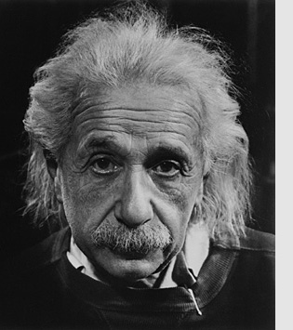
Λ
Einstein’s Biggest Blunder

Slide 31
Type Ia Supernovae

Slide 32
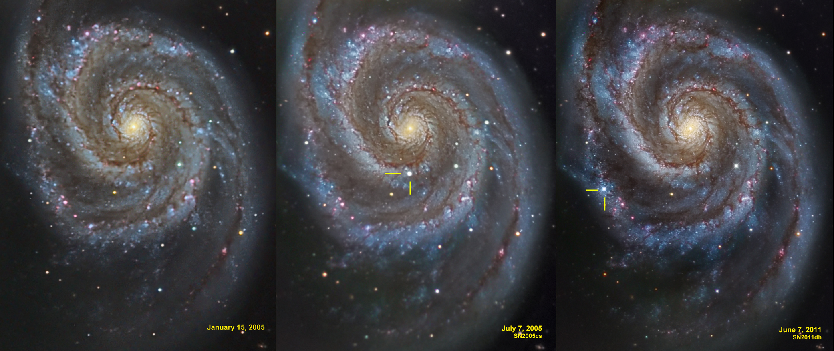
Supernova Explosion & Host Galaxy
M51 supernovae

Slide 33
Type Ia Supernova Explosion

Slide 34
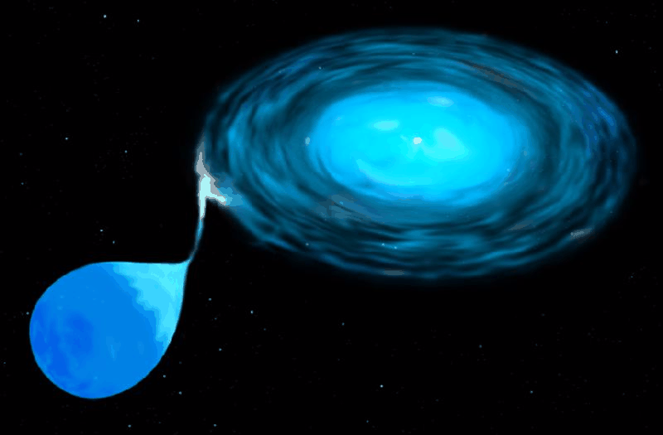
Type Ia Supernova
Amongst the most energetic explosions in our Universe:
E ~ 10⁵⁴ ergs
During explosion the star is as bright as entire galaxy ! (ie. 10¹¹ stars)
• Violent explosion Carbon-Oxygen white dwarfs:
• Embedded in binary, mass accretion from companion star
• When nearing Chandrasekhar Limit (1.38 M•), electron degeneracy pressure
can no longer sustain star.
• while contracting under its weight, carbon fusion sets in, powering a
catastrophic deflagration or detonation wave,
• leading to a violent explosion, ripping apart entire star
• Because exploding stars have nearly uniform progenitor (~1.38 M• white dwarf),
their luminosity is almost the same: M ~ -19.3
Standard Candle

Slide 35
SN1006
Supernova SN1006:
brightest stellar event recorded in history

Slide 36
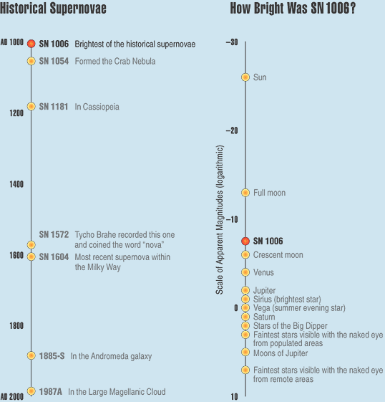
SN1006
Supernova SN1006:
- brightness: m = -7.5
distance: d=2.2 kpc
recorded: China, Egypt, Iraq, Japan,
Switzerland, North America
Supernova SN1006:
brightest stellar event recorded in history

Slide 37
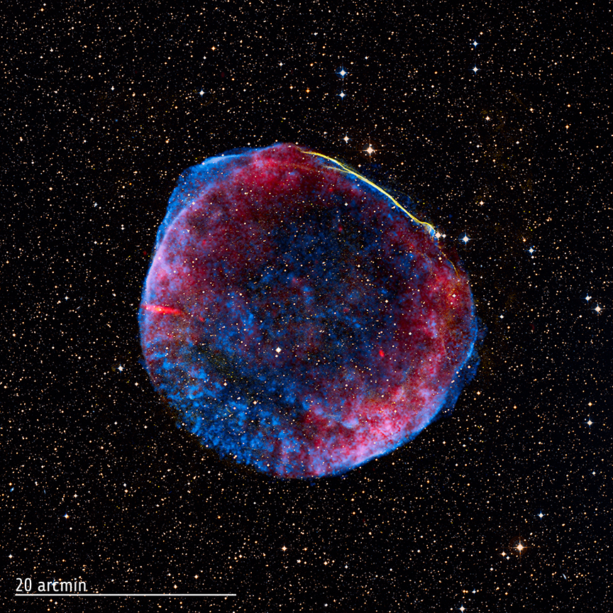
SN1006
Supernova SN1006:
- brightness: m = -7.5
distance: d=2.2 kpc
recorded: China, Egypt, Iraq, Japan,
Switzerland, North America
present-day
Supernova Remnant
Supernova SN1006:
brightest stellar event recorded in history

Slide 38
White Dwarfs

Slide 39
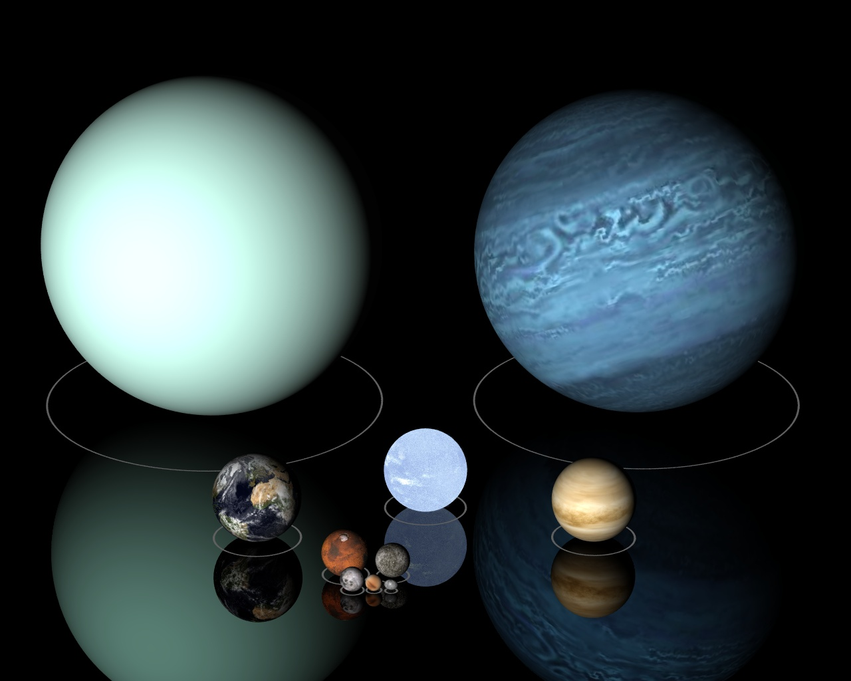
Low Mass Stars
Sirius B

Slide 40
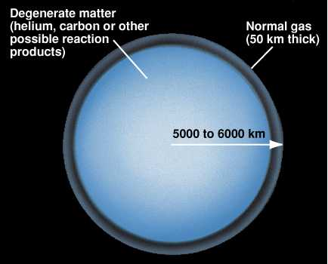
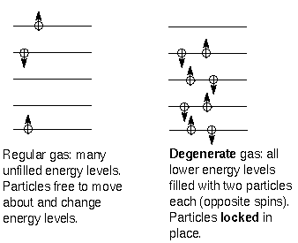

Slide 41
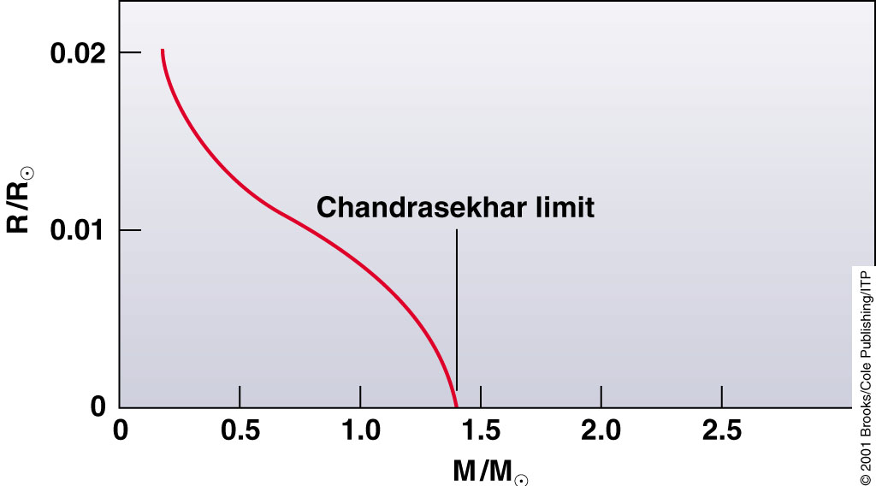
Chandrasekhar Mass Limit
What is the maximum mass that can be supported by
the dense compact material of a white dwarf star?

Slide 42
Supernova Lightcurves

Slide 43
SN 2007uy
Supernova SN 2007uy in NGC2770
while fading, another supernova, SN2008D, went off in same galaxy

Slide 44
Supernova Lightcurve & Spectrum

Slide 45
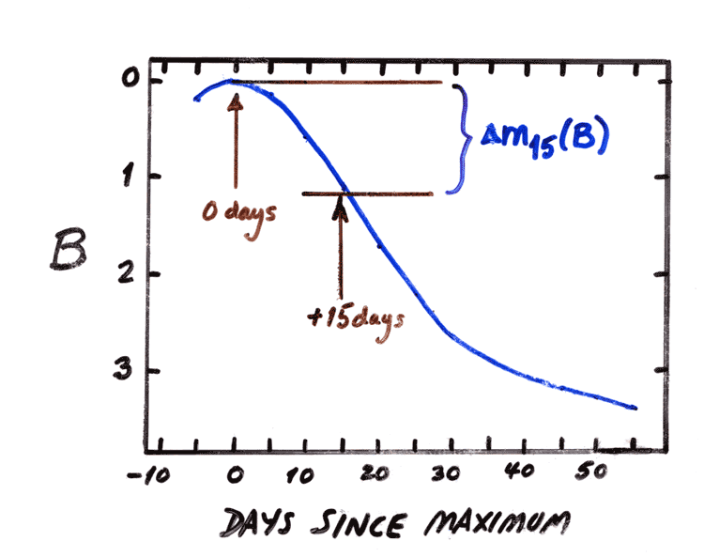
the Phillips Relation
Relationship between
peak luminosity of a Type Ia supernova
speed of luminosity evolution after maximum light.
Mark Phillips (1993):
on the basis of Calan/Tololo Supernova Survey
the faster a supernova fades after peak,
the fainter its intrinsic peak luminosity
reduces scatter in Hubble diagram to <0.2 mag
heuristic relationship, as yet not theoretically “understood”

Slide 46
Supernova Cosmology Project
High-z Supernova Search Team

Slide 47
Supernova Cosmology Project
diligently monitoring millions
of galaxies, in search for that
one explosion …
High-z Supernova Search Team

Slide 48
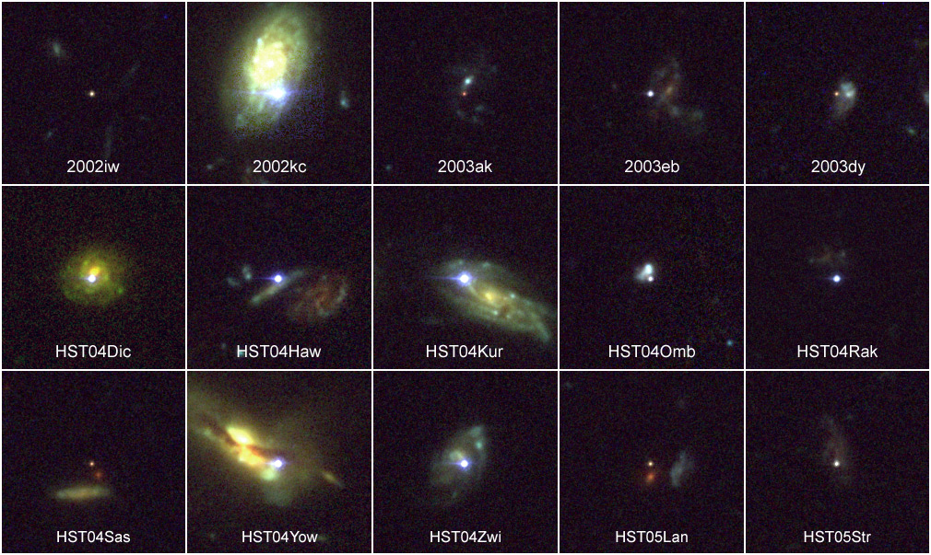
High-z SNIa: sample

Slide 49
Cosmic Acceleration
&
Cosmic Density

Slide 50
Cosmic Acceleration
Hubble Diagram high-z SNIa
• distance vs. redshift z
m-M vs. redshift z
• determine:
- absolute brightness of supernova Ia
- from dimming rate (Phillips relation)
• measure:
- apparent brightness of explosion
• translates into:
- luminosity distance of supernova
- dependent on acceleration parm. q

Slide 51
Luminosity Distance
For all general FRW Universe, the
second-order luminosity distance-redshift relation,
only depends on the deceleration parameter q₀:
q₀ can be related to Ω₀ once the equation of state is known.

Slide 52
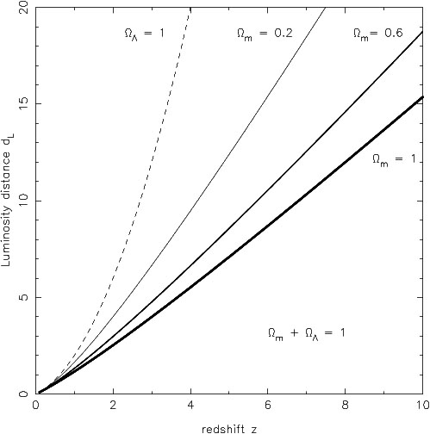
Luminosity Distance
matter-dominated FRW Universe
In a matter-dominated Universe, the luminosity distance as function of redshift is given by:

Slide 53
Cosmic Acceleration
Hubble Diagram high-z SNIa
distance vs. redshift z
m-M vs. redshift z
• determine:
- absolute brightness of supernova Ia
- from dimming rate (Phillips relation)
• measure:
- apparent brightness of explosion
• translates into:
- luminosity distance of supernova
- dependent on acceleration parm. q

Slide 54
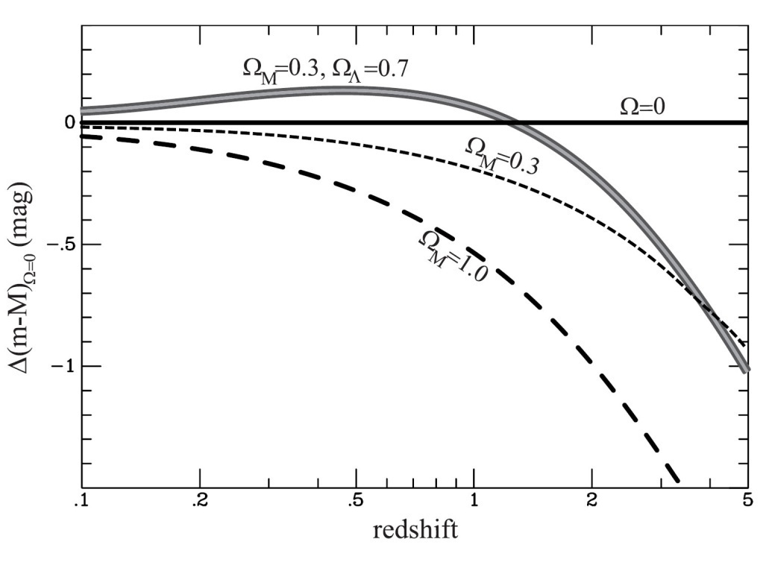
Cosmic Acceleration
Relative Hubble Diagram
∆(m-M) vs. Redshift z
with Hubble diagram for empty Universe
Ω_{m}=0.0, Ω_{Λ}=0.0
as reference.
Acceleration of the Universe:

Slide 55
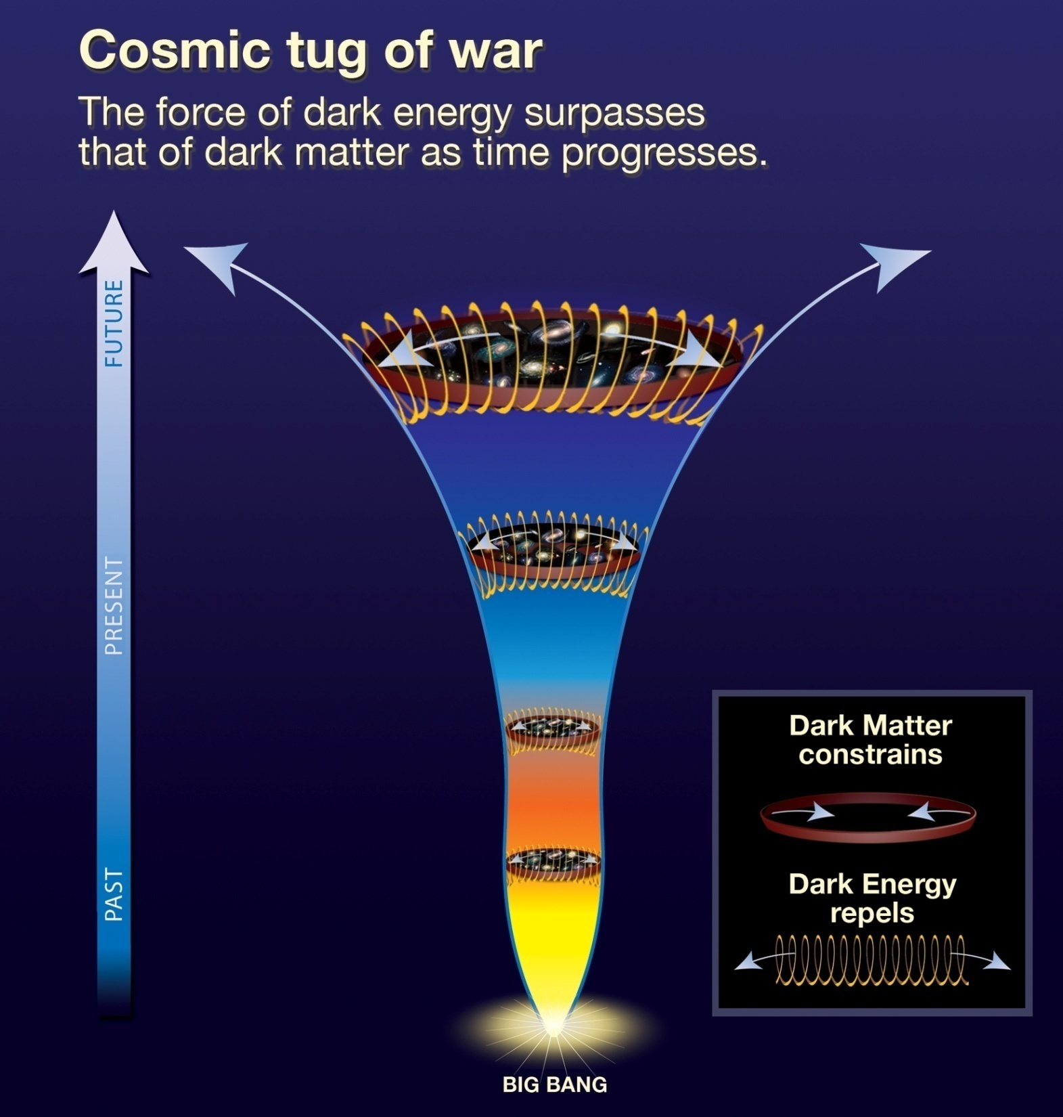
Present:
ACCELERATION
Past:
DECELERATION

Slide 57
Cosmic Deceleration
Before current Dark Energy epoch
• Universe dominated by matter:
Decelerating Expansion
Observable in SNIa at very high z:
z > 0.73
Cosmic deceleration:
SNIa brighter
Cosmic acceleration:
SNIa fainter

Slide 58
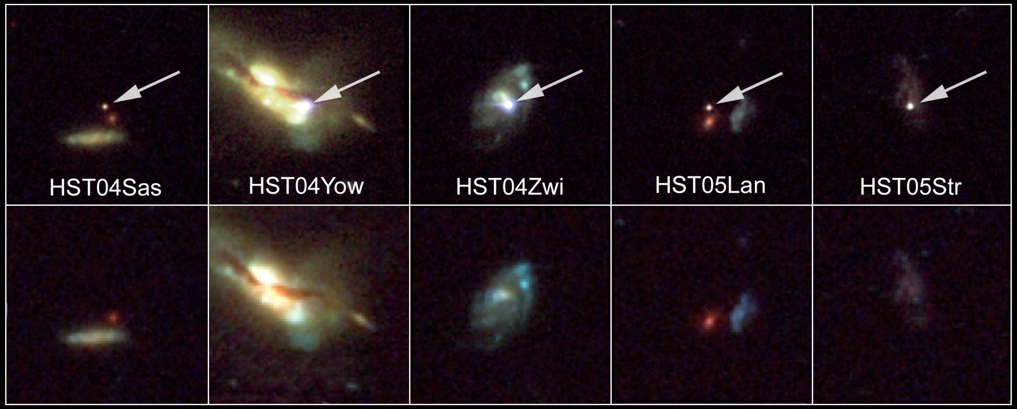
Beyond Acceleration: SNe Ia at z > 0.7
Five high-z SNIa, images HST-ACS camera
SNIa and host galaxies lower panel: before
top panel: after explosion)

Slide 59
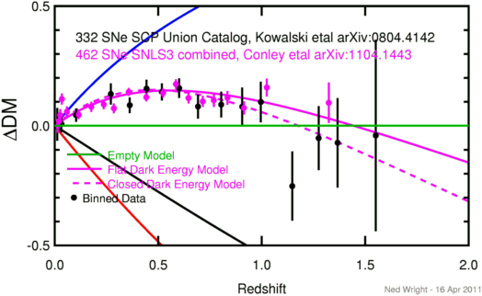
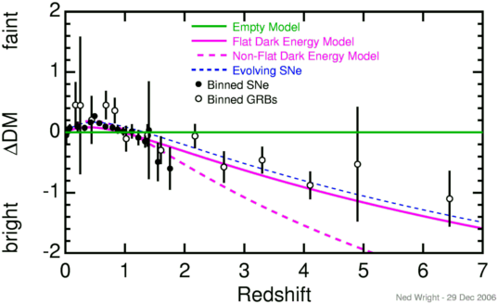
Cosmic Deceleration
Before current Dark Energy epoch
• Universe dominated by matter:
Decelerating Expansion
(“Einstein-de Sitter phase”)
• Observable in SNIa at very high z:
z > 0.73

Slide 60
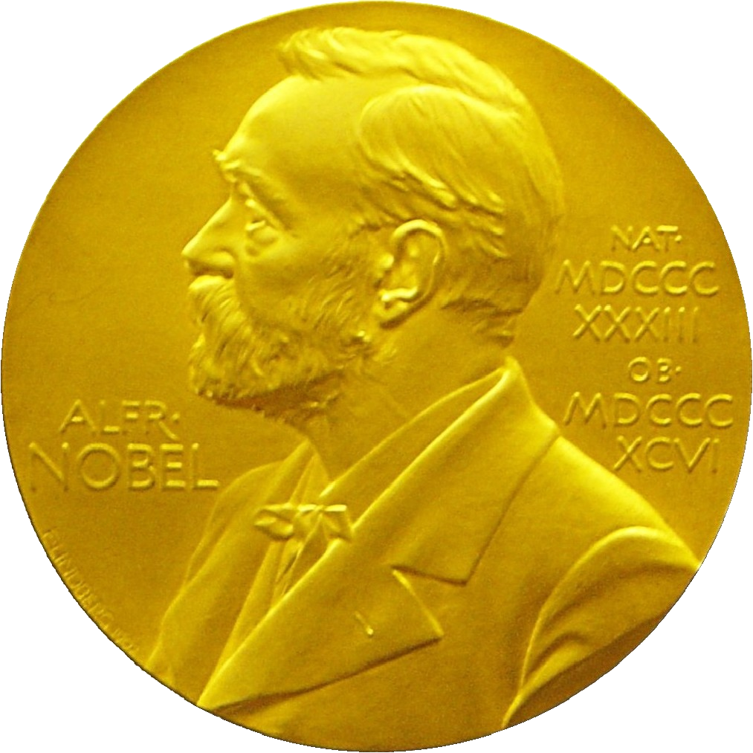
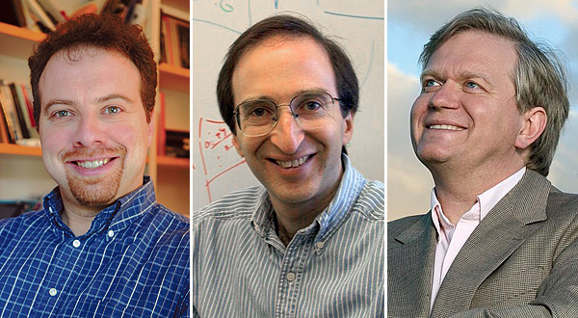
Nobel Prize Laureates
Adam Riess
Saul Perlmutter
Brian Schmidt

Slide 61
Cosmic Curvature
Measured

Slide 62
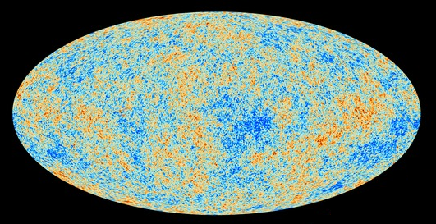
Cosmic Microwave Background
Map of the Universe at Recombination Epoch (Planck, 2013):
• 379,000 years after Big Bang
• Subhorizon perturbations: primordial sound waves
• ∆T/T < 10-5

Slide 63
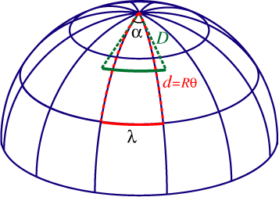
Measuring Curvature
Measuring the Geometry of the Universe:
• Object with known physical size,
at large cosmological distance
● Measure angular extent on sky
● Comparison yields light path,
and from this the curvature of space
W. Hu
FRW Universe:
lightpaths described by Robertson-Walker metric
Here: angular diameter distance D_{A}:
Geometry of Space

Slide 64
Angular Size - Redshift
FRW Universe
The angular size (z) of an object of physical size  at a redshift z displays an interesting
behaviour. In most FRW universes is has a
minimum at a medium range redshift –
z=1.25 in an Ω_{m}=1 EdS universe – and increases
again at higher redshifts.
In a matter-dominated Universe, the angular diameter distance as function of redshift is given by:

Slide 65
Measuring Curvature
• Object with known physical size,
at large cosmological distance:
• Sound Waves in the Early Universe !!!!
W. Hu
FRW Universe:
lightpaths described by Robertson-Walker metric
Here: angular diameter distance D_{A}:
Temperature Fluctuations
CMB

Slide 66
Fluctuations-Origin

Slide 67
Music of the Spheres
● small ripples in
primordial matter & photon distribution
● gravity:
- compression primordial photon gas
- photon pressure resists
● compressions and rarefactions
in photon gas: sound waves
● sound waves not heard, but seen:
- compressions: (photon) T higher
- rarefactions: lower
● fundamental mode sound spectrum
- size of “instrument”:
- (sound) horizon size last scattering
● Observed, angular size: θ~1º
- exact scale maximum compression, the
“cosmic fundamental mode of music”
W. Hu

Slide 68
Cosmic Microwave Background
Size Horizon Recombination
COBE measured fluctuations: > 7º
Size Horizon at Recombination spans angle ~ 1º
COBE proved that superhorizon fluctuations do exist: prediction Inflation !!!!!

Slide 69
Flat universe from CMB
First peak: flat universe
We know the redshift and the time it took for the light to reach us:
from this we know the
- length of the legs of the
triangle
- the angle at which we are
measuring the sound horizon.
Closed:
hot spots
appear larger
Flat:
appear as big as they are
Open:
spots appear smaller

Slide 70
The Cosmic Tonal Ladder
The WMAP CMB temperature
power spectrum
Cosmic sound horizon
The Cosmic Microwave Background Temperature Anisotropies:
Universe is almost perfectly FLAT !!!!

Slide 71
Planck CMB Temperature Fluctuations

Slide 72
The WMAP CMB temperature
power spectrum

Slide 73
FRW Universe: Curvature
There is a 1-1 relation between the total energy content
of the Universe and its curvature. From FRW equations:

Slide 74
Cosmic Curvature
&
Cosmic Density
SCP Union2 constraints (2010)
on values of matter density Ω_{m}
dark energy density Ω_{Λ}

