Slide 1
Cosmology,
lect. 5
Curved Cosmos
&
Observational Cosmology

Slide 2
Einstein Field Equation

Slide 3
Cosmological Principle

Slide 4
General Relativity
A crucial aspect of any particular configuration is the geometry of
spacetime: because Einstein’s General Relativity is a metric
theory, knowledge of the geometry is essential.
Einstein Field Equations are notoriously complex, essentially
10 equations. Solving them for general situations is almost
impossible.
However, there are some special circumstances that do allow a
full solution. The simplest one is also the one that describes
our Universe. It is encapsulated in the
Cosmological Principle
On the basis of this principle, we can constrain the geometry
of the Universe and hence find its dynamical evolution.

Slide 5
Cosmological Principle: the Universe Simple & Smooth
“God is an infinite sphere whose centre is
everywhere and its circumference nowhere”
Empedocles, 5th cent BC
Cosmological Principle:
Describes the symmetries in global appearance of the Universe:
● Homogeneous
● Isotropic
● Universality
● Uniformly Expanding
The Universe is the same everywhere:
- physical quantities (density, T,p,…)
The Universe looks the same in every direction
Physical Laws same everywhere
The Universe “grows” with same rate in
- every direction
- at every location
”all places in the Universe are alike’’
Einstein, 1931

Slide 6
Geometry of the Universe
Fundamental Tenet
of (Non-Euclidian = Riemannian) Geometry
There exist no more than THREE uniform spaces:
1) Euclidian (flat) Geometry Euclides
2) Hyperbolic Geometry Gauß, Lobachevski, Bolyai
3) Spherical Geometry Riemann
uniform=
homogeneous & isotropic
(cosmological principle)

Slide 8
Curvature of the Universe:
Robertson-Walker Metric

Slide 9
Spherical Surface Distances

Slide 10
Spherical Surface Distances: alternative – geodetic distance x

Slide 11
Spherical Space Distances
Spherical surface is a 2-D section through an isotropic curved 3D space:
generalization to 3D solid angle (θ,φ)

Slide 12
Spherical Space Distances alternative: geodetic distance

Slide 13
Minkowski Metric spherically isotropic 3D space

Slide 14
Robertson-Walker Metric
Distances in a uniformly curved spacetime is specified in terms of the
Robertson-Walker metric. The spacetime distance of a point at coordinate
(r,θ,φ) is:
where the function S_{k}(r/R_{c})
specifies the effect of curvature
on the distances between
points in spacetime

Slide 16
Conformal Time

Slide 17
Conformal Time
Proper time τ Robertson-Walker metric
Conformal Time η(t)

Slide 18
Observational Cosmology
in
FRW Universe

Slide 19
Redshift

Slide 20
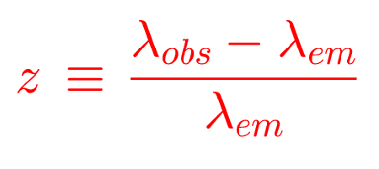
Cosmic Redshift

Slide 21
Cosmic Time Dilation

Slide 22
Cosmic Time Dilation
In an (expanding) space with Robertson-Walker metric,
In a RW metric, light travels with
Cosmic Time Dilation:

Slide 23
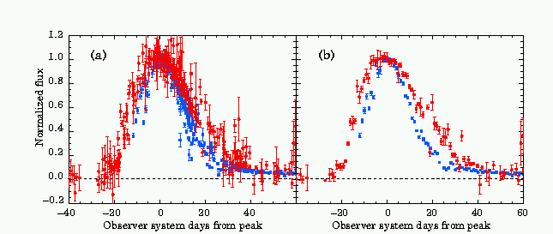
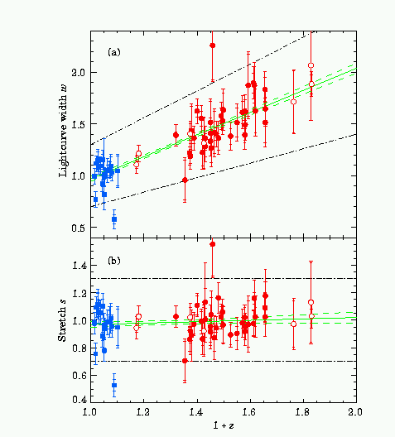
Cosmic Time Dilation
In Evidence Cosmic Time Dilation:
light curves supernovae (exploding stars):
characteristic time interval over which
the supernova rises and then dims:
systematic shift with redshift (depth)

Slide 24
Hubble Expansion

Slide 25
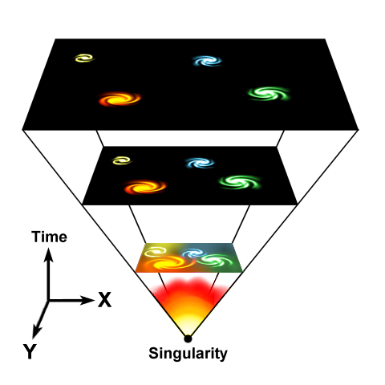
Expanding Universe
Einstein, de Sitter, Friedmann and Lemaitre all realized that in
General Relativity, there cannot be a stable and static Universe:
The Universe either expands, or it contracts …
Expansion Universe encapsulated in a
GLOBAL expansion factor a(t)
All distances/dimensions of objects
uniformly increase by a(t):
at time t, the distance between
two objects i and j has increased to
Note: by definition we chose a(t₀)=1,
i.e. the present-day expansion factor

Slide 26
Interpreting Hubble Expansion
Cosmic Expansion manifests itself in the
in a recession velocity which linearly increases with distance
this is the same for any galaxy within the Universe !
There is no centre of the Universe:
would be in conflict with the Cosmological Principle

Slide 27
Hubble Expansion
Cosmic Expansion is a uniform expansion of space
Objects do not move themselves:
they are like beacons tied to a uniformly expanding sheet:

Slide 28
Hubble Expansion
Cosmic Expansion is a uniform expansion of space
Objects do not move themselves:
they are like beacons tied to a uniformly expanding sheet:
Comoving Position
Hubble Parameter:
Hubble “constant”:
H₀H(t=t₀)
Comoving Position

Slide 29
Hubble Parameter
For a long time, the correct value of the Hubble constant H₀
was a major unsettled issue:
H₀ = 50 km s⁻¹ Mpc⁻¹ H₀ = 100 km s⁻¹ Mpc⁻¹
This meant distances and timescales in the Universe had to
deal with uncertainties of a factor 2 !!!
Following major programs, such as Hubble Key Project, the
Supernova key projects and the WMAP CMB measurements,

Slide 30
Hubble Expansion
Edwin Hubble
(1889-1953)
v = H r
Hubble Expansion

Slide 31
Hubble Parameter
For a long time, the correct value of the Hubble constant H₀
was a major unsettled issue:
H₀ = 50 km s⁻¹ Mpc⁻¹ H₀ = 100 km s⁻¹ Mpc⁻¹
This meant distances and timescales in the Universe had to
deal with uncertainties of a factor 2 !!!
Following major programs, such as Hubble Key Project, the
Supernova key projects and the WMAP CMB measurements,

Slide 32
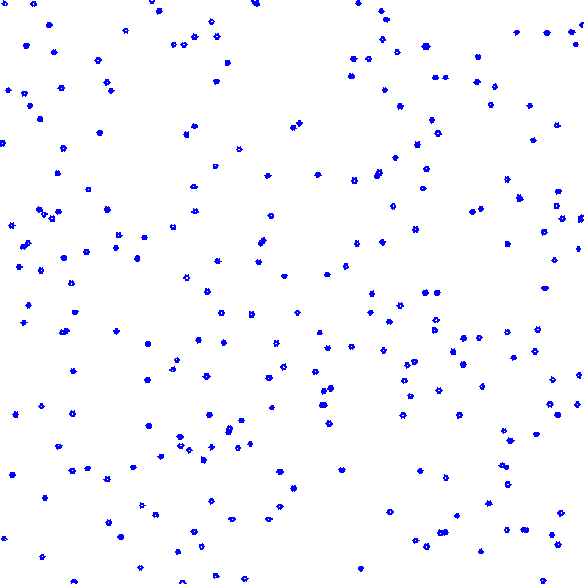
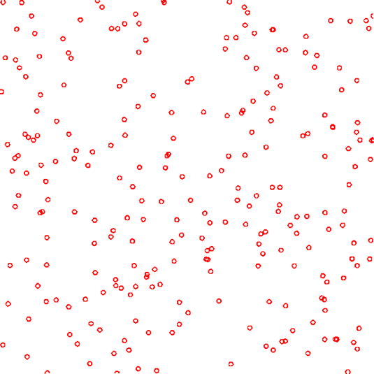
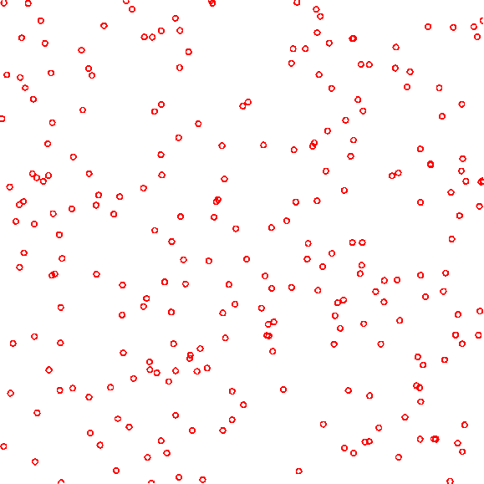
Hubble Expansion
Space expands:
displacement - distance Hubble law: velocity - distance

Slide 33
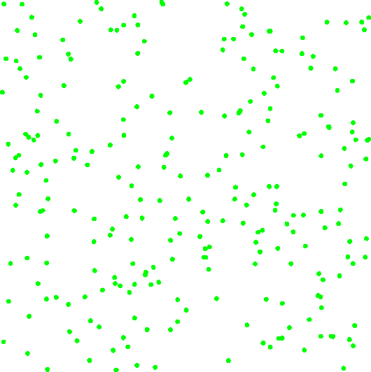

Slide 39
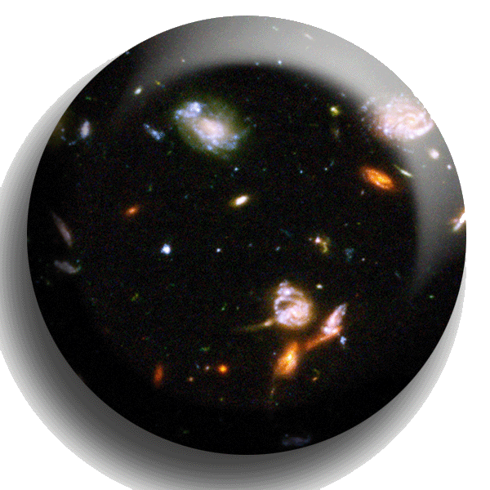
Nonlinear Descriptions
Deformation Cosmic Volume Element
The evolution of a fluid element on its path through space may be specified by its velocity gradient:
in which
θ: velocity divergence
contraction/expansion
σ: velocity shear
deformation
ω: vorticity
rotation of element

Slide 40
Nonlinear Descriptions
Deformation Cosmic Volume Element
Global Anisotropic
expansion/contraction
Anisotropic Relativistic Universe Models:
Bianchi I-IX Universe models
• expand anisotropically
• have to be characterized by at least
3 Hubble parameters (expansion rate
different in
different directions)
• Only marginal claims indicate the
possibility on the basis of
CMB anisotropies

Slide 41
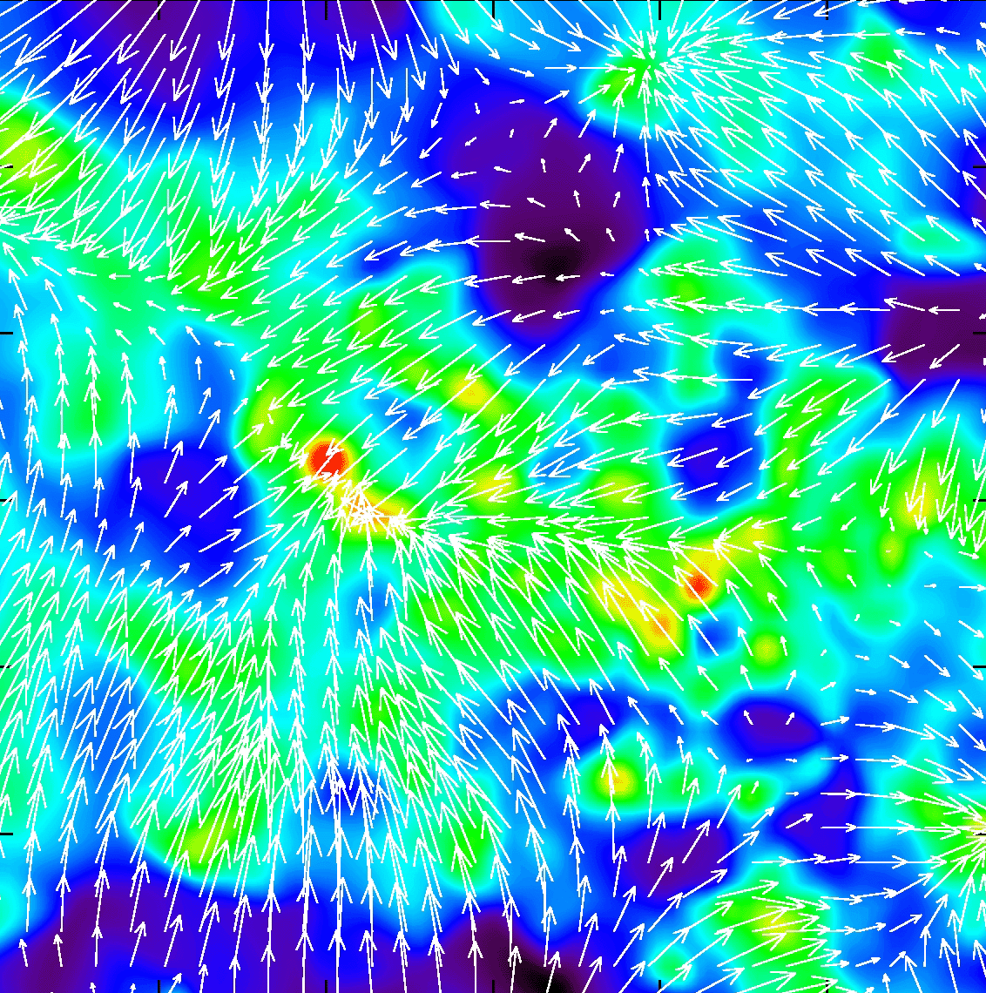
Nonlinear Descriptions
Deformation Cosmic Volume Element
Local Anisotropic Flows:
“fatal” attractions
• In our local neighbourhood the
cosmic flow field has a significant shear
• This shear is a manifestation of
- infall of our Local Group into
the Local Supercluster
- motion towards the Great Attractor
- possibly motion towards even larger
mass entities: Shapley concentration
Horologium supercluster

Slide 42
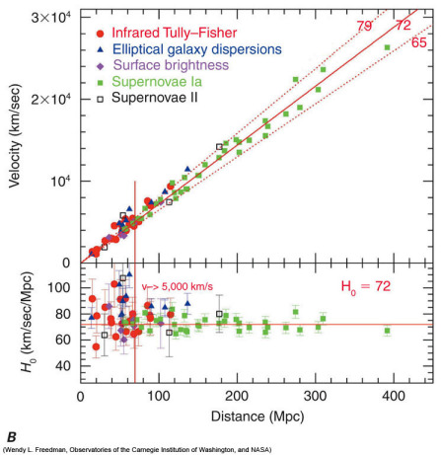
Nonlinear Descriptions
Deformation Cosmic Volume Element
Global Hubble Expansion
Observations over large regions
of the sky, out to large cosmic depth:
• the Hubble expansion offers a very good
description of the actual Universe
• the Hubble expansion is the same
in whatever direction you look: isotropic
Hubble flow:
Pure expansion/contraction

Slide 43
Cosmic Distances

Slide 44
Light paths RW space
In an (expanding) space with Robertson-Walker metric,
radial comoving distance r
travelled by radiation
in a RW space:

Slide 45
Distance Measure

Slide 46
RW Distance Measure
In an (expanding) space with Robertson-Walker metric,
there are several definitions for distance, dependent on how you measure it.
They all involve the central distance function, the RW Distance Measure,

Slide 47
RW Redshift-Distance
Light propagation in a RW metric (curved space):
Note: - light propagation is along radial lines
- the “-” sign is an expression for the fact that the
light ray propagating towards you moves in
opposite direction of radial coordinate r
After some simplification and reordering, we find

Slide 48
RW Redshift-Distance
Observing in a FRW Universe, we locate galaxies in terms of their redshift z. To
connect this to their true physical distance, we need to know what the coordinate distance r of an object with redshift z,
In a FRW Universe, the dependence of the Hubble expansion rate H(z) at any
redshift z depends on the content of matter, dark energy and radiation, as well
ss its curvature. This leads to the following explicit expression for the
redshift-distance relation,

Slide 49
Matter-Dominated FRW Universe
Observing in a FRW Universe, we locate galaxies in terms of their redshift z. To
connect this to their true physical distance, we need to know what the coordinate distance r of an object with redshift z,
In a FRW Universe, the dependence of the Hubble expansion rate H(z) at any
redshift z depends on the content of matter, dark energy and radiation, as well
ss its curvature. This leads to the following explicit expression for the
redshift-distance relation,
in a matter-dominated Universe, the redshift-distance relation is
from which one may find that

Slide 50
Mattig’s Formula
The integral expression
can be evaluated by using the substitution:
This leads to Mattig’s formula:
This is one of the very most important and most useful equations
in observational cosmology.

Slide 51
Mattig’s Formula
In a low-density Universe, it is better to use the following version:
For a Universe with a cosmological constant, there is not an easily
tractable analytical expression (a Mattig’s formula). The comoving
Distance r has to be found through a numerical evaluation of the fundamental dr/dz expression.

Slide 52
Distance-Redshift Relation, 2nd order
For all general FRW Universe, the
second-order distance-redshift relation is identical,
only depending on the deceleration parameter q₀:
q₀ can be related to Ω₀ once the equation of state is known.

Slide 53
Angular Diameter Distance
Luminosity Distance

Slide 54
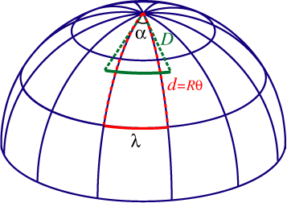
Angular Diameter Distance
Imagine an object of proper size d, at redshift z, its angular size  is given by
Angular Diameter distance:

Slide 55
Luminosity Distance
Imagine an object of luminosity L(ν_{e}), at redshift z, its flux density at observed frequency ν_{o} is
Luminosity distance:

Slide 56
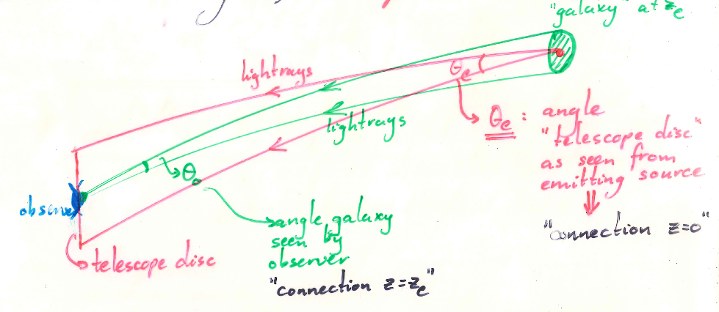
Angular vs. Luminosity
Distance
The relation between the Luminosity and the Angular Diameter distance of
an object at redshift z is sometimes indicated as
Reciprocity Theorem
The difference between these 2 fundamental cosmological measures stems from the fact that they involve “radial paths” measured in opposite directions along
the lightcone, and thus are
forward - luminosity distance
backward - angular diameter distance
wrt. expansion of the Universe

Slide 57
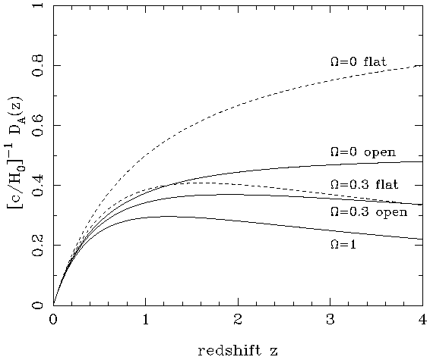
Angular Diameter Distance
matter-dominated FRW Universe
In a matter-dominated Universe, the angular diameter distance as function of redshift is given by:

Slide 58
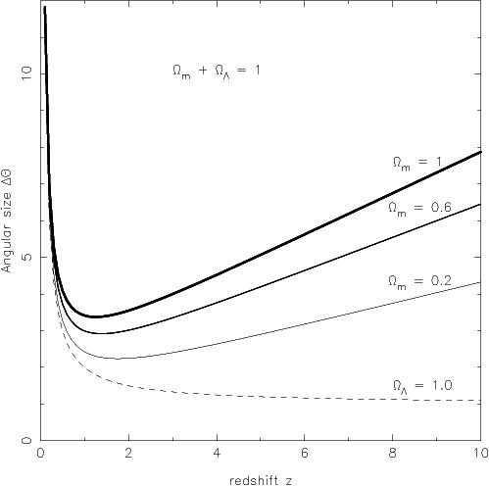
Angular Size - Redshift
FRW Universe
The angular size (z) of an object of physical size  at a redshift z displays an interesting
behaviour. In most FRW universes is has a
minimum at a medium range redshift –
z=1.25 in an Ω_{m}=1 EdS universe – and increases
again at higher redshifts.
In a matter-dominated Universe, the angular diameter distance as function of redshift is given by:

Slide 59
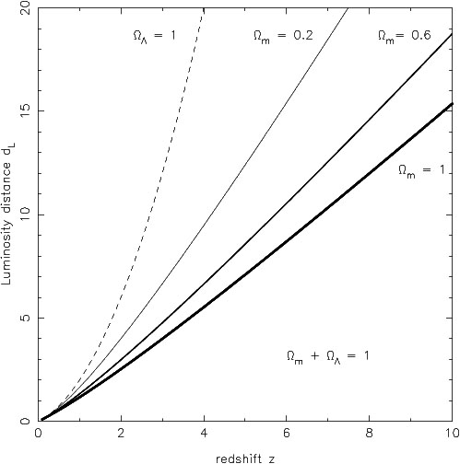
Luminosity Distance
matter-dominated FRW Universe
In a matter-dominated Universe, the luminosity distance as function of redshift is given by:

Slide 60
Cosmological Distances:
Comparison

Slide 61
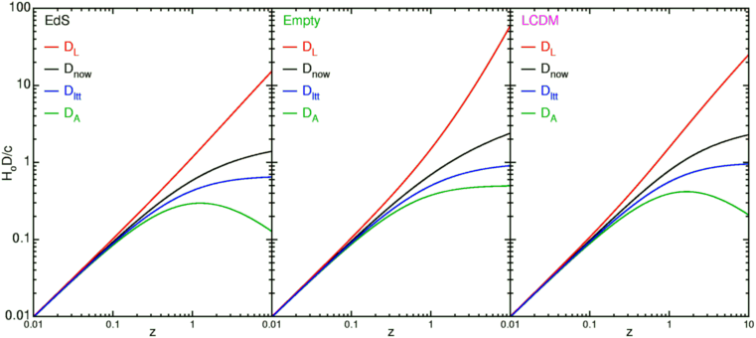
FRW Universe Distances
summary

Slide 62
Cosmology:
the search for 2 numbers

Slide 63
Cosmology, the search for 2 numbers
Sandage, ARAA 1970 :
Cosmology is the “Search for 2 numbers”:
How to measure the values of H₀ and q₀, without any prior assumption on the dynamics, ie. of the particular FRWL cosmological model ? Ie. how to infer these numbers from observables:
- redshift - luminosity - angular size
Establish relation expansion factor a(t) up to 2nd order (Taylor series):

Slide 64
Time of Emission - Redshift
The corresponding redshift z of the source that emitted its radiation
at time t_{e}:
whose inversion translates into the expression of the emission time t_{e}
for a given redshift z:

Slide 65
Coordinate Distance - Redshift
Coordinate distance d_{P}(t₀) of source
whose radiation is emitted at t_{e}, and reached us at t₀:
Using the relation between (t0-te) and redshift z, establishes the relation
between coordinate distance d_{P}(t₀) of source and z:

Slide 66
Luminosity Distance - Redshift
Luminosity Distance
In terms of an object at redshift z, with absolute bolometric magnitude M_{bol}, we may infer the acceleration parameter q₀ from:

Slide 67
Cosmic Curvature
Measured

Slide 68
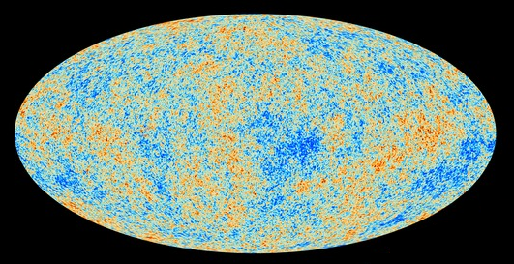
Cosmic Microwave Background
Map of the Universe at Recombination Epoch (Planck, 2013):
• 379,000 years after Big Bang
• Subhorizon perturbations: primordial sound waves
• ∆T/T < 10-5

Slide 69
Measuring Curvature
Measuring the Geometry of the Universe:
• Object with known physical size,
at large cosmological distance
● Measure angular extent on sky
● Comparison yields light path,
and from this the curvature of space
W. Hu
FRW Universe:
lightpaths described by Robertson-Walker metric
Here: angular diameter distance D_{A}:
Geometry of Space

Slide 70
Angular Size - Redshift
FRW Universe
The angular size (z) of an object of physical size  at a redshift z displays an interesting
behaviour. In most FRW universes is has a
minimum at a medium range redshift –
z=1.25 in an Ω_{m}=1 EdS universe – and increases
again at higher redshifts.
In a matter-dominated Universe, the angular diameter distance as function of redshift is given by:

Slide 71
Measuring Curvature
• Object with known physical size,
at large cosmological distance:
• Sound Waves in the Early Universe !!!!
W. Hu
FRW Universe:
lightpaths described by Robertson-Walker metric
Here: angular diameter distance D_{A}:
Temperature Fluctuations
CMB

Slide 72
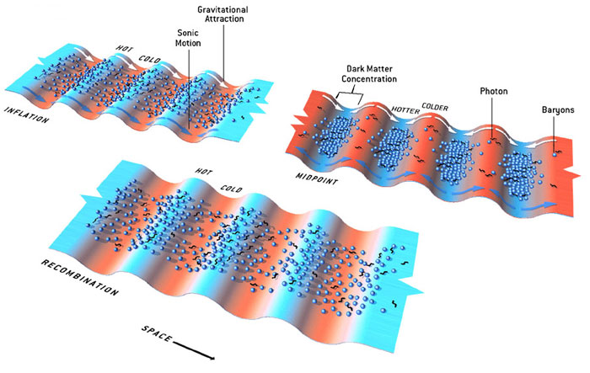
Fluctuations-Origin

Slide 73
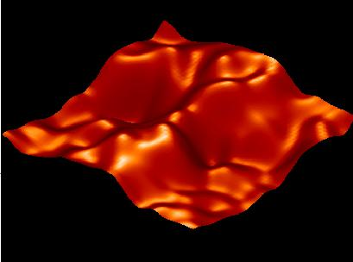
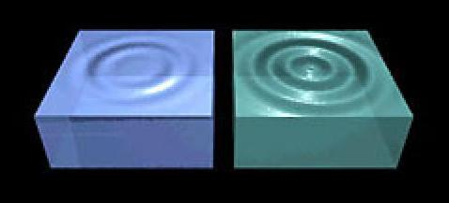
Music of the Spheres
● small ripples in
primordial matter & photon distribution
● gravity:
- compression primordial photon gas
- photon pressure resists
● compressions and rarefactions
in photon gas: sound waves
● sound waves not heard, but seen:
- compressions: (photon) T higher
- rarefactions: lower
● fundamental mode sound spectrum
- size of “instrument”:
- (sound) horizon size last scattering
● Observed, angular size: θ~1º
- exact scale maximum compression, the
“cosmic fundamental mode of music”
W. Hu

Slide 74
Cosmic Microwave Background
Size Horizon Recombination
COBE measured fluctuations: > 7º
Size Horizon at Recombination spans angle ~ 1º
COBE proved that superhorizon fluctuations do exist: prediction Inflation !!!!!

Slide 75
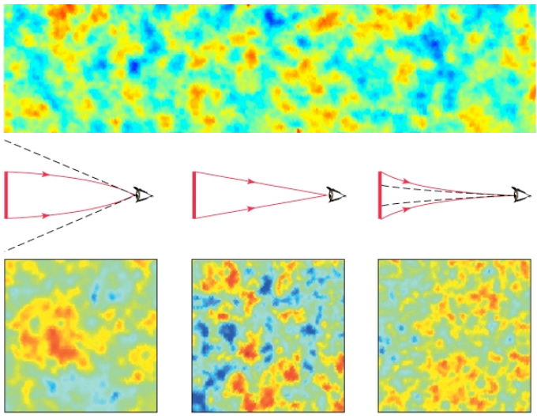
Flat universe from CMB
First peak: flat universe
We know the redshift and the time it took for the light to reach us:
from this we know the
- length of the legs of the
triangle
- the angle at which we are
measuring the sound horizon.
Closed:
hot spots
appear larger
Flat:
appear as big as they are
Open:
spots appear smaller

Slide 76
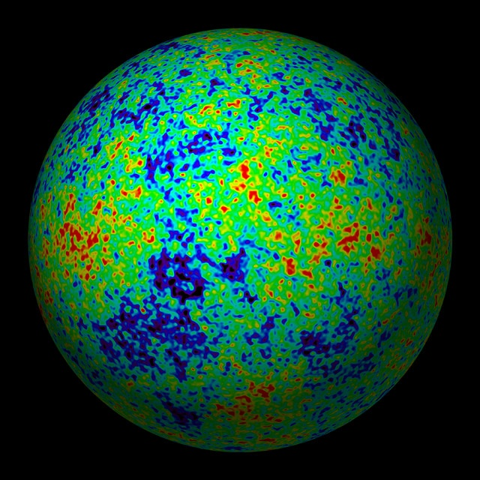
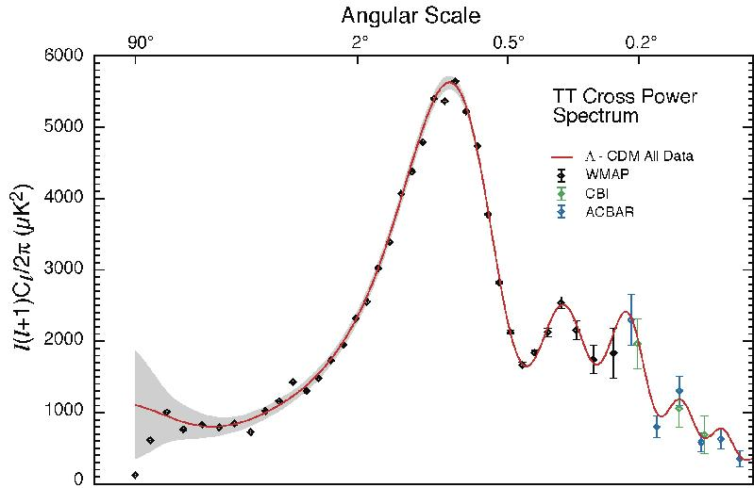
The Cosmic Tonal Ladder
The WMAP CMB temperature
power spectrum
Cosmic sound horizon
The Cosmic Microwave Background Temperature Anisotropies:
Universe is almost perfectly FLAT !!!!

Slide 77
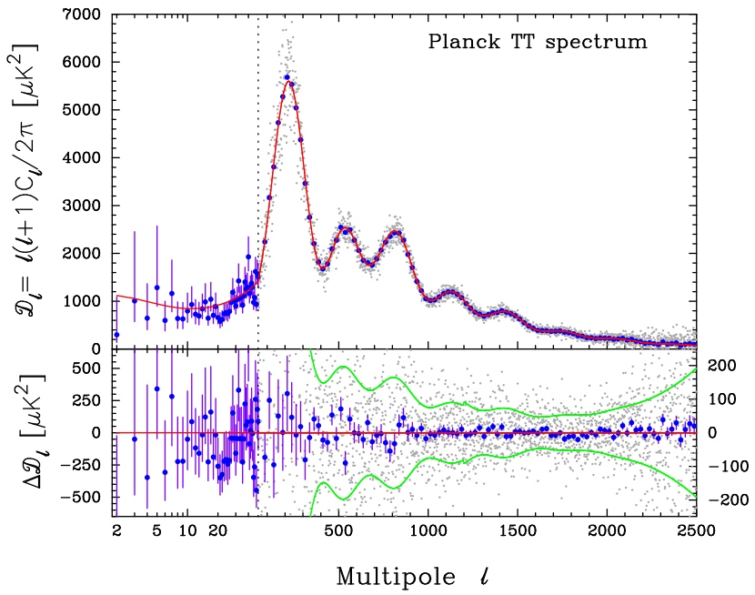
Planck CMB Temperature Fluctuations

Slide 78
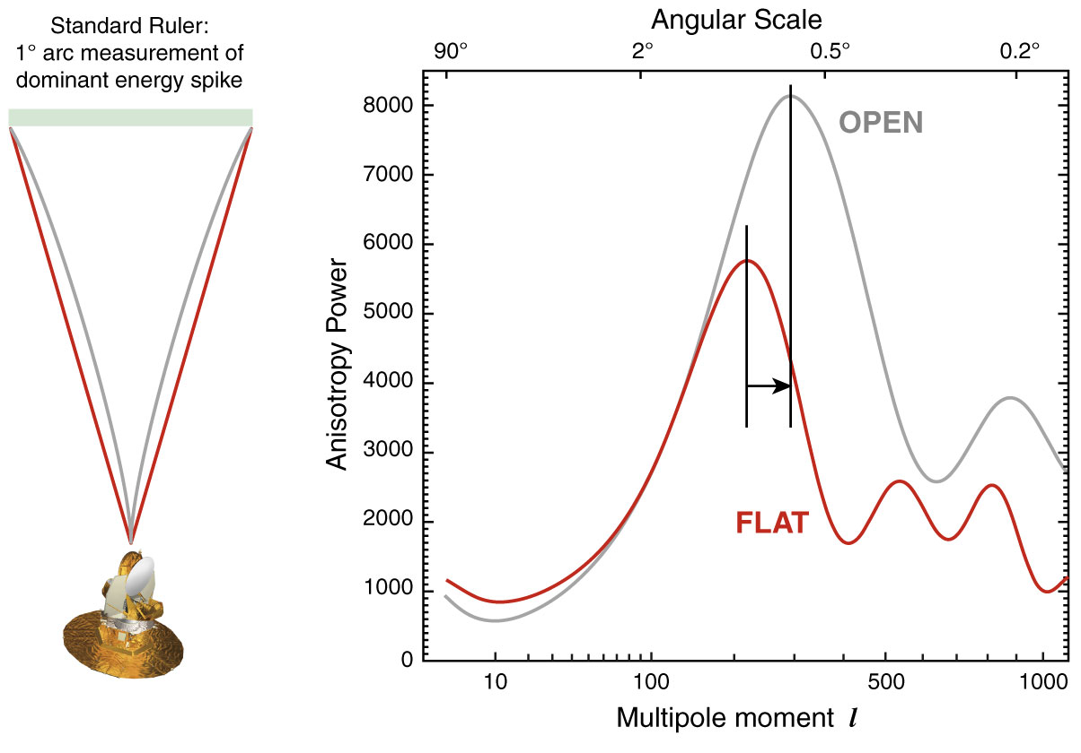
The WMAP CMB temperature
power spectrum

Slide 79
FRW Universe: Curvature
There is a 1-1 relation between the total energy content
of the Universe and its curvature. From FRW equations:

Slide 80
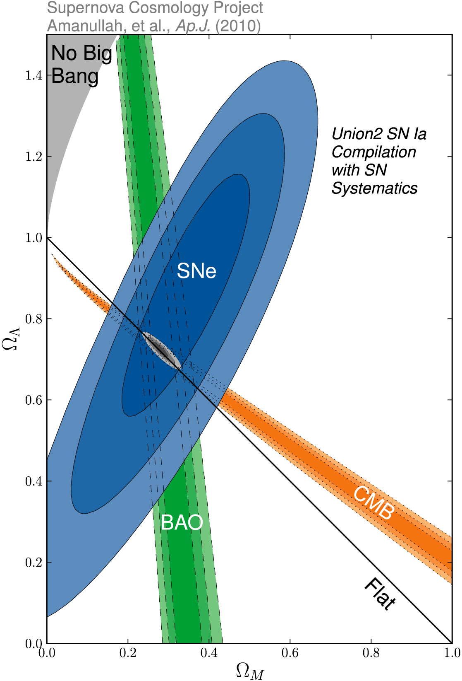
Cosmic Curvature
&
Cosmic Density
SCP Union2 constraints (2010)
on values of matter density Ω_{m}
dark energy density Ω_{Λ}

