Slide 1
Cosmology,
lect. 4
Dynamics
of
FRWL Universes

Slide 2
Dynamics
FRW Universe

Slide 3
Friedmann-Robertson-Walker-Lemaitre Universe

Slide 4
Cosmic Constituents:
Evolving Energy Density

Slide 5
FRW Energy Equation
To infer the evolving energy density (t) of each cosmic component, we refer to
the cosmic energy equation. This equation can be directly inferred from the FRW equations
The equation forms a direct expression of the adiabatic expansion of the Universe,
ie.
Internal energy
Expanding volume

Slide 6
FRW Energy Equation
To infer (t) from the energy equation, we need to know the pressure p(t) for
that particular medium/ingredient of the Universe.
To infer p(t), we need to know the nature of the medium, which provides
us with the equation of state,

Slide 7
Cosmic Constituents: Evolution of Energy Density
Matter:
• Radiation:
• Dark Energy:

Slide 8
FRWL Dynamics
&
Cosmological Density

Slide 9
FRW Dynamics
•The individual contributions to the energy density of
the Universe can be figured into the  parameter:
- radiation
- matter
- dark energy/
cosmological constant

Slide 10
Critical Density
There is a 1-1 relation between the total energy content
of the Universe and its curvature. From FRW equations:

Slide 11
FRW Universe: Curvature
There is a 1-1 relation between the total energy content
of the Universe and its curvature. From FRW equations:

Slide 12
Radiation, Matter & Dark Energy
The individual contributions to the energy density of
the Universe can be figured into the  parameter:
- radiation
- matter
- dark energy/
cosmological constant

Slide 13
General Solution Expanding FRW Universe
From the FRW equations:
Expansion history Universe

Slide 14
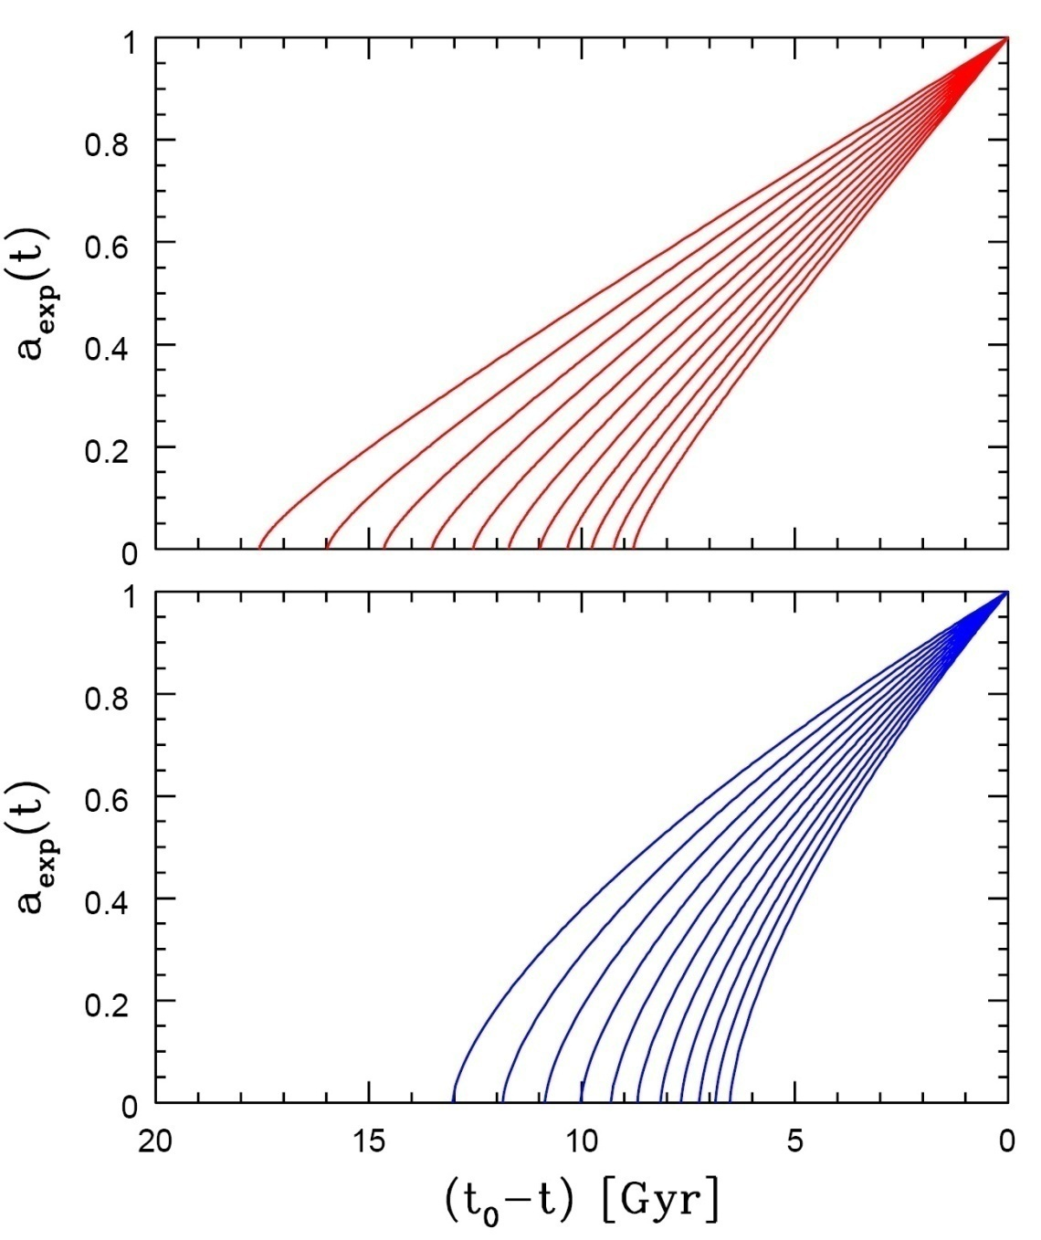
Age of the Universe
Age of a FRW universe at
Expansion factor a(t)
Matter-dominated
Hubble time
Matter-dominated

Slide 15
Specific Solutions FRW Universe
While general solutions to the FRW equations is only possible
by numerical integration, analytical solutions may be found for particular classes of cosmologies:
Single-component Universes:
- empty Universe
- flat Universes, with only radiation, matter or
dark energy
Matter-dominated Universes
Matter+Dark Energy flat Universe

Slide 16
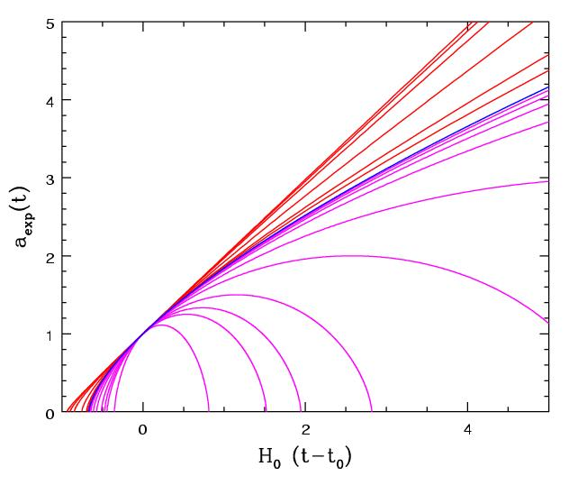
Matter-Dominated Universes
Assume radiation contribution is negligible:
Zero cosmological constant:
Matter-dominated, including curvature

Slide 17
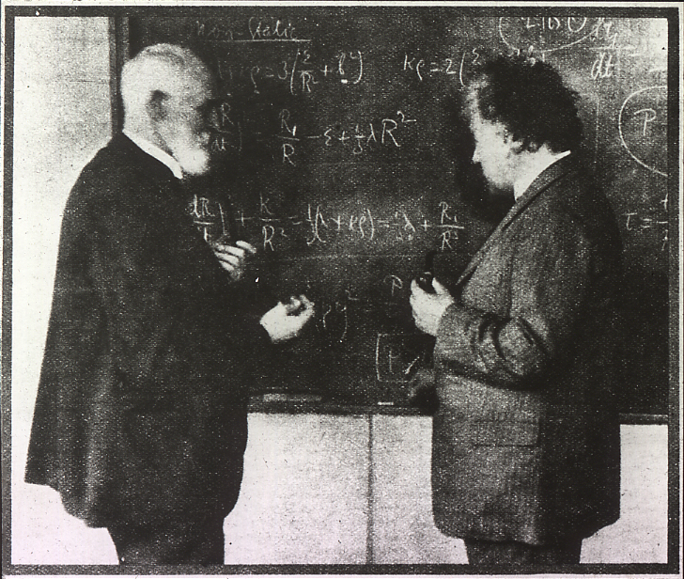
Einstein-de Sitter Universe
FRW:
Albert Einstein and Willem de Sitter discussing the Universe. In 1932 they published a paper together on the Einstein-de Sitter universe, which is a model with flat geometry containing matter as the only significant substance.
Age
EdS Universe:

Slide 18
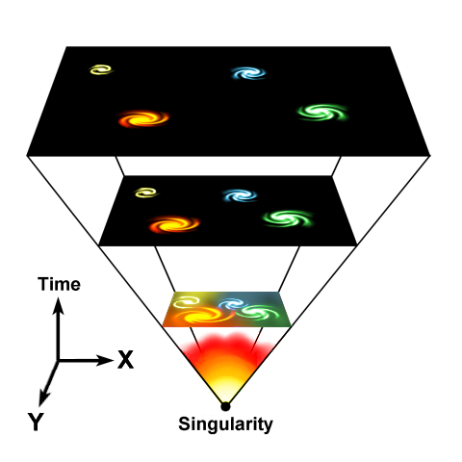
Free Expanding "Milne" Universe
Empty space is curved
FRW:
Age
Empty Universe:

Slide 19
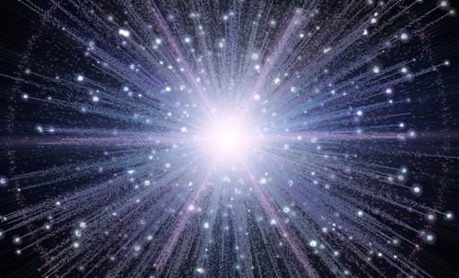
Expansion Radiation-dominated Universe
In the very early Universe, the energy density is completely dominated by radiation. The dynamics of the very early Universe is therefore fully determined by the evolution of the radiation energy density:
FRW:
Age
Radiation
Universe:

Slide 20
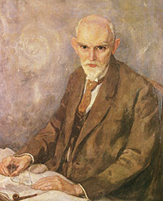
De Sitter Expansion
FRW:
Willem de Sitter (1872-1934; Sneek-Leiden)
director Leiden Observatory
alma mater: Groningen University
Age
De Sitter Universe: infinitely old

Slide 21
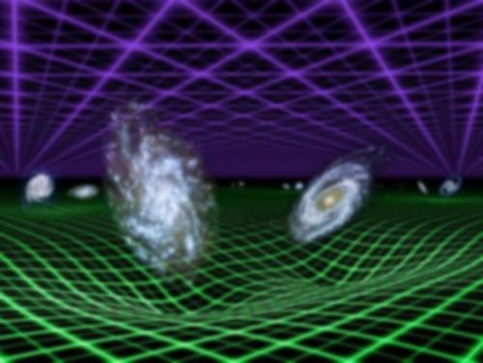
General Flat FRW Universe
FRW:

Slide 22
Evolving
Cosmic Composition

Slide 23
matter
Density Evolution Cosmic Components
radiation
dark energy

Slide 24
Matter-Dark Energy
Transition
matter
Radiation-Matter transition
radiation
dark energy

Slide 25
matter
radiation
Evolution Cosmic Density Parameter Ω
radiation, matter, dark energy
(in concordance Universe)
dark energy

Slide 26
matter
radiation
dark energy

Slide 27
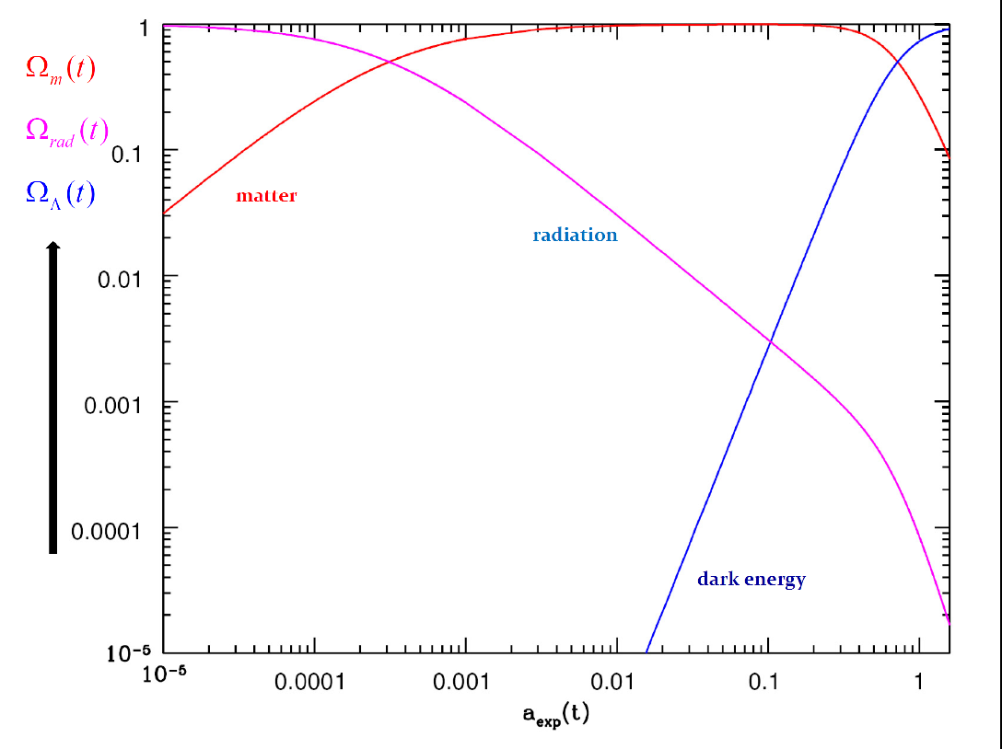
Evolving
Composition
FRWL Universe

Slide 28
Cosmological Transitions

Slide 29
Dynamical Transitions
Because radiation, matter, dark energy (and curvature) of the Universe evolve differently as the Universe expands, at different epochs the energy density of the Universe is alternately dominated by these different ingredients.
As the Universe is dominated by either radiation, matter, curvature or
dark energy, the cosmic expansion a(t) proceeds differently.
We therefore recognize the following epochs:
• radiation-dominated era
• matter-dominated era
• curvature-dominated expansion
• dark energy dominated epoch
The different cosmic expansions at these eras have a huge effect on relevant physical processes

Slide 30
Dynamical Transitions
• Radiation Density Evolution
• Matter Density Evolution
• Curvature Evolution
Dark Energy
(Cosmological Constant)
Evolution

Slide 31
matter
radiation
Evolution Cosmic Density Parameter 
radiation, matter, dark energy
(in concordance Universe)
dark energy

Slide 32
matter
radiation
Matter-
Dark Energy
Transition
Radiation-Matter transition
dark energy

Slide 33
Radiation-Matter
Transition
• Radiation Density Evolution
• Matter Density Evolution
Radiation energy density decreases more rapidly than matter density:
this implies radiation to have had a higher energy density before a
particular cosmic time:
Radiation
dominance
Matter
dominance

Slide 34
Matter-Dark Energy
Transition
• Matter Density Evolution
• Dark Energy Density Evolution
While matter density decreases due to the expansion of the Universe,
the cosmological constant represents a small, yet constant, energy density.
As a result, it will represent a higher density after
Matter
dominance
Dark energy
dominance

Slide 35
Matter-Dark Energy
Transition
Note: a more appropriate characteristic transition
is that at which the deceleration turns into
acceleration:
Flat
Universe

Slide 36
Evolution
Cosmological Density Parameter
Limiting ourselves to a flat Universe
(and discarding the contribution by and evolution of curvature):
to appreciate the dominance of radiation, matter and dark energy in the subsequent cosmological eras, it is most illuminating to look at the evolution
of the cosmological density parameter of these cosmological components:
e.g.

Slide 37
Evolution
Cosmological Density Parameter
From the FRW equations, one can infer that the evolution of  goes like
(for simplicity, assume matter-dominated Universe),
These equations directly show that
implying that the early Universe was very
nearly flat …

Slide 38
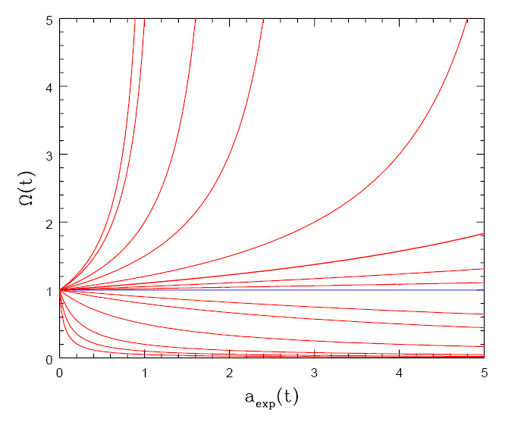
Flatness Evolution
• At radiation-matter equiv.
• Big Bang nucleosynthesis
a_{nuc}≈3.6 x 10⁻⁸
• Planck time

Slide 39
Concordance Universe

Slide 40
Concordance Universe Parameters
Hubble Parameter
Age of the Universe
Temperature CMB
Matter | Baryonic Matter Dark Matter
Radiation | Photons (CMB) Neutrinos (Cosmic)
Dark Energy
Total

Slide 41
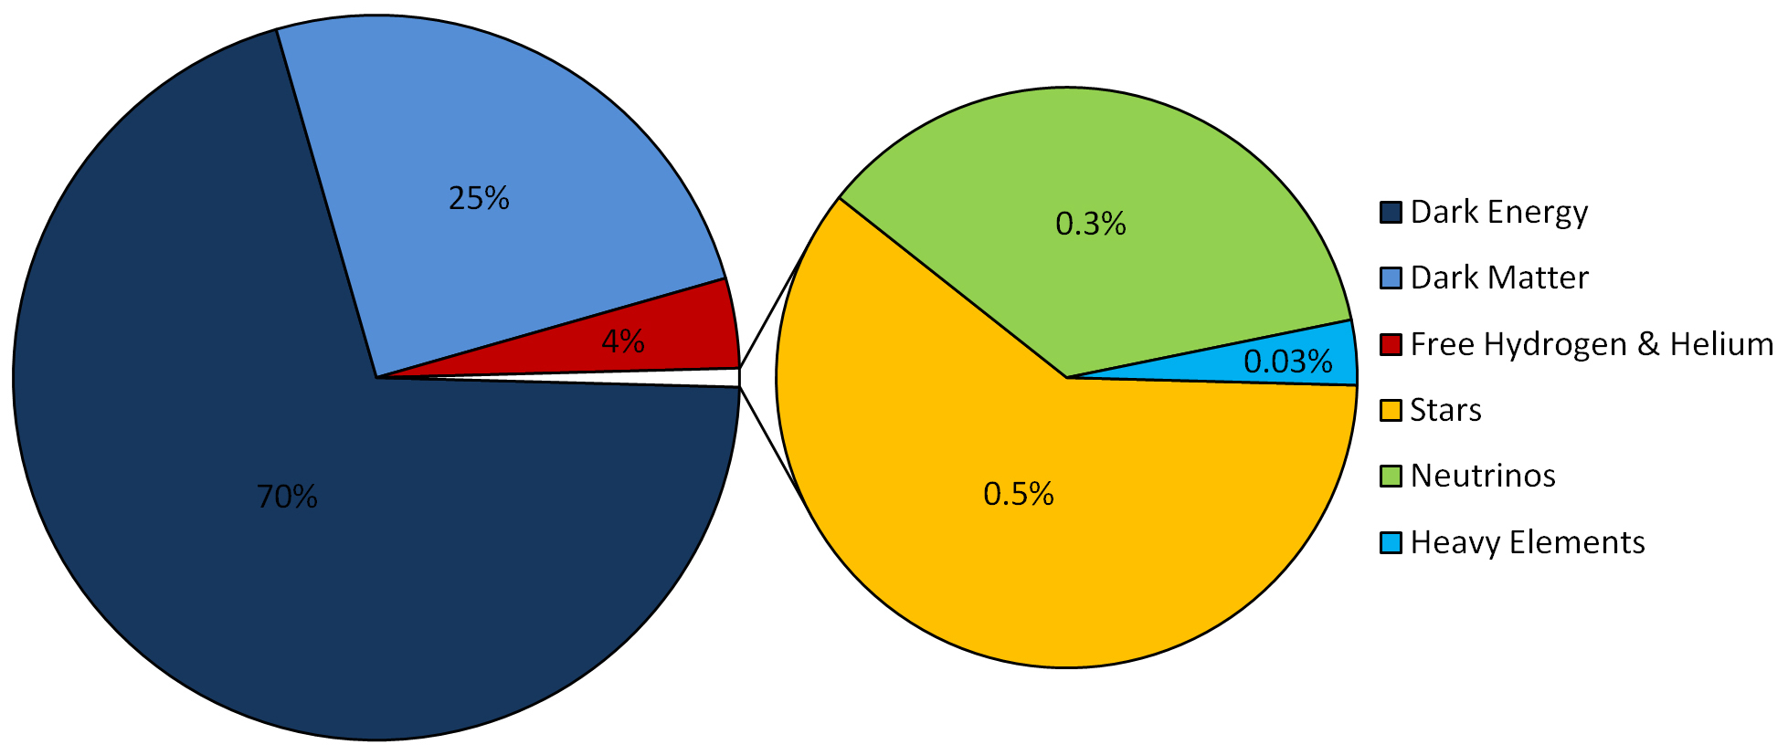
LCDM Cosmology
Concordance cosmology
- model that fits the majority of cosmological observations
- universe dominated by Dark Matter and Dark Energy
LCDM composition today …

Slide 42
Concordance Expansion
transition epoch:
matter-dominate to
☹ dominated
a_{m☹}0.75

Slide 43
Concordance Expansion
We can recognize two extreme regimes:
• very early times
matter dominates the expansion, and : Einstein-de Sitter expansion,
• very late times
matter has diluted to oblivion, and : de Sitter expansion driven by
dark energy

Slide 44
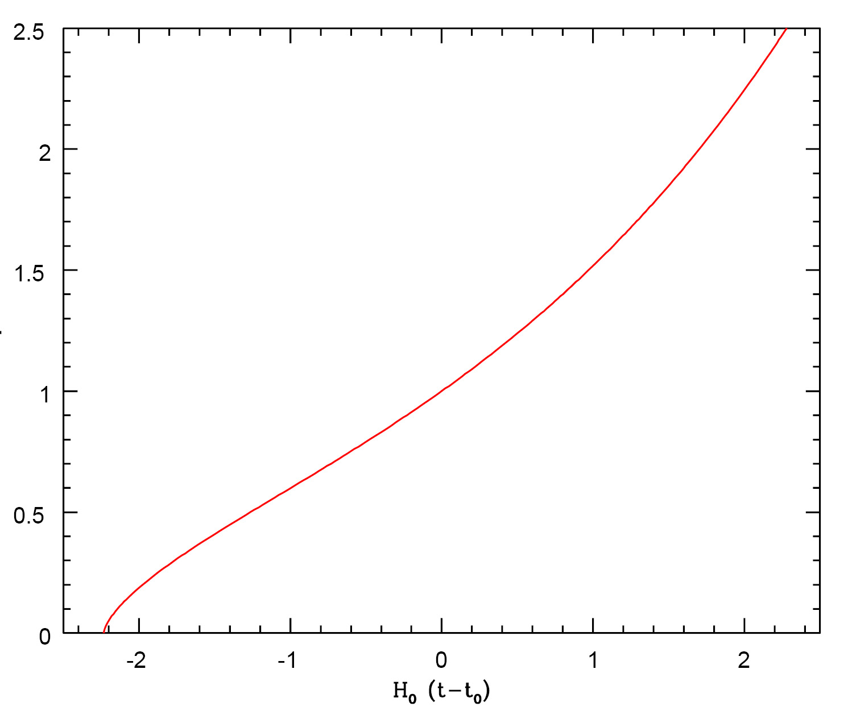
Concordance Expansion

Slide 45
Concordance Expansion
expansion like
De Sitter expansion
acceleration
past
future
expansion like
EdS universe
today
deceleration

Slide 46
Matter-Dark Energy
Transition
Note: a more appropriate characteristic transition
is that at which the deceleration turns into
acceleration:
Flat
Universe

Slide 47
Key Epochs Concordance Universe
Radiation-Matter Equality
Recombination/ Decoupling
Reionization | Optical Depth Redshift
Matter-Dark Energy Transition | Acceleration Energy
Today

Slide 48
General FRWL
cxpansion histories:
cosmic “phase diagram”

Slide 49
Cosmological Evolution Modes
It is interesting to inspect the possible expansion histories for generic FRWL cosmologies with matter & cosmological constant.
The expansion histories entirely determined by 2 parameters:
matter density
cosmological constant
• 4 (qualitatively) different and possible modes of cosmic evolution:
1) Bouncing universe
2) Collapsing universe “Big Crunch”
3) Loitering universe
4) Expansion (only) universe

Slide 50
Cosmological Evolution Modes
Expanding solution
“Big Chill”
Big Bounce
Collapsing solution
“Big Crunch”
Loitering Universe

Slide 51
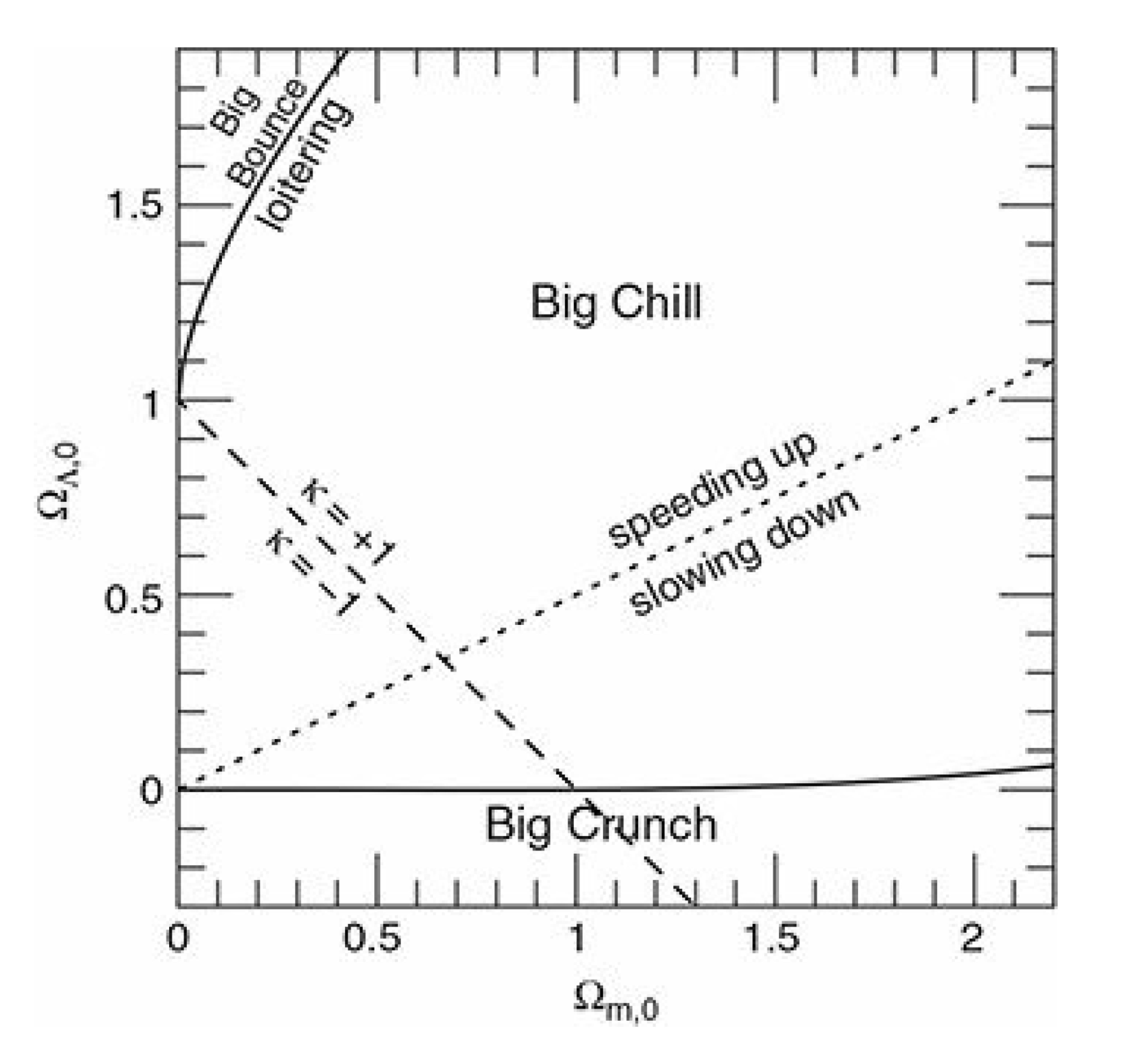
Cosmological Evolution Modes
Expansion Modes:
different combinations
and
In the diagram you can
identify regions of
• curvature
• acceleration

