Slide 1
Cosmology,
lect. 3
Cosmological Principle
&
Friedmann-Lemaitre Equations

Slide 2
Einstein Field Equation

Slide 3
Cosmological Principle

Slide 4
General Relativity
A crucial aspect of any particular configuration is the geometry of
spacetime: because Einstein’s General Relativity is a metric
theory, knowledge of the geometry is essential.
Einstein Field Equations are notoriously complex, essentially
10 equations. Solving them for general situations is almost
impossible.
However, there are some special circumstances that do allow a
full solution. The simplest one is also the one that describes
our Universe. It is encapsulated in the
Cosmological Principle
On the basis of this principle, we can constrain the geometry
of the Universe and hence find its dynamical evolution.

Slide 5
Cosmological Principle: the Universe Simple & Smooth
“God is an infinite sphere whose centre is
everywhere and its circumference nowhere”
Empedocles, 5th cent BC
Cosmological Principle:
Describes the symmetries in global appearance of the Universe:
● Homogeneous
● Isotropic
● Universality
● Uniformly Expanding
The Universe is the same everywhere:
- physical quantities (density, T,p,…)
The Universe looks the same in every direction
Physical Laws same everywhere
The Universe “grows” with same rate in
- every direction
- at every location
”all places in the Universe are alike’’
Einstein, 1931

Slide 6
Geometry of the Universe
Fundamental Tenet
of (Non-Euclidian = Riemannian) Geometry
There exist no more than THREE uniform spaces:
1) Euclidian (flat) Geometry Euclides
2) Hyperbolic Geometry Gauß, Lobachevski, Bolyai
3) Spherical Geometry Riemann
uniform=
homogeneous & isotropic
(cosmological principle)

Slide 8
Robertson-Walker Metric
Distances in a uniformly curved spacetime is specified in terms of the
Robertson-Walker metric. The spacetime distance of a point at coordinate
(r,,) is:
where the function S_{k}(r/R_{c})
specifies the effect of curvature
on the distances between
points in spacetime

Slide 10
Friedmann-Robertson-Walker-Lemaitre
(FRLW)
Universe

Slide 11
Einstein Field Equation

Slide 12
Einstein Field Equation

Slide 13
Friedmann-Robertson-Walker-Lemaitre Universe

Slide 14
Cosmic Expansion Factor

Slide 15
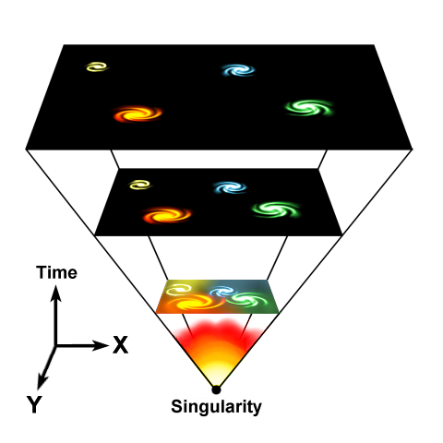
Cosmic Expansion Factor
Cosmic Expansion is a
uniform expansion of
space

Slide 16
Friedmann-Robertson-Walker-Lemaitre Universe

Slide 17
Friedmann-Robertson-Walker-Lemaitre Universe
pressure
cosmological
constant
density
curvature term

Slide 18
Friedmann-Robertson-Walker-Lemaitre Universe
Because of General Relativity, the evolution of the Universe is
fully determined by four factors:
• density
• pressure
• curvature
: present curvature radius
• cosmological constant
• Density & Pressure: - in relativity, energy & momentum need to be
seen as one physical quantity (four-vector)
- pressure = momentum flux
• Curvature: - gravity is a manifestation of geometry spacetime
• Cosmological Constant: - free parameter in General Relativity
- Einstein’s “biggest blunder”
- mysteriously, since 1998 we know it dominates
the Universe

Slide 19
Friedmann-Robertson-Walker-Lemaitre Universe
Relativistic Cosmology
Newtonian Cosmology
Curvature
Cosmological Constant
Pressure
Energy

Slide 20
Hubble Parameter

Slide 21
Hubble Expansion
• Cosmic Expansion is a uniform expansion of space
• Objects do not move themselves:
they are like beacons tied to a uniformly expanding sheet:

Slide 22
Hubble Expansion
• Cosmic Expansion is a uniform expansion of space
• Objects do not move themselves:
they are like beacons tied to a uniformly expanding sheet:
Comoving Position
Hubble Parameter:
Hubble “constant”:
H₀H(t=t₀)
Comoving Position

Slide 23
Hubble Parameter
For a long time, the correct value of the Hubble constant H₀
was a major unsettled issue:
H₀ = 50 km s⁻¹ Mpc⁻¹ H₀ = 100 km s⁻¹ Mpc⁻¹
This meant distances and timescales in the Universe had to
deal with uncertainties of a factor 2 !!!
Following major programs, such as Hubble Key Project, the
Supernova key projects and the WMAP CMB measurements,

Slide 24
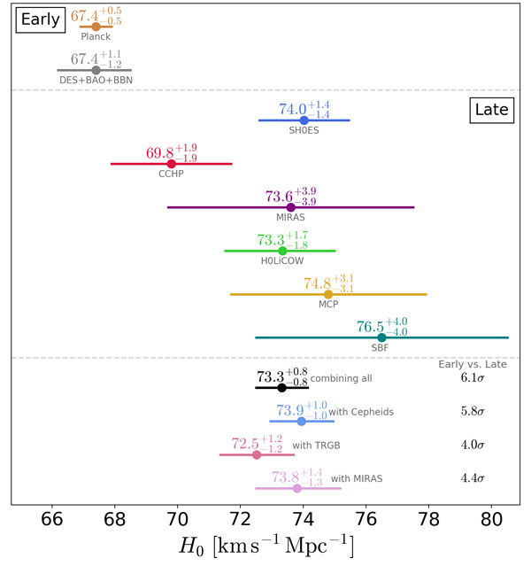
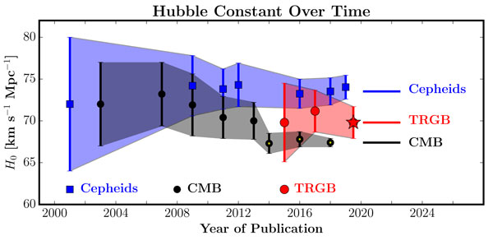
Hubble Constant: Tension
As more accurate measurements of H₀ become available,
gradual rising tension
CMB determination much lower than
“local values”
Latest value:
strong grav. lensing
H0 = 82.4 +/- 8.3 km/s/Mpc

Slide 25
Hubble Time

Slide 26
Cosmological Constant
&
FRW equations

Slide 27
Friedmann-Robertson-Walker-Lemaitre Universe

Slide 28
Dark Energy & Energy Density

Slide 29
Friedmann-Robertson-Walker-Lemaitre Universe

Slide 30
Cosmic Constituents

Slide 31
Cosmic Constituents
The total energy content of Universe made up by various constituents, principal ones:
matter
Ω_{b}
baryonic matter
Ω_{m}
Ω_{DM}
dark matter
radiation
Ω_{γ}
photons
Ω_{tot}
Ω_{rad}
Ω_{ν}
neutrino’s
Ω_{v}
dark/ vacuum energy
In addition, contributions by - gravitational waves
- magnetic fields,
- cosmic rays …
Poor constraints on their contribution: henceforth we will not take them into account !

Slide 32
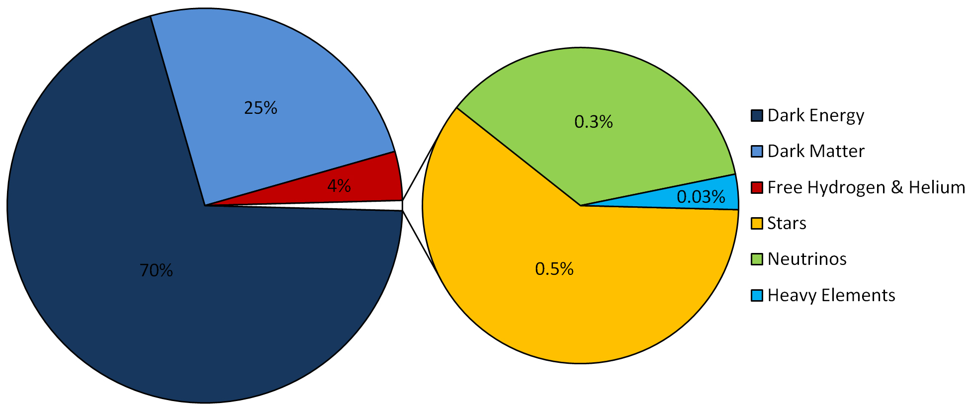
LCDM Cosmology
Concordance cosmology
- model that fits the majority of cosmological observations
- universe dominated by Dark Matter and Dark Energy
LCDM composition today …

Slide 33
Cosmic Energy Inventory
Fukugita & Peebles 2004

Slide 34
Critical Density & Omega

Slide 35
FRW Dynamics
Critical Density:
- For a Universe with Ω=0
- Given a particular expansion rate H(t)
Density corresponding to a
flat Universe (k=0)

Slide 36
FRW Dynamics
In a FRW Universe,
densities are in the order of the critical density,

Slide 37
FRW Dynamics
In a matter-dominated Universe,
the evolution and fate of the Universe entirely determined
by the (energy) density in units of critical density:
Arguably,  is the most important parameter of cosmology !!!
Present-day
Cosmic Density:

Slide 38
FRWL Dynamics
&
Cosmological Density

Slide 39
FRW Dynamics
•The individual contributions to the energy density of
the Universe can be figured into the  parameter:
- radiation
- matter
- dark energy/
cosmological constant

Slide 40
Critical Density
There is a 1-1 relation between the total energy content
of the Universe and its curvature. From FRW equations:

Slide 41
FRW Universe: Curvature
There is a 1-1 relation between the total energy content
of the Universe and its curvature. From FRW equations:

Slide 42
Radiation, Matter & Dark Energy
The individual contributions to the energy density of
the Universe can be figured into the  parameter:
- radiation
- matter
- dark energy/
cosmological constant

Slide 43
Cosmic Constituents:
Evolving Energy Density

Slide 44
FRW Energy Equation
To infer the evolving energy density (t) of each cosmic component, we refer to
the cosmic energy equation. This equation can be directly inferred from the FRW equations
The equation forms a direct expression of the adiabatic expansion of the Universe,
ie.
Internal energy
Expanding volume

Slide 45
FRW Energy Equation
To infer (t) from the energy equation, we need to know the pressure p(t) for
that particular medium/ingredient of the Universe.
To infer p(t), we need to know the nature of the medium, which provides
us with the equation of state,

Slide 46
Cosmic Constituents: Evolution of Energy Density
Matter:
• Radiation:
• Dark Energy:

Slide 47
Dark Energy:
Equation of State

Slide 48
Einstein Field Equation
curvature side
energy-momentum side

Slide 49
Equation of State
restframe
restframe:

Slide 50
Equation of State

Slide 51
Dynamics
Relativistic Poisson Equation:
Repulsion !!!

Slide 52
Dark Energy & Cosmic Acceleration
Nature Dark Energy:
(Parameterized) Equation of State
Cosmic Acceleration:
Gravitational Repulsion:

Slide 53
Dark Energy & Cosmic Acceleration
DE equation of State
Cosmological Constant:
-1/3 > w > -1:
decreases with time
Phantom Energy:
increases with time

Slide 54
Dynamic Dark Energy
DE equation of State
Dynamically evolving dark energy,
parameterization:

Slide 55
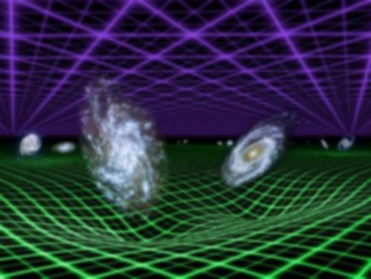
General Flat FRW Universe
FRW:

Slide 56
Acceleration Parameter

Slide 57
FRW Dynamics: Cosmic Acceleration
Cosmic acceleration quantified
by means of dimensionless deceleration parameter q(t):
Examples:

Slide 58
Dynamical Evolution
FRWL Universe

Slide 59
General Solution Expanding FRW Universe
From the FRW equations:
Expansion history Universe

Slide 60
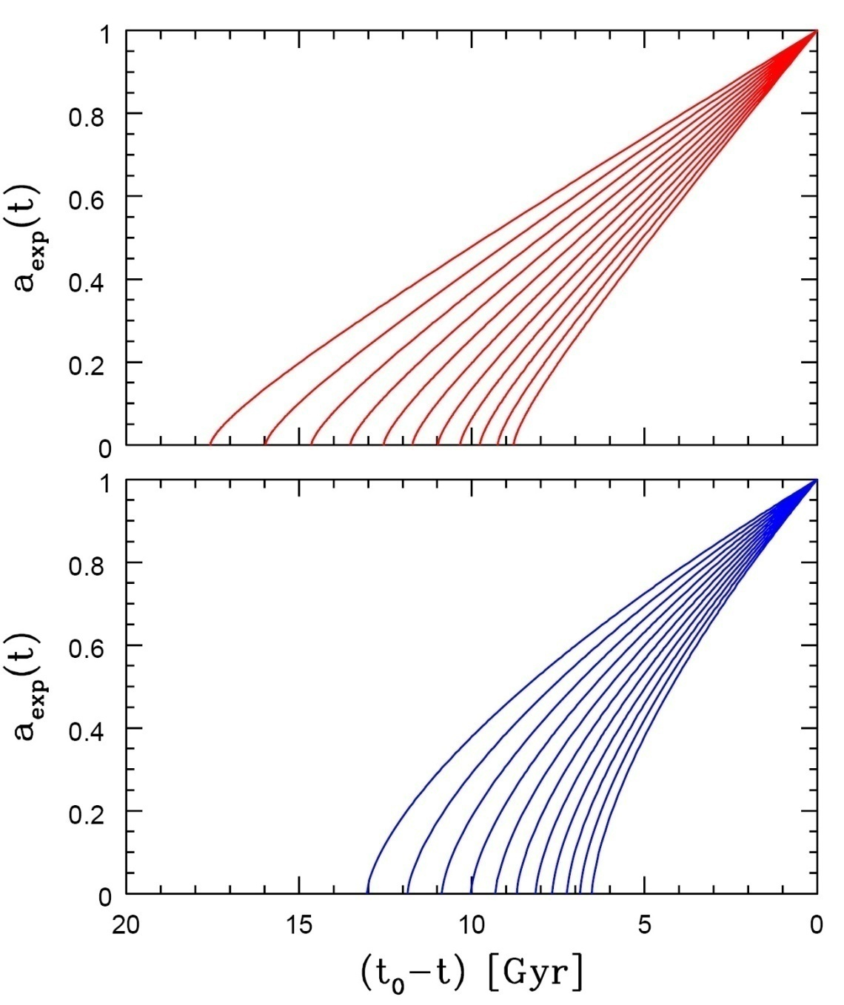
Age of the Universe
Age of a FRW universe at
Expansion factor a(t)
Matter-dominated
Hubble time
Matter-dominated

Slide 61
Specific Solutions FRW Universe
While general solutions to the FRW equations is only possible
by numerical integration, analytical solutions may be found for particular classes of cosmologies:
• Single-component Universes:
- empty Universe
- flat Universes, with only radiation, matter or
dark energy
• Matter-dominated Universes
• Matter+Dark Energy flat Universe

Slide 62
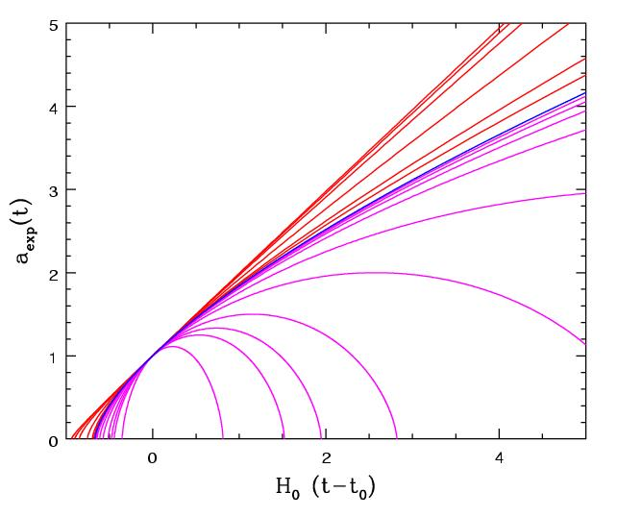
Matter-Dominated Universes
Assume radiation contribution is negligible:
Zero cosmological constant:
Matter-dominated, including curvature

Slide 63
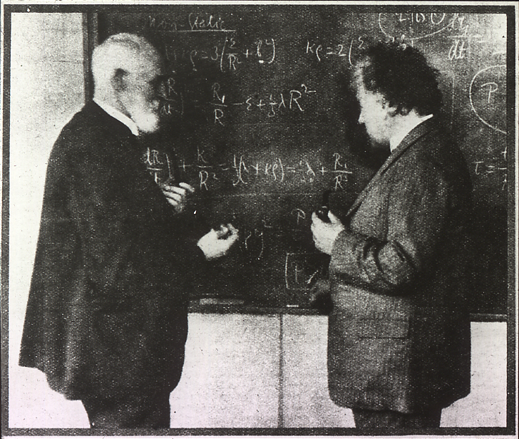
Einstein-de Sitter Universe
FRW:
Albert Einstein and Willem de Sitter discussing the Universe. In 1932 they published a paper together on the Einstein-de Sitter universe, which is a model with flat geometry containing matter as the only significant substance.
Age
EdS Universe:

Slide 64
Free Expanding "Milne" Universe
Empty space is curved
FRW:
Age
Empty Universe:

Slide 65
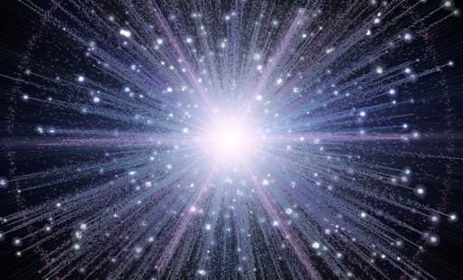
Expansion Radiation-dominated Universe
In the very early Universe, the energy density is completely dominated by radiation. The dynamics of the very early Universe is therefore fully determined by the evolution of the radiation energy density:
FRW:
Age
Radiation
Universe:

Slide 66
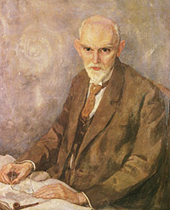
De Sitter Expansion
FRW:
Willem de Sitter (1872-1934; Sneek-Leiden)
director Leiden Observatory
alma mater: Groningen University
Age
De Sitter Universe: infinitely old

