Slide 1
Cosmology,
lect. 1
In search of our Origins

Slide 3
Cosmic Origins
Universe 380.000 yrs after Big Bang
13.8 Gyrs ago (13.798±0.037 Gyrs)
Temperature T = 2.72548±0.00057 K
temperature/density fluctuations (ΔT/T<10⁻⁵)
Planck Baby Photo
of our Universe

Slide 4
Age of Precision Cosmology
Over the past century - in particular the last 2 decades - we have established an
amazingly accurate view of the Universe in which we live:
It was formed in the Hot Big Bang: T₀ = 13.798 ± 0.037 Gigayears ago
Space (!!!) is expanding ever since: H₀ = 67.74 ± 0.46 km/s/Mpc
expansion acceleraring since: 6.7 ± 0.4 Gigayears ago
It has an average energy density of: Ω₀ = 0.862 x 10⁻²⁹ g/cm³
The outer edge/Horizon of the visible Universe: d_{H} ~ 41 Giga lightyears
within Horizon: # galaxies ~ 100 x 10⁹
# stars ~ 200 x 10¹⁸
On every atom (proton/neutron): n_{γ}/n_{b} ~1.9 x 10⁹
Space is almost perfectly flat: Ω_{k} ~ 0.000 ± 0.005
Cosmic composition: Baryons (protons/neutrons) ~ 4.9%
Dark Matter ~ 26.8%
Dark Energy ~ 68.3%

Slide 5
Cosmology,
Science of the Universe

Slide 6
Cosmology:
Science of the Universe
Van Dale
(astronomical) science or theory of
the universe as an ordered unity;
study of the structure and evolution of the universe.
Broadest Sense:
human enterprise joining science, philosophy,
theology and the arts to seek to gain understanding
of what unifies and is fundamental to our world.
Scientific:
Study of large and small structures of the Universe

Slide 7
Essential & Existential Questions
Occupying Humanity
since Dawn of Civilization
Where does the World come from ?
What is the World made of ?
How did the World begin ?
When did the World begin ?
Did it begin at all ?
How “big” is the World ? (finite, infinite …)
What is the role of humans in the cosmos ?
What is the fate of the Universe ?

Slide 8
Cosmic Time:
Origin and Fate ?
Does the Universe have an origin ?
If so, how old is it ?
Or, … did it always exist, infinitely old …
What is the fate of the Universe ?
… will it always be there, or is there an end ?

Slide 9
Energy:
Content of the Universe
What are the components of the Universe ?
How does each influence the evolution of
the Universe ?
… and …
How is each influenced by the evolution of
the Universe ?

Slide 10
Cosmological Riddles
Is our Universe unique, or are there many
other Universes (multiverse) … ?
What made the Universe originate ?

Slide 11
Cosmological Riddles
Why are the physical laws as they are ?
Do they need to be ?
How many dimensions does the Universe have?
More than 1timelike + 3 spacelike ?

Slide 12
Cosmological Riddles
… and …
Are our brains sufficiently equipped to
understand and answer
the ultimate questions … ?

Slide 13
the Universe:
a Unique Object
There is only one (visible) Universe …

Slide 14
A unique time …
The past century, since 1915,
marks a special epoch
For the first time in human history,
we are able to address the
great questions of Cosmology …
scientifically …

Slide 15
Observing the Universe
&
Cosmic Horizons

Slide 16
Cosmology: exploring Space & Time
Cosmology is a unique science:
not only it looks out to the deepest realms and
largest scales of our Universe
on cosmological scales,
the finite velocity of light becomes a critical factor …
thus, it also looks back in time, to the earliest moments,
and thus is the ultimate archaeological science

Slide 17
the Universe:
a Unique Astrophysical Object
Finite velocity of light, c:
… a look in depth = a look back in time …
c & implications for space-time:
observational cosmology limited to only
a minor thin “shell” of all of spacetime …

Slide 18
Cosmic Depth = Cosmic Time
Light propagation through the Universe:
light has a finite velocity (c=300,000 km/s)
the further you look, the further you look in time !

Slide 19
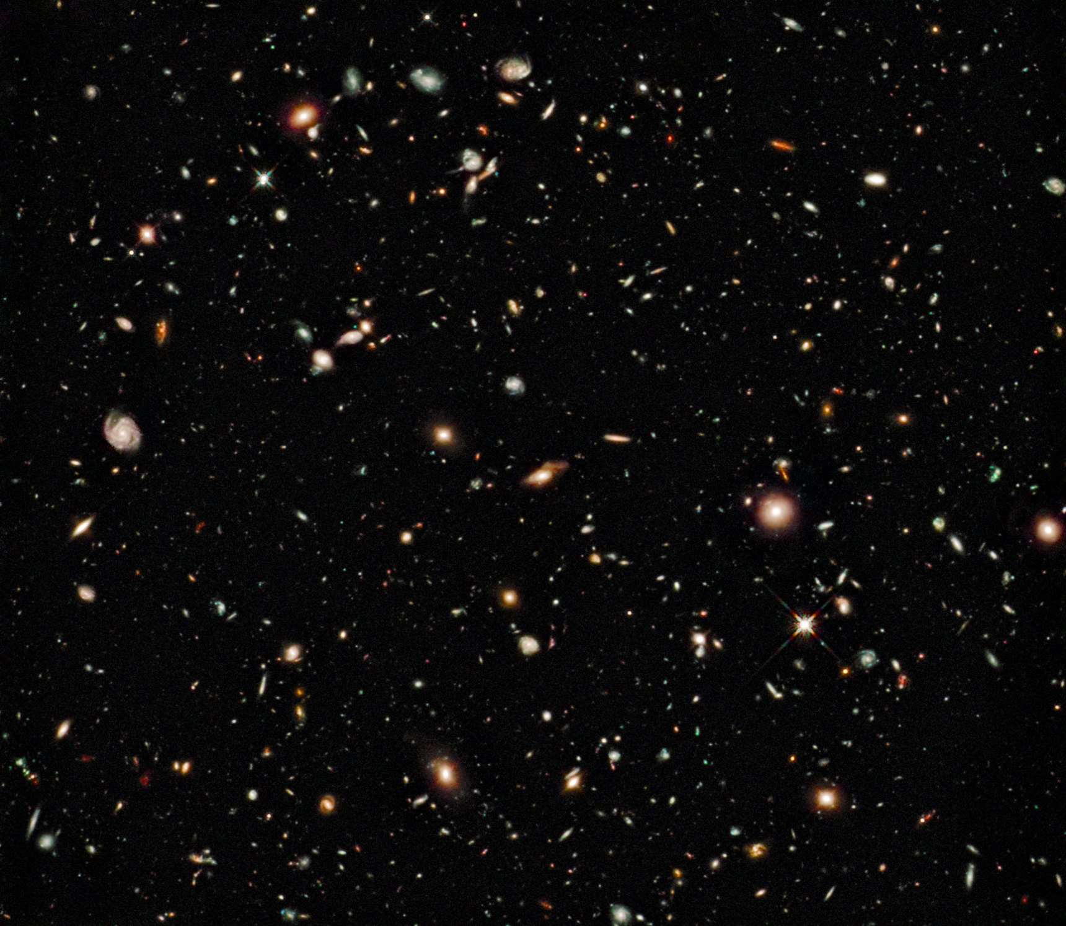

Slide 21
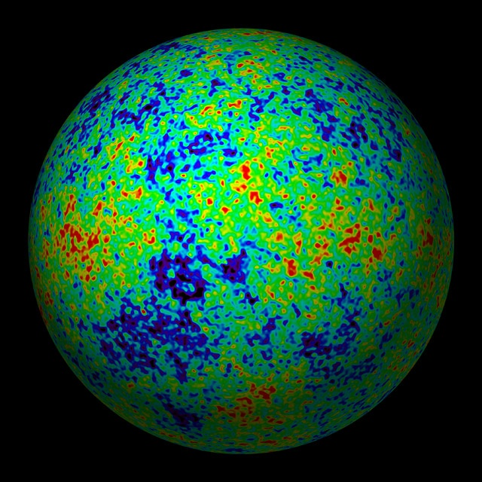
Edge of the Visible Universe
WMAP
CMB
temperature map
Earliest View
of our Cosmos:
the Universe
379,000 years
after the Big Bang
Cosmic Microwave Background

Slide 22
Cosmic Horizons
Horizon distance in physical space
Horizon of the Universe:
distance that light travelled since the Big Bang

Slide 23
Cosmic Horizons
Horizon distance in physical space
In an Einstein-de Sitter Universe
Horizon of the Universe:
distance that light travelled since the Big Bang

Slide 24
the Universe
has a
Beginning

Slide 25
Night Sky is Dark
In an infinitely large, old and unchanging
Universe each line of sight would hit a star:
Sky would be as bright as surface of star:
Night sky as bright as
Solar Surface, yet
the night sky is dark
finite age of Universe (13.8 Gyr)

Slide 28
Cosmic Calendar:
13.8 Gigayears
of
Cosmic History

Slide 29
Big Bang Chronology

Slide 31
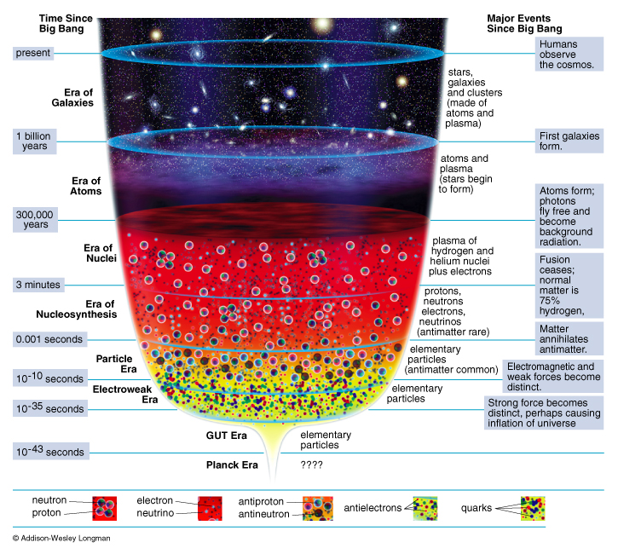
Adiabatic Expansion
reconstruction
Thermal History
of the Universe

Slide 33
Cosmic Composition

Slide 34
Cosmic Constituents
The total energy content of Universe made up by various constituents, principal ones:
matter
_{b}
baryonic matter
_{m}
_{DM}
dark matter
radiation

photons
_{tot}
_{rad}

neutrino’s
_{v}
dark/ vacuum energy
In addition, contributions by - gravitational waves
- magnetic fields,
- cosmic rays …
Poor constraints on their contribution: henceforth we will not take them into account !

Slide 35
Cosmic Light: most abundant species
By far,
the most abundant particle species
in the Universe
to every proton/neutron
n_{γ}/n _{B} ~ 1.9 billion

Slide 36
the Cosmic TV Show
Note:
The cosmic microwave background is not an exotic phenomenon:
1% of the radiation (noise) on your (camping) tv is this CMB radiation:
!!!!! Live broadcast Big Bang !!!!!
Courtesy: W. Hu

Slide 37
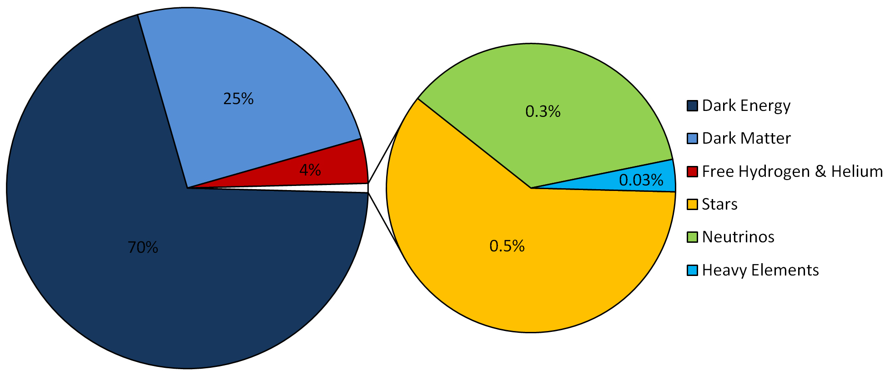
LCDM Cosmology
Concordance cosmology
- model that fits the majority of cosmological observations
- universe dominated by Dark Matter and Dark Energy
LCDM composition today …

Slide 38
Cosmic Energy Inventory
Fukugita & Peebles 2004

Slide 39
Cosmic Forces

Slide 40
Gravity
Ruler of the Universe

Slide 41
Four Fundamental Forces of Nature
Strong Nuclear Force
Responsible for holding particles together inside the nucleus.
The nuclear strong force carrier particle is called the gluon.
The nuclear strong interaction has a range of 10⁻¹⁵ m (diameter of a proton).
Electromagnetic Force
Responsible for electric and magnetic interactions, and determines structure of
atoms and molecules.
The electromagnetic force carrier particle is the photon (quantum of light)
The electromagnetic interaction range is infinite.
Weak Force
Responsible for (beta) radioactivity.
The weak force carrier particles are called weak gauge bosons (Z,W⁺,W⁻).
The nuclear weak interaction has a range of 10⁻¹⁷ m (1% of proton diameter).
Gravity
Responsible for the attraction between masses. Although the gravitational force carrier
The hypothetical (carrier) particle is the graviton.
The gravitational interaction range is infinite.
By far the weakest force of nature.

Slide 42
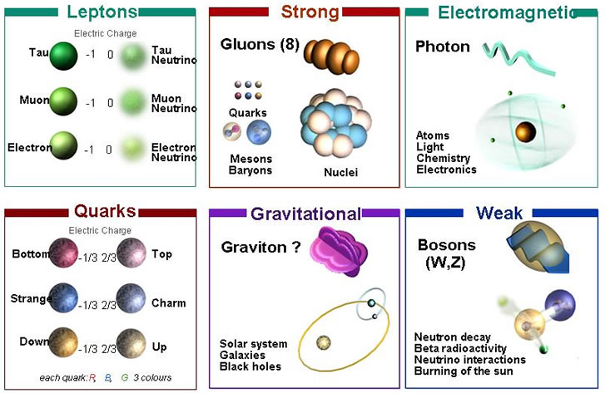
Four Fundamental Forces of Nature

Slide 43
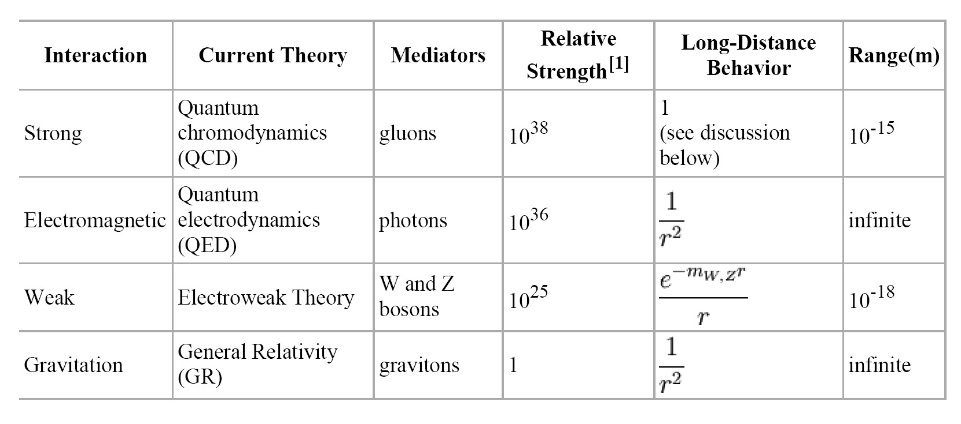
The weakest force, by far, rules the Universe …
Gravity has dominated its evolution, and determines its fate …

Slide 44
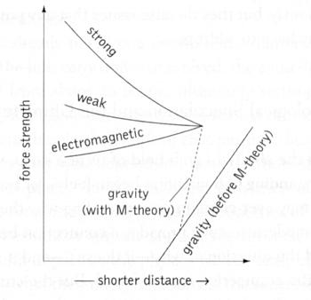
Grand Unified Theories (GUT)
Grand Unified Theories
* describe how
• Strong
• Weak
• Electromagnetic
Forces are manifestations of the same
underlying GUT force …
* This implies the strength of the forces to
diverge from their uniform GUT strength
* Interesting to see whether gravity at some
very early instant unifies
with these forces ???

Slide 45
Newton’s Static Universe

Slide 46
The Unchanging Universe
• In two thousand years of astronomy,
no one ever guessed that the universe might be expanding.
• To ancient Greek astronomers and philosophers,
the universe was seen as the embodiment of perfection,
the heavens were truly heavenly:
– unchanging, permanent, and geometrically perfect.
• In the early 1600s, Isaac Newton developed his law of gravity,
showing that motion in the heavens obeyed the same laws
as motion on Earth.

Slide 47
Newton's Universe
• However, Newton ran into trouble when he tried to apply
his theory of gravity to the entire universe.
• Since gravity is always attractive,
his law predicted that all the matter in the universe should
eventually clump into one big ball.
• Newton knew this was not the case, and assumed that
the universe had to be static
• So he conjectured that:
the Creator placed the stars such that they were
``at immense distances from one another.’’

Slide 48
Renaissance of Western Science
In footsteps of Copernicus, Galilei & Kepler,
Isaac Newton (1687) in his Principia
formulated a comprehensive model of the
world. Cosmologically, it meant
absolute and uniform time
space & time independent of matter
dynamics: - action at distance
- instantaneous
Universe edgeless, centerless & infinite
Cosmological Principle:
Universe looks the same at every
place in space, every moment in time
absolute, static & infinite space

Slide 49
Einstein’s
Dynamic & Geometric Universe

Slide 50
Einstein’s Universe
In 1915,
Albert Einstein completed his General Theory of Relativity.
• General Relativity is a “metric theory’’:
gravity is a manifestation of the geometry, curvature, of space-time.
• Revolutionized our thinking about the nature of space & time:
- no longer Newton’s static and rigid background,
- a dynamic medium, intimately coupled to
the universe’s content of matter and energy.
• All phrased into perhaps
the most beautiful and impressive scientific equation
known to humankind, a triumph of human genius,
Einstein Field Equations

Slide 51
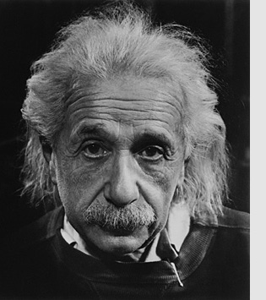
… Spacetime becomes a dynamic continuum,
integral part of the structure of the cosmos …
curved spacetime becomes force of gravity
… its geometry rules the world,
the world rules its geometry…

Slide 52
Albert Einstein
Albert Einstein
(1879-1955; Ulm-Princeton)
father of
General Relativity (1915),
opening the way towards
Physical Cosmology
The supreme task of the physicist is to arrive at those universal elementary laws from which the cosmos can be built up by pure deduction.
(Albert Einstein, 1954)

Slide 53
Dark Energy
&
the Fate of the Universe

Slide 55
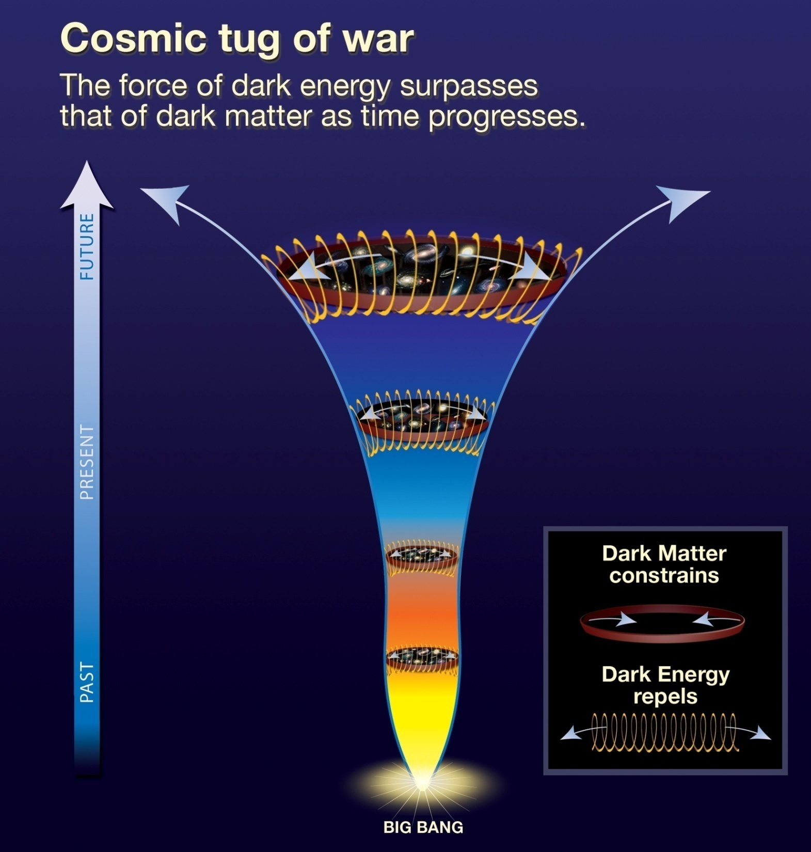
Present:
ACCELERATION
Past:
DECELERATION

Slide 56
Cosmic Acceleration
Hubble Diagram high-z SNIa
• distance vs. redshift z
m-M vs. redshift z
• determine:
- absolute brightness of supernova Ia
- from dimming rate (Phillips relation)
• measure:
- apparent brightness of explosion
• translates into:
- luminosity distance of supernova
- dependent on acceleration parm. q

Slide 57
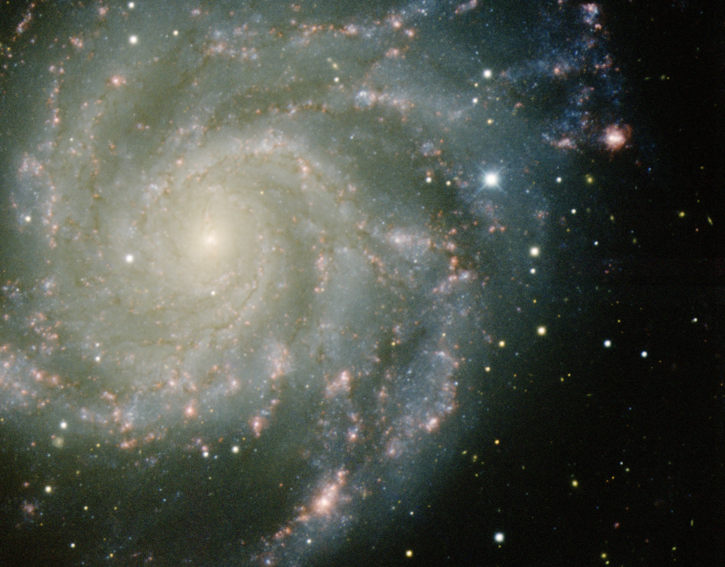
Dark Energy
Nature of Dark Energy

Slide 58
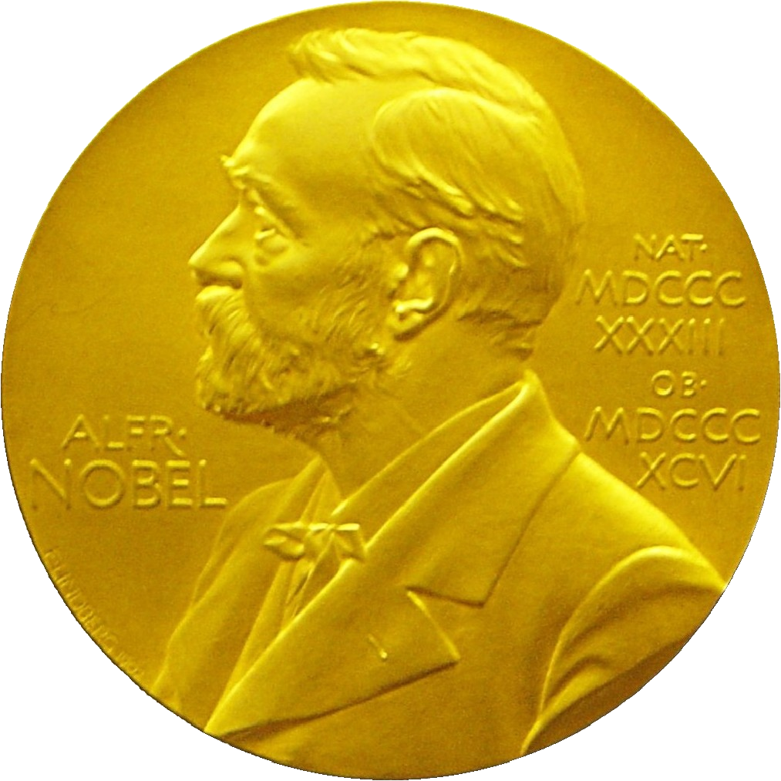
Nobel Prize Physics 2011
“the most startling discovery in physics since
I have been in the field.”
E. Witten
“I was shocked by my discovery, I just
assumed we made a mistake"
Brian Schmidt

Slide 59
Galaxy Clustering

Slide 60
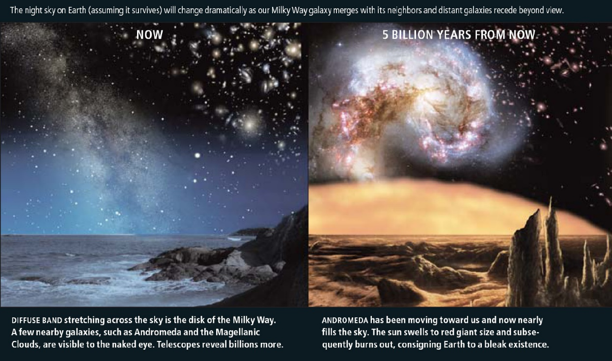
Cosmic Fate
100 Gigayears:
the end of Cosmology

