Slide 1
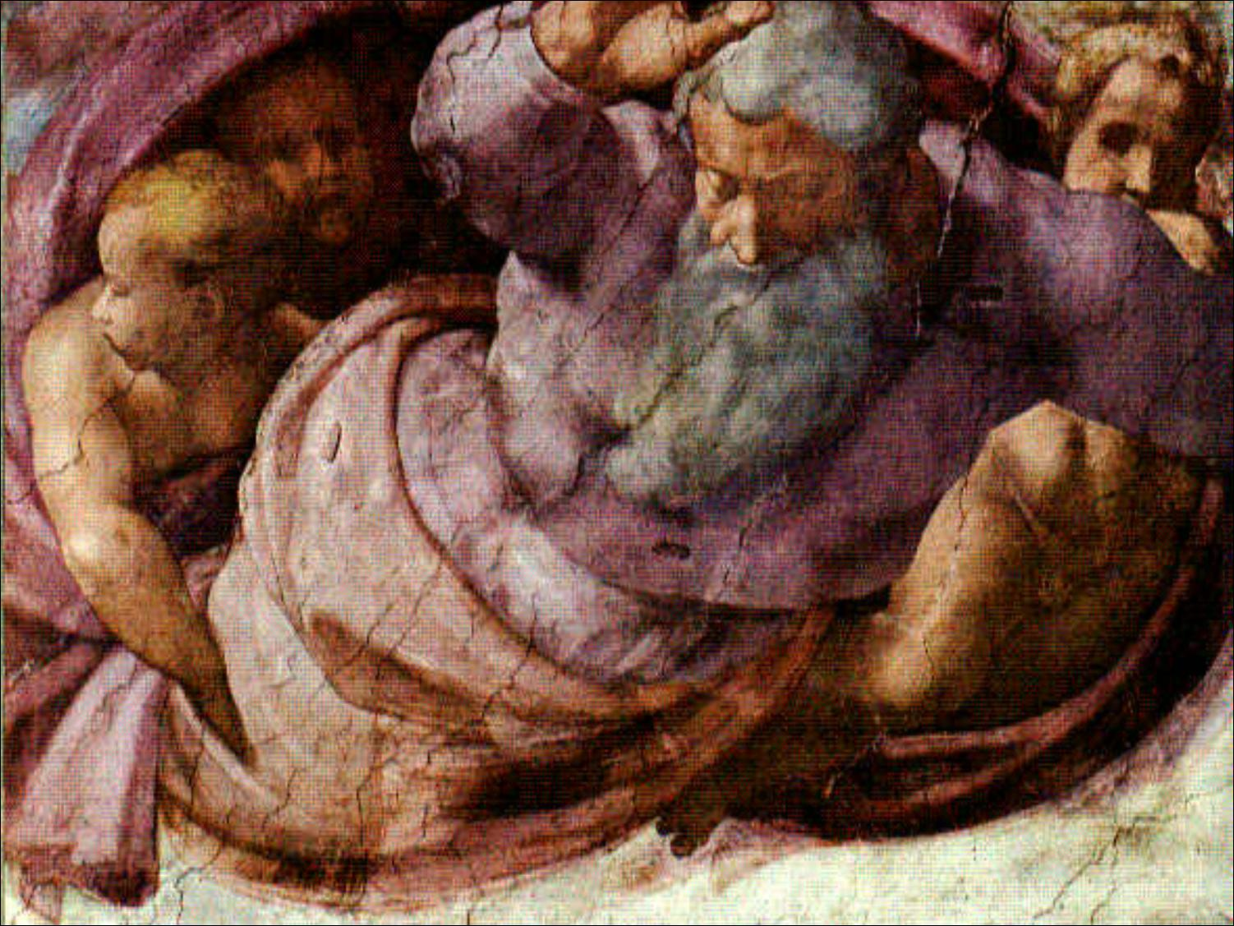
Cosmology,, lect 0
Lecture course University of Groningen September 2019-October 2019

Slide 2
Practical Matters
Lectures: Kapteynborg
tuesday 11:00-13:00 Kapteynborg 5419 - 161
wednesday 15:00-17:00 Kapteynborg 5419 – 161
wednesday 17:00-19:00 Kapteynborg 5419 – 161/257
Lectures: Rien van de Weygaert
rm. 186; tel. 050-3634086;
weygaert@astro.rug.nl
Tutorials: Alex Taun taun@astro.rug.nl ZG 161
Roi Kugel RoiKugul@hotmail.com ZG257
Website: www.astro.rug.nl/~weygaert/cosmo2019.html

Slide 3
Exam
Three Constituents:
1. Exam (written) 75% wed. Oct 31
2. Tutorial Assignments (mandatory) 25%
(incl. computer assignment)

Slide 4
Literature
Introduction to Cosmology
B. Ryden,
Addison-Wesley, 2003 (1st ed.)/Cambridge Univ. Press, 2016 (2nd ed.)
perfect textbook on basic cosmology, joy to read
Lecture Notes Cosmology
R. van de Weygaert
Cosmological Physics
J. Peacock; Cambridge Univ. Press, 1998
very thorough treatment of relevant topics, advanced level
Precision Cosmology
B.J.T. Jones, Cambridge Univ. Press, 2017
perfect advanced level textbook cosmology
Cosmology
S. Weinberg; Oxford Univ. Press, 2008
Impressive book, covering most of relevant cosmological topics, including
structure formation, inflation theory, origin perturbations, CMB

Slide 5
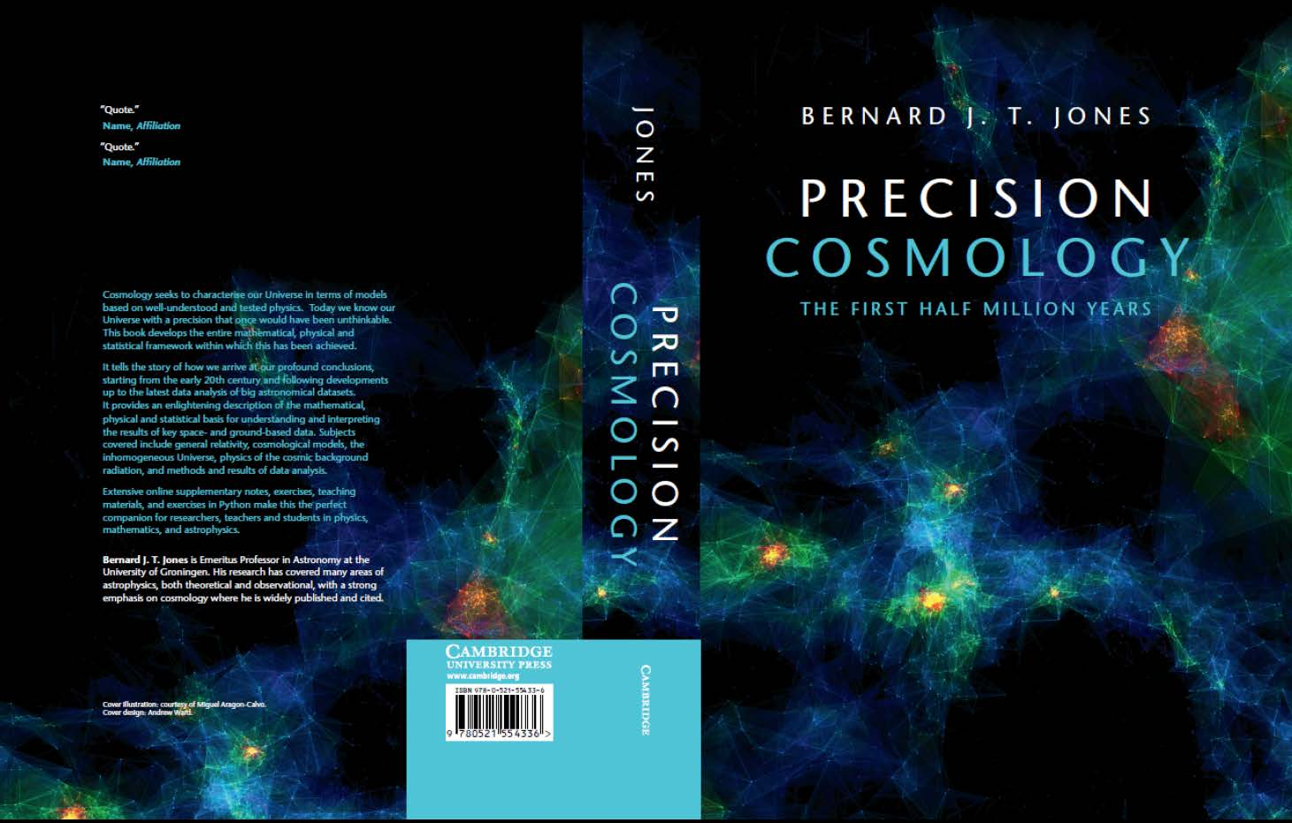
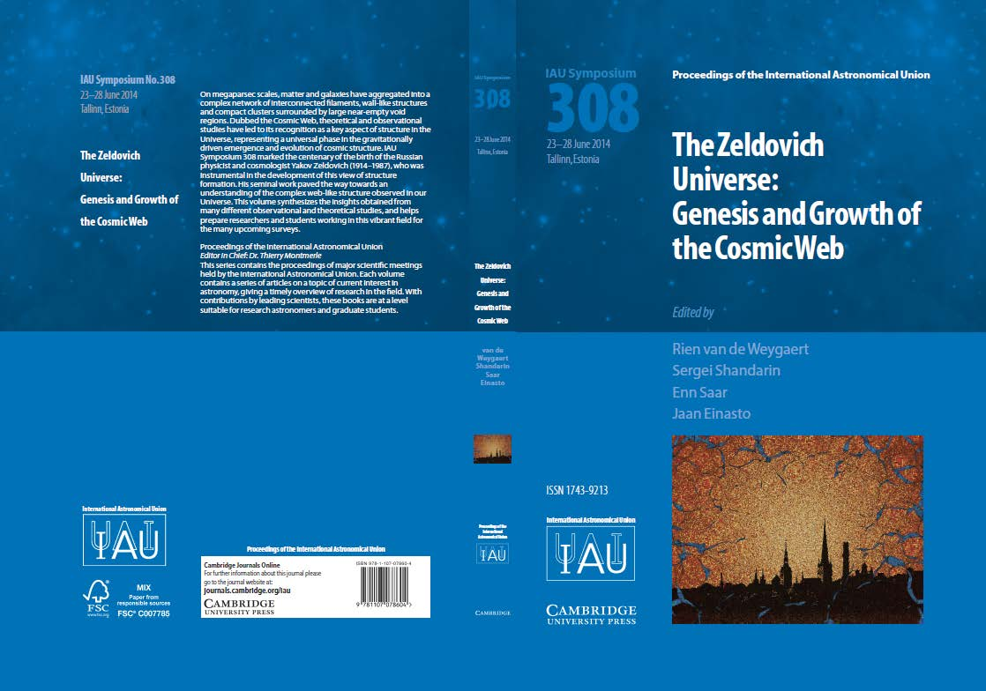
Groningen Books
The Zeldovich Universe:
Genesis and Growth of the Cosmic Web
Proc. IAU Symposium 308
R. van de Weygaert et al., eds.
Cambridge Univ. Press, £80.00
Nov. 30, 2016
Precision Cosmology
the first half million years
B.J.T. Jones
Cambridge Univ. Press, £64.99
Mar. 31, 2017

