Slide 1
Constraining Peaks

Slide 2
Gaussian Peaks

Slide 3
Gaussian Peaks

Slide 4
Gaussian Peaks
Characterization of
Peaks in a
Gaussian Random Field

Slide 5
Gaussian Peaks
Gaussian Peaks

Slide 6
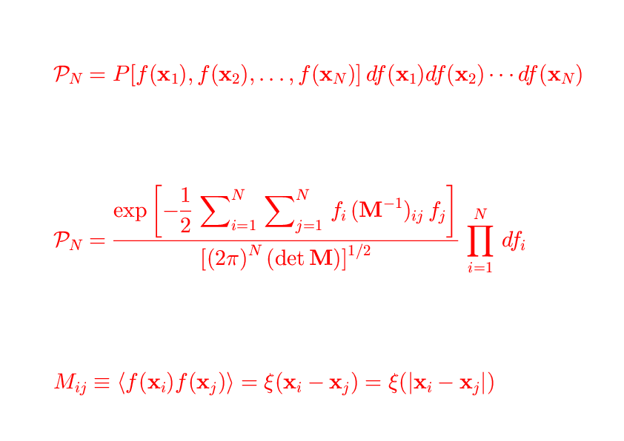
Constrained Random Fields
Gaussian Peaks

Slide 7
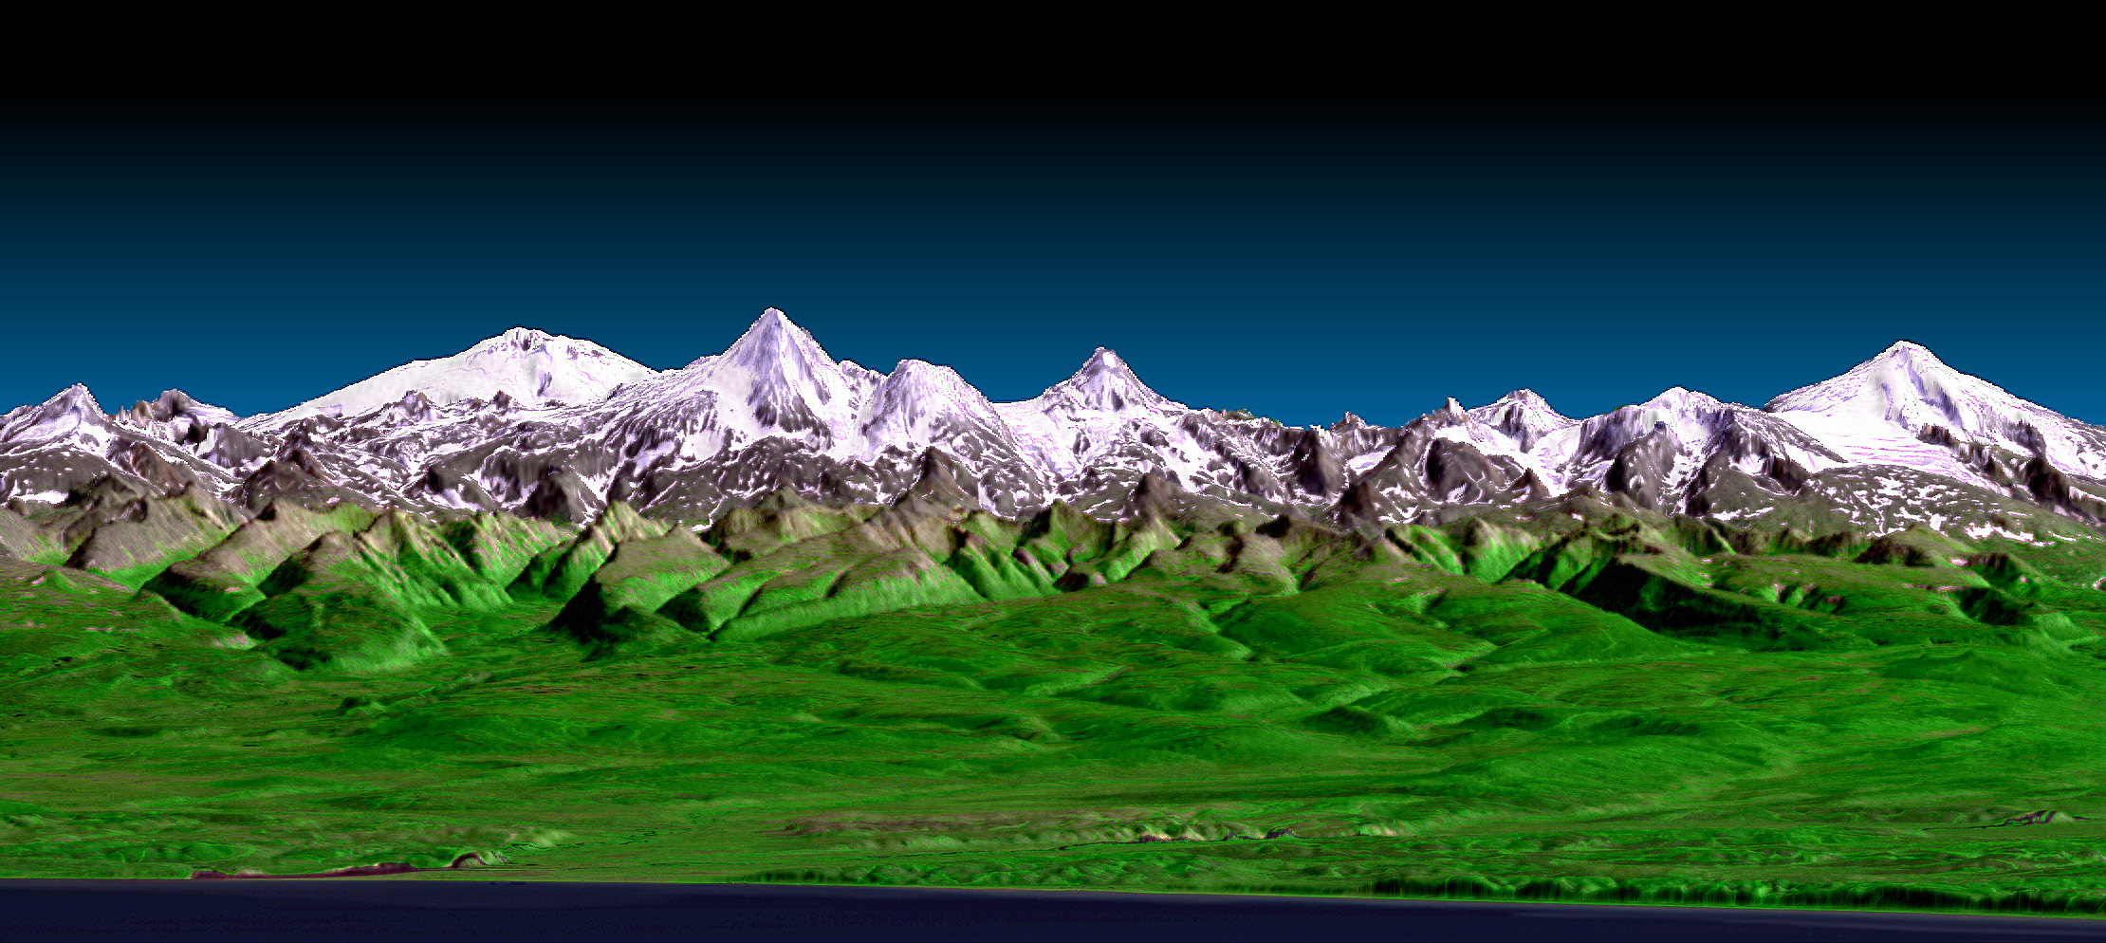
Constrained Random Fields
Gaussian Peaks

Slide 8
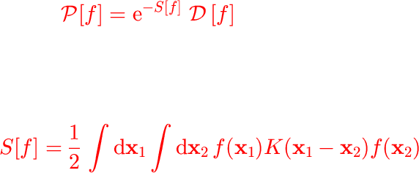
Constrained Random Fields
Gaussian Peaks

Slide 9
Gaussian Peaks
Gaussian Peaks

Slide 10
Constrained Random Fields
Gaussian Peaks

Slide 11
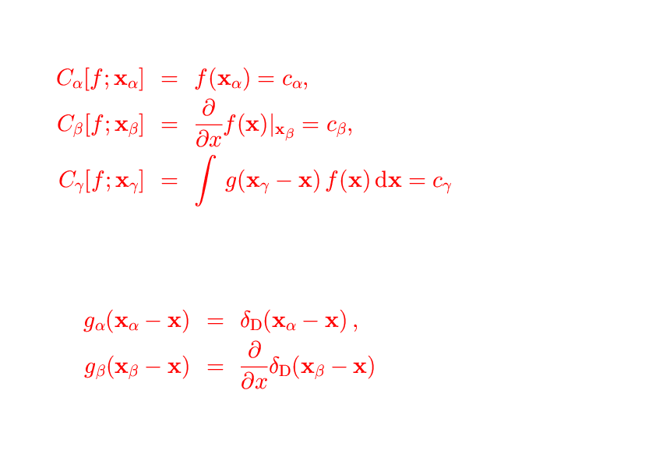
Constrained Random Fields
Gaussian Peaks

Slide 12
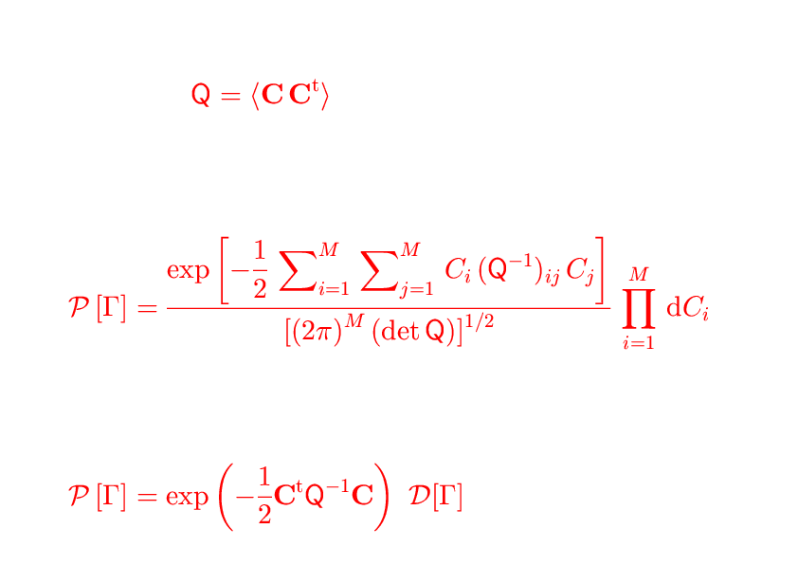
Constrained Random Fields
Gaussian Peaks

Slide 13
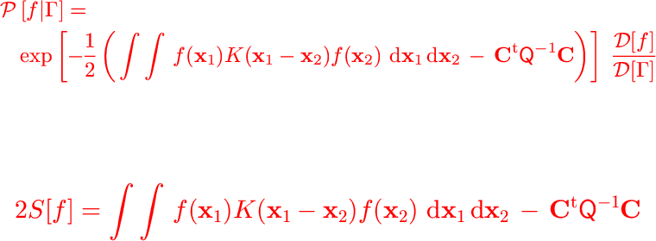
Constrained Random Fields
Gaussian Peaks

Slide 14
Constrained Random Fields
Gaussian Peaks

Slide 15
Constrained Random Fields
Gaussian Peaks

Slide 16
Constrained Random Fields
Gaussian Peaks

Slide 17
Constrained Random Fields
Gaussian Peaks

Slide 18
Constrained Random Fields
Gaussian Peaks

Slide 20
Constrained Random Fields
Gaussian Peaks

Slide 21
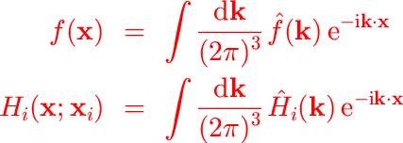
Constrained Random Fields
Gaussian Peaks

Slide 22
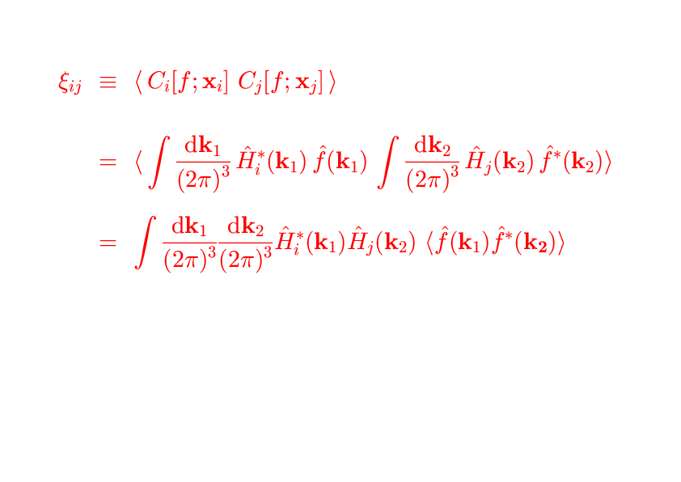
Constrained Random Fields
Gaussian Peaks

Slide 23
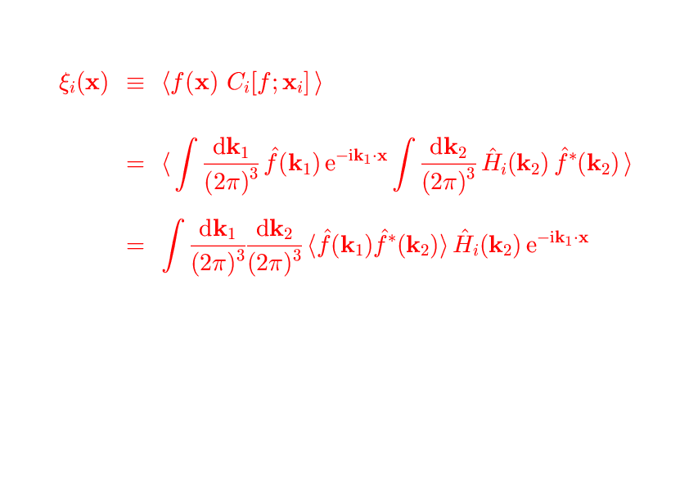
Constrained Random Fields
Gaussian Peaks

Slide 25
Constrained Random Fields
Gaussian Peaks

Slide 31
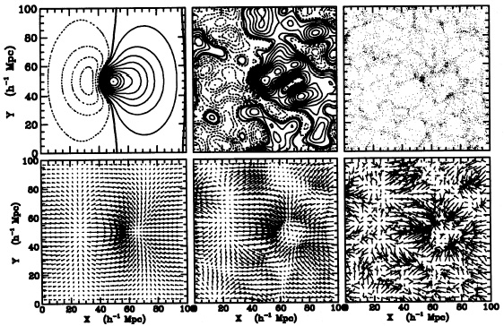

Slide 35
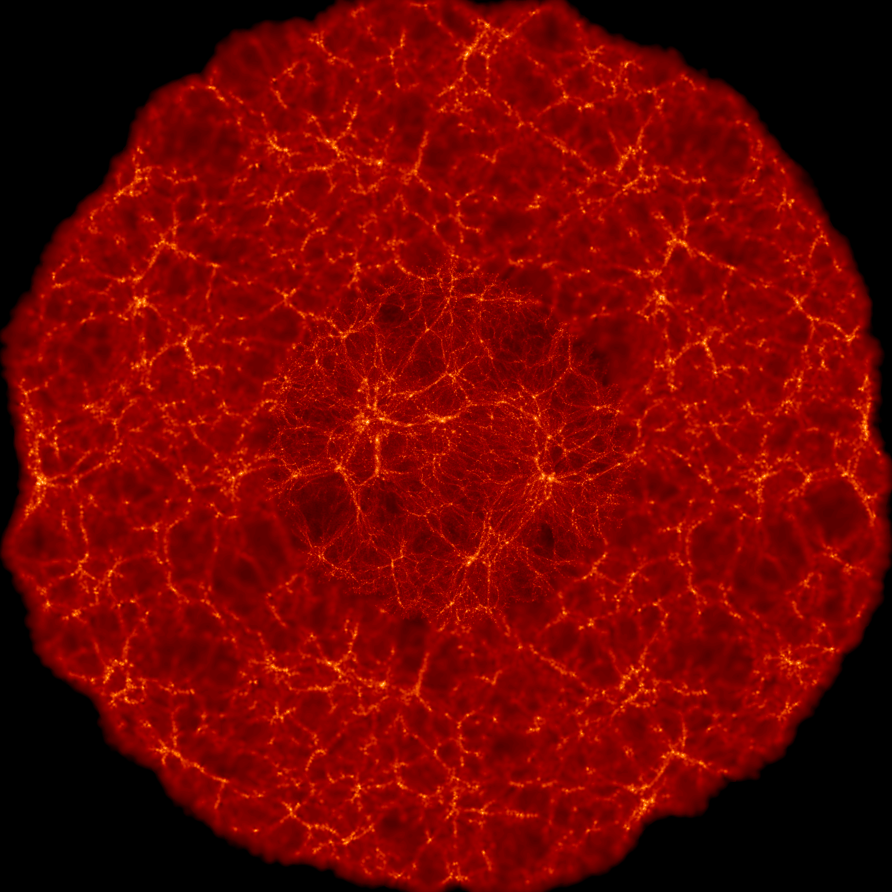
Constrained Random Fields
Gaussian Peaks

Slide 36
Constrained Random Fields
Gaussian Peaks

Slide 37
Constrained Random Fields
Gaussian Peaks

Slide 38
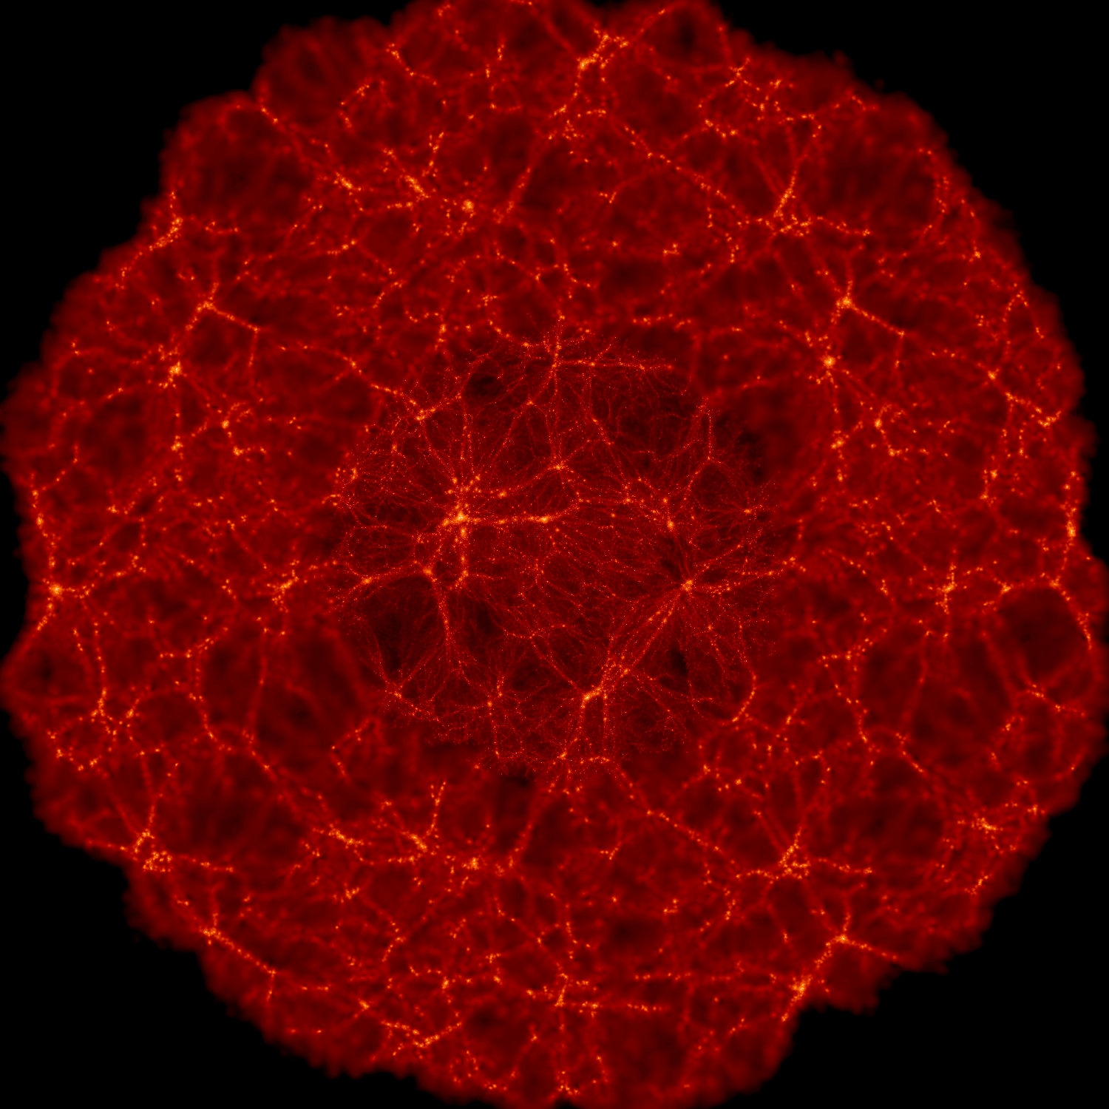
Constrained Random Fields
Gaussian Peaks

Slide 39
Constrained Random Fields
Gaussian Peaks

Slide 40
Constrained Random Fields
Gaussian Peaks

