Slide 1
Timeline
Cosmology
Rien van de Weygaert
with thanks to Bernard J.T. Jones

Slide 2
Timeline Cosmology
2nd Millennium BCEBC
Mesopotamian cosmology has a flat,circular Earth enclosed in a cosmic Ocean
12th century BCEC
Rigveda has some cosmological hymns, most notably the Nasadiya Sukta
6th century BCE
Anaximander, the first (true) cosmologist
- pre-Socratic philosopher from Miletus, Ionia
- Nature ruled by natural laws
- Apeiron (boundless, infinite, indefinite), that out of which the universe originates
6th century BCE
Pythagoras,
- replaced the divine, God, and myths witH principles of higher purity and precision:
numbers and their relations (rather than anthropomorphic creatures)
• strictly ordered Universe, on the basis of mathematics
no room for Gods and their stories

Slide 3
Timeline Cosmology
5th century BCE
Plato
- Timaeus
- dialogue describing the creation of the Universe,
- demiurg created the world on the basis of geometric forms (Platonic solids)
4th century BCE
Aristotle
- proposes an Earth-centered universe in which the Earth is stationary and the cosmos,
is finite in extent but infinite in time

Slide 4
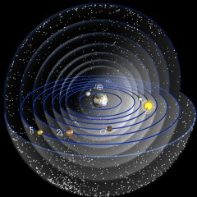
Aristotle’s Universe

Slide 5
Hellenistic Scientific Revolution
3rd century BCE
Aristarchus of Samos (c. 310-230 BCE)
- proposes a heliocentric (sun-centered) Universe, based on his conclusion/determination
that the Sun is much larger than Earth
- Earth rotates around its own axis, while it orbits the Sun
3rd century BCE
Archimedes (c. 287-212 BCE)
- book The Sand Reckoner: diameter of cosmos ~ 2 lightyears
- heliocentric Universe not possible
3rd century BCE
Eratosthenes (c. 276-195/194 BCE)
- first person to calculate/measure the circumference of the Earth: ~ 46100 km, 15% error wrt. real value
3rd century BCE (late) - 2nd century BCE (early)
Apollonius of Perga
- epicycle theory for lunar and planetary motions
2nd century BCE
Seleucus of Seleucia (c.190-150 BCE)
- proponent of heliocentric theory of Aristarchus of Samos
- proposes theory for the origin of tides caused by the Moon
- argues that therefore the annual cycle of tides can only be explained in a heliocentric Universe
- first to assume that the Universe is Infinite (according to Strabo)
2nd century CE
Ptolemaeus
- Almagest/Syntaxis: culmination of ancient Graeco-Roman astronomy
- Earth-centered Universe, with Sun, Moon and planets revolving on epicyclic orbits around Earth

Slide 6
Hellenistic Scientific Revolution
2nd century CE
Ptolemaeus (c. AD 100-170)
Almagest/Syntaxis:
- culmination of ancient Graeco-Roman astronomy
- Earth-centered Universe, with Sun, Moon and planets revolving on epicyclic orbits around Earth

Slide 7
1st century BCE
Lucretius (c. 99 BCE - 55 BCE)
De Rerum Natura - On the Nature of Things
- didactic poem exploring Epicurean physics, exploring the principles of atomism
- the universe described in the poem operates by these physical principles,
and NOT by the divine intervention of the traditional Roman deities.
- its 5th (of 6) book describes the origin of the world and all things therein
5th century CE
Martianus Capella (c. 410-420)
- De nuptiis Philologiae et Mercurii (aka ‘’De septem disciplinis’’), 5th century encyclopedia
- 8th book describes a geocentric universe, with the Sun orbiting Earth, and Venus and Mercury orbiting the Sun,
(much like late 16th century Brahe model)
6th century CE
John Philoponus (c. 490-570)
- proposes a universe that is finite in time, and argues agains the ancient Greek notion of an infinite Universe
- states the heavens and the earth have the same physical properties
- held that God created all matter with its physical properties
with natural laws that would allow matter to progress from a state of chaos to
an organized state forming the present universe
Roman - Byzantine Antiquity

Slide 8
Medieval Hindu & Islamic World
5th-13th century CE
Aryabhata (India) and Al-Sijzi (Iran)
propose that the Earth rotates around its axis.
Nasir al-Din al-Tusi (1201 –1274)
First empirical evidence for Earth’s rotation by Nasir al-Din al-Tusi.
8th century CE
Puranic Hindu cosmology,
the Universe goes through repeated cycles of creation, destruction and rebirth, with
each cycle lasting 4.32 billion years.
8th century CE
Imam Muhammed al-Baqir (676-733)
medieval Islamic scholars endorse idea of pluralistic universe
"Maybe you see that God created only this single world and that God did not create humans besides you.
Well, I swear by God that God created thousands and thousands of worlds and
thousands and thousands of humankind.“
13th century CE
Fakhr ad-Din ar-Razi (1149–1209),
Matalib al-Aliya
criticizes geocentric model and within the universe and explores the notion of the existence of a plural worlds in
the context of his commentary on the Quranic verse, "All praise belongs to God, Lord of the Worlds”. He raises the
question of whether the term "worlds" in this verse refers to
"multiple worlds within this single universe or cosmos, or to many other universes or a multiverse beyond
this known universe."
.

Slide 9
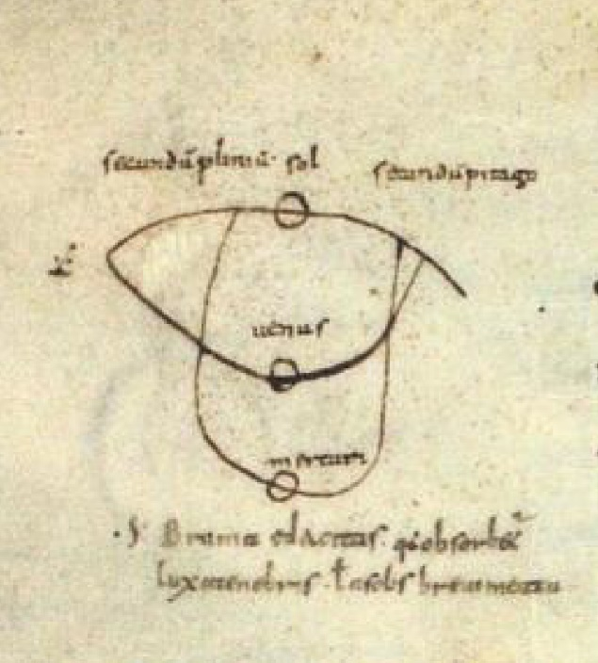
10th century CE, Carolingian times
unknown Irish monk, ~ 950-960 CE
- awareness of alternatives to geocentric universe:
sketch Venus & Mercury orbit around Sun (!!!!),
in copy of Martianus Capella ‘’De septem disciplinis’’
1230
Johannes de Sacrobosco, 1195-1230
Tractatus de Sphaera/De sphaera mundi (1230)
- Earth as a sphere
13th century CE
Robert Grosseteste (1175-1253), Anglo-Norman
De Luce (On Light) (1225)
- first work stating that a single set of physical laws account for different structures of heavens and Earth
- nine-sphere universe, formed in series of “phase” transitions
- an initial explosion (!!!!!) of a primordial sort of light, expands the Universe into an enormous sphere,
thinning matter as it goes. Sounds like Big Bang
European Middle Ages

Slide 10
15th century CE
Nicolas de Cusa, 1401-1464
De Docta Ignorantia (1440)
- first European work stating that other stars would be other worlds:
“Life, as it exists on Earth in the form of men, animals and plants, is to be found,
let us suppose in a high form in the solar and stellar regions. Rather than think that so many stars and parts
of the heavens are uninhabited and that this earth of ours alone is peopled we will suppose that in every region
there are inhabitants, differing in nature by rank and all owing their origin to God …”,
- work explicitly states a “Cosmological Principle”
“The universe has no circumference, for if it had a center and a circumference there would be some
and some thing beyond the world, suppositions which are wholly lacking in truth. Since, therefore, it is
impossible that the universe should be enclosed within a corporeal center and corporeal boundary, it is
not within our power to understand the universe, whose center and circumference are God. ”
1584
Giordano Bruno, 1548-1600
De l'Infinito, Universo e Mondi (1584)
“ ”Innumerable celestial bodies, stars, globes, suns and earths may be sensibly perceived therein by us and
an infinite number of them may be inferred by our own reason.’’

Slide 11
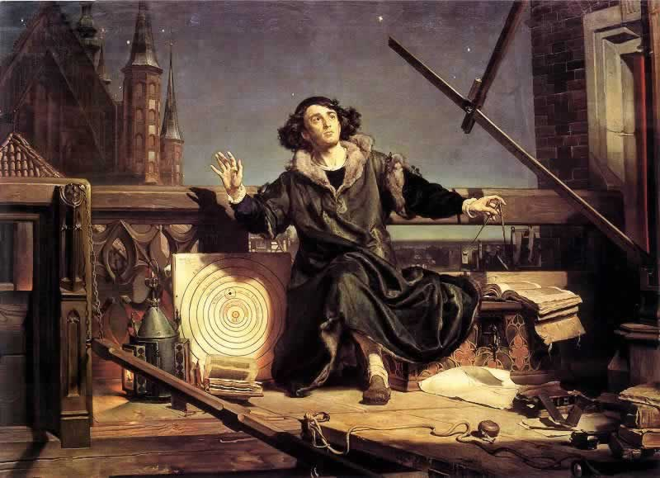
Nikolaus Copernicus
(1473-1543)

Slide 12
The Scientific Revolution
1543
Nicolaus Copernicus
- publishes heliocentric universe in De Revolutionibus Orbium Coelestium
- implicit introduction Copernican principle: Earth/Sun is not special
1576
Thomas Digges (1546-1595)
A Prognostication everlasting (1576)
First expose – in appendix - of Copernican heliocentric model of the Universe in English language.
Digges states – going further than Copernicus - that the Universe is infinite, and contains infinitely many stars.
“Digges’ original contribution to cosmology consisted of dismantling the starry sphere throughout endless space
… Digges pioneered … the idea of an unlimited sphere filled with the mingling rays of countless stars.” (E. Harrison)
1572
Tycho Brahe
Tycho’s supernova
Ultimate evidence and challenge against the Aristotelian view of a serene unchanging Universe.
1609-1632
Galileo Galilei
by means of (telescopic) observations, proves the validity of the heliocentric Universe.
1610 , Siderius Nuncius
first published work on observations made by telescope
1632, Dialogue Concerning the Two Chief World Systems
Debate between Salviati, exposing the Copernican heliocentric Universe and Simplicio, defending the
old traditional Ptolemiac geocentric model.

Slide 13
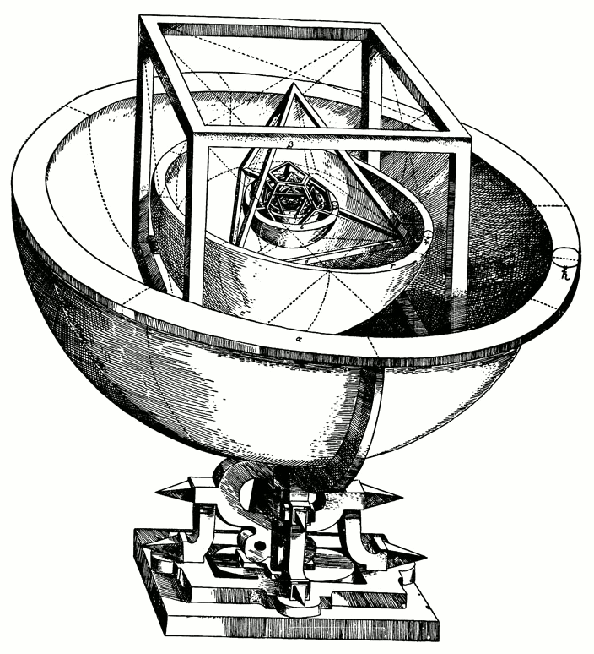
Johannes Kepler
(1571-1630)

Slide 14
The Scientific Revolution:
Mechanization of the Universe
1609/1619
Johannes Kepler
- the 3 Kepler laws, describing the elliptical orbits of the planets around the Sun
1687
Isaac Newton
Philosophiae Naturalis Principia Mathematica
- discovers Gravitational Force as agent behind cosmic motions
- publishes his Principia (Philosophiae Naturalis Principia Mathematica), which establishes
the natural laws of motion and gravity (the latter only to be replaced by Einstein’s theory of GR)

Slide 15
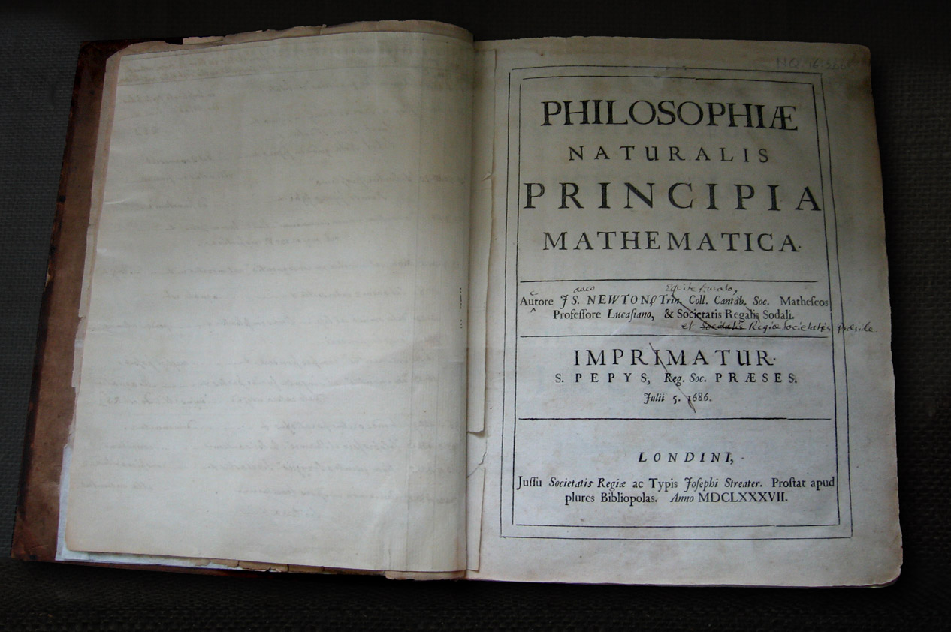
Isaac Newton
(1642-1726)

Slide 16
The Scientific Revolution Completed: Expanding Worldview
1576
Thomas Digges
Following his statement of an infinite universe, filled with an infinite number of stars, Digges is the
first to identiy the “dark night sky paradox”.
1610
Johannes Kepler
Letter to Galilei (1610)
Puzzled by the night’s darkness: in 1610 he wrote in a letter to Galileo that in an infinite universe filled with stars,
“the whole celestial vault would be as luminous as the Sun.” Kepler’s proposed solution to the paradox is that
the universe has to be finite( this fell in line with Kepler’s religious beliefs that the entire universe was “for
man’s sake.”)
1686
Bernard le Bovier de Fontenelle (1657-1757)
Entretiens sur la pluralité des mondes/Conversations on the Plurality of the Worlds (1686)
Book describes new Copernican cosmology, and speculates on the plurality of worlds.
In a series of conversations between a philosopher and a marquise, who walk in the latter's garden at night
and gaze at stars, the philosopher explains the heliocentric model and also muses on the possibility of extraterrestrial life.
1755
Immanuel Kant
- asserts that nebulae are really galaxies separate from and outside from the Milky Way,
- calling these Island Universes
1785
William Herschel
- proposes theory that our Sun is at or near the center of ou Galaxy (Milky Way)

Slide 17
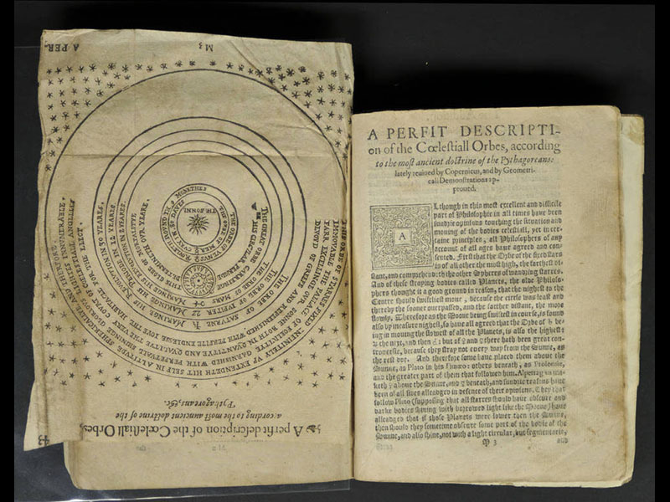
Thomas Digges
(1546-1595)

Slide 18
19th Century
1826
Heinrich Wilhelm Olbers
- Olber’s paradox (why is the night sky dark ?)
1837
Friedrich Bessel, Thomas Henderson, Otto Struve
- measurement parallax of a few nearby stars: the first measurement of any distances
outside the Solar System.
- establishes the vast distances between the stars
1848
Edgar Allan Poe
- first correct solution to Olber’s paradox in Eureka: A Prose Poem,
an essay that also suggests the expansion of the universe
1860
William Huggins
- develops astronomical spectroscopy :
Orion nebula is mostly made of gas, the Andromeda nebula dominated by stars

Slide 19
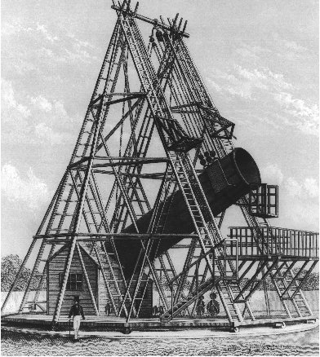
William Herschel’s
telescope

Slide 20
20th Century – Relativistic Cosmology
1905
Albert Einstein
- Special Theory of Relativity
- space and time are not separate continua, instead they define a 4-dim. spacetime continuum
1915
Albert Einstein
- General Theory of Relativity:
Einstein field equations
- represents an entirely new theory of gravity, in which gravity is the result of the local
curvature of space, hence replacing the action-at-a-distance theory of Newton.
- spacetime becomes a flexible dynamic medium, warped by energy density
1917
Willem de Sitter
- first general relativistic cosmology, de Sitter Universe
- empty expanding Universe with cosmological constant
1922
Alexander Friedmann
- Friedmann solution to the Einstein field equations, now known as
Friedmann-Robertson-Walker-Lemaitre equations
- solutions for a perfectly uniform space
- imply expansion of the space
1927
Georges Lemaitre
- solutions for Einstein field equations, for a perfectly uniform space, confirming Friedmann
- discusses the implications, that of an expanding Universe and the creation of the Universe
1933
Edward Milne
- formulation of the Cosmological Principle
- Universe is Isotropic and Homogeneous (on scales larger than 100 million lightyears)
-

Slide 21
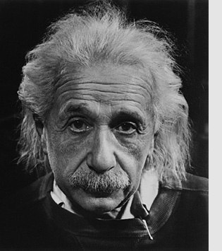
Albert Einstein
(1879-1955)

Slide 22
20th Century – the Universe Expanding
1912
Henrietta Leavitt
- Cepheid variable stars period-luminosity relation
- crucial step in measuring distances to other galaxies
1920-1921
Harlow Shapley & Heber Curtis
- Shapley – Curtis debate or “Great Debate”, National Academy of Science
- debate on the distances to spiral nebulae:
are they individual galaxies like the Milky Way or are they part of the Milky Way
1922
Vesto Slipher
- finds that spiral nebulae are systematically redshifted, ie. moving away from us
1923/1925
Edwin Hubble
- measures distance to few nearby spiral nebulae (Andromeda Galaxy, Triangulum galaxy, NGC 6822)
- distances place them far outside our Milky Way
- demonstrates that the spiral nebulae are galaxies outside our own Galaxy, the Milky Way
- In other words, overnight the Galaxy loses its central unique position and the Universe turns out to be much,
much larger than previously presumed
-

Slide 23
1927
Georges Lemaitre
Annales de la Société Scientifique de Bruxelles, Un
“Univers homogène de masse constante et de rayon croissant rendant compte de la vitesse radiale
des nébuleuses extragalactiques"
("A homogeneous Universe of constant mass and growing radius accounting for the radial velocity of
extragalactic nebulae“)
- predicts distance-redshift relation (later known as Hubble relation, since Oct. 2018 “Hubble-Lemaitre relation”)
- discovered the EXPANSION OF THE UNIVERSE from existing data (formally recognized by IAU in Oct. 2018)
1929
Edwin Hubble
PNAS, "A relation between distance and radial velocity among extra-galactic nebulae”
- discovery linear redshift-distance relation (the Hubble relation, since Oct. 2018 “Hubble-Lemaitre relation”)
- ie. the discovery of the EXPANDING UNIVERSE
20th Century – the Universe Expanding
-

Slide 24
1930s - early Big Bang theory & discovery Dark Matter
1931
Georges Lemaitre
proposes Big Bang theory:
the universe expanded from an initial point, called the "Primeval Atom"
Lemaître himself also described his theory as "the Cosmic Egg exploding at the moment of the creation“
1950
Fred Hoyle
- coins the term Big Bang, meant in a derisive way
1932
Jan Oort
- first indication for the existence of dark matter,
- from measurements of the motions of stars in the Milky Way, implying the mass of the Galactic plane
must be more than the mass of the stars that can be seen
1933
Fritz Zwicky
- discovery of existence of dark matter, from galaxy velocities in Coma cluster of galaxies
1934
Georges Lemaitre
- Cosmological constant (free factor in Einstein field equations):
interpretation in terms of vacuum energy with an unusual perfect equation of state

Slide 25
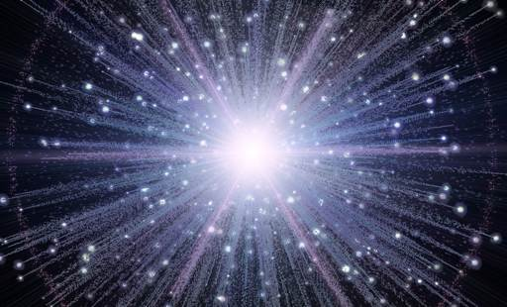
the Hot Big Bang

Slide 26
1940s & 1950s - the Big Bang theory
1946
Evgeni M. Lifschitz
- formulation, in a relativistic context, of gravitational instability in an expanding universe,
the prevailing theory for the formation of structure in the Universe
1946
George Gamow
- Hot Big Bang
- predicts the existence of a cosmic radiation field with a temperature of 50 K (is 2.725K), presuming
all chemical elements were formed in the hot Big Bang.
1948
Ralph Alpher , Hans Bethe, George Gamow
- the -- paper
- describes how the Big bang would by means of nuclear synthesis in the early universe create hydrogen, helium
and heavier elements
1948
Ralph Alpher & Robert Herman
- as a consequence of their studies of nucleosynthesis in the early expanding Big Bang universe,
theoretical prediction of the existence of a residual, homogeneous, isotropic blackbody radiation
- they estimate "the temperature in the universe" at 5 K.
- in 1965 discovered as the Cosmic Microwave Background Radiation
1948
Hermann Bondi, Thomas Gold, Fred Hoyle
- proposal Steady State Cosmology, based on the perfect cosmological principle
1957
Margaret Burbidge, Geoffrey Burbidge, William Fowler & Fred Hoyle
- landmark B²FH paper
- Synthesis of the Elements in Stars
- describes how all elements, heaver than lithium, are synthesize by nuclear processes in the cores of stars
- We are stardust !

Slide 27
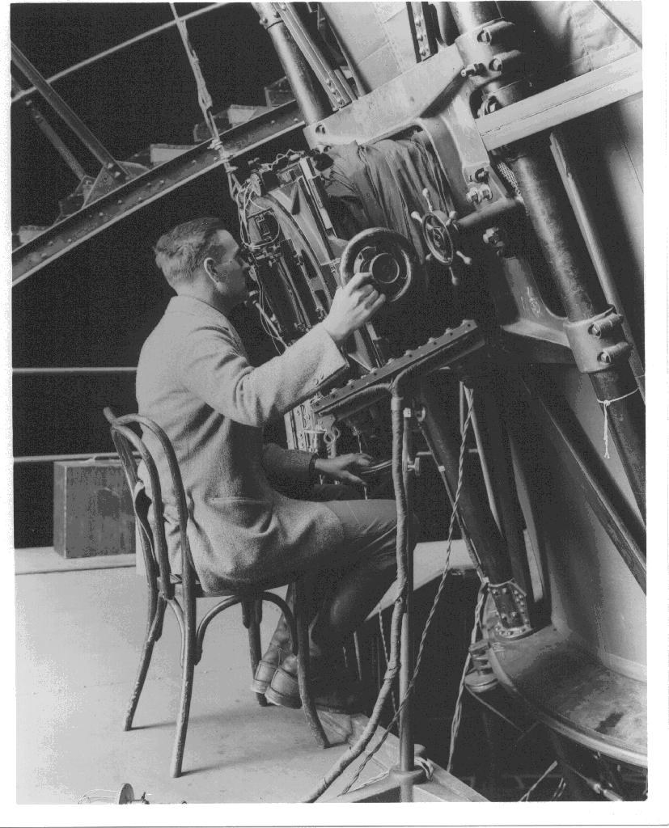
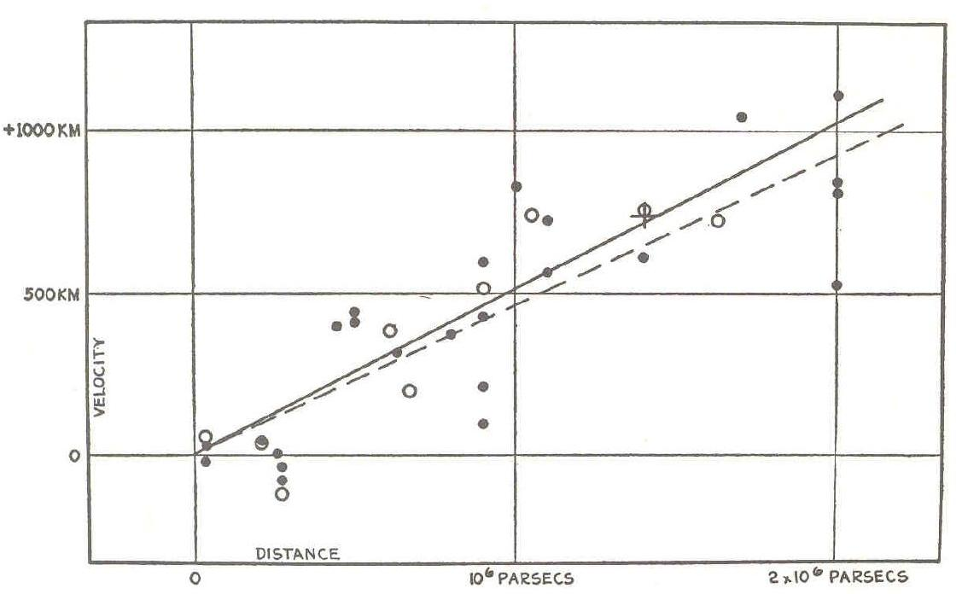
Expanding Universe
Edwin Hubble
(1889-1953)
v = H r
Hubble Expansion

Slide 28
1960s – Big Bang & Physical Cosmology
1963
Maarten Schmidt
- discovery of the first quasar, active nuclei of galaxies visible out to very high redshifts in the Universe
1965
Arno Penzias & Robert Wilson
- Discovery of the 2.7K Microwave Background Radiation (CMB)
- ultimate proof of the Hot Big Bang
- Nobelprize Physics in 1978
1965
Robert Dicke, Jim Peebles, Peter Roll & David Wilkinson
- interpretation of the CMB as the relic radiation from the Big Bang
1966
Jim Peebles
- predicts the correct helium abundance, produced as a result of early Universe Big Bang nucleosynthesis
1966
Stephen Hawking & George Ellis
- Singularity Theorem
- they show that any plausible general relativistic cosmology is singular
1978
Albert Bosma
PhD thesis, Univ. Groningen (1978)
clinching evidence of dark matter through the 21cm flat rotation curves of disk galaxies
1980
Vera Rubin
- Dark Matter confirmed as making up 5-10 times more than ordinary matter, through the
flat rotation curves of spiral galaxies

Slide 29
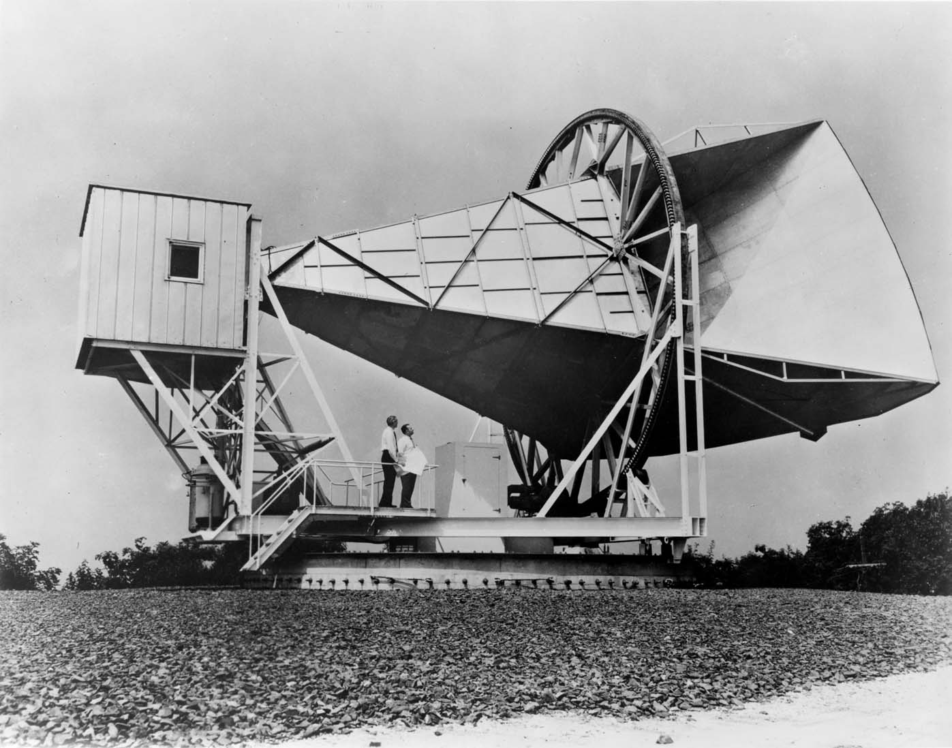
1965: Penzias & Wilson
discovery Cosmic Microwave Background Radiation
Echo of the Big Bang

Slide 30
1980s – Cosmic Structure & the Cosmic Web
1970
Yakov Zeldovich
- Zeldovich formalism
- theory of anisotropic gravitational collapse for the formation of structure in the Universe
1980
Alan Guth, Alexei Starobinsky
- Inflationary Big Bang universe
- possible solution to the socalled horizon and flatness problems of standard Big Bang models
- has become a key element of the standard Big Bang model
1982-1984
Jim Peebles, Dick Bond, George Blumenthal
- universe dominated by Cold Dark Matter
1983-1987
Klypin & Shandarin 1983
Davis, Efstathiou, Frenk & White 1985-1987
- the first large computer simulations of cosmic structure formation
- DEFW show that cold dark matter based simulations produce a reasonable match to observations
1986
de Lapparent, Geller & Huchra
discovery of the Cosmic Web by the CfA2 survey “Slice of the Universe”
- final confirmation of earlier suggestions/indictions of a weblike/cellular structure in the Universe
- by Einasto et al. (1980) while
- later the reality of the Cosmic Web got confirmed in an unambiguous fashion
by the maps of the 2dFGRS redshift survey (1997-2002)
1990
George Efstathiou, Steve Maddox & Will Sutherland
- APM survey: computer processed measurement of the galaxy distribution on the southern sky
- first direct detection and claim of the impact of a Cosmological Constant

Slide 31
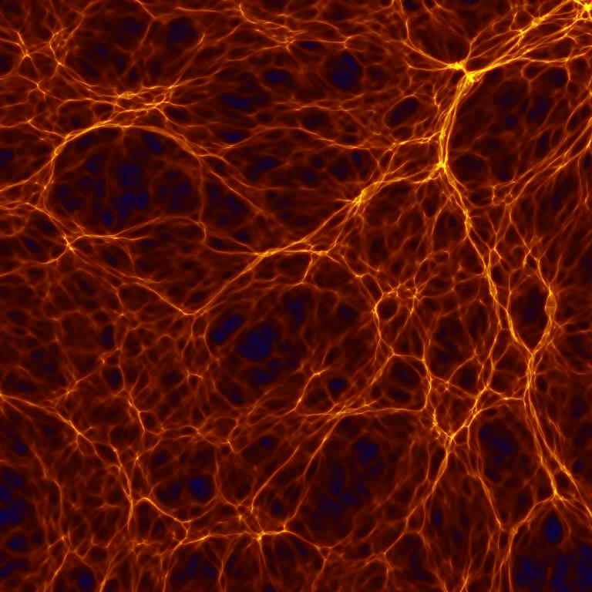
Yakov Zeldovich
(1914-1987):
Cosmic Web

Slide 32
1990
COBE CMB satellite, John Mather
- precise measurement of the blackbody spectrum of the Cosmic Microwave Background
- confirmation of blackbody nature of CMB, to a precision of 1 in 10⁵, the strongest and ultimate evidence for
the reality of the Hot Big Bang
- T=2.725 K
- Nobelprize physics 2006
1990
COBE CMB satellite, George Smoot
- discovery of tiny anisotropies in the CMB,
- the seeds of structure formation in the Universe
- confirmation of the gravitational instability theory for structure formation in the Universe
- provides the baby picture of structure of the Universe “only” 379,000 years after the Big Bang
- Nobelprize physics 2006
1997-2002
2dFGRS galaxy redshift survey
- first large scale systematic survey of the spatial galaxy distribution
- conducted with the 3.9m Anglo-Australian Telescope
- mapped the positions of 232,155 galaxies in 2 narrow slices out to a redshift of 0.2
- structure mapped is that of a Cosmic Web
1998
Supernova Cosmology Project, High-Z Supernova Search Team,
lead by Saul Perlmutter, Adam Riess & Brian Schmidt
- discovery of the acceleration of cosmic expansion
- provides first direct evidence for the existence of a non-zero cosmological constant
- Nobelprize Physics 2012: Perlmutter, Schmidt, Riess
2000-
Sloan Digital Sky Survey (SDSS)
Maj-- multi-filter imaging and spectroscopic redshift survey using a dedicated 2.5-m
wide-angle optical telescope at Apache Point Observatory in New Mexico
- systematic mapping of the spatial galaxy distribution in major regions of the nearby Universe
- as yet around 2,000,000 galaxies
- clustering consistent with the cold dark matter theory of cosmic structure formation,
including Cosmological Constant, the socalled ☹CDM cosmology

Slide 33
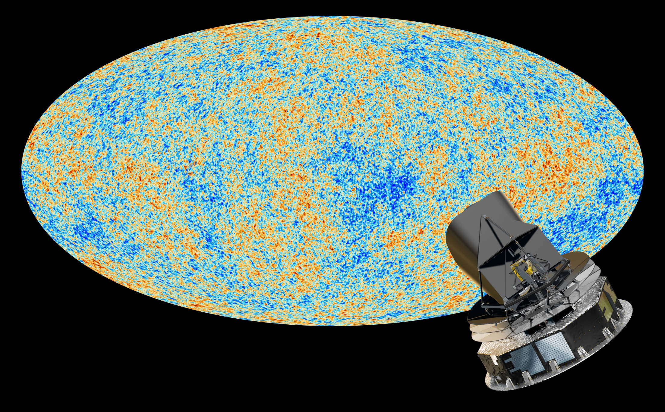
Precision
Cosmology
Universe 380.000 yrs after Big Bang
13.8 Gyrs ago (13.7980.037 Gyrs)
Temperature T = 2.725480.00057 K
temperature/density fluctuations (T/T<10⁻⁵)
Planck satellite map
of the primordial Universe

Slide 34
21st Century - 3rd Millennium: Precision Cosmology
2000
Witman et al., Bacon et al., Kaiser et al., van Waerbeke et al. (4 independent groups)
discovery/detection Cosmic Shear
- gravitational lensing by cosmic mass distribution
- induced by the dominant dark matter component in the cosmic mass distribution
- proviedes a new and competitive probe of cosmological parameters
2003
WMAP CMB satellite
- Wilkinson Microwave Anisotropy Probe,
- US satellite mission measuring the CMB to subhorizon scales
- mapping of cosmic acoustic waves and measurement angular fluctuation spectrum
- opening era of Precision Cosmology
- establishes accurate age determination of the Universe: 13.7 Gyr
- establishes that the Universe has zero curvature (flat Universe)
- established reality of Cosmological Constant/Dark Energy
2005
Cole et al. , Eisenstein et al.
discovery Baryonic Acoustic Oscillations
- from the maps of galaxy distribution from the 2dFGRS and SDSS galaxy redshift surveys, the first
detection of the remnant acoustic oscillations: remnant of the primordial sound waves
- new probe that confirms realiyt of Dark Energy/Cosmological Constant
2013-2018
Planck CMB satellite
- European satellite mission measuring the CMB to unprecedented detail and accuracy
- maps the polarization of the cosmic microwave background
- detects the gravitational lensing of the CMB
- establishes the age of the Universe to 13.8 Gyr

Slide 35
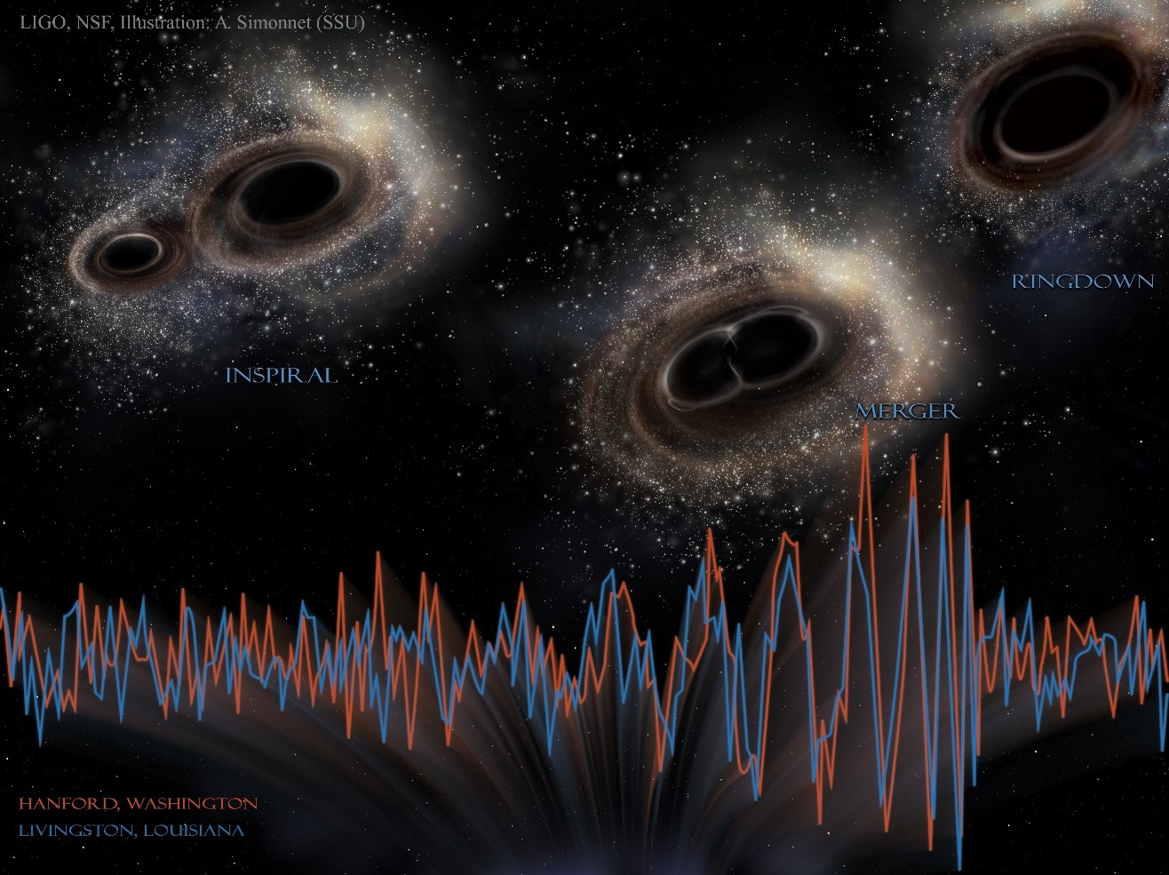
2015-2017
LIGO discovery of gravitational waves
- Largest and most ambitious project ever funded by (US) NSF
- Confirmation of General Theory of Relativity, to amazingly high precision
- 6th discovered event: aug. 2017, collision 2 neutron stars: velocity of gravity = velocity light
- Nobelprize physics 2017: Weiss, Thorne, Barish
- entirely new window on the Universe

Slide 36
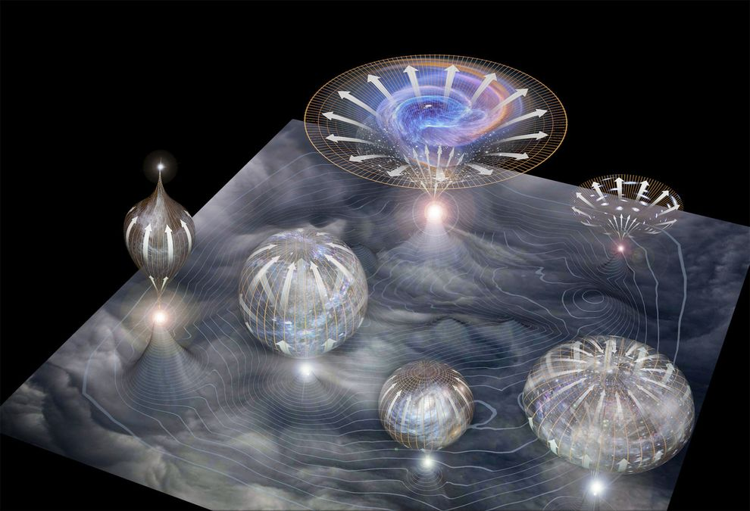
Inflationary Universe

