Slide 1
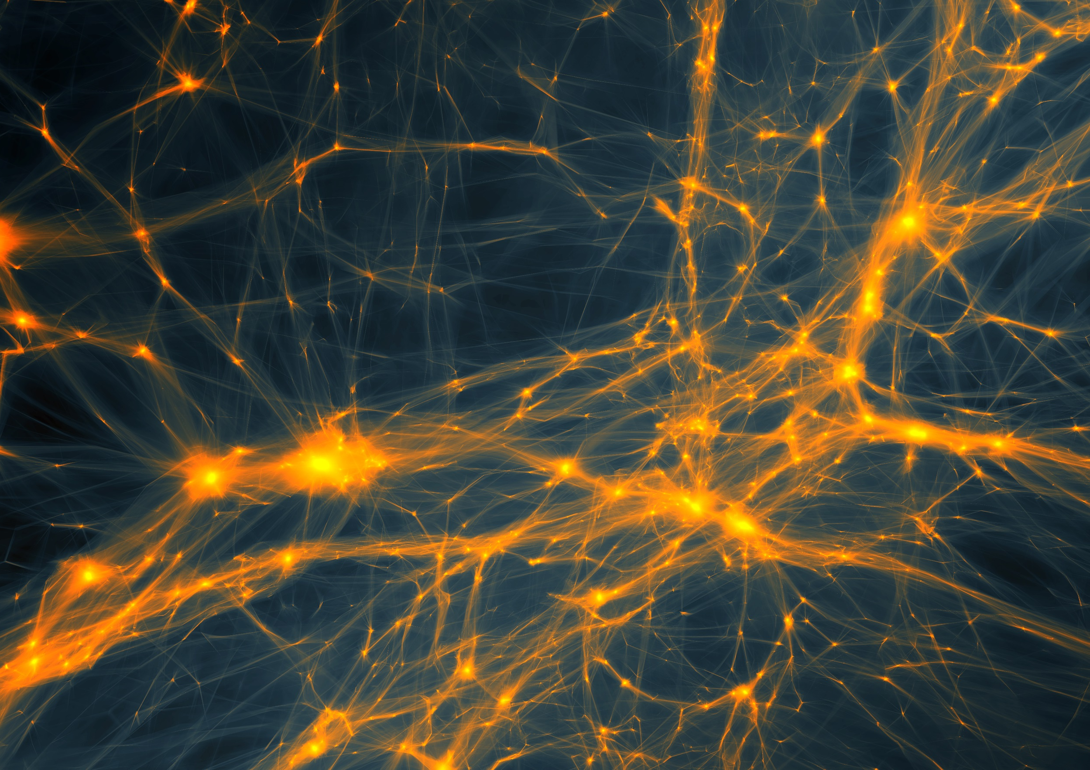
the Early Universe:
from
Cosmic Birth
to
Cosmic Web

Slide 2
Dark Matter

Slide 3
Matter
• Baryonic Matter
• Nonbaryonic Dark Matter

Slide 4
Baryonic Matter
The amount of baryonic matter in the Universe is (by now) very well determined, by two independent determinations:
1) Primordial Nucleosynthesis
2) Acoustic Oscillations in CMB power spectrum,
2nd peak (CMB)

Slide 5
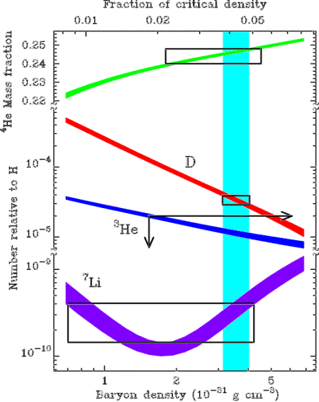
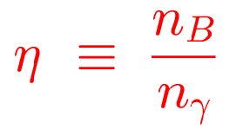

Baryonic Matter: primordial nucleosynthesis
From measured light element abundances:

Slide 6
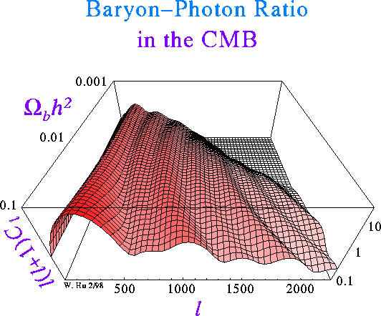
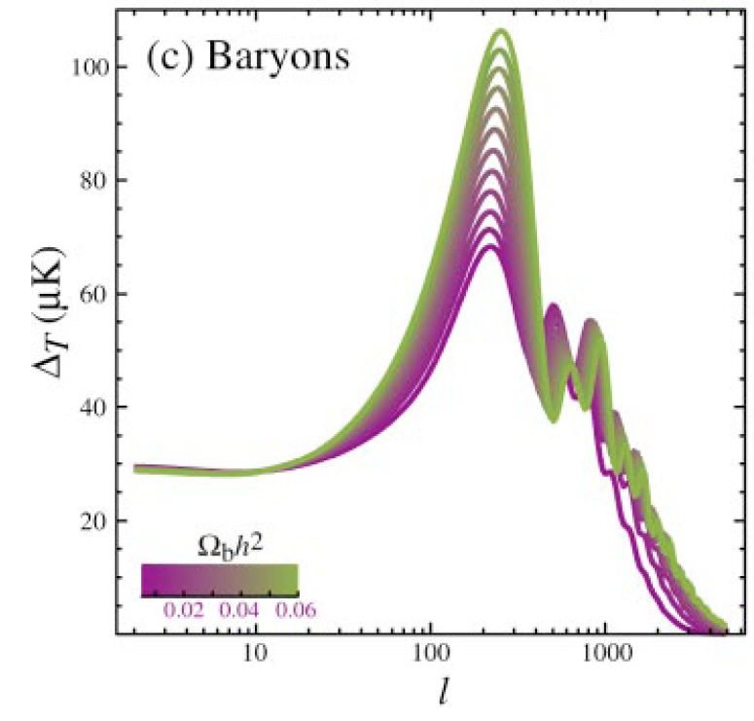
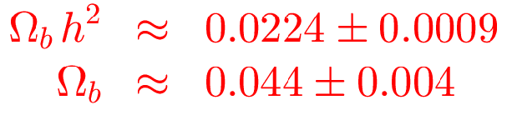
Baryonic Matter: CMB
Due to baryon drag in the primordial baryon-photon gas, 2nd peak in CMB spectrum is suppressed:

Slide 7
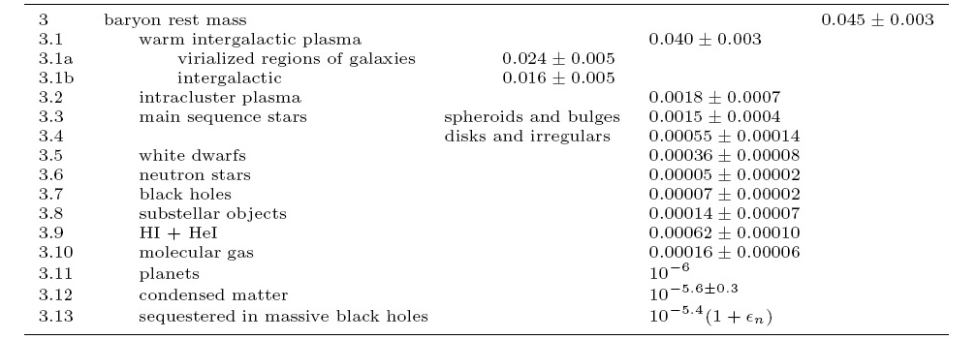
Baryonic Matter
Cosmic Baryons
Fukugita & Peebles 2004

Slide 8
Baryonic Matter
Note:
STARS are but a fraction of the total amount of baryonic matter
There is still a large amount of undetected baryonic matter:
- hiding as warm Intergalactic Gas (WHIM) ?
Fukugita & Peebles 2004

Slide 9
Non-baryonic DM: candidates
WIMPs: Weakly Interacting Massive Particles
- neutrinos
- sterile neutrinos
- neutralinos
- ....
MACHOs: Massive astrophysical compact halo object
Modified Gravity: modification of General Relativity
SIMPs ... Strongly Interacting Massive Particles

Slide 10
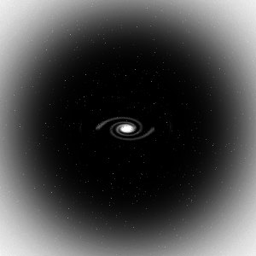
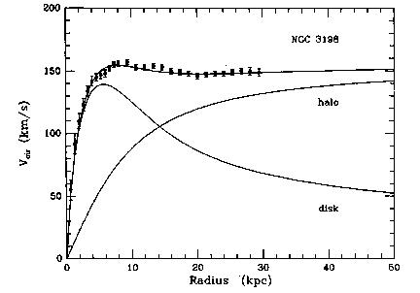
Dark Matter: disk galaxies
The dark matter in these galactic dark halos will keep the stars and gas clouds in the outer reaches of the spiral galaxies swirling around the galaxy with such high velocities.
GM(r)/r = v_{c}²
Moreover, the dark matter halos would provide a natural stabilization of the thin and fragile rotating spiral discs, which otherwise are rather unstable structures which would easily be disrupted by “perturbative vibrations”.
Van Albada & Sancisi

Slide 11
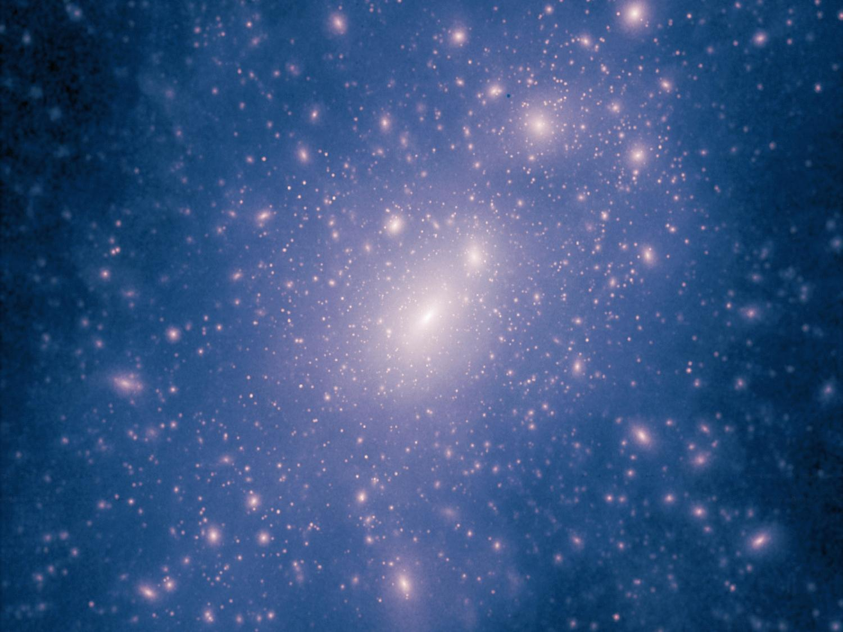
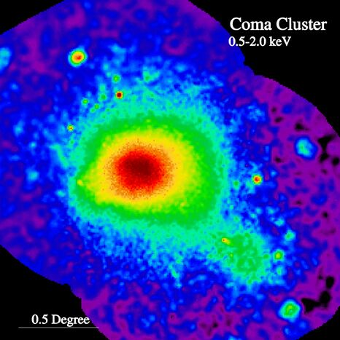
Clusters of Galaxies:
X-ray intracluster gas
Baryonic matter in clusters is not only confined to galaxies:
~ 2 to 5 times more baryonic mass in the form of a diffuse hot X-ray emitting
Intracluster Gas,
trapped and heated to a temperature of the order of
T ~ 10⁸ K
by the gravitational potential of the cluster.
At such high temperatures, this gas is a fully ionized plasma, producing powerful X-ray emission, bremsstrahlung radiation induced by the electron-ion interactions.
M51
ROSAT X-ray image Coma Cluster

Slide 12
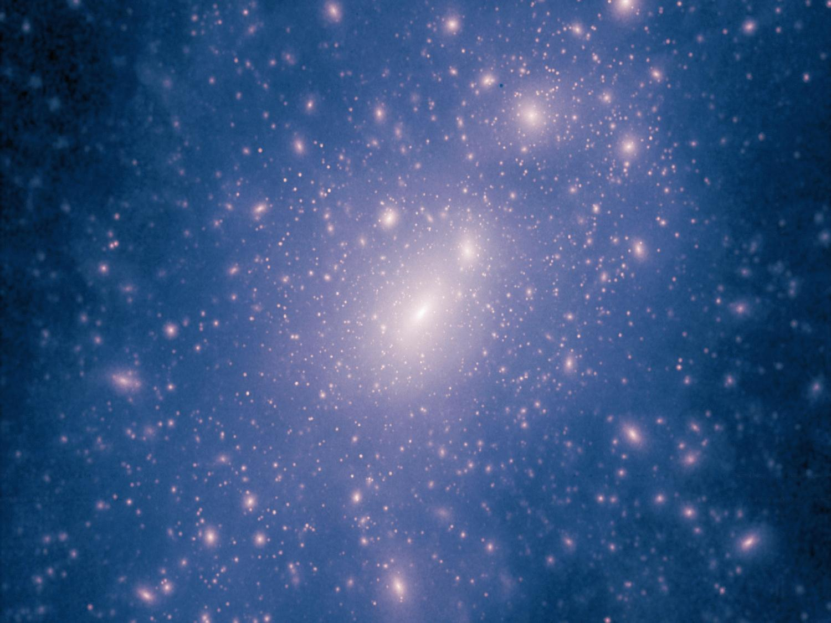
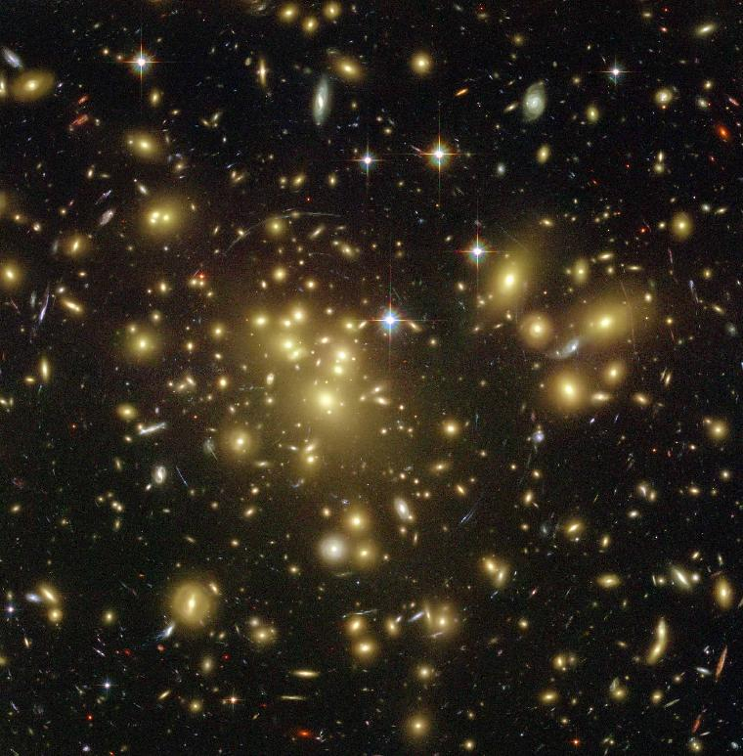
Clusters of Galaxies:
Gravitational Lenses
Courtesy:
T. Broadhurst et al.
A highly promising method to determine the amount and distribution of
matter in the Universe
looks at the way it affects
the trajectories of photons
According to
Einstein’s theory of
General Relativity,
gravitational potential wells will bend and focus light. Dark matter concentrations act as a
Gravitational Lens
A1689

Slide 13
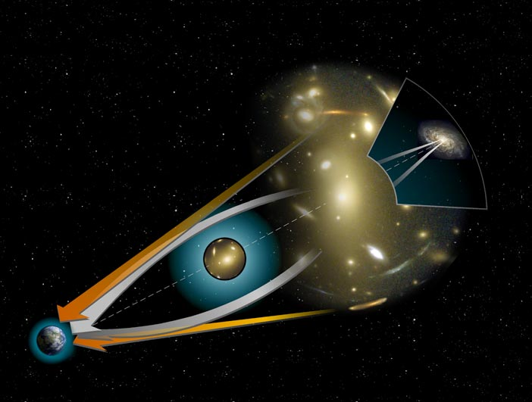
Clusters:
Gravitational Lensing
Geometry of Gravitational Lenses

Slide 14
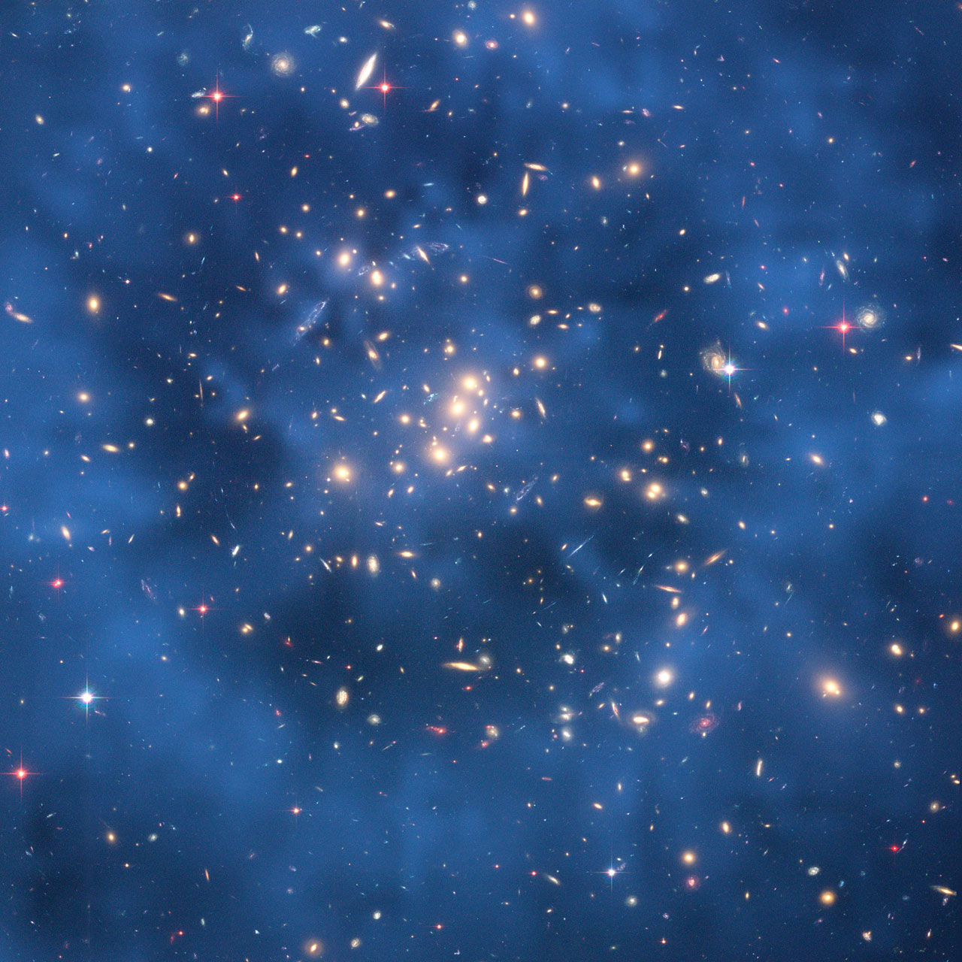
Clusters of Galaxies:
Dark Matter Map
A highly promising method to determine the amount and distribution of
matter in the Universe
looks at the way it affects
the trajectories of photons.
According to
Einstein’s theory of
General Relativity,
gravitational potential wells will bend and focus light. Dark matter concentrations act as a
Gravitational Lens.
Cl0024

Slide 15

Bullet Cluster colliding …
red:
hot Xray cluster gas
blue:
dark matter
Clowe et al. 2006

Slide 16
Dark Energy

Slide 17
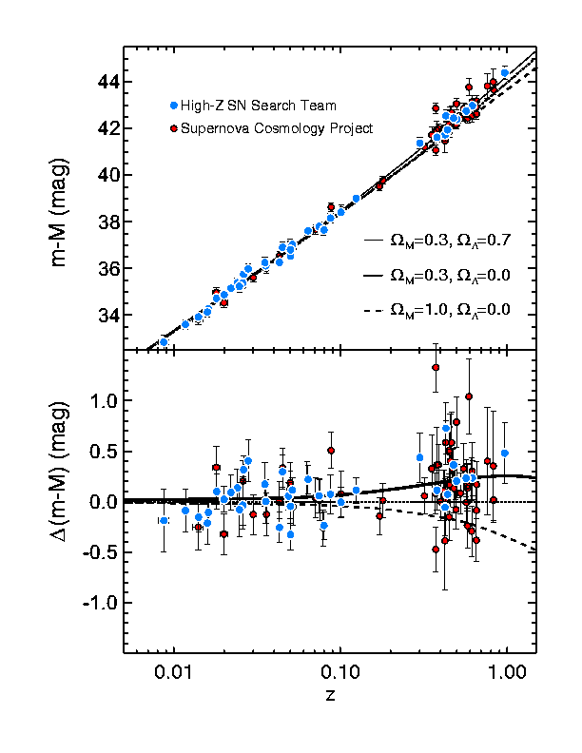
Cosmic Acceleration
Hubble Diagram high-z SNIa
distance vs. redshift z
m-M vs. redshift z
• determine:
- absolute brightness of supernova Ia
- from dimming rate (Phillips relation)
• measure:
- apparent brightness of explosion
• translates into:
- luminosity distance of supernova
- dependent on acceleration parm. q

Slide 18
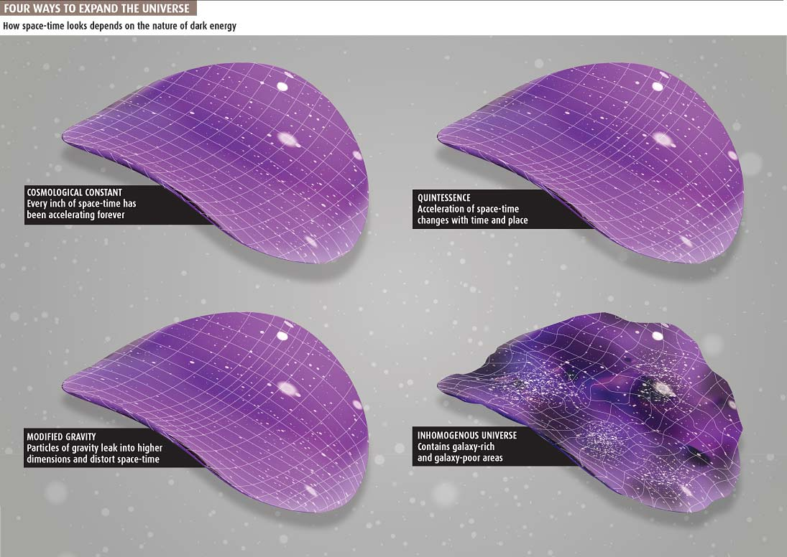
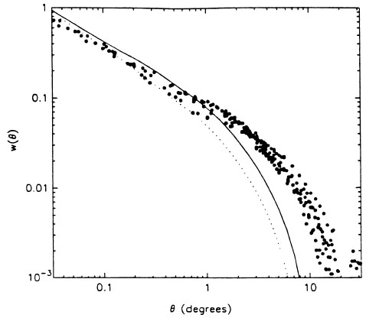
Galaxy Clustering

Slide 19
Dark Energy: Identity & Nature
Huge and ever growing
list of suggestions on
identity & nature of Dark Energy:
Cosmological Constant
Cosmic Backreaction
(inhomogeneities)
Modified Gravity
Quintessence,
in a variety of flavours
Phantom Energy
Chameleon Energy
Chaplygin gas
Agegraphic DE
….
Dark Energy = Vacuum Energy
Ya. Zel’dovich - 1960s
S. Weinberg - 1989
Cosmological Constant to be
identified with zero-point
vacuum energy ?
minor problem:
1st order estimate
off by 120 orders magnitude:
~ 10¹²⁰

Slide 20
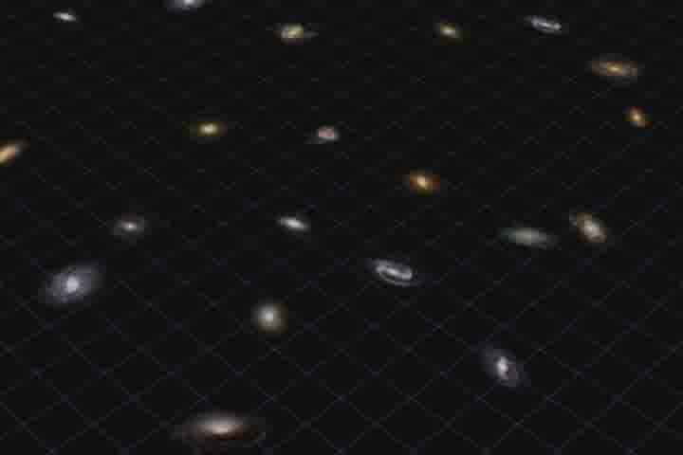
Phantom Energy:
De Big Rip ?

Slide 21
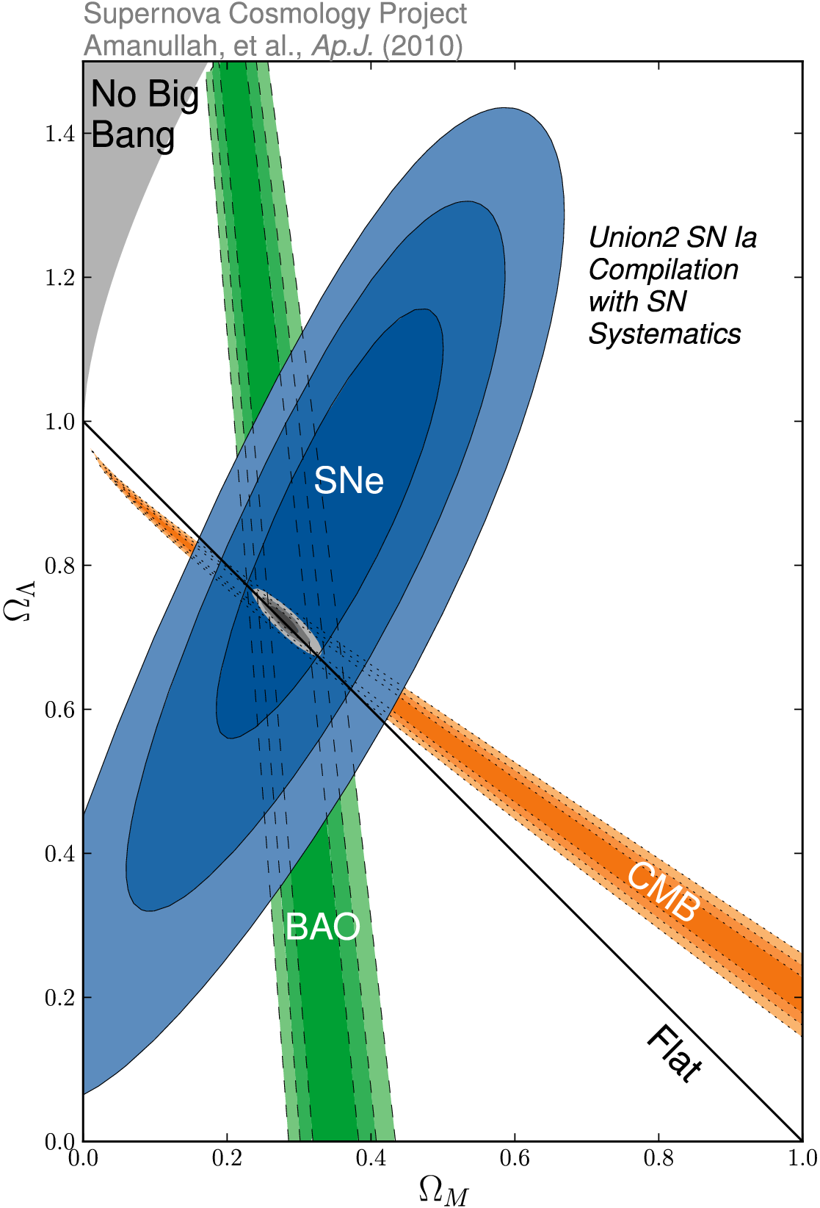
Ω_{m} vs. Ω_{Λ}
SCP Union2 constraints (2010)
on values of matter density Ω_{m}
dark energy density Ω_{Λ}

Slide 22
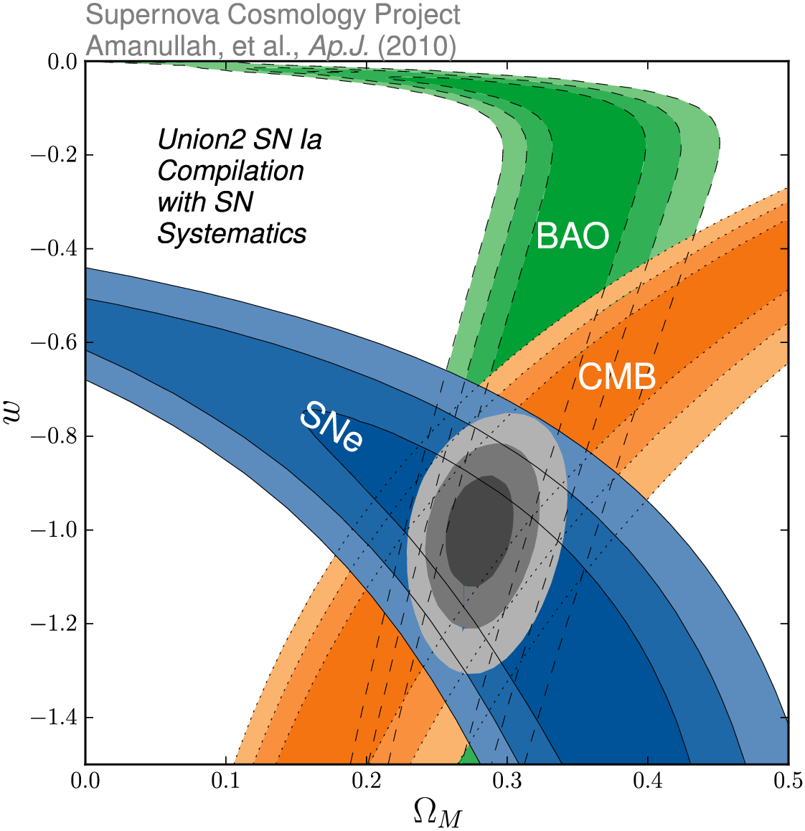
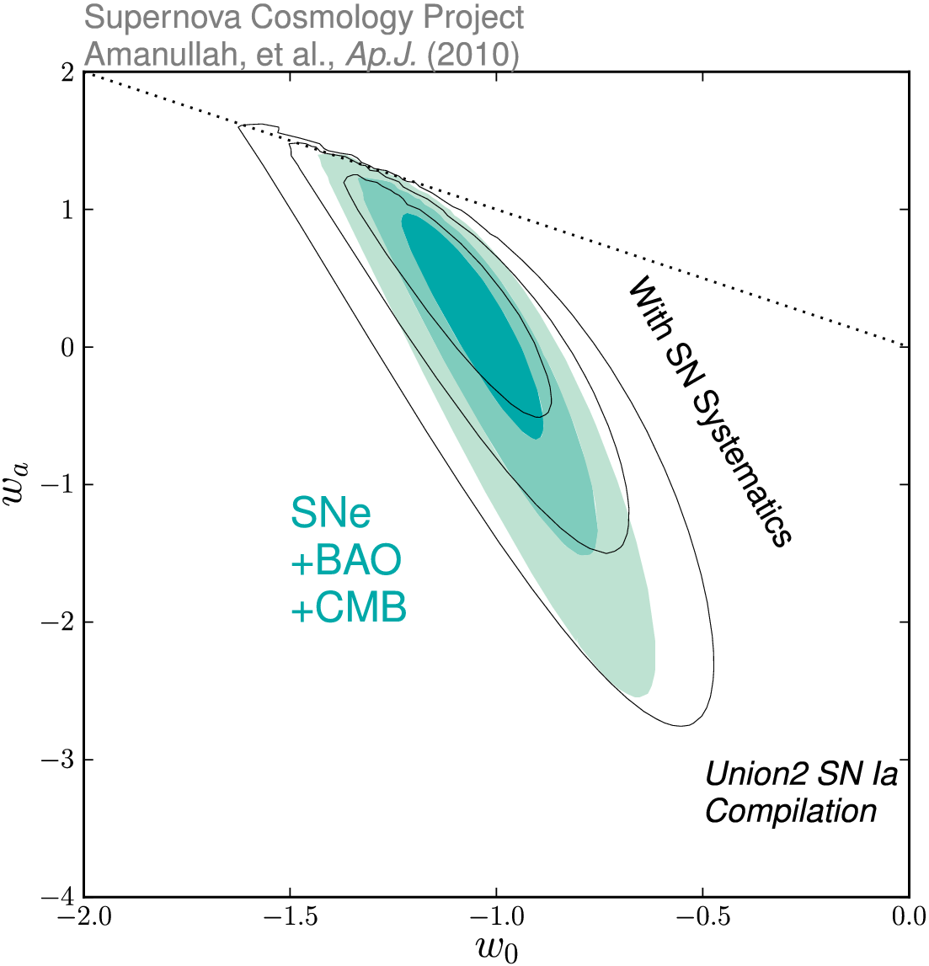
Dark Energy Eqn.State
on dynamical evolution dark energy:
eqn. state parameters w₀
w_{a}
SCP Union2 constraints (2010)
on values of matter density Ω_{m}
dark energy eqn. state w

Slide 23
Hot Big Bang
Eras

Slide 24
Adiabatic Expansion
The Universe of Einstein, Friedmann & Lemaitre
expands adiabatically
Energy of the expansion of the Universe corresponds to the decrease in the energy of its constituents
The Universe COOLS as a result of its expansion !

Slide 25
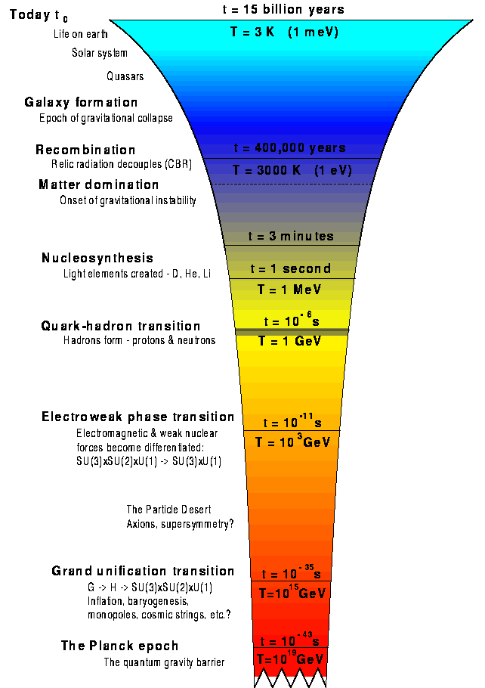
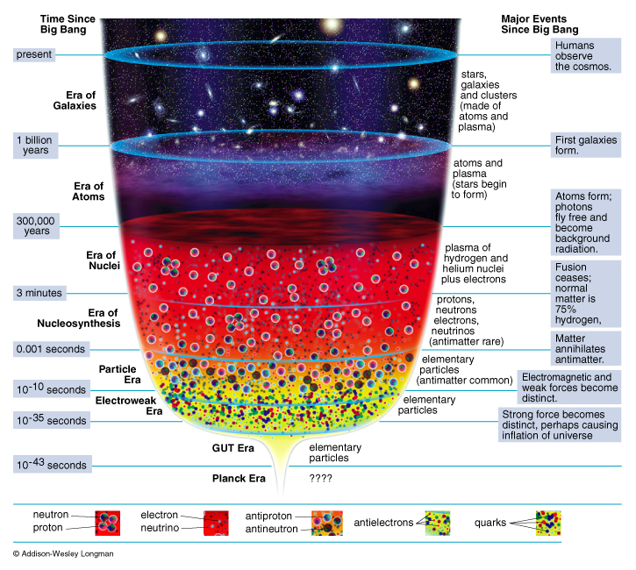
Adiabatic Expansion
reconstruction
Thermal History
of the Universe

Slide 26
Cosmic Epochs
Planck Epoch t < 10⁻⁴³ sec
Phase Transition Era 10⁻⁴³ sec < t < 10⁵sec
Hadron Era t ~10⁻⁵ sec
Lepton Era 10⁻⁵ sec < t < 1 min
Radiation Era 1 min < t <379,000 yrs
Post-Recombination Era t > 379,000 yrs
GUT transition
electroweak transition
quark-hadron transition
muon annihilation
neutrino decoupling
electron-positron annihilation
primordial nucleosynthesis
radiation-matter equivalence
recombination & decoupling
Structure & Galaxy formation
Dark Ages
Reionization
Matter-Dark Energy transition

Slide 27
History of the Universe
in Four Episodes: I
On the basis of the
1) complexity of the involved physics
2) our knowledge of the physical processes
we may broadly distinguish four cosmic episodes:
(I)
Origin universe
???
t < 10⁻⁴³ sec
fundamental physics:
totally unknown
Planck Era

Slide 28
History of the Universe
in Four Episodes: II
(II)
_{tot:}
curvature/
flatness
_{b} (n_{b}/n)
`exotic’
dark matter
primordial
fluctuations
10⁻⁴³ < t < 10⁻³ sec
fundamental physics:
poorly known
speculative
VERY early universe

Slide 29
History of the Universe
in Four Episodes: III
(III)
primordial
nucleo-
synthesis
blackbody
radiation:
CMB
10⁻³ < t < 10¹³ sec
Standard
Hot Big Bang
Fireball
fundamental microphysics:
known very well

Slide 30
History of the Universe in Four Episodes: IV
(IV)
t > 10¹³ sec
structure
formation:
stars,
galaxies
clusters
…
Post
(Re)Combination
universe
complex macrophysics:
Fundamentals known
complex interplay

Slide 31
Standard Big Bang:
what it cannot explain …

Slide 32
Flatness Problem
the Universe is remarkably flat, and was even (much)
flatter in the past
Horizon Problem
the Universe is nearly perfectly isotropic and
homogeneous, much more so in the past
Monopole Problem:
There are hardly any magnetic monopoles in
our Universe
Fluctuations, seeds of structure
Structure in the Universe: origin

Slide 33
Flatness Problem

Slide 34
Flatness Problem
FRW Dynamical Evolution:
Going back in time, we find that the Universe was much flatter than it is at the
present.
Reversely, that means that any small deviation from flatness in the early Universe would have been strongly amplified nowadays …
We would therefore expect to live in a Universe that would either be almost
=0 or ;
Yet, we find ourselves to live in a Universe that is almost perfectly flat … _{tot}1
How can this be ?

Slide 35
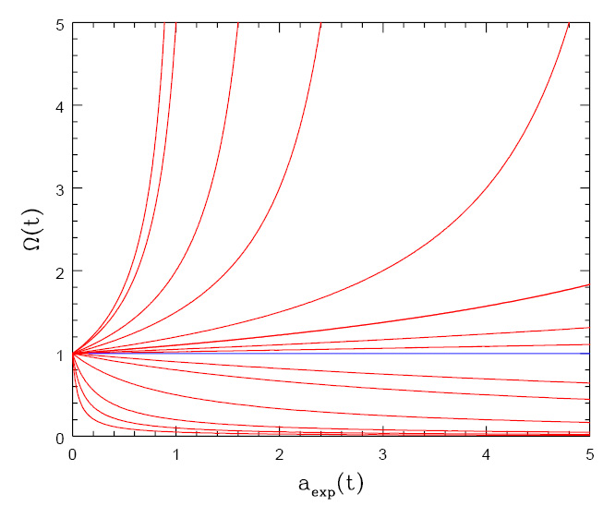
Flatness Evolution
• At radiation-matter equiv.
• Big Bang nucleosynthesis
a_{nuc}3.610⁻⁸
• Planck time

Slide 36
Cosmic Curvature

Slide 37
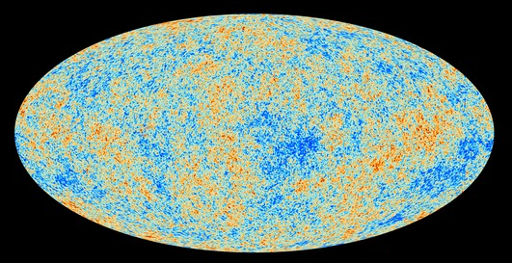
Cosmic Microwave Background
Map of the Universe at Recombination Epoch (Planck, 2013):
• 379,000 years after Big Bang
• Subhorizon perturbations: primordial sound waves
• ∆T/T < 10-5

Slide 38
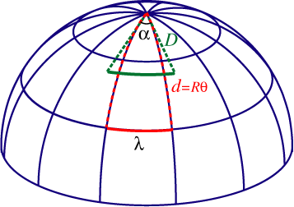
Measuring Curvature
Measuring the Geometry of the Universe:
• Object with known physical size,
at large cosmological distance
● Measure angular extent on sky
● Comparison yields light path,
and from this the curvature of space
W. Hu
Geometry of Space

Slide 39
Measuring Curvature
• Object with known physical size,
at large cosmological distance:
• Sound Waves in the Early Universe !!!!
W. Hu
Temperature Fluctuations
CMB

Slide 40
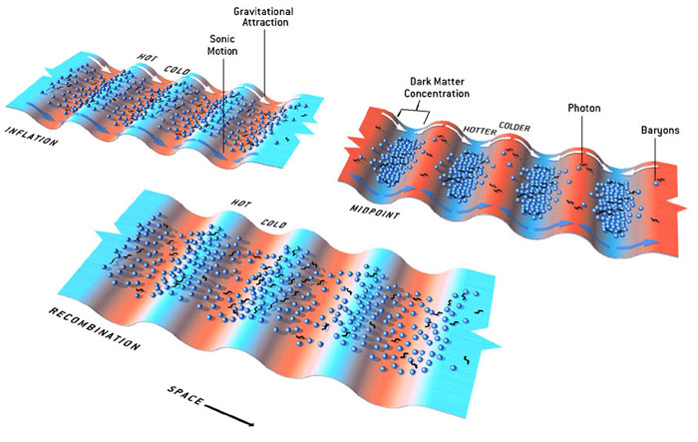
Fluctuations-Origin

Slide 41
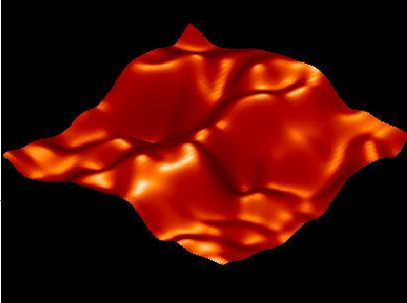
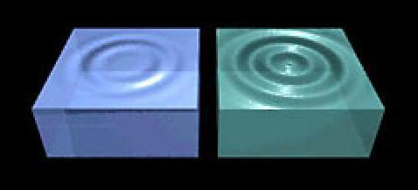
Music of the Spheres
● small ripples in
primordial matter & photon distribution
● gravity:
- compression primordial photon gas
- photon pressure resists
● compressions and rarefactions
in photon gas: sound waves
● sound waves not heard, but seen:
- compressions: (photon) T higher
- rarefactions: lower
● fundamental mode sound spectrum
- size of “instrument”:
- (sound) horizon size last scattering
● Observed, angular size: θ~1º
- exact scale maximum compression, the
“cosmic fundamental mode of music”
W. Hu

Slide 42
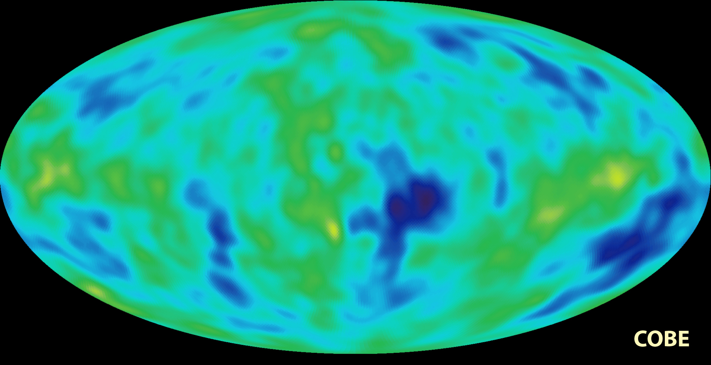
Cosmic Microwave Background
Size Horizon Recombination
COBE measured fluctuations: > 7º
Size Horizon at Recombination spans angle ~ 1º

Slide 43
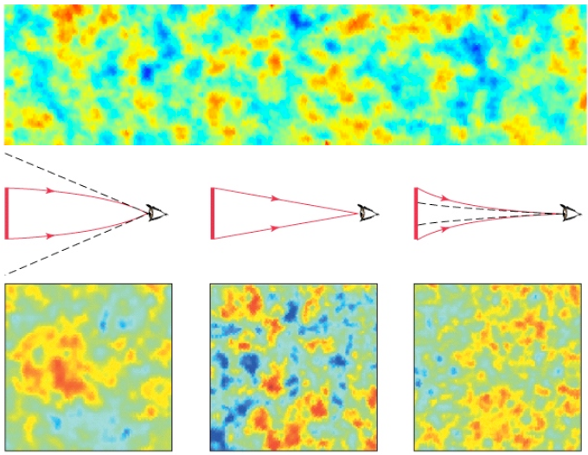


Flat universe from CMB
First peak: flat universe
We know the redshift and the time it took for the light to reach us:
from this we know the
- length of the legs of the
triangle
- the angle at which we are
measuring the sound horizon.
Closed:
hot spots
appear larger
Flat:
appear as big as they are
Open:
spots appear smaller

Slide 44
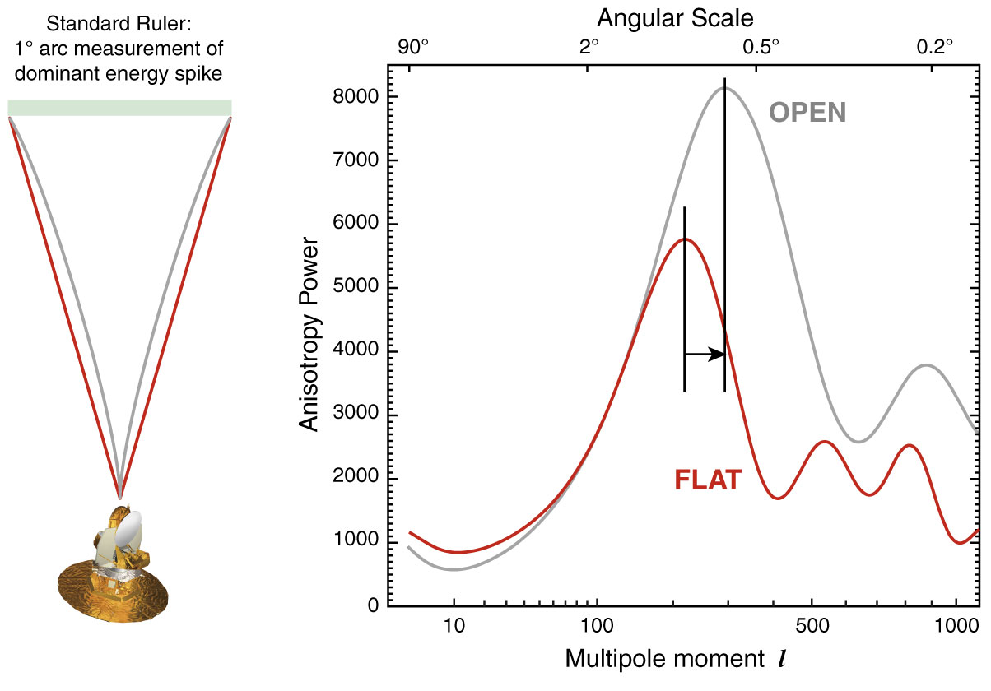
The WMAP CMB temperature
power spectrum

Slide 45
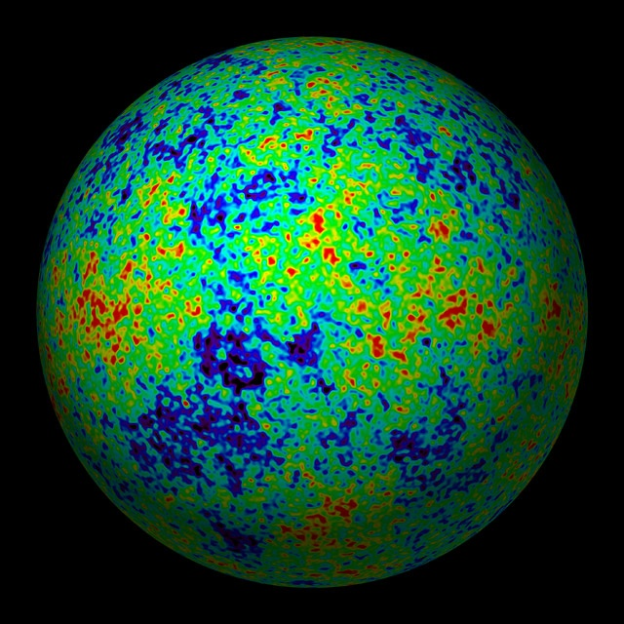
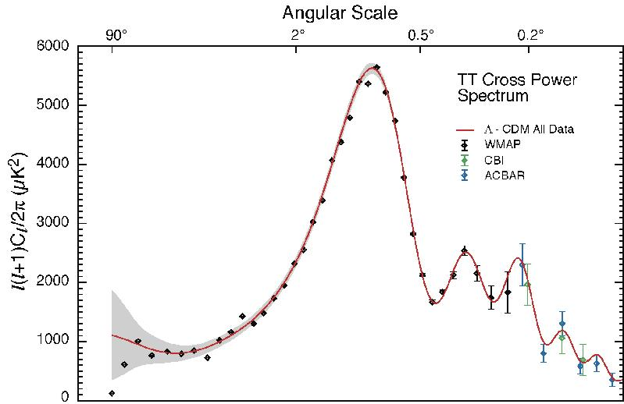
The Cosmic Tonal Ladder
The WMAP CMB temperature
power spectrum
Cosmic sound horizon
The Cosmic Microwave Background Temperature Anisotropies:
Universe is almost perfectly FLAT !!!!

Slide 46
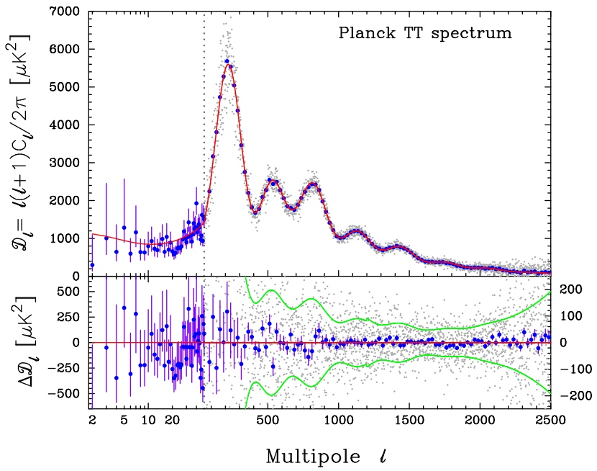
CMB - Fluctuations

Slide 47
Horizon Problem

Slide 48
Cosmic Horizons
Fundamental Concept for our understanding of the physics of the Universe:
Physical processes are limited to the region of space with which we are
or have ever been in physical contact.
What is the region of space with which we are in contact ?
Region with whom we have been able to exchange photons
(photons: fastest moving particles)
From which distance have we received light.
Complication: - light is moving in an expanding and curved space
- fighting its way against an expanding background
This is called the
Horizon of the Universe
:

Slide 49
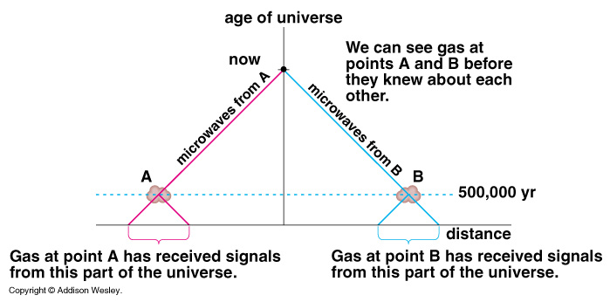
Cosmic Horizons
Horizon of the Universe:
distance that light travelled since the Big Bang

Slide 50
Cosmic Horizons
In an Einstein-de Sitter Universe
Horizon distance in physical space
Horizon of the Universe:
distance that light travelled since the Big Bang

Slide 51
Cosmic Horizons
The horizon distance at recombination/decoupling
(ie. time at which Cosmic Microwave Background is coming from)
angular size on the sky:
Large angular scales:
NOT in physical contact
Small angular scales:
In physical (thus, also thermal) contact
Horizon of the Universe:
distance that light travelled since the Big Bang

Slide 52
Cosmic Microwave Background
Size Horizon Recombination
COBE measured fluctuations: > 7º
Size Horizon at Recombination spans angle ~ 1º
How can it be that regions totally out of thermal contact have the same temperature ?

Slide 53
Cosmic Microwave Background
Size Horizon Recombination
COBE measured fluctuations: > 7º
Size Horizon at Recombination spans angle ~ 1º
COBE proved that superhorizon fluctuations do exist: prediction Inflation !!!!!

Slide 54
Structure Problem

Slide 55
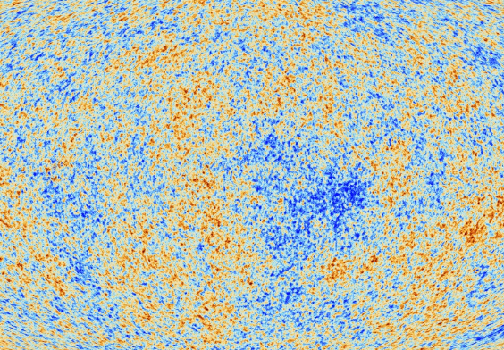
Primordial Noise:
Seeds of
Cosmic Structure

Slide 56

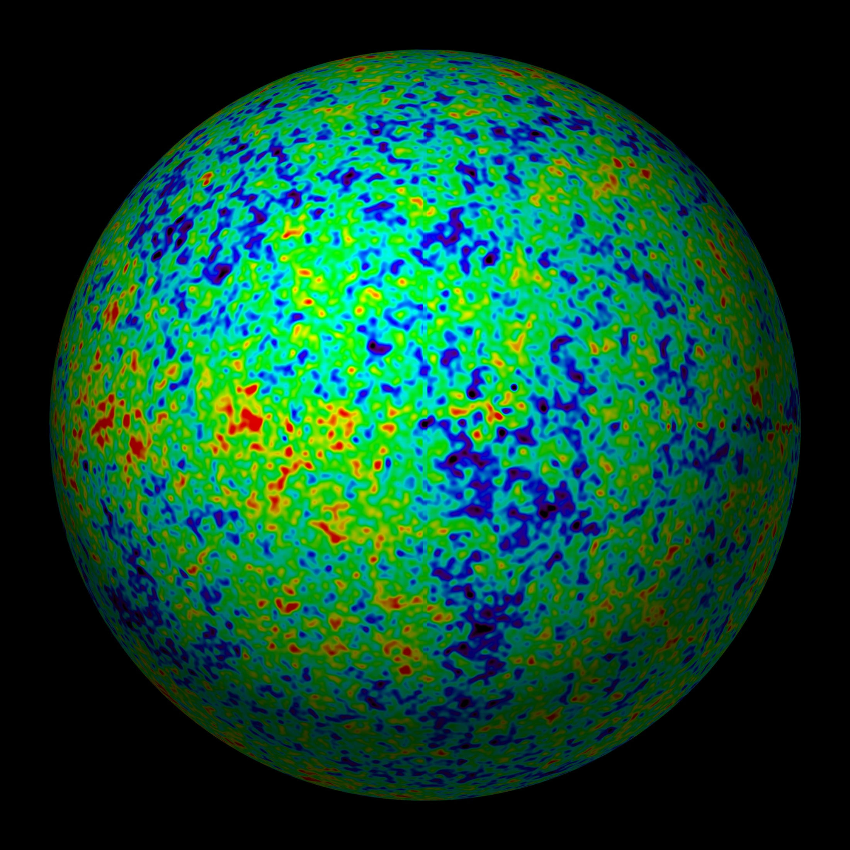
Universe at
379000 years:
almost featureless

Slide 57
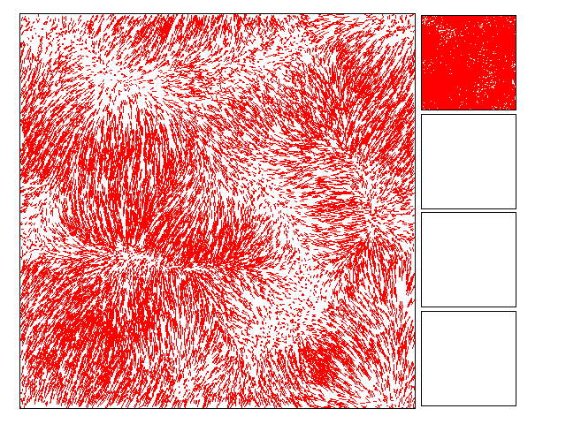
The Universe should be
Uniform: homogeneous & isotropic
Migration Streams of
matter induced by gravity
resulting from small perturbations

Slide 58
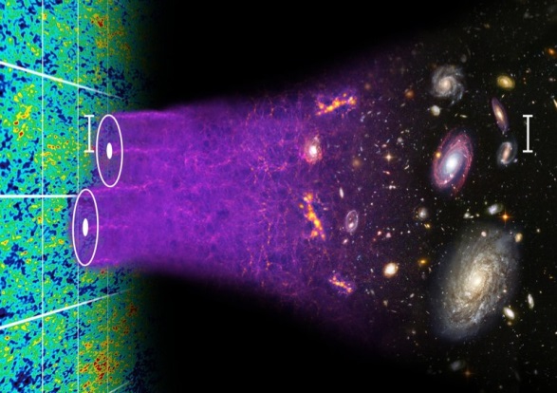
Formation Cosmic Structures

Slide 59
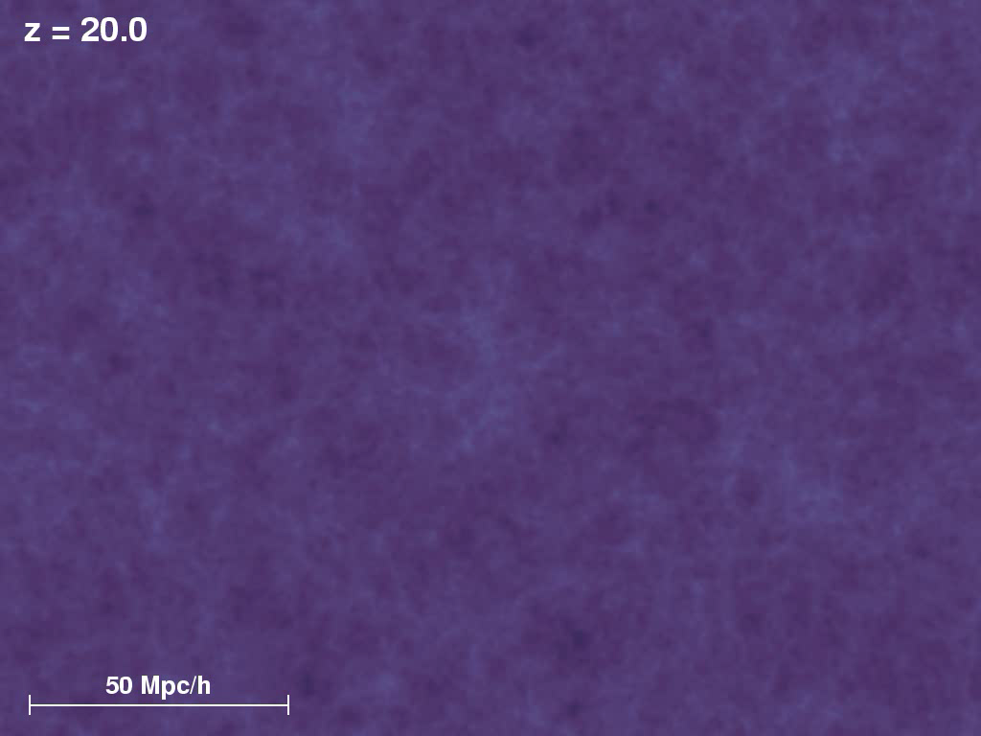

Cosmic Structure Formation
Formation
Cosmic Web:
simulation
sequence
(cold)
dark matter
(courtesy:
Virgo/V. Springel).

Slide 60
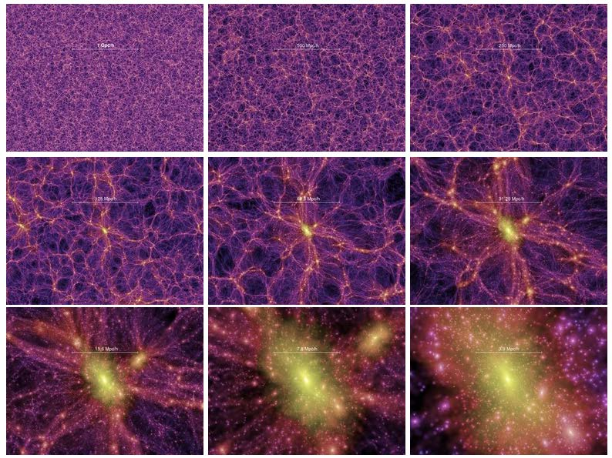
Millennium
Nbody simulation
time
resolution
Springel 2005

Slide 61
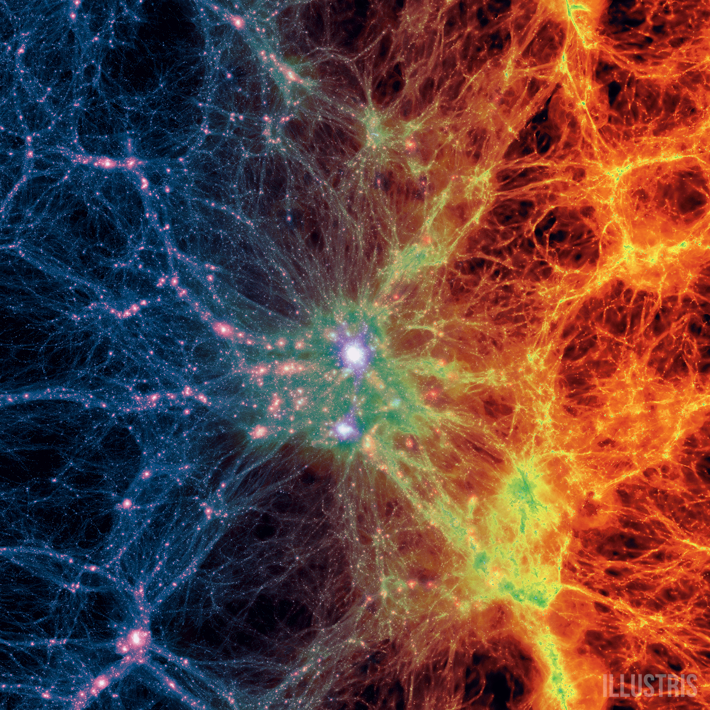
Illustris Simulation:
Cosmic Web
Dark Matter - Gas - Galaxies

Slide 62
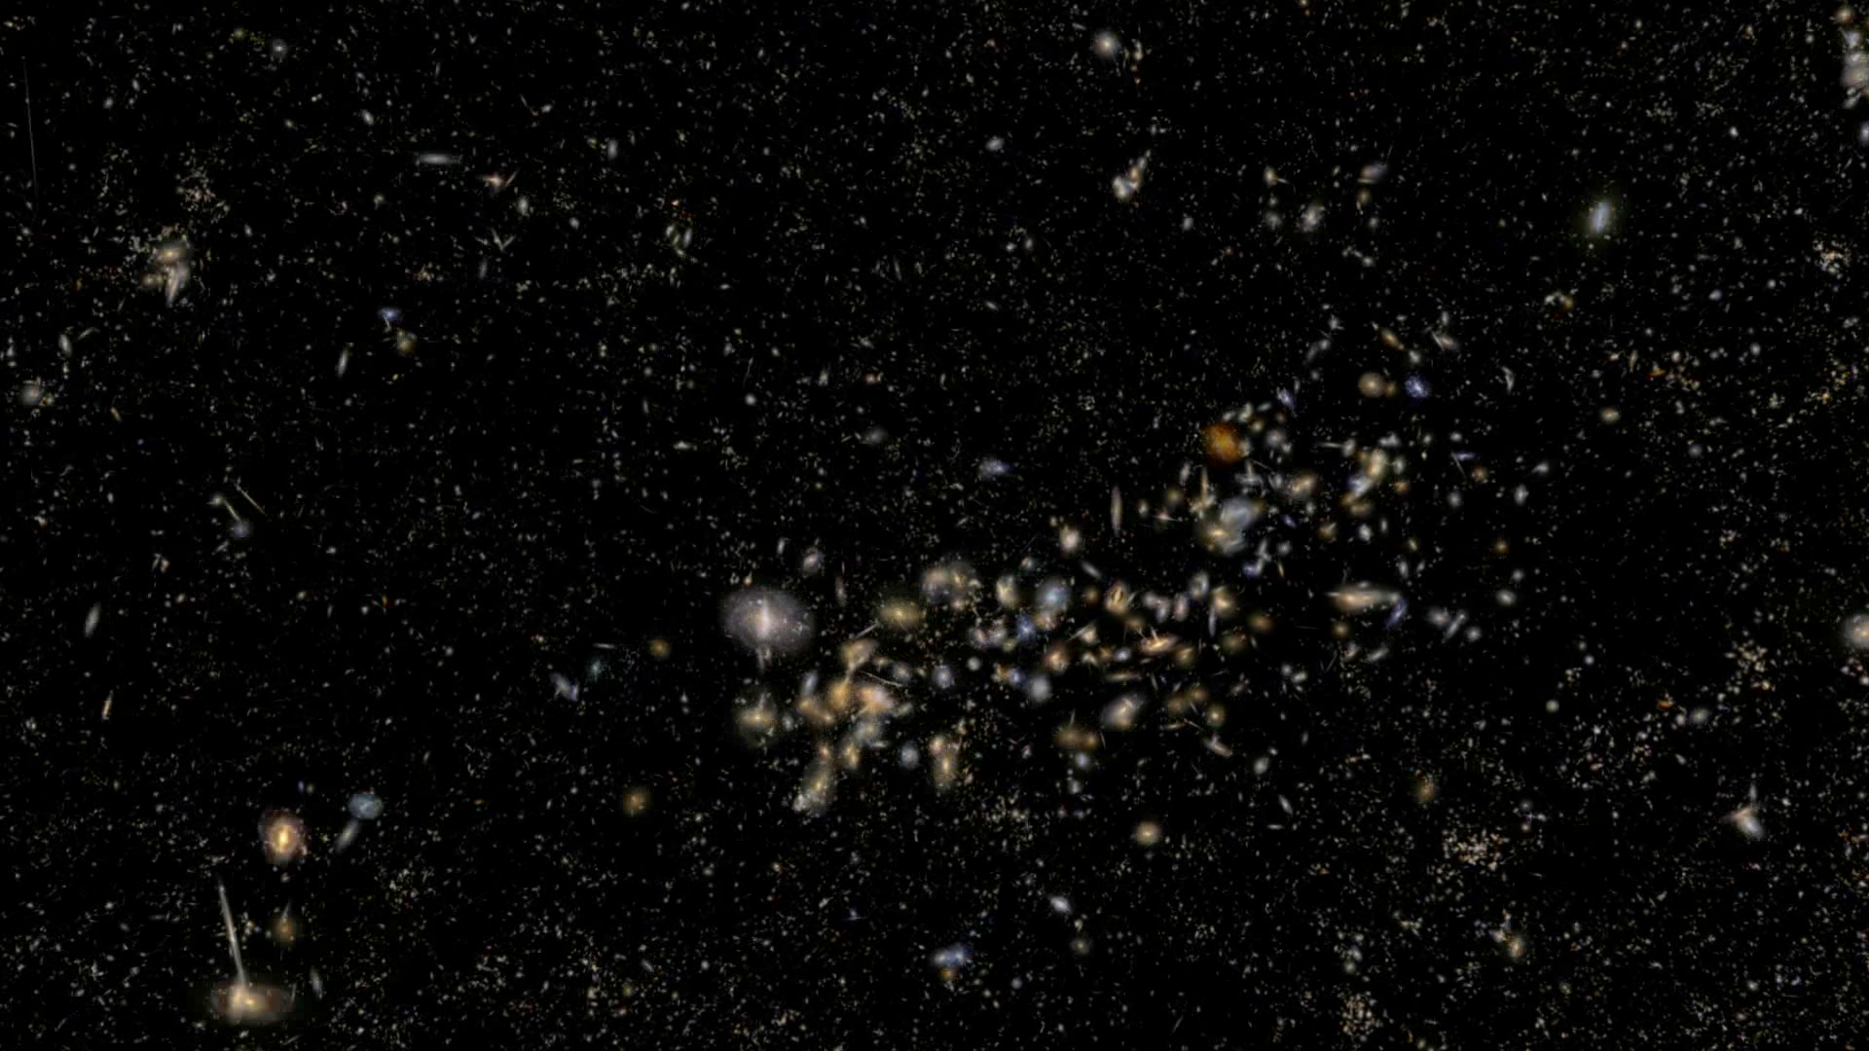
Universe at 13.8 Gyrs:
rich & complex structure

Slide 63
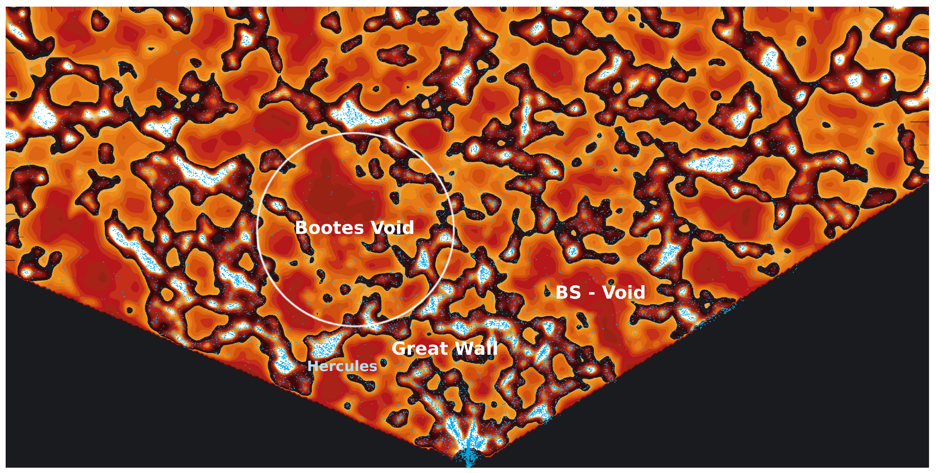
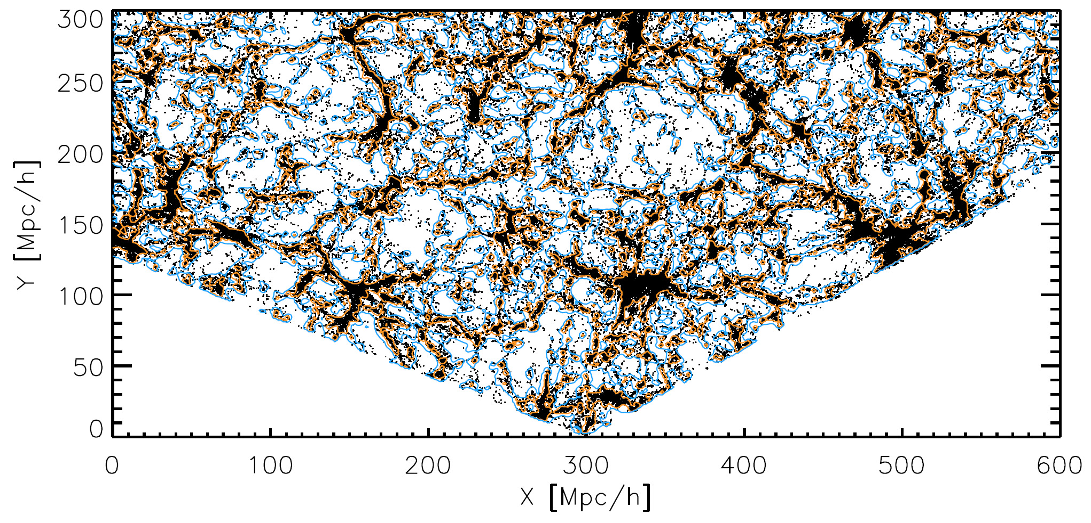
SDSS Galaxy Survey
map SDSS, clearly visible underdensities (Platen et al. 2010)
map SDSS, clearly visible underdensities (Platen et al. 2010)
with the advent of large galaxy redshift surveys
– LCRS, 2dFGRS, SDSS, 2MRS –
voids have been recognized as one of the quintessential components of the Cosmic Web

Slide 64
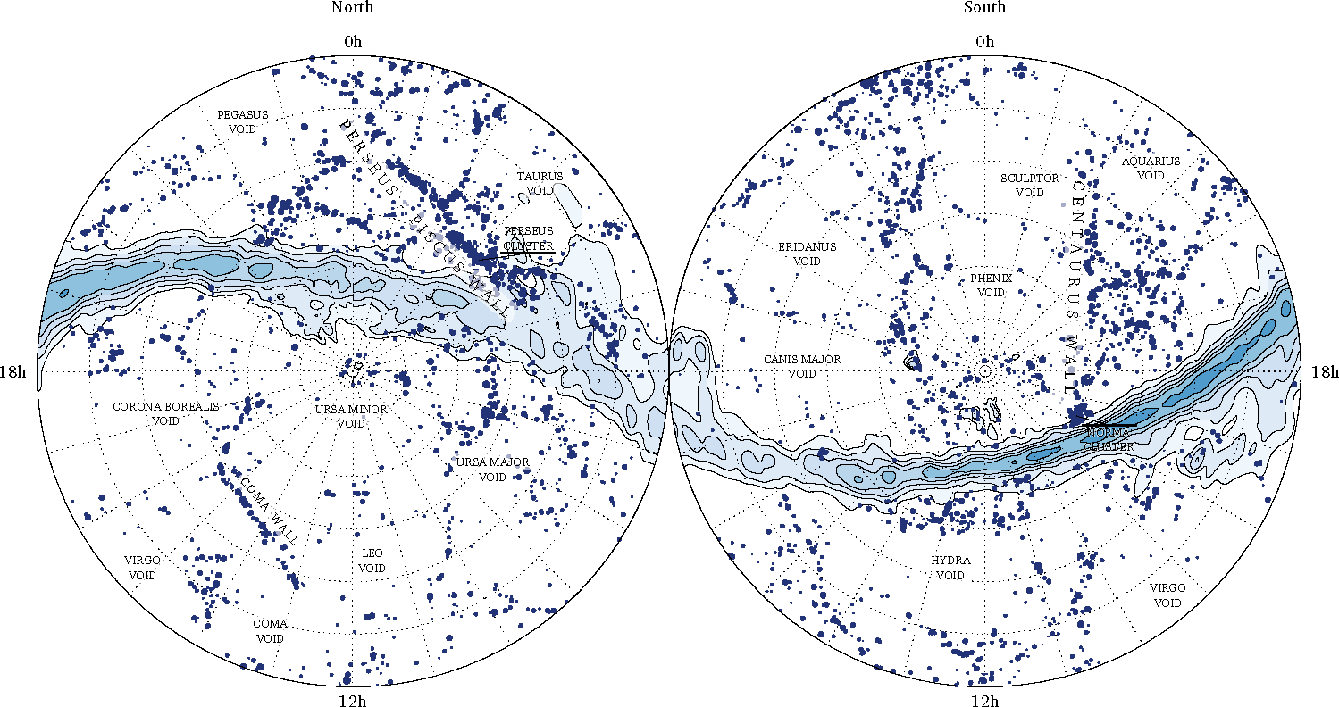
local Cosmic Web: 2MRS
cz=5,000-6,000 km/s
Courtesy: Johan Hidding

Slide 65
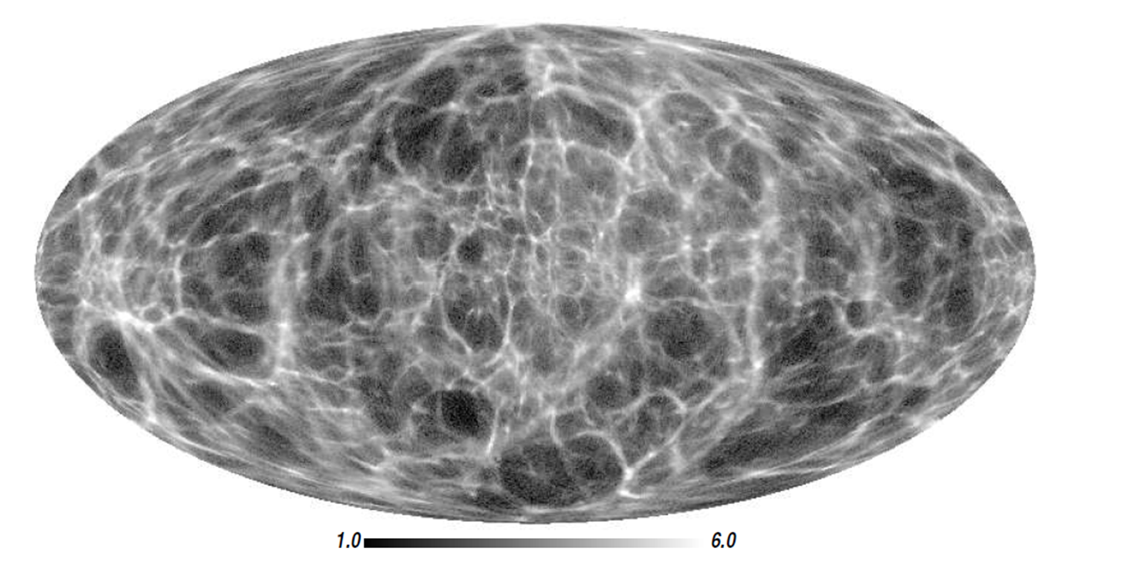
local Cosmic Web: 2MRS
most detailed reconstruction of the
local dark matter
Cosmic Web
Courtesy: Francisco Kitaura

Slide 66
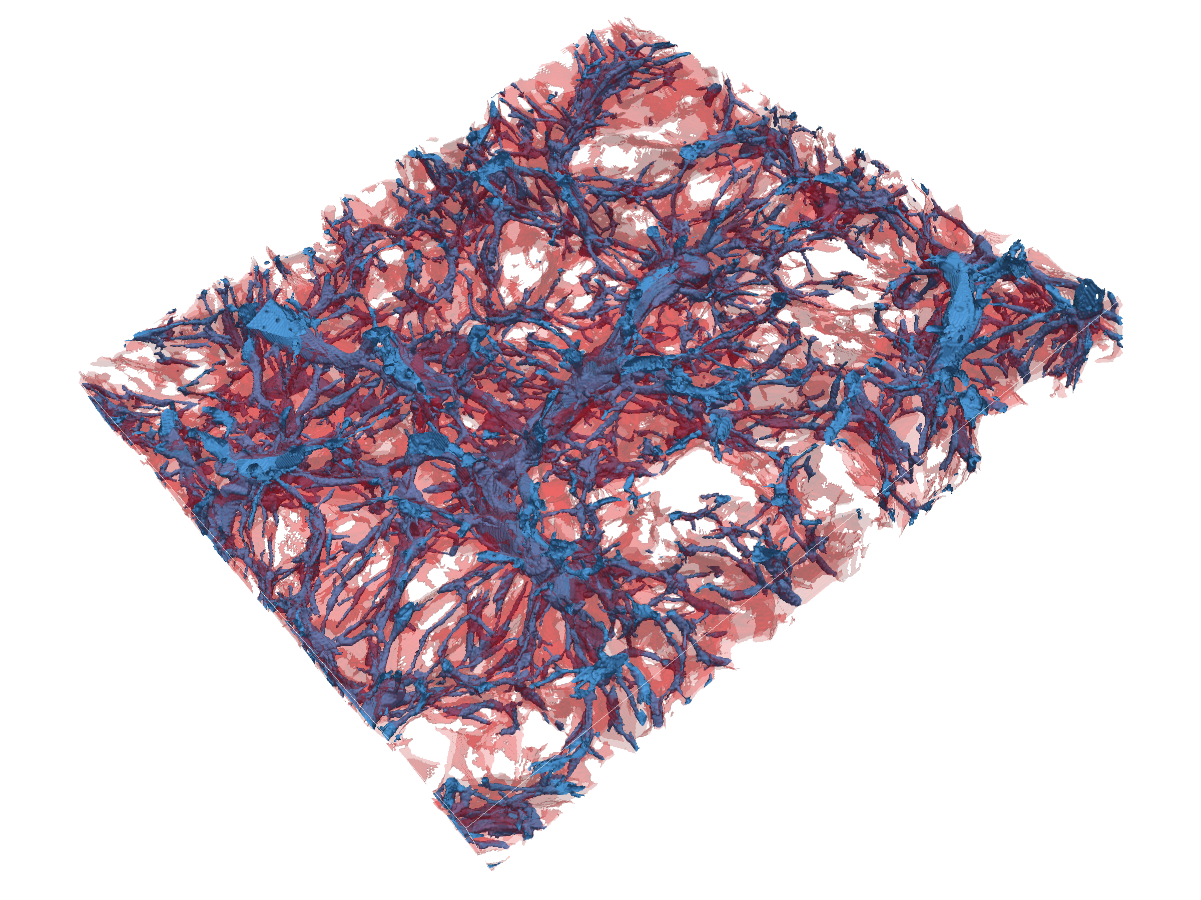
Nexus+ tracing of filaments:
inherent multiscale
character of filamentary web
Hidding, Cautun, vdW 2015

Slide 67
INFLATION

Slide 68

10⁻³⁶ sec after Big Bang:
Inflation of the Universe

Slide 69


Slide 70


Kosmische Inflatie
~ 10⁻³⁶ sec. na Big Bang:
Heelal dijt exponentieel uit:
factor 10⁶⁰ in 10⁻³⁴ sec
Afmeting huidige zichtbare Heelal:
begin inflatie: 10⁻¹⁵ afmeting atoom
eind inflatie: diameter van stuiver

Slide 71


Slide 72

Propelling Inflation: Inflaton

Slide 73

Inflatie & Multiverse

Slide 74
Cosmic Future

Slide 75


Cosmic Fate
100 Gigayears:
the end of Cosmology

Slide 76


