Slide 1
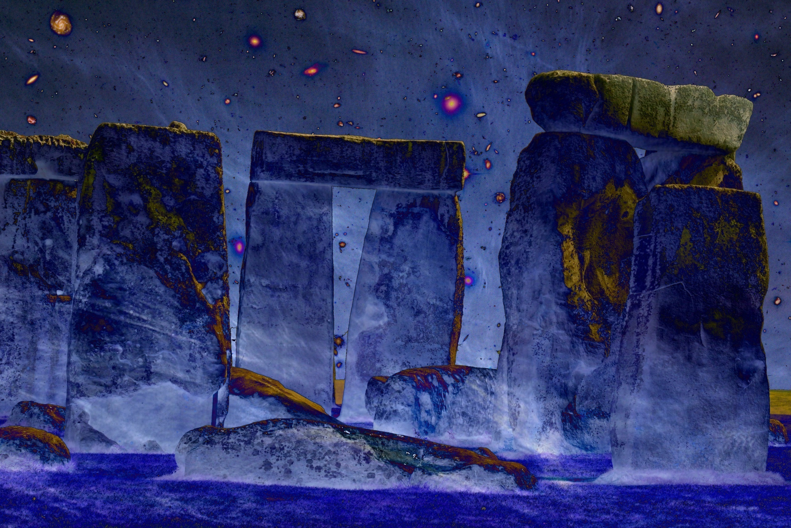
v
Cosmic Origins
Lecture Course Minor Astronomy
University of Groningen
November 2019-January 2020

Slide 2
Practical Matters
Agenda: Monday 19:00-21:00 Heymanszaal
Friday 15:oo-17:00 Kapteynborg, Zernike campus
5419.0008
Lectures: - 12 lectures/hoorcolleges Monday: 8
Friday: 4
- 4 tutorial/werkcolleges Friday: 4
Lecturer: Rien van de Weygaert
Kapteyn Astronomical Institute
Kapteynborg, Zernike campus, rm. 186;
tel. 050-3634086;
weygaert@astro.rug.nl
Lecture website: http://www.astro.rug.nl/~weygaert/cosmic_origins2019.html
Website: www.astro.rug.nl/~weygaert/cosmic_origins2016.html

Slide 3
Exam
Written exam (Jan. 21, 2020) 65%
2. Tutorial Group assignments 35%

Slide 4
Topics/Agenda I.
Lecture 1, November 12
Introduction
Cosmology, the Search for the Origin of our World
the Fundamental Questions of our Existence
Lecture 2, November 16
Cosmology Timeline
Lecture 3, November 19
Gods and Myths: Genesis of our World
Lecture 4, November 23, tutorial
Tutorial: the Fundamental Cosmological Questions: society responds ...
Lecture 5, November 26,
Cosmology: the philosophy of our world
Lecture 6, November 30
Order in the Cosmos:
how the Babylonians and Greeks rationalized the heavens

Slide 5
Topics/Agenda II.
Lecture 7, December 3
the Cosmos Mechanized: Hellenistic Cosmology
Lecture 8, December 7
the Cosmos Mechanized:
a case study: the Antikythera Mechanism
Tutorial: a Cosmic Debate between Worldviews
Lecture 9, December 10
the Scientific Revolution: the Mechanization of Nature
Lecture 10, December 14
Tutorial: the Fundamental Cosmological Questions: society responds II ...
Lecture 11, December 17
the Dynamical Universe
Einstein, Gravity and the Dynamics of our Universe
Lecture 12, December 21
the Big Bang

Slide 6
Topics/Agenda III.
Lecture 13, January 7
Kant to Hubble:
on Island Universes and the Size of our World
the Universe expands !
Lecture 14 January 11
Tutorial: a Cosmic Debate between Worldviews II
Lecture 15, January 14
the Hot Big Bang:
journey to the very first moments of our Cosmos ...
Lecture 16, January 18
the Cosmic Web
the emergence of complexity in the Universe

Slide 7
Literature
Lecture Notes (ppt slides etc.)
Cosmos,
an illustrated history of astronomy and cosmology
John North, 2nd ed., 2008, Univ. Chicago Press (paperback)
Cosmology, the Science of the Universe
E. Harrison, 2nd ed., 2000, Cambridge Univ. Press
Conceptions of Cosmos:
From Myths to the Accelerating Universe: A History of Cosmology
H. Kragh, 2013, Oxford Univ. Press
the History and Practice of Ancient Astronomy
J. Evans, 1998, Oxford Univ. Press
Ancient Cosmologies
ed. C. Blacker, M. Loewe, 1975, George Allen & Unwin Ltd.

