Slide 1
the
Expanding Universe

Slide 2
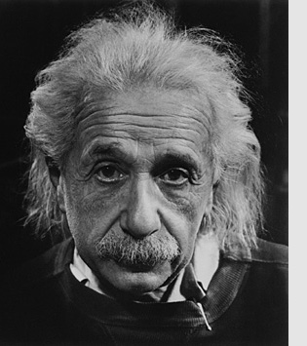
Albert Einstein - 1915
Albert Einstein
(1879-1955; Ulm-Princeton)
father of theory of
General Relativity (1915)
new theory of gravity
opens road to Cosmology
The supreme task of the physicist is to arrive at those universal elementary laws from which the cosmos can be built up by pure deduction.
(Albert Einstein, 1954)

Slide 3
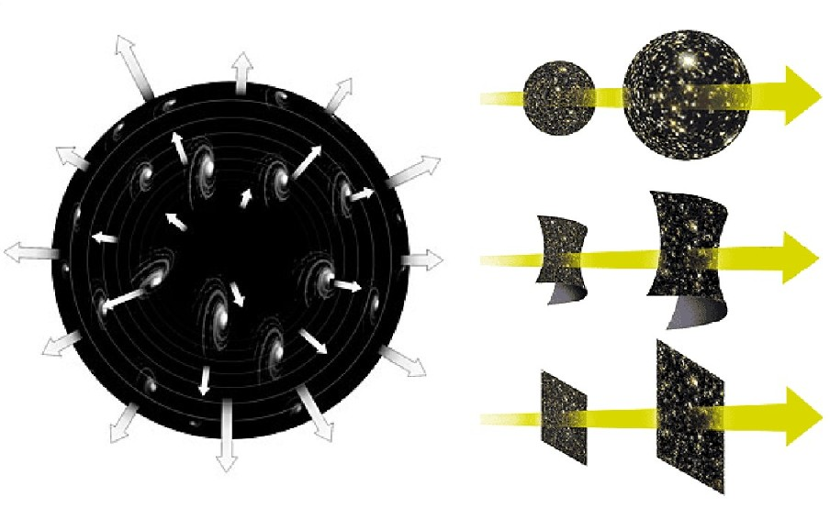
Edwin Hubble - 1929
Discovery of the
Expanding Universe

Slide 4
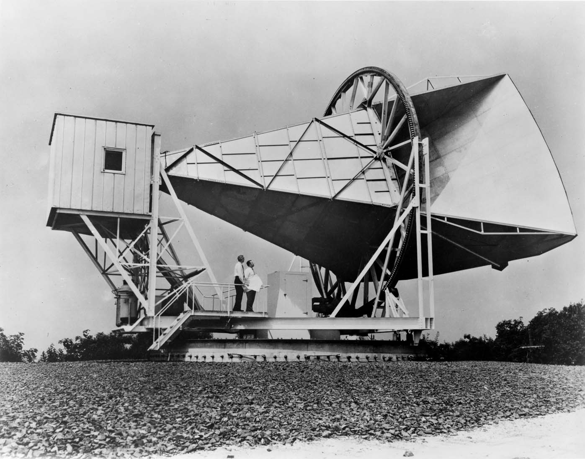
Penzias & Wilson - 1965
Discovery of the Cosmic Microwave Background
utlimate proof of the Hot Big Bang

Slide 5
Cosmology:
Journey in Space & Time

Slide 6
Velocity of Light
The fastest way of communication in nature is by means of light.
Light is an electromagnetic wave
- and as quantum phenomenon: both a wave and particle nature:
- light is the propagation of photons – light particles – which have a wave nature
Einstein (1905):
- the velocity of light propagation is CONSTANT, always,
independent of from which system you look at it.
- the velocity of light is the maximum velocity attainable in nature

Slide 7
Cosmic Archaeology
The finite velocity of light has highly interesting implications for the study of
cosmology.
Distances in the Universe are so vast – out to billions of lightyears - that the
corresponding light travel time is in the order of billions of years:
- this means that when receiving light from cosmological probes (galaxies at
cosmological distances), the light was emitted billions of years ago.
- hence, as we look deeper into space, we are looking back earlier and earlier
in time
- in other words, Cosmology is Archaeology !
An additional consequence is that as cosmological timescales are in the order of
billions of years, we see the universe change as we look further out into the Universe.

Slide 8
Cosmic Depths & Time

Slide 9
to the depths of our Universe
Hubble Ultra Deep Field:
weakest, reddest galaxies
~ 300-400 million years
after Big Bang (> 13 Gyr old)

Slide 10
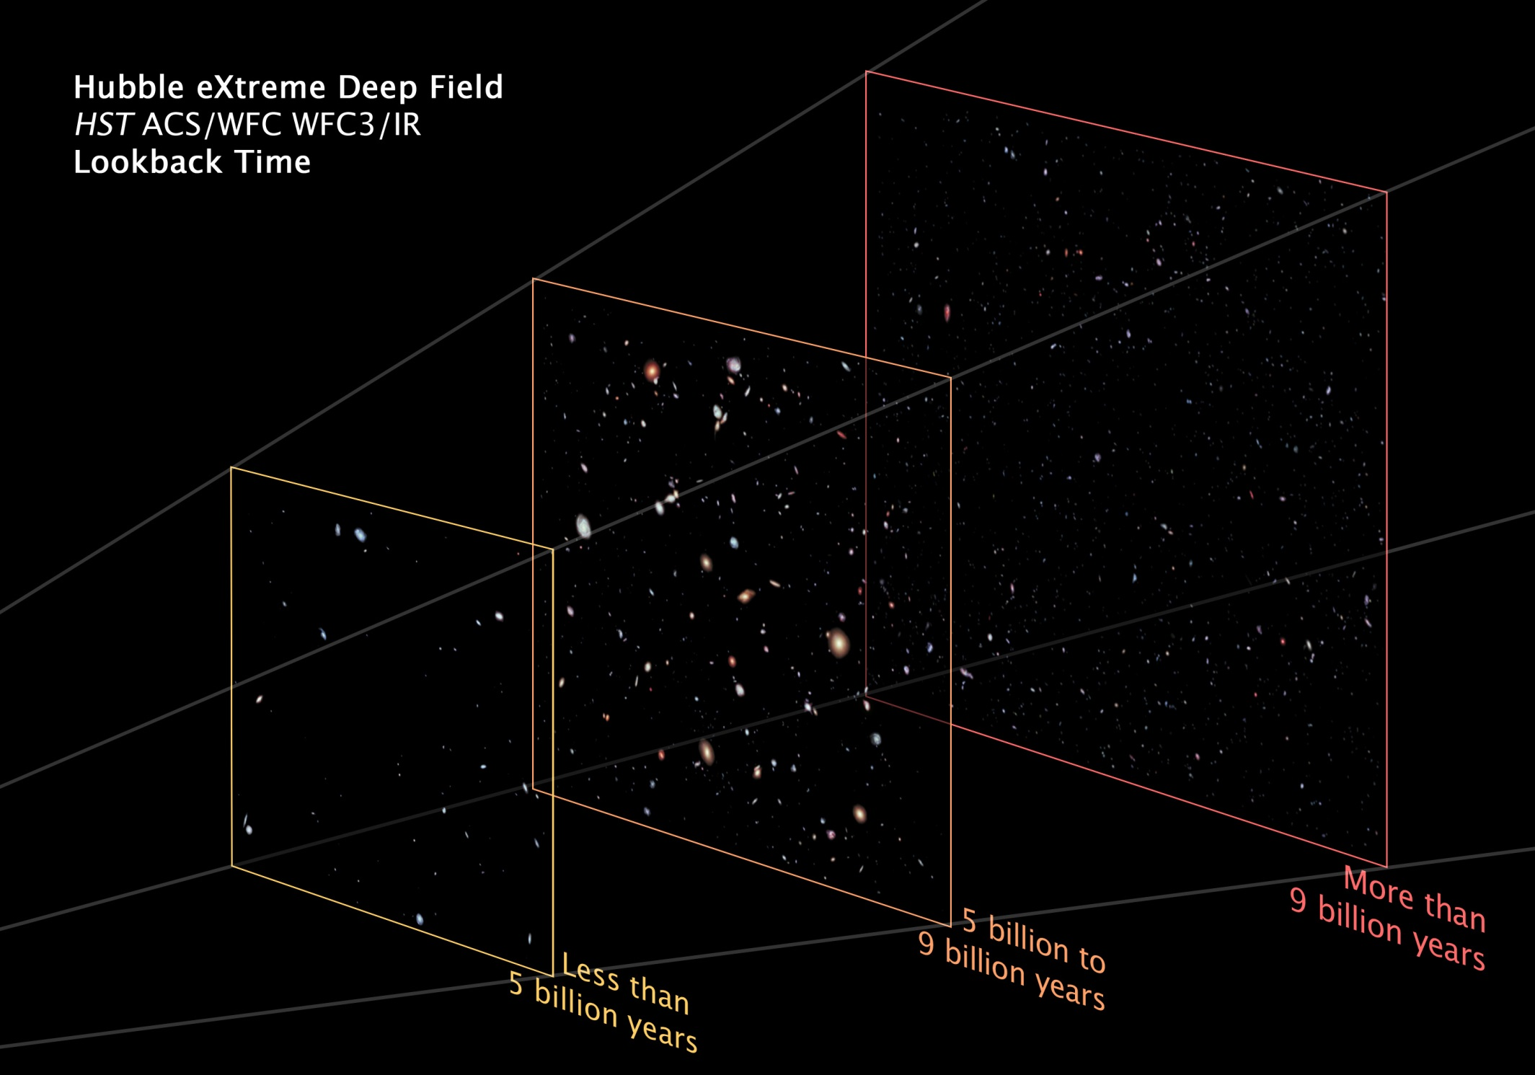
to the depths of our Universe

Slide 11
… to the edge of the visible Universe… ~ 42 Giga lightyears

Slide 12
Universe
of
Galaxies

Slide 13
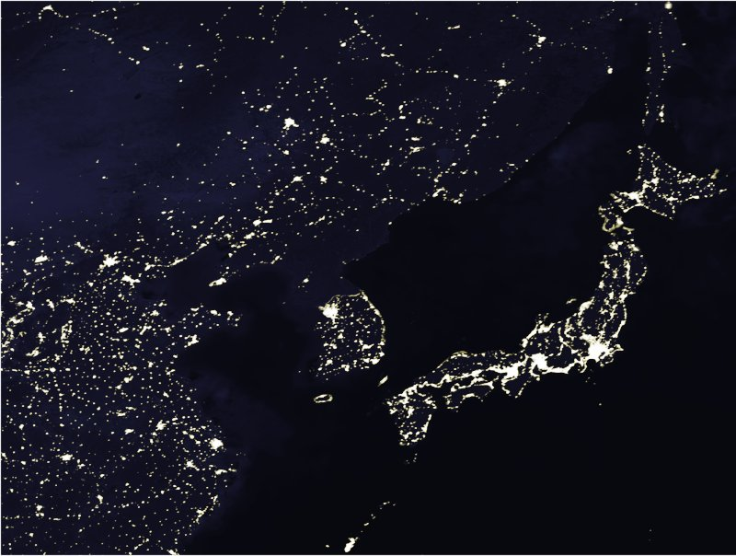
a Universe of Galaxies
How to probe
the structure and dynamics
of the Universe ?
Most mass not visible
Galaxies as light beacons
Use galaxies to map positions
and motions of the galaxies

Slide 14
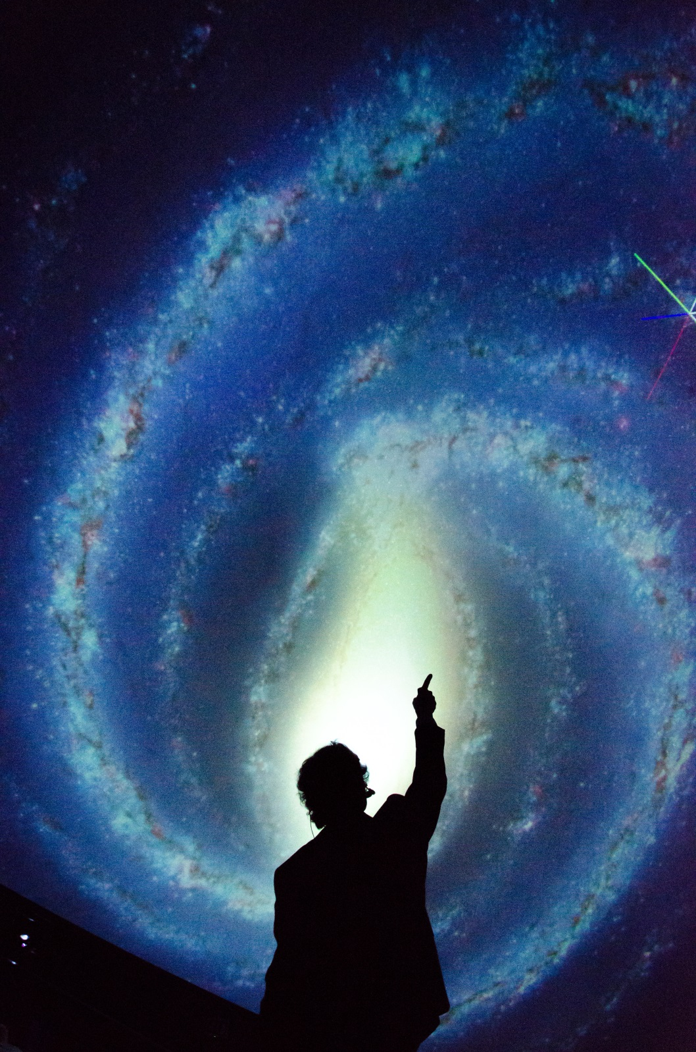
the Galaxy

Slide 15
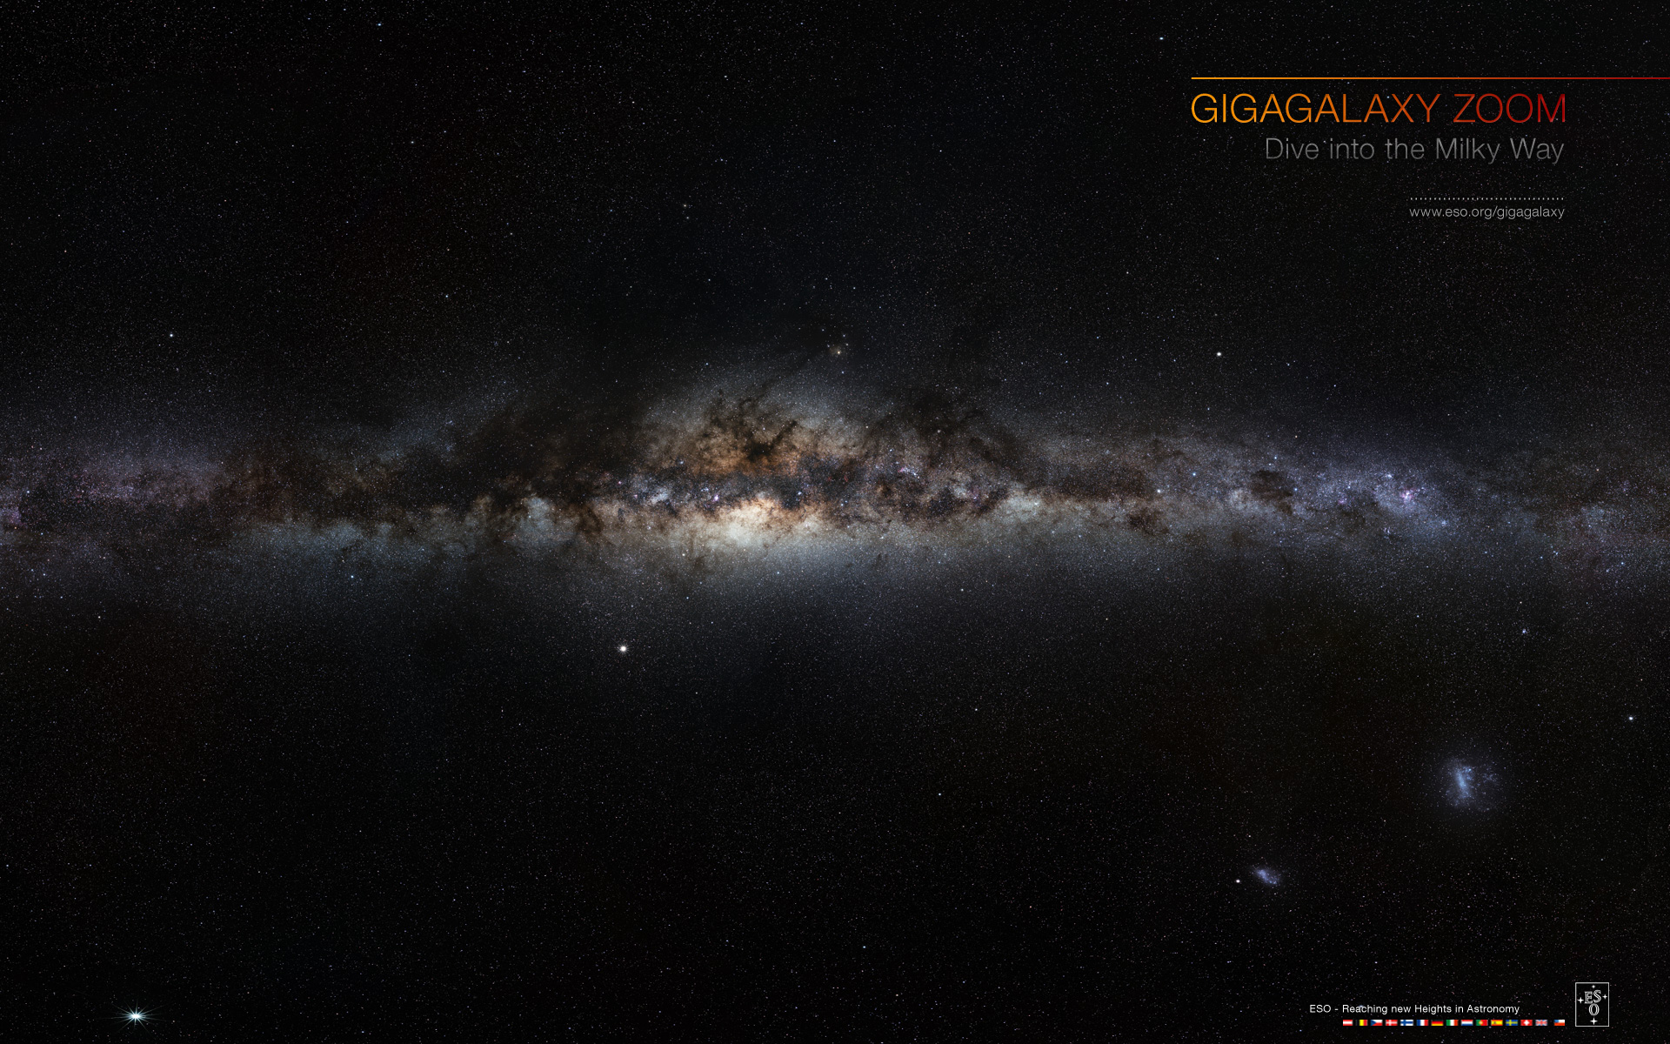
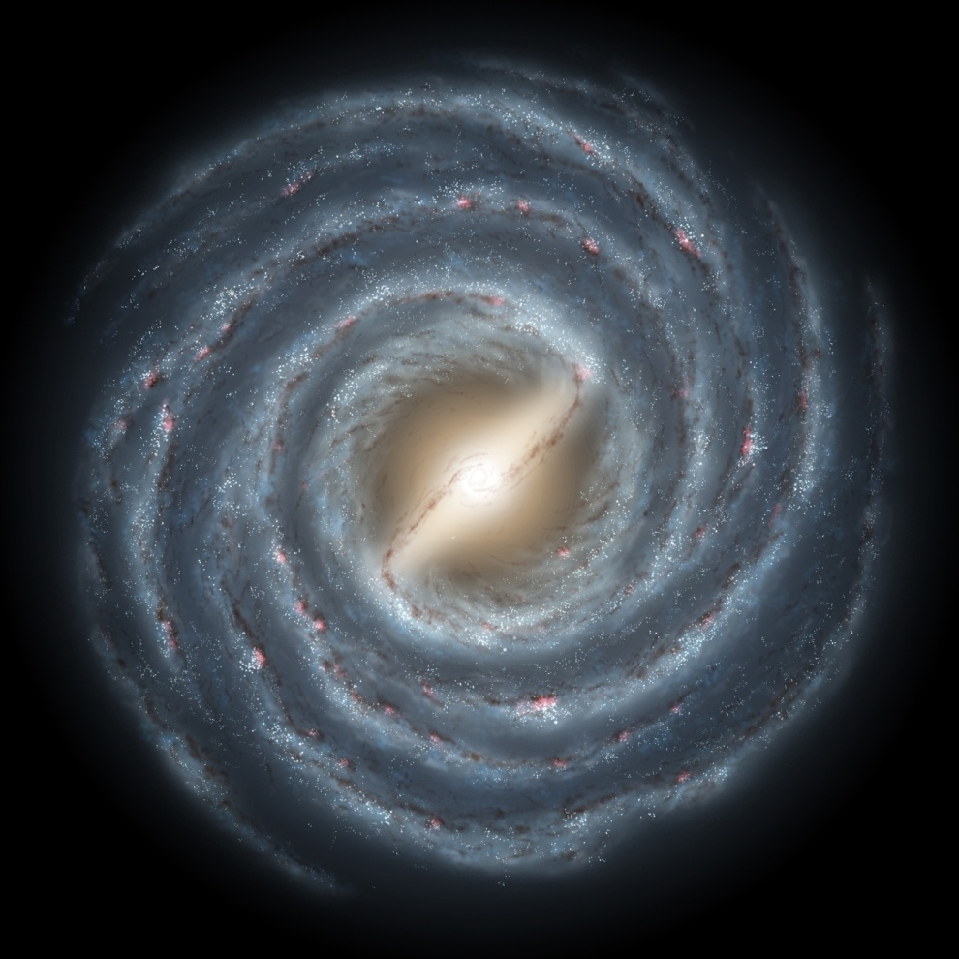
the Milky Way Galaxy: as it would appear from a distant vista point,
outside its plane (face-on view)
.

Slide 16
We live in a galaxy, the Milky Way:
200 billion stars
most concentrated in a thin disk of ~100.000 lightyears diameter
central bulge of mostly redder/older stars around centre Galaxy
Black hole of ~ 1 million solar massses in centre
Sun ~ 30000 lightyears from Centre Galaxy
moves in circular orbit around with period of 220 million years
.
the Milky Way Galaxy: as it would appear from a distant vista point,
outside its plane (face-on view)
.

Slide 17
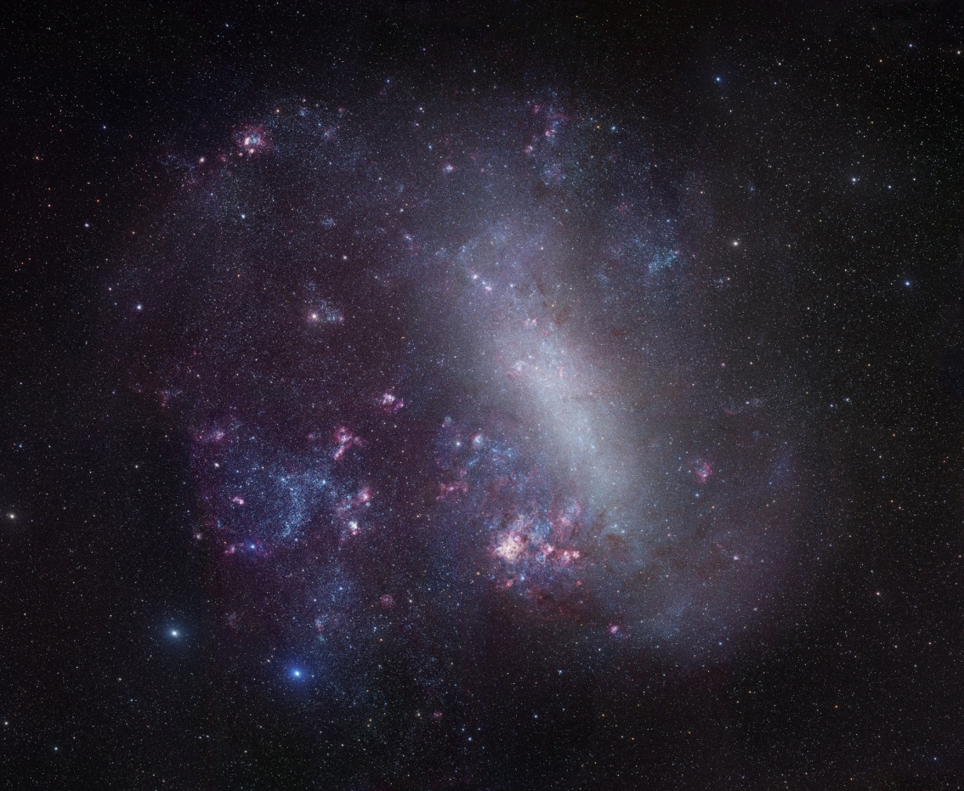
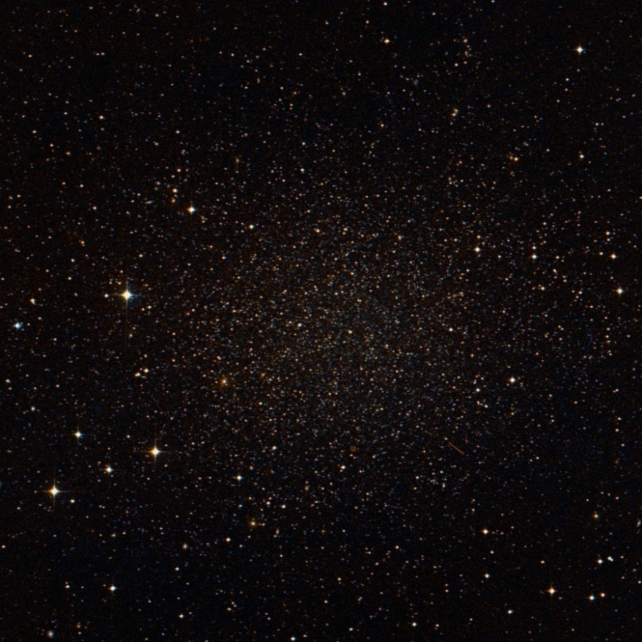
Milky Way Satellites
LMC
Sculptor Dwarf Galaxy
The Milky Way has at least ~14 satellite galaxies.
Large & Small Magellanic Clouds: Irregular galaxies
all other satellite galaxies: Dwarf Spheroidal

Slide 18
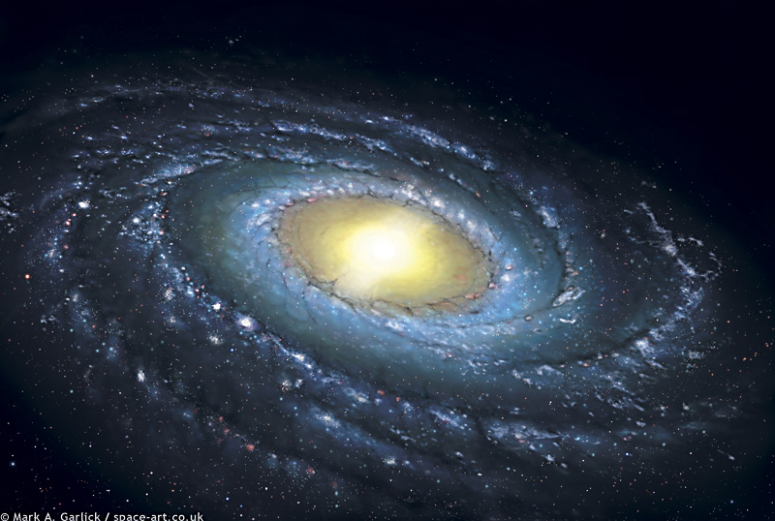
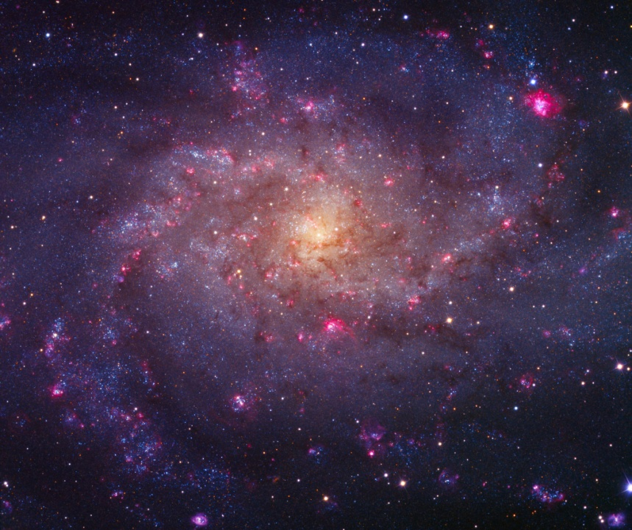
Local Group
M31
NGC 224
Andromeda
Group Portrait
The Galaxy
Milky Way
M33
NGC 598
Triangulum

Slide 19
… Galaxies …

Slide 20
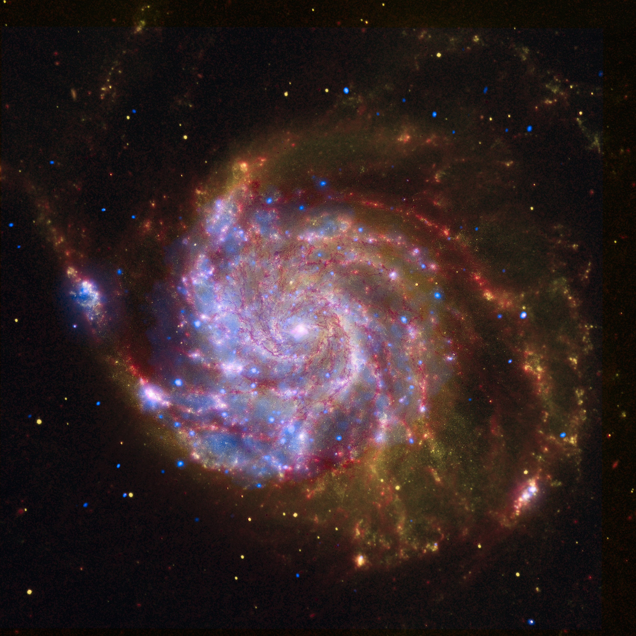
Within the visible Universe:
~ 100 billion galaxies .
… Galaxies …

Slide 21
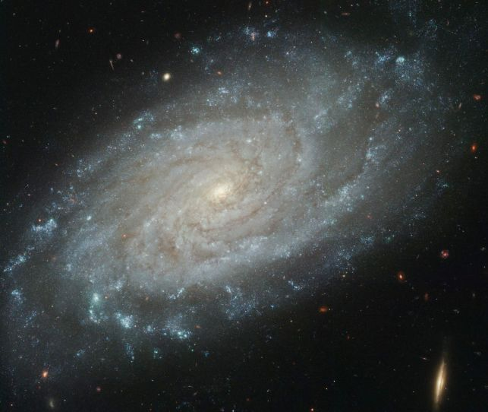
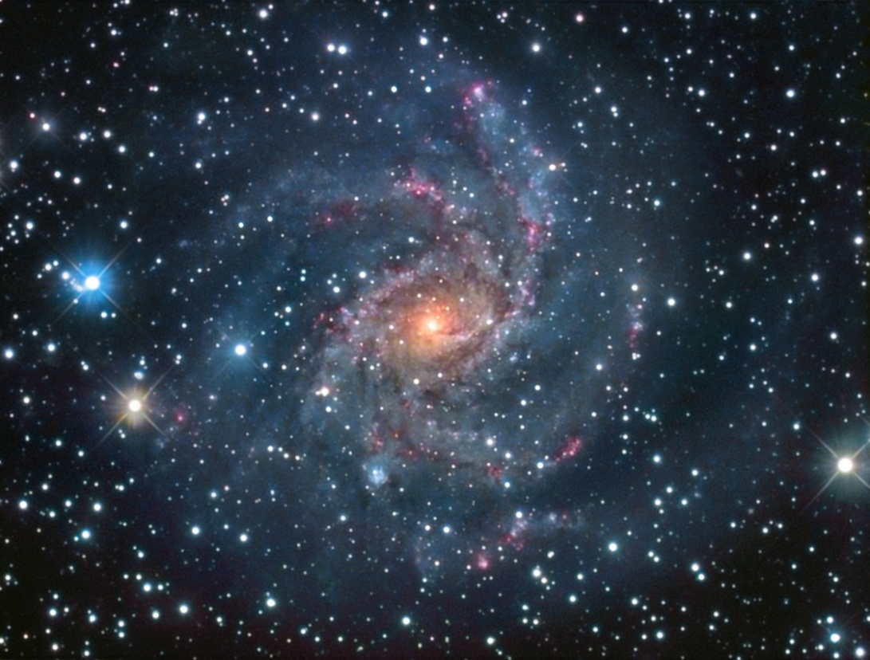
… Spiral
Galaxies …

Slide 22
NGC 1300: a Milky Way look-alike ?

Slide 23
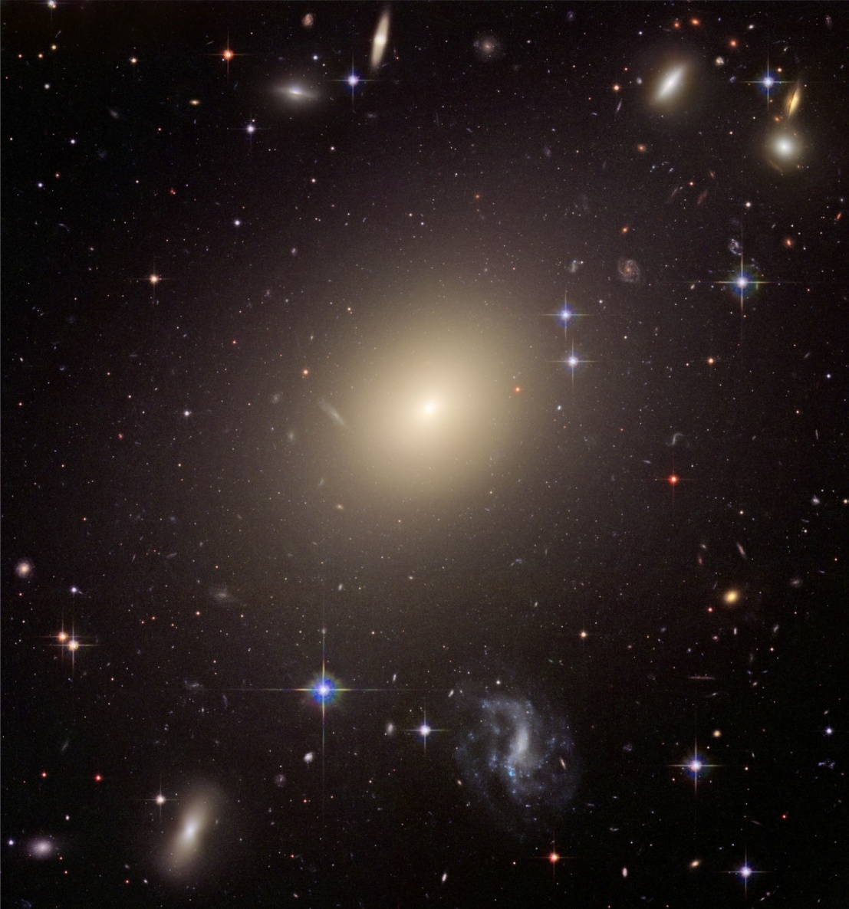
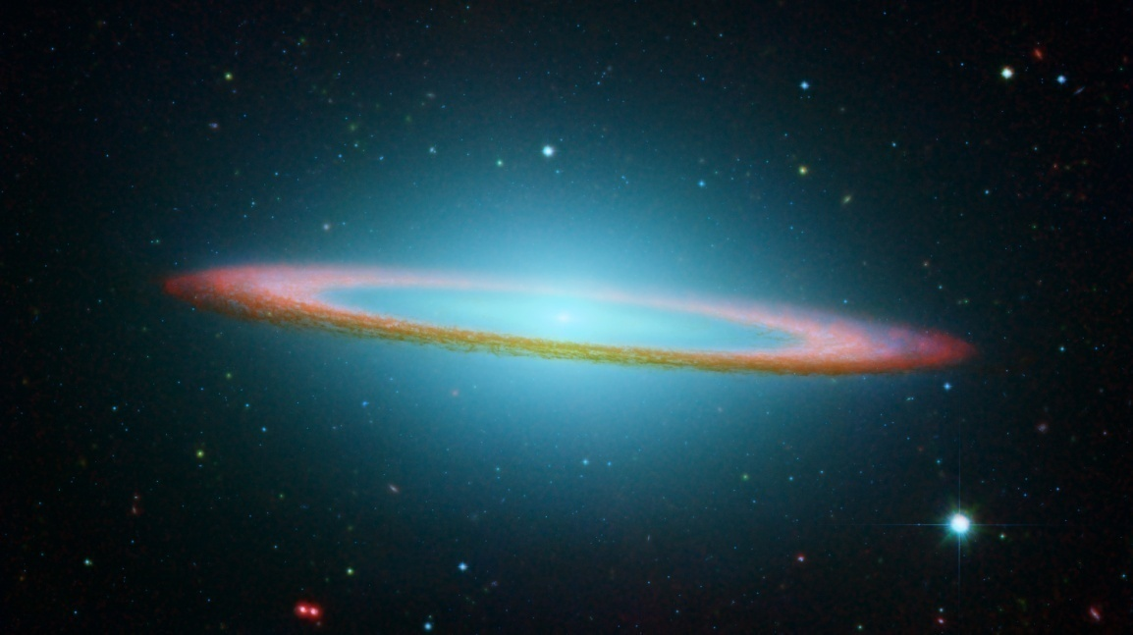
… Elliptical
… Lenticular

Slide 24
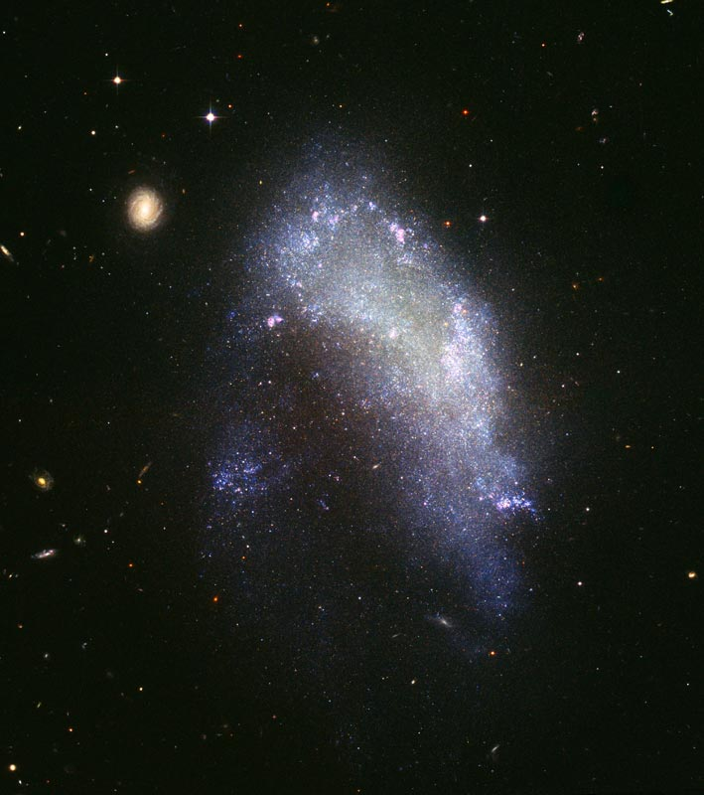
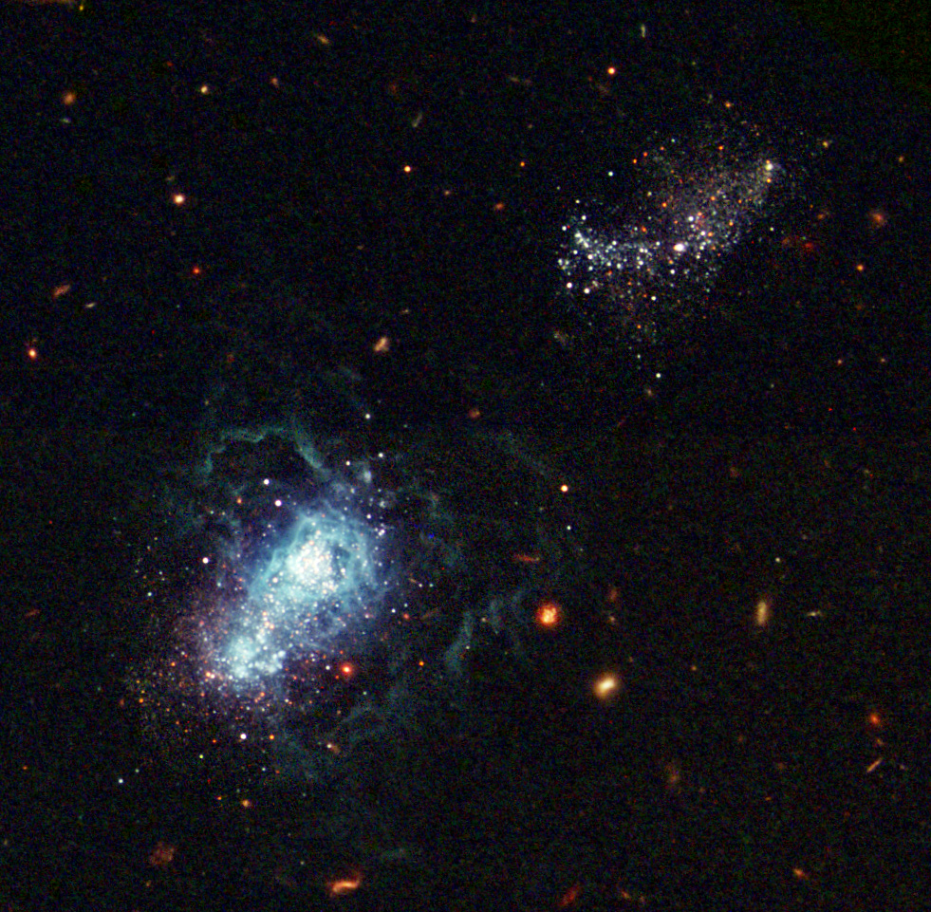
… Irregular
… Dwarf

Slide 26
Galaxies & the Cosmos:
Distances & Motions

Slide 27
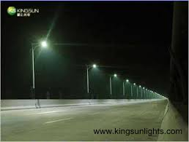
Distance Measurement
Given the vast distances in the Universe, it is impossible to measure distances directly.
Hence, we need to develop indirect methods that allow us to infer
reliable estimates of the distances of objects.
One of the most practical means is based on the comparison between
- observed brightness of an object
(apparent brightness)
- intrinsic brightness of an object
(absolute brightness)
Compare this with distance of streetlights :

Slide 28
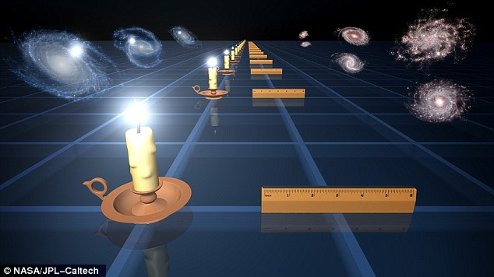
Standard Candles
To determine distances in the Universe, astronomers identify objects
of which they know the intrinsic brightness: standard candles.

Slide 29
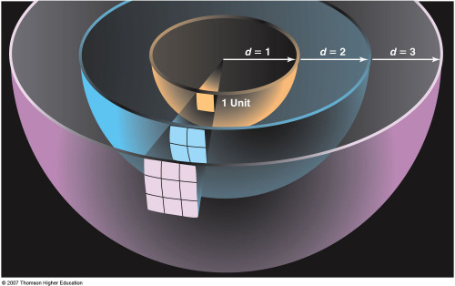
Standard Candles
To determine distances in the Universe, astronomers identify objects
of which they know the intrinsic brightness:
Standard Candles
Knowing the intrinsic luminosity/brightness L_{abs} of a star/object,
and measuring its apparent brightness, or flux S (light through per unit area),
the distance D_{L} may simply be inferred from

Slide 30
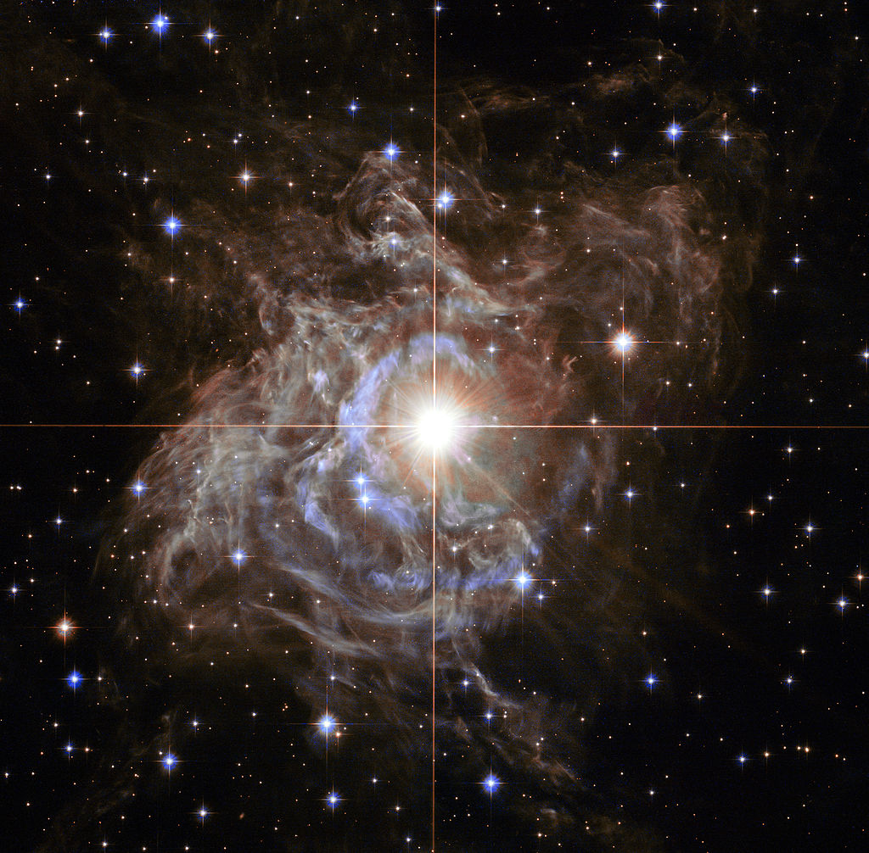
Cepheids: Period-Luminosity
To be able to determine cosmological distances, the reference Standard Candles
need to be very bright objects/stars, whose intrinsic luminosity has been
determined to high precision.
It was Henrietta Swan Leavitt (1868-1921) who
discovered that a particular type of variable stars,
the Cepheid stars,
- whose brightness varies as a result of their
weeks long rhythmic pulsations –
have a characteristic relation between
- the period of their variation/pulsation
- their intrinsic brightness
- the socalled Period-Luminosity relation
As individual Cepheid stars are very bright
- up to 100,000 times the Sun’s luminosity,
with masses in the order of 4-20 M• -
they can be identified in other galaxies
and the distance to those galaxies determined.

Slide 31
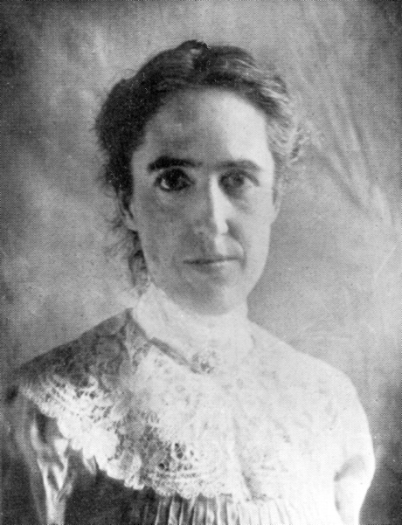
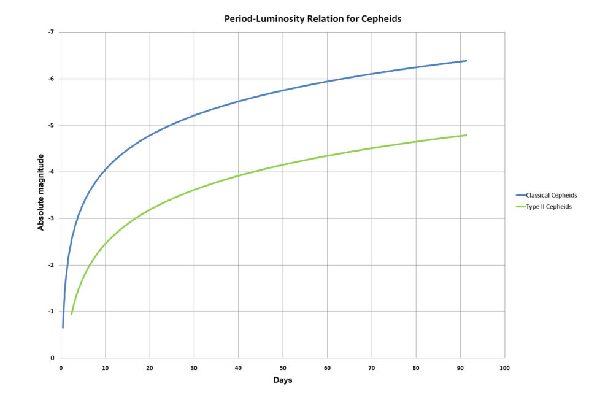
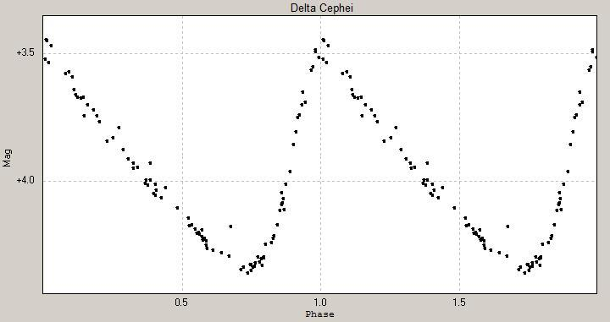
Henrietta Leavitt (1868-1921)
Henrietta Swan-Leavitt started working in 1893 at
Harvard College Observatory as one of the women human computers
hired by Edward Pickering to measure and catalog brightness of
stars on photographic plates.
In this time, she made the fundamental discovery of the
period-luminosity relation of Cepheid stars.
During her lifetime she hardly got recognition for this discovery,
which is one of astronomy’s most significant ones as it allowed
the measurement of extragalactic distances.
Edwin Hubble used this relation to establish the distances to
nearby galaxies and discover the expansion of the Universe.

Slide 32
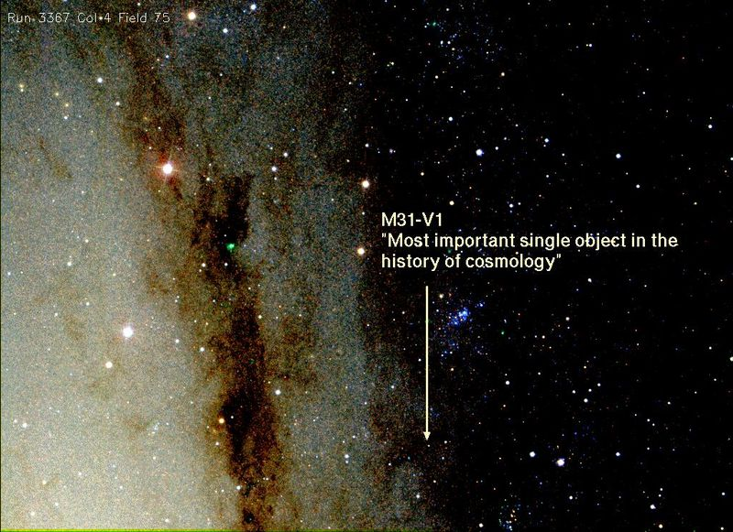
Andromeda-V1

Slide 33
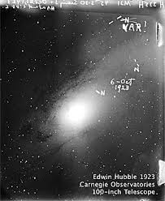
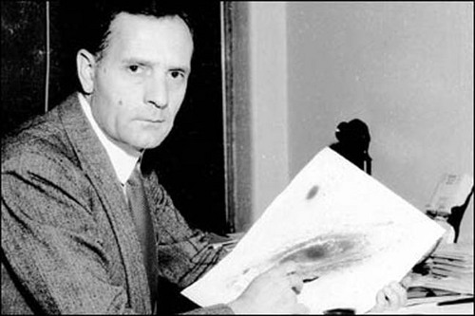
Andromeda-V1: the object that changed the Universe
October 6, 1923:
Edwin Hubble 45 minute exposure of
the Andromeda galaxy M31 with the
100 inch Hooker telescope at Mount Wilson
Identifies 3 stars as N, thinking they are Novae
Comparison with earlier plates of same region,
he realizes one is a variable: VAR !
And that it is a Cepheid variable, enabling the
determination of the distance to M31
finding it is ~ 1 million lightyears
Virtually overnight,
our perception of the Universe, and cosmic distances,
changed radically !

Slide 34
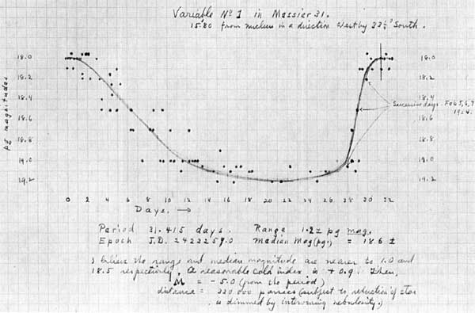
Andromeda-V1: the object that changed the Universe
October 6, 1923:
Edwin Hubble 45 minute exposure of
the Andromeda galaxy M31 with the
100 inch Hooker telescope at Mount Wilson
Identifies 3 stars as N, thinking they are Novae
Comparison with earlier plates of same region,
he realizes one is a variable: VAR !
And that it is a Cepheid variable, enabling the
determination of the distance to M31
finding it is ~ 1 million lightyears
Virtually overnight,
our perception of the Universe,
- of cosmic scales and distances -
changed in a radical and revolutionary way !

Slide 35
Andromeda-V1

Slide 36
Andromeda-V1
In 2010, the
Hubble Space Telescope
followed M31-V1 again.

Slide 37
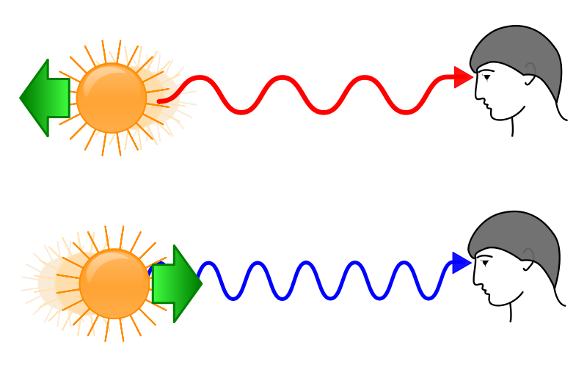
Galaxy Velocities: Redshift
Velocity measurement:
redshift/blueshift of radiation emitted by a source (galaxy, star)
Comparable to Doppler shift:
the wavelength of radiation emitted by a source
changes as it has a velocity towards or away from us:
towards us:
- towards shorter wavelength/higher frequency
- towards blue
away from us:
- towards larger wavelength/lower frequence
- towards red

Slide 38
Doppler Effect
The Doppler effect explains why objects moving towards us or away from us at high speed appear to have their colours shifted either towards blue or red respectively.
When an object moves towards us, the crests of the light waves we see from it are compressed together, making the wavelength of the light shorter (and hence bluer), while for an object moving away the separation between crests is stretched, making the light's wavelength longer (and hence redder). In this simulation, the monochromatic source of light, as it moves right, would appear blue to an observer on the right-hand side, and red to an observer on the left.

Slide 39
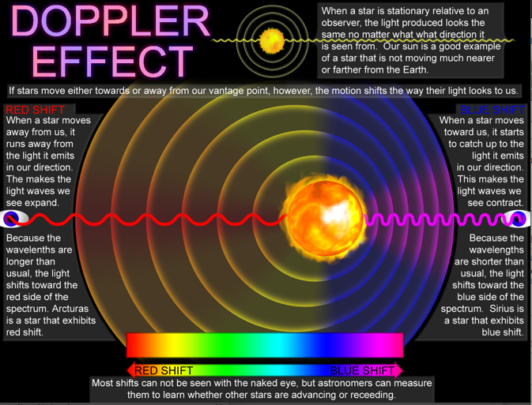

Slide 40
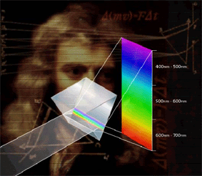
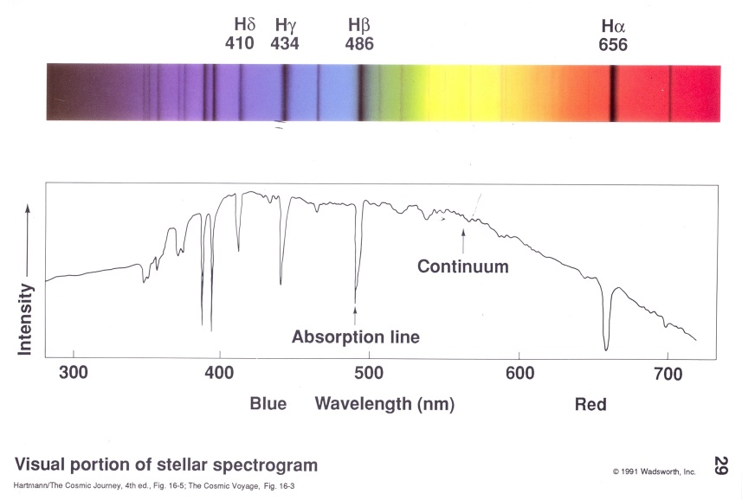
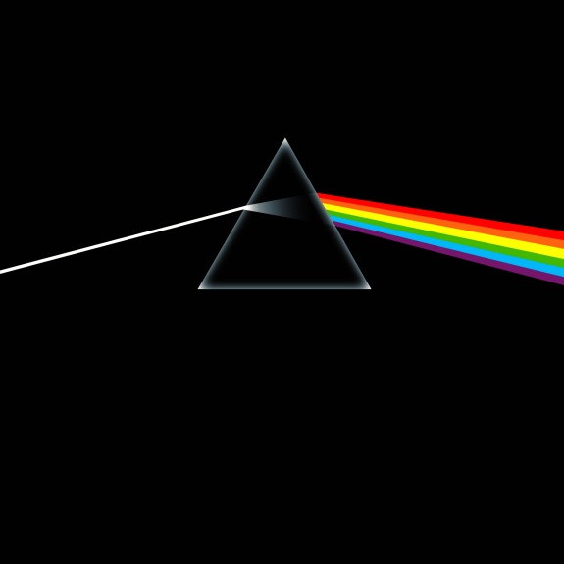
Stellar Spectra & Spectral Lines
Look at the spectrum of the light emitted by a galaxy:
Spectrum: energy distribution of light
red: lower energy
blue: higher energy
Example: use prism to dissect light
In the spectrum of stars, you see a large number of lines:
- light/photons of specific energy/frequencies absorbed
by atoms & molecules in the atmospheres of stars
- the frequencies of these spectral lines are fixed,
by the quantum laws
governing the structure and dynamics of atoms

Slide 41
Solar Spectrum
Notice the signatures/absorption lines of atoms (and molecules) in the atmosphere of the Sun

Slide 42
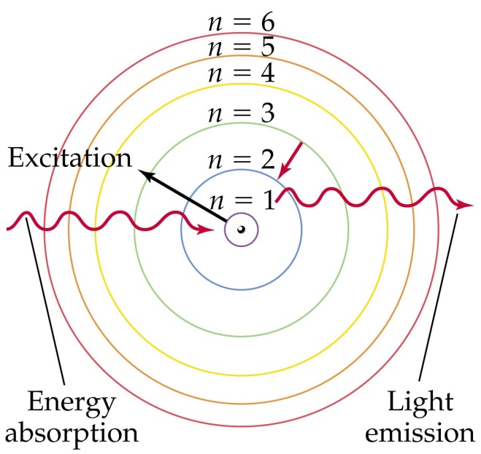
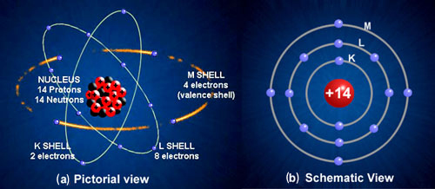
Atoms & Spectral Lines
Atoms (and molecules and other fundamental particles) are highly structured:
- nucleus (consisting of protons and neutrons)
- electron clouds, with electrons encircling the nucleus
The precise structure is hard to imagine, and dictated by quantum physics
(a world our visual imagination cannot fully grasp)
From quantum physics we know that the electrons occupy a discrete set of orbits,
with specific discrete energy levels (unlike the macroscopic world) ,
entirely determined by the structure and dynamics of the atom.
Energy transitions:
discrete jumps between discrete atomic energy levels
The energy transitions go along with
towards higher level:
absorption of photon with
that specific energy
towards lower level:
emission of photon with
that specific energy
Energy of photon = frequency light

Slide 43
Atoms & Spectral Lines
The energy of a photon is directly proportional to
- directly proporotional to its frequency (ie. colour) 
- inversely proportional to its wavelength 
in this: c - velocity of light; h – Planck constant
The energy transitions go along with
towards higher level:
absorption of photon with
that specific energy
towards lower level:
emission of photon with
that specific energy
Energy of photon = frequency light

Slide 44
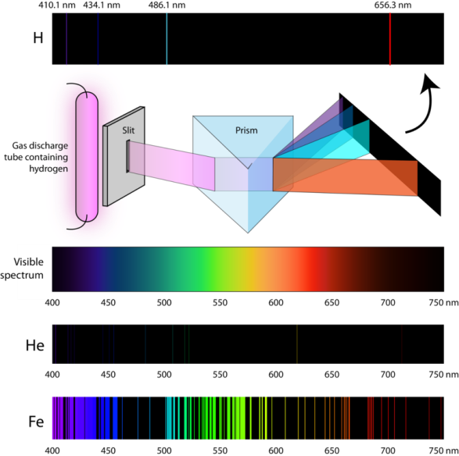
Redshift Measurement & Spectral Lines
When a star moves wrt. us, its light gets
redshifted (away from us) or blueshifted (towards us)
Also the spectral lines get shifted,
ie. the frequency of the photons that were
absorbed or emitted by the atoms in the
stellar atmosphere.
This provides the astronomer with a powerful tool:
- find the spectral lines in a stellar spectrum
- identify which atomic transition they correspond to
- this always corresponds to very specific
frequency / wavelength:
the rest frequency ₀
rest wavelength ₀
of the transition
- compare this with the measured
(redshifted or blueshifted) frequency /
wavelength 
Redshift:

Slide 45
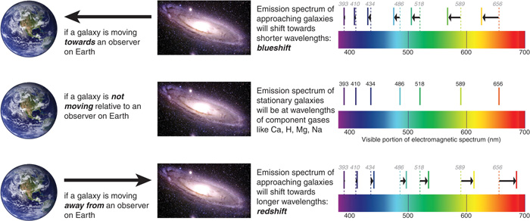
Galaxy Spectra & Cosmic Redshift
Galaxy spectra:
- the combined light of 100s billions of stars
- absorption lines mark the frequencies at which the
atmospheres of the stars in the galaxy have absorbed
light emitted by the stars
Galaxy redshift determination:
- identify (well-known and strong) spectral lines
- compare to rest wavelength, then determine z
- light/photons of specific energy/frequencies absorbed

Slide 46
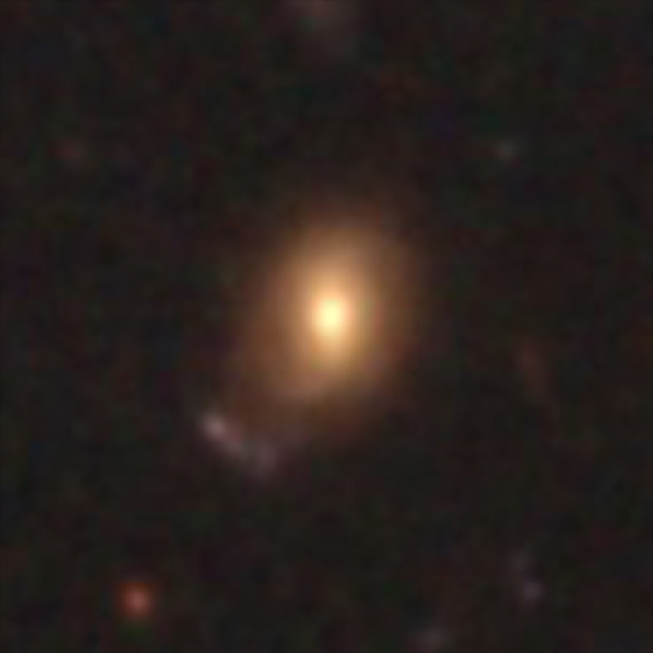
Redshifted Galaxy

Slide 47
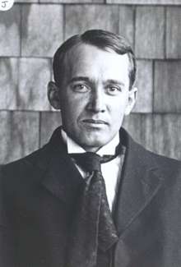
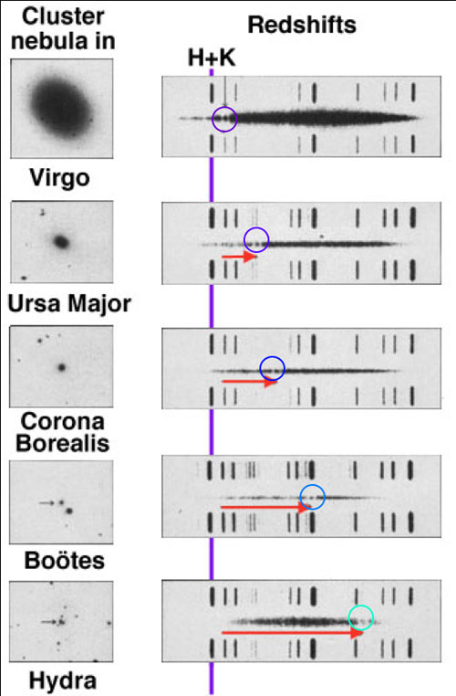
Slipher & Galaxy Redshifts
Vesto Slipher
(1875-1969)
US astronomer who was the first
to measure redshifts of galaxies
For a major part of his career
he was director of
Lowell Observatory,
Flagstaff, Arizona, USA
1913: Slipher finds that the spectrum of M31 is shifted to
blue, corresponding to a velocity of ~ 300 km/s
Note: and, indeed, M31 is belonging with our Galaxy
to a dense group of galaxies, the Local Group,
and is moving towards us.
M31 and the Galaxy will collide in 4.5 billion years
1914: additional redshifts of 14 spirals,
some blueshifted (approaching),
some redshifted (moving away)

Slide 48
Slipher & Galaxy Redshifts
Vesto Slipher
(1875-1969)
US astronomer who was the first
to measure redshifts of galaxies
For a major part of his career
he was director of
Lowell Observatory,
Flagstaff, Arizona, USA
1917: Slipher measures more galaxy redshifts:
- more and more galaxies are redshifted
- proportion of redshifted galaxies such that it is no
longer in accordance with random galaxy motions
AND
- redshift on average larger as
galaxy is smaller (ie. seems further away) !!!!!
Is there a physical relationship between
Radial Velocity and Distance of a galaxy ???

Slide 49
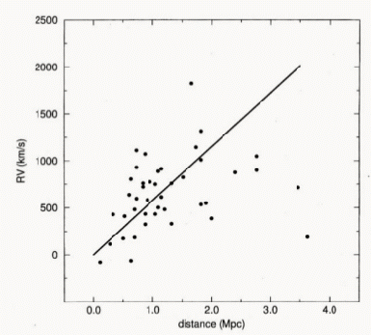
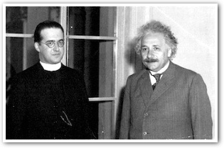
Cosmic Expansion: first indications
1925: Lundmark, Swedish astronomer (1889-1958)
- radial velocity 44 galaxies
- rough distance estimates,
comparing distances and brightnesses
- comparing to M31, estimated to be at 650,000 ly
(in fact ~2,000,000 ly).
Lundmark concluded that there may be a relationship
between galactic redshift and distance,
but “not a very definitive one”
1927:
Georges Lemaitre
(1894-1966)
Belgian priest
One of few who by
1920s understood
General Relativity,
Predicted linear
relationship
redshift – distance
and ... inferred it from data
Block 2011

Slide 50
Lemaitre Expansion ?
Georges Lemaitre (1894-1966)
On the basis of the General Theory of Relativity,
Lemaitre derived the equations describing the expansion of the
Universe:
Friedmann-Robertson-Walker-Lemaitre equations
He then went on to show that this predicted a linear
relation between redshift/recession velocity and distance.
In a remarkable paper, in an “obscure” French-language journal,
1927, Annales de la Societe Scientifique de Bruxelles, A47, 49
he then used redshifts and distances of 42 galaxies to show
that it seems indeed there is such a relation, and inferred the
slope of the relation, now known as the “”Hubble constant”
He assumed that the absolute brightness of galaxies can be
used as standard candle, and thus inferred distances on the
basis of galaxy brightnesses.
Strangely enough, when the paper got later translated into
English, the passage in which the expansion constant was
determined got omitted.
Had Hubble tried to cover up the earlier finding of expansion
by Lemaitre ? A few years it was found Lemaitre himself who
had tranlated the paper.
Note: the scatter of the distance estimates on the basis
of intrinsic brightness has a large scatter.. Significance of
result was not very strong.

Slide 51
Hubble Expansion – Hubble Law
Finally, the ultimate evidence for an expanding Universe follows in 1929,
when Edwin Hubble (1889-1953) describes his finding of a
linear recession velocity – distance relation
This relation is now known as the Hubble Law.
A relation between distance and radial velocity among extragalactic nebulae
E. Hubble, Proc. Nat. Acad. Sciences, 1929, 15, 168-173
Note: Hubble himself never grasped that this was the evidence for an
expanding Universe as described by the Friedmann-Lemaitre equations,
ie. as implied by Einstein’s theory of General Relativity.
Hubble constant
specifies expanssion rate of the Universe

Slide 52
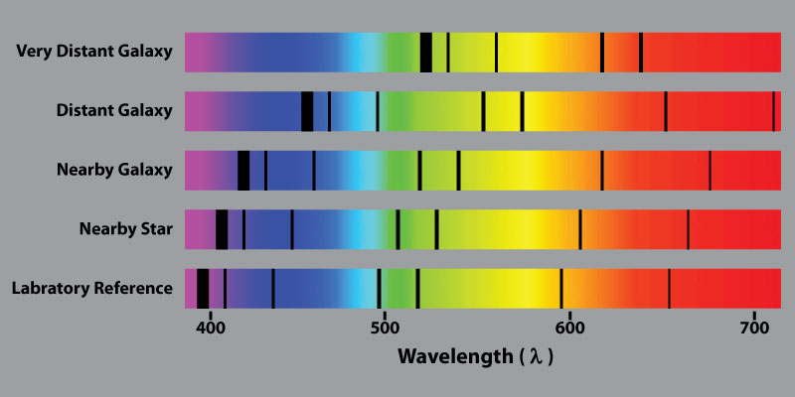
Hubble Expansion & Galaxy Redshift
The Hubble law tells us that the further a galaxy is, the more redshifted it is.
Moreover, because this a linear relation, we can even estimate distances to galaxies once we know
the value of the Hubble constant !

Slide 53
Hubble Expansion
Edwin Hubble
(1889-1953)
v = H r
Hubble Expansion

Slide 54
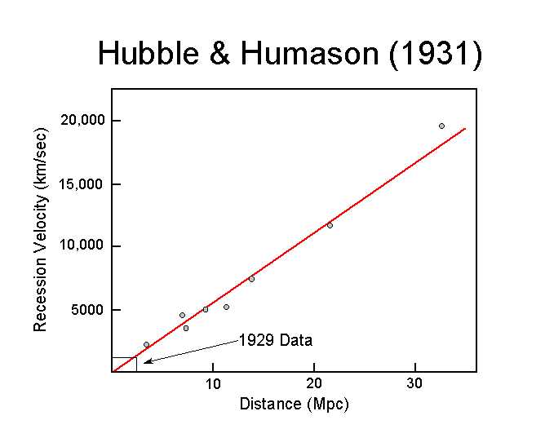
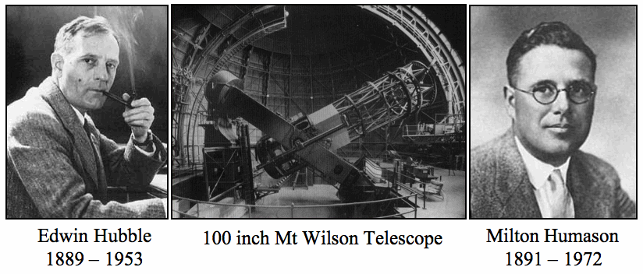
Hubble – Humason (1931)
It was in the additional publication by Hubble & Humason (1931) that the linear Hubble relation was firmly established to far larger depths into the Universe:
Hubble, Humason, 1931, Astrophys. J., 74, 43
Humason (1891-1972) assisted Hubble, and did most of the work on
world’s most powerful telescope at the time, the 100 inch Mt. Wilson telescope.
Humason did not have a PhD, left school at 14, and was hired as janitor at Mt. Wilson Observatory.
His role in the discovery of the expansion of the Universe was seminal.

Slide 55
Hubble Diagram: end 20th Century

Slide 57
Interpreting Hubble Expansion
Cosmic Expansion manifests itself in the
in a recession velocity which linearly increases with distance
this is the same for any galaxy within the Universe !
There is no centre of the Universe:
would be in conflict with the Cosmological Principle

Slide 58
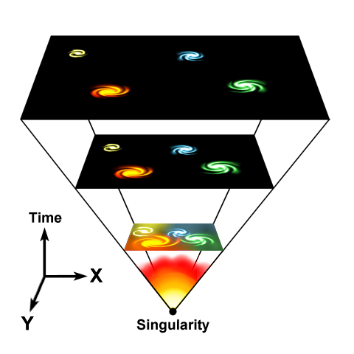
Expanding Universe
Einstein, de Sitter, Friedmann and Lemaitre all realized that in
General Relativity, there cannot be a stable and static Universe:
The Universe either expands, or it contracts …
Expansion Universe encapsulated in a
GLOBAL expansion factor a(t)
All distances/dimensions of objects
uniformly increase by a(t):
at time t, the distance between
two objects i and j has increased to
Note: by definition we chose a(t₀)=1,
i.e. the present-day expansion factor

Slide 59
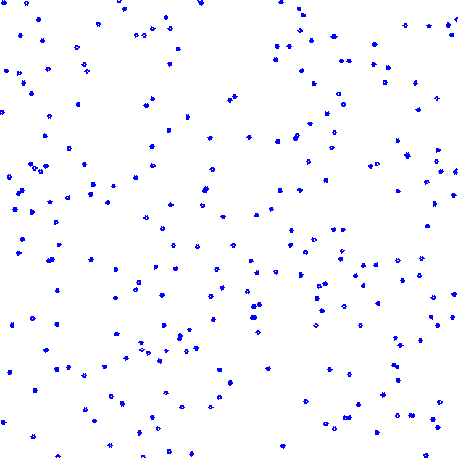
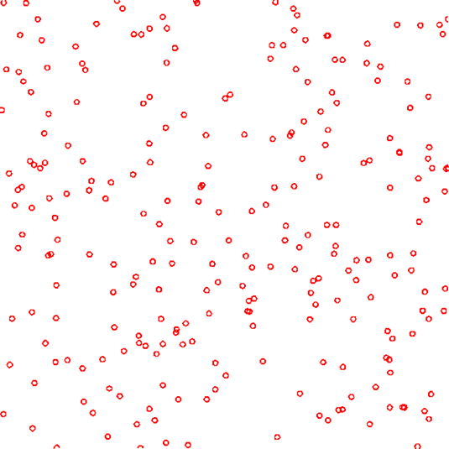
Hubble Expansion
Space expands:
displacement - distance Hubble law: velocity - distance

Slide 66
Hubble Parameter
For a long time, the correct value of the Hubble constant H₀
was a major unsettled issue:
H₀ = 50 km s⁻¹ Mpc⁻¹ H₀ = 100 km s⁻¹ Mpc⁻¹
This meant distances and timescales in the Universe had to
deal with uncertainties of a factor 2 !!!
Following major programs, such as Hubble Key Project, the
Supernova key projects and the WMAP CMB measurements,

Slide 67
Hubble Time
• The repercussions of Hubble’s discovery are truly tremendous:
the inescapable conclusion is that the universe has a finite age !
• Just by simple extrapolation back in time we find that at some instant the objects will
have touched upon each other, i.e. r(t_{H})=0. If we assume for simplicity that the
expansion rate did remain constant (which it did not !), we find a direct measure for
the age of the universe, the
Hubble Time:
The Hubble parameter is usually stated in units of km/s/Mpc.
It’s customary to express it in units of 100 km/s/Mpc, expressing the real value in terms of
the dimensionless value h=H₀/[100 km/s/Mpc].
The best current estimate is H₀=72 km/s/Mpc. This sets t₀~10 Gyr.

Slide 68
Cosmic
Redshift

Slide 69
Cosmic Redshift & Expansion
As a result of the expansion of the Universe,
not only distances get stretched:
also the wavelength of light stretches along
with the cosmic expansion
Cosmic Redshift z:
directly related to the expansion factor a(t) at which
light gets emitted
As a result, redshift z can be directly translated into:
• distance of observed object
• via its 1-1 relation with expansion factor a(t),
alternative indication cosmic time t

Slide 70
Cosmic Redshift

Slide 71
Expansion
Accelerates !

Slide 72
Science Magazine 1998
Science
Breakthrough of the Year
1998

Slide 73
☹
Einstein’s Biggest Blunder

Slide 74
Type Ia Supernovae

Slide 75
Supernova Explosion & Host Galaxy
M51 supernovae

Slide 76
Type Ia Supernova Explosion

Slide 78
Type Ia Supernova
Amongst the most energetic explosions in our Universe:
E ~ 10⁵⁴ ergs
During explosion the star is as bright as entire galaxy ! (ie. 10¹¹ stars)
• Violent explosion Carbon-Oxygen white dwarfs:
• Embedded in binary, mass accretion from companion star
• When nearing Chandrasekhar Limit (1.38 M•), electron degeneracy pressure
can no longer sustain star.
• while contracting under its weight, carbon fusion sets in, powering a
catastrophic deflagration or detonation wave,
• leading to a violent explosion, ripping apart entire star
• Because exploding stars have nearly uniform progenitor (~1.38 M• white dwarf),
their luminosity is almost the same: M ~ -19.3
Standard Candle

Slide 79
SN1006
Supernova SN1006:
brightest stellar event recorded in history

Slide 80
SN1006
Supernova SN1006:
- brightness: m = -7.5
distance: d=2.2 kpc
recorded: China, Egypt, Iraq, Japan,
Switzerland, North America
Supernova SN1006:
brightest stellar event recorded in history

Slide 81
SN1006
Supernova SN1006:
- brightness: m = -7.5
distance: d=2.2 kpc
recorded: China, Egypt, Iraq, Japan,
Switzerland, North America
present-day
Supernova Remnant
Supernova SN1006:
brightest stellar event recorded in history

Slide 82
White Dwarfs

Slide 83
Low Mass Stars
Sirius B

Slide 85
Chandrasekhar Mass Limit
What is the maximum mass that can be supported by
the dense compact material of a white dwarf star?

Slide 86
Supernova Lightcurves

Slide 87
SN 2007uy
Supernova SN 2007uy in NGC2770
while fading, another supernova, SN2008D, went off in same galaxy

Slide 88
Supernova Lightcurve & Spectrum

Slide 89
the Phillips Relation
Relationship between
peak luminosity of a Type Ia supernova
speed of luminosity evolution after maximum light.
Mark Phillips (1993):
on the basis of Calan/Tololo Supernova Survey
the faster a supernova fades after peak,
the fainter its intrinsic peak luminosity
reduces scatter in Hubble diagram to <0.2 mag
heuristic relationship, as yet not theoretically “understood”

Slide 90
Cosmic Acceleration

Slide 91
Supernova Cosmology Project
High-z Supernova Search Team

Slide 92
Supernova Cosmology Project
diligently monitoring millions
of galaxies, in search for that
one explosion …
High-z Supernova Search Team

Slide 93
Cosmic Acceleration
Hubble Diagram high-z SNIa
• distance vs. redshift z
m-M vs. redshift z
• determine:
- absolute brightness of supernova Ia
- from dimming rate (Phillips relation)
• measure:
- apparent brightness of explosion
• translates into:
- luminosity distance of supernova
- dependent on acceleration parm. q

Slide 94
High-z SNIa: sample

Slide 95
Cosmic Acceleration
Hubble Diagram high-z SNIa
distance vs. redshift z
m-M vs. redshift z
• determine:
- absolute brightness of supernova Ia
- from dimming rate (Phillips relation)
• measure:
- apparent brightness of explosion
• translates into:
- luminosity distance of supernova
- dependent on acceleration parm. q

Slide 96
Cosmic Acceleration
Relative Hubble Diagram
∆(m-M) vs. Redshift z
with Hubble diagram for empty Universe
Ω_{m}=0.0, Ω_{Λ}=0.0
as reference.
Acceleration of the Universe:

Slide 97
Present:
ACCELERATION
Past:
DECELERATION

Slide 99
Cosmic Deceleration
Before current Dark Energy epoch
• Universe dominated by matter:
Decelerating Expansion
Observable in SNIa at very high z:
z > 0.73
Cosmic deceleration:
SNIa brighter
Cosmic acceleration:
SNIa fainter

Slide 100
Beyond Acceleration: SNe Ia at z > 0.7
Five high-z SNIa, images HST-ACS camera
SNIa and host galaxies lower panel: before
top panel: after explosion)

Slide 101
Cosmic Deceleration
Before current Dark Energy epoch
• Universe dominated by matter:
Decelerating Expansion
• Observable in SNIa at very high z:
z > 0.73

Slide 102
Nobel Prize Laureates
Adam Riess
Saul Perlmutter
Brian Schmidt

