Slide 1
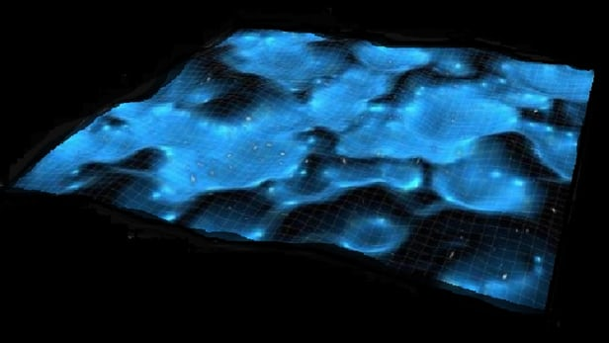

Gravity:
Ruler of the Universe

Slide 2
Gravity:
Ruler of the Universe

Slide 3
Four Fundamental Forces of Nature
Strong Nuclear Force
Responsible for holding particles together inside the nucleus.
The nuclear strong force carrier particle is called the gluon.
The nuclear strong interaction has a range of 10⁻¹⁵ m (diameter of a proton).
Electromagnetic Force
Responsible for electric and magnetic interactions, and determines structure of
atoms and molecules.
The electromagnetic force carrier particle is the photon (quantum of light)
The electromagnetic interaction range is infinite.
Weak Force
Responsible for (beta) radioactivity.
The weak force carrier particles are called weak gauge bosons (Z,W⁺,W⁻).
The nuclear weak interaction has a range of 10⁻¹⁷ m (1% of proton diameter).
Gravity
Responsible for the attraction between masses. Although the gravitational force carrier
The hypothetical (carrier) particle is the graviton.
The gravitational interaction range is infinite.
By far the weakest force of nature.

Slide 4
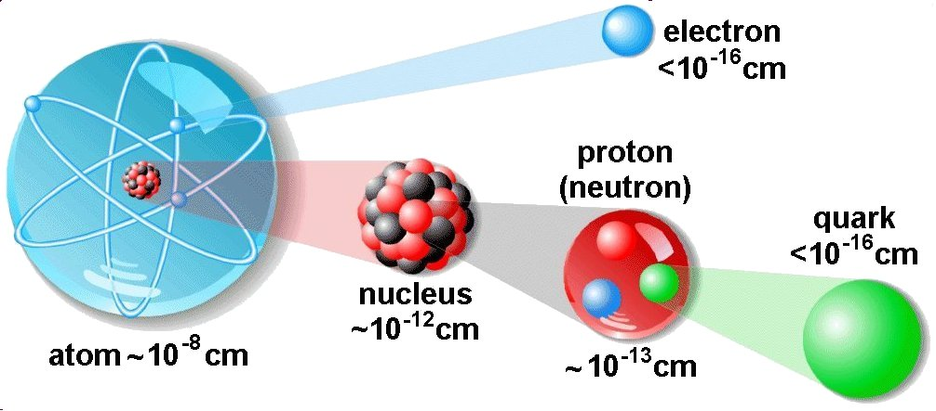
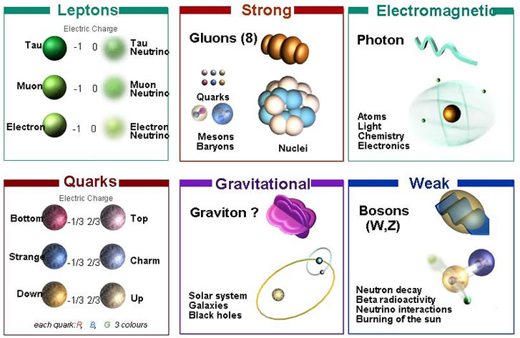
Four Fundamental
Forces of Nature

Slide 5
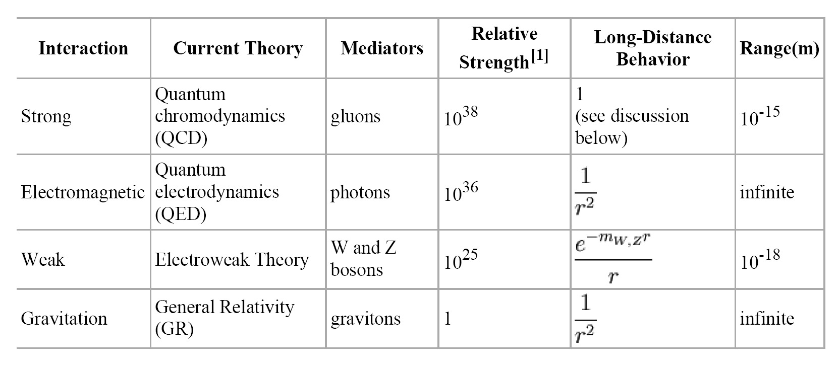
The weakest force is Gravity !
However, note that
.

Slide 6
The weakest force is Gravity !
However:
its range is infinite, not shielded
it is cumulative as all mass adds,
while electromagetic charges can be + or - , cancelling each others effect.

Slide 7
The weakest force, by far, rules the Universe …
Gravity has dominated its evolution, and determines its fate …

Slide 8
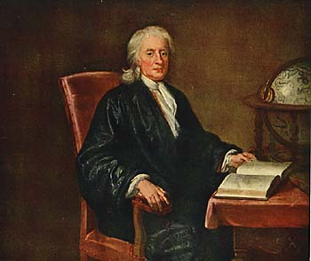
Newton’s
Static Universe

Slide 9
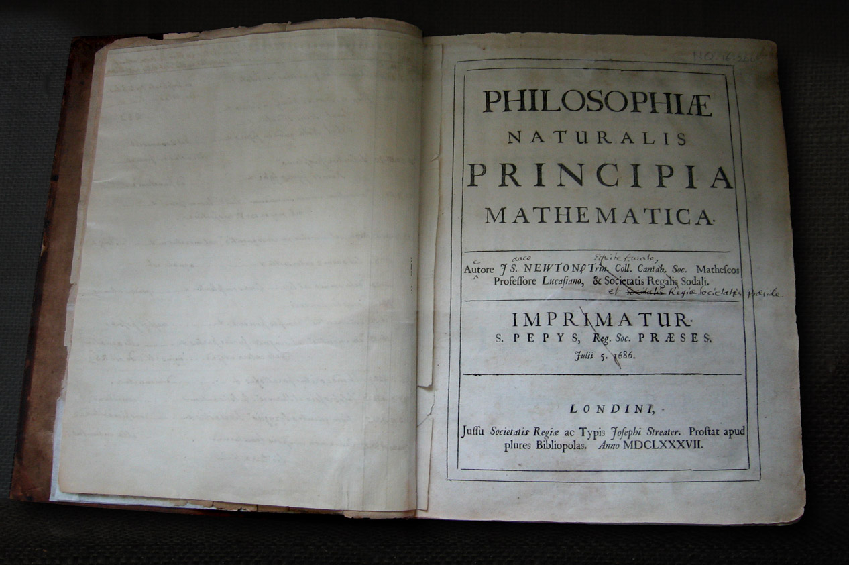
Isaac Newton
(1642-1726)

Slide 10
Newton's
Laws of Motion
Newton’s 1st Law:
zero force - body keeps constant velocity
Newton’s 2nd Law:
force = acceleration x mass = change of velocity x mass
Newton’s 3rd Law:
action = reaction

Slide 11
Newton's Gravity

Slide 12
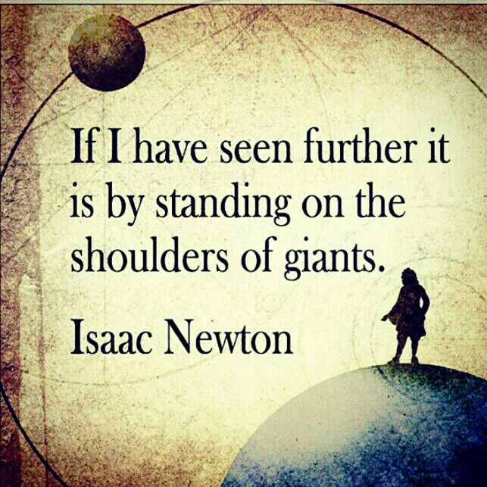

Slide 13
The Unchanging Universe
• In two thousand years of astronomy,
no one ever guessed that the universe might be expanding.
• To ancient Greek astronomers and philosophers,
the universe was seen as the embodiment of perfection,
the heavens were truly heavenly:
– unchanging, permanent, and geometrically perfect.
• In the early 1600s, Isaac Newton developed his law of gravity,
showing that motion in the heavens obeyed the same laws
as motion on Earth.

Slide 14
Newton's Universe
• However, Newton ran into trouble when he tried to apply
his theory of gravity to the entire universe.
• Since gravity is always attractive,
his law predicted that all the matter in the universe should
eventually clump into one big ball.
• Newton knew this was not the case, and assumed that
the universe had to be static
• So he conjectured that:
the Creator placed the stars such that they were
``at immense distances from one another.’’

Slide 15
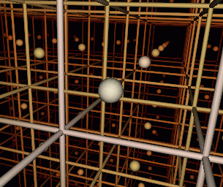
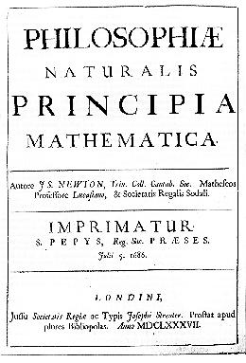
Renaissance of Western Science
In footsteps of Copernicus, Galilei & Kepler,
Isaac Newton (1687) in his Principia
formulated a comprehensive model of the
world. Cosmologically, it meant
absolute and uniform time
space & time independent of matter
dynamics: - action at distance
- instantaneous
Universe edgeless, centerless & infinite
Cosmological Principle:
Universe looks the same at every
place in space, every moment in time
absolute, static & infinite space

Slide 16
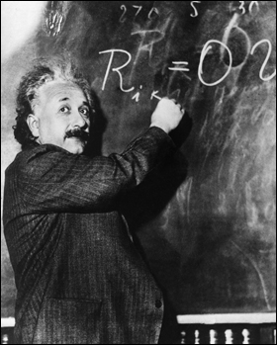
Einstein’s
Dynamic & Geometric
Universe

Slide 17
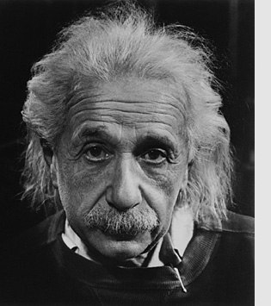
Albert Einstein
Albert Einstein
(1879-1955; Ulm-Princeton)
father of
General Relativity (1915),
opening the way towards
Physical Cosmology
The supreme task of the physicist is to arrive at those universal elementary laws from which the cosmos can be built up by pure deduction.
(Albert Einstein, 1954)

Slide 18
Relativity: Space & Time
Special Relativity,
published by Einstein in 1905
states that there is no such thing as
absolute Space or Time
Space and Time are
not wholly independent,
but aspects of a single entity,
Spacetime

Slide 19
Einstein’s principle of relativity
Principle of relativity:
  All the laws of physics are identical in all inertial reference frames.
Constancy of speed of light:
  Speed of light is same in all inertial frames
  (e.g. independent of velocity of observer, velocity of source emitting light)

Slide 20
Relativity:
Space & Time

Slide 21
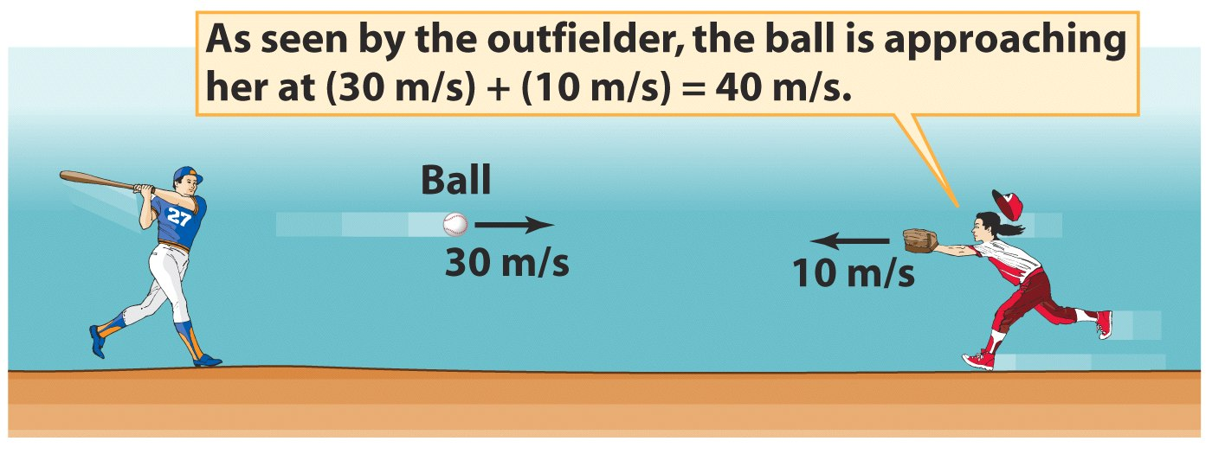
Galilean Relativity

Slide 22
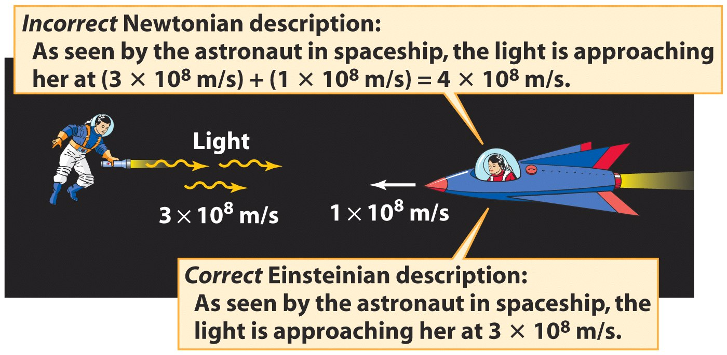
Constant Speed of Light

Slide 23
Relativistic Spacetime
speed of light constant = c = 3 x 10⁸ km/s
in all reference systems
Only possible if time and space not absolute, but dependent
on reference system
Manifests itself:
- Time dilation
- Length contraction
- Relativity of Simultaneity

Slide 24
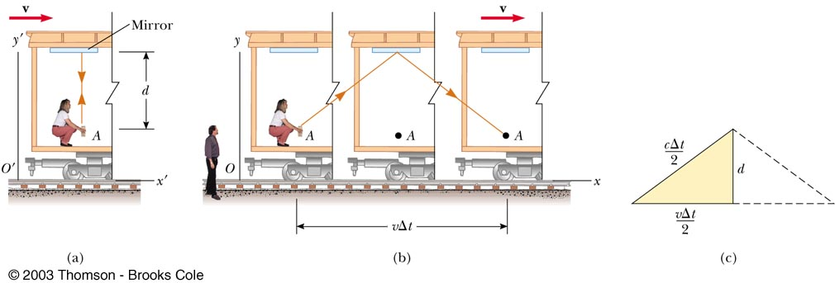
Time Dilation
Time interval in frame train passenger
(observer 1)
Observer 2 measures a longer time
Lorentz factor:

Slide 25
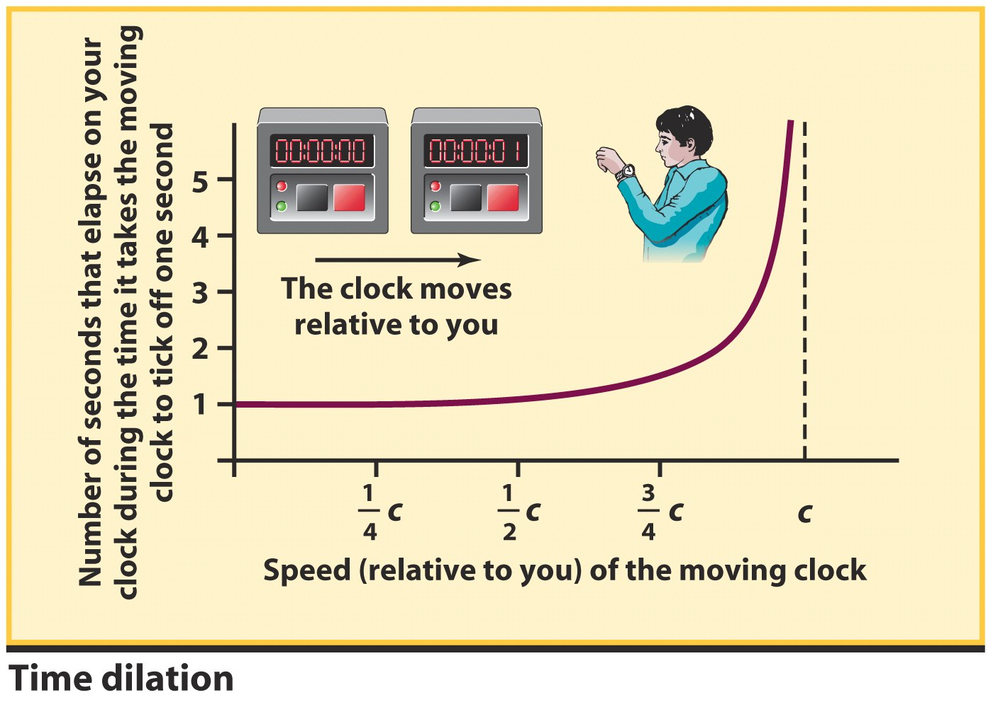
An observer will note a
- slowing of clocks
(time dilation)
- a shortening of rulers
(length contraction) that are moving with respect to the observer
Time Dilation
This effect becomes significant only if
the clock or ruler is moving at a
substantial fraction of the speed of light

Slide 26
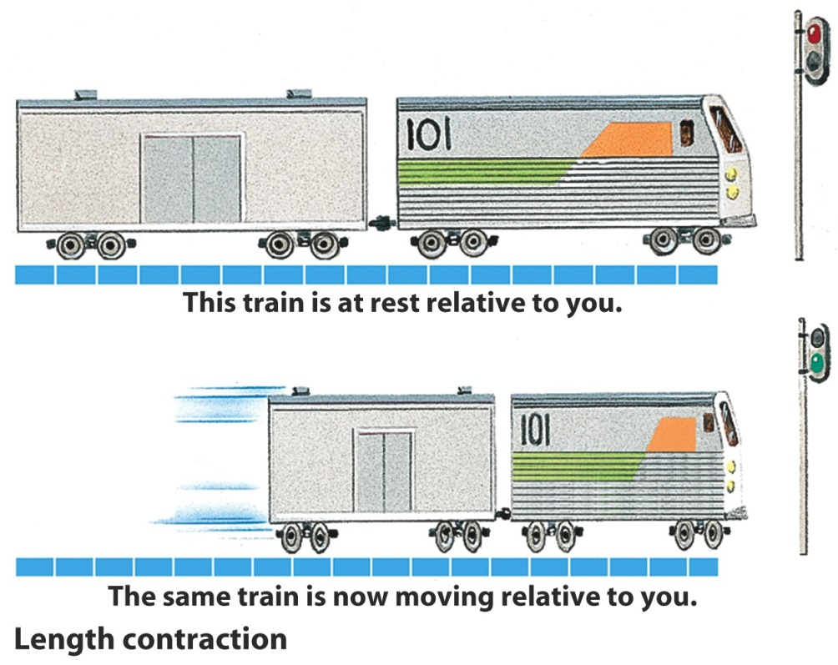
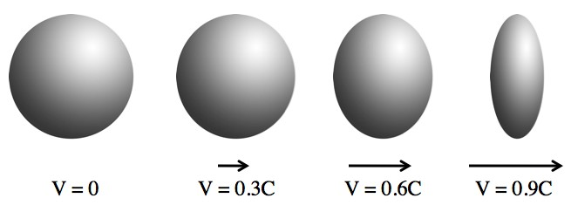
Length Contraction
at the same time, we notice the
effect on the other component
of spacetime,

Slide 27
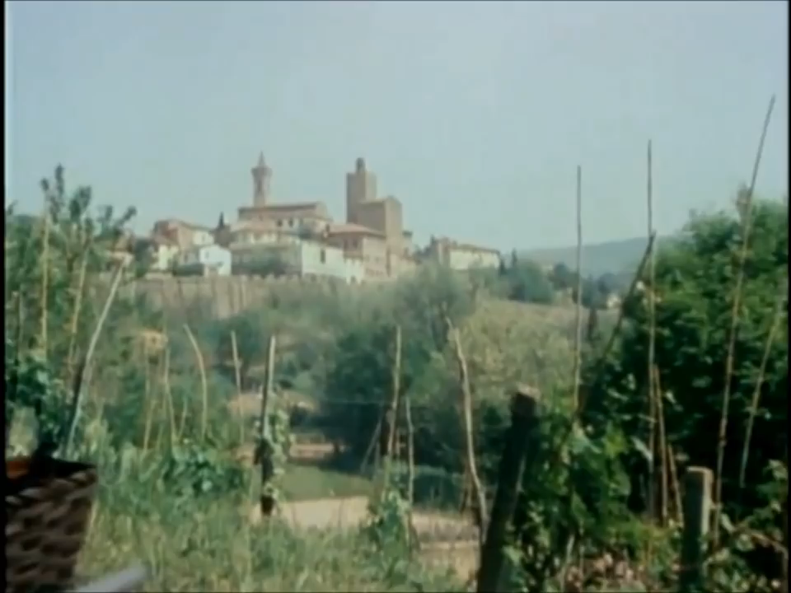
Relativistic
Time Dilation & Length Contraction
Carl Sagan
Cosmos

Slide 28
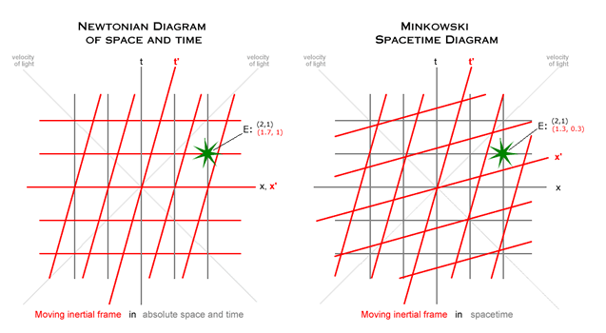
Space Time Diagrams
Note: relativity of time intervals –
time interval in restframe different from moving frame !

Slide 29
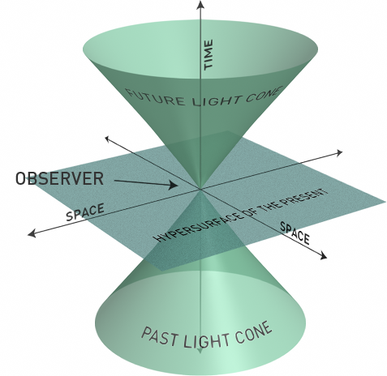
Frames of Reference
In relativity events look different in reference frame moving at some velocity
The new reference frame can be represented as same events along different coordinate axes
A graphical way of showing that length and time are contracted or expanded.
Light Cone
New frame moving relative to original
ct’
ct
Coordinates in new frame
x’
x
Coordinates in original frame

Slide 30
Relativity:
Curved Space

Slide 31
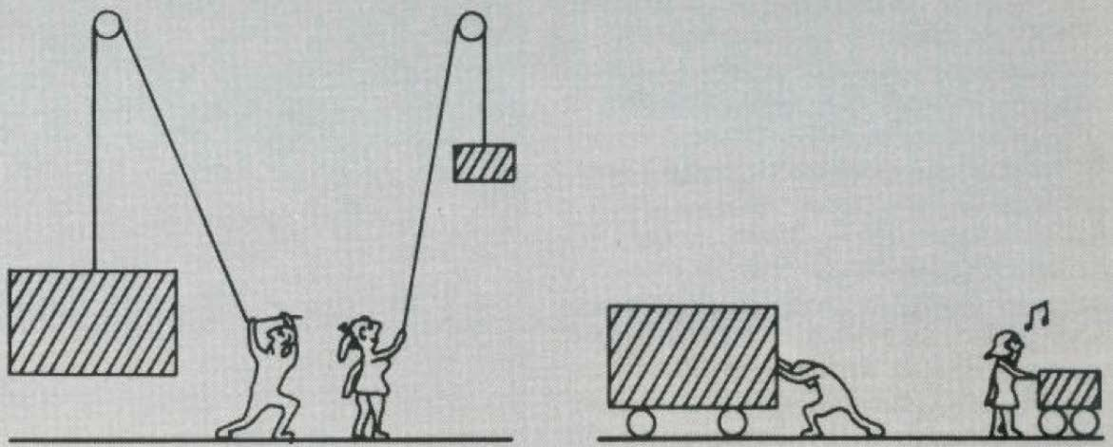
Inertial vs Gravitational Mass
a larger mass experiences a stronger gravitational force gravitational mass
than a light mass
a larger mass is more difficult to get moving inertial mass
than a light mass
As a result, a heavy mass falls equally fast as the light mass:
Gravitational Mass = Inertial Mass

Slide 32
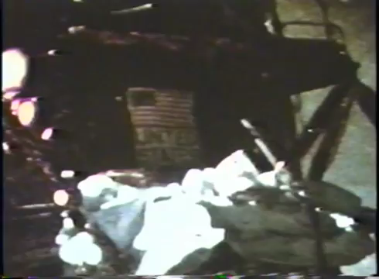
Pollo
Inertial vs Gravitational Mass:
Hammer vs. Feather
David Scott
Apollo 15
1971

Slide 33
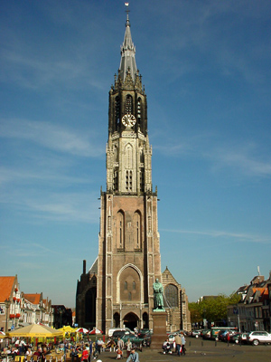
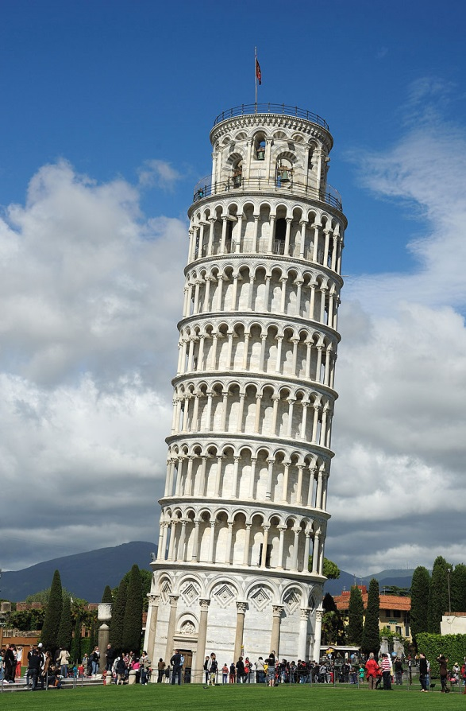
Simon Stevin & Galilei
1586: Simon Stevin,
Nieuwe Kerk, Delft
1589 ???? - Galileo Galilei,
leaning tower of Pisa

Slide 34
de Beghinselen der Weeghconst
Laet nemen (soo den hoochgheleerden H. IAN CORNETS DE GROOT vlietichste ondersoucker der Naturens verborghentheden, ende ick ghedaen hebben) twee loyen clooten d'een thienmael grooter en swaerder als d'ander, die laet t'samen vallen van 30 voeten hooch, op een bart oft yet daer sy merckelick gheluyt tegen gheven, ende sal blijcken, dat de lichste gheen thienmael langher op wech en blijft dan de swaerste, maer datse t'samen so ghelijck opt bart vallen, dat haer beyde gheluyden een selve clop schijnt te wesen. S'ghelijcx bevint hem daetlick oock also, met twee evegroote lichamen in thienvoudighe reden der swaerheyt, daerom Aristoteles voornomde everedenheyt is onrecht.
In: Simon Stevin: De Beghinselen der Weeghconst, 1586.

Slide 35
de Beghinselen der Weeghconst
Let us take (as the highly educated Jan Cornets de Groot, the diligent researcher of the mysteries of Nature, and I have done) two balls of lead, the one ten times bigger and heavier than the other, and let them drop together from 30 feet high, and it will show, that the lightest ball is not ten times longer under way than the heaviest, but they fall together at the same time on the ground. (...) This proves that Aristotle is wrong.'
In: Simon Stevin: De Beghinselen der Weeghconst, 1586.

Slide 36
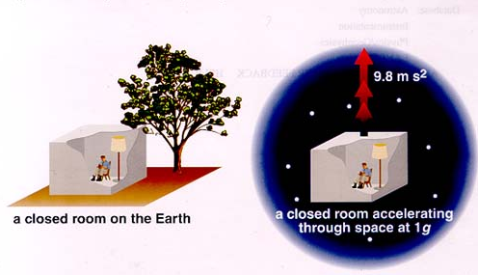
Equivalence Principle
Einstein’s “happiest thought” came from the realization of
the equivalence principle
Einstein reasoned that:
There is no experiment that can distinguish between
uniform acceleration and
a uniform gravitational field.

Slide 37
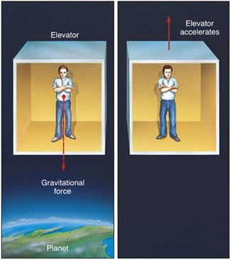
Equivalence Principle
being in
an accelerating frame
indistinguishable
from being in
a gravitational field

Slide 38
Light follows the same path
Velocity = v+2at_{o}
path of light beam in our frame
Velocity = v+at_{o}
Velocity = v
path of light beam in accelerating frame
t=0
t=t_{o}
t=2t_{o}

Slide 39
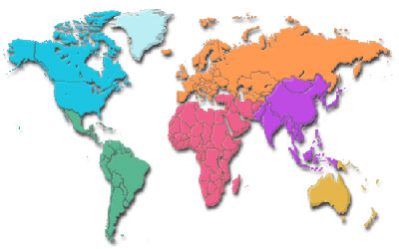
which of these is a straight line?
A
B
A
B
C
All of them
C

Slide 40
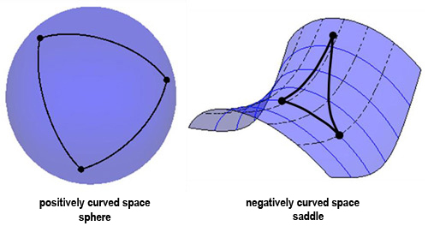
Curved Space:
Positive vs. Negative
Triangle angles >180 degrees
Circle circumference < 2πr
Triangle angles <180 degrees
Circle circumference > 2πr

Slide 41
Relativity:
Spacetime is Dynamic

Slide 42
Einstein’s
Metric theory of Gravity:
how Gravity = Curved Space

Slide 43
Gravity & Curved Spacetime
Equivalence of acceleration of a frame &
location in gravitational field
in gravity field, light follows a curved path
Curved paths:
straight lines in curved spacetime: Geodesics
(cf. flightpaths airplanes over surface Earth)
Fundamental tenet of General Relativity:
!!!!!!!! Gravity is the effect of curved spacetime !!!!!!!!
:

Slide 44
Einstein’s Universe
In 1915,
Albert Einstein completed his General Theory of Relativity.
• General Relativity is a “metric theory’’:
gravity is a manifestation of the geometry, curvature, of space-time.
• Revolutionized our thinking about the nature of space & time:
- no longer Newton’s static and rigid background,
- a dynamic medium, intimately coupled to
the universe’s content of matter and energy.
• All phrased into perhaps
the most beautiful and impressive scientific equation
known to humankind, a triumph of human genius,
Einstein Field Equations

Slide 45
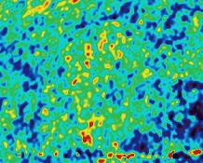
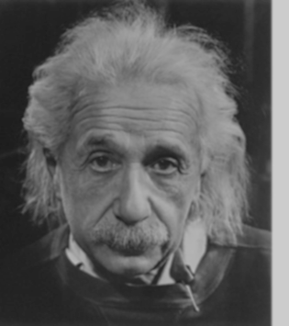
… Spacetime becomes a dynamic continuum,
integral part of the structure of the cosmos …
curved spacetime becomes force of gravity
… its geometry rules the world,
the world rules its geometry…

Slide 46
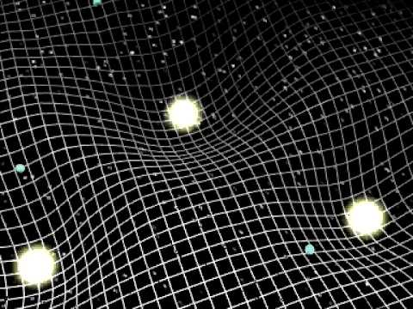
Einstein’s Universe
spacetime is dynamic
local curvature & time determined by mass
bodies follow shortest path through
curved spacetime (geodesics)
dynamics: - action through curvature space
- travels with velocity of light

Slide 47
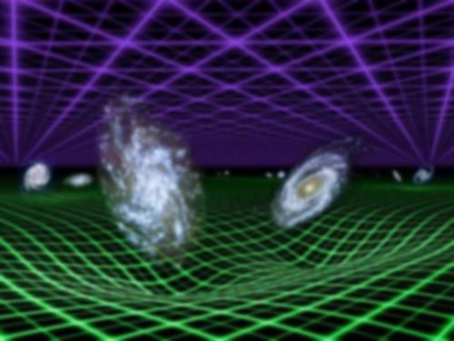

Slide 48
the
Cosmological Principle

Slide 49
General Relativity
A crucial aspect of any particular configuration is the geometry of
spacetime: because Einstein’s General Relativity is a metric
theory, knowledge of the geometry is essential.
Einstein Field Equations are notoriously complex, essentially
10 equations. Solving them for general situations is almost
impossible.
However, there are some special circumstances that do allow a
full solution. The simplest one is also the one that describes
our Universe. It is encapsulated in the
Cosmological Principle
On the basis of this principle, we can constrain the geometry
of the Universe and hence find its dynamical evolution.

Slide 50
Cosmological Principle: the Universe Simple & Smooth
“God is an infinite sphere whose centre is
everywhere and its circumference nowhere”
Empedocles, 5th cent BC
Cosmological Principle:
Describes the symmetries in global appearance of the Universe:
● Homogeneous
● Isotropic
● Universality
● Uniformly Expanding
The Universe is the same everywhere:
- physical quantities (density, T,p,…)
The Universe looks the same in every direction
Physical Laws same everywhere
The Universe “grows” with same rate in
- every direction
- at every location
”all places in the Universe are alike’’
Einstein, 1931

Slide 51
Geometry of the Universe
Fundamental Tenet
of (Non-Euclidian = Riemannian) Geometry
There exist no more than THREE uniform spaces:
1) Euclidian (flat) Geometry Euclides
2) Hyperbolic Geometry Gauß, Lobachevski, Bolyai
3) Spherical Geometry Riemann
uniform=
homogeneous & isotropic
(cosmological principle)

Slide 52
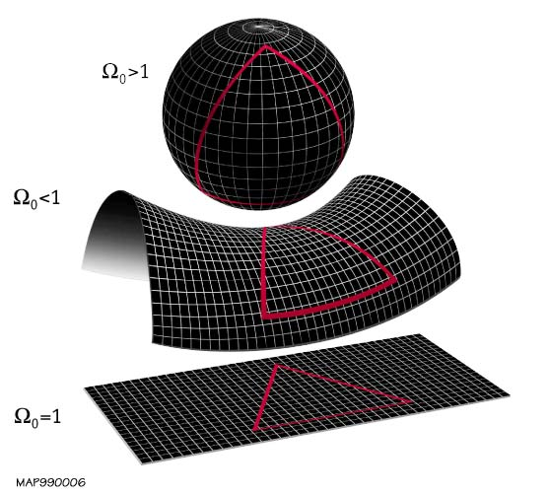
Geometry of the
Universe
Positive
Curvature
K=+1
Negative
Curvature
K= -1
K=0
Flat

Slide 53
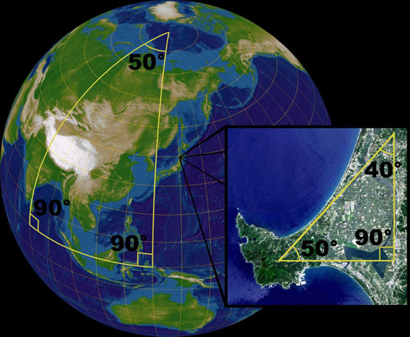
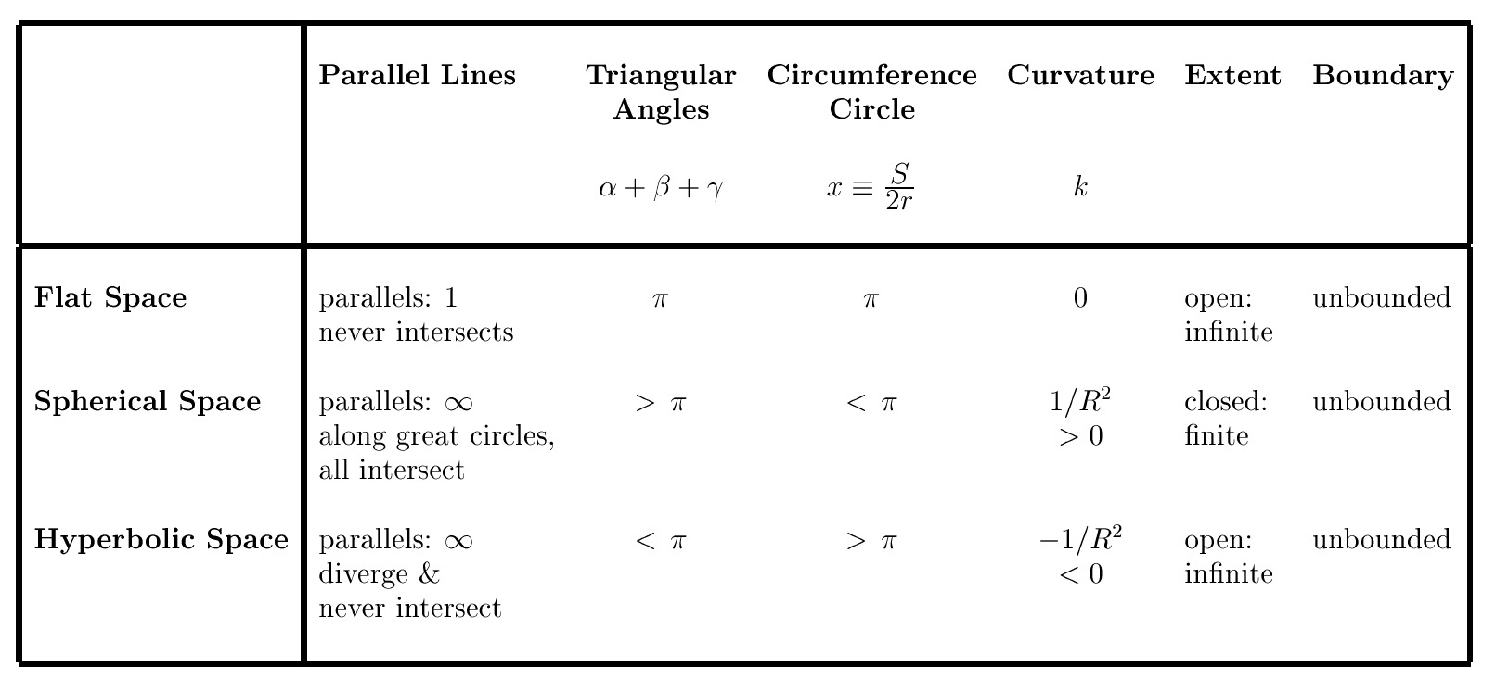
Uniform Spaces:
Geometric Characteristics

