Slide 1
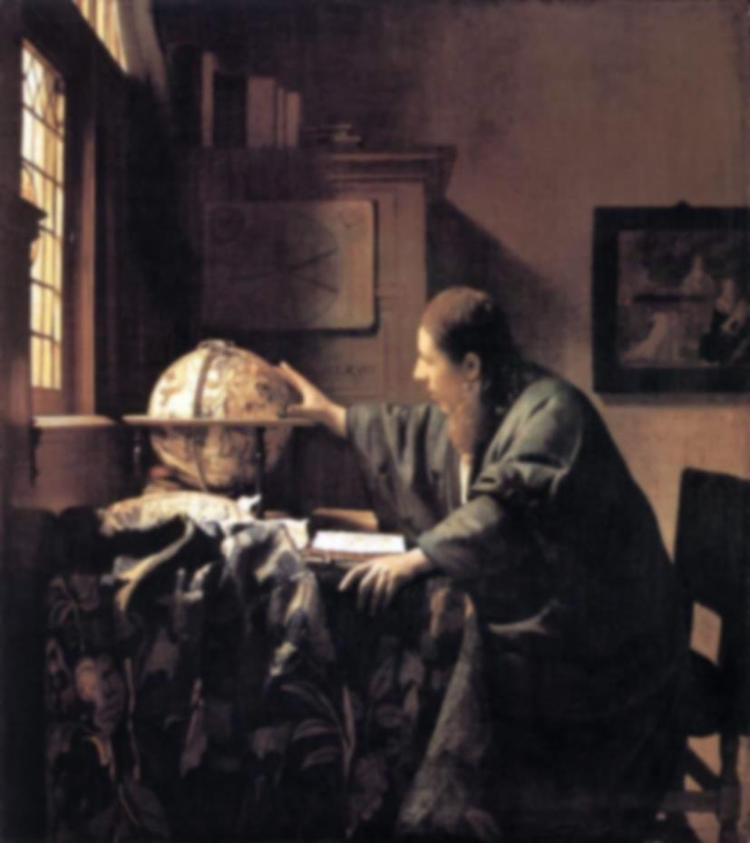
the Scientific Revolution:
the Cosmos Mechanized

Slide 2
Ptolemaeus to Copernicus
One school in history of astronomy:
minor imperfections in the original Ptolemaic system were discovered through observations accumulated over time.
It was mistakenly believed that more levels of epicycles (circles within circles) were added to the models to match more accurately the observed planetary motions.
The multiplication of epicycles is believed to have led to a nearly unworkable system by the 16th century.
Copernicus created his heliocentric system in order to simplify the Ptolemaic astronomy of his day, thus succeeding in drastically reducing the number of circles.
With better observations additional epicycles and eccentrics were used to represent the newly observed phenomena till in the later Middle Ages the universe became a 'Sphere/With Centric and Eccentric scribbled o'er,/Cycle and Epicycle, Orb in Orb'

Slide 3
Alfonsine Tables
Tables of solar, lunar and planetary positions wrt.
fixed stars
Called after Alfons X of Castile the Wise (el Sabio)
(1221-1284)
composed in 1252, in Toledo
assembled by translators of Toledo
based on observations an studies of Islamic scholars
most popular astronomical tables for 300 years
(incl. Copernicus)

Slide 4
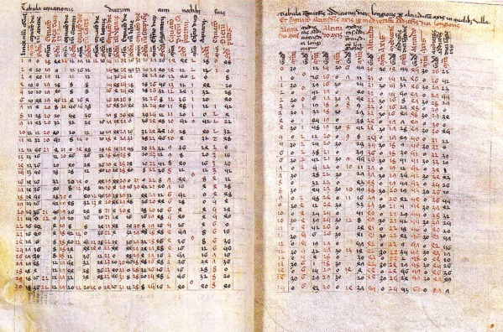

Slide 5
Ptolemaeus to Copernicus
As a measure of complexity:
- the number of circles is given as 80 for Ptolemy,
- versus a mere 34 for Copernicus
By this time each planet had been provided with from 40 to 60 epicycles to represent after a fashion its complex movement among the stars. Amazed at the difficulty of the project, Alfonso is credited with the remark that had he been present at the Creation he might have given excellent advice.

Slide 6
15th century CE
Nicolas de Cusa, 1401-1464
De Docta Ignorantia (1440)
- first European work stating that other stars would be other worlds:
“Life, as it exists on Earth in the form of men, animals and plants, is to be found,
let us suppose in a high form in the solar and stellar regions. Rather than think that so many stars and parts
of the heavens are uninhabited and that this earth of ours alone is peopled we will suppose that in every region
there are inhabitants, differing in nature by rank and all owing their origin to God …”,
- work explicitly states a “Cosmological Principle”
“The universe has no circumference, for if it had a center and a circumference there would be some
and some thing beyond the world, suppositions which are wholly lacking in truth. Since, therefore, it is
impossible that the universe should be enclosed within a corporeal center and corporeal boundary, it is
not within our power to understand the universe, whose center and circumference are God. ”
1584
Giordano Bruno, 1548-1600
De l'Infinito, Universo e Mondi (1584)
“ ”Innumerable celestial bodies, stars, globes, suns and earths may be sensibly perceived therein by us and
an infinite number of them may be inferred by our own reason.’’

Slide 7
The Scientific Revolution
1543
Nicolaus Copernicus
- publishes heliocentric universe in De Revolutionibus Orbium Coelestium
- implicit introduction Copernican principle: Earth/Sun is not special
1576
Thomas Digges (1546-1595)
A Prognostication everlasting (1576)
First expose – in appendix - of Copernican heliocentric model of the Universe in English language.
Digges states – going further than Copernicus - that the Universe is infinite, and contains infinitely many stars.
“Digges’ original contribution to cosmology consisted of dismantling the starry sphere throughout endless space
… Digges pioneered … the idea of an unlimited sphere filled with the mingling rays of countless stars.” (E. Harrison)
1572
Tycho Brahe
Tycho’s supernova
Ultimate evidence and challenge against the Aristotelian view of a serene unchanging Universe.
1609-1632
Galileo Galilei
by means of (telescopic) observations, proves the validity of the heliocentric Universe.
1610 , Siderius Nuncius
first published work on observations made by telescope
1632, Dialogue Concerning the Two Chief World Systems
Debate between Salviati, exposing the Copernican heliocentric Universe and Simplicio, defending the
old traditional Ptolemiac geocentric model.

Slide 8
The Scientific Revolution:
Mechanization of the Universe
1609/1619
Johannes Kepler
- the 3 Kepler laws, describing the elliptical orbits of the planets around the Sun
1687
Isaac Newton
Philosophiae Naturalis Principia Mathematica
- discovers Gravitational Force as agent behind cosmic motions
- publishes his Principia (Philosophiae Naturalis Principia Mathematica), which establishes
the natural laws of motion and gravity (the latter only to be replaced by Einstein’s theory of GR)

Slide 9
The Scientific Revolution Completed: Expanding Worldview
1576
Thomas Digges
Following his statement of an infinite universe, filled with an infinite number of stars, Digges is the
first to identiy the “dark night sky paradox”.
1610
Johannes Kepler
Letter to Galilei (1610)
Puzzled by the night’s darkness: in 1610 he wrote in a letter to Galileo that in an infinite universe filled with stars,
“the whole celestial vault would be as luminous as the Sun.” Kepler’s proposed solution to the paradox is that
the universe has to be finite( this fell in line with Kepler’s religious beliefs that the entire universe was “for
man’s sake.”)
1686
Bernard le Bovier de Fontenelle (1657-1757)
Entretiens sur la pluralité des mondes/Conversations on the Plurality of the Worlds (1686)
Book describes new Copernican cosmology, and speculates on the plurality of worlds.
In a series of conversations between a philosopher and a marquise, who walk in the latter's garden at night
and gaze at stars, the philosopher explains the heliocentric model and also muses on the possibility of extraterrestrial life.
1755
Immanuel Kant
- asserts that nebulae are really galaxies separate from and outside from the Milky Way,
- calling these Island Universes
1785
William Herschel
- proposes theory that our Sun is at or near the center of ou Galaxy (Milky Way)

Slide 10
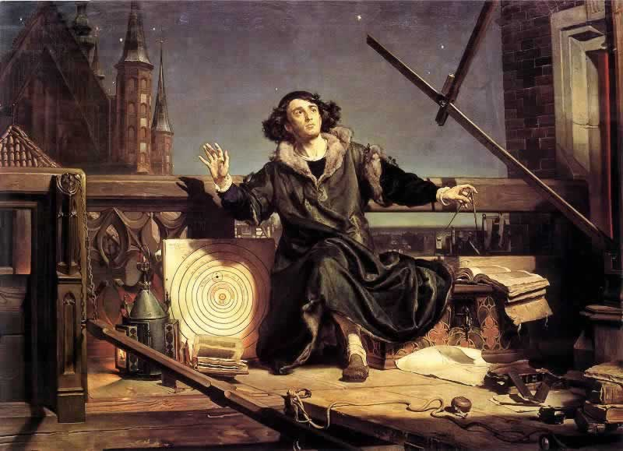
Nikolaus Copernicus
(1473-1543)

Slide 11
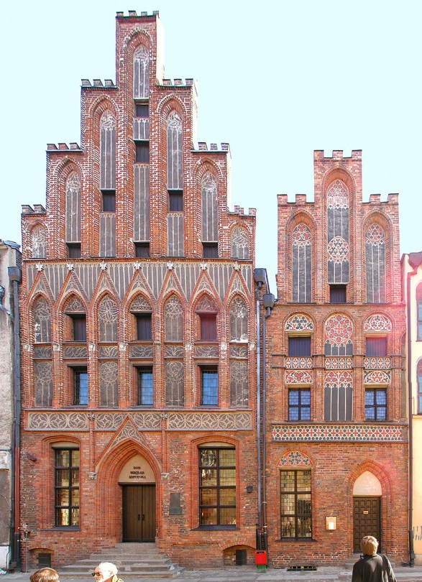
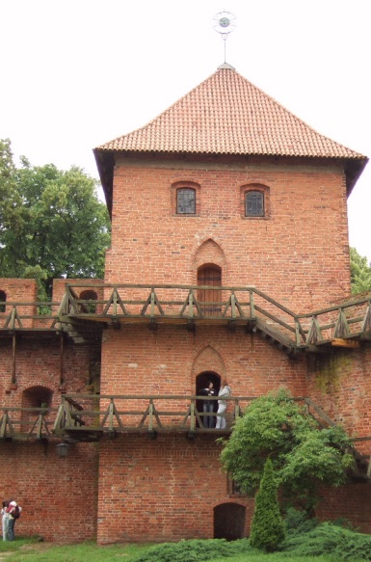
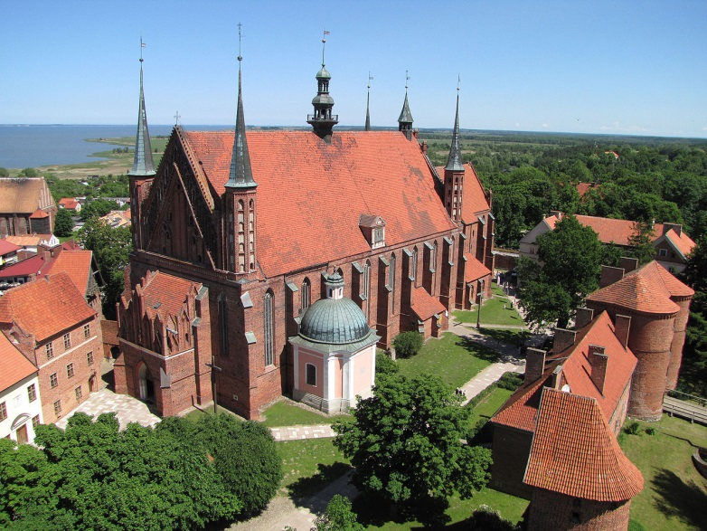
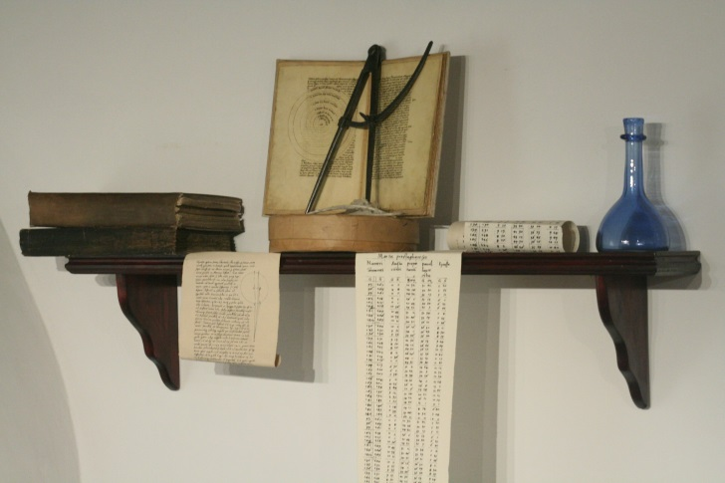
Nicolaus Copernicus
Birthhouse Copernicus,
Torun
1473 – born in Torun (Poland)
1491-1495 - study Univ. Krakow
1496-1501 - 3 years Univ. Bologna - canon law
1503- - Warmia
1514 - Frombork
Languages: Latin , German
- Commentariolus
Nicolai Copernici de hypothesibus motuum coelestium a se
constitutis commentariolus
+ theoretical treatise on heliocentric mechanism
+ 40 pages, 7 basic assumptions
Tower (living) Copernicus, Frombork Frombork Cathedral

Slide 12
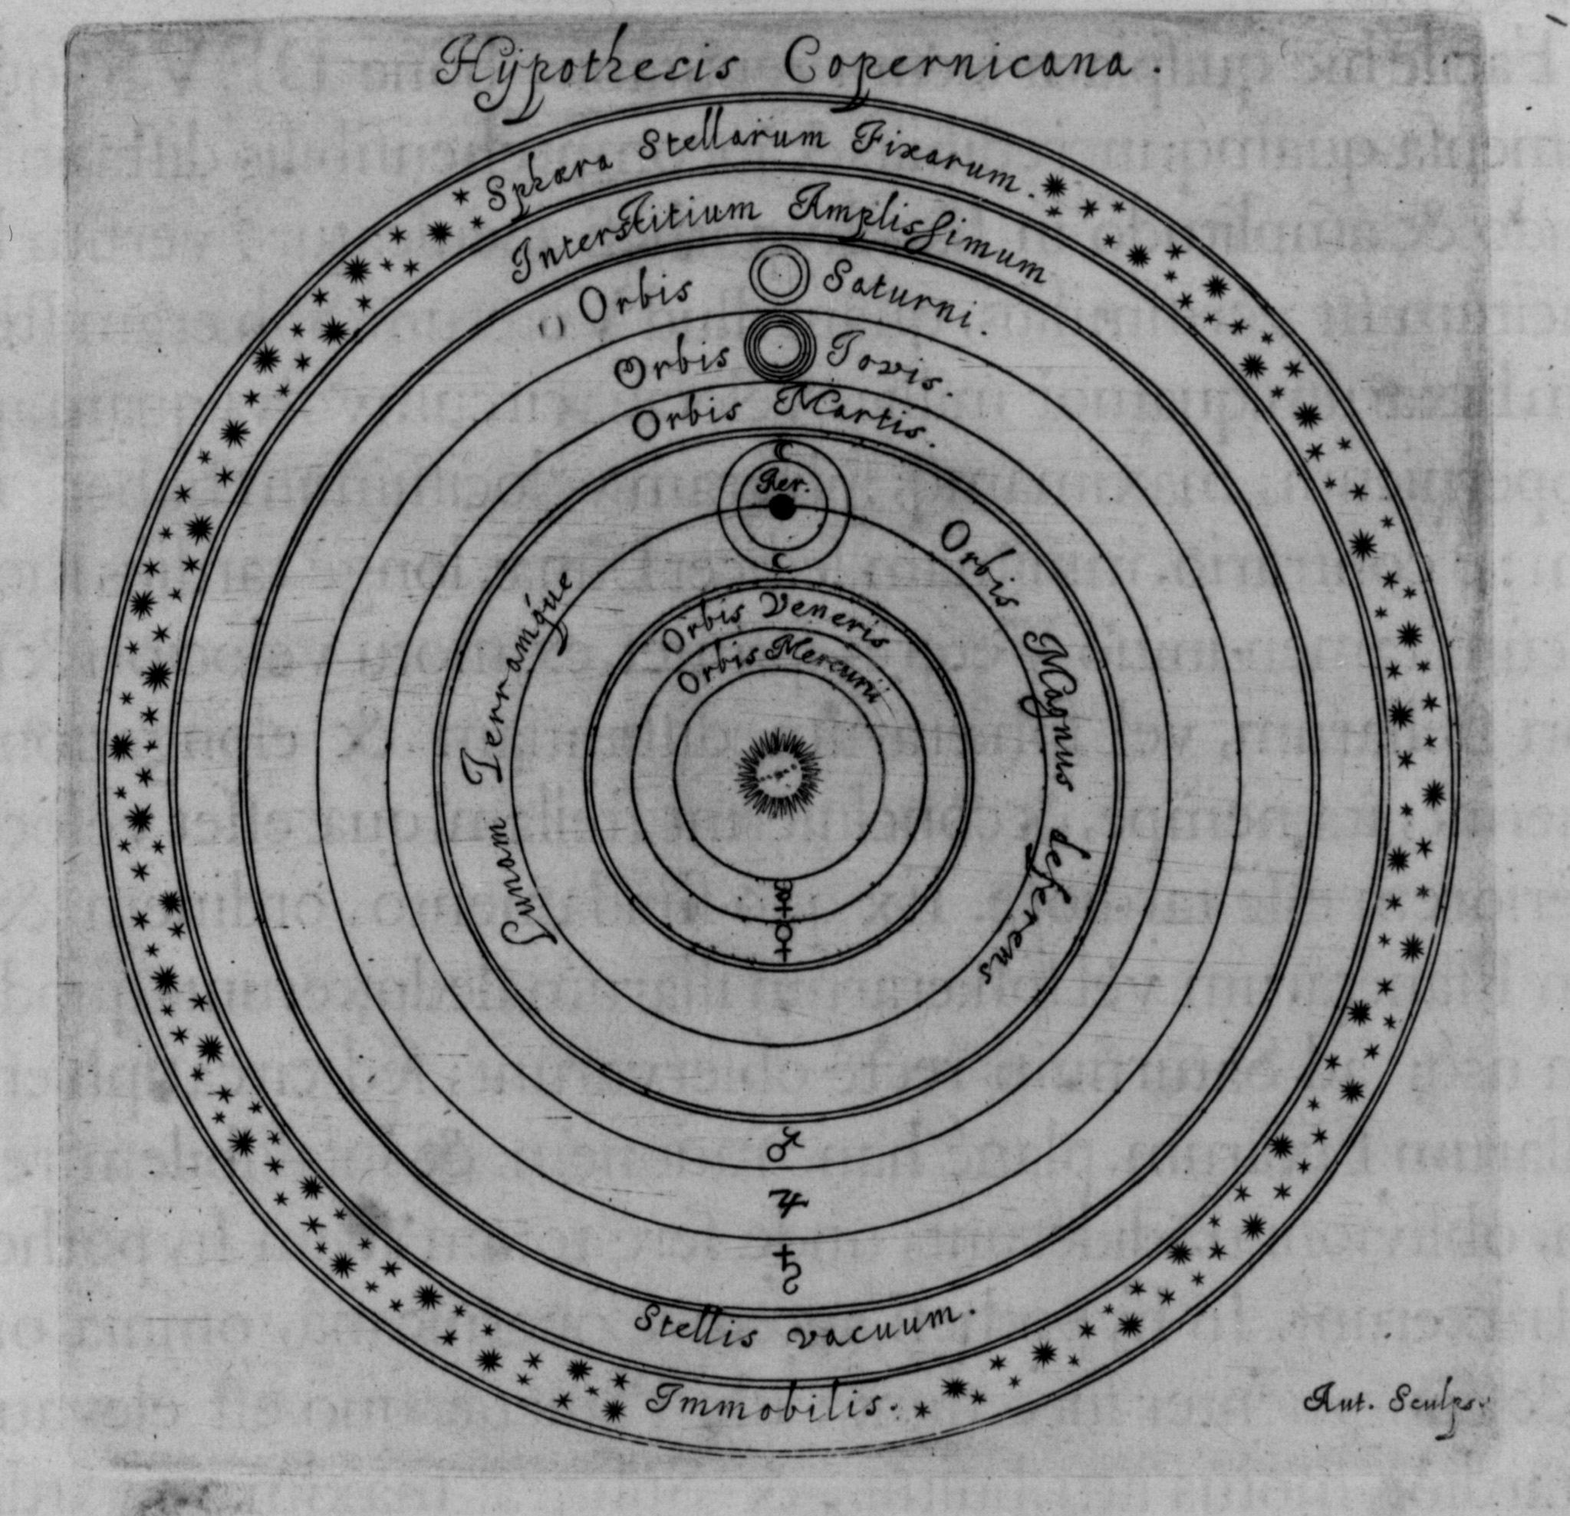
There is no one center of all the celestial circles or spheres.
The center of the earth is not the center of the universe, but only of
gravity and of the lunar sphere.
3. All the spheres revolve about the sun as their midpoint, and therefore
the sun is the center of the universe.
4. The ratio of the earth's distance from the sun to the height of the firmament
(outermost celestial sphere containing the stars) is so much smaller than the
ratio of the earth's radius to its distance from the sun that the distance from
the earth to the sun is imperceptible in comparison with the height of the
firmament.
5. Whatever motion appears in the firmament arises not from any motion of the
firmament, but from the earth's motion. The earth together with its circumjacent
elements performs a complete rotation on its fixed poles in a daily motion, while
the firmament and highest heaven abide unchanged.
6. What appear to us as motions of the sun arise not from its motion but from the
motion of the earth and our sphere, with which we revolve about the sun like
any other planet. The earth has, then, more than one motion.
The apparent retrograde and direct motion of the planets arises not from their
motion but from the earth's. The motion of the earth alone, therefore, suffices
to explain so many apparent inequalities in the heavens.
Commentariolus

Slide 13
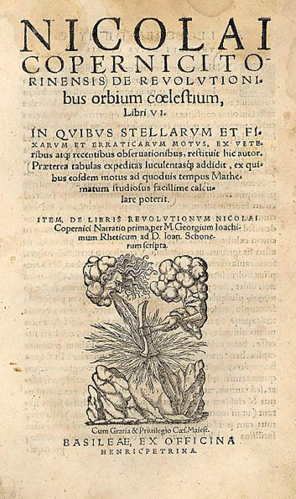
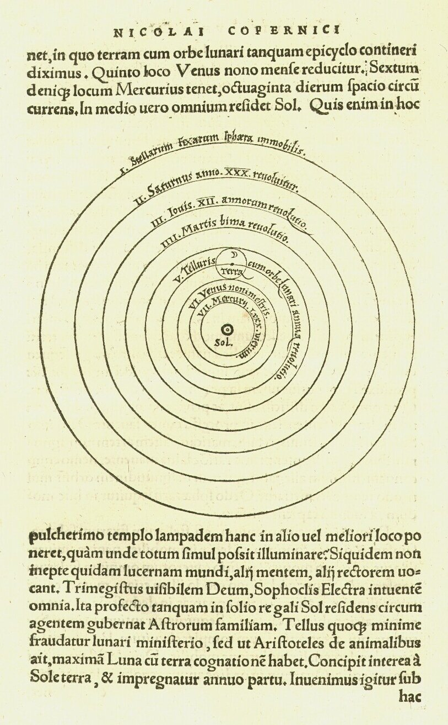
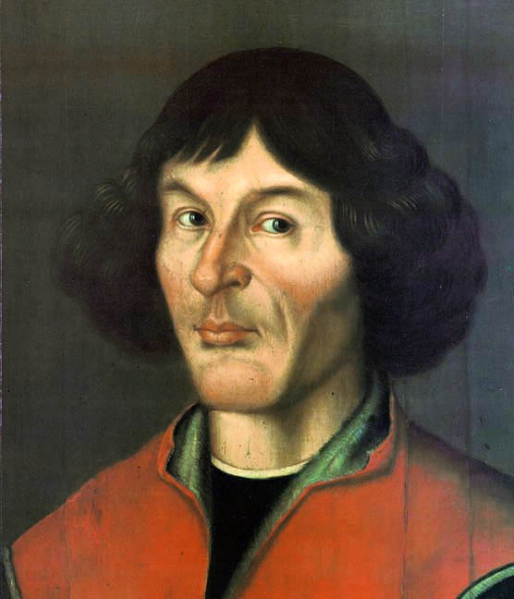
De Revolutionibus
Orbium Coelestium

Slide 15
Nicolaus Copernicus
1543 – publication
De Revolutionibus Orbium Coelestium
(On the Revolution of the Celestial Spheres)
1514- Commentariolus (Little Commentary)
1532 – finished work on Revolutionibus
- publication pushed and processed
by George Joachim Rheticus
(mathematician Wittenberg)
- printed by
Johannes Petreius, Nuremburg
May 24, 1543 - death Copernicus
- legend: presentation last
pages printed Revolutionibus
Note:
Copernicus cited Aristarchus of Samos in an early (unpublished) manuscript of De Revolutionibus (which still survives), though he removed the reference from
his final published manuscript.

Slide 16
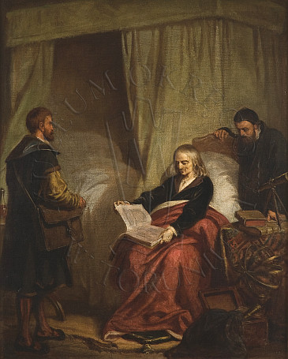
Nikolaus Copernicus
(1473-1543)

Slide 17
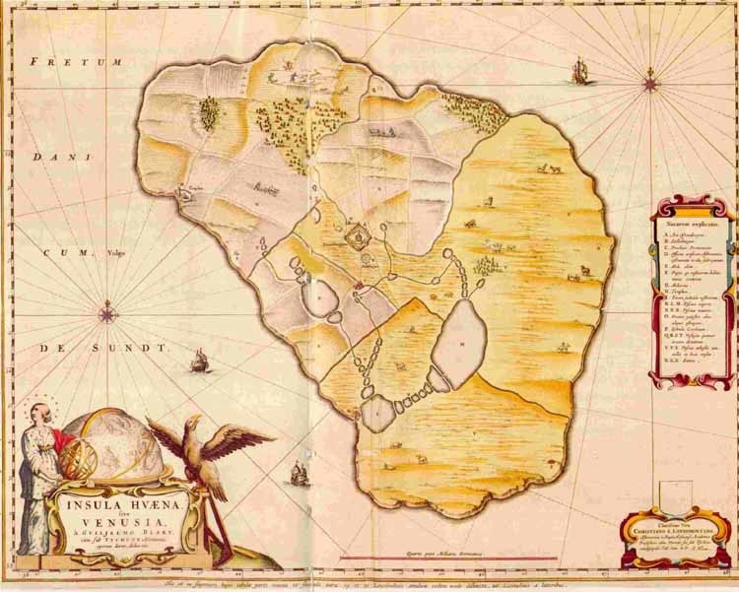
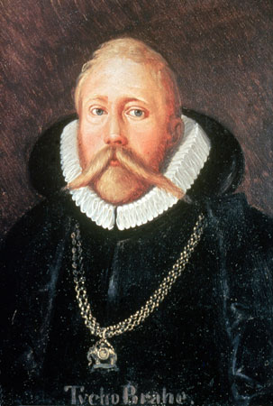
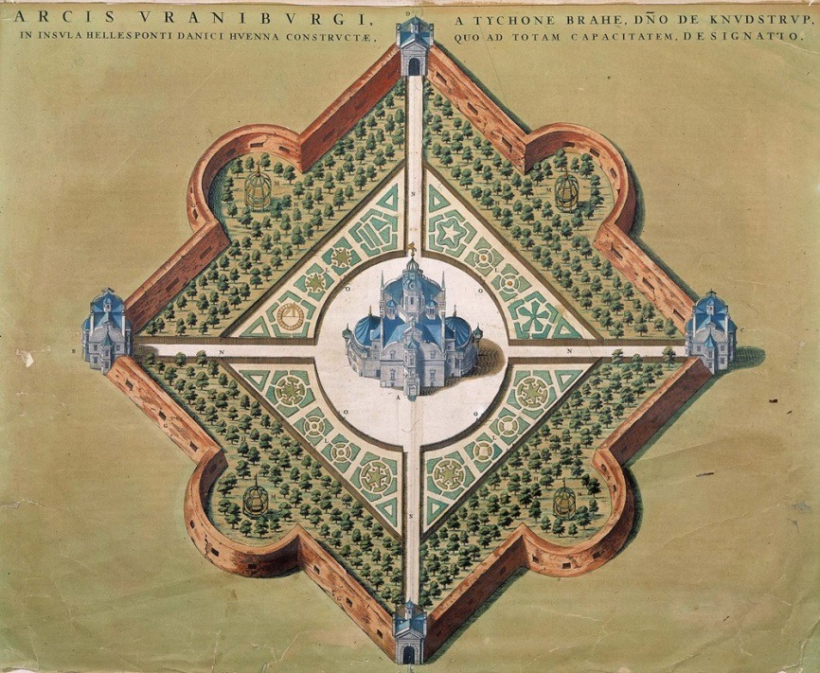
Tycho Brahe
(1546-1601)
Observatory Uranienborg
on island Hven (nowadays between Sweden-Denmark)

Slide 18
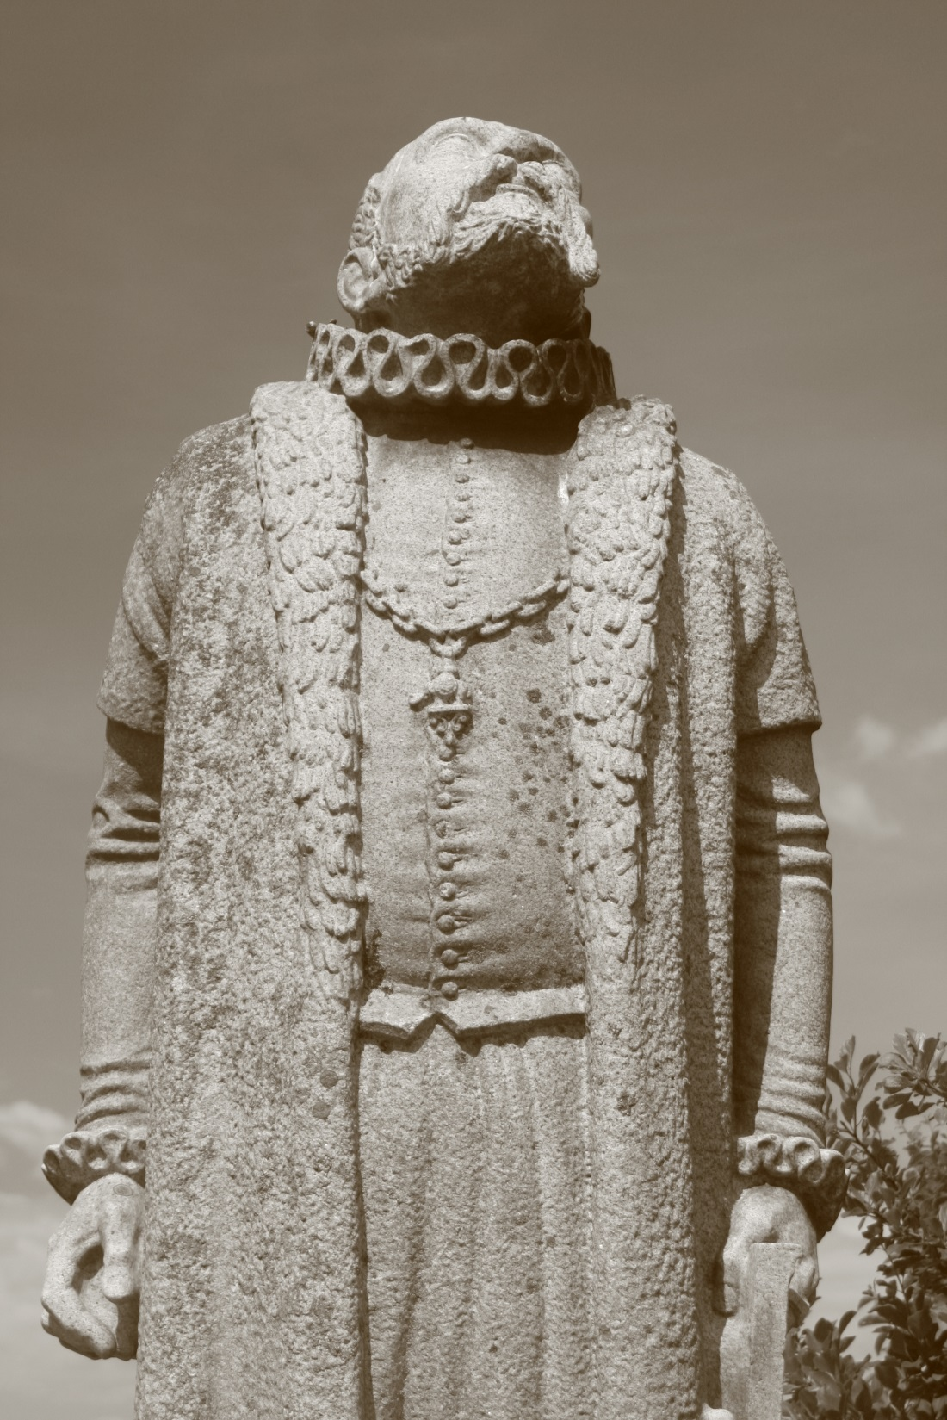
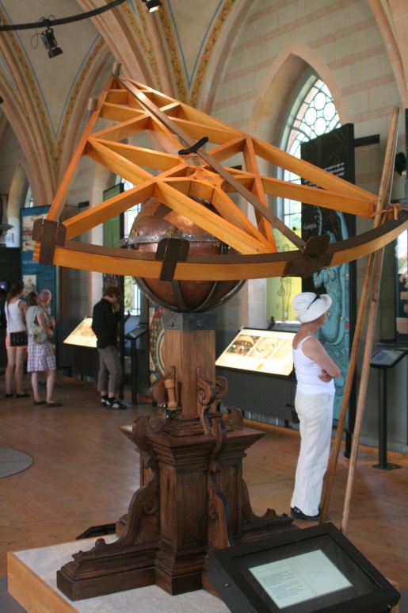
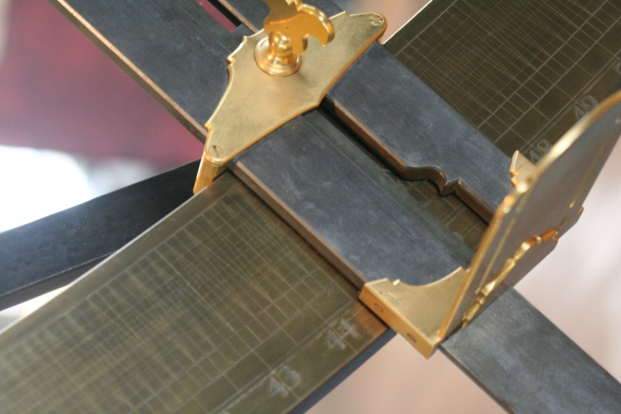
Tycho Brahe (1546-1601)
Danish nobleman
astronomer, astrologer,
alchemist
Observatory Uraniborg
on island Hven
- Hven was his fiefdom
entire island Hven
devoted to exploitation
for observatory
Brahe famous for
high
+ acccuracy
+ quantity
astronomical and
planetary observations
before telescope
Key to Scientific Revolution
Quadrant
Achieved
Accuracy
~1’-2’

Slide 19
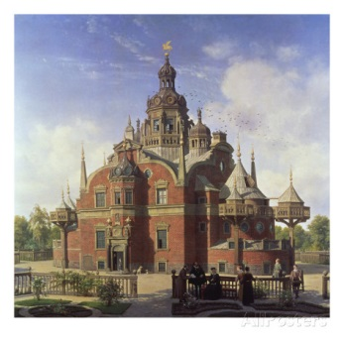
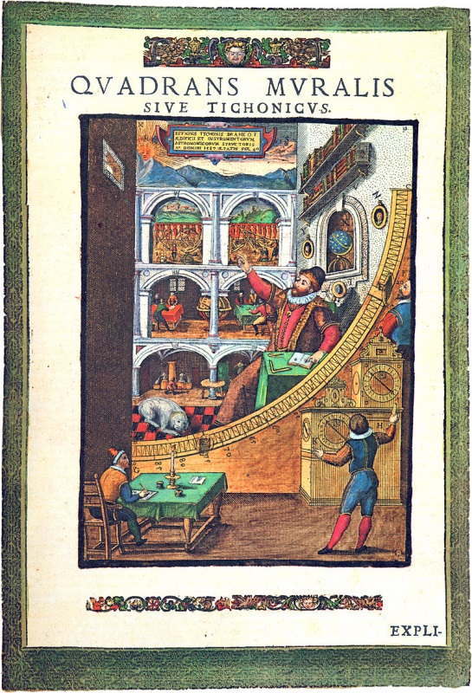
Uraniborg
Uraniborg
Island Hven given to
Tycho by Danish king
Frederik II
1576:
building of Uraniborg
1581:
building of annex,
Stjerneborg
cellar Uraniborg:
alchemy experiments
1576-1597
~ 100 students & assistants
research community in
Research Center &
Institution of Education

Slide 20
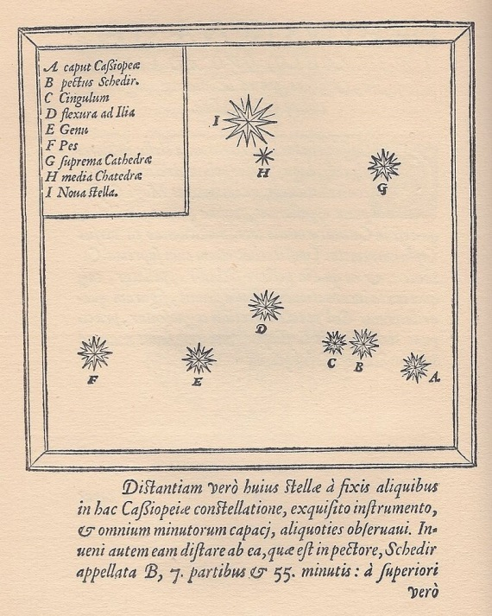
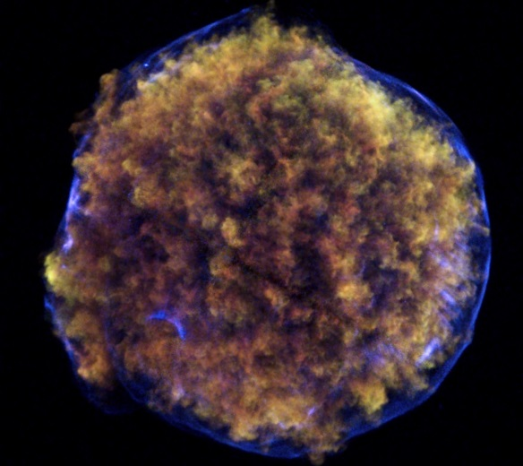
De Nova Stella (1572)
End of the Aristoteleian cosmological view that
- the world beyond the Moon is eternally unchanging
- 11 Nov. 1572
Tycho observed
a new star
- Constellation Cassiopeia
At hindisight it has
been 1 of the 5 visible
supernovae that have
exploded in the Galaxy
over the past 1000 years
- distance: 7500 lightyears
Tycho published this
in De Nova Stella
Supernova remnant
SN1572
Tycho’s SNR (1572)
Exploding star

Slide 21
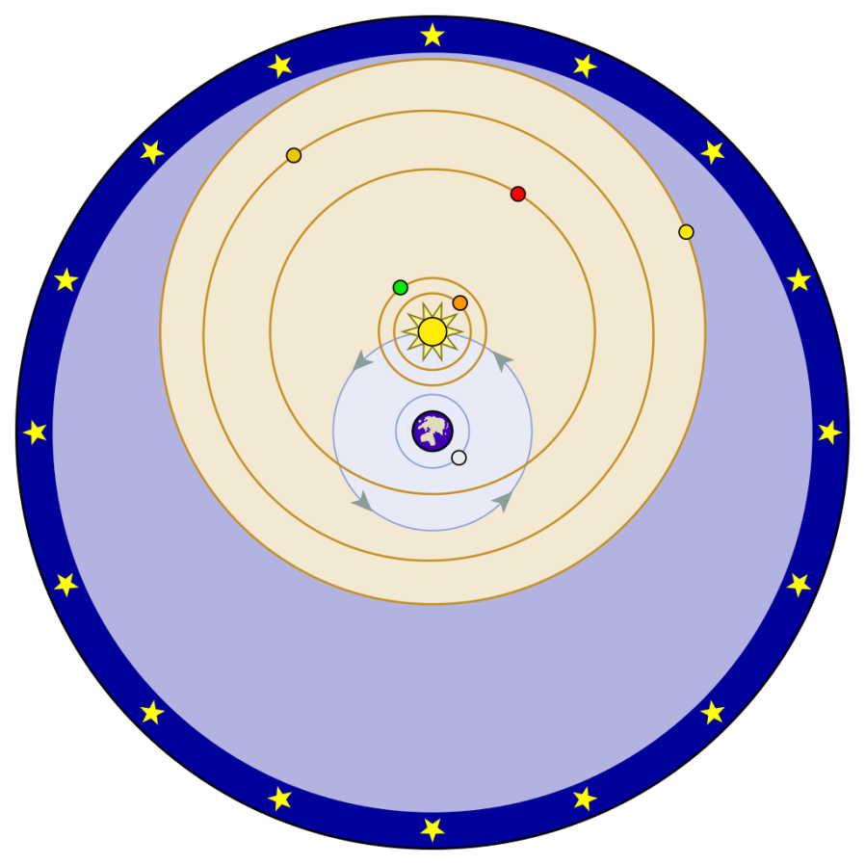
Geo-Heliocentric Model
Tycho’s Geo-Heliocentric Model:
Sun circles the Earth
Planets circle the Sun

Slide 22
Geo-Heliocentric Model
Tycho did not accept the heliocentric view of Copernicus:
Observational data in 16th century were not
good enough to prove it.
No stellar parallax could be measured:
would imply stars to be so distant they would be larger than Sun
Completely eliminited the ancient (Aristotelean)
idea of heavely spheres
“Earth is a lazy body”:
“such a fast motion could not belong to the earth, a body very heavy and dense and opaque, but rather belongs to the sky itself whose form and subtle and constant matter are better suited to a perpetual motion, however fast”

Slide 23
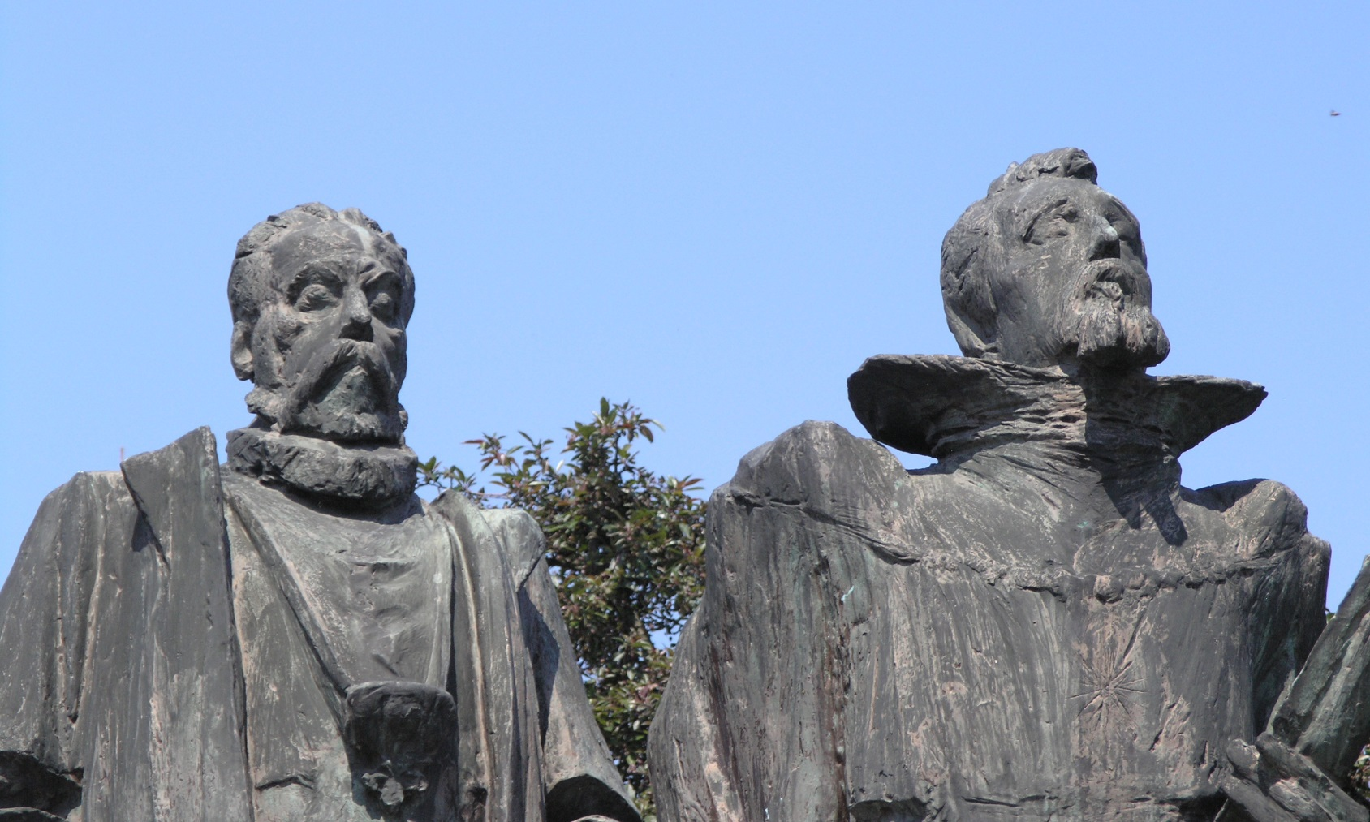
Brahe & Kepler
Arguably, the most significant step in Tycho’s career:
move to the German imperial court in Prague
(following tensions with new Danish king Christian IV)
- meeting up with (young) Johannes Kepler
The analytical genius of Kepler gained access to the state of the art accurate observations of
Tycho Brahe, opening up the path towards unravelling the laws of motion in the solar system.

Slide 24
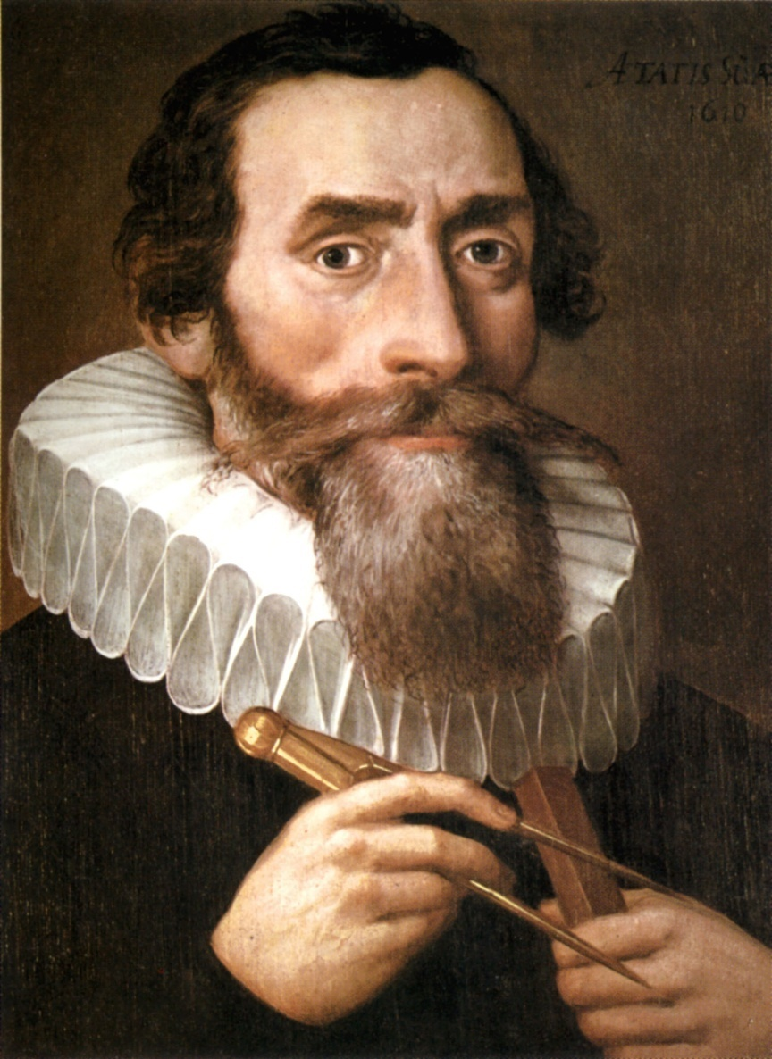
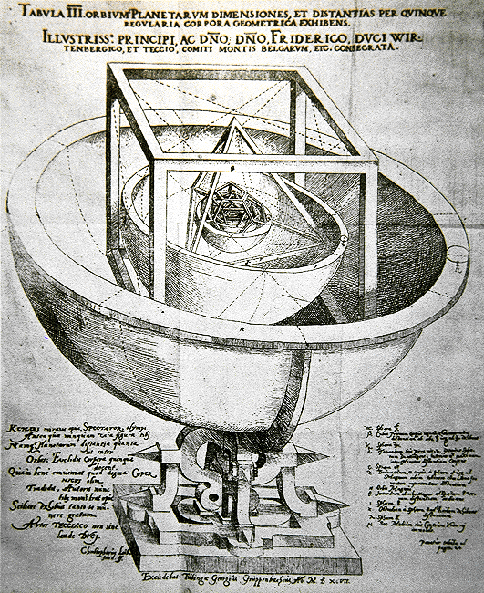
Johannes
Kepler
(1571-1630)
Mysterium Cosmographicum

Slide 25
Johannes
Kepler
(1571-1630)
Johannes Kepler may be considered as
THE key genius of
the European Scientific Revolution
In his 3 books he established an entirely
new, revolutionary, look on the workings
of the Universe, the cosmology of Kepler,
• Mysterium Cosmographicum 1596
• Astronomica Nova 1609
• Harmonices Mundi 1619
His main goal was to reveal the
divine laws and plan dictating the motion of the
planets according to Copernicus heliocentric system,
• establishing that the orbits of the planets are
elliptical and formulating the 3 laws of Kepler
for planetary motion
• strongly leaning on mathematics as the language of
nature, much in line with Pythagoras and Plato.

Slide 26
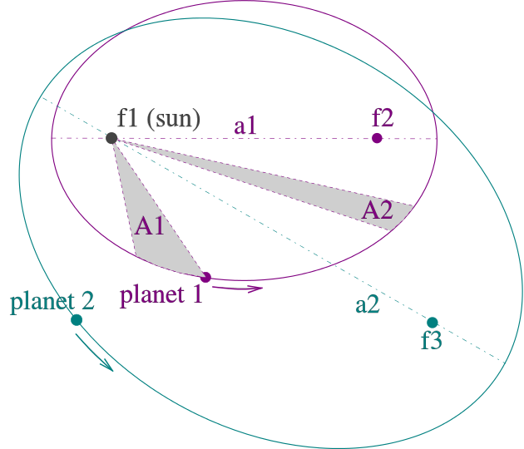
Kepler Laws
Kepler laws of planetary motion
1. The orbit of a planet is an
ellipse with the Sun at one focus.
2. A line segment joining a planet
and the Sun sweeps out
equal areas
during
equal intervals of ime.
(planets do not move with
uniform speed along their orbit).
3. Relation Orbital Time – Size orbit:
The square of the orbital period
of a planet is proportional to
the cube of the orbit’s semi-major axis
T²/a³=const.

Slide 27
Johannes
Kepler
(1571-1630)
Fields:
astronomy, astrology, mathematics,
natural philosophy
Kepler described his
new astronomy as "celestial physics“:
his entire astronomical career devote to
elaboration of the following questions:
why are there six planets (then known) ?
why are they spaced around the Sun as
they are.
- why do they move as they do ?

Slide 28
Johannes
Kepler
(1571-1630)
Fields:
astronomy, astrology, mathematics,
natural philosophy
Kepler described his
new astronomy as "celestial physics",
as
"an excursion into Aristotle's Metaphysics",
and as
"a supplement to Aristotle's On the Heavens",[
transforming the ancient tradition of physical cosmology by treating astronomy as part of a universal mathematical physics.

Slide 29
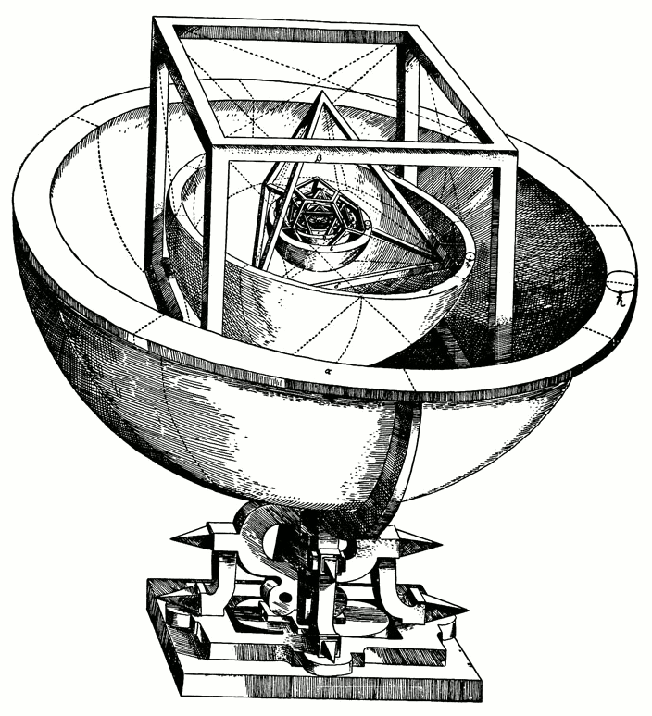
Mysterium Cosmographicum
Prodromus dissertationum cosmographicarum, continens mysterium cosmographicum, de admirabili proportione orbium coelestium, de que causis coelorum numeri, magnitudinis, motuumque periodicorum genuinis & proprijs, demonstratum, per quinque regularia corpora geometrica
Forerunner of the Cosmological Essays, Which Contains the Secret of the Universe; on the Marvelous Proportion of the Celestial Spheres, and on the True and Particular Causes of the Number, Magnitude, and Periodic Motions of the Heavens; Established by Means of the Five Regular Geometric Solids

Slide 30
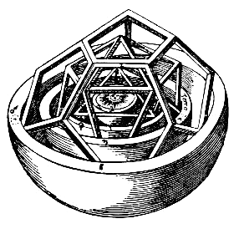
Mysterium Cosmographicum
First published defense of Copernican system
published 1596 (at age 26 !)
2nd ed. 1621 (half as long)
Book explains Kepler's cosmological theory:
God’s Geometrical Plan for the Universe
based on the Copernican system:
first published defense of Copernican system
Five Pythagorean regular polyhedra dictate
the structure of the universe and
reflect God's plan through geometry.
Kepler found that each of the five Platonic solids could be uniquely inscribed and circumscribed by spherical orbs;
nesting these solids, each encased in a sphere, within one another would produce six layers, corresponding to the six known planets
Mercury, Venus, Earth, Mars, Jupiter, and Saturn.
By ordering the solids correctly
octahedron, icosahedron, dodecahedron,
tetrahedron, cube
Kepler found that circumscribing spheres could
be placed at intervals corresponding
(within the accuracy limits of available
astronomical observations)
to the relative sizes of each planet’s path,
assuming the planets circle the Sun

Slide 31

Mysterium Cosmographicum

Slide 32
Mysterium Cosmographicum
Kepler thought he had revealed
God’s geometrical plan for the universe.
Much of Kepler’s enthusiasm for the Copernican system stemmed from his theological convictions about the
connection between the physical and the spiritual.
The universe itself was an image of God,
- His first manuscript of Mysterium
contained an extensive chapter reconciling
heliocentrism with biblical passages that
seemed to support geocentrism.[
- Kepler never relinquished the Platonist
polyhedral-spherist cosmology of
Mysterium Cosmographicum.
- His subsequent main astronomical works were
in some sense only further developments of it,

Slide 33
Mysterium Cosmographicum
Modern astronomy owes much to
Mysterium Cosmographicum
- Despite flaws in its main thesis, "since it
represents the first step in cleansing the
Copernican system of the remnants of the
Ptolemaic theory still clinging to it." (Dryer)
- Especially when dealing with the geometry of the
universe, Kepler consistently utilizes
Platonic and Neo-Platonic frameworks of thought.
- The entirety of the polyhedral idea is based on
the same "formal cause" postulated by Plato for
the structure of the universe.
- In an argument from design,
Kepler postulates the existence and necessity
of God the Creator as this "efficient cause”

Slide 34
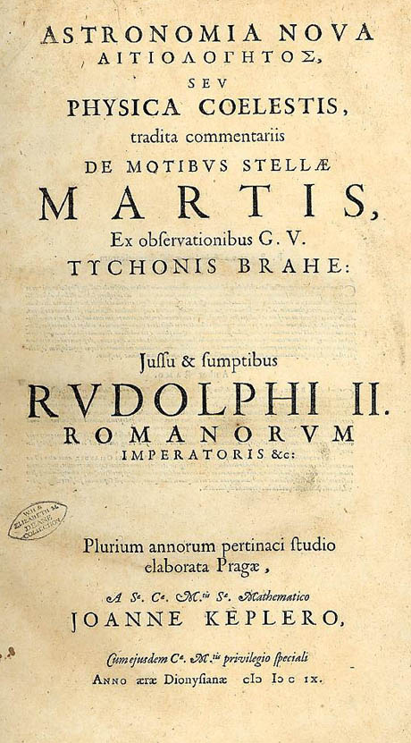
Astronomia Nova
Full title:
Astronomia Nova ΑΙΤΙΟΛΟΓΗΤΟΣ seu physica coelestis, tradita commentariis de motibus stellae Martis ex observationibus
G.V. Tychonis Brahe
Published 1609
One of the most important works of the
Scientific Revolution
Reports Kepler’s 10 year long investigation of
motion of planet Mars.
In addition to providing strong arguments
heliocentrism, it describes the motion of planets, incl. elliptical shape of orbits
- first 2 laws of Kepler

Slide 35
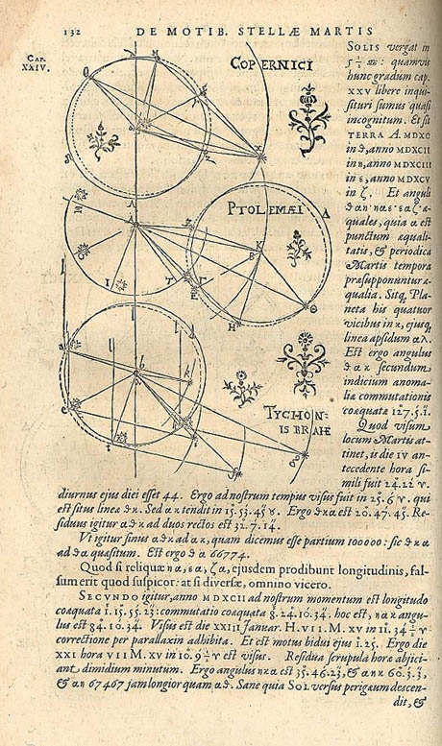
Astronomia Nova
Published 1609
One of the most important works of the
Scientific Revolution
In addition to providing strong arguments
heliocentrism, it describes the motion of planets,
incl. elliptical shape of orbits:
• first 2 laws of Kepler:
1. The orbit of a planet is an
ellipse with the Sun at
one focus.
2. A line segment joining a planet
and the Sun sweeps out
equal areas during equal intervals of time.
(planets do not move with uniform speed along their orbit).

Slide 36
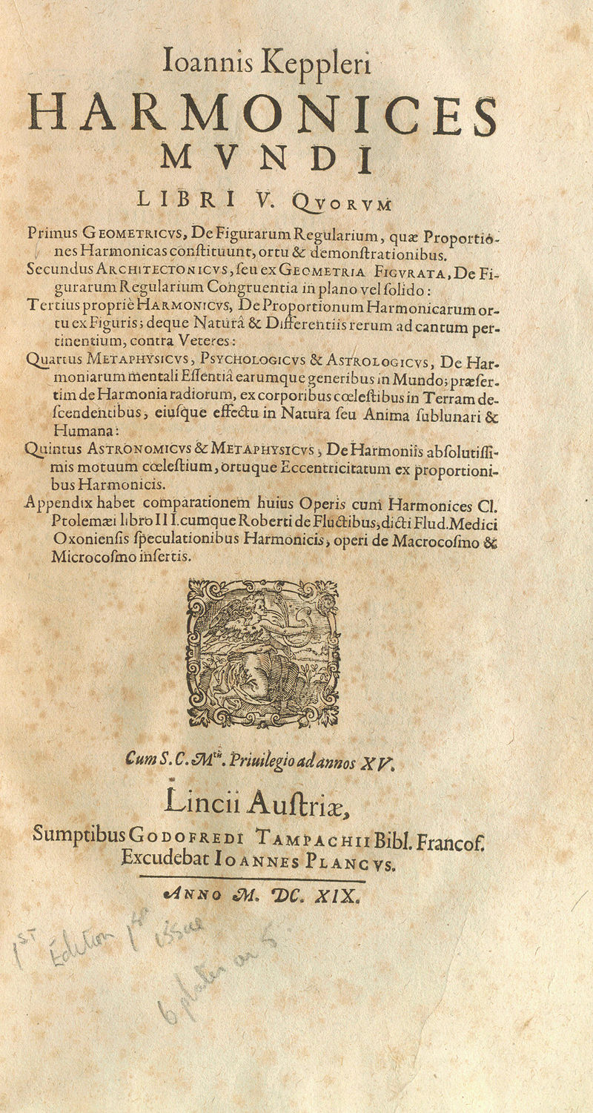
Harmonices Mundi
Harmony of the World
Published 1619
In a sense return to Pythagoras’
“Music of the Spheres”. However, not based on
numerology, but on Geometry !
Kepler discovered physical harmonies in planetary motion:
• difference maximum – minimum
angular speeds of a planet
approximates harmonic proportion
• eg. the maximum angular speed of Earth
as measured from the Sun varies by a
semitone (ratio: 16:15)

Slide 37
Harmonices Mundi
Harmony of the World
Published 1619
Musical harmonies for
arrangement and motion of heavenly bodies
Celestial choir:
Mercury soprano
Venus alto
Earth alto
Mars tenor
Jupiter tenor
Saturn bass
Mercury - large elliptical orbit
- greatest number of notes
Venus - orbit nearly a circle
- only a single note

Slide 38

Harmonices Mundi

Slide 39
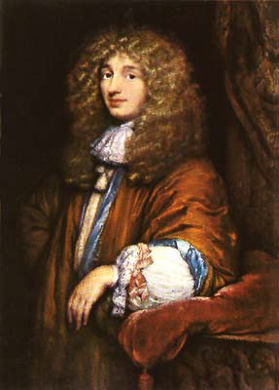
Christiaan
Huygens
(1629-1695)

Slide 40
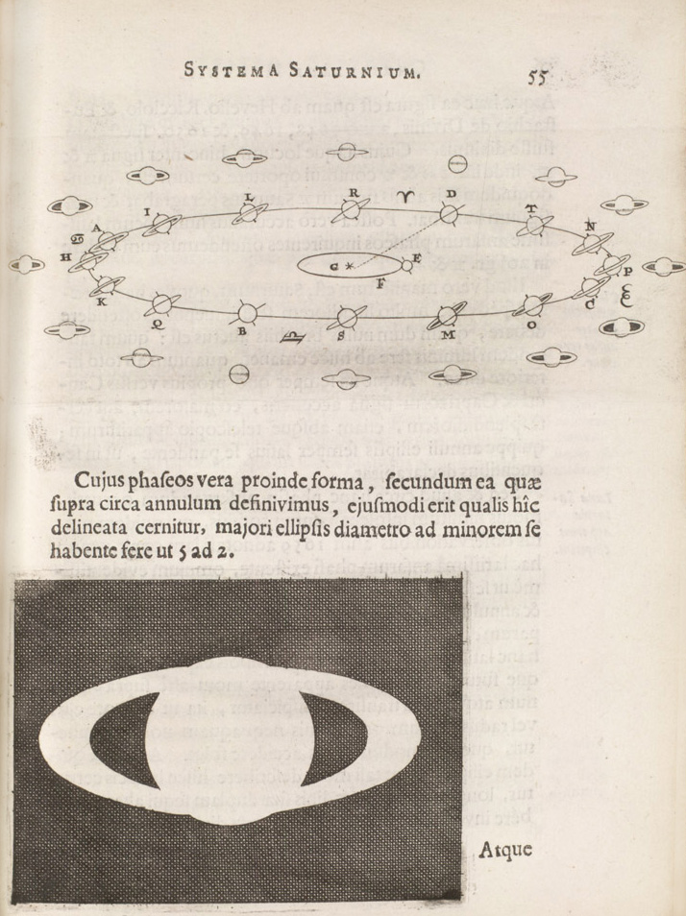
Huygens
&
Saturn

Slide 41
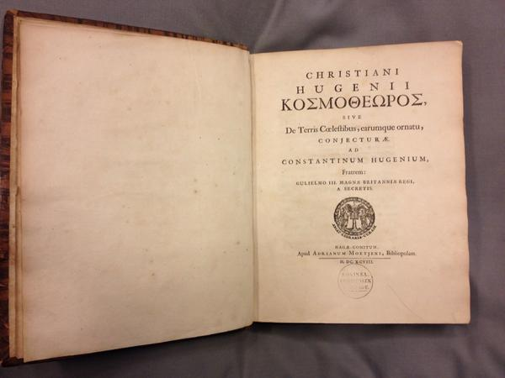
Cosmotheoros
1695-1698:
Speculation on the existence of extraterrestrial life
Identification (liquid) water as main condition for the emergence of life
Method for estimating distances

Slide 42
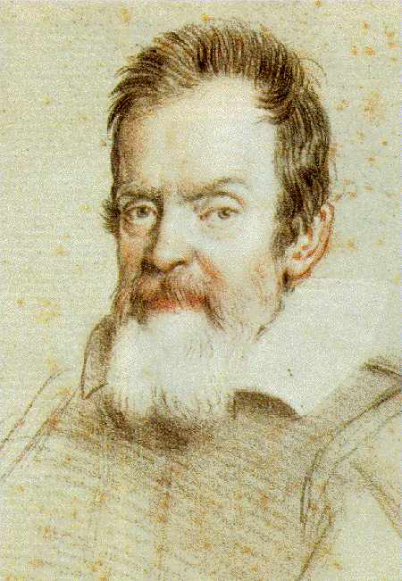
Galileo Galilei
(1564-1642)
(Pisa-Arcetri)

Slide 43
Galileo Galilei
(1564-1642)
father of observational astronomy
father of modern physics
father of scientific method

Slide 44
Galileo Galilei
(1564-1642)
astronomer, physicist,
engineer,
philosopher, mathematician

Slide 45
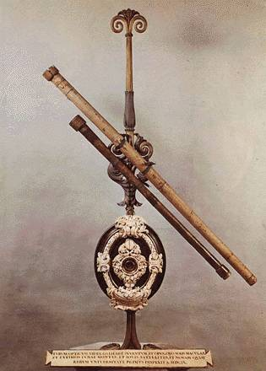
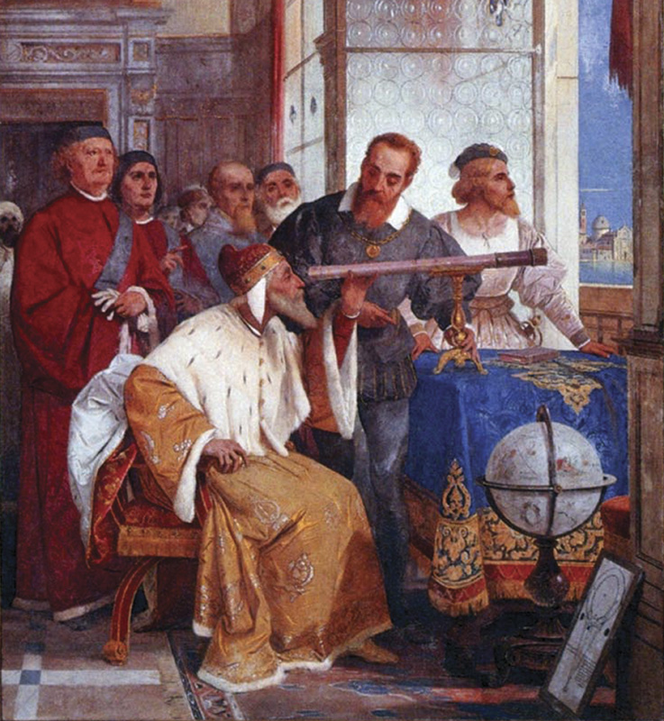
Telescope (1609)
Following vague descriptions of the patent for a telescope by Lippershey in the Netherlands (1608),
basically 2 lenses in line cause a magnification,
Galilei developed his own telescope in 1609:
3 x magnification
30 x magnification (later).

Slide 46
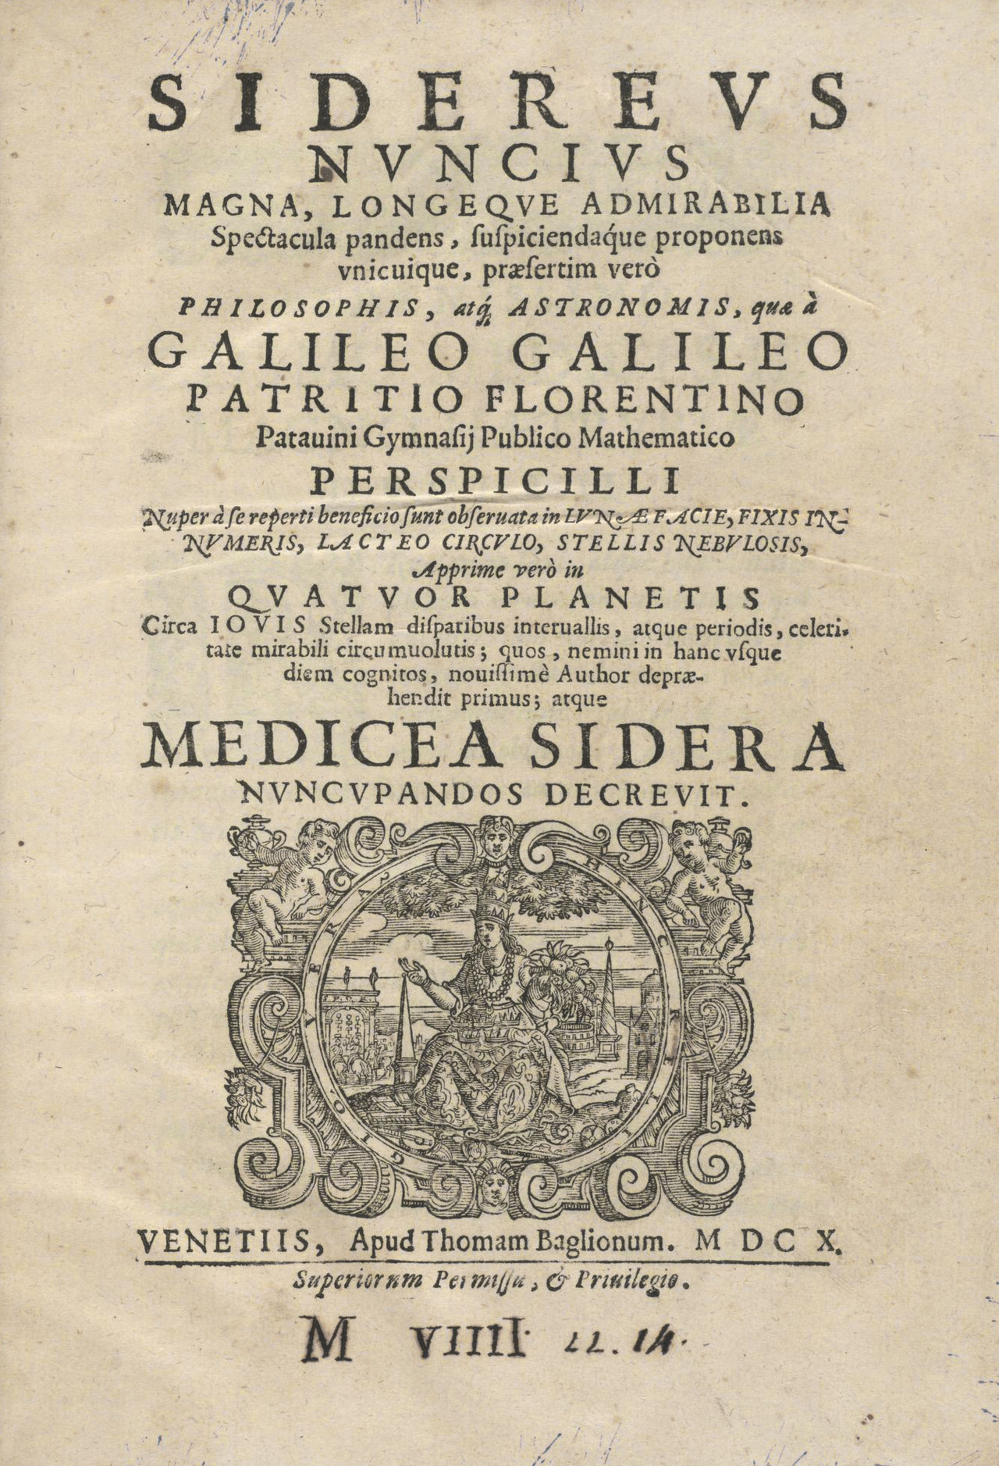
Siderius
Nuncius
1610
Starry
Messenger
Publication of initial telescope
astronomical observations.

Slide 47
Contents:
70 drawings of
Moon: real world of valleys & mountains
Orion
Pleiades: > 10 x number of stars
Taurus than visible by eye
Milky Way: congeries of innumerable stars
grouped in clusters
Galilean Moons (Medicean stars):
- illustrations of relative positions
between Jan. 1610 – Mar. 1610
- remain on same line: orbiting Jupiter
- in conflict with Aristotelean cosmology
(which states everything orbits Earth)
Phases of Venus:
- soid evidence for Venus and Earth
orbiting the Sun
Planet Saturn:
- did not realize he saw rings, and thought Saturn
was 3 objects
Neptune
- Galilei did see Neptune, but did not realize
it was a planet
- would take another 236 years before it
was discovered as planet by Le Verrier
Sunspots

Slide 48
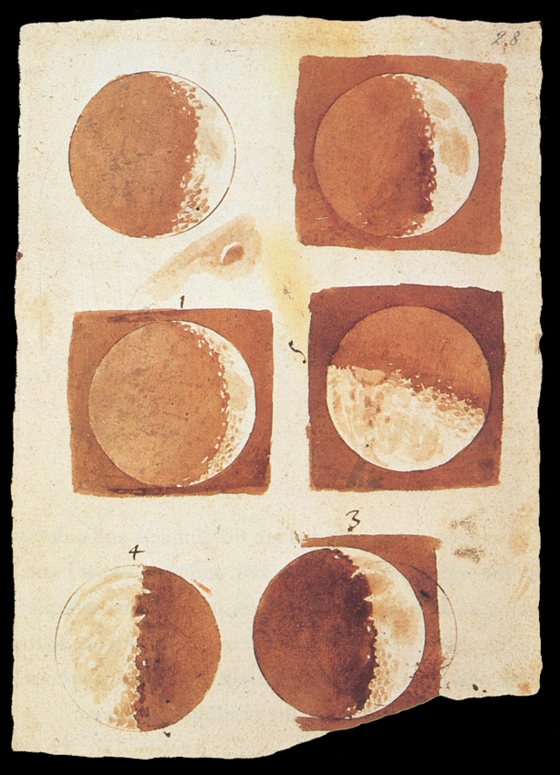
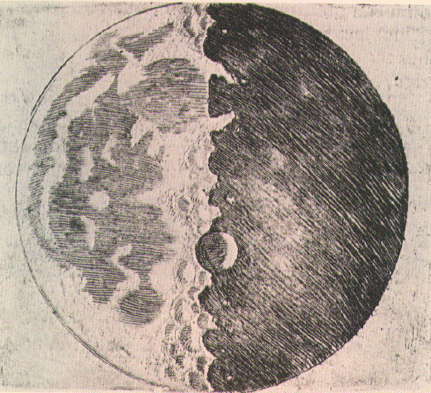
the Moon
Galilei’s telescopic study of the Moon
revealed it was a real world of its own,
with valleys, mountains, etc.
Directly conflicting serene & perfect
Aristotle’s & Ptolemaic cosmology
Moon:
surface valleys & hills

Slide 49
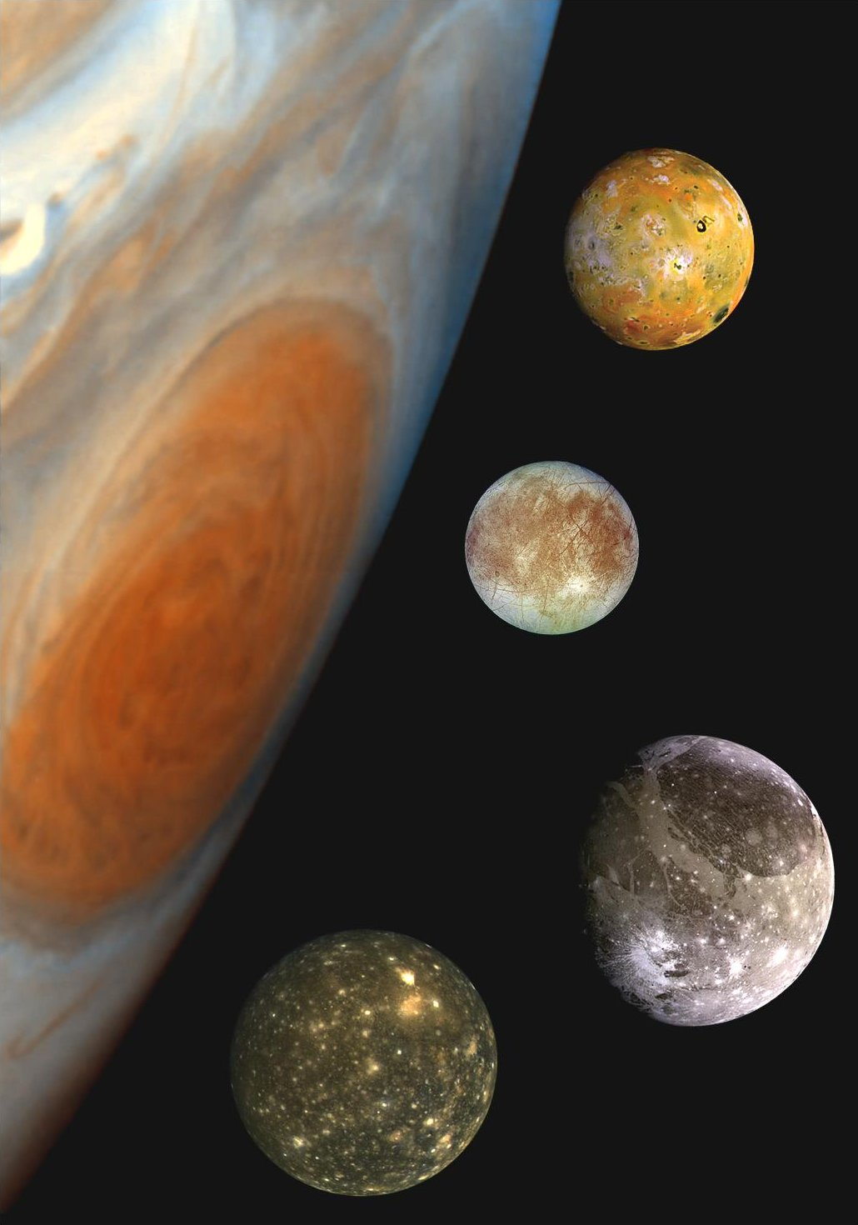
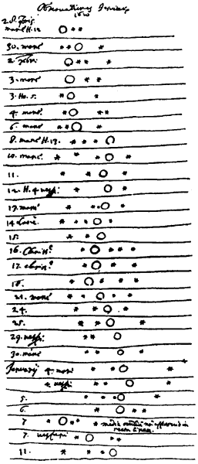
Galileo
Galilei
(1564-1642)
Galilean Moons
of Jupiter:
Ganymedes, Io,
Callisto, Europa

Slide 50
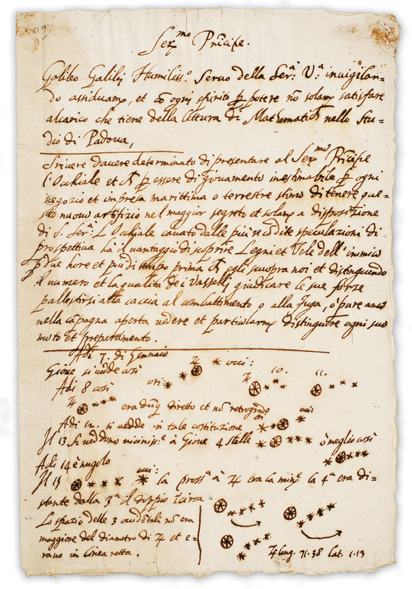
Galilean Moons
Ganymedes, Io, Callisto & Europa:
discovery of their orbital motion, demonstrated that Earth was not the only center in the Universe
directly conflicting Ptolemaeic and Aristotle’s cosmology

Slide 51
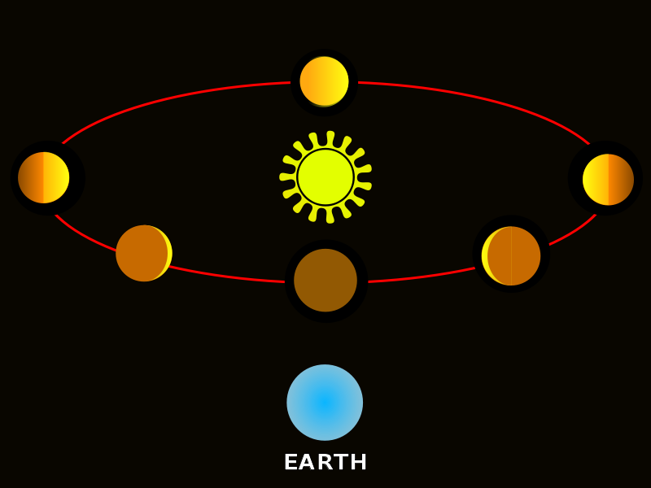
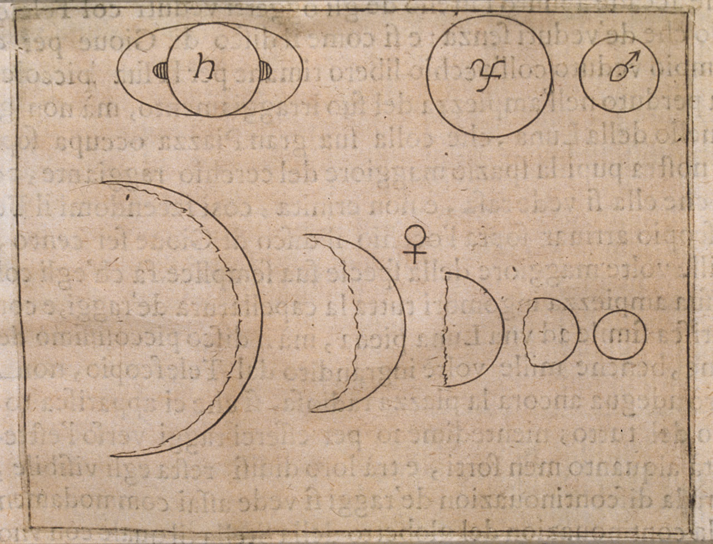
Galileo
Galilei
(1564-1642)
Phases of Venus

Slide 52
Phases of Venus
Evidence for heliocentric Universe:
Phases of Venus correlated with
size of Venus’ disk
Full Venus: small disk
New Venus: large disk

Slide 53
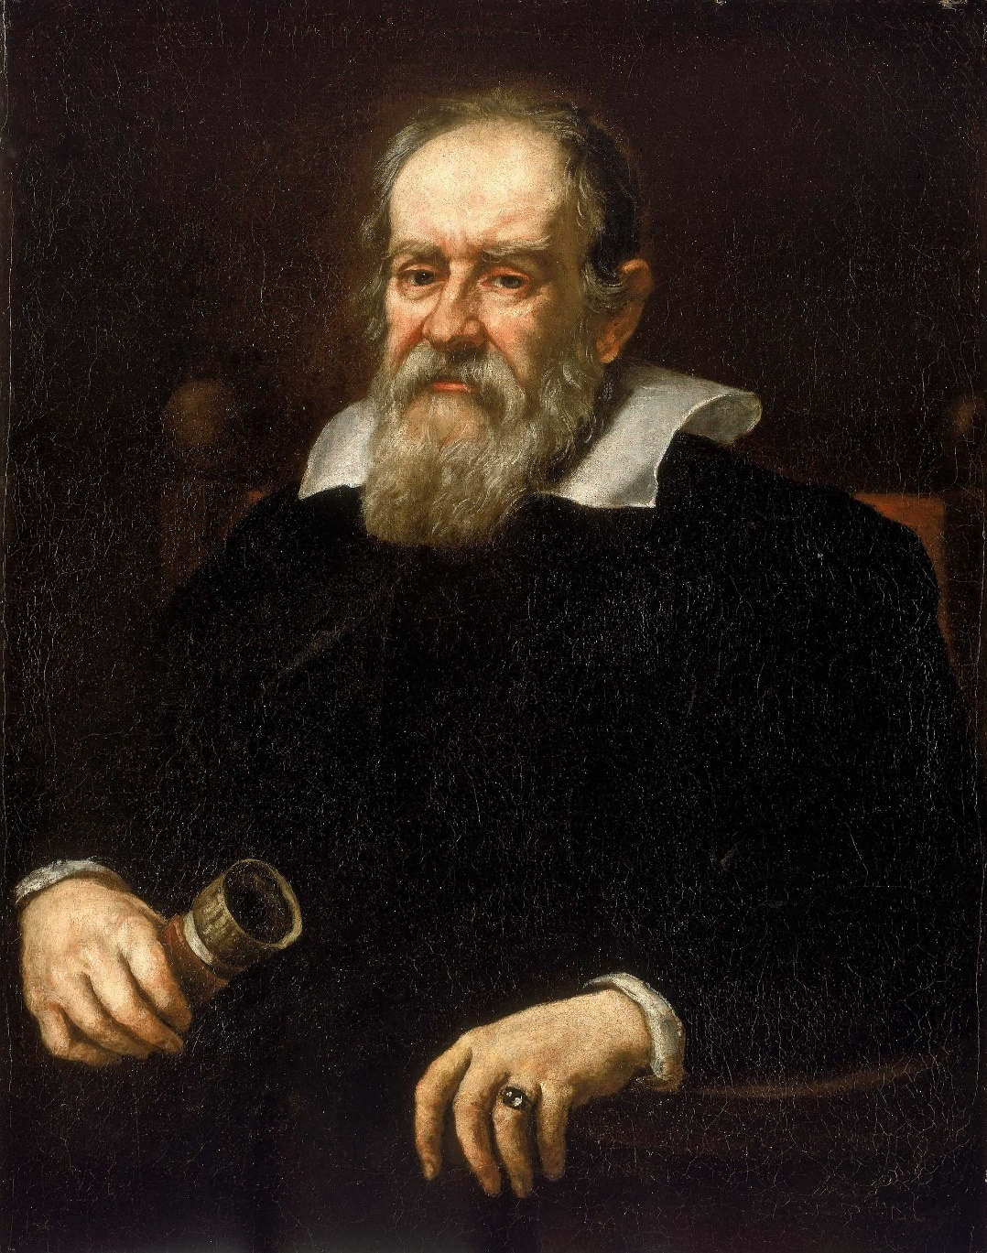
Dialogue concerning the two chief world systems
(1632)
Latin: Systema Cosmicum
book comparing the
Copernican system with traditional Ptolemaic system
- Stated intention was to be objective.
- However, could not hide Galilei’s conviction that
Copernican system represented the physical reality
- book considered attack on Aristotelian geocentrism
- also insulted the pope
1633:
- Galilei accused of heresy
- Dialogo on Index of Forbidden Books (until 1835)
- Galilei narrowly escapes torture
- house arrest for the rest of his life.

Slide 54
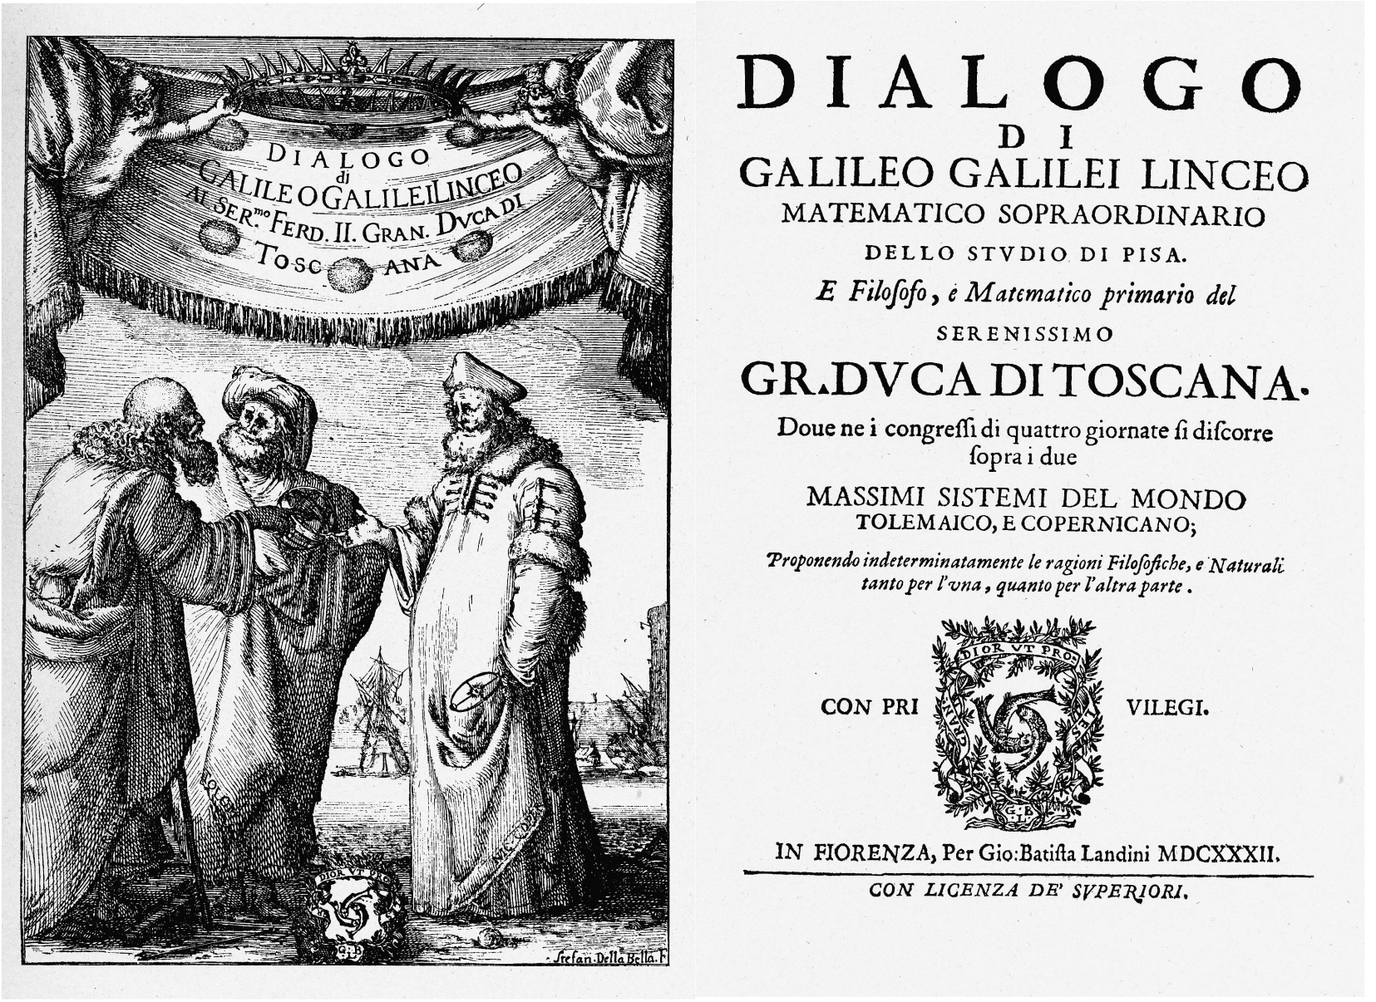
Galileo Galilei

Slide 55
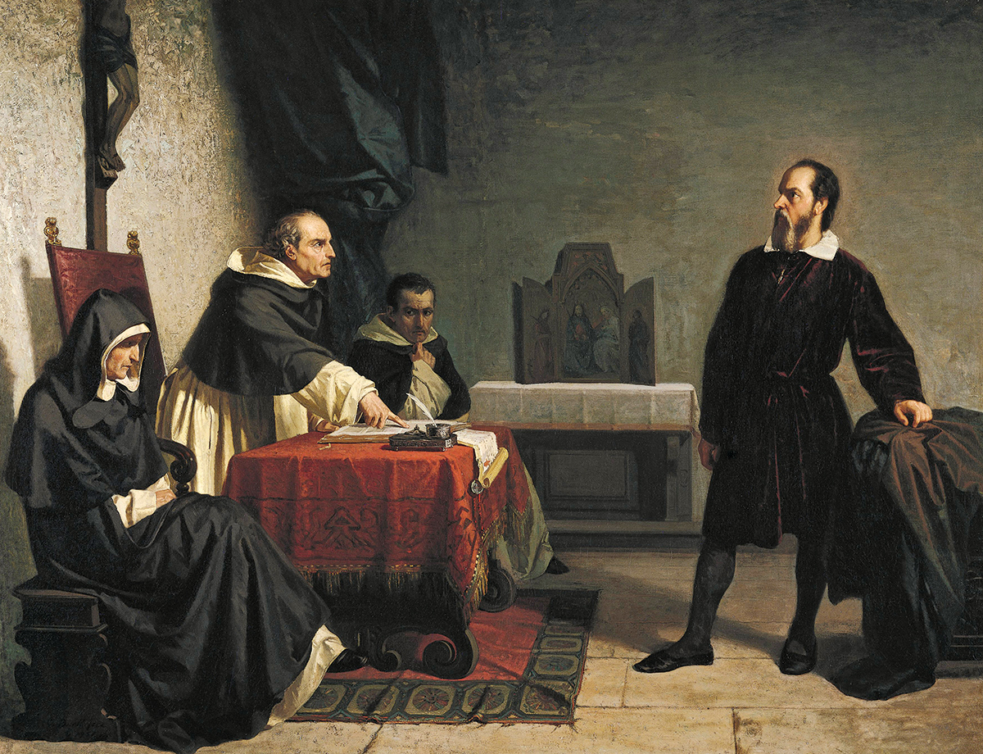
Galilei facing the Roman inquisition

Slide 56
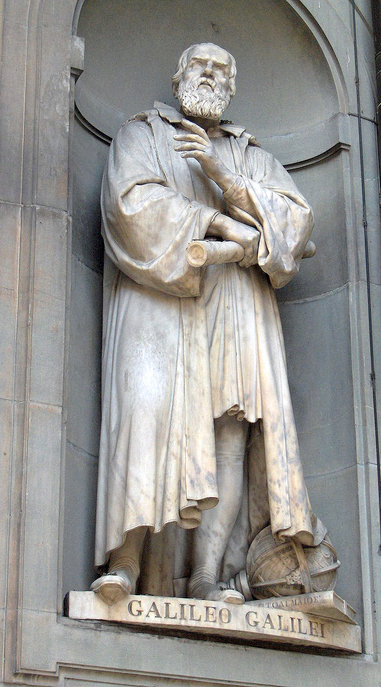

Galileo Galilei
Scientific significance stretches to
at least 2 other main aspects:
Physics
Scientific Method
Physics
velocity & speed, gravity,
free fall
principle of relativity
inertia
Pendulums &
Hydrostatic balances
Thermoscope
tower of Pisa:
heavy objects fall equally fast as
light objects

Slide 57
Galileo Galilei
Scientific significance stretches to
at least 2 other main aspects:
Physics
Scientific Method
Scientific Method
Innovative combination Experiment – Mathematics
Laws of Nature are mathematical
in book “The Assayer”:
“Philosophy is written in this grand book, the universe ... It is written in the language of mathematics, and its characters are triangles, circles, and other geometric figures;...”
Appreciation proper relationship
mathematics, theoretical physics & experimental physics

Slide 58

Isaac Newton
(1643-1727)
“If I have seen further
it is by standing on the
shoulders of giants “

Slide 59


Isaac Newton
Birthhouse
Woolshorpe

Slide 60
Philosophiae Naturalis
Principia Mathematica
(1687)
... Rational Mechanics will be the sciences of motion resulting from any forces whatsoever, and of the forces required to produce any motion, accurately proposed and demonstrated ... And therefore we offer this work as mathematical principles of his philosophy. For all the difficulty of philosophy seems to consist in this—from the phenomenas of motions to investigate the forces of Nature, and then from these forces to demonstrate the other phenomena ...
Principia is considered one of the most important works in the history of science

Slide 61

Principia
(1687)

Slide 62
Philosophiae Naturalis
Principia Mathematica
(1687)
Newton’s 3-volume work:
Newton’s laws of motion
- forming the foundation of classical mechanics
Newton’s law of universal gravitation
- in essence, the discovery of the force of gravity
Derivation of Kepler’s laws of planetary motion
- ie. the laws that Kepler had found empiricially
Integral and Differential Calculus
- however, language of calculus as we know it is from Leibniz
- Newton gave the proofs in a geometric form of infinitesimal calculus
Notes:
of i

Slide 63

Principia
(1687)

Slide 64
Philosophiae Naturalis
Principia Mathematica
(1687)
1687 Volume 1 (Latin)
Volume 2
Volume 3
1728 Published in English

Slide 65
Newton's
Laws of Motion
Newton’s 1st Law:
zero force - body keeps constant velocity
Newton’s 2nd Law:
force = acceleration x mass = change of velocity x mass
Newton’s 3rd Law:
action = reaction

Slide 66

Newton's Gravity
(the apple incident, 1666)

Slide 67
Newton's Gravity

Slide 68

Newton Telescope
(1st mirror telescope)

Slide 69


