Slide 1
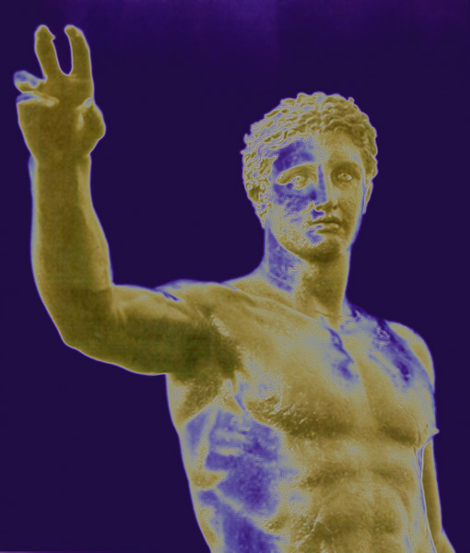
the Universe Mechanized:
Hellenistic Cosmology

Slide 2
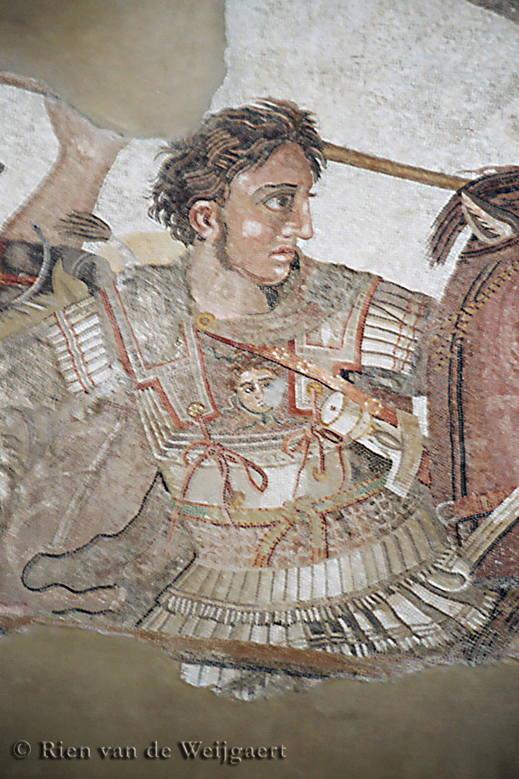
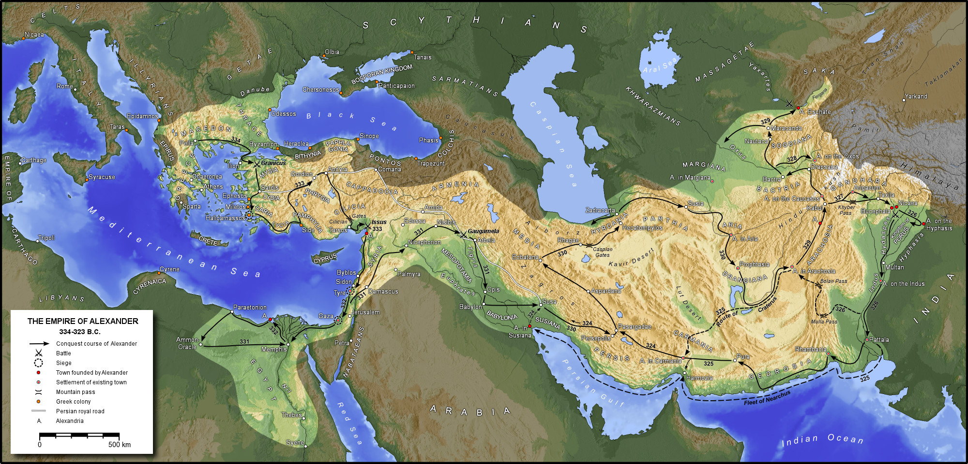
the First
Scientific Revolution:
Hellenistic World

Slide 3
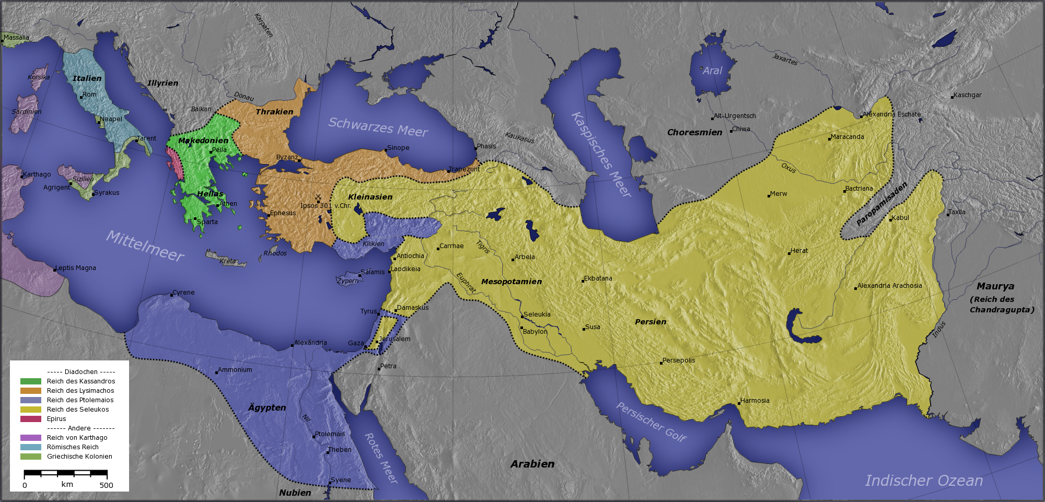
Hellenistic States
& Centers of Science
Pergamum
Syracuse
Rhodos
Alexandria

Slide 4
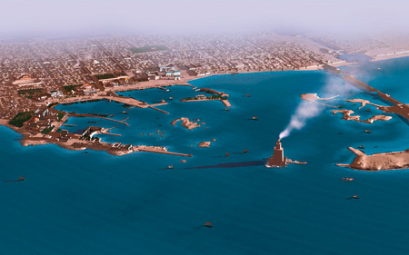
Alexandria

Slide 5
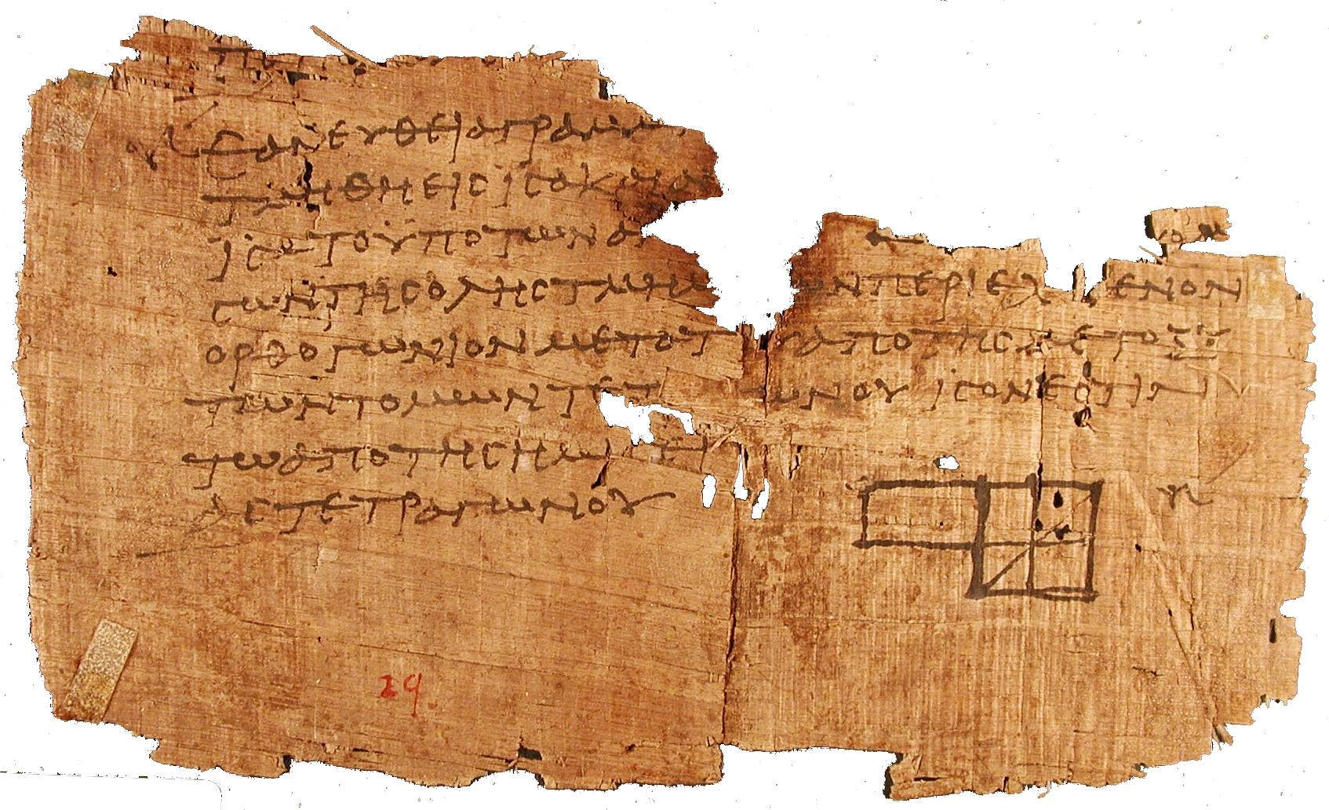
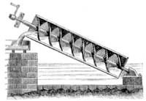
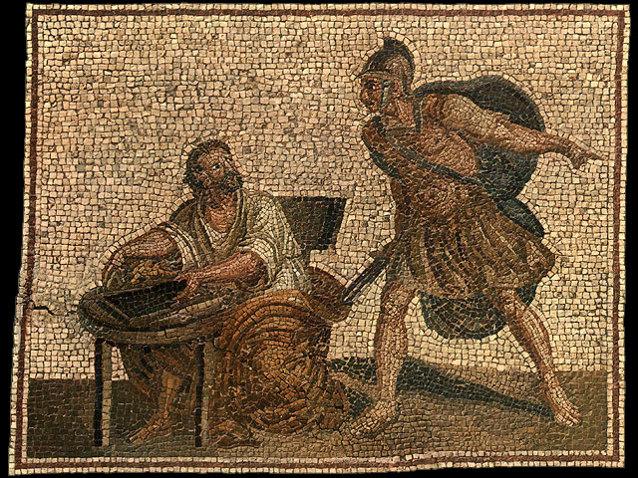
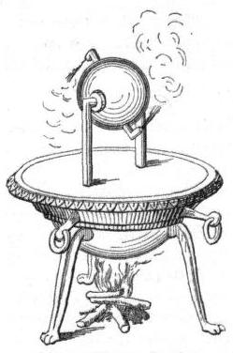
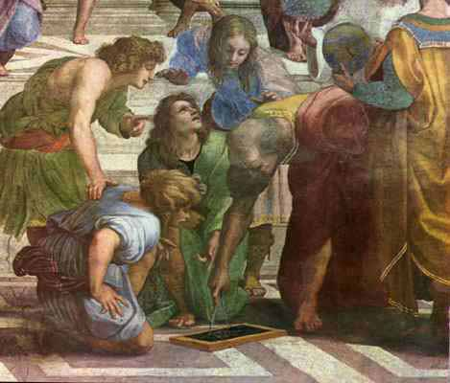
First Scientific Revolution

Slide 6
Euclides
Herophilus
Aristarchus
Ctesibius
Archimedes
Eratosthenes
Apollonius
Hipparchus
Heron of Alexandria
Ptolemaeus

Slide 7
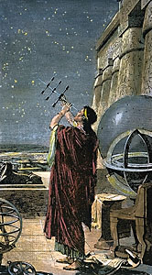
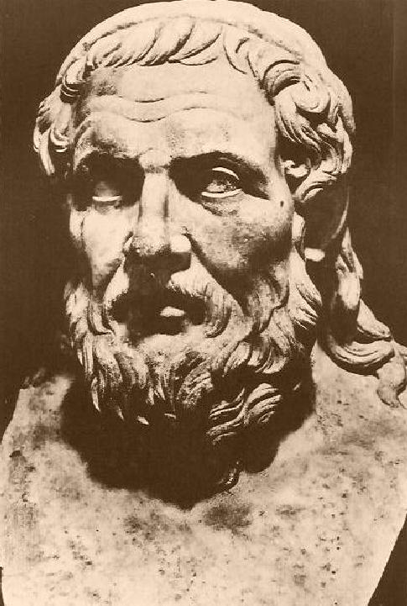
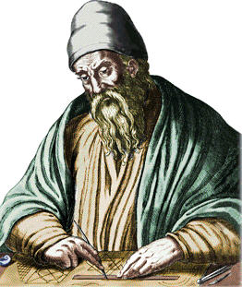
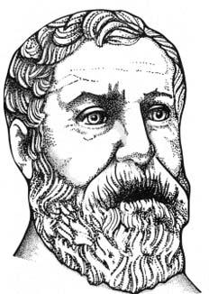
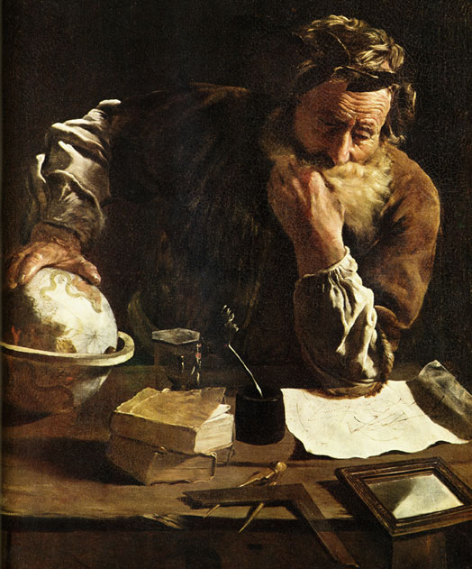
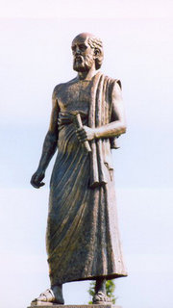
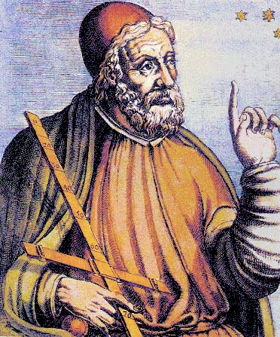
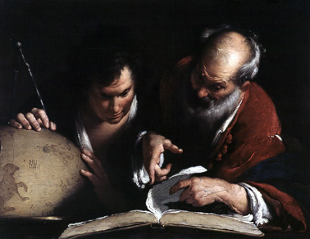
Hipparchus
Euclides
Heron
Apollonius of Perga
Aristarchus
Ptolemaeus
Eratosthenes
Archimedes

Slide 8
Euclides (~ 300 BC)
Herophilus (335-280 BC)
Aristarchus of Samos (310-230 BC)
Ctesibius (285-222 BC)
Archimedes (287-212 BC)
Eratosthenes (276-194 BC)
Apollonius of Perga (262-190 BC)
Hipparchus of Samos (190-120 BC)
Heron of Alexandria (10-70 AD)
Ptolemaeus (83-168 AD)

Slide 9
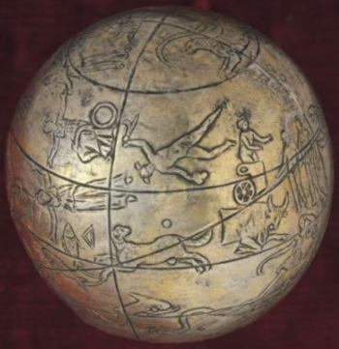
Hellenistic Astronomers
Various astronomers made significant,
even amazing, contributions. Noteworthy examples:
• Aristarchus of Samos - Heliocentric Universe
- distance Moon & Sun
- size Sun
• Archimedes - Planisphere/Planetarium ?
• Eratosthenes - Diameter Earth
• Hipparchus - multitude
essential contributions
Problematic is the loss of nearly all, except for a few,
of the books and works they have written …

Slide 10
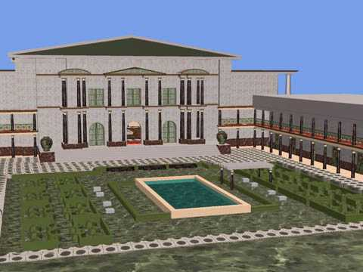
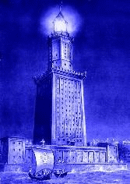
Alexandria:
Birthplace of the
Western Mind
Mouseion: the Library

Slide 11
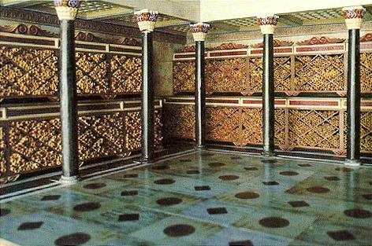
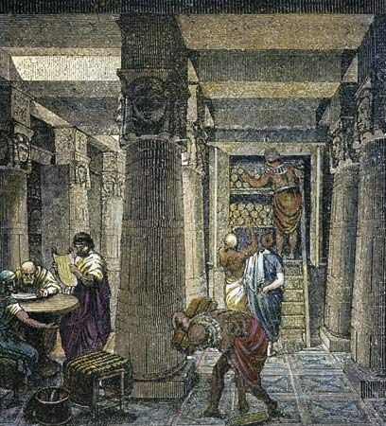
Great Library of Alexandria
Mouseion: World’s first “university”
Library: 700,000 book scrolls
Storage of all knowledge ancient world

Slide 12

Carl Sagan – Cosmos
Library of Alexandria

Slide 13
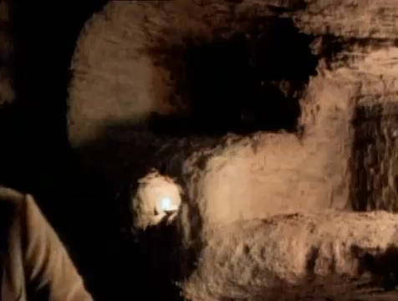
Carl Sagan – Cosmos
Library of Alexandria

Slide 14
Aristarchus of Samos
Ἀρίσταρχος
310-230 BCE

Slide 15
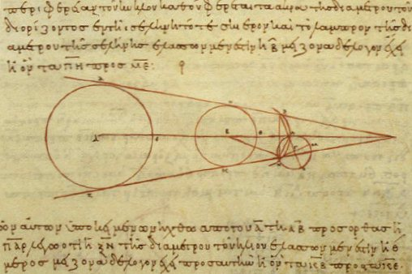
Aristarchus of Samos
(Samos, 310-230 BCE) the ancient Copernicus
“On the Sizes & Distances of the Sun and Moon ”:

Slide 16
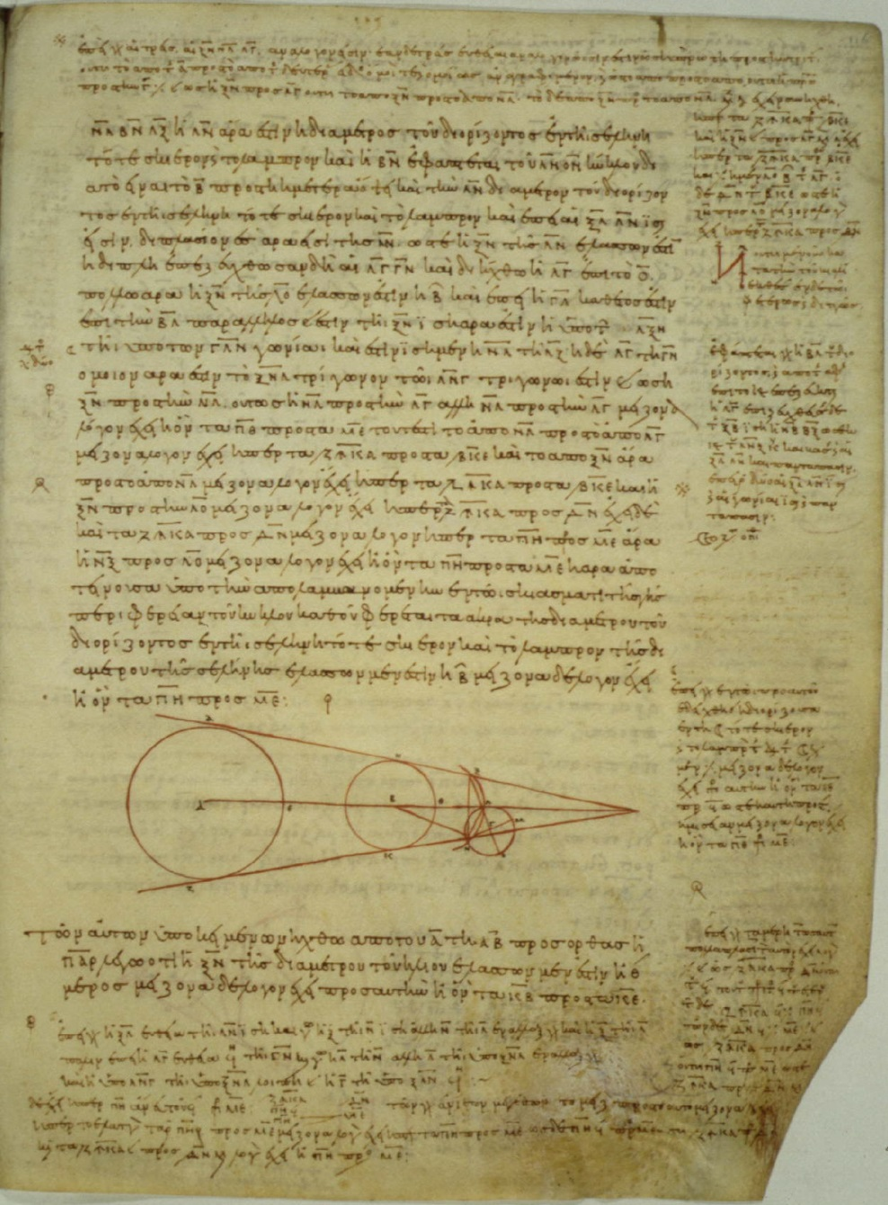
On the Sizes and Distances
Only one work of Aristarchus survives:
On the Sizes and the Distances
of the Sun and Moon
First mathematically based attempt
to measure distance Earth-Sun, thus
First attempt to measure scale Universe
Based upon geocentric view of Universe
On the Sizes and the Distances
Greek copy 10th century

Slide 17
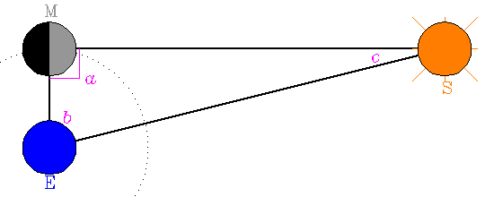
On the Sizes and Distances
Aristarchus' geometric construction used to estimate the distance to the Sun.
Earth (E) –Sun (S)-Moon (M) triangle and sizes are not drawn to scale.
Measure angle b:
c = 90 ̊-b EM/ES = sin(c)
Aristarchus:
b = 87 ̊ real value: b = 89 ̊50
ES = 19 EM real value: ES = 397 EM
Numerically, very unstable procedure, reason
for huge error. Nonetheless,
On the Sizes and the Distances
Greek copy 10th century

Slide 18
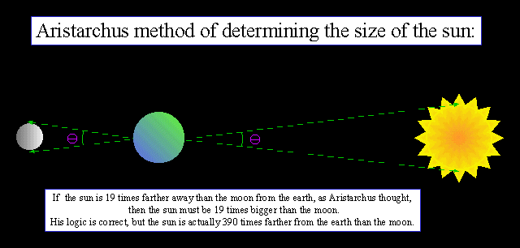
On the Sizes and Distances
Aristarchus' estimate of size Sun:
angular diameter Sun ~
angular diameter Moon
Dist. Earth-Sun = 19 Dist. Earth-Moon
size Sun = 19 x size Moon
size Sun > size Earth
On the Sizes and the Distances
Greek copy 10th century

Slide 19
Aristarchus:
Heliocentric Universe
Archimedes, “the Sand Reckoner” (~200 BCE):
You King Gelon are aware the ‘universe' is the name given by most astronomers to the sphere the center of which is the center of the Earth, while its radius is equal to the straight line between the center of the Sun and the center of the Earth. This is the common account as you have heard from astronomers.
But Aristarchus has brought out a book consisting of certain hypotheses, wherein it appears, as a consequence of the assumptions made, that the universe is many times greater than the 'universe' just mentioned.
His hypotheses are that the fixed stars and the Sun remain unmoved, that
the Earth revolves about the Sun
on the circumference of a circle, the Sun lying in the middle of the orbit, and that the sphere of fixed stars, situated about the same center as the Sun, is so great that the circle in which he supposes the Earth to revolve bears such a proportion to the distance of the fixed stars as the center of the sphere bears to its surface.

Slide 20
Aristarchus:
Heliocentric Universe
Aristarchus’ idea of Heliocentric Universe
encountered sceptical, even hostile, reactions:
• Could not explain the absence of
parallax of fixed stars
(or they should be very, very far away …)
• Impiety … (even for those “rational” Greeks …)
“Cleanthes thought it was the duty of the Greeks to indict Aristarchus of Samos on the charge of impiety for putting in motion the Hearth of the universe [i.e. the earth], . . . supposing the heaven to remain at rest and the earth to revolve in an oblique circle, while it rotates, at the same time, about its own axis”
Plutarchus, “On the Apparent Face in the Orb of the Moon”

Slide 21
Eratosthenes of Cyrene
Ἐρατοσθένης
276 BC - 194 BC

Slide 22
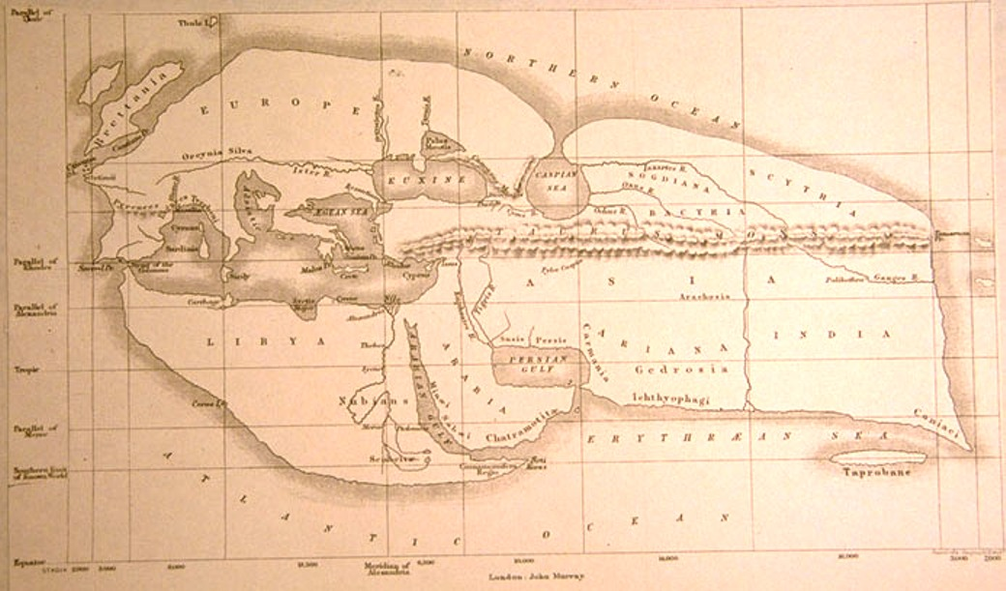
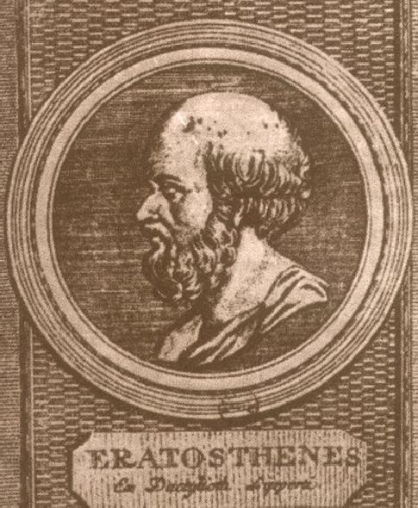
Eratosthenes of Cyrene
(276 -194 B.C.E.)
• Studied in Alexandria & Athens
- Mathematician
- Astronomer
- Geographer
- Poet
- Athlete
• 2nd Chief librarian
Great Library of Alexandria
• Friend of Archimedes
• Invented armillary sphere
(240 BC)
• Calculated Earth’s Circumference
• Became blind in 194 BC,
starved himself to death

Slide 23
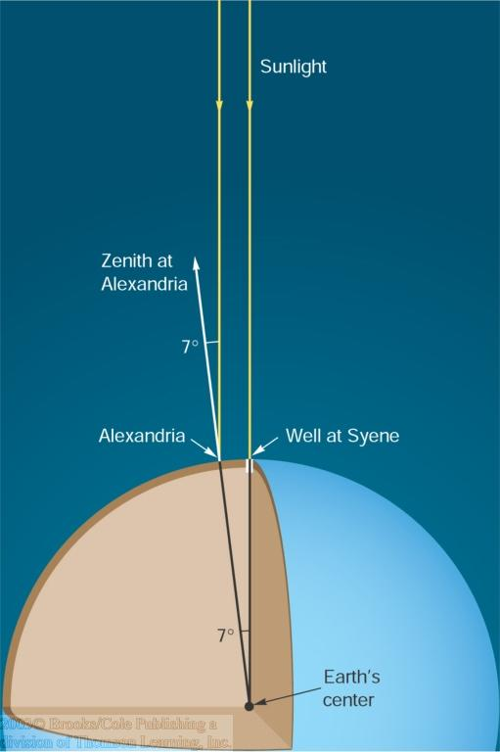
Earth Circumference:
Eratosthenes’ measurement: 39,690 km - within 1%
(if Egyptian stadia)
Linear distance
Syene - Alexandria:
~ 5,000 stadia
Angular distance
Syene - Alexandria:
~ 7⁰
Eratosthenes’ measurement Earth diameter

Slide 24

Eratosthenes
Earth Circumference Measurement

Slide 25
Archimedes of Syracuse
Aρχιμηδηζ c. 287 – 212 BCE

Slide 26
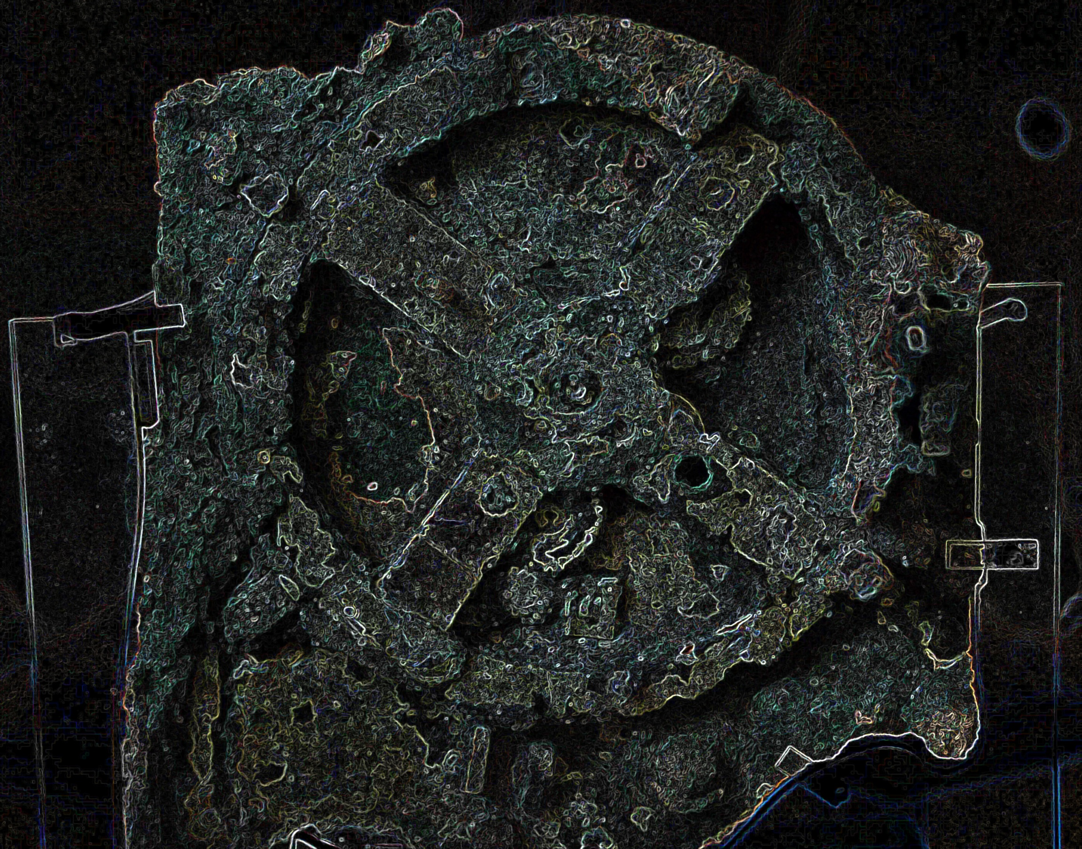
Archimedes
Syracuse, 287-211/212 BC,
Greatest mathematician &
scientist of antiquity (all time ?):
• Probably studied in Alexandria,
under followers Euclides
• Killed by Roman soldier, upon
Roman conquest Syracuse
• Family Hieron II, king Syracuse ?
• Inventions:
- war machines …
- water screw
- water organ (?)
- burning mirrors (???)
- planetarium !!!!!!!

Slide 27
Cicero mentions two planetarium like machines…
“For when Archimedes fastened on a globe the
movements of moon, sun and five wandering stars,
he, just like Plato’s God who built the world in the
“Timaeus”, made one revolution of the sphere
control several movements utterly unlike in
slowness and speed. Now if in this world of ours
phenomena cannot take place without the act of
God, neither could Archimedes have reproduced
the same movements upon a globe without
divine genius''
Cicero, Tusculan Disputations, Book I, Section XXV

Slide 28
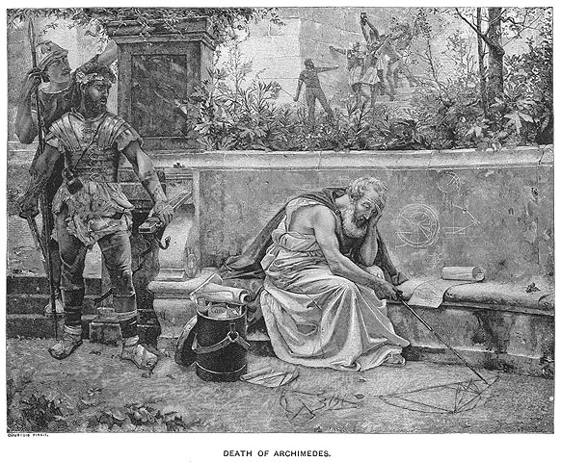

Slide 29
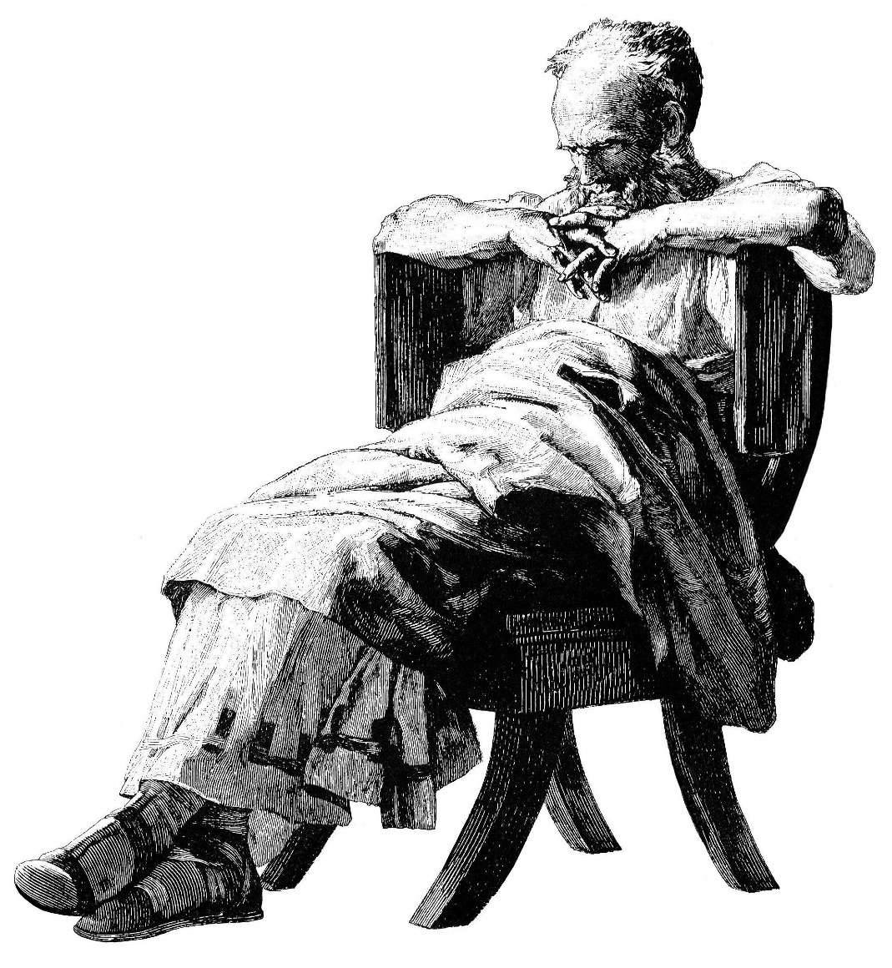
Archimedes
Pappus of Alexandria:
Archimedes wrote book
“On Sphere-Making”
… is this Antikythera … ?
Compare with
Archimedes Palimpsest:
… “On the Method” …
Fundamentals Calculus,
Integral calculus …

Slide 30
Hipparcus
Iππαρχοζ c. 190 – 120 BCE

Slide 31
Hipparchus of Nicaea (190-120 BC)
• Antiquities' Greatest Astronomer
• Responsible for the true
Revolution in Astronomy
• S ynthesis of
Babylonian Observational Astronomy
Greek Theoretical/Geometric Models
• Astronomy as true Modern Science:
Experiment & Theory

Slide 32
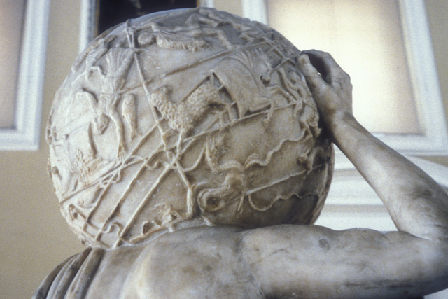
Hipparcus
(Nicaea-Rhodos 190-120 BCE)
Greatest astronomer Greek antiquity
• Trigonometric Tables
• Precession of the Equinoxes
• Motion moon:
synodic, anomalistic, … month
• Solar & Lunar eclipses
• Orbit of the Moon:
epicyclic theory
• Distance Moon
• Star catalogue & Celestial Globe
Lost, yet … Farnese Atlas ?
• Defined Magnitude Scale
• Invented the Astrolabe
•

Slide 33
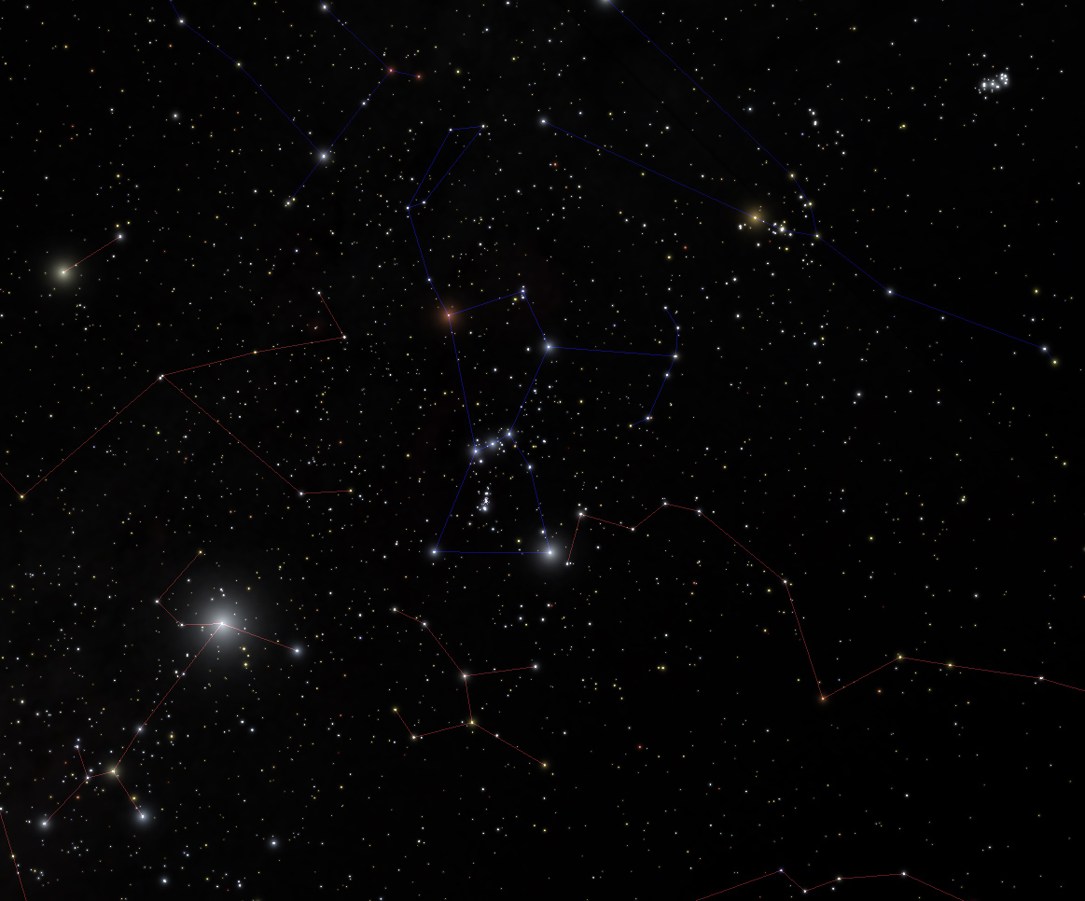
Star Magnitudes

Slide 34
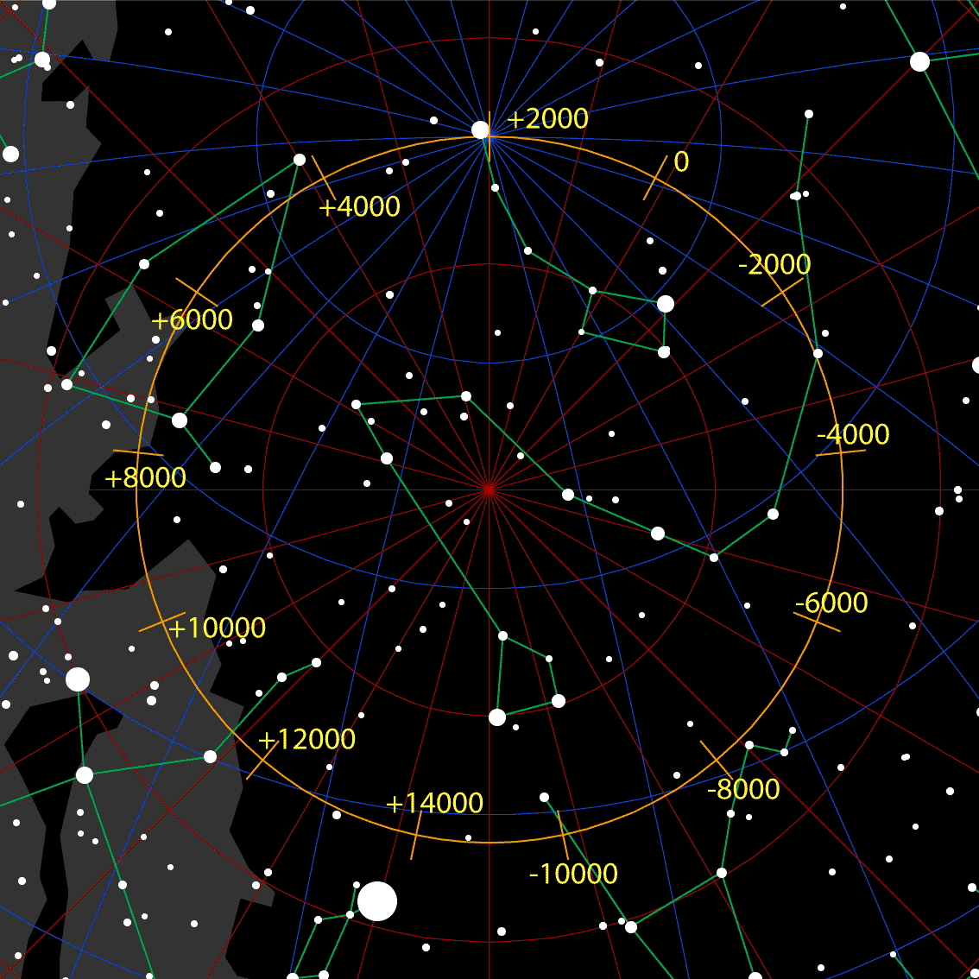
Precession

Slide 35
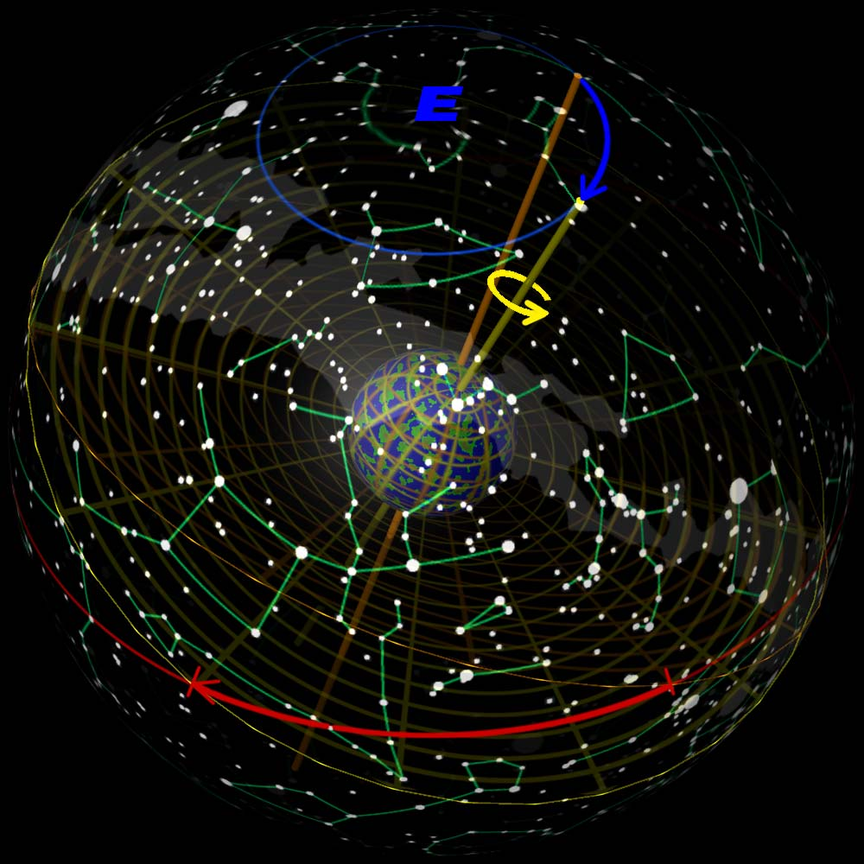
Precession

Slide 36
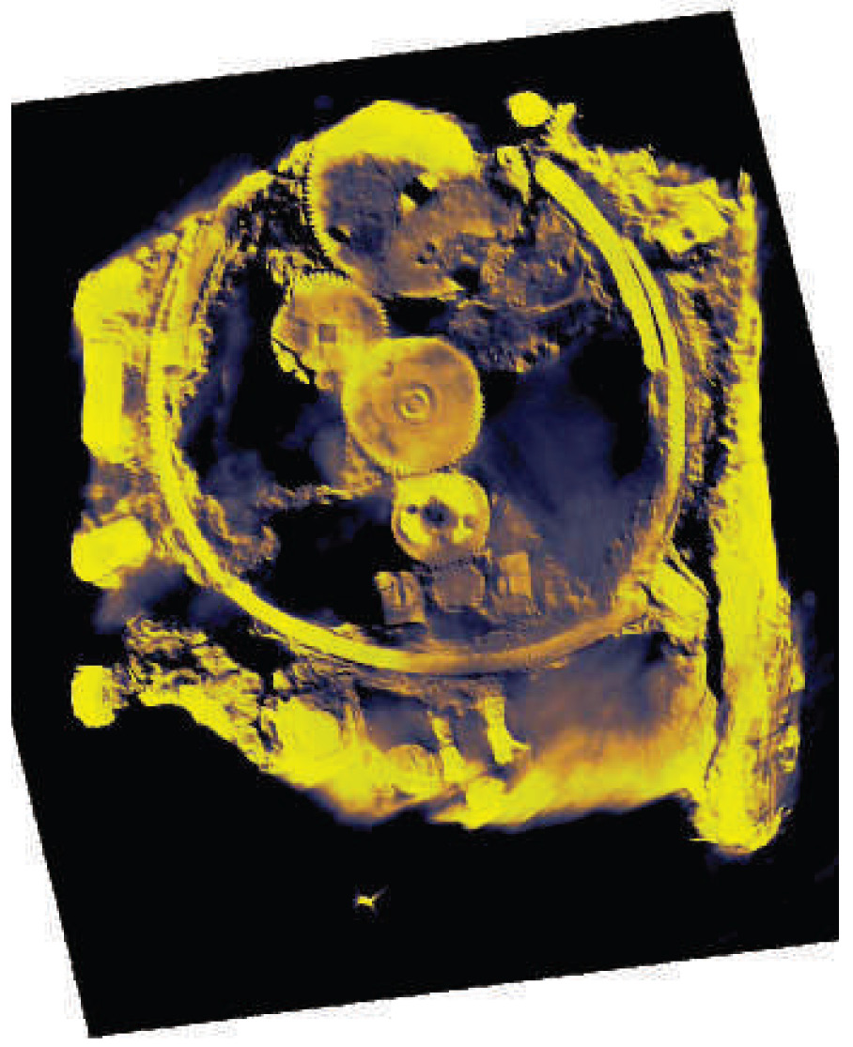
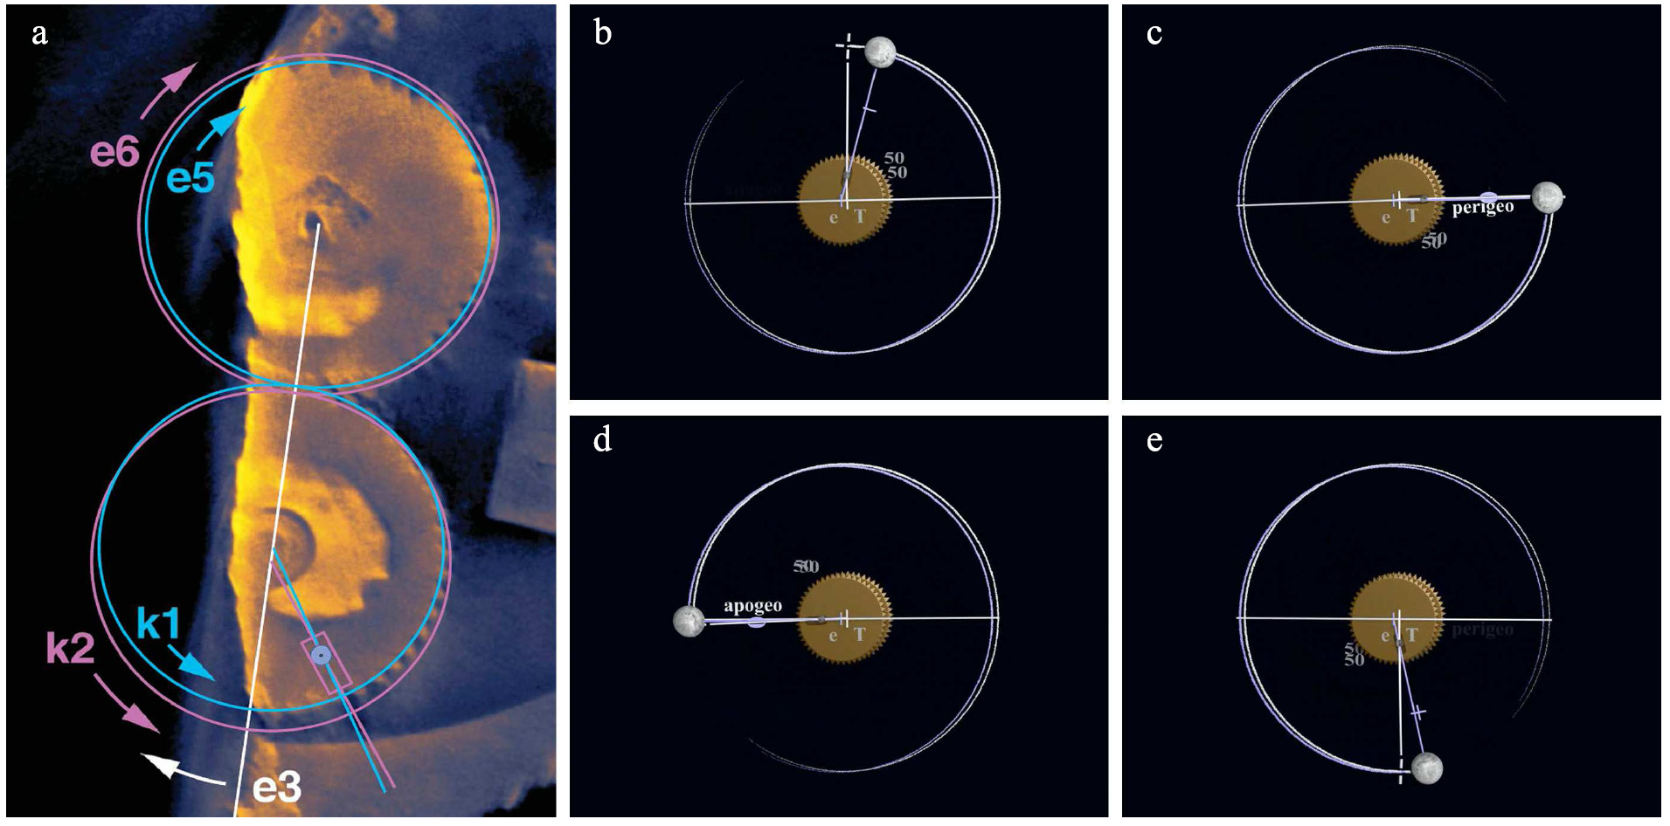
… and Astronomy
Greek Miracle ?
Hipparcus’ Moon Orbit Computer

Slide 37
Farnese Atlas:
Hipparchus’ star catalog ?

Slide 38
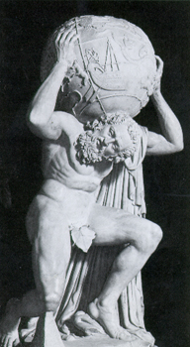
Farnese Atlas:
Hipparchus star catalog ?
Farnese Atlas is the oldest surviving pictorial
Record of Western constellations
Roman times ~ A.D. 150,
presumed to represent constellations mapped in earlier Greek work
Atlas labors under the weight because he had been sentenced by Zeus to hold up the sky.
The globe shows:
a depiction of the night sky as seen from
outside the outermost celestial sphere
low reliefs depicting 41 (42) of the
48 classical Greek constellations including:
- Aries the ram
- Cygnus the swan
- Hercules

Slide 39
Epicycle Theory

Slide 40
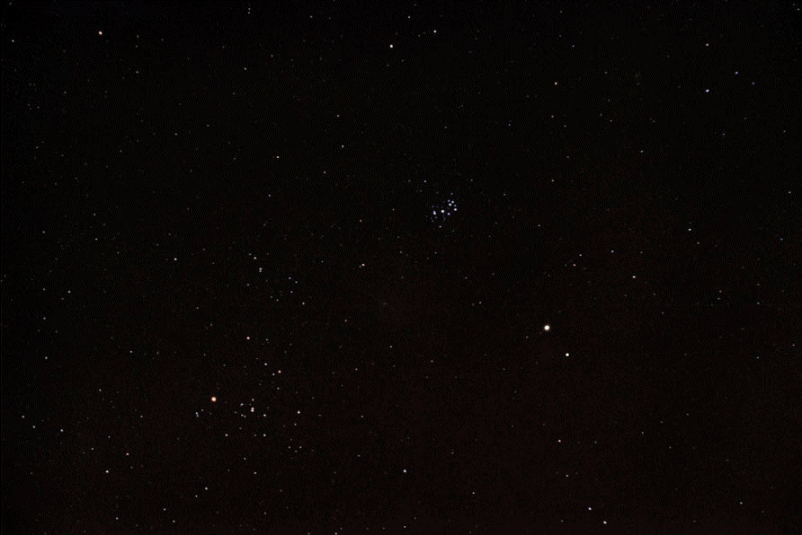

Slide 41
Retrograde Planetary Motion
Superior Planets:
- planet moves through in the night sky slower than the stars.
- each night planet appears to lag a little behind the stars: prograde motion
- near opposition, the planet would appear to reverse and move through
- the night sky faster than the stars for a time in retrograde motion
before reversing again and resuming prograde.
Inferior planets:
always observed to be near the sun
appearing only shortly before sunrise or shortly after sunset
apparent retrograde motion occurs during
the transition between evening star into morning star, as they pass
between Earth and the sun.

Slide 42
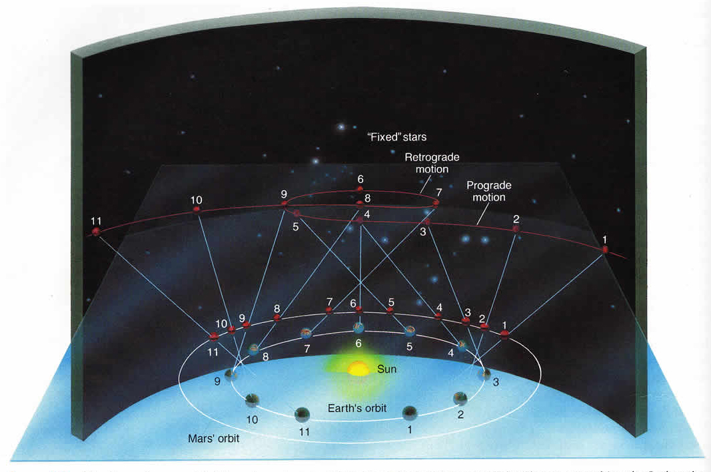

Slide 43
Epicycle Theory
Apollonius of Perga 262-190 BCE
Hipparchus (of Rhodos) 190-120 BCE
Ptolemaeus 100-170 AD
Planetary motion in a Geocentric Universe:
planets move on
- small circle - epicycle
Superimposed and moving on
- large circle - deferent
- both epicycle and deferent rotate clockwise
roughly parallel to ecliptic
Explains retrograde motion of planets on the sky

Slide 44
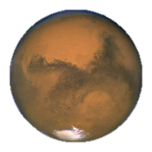
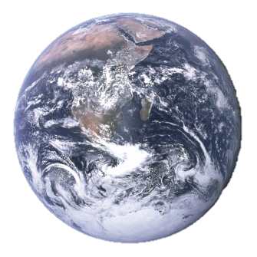
Epicycle Model: essentials
Epicycle
Anomalistic motion
Deferent
Longitudinal motion

Slide 45
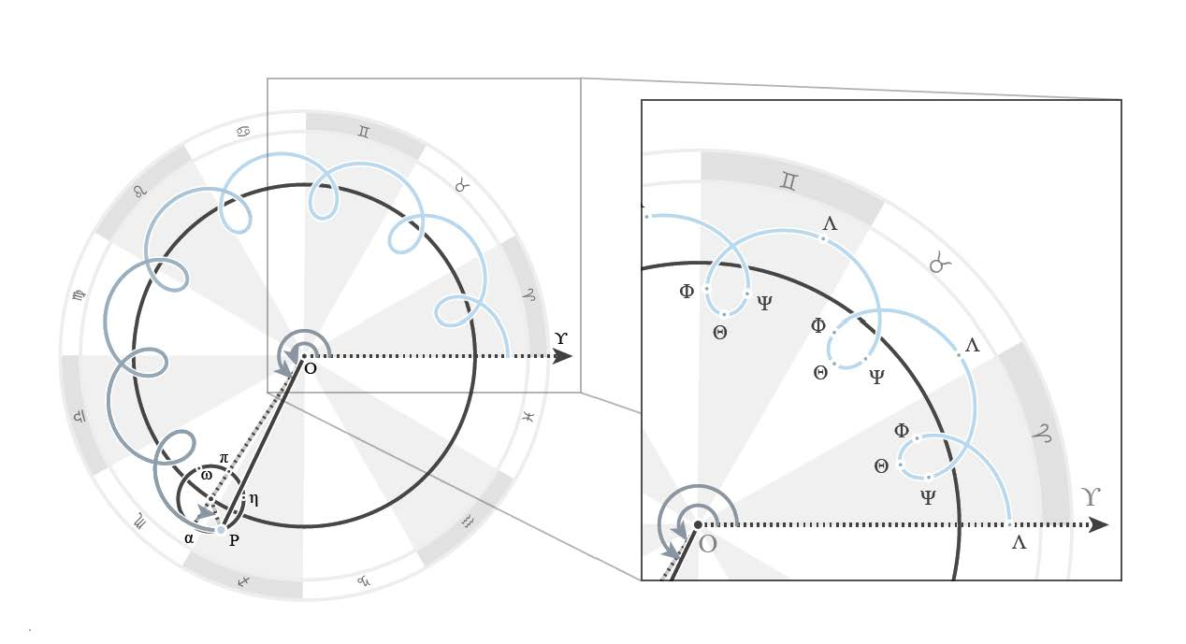

Slide 46
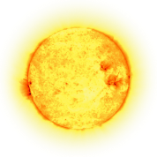
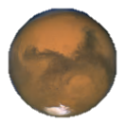
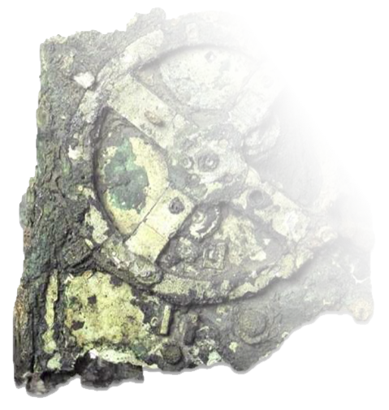
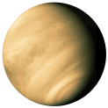

Inferior and Superior planets
Period of time = Number of anomalistic periods + Number of longitudinal periods

Slide 47
Ptolemaeus Epicycle Theory: Equant
The angular rate at which the epicycle traveled was not constant unless he measured it from another point which he called the equant.
It was the angular rate at which the deferent moved around the point midway between the equant and the Earth (the eccentric) that was constant;
the epicycle center swept out equal angles over equal times only when viewed from the equant.
It was the use of equants to decouple uniform motion from the center of the circular deferents that distinguished the Ptolemaic system.

Slide 48




Ptolemaeus Epicycle Theory
eccentric
equant
epicycle (basic)

Slide 49
Ptolemaeus Planet Orbits
Ptolemaeus estimates of orbit sizes
Body | Mean size (in Earth radii) | Modern value (semi-major axis, in Earth radii) | Ratio (modern/Ptolemy) | Ratio (modern/Ptolemy, normalized to sun = 1)
Moon | 48 | 60.3 | 1.26 | 0.065
Mercury | 115 | 9090 | 79.0 | 4.1
Venus | 622.5 | 16,980 | 27.3 | 1.4
Sun | 1210 | 23,480 | 19.4 | 1
Mars | 5040 | 35,780 | 7.10 | 0.37
Jupiter | 11,504 | 122,200 | 10.6 | 0.55
Saturn | 17,026 | 225,000 | 13.2 | 0.68
Star shell | 20,000 | ---- | ---- | ----

Slide 50


Ptolemaeus Epicycle Theory
Ptolemaeus Epicycle Theory
0

Slide 51


Geocentric Universe
Ptolemaeus’ Geocentric Universe is one
of the 2 world world systems under
discussion in Galileo Galilei’s book (1632)
Dialogue Concerning the
Two Chief World System
It had to give way to the heliocentric Universe, 1500 yrs after the Almagest

Slide 52
Claudius Ptolemaeus
Kλαυδιοζ Πτολεμαιοζ
AD 83-168

Slide 53

Claudius Ptolemaeus
 
AD 83-168

Slide 54

Claudius
Ptolemaeus
Thebaid/Ptolemais Hermiou-
Alexandria 83-168 A.D.
• Mathematician
• Astronomer
• Geographer
• Astrologer additional interests in
• Optics
• Music
• Philosophy

Slide 55

Claudius
Ptolemaeus
• Culmination & Synthesis
Hellenistic Astronomy
Geography in Classical World
• Lasting and dominant influence,
> 1500 yrs,
European & Islamic science

Slide 56

Ptolemy's Bibliography
Almagest (13 books) astronomy
Geography (8 books) geography
Optics (5 books) physics
Tetrabiblos (4 books) astrology
Harmonics (3 books)
Planetary Hypotheses (2 books) astronomy
Analemma
Canobic Inscription
Planispherium astronomy
Other astronomical works
Lost works

Slide 57


Almagest
Geografia
Tetrabiblos

Slide 58

Geografia

Slide 59
Geografia
• Standard of geographical theory until the 1500’s,
until age of exploration•
Only surviving geographical treatise from antiquity
• Represents whole corpus of geographical knowledge
acquired in Graeco-Roman antiquity
• Mapping earth with mathematical procedures
from astronomy: coordinates, parallels, meridians
• Divided into 8 books:
Book 1: Introduction and
directions to recreate Ptolemy’s Map
Books 2-7: Latitudinal and longitudinal data for
~ 8,000 cities
Book 8: Description of 28 regional maps

Slide 60

Geografia
Map of Ancient India:
crucial importance for development Roman
trade network with India

Slide 61
Geografia - Oikoumene/
Based on the work of his immediate predecessor,
Marinus of Tyre (80-130 A.D.)
Combined data from a variety of sources
Ptolemy was the first geographer to use longitude and latitude to create coordinates
Derived 21 latitude lines – fairly accurate
Described 4 different projections
Believed the oikoumene (inhabited world) to span
180 degrees (longitude) of the earth’s 360
Limits of the oikoumene
  Northern bound: 63°N (the Thule parallel)
  Southern bound: 16°25’S
  (the parallel opposite the equator from the one running through Meroë)
  Oikoumene stretches from
  the Canary Islands in the west to China in the east

Slide 62


Geografia: four Map Projections
Projection 2
Projection 1
  Straight meridians & Straight parallels
  Very similar to Marinus’ map
Projection 2
  Straight meridians & Curved parallels
  Preferred method of Ptolemy’s successors
  Constant scale in relation to Rhodes parallel
  36+1 parallel meridians, each 5 degrees apart
Projection 3
  Curved meridians & Straight parallels
  made extreme parallels more accurate
Projection 4
  View of globe from distance
  External rings represent latitude lines
Projection 3

Slide 63
Almagest
I Mεγαλι Συνταξιζ
Mαθηματικη Συνταξιζ

Slide 64

  - Almagest
Almagest, Greek copy 13th century
“The Great Book”
Most Important & Influential
Astronomical Work of Antiquity
• Mathematical and Astronomical treatise proposing
the complex motions of stars and planetary paths
• Written in 147 / 148 A.D.:
inscription in Canopus, by Ptolemaeus
•Thirteen Books
• Original in Greek:
Mathematike Syntaxis - Mathematical Treatise
He Megale Syntaxis - “The Great Treatise”
• Best known by its Arab name:
Almagest - “The Great Book”

Slide 65
Almagest the Greatest
One of the most influential scientific works in history
(along with Euclid’s “Elements”, Copernicus’ “Revolutionibus”,
Galilei’s “Dialogues” Newton’s “Principia”,
Darwin’s “Origin of Species”)
One of most influential books of all time
(perhaps only after Bible, Qur’an,
along with Euclid’s “Elements”, …)

Slide 66
Almagest the Greatest
Systematic methodology
Observational Data
Numerical parameters planetary models
Construction tables celestial phenomena
(solar, lunar & planetary positions; solar & lunar eclipses, …)

Slide 67
Almagest the Greatest
Success Almagest:
Loss of most of work scientific predecessors:
being obsolete, they ceased to be copied
Is this true ?

Slide 68

Almagest the Greatest

Slide 69
Almagest - the Greatest
Mαθηματικη Συνταξιζ
Almagest, Greek copy 9th century

Slide 70
Syntaxis - Almagest
Almagest, Greek copy 13th century
“The Great Book”
most Important & Influential
Astronomical Work of Antiquity
Ptolemy first scientist to spell out inductive method:
- models framed from preliminary facts
- expand models by logical induction
- testing hypothesis against reality
Only surviving comprehensive ancient
treatise on astronomy:
- most important source of information on
ancient Greek astronomy
Geocentric Model
Epicycle Theory
Dominated astronomy for > 13 centuries
- Roman (Byzantine, Western) world
Arab world

Slide 71
Syntaxis - Almagest
Almagest, Greek copy 13th century
“The Great Book”
most Important & Influential
Astronomical Work of Antiquity
Geometrical models based on 800 yrs observations
(Babylonians, Hipparchus, …)
Models presented in convenient tables
Calculations fairly accurate for prediction
solar and lunar eclipses
Almagest also contains star catalogue
- appropriated version Hipparchus’ catalogue
- 48 constellations: modern ones, not full sky

Slide 72
Syntaxis - Almagest
Almagest, Greek copy 13th century
Ptolemaeus’ Cosmos
The cosmology of the Almagest:
five main points
each subject of a chapter Book I.
The celestial realm is spherical,
and moves as a sphere.
The earth is a sphere.
The earth is at the center of the cosmos.
The earth,
in relation to the distance of the fixed stars,
has no appreciable size,
must be treated as a mathematical point
The earth does not move.

Slide 73
Syntaxis - Almagest
Almagest, Greek copy 13th century
Ptolemaeus’
Planetary Models
Order of planetary spheres:
Moon
Mercury
Venus
Sun
Mars
Jupiter
Saturn
Sphere fixed stars

Slide 74
Almagest:
Detailed Inventory

Slide 75
Syntaxis - Almagest
Almagest: 13 books
Almagest, Greek copy 13th century
Book III:
- length of the year, and the motion of the Sun
- explains Hipparchus' discovery of the
precession of the equinoxes
- begin explanation epicycles
Books IV & V:
the motion of the Moon:
- lunar parallax
- motion of the lunar apogee
- sizes and distances of the Sun and Moon relative
to Earth
Book VI:
solar and lunar eclipses

Slide 76
Syntaxis - Almagest
Almagest: 13 books
Almagest, Greek copy 13th century
Book I:
outline of Aristotelian cosmology:
- on the spherical form of the heavens,
- the (spherical) Earth lying motionless at centre
- the fixed stars and the various planets revolving
around the earth
- followed by explanation of chords with a set of
chord tables
- observations of the obliquity of the ecliptic
- introduction to spherical trigonometry
Book II:
problems associated with the daily motion attributed
to the heavens:
- risings and settings of celestial object
- length of daylight
- determination of latitude
- points at which the Sun is vertical
- shadows of the gnomon at the equinoxes and
solstices
- other things which change with the spectator's
position. There is also
- a study of the angles made by the ecliptic with
vertical, with tables.

Slide 77
Syntaxis - Almagest
Almagest: 13 books
Almagest, Greek copy 13th century
Books VII & VIII:
motions of the fixed stars:
- includes precession of the equinoxes
star catalogue of 1022 stars:
- described by positions in the constellations
- magnitude scale for brightness:
+ brightness brightest stars marked of the
1st magnitude (m = 1),
+ faintest 6th magnitude (m = 6),
limit human visual perception
+ each grade of magnitude considered twice the
brightness of the following grade (log. scale).
+ system believed to have originated with
Hipparchus
+ Stellar positions: Hipparchan origin
(despite Ptolemy's claim to the contrary)

Slide 78
Syntaxis - Almagest
Almagest: 13 books
Almagest, Greek copy 13th century
Book IX:
- general issues associated with creating models
for the five (naked eye) planets
- motion of Mercury
Book X:
motions of Venus and Mars
Book XI:
motions of Jupiter and Saturn
Book XII:
stations and retrogradations,
- occurring when planets appear to pause,
then briefly reverse their motion against the
background of the zodiac.
- Ptolemy understood these terms to apply to
Mercury and Venus as well as the outer planets
Book XIII:
motion in latitude:
the deviation of planets from the ecliptic

Slide 79
Epicycle Theory
Middle Ages

Slide 80
Ptolemaeus to Copernicus
One school in history of astronomy:
minor imperfections in the original Ptolemaic system were discovered through observations accumulated over time.
It was mistakenly believed that more levels of epicycles (circles within circles) were added to the models to match more accurately the observed planetary motions.
The multiplication of epicycles is believed to have led to a nearly unworkable system by the 16th century.
Copernicus created his heliocentric system in order to simplify the Ptolemaic astronomy of his day, thus succeeding in drastically reducing the number of circles.
With better observations additional epicycles and eccentrics were used to represent the newly observed phenomena till in the later Middle Ages the universe became a 'Sphere/With Centric and Eccentric scribbled o'er,/Cycle and Epicycle, Orb in Orb'

Slide 81
Alfonsine Tables
Tables of solar, lunar and planetary positions wrt.
fixed stars
Called after Alfons X of Castile the Wise (el Sabio)
(1221-1284)
composed in 1252, in Toledo
assembled by translators of Toledo
based on observations an studies of Islamic scholars
most popular astronomical tables for 300 years
(incl. Copernicus)

Slide 82


Slide 83
Ptolemaeus to Copernicus
As a measure of complexity:
- the number of circles is given as 80 for Ptolemy,
- versus a mere 34 for Copernicus
By this time each planet had been provided with from 40 to 60 epicycles to represent after a fashion its complex movement among the stars. Amazed at the difficulty of the project, Alfonso is credited with the remark that had he been present at the Creation he might have given excellent advice.

