Slide 1
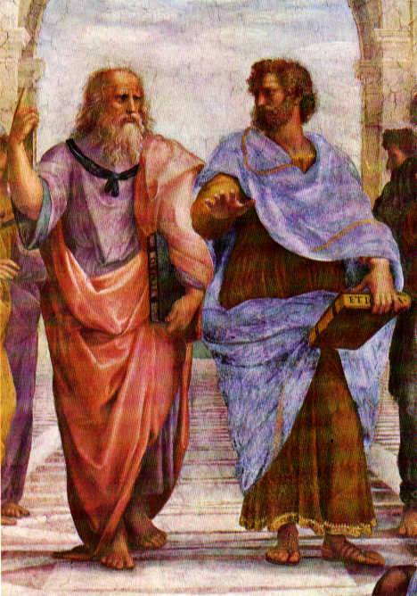
Order in the Cosmos:
how
Babylonians and Greeks
rationalized the heavens

Slide 2
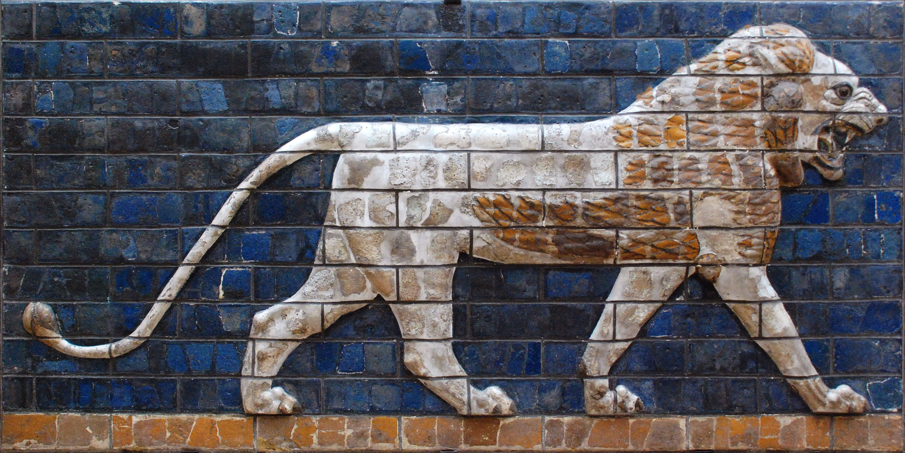
Babylonians
Astronomers of Antiquity

Slide 3
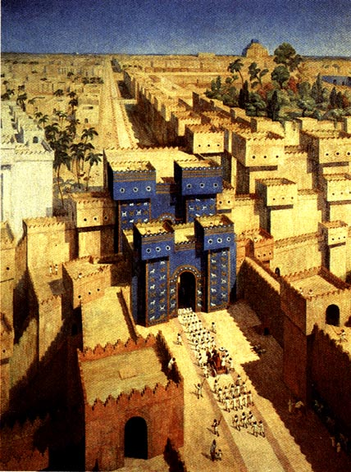

Slide 4
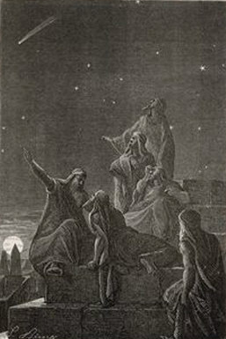
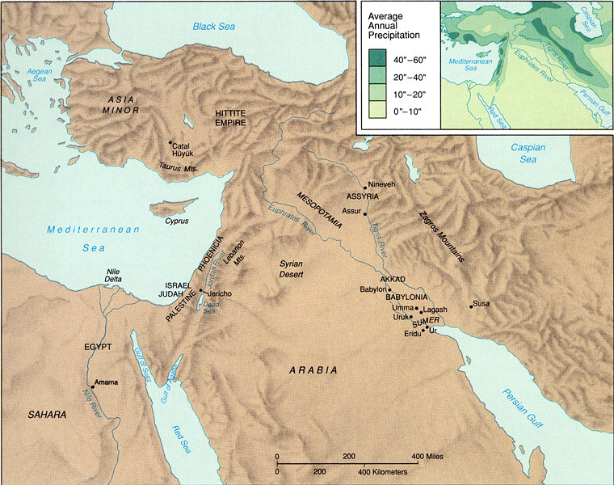
Babylonian Astronomy
Mesopotamia = “land of two rivers”
land between the rivers Euphrates & Tigris

Slide 5
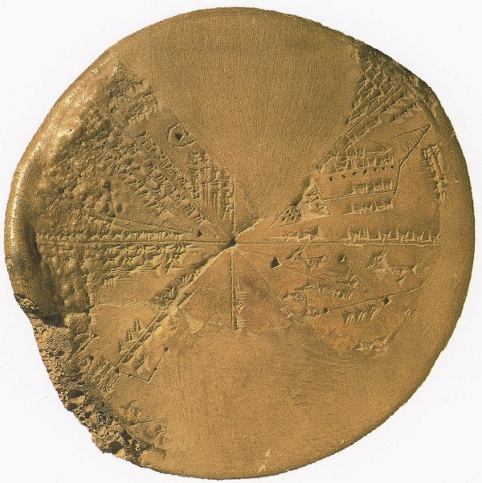
Babylonian Astronomy
Lasting Astronomical Influence:
• Constellation Names
• Zodiac
• Degree - unit angle
• Sexagesimal number system:
circle: 360 degrees
degree: 60 minutes
place value number system
(crucial for Greek science !)
• Eclipse Observations & Periods
• Synodic, Siderial, Draconic, Anomalistic
months
• and …

Slide 6
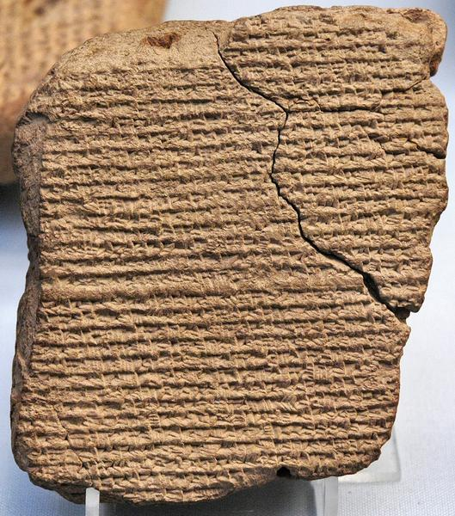
Babylonian Astronomy
Two distinct periods of flowering:
Old Babylonian astronomy:
during and after
First Babylonian dynasty (Hammurabi) 1830-1531 BCE
New Babylonian/Chaldean astronomy:
Neo-Babylonian (Nebuchadnezzar) 626-539 BCE
Medo-Persian 539-331 BCE
Seleucid 335-141 BCE
Parthian 129 BCE-224 AD

Slide 7
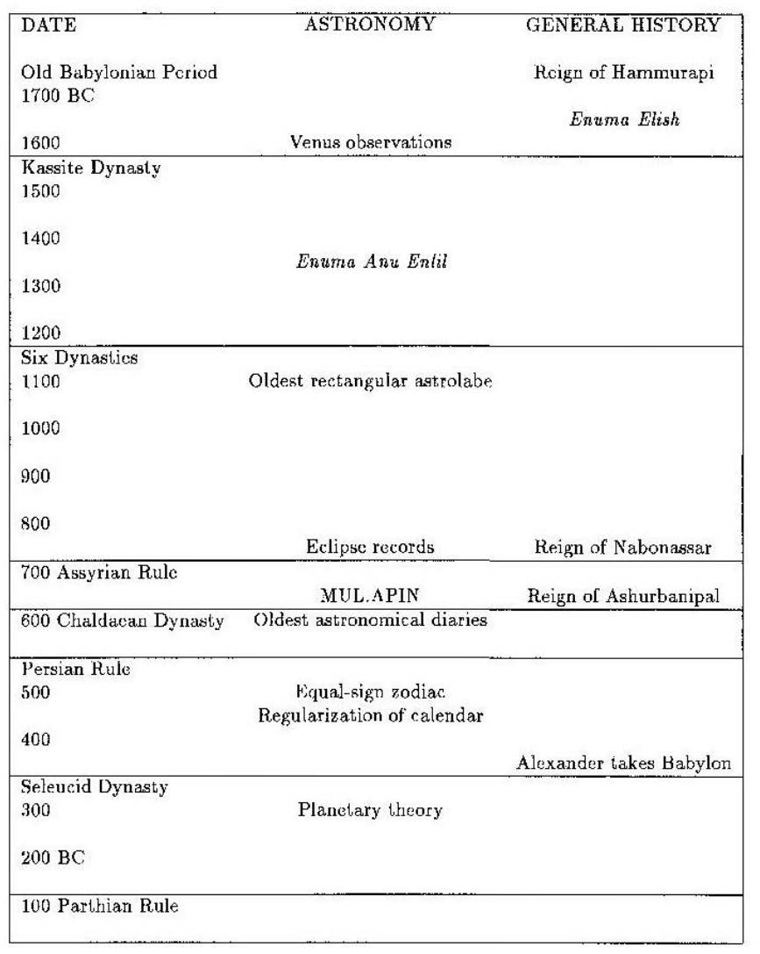
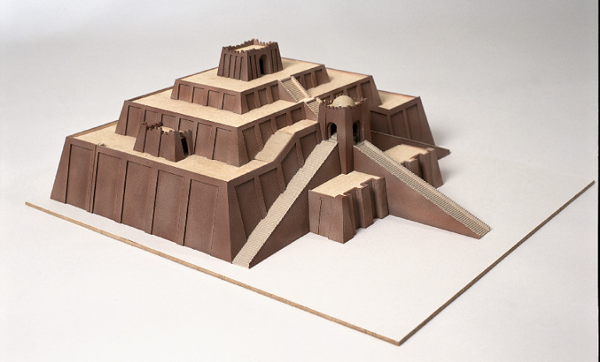
Babylonian
Astronomy
timeline
Babylonian astronomy
Evans 1998

Slide 8
Babylonian Astronomy
Babylonian Astronomers:
• most consistent, systematic and thorough
astronomical observers of antiquity
• First to recognize periodicity astronomical phenomena (e.g. eclipses !),
and apply mathematical techniques for predictions
• Systematically observed and recorded the heavens:
- Records spanning many centuries (> millennium)
- Archives of cuneiform tablets
- Famous Examples:
Enuma Anu Enlil 68-70 tablets Kassite period (1650-1150)
tablet 63: Venus tablet of Ammisaduga
MUL.APIN 700 BCE
oldest copy: 686 BCE

Slide 9
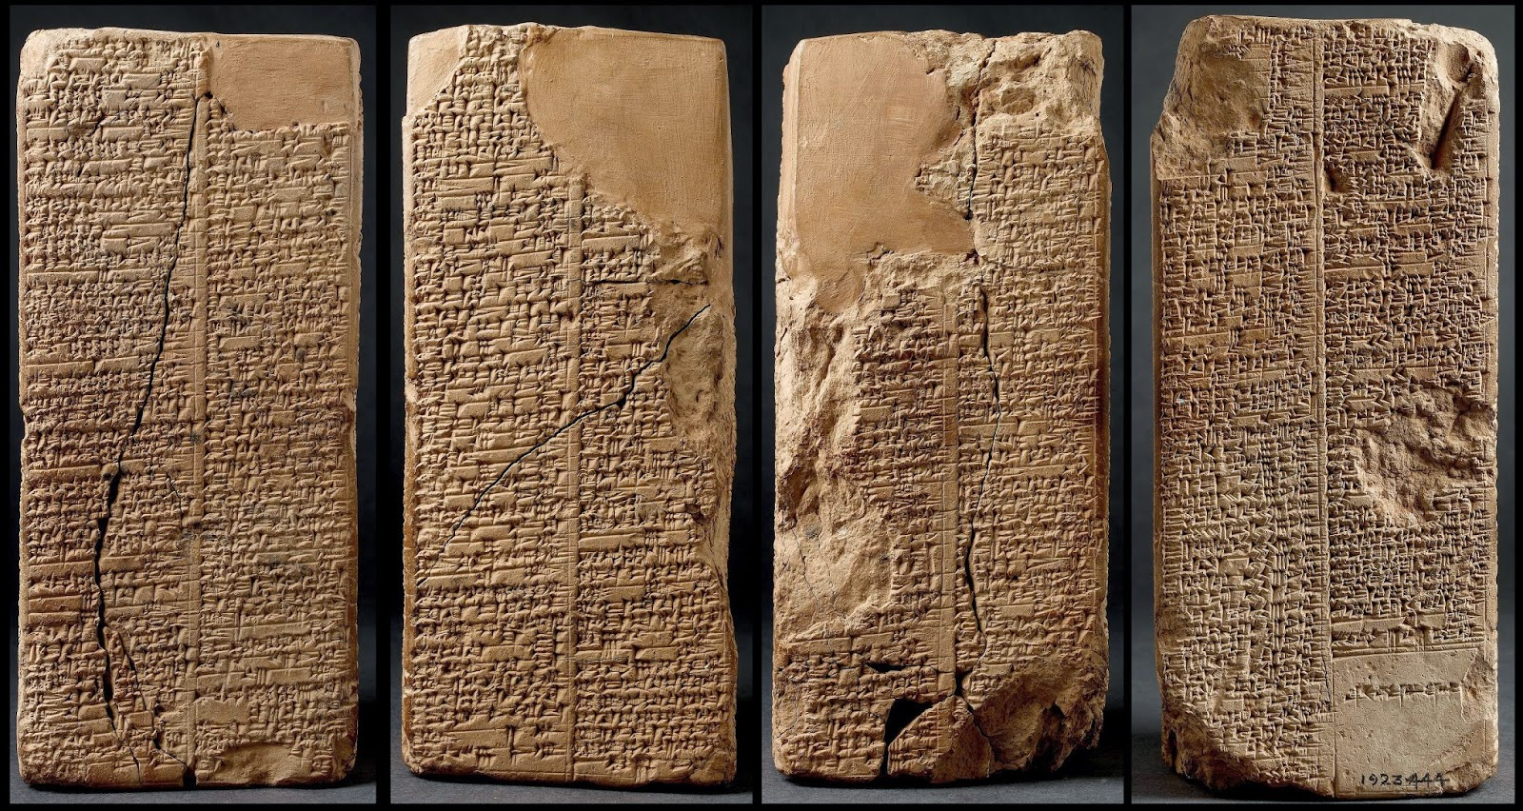
Astronomical Texts
Several types of astronomical texts
in Babylonian astronomy.
Four principal types:
1) astronomical diaries
2) goal year texts
3) ephemerides
4) procedure texts
Ephemerides:
- listing of positions of planets and
their meaning
(eg. extreme points retrograde path)
- predictive: positions based on
calculations (based on scheme)
- ephemerides for Moon
- ephemerides for planets
Procedure texts:
description of procedure(s)
to calculate ephemerides
-

Slide 10
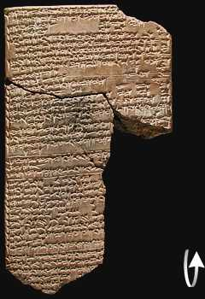
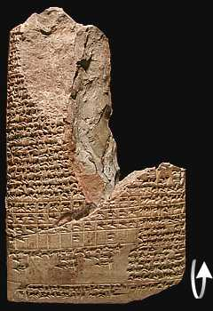
ENUMA ANU ENLIL
Old text, probably Kassite period
(1595-1157 BCE)
A major series of 68 or 70 tablets
dealing with Babylonian astrology.
bulk is a substantial collection of omens, estimated to number between 6500 and 7000,
interpreting a wide variety of celestial and atmospheric phenomena in terms relevant to the king and state

Slide 11
ENUMA ANU ENLIL
2. If with it a cloudbank lies on the right of the sun:
the trade in barley and straw will expand.
3. If with it a cloudbank lies to the left of the sun:
misfortune
4. If with it a cloudbank lies in front of the sun:
the king of Elam [will die]
5. If with it a cloudbank lies behind the sun:
the king of the Gutians [will die]
6. If in Pit babi the sun is surrounded by a halo in
the morning: there will be a severe heat in the
country and the Lamashtu-demon will attack the
country.
7. If with it a cloudbank lies to the right of the sun:
the king of Eshnunna will die.
8. If with it a cloudbank lies to the left of the sun: the
king of Subartu will die and his dynasty will come
to an end.
9. If with it a cloudbank lies in front of the sun: the
rains from heaven (and) the floods from the
depths will dry up.
10. If with it a cloudbank lies behind the sun: the
harvest of the land will not be brought in.

Slide 12
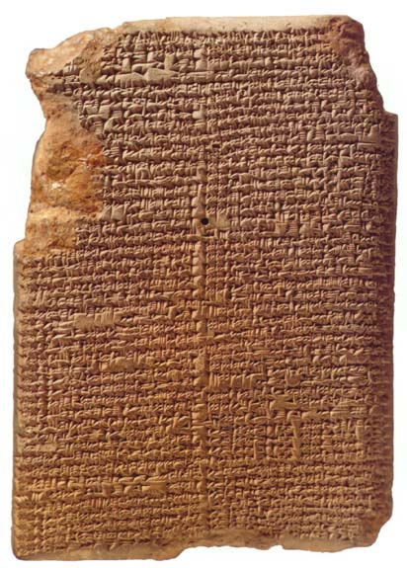
MUL.APIN
Around 700 BCE,
after king Nabonassar
- summary of astronomical knowledge
(Neugebauer)
- Parapegma (Evans)
Catalogue of stars & constellations
Schemes
heliacal risings/settings planets
Measurements lengths daylight
66 stars

Slide 13
Chaldean Astronomy
• Most Chaldean astronomers strictly concerned with ephemerides,
not with theoretical models
• Predictive planetary models empirical,
usually sophisticated arithmetical/numerical schemes
• Models do not involve geometry & cosmology (that’s the Greeks !)
• Discovery (lunar & solar) eclipse cycles & Saros period

Slide 14
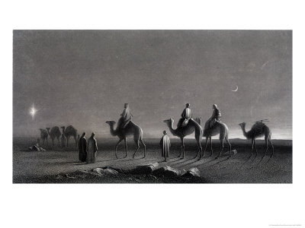
Magi: Chaldean Astronomers

Slide 15
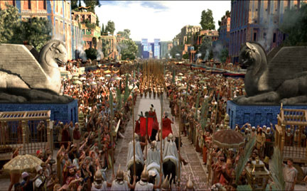
Babylonian Astronomy
Transmission:
• Transfer of Babylonian astronomical
knowledge essential for Hellenistic
astronomy
• Alexander the Great:
orders translation
astronomical records,
under supervision
Callisthenes of Olynthus,
to be sent to his uncle
Aristoteles
• Direct contacts:
e.g. Hipparchus

Slide 16
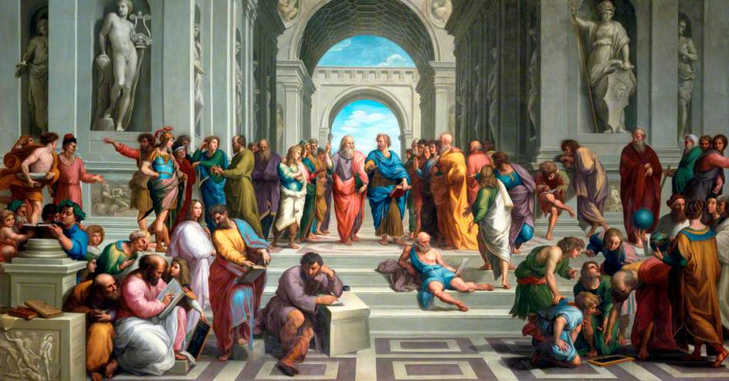
Reason & the Cosmos
Greek Cosmology

Slide 17
Timeline & Overview
Greek Cosmology

Slide 18
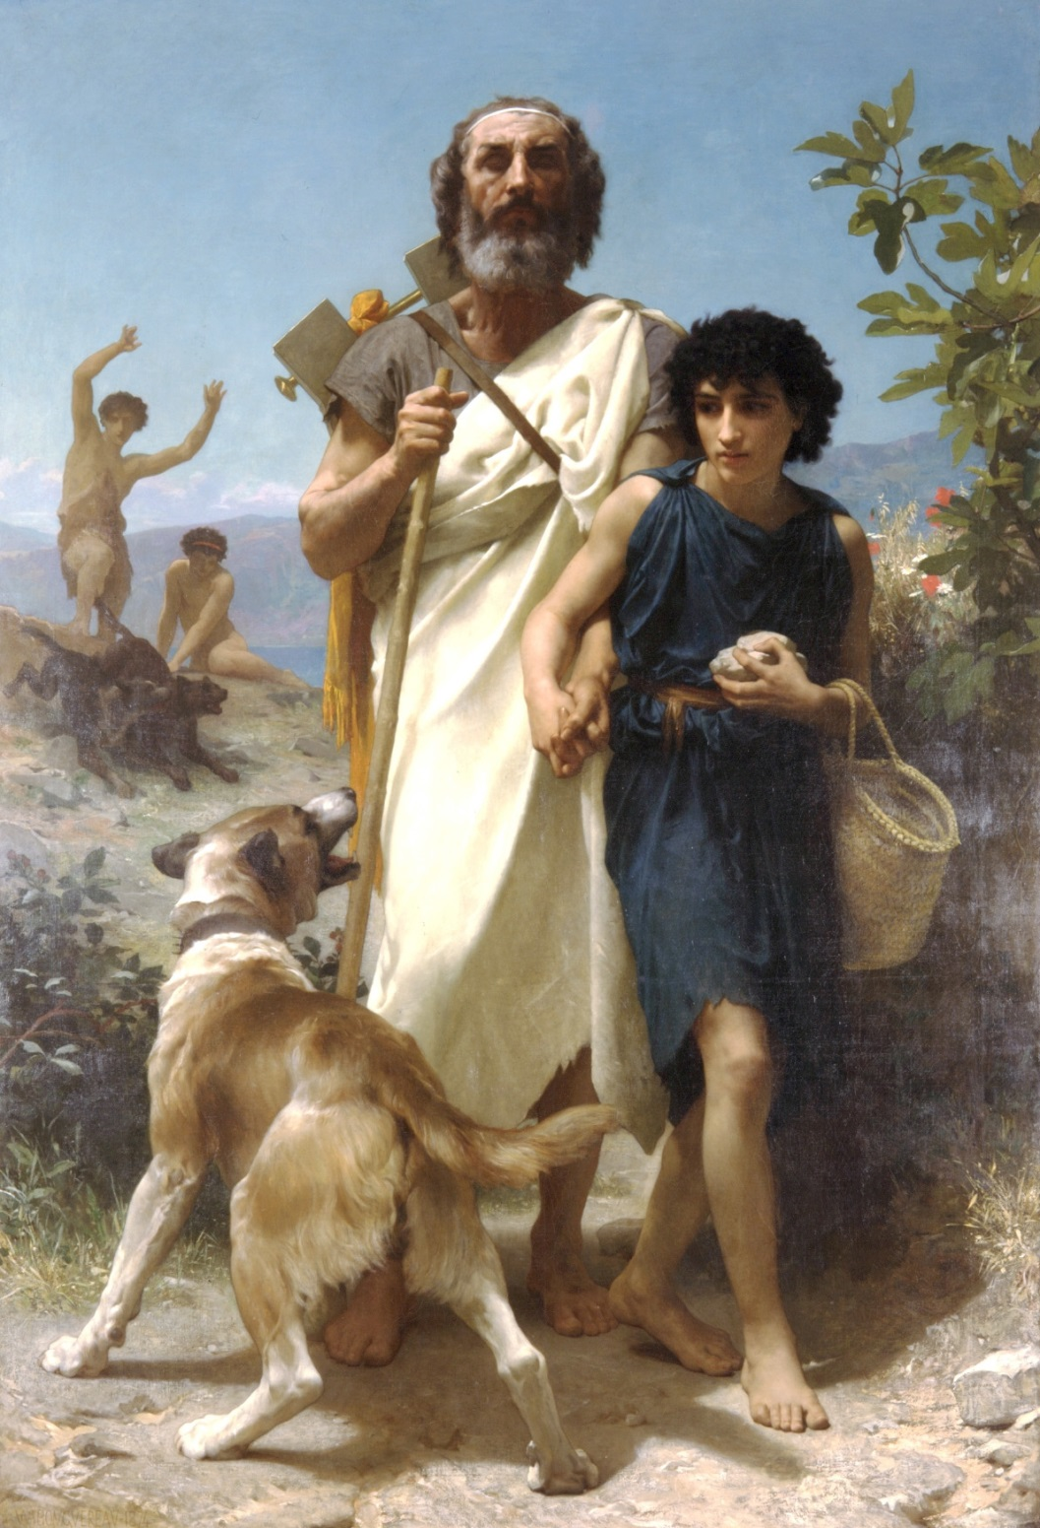
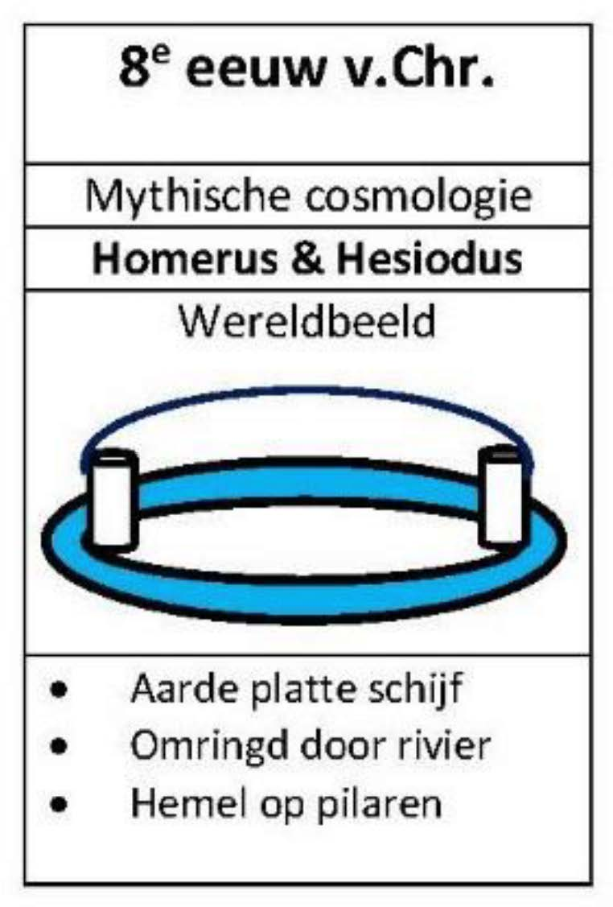
8th Century BCE: mythical cosmology
8th Cent. BCE
Mythical Cosmology
Worldview
• Earth flat disc
• surrounded by river
• Heavens mounted on pillars
Homerus and guide
W-A Bouguereau

Slide 19
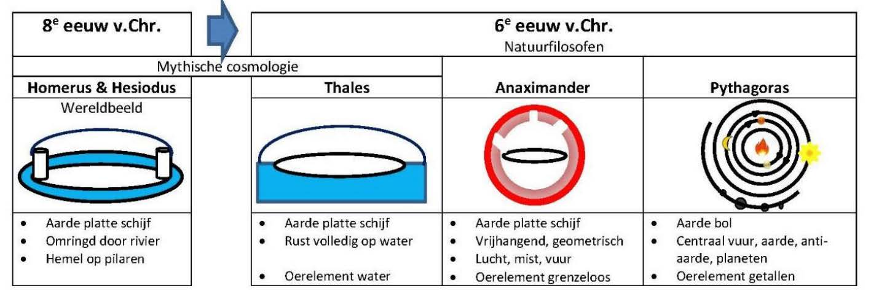
6th Century BCE:
Pre-Socratic Ionian Natural Philosophers
8th Cent. BCE
6th Cent. BCE
Natural Philosophers
Mythical Cosmology
Worldview
• Earth flat disk
• surrounded by a river
• Heavens mounted on pillars
• Earth flat disk
• lies entirely on water
• primeval element = water
• Earth flat disk
• freehanging, geometric
• air, fog, fire
• primeval element = apeiron,
without boundary
• Earth is a sphere
• central fire, earth, anti-earth, planets
• primeval element = numbers
• geocentric worldview
Homerus and guide
W-A Bouguereau

Slide 20
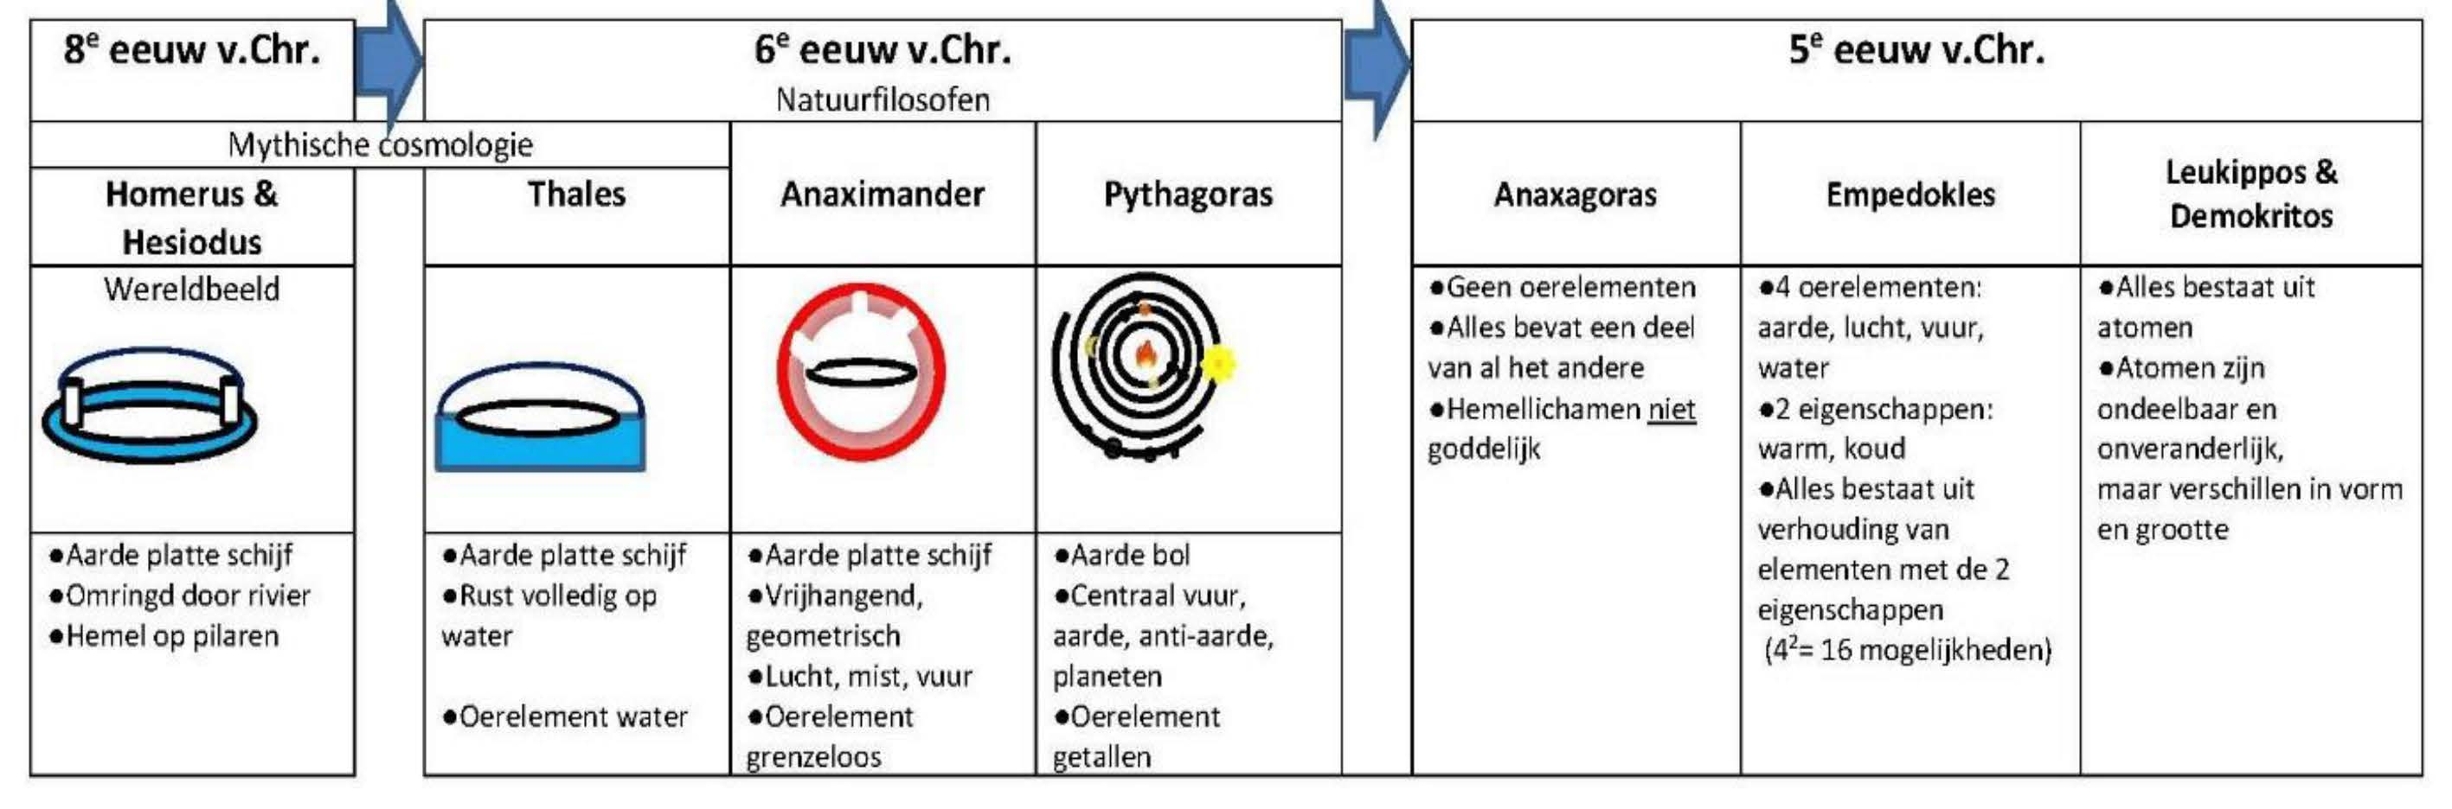
5th Century BCE:
Pre-Socratic Natural Philosophers
8th Cent. BCE
6th Cent. BCE
5th Cent. BCE
Natural Philosophers
Mythical Cosmology
Worldview
• No
primeval elements
• everything contains
part of
everything else
• Heavenly bodies
NOT divine
• everything consists
of atoms
• atoms are
indivisible,
unchanging
• but differ in
shape and size
• 4 primeval elements:
earth, water, air, fire
• 2 characteristics:
warm, cold
• everything consists
of proportion of
elements of the
2 characteristics
• Earth flat disk
• surrounded by
a river
• Heavens mounted
on pillars
• Earth flat disk
• freehanging,
geometric
• air, fog, fire
• primeval element
= apeiron,
without boundary
• Earth is a sphere
• central fire, earth,
anti-earth, planets
• primeval element
= numbers
• geocentric
worldview
• Earth flat disk
• lies entirely on water
• primeval element
= water
Homerus and guide
W-A Bouguereau

Slide 21
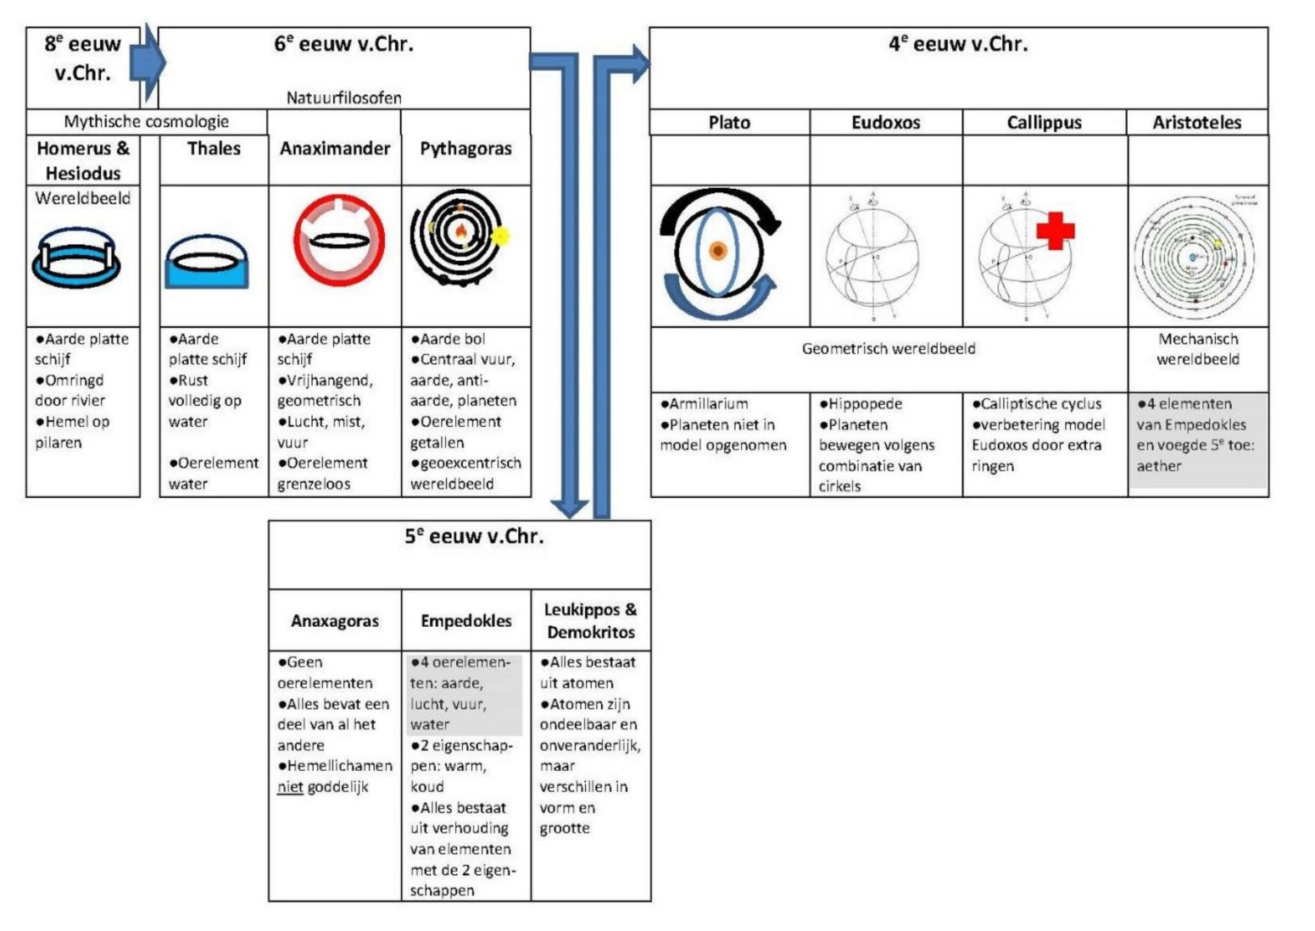
4th Century BCE: from Plato to Aristoteles
8th Cent.
BCE
6th Cent. BCE
4th Cent. BCE
Natural Philosophers
Mythical Cosmology
Worldview
• Earth
flat disk
• freehanging,
geometric
• air, fog, fire
• primeval
element = apeiron,
without
boundary
• Earth
flat disk
• lies entirely
on water
• primeval
element
= water
• Earth is
a sphere
• central fire, earth,
anti-earth, planets
• primeval element
= numbers
• geocentric
worldview
• Earth
flat disk
• surrounded by
a river
• Heavens
mounted
on pillars
Geometric Worldview
Mechanical
Worldview
• Hippopede
• Planets move
according to
combination of
circles
• Cosmos of Aristotle
55 heavenly spheres
• Earth
center Universe
• Universe always
existed
(no creation)
• 4 causes
• heavenly bodies
move on circles
• Dominant cosmology
for 18 centurries
• Timaeus
• Amillarium
• Platonic solids
• Planets not included
• Calliptic cycle
• improvement
Eudoxus model
through extra rings
5th Cent. BCE
• No primeval
elements
• everything
contains
part of
everything else
• Heavenly bodies
NOT divine
• 4 primeval
elements:
earth, water, air,
fire
• 2
characteristics:
warm, cold
• everything
consists
of proportion of
elements of the
2 characteristics
• everything
consists
of atoms
• atoms are
indivisible,
unchanging
• but differ in
shape and
size
Homerus and guide
W-A Bouguereau

Slide 22
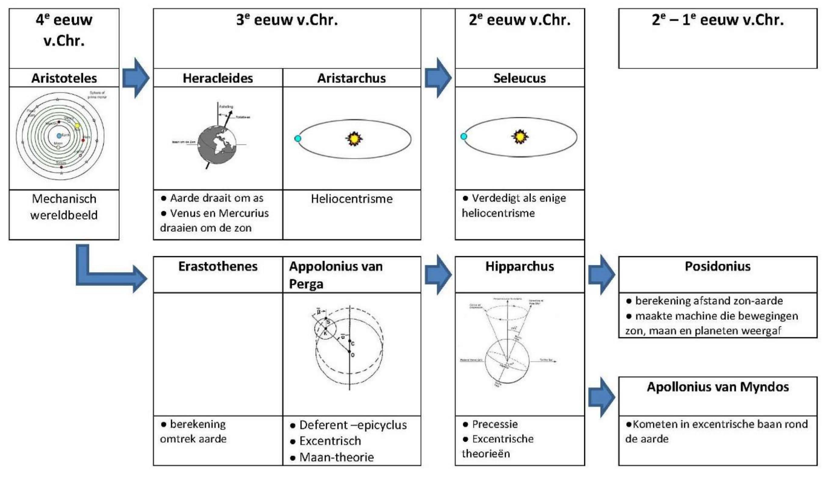
3rd Century BCE – 1st Century AD: the Hellenistic Scientific Revolution
4th Cent. BCE
3rd Cent. BCE
2nd Cent. BCE
2nd-1st Cent. BCE
• Mechanical
worldview
• Earth revolves around axis
• Venus & Mercury
circle around the Sun
• Heliocentrism
• Defends heliocentrism,
as only one
• calculation distance Sun-Earth
• made a machine to simulate motion
of sun, moon and planets
• determines
circumference of Earth
• Deferent-Epicycle
• excentric
• Lunar theory
• Precession
• Excentric theories
• comets in excentric orbit around
Earth
Homerus and guide
W-A Bouguereau

Slide 23
Ionia
Natural Philosophers

Slide 24
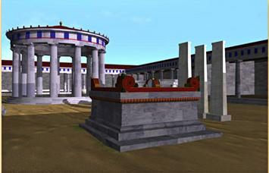
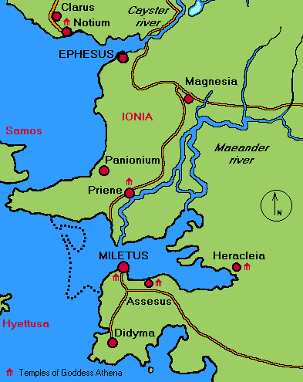
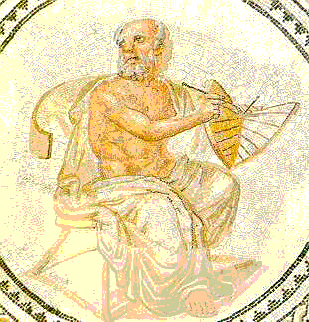
Ionia, 6th century B.C.
Phase transition in human history:
the mythical world obsolete
… the Ionian coast, 6th century B.C.,
regularities and symmetries in nature
recognized as keys to the cosmos …
Pythagoras
Anaximander
Miletus
Mathematics as natural language of cosmos
➔ Physical cosmos modelled after ideal form,
encrypted in concepts of geometry
… Anaximander of Miletus: the Apeiron
Pythagoras of Samos: music of spheres
Plato: Platonic solids

Slide 25
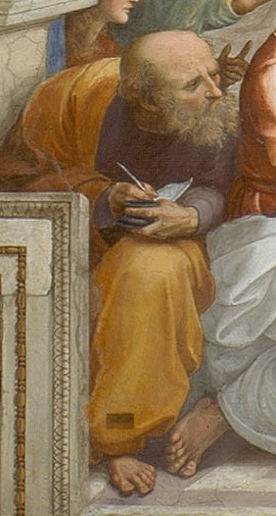
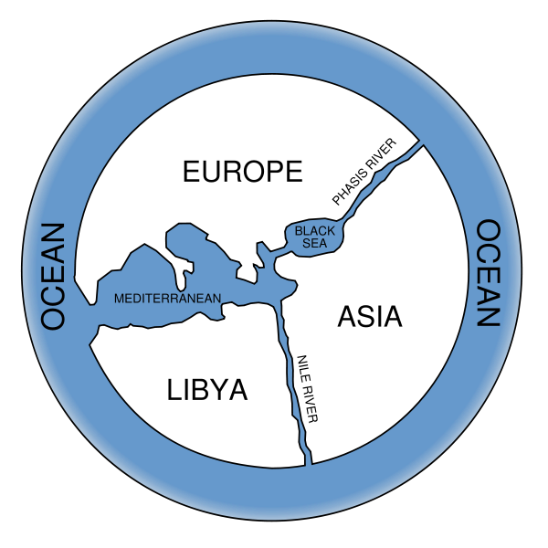
Anaximander the First Cosmologist
(Miletus, 610-546 BCE)
Cartography of Anaximander

Slide 26
Anaximander the First Cosmologist
(Miletus, 610-546 BCE)
Cosmology of Anaximander:
Earth floats free without falling
Karl Popper:
“one of the most boldest, most
revolutionary, and most portentous ideas
in the whole history of human thinking”

Slide 27
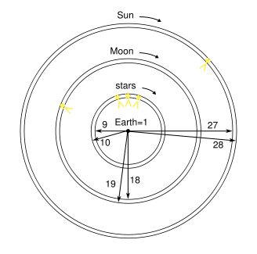
Anaximander
founder scientific
Astronomy and Cosmology
(Miletus, 610-546 BCE)
Cosmology Anaximander
heavenly sphere is a ring of fire
invisible, surrounded by fog
Heavenly bodies part of ring, visible through openings through fog.
ring for the Moon
ring for the Sun

Slide 28
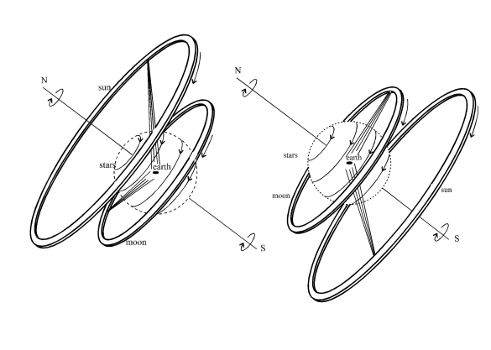
Anaximander
founder scientific
Astronomy and Cosmology
(Miletus, 610-546 BCE)
Daytime in summer
Nighttime in winter
Cosmology Anaximander
Ring model could not explain all observations
Anaximander preferred symmetry & number 3
diameter Sun ring = 27 x diameter Earth
diameter Moon ring = 18 x diameter Earth
diameter stellar ring = 9 x diameter Earth

Slide 29
“The Apeiron, from which the elements
[are formed], is something that is different”
Anaximander
founder scientific
Astronomy and Cosmology
(Miletus, 610-546 BCE)
The idea of Apeiron, the “infinite” or “limitless” out of which the world emerged, is suggested to be close to our current idea of vacuum energy

Slide 30
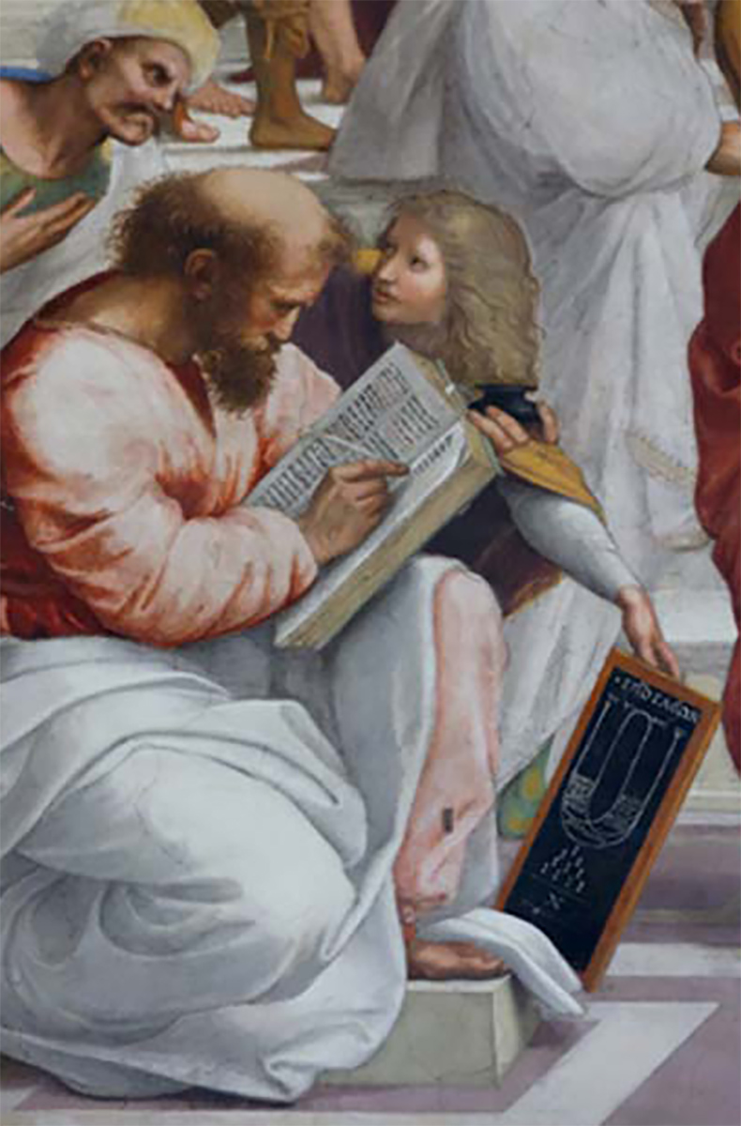
Pythagoras
(Samos, 570-495 BCE)
The
Pythagoras:
Mathematical Cosmology
replaced Gods, the divine, and myths
with principles of higher purity and precision:
numbers and their relations
(rather than anthropomorphic creatures)
• strictly ordered Universe
• on the basis of mathematics
• no room for Gods and their stories

Slide 31
Pythagoras
(Samos, 570-495 BCE)
The “The principle of all things is the monad or unit; arising from this monad the undefined dyad or two serves as material substratum to the monad, which is cause; from the monad and the undefined dyad spring numbers; from numbers, points; from points, lines; from lines, plane figures; from plane figures, solid figures; from solid figures, sensible bodies, the elements of which are four, fire, water, earth and air; these elements interchange and turn into one another completely, and combine to produce a universe animate, intelligent, spherical, with the earth at its centre, the earth itself too being spherical and inhabited round about. There are also antipodes, and our 'down' is their 'up’.”'.
Pythagoras: Mathematical Cosmology
Diogenes Laertius

Slide 32
Pythagoras
(Samos, 570-495 BCE)
The
All is Number
God is Number
Pythagoras & Pythagoreans (his sect/followers)
practised Numerology – Number worship
Chaotic world can only be understood in
terms of numbers:
- musical harmony
- harmony of the spheres

Slide 33
Pythagoras
(Samos, 570-495 BCE)
The
the Book of Nature
is written in
the Language of Mathematics
• In a sense, the lasting legacy of
Pythagoras & the Pythagoreans:
• theme underlying present-day science:
nature is written in mathematics

Slide 34
Pythagoras
(Samos, 570-495 BCE)
The
All is Number
God is Number
Pythagoras & Pythagoreans (his sect/followers)
practised Numerology – Number worship
each number its own character & meaning:
- 1: generator of all numbers
- 2: opinion
- 3: harmony
- 4: justice
- 5: marriage
- 6: creation
- 7: 7 wandering stars (planets)
• odd numbers: female
even numbers: male

Slide 35
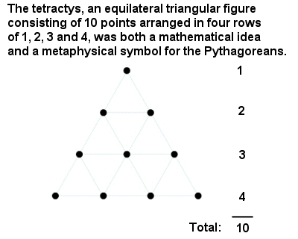
Pythagoras
(Samos, 570-495 BCE)
The
All is Number
God is Number
• Holiest number: Tetractys = 10
triangular number = 1+2+3+4

Slide 36
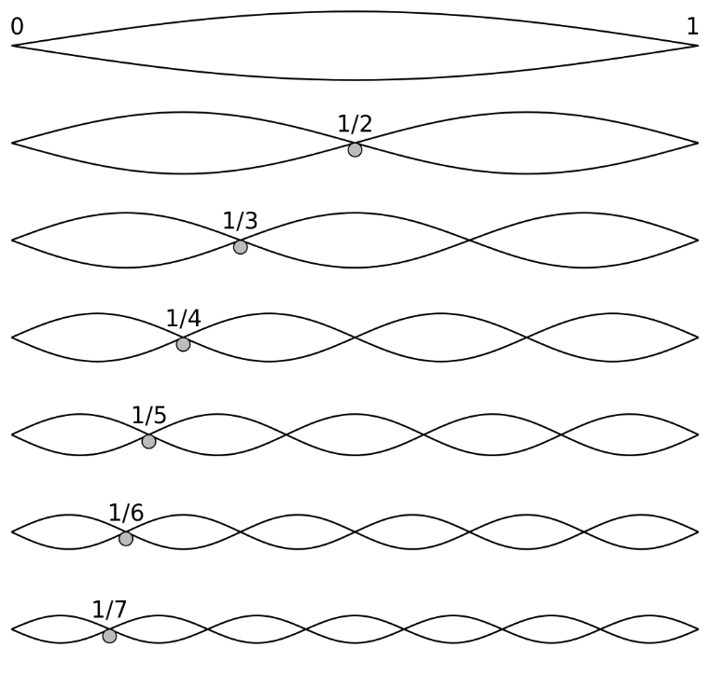
Pythagoras
(Samos, 570-495 BCE)
The
Musical Harmony - Numbers
Pythagoras is credited with discovery:
• the pitch of a musical tone
• inversely proportional to the length of the string
• intervals between harmonious sound frequencies
define simple numerical ratios

Slide 37
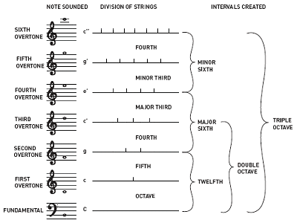
Pythagoras
(Samos, 570-495 BCE)
The
Musical Harmony - Numbers
Pythagoras is credited with discovery:
• harmonious musical notes – whole number ratios
• described the first 4 overtones
• forming the primary building blocks of musical harmony

Slide 38
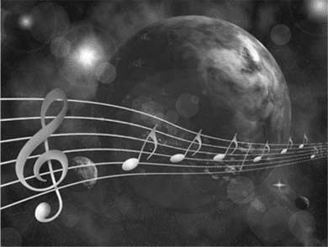
Pythagoras
(Samos, 570-495 BCE)
Harmony of the Spheres
Pythagoras:
• The proportion in movements of the
celestial bodies – sun, moon, and planets –
is such that it resembles musical notes,
it is a form of musica, and thus produce a symphony:
Music of the Spheres
• Pythagoras claimed that the sun, moon and planets
emit their own hum, based on orbital revolution
(imperceptible to human ear).
• Legend: Pythagoras could hear the 'music of the spheres’
enabling him to discover that consonant musical
intervals can be expressed in simple ratios of small
integers.

Slide 39
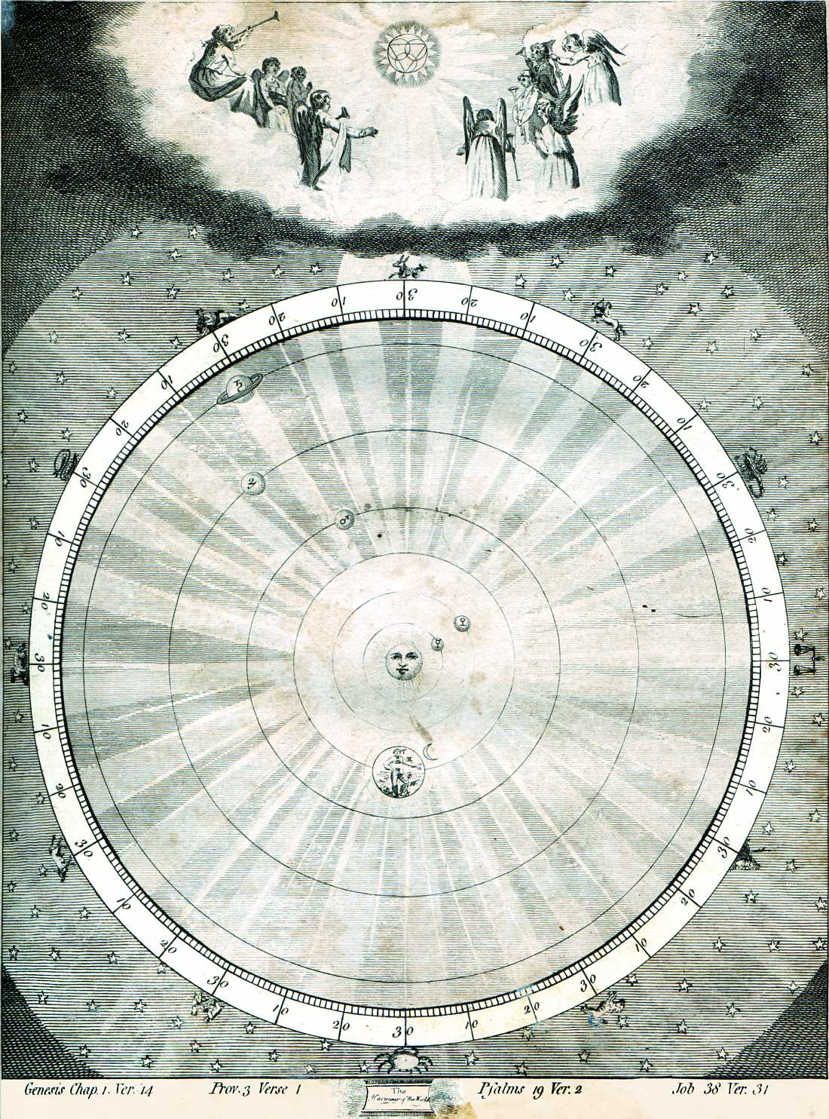
Pythagoras
(Samos, 570-495 BCE)
The
Harmony of the Spheres

Slide 40
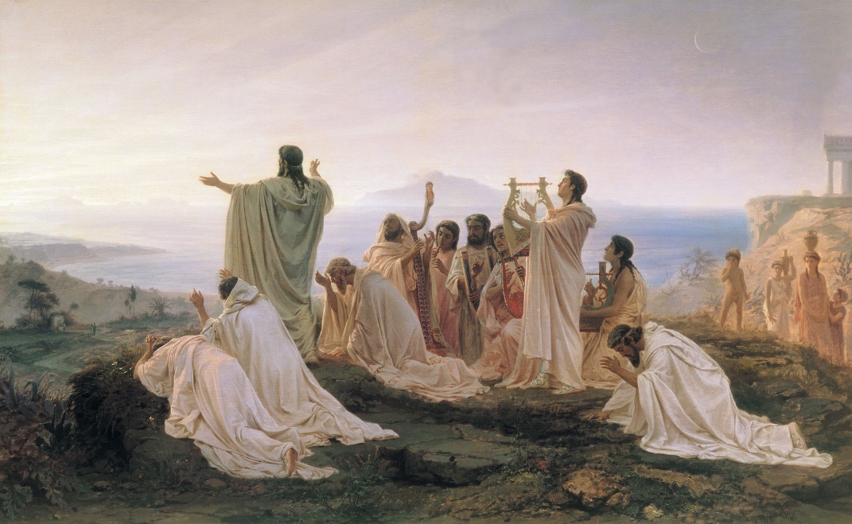
Pythagoras
(Samos, 570-495 BCE)
The
Mystical Sect of Pythagoreans
• Pythagoras established a school/mystical sect
• Croton in southern Italy (530 BCE) nucleus of sect
• Bizarre sect:
- although largely dominated by mathematics,
- also profoundly mystical

Slide 41
Pythagoras
(Samos, 570-495 BCE)
The
Mystical Sect of Pythagoreans
• Pythagoras established a school/mystical sect
• Croton in southern Italy (530 BCE) nucleus of sect
• Bizarre sect:
- although largely dominated by mathematics,
- also profoundly mystical,
• Pythagoras imposed
- quasi-religious philosophies
- strict vegetarianism
- communal living
- secret rites
- odd rules on all the members of his school
• Two groups of members:
- Mathematikoi - “learners”
extending and developing scientific & mathematical work
- Akousmatikoi - “listeners”
focus on religious & ritualistic aspects of teachings

Slide 42
Pythagoras
(Samos, 570-495 BCE)
The
the Book of Nature
is written in
the Language of Mathematics
• No original texts/writings of Pythagoras known,
all we know comes via his adherents, Pythagoreans
• Lasting influence:
- Philosophy Plato heavily dependent on teaching Pythagoreans
- Nature written in language of mathematics
• Bertrand Russell, A History of Western Philosophy:
“ … the influence of Pythagoras on Plato and others was
so great that he should be considered the most influential
philosopher of all time.”
“ I do not know of any other man who has been as influential
as he was in the school of thought."

Slide 43
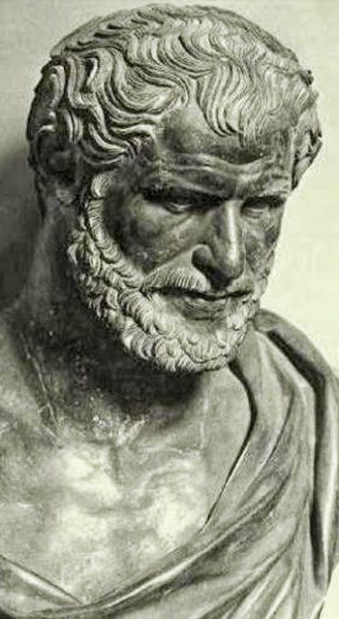
Democritus
(Abdera, 460-370 BCE)
The
Atomic Theory
All matter consists of
invisible particles called atoms.
Atoms are indestructible.
Atoms are solid but invisible.
Atoms are homogenous
Atoms differ in
size, shape, mass, position, and arrangement.

Slide 44

Democritus
(Abdera, 460-370 BCE)
The
Atomic Theory

Slide 45
Democritus
(Abdera, 460-370 BCE)
The
Atomic Theory
All matter consists of invisible particles
Solids are made of small, pointy atoms.
Liquids are made of large, round atoms.
Oils are made of
very fine, small atoms
that can easily slip past each other.
.

Slide 46
Classical Greek Cosmology
Plato & Aristoteles

Slide 47
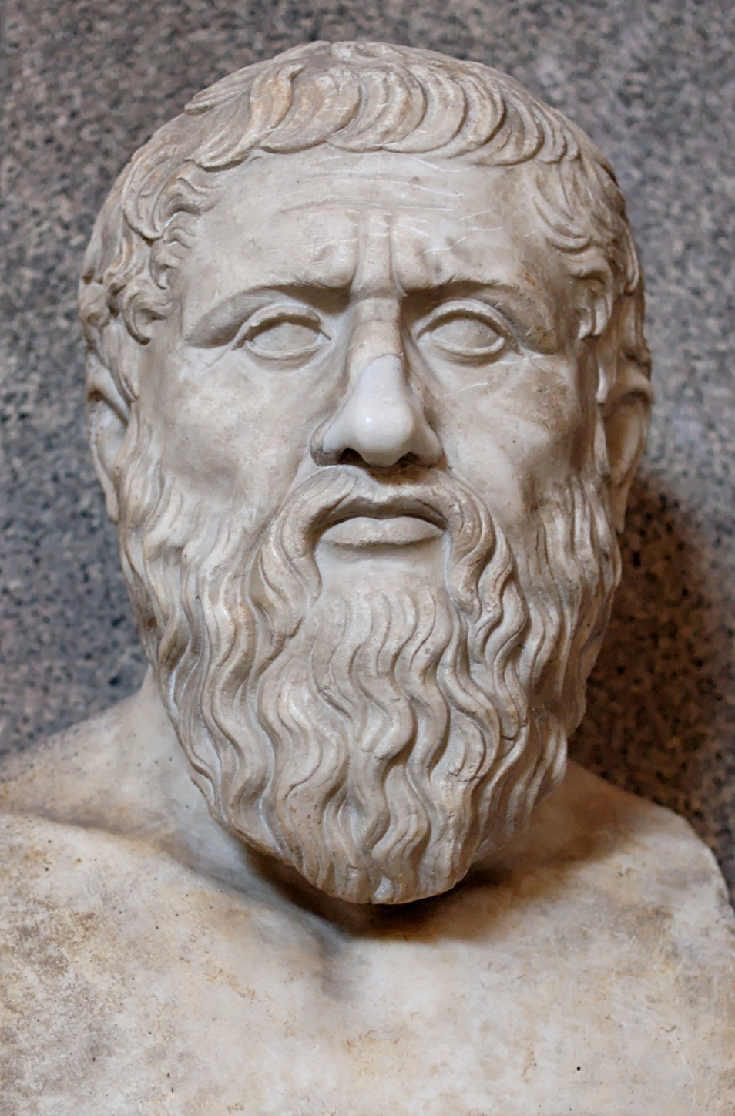
Plato
(Athens,
428-348 BCE)
Geometry as
organizing principle
of the world
Founded Academy, Athens
• Philosophy
• Mathematics
• Philosophical Dialogues

Slide 48
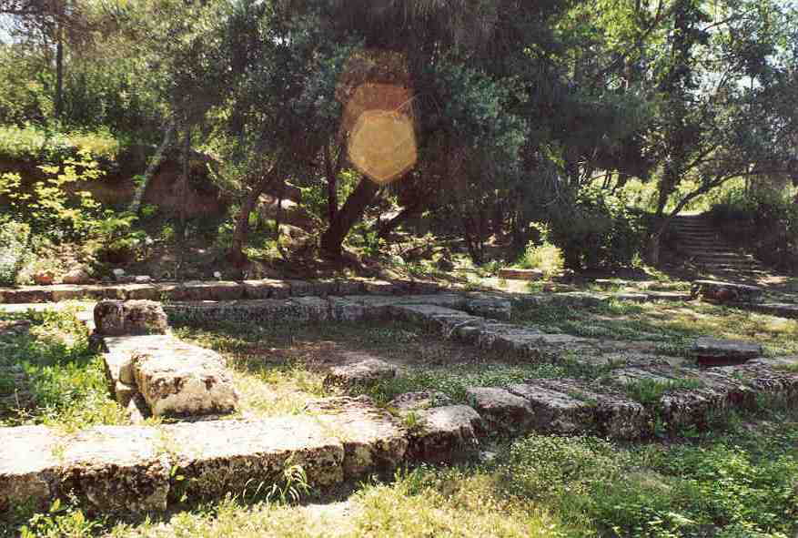
Academia Platon
“Let no one unversed
in geometry enter here”

Slide 49
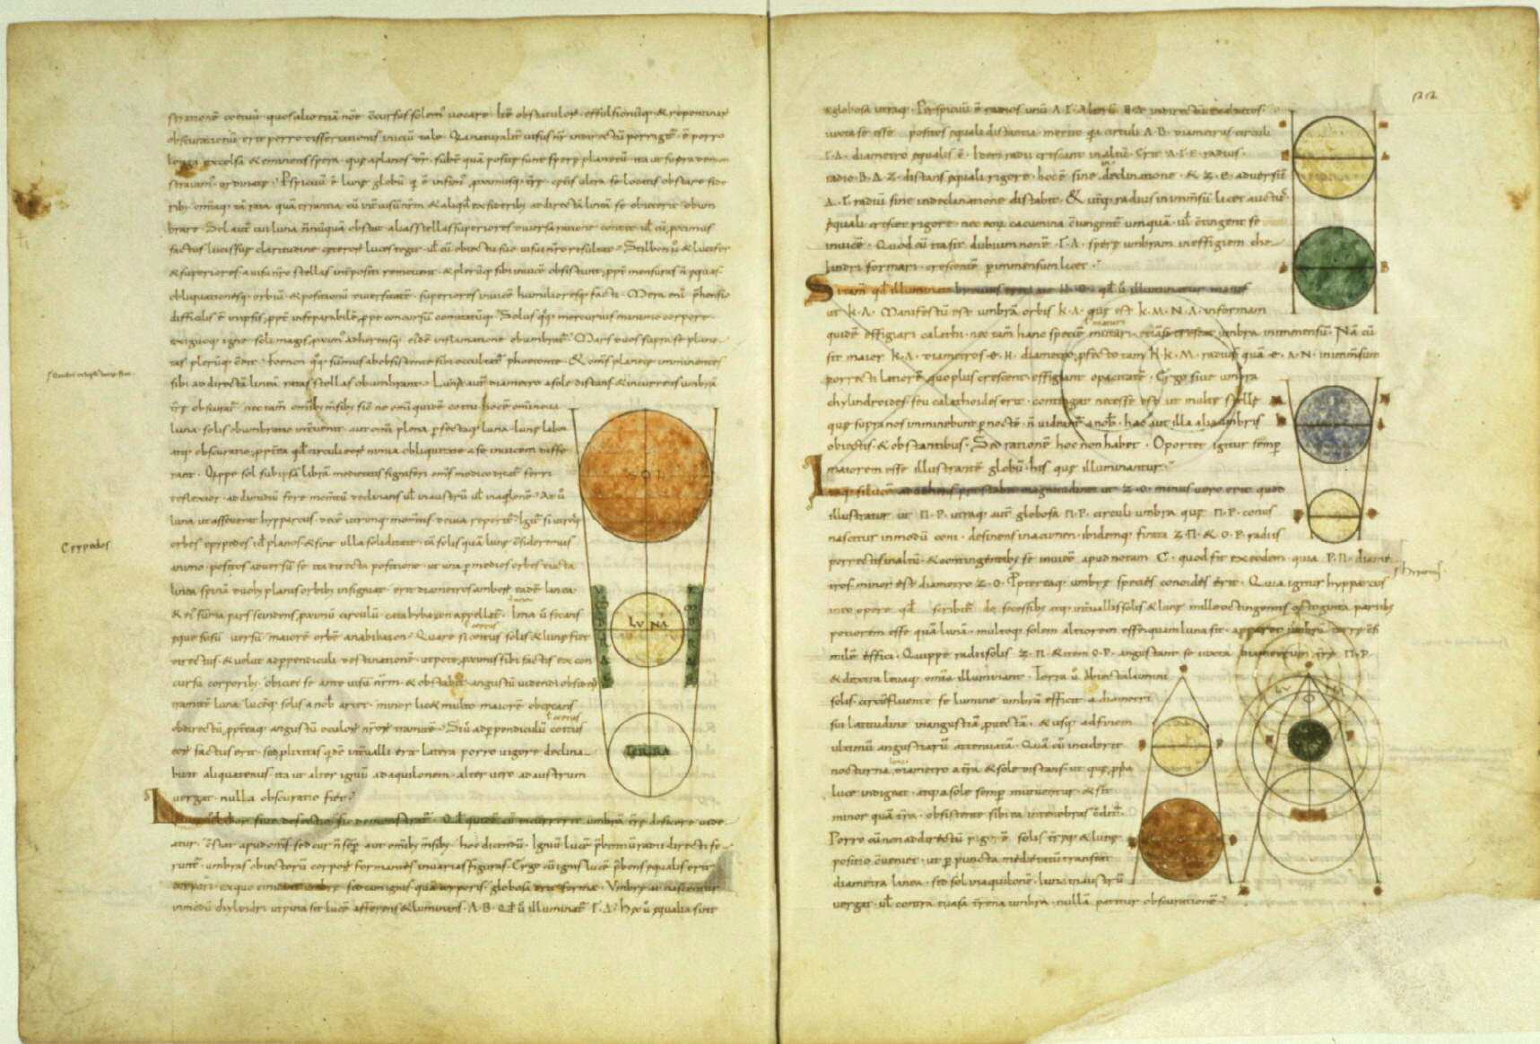
Timaeus:
Plato’s Cosmology

Slide 50
Timaeus:
Plato’s Cosmology
Plato’s Cosmic Scheme:
• Demiurge, divine craftsman, is a mathematician:
• Universe constructed according to geometric principles

Slide 51
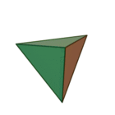
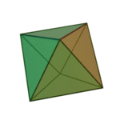
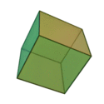

Platonic Solids
the Five Platonic solids
● there are only five convex regular polyhedra !
● Plato identified them with the cosmos and its constituents
Tetrahedron:
fire
Octahedron:
air
Cube:
earth
Icosahedron:
water

Slide 52

Platonic Solids
Dodecahedron Quintessence
of which the Cosmos itself is made:
“the stuff for embroidering
the constellations on the heavens”
Tetrahedron:
fire
Octahedron:
air
Cube:
earth
Icosahedron:
water

Slide 53
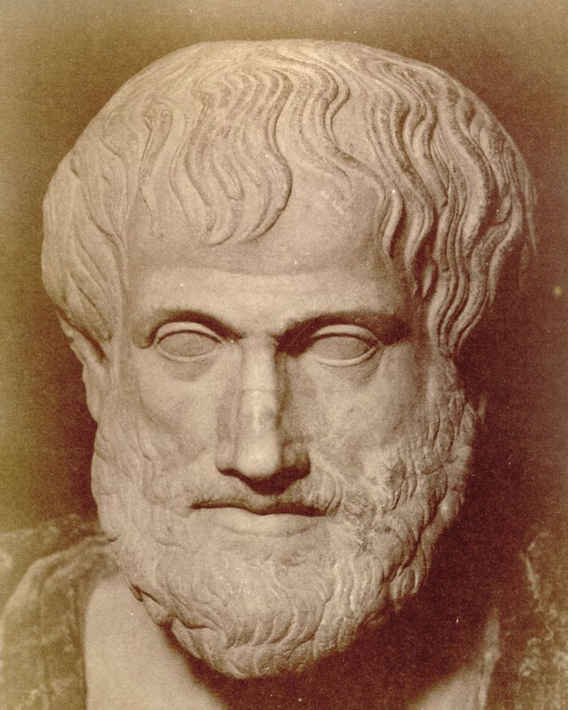
Aristoteles
(Chalcidice-Athens, 384-322 BCE)
- “Aristotle was the first genuine scientist
in history ... every scientist is in his debt”
Physics, Metaphysics,Astronomy,
Poetry, Theater, Music,
Logic, Rhetoric, Ethics,
Politics, Government,
Geology, Biology, Zoology
- Student Plato
- teacher Alexander the Great
- literary style:
“River of Gold” (Cicero)
- founded Lyceum, Athens
- Dominant influence for over 1800 years
both in Christian philosophy & theology
and in Muslim intellectual history
Father of Western Science

Slide 54
Aristoteles
(384-322 BCE)
I saw the Master there of those who know, Amid the philosophic family,
By all admired,
and by all reverenced;
There Plato too I saw, and Socrates, Who stood beside him closer than the rest.
Dante, Divina Commedia
(1st level hell)

Slide 55
On the Heavens
Aristotle’s cosmological work
the most influential treatise of its kind in the history
of humanity.
It was accepted for more that 18 centuries from its
inception (around 350 B.C.) until the works of
Copernicus in the early 1500s.
Key aspects of Aristotle’s Cosmology:
1) Earth is at the centre of the Universe
2) the Universe is finite
3) the Universe is eternal and unchanged
4) the motion of the heavenly bodies are
uniform and circular

Slide 56
On the Heavens
Four causes
Aristotle suggested that the reason for anything coming about can be attributed to four different types of simultaneously active causal factors:
Material cause - the material out of which something
is composed.
Formal cause - its form, i.e., the arrangement of
that matter.
Efficient cause - "the primary source", or that
from which the change under
consideration proceeds.
This is akin to the modern concept
of cause.
Final cause - its purpose, or that for the sake of
which a thing exists or is done. This
covers modern ideas of motivating
causes, such as volition, need, desire,
ethics, or spiritual beliefs.

Slide 57
On the Heavens
Elements - composition
4 elements (Empedokles)
1) Earth cold and dry - modern idea solid.
2) Water cold and wet - modern idea liquid
3) Air hot and wet - modern idea of a gas.
4) Fire hot and dry - modern ideas of plasma
in addition,a 5th element
5) Aether divine substance making up the
spheres and heavenly bodies
(stars and planets)

Slide 58
On the Heavens
Movement of bodies
- all bodies, by their very nature, have a natural way
of moving.
- Movement is not, he states, the result of the
influence of one body on another
- Some bodies naturally move in straight lines
- others naturally stay put.
- Yet another natural movement:
the circular motion.
Since to each motion there must correspond a
substance, there ought to be some things that
naturally move in circles:
the heavenly bodies
(made of a more exalted and perfect substance
than all earthly objects).

Slide 59
On the Heavens
Aristotle’s Cosmos
Aristotle’s Cosmos made of
a central earth (which he accepted as spherical)
surrounded by
- the moon,
- the sun
- stars all moving in circles around it.
This conglomerate he called ``the world''.
Note the strange idea that all celestial bodies
are perfect, yet they must circle the imperfect Earth.
The initial motion of these spheres was caused by the
action of a ``prime mover'' which (who?) acts on the
outermost sphere of the fixed stars;
the motion then trickles down to the other spheres
through a dragging force.
Heavens consisted of a complex system of 55 spheres !
- could explain and predict the motions of
stars and planets
- a real scientific theory

Slide 60
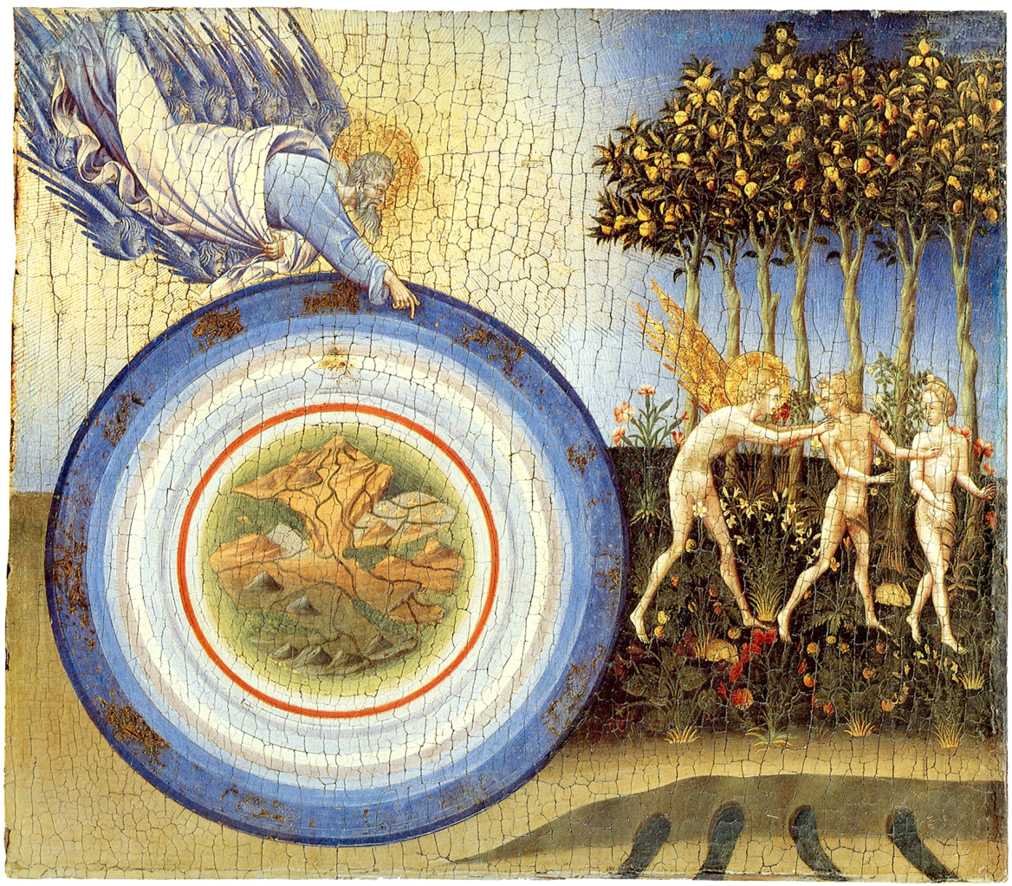
Aristotles’ Cosmos
Cosmos of Aristoteles
Moon
Mercury
Venus
Sun
Mars
Jupiter
Saturn

Slide 61
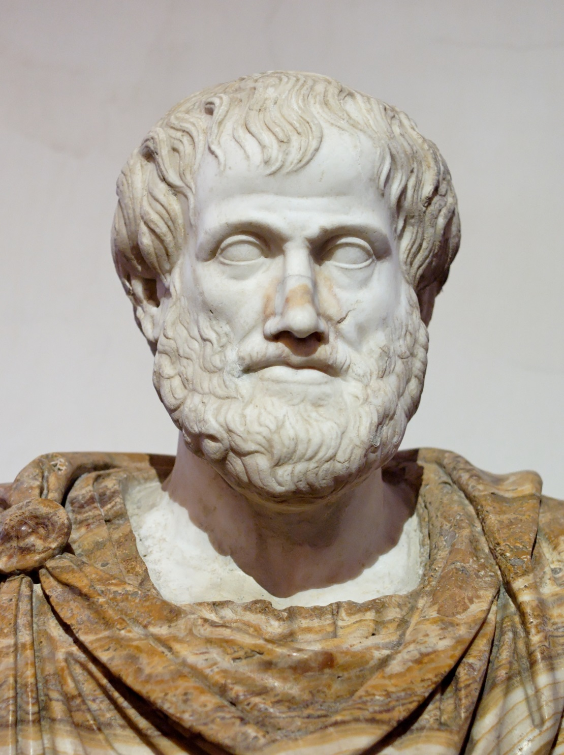
On the Heavens
Aristotle’s cosmology
this world is unique.
the argument goes as follows:
- earth (the substance) moves naturally to the center
- if the world is not unique there ought to be
at least two centers
- but then, how can earth know to which of
the two centers to go?
- since ``earthy'' objects have no trouble deciding
how to move, there can only be one center
(the Earth) circled endlessly by
all heavenly bodies.
Note:
- this cosmological tenet turned out to be
completely wrong with the discovery of the
moons of Jupiter

Slide 62
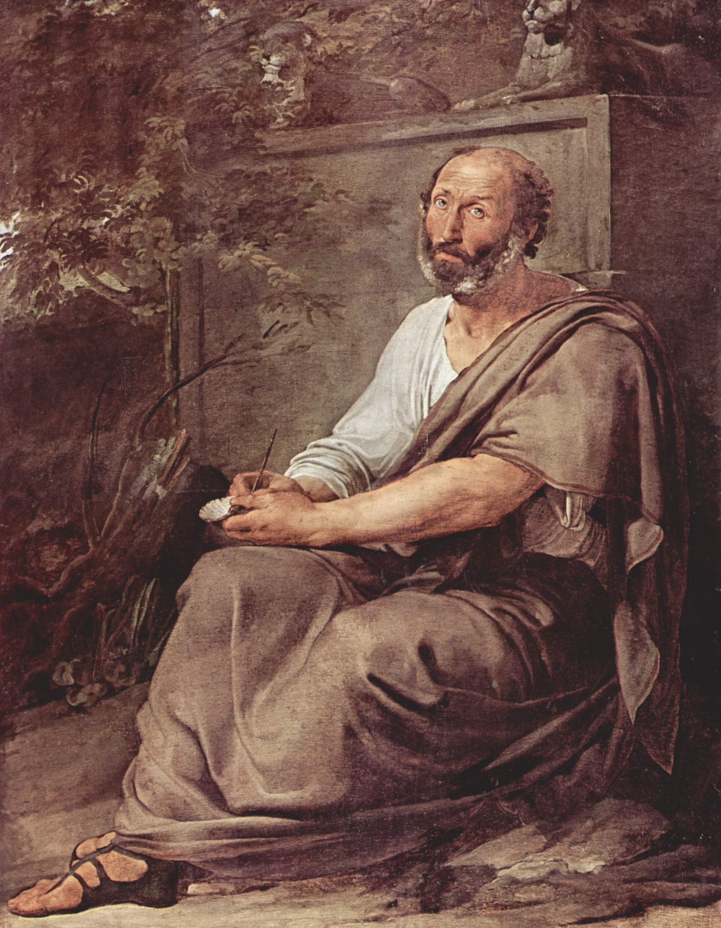
On the Heavens
Existence
the world did not come into being at one time
The world has existed, unchanged for all eternity
- it had to be that way since it was ``perfect'';
- the universe is in a kind of ``steady state scenario''.
Still, since he believed that the sphere was the most perfect of the geometrical shapes,
the universe did have a center (the Earth)
and its ``material'' part had an edge,
which was ``gradual''
- starting in the lunar and
- ending in the fixed star sphere.
Beyond the sphere of the stars the universe continued
into the spiritual realm where material things cannot be
This is in direct conflict with the Biblical description
of creation, and an enormous amount of effort was
spent by the medieval philosophers in trying to
reconcile these views.

Slide 63
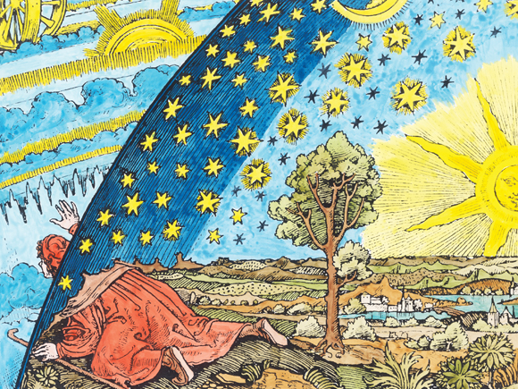
Pictorial view
Aristotelian view of the Cosmos

