Slide 1
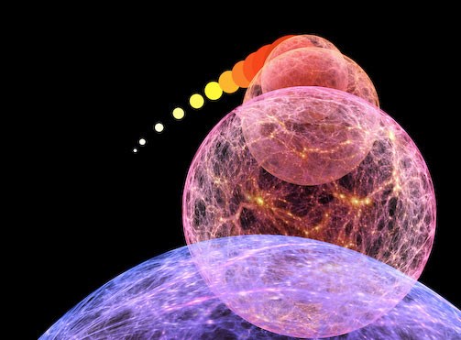
the
Big Bang

Slide 2
Friedmann, Lemaitre
&
Cosmic Expansion History

Slide 3
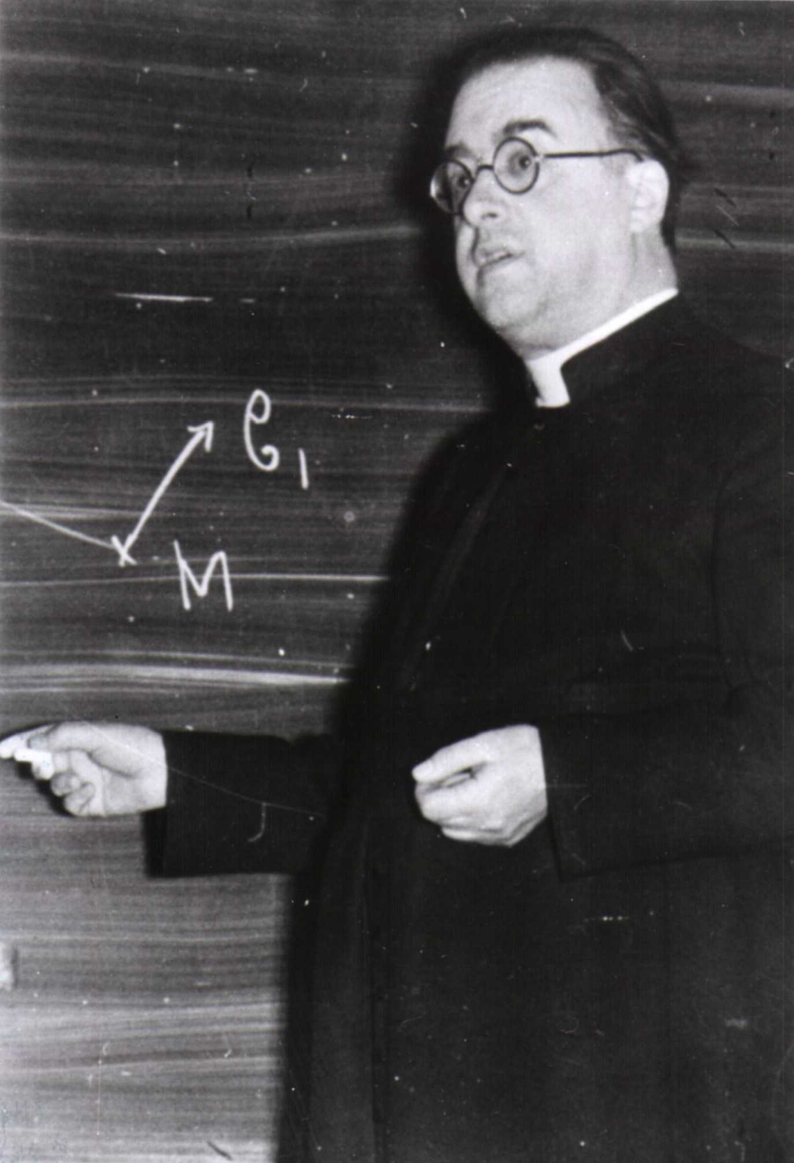
Friedmann & Lemaitre
Alexander Friedmann (1888 -1925)
George Lemaitre (1894-1966)
They discovered (independently)
theoretically the expansion of the
Universe as a solution to the
Theory of General Relativity.
… and derived the equations
that describe the expansion and
evolution of the universe,
the foundation for all of modern
Cosmology:
Friedmann-Lemaitre
Equation

Slide 4
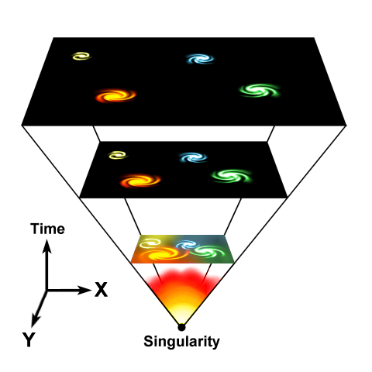
Evolving Universe
Einstein, de Sitter, Friedmann and Lemaitre all realized that in
General Relativity, there cannot be a stable and static Universe:
The Universe either expands, or it contracts …
Expansion Universe encapsulated in a
GLOBAL expansion factor a(t)
All distances/dimensions of objects
uniformly increase by a(t):
at time t, the distance between
two objects i and j has increased to
Note: by definition we chose a(t₀)=1,
i.e. the present-day expansion factor

Slide 5
Evolution & Fate Friedmann-Robertson-Walker-Lemaitre Universe
Completely determined by 3 factors:
• energy and matter content
(density and pressure)
• geometry of the Universe
(curvature)
• Cosmological Constant

Slide 6
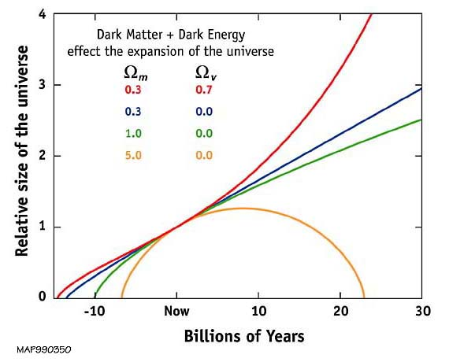
Our Universe ?
Einstein-de Sitter
Universe ?

Slide 7
Friedmann-Robertson-Walker-Lemaitre Universe

Slide 8
Friedmann-Robertson-Walker-Lemaitre Universe
Because of General Relativity, the evolution of the Universe is
determined by four factors:
• density
• pressure
• curvature
: present curvature radius
• cosmological constant
• Density & Pressure: - in relativity, energy & momentum need to be
seen as one physical quantity (four-vector)
- pressure = momentum flux
• Curvature: - gravity is a manifestation of geometry spacetime
• Cosmological Constant: - free parameter in General Relativity
- Einstein’s “biggest blunder”
- mysteriously, since 1998 we know it dominates
the Universe

Slide 9
FRW Dynamics
In a FRW Universe,
densities are in the order of the critical density,
the density at which the Universe has a flat curvature

Slide 10
FRW Dynamics
In a matter-dominated Universe,
the evolution and fate of the Universe entirely determined
by the (energy) density in units of critical density:
Arguably,  is the most important parameter of cosmology !!!
Present-day
Cosmic Density:

Slide 11
what the Universe exists of:
Cosmic Constituents

Slide 12
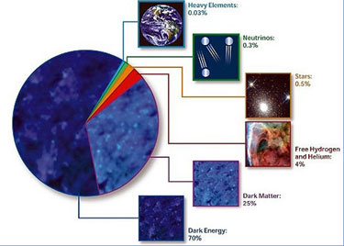
Cosmic Components

Slide 13
Cosmic Energy Inventarisation
sterren slechts ~0.1% energie
Heelal
Fukugita & Peebles 2004

Slide 14
Cosmic Constitution
Cosmic Pie Diagram
Changes in Time:

Slide 15
Matter-Dark Energy
Transition
matter
Radiation-Matter transition
radiation
dark energy

Slide 16
matter
radiation
Matter-
Dark Energy
Transition
Radiation-Matter transition
dark energy

Slide 17
Our Universe:
the Concordance Cosmos

Slide 18
Concordance Universe Parameters
Hubble Parameter
Age of the Universe
Temperature CMB
Matter | Baryonic Matter Dark Matter
Radiation | Photons (CMB) Neutrinos (Cosmic)
Dark Energy
Total

Slide 19
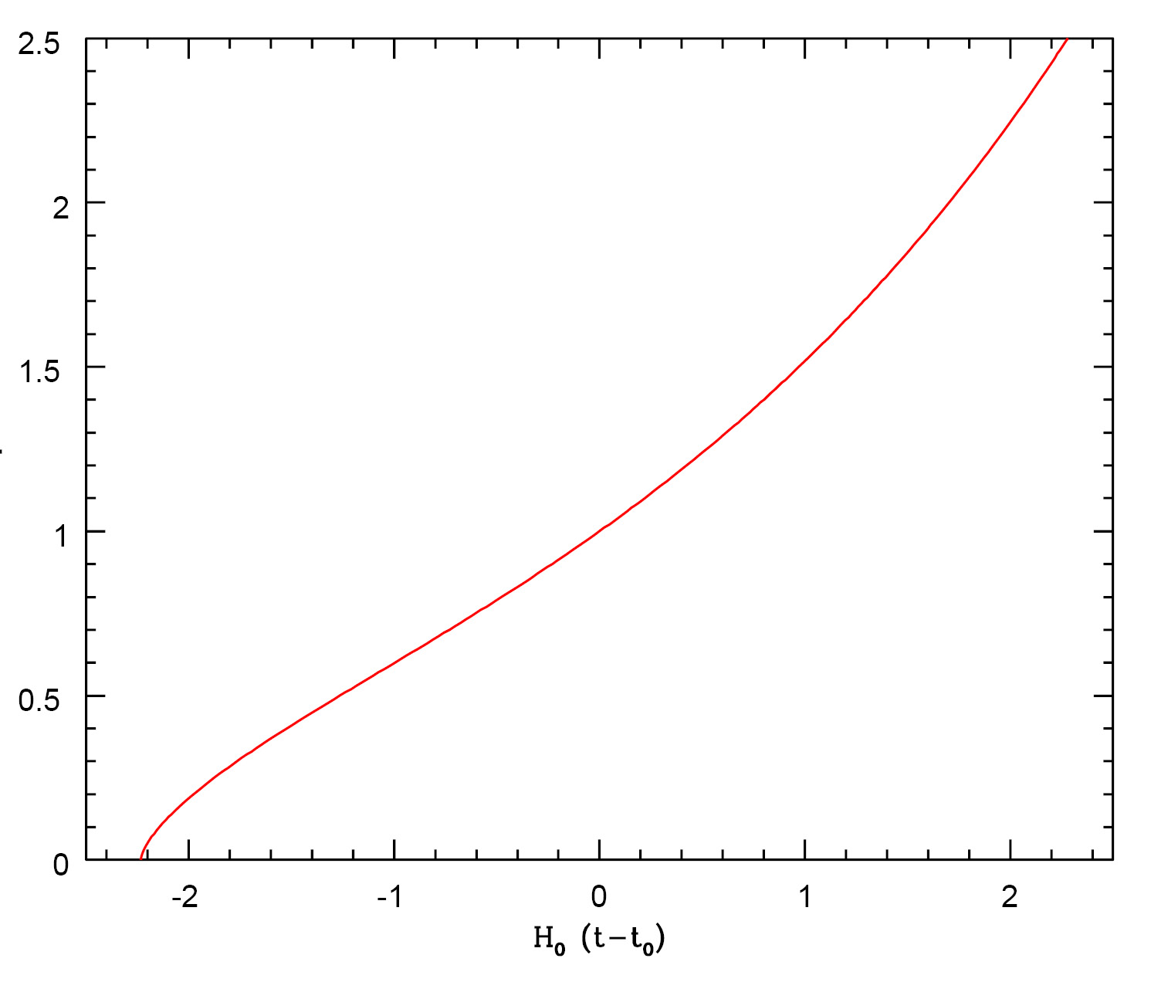
Concordance Expansion

Slide 20
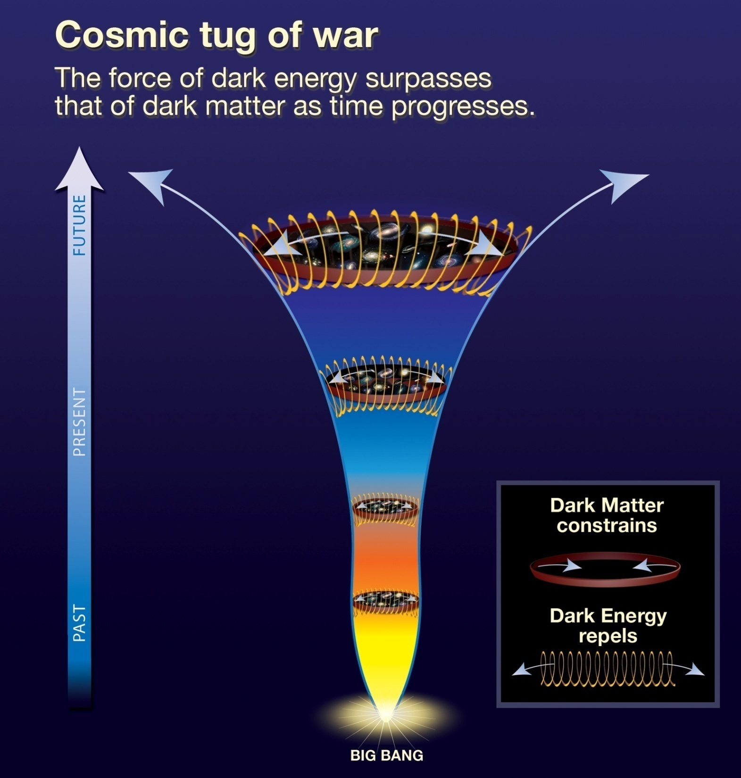
Heden & Toekomst:
VERSNELLING
Vroeger:
VERTRAGING

Slide 21
Age of the Universe

Slide 22
Hubble Time
• The repercussions of Hubble’s discovery are truly tremendous:
the inescapable conclusion is that the universe has a finite age !
• Just by simple extrapolation back in time we find that at some instant the objects will
have touched upon each other, i.e. r(t_{H})=0. If we assume for simplicity that the
expansion rate did remain constant (which it did not !), we find a direct measure for
the age of the universe, the
Hubble Time:
The Hubble parameter is usually stated in units of km/s/Mpc.
It’s customary to express it in units of 100 km/s/Mpc, expressing the real value in terms of
the dimensionless value h=H₀/[100 km/s/Mpc].
The best current estimate is H₀=72 km/s/Mpc. This sets t₀~10 Gyr.

Slide 23
Hubble Parameter
For a long time, the correct value of the Hubble constant H₀
was a major unsettled issue:
H₀ = 50 km s⁻¹ Mpc⁻¹ H₀ = 100 km s⁻¹ Mpc⁻¹
This meant distances and timescales in the Universe had to
deal with uncertainties of a factor 2 !!!
Following major programs, such as Hubble Key Project, the
Supernova key projects and the WMAP CMB measurements,

Slide 24
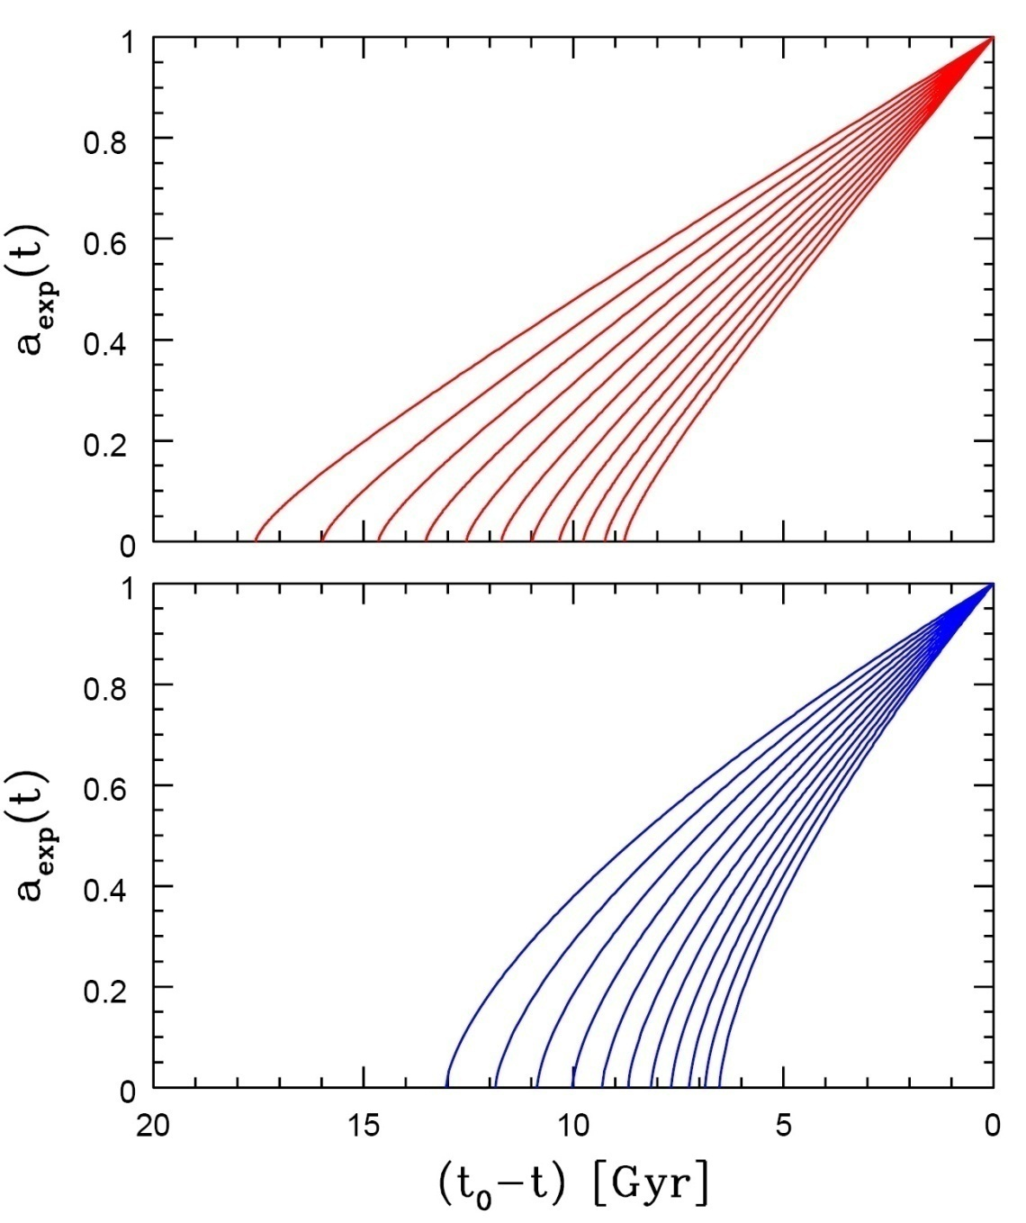
Age of the Universe
Age of a FRW universe at
Expansion factor a(t)
Matter-dominated
Hubble time
Matter-dominated

Slide 25
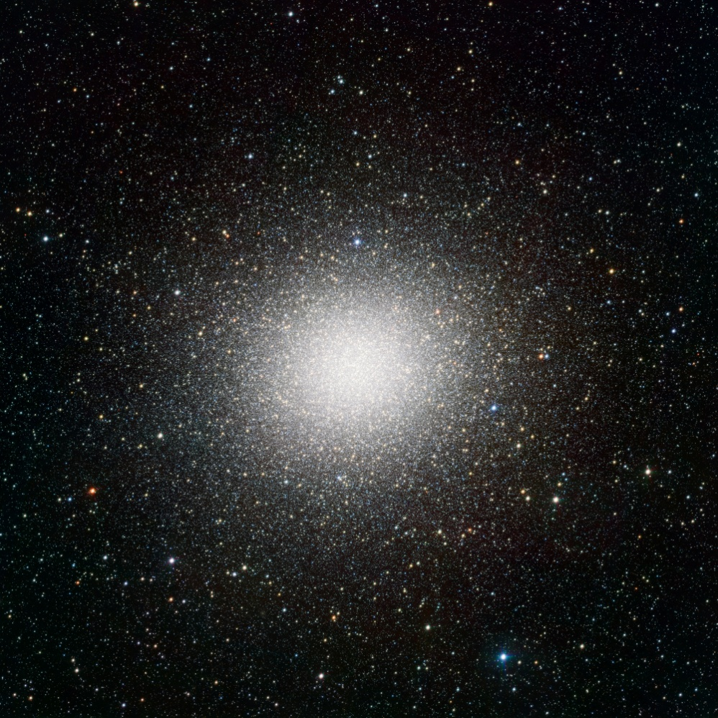
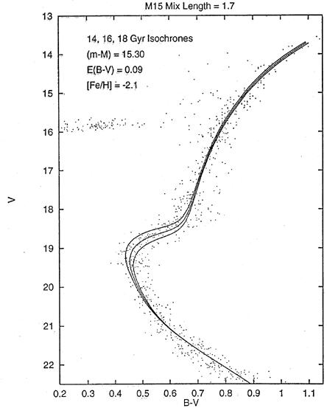
Cosmic Age
estimated age of the oldest stars in Universe
far in excess of estimated
age of matter-dominated FRW Universe:
Globular cluster stars: 13-15 Gyr
Universe: 10-12 Gyr
Globular Clusters
Roughly spherical assemblies of 100,000-200,000 stars
Radius ~ 20-50 pc: extremely high star density
Globulars are very old, amongst oldest objects in local Universe
Stars formed around same time: old, red, population
Colour-magnitude diagram characteristic:
accurate age determination on the basis of stellar evolution theories.
APM
Typical
1980-1990s isochrone fit
Omega Centauri

Slide 26
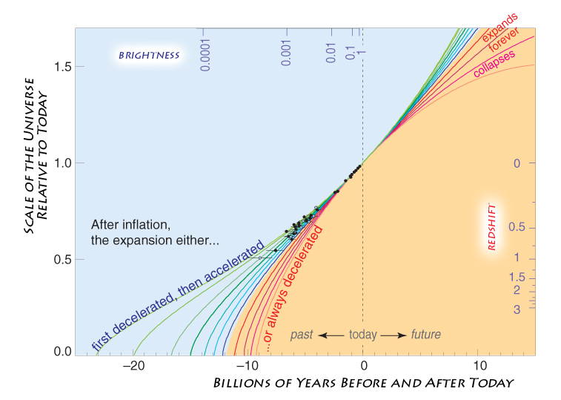
Concordance Expansion

Slide 27
Adiabatic Expansion

Slide 28
Adiabatic Expansion
The Universe of Einstein, Friedmann & Lemaitre
expands adiabatically
Energy of the expansion of the Universe corresponds to the decrease in the energy of its constituents
The Universe COOLS as a result of its expansion !

Slide 29
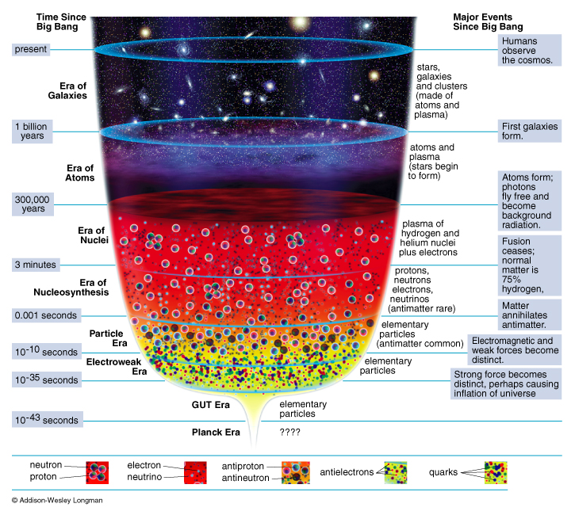
Adiabatic Expansion
reconstruction
Thermal History
of the Universe

Slide 30
Cosmic Epochs
Planck Epoch t < 10⁻⁴³ sec
Phase Transition Era 10⁻⁴³ sec < t < 10⁵sec
Hadron Era t ~10⁻⁵ sec
Lepton Era 10⁻⁵ sec < t < 1 min
Radiation Era 1 min < t <379,000 yrs
Post-Recombination Era t > 379,000 yrs
GUT transition
electroweak transition
quark-hadron transition
muon annihilation
neutrino decoupling
electron-positron annihilation
primordial nucleosynthesis
radiation-matter equivalence
recombination & decoupling
Structure & Galaxy formation
Dark Ages
Reionization
Matter-Dark Energy transition

Slide 31
Big Bang:
the Evidence

Slide 32
Big Bang Evidence
Olber’s paradox:
the night sky is dark
finite age Universe (13.7 Gyr)
Hubble Expansion
uniform expansion, with
expansion velocity ~ distance: v = H r
Explanation Helium Abundance 24%:
light chemical elements formed (H, He, Li, …)
after ~3 minutes …
The Cosmic Microwave Background Radiation:
the 2.725K radiation blanket, remnant left over
hot ionized plasma neutral universe
(379,000 years after Big Bang)
Distant, deep Universe indeed looks different …

Slide 33
1. Olber’s Paradox
In an infinitely large, old and unchanging
Universe each line of sight would hit a star:
Sky would be as bright as surface of star:

Slide 34
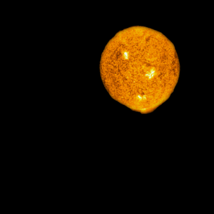
1. Olber’s Paradox
In an infinitely large, old and unchanging
Universe each line of sight would hit a star:
Sky would be as bright as surface of star:
Night sky as bright as
Solar Surface, yet
the night sky is dark
finite age of Universe (13.8 Gyr)

Slide 35
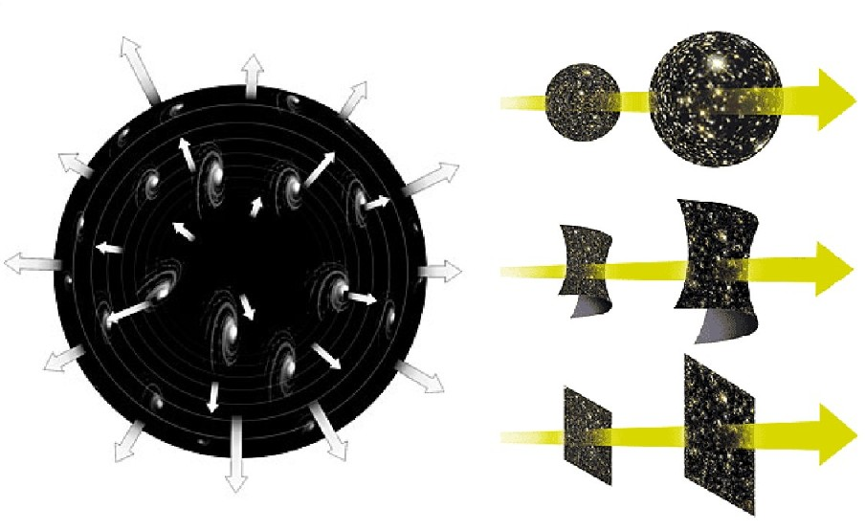
2. Hubble Expansion
Hubble constant
specifies expanssion rate of the Universe

Slide 36
3. And there was light ...

Slide 37
… and there was light … 379.000 years after the Big Bang

Slide 38
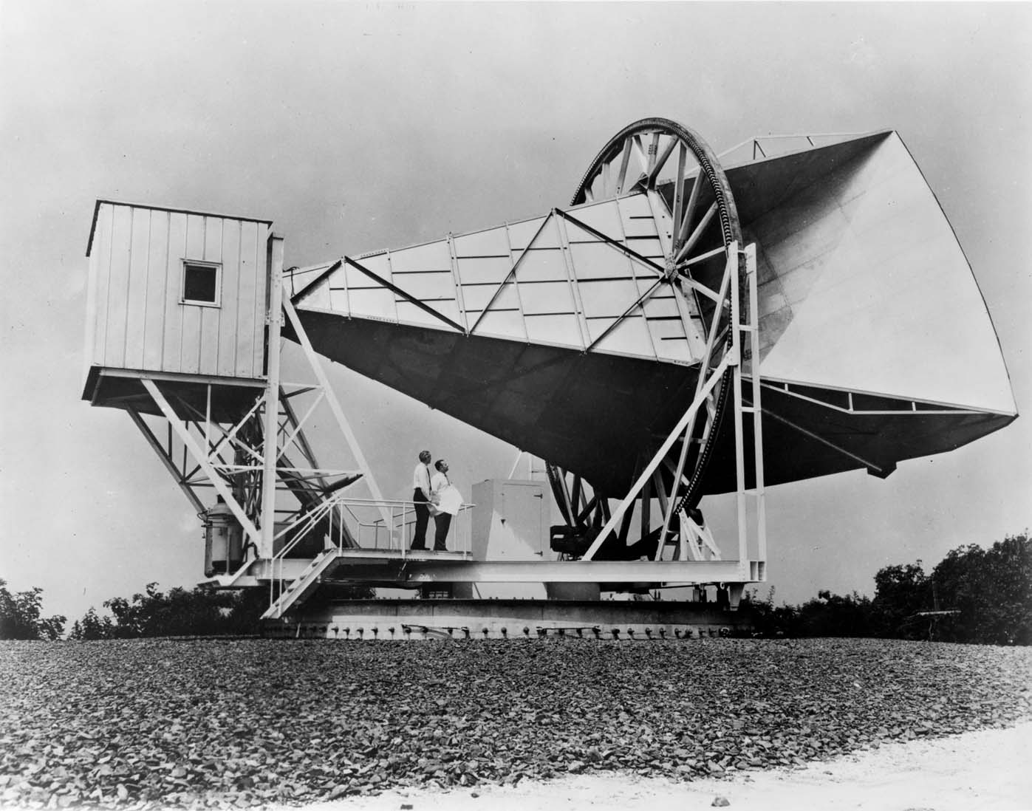
3. Cosmic Microwave Background Radiation

Slide 39
Cosmic Light (CMB): the facts
Discovered serendipitously in 1965 Penzias & Wilson,
Nobelprize 1978 !!!!!
Cosmic Licht that fills up the Universe uniformly
Temperature: T_{γ}=2.725 K
(CMB) photons most abundant particle in the Universe:
n_{γ} ~ 415 cm⁻³
Per atom in the Universe: n_{γ}/n _{B} ~ 1.9 x 10⁹
Ultimate evidence of the Big Bang !!!!!!!!!!!!!!!!!!!

Slide 40
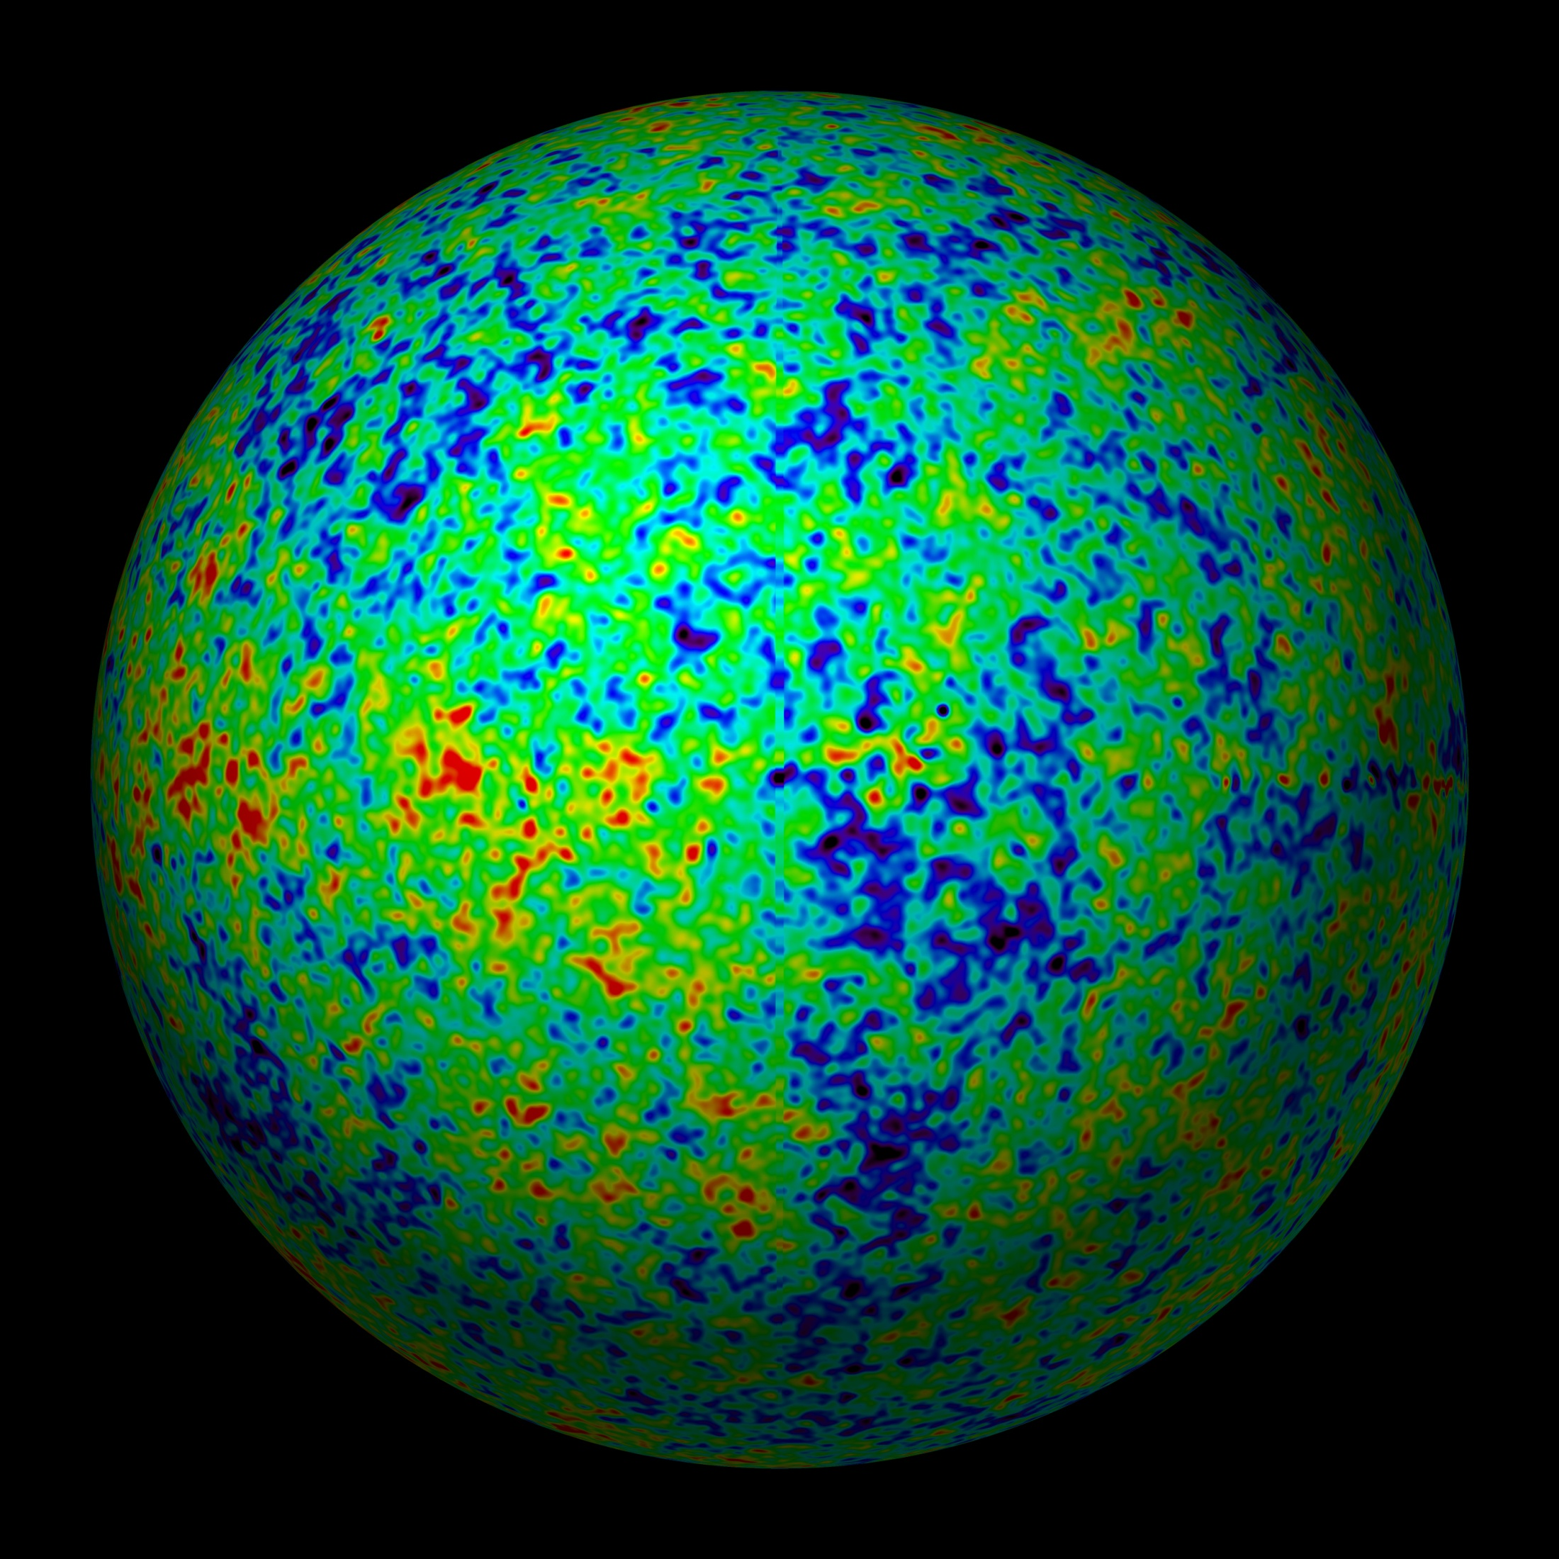
Extremely Smooth Radiation Field

Slide 41
Recombination & Decoupling
protonen & electronen
waterstofatomen
lichtdeeltjes/fotonen

Slide 43
the Cosmic TV Show
Note:
far from being an exotic faraway phenomenon, realize that the CMB nowadays is counting for approximately 1% of the noise on your (camping) tv set …
!!!! Live broadcast from the Big Bang !!!!
Courtesy: W. Hu

Slide 44
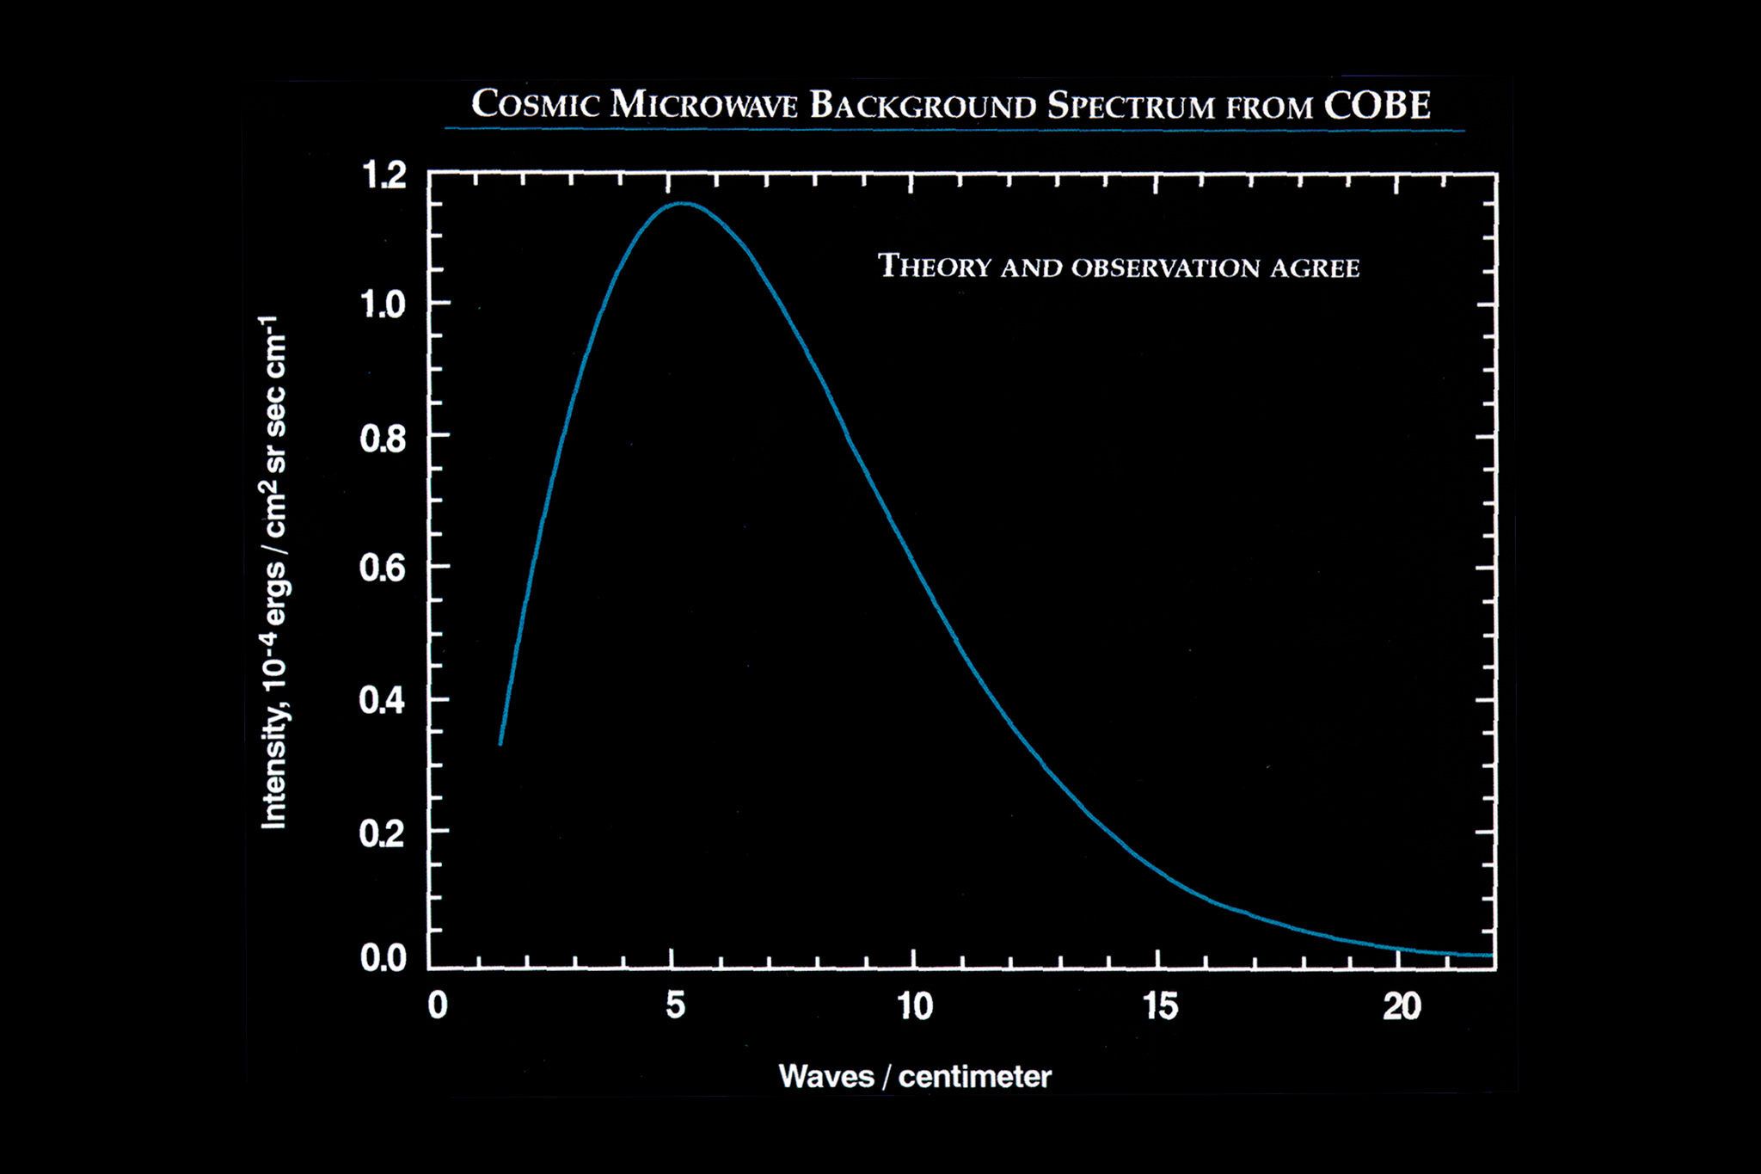
Energy Spectrum
Cosmic Light
• COBE-DIRBE:
temperatureT = 2.725 K
John Mather
Nobelprize physics
2006
• Most perfect
Black Body
Spectrum ever seen !!!!

Slide 45
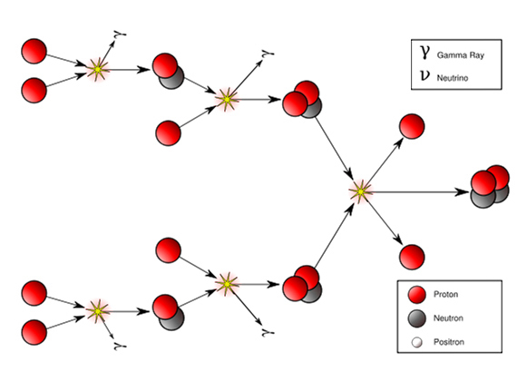
4. Proton-Neutron & Helium
Mass Fraction Light Elements
24% ⁴He nuclei
traces D, ³He, ⁷Li nuclei
75% H nuclei (protons)
p/n ~1/7: 1 min na BB
Between 1-200 seconds after Big Bang,
temperature dropped to 10⁹ K:
Fusion protons & neutrons
into light atomic nuclei

Slide 46
5. the Changing Universe
At great depths
the Universe
looks completely
different
and thus
long ago :
Depth= Time
Galaxies in Hubble Ultra Deep Field

Slide 47
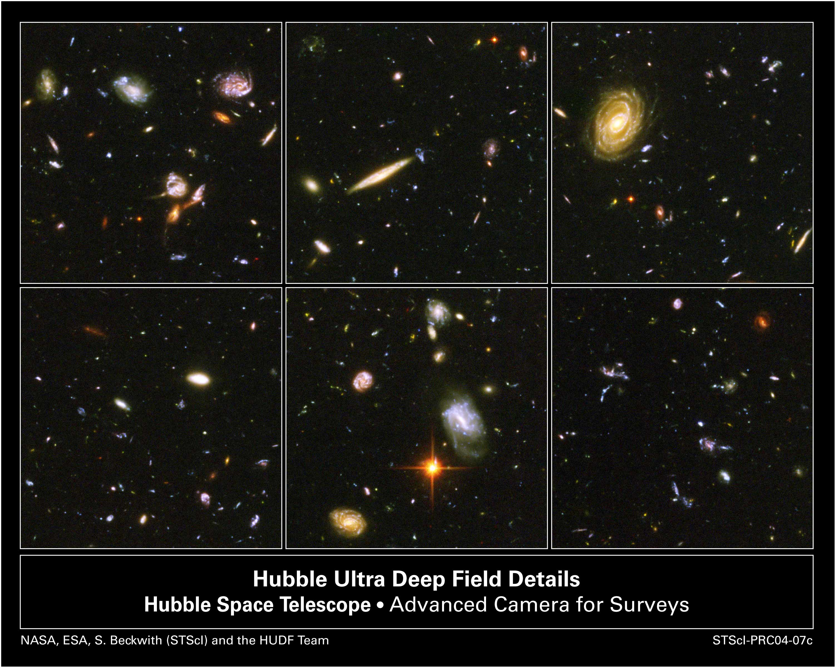
5. the Changing Universe
At great depths
the Universe
looks completely
different
and thus
long ago :
Depth= Time
Galaxies in Hubble Ultra Deep Field

Slide 48
Cosmic Curvature

Slide 49
How Much ?
Cosmic Curvature

Slide 50
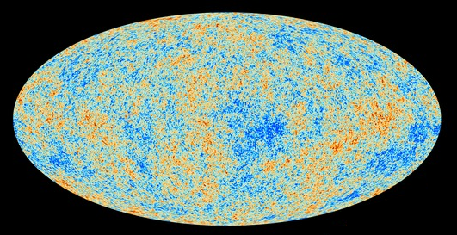
Cosmic Microwave Background
Map of the Universe at Recombination Epoch (Planck, 2013):
• 379,000 years after Big Bang
• Subhorizon perturbations: primordial sound waves
• ∆T/T < 10-5

Slide 51
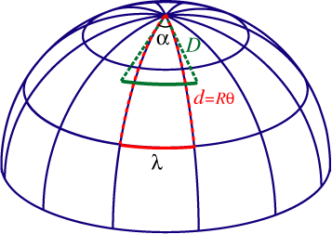
Measuring Curvature
Measuring the Geometry of the Universe:
• Object with known physical size,
at large cosmological distance
● Measure angular extent on sky
● Comparison yields light path,
and from this the curvature of space
W. Hu
Geometry of Space

Slide 52
Measuring Curvature
• Object with known physical size,
at large cosmological distance:
• Sound Waves in the Early Universe !!!!
W. Hu
Temperature Fluctuations
CMB

Slide 53
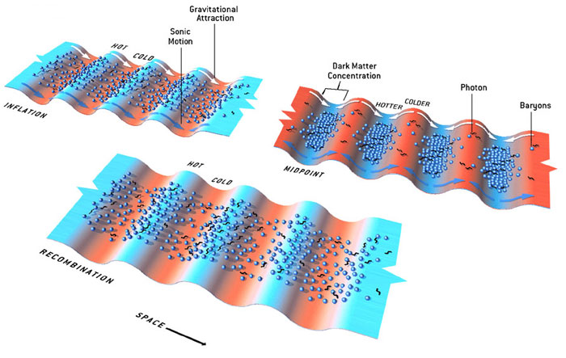
Fluctuations-Origin

Slide 54
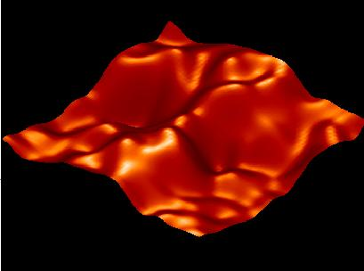
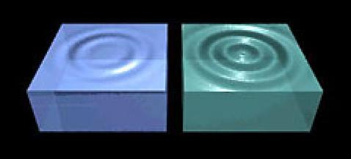
Music of the Spheres
● small ripples in
primordial matter & photon distribution
● gravity:
- compression primordial photon gas
- photon pressure resists
● compressions and rarefactions
in photon gas: sound waves
● sound waves not heard, but seen:
- compressions: (photon) T higher
- rarefactions: lower
● fundamental mode sound spectrum
- size of “instrument”:
- (sound) horizon size last scattering
● Observed, angular size: θ~1º
- exact scale maximum compression, the
“cosmic fundamental mode of music”
W. Hu

Slide 55
Cosmic Microwave Background
Size Horizon Recombination
COBE measured fluctuations: > 7º
Size Horizon at Recombination spans angle ~ 1º

Slide 56
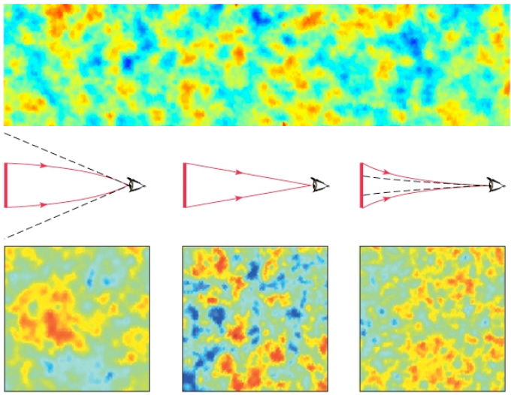
Flat universe from CMB
First peak: flat universe
We know the redshift and the time it took for the light to reach us:
from this we know the
- length of the legs of the
triangle
- the angle at which we are
measuring the sound horizon.
Closed:
hot spots
appear larger
Flat:
appear as big as they are
Open:
spots appear smaller

Slide 57
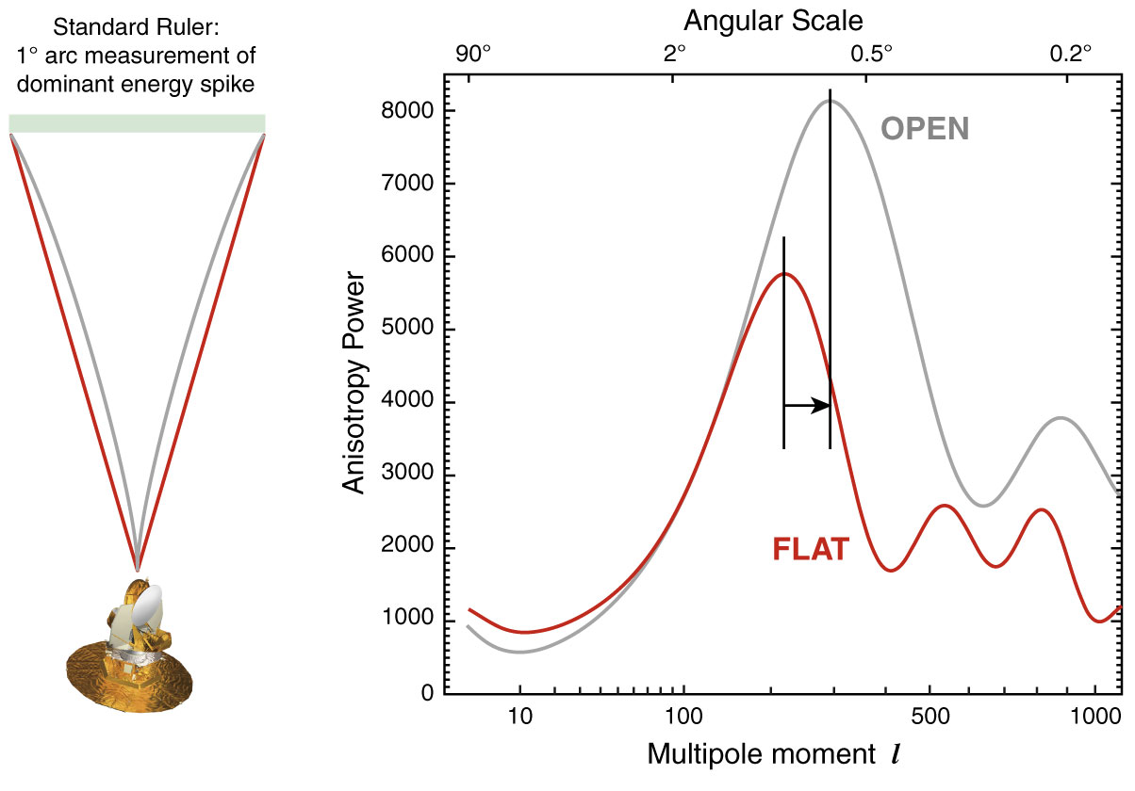
The WMAP CMB temperature
power spectrum

Slide 58
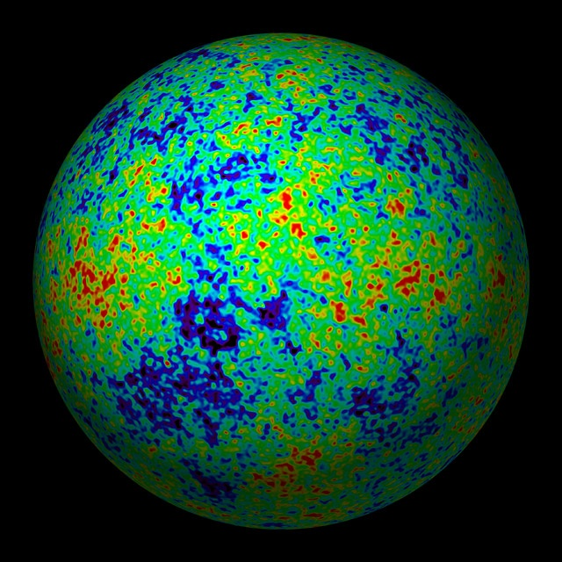
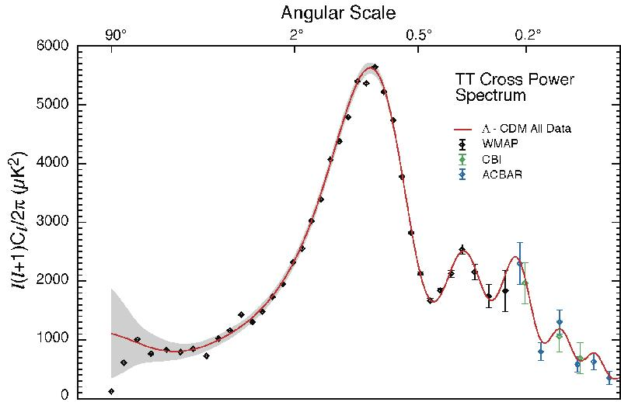
The Cosmic Tonal Ladder
The WMAP CMB temperature
power spectrum
Cosmic sound horizon
The Cosmic Microwave Background Temperature Anisotropies:
Universe is almost perfectly FLAT !!!!

Slide 59
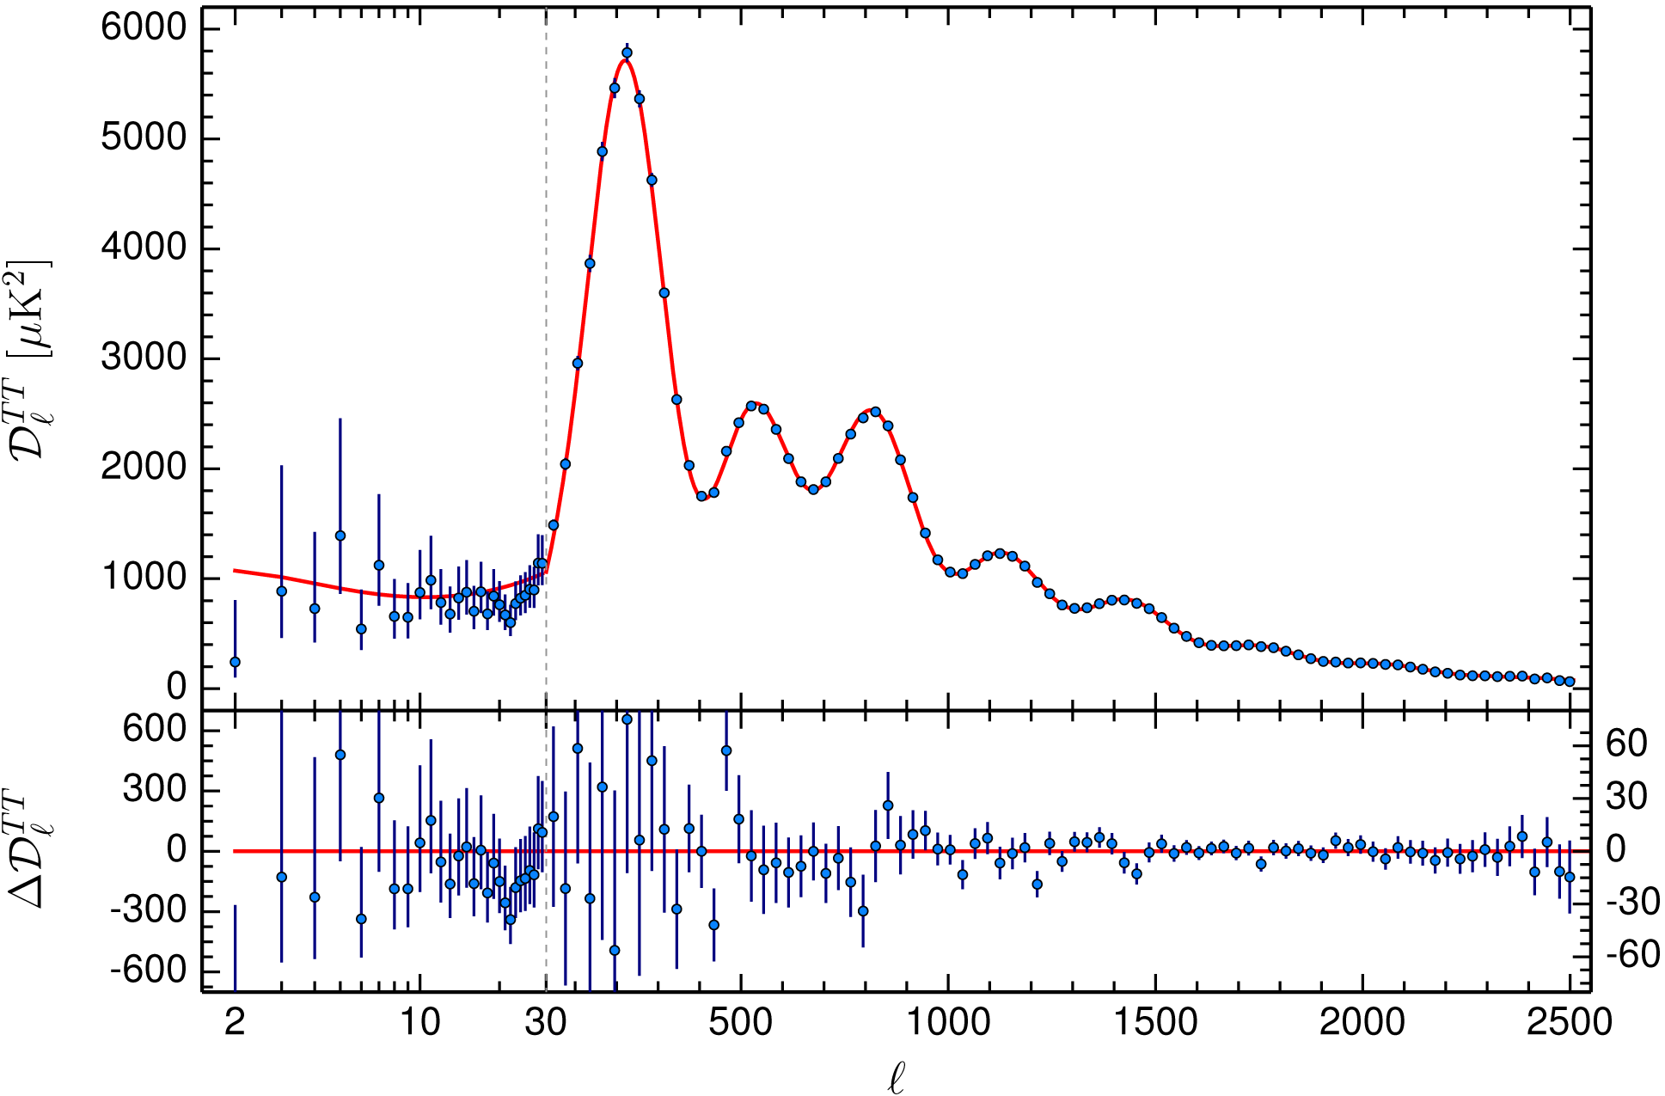
CMB - Fluctuations

Slide 60
Cosmic Horizons

Slide 61
Cosmic Horizons
Fundamental Concept for our understanding of the physics of the Universe:
• Physical processes are limited to the region of space with which we are
or have ever been in physical contact.
• What is the region of space with which we are in contact ?
Region with whom we have been able to exchange photons
(photons: fastest moving particles)
• From which distance have we received light.
• Complication: - light is moving in an expanding and curved space
- fighting its way against an expanding background
• This is called the
Horizon of the Universe
:

Slide 62
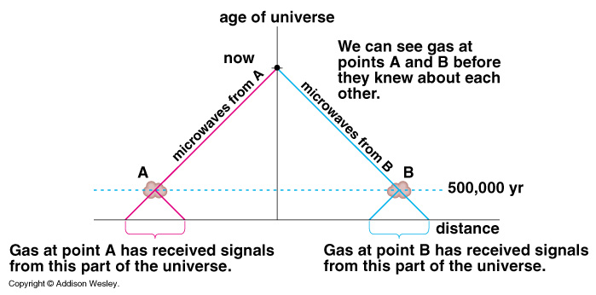
Cosmic Horizons
Horizon of the Universe:
distance that light travelled since the Big Bang

Slide 64
Cosmic Future

Slide 65
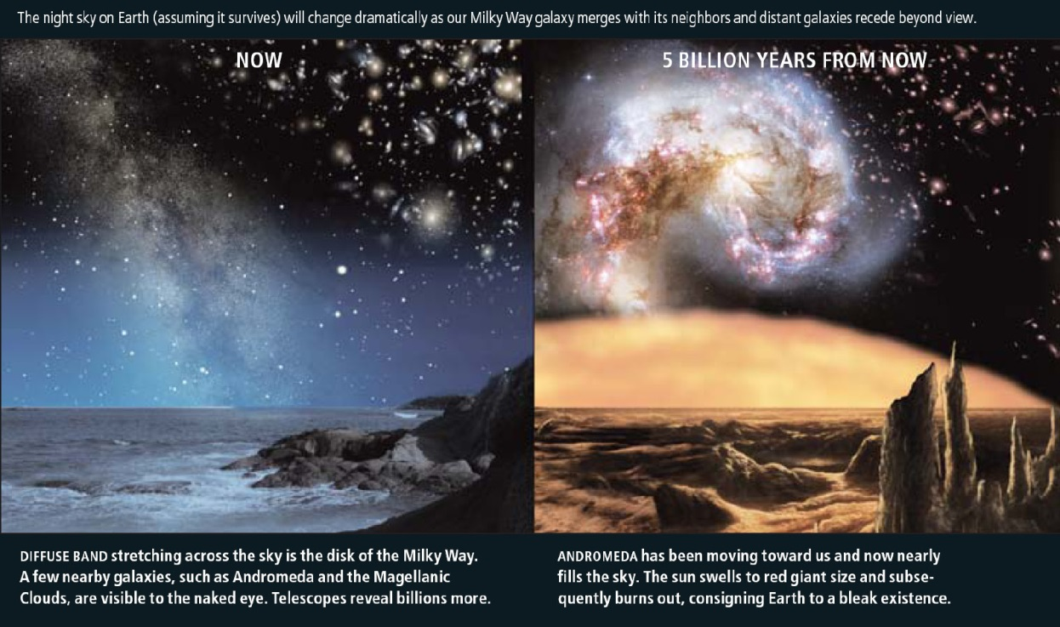
Cosmic Fate
100 Gigayears:
the end of Cosmology

