Slide 1
Timeline
Cosmology

Slide 2
Timeline Cosmology
2nd Millennium BCEBC
Mesopotamian cosmology has a flat,circular Earth enclosed in a cosmic Ocean
12th century BCEC
Rigveda has some cosmological hymns, most notably the Nasadiya Sukta
6th century BCE
Anaximander, the first (true) cosmologist
- pre-Socratic philosopher from Miletus, Ionia
- Nature ruled by natural laws
- Apeiron (boundless, infinite, indefinite), that out of which the universe originates
5th century BCE
Plato
- Timaeus
- dialogue describing the creation of the Universe,
- demiurg created the world on the basis of geometric forms (Platonic solids)
4th century BCE
Aristotle
- proposes an Earth-centered universe in which the Earth is stationary and the cosmos,
is finite in extent but infinite in time

Slide 3
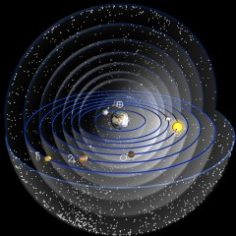
Aristotle’s Universe

Slide 4
3rd century BCE
Aristarchus of Samos
- proposes a heliocentric (sun-centered) Universe, based on his conclusion/determination
that the Sun is much larger than Earth
- further support in 2nd century BCE by Seleucus of Seleucia
3rd century BCE
Archimedes
- book The Sand Reckoner: diameter of cosmos  2 lightyears
- heliocentric Universe not possible
3rd century BCE
Apollonius of Perga
- epicycle theory for lunar and planetary motions
2nd century CE
Ptolemaeus
- Almagest/Syntaxis: culmination of ancient Graeco-Roman astronomy
- Earth-centered Universe, with Sun, Moon and planets revolving on epicyclic orbits around Earth
5th-13th century CE
Aryabhata (India) and Al-Sijzi (Iran) propose that the Earth rotates around its axis.
First empirical evidence for Earth’s rotation by Nasir al-Din al-Tusi.
8th century CE
Puranic Hindu cosmology, in which the Universe goes through repeated cycles of creation,
destruction and rebirth, with each cycle lasting 4.32 billion years.

Slide 5
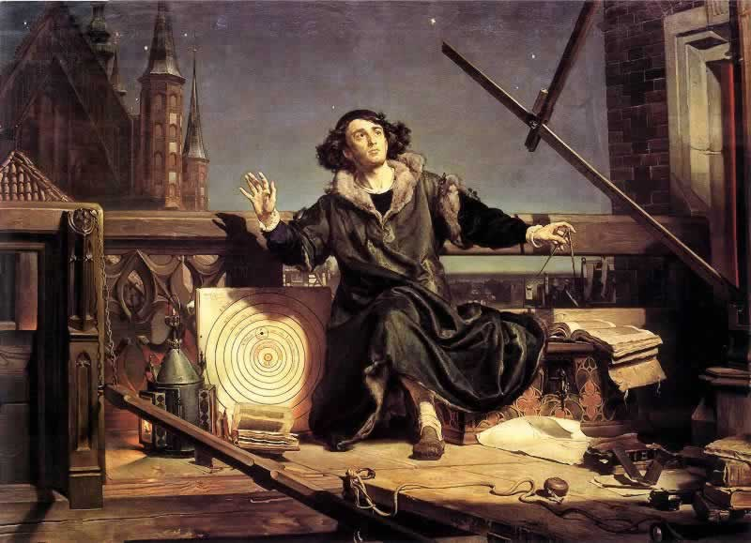
Nikolaus Copernicus
(1473-1543)

Slide 6
1543
Nicolaus Copernicus
- publishes heliocentric universe in De Revolutionibus Orbium Coelestium
- implicit introduction Copernican principle: Earth/Sun is not special
1609-1632
Galileo Galilei
- by means of (telescopic) observations, proves the validity of the heliocentric Universe.
1609/1619
Johannes Kepler
- the 3 Kepler laws, describing the elliptical orbits of the planets around the Sun
1687
Isaac Newton
- discovers Gravitational Force as agent behind cosmic motions
- publishes his Principia (Philosophiae Naturalis Principia Mathematica), which establishes
the natural laws of motion and gravity (the latter only to be replaced by Einstein’s theory of GR)
1755
Immanuel Kant
- asserts that nebulae are really galaxies separate from and outside from the Milky Way,
- calling these Island Universes
1785
William Herschel
- proposes theory that our Sun is at or near the center of ou Galaxy (Milky Way)

Slide 7
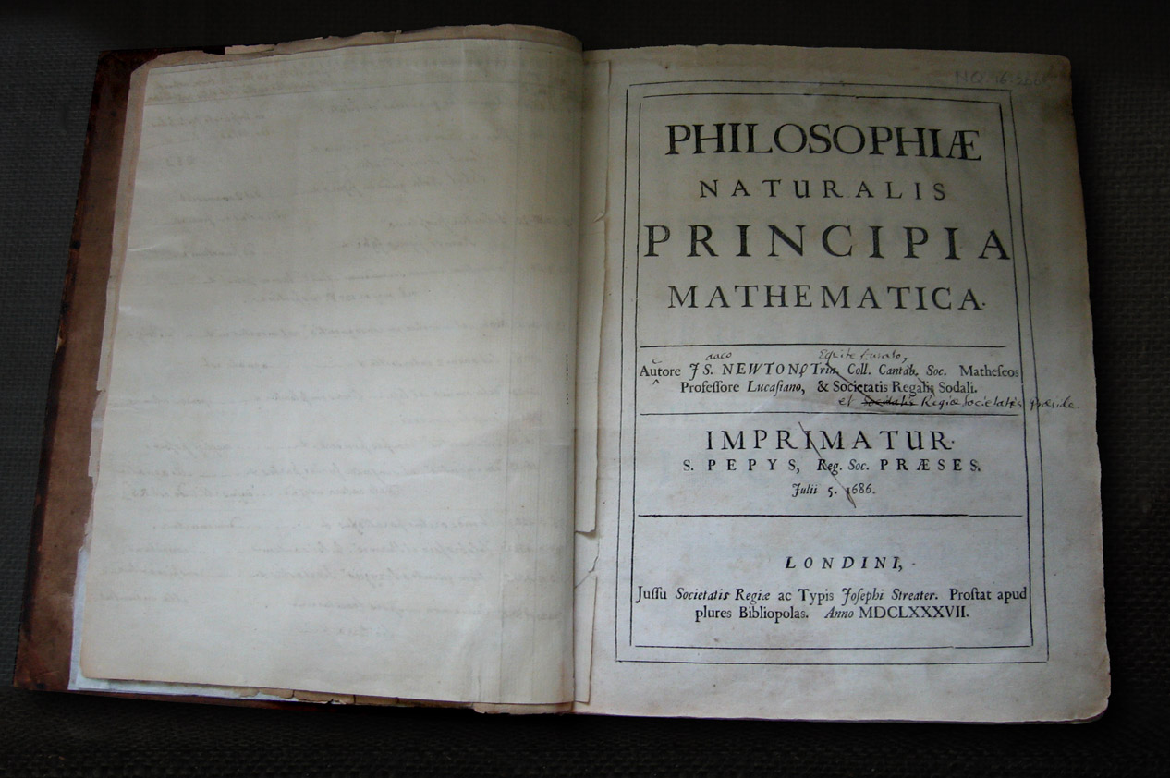
Isaac Newton
(1642-1726)

Slide 8
1826
Heinrich Wilhelm Olbers
- Olber’s paradox (why is the night sky dark ?)
1837
Friedrich Bessel, Thomas Henderson, Otto Struve
- measurement parallax of a few nearby stars: the first measurement of any distances
outside the Solar System.
- establishes the vast distances between the stars
1848
Edgar Allan Poe
- first correct solution to Olber’s paradox in Eureka: A Prose Poem,
an essay that also suggests the expansion of the universe
1860
William Huggins
- develops astronomical spectroscopy :
Orion nebula is mostly made of gas, the Andromeda nebula dominated by stars

Slide 9
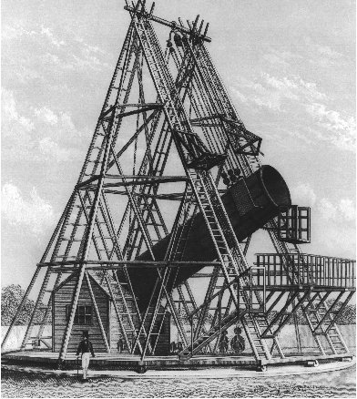
William Herschel’s
telescope

Slide 10
1905
Albert Einstein
- Special Theory of Relativity
- space and time are not separate continua, instead they define a 4-dim. spacetime continuum
1915
Albert Einstein
- General Theory of Relativity:
Einstein field equations
- represents an entirely new theory of gravity, in which gravity is the result of the local
curvature of space, hence replacing the action-at-a-distance theory of Newton.
- spacetime becomes a flexible dynamic medium, warped by energy density
1917
Willem de Sitter
- first general relativistic cosmology, de Sitter Universe
- empty expanding Universe with cosmological constant
1912
Henrietta Leavitt
- Cepheid variable stars period-luminosity relation
- crucial step in measuring distances to other galaxies
1920-1921
Harlow Shapley & Heber Curtis
- Shapley – Curtis debate or “Great Debate”, National Academy of Science
- debate on the distances to spiral nebulae:
are they individual galaxies like the Milky Way or are they part of the Milky Way
1923
Edwin Hubble
- measures distance to few nearby spiral nebulae (Andromeda Galaxy, Triangulum galaxy, NGC 6822)
- distances place them far outside our Milky Way
- demonstrates that the spiral nebulae are galaxies outside our own Galaxy, the Milky Way
- In other words, the Galaxy loses its central unique position and the Universe turns out to be much,
much larger

Slide 11
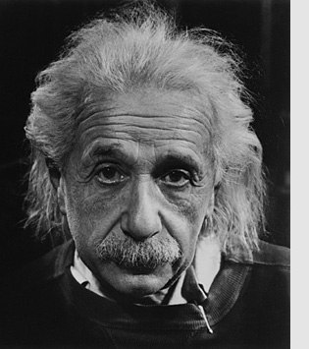
Albert Einstein
(1879-1955)

Slide 12
1922
Vesto Slipher
- finds that spiral nebulae are systematically redshifted, ie. moving away from us
1922
Alexander Friedmann
- Friedmann solution to the Einstein field equations, now known as
Friedmann-Robertson-Walker-Lemaitre equations
- solutions for a perfectly uniform space
- imply expansion of the space
1927
Georges Lemaitre
- solutions for Einstein field equations, for a perfectly uniform space, confirming Friedmann
- discusses the implications, that of an expanding Universe and the creation of the Universe
- predicts distance-redshift relation (later known as Hubble relation)
- may indeed have discovered the expansion of the Universe from existing data (ongoing discusssion)
1929
Edwin Hubble
- discovery linear redshift-distance relation (the Hubble relation)
- ie. the discovery of the EXPANDING UNIVERSE
1933
Edward Milne
- formulation of the Cosmological Principle
- Universe is Isotropic and Homogeneous (on scales larger than 100 million lightyears)
1933
Fritz Zwicky
- discovery of existence of dark matter, from galaxy velocities in Coma cluster of galaxies
1934
Georges Lemaitre
- Cosmological constant (free factor in Einstein field equations):
interpretation in terms of vacuum energy with an unusual perfect equation of state

Slide 13
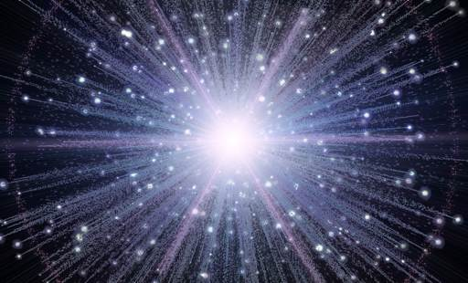
the Hot Big Bang

Slide 14
1946
Evgeni M. Lifschitz
- formulation, in a relativistic context, of gravitational instability in an expanding universe,
the prevailing theory for the formation of structure in the Universe
1946
George Gamow
- Hot Big Bang
- predicts the existence of a cosmic radiation field with a temperature of 50 K (is 2.725K), presuming
all chemical elements were formed in the hot Big Bang.
1948
Ralph Alpher , Hans Bethe, George Gamow
- the -- paper
- describes how the Big bang would by means of nuclear synthesis in the early universe create hydrogen, helium
and heavier elements
1948
Ralph Alpher & Robert Herman
- as a consequence of their studies of nucleosynthesis in the early expanding Big Bang universe,
theoretical prediction of the existence of a residual, homogeneous, isotropic blackbody radiation
- they estimate "the temperature in the universe" at 5 K.
- in 1965 discovered as the Cosmic Microwave Background Radiation
1948
Hermann Bondi, Thomas Gold, Fred Hoyle
- proposal Steady State Cosmology, based on the perfect cosmological principle
1950
Fred Hoyle
- coins the term Big Bang, meant in a derisive way
1957
Margaret Burbidge, Geoffrey Burbidge, William Fowler & Fred Hoyle
- landmark B²FH paper
- Synthesis of the Elements in Stars
- describes how all elements, heaver than lithium, are synthesize by nuclear processes in the cores of stars
- We are stardust !

Slide 15
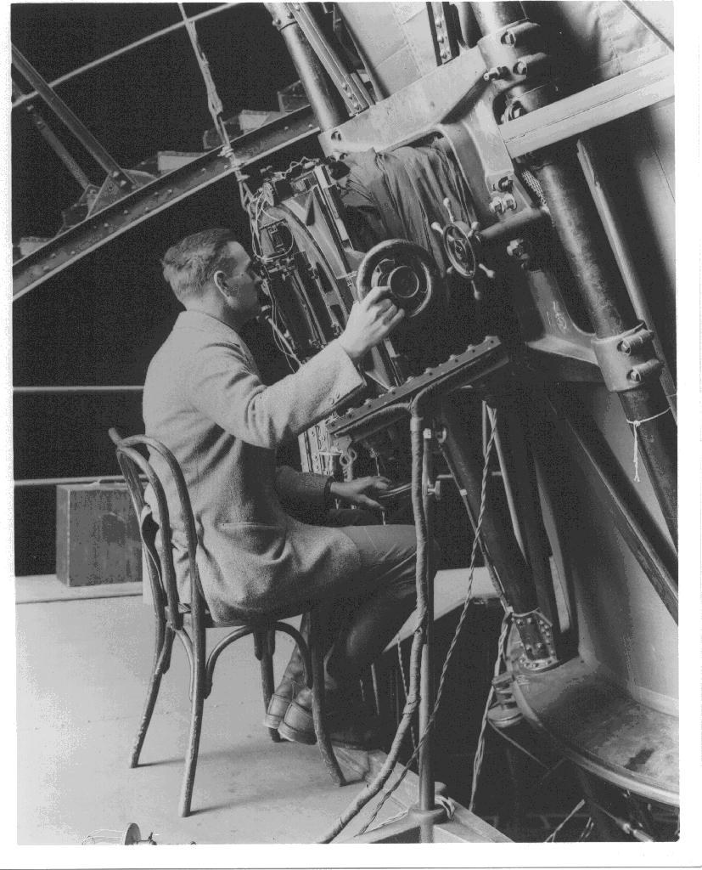
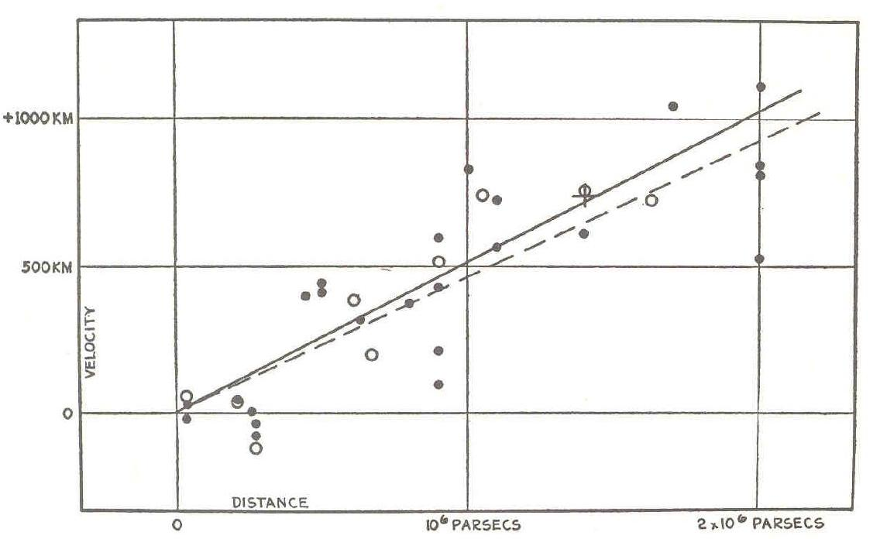
Expanding Universe
Edwin Hubble
(1889-1953)
v = H r
Hubble Expansion

Slide 16
1963
Maarten Schmidt
- discovery of the first quasar, active nuclei of galaxies visible out to very high redshifts in the Universe
1965
Arno Penzias & Robert Wilson
- Discovery of the 2.7K Microwave Background Radiation (CMB)
- ultimate proof of the Hot Big Bang
- Nobelprize Physics in 1978
1965
Robert Dicke, Jim Peebles, Peter Roll & David Wilkinson
- interpretation of the CMB as the relic radiation from the Big Bang
1966
Jim Peebles
- predicts the correct helium abundance, produced as a result of early Universe Big Bang nucleosynthesis
1966
Stephen Hawking & George Ellis
- Singularity Theorem
- they show that any plausible general relativistic cosmology is singular

Slide 17
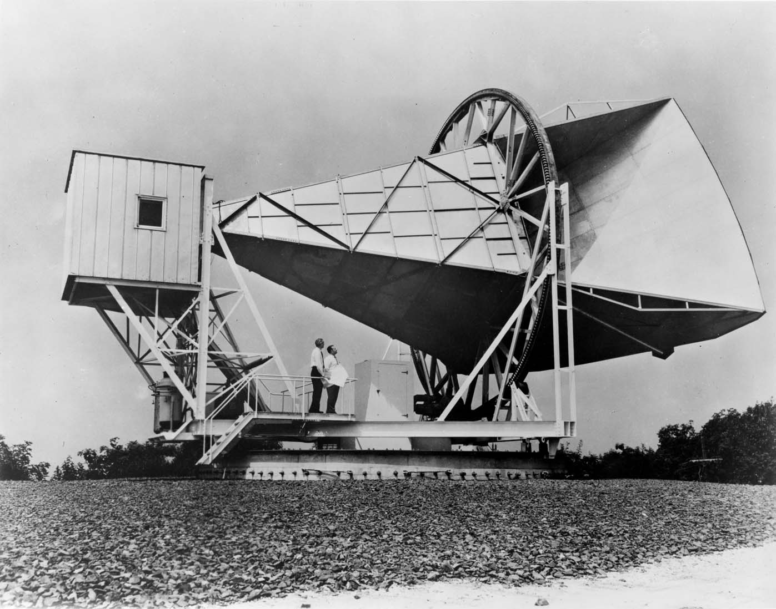
1965: Penzias & Wilson
discovery Cosmic Microwave Background Radiation
Echo of the Big Bang

Slide 18
1970
Yakov Zeldovich
- Zeldovich formalism
- theory of anisotropic gravitational collapse for the formation of structure in the Universe
1980
Alan Guth, Alexei Starobinsky
- Inflationary Big Bang universe
- possible solution to the socalled horizon and flatness problems of standard Big Bang models
- has become a key element of the standard Big Bang model
1982-1984
Jim Peebles, Dick Bond, George Blumenthal
- universe dominated by Cold Dark Matter
1983-1987
Klypin & Shandarin 1983
Davis, Efstathiou, Frenk & White 1985-1987
- the first large computer simulations of cosmic structure formation
- DEFW show that cold dark matter based simulations produce a reasonable match to observations
1986
de Lapparent, Geller & Huchra
discovery of the Cosmic Web by the CfA2 survey “Slice of the Universe”
- final confirmation of earlier suggestions/indictions of a weblike/cellular structure in the Universe
- by Einasto et al. (1980) while
- later the reality of the Cosmic Web got confirmed in an unambiguous fashion
by the maps of the 2dFGRS redshift survey (1997-2002)
1990
George Efstathiou, Steve Maddox & Will Sutherland
- APM survey: computer processed measurement of the galaxy distribution on the southern sky
- first direct detection and claim of the impact of a Cosmological Constant

Slide 19
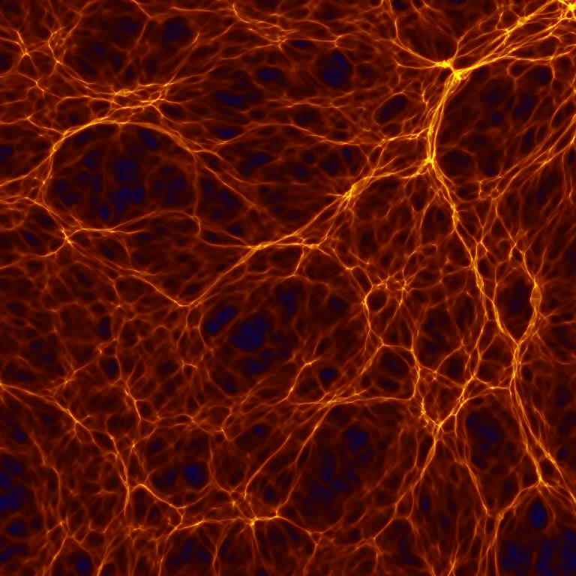
Yakov Zeldovich
(1914-1987):
Cosmic Web

Slide 20
1990
COBE CMB satellite, John Mather
- precise measurement of the blackbody spectrum of the Cosmic Microwave Background
- confirmation of blackbody nature of CMB, to a precision of 1 in 10⁵, the strongest and ultimate evidence for
the reality of the Hot Big Bang
- T=2.725 K
- Nobelprize physics 2006
1990
COBE CMB satellite, George Smoot
- discovery of tiny anisotropies in the CMB,
- the seeds of structure formation in the Universe
- confirmation of the gravitational instability theory for structure formation in the Universe
- provides the baby picture of structure of the Universe “only” 379,000 years after the Big Bang
- Nobelprize physics 2006
1997-2002
2dFGRS galaxy redshift survey
- first large scale systematic survey of the spatial galaxy distribution
- conducted with the 3.9m Anglo-Australian Telescope
- mapped the positions of 232,155 galaxies in 2 narrow slices out to a redshift of 0.2
- structure mapped is that of a Cosmic Web
1998
Supernova Cosmology Project, High-Z Supernova Search Team,
lead by Saul Perlmutter, Adam Riess & Brian Schmidt
- discovery of the acceleration of cosmic expansion
- provides first direct evidence for the existence of a non-zero cosmological constant
- Nobelprize Physics 2012
2000-
Sloan Digital Sky Survey (SDSS)
Maj-- multi-filter imaging and spectroscopic redshift survey using a dedicated 2.5-m
wide-angle optical telescope at Apache Point Observatory in New Mexico
- systematic mapping of the spatial galaxy distribution in major regions of the nearby Universe
- as yet around 2,000,000 galaxies
- clustering consistent with the cold dark matter theory of cosmic structure formation,
including Cosmological Constant, the socalled ☹CDM cosmology

Slide 21
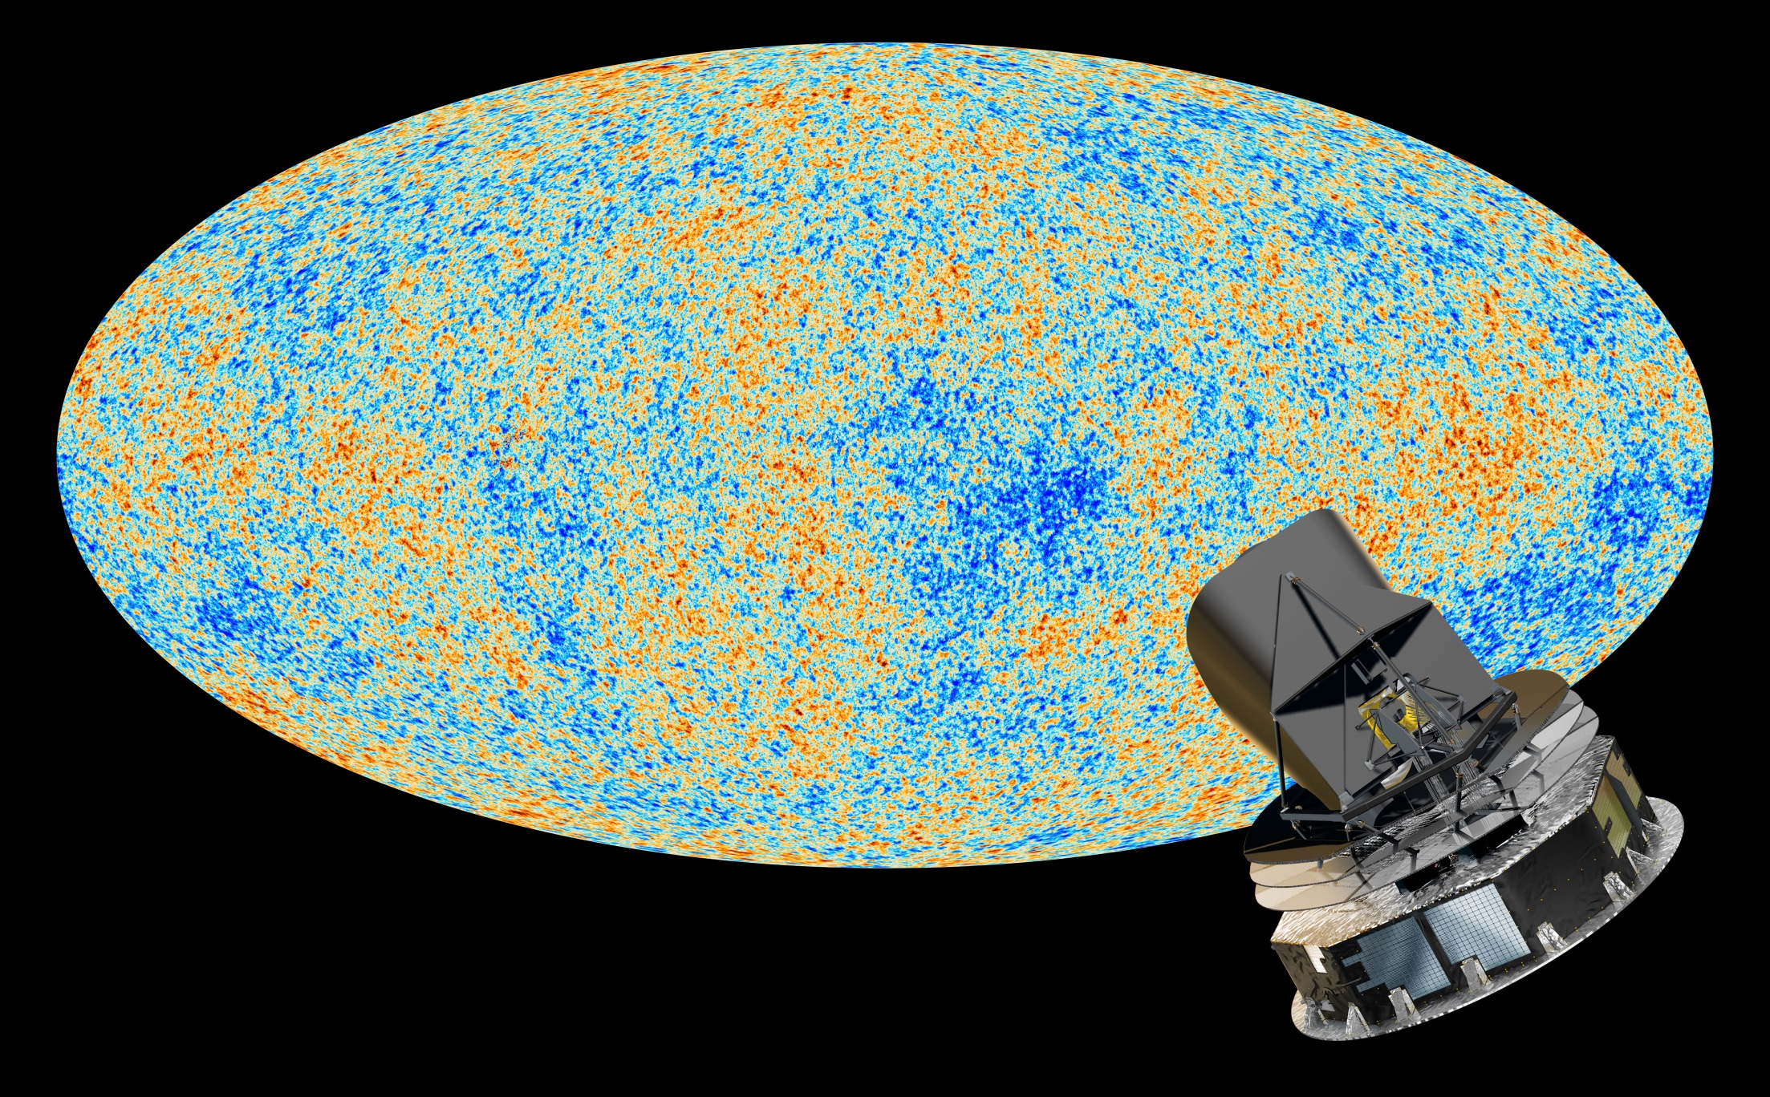
Precision
Cosmology
Universe 380.000 yrs after Big Bang
13.8 Gyrs ago (13.7980.037 Gyrs)
Temperature T = 2.725480.00057 K
temperature/density fluctuations (T/T<10⁻⁵)
Planck satellite map
of the primordial Universe

Slide 22
2000
Witman et al., Bacon et al., Kaiser et al., van Waerbeke et al. (4 independent groups)
discovery/detection Cosmic Shear
- gravitational lensing by cosmic mass distribution
- induced by the dominant dark matter component in the cosmic mass distribution
- proviedes a new and competitive probe of cosmological parameters
2003
WMAP CMB satellite
- Wilkinson Microwave Anisotropy Probe,
- US satellite mission measuring the CMB to subhorizon scales
- mapping of cosmic acoustic waves and measurement angular fluctuation spectrum
- opening era of Precision Cosmology
- establishes accurate age determination of the Universe: 13.7 Gyr
- establishes that the Universe has zero curvature (flat Universe)
- established reality of Cosmological Constant/Dark Energy
2005
Cole et al. , Eisenstein et al.
discovery Baryonic Acoustic Oscillations
- from the maps of galaxy distribution from the 2dFGRS and SDSS galaxy redshift surveys, the first
detection of the remnant acoustic oscillations: remnant of the primordial sound waves
- new probe that confirms realiyt of Dark Energy/Cosmological Constant
2013-2015
Planck CMB satellite
- European satellite mission measuring the CMB to unprecedented detail and accuracy
- maps the polarization of the cosmic microwave background
- detects the gravitational lensing of the CMB
- establishes the age of the Universe to 13.8 Gyr

Slide 23
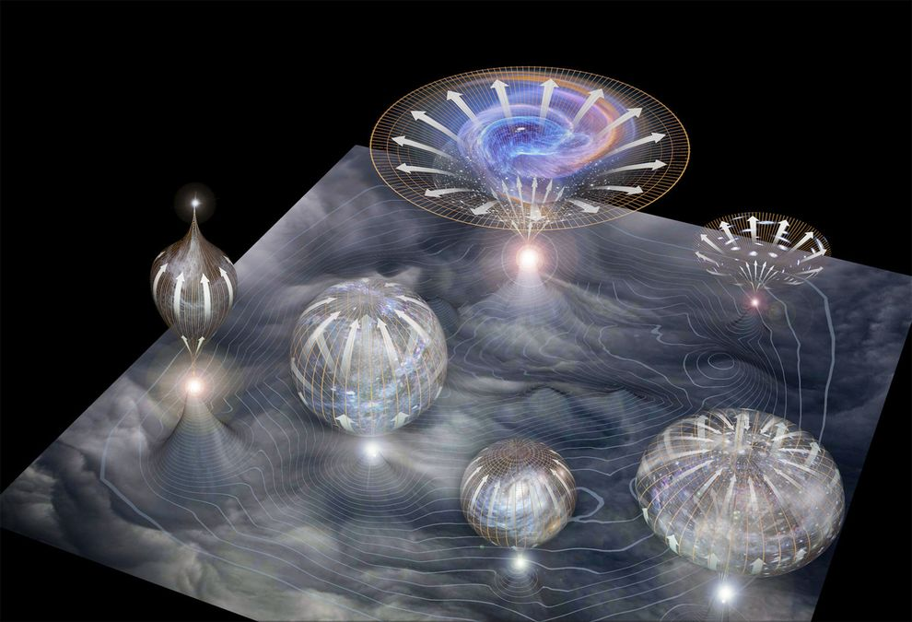
Inflationary Universe

