Slide 1
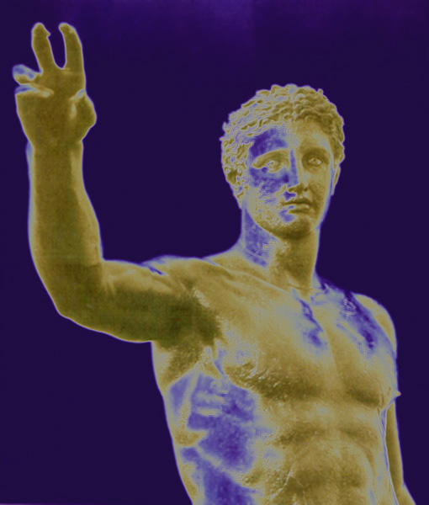
the Universe Mechanized: Hellenistic Cosmology

Slide 2
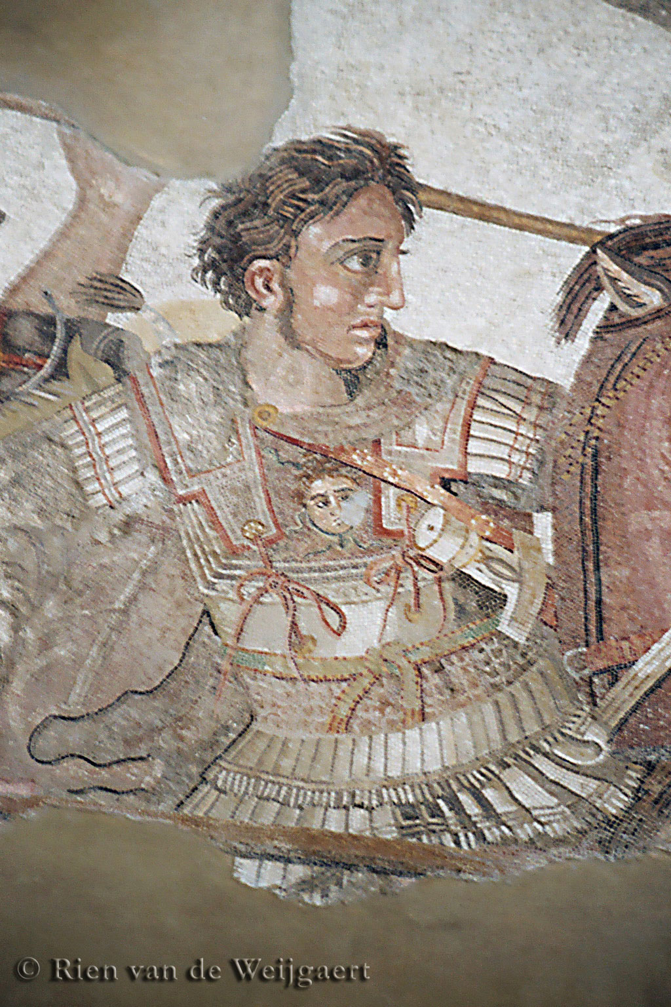
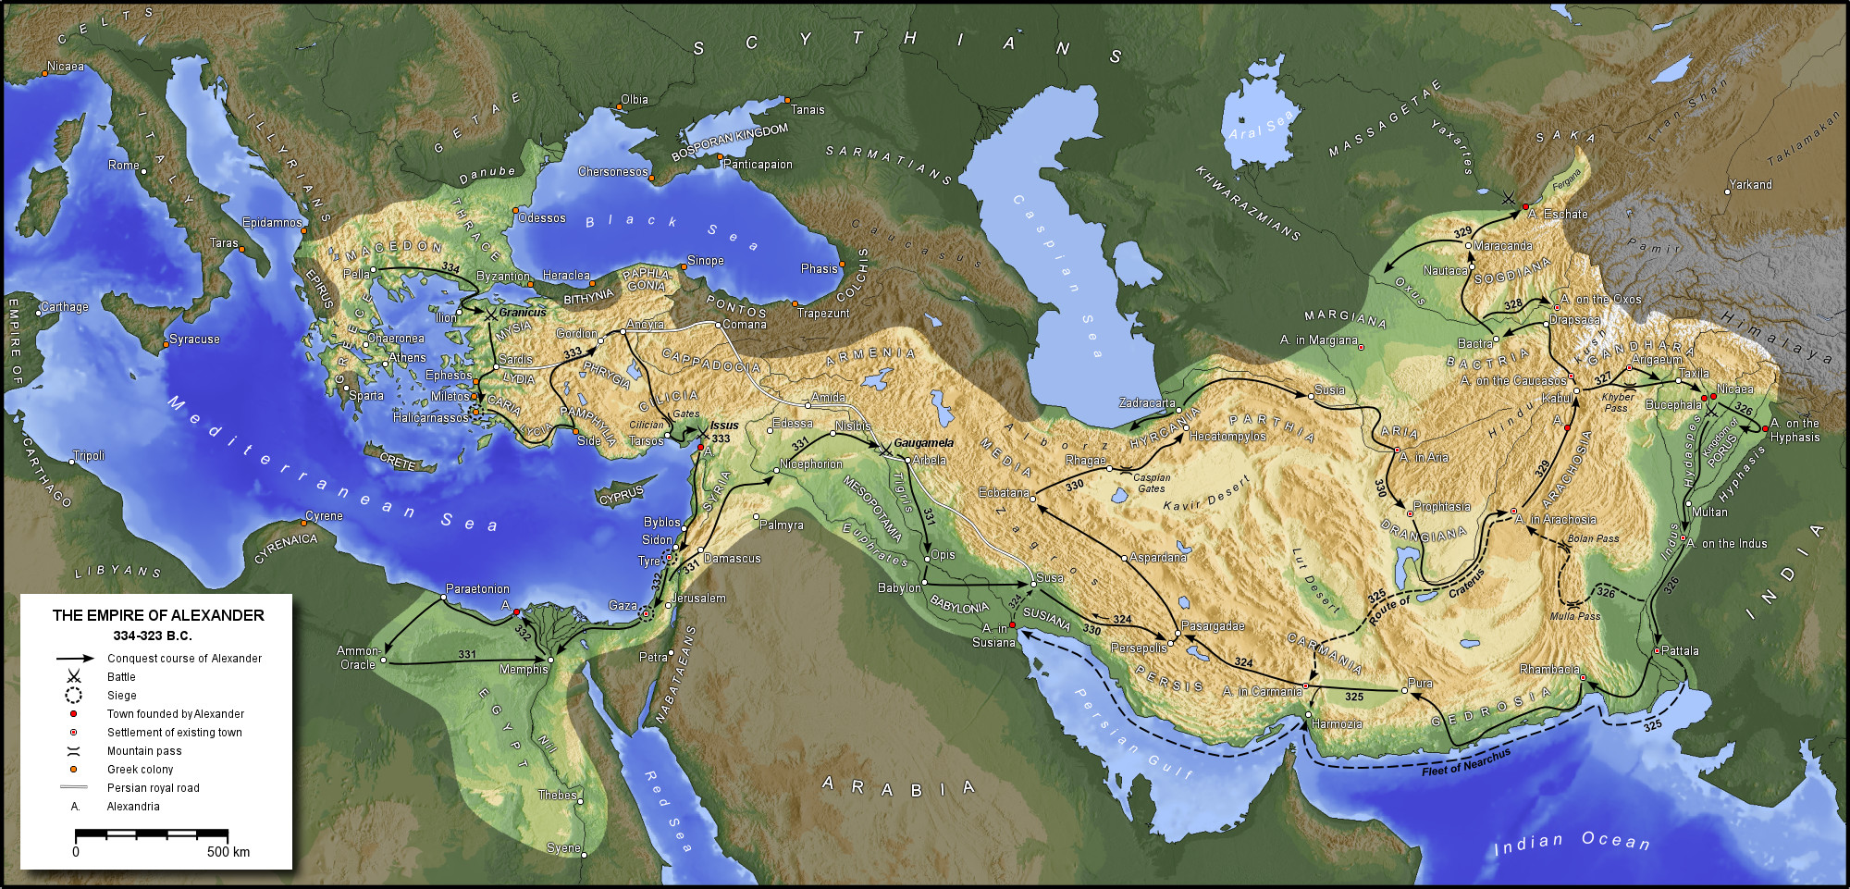
the First Scientific Revolution: Hellenistic World

Slide 3
Hellenistic States & Centers of Science
Pergamum
Syracuse
Rhodos
Alexandria

Slide 4
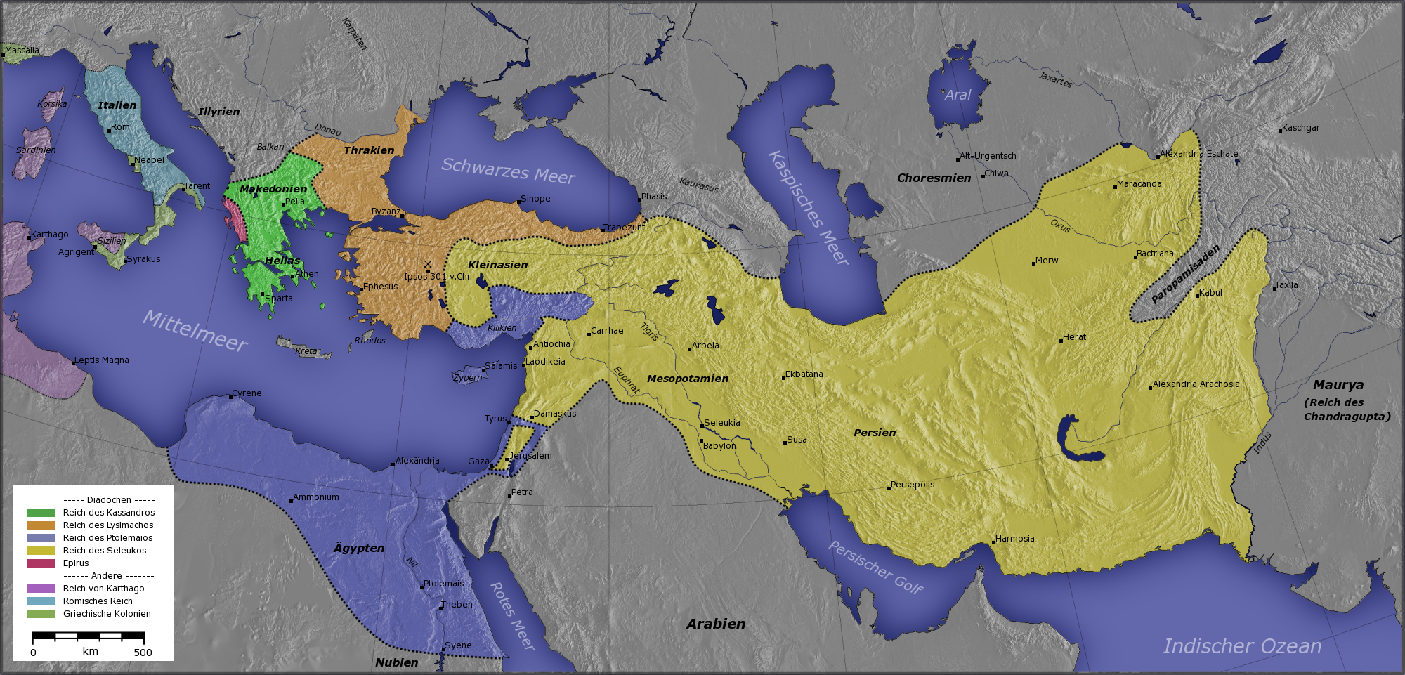
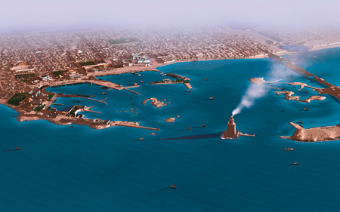
Alexandria

Slide 5
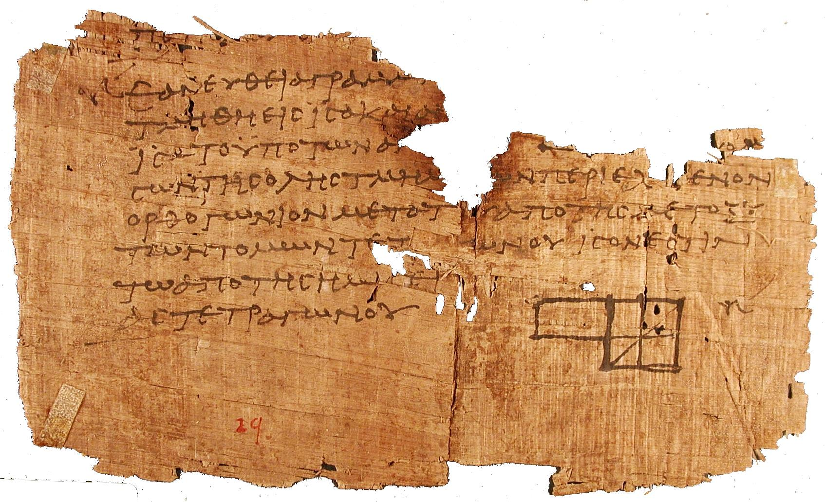
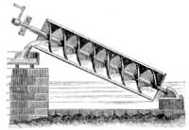
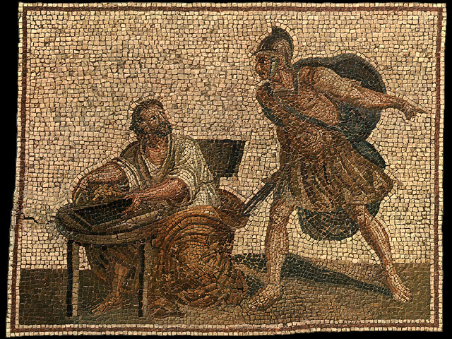
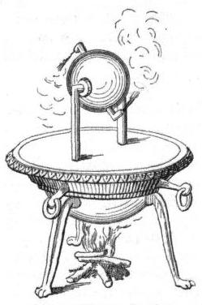
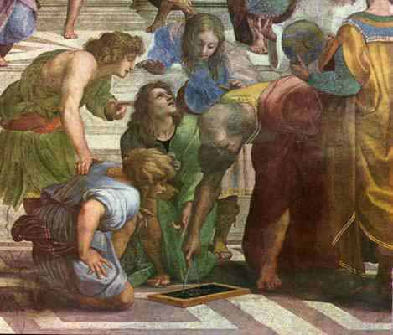
First Scientific Revolution

Slide 6
Euclides Herophilus Aristarchus Ctesibius Archimedes Eratosthenes Apollonius Hipparchus Heron of Alexandria Ptolemaeus

Slide 7
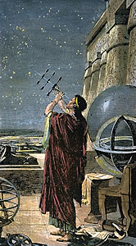
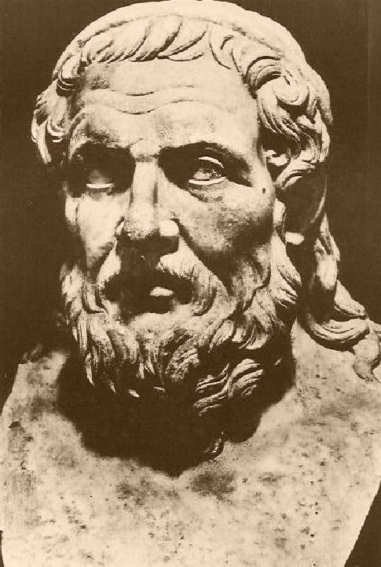
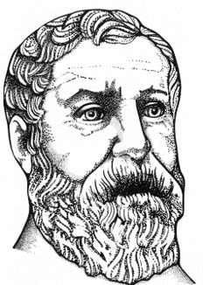
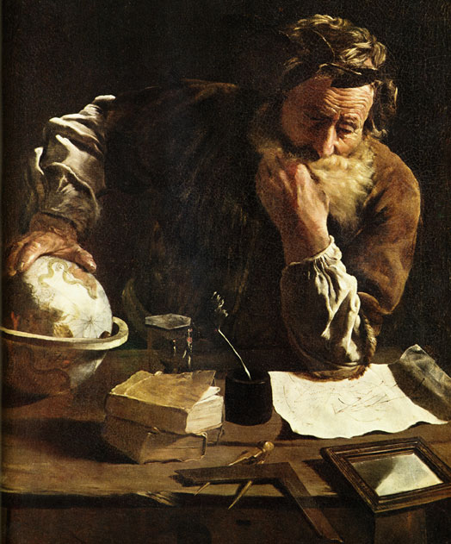
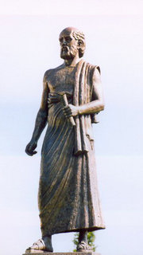
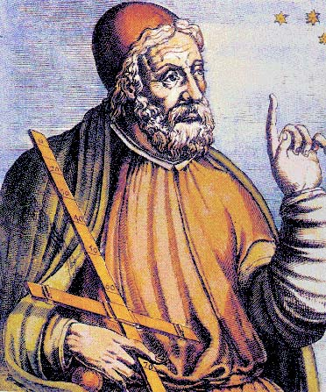
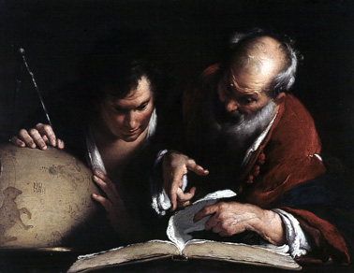
Hipparchus
Euclides
Heron
Apollonius of Perga
Aristarchus
Ptolemaeus
Eratosthenes
Archimedes

Slide 8
Euclides (~ 300 BC) Herophilus (335-280 BC) Aristarchus of Samos (310-230 BC) Ctesibius (285-222 BC) Archimedes (287-212 BC) Eratosthenes (276-194 BC) Apollonius of Perga (262-190 BC) Hipparchus of Samos (190-120 BC) Heron of Alexandria (10-70 AD) Ptolemaeus (83-168 AD)

Slide 9
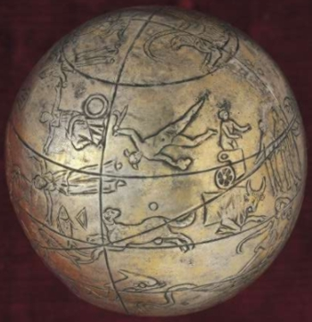
Hellenistic Astronomers
Various astronomers made significant,
even amazing, contributions. Noteworthy examples:
• Aristarchus of Samos - Heliocentric Universe
- distance Moon & Sun
- size Sun
• Archimedes - Planisphere/Planetarium ?
• Eratosthenes - Diameter Earth
• Hipparchus - multitude
essential contributions
Problematic is the loss of nearly all, except for a few,
of the books and works they have written …

Slide 10
Aristarchus of Samos Ἀρίσταρχος 310-230 BCE

Slide 11
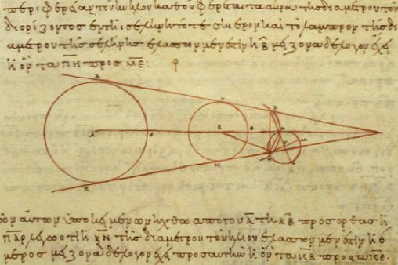
Aristarchus of Samos (Samos, 310-230 BCE) the ancient Copernicus
“On the Sizes & Distances of the Sun and Moon ”:

Slide 12
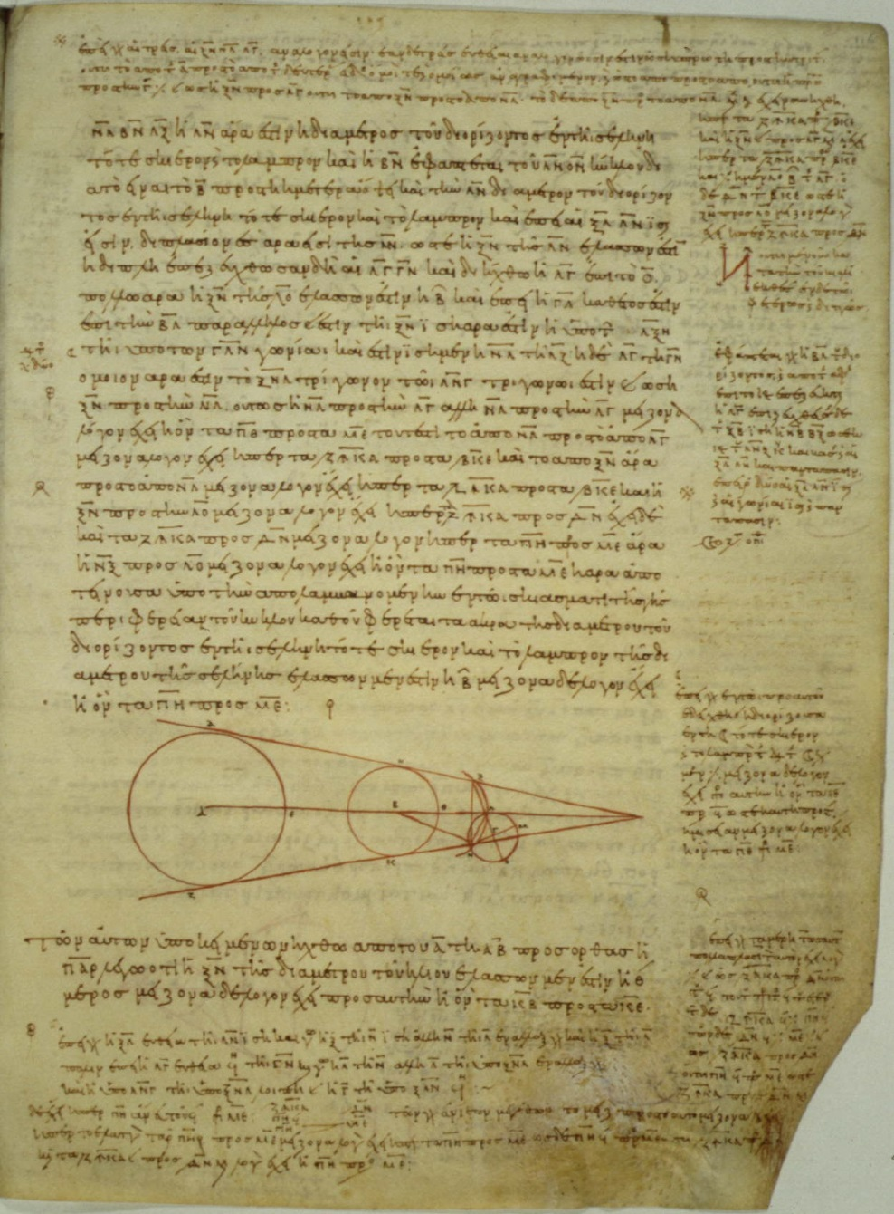
On the Sizes and Distances
Only one work of Aristarchus survives:
On the Sizes and the Distances
of the Sun and Moon
First mathematically based attempt
to measure distance Earth-Sun, thus
First attempt to measure scale Universe
Based upon geocentric view of Universe
On the Sizes and the Distances
Greek copy 10th century

Slide 13
On the Sizes and Distances
Aristarchus' geometric construction used to estimate the distance to the Sun.
Earth (E) –Sun (S)-Moon (M) triangle and sizes are not drawn to scale.
Measure angle b:
c = 90-b EM/ES = sin(c)
Aristarchus:
b = 87 real value: b = 8950
ES = 19 EM real value: ES = 397 EM
Numerically, very unstable procedure, reason
for huge error. Nonetheless,
On the Sizes and the Distances
Greek copy 10th century

Slide 14
On the Sizes and Distances
Aristarchus' estimate of size Sun:
angular diameter Sun ~
angular diameter Moon
Dist. Earth-Sun = 19 Dist. Earth-Moon
size Sun = 19 x size Moon
size Sun > size Earth
On the Sizes and the Distances
Greek copy 10th century

Slide 15
Aristarchus: Heliocentric Universe
Archimedes, “the Sand Reckoner” (~200 BCE):
You King Gelon are aware the ‘universe' is the name given by most astronomers to the sphere the center of which is the center of the Earth, while its radius is equal to the straight line between the center of the Sun and the center of the Earth. This is the common account as you have heard from astronomers.
But Aristarchus has brought out a book consisting of certain hypotheses, wherein it appears, as a consequence of the assumptions made, that the universe is many times greater than the 'universe' just mentioned.
His hypotheses are that the fixed stars and the Sun remain unmoved, that
the Earth revolves about the Sun
on the circumference of a circle, the Sun lying in the middle of the orbit, and that the sphere of fixed stars, situated about the same center as the Sun, is so great that the circle in which he supposes the Earth to revolve bears such a proportion to the distance of the fixed stars as the center of the sphere bears to its surface.

Slide 16
Aristarchus: Heliocentric Universe
Aristarchus’ idea of Heliocentric Universe
encountered sceptical, even hostile, reactions:
• Could not explain the absence of
parallax of fixed stars
(or they should be very, very far away …)
• Impiety … (even for those “rational” Greeks …)
“Cleanthes thought it was the duty of the Greeks to indict Aristarchus of Samos on the charge of impiety for putting in motion the Hearth of the universe [i.e. the earth], . . . supposing the heaven to remain at rest and the earth to revolve in an oblique circle, while it rotates, at the same time, about its own axis”
Plutarchus, “On the Apparent Face in the Orb of the Moon”

Slide 17
Eratosthenes of Cyrene Ἐρατοσθένης 276 BC - 194 BC

Slide 18
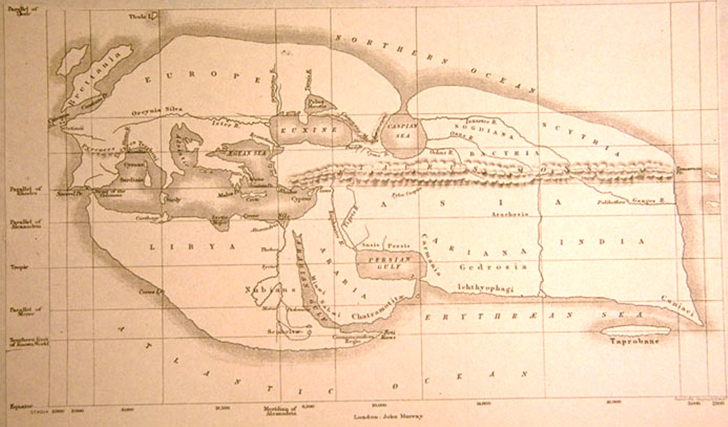
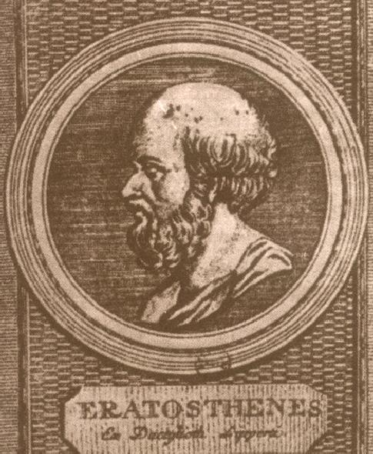
Eratosthenes of Cyrene (276 -194 B.C.E.)
• Studied in Alexandria & Athens
- Mathematician
- Astronomer
- Geographer
- Poet
- Athlete
• 2nd Chief librarian
Great Library of Alexandria
• Friend of Archimedes
Invented armillary sphere
(240 BC)
• Calculated Earth’s Circumference
• Became blind in 194 BC,
starved himself to death

Slide 19
Earth Circumference:
Eratosthenes’ measurement: 39,690 km - within 1%
(if Egyptian stadia)
Linear distance
Syene - Alexandria:
~ 5,000 stadia
Angular distance
Syene - Alexandria:
~ 7⁰
Eratosthenes’ measurement Earth diameter

Slide 20
Eratosthenes Earth Circumference Measurement

Slide 21
Archimedes of Syracuse  c. 287 – 212 BCE

Slide 22
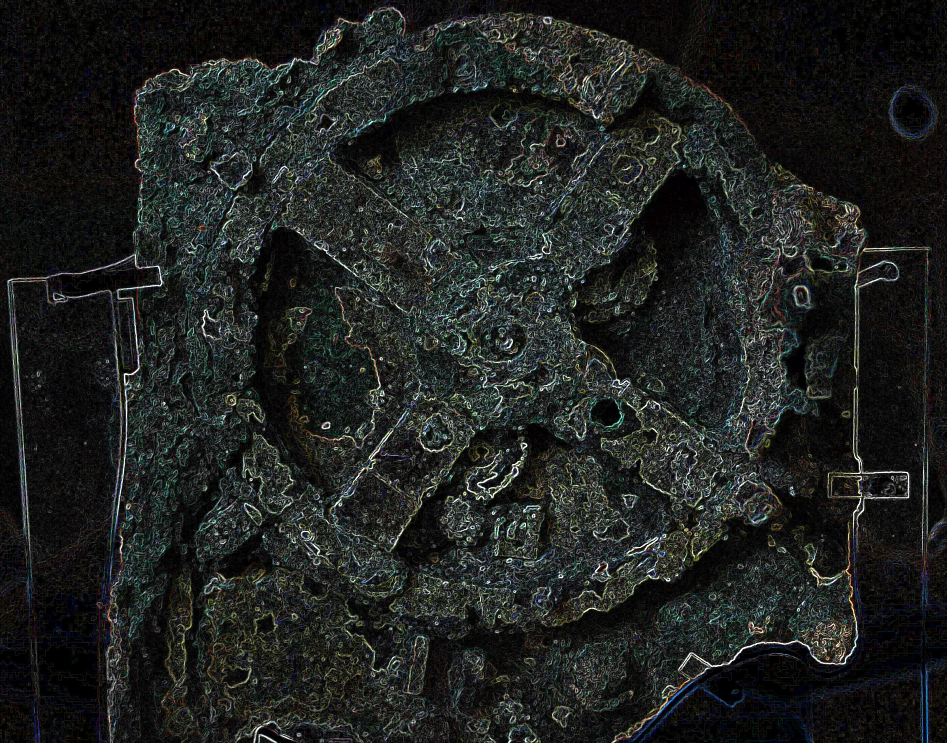
Archimedes
Syracuse, 287-211/212 BC,
Greatest mathematician &
scientist of antiquity (all time ?):
• Probably studied in Alexandria,
under followers Euclides
• Killed by Roman soldier, upon
Roman conquest Syracuse
• Family Hieron II, king Syracuse ?
• Inventions:
- war machines …
- water screw
- water organ (?)
- burning mirrors (???)
- planetarium !!!!!!!

Slide 23
Cicero mentions two planetarium like machines…
“For when Archimedes fastened on a globe the
movements of moon, sun and five wandering stars,
he, just like Plato’s God who built the world in the
“Timaeus”, made one revolution of the sphere
control several movements utterly unlike in
slowness and speed. Now if in this world of ours
phenomena cannot take place without the act of
God, neither could Archimedes have reproduced
the same movements upon a globe without
divine genius''
Cicero, Tusculan Disputations, Book I, Section XXV

Slide 24
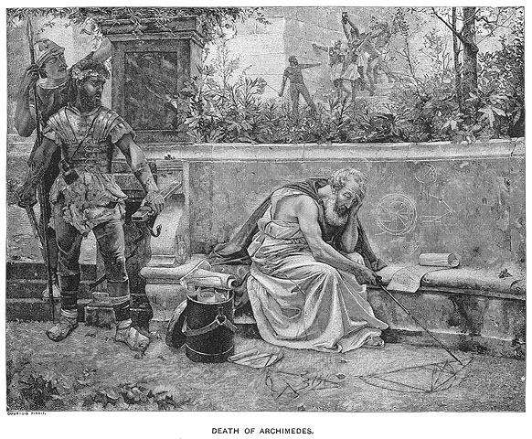

Slide 25
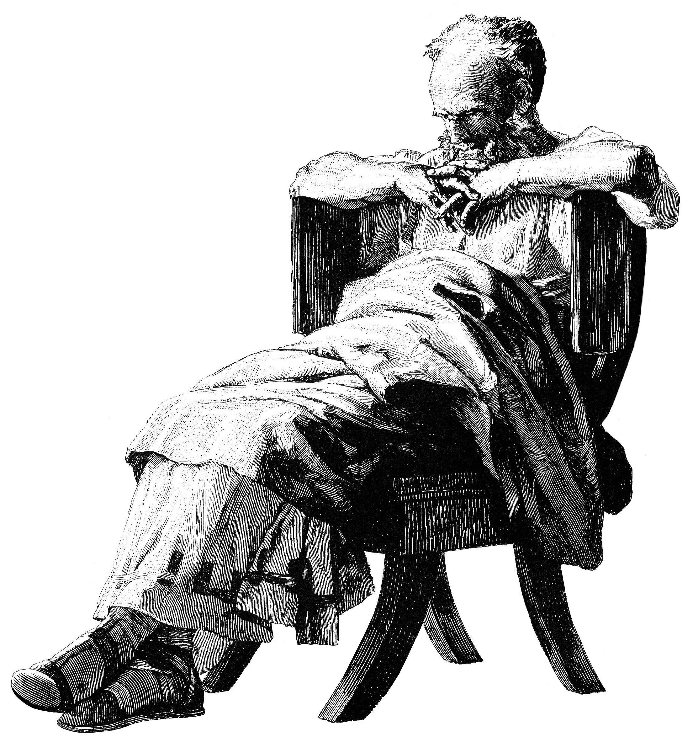
Archimedes
Pappus of Alexandria:
Archimedes wrote book
“On Sphere-Making”
… is this Antikythera … ?
Compare with
Archimedes Palimpsest:
… “On the Method” …
Fundamentals Calculus,
Integral calculus …

Slide 26
Hipparcus  c. 190 – 120 BCE

Slide 27
Hipparchus of Nicaea (190-120 BC) Antiquities' Greatest Astronomer Responsible for the true Revolution in Astronomy Synthesis of Babylonian Observational Astronomy Greek Theoretical/Geometric Models Astronomy as true Modern Science: Experiment & Theory

Slide 28
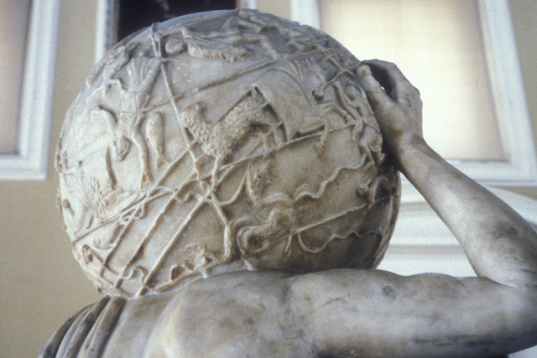
Hipparcus (Nicaea-Rhodos 190-120 BCE)
Greatest astronomer Greek antiquity
• Trigonometric Tables
• Precession of the Equinoxes
• Motion moon:
synodic, anomalistic, … month
• Solar & Lunar eclipses
• Orbit of the Moon:
epicyclic theory
• Distance Moon
• Star catalogue & Celestial Globe
Lost, yet … Farnese Atlas ?
• Defined Magnitude Scale
• Invented the Astrolabe
•

Slide 29
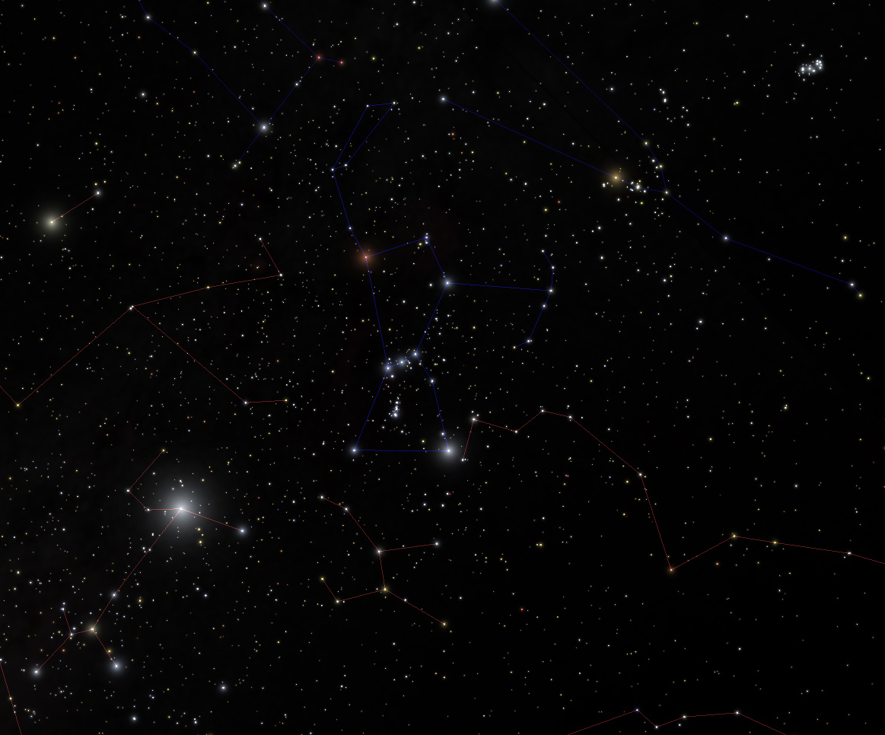
Star Magnitudes

Slide 30
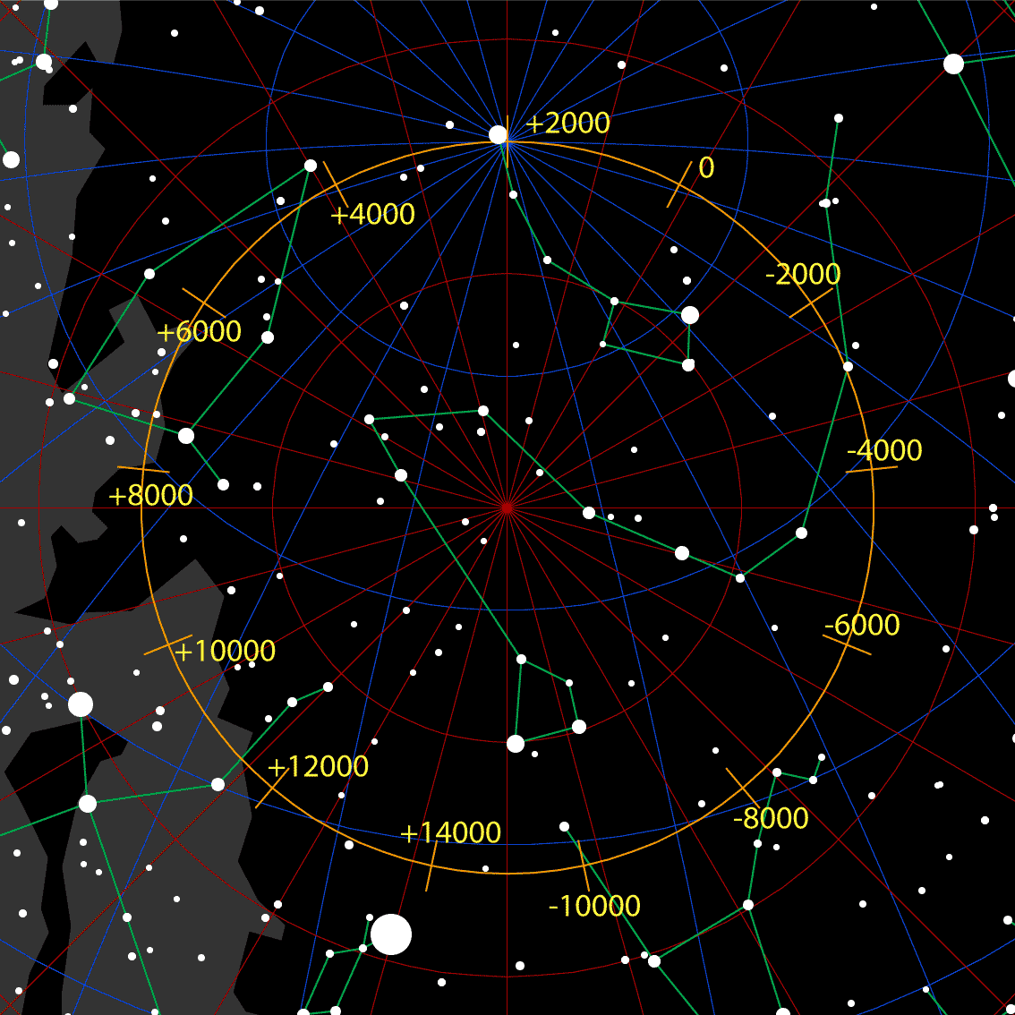
Precession

Slide 31
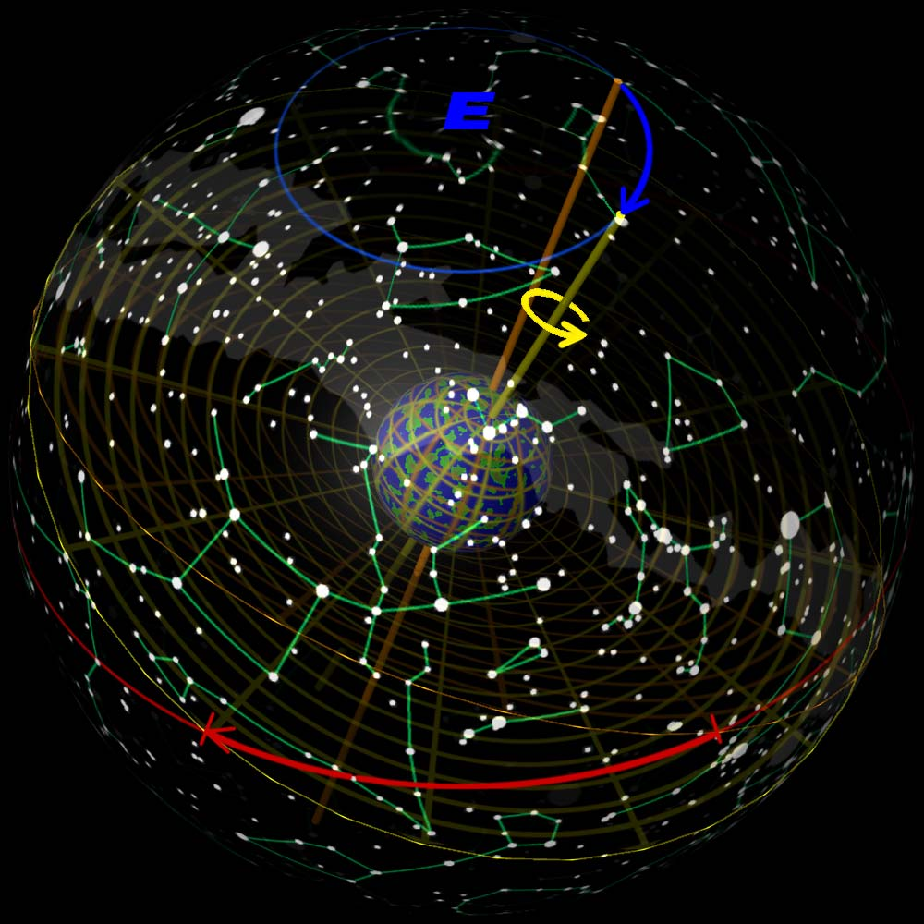
Precession

Slide 32
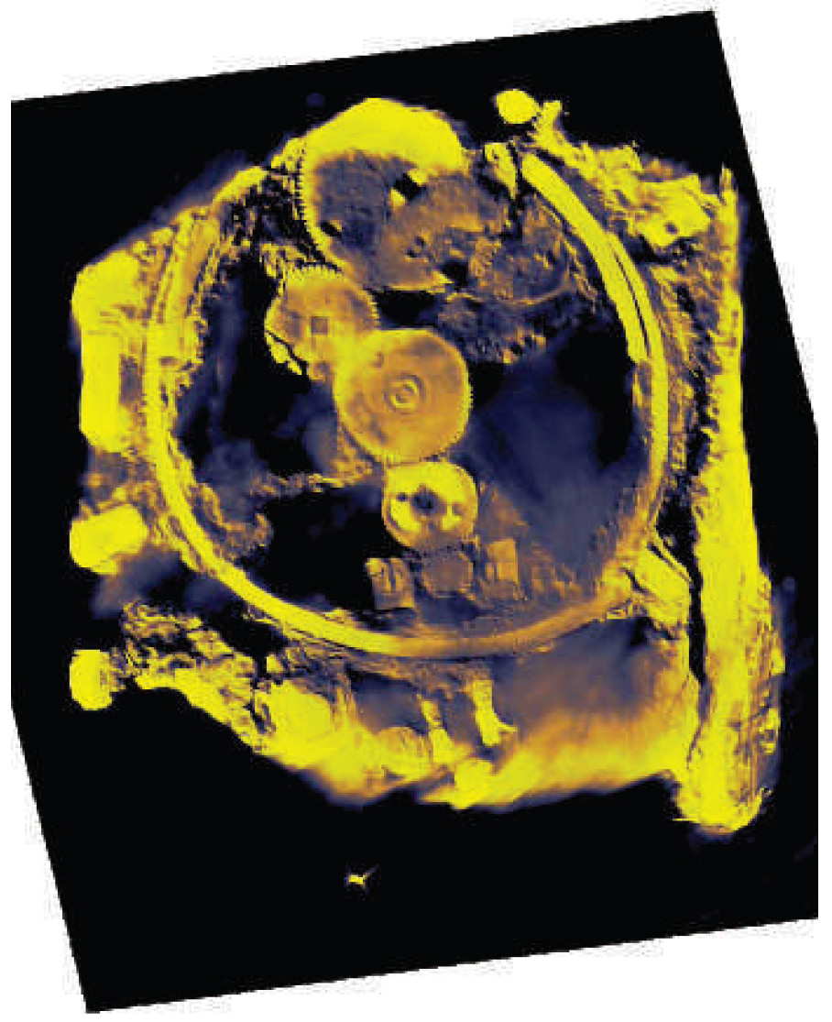
… and Astronomy
Greek Miracle ?
Hipparcus’ Moon Orbit Computer

Slide 33
Farnese Atlas: Hipparchus’ star catalog ?

Slide 34
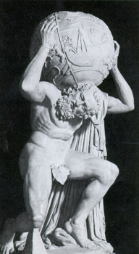
Farnese Atlas: Hipparchus star catalog ?
Farnese Atlas is the oldest surviving pictorial
Record of Western constellations
Roman times ~ A.D. 150,
presumed to represent constellations mapped in earlier Greek work
Atlas labors under the weight because he had been sentenced by Zeus to hold up the sky.
The globe shows:
a depiction of the night sky as seen from
outside the outermost celestial sphere
low reliefs depicting 41 (42) of the
48 classical Greek constellations including:
- Aries the ram
- Cygnus the swan
- Hercules

Slide 35
Claudius Ptolemaeus   AD 83-168

Slide 36
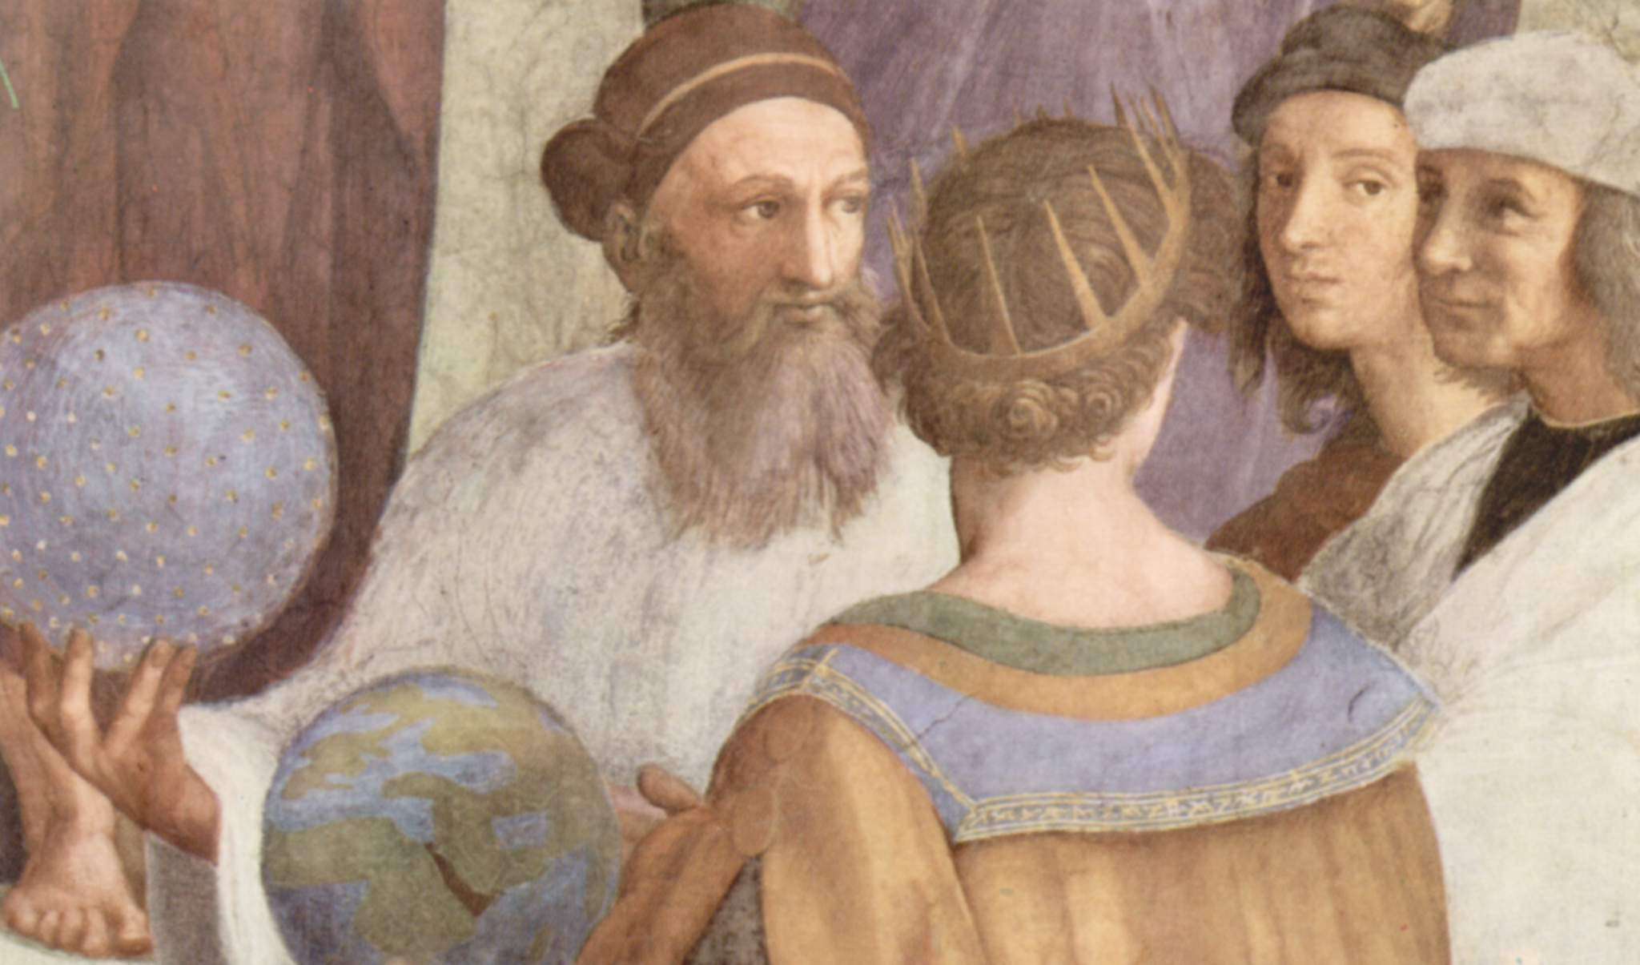
Claudius Ptolemaeus   AD 83-168

Slide 37
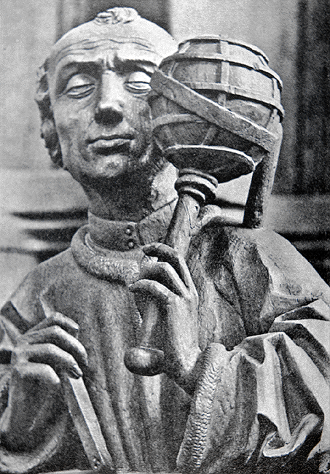
Claudius Ptolemaeus Thebaid/Ptolemais Hermiou- Alexandria 83-168 A.D.  Mathematician  Astronomer  Geographer  Astrologer additional interests in  Optics  Music  Philosophy

Slide 38
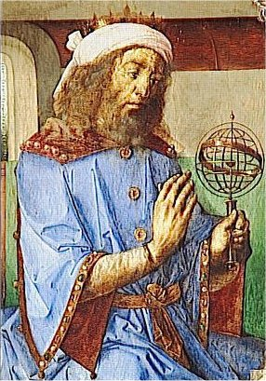
Claudius Ptolemaeus Culmination & Synthesis Hellenistic Astronomy Geography in Classical World Lasting and dominant influence, > 1500 yrs, European & Islamic science

Slide 39
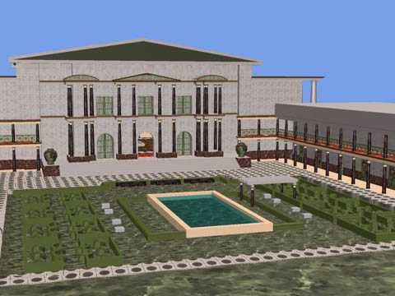
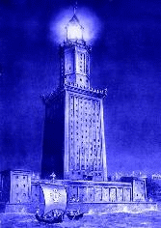
Alexandria: Birthplace of the Western Mind
Mouseion: the Library

Slide 40
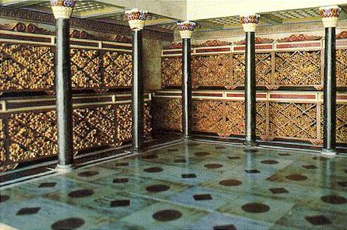
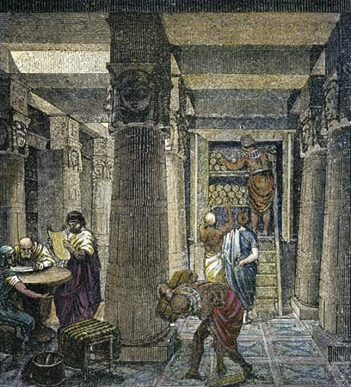
Great Library of Alexandria
Ptolemaeus’ Workplace:
Mouseion: World’s first “university”
Library: 700,000 book scrolls
Storage of all knowledge ancient world

Slide 41
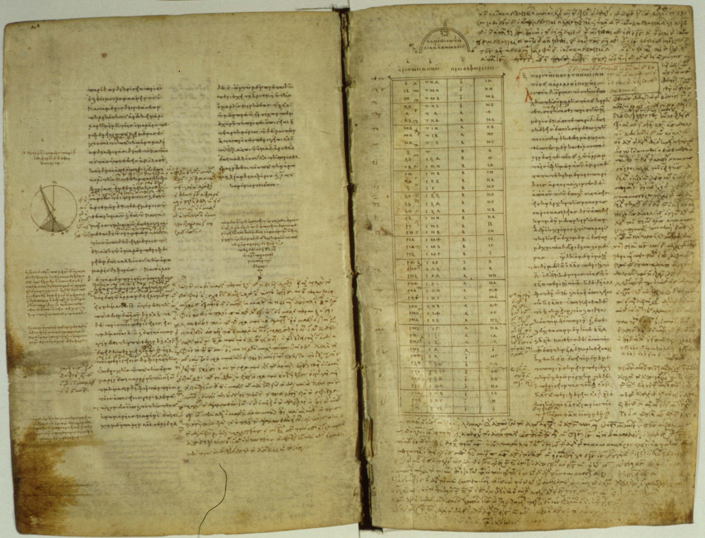
Ptolemy's Bibliography
Almagest (13 books) astronomy
Geography (8 books) geography
Optics (5 books) physics
Tetrabiblos (4 books) astrology
Harmonics (3 books)
Planetary Hypotheses (2 books) astronomy
Analemma
Canobic Inscription
Planispherium astronomy
Other astronomical works
Lost works

Slide 42
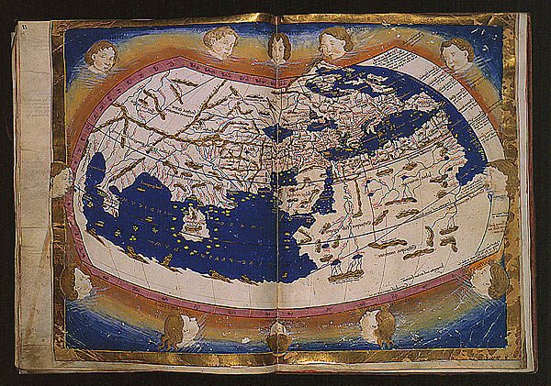
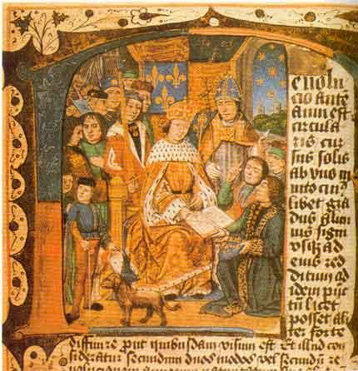
Almagest
Geografia
Tetrabiblos

Slide 43
Geografia

Slide 44
Geografia
Standard of geographical theory until the 1500’s,
until age of exploration
• Only surviving geographical treatise from antiquity
• Represents whole corpus of geographical knowledge
acquired in Graeco-Roman antiquity
• Mapping earth with mathematical procedures
from astronomy: coordinates, parallels, meridians
• Divided into 8 books:
Book 1: Introduction and
directions to recreate Ptolemy’s Map
Books 2-7: Latitudinal and longitudinal data for
~ 8,000 cities
Book 8: Description of 28 regional maps

Slide 45
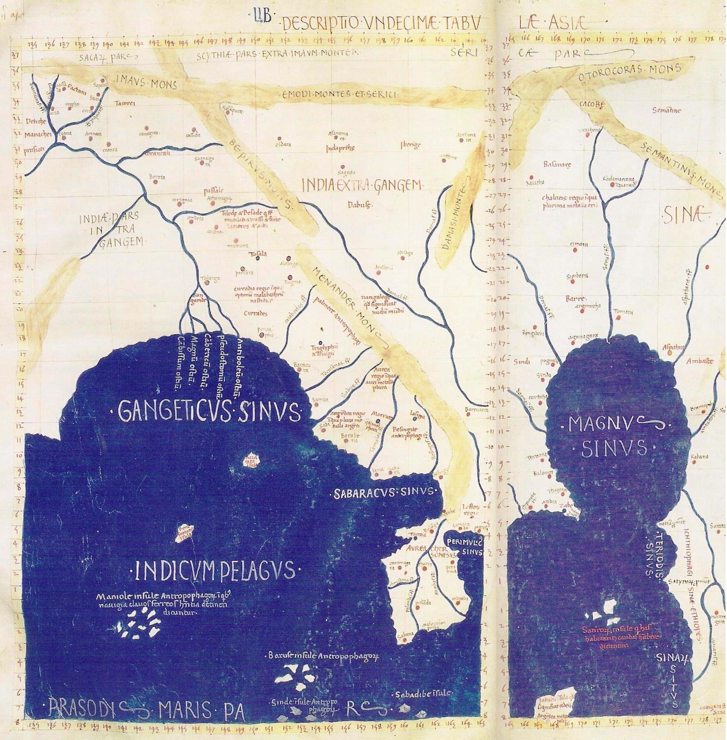
Geografia
Map of Ancient India:
crucial importance for development Roman
trade network with India

Slide 46
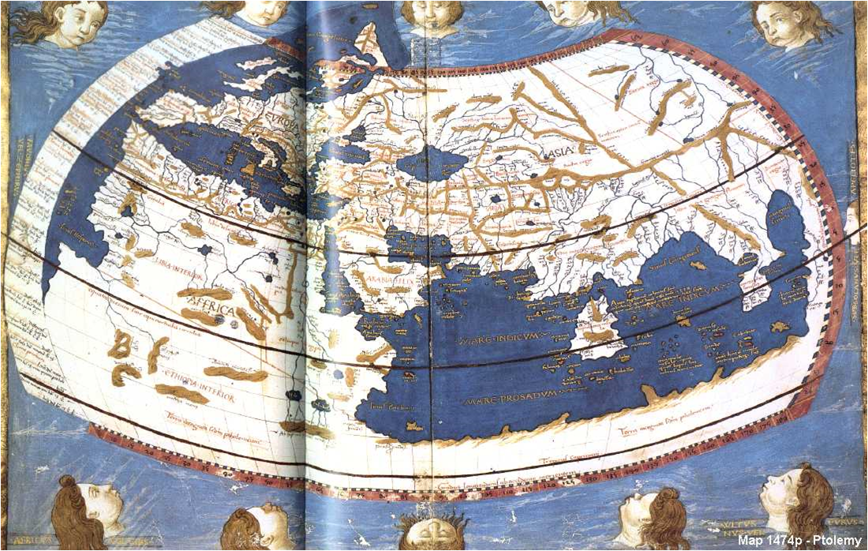
Geografia - Oikoumene/
Based on the work of his immediate predecessor,
Marinus of Tyre (80-130 A.D.)
Combined data from a variety of sources
Ptolemy was the first geographer to use longitude and latitude to create coordinates
Derived 21 latitude lines – fairly accurate
Described 4 different projections
Believed the oikoumene (inhabited world) to span
180 degrees (longitude) of the earth’s 360
Limits of the oikoumene
Northern bound: 63°N (the Thule parallel)
Southern bound: 16°25’S
(the parallel opposite the equator from the one running through Meroë)
Oikoumene stretches from
the Canary Islands in the west to China in the east

Slide 47
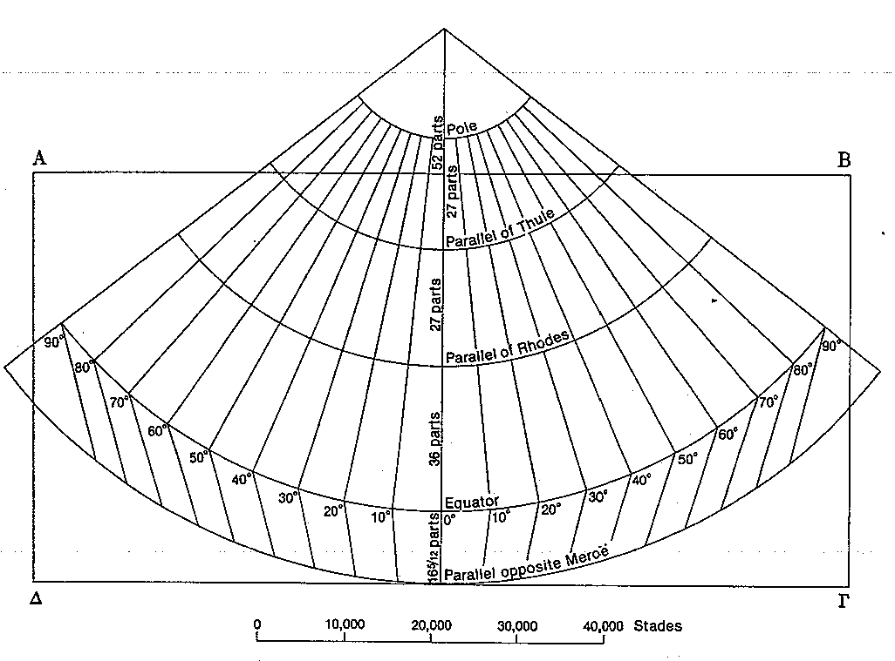
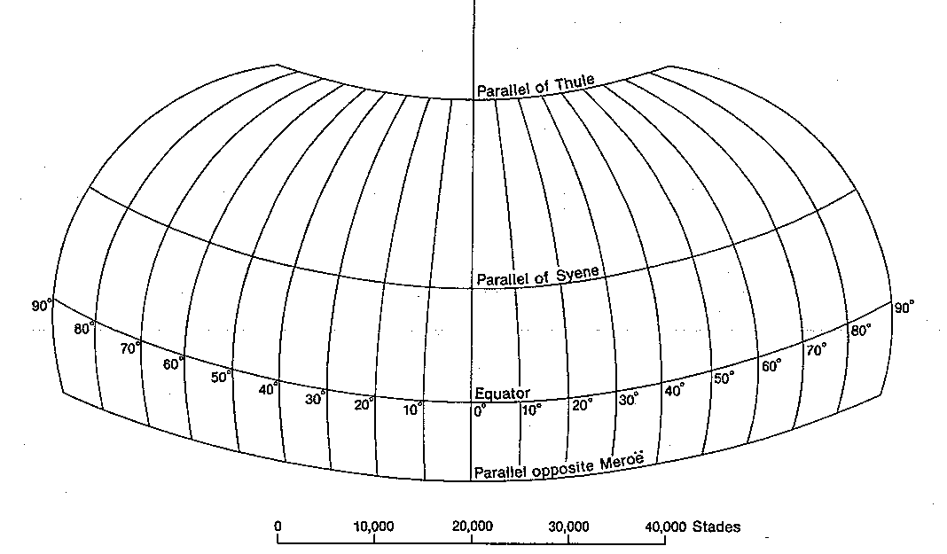
Geografia: four Map Projections
Projection 2
Projection 1
Straight meridians & Straight parallels
Very similar to Marinus’ map
Projection 2
Straight meridians & Curved parallels
Preferred method of Ptolemy’s successors
Constant scale in relation to Rhodes parallel
36+1 parallel meridians, each 5 degrees apart
Projection 3
Curved meridians & Straight parallels
made extreme parallels more accurate
Projection 4
View of globe from distance
External rings represent latitude lines
Projection 3

Slide 48
Almagest - the Greatest
 
Almagest, Greek copy 9th century

Slide 49
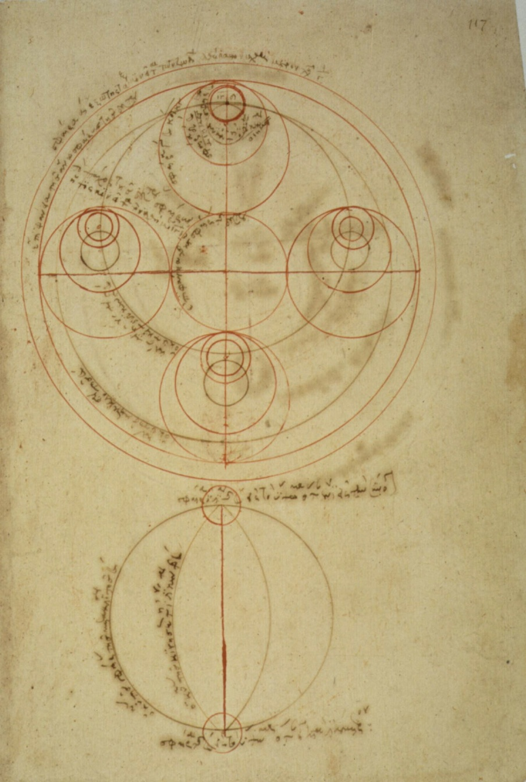
  - Almagest
Almagest, Greek copy 13th century
“The Great Book”
Most Important & Influential
Astronomical Work of Antiquity
Mathematical and Astronomical treatise proposing
the complex motions of stars and planetary paths
Written in 147 / 148 A.D.:
inscription in Canopus, by Ptolemaeus
Thirteen Books
Original in Greek:
Mathematike Syntaxis - Mathematical Treatise
He Megale Syntaxis - “The Great Treatise”
Best known by its Arab name:
Almagest - “The Great Book”

Slide 50
Almagest the Greatest
One of the most influential scientific works in history
(along with Euclid’s “Elements”, Copernicus’ “Revolutionibus”,
Galilei’s “Dialogues” Newton’s “Principia”,
Darwin’s “Origin of Species”)
One of most influential books of all time
(perhaps only after Bible, Qur’an,
along with Euclid’s “Elements”, …)

Slide 51
Almagest the Greatest
Masterwork technical exposition
Brilliant synthesis
Theoretical Astronomy
Practical Handbook computation Ephemerides

Slide 52
Almagest the Greatest
Systematic methodology
Observational Data
Numerical parameters planetary models
Construction tables celestial phenomena
(solar, lunar & planetary positions; solar & lunar eclipses, …)

Slide 53
Almagest the Greatest
More than any other book, demonstrated
complex phenomena of heavens
demonstratable & observable regularities
underlying mathematical description
predictions celestial events
Implication:
Secrets other aspects of our world
also understandable via underlying regularities

Slide 54
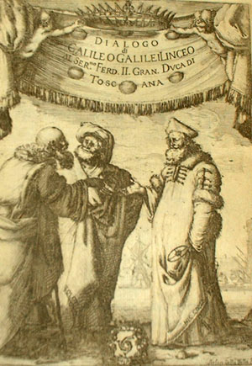
Geocentric Universe
Ptolemaeus’ Geocentric Universe is one
of the 2 world world systems under
discussion in Galileo Galilei’s book (1632)
Dialogue Concerning the
Two Chief World System
It had to give way to the heliocentric Universe, 1500 yrs after the Almagest

Slide 55
Almagest the Greatest
Success Almagest:
Loss of most of work scientific predecessors:
being obsolete, they ceased to be copied
Is this true ?

Slide 56
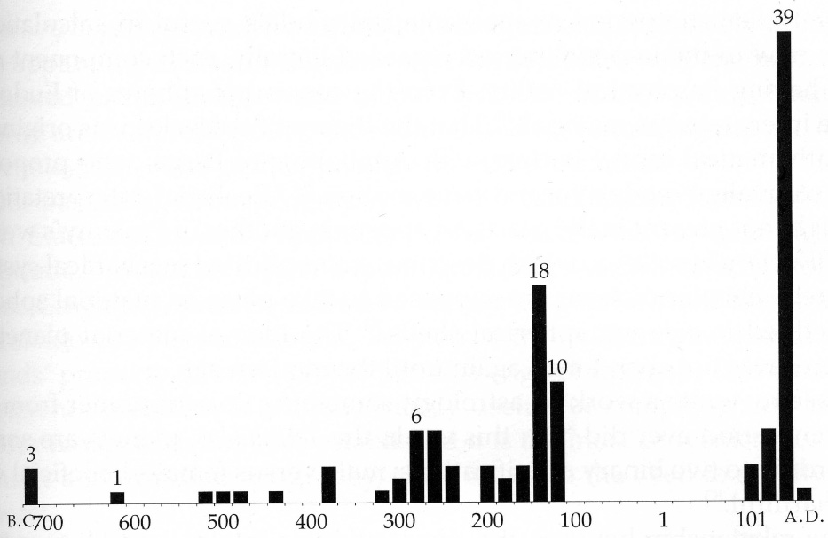
Almagest the Greatest

Slide 57
Epicyclic Theory

Slide 60
Epicycle Theory: refinements (2nd century B.C.)
0
Hipparchus:
Eccentric: placing the Earth away from the centers of the “perfect spheres”
Ptolemy: further refinements, including equants

Slide 61
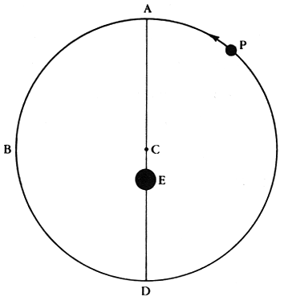
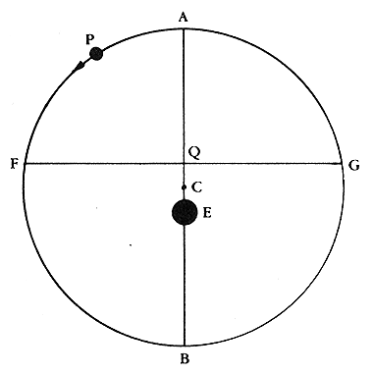
Ptolemaeus Epicycle Theory
eccentric
equant
epicycle (basic)

Slide 62
Early geometric planetary models
Epicycle
Anomalistic motion
Deferent
Longitudinal motion

Slide 63
The inferior and superior planets
Period of time = Number of anomalistic periods + Number of longitudinal periods

Slide 64
Ptolemaeus Epicycle Theory
Ptolemaeus Epicycle Theory
0

Slide 65
Almagest     

Slide 66
Syntaxis - Almagest
Almagest, Greek copy 13th century
“The Great Book”
most Important & Influential
Astronomical Work of Antiquity
Ptolemy first scientist to spell out inductive method:
- models framed from preliminary facts
- expand models by logical induction
- testing hypothesis against reality
Only surviving comprehensive ancient
treatise on astronomy:
- most important source of information on
ancient Greek astronomy
Geocentric Model
Epicycle Theory
Dominated astronomy for > 13 centuries
- Roman (Byzantine, Western) world
Arab world

Slide 67
Syntaxis - Almagest
Almagest, Greek copy 13th century
“The Great Book”
most Important & Influential
Astronomical Work of Antiquity
Geometrical models based on 800 yrs observations
(Babylonians, Hipparchus, …)
Models presented in convenient tables
Calculations fairly accurate for prediction
solar and lunar eclipses
Almagest also contains star catalogue
- appropriated version Hipparchus’ catalogue
- 48 constellations: modern ones, not full sky

Slide 68
Syntaxis - Almagest
Almagest, Greek copy 13th century
Ptolemaeus’ Cosmos
The cosmology of the Almagest:
five main points
each subject of a chapter Book I.
The celestial realm is spherical,
and moves as a sphere.
The earth is a sphere.
The earth is at the center of the cosmos.
The earth,
in relation to the distance of the fixed stars,
has no appreciable size,
must be treated as a mathematical point
The earth does not move.

Slide 69
Syntaxis - Almagest
Almagest, Greek copy 13th century
Ptolemaeus’
Planetary Models
Order of planetary spheres:
Moon
Mercury
Venus
Sun
Mars
Jupiter
Saturn
Sphere fixed stars

Slide 70
Syntaxis - Almagest
Almagest: 13 books
Almagest, Greek copy 13th century
Book I:
outline of Aristotelian cosmology:
- on the spherical form of the heavens,
- the (spherical) Earth lying motionless at centre
- the fixed stars and the various planets revolving
around the earth
- followed by explanation of chords with a set of
chord tables
- observations of the obliquity of the ecliptic
- introduction to spherical trigonometry
Book II:
problems associated with the daily motion attributed
to the heavens:
- risings and settings of celestial object
- length of daylight
- determination of latitude
- points at which the Sun is vertical
- shadows of the gnomon at the equinoxes and
solstices
- other things which change with the spectator's
position. There is also
- a study of the angles made by the ecliptic with
vertical, with tables.

Slide 71
Syntaxis - Almagest
Almagest: 13 books
Almagest, Greek copy 13th century
Book III:
- length of the year, and the motion of the Sun
- explains Hipparchus' discovery of the
precession of the equinoxes
- begin explanation epicycles
Books IV & V:
the motion of the Moon:
- lunar parallax
- motion of the lunar apogee
- sizes and distances of the Sun and Moon relative
to Earth
Book VI:
solar and lunar eclipses

Slide 72
Syntaxis - Almagest
Almagest: 13 books
Almagest, Greek copy 13th century
Books VII & VIII:
motions of the fixed stars:
- includes precession of the equinoxes
star catalogue of 1022 stars:
- described by positions in the constellations
- magnitude scale for brightness:
+ brightness brightest stars marked of the
1st magnitude (m = 1),
+ faintest 6th magnitude (m = 6),
limit human visual perception
+ each grade of magnitude considered twice the
brightness of the following grade (log. scale).
+ system believed to have originated with
Hipparchus
+ Stellar positions: Hipparchan origin
(despite Ptolemy's claim to the contrary)

Slide 73
Syntaxis - Almagest
Almagest: 13 books
Almagest, Greek copy 13th century
Book IX:
- general issues associated with creating models
for the five (naked eye) planets
- motion of Mercury
Book X:
motions of Venus and Mars
Book XI:
motions of Jupiter and Saturn
Book XII:
stations and retrogradations,
- occurring when planets appear to pause,
then briefly reverse their motion against the
background of the zodiac.
- Ptolemy understood these terms to apply to
Mercury and Venus as well as the outer planets
Book XIII:
motion in latitude:
the deviation of planets from the ecliptic

