Slide 1
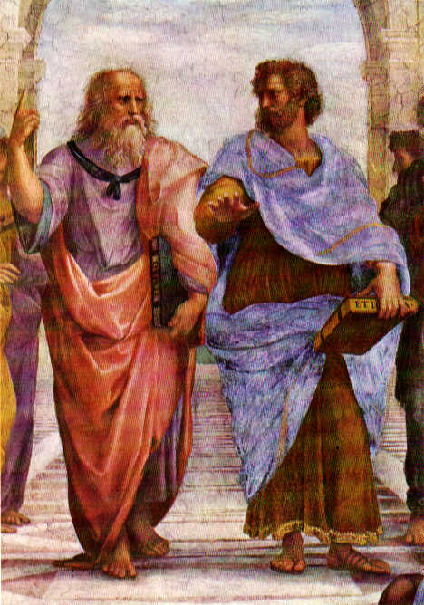
Order in the Cosmos:
how
Babylonians and Greeks
rationalized the heavens

Slide 2
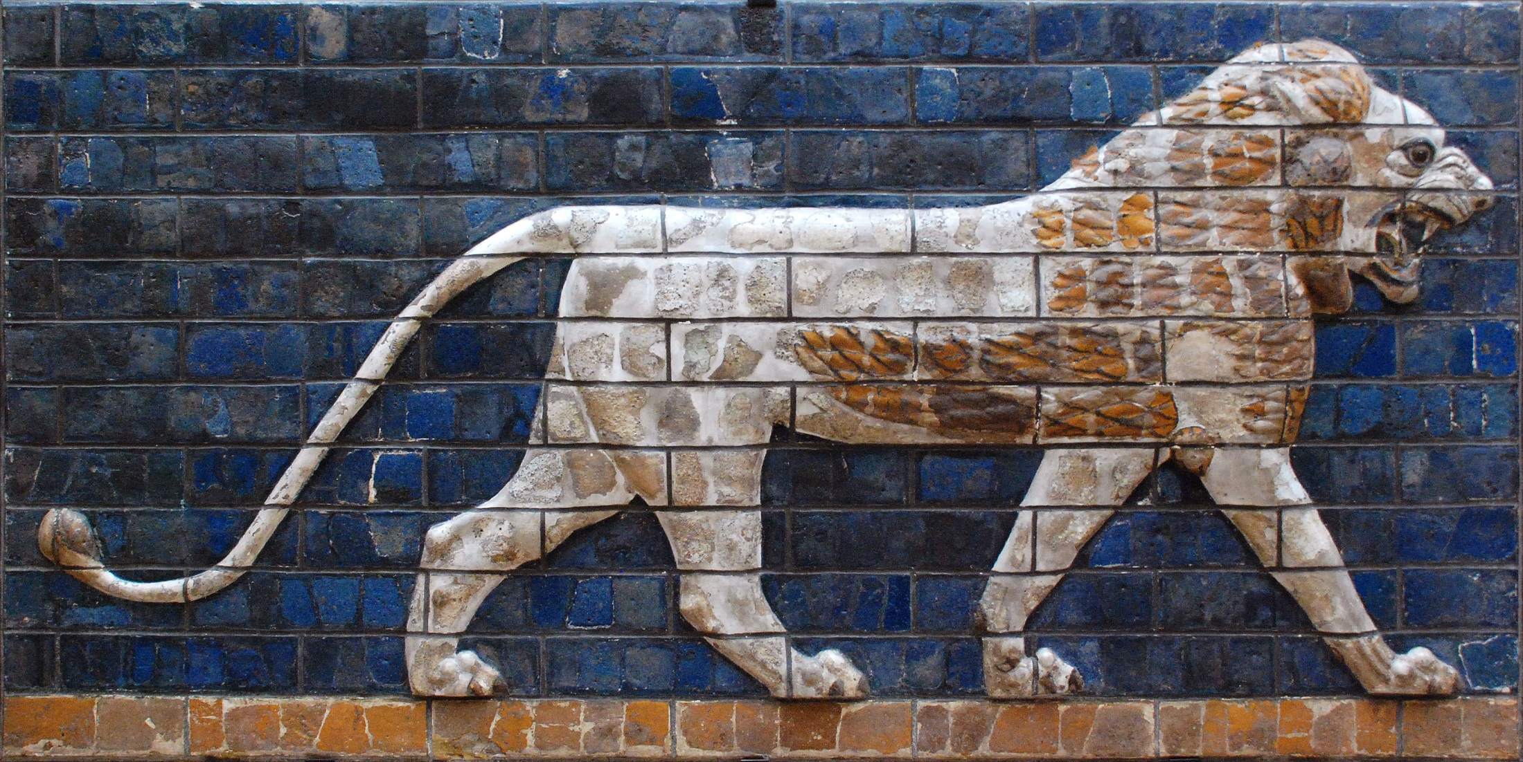
Babylonians Astronomers of Antiquity

Slide 3
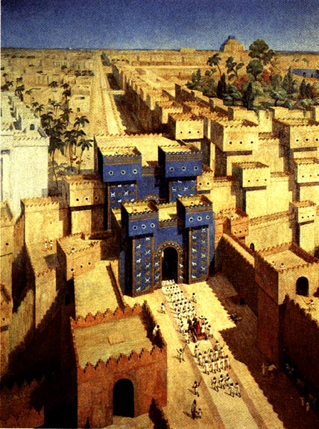

Slide 4
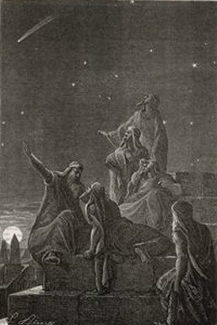
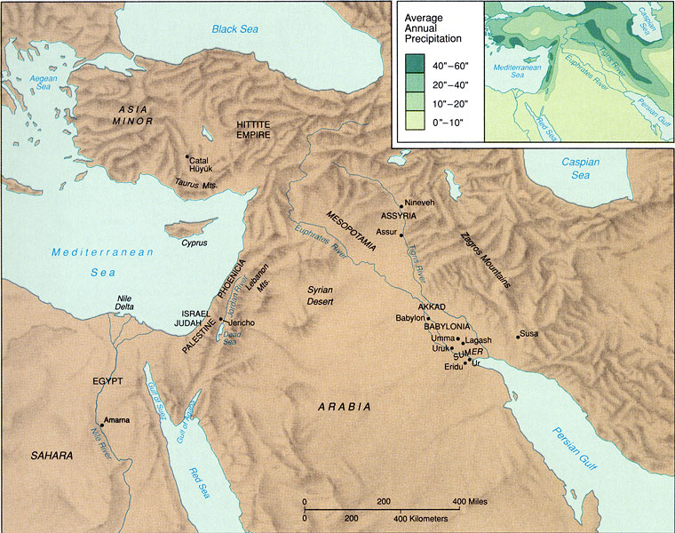
Babylonian Astronomy
Mesopotamia = “land of two rivers”
land between the rivers Euphrates & Tigris

Slide 5
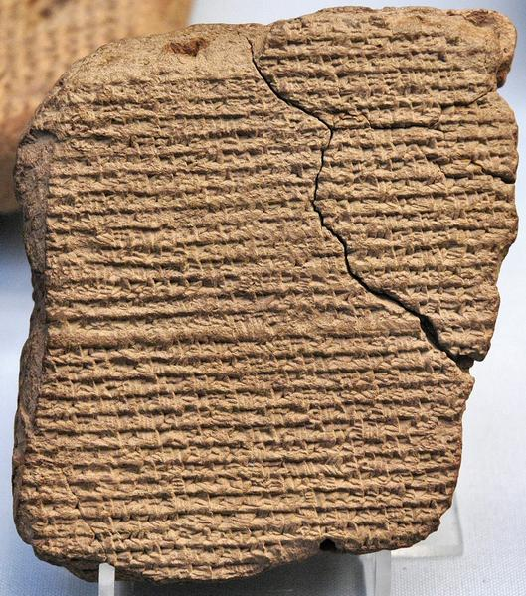
Babylonian Astronomy
Two distinct periods of flowering:
Old Babylonian astronomy:
during and after
First Babylonian dynasty (Hammurabi) 1830-1531 BCE
New Babylonian/Chaldean astronomy:
Neo-Babylonian (Nebuchadnezzar) 626-539 BCE
Medo-Persian 539-331 BCE
Seleucid 335-141 BCE
Parthian 129 BCE-224 AD

Slide 6
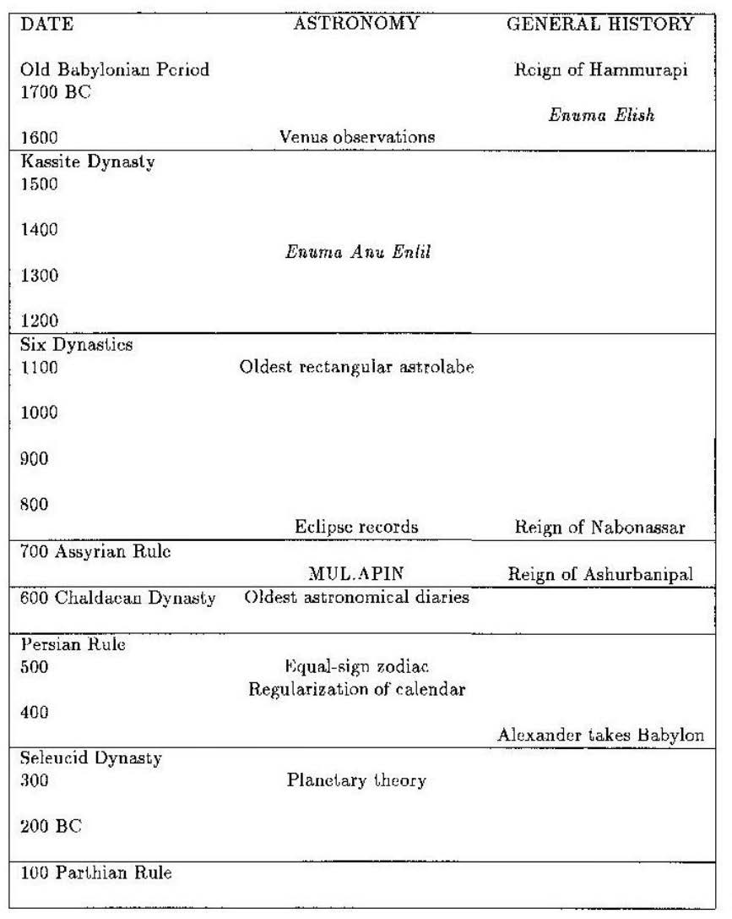
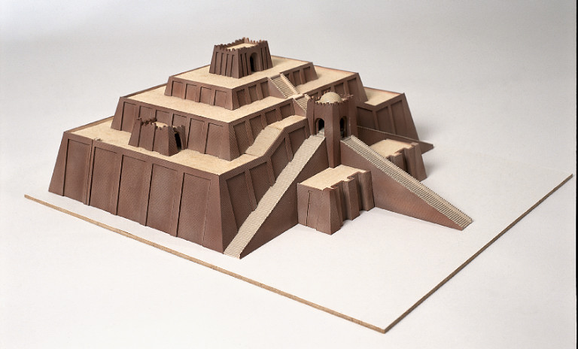
Babylonian Astronomy
timeline
Babylonian astronomy
Evans 1998

Slide 7
Babylonian Astronomy
Babylonian Astronomers:
most consistent, systematic and thorough
astronomical observers of antiquity
• First to recognize periodicity astronomical phenomena (e.g. eclipses !),
and apply mathematical techniques for predictions
• Systematically observed and recorded the heavens:
- Records spanning many centuries (> millennium)
- Archives of cuneiform tablets
- Famous Examples:
Enuma Anu Enlil 68-70 tablets Kassite period (1650-1150)
tablet 63: Venus tablet of Ammisaduga
MUL.APIN 700 BCE
oldest copy: 686 BCE

Slide 8
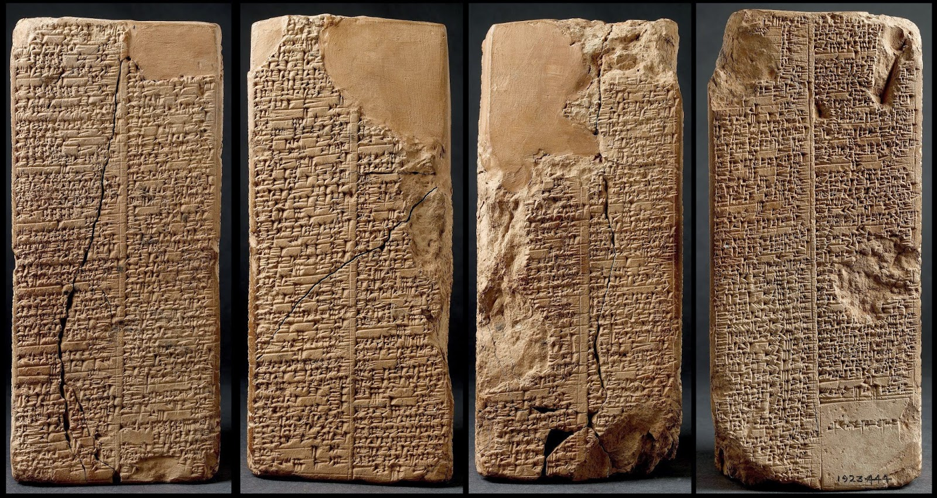
Astronomical Texts
Several types of astronomical texts
in Babylonian astronomy.
Four principal types:
1) astronomical diaries
2) goal year texts
3) ephemerides
4) procedure texts
Ephemerides:
- listing of positions of planets and
their meaning
(eg. extreme points retrograde path)
- predictive: positions based on
calculations (based on scheme)
- ephemerides for Moon
- ephemerides for planets
Procedure texts:
description of procedure(s)
to calculate ephemerides
-

Slide 9
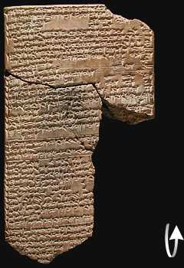
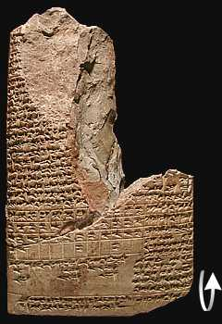
ENUMA ANU ENLIL
Old text, probably Kassite period
(1595-1157 BCE)
A major series of 68 or 70 tablets
dealing with Babylonian astrology.
bulk is a substantial collection of omens, estimated to number between 6500 and 7000,
interpreting a wide variety of celestial and atmospheric phenomena in terms relevant to the king and state

Slide 10
ENUMA ANU ENLIL
2. If with it a cloudbank lies on the right of the sun:
the trade in barley and straw will expand.
3. If with it a cloudbank lies to the left of the sun:
misfortune
4. If with it a cloudbank lies in front of the sun:
the king of Elam [will die]
5. If with it a cloudbank lies behind the sun:
the king of the Gutians [will die]
6. If in Pit babi the sun is surrounded by a halo in
the morning: there will be a severe heat in the
country and the Lamashtu-demon will attack the
country.
7. If with it a cloudbank lies to the right of the sun:
the king of Eshnunna will die.
8. If with it a cloudbank lies to the left of the sun: the
king of Subartu will die and his dynasty will come
to an end.
9. If with it a cloudbank lies in front of the sun: the
rains from heaven (and) the floods from the
depths will dry up.
10. If with it a cloudbank lies behind the sun: the
harvest of the land will not be brought in.

Slide 11
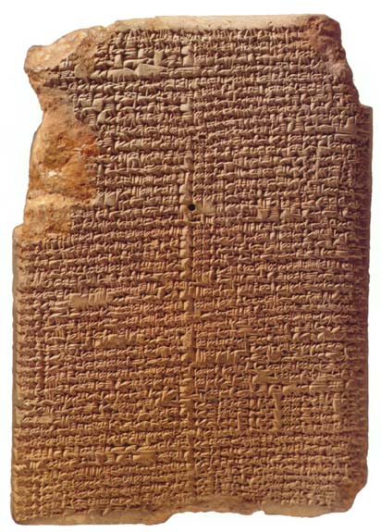
MUL.APIN
Around 700 BCE,
after king Nabonassar
- summary of astronomical knowledge
(Neugebauer)
- Parapegma (Evans)
Catalogue of stars & constellations
Schemes
heliacal risings/settings planets
Measurements lengths daylight
66 stars

Slide 12
Chaldean Astronomy
Most Chaldean astronomers strictly concerned with ephemerides,
not with theoretical models
Predictive planetary models empirical,
usually sophisticated arithmetical/numerical schemes
• Models do not involve geometry & cosmology (that’s the Greeks !)
• Discovery (lunar & solar) eclipse cycles & Saros period

Slide 13
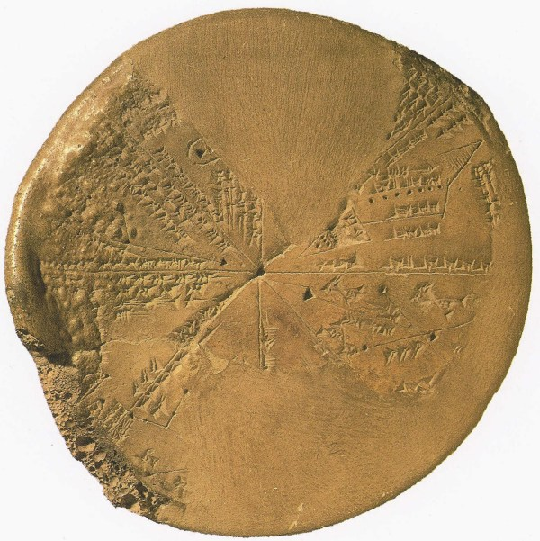
Babylonian Astronomy
Lasting Astronomical Influence:
• Constellation Names
• Zodiac
• Degree - unit angle
• Sexagesimal number system:
circle: 360 degrees
degree: 60 minutes
place value number system
(crucial for Greek science !)
• Eclipse Observations & Periods
• Synodic, Siderial, Draconic, Anomalistic
months
• and …

Slide 14
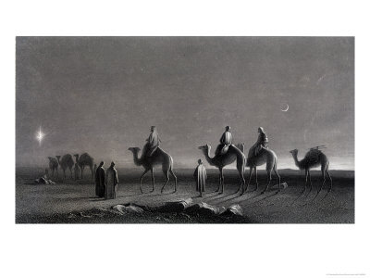
Magi: Chaldean Astronomers

Slide 15
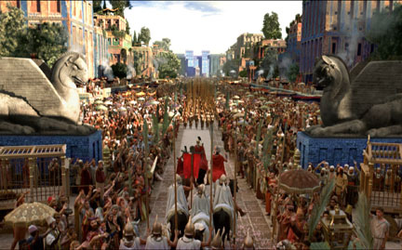
Babylonian Astronomy
Transmission:
• Transfer of Babylonian astronomical
knowledge essential for Hellenistic
astronomy
• Alexander the Great:
orders translation
astronomical records,
under supervision
Callisthenes of Olynthus,
to be sent to his uncle
Aristoteles
• Direct Contacts:
e.g. Hipparchus

Slide 16
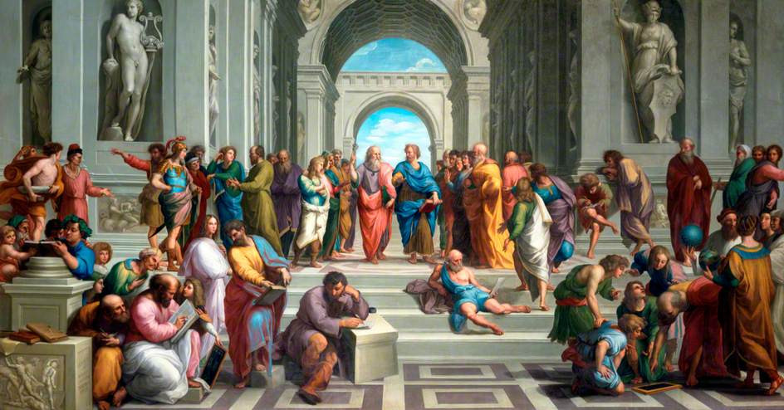
Reason & the Cosmos Greek Cosmology

Slide 17
Timeline & Overview Greek Cosmology

Slide 18
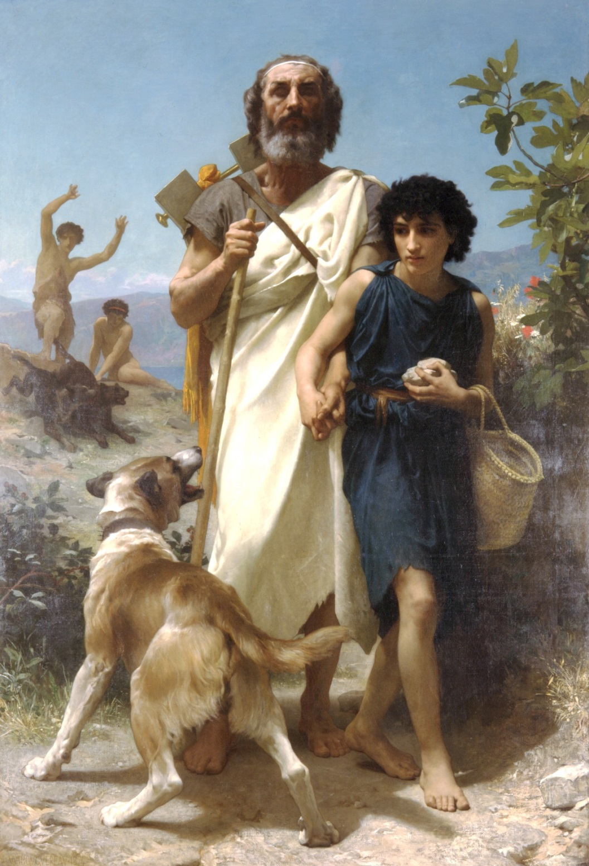
8th Century BCE: mythical cosmology
Homerus and guide
W-A Bouguereau

Slide 19
6th Century BCE: Pre-Socratic Ionian Natural Philosophers
Homerus and guide
W-A Bouguereau

Slide 20
5th Century BCE: Pre-Socratic Natural Philosophers
Homerus and guide
W-A Bouguereau

Slide 21
4th Century BCE: from Plato to Aristoteles
Homerus and guide
W-A Bouguereau

Slide 22
3rd Century BCE – 1st Century AD: the Hellenistic Scientific Revolution
Homerus and guide
W-A Bouguereau

Slide 23
Ionia Natural Philosophers

Slide 24
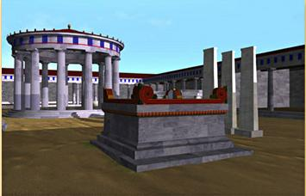
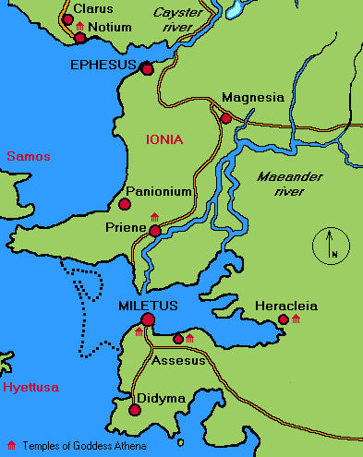
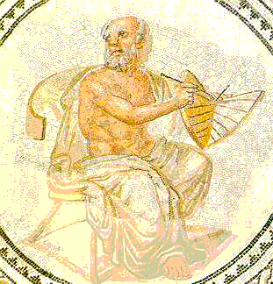
Ionia, 6th century B.C.
Phase transition in human history:
the mythical world obsolete
… the Ionian coast, 6th century B.C.,
regularities and symmetries in nature
recognized as keys to the cosmos …
Pythagoras
Anaximander
Miletus
Mathematics as natural language of cosmos
➔ Physical cosmos modelled after ideal form,
encrypted in concepts of geometry
… Anaximander of Miletus: the Apeiron
Pythagoras of Samos: music of spheres
Plato: Platonic solids

Slide 25
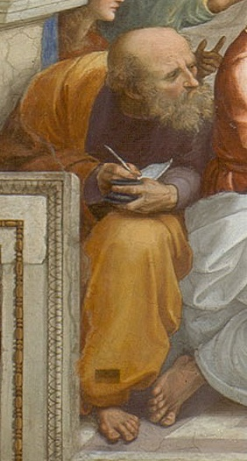
Anaximander the First Cosmologist (Miletus, 610-546 BCE)
Cartography of Anaximander

Slide 26
Anaximander the First Cosmologist (Miletus, 610-546 BCE)
Cosmology of Anaximander:
Earth floats free without falling
Karl Popper:
“one of the most boldest, most
revolutionary, and most portentous ideas
in the whole history of human thinking”

Slide 27
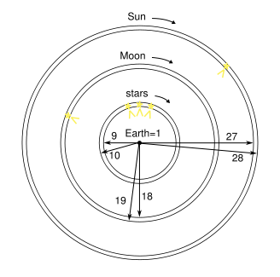
Anaximander founder scientific
Astronomy and Cosmology (Miletus, 610-546 BCE)
Cosmology Anaximander
heavenly sphere is a ring of fire
invisible, surrounded by fog
Heavenly bodies part of ring, visible through openings through fog.
ring for the Moon
ring for the Sun

Slide 28
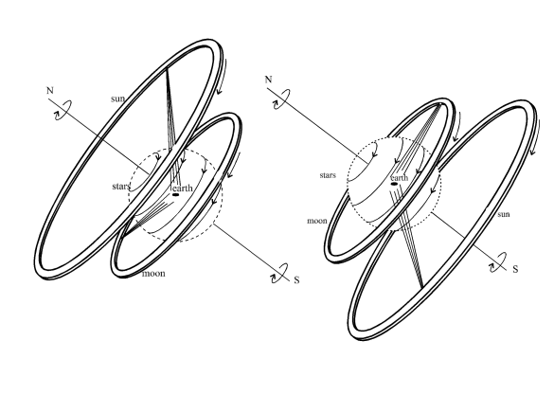
Anaximander founder scientific
Astronomy and Cosmology (Miletus, 610-546 BCE)
Daytime in summer
Nighttime in winter
Cosmology Anaximander
Ring model could not explain all observations
Anaximander preferred symmetry & number 3
diameter Sun ring = 27 x diameter Earth
diameter Moon ring = 18 x diameter Earth
diameter stellar ring = 9 x diameter Earth

Slide 29
“The Apeiron, from which the elements [are formed], is something that is different”
Anaximander founder scientific
Astronomy and Cosmology (Miletus, 610-546 BCE)
The idea of Apeiron, the “infinite” or “limitless” out of which the world emerged, is suggested to be close to our current idea of vacuum energy

Slide 30
Classical Greek Cosmology Plato & Aristoteles

Slide 31
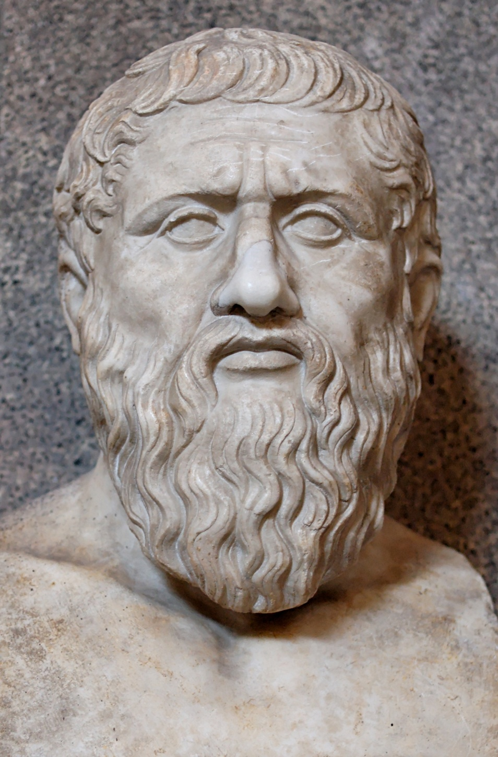
Plato (Athens, 428-348 BCE)
Geometry as
organizing principle
of the world
Founded Academy, Athens
Philosophy
Mathematics
Philosophical Dialogues

Slide 32
Academia Platon
“Let no one unversed
in geometry enter here”

Slide 33
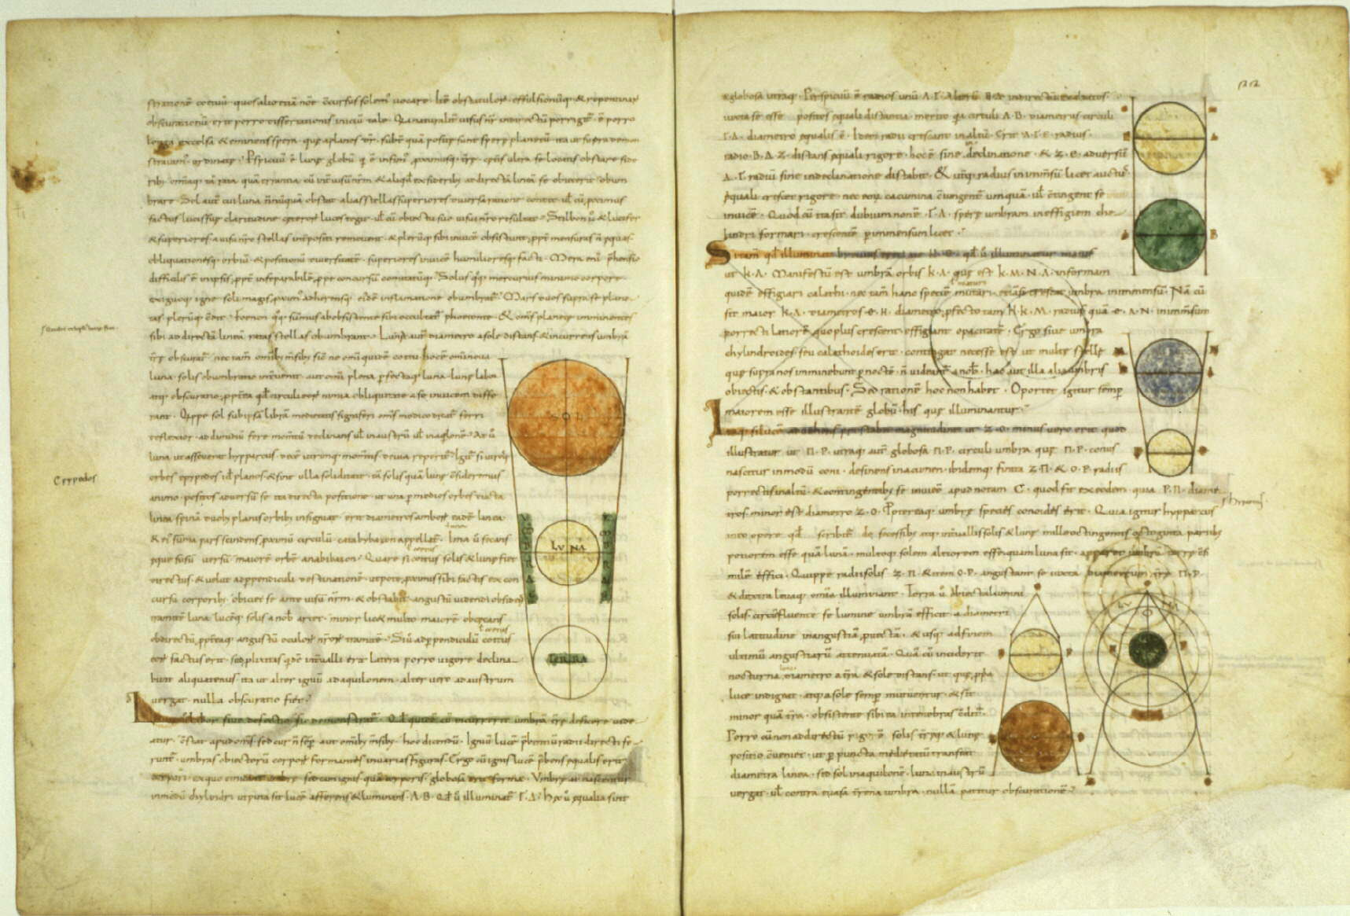
Timaeus: Plato’s Cosmology

Slide 34
Timaeus: Plato’s Cosmology
Plato’s Cosmic Scheme:
• Demiurge, divine craftsman, is a mathematician:
• Universe constructed according to geometric principles

Slide 35
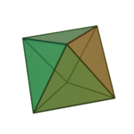
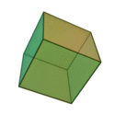
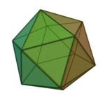
Platonic Solids
the Five Platonic solids
● there are only five convex regular polyhedra !
● Plato identified them with the cosmos and its constituents
Tetrahedron:
fire
Octahedron:
air
Cube:
earth
Icosahedron:
water

Slide 36
Platonic Solids
Dodecahedron Quintessence
of which the Cosmos itself is made:
“the stuff for embroidering
the constellations on the heavens”
Tetrahedron:
fire
Octahedron:
air
Cube:
earth
Icosahedron:
water

Slide 37
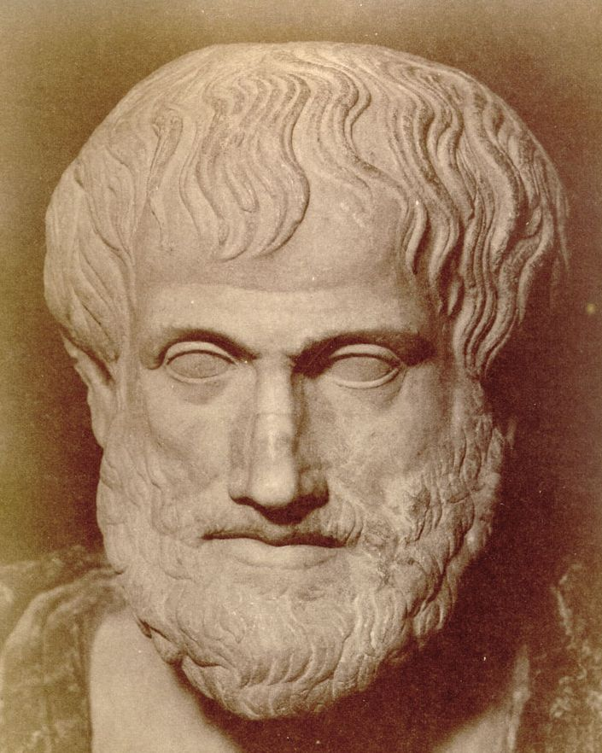
Aristoteles (Chalcidice-Athens, 384-322 BCE)
- “Aristotle was the first genuine scientist
in history ... every scientist is in his debt”
Physics, Metaphysics,Astronomy,
Poetry, Theater, Music,
Logic, Rhetoric, Ethics,
Politics, Government,
Geology, Biology, Zoology
- Student Plato
- teacher Alexander the Great
- literary style:
“River of Gold” (Cicero)
- founded Lyceum, Athens
- Dominant influence for over 1800 years
both in Christian philosophy & theology
and in Muslim intellectual history
Father of Western Science

Slide 38
Aristoteles (384-322 BCE)
I saw the Master there of those who know, Amid the philosophic family,
By all admired,
and by all reverenced;
There Plato too I saw, and Socrates, Who stood beside him closer than the rest.
Dante, Divina Commedia
(1st level hell)

Slide 39
On the Heavens
Aristotle’s cosmological work
the most influential treatise of its kind in the history
of humanity.
It was accepted for more that 18 centuries from its
inception (around 350 B.C.) until the works of
Copernicus in the early 1500s.
Key aspects of Aristotle’s Cosmology:
1) Earth is at the centre of the Universe
2) the Universe is finite
3) the Universe is eternal and unchanged
4) the motion of the heavenly bodies are
uniform and circular

Slide 40
On the Heavens
Four causes
Aristotle suggested that the reason for anything coming about can be attributed to four different types of simultaneously active causal factors:
Material cause - the material out of which something
is composed.
Formal cause - its form, i.e., the arrangement of
that matter.
Efficient cause - "the primary source", or that
from which the change under
consideration proceeds.
This is akin to the modern concept
of cause.
Final cause - its purpose, or that for the sake of
which a thing exists or is done. This
covers modern ideas of motivating
causes, such as volition, need, desire,
ethics, or spiritual beliefs.

Slide 41
On the Heavens
Elements - composition
4 elements (Empedokles)
1) Earth cold and dry - modern idea solid.
2) Water cold and wet - modern idea liquid
3) Air hot and wet - modern idea of a gas.
4) Fire hot and dry - modern ideas of plasma
in addition,a 5th element
5) Aether divine substance making up the
spheres and heavenly bodies
(stars and planets)

Slide 42
On the Heavens
Movement of bodies
- all bodies, by their very nature, have a natural way
of moving.
- Movement is not, he states, the result of the
influence of one body on another
- Some bodies naturally move in straight lines
- others naturally stay put.
- Yet another natural movement:
the circular motion.
Since to each motion there must correspond a
substance, there ought to be some things that
naturally move in circles:
the heavenly bodies
(made of a more exalted and perfect substance
than all earthly objects).

Slide 43
On the Heavens
Aristotle’s Cosmos
Aristotle’s Cosmos made of
a central earth (which he accepted as spherical)
surrounded by
- the moon,
- the sun
- stars all moving in circles around it.
This conglomerate he called ``the world''.
Note the strange idea that all celestial bodies
are perfect, yet they must circle the imperfect Earth.
The initial motion of these spheres was caused by the
action of a ``prime mover'' which (who?) acts on the
outermost sphere of the fixed stars;
the motion then trickles down to the other spheres
through a dragging force.
Heavens consisted of a complex system of 55 spheres !
- could explain and predict the motions of
stars and planets
- a real scientific theory

Slide 44
Aristotles’ Cosmos
Cosmos of Aristoteles
Moon
Mercury
Venus
Sun
Mars
Jupiter
Saturn

Slide 45
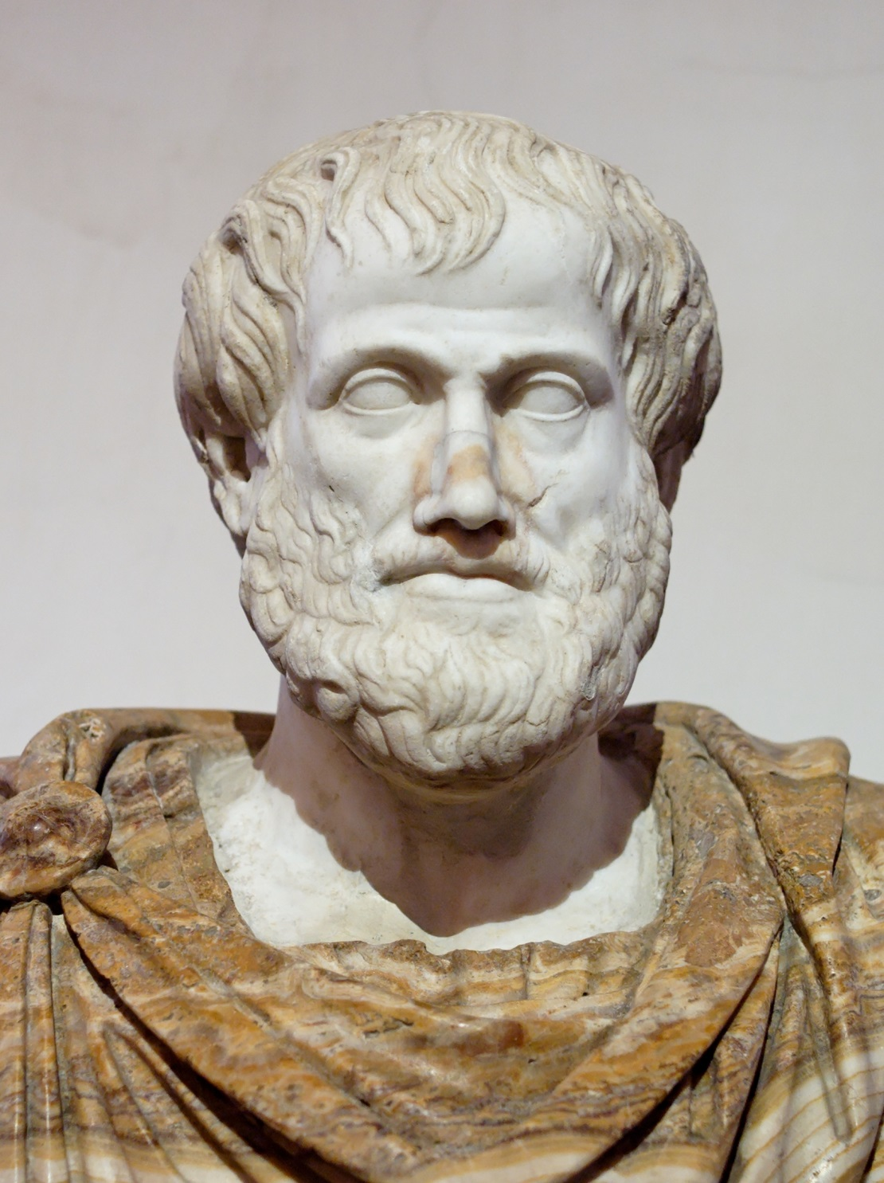
On the Heavens
Aristotle’s cosmology
this world is unique.
the argument goes as follows:
- earth (the substance) moves naturally to the center
- if the world is not unique there ought to be
at least two centers
- but then, how can earth know to which of
the two centers to go?
- since ``earthy'' objects have no trouble deciding
how to move, there can only be one center
(the Earth) circled endlessly by
all heavenly bodies.
Note:
- this cosmological tenet turned out to be
completely wrong with the discovery of the
moons of Jupiter

Slide 46
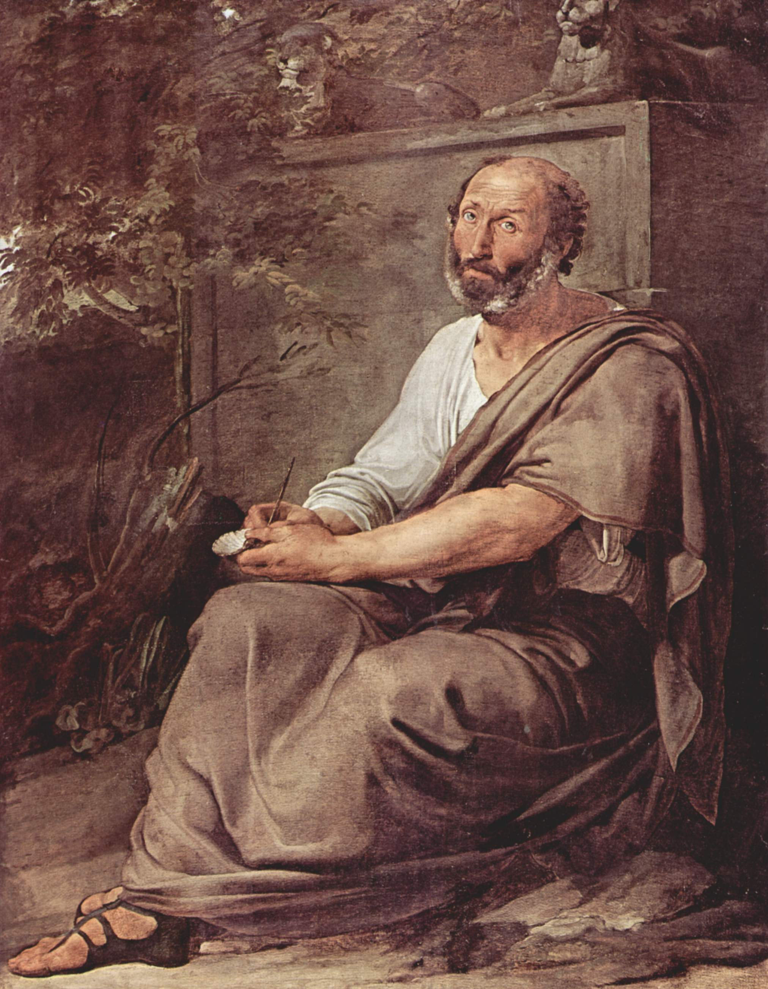
On the Heavens
Existence
the world did not come into being at one time
The world has existed, unchanged for all eternity
- it had to be that way since it was ``perfect'';
- the universe is in a kind of ``steady state scenario''.
Still, since he believed that the sphere was the most perfect of the geometrical shapes,
the universe did have a center (the Earth)
and its ``material'' part had an edge,
which was ``gradual''
- starting in the lunar and
- ending in the fixed star sphere.
Beyond the sphere of the stars the universe continued
into the spiritual realm where material things cannot be
This is in direct conflict with the Biblical description
of creation, and an enormous amount of effort was
spent by the medieval philosophers in trying to
reconcile these views.

Slide 47
Pictorial view
Aristotelian view of the Cosmos

