Slide 1
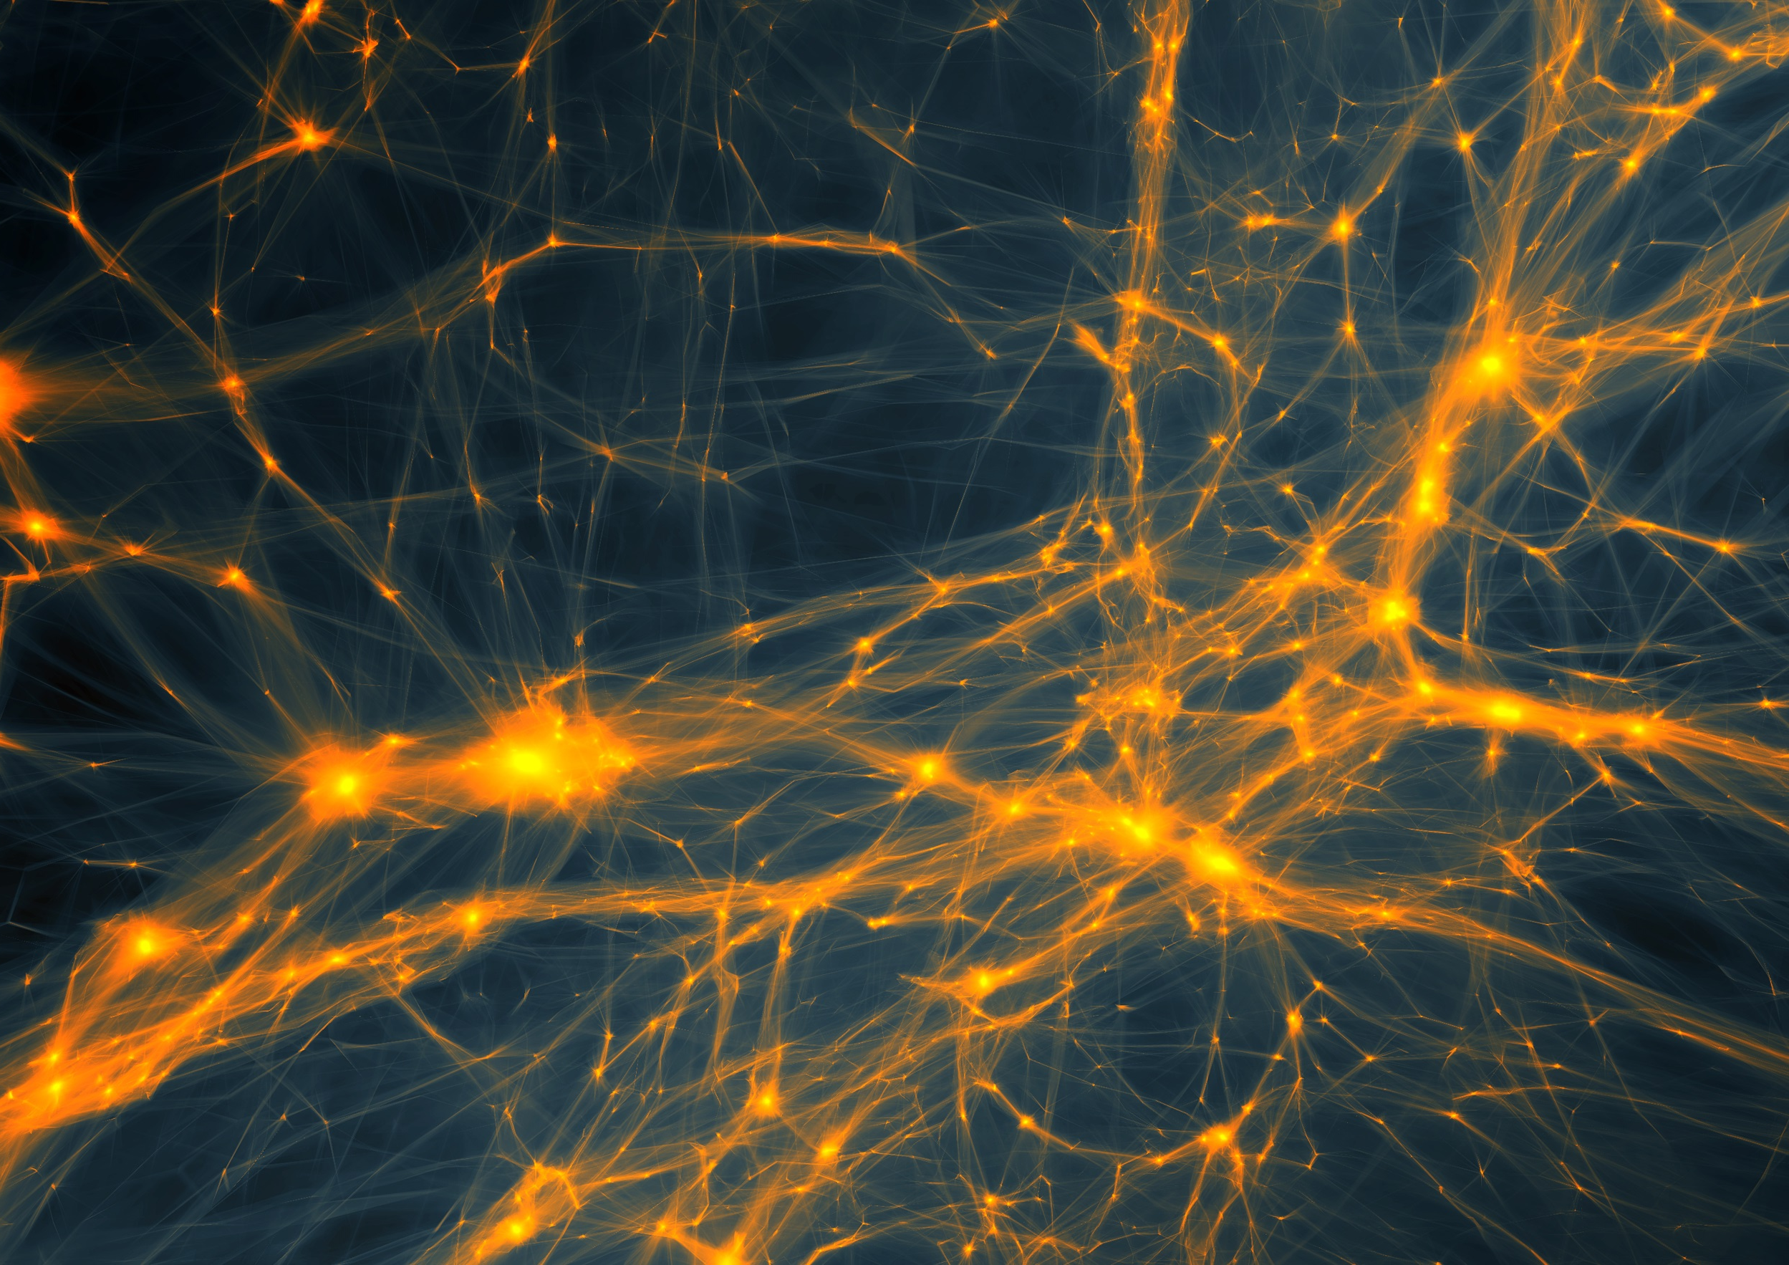
from
Cosmic Birth
to
Cosmic Web

Slide 2
FRW Dynamics
In a FRW Universe,
densities are in the order of the critical density,
the density at which the Universe has a flat curvature

Slide 3
FRW Dynamics
In a matter-dominated Universe,
the evolution and fate of the Universe entirely determined
by the (energy) density in units of critical density:
Arguably,  is the most important parameter of cosmology !!!
Present-day
Cosmic Density:

Slide 4
what the Universe exists of:
Cosmic Constituents

Slide 5
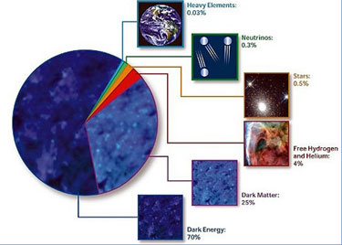
Cosmic Components

Slide 6
Cosmic Energy Inventarisation
sterren slechts ~0.1% energie
Heelal
Fukugita & Peebles 2004

Slide 7
Cosmic Constitution
Cosmic Pie Diagram
Changes in Time:

Slide 8
Matter-Dark Energy
Transition
matter
Radiation-Matter transition
radiation
dark energy

Slide 9
matter
radiation
Matter-
Dark Energy
Transition
Radiation-Matter transition
dark energy

Slide 10
Dark Matter

Slide 11
Matter
• Baryonic Matter
• Nonbaryonic Dark Matter

Slide 12
Baryonic Matter
The amount of baryonic matter in the Universe is (by now) very well determined, by two independent determinations:
1) Primordial Nucleosynthesis
2) Acoustic Oscillations in CMB power spectrum,
2nd peak (CMB)

Slide 13
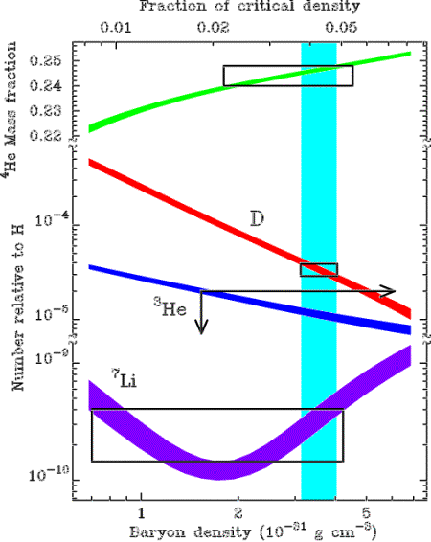
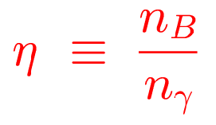
Baryonic Matter: primordial nucleosynthesis
From measured light element abundances:

Slide 14
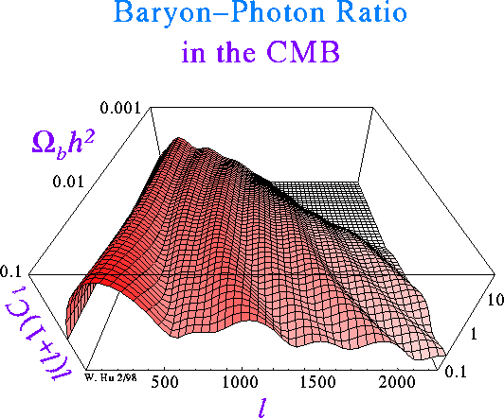
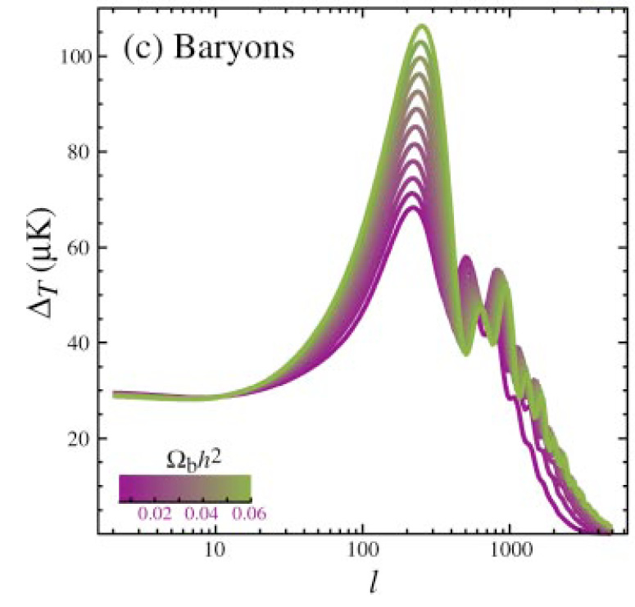
Baryonic Matter: CMB
Due to baryon drag in the primordial baryon-photon gas, 2nd peak in CMB spectrum is suppressed:

Slide 15
Baryonic Matter
Cosmic Baryons
Fukugita & Peebles 2004

Slide 16
Baryonic Matter
Note:
STARS are but a fraction of the total amount of baryonic matter
There is still a large amount of undetected baryonic matter:
- hiding as warm Intergalactic Gas (WHIM) ?
Fukugita & Peebles 2004

Slide 17
Non-baryonic DM: candidates
WIMPs: Weakly Interacting Massive Particles
- neutrinos
- sterile neutrinos
- neutralinos
- ....
MACHOs: Massive astrophysical compact halo object
Modified Gravity: modification of General Relativity
SIMPs ... Strongly Interacting Massive Particles

Slide 18
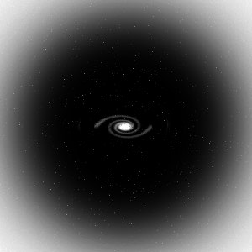
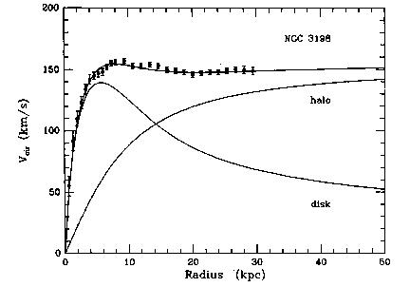
Dark Matter: disk galaxies
The dark matter in these galactic dark halos will keep the stars and gas clouds in the outer reaches of the spiral galaxies swirling around the galaxy with such high velocities.
GM(r)/r = v_{c}²
Moreover, the dark matter halos would provide a natural stabilization of the thin and fragile rotating spiral discs, which otherwise are rather unstable structures which would easily be disrupted by “perturbative vibrations”.
Van Albada & Sancisi

Slide 19
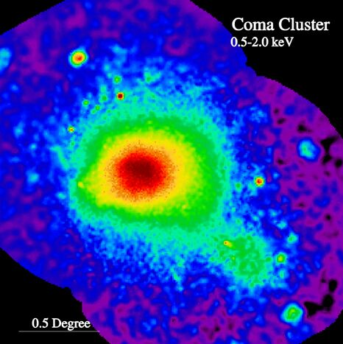
Clusters of Galaxies: X-ray intracluster gas
Baryonic matter in clusters is not only confined to galaxies:
~ 2 to 5 times more baryonic mass in the form of a diffuse hot X-ray emitting
Intracluster Gas,
trapped and heated to a temperature of the order of
T ~ 10⁸ K
by the gravitational potential of the cluster.
At such high temperatures, this gas is a fully ionized plasma, producing powerful X-ray emission, bremsstrahlung radiation induced by the electron-ion interactions.
M51
ROSAT X-ray image Coma Cluster

Slide 20
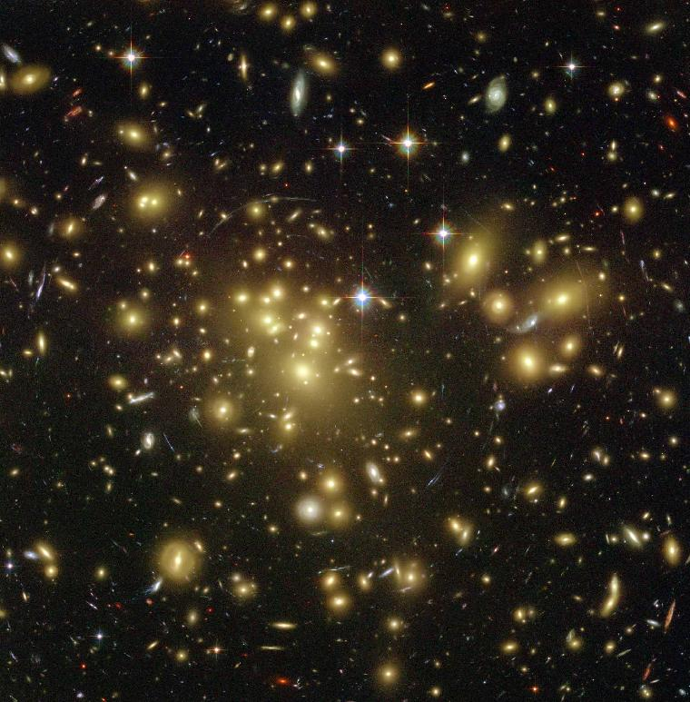
Clusters of Galaxies: Gravitational Lenses
Courtesy:
T. Broadhurst et al.
A highly promising method to determine the amount and distribution of
matter in the Universe
looks at the way it affects
the trajectories of photons
According to
Einstein’s theory of
General Relativity,
gravitational potential wells will bend and focus light. Dark matter concentrations act as a
Gravitational Lens
A1689

Slide 21
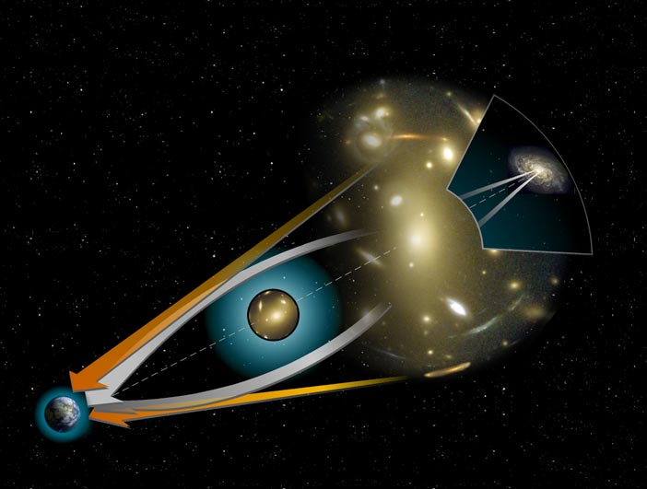
Clusters: Gravitational Lensing
Geometry of Gravitational Lenses

Slide 22
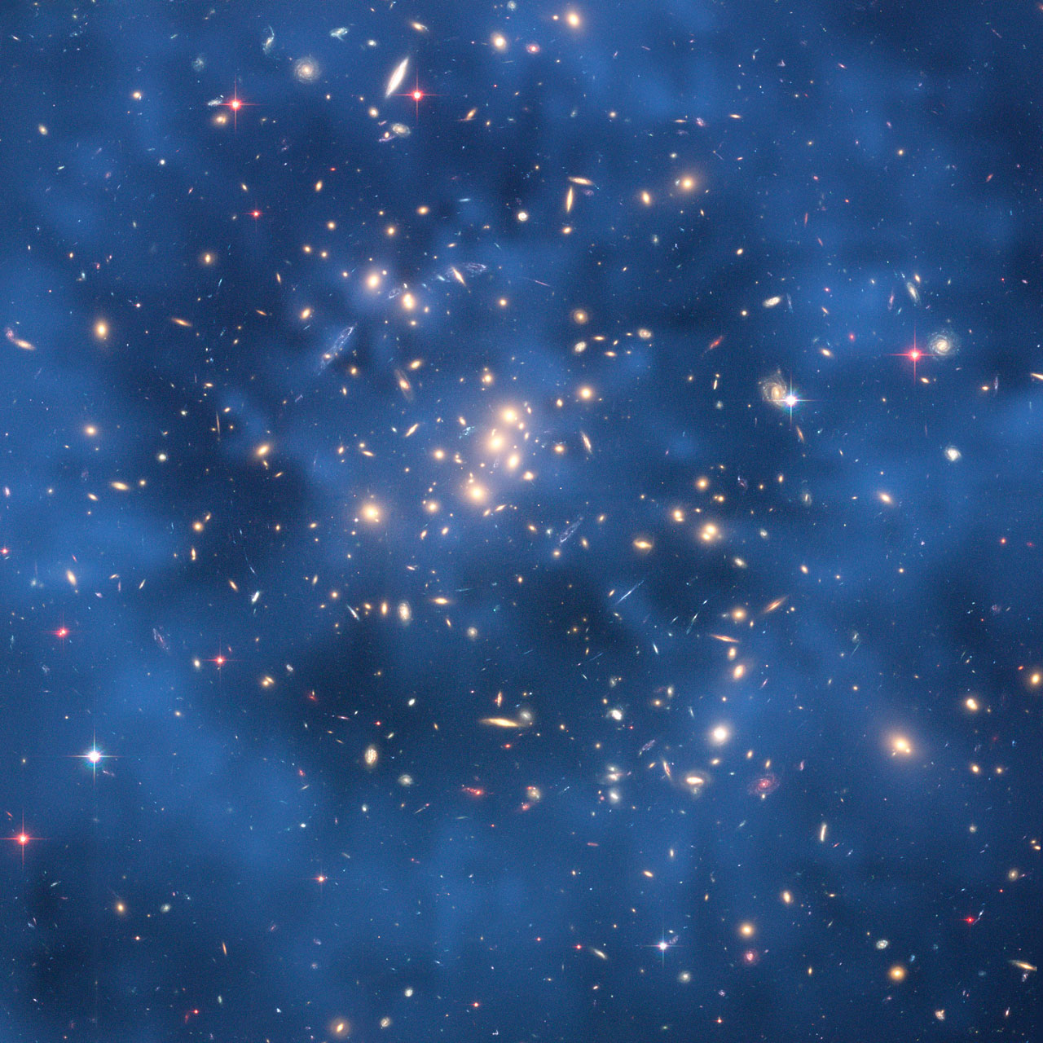
Clusters of Galaxies: Dark Matter Map
A highly promising method to determine the amount and distribution of
matter in the Universe
looks at the way it affects
the trajectories of photons.
According to
Einstein’s theory of
General Relativity,
gravitational potential wells will bend and focus light. Dark matter concentrations act as a
Gravitational Lens.
Cl0024

Slide 23
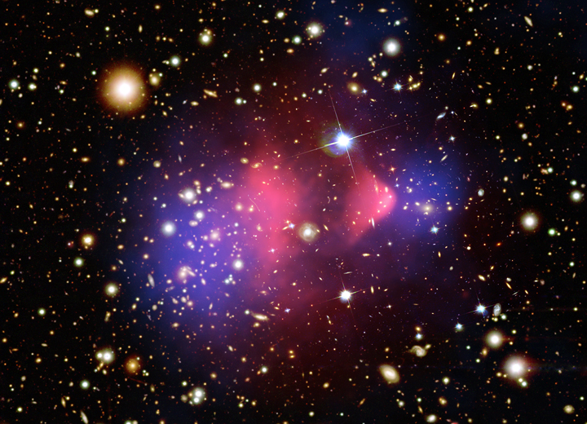
Bullet Cluster colliding …
red:
hot Xray cluster gas
blue:
dark matter
Clowe et al. 2006

Slide 24
Dark Energy

Slide 25
Galaxy Clustering

Slide 26
Dark Energy: Identity & Nature
Huge and ever growing
list of suggestions on
identity & nature of Dark Energy:
Cosmological Constant
Cosmic Backreaction
(inhomogeneities)
Modified Gravity
Quintessence,
in a variety of flavours
Phantom Energy
Chameleon Energy
Chaplygin gas
Agegraphic DE
….
Dark Energy = Vacuum Energy
Ya. Zel’dovich - 1960s
S. Weinberg - 1989
Cosmological Constant to be
identified with zero-point
vacuum energy ?
minor problem:
1st order estimate
off by 120 orders magnitude:
~ 10¹²⁰

Slide 27
Phantom Energy:
De Big Rip ?

Slide 28
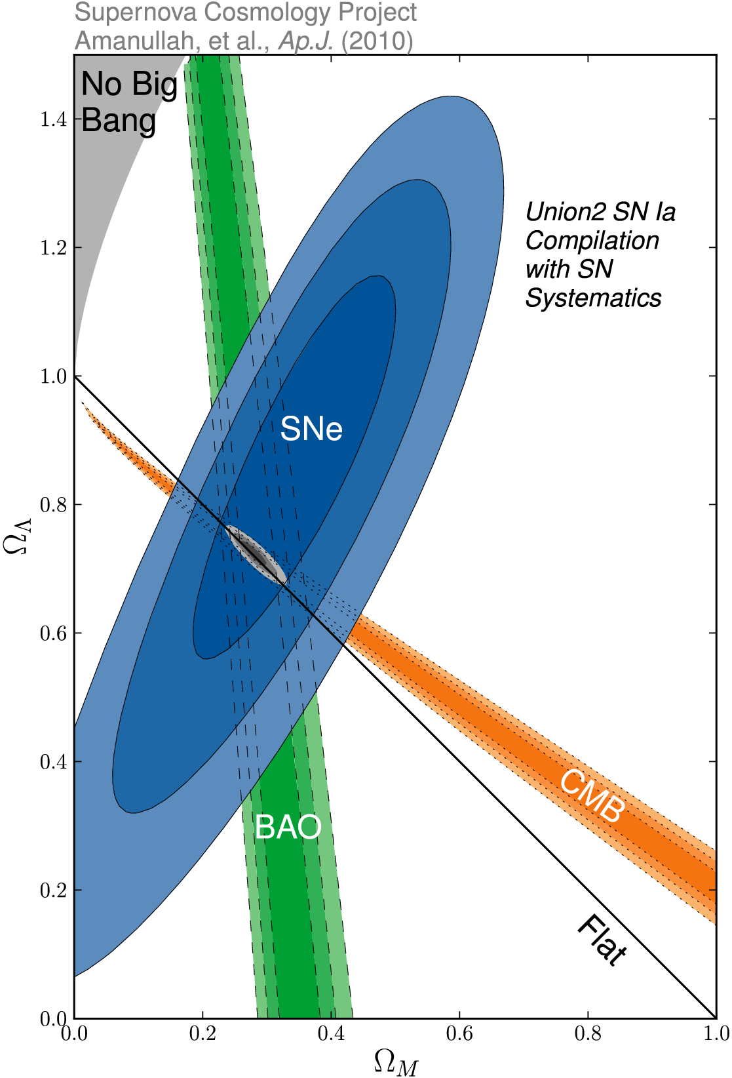
_{m} vs. ☹
SCP Union2 constraints (2010)
on values of matter density _{m}
dark energy density ☹

Slide 29
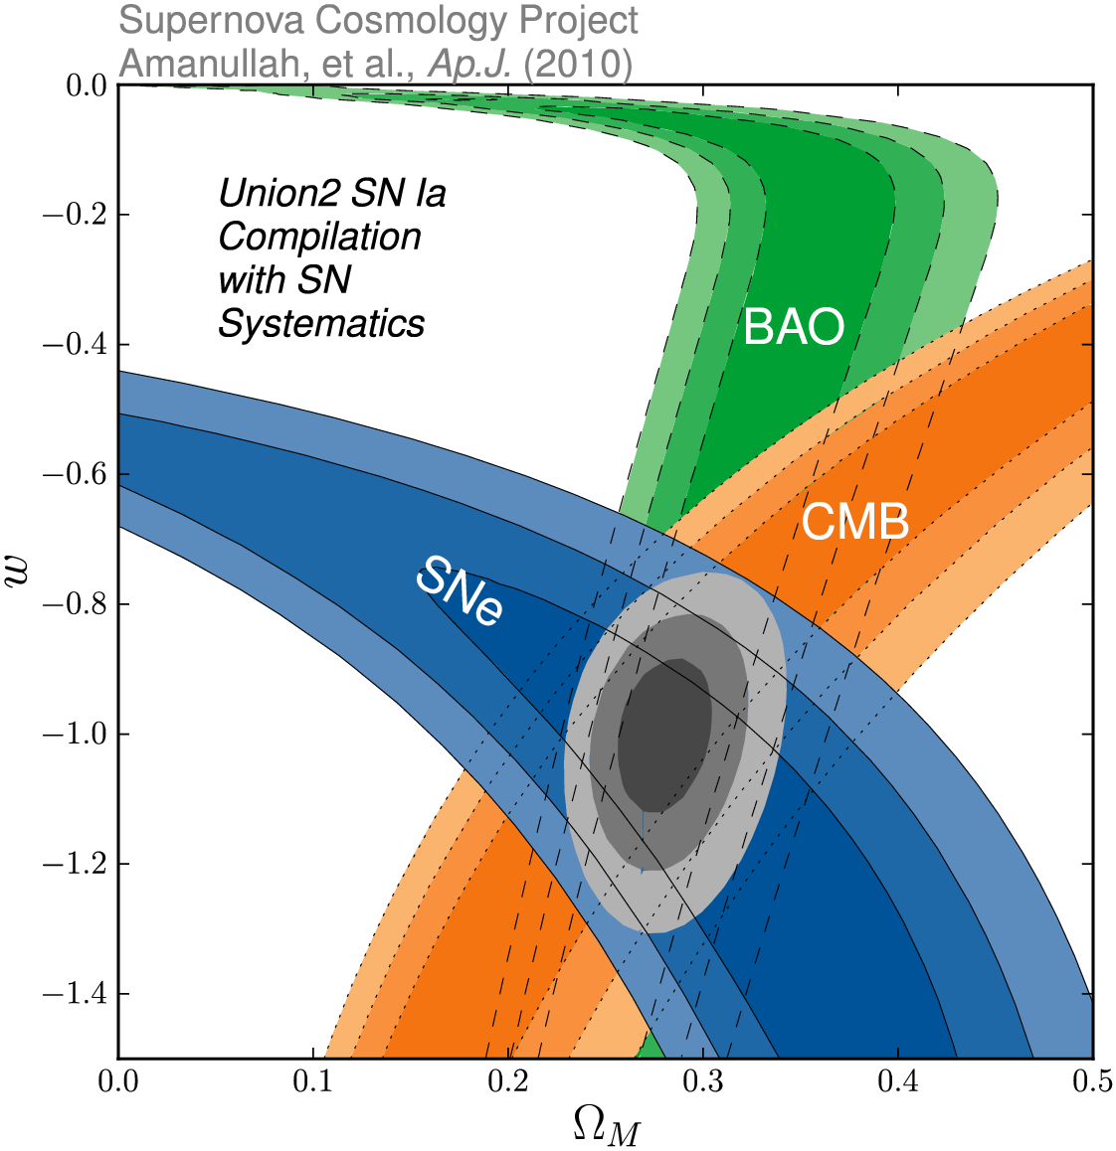
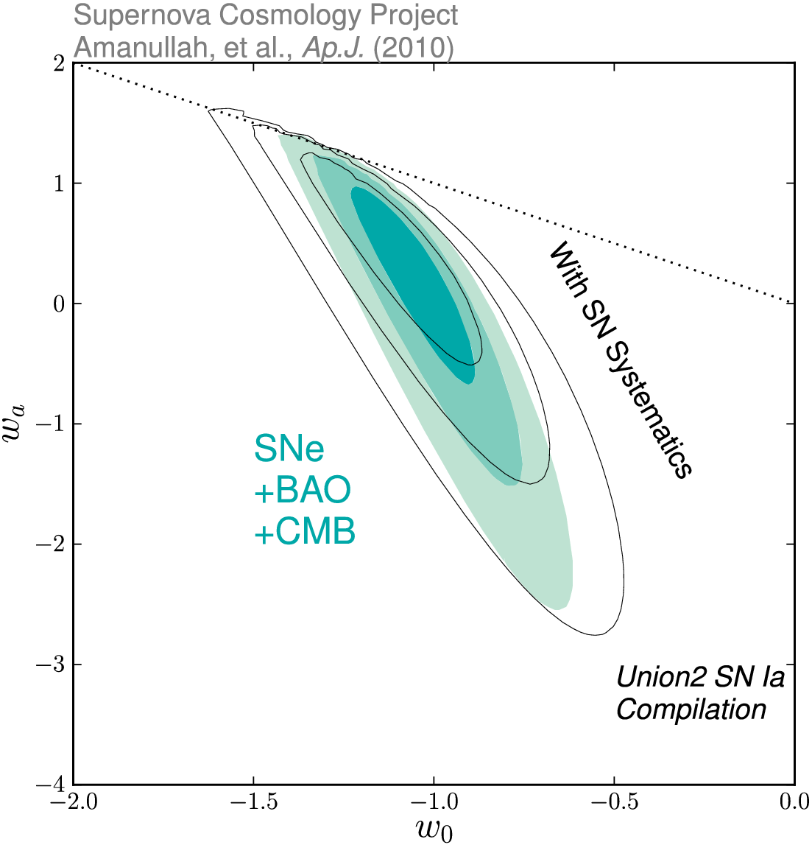
Dark Energy Eqn.State
on dynamical evolution dark energy:
eqn. state parameters w₀
w_{a}
SCP Union2 constraints (2010)
on values of matter density _{m}
dark energy eqn. state w

Slide 30
Adiabatic Expansion

Slide 31
Adiabatic Expansion
The Universe of Einstein, Friedmann & Lemaitre
expands adiabatically
Energy of the expansion of the Universe corresponds to the decrease in the energy of its constituents
The Universe COOLS as a result of its expansion !

Slide 32
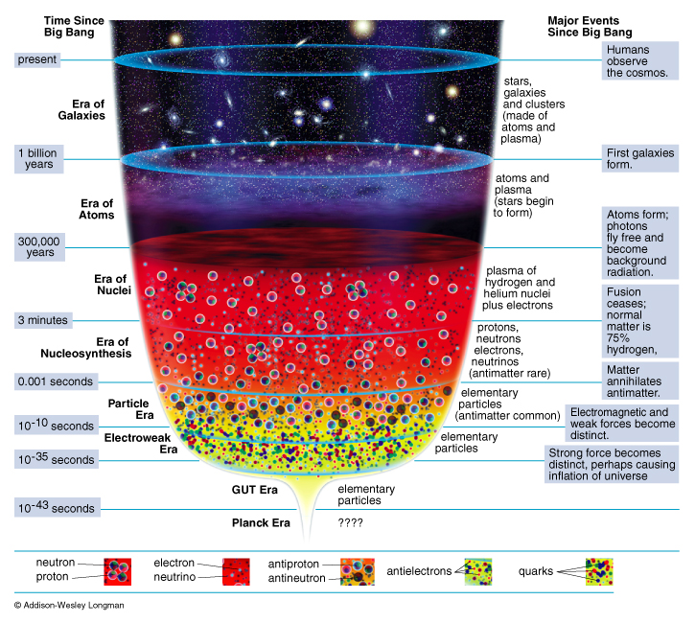
Adiabatic Expansion
reconstruction
Thermal History
of the Universe

Slide 33
Cosmic Epochs
Planck Epoch t < 10⁻⁴³ sec
Phase Transition Era 10⁻⁴³ sec < t < 10⁵sec
Hadron Era t ~10⁻⁵ sec
Lepton Era 10⁻⁵ sec < t < 1 min
Radiation Era 1 min < t <379,000 yrs
Post-Recombination Era t > 379,000 yrs
GUT transition
electroweak transition
quark-hadron transition
muon annihilation
neutrino decoupling
electron-positron annihilation
primordial nucleosynthesis
radiation-matter equivalence
recombination & decoupling
Structure & Galaxy formation
Dark Ages
Reionization
Matter-Dark Energy transition

Slide 34
History of the Universe in Four Episodes: I
On the basis of the
1) complexity of the involved physics
2) our knowledge of the physical processes
we may broadly distinguish four cosmic episodes:
(I)
Origin universe
???
t < 10⁻⁴³ sec
fundamental physics:
totally unknown
Planck Era

Slide 35
History of the Universe in Four Episodes: II
(II)
_{tot:}
curvature/
flatness
_{b} (n_{b}/n)
`exotic’
dark matter
primordial
fluctuations
10⁻⁴³ < t < 10⁻³ sec
fundamental physics:
poorly known
speculative
VERY early universe

Slide 36
History of the Universe in Four Episodes: III
(III)
primordial
nucleo-
synthesis
blackbody
radiation:
CMB
10⁻³ < t < 10¹³ sec
Standard
Hot Big Bang
Fireball
fundamental microphysics:
known very well

Slide 37
History of the Universe in Four Episodes: IV
(IV)
t > 10¹³ sec
structure
formation:
stars,
galaxies
clusters
…
Post
(Re)Combination
universe
complex macrophysics:
Fundamentals known
complex interplay

Slide 38
Cosmic Curvature

Slide 39
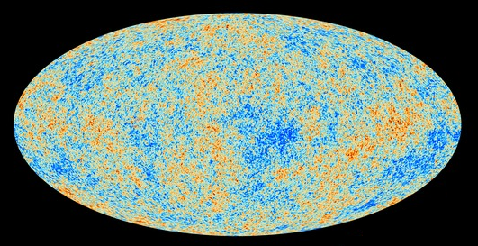
Cosmic Microwave Background
Map of the Universe at Recombination Epoch (Planck, 2013):
• 379,000 years after Big Bang
• Subhorizon perturbations: primordial sound waves
• ∆T/T < 10-5

Slide 40
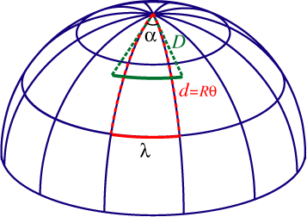
Measuring Curvature
Measuring the Geometry of the Universe:
• Object with known physical size,
at large cosmological distance
● Measure angular extent on sky
● Comparison yields light path,
and from this the curvature of space
W. Hu
Geometry of Space

Slide 41
Measuring Curvature
• Object with known physical size,
at large cosmological distance:
• Sound Waves in the Early Universe !!!!
W. Hu
Temperature Fluctuations
CMB

Slide 42
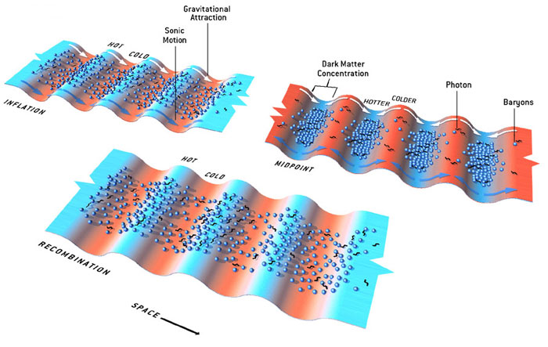
Fluctuations-Origin

Slide 43
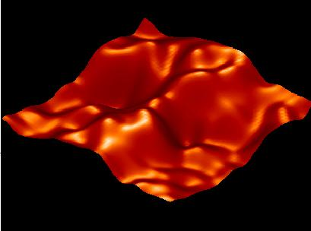
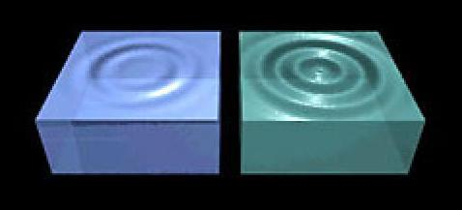
Music of the Spheres
● small ripples in
primordial matter & photon distribution
● gravity:
- compression primordial photon gas
- photon pressure resists
● compressions and rarefactions
in photon gas: sound waves
● sound waves not heard, but seen:
- compressions: (photon) T higher
- rarefactions: lower
● fundamental mode sound spectrum
- size of “instrument”:
- (sound) horizon size last scattering
● Observed, angular size: θ~1º
- exact scale maximum compression, the
“cosmic fundamental mode of music”
W. Hu

Slide 44
Cosmic Microwave Background
Size Horizon Recombination
COBE measured fluctuations: > 7º
Size Horizon at Recombination spans angle ~ 1º

Slide 45
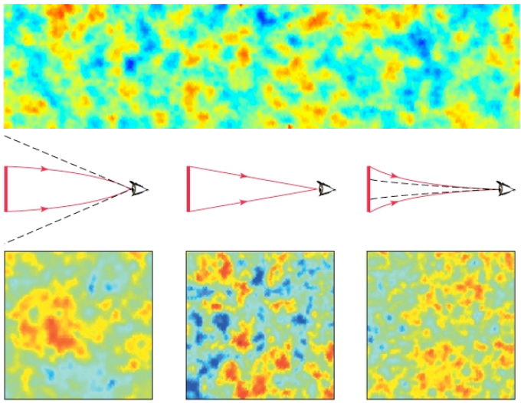
Flat universe from CMB
First peak: flat universe
We know the redshift and the time it took for the light to reach us:
from this we know the
- length of the legs of the
triangle
- the angle at which we are
measuring the sound horizon.
Closed:
hot spots
appear larger
Flat:
appear as big as they are
Open:
spots appear smaller

Slide 46
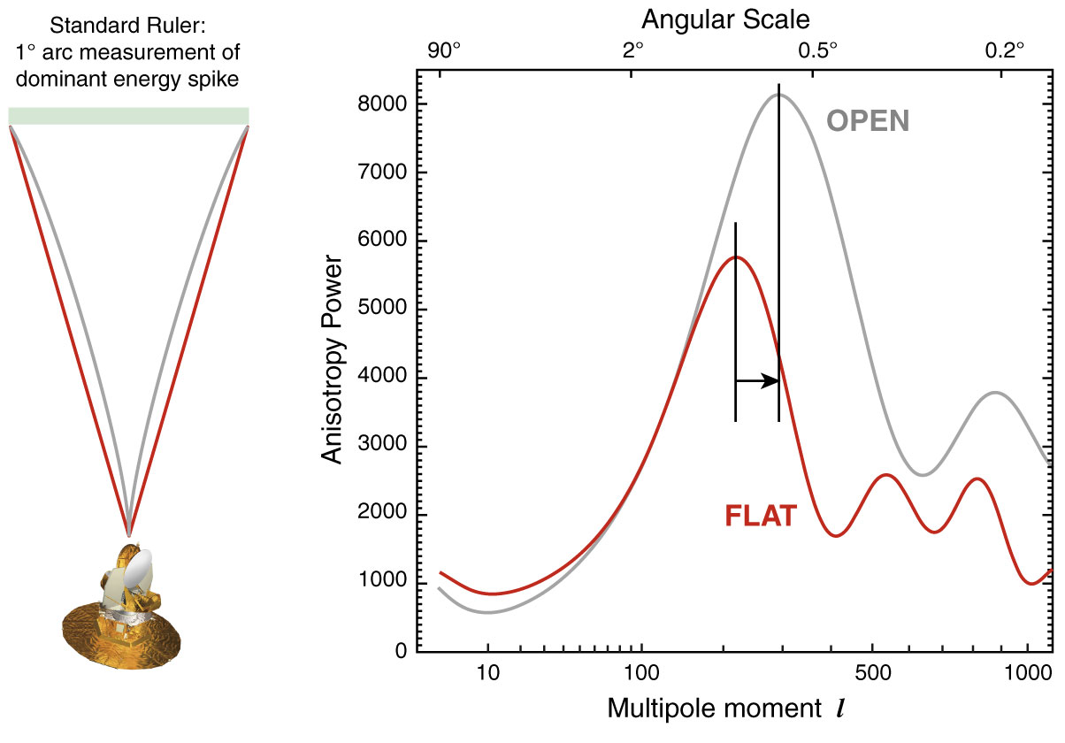
The WMAP CMB temperature
power spectrum

Slide 47
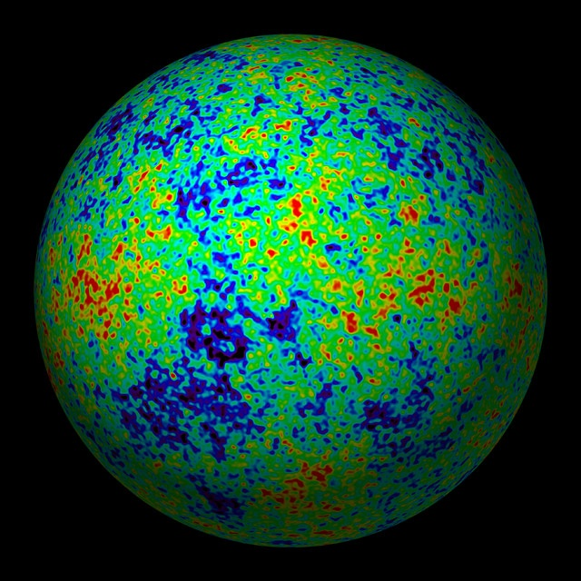
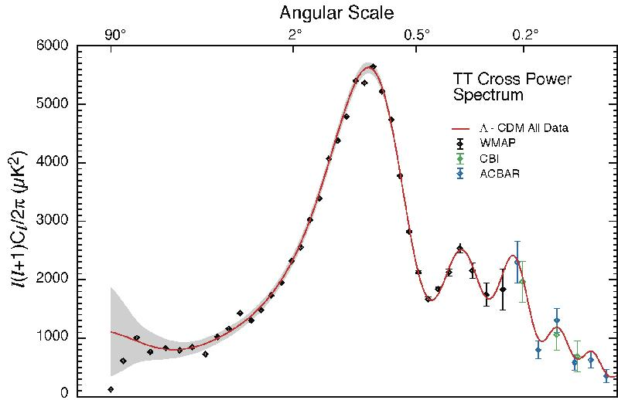
The Cosmic Tonal Ladder
The WMAP CMB temperature
power spectrum
Cosmic sound horizon
The Cosmic Microwave Background Temperature Anisotropies:
Universe is almost perfectly FLAT !!!!

Slide 48
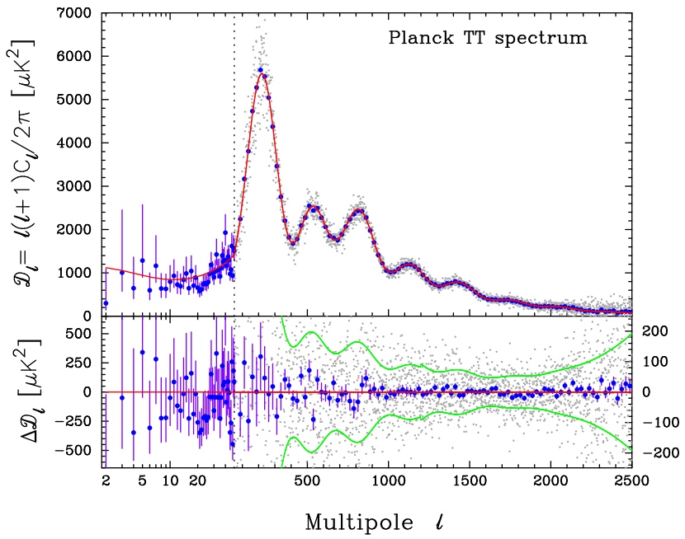
CMB - Fluctuations

Slide 49
Standard Big Bang:
what it cannot explain …

Slide 50
Flatness Problem
the Universe is remarkably flat, and was even (much)
flatter in the past
Horizon Problem
the Universe is nearly perfectly isotropic and
homogeneous, much more so in the past
Monopole Problem:
There are hardly any magnetic monopoles in
our Universe
Fluctuations, seeds of structure
Structure in the Universe: origin

Slide 51
Flatness Problem

Slide 52
Flatness Problem
FRW Dynamical Evolution:
Going back in time, we find that the Universe was much flatter than it is at the
present.
Reversely, that means that any small deviation from flatness in the early Universe would have been strongly amplified nowadays …
We would therefore expect to live in a Universe that would either be almost
=0 or ;
Yet, we find ourselves to live in a Universe that is almost perfectly flat … _{tot}1
How can this be ?

Slide 53
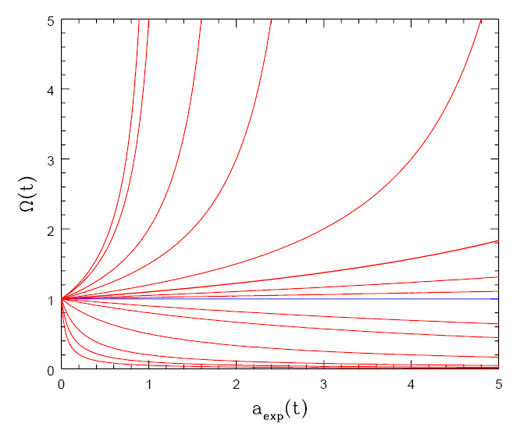
Flatness Evolution
• At radiation-matter equiv.
• Big Bang nucleosynthesis
a_{nuc}3.610⁻⁸
• Planck time

Slide 54
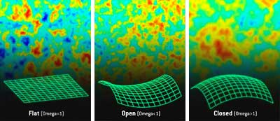
Angular CMB temperature fluctuations
CMB: Universe almost perfectly Flat !

Slide 55
The Cosmic Tonal Ladder
The WMAP CMB temperature
power spectrum
Cosmic sound horizon
The Cosmic Microwave Background Temperature Anisotropies:
Universe is almost perfectly flat

Slide 56
Horizon Problem

Slide 57
Cosmic Horizons
Fundamental Concept for our understanding of the physics of the Universe:
Physical processes are limited to the region of space with which we are
or have ever been in physical contact.
What is the region of space with which we are in contact ?
Region with whom we have been able to exchange photons
(photons: fastest moving particles)
From which distance have we received light.
Complication: - light is moving in an expanding and curved space
- fighting its way against an expanding background
This is called the
Horizon of the Universe
:

Slide 58
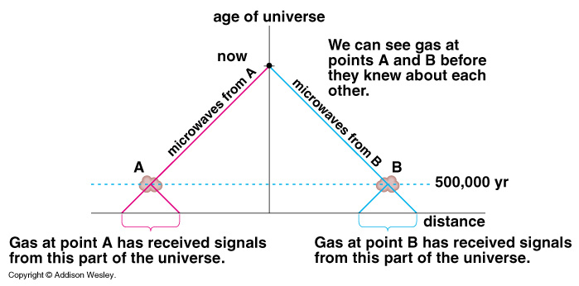
Cosmic Horizons
Horizon of the Universe:
distance that light travelled since the Big Bang

Slide 59
Cosmic Horizons
In an Einstein-de Sitter Universe
Horizon distance in physical space
Horizon of the Universe:
distance that light travelled since the Big Bang

Slide 60
Cosmic Horizons
The horizon distance at recombination/decoupling
(ie. time at which Cosmic Microwave Background is coming from)
angular size on the sky:
Large angular scales:
NOT in physical contact
Small angular scales:
In physical (thus, also thermal) contact
Horizon of the Universe:
distance that light travelled since the Big Bang

Slide 61
Cosmic Microwave Background
Size Horizon Recombination
COBE measured fluctuations: > 7º
Size Horizon at Recombination spans angle ~ 1º
How can it be that regions totally out of thermal contact have the same temperature ?

Slide 62
Cosmic Microwave Background
Size Horizon Recombination
COBE measured fluctuations: > 7º
Size Horizon at Recombination spans angle ~ 1º
COBE proved that superhorizon fluctuations do exist: prediction Inflation !!!!!

Slide 63
Structure Problem

Slide 64
Primordial Noise: Seeds of Cosmic Structure

Slide 65
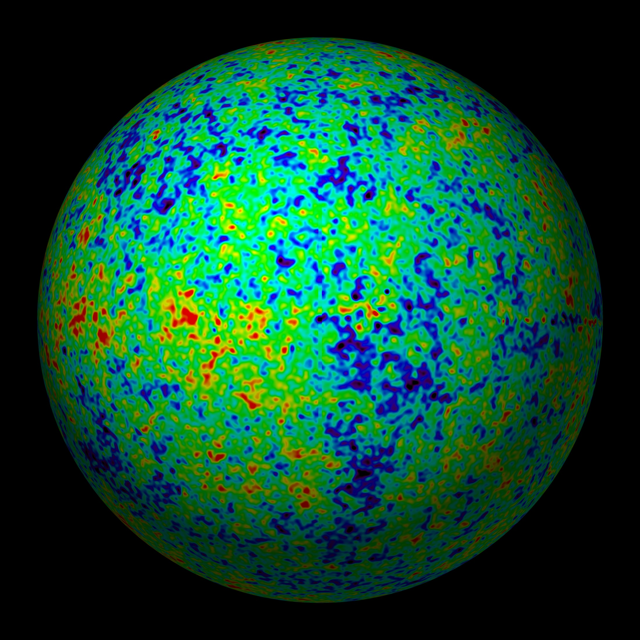
Universe at
379000 years:
almost featureless

Slide 66
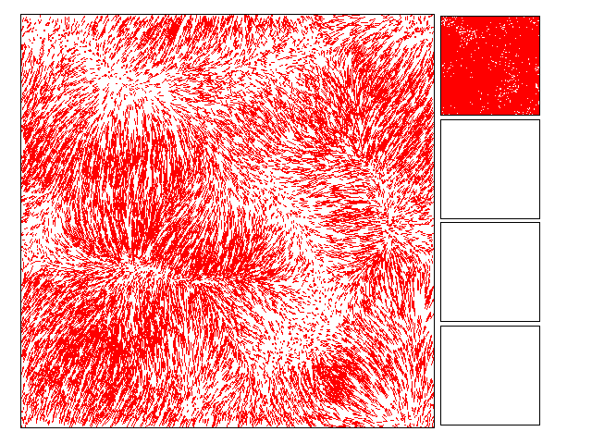
The Universe should be
Uniform: homogeneous & isotropic
Migration Streams of
matter induced by gravity
resulting from small perturbations

Slide 67
Cosmic Structure Formation
Formation
Cosmic Web:
simulation
sequence
(cold)
dark matter
(courtesy:
Virgo/V. Springel).

Slide 68
Millennium
Nbody simulation
time
resolution
Springel 2005

Slide 69
Illustris Simulation:
Cosmic Web
Dark Matter - Gas - Galaxies

Slide 70
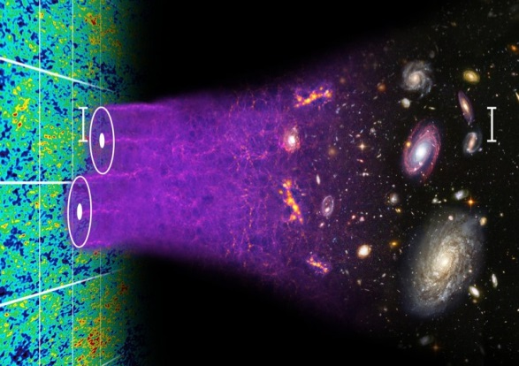
Formation Cosmic Structures

Slide 71
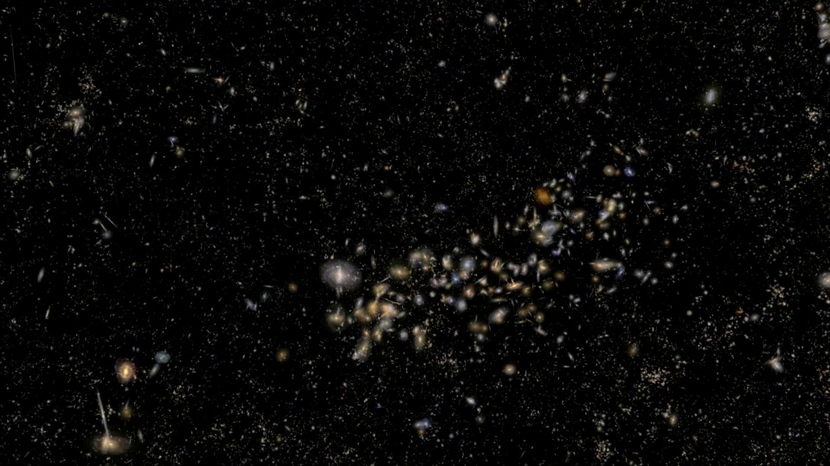
Universe at 13.8 Gyrs:
rich & complex structure

Slide 72
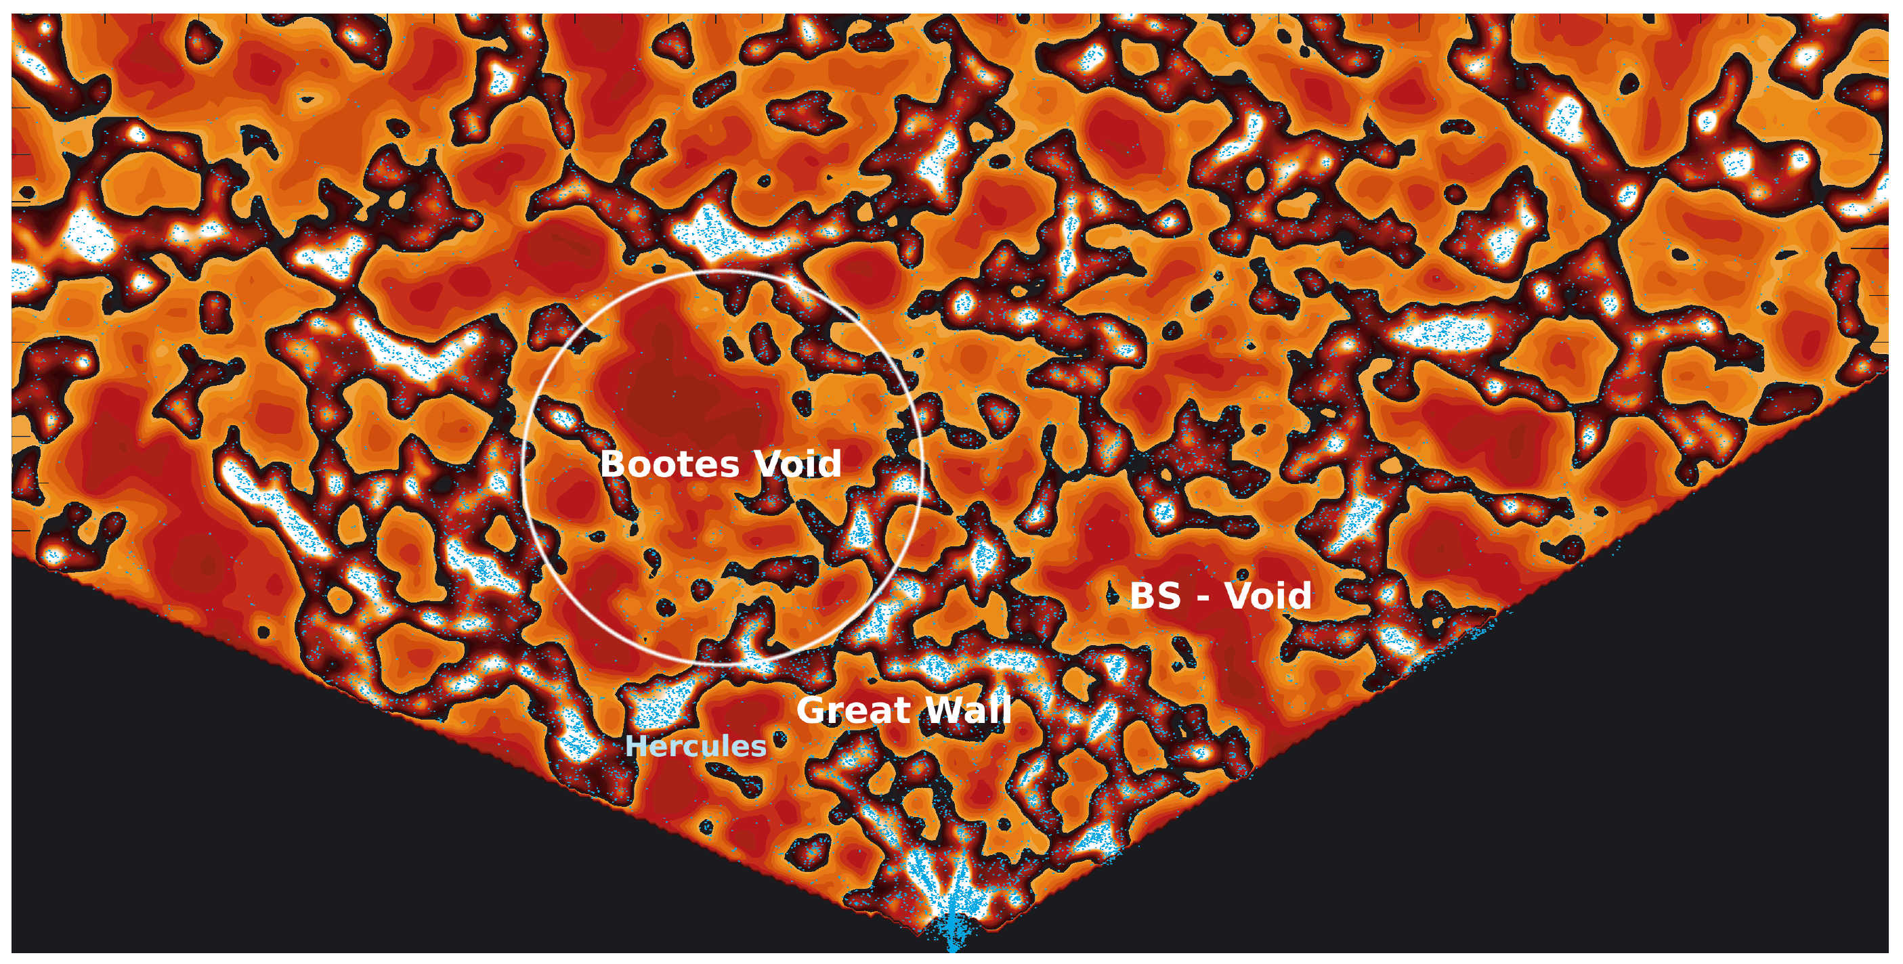
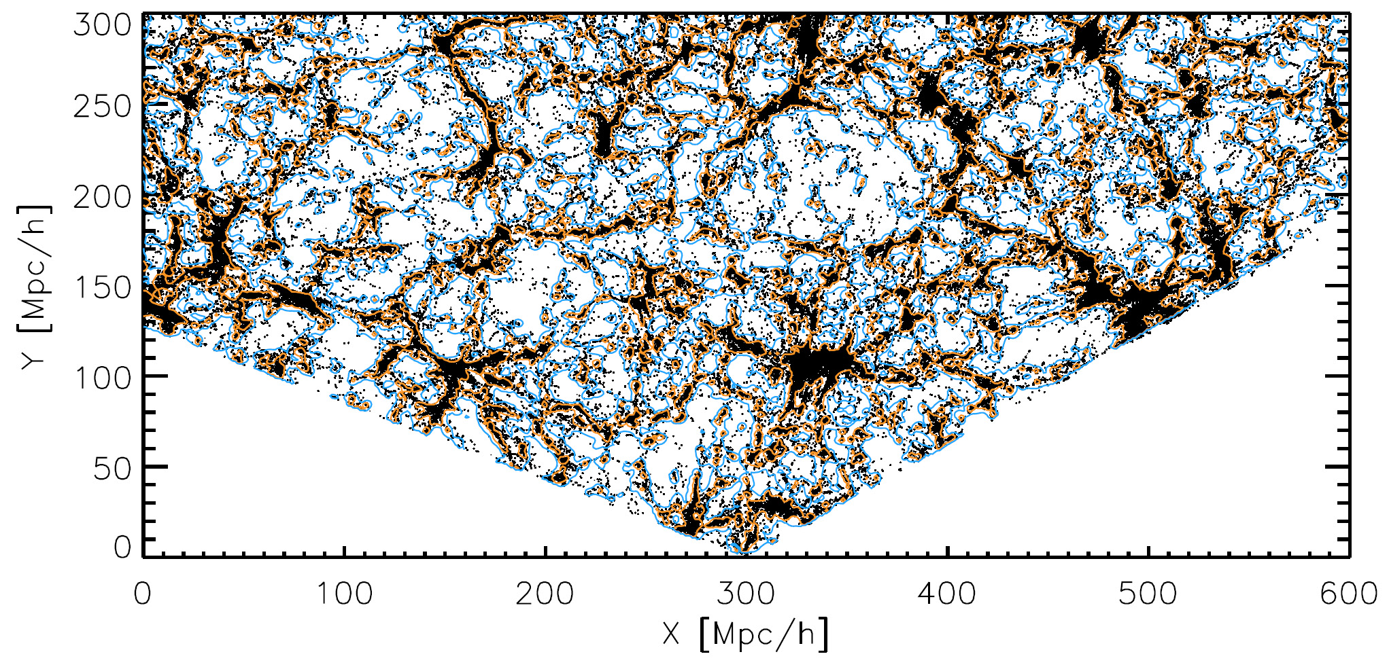
SDSS Galaxy Survey
map SDSS, clearly visible underdensities (Platen et al. 2010)
map SDSS, clearly visible underdensities (Platen et al. 2010)
with the advent of large galaxy redshift surveys
– LCRS, 2dFGRS, SDSS, 2MRS –
voids have been recognized as one of the quintessential components of the Cosmic Web

Slide 73
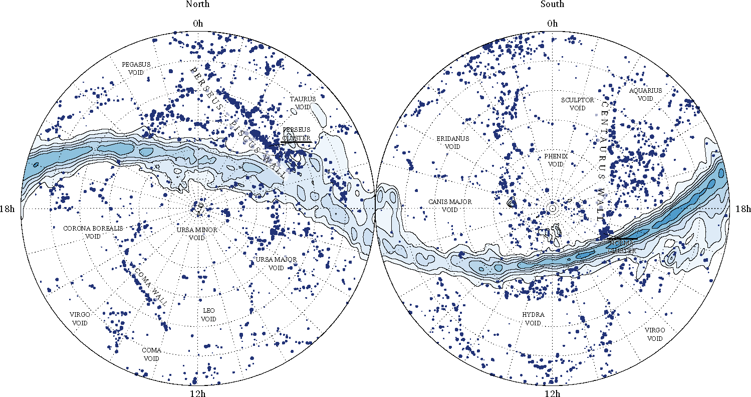
local Cosmic Web: 2MRS
cz=5,000-6,000 km/s
Courtesy: Johan Hidding

Slide 74
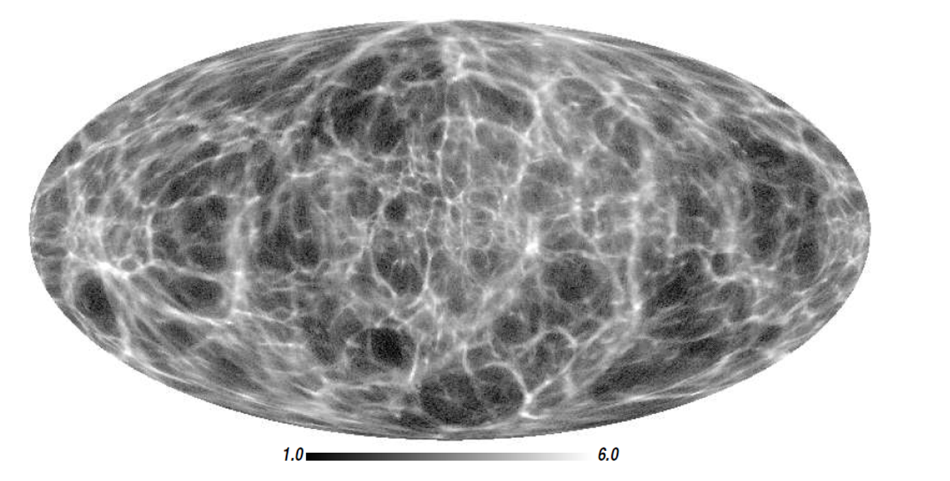
local Cosmic Web: 2MRS
most detailed reconstruction of the
local dark matter
Cosmic Web
Courtesy: Francisco Kitaura

Slide 75
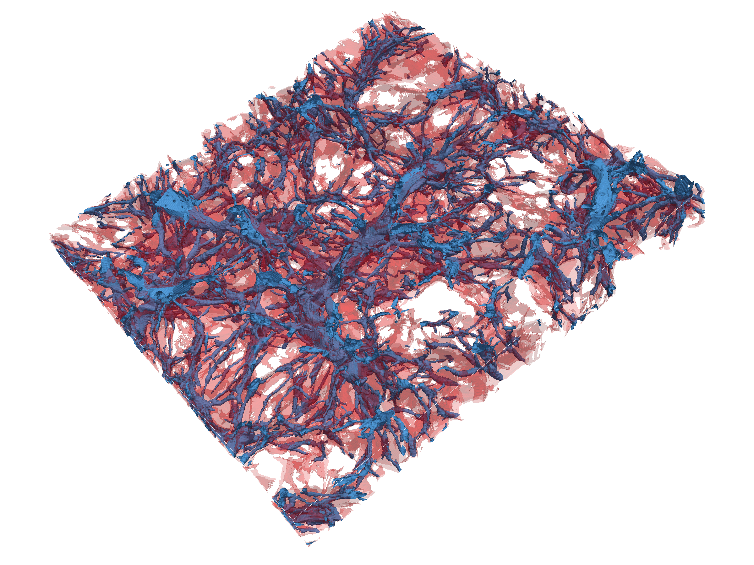
Nexus+ tracing of filaments:
inherent multiscale
character of filamentary web
Hidding, Cautun, vdW 2015

Slide 76
Horizon Problem

Slide 77
Cosmic Horizons
Fundamental Concept for our understanding of the physics of the Universe:
Physical processes are limited to the region of space with which we are
or have ever been in physical contact.
What is the region of space with which we are in contact ?
Region with whom we have been able to exchange photons
(photons: fastest moving particles)
From which distance have we received light.
Complication: - light is moving in an expanding and curved space
- fighting its way against an expanding background
This is called the
Horizon of the Universe
:

Slide 78
Cosmic Horizon
(Particle) Horizon of the Universe:
distance that light travelled since Big Bang

Slide 79
Probleem van Kosmische Horizon
Size Horizon Recombination
COBE metingen CMB temperatuur fluctuaties: > 7º
Schaal Horizon Zichtbare Heelal 379000 jr. na Big Bang: ~ 1º
Temperatuur hetzelfde over gehele hemel,
maar hoe kan dat zonder ooit in thermisch contact te zijn geweest?

Slide 80
INFLATION

Slide 81
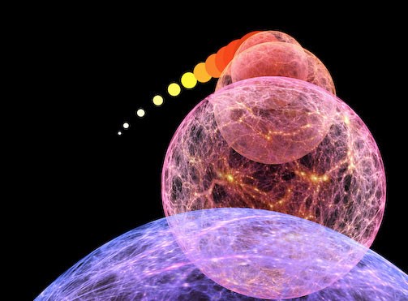
10⁻³⁶ sec after Big Bang: Inflation of the Universe

Slide 83
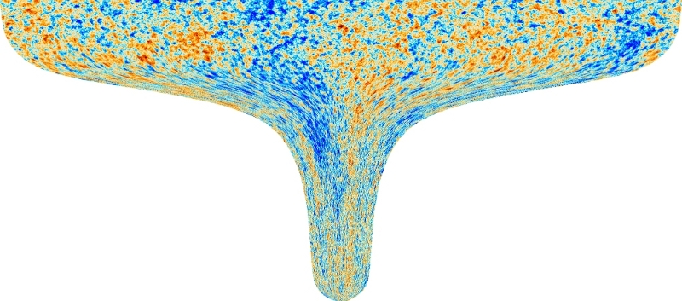
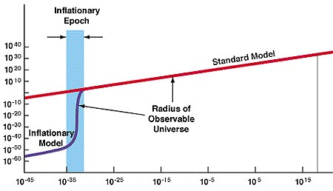
Kosmische Inflatie
~ 10⁻³⁶ sec. na Big Bang:
Heelal dijt exponentieel uit:
factor 10⁶⁰ in 10⁻³⁴ sec
Afmeting huidige zichtbare Heelal:
begin inflatie: 10⁻¹⁵ afmeting atoom
eind inflatie: diameter van stuiver

Slide 85
Propelling Inflation: Inflaton

Slide 86
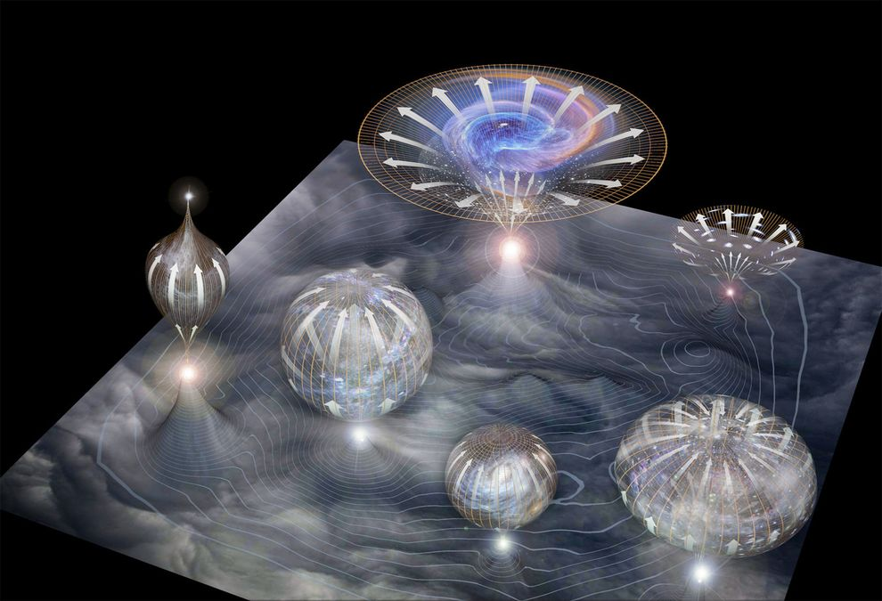
Inflatie & Multiverse

Slide 87
Cosmic Future

Slide 88
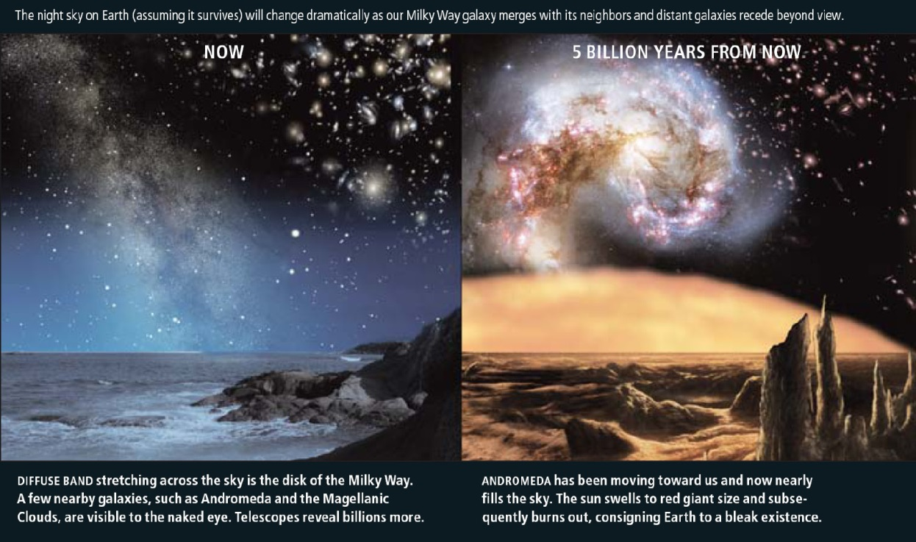
Cosmic Fate
100 Gigayears:
the end of Cosmology

