Slide 1
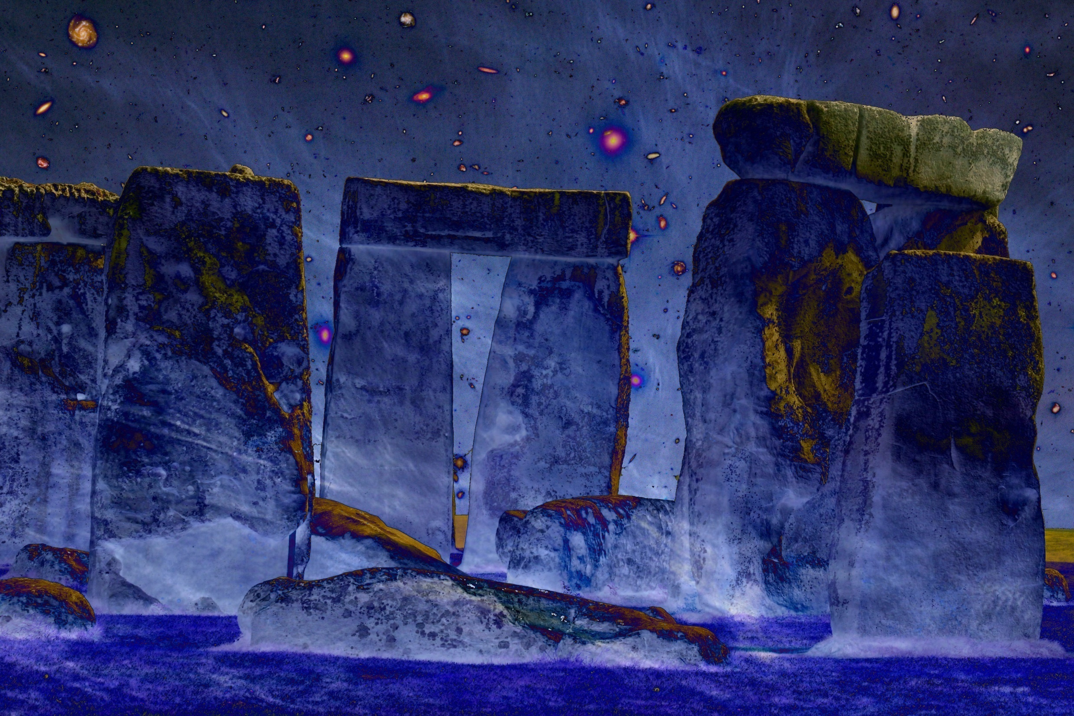
v
Cosmic Origins
Lecture Course Minor Astronomy
University of Groningen
November 2016-January 2017

Slide 2
Practical Matters
Agenda: Wednesday 19:00-21:00 Academiegebouw, vd Leeuwzaal
Friday 15:oo-17:00 Nijenborgh 5118-156
Lectures: - 12 lectures/hoorcolleges Wednesday: 8
Friday: 4
- 4 tutorial/werkcolleges Friday: 4
Lecturer: Rien van de Weygaert
Kapteyn Astronomical Institute
Kapteynborg, Zernike campus, rm. 186;
tel. 050-3634086;
weygaert@astro.rug.nl
Website: www.astro.rug.nl/~weygaert/cosmic_origins2016.html

Slide 3
Exam
Written exam (Jan. 23, 2016) 60%
Report on specific topic (20-25 pages) 25%
- in groups of 2
- deadline report: Mar. 1, 2016
3. Werkcollege/Tutorial assignments 15%

Slide 4
Topics/Agenda I.
Lecture 1, November 16
Introduction
Cosmology, the Search for the Origin of our World
the Fundamental Questions of our Existence
Lecture 2, November 18
Heavenly Rhythms: from Awe to Calendar
Lecture 3, November 23
Gods and Myths: Genesis of our World
Lecture 4, November 25, tutorial
the Fundamental Cosmological Questions: society responds ...
Lecture 5, November 30,
Cosmology: the philosophy of our world
Lecture 6, December 2
Order in the Cosmos:
how the Babylonians and Greeks rationalized the heavens

Slide 5
Topics/Agenda II.
Lecture 7, December 7
the Cosmos Mechanized:
a case study: the Antikythera Mechanism
Lecture 8, December 9
Tutorial: Circles, Epicylces and Ellipses ...
Lecture 9, December 14
the Scientific Revolution
the Cosmos Mechanized
Lecture 10, December 16
Kant to Hubble:
on Island Universes and the Size of our World
Lecture 11, December 21
the Universe Expands !
Lecture 12, December 23
Tutorial: a Cosmic Debate between Worldviews

Slide 6
Topics/Agenda III.
Lecture 13, January 11
the Dynamical Universe
Einstein, Gravity and the Dynamics of our Universe
Lecture 12, January 13
the Hot Big Bang:
journey to the very first moments of our Cosmos ...
Lecture 14, January 18
the Cosmic Web
the emergence of complexity in the Universe
Lecture 16 January 20
Tutorial: the self-conscious Universe

Slide 7
Literature
Lecture Notes (ppt slides etc.)
Cosmos,
an illustrated history of astronomy and cosmology
John North, 2nd ed., 2008, Univ. Chicago Press (paperback)
Cosmology, the Science of the Universe
E. Harrison, 2nd ed., 2000, Cambridge Univ. Press
Conceptions of Cosmos:
From Myths to the Accelerating Universe: A History of Cosmology
H. Kragh, 2013, Oxford Univ. Press
the History and Practice of Ancient Astronomy
J. Evans, 1998, Oxford Univ. Press
Ancient Cosmologies
ed. C. Blacker, M. Loewe, 1975, George Allen & Unwin Ltd.

