Slide 1
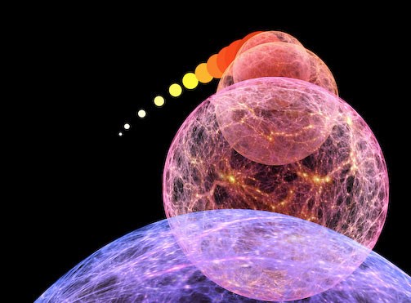
the
Big Bang

Slide 2
Gravity:
Ruler of the Universe

Slide 3
Four Fundamental Forces of Nature
Strong Nuclear Force
Responsible for holding particles together inside the nucleus.
The nuclear strong force carrier particle is called the gluon.
The nuclear strong interaction has a range of 10⁻¹⁵ m (diameter of a proton).
Electromagnetic Force
Responsible for electric and magnetic interactions, and determines structure of
atoms and molecules.
The electromagnetic force carrier particle is the photon (quantum of light)
The electromagnetic interaction range is infinite.
Weak Force
Responsible for (beta) radioactivity.
The weak force carrier particles are called weak gauge bosons (Z,W⁺,W⁻).
The nuclear weak interaction has a range of 10⁻¹⁷ m (1% of proton diameter).
Gravity
Responsible for the attraction between masses. Although the gravitational force carrier
The hypothetical (carrier) particle is the graviton.
The gravitational interaction range is infinite.
By far the weakest force of nature.

Slide 4
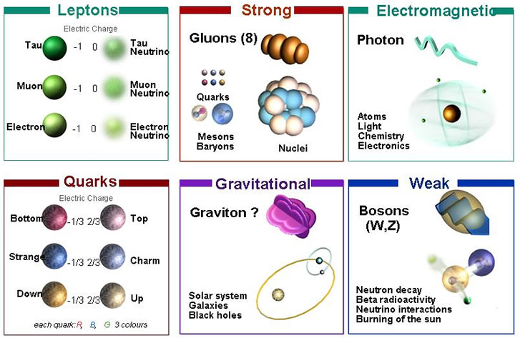
Four Fundamental Forces of Nature

Slide 5
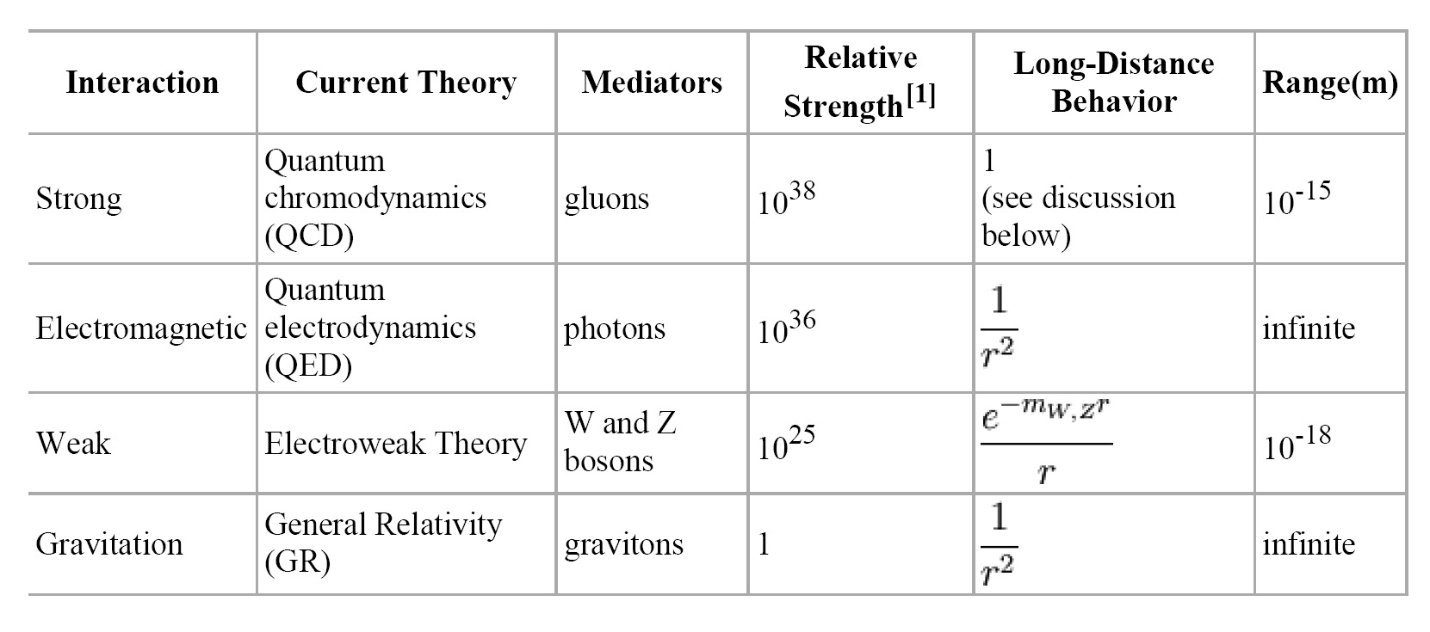
The weakest force is Gravity !
However, note that
.

Slide 6
The weakest force is Gravity !
However:
its range is infinite, not shielded
it is cumulative as all mass adds,
while electromagetic charges can be + or - , cancelling each others effect.

Slide 7
The weakest force, by far, rules the Universe …
Gravity has dominated its evolution, and determines its fate …

Slide 8
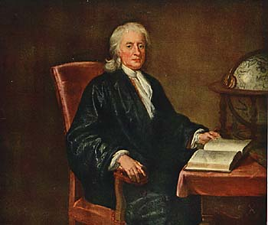
Newton’s
Static Universe

Slide 9
The Unchanging Universe
• In two thousand years of astronomy,
no one ever guessed that the universe might be expanding.
• To ancient Greek astronomers and philosophers,
the universe was seen as the embodiment of perfection,
the heavens were truly heavenly:
– unchanging, permanent, and geometrically perfect.
• In the early 1600s, Isaac Newton developed his law of gravity,
showing that motion in the heavens obeyed the same laws
as motion on Earth.

Slide 10
Newton's Universe
• However, Newton ran into trouble when he tried to apply
his theory of gravity to the entire universe.
• Since gravity is always attractive,
his law predicted that all the matter in the universe should
eventually clump into one big ball.
• Newton knew this was not the case, and assumed that
the universe had to be static
• So he conjectured that:
the Creator placed the stars such that they were
``at immense distances from one another.’’

Slide 11
Renaissance of Western Science
In footsteps of Copernicus, Galilei & Kepler,
Isaac Newton (1687) in his Principia
formulated a comprehensive model of the
world. Cosmologically, it meant
absolute and uniform time
space & time independent of matter
dynamics: - action at distance
- instantaneous
Universe edgeless, centerless & infinite
Cosmological Principle:
Universe looks the same at every
place in space, every moment in time
absolute, static & infinite space

Slide 12
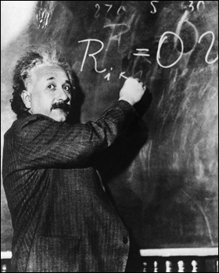
Einstein’s
Dynamic & Geometric
Universe

Slide 13
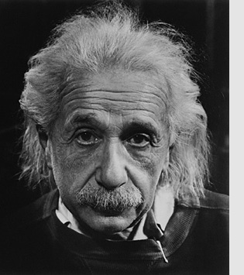
Albert Einstein
Albert Einstein
(1879-1955; Ulm-Princeton)
father of
General Relativity (1915),
opening the way towards
Physical Cosmology
The supreme task of the physicist is to arrive at those universal elementary laws from which the cosmos can be built up by pure deduction.
(Albert Einstein, 1954)

Slide 14
Relativity: Space & Time
Special Relativity,
published by Einstein in 1905
states that there is no such thing as
absolute Space or Time
Space and Time are
not wholly independent,
but aspects of a single entity,
Spacetime

Slide 15
Einstein’s principle of relativity
Principle of relativity:
All the laws of physics are identical in all inertial reference frames.
Constancy of speed of light:
Speed of light is same in all inertial frames (e.g. independent of velocity of observer, velocity of source emitting light)

Slide 16
Einstein’s Universe
In 1915,
Albert Einstein completed his General Theory of Relativity.
• General Relativity is a “metric theory’’:
gravity is a manifestation of the geometry, curvature, of space-time.
• Revolutionized our thinking about the nature of space & time:
- no longer Newton’s static and rigid background,
- a dynamic medium, intimately coupled to
the universe’s content of matter and energy.
• All phrased into perhaps
the most beautiful and impressive scientific equation
known to humankind, a triumph of human genius,
Einstein Field Equations

Slide 17
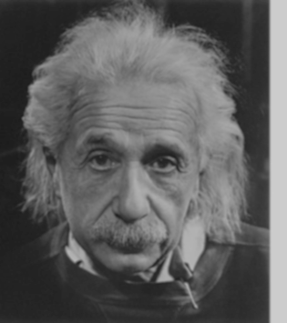
… Spacetime becomes a dynamic continuum,
integral part of the structure of the cosmos …
curved spacetime becomes force of gravity
… its geometry rules the world,
the world rules its geometry…

Slide 18
Einstein’s Universe
spacetime is dynamic
local curvature & time determined by mass
bodies follow shortest path through
curved spacetime (geodesics)
dynamics: - action through curvature space
- travels with velocity of light

Slide 19
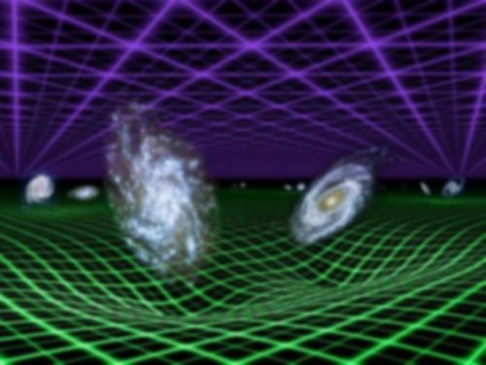

Slide 20
Einstein’s
Metric theory of Gravity:
how Gravity = Curved Space

Slide 21
Inertial vs Gravitational Mass
a larger mass experiences a stronger gravitational force gravitational mass
than a light mass
a larger mass is more difficult to get moving inertial mass
than a ligt mass
As a result, a heavy mass falls equally fast as the light mass:
Gravitational Mass = Inertial Mass

Slide 22
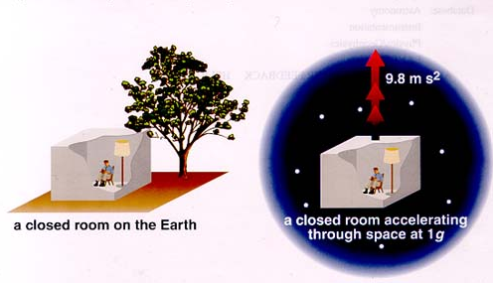
Equivalence Principle
Einstein’s “happiest thought” came from the realization of
the equivalence principle
Einstein reasoned that:
There is no experiment that can distinguish between
uniform acceleration and
a uniform gravitational field.

Slide 23
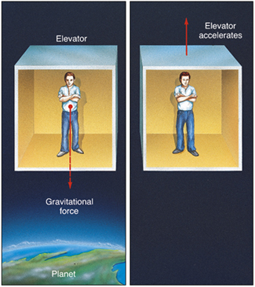
Equivalence Principle
being in
an accelerating frame
indistinguishable
from being in
a gravitational field

Slide 24
Light follows the same path
Velocity = v+2at_{o}
path of light beam in our frame
Velocity = v+at_{o}
Velocity = v
path of light beam in accelerating frame
t=0
t=t_{o}
t=2t_{o}

Slide 25
Gravity & Curved Spacetime
Equivalence of acceleration of a frame &
location in gravitational field
in gravity field, light follows a curved path
Curved paths:
straight lines in curved spacetime: Geodesics
(cf. flightpaths airplanes over surface Earth)
Fundamental tenet of General Relativity:
!!!!!!!! Gravity is the effect of curved spacetime !!!!!!!!
:

Slide 26
which of these is a straight line?
A
B
A
B
C
All of them
C

Slide 27
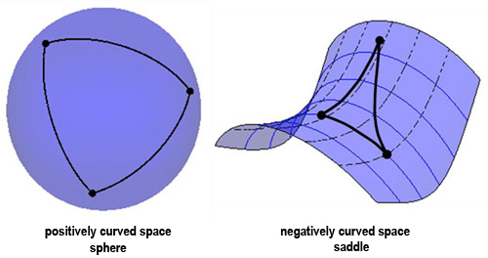
Curved Space:
Positive vs. Negative
Triangle angles >180 degrees
Circle circumference < 2πr
Triangle angles <180 degrees
Circle circumference > 2πr

Slide 28
the
Cosmological Principle

Slide 29
General Relativity
A crucial aspect of any particular configuration is the geometry of
spacetime: because Einstein’s General Relativity is a metric
theory, knowledge of the geometry is essential.
Einstein Field Equations are notoriously complex, essentially
10 equations. Solving them for general situations is almost
impossible.
However, there are some special circumstances that do allow a
full solution. The simplest one is also the one that describes
our Universe. It is encapsulated in the
Cosmological Principle
On the basis of this principle, we can constrain the geometry
of the Universe and hence find its dynamical evolution.

Slide 30
Cosmological Principle: the Universe Simple & Smooth
“God is an infinite sphere whose centre is
everywhere and its circumference nowhere”
Empedocles, 5th cent BC
Cosmological Principle:
Describes the symmetries in global appearance of the Universe:
● Homogeneous
● Isotropic
● Universality
● Uniformly Expanding
The Universe is the same everywhere:
- physical quantities (density, T,p,…)
The Universe looks the same in every direction
Physical Laws same everywhere
The Universe “grows” with same rate in
- every direction
- at every location
”all places in the Universe are alike’’
Einstein, 1931

Slide 31
Geometry of the Universe
Fundamental Tenet
of (Non-Euclidian = Riemannian) Geometry
There exist no more than THREE uniform spaces:
1) Euclidian (flat) Geometry Euclides
2) Hyperbolic Geometry Gauß, Lobachevski, Bolyai
3) Spherical Geometry Riemann
uniform=
homogeneous & isotropic
(cosmological principle)

Slide 32
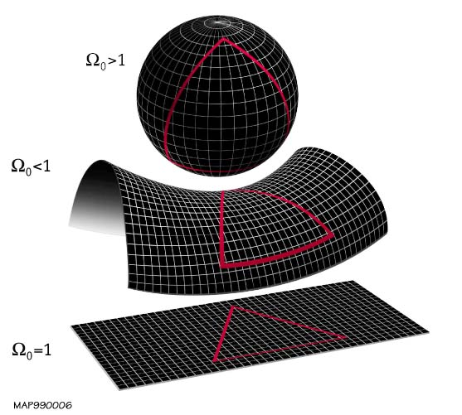
Geometry of the Universe
Positive
Curvature
K=+1
Negative
Curvature
K= -1
K=0
Flat

Slide 33
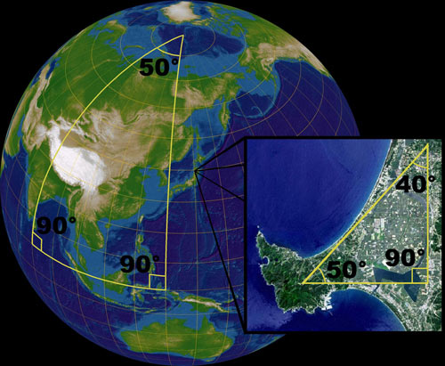
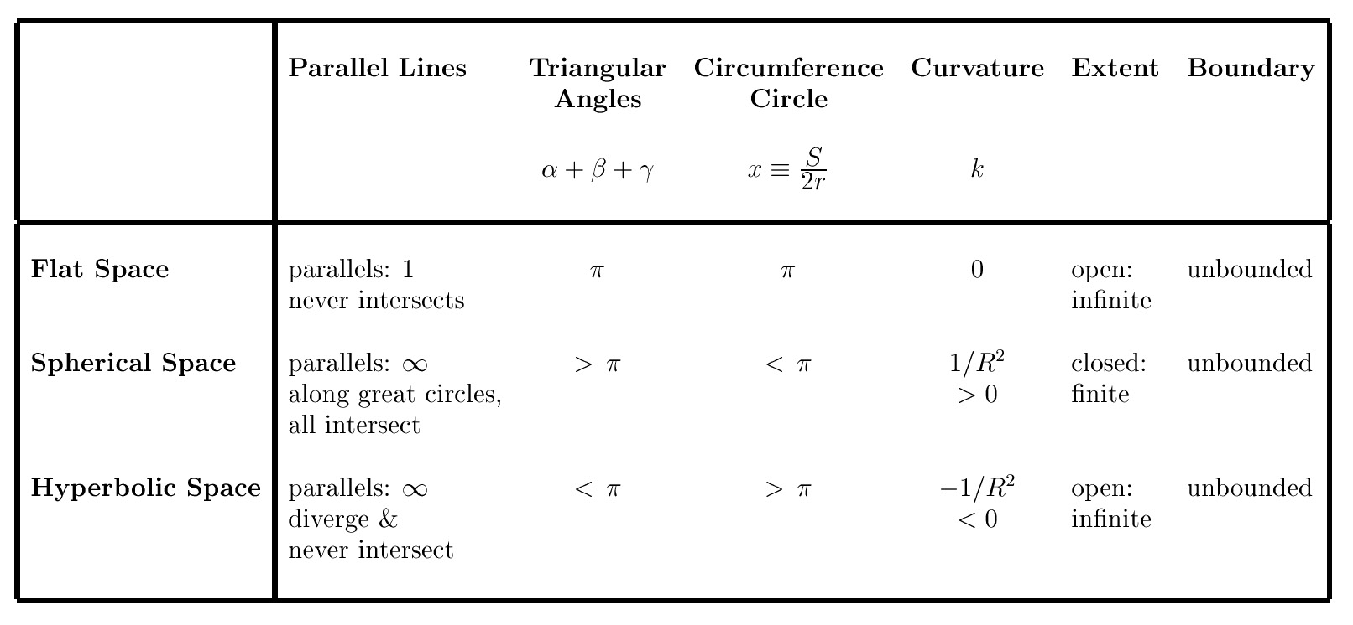
Uniform Spaces:
Geometric Characteristics

Slide 34
Friedmann, Lemaitre
&
Cosmic Expansion History

Slide 35
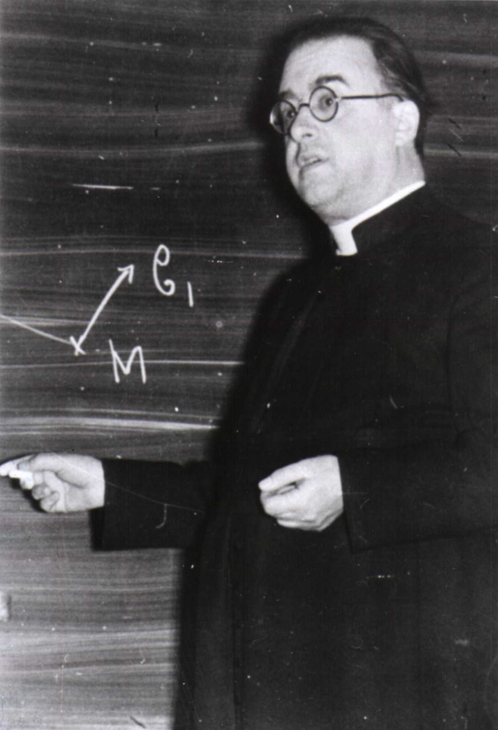
Friedmann & Lemaitre
Alexander Friedmann (1888 -1925)
George Lemaitre (1894-1966)
They discovered (independently)
theoretically the expansion of the
Universe as a solution to the
Theory of General Relativity.
… and derived the equations
that describe the expansion and
evolution of the universe,
the foundation for all of modern
Cosmology:
Friedmann-Lemaitre
Equation

Slide 36
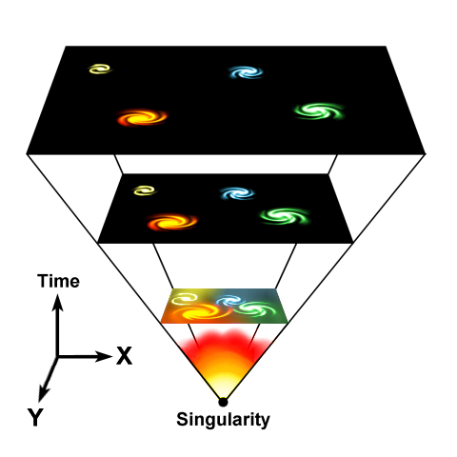
Evolving Universe
Einstein, de Sitter, Friedmann and Lemaitre all realized that in
General Relativity, there cannot be a stable and static Universe:
The Universe either expands, or it contracts …
Expansion Universe encapsulated in a
GLOBAL expansion factor a(t)
All distances/dimensions of objects
uniformly increase by a(t):
at time t, the distance between
two objects i and j has increased to
Note: by definition we chose a(t₀)=1,
i.e. the present-day expansion factor

Slide 37
Evolution & Fate Friedmann-Robertson-Walker-Lemaitre Universe
Completely determined by 3 factors:
• energy and matter content
(density and pressure)
• geometry of the Universe
(curvature)
• Cosmological Constant

Slide 38
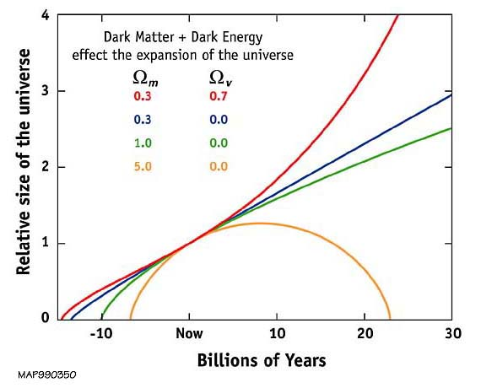
Our Universe ?
Einstein-de Sitter
Universe ?

Slide 39
Friedmann-Robertson-Walker-Lemaitre Universe

Slide 40
Friedmann-Robertson-Walker-Lemaitre Universe
Because of General Relativity, the evolution of the Universe is
determined by four factors:
• density
• pressure
• curvature
: present curvature radius
• cosmological constant
• Density & Pressure: - in relativity, energy & momentum need to be
seen as one physical quantity (four-vector)
- pressure = momentum flux
• Curvature: - gravity is a manifestation of geometry spacetime
Cosmological Constant: - free parameter in General Relativity
- Einstein’s “biggest blunder”
- mysteriously, since 1998 we know it dominates
the Universe

Slide 41
FRW Dynamics
In a FRW Universe,
densities are in the order of the critical density,
the density at which the Universe has a flat curvature

Slide 42
FRW Dynamics
In a matter-dominated Universe,
the evolution and fate of the Universe entirely determined
by the (energy) density in units of critical density:
Arguably,  is the most important parameter of cosmology !!!
Present-day
Cosmic Density:

Slide 43
what the Universe exists of:
Cosmic Constituents

Slide 44
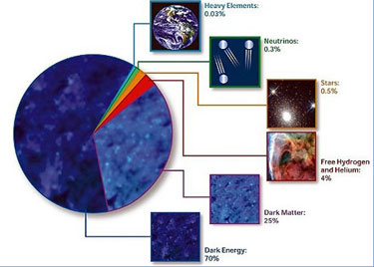
Cosmic Components

Slide 45
Cosmic Energy Inventarisation
sterren slechts ~0.1% energie
Heelal
Fukugita & Peebles 2004

Slide 46
Cosmic Constitution
Cosmic Pie Diagram
Changes in Time:

Slide 47
Matter-Dark Energy
Transition
matter
Radiation-Matter transition
radiation
dark energy

Slide 48
matter
radiation
Matter-
Dark Energy
Transition
Radiation-Matter transition
dark energy

Slide 49
Our Universe:
the Concordance Cosmos

Slide 50
Concordance Universe Parameters
Hubble Parameter
Age of the Universe
Temperature CMB
Matter | Baryonic Matter Dark Matter
Radiation | Photons (CMB) Neutrinos (Cosmic)
Dark Energy
Total

Slide 51
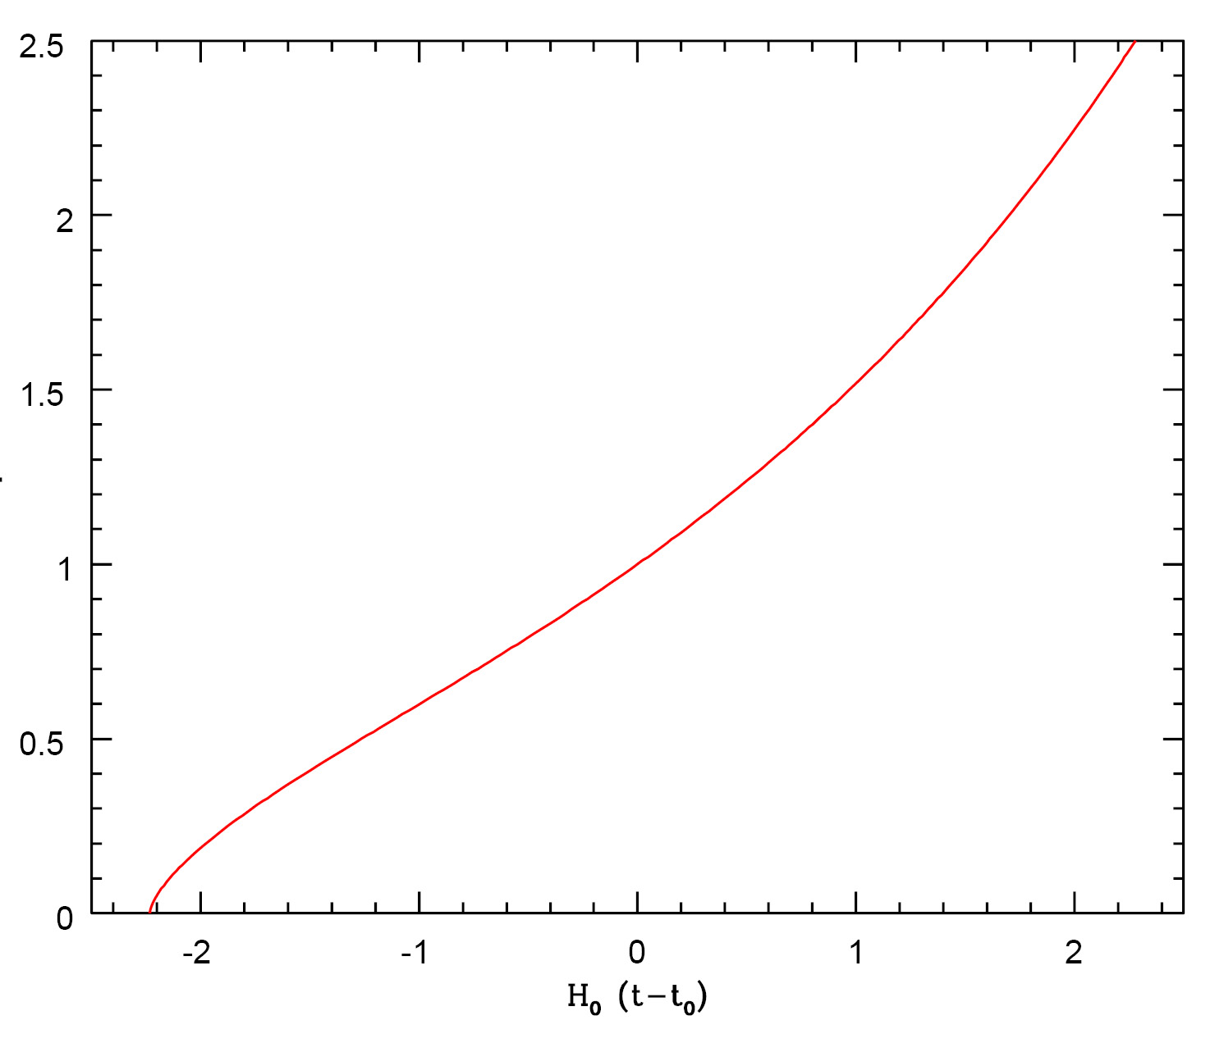
Concordance Expansion

Slide 52
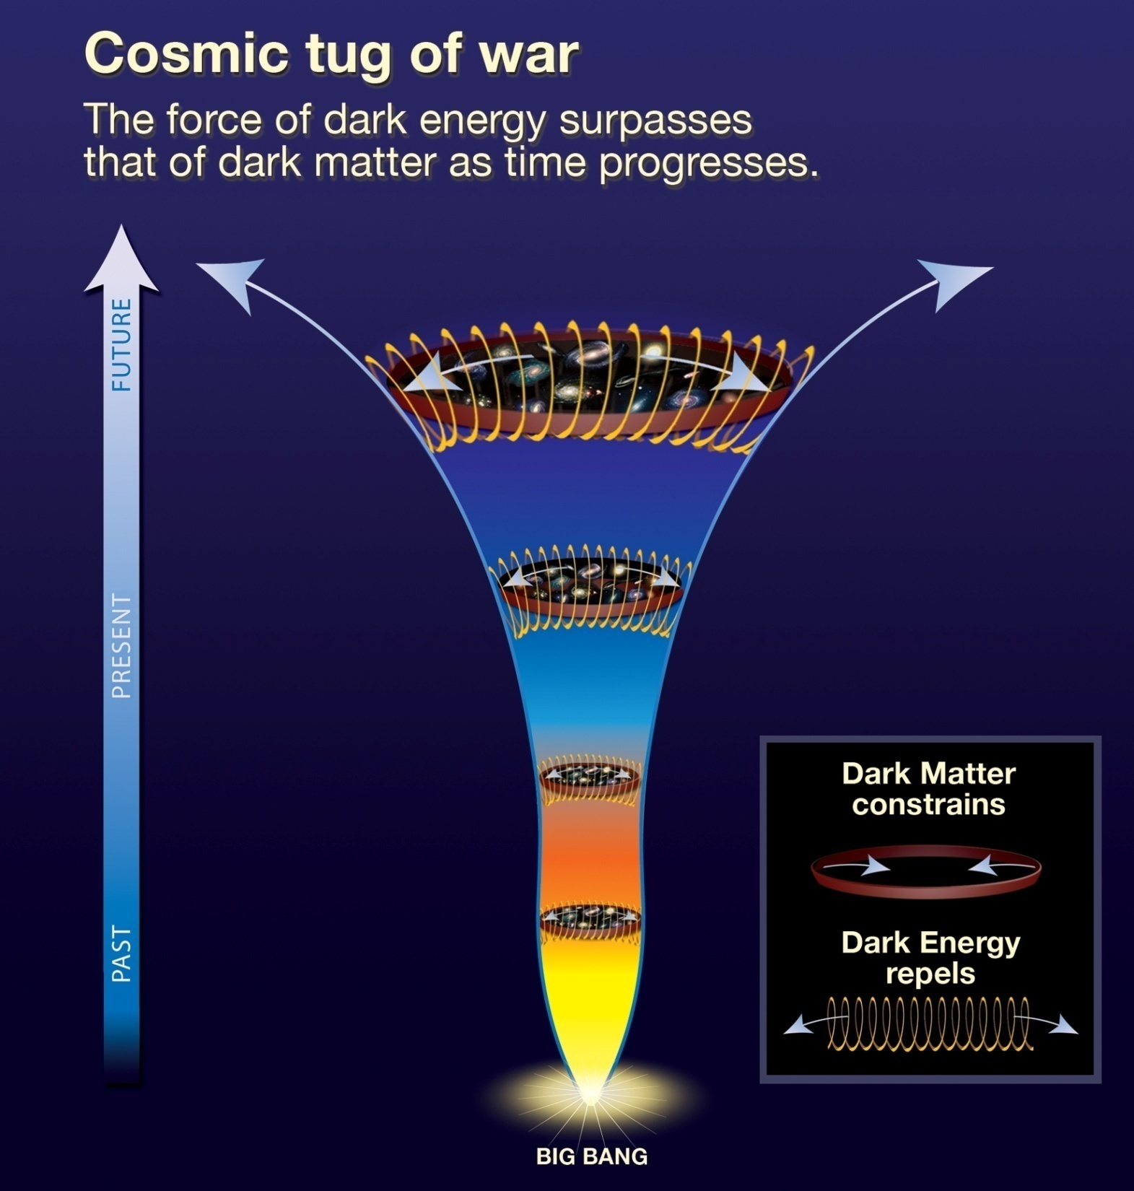
Heden & Toekomst:
VERSNELLING
Vroeger:
VERTRAGING

Slide 53
Age of the Universe

Slide 54
Hubble Time
• The repercussions of Hubble’s discovery are truly tremendous:
the inescapable conclusion is that the universe has a finite age !
• Just by simple extrapolation back in time we find that at some instant the objects will
have touched upon each other, i.e. r(t_{H})=0. If we assume for simplicity that the
expansion rate did remain constant (which it did not !), we find a direct measure for
the age of the universe, the
Hubble Time:
The Hubble parameter is usually stated in units of km/s/Mpc.
It’s customary to express it in units of 100 km/s/Mpc, expressing the real value in terms of
the dimensionless value h=H₀/[100 km/s/Mpc].
The best current estimate is H₀=72 km/s/Mpc. This sets t₀~10 Gyr.

Slide 55
Hubble Parameter
For a long time, the correct value of the Hubble constant H₀
was a major unsettled issue:
H₀ = 50 km s⁻¹ Mpc⁻¹ H₀ = 100 km s⁻¹ Mpc⁻¹
This meant distances and timescales in the Universe had to
deal with uncertainties of a factor 2 !!!
Following major programs, such as Hubble Key Project, the
Supernova key projects and the WMAP CMB measurements,

Slide 56
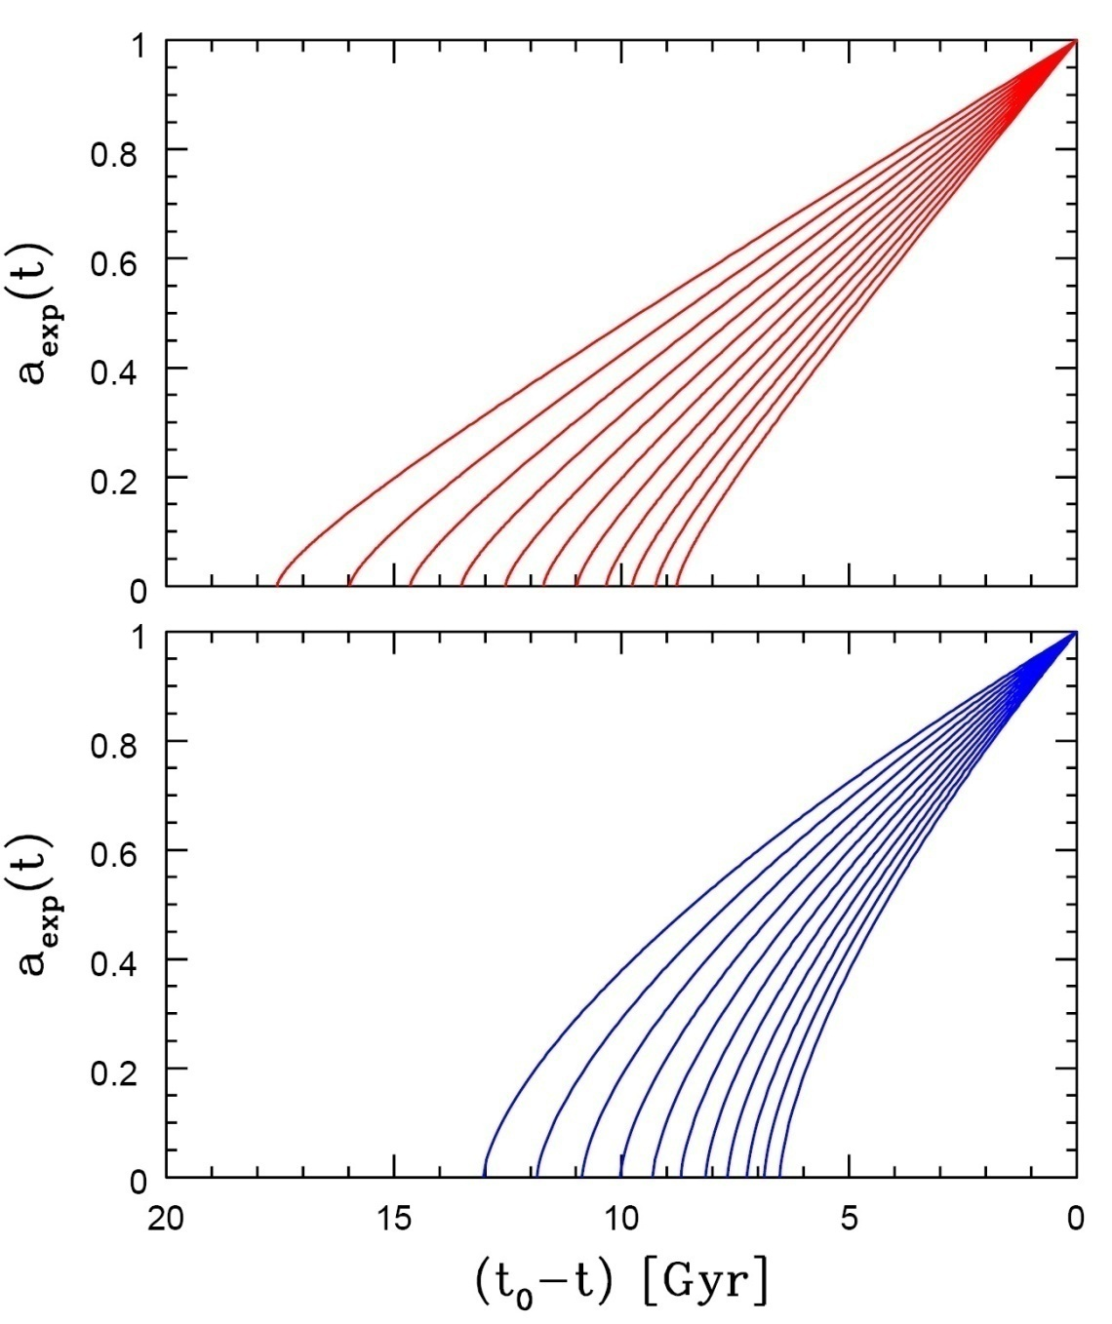
Age of the Universe
Age of a FRW universe at
Expansion factor a(t)
Matter-dominated
Hubble time
Matter-dominated

Slide 57
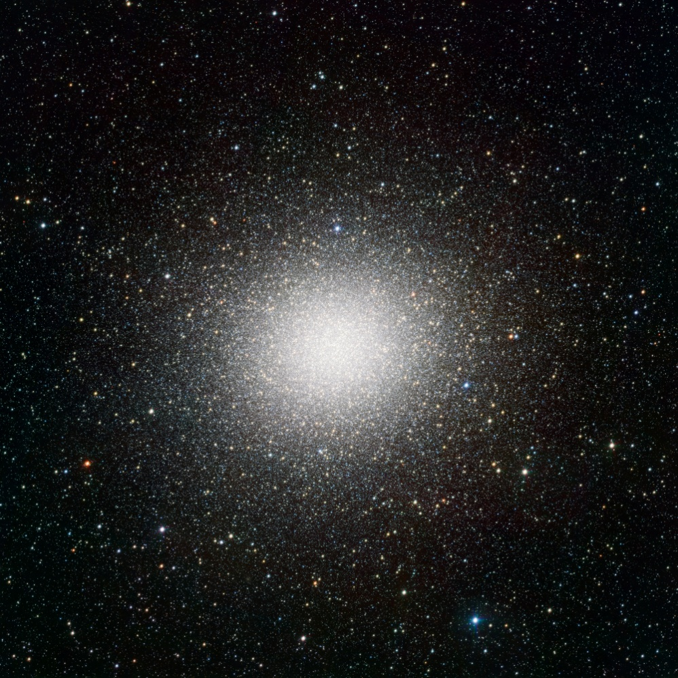
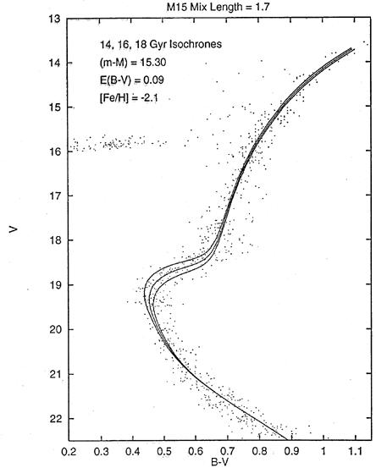
Cosmic Age
estimated age of the oldest stars in Universe
far in excess of estimated
age of matter-dominated FRW Universe:
Globular cluster stars: 13-15 Gyr
Universe: 10-12 Gyr
Globular Clusters
Roughly spherical assemblies of 100,000-200,000 stars
Radius ~ 20-50 pc: extremely high star density
Globulars are very old, amongst oldest objects in local Universe
Stars formed around same time: old, red, population
Colour-magnitude diagram characteristic:
accurate age determination on the basis of stellar evolution theories.
APM
Typical
1980-1990s isochrone fit
Omega Centauri

Slide 58
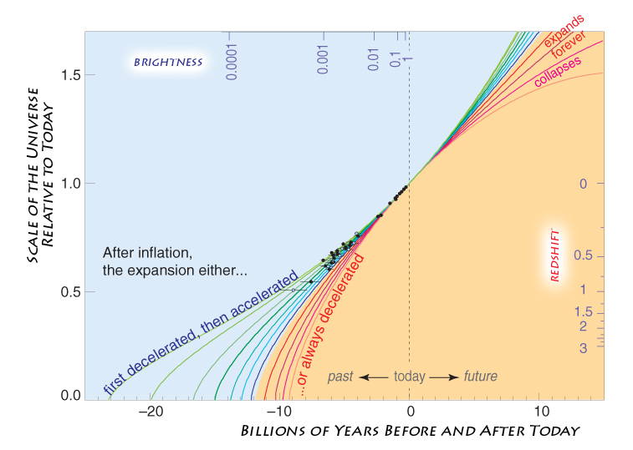
Concordance Expansion

Slide 59
Adiabatic Expansion

Slide 60
Adiabatic Expansion
The Universe of Einstein, Friedmann & Lemaitre
expands adiabacally
Energy of the expansion of the Universe corresponds to the decrease in the energy of its constituents
The Universe COOLS as a result of its expansion !

Slide 61
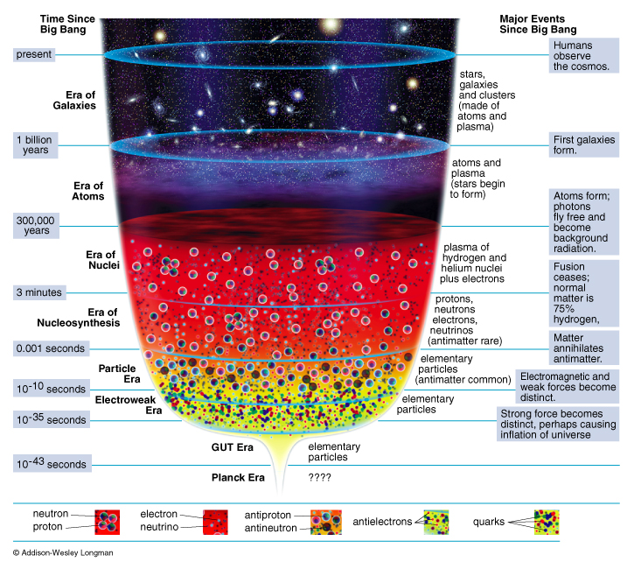
Adiabatic Expansion
reconstruction
Thermal History
of the Universe

Slide 62
Cosmic Epochs
Planck Epoch t < 10⁻⁴³ sec
Phase Transition Era 10⁻⁴³ sec < t < 10⁵sec
Hadron Era t ~10⁻⁵ sec
Lepton Era 10⁻⁵ sec < t < 1 min
Radiation Era 1 min < t <379,000 yrs
Post-Recombination Era t > 379,000 yrs
GUT transition
electroweak transition
quark-hadron transition
muon annihilation
neutrino decoupling
electron-positron annihilation
primordial nucleosynthesis
radiation-matter equivalence
recombination & decoupling
Structure & Galaxy formation
Dark Ages
Reionization
Matter-Dark Energy transition

Slide 63
Big Bang:
the Evidence

Slide 64
Big Bang Evidence
Olber’s paradox:
the night sky is dark
finite age Universe (13.7 Gyr)
Hubble Expansion
uniform expansion, with
expansion velocity ~ distance: v = H r
Explanation Helium Abundance 24%:
light chemical elements formed (H, He, Li, …)
after ~3 minutes …
The Cosmic Microwave Background Radiation:
the 2.725K radiation blanket, remnant left over
hot ionized plasma neutral universe
(379,000 years after Big Bang)
Distant, deep Universe indeed looks different …

Slide 65
1. Olber’s Paradox
In an infinitely large, old and unchanging
Universe each line of sight would hit a star:
Sky would be as bright as surface of star:

Slide 66
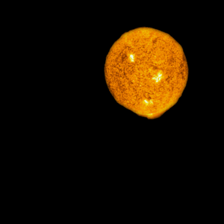
1. Olber’s Paradox
In an infinitely large, old and unchanging
Universe each line of sight would hit a star:
Sky would be as bright as surface of star:
Night sky as bright as
Solar Surface, yet
the night sky is dark
finite age of Universe (13.8 Gyr)

Slide 67
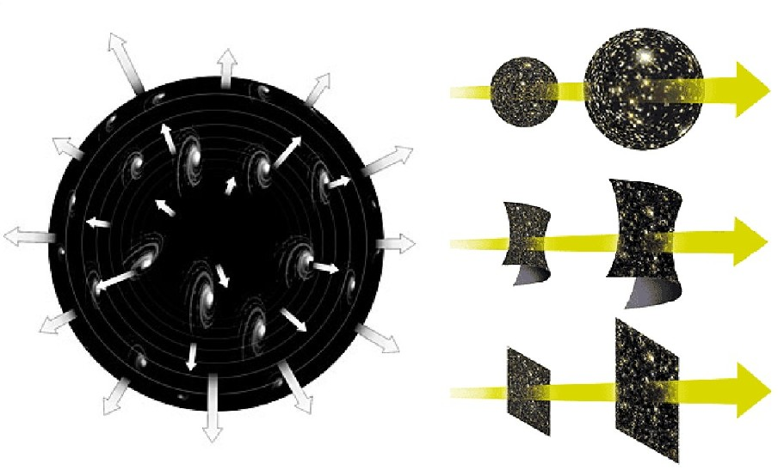
2. Hubble Expansion
Hubble constant
specifies expanssion rate of the Universe

Slide 68
3. And there was light ...

Slide 69
… and there was light … 379.000 years after the Big Bang

Slide 70
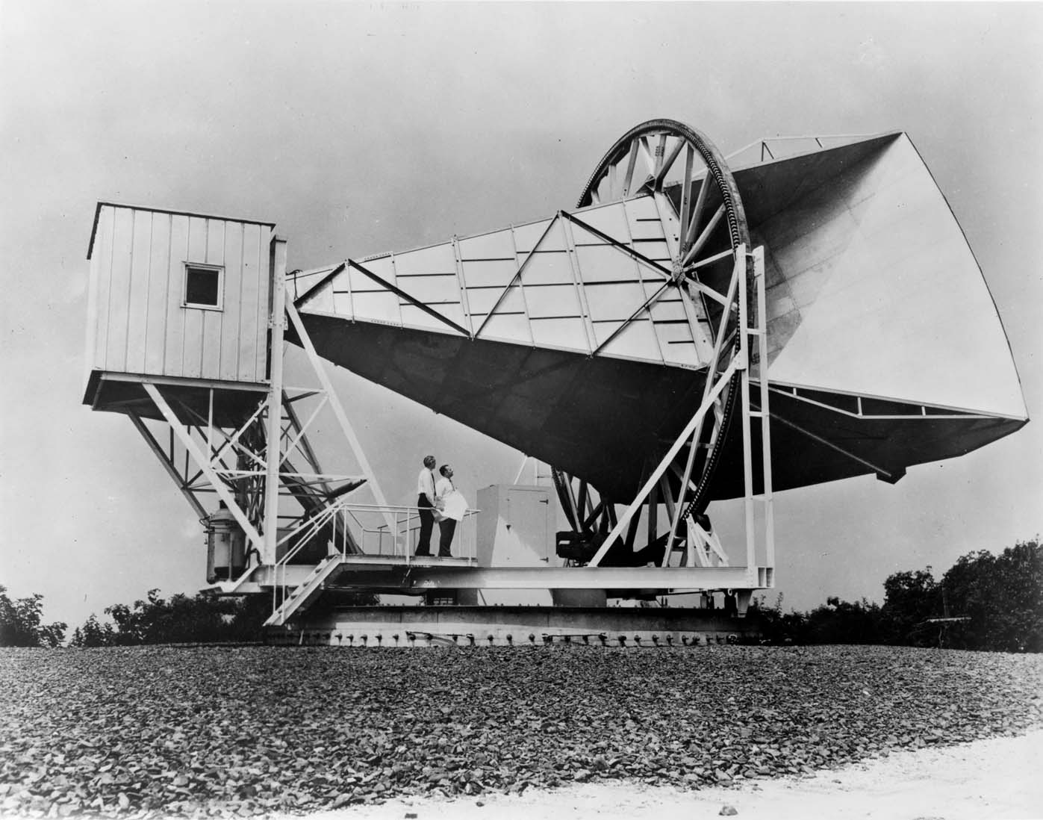
3. Cosmic Microwave Background Radiation

Slide 71
Cosmic Light (CMB): the facts
Discovered serendipitously in 1965 Penzias & Wilson,
Nobelprize 1978 !!!!!
Cosmic Licht that fills up the Universe uniformly
Temperature: T_{γ}=2.725 K
(CMB) photons most abundant particle in the Universe:
n_{γ} ~ 415 cm⁻³
Per atom in the Universe: n_{γ}/n _{B} ~ 1.9 x 10⁹
Ultimate evidence of the Big Bang !!!!!!!!!!!!!!!!!!!

Slide 72
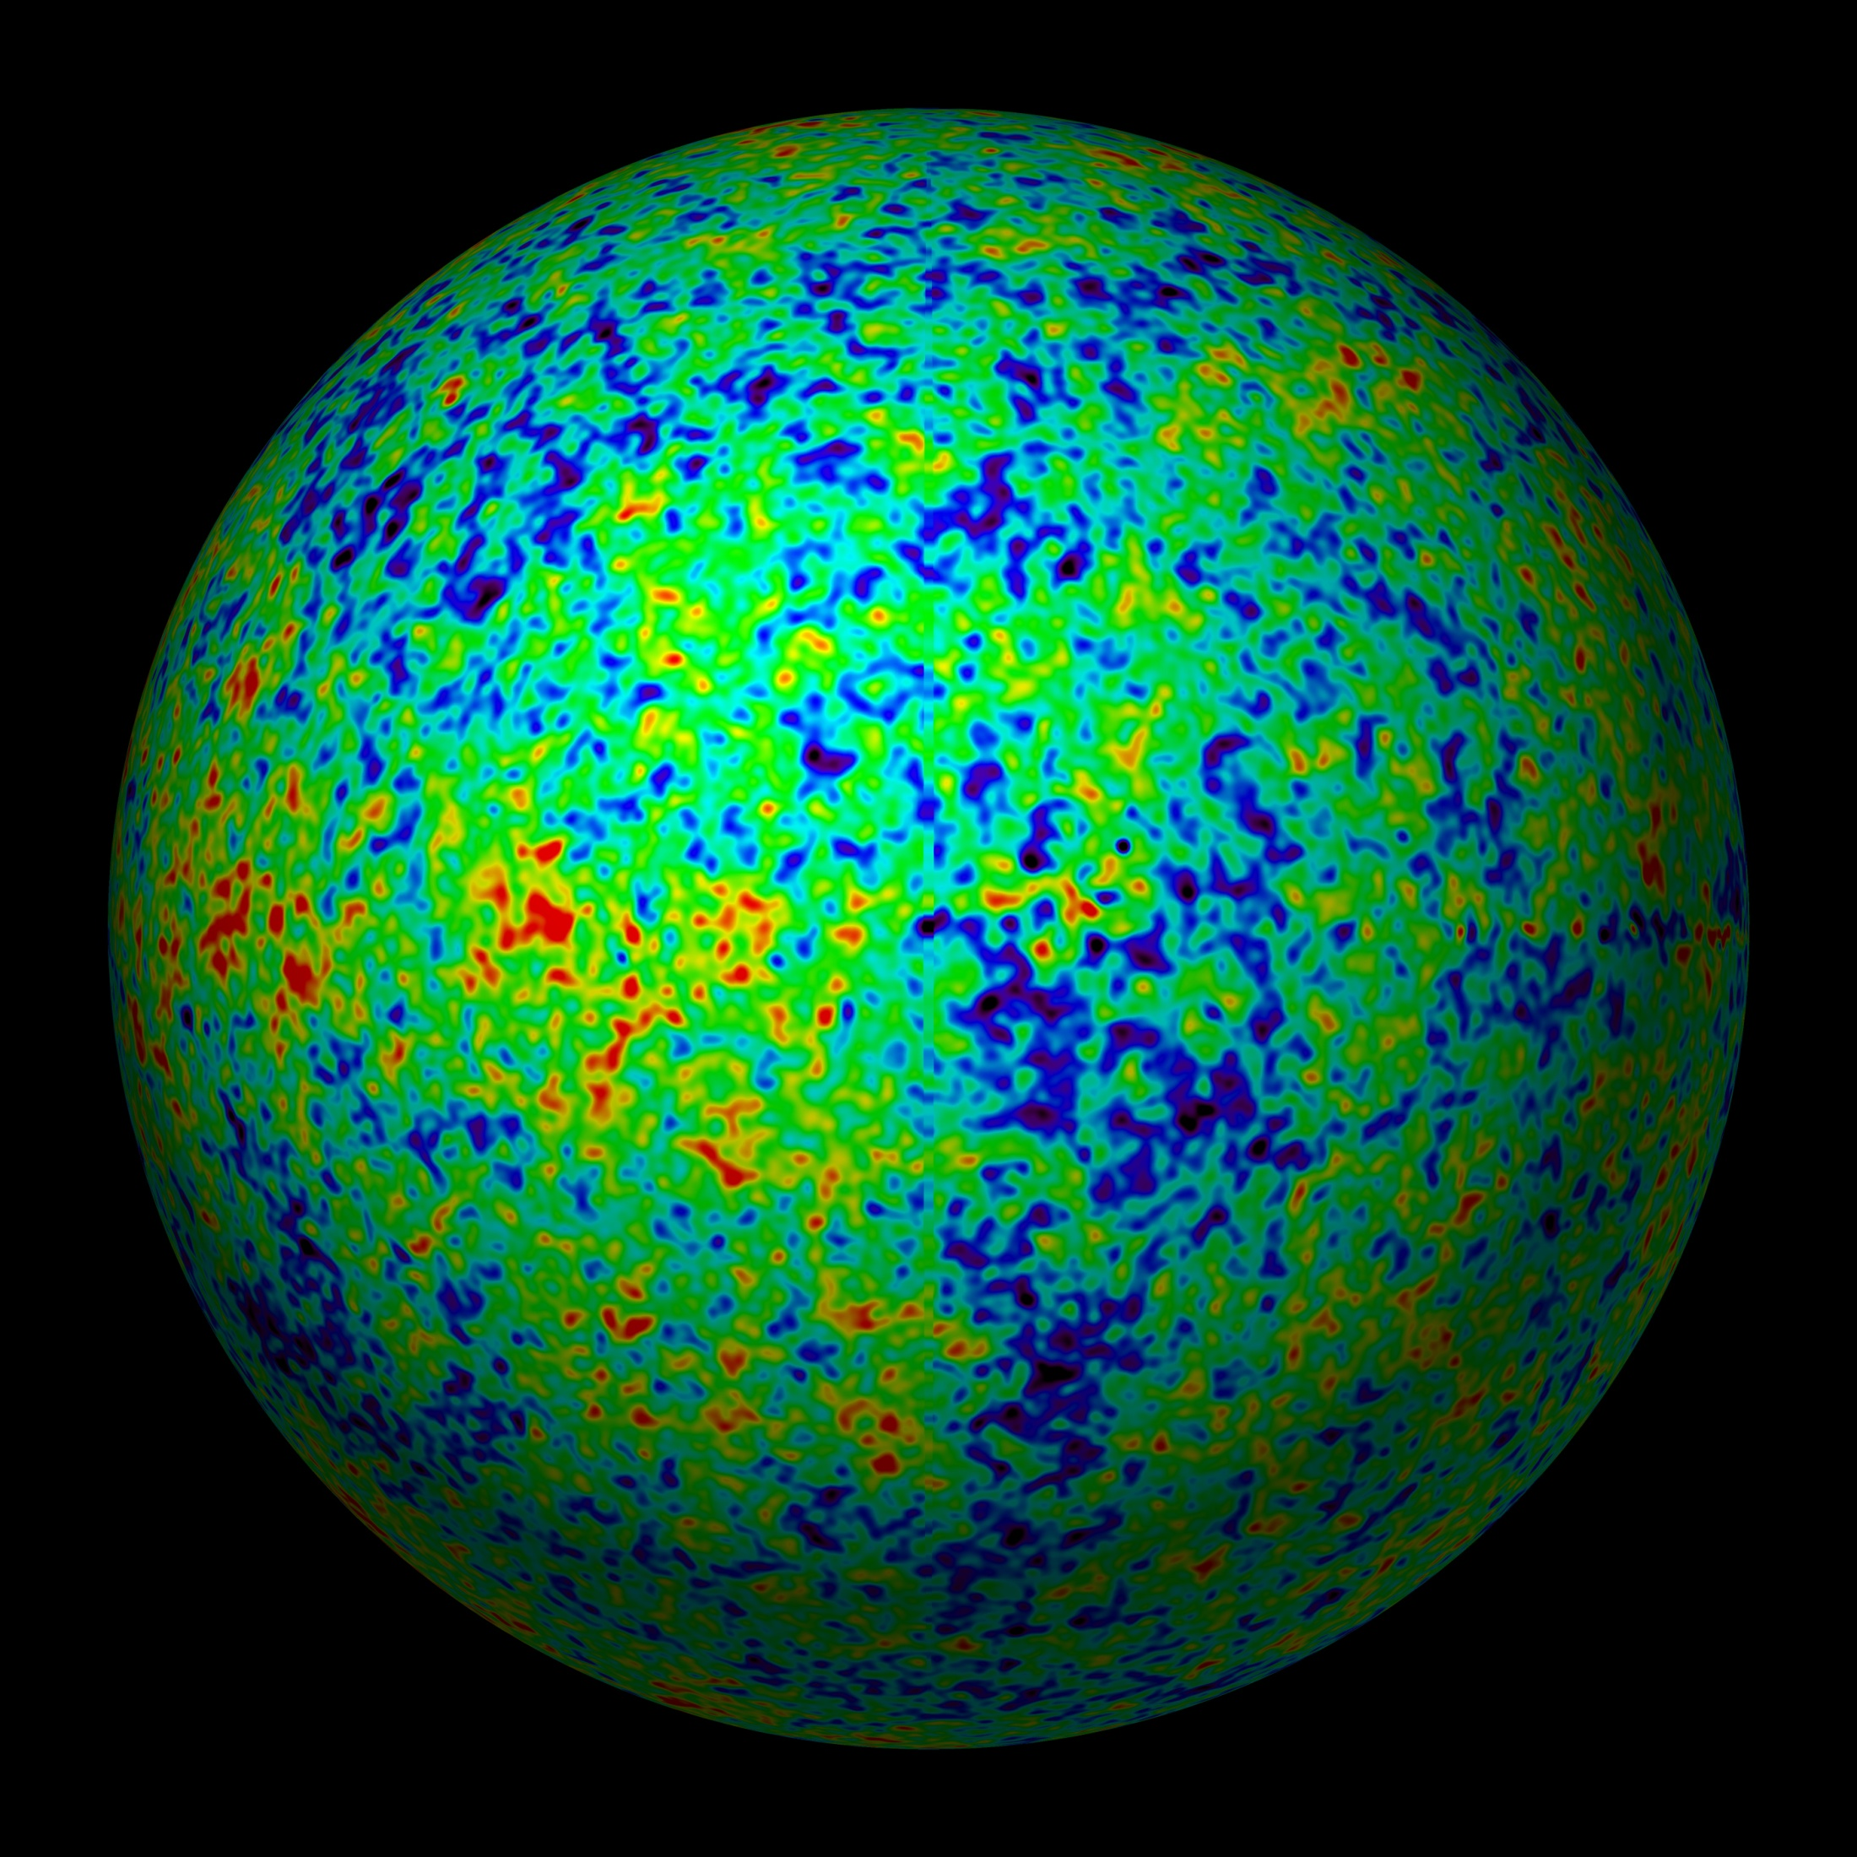
Extremely Smooth Radiation Field

Slide 73
Recombination & Decoupling
protonen & electronen
waterstofatomen
lichtdeeltjes/fotonen

Slide 75
the Cosmic TV Show
Note:
far from being an exotic faraway phenomenon, realize that the CMB nowadays is counting for approximately 1% of the noise on your (camping) tv set …
!!!! Live broadcast from the Big Bang !!!!
Courtesy: W. Hu

Slide 76
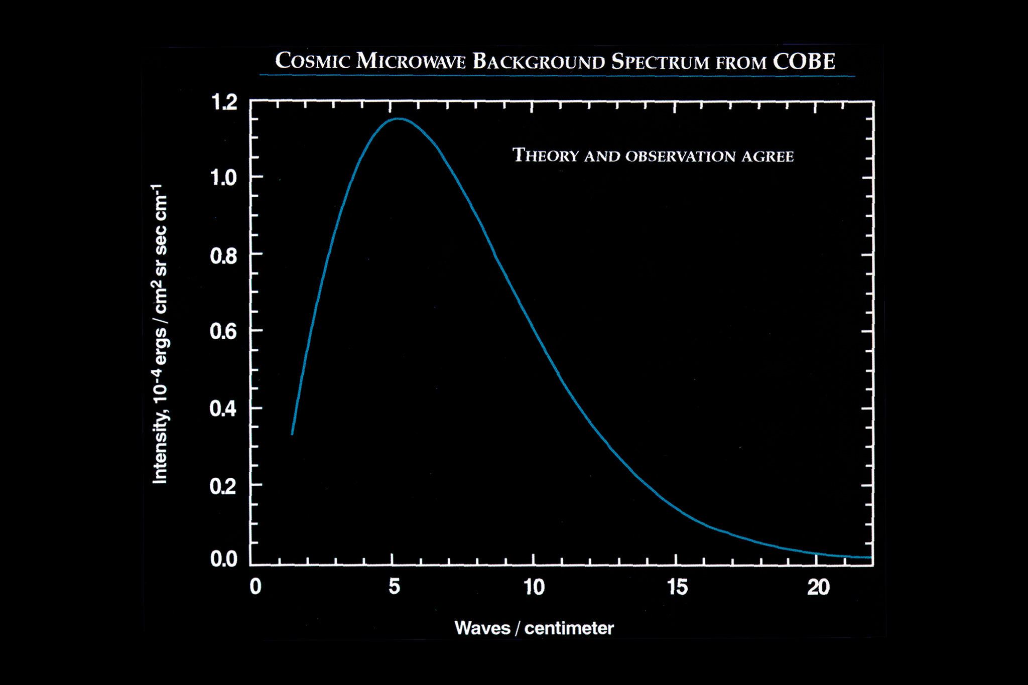
Energy Spectrum
Cosmic Light
• COBE-DIRBE:
temperatureT = 2.725 K
John Mather
Nobelprize physics
2006
• Most perfect
Black Body
Spectrum ever seen !!!!

Slide 77
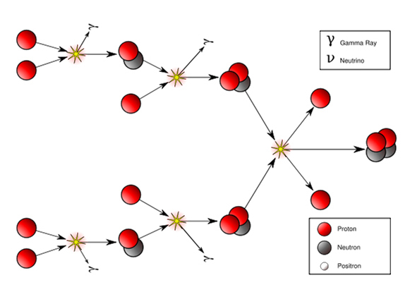
4. Proton-Neutron & Helium
Mass Fraction Light Elements
24% ⁴He nuclei
traces D, ³He, ⁷Li nuclei
75% H nuclei (protons)
p/n ~1/7: 1 min na BB
Between 1-200 seconds after Big Bang,
temperature dropped to 10⁹ K:
Fusion protons & neutrons
into light atomic nuclei

Slide 78
5. the Changing Universe
At great depths
the Universe
looks completely
different
and thus
long ago :
Depth= Time
Galaxies in Hubble Ultra Deep Field

Slide 79
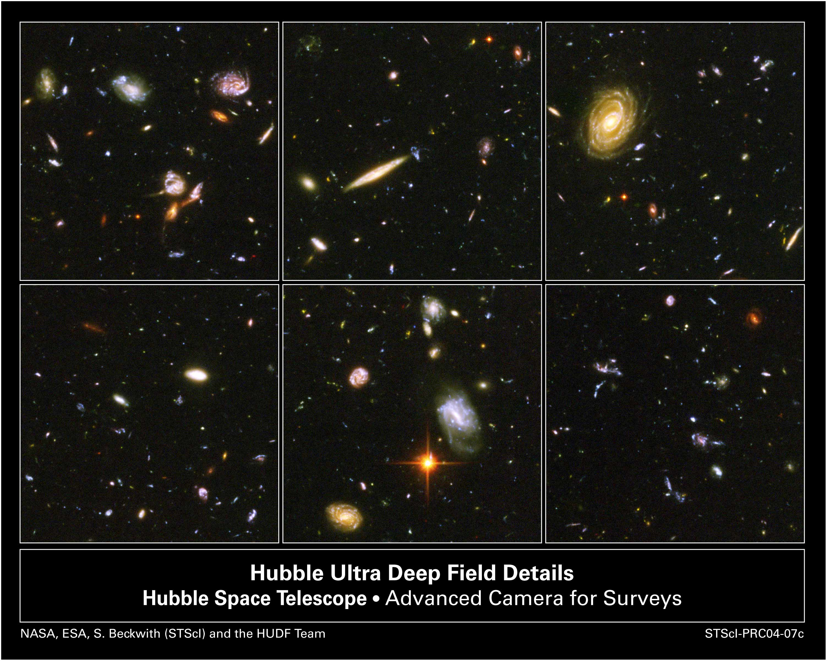
5. the Changing Universe
At great depths
the Universe
looks completely
different
and thus
long ago :
Depth= Time
Galaxies in Hubble Ultra Deep Field

Slide 80
Cosmic Curvature

Slide 81
How Much ?
Cosmic Curvature

Slide 82
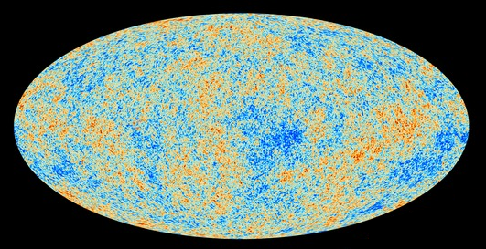
Cosmic Microwave Background
Map of the Universe at Recombination Epoch (Planck, 2013):
• 379,000 years after Big Bang
• Subhorizon perturbations: primordial sound waves
• ∆T/T < 10-5

Slide 83
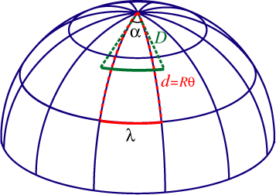
Measuring Curvature
Measuring the Geometry of the Universe:
• Object with known physical size,
at large cosmological distance
● Measure angular extent on sky
● Comparison yields light path,
and from this the curvature of space
W. Hu
Geometry of Space

Slide 84
Measuring Curvature
• Object with known physical size,
at large cosmological distance:
• Sound Waves in the Early Universe !!!!
W. Hu
Temperature Fluctuations
CMB

Slide 85
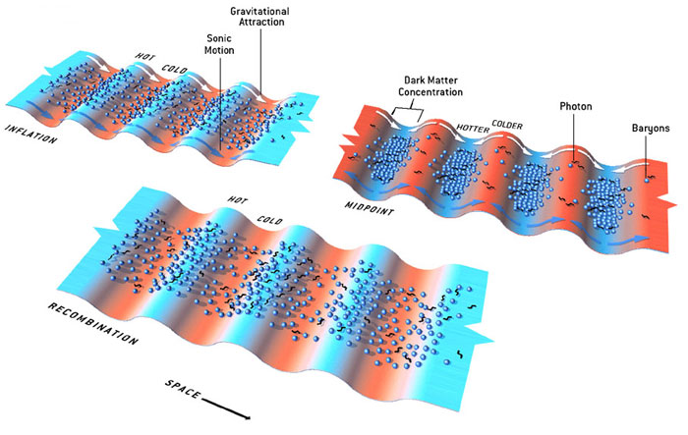
Fluctuations-Origin

Slide 86
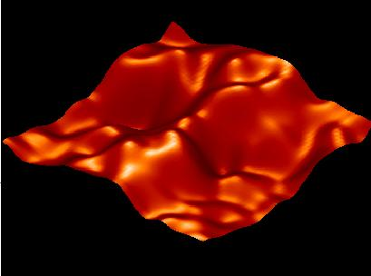
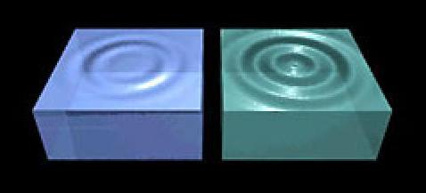
Music of the Spheres
● small ripples in
primordial matter & photon distribution
● gravity:
- compression primordial photon gas
- photon pressure resists
● compressions and rarefactions
in photon gas: sound waves
● sound waves not heard, but seen:
- compressions: (photon) T higher
- rarefactions: lower
● fundamental mode sound spectrum
- size of “instrument”:
- (sound) horizon size last scattering
● Observed, angular size: θ~1º
- exact scale maximum compression, the
“cosmic fundamental mode of music”
W. Hu

Slide 87
Cosmic Microwave Background
Size Horizon Recombination
COBE measured fluctuations: > 7º
Size Horizon at Recombination spans angle ~ 1º

Slide 88
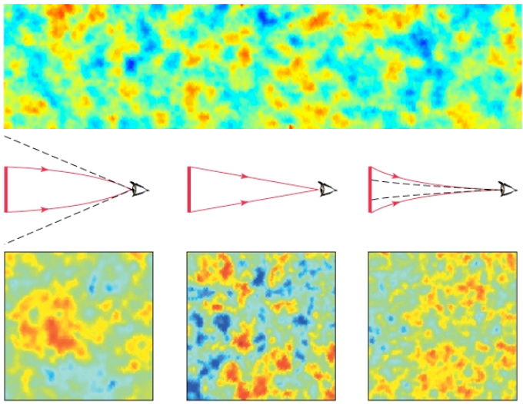
Flat universe from CMB
First peak: flat universe
We know the redshift and the time it took for the light to reach us:
from this we know the
- length of the legs of the
triangle
- the angle at which we are
measuring the sound horizon.
Closed:
hot spots
appear larger
Flat:
appear as big as they are
Open:
spots appear smaller

Slide 89
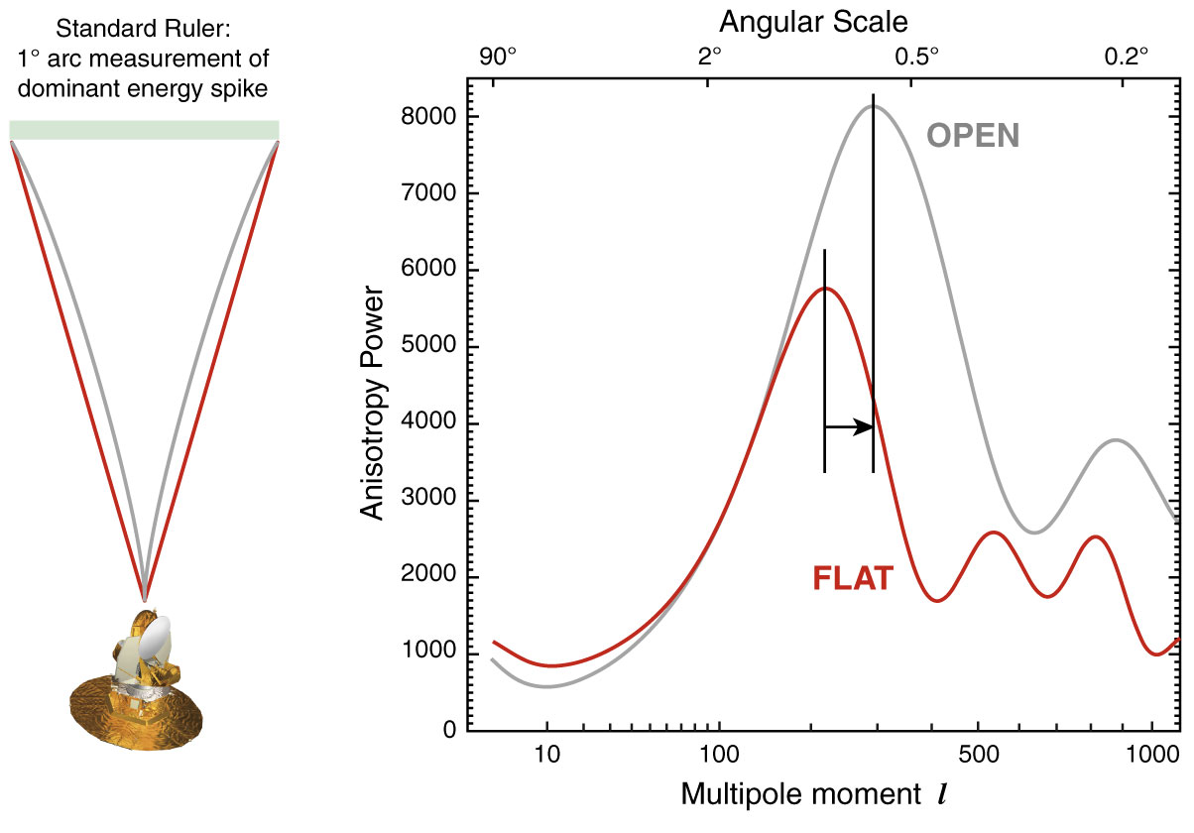
The WMAP CMB temperature
power spectrum

Slide 90
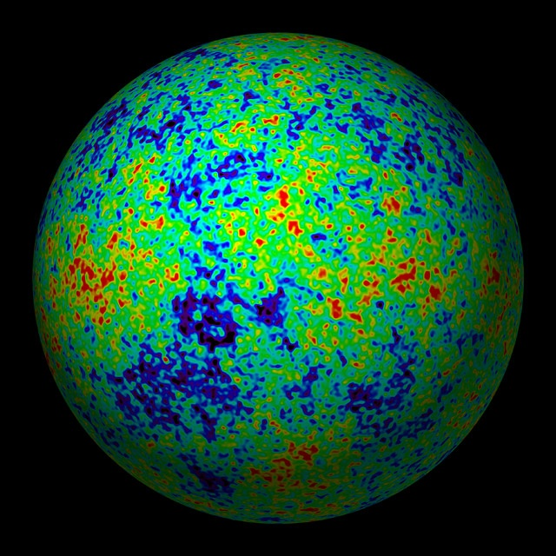
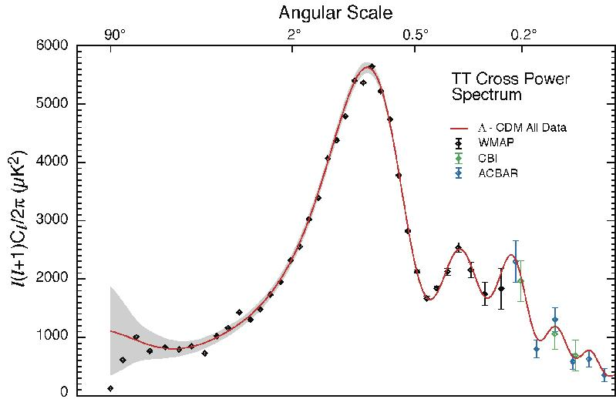
The Cosmic Tonal Ladder
The WMAP CMB temperature
power spectrum
Cosmic sound horizon
The Cosmic Microwave Background Temperature Anisotropies:
Universe is almost perfectly FLAT !!!!

Slide 91
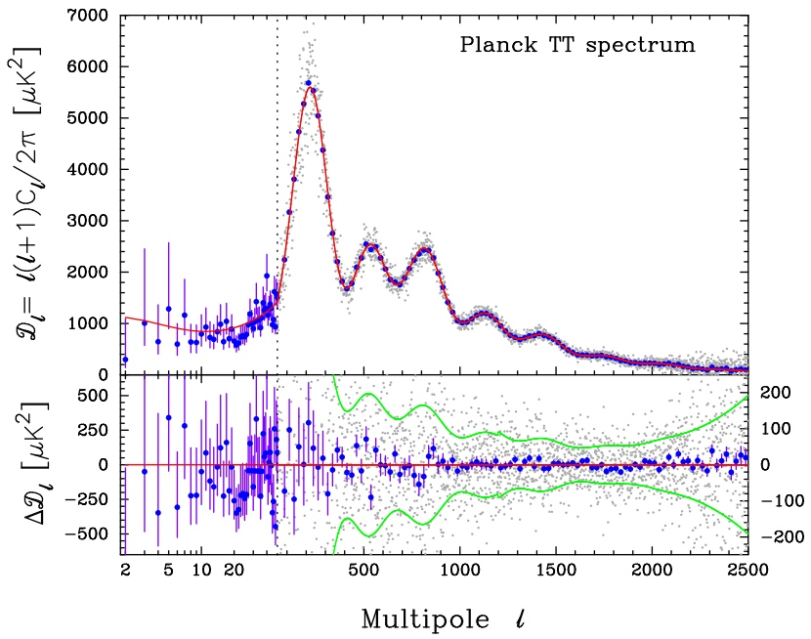
CMB - Fluctuations

Slide 92
Cosmic Horizons

Slide 93
Cosmic Horizons
Fundamental Concept for our understanding of the physics of the Universe:
Physical processes are limited to the region of space with which we are
or have ever been in physical contact.
What is the region of space with which we are in contact ?
Region with whom we have been able to exchange photons
(photons: fastest moving particles)
From which distance have we received light.
Complication: - light is moving in an expanding and curved space
- fighting its way against an expanding background
This is called the
Horizon of the Universe
:

Slide 94
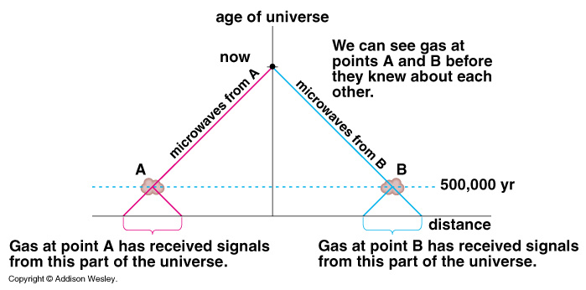
Cosmic Horizons
Horizon of the Universe:
distance that light travelled since the Big Bang

Slide 96
Cosmic Future

Slide 97
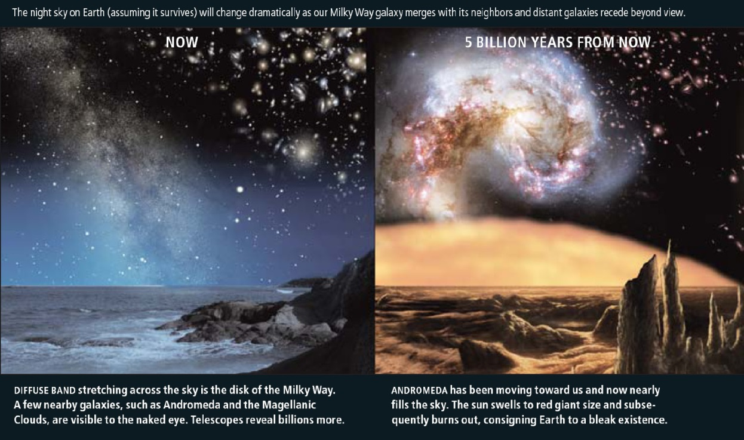
Cosmic Fate
100 Gigayears:
the end of Cosmology

