Slide 1
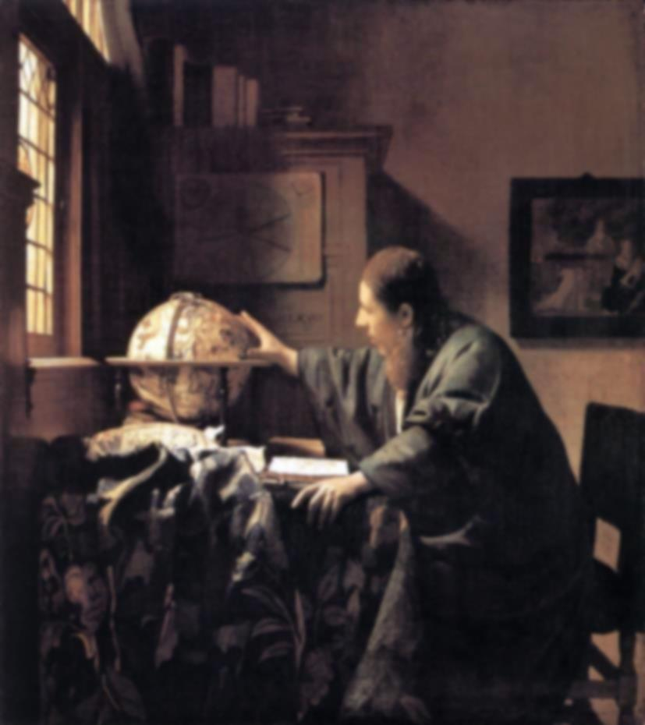
the Scientific Revolution:
the Cosmos Mechanized

Slide 2
1543
Nicolaus Copernicus
- publishes heliocentric universe in De Revolutionibus Orbium Coelestium
- implicit introduction Copernican principle: Earth/Sun is not special
1609-1632
Galileo Galilei
- by means of (telescopic) observations, proves the validity of the heliocentric Universe.
1609/1619
Johannes Kepler
- the 3 Kepler laws, describing the elliptical orbits of the planets around the Sun
1687
Isaac Newton
- discovers Gravitational Force as agent behind cosmic motions
- publishes his Principia (Philosophiae Naturalis Principia Mathematica), which establishes
the natural laws of motion and gravity (the latter only to be replaced by Einstein’s theory of GR)
1755
Immanuel Kant
- asserts that nebulae are really galaxies separate from and outside from the Milky Way,
- calling these Island Universes
1785
William Herschel
- proposes theory that our Sun is at or near the center of ou Galaxy (Milky Way)

Slide 3
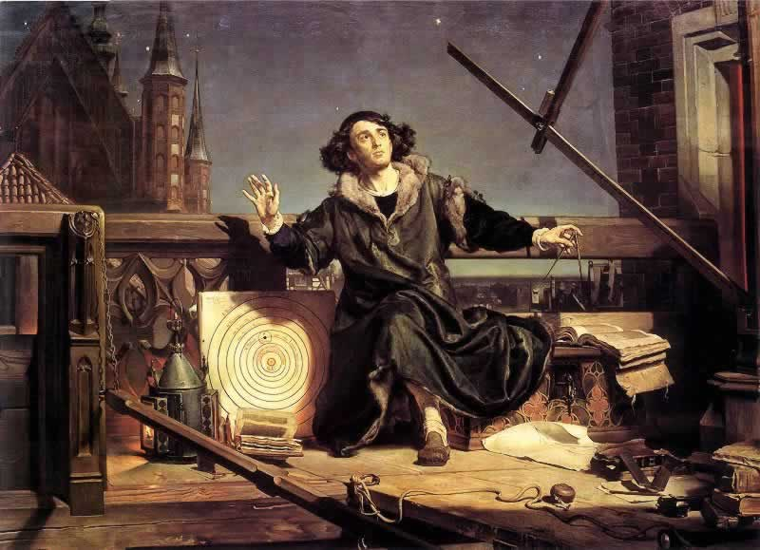
Nikolaus Copernicus (1473-1543)

Slide 4
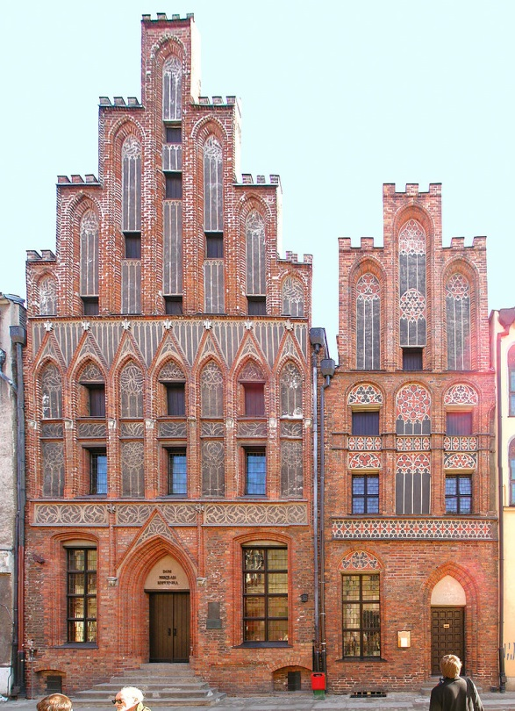
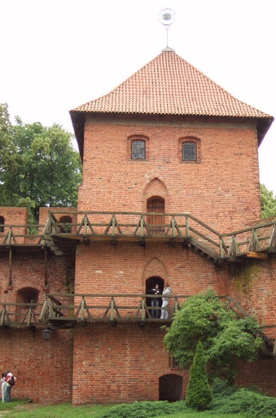
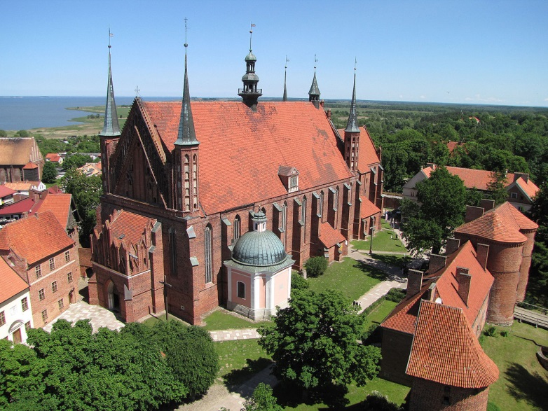
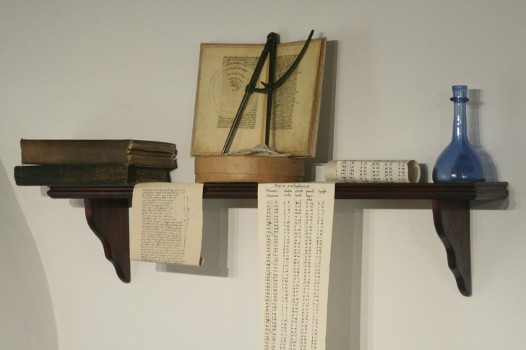
Nicolaus Copernicus
Birthhouse Copernicus,
Torun
1473 – born in Torun (Poland)
1491-1495 - study Univ. Krakow
1496-1501 - 3 years Univ. Bologna - canon law
1503- - Warmia
1514 - Frombork
Languages: Latin , German
- Commentariolus
Nicolai Copernici de hypothesibus motuum coelestium a se
constitutis commentariolus
+ theoretical treatise on heliocentric mechanism
+ 40 pages, 7 basic assumptions
Tower (living) Copernicus, Frombork Frombork Cathedral

Slide 5
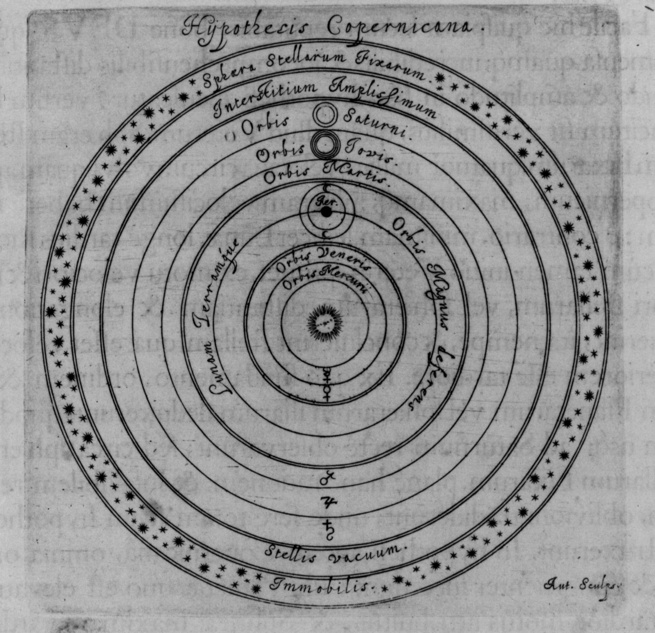
There is no one center of all the celestial circles or spheres.
The center of the earth is not the center of the universe, but only of
gravity and of the lunar sphere.
3. All the spheres revolve about the sun as their midpoint, and therefore
the sun is the center of the universe.
4. The ratio of the earth's distance from the sun to the height of the firmament
(outermost celestial sphere containing the stars) is so much smaller than the
ratio of the earth's radius to its distance from the sun that the distance from
the earth to the sun is imperceptible in comparison with the height of the
firmament.
5. Whatever motion appears in the firmament arises not from any motion of the
firmament, but from the earth's motion. The earth together with its circumjacent
elements performs a complete rotation on its fixed poles in a daily motion, while
the firmament and highest heaven abide unchanged.
6. What appear to us as motions of the sun arise not from its motion but from the
motion of the earth and our sphere, with which we revolve about the sun like
any other planet. The earth has, then, more than one motion.
The apparent retrograde and direct motion of the planets arises not from their
motion but from the earth's. The motion of the earth alone, therefore, suffices
to explain so many apparent inequalities in the heavens.
Commentariolus

Slide 6
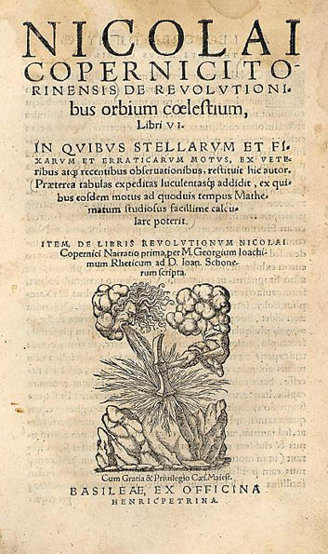
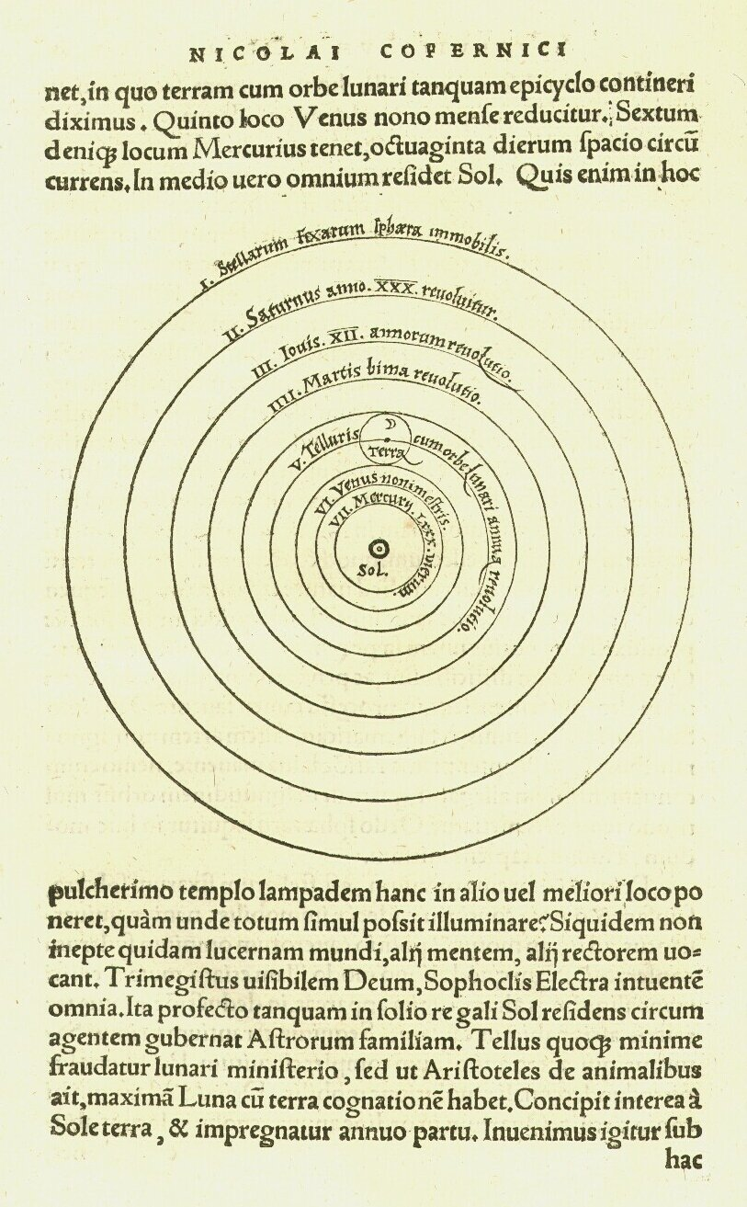
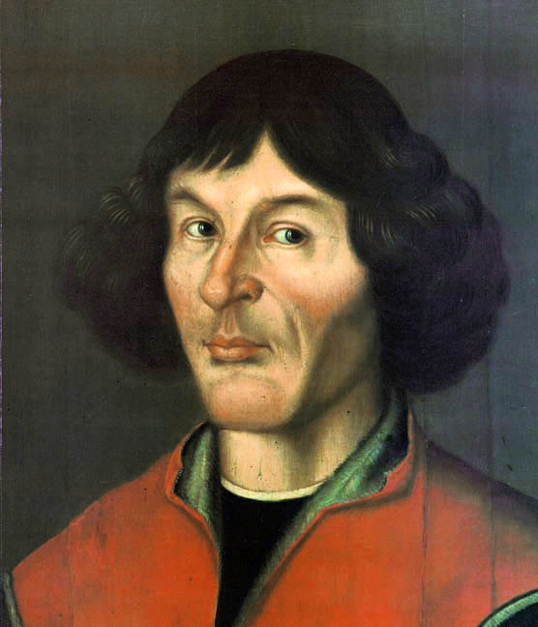
De Revolutionibus
Orbium Coelestium

Slide 8
Nicolaus Copernicus
1543 – publication
De Revolutionibus Orbium Coelestium
(On the Revolution of the Celestial Spheres)
1514- Commentariolus (Little Commentary)
1532 – finished work on Revolutionibus
- publication pushed and processed
by George Joachim Rheticus
(mathematician Wittenberg)
- printed by
Johannes Petreius, Nuremburg
May 24, 1543 - death Copernicus
- legend: presentation last
pages printed Revolutionibus
Note:
Copernicus cited Aristarchus of Samos in an early (unpublished) manuscript of De Revolutionibus (which still survives), though he removed the reference from
his final published manuscript.

Slide 9
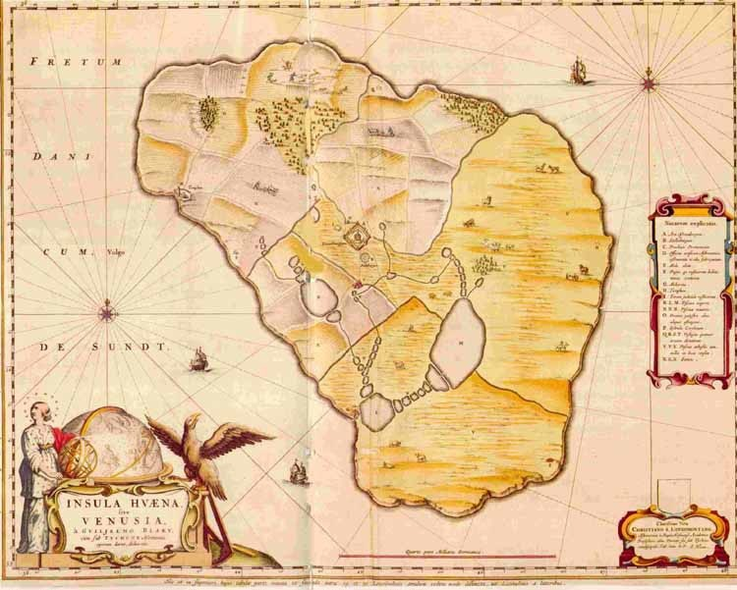
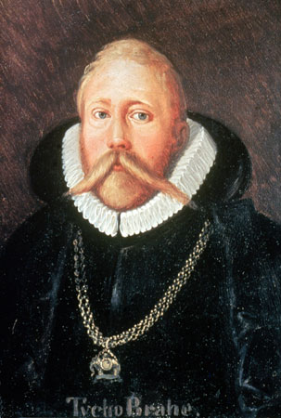
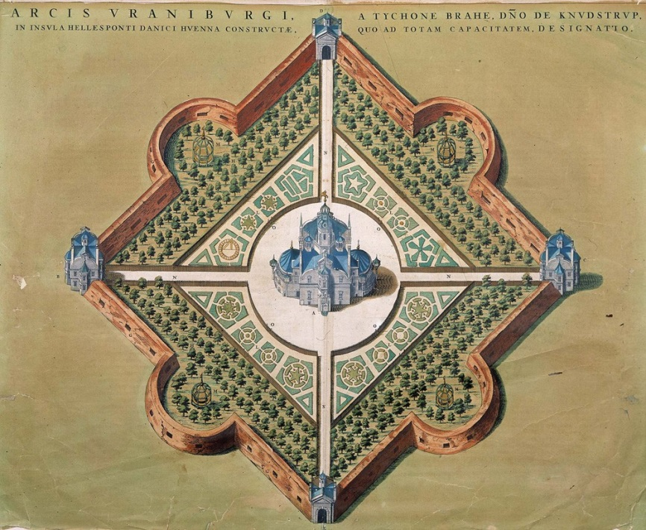
Tycho Brahe (1546-1601)
Observatory Uranienborg
on island Hven (nowadays between Sweden-Denmark)

Slide 10
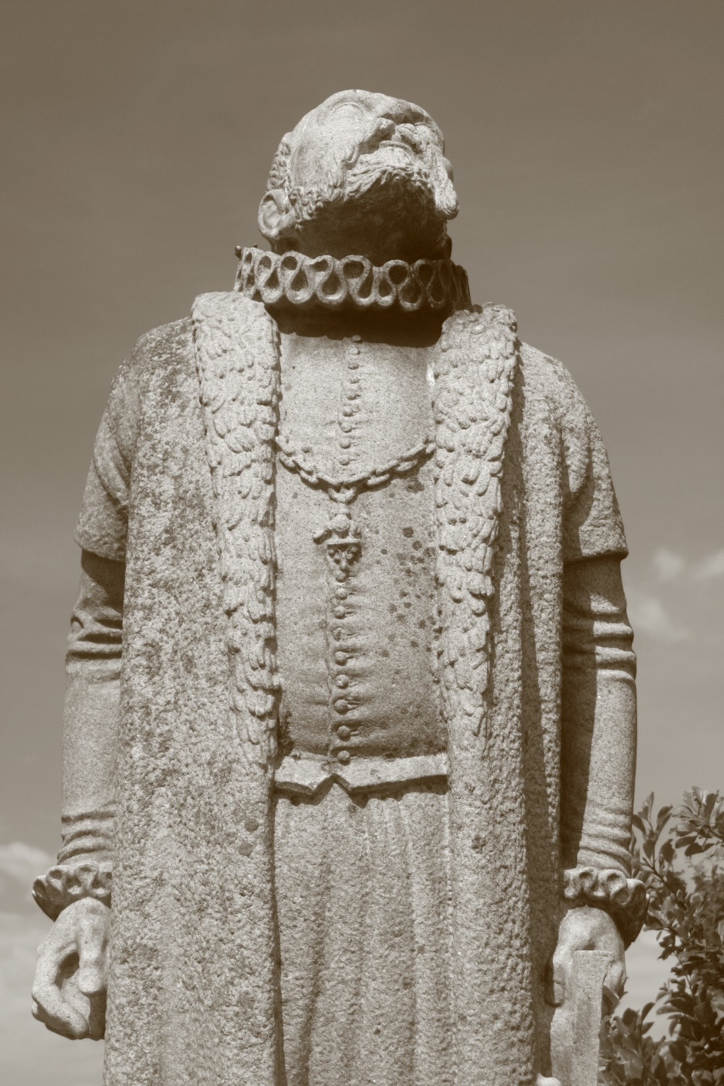
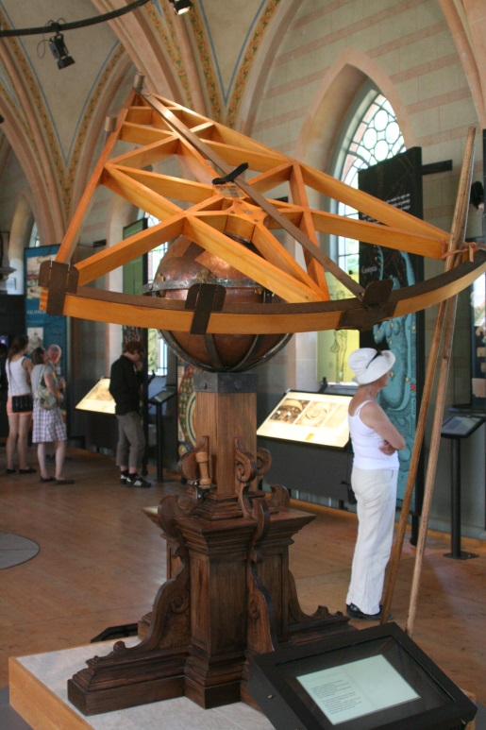
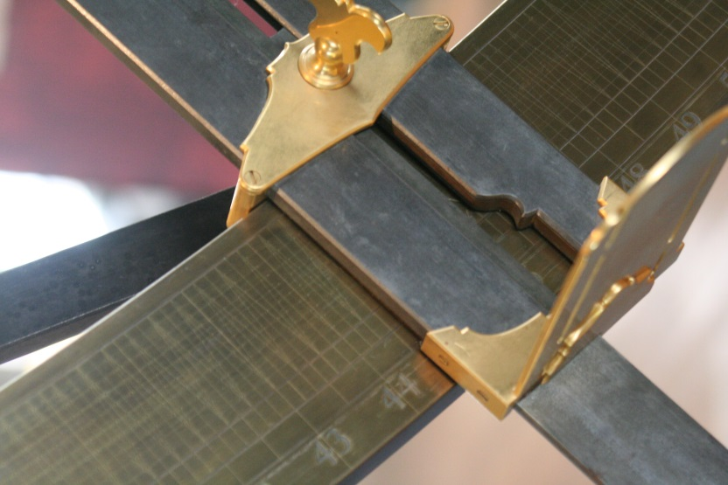
Tycho Brahe (1546-1601)
Danish nobleman
astronomer, astrologer,
alchemist
Observatory Uraniborg
on island Hven
- Hven was his fiefdom
entire island Hven
devoted to exploitation
for observatory
Brahe famous for
high
+ acccuracy
+ quantity
astronomical and
planetary observations
before telescope
Key to Scientific Revolution
Quadrant
Achieved
Accuracy
~1’-2’

Slide 11
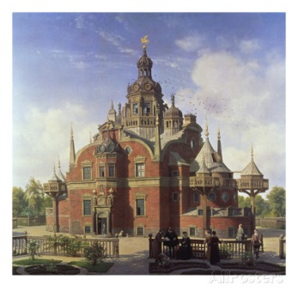
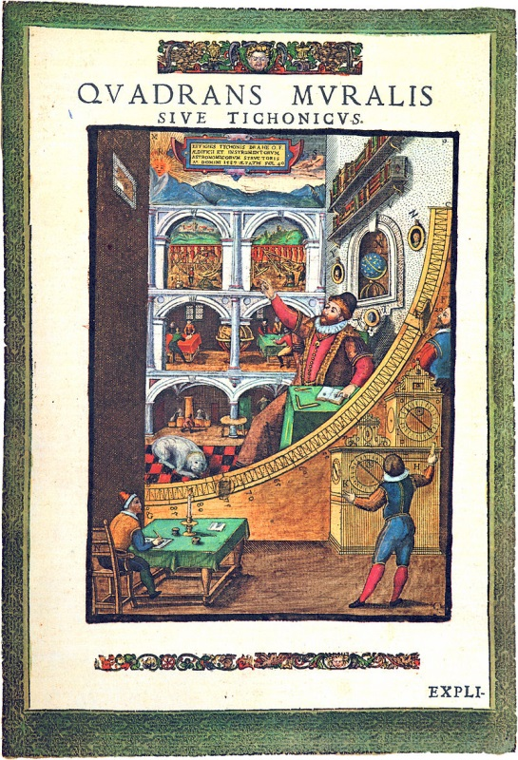
Uraniborg
Uraniborg
Island Hven given to
Tycho by Danish king
Frederik II
1576:
building of Uraniborg
1581:
building of annex,
Stjerneborg
cellar Uraniborg:
alchemy experiments
1576-1597
~ 100 students & assistants
research community in
Research Center &
Institution of Education

Slide 12
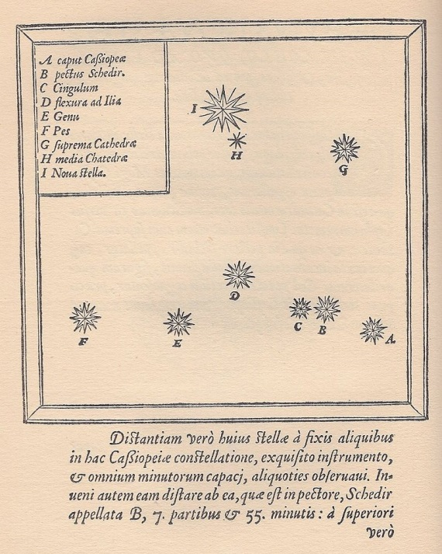
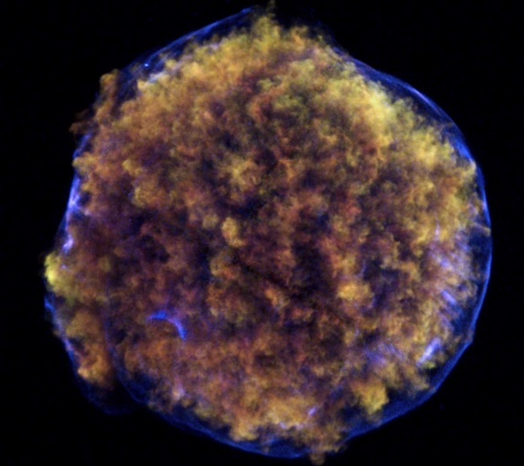
De Nova Stella (1572)
End of the Aristoteleian cosmological view that
- the world beyond the Moon is eternally unchanging
- 11 Nov. 1572
Tycho observed
a new star
- Constellation Cassiopeia
At hindisight it has
been 1 of the 5 visible
supernovae that have
exploded in the Galaxy
over the past 1000 years
- distance: 7500 lightyears
Tycho published this
in De Nova Stella
Supernova remnant
SN1572
Tycho’s SNR (1572)
Exploding star

Slide 13
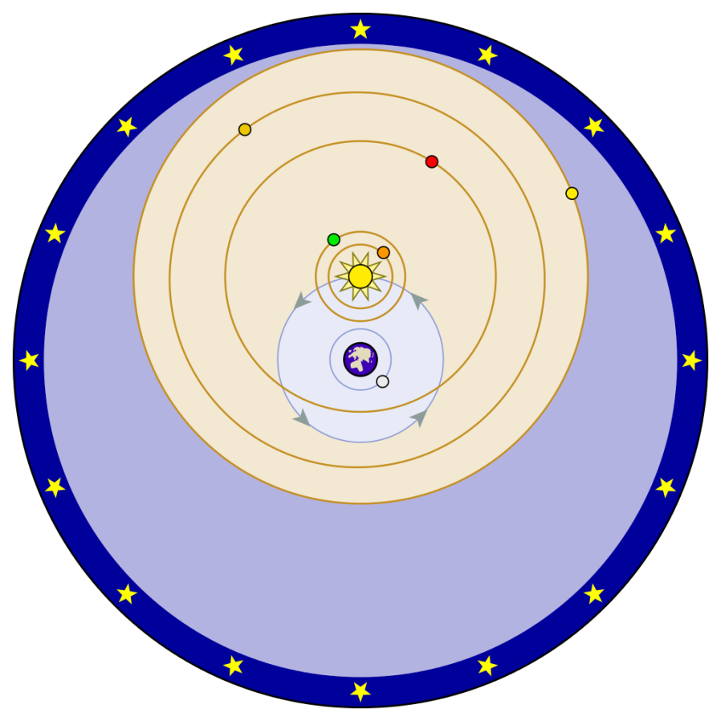
Geo-Heliocentric Model
Tycho did not accept the heliocentric view of Copernicus:
Observational data in 16th century were not
good enough to prove it.
Completely eliminited the ancient (Aristotelean)
idea of heavely spheres
“Earth is a lazy body”:
“such a fast motion could not belong to the earth, a body very heavy and dense and opaque, but rather belongs to the sky itself whose form and subtle and constant matter are better suited to a perpetual motion, however fast”

Slide 14
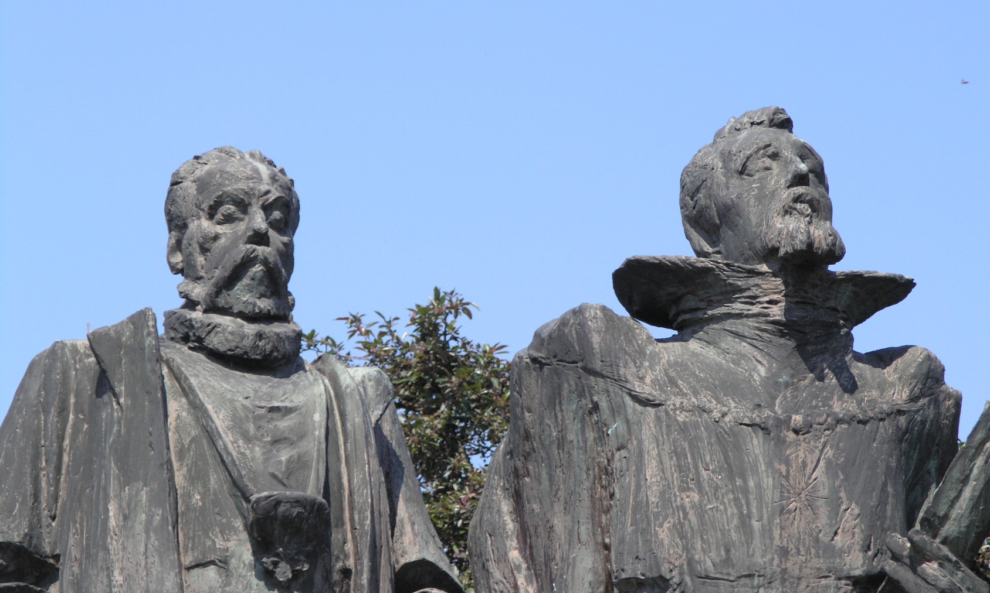
Brahe & Kepler
Arguably, the most significant step in Tycho’s career:
move to the German imperial court in Prague
(following tensions with new Danish king Christian IV)
- meeting up with (young) Johannes Kepler
The analytical genius of Kepler gained access to the state of the art accurate observations of
Tycho Brahe, opening up the path towards unravelling the laws of motion in the solar system.

Slide 15
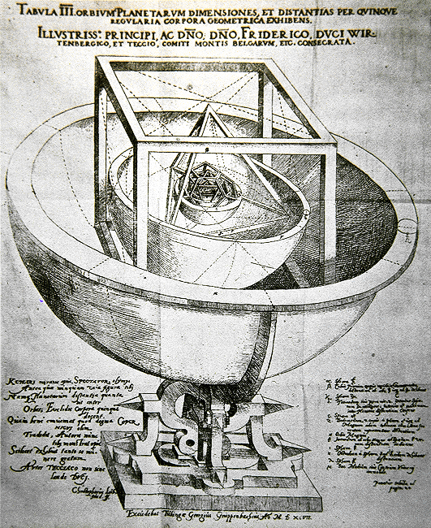
Johannes Kepler (1571-1630)
Mysterium Cosmographicum

Slide 16
Johannes Kepler (1571-1630)
Fields:
astronomy, astrology, mathematics,
natural philosophy
Kepler described his
new astronomy as "celestial physics",
as "an excursion into Aristotle's Metaphysics", and as
"a supplement to Aristotle's On the Heavens",[
transforming the ancient tradition of physical cosmology by treating astronomy as part of a universal mathematical physics.

Slide 17
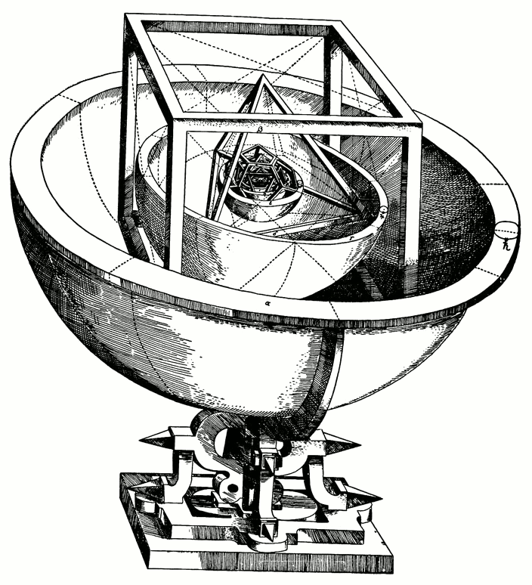
Mysterium Cosmographicum
Prodromus dissertationum cosmographicarum, continens mysterium cosmographicum, de admirabili proportione orbium coelestium, de que causis coelorum numeri, magnitudinis, motuumque periodicorum genuinis & proprijs, demonstratum, per quinque regularia corpora geometrica
Forerunner of the Cosmological Essays, Which Contains the Secret of the Universe; on the Marvelous Proportion of the Celestial Spheres, and on the True and Particular Causes of the Number, Magnitude, and Periodic Motions of the Heavens; Established by Means of the Five Regular Geometric Solids

Slide 18
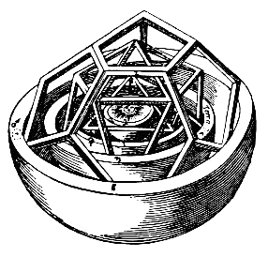
Mysterium Cosmographicum
First published defense Copernican system
Published 1596
Book explains Kepler's cosmological theory, based on the Copernican system
Five Pythagorean regular polyhedra dictate
the structure of the universe and
reflect God's plan through geometry.
Kepler found that each of the five Platonic solids could be uniquely inscribed and circumscribed by spherical orbs;
nesting these solids, each encased in a sphere, within one another would produce six layers, corresponding to the six known planets
Mercury, Venus, Earth, Mars, Jupiter, and Saturn.
By ordering the solids correctly
octahedron, icosahedron, dodecahedron, tetrahedron, cube
Kepler found that the spheres could
be placed at intervals corresponding
(within the accuracy limits of available
astronomical observations)
to the relative sizes of each
planet’s path,
assuming the planets circle the Sun

Slide 19
Mysterium Cosmographicum
Kepler thought he had revealed
God’s geometrical plan for the universe.
Much of Kepler’s enthusiasm for the Copernican system stemmed from his theological convictions about the
connection between the physical and the spiritual.
The universe itself was an image of God,
- His first manuscript of Mysterium
contained an extensive chapter reconciling
heliocentrism with biblical passages that
seemed to support geocentrism.[
- Kepler never relinquished the Platonist
polyhedral-spherist cosmology of
Mysterium Cosmographicum.
- His subsequent main astronomical works were
in some sense only further developments of it,

Slide 20
Mysterium Cosmographicum
Modern astronomy owes much to
Mysterium Cosmographicum
- Despite flaws in its main thesis, "since it
represents the first step in cleansing the
Copernican system of the remnants of the
Ptolemaic theory still clinging to it." (Dryer)
- Especially when dealing with the geometry of the
universe, Kepler consistently utilizes
Platonic and Neo-Platonic frameworks of thought.
- The entirety of the polyhedral idea is based on
the same "formal cause" postulated by Plato for
the structure of the universe.
- In an argument from design,
Kepler postulates the existence and necessity
of God the Creator as this "efficient cause

Slide 21
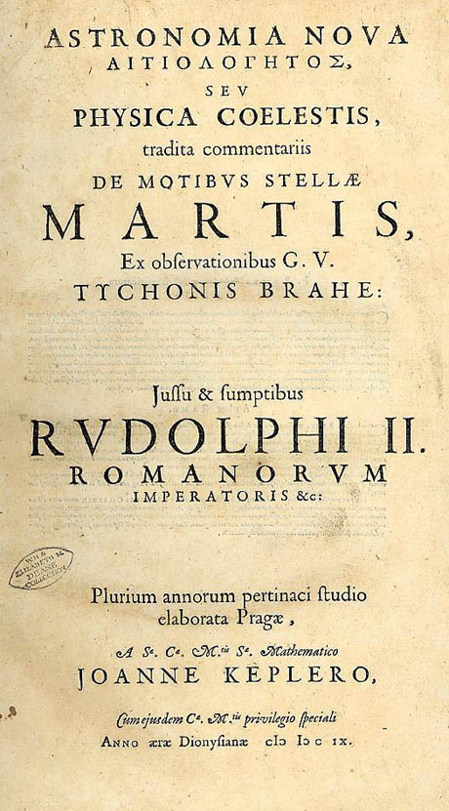
Astronomia Nova
Full title:
Astronomia Nova ΑΙΤΙΟΛΟΓΗΤΟΣ seu physica coelestis, tradita commentariis de motibus stellae Martis ex observationibus
G.V. Tychonis Brahe
Published 1609
One of the most important works of the
Scientific Revolution
Reports Kepler’s 10 year long investigation of
motion of planet Mars.
In addition to providing strong arguments
heliocentrism, it describes the motion of planets, incl. elliptical shape of orbits
- first 2 laws of Kepler

Slide 22
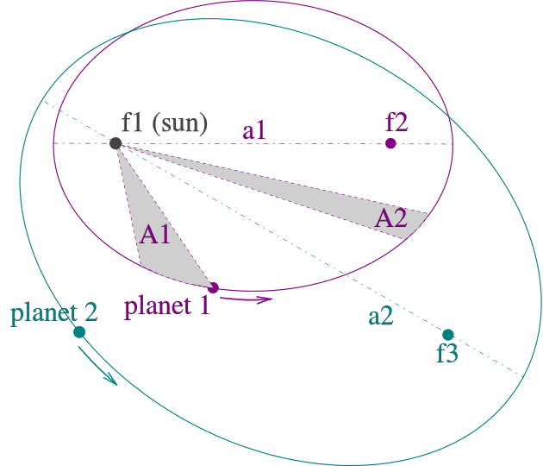
Kepler Laws
Kepler laws of planetary motion
1. The orbit of a planet is an
ellipse with the Sun at one
of the two foci.
2. A line segment joining a planet
and the Sun sweeps out equal
areas during equal intervals of
time.
The
square of the orbital period
of a planet is proportional to
the cube of the semi-major axis
of its orbit.

Slide 23
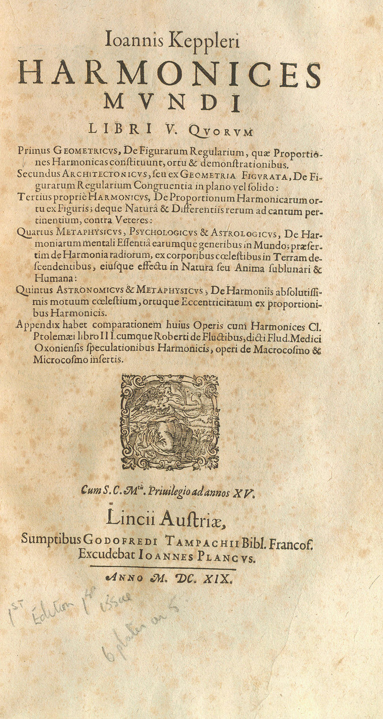
Harmonices Mundi
Harmony of the World
Published 1619
discusses harmony and congruence in
geometrical forms and physical phenomena.
Musical harmonies for
arrangement heavenly bodies
Final section:
discovery of "third law of planetary motion.

Slide 24
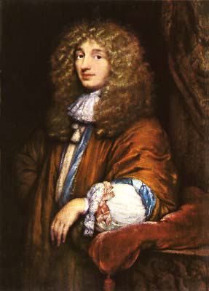
Christiaan
Huygens
(1629-1695)

Slide 25
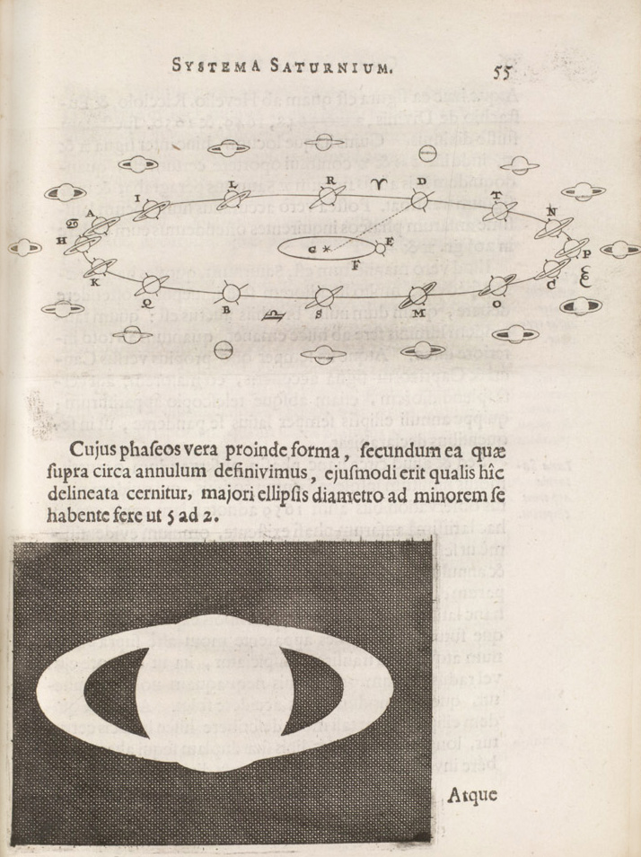
Huygens
&
Saturn

Slide 26
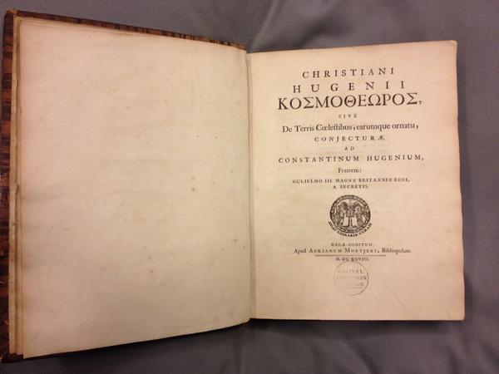
Cosmotheoros
1695-1698:
Speculation on the existence of extraterrestrial life
Identification (liquid) water as main condition for the emergence of life
Method for estimating distances

Slide 27
Galileo Galilei (1564-1642)

Slide 28
Galileo Galilei

Slide 29
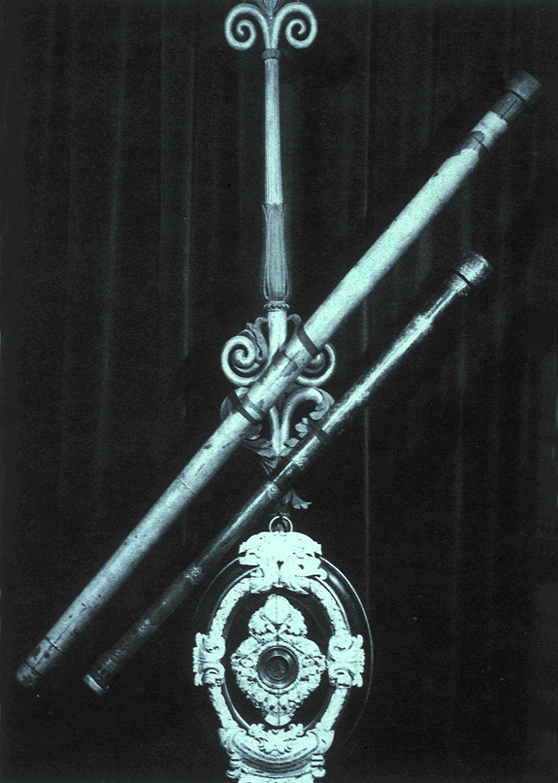
Galileo Galilei (1564-1642)
Moon:
surface valleys & hills

Slide 30
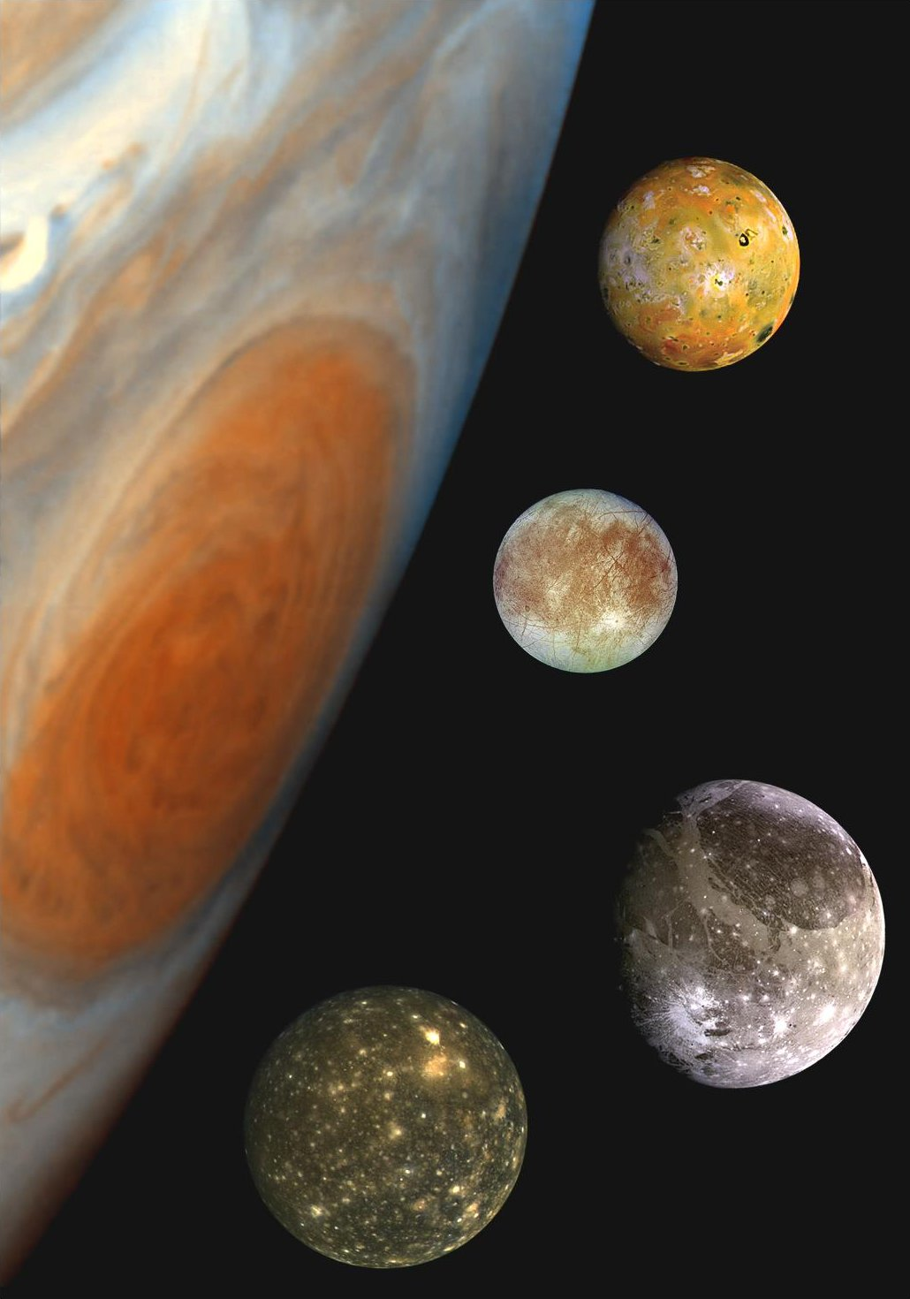
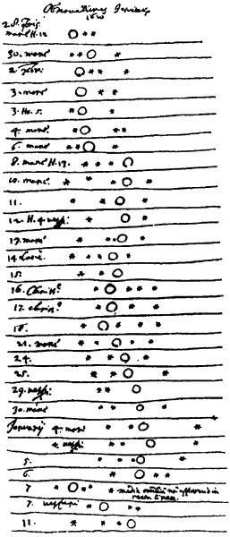
Galileo
Galilei
(1564-1642)

Slide 31
Galileo Galilei (1564-1642)
Galilean
Moons:
Europa
Ganymedes
Callisto
Io

Slide 32
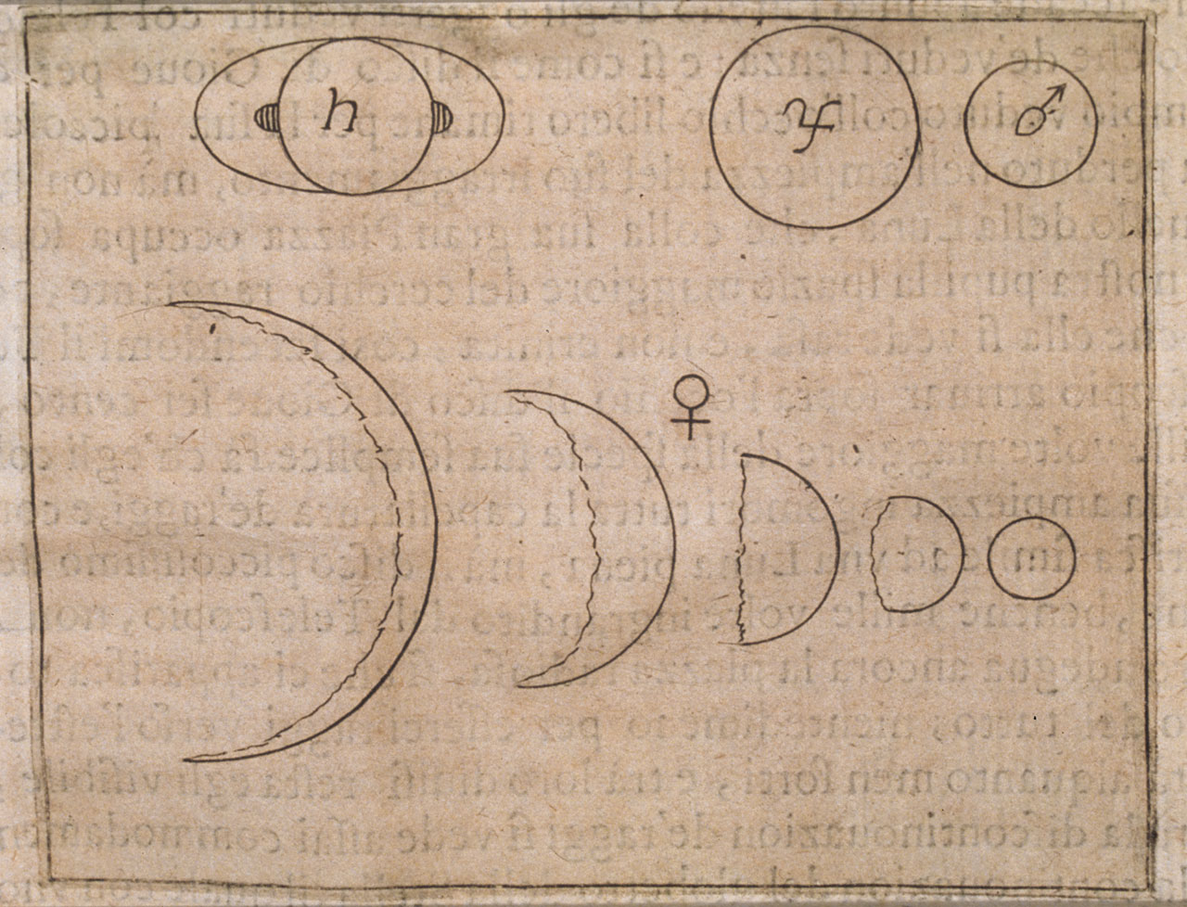
Galileo Galilei (1564-1642)
Phases of Venus

Slide 33
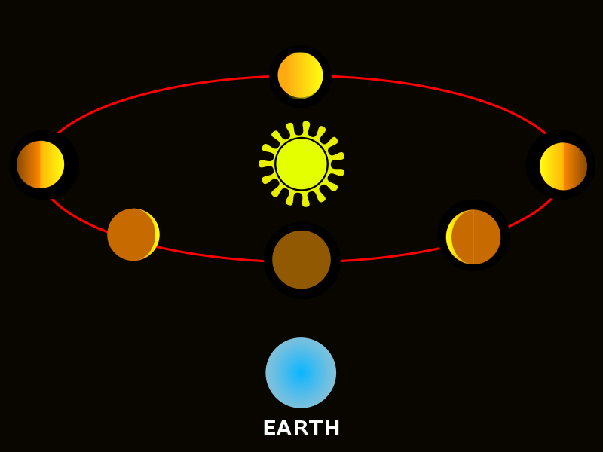
Galileo
Galilei
(1564-1642)

Slide 34
Galileo
Galilei
(1564-1642)

Slide 35
Isaac Newton (1643-1727)
“If I have seen further
it is by standing on the
shoulders of giants “

Slide 36
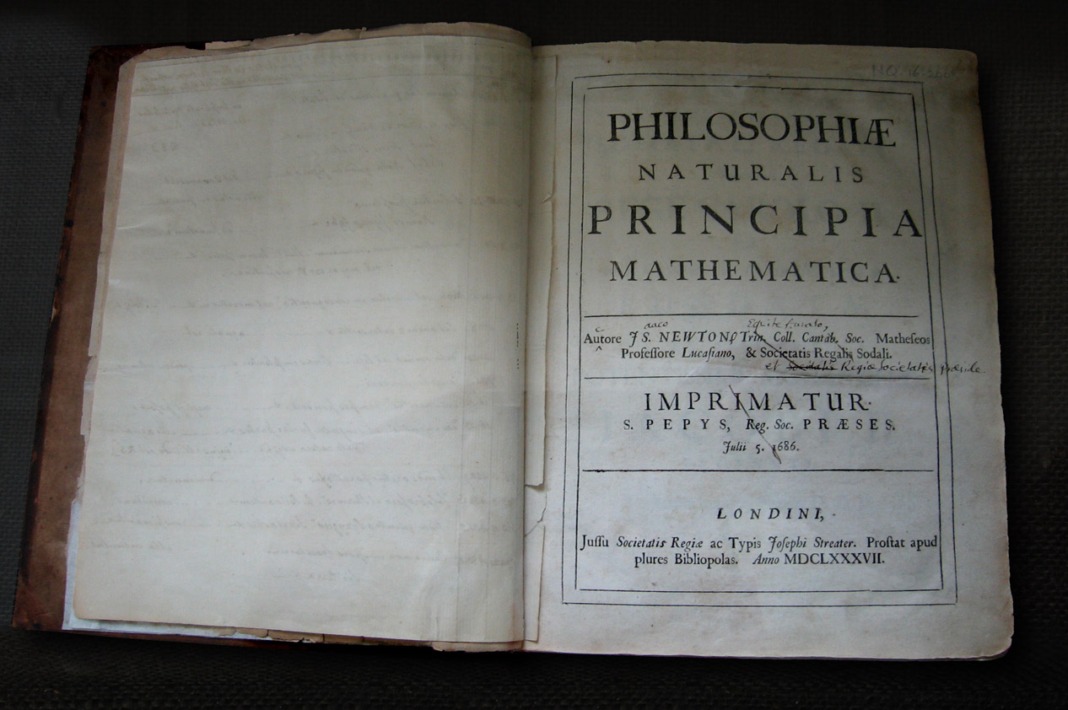
Isaac Newton (1642-1726)

Slide 37
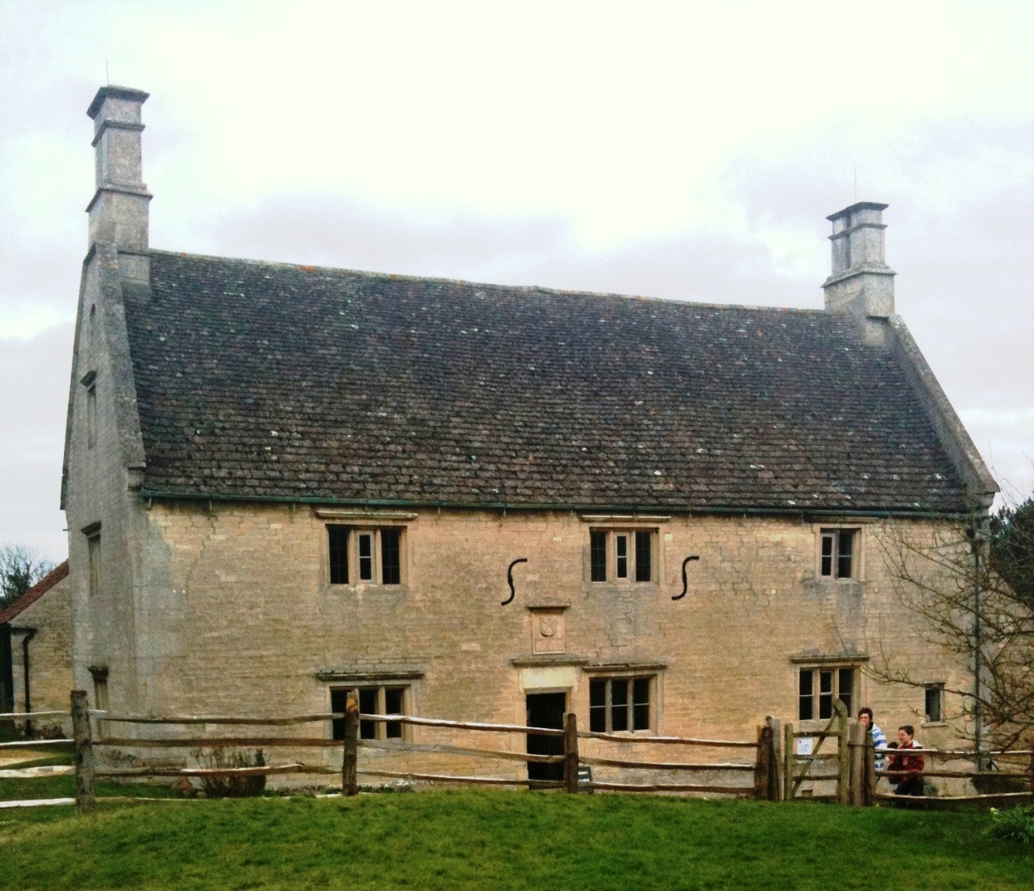
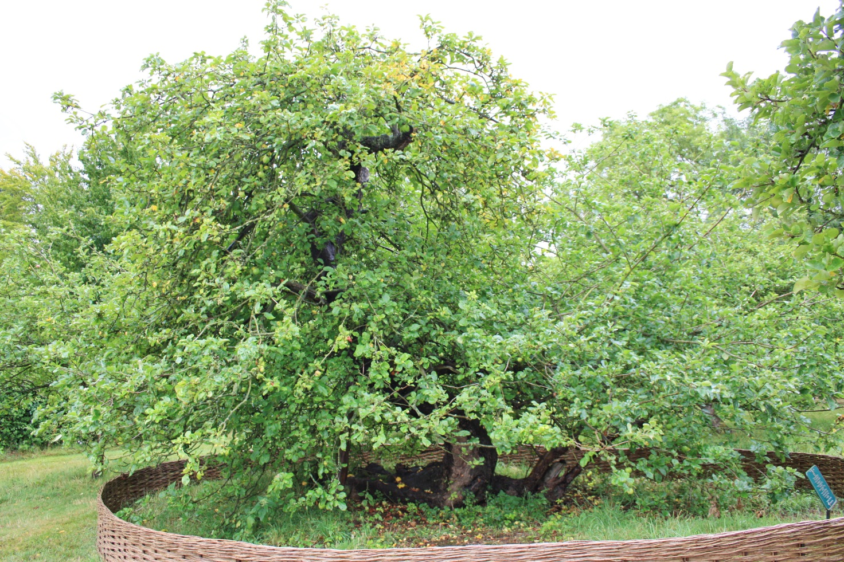
Isaac Newton
Birthhouse
Woolshorpe

