Slide 1
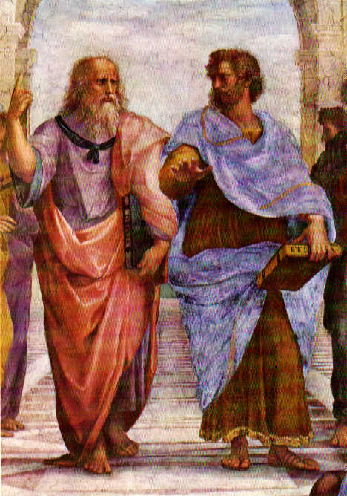
Order in the Cosmos:
how
Babylonians and Greeks
Shaped our World

Slide 2
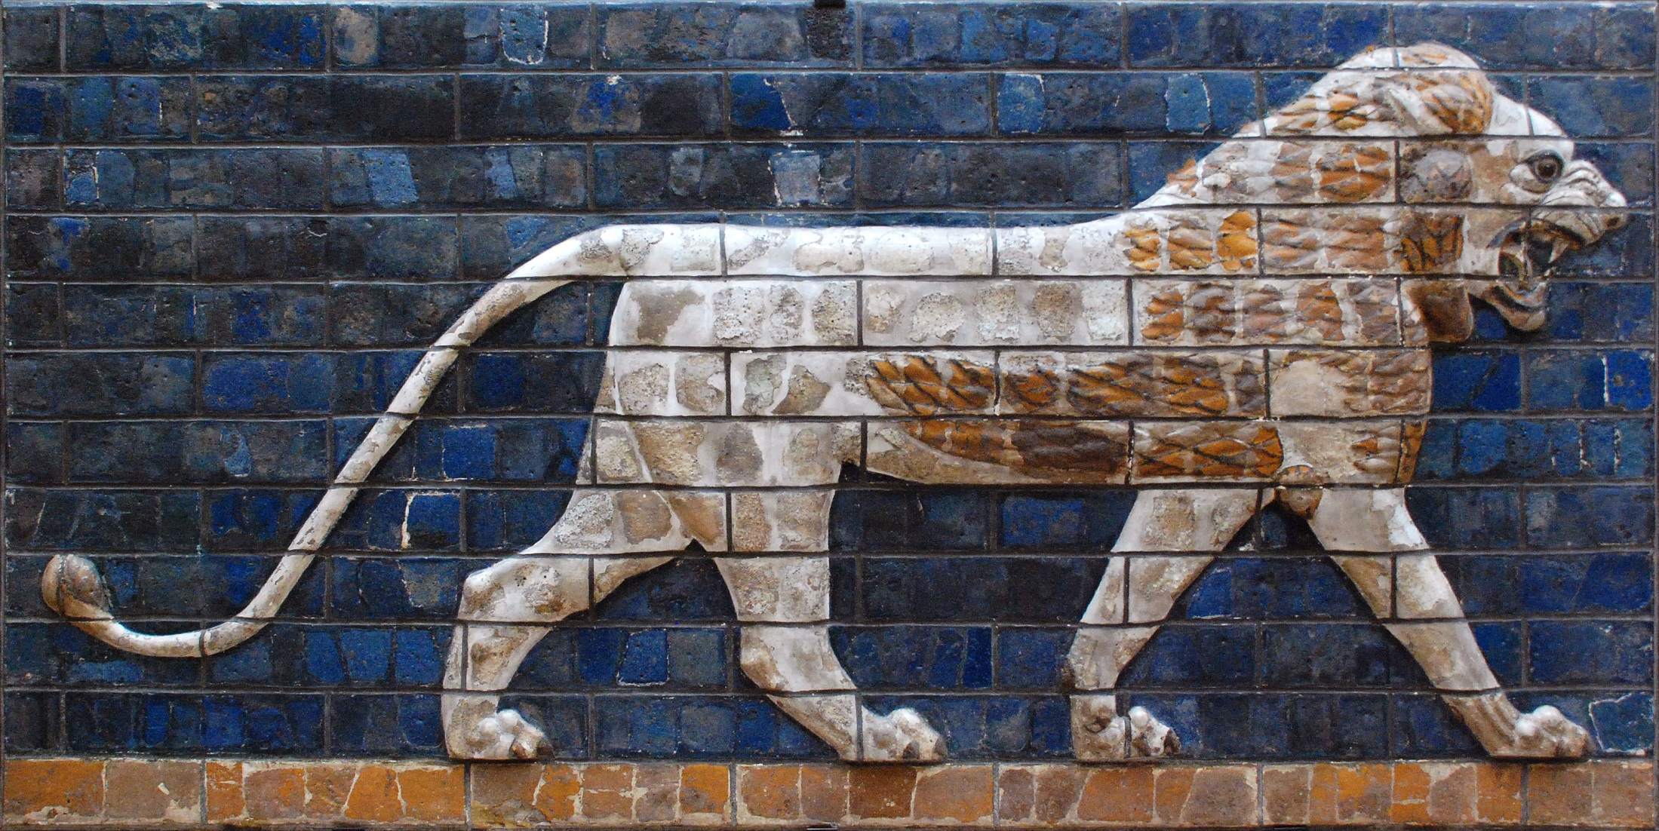
Babylonians Astronomers of Antiquity

Slide 3
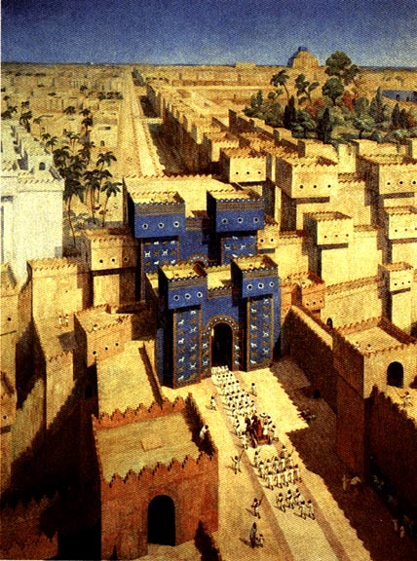

Slide 4
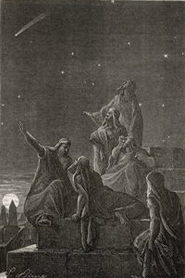
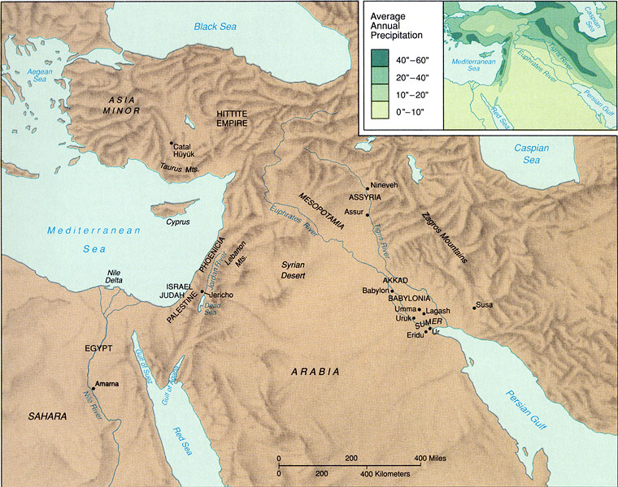
Babylonian Astronomy
Mesopotamia = “land of two rivers”
land between the rivers Euphrates & Tigris

Slide 5
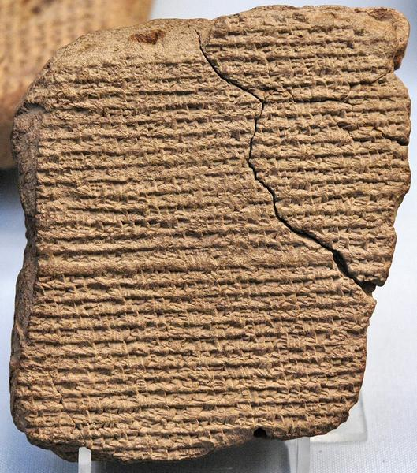
Babylonian Astronomy
Two distinct periods of flowering:
Old Babylonian astronomy:
during and after
First Babylonian dynasty (Hammurabi) 1830-1531 BCE
New Babylonian/Chaldean astronomy:
Neo-Babylonian (Nebuchadnezzar) 626-539 BCE
Medo-Persian 539-331 BCE
Seleucid 335-141 BCE
Parthian 129 BCE-224 AD

Slide 6
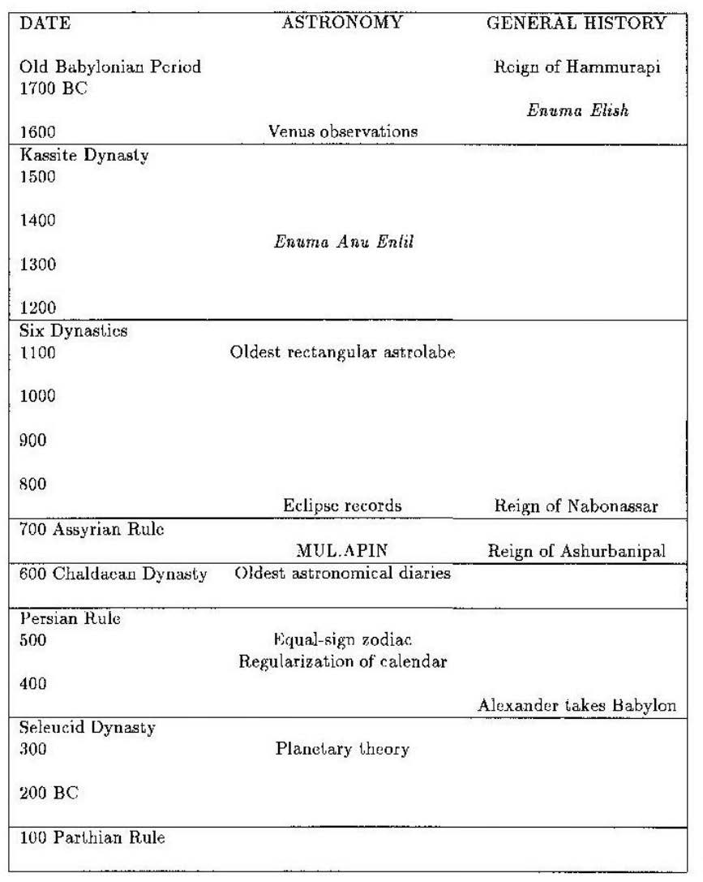
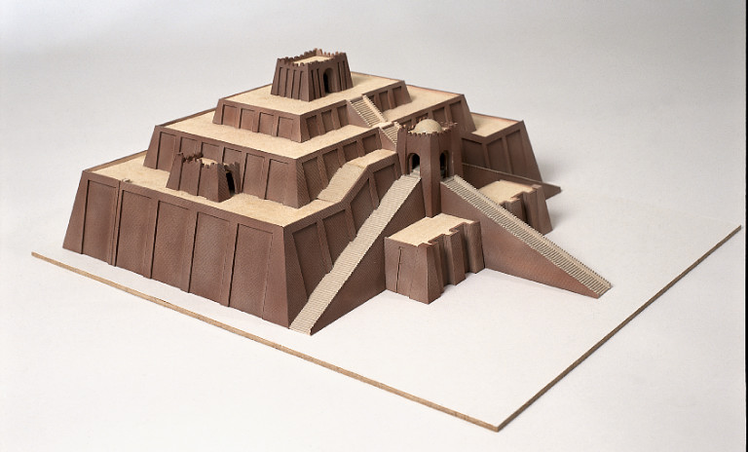
Babylonian Astronomy
timeline
Babylonian astronomy
Evans 1998

Slide 7
Babylonian Astronomy
Babylonian Astronomers:
most consistent, systematic and thorough
astronomical observers of antiquity
• First to recognize periodicity astronomical phenomena (e.g. eclipses !),
and apply mathematical techniques for predictions
• Systematically observed and recorded the heavens:
- Records spanning many centuries (> millennium)
- Archives of cuneiform tablets
- Famous Examples:
Enuma Anu Enlil 68-70 tablets Kassite period (1650-1150)
tablet 63: Venus tablet of Ammisaduga
MUL.APIN 700 BCE
oldest copy: 686 BCE

Slide 8
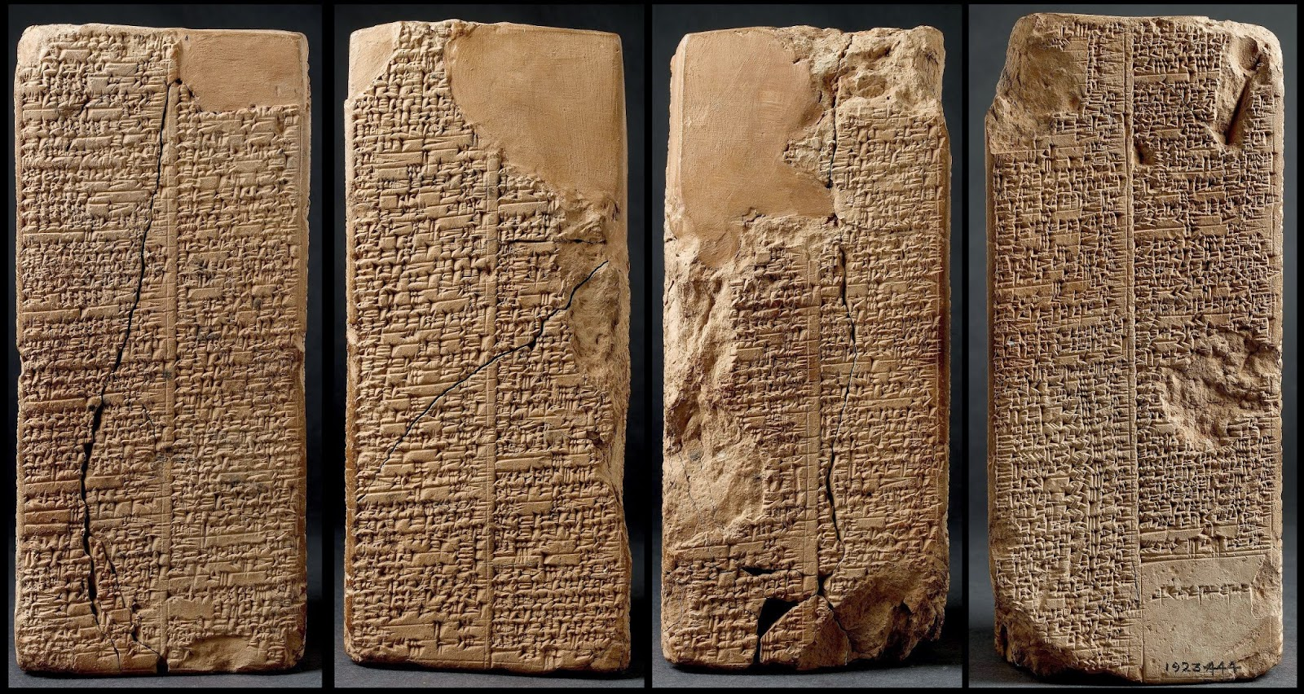
Astronomical Texts
Several types of astronomical texts
in Babylonian astronomy.
Four principal types:
1) astronomical diaries
2) goal year texts
3) ephemerides
4) procedure texts
Ephemerides:
- listing of positions of planets and
their meaning
(eg. extreme points retrograde path)
- predictive: positions based on
calculations (based on scheme)
- ephemerides for Moon
- ephemerides for planets
Procedure texts:
description of procedure(s)
to calculate ephemerides
-

Slide 9
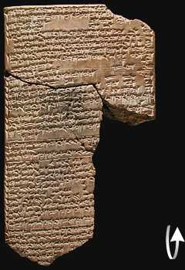
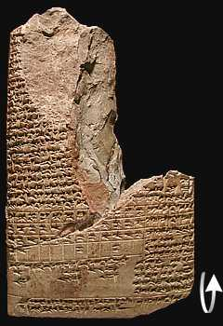
ENUMA ANU ENLIL
Old text, probably Kassite period
(1595-1157 BCE)
A major series of 68 or 70 tablets
dealing with Babylonian astrology.
bulk is a substantial collection of omens, estimated to number between 6500 and 7000,
interpreting a wide variety of celestial and atmospheric phenomena in terms relevant to the king and state

Slide 10
ENUMA ANU ENLIL
2. If with it a cloudbank lies on the right of the sun:
the trade in barley and straw will expand.
3. If with it a cloudbank lies to the left of the sun:
misfortune
4. If with it a cloudbank lies in front of the sun:
the king of Elam [will die]
5. If with it a cloudbank lies behind the sun:
the king of the Gutians [will die]
6. If in Pit babi the sun is surrounded by a halo in
the morning: there will be a severe heat in the
country and the Lamashtu-demon will attack the
country.
7. If with it a cloudbank lies to the right of the sun:
the king of Eshnunna will die.
8. If with it a cloudbank lies to the left of the sun: the
king of Subartu will die and his dynasty will come
to an end.
9. If with it a cloudbank lies in front of the sun: the
rains from heaven (and) the floods from the
depths will dry up.
10. If with it a cloudbank lies behind the sun: the
harvest of the land will not be brought in.

Slide 11
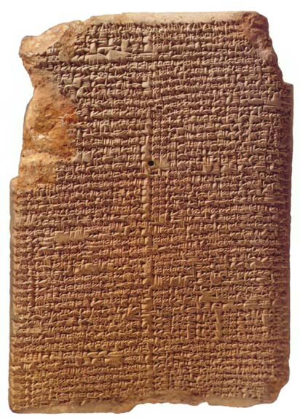
MUL.APIN
Around 700 BCE,
after king Nabonassar
- summary of astronomical knowledge
(Neugebauer)
- Parapegma (Evans)
Catalogue of stars & constellations
Schemes
heliacal risings/settings planets
Measurements lengths daylight
66 stars

Slide 12
Chaldean Astronomy
Most Chaldean astronomers strictly concerned with ephemerides,
not with theoretical models
Predictive planetary models empirical,
usually sophisticated arithmetical/numerical schemes
• Models do not involve geometry & cosmology (that’s the Greeks !)
• Discovery (lunar & solar) eclipse cycles & Saros period

Slide 13
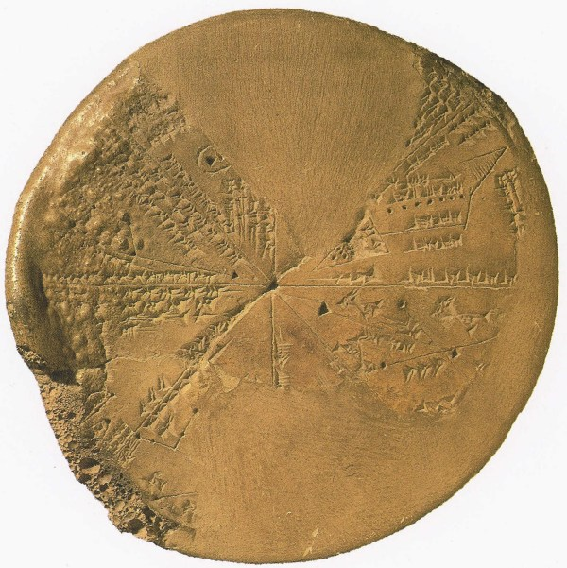
Babylonian Astronomy
Lasting Astronomical Influence:
• Constellation Names
• Zodiac
• Degree - unit angle
• Sexagesimal number system:
circle: 360 degrees
degree: 60 minutes
place value number system
(crucial for Greek science !)
• Eclipse Observations & Periods
• Synodic, Siderial, Draconic, Anomalistic
months
• and …

Slide 14
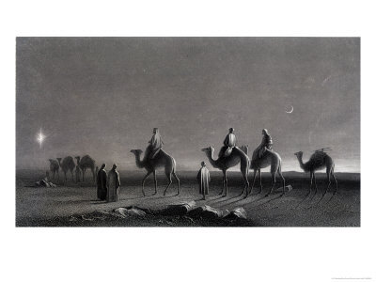
Magi: Chaldean Astronomers

Slide 15
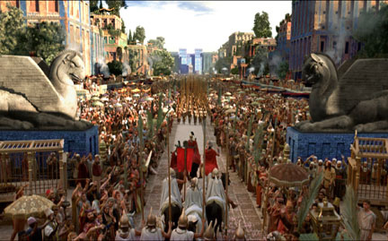
Babylonian Astronomy
Transmission:
• Transfer of Babylonian astronomical
knowledge essential for Hellenistic
astronomy
• Alexander the Great:
orders translation
astronomical records,
under supervision
Callisthenes of Olynthus,
to be sent to his uncle
Aristoteles
• Direct Contacts:
e.g. Hipparchus

Slide 16
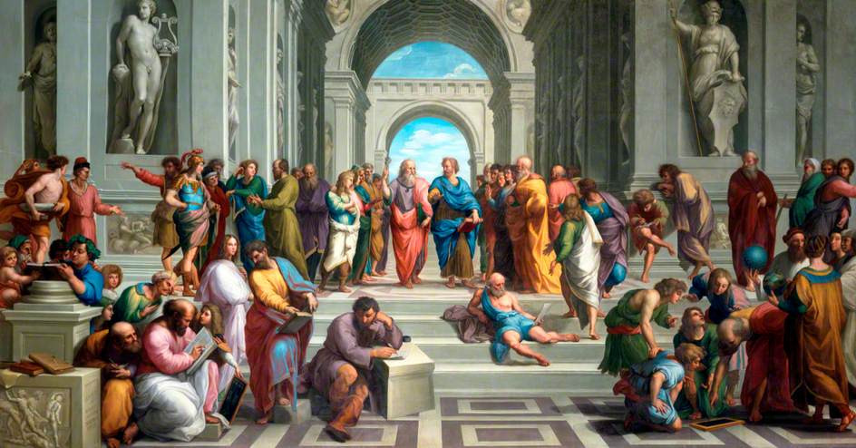
Reason & the Cosmos Greek Cosmology

Slide 17
Timeline & Overview Greek Cosmology

Slide 18
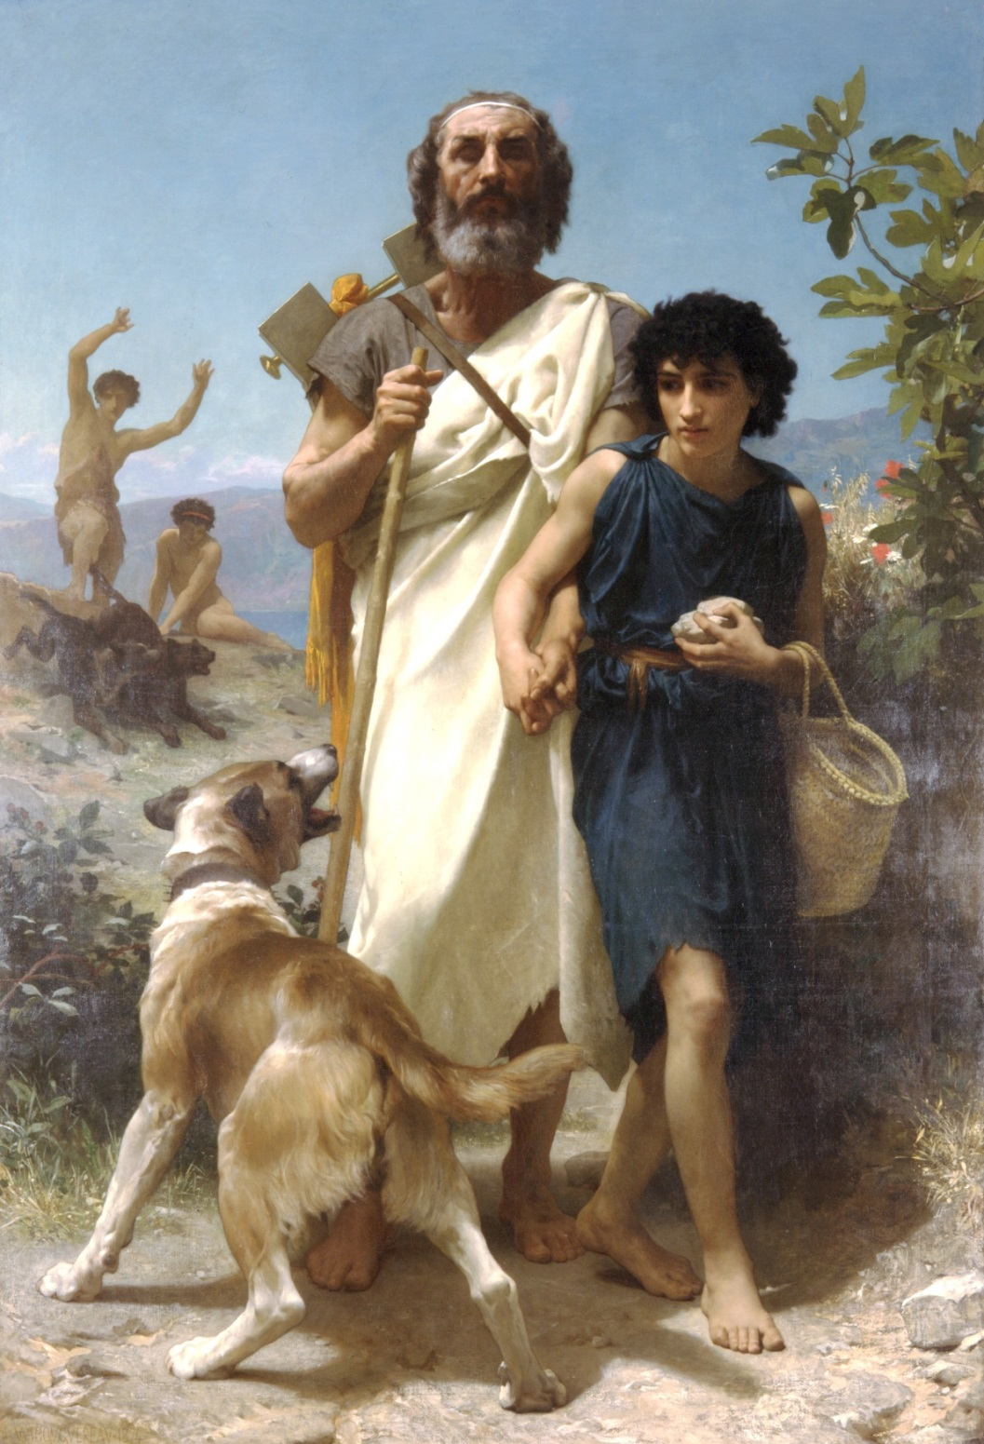
8th Century BCE: mythical cosmology
Homerus and guide
W-A Bouguereau

Slide 19
6th Century BCE: Pre-Socratic Ionian Natural Philosophers
Homerus and guide
W-A Bouguereau

Slide 20
5th Century BCE: Pre-Socratic Natural Philosophers
Homerus and guide
W-A Bouguereau

Slide 21
4th Century BCE: from Plato to Aristoteles
Homerus and guide
W-A Bouguereau

Slide 22
3rd Century BCE – 1st Century AD: the Hellenistic Scientific Revolution
Homerus and guide
W-A Bouguereau

Slide 23
Ionia Natural Philosophers

Slide 24
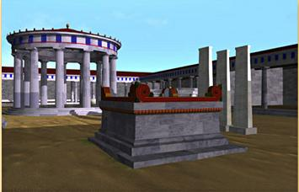
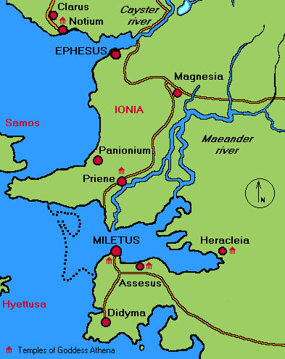
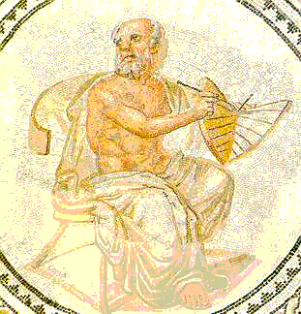
Ionia, 6th century B.C.
Phase transition in human history:
the mythical world obsolete
… the Ionian coast, 6th century B.C.,
regularities and symmetries in nature
recognized as keys to the cosmos …
Pythagoras
Anaximander
Miletus
Mathematics as natural language of cosmos
➔ Physical cosmos modelled after ideal form,
encrypted in concepts of geometry
… Anaximander of Miletus: the Apeiron
Pythagoras of Samos: music of spheres
Plato: Platonic solids

Slide 25
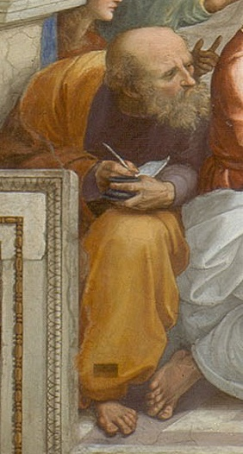
Anaximander the First Cosmologist (Miletus, 610-546 BCE)
Cartography of Anaximander

Slide 26
Anaximander the First Cosmologist (Miletus, 610-546 BCE)
Cosmology of Anaximander:
Earth floats free without falling
Karl Popper:
“one of the most boldest, most
revolutionary, and most portentous ideas
in the whole history of human thinking”

Slide 27
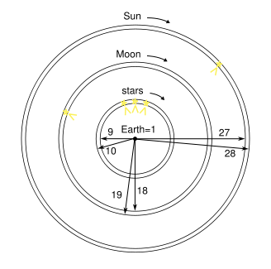
Anaximander founder scientific
Astronomy and Cosmology (Miletus, 610-546 BCE)
Cosmology Anaximander
heavenly sphere is a ring of fire
invisible, surrounded by fog
Heavenly bodies part of ring, visible through openings through fog.
ring for the Moon
ring for the Sun

Slide 28
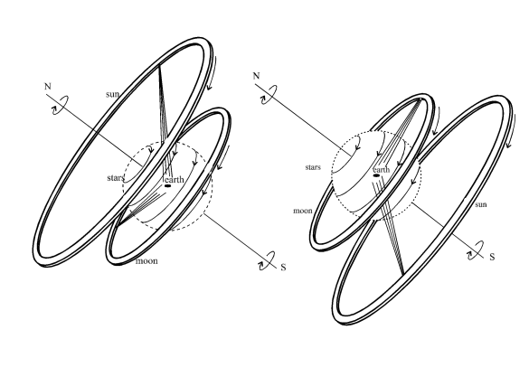
Anaximander founder scientific
Astronomy and Cosmology (Miletus, 610-546 BCE)
Daytime in summer
Nighttime in winter
Cosmology Anaximander
Ring model could not explain all observations
Anaximander preferred symmetry & number 3
diameter Sun ring = 27 x diameter Earth
diameter Moon ring = 18 x diameter Earth
diameter stellar ring = 9 x diameter Earth

Slide 29
“The Apeiron, from which the elements [are formed], is something that is different”
Anaximander founder scientific
Astronomy and Cosmology (Miletus, 610-546 BCE)
The idea of Apeiron, the “infinite” or “limitless” out of which the world emerged, is suggested to be close to our current idea of vacuum energy

Slide 30
Classical Greek Cosmology Plato & Aristoteles

Slide 31
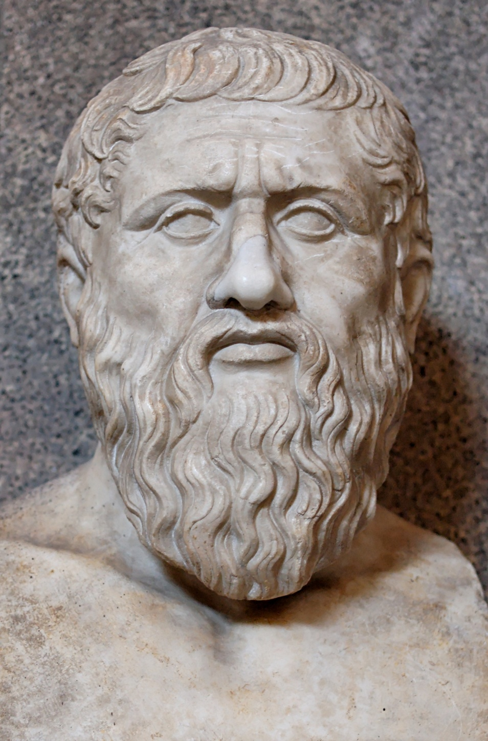
Plato (Athens, 428-348 BCE)
Geometry as
organizing principle
of the world
Founded Academy, Athens
Philosophy
Mathematics
Philosophical Dialogues

Slide 32
Academia Platon
“Let no one unversed
in geometry enter here”

Slide 33
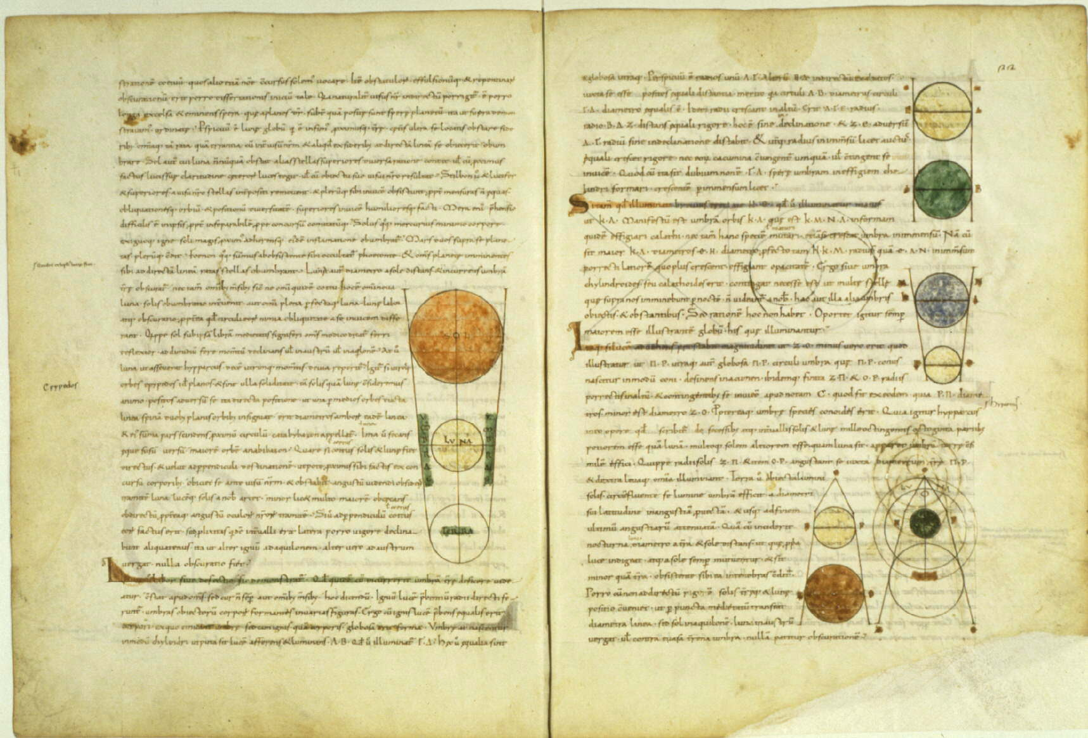
Timaeus: Plato’s Cosmology

Slide 34
Timaeus: Plato’s Cosmology
Plato’s Cosmic Scheme:
• Demiurge, divine craftsman, is a mathematician:
• Universe constructed according to geometric principles

Slide 35
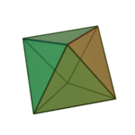
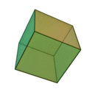
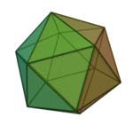
Platonic Solids
the Five Platonic solids
● there are only five convex regular polyhedra !
● Plato identified them with the cosmos and its constituents
Tetrahedron:
fire
Octahedron:
air
Cube:
earth
Icosahedron:
water

Slide 36
Platonic Solids
Dodecahedron Quintessence
of which the Cosmos itself is made:
“the stuff for embroidering
the constellations on the heavens”
Tetrahedron:
fire
Octahedron:
air
Cube:
earth
Icosahedron:
water

Slide 37
Timaeus: Plato’s Cosmology
Plato’s Cosmic Scheme:
• Demiurge, divine craftsman, is a mathematician:
• Universe constructed according to geometric principles

Slide 38
Platonic Solids
the Five Platonic solids
● there are only five convex regular polyhedra !
● Plato identified them with the cosmos and its constituents
Tetrahedron:
fire
Octahedron:
air
Cube:
earth
Icosahedron:
water

Slide 39
Platonic Solids
Dodecahedron Quintessence
of which the Cosmos itself is made:
“the stuff for embroidering
the constellations on the heavens”
Tetrahedron:
fire
Octahedron:
air
Cube:
earth
Icosahedron:
water

Slide 40
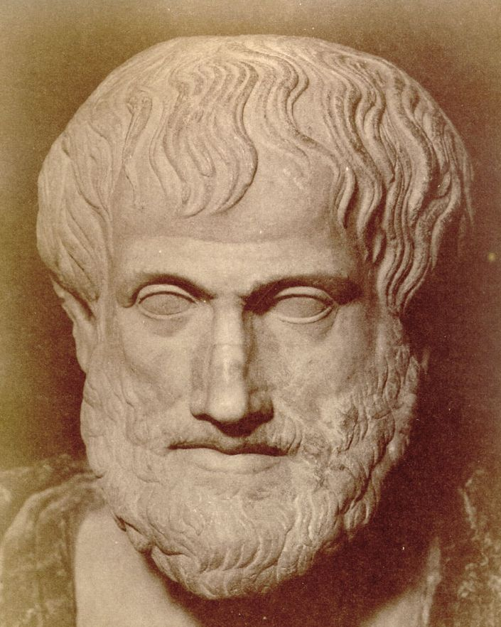
Aristoteles (Chalcidice-Athens, 384-322 BCE)
- “Aristotle was the first genuine scientist
in history ... every scientist is in his debt”
Physics, Metaphysics,Astronomy,
Poetry, Theater, Music,
Logic, Rhetoric, Ethics,
Politics, Government,
Geology, Biology, Zoology
- Student Plato
- teacher Alexander the Great
- literary style:
“River of Gold” (Cicero)
- founded Lyceum, Athens
- Dominant influence for over 1800 years
both in Christian philosophy & theology
and in Muslim intellectual history
Father of Western Science

Slide 41
Aristoteles (384-322 BCE)
I saw the Master there of those who know, Amid the philosophic family,
By all admired,
and by all reverenced;
There Plato too I saw, and Socrates, Who stood beside him closer than the rest.
Dante, Divina Commedia
(1st level hell)

Slide 42
On the Heavens
Aristotle’s cosmological work
the most influential treatise of its kind in the history
of humanity.
It was accepted for more that 18 centuries from its
inception (around 350 B.C.) until the works of
Copernicus in the early 1500s.
Key aspects of Aristotle’s Cosmology:
1) Earth is at the centre of the Universe
2) the Universe is finite
3) the Universe is eternal and unchanged
4) the motion of the heavenly bodies are
uniform and circular

Slide 43
On the Heavens
Four causes
Aristotle suggested that the reason for anything coming about can be attributed to four different types of simultaneously active causal factors:
Material cause - the material out of which something
is composed.
Formal cause - its form, i.e., the arrangement of
that matter.
Efficient cause - "the primary source", or that
from which the change under
consideration proceeds.
This is akin to the modern concept
of cause.
Final cause - its purpose, or that for the sake of
which a thing exists or is done. This
covers modern ideas of motivating
causes, such as volition, need, desire,
ethics, or spiritual beliefs.

Slide 44
On the Heavens
Elements - composition
4 elements (Empedokles)
1) Earth cold and dry - modern idea solid.
2) Water cold and wet - modern idea liquid
3) Air hot and wet - modern idea of a gas.
4) Fire hot and dry - modern ideas of plasma
in addition,a 5th element
5) Aether divine substance making up the
spheres and heavenly bodies
(stars and planets)

Slide 45
On the Heavens
Movement of bodies
- all bodies, by their very nature, have a natural way
of moving.
- Movement is not, he states, the result of the
influence of one body on another
- Some bodies naturally move in straight lines
- others naturally stay put.
- Yet another natural movement:
the circular motion.
Since to each motion there must correspond a
substance, there ought to be some things that
naturally move in circles:
the heavenly bodies
(made of a more exalted and perfect substance
than all earthly objects).

Slide 46
On the Heavens
Aristotle’s Cosmos
Aristotle’s Cosmos made of
a central earth (which he accepted as spherical)
surrounded by
- the moon,
- the sun
- stars all moving in circles around it.
This conglomerate he called ``the world''.
Note the strange idea that all celestial bodies
are perfect, yet they must circle the imperfect Earth.
The initial motion of these spheres was caused by the
action of a ``prime mover'' which (who?) acts on the
outermost sphere of the fixed stars;
the motion then trickles down to the other spheres
through a dragging force.
Heavens consisted of a complex system of 55 spheres !
- could explain and predict the motions of
stars and planets
- a real scientific theory

Slide 47
Aristotles’ Cosmos
Cosmos of Aristoteles
Moon
Mercury
Venus
Sun
Mars
Jupiter
Saturn

Slide 48
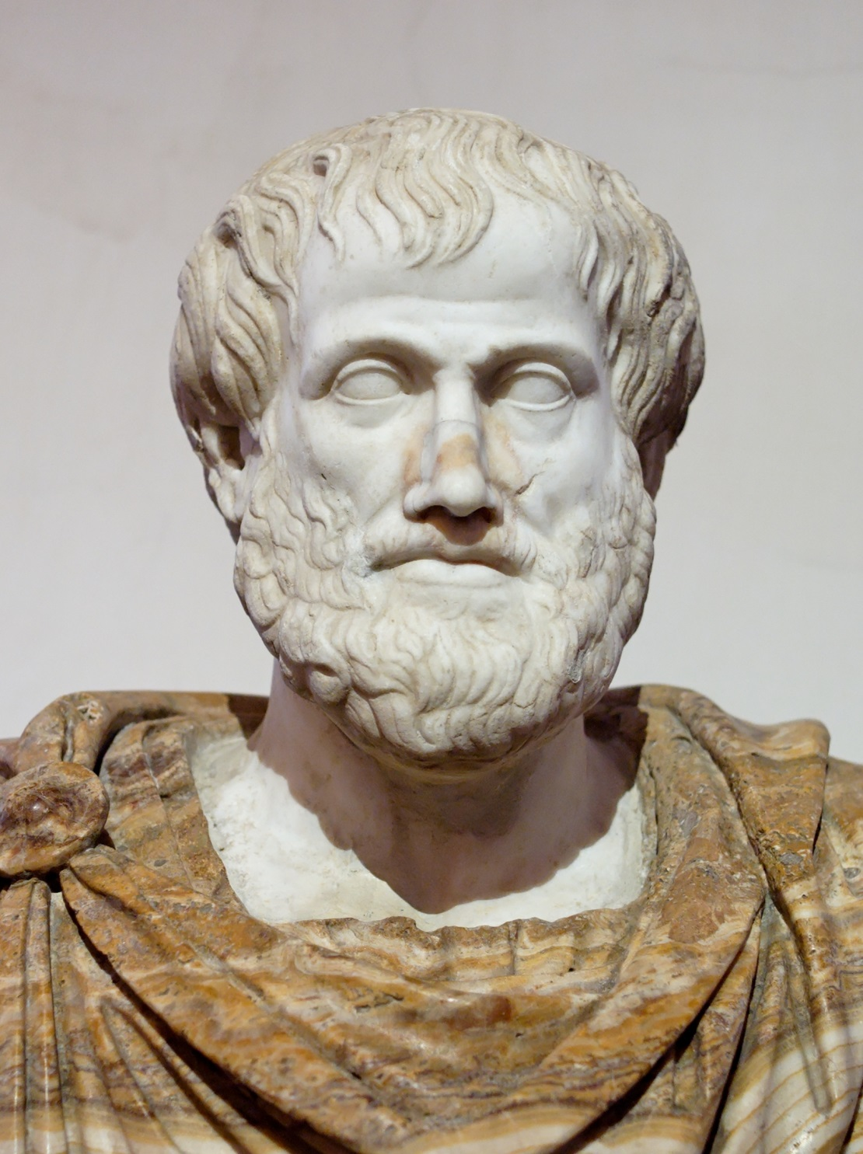
On the Heavens
Aristotle’s cosmology
this world is unique.
the argument goes as follows:
- earth (the substance) moves naturally to the center
- if the world is not unique there ought to be
at least two centers
- but then, how can earth know to which of
the two centers to go?
- since ``earthy'' objects have no trouble deciding
how to move, there can only be one center
(the Earth) circled endlessly by
all heavenly bodies.
Note:
- this cosmological tenet turned out to be
completely wrong with the discovery of the
moons of Jupiter

Slide 49
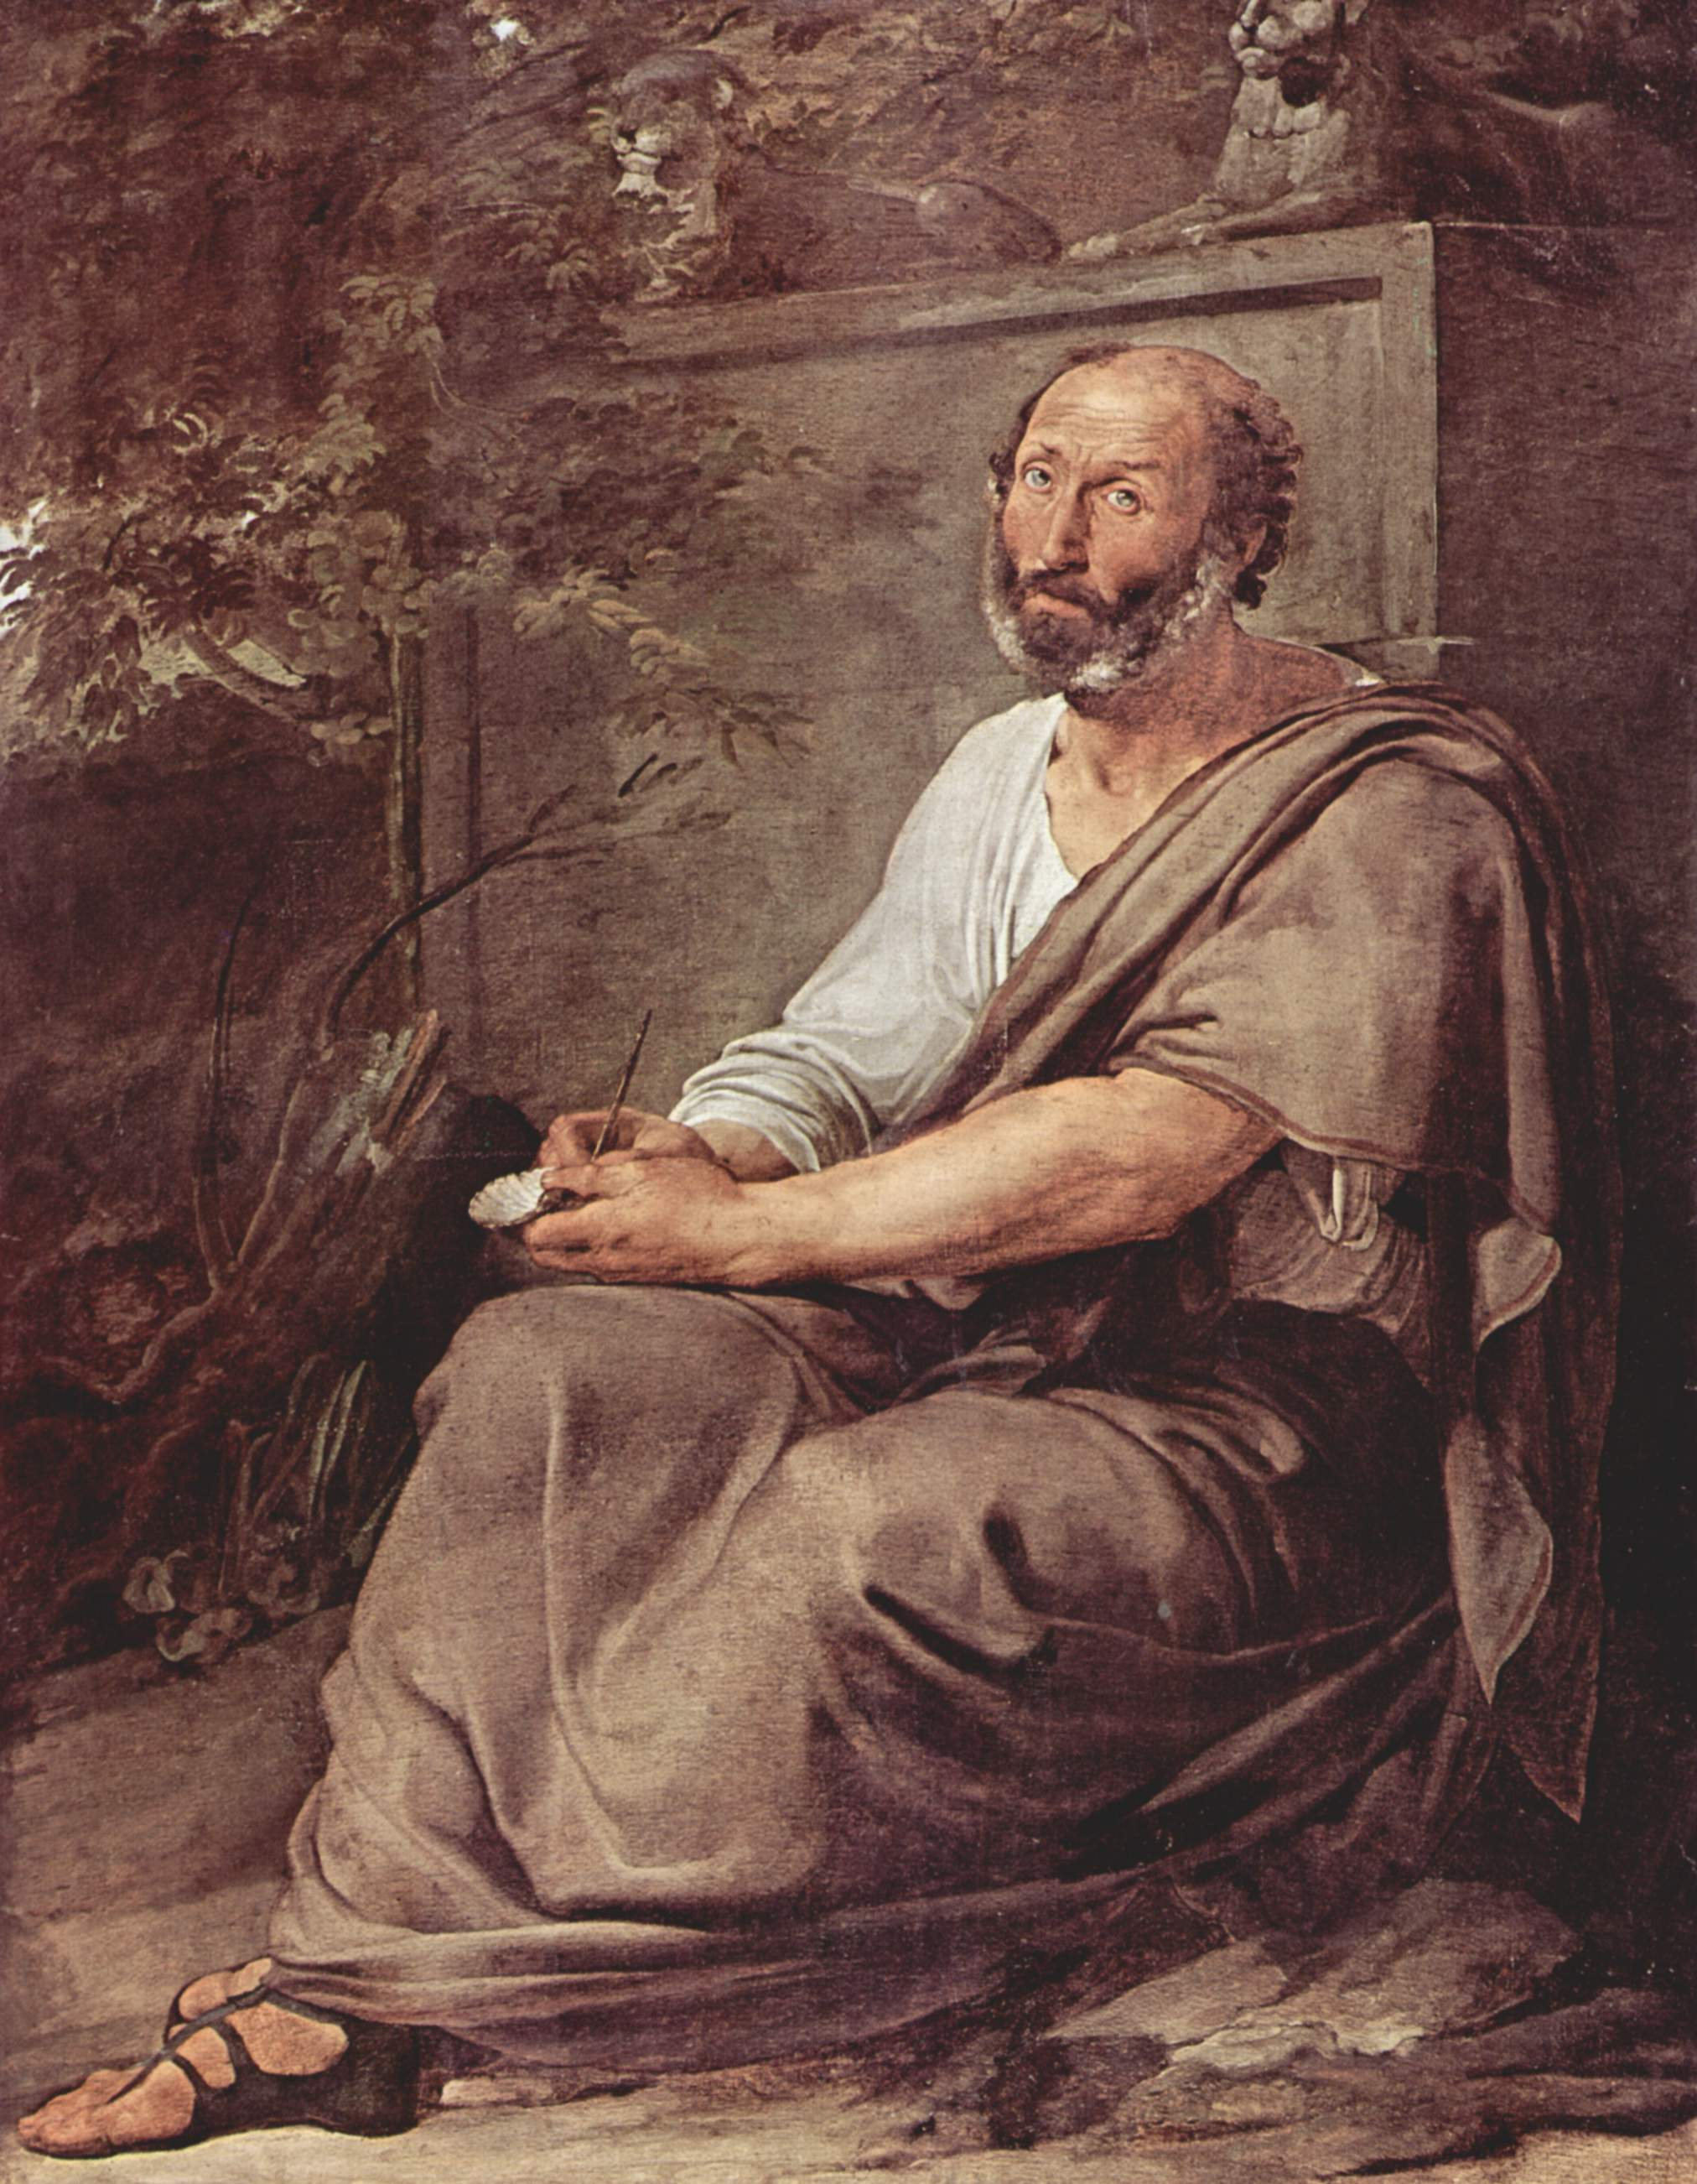
On the Heavens
Existence
the world did not come into being at one time
The world has existed, unchanged for all eternity
- it had to be that way since it was ``perfect'';
- the universe is in a kind of ``steady state scenario''.
Still, since he believed that the sphere was the most perfect of the geometrical shapes,
the universe did have a center (the Earth)
and its ``material'' part had an edge,
which was ``gradual''
- starting in the lunar and
- ending in the fixed star sphere.
Beyond the sphere of the stars the universe continued
into the spiritual realm where material things cannot be
This is in direct conflict with the Biblical description
of creation, and an enormous amount of effort was
spent by the medieval philosophers in trying to
reconcile these views.

Slide 50
Pictorial view
Aristotelian view of the Cosmos

Slide 51
Hellenistic Cosmology: the first Scientific Revolution

Slide 52
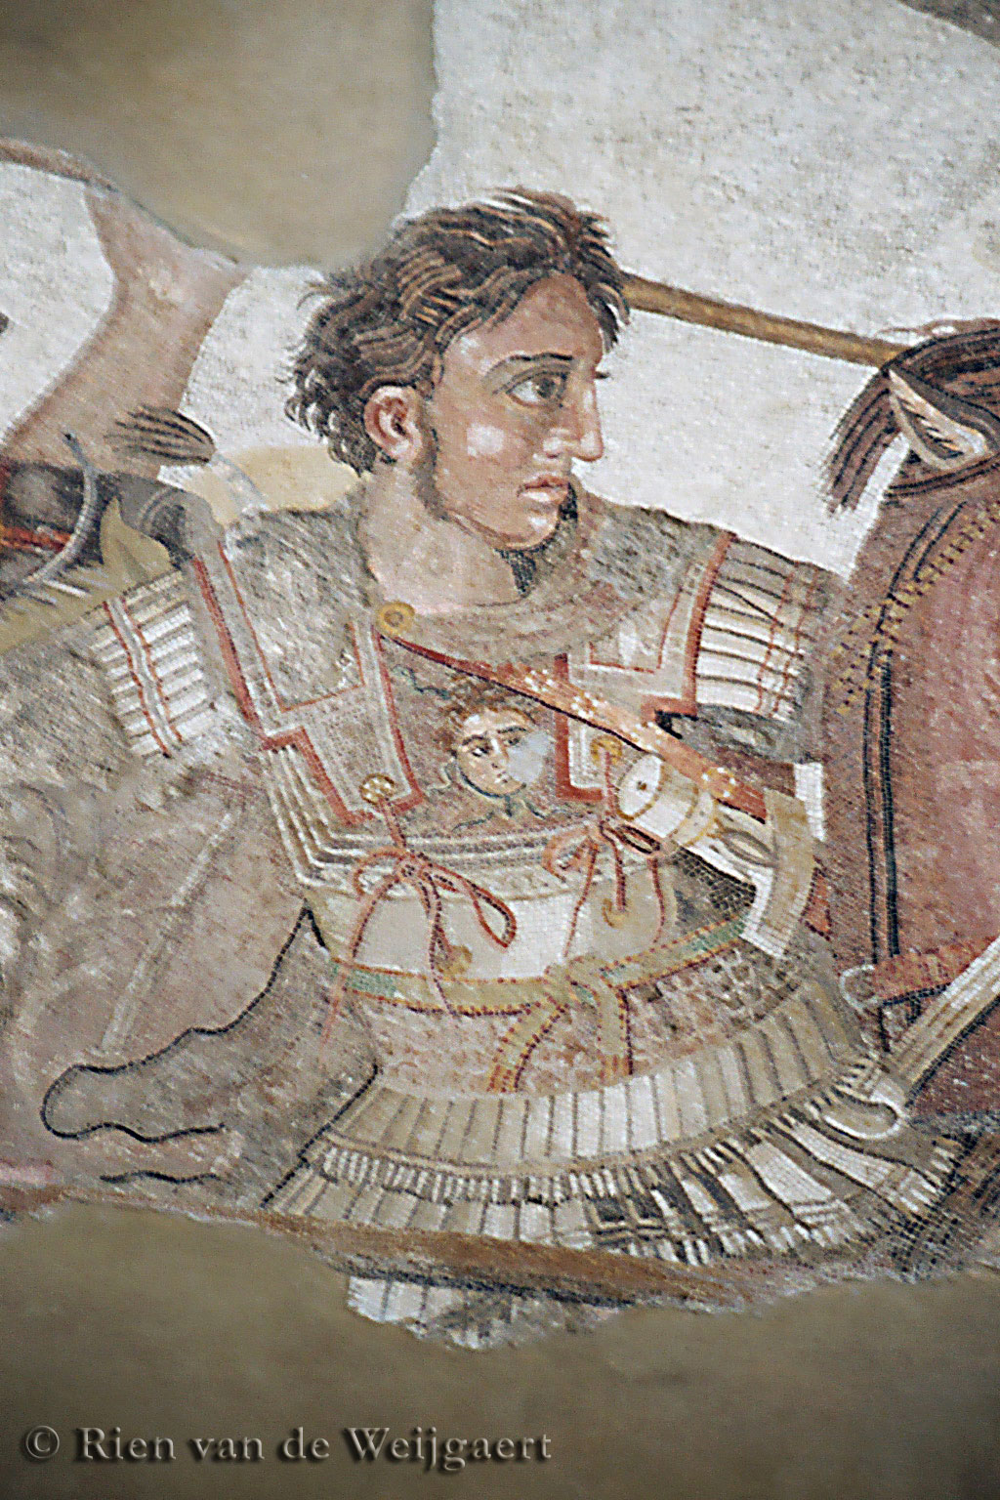
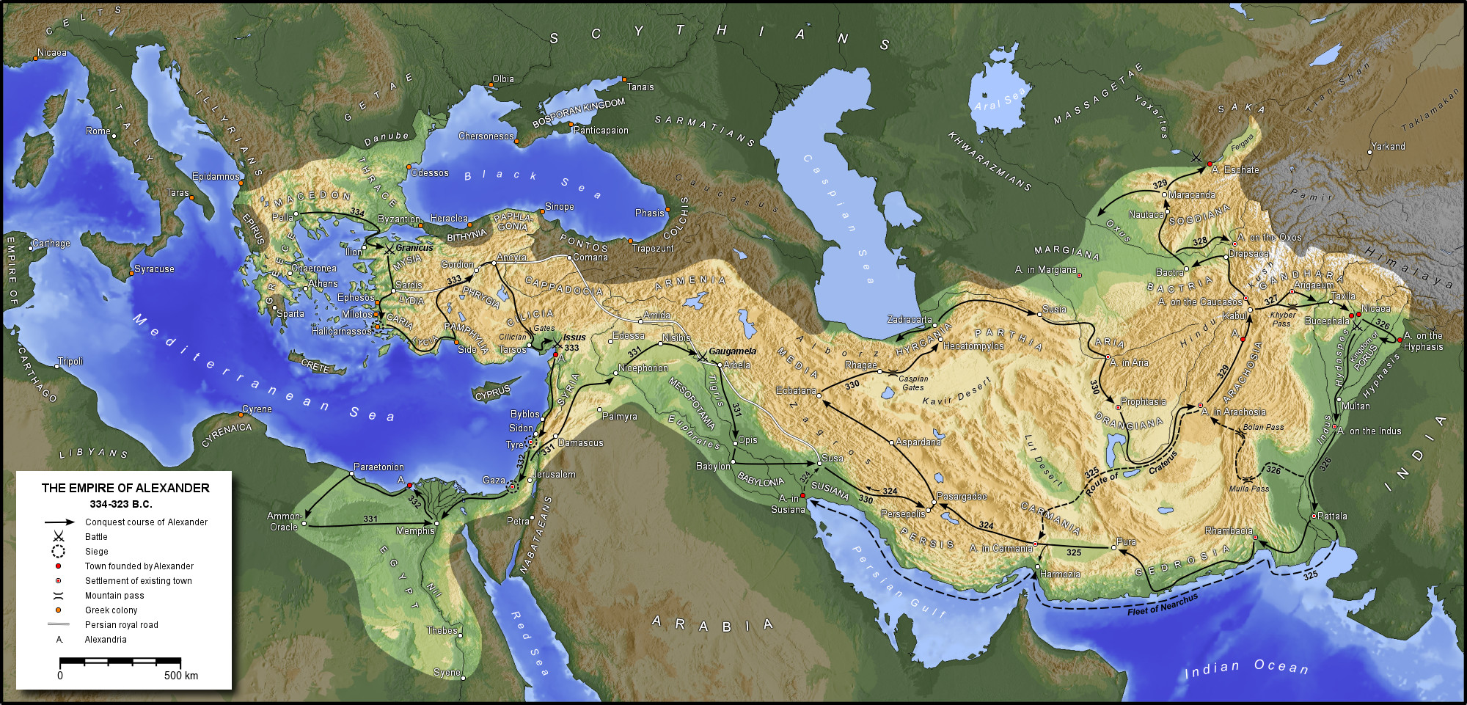
First Scientific Revolution: Hellenistic World

Slide 53
Hellenistic States & Centers of Science
Pergamum
Syracuse
Rhodos
Alexandria

Slide 54
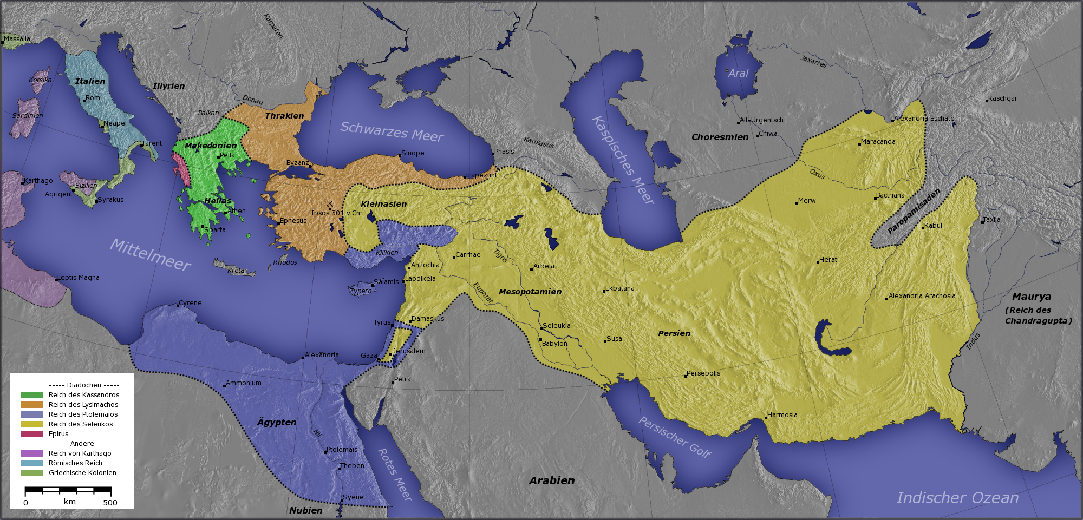
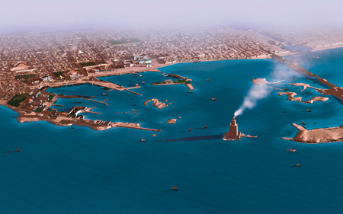
Alexandria

Slide 55
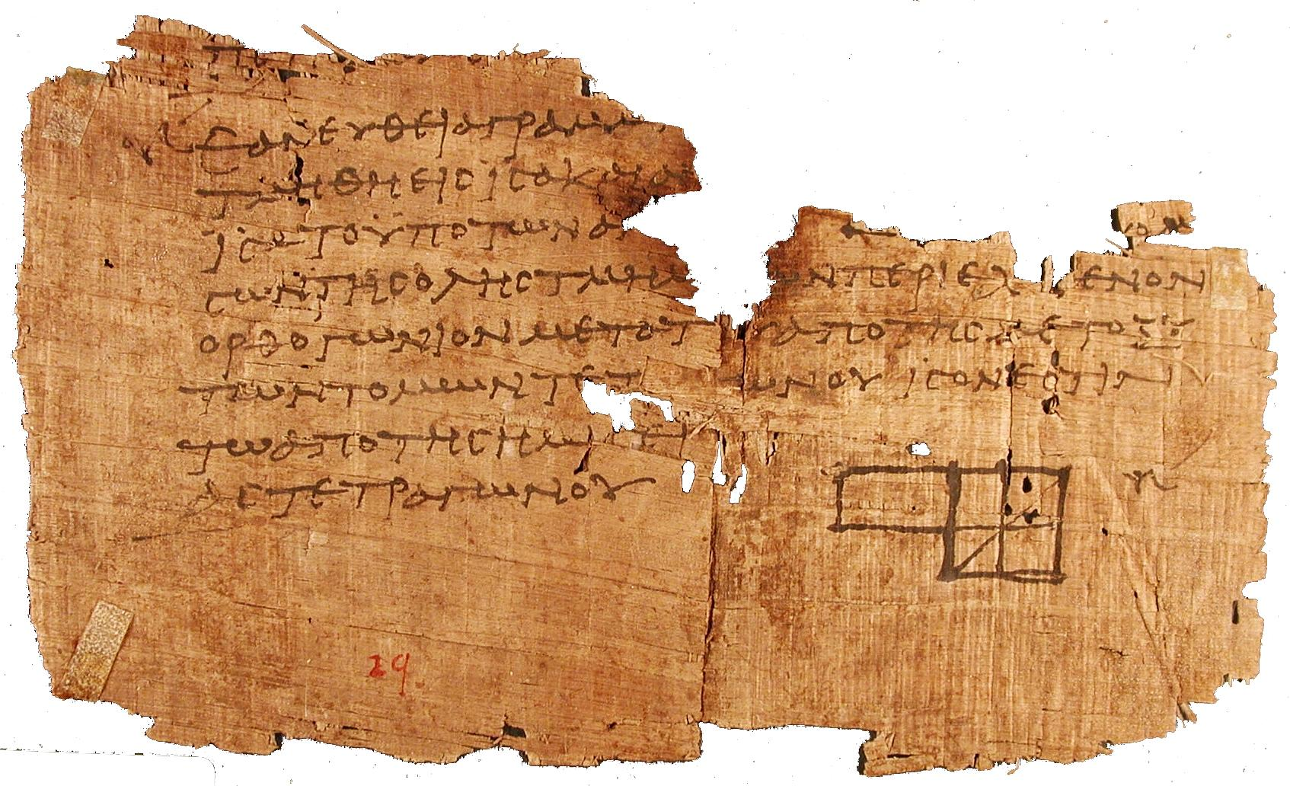
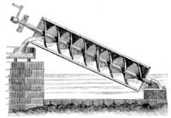
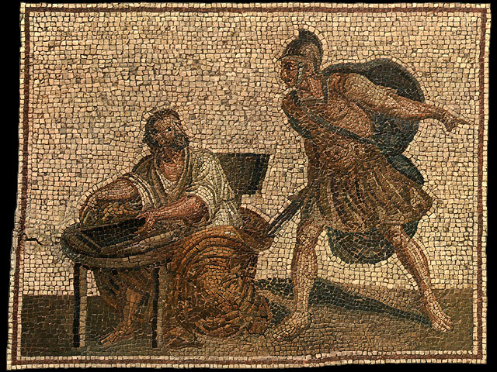
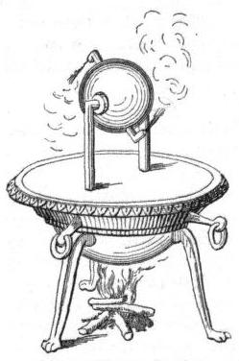
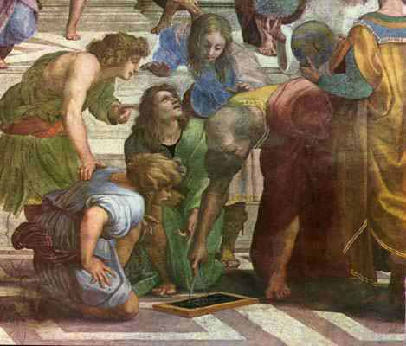
First Scientific Revolution

Slide 56
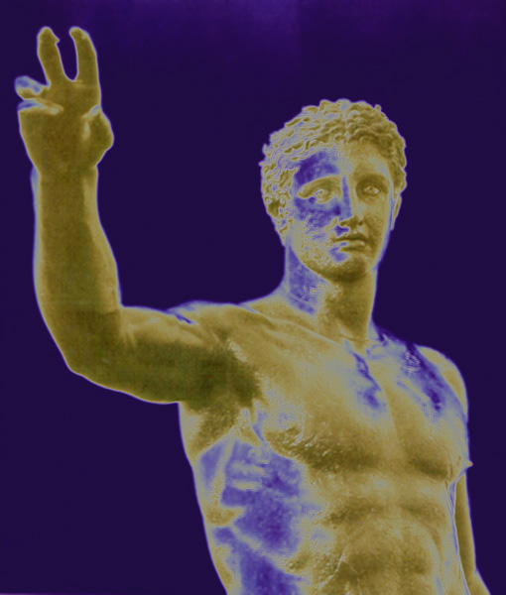
Euclides Herophilus Aristarchus Ctesibius Archimedes Eratosthenes Apollonius Hipparchus Heron of Alexandria Ptolemaeus

Slide 57
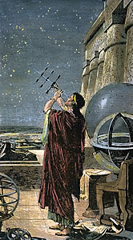
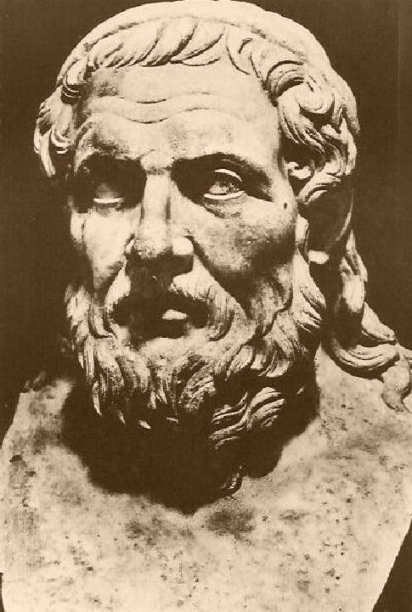
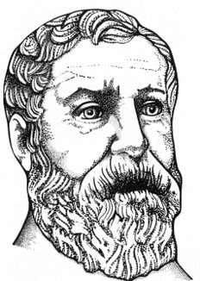
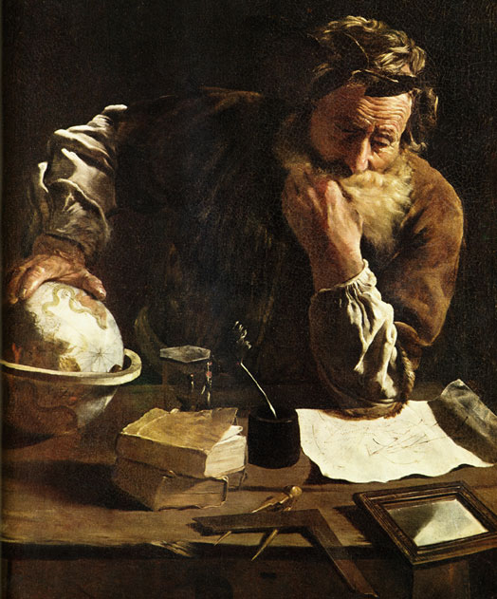
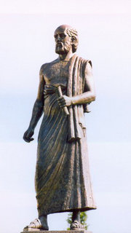
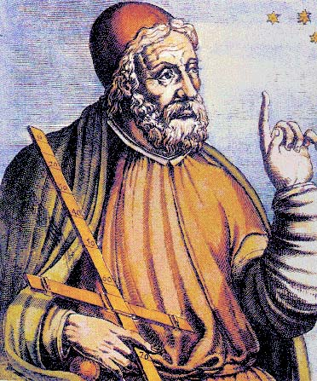
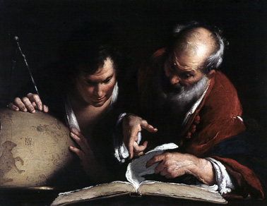
Hipparchus
Euclides
Heron
Apollonius of Perga
Aristarchus
Ptolemaeus
Eratosthenes
Archimedes

Slide 58
Euclides (~ 300 BC) Herophilus (335-280 BC) Aristarchus of Samos (310-230 BC) Ctesibius (285-222 BC) Archimedes (287-212 BC) Eratosthenes (276-194 BC) Apollonius of Perga (262-190 BC) Hipparchus of Samos (190-120 BC) Heron of Alexandria (10-70 AD) Ptolemaeus (83-168 AD)

Slide 59
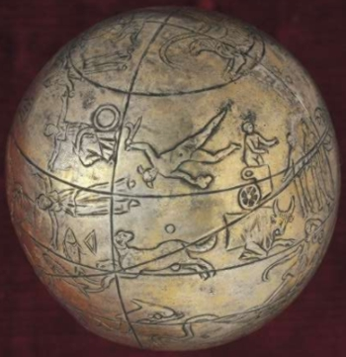
Hellenistic Astronomers
Various astronomers made significant,
even amazing, contributions. Noteworthy examples:
• Aristarchus of Samos - Heliocentric Universe
- distance Moon & Sun
- size Sun
• Archimedes - Planisphere/Planetarium ?
• Eratosthenes - Diameter Earth
• Hipparchus - multitude
essential contributions
Problematic is the loss of nearly all, except for a few,
of the books and works they have written …

Slide 60
Aristarchus of Samos Ἀρίσταρχος 310-230 BCE

Slide 61
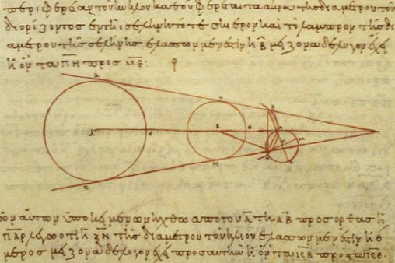
Aristarchus of Samos (Samos, 310-230 BCE) the ancient Copernicus
“On the Sizes & Distances of the Sun and Moon ”:

Slide 62
On the Sizes and Distances
Only one work of Aristarchus survives:
On the Sizes and the Distances
of the Sun and Moon
First mathematically based attempt
to measure distance Earth-Sun, thus
First attempt to measure scale Universe
Based upon geocentric view of Universe
On the Sizes and the Distances
Greek copy 10th century

Slide 63
On the Sizes and Distances
Aristarchus' geometric construction used to estimate the distance to the Sun.
Earth (E) –Sun (S)-Moon (M) triangle and sizes are not drawn to scale.
Measure angle b:
c = 90-b EM/ES = sin(c)
Aristarchus:
b = 87 real value: b = 8950
ES = 19 EM real value: ES = 397 EM
Numerically, very unstable procedure, reason
for huge error. Nonetheless,
On the Sizes and the Distances
Greek copy 10th century

Slide 64
On the Sizes and Distances
Aristarchus' estimate of size Sun:
angular diameter Sun ~
angular diameter Moon
Dist. Earth-Sun = 19 Dist. Earth-Moon
size Sun = 19 x size Moon
size Sun > size Earth
On the Sizes and the Distances
Greek copy 10th century

Slide 65
Aristarchus: Heliocentric Universe
Archimedes, “the Sand Reckoner” (~200 BCE):
You King Gelon are aware the ‘universe' is the name given by most astronomers to the sphere the center of which is the center of the Earth, while its radius is equal to the straight line between the center of the Sun and the center of the Earth. This is the common account as you have heard from astronomers.
But Aristarchus has brought out a book consisting of certain hypotheses, wherein it appears, as a consequence of the assumptions made, that the universe is many times greater than the 'universe' just mentioned.
His hypotheses are that the fixed stars and the Sun remain unmoved, that
the Earth revolves about the Sun
on the circumference of a circle, the Sun lying in the middle of the orbit, and that the sphere of fixed stars, situated about the same center as the Sun, is so great that the circle in which he supposes the Earth to revolve bears such a proportion to the distance of the fixed stars as the center of the sphere bears to its surface.

Slide 66
Aristarchus: Heliocentric Universe
Aristarchus’ idea of Heliocentric Universe
encountered sceptical, even hostile, reactions:
• Could not explain the absence of
parallax of fixed stars
(or they should be very, very far away …)
• Impiety … (even for those “rational” Greeks …)
“Cleanthes thought it was the duty of the Greeks to indict Aristarchus of Samos on the charge of impiety for putting in motion the Hearth of the universe [i.e. the earth], . . . supposing the heaven to remain at rest and the earth to revolve in an oblique circle, while it rotates, at the same time, about its own axis”
Plutarchus, “On the Apparent Face in the Orb of the Moon”

Slide 67
Eratosthenes of Cyrene Ἐρατοσθένης 276 BC - 194 BC

Slide 68
Eratosthenes of Cyrene (276 -194 B.C.E.)
• Studied in Alexandria & Athens
- Mathematician
- Astronomer
- Geographer
- Poet
- Athlete
• 2nd Chief librarian
Great Library of Alexandria
• Friend of Archimedes
Invented armillary sphere
(240 BC)
• Calculated Earth’s Circumference
• Became blind in 194 BC,
starved himself to death

Slide 69
Earth Circumference:
Eratosthenes’ measurement: 39,690 km - within 1%
(if Egyptian stadia)
Linear distance
Syene - Alexandria:
~ 5,000 stadia
Angular distance
Syene - Alexandria:
~ 7⁰
Eratosthenes’ measurement Earth diameter

Slide 70
Eratosthenes Earth Circumference Measurement

Slide 71
Archimedes of Syracuse  c. 287 – 212 BCE

Slide 72
Archimedes
Syracuse, 287-211/212 BC,
Greatest mathematician &
scientist of antiquity (all time ?):
• Probably studied in Alexandria,
under followers Euclides
• Killed by Roman soldier, upon
Roman conquest Syracuse
• Family Hieron II, king Syracuse ?
• Inventions:
- war machines …
- water screw
- water organ (?)
- burning mirrors (???)
- planetarium !!!!!!!

Slide 73
Cicero mentions two planetarium like machines…
“For when Archimedes fastened on a globe the
movements of moon, sun and five wandering stars,
he, just like Plato’s God who built the world in the
“Timaeus”, made one revolution of the sphere
control several movements utterly unlike in
slowness and speed. Now if in this world of ours
phenomena cannot take place without the act of
God, neither could Archimedes have reproduced
the same movements upon a globe without
divine genius''
Cicero, Tusculan Disputations, Book I, Section XXV

Slide 75
Archimedes
Pappus of Alexandria:
Archimedes wrote book
“On Sphere-Making”
… is this Antikythera … ?
Compare with
Archimedes Palimpsest:
… “On the Method” …
Fundamentals Calculus,
Integral calculus …

Slide 76
Hipparcus  c. 190 – 120 BCE

Slide 77
Hipparchus of Nicaea (190-120 BC) Antiquities' Greatest Astronomer Responsible for the true Revolution in Astronomy Synthesis of Babylonian Observational Astronomy Greek Theoretical/Geometric Models Astronomy as true Modern Science: Experiment & Theory

Slide 78
Hipparcus (Nicaea-Rhodos 190-120 BCE)
Greatest astronomer Greek antiquity
• Trigonometric Tables
• Precession of the Equinoxes
• Motion moon:
synodic, anomalistic, … month
• Solar & Lunar eclipses
• Orbit of the Moon:
epicyclic theory
• Distance Moon
• Star catalogue & Celestial Globe
Lost, yet … Farnese Atlas ?
• Defined Magnitude Scale
• Invented the Astrolabe
•

Slide 79
Star Magnitudes

Slide 80
Precession

Slide 81
Precession

Slide 82
… and Astronomy
Greek Miracle ?
Hipparcus’ Moon Orbit Computer

Slide 83
Farnese Atlas: Hipparchus’ star catalog ?

Slide 84
Farnese Atlas: Hipparchus star catalog ?
Farnese Atlas is the oldest surviving pictorial
Record of Western constellations
Roman times ~ A.D. 150,
presumed to represent constellations mapped in earlier Greek work
Atlas labors under the weight because he had been sentenced by Zeus to hold up the sky.
The globe shows:
a depiction of the night sky as seen from
outside the outermost celestial sphere
low reliefs depicting 41 (42) of the
48 classical Greek constellations including:
- Aries the ram
- Cygnus the swan
- Hercules

Slide 85
Antikythera Mechanism c. 150 BCE

Slide 86
National Archaeological Museum, Athens
Fragment C, Fragment A, Fragment B

Slide 87
Fragment B
Fragment A
Fragment C

Slide 89
Interior
AMRP
X-Tek X-ray
Tomography

Slide 91
image courtesy: Tony Freeth/Images First Ltd.

Slide 92
... Phosphorou ...
Venus !
... of the Cosmos ...
AMRP/Alexander Jones

Slide 93
Technical Inscriptions:
• “Tap”; “Gnomon”; “Perforations”; “Pointers”; “Gears”;
• “Spiral divided in 235 sections …”
• “small golden ball”
• “small ball”
Astronomical Inscriptions:
• “”: stationary point planets’ retrograde motion
• “Venus approaches the Sun”
“The Hyades set in the evening”
“Gemini begins to rise”, …
“ the 76 years, 19 years of the …”

Slide 94
Metonic
Cycle Dial:
5 spiral
235 glyphs
Callipic Cycle
Subdial
Olympic Cycle
Subdial
Exeligmos Cycle
Subdial
Saros
Cycle Dial:
4 spiral
223 glyphs

Slide 95
Astronomical Cycles
Saros Cycle
Eclipse cycle:
multiple of
Synodic, Draconic and Anomalistic month
223 synodic;
242 draconic;
239 anomalistic:
18 yrs, 11 days, 8 hrs (6585 1/3 days)
Exeligmos Cycle
3 Saros cycles:
following Exeligmos cycle, eclipse returns
at same location Earth
669 synodic;
726 draconic;
717 anomalistic:
54 yrs, 34 days (19756 days)
• Metonic Cycle
multiple of Tropical Year and Synodic Month
19 tropical years;
235 synodic months
254 siderial months
6940 days
• Callippic Cycle
more accurate multiple
Tropical Year & Synodic Month
4 Metonic cycles - 1 days;
76 tropical years;
940 synodic months

Slide 96
Saros Dial

Slide 97
Saros Dial
glyph

Slide 98
Mechanical Elements
evidence of
pillars, bearing and
other fittings on the
Main Drive Wheel

Slide 99
Mechanical Elements
pierced end
shoulders

Slide 100
M. Wright
copper hardware models of
Antikythera planetarium
- Archimedes Sphera

Slide 101
Jones found all
5 planet names &
Moon and Sun
in inscriptions:
ordered like Cosmos
each with
descriptive &
theophoric name
e.g. Venus:
+ Phosphoros
+ star of Aphrodite
Antikythera Mechanism
may be a planetarium
following the
Cosmos of Aristoteles
Moon
Mercury
Venus
Sun
Mars
Jupiter
Saturn
Freeth & Jones 2012
ISAW publ.

Slide 102
Claudius Ptolemaeus   AD 83-168

Slide 103
Claudius Ptolemaeus   AD 83-168

Slide 104
Claudius Ptolemaeus Thebaid/Ptolemais Hermiou- Alexandria 83-168 A.D.  Mathematician  Astronomer  Geographer  Astrologer additional interests in  Optics  Music  Philosophy

Slide 105
Claudius Ptolemaeus Culmination & Synthesis Hellenistic Astronomy Geography in Classical World Lasting and dominant influence, > 1500 yrs, European & Islamic science

Slide 106
Alexandria: Birthplace of the Western Mind
Mouseion: the Library

Slide 107
Great Library of Alexandria
Ptolemaeus’ Workplace:
Mouseion: World’s first “university”
Library: 700,000 book scrolls
Storage of all knowledge ancient world

Slide 108
Ptolemy's Bibliography
Almagest (13 books) astronomy
Geography (8 books) geography
Optics (5 books) physics
Tetrabiblos (4 books) astrology
Harmonics (3 books)
Planetary Hypotheses (2 books) astronomy
Analemma
Canobic Inscription
Planispherium astronomy
Other astronomical works
Lost works

Slide 109
Almagest
Geografia
Tetrabiblos

Slide 110
Geografia

Slide 111
Geografia
Standard of geographical theory until the 1500’s,
until age of exploration
• Only surviving geographical treatise from antiquity
• Represents whole corpus of geographical knowledge
acquired in Graeco-Roman antiquity
• Mapping earth with mathematical procedures
from astronomy: coordinates, parallels, meridians
• Divided into 8 books:
Book 1: Introduction and
directions to recreate Ptolemy’s Map
Books 2-7: Latitudinal and longitudinal data for
~ 8,000 cities
Book 8: Description of 28 regional maps

Slide 112
Geografia
Map of Ancient India:
crucial importance for development Roman
trade network with India

Slide 113
Geografia - Oikoumene/
Based on the work of his immediate predecessor,
Marinus of Tyre (80-130 A.D.)
Combined data from a variety of sources
Ptolemy was the first geographer to use longitude and latitude to create coordinates
Derived 21 latitude lines – fairly accurate
Described 4 different projections
Believed the oikoumene (inhabited world) to span
180 degrees (longitude) of the earth’s 360
Limits of the oikoumene
Northern bound: 63°N (the Thule parallel)
Southern bound: 16°25’S
(the parallel opposite the equator from the one running through Meroë)
Oikoumene stretches from
the Canary Islands in the west to China in the east

Slide 114
Geografia: four Map Projections
Projection 2
Projection 1
Straight meridians & Straight parallels
Very similar to Marinus’ map
Projection 2
Straight meridians & Curved parallels
Preferred method of Ptolemy’s successors
Constant scale in relation to Rhodes parallel
36+1 parallel meridians, each 5 degrees apart
Projection 3
Curved meridians & Straight parallels
made extreme parallels more accurate
Projection 4
View of globe from distance
External rings represent latitude lines
Projection 3

Slide 115
Almagest - the Greatest
 
Almagest, Greek copy 9th century

Slide 116
  - Almagest
Almagest, Greek copy 13th century
“The Great Book”
Most Important & Influential
Astronomical Work of Antiquity
Mathematical and Astronomical treatise proposing
the complex motions of stars and planetary paths
Written in 147 / 148 A.D.:
inscription in Canopus, by Ptolemaeus
Thirteen Books
Original in Greek:
Mathematike Syntaxis - Mathematical Treatise
He Megale Syntaxis - “The Great Treatise”
Best known by its Arab name:
Almagest - “The Great Book”

Slide 117
Almagest the Greatest
One of the most influential scientific works in history
(along with Euclid’s “Elements”, Copernicus’ “Revolutionibus”,
Galilei’s “Dialogues” Newton’s “Principia”,
Darwin’s “Origin of Species”)
One of most influential books of all time
(perhaps only after Bible, Qur’an,
along with Euclid’s “Elements”, …)

Slide 118
Almagest the Greatest
Masterwork technical exposition
Brilliant synthesis
Theoretical Astronomy
Practical Handbook computation Ephemerides

Slide 119
Almagest the Greatest
Systematic methodology
Observational Data
Numerical parameters planetary models
Construction tables celestial phenomena
(solar, lunar & planetary positions; solar & lunar eclipses, …)

Slide 120
Almagest the Greatest
More than any other book, demonstrated
complex phenomena of heavens
demonstratable & observable regularities
underlying mathematical description
predictions celestial events
Implication:
Secrets other aspects of our world
also understandable via underlying regularities

Slide 121
Geocentric Universe
Ptolemaeus’ Geocentric Universe is one
of the 2 world world systems under
discussion in Galileo Galilei’s book (1632)
Dialogue Concerning the
Two Chief World System
It had to give way to the heliocentric Universe, 1500 yrs after the Almagest

Slide 122
Almagest the Greatest
Success Almagest:
Loss of most of work scientific predecessors:
being obsolete, they ceased to be copied
Is this true ?

Slide 123
Almagest the Greatest

Slide 124
Epicyclic Theory

Slide 127
Epicycle Theory: refinements (2nd century B.C.)
0
Hipparchus:
Eccentric: placing the Earth away from the centers of the “perfect spheres”
Ptolemy: further refinements, including equants

Slide 128
Ptolemaeus Epicycle Theory
eccentric
equant
epicycle (basic)

Slide 129
Early geometric planetary models
Epicycle
Anomalistic motion
Deferent
Longitudinal motion

Slide 130
The inferior and superior planets
Period of time = Number of anomalistic periods + Number of longitudinal periods

Slide 131
Ptolemaeus Epicycle Theory
Ptolemaeus Epicycle Theory
0

Slide 132
Almagest     

Slide 133
Syntaxis - Almagest
Almagest, Greek copy 13th century
“The Great Book”
most Important & Influential
Astronomical Work of Antiquity
Ptolemy first scientist to spell out inductive method:
- models framed from preliminary facts
- expand models by logical induction
- testing hypothesis against reality
Only surviving comprehensive ancient
treatise on astronomy:
- most important source of information on
ancient Greek astronomy
Geocentric Model
Epicycle Theory
Dominated astronomy for > 13 centuries
- Roman (Byzantine, Western) world
Arab world

Slide 134
Syntaxis - Almagest
Almagest, Greek copy 13th century
“The Great Book”
most Important & Influential
Astronomical Work of Antiquity
Geometrical models based on 800 yrs observations
(Babylonians, Hipparchus, …)
Models presented in convenient tables
Calculations fairly accurate for prediction
solar and lunar eclipses
Almagest also contains star catalogue
- appropriated version Hipparchus’ catalogue
- 48 constellations: modern ones, not full sky

Slide 135
Syntaxis - Almagest
Almagest, Greek copy 13th century
Ptolemaeus’ Cosmos
The cosmology of the Almagest:
five main points
each subject of a chapter Book I.
The celestial realm is spherical,
and moves as a sphere.
The earth is a sphere.
The earth is at the center of the cosmos.
The earth,
in relation to the distance of the fixed stars,
has no appreciable size,
must be treated as a mathematical point
The earth does not move.

Slide 136
Syntaxis - Almagest
Almagest, Greek copy 13th century
Ptolemaeus’
Planetary Models
Order of planetary spheres:
Moon
Mercury
Venus
Sun
Mars
Jupiter
Saturn
Sphere fixed stars

Slide 137
Syntaxis - Almagest
Almagest: 13 books
Almagest, Greek copy 13th century
Book I:
outline of Aristotelian cosmology:
- on the spherical form of the heavens,
- the (spherical) Earth lying motionless at centre
- the fixed stars and the various planets revolving
around the earth
- followed by explanation of chords with a set of
chord tables
- observations of the obliquity of the ecliptic
- introduction to spherical trigonometry
Book II:
problems associated with the daily motion attributed
to the heavens:
- risings and settings of celestial object
- length of daylight
- determination of latitude
- points at which the Sun is vertical
- shadows of the gnomon at the equinoxes and
solstices
- other things which change with the spectator's
position. There is also
- a study of the angles made by the ecliptic with
vertical, with tables.

Slide 138
Syntaxis - Almagest
Almagest: 13 books
Almagest, Greek copy 13th century
Book III:
- length of the year, and the motion of the Sun
- explains Hipparchus' discovery of the
precession of the equinoxes
- begin explanation epicycles
Books IV & V:
the motion of the Moon:
- lunar parallax
- motion of the lunar apogee
- sizes and distances of the Sun and Moon relative
to Earth
Book VI:
solar and lunar eclipses

Slide 139
Syntaxis - Almagest
Almagest: 13 books
Almagest, Greek copy 13th century
Books VII & VIII:
motions of the fixed stars:
- includes precession of the equinoxes
star catalogue of 1022 stars:
- described by positions in the constellations
- magnitude scale for brightness:
+ brightness brightest stars marked of the
1st magnitude (m = 1),
+ faintest 6th magnitude (m = 6),
limit human visual perception
+ each grade of magnitude considered twice the
brightness of the following grade (log. scale).
+ system believed to have originated with
Hipparchus
+ Stellar positions: Hipparchan origin
(despite Ptolemy's claim to the contrary)

Slide 140
Syntaxis - Almagest
Almagest: 13 books
Almagest, Greek copy 13th century
Book IX:
- general issues associated with creating models
for the five (naked eye) planets
- motion of Mercury
Book X:
motions of Venus and Mars
Book XI:
motions of Jupiter and Saturn
Book XII:
stations and retrogradations,
- occurring when planets appear to pause,
then briefly reverse their motion against the
background of the zodiac.
- Ptolemy understood these terms to apply to
Mercury and Venus as well as the outer planets
Book XIII:
motion in latitude:
the deviation of planets from the ecliptic

