Slide 1
Gods and Myths:
Creation of the World

Slide 2
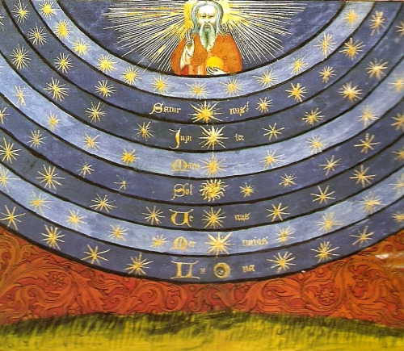
Ancient Cosmology: Space and Time

Slide 3
Ancient Cosmology
- What was the shape of the Universe imaged by those ancient peoples to whom all
modern knowledge of geography and astronomy was inacessible ?
- How did they conceive the form of the cosmos which accommodated not only the known
face of the earth and the visible heavenly bodies, but also those other worlds
ie. the realms of the dead, both blessed and damned,
and the countries inhabited by gods and demons ?

Slide 4
Space and Time
In some cosmologies space inseparable from time :
- no account of the shape of the universe would make sense
unless we know how it came to be so in the first place
- in other words, the cosmologies go along with creation myths
ie. the creation of the universe is an essential feature of cosmology
- uniquely, this lead the Jewish (biblical and rabbinical) sources to the solution of a
notion of linear time
- by contrast:
China: notion of creation not of prime importance
Greeks: not so interested in beginnings
Jains: uninterested in beginnings
India: time scales as vast as space, leading to the notion of cyclical time
Norse/Greeks/Chines: also cyclical time notion

Slide 5
Gods and Myths of Creation

Slide 6
Religious Cosmology
- A Way of explaining the Origin, History and Evolution of the Cosmos or Universe
on the Religious Mythology of a specific tradition.
- Religious cosmologies usually include an act or process of creation by a
creator deity or pantheon
Creation Myth
- A symbolic narrative of how the world began and how people first became to inhabit it.
- Usually – not always – they are Cosmogonical myths:
describe the ordering of the Cosmos from a state of Chaos
- nearly always sacred accounts
- found in nearly all known religious traditions
- they are all stories with a plot and characters who are either deities,
human-like figures or animals
- Creation myths address questions deeply meaningful to the society that shares them,
revealing their central worldview and the framework for the self-identity of the
culture and individual in a universal context.

Slide 7
Creation Myths
M. Eliade (1964)
“Myth narrates a sacred history; it relates an event that took place in primordial Time, the fabled time of the "beginnings." In other words, myth tells how, through the deeds of Supernatural Beings, a reality came into existence, be it the whole of reality, the Cosmos, or only a fragment of reality – an island, a species of plant, a particular kind of human behavior, an institution”
Definitions:
A "symbolic narrative of the beginning of the world as understood in a particular tradition and community. Creation myths are of central importance for the valuation of the world, for the orientation of humans in the universe, and for the basic patterns of life and culture.“ (Websters)
"Creation myths tell us how things began. All cultures have creation myths; they are our primary myths, the first stage in what might be called the psychic life of the species. As cultures, we identify ourselves through the collective dreams we call creation myths, or cosmogonies. … Creation myths explain in metaphorical terms our sense of who we are in the context of the world, and in so doing they reveal our real priorities, as well as our real prejudices. Our images of creation say a great deal about who we are.“ Leeming 2010 (Creation Myths of the World)
A "philosophical and theological elaboration of the primal myth of creation within a religious community. The term myth here refers to the imaginative expression in narrative form of what is experienced or apprehended as basic reality … The term creation refers to the beginning of things, whether by the will and act of a transcendent being, by emanation from some ultimate source, or in any other way.“ (Britannica)

Slide 8
Dilemma: the Beginning
D. Christian (historian)
How did everything begin? This is the first question faced by any creation myth and ... answering it remains tricky.
Each beginning seems to presuppose an earlier beginning. ... Instead of meeting a single starting point, we encounter an infinity of them, each of which poses the same problem. ...
There are no entirely satisfactory solutions to this dilemma. What we have to find is not a solution but some way of dealing with the mystery .... And we have to do so using words.
The words we reach for, from God to gravity, are inadequate to the task. So we have to use language poetically or symbolically;
and such language, whether used by a scientist, a poet, or a shaman, can easily be misunderstood
(Christian, Maps of Time, 2004)
Daoist creation myth
"The Way gave birth to unity;
unity gave birth to duality;
duality gave birth to trinity;
trinity gave birth to the myriad creatures."
(Daodejing, 4th century BCE

Slide 9
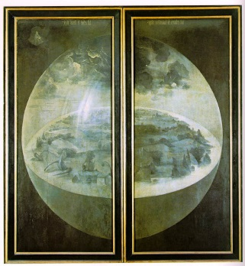
Creation Myths
Classification in 5 basic types (Eliade & Long)
Creation Ex Nihilo
Creation through thought, word, dream, bodily secretions
of divine being.
Creation from Chaos
Creation from chaos. Initially there is nothing but a formless,
shapeless expanse. In these stories “chaos” means “disorder”
and this formless expanse (void, abyss) contains the
material with which the created world will be made. The
act of creation is bringing order from disorder.
Earth Diver creation
in which a diver, usually a bird or amphibian sent by a
creator, plunges to the seabed through a primordial ocean
to bring up sand or mud which develops into a terrestrial world.
Emphasis is placed on beginnings emanating from the depths.
Emergence Myths
In emergence myths humanity emerges from another world
into the one they currently inhabit. The previous world is often
considered the womb of the earth mother, and the process of
emergence is likened to the act of giving birthworld.
World Parent Myths
Separation or splitting of a primordial entity,
the world parent or parents.
Hieronymus Bosch - Creation
exterior shutters the Garden of Delight

Slide 10
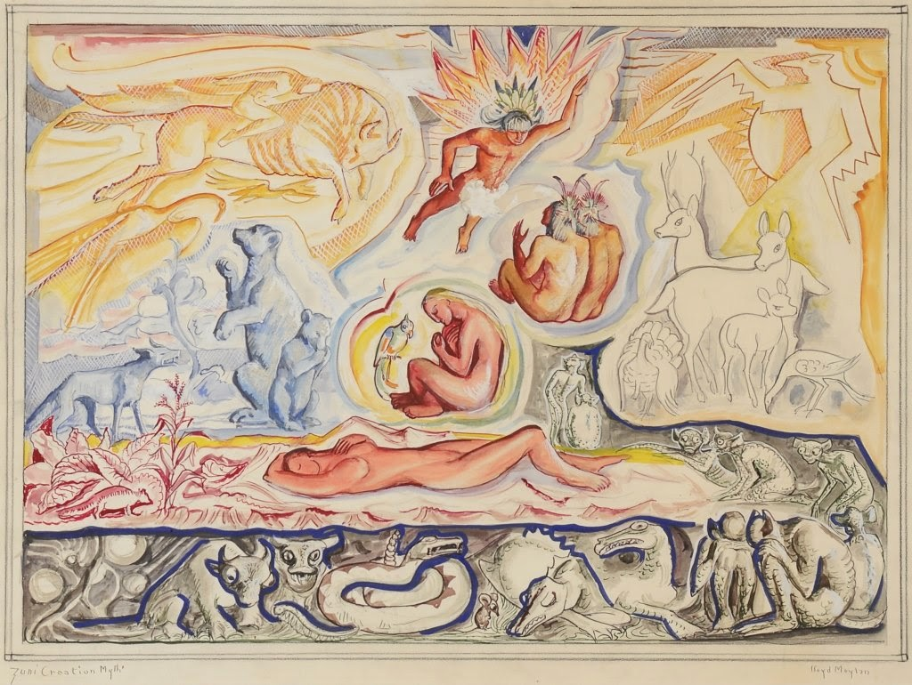
Emergence
In emergence myths humanity emerges from another world into the
one they currently inhabit.
The previous world is often considered the womb of the earth mother,
and the process of emergence is likened to the act of giving birth.
The role of midwife is usually played by a female deity, like the spider
woman of Native American mythology. Male characters rarely figure into
these stories.
These myths are often considered as a counterpoint to
male-oriented creation myths (eg. the ex-nihilo type)
Emergence myths commonly describe the creation of people and/or supernatural beings as a staged ascent or metamorphosis from nascent forms through a series of subterranean worlds to arrive at their current place and form.
Often the passage from one world or stage to the next is impelled by inner
forces, a process of germination or gestation from earlier, embryonic
forms.
The genre is most commonly found in Native American cultures where the myths frequently link the final emergence of people from a hole opening to the underworld to stories about their subsequent migrations and eventual settlement in their current homeland
Examples:
Zuni (Pueblo) creation myth
Hopi creation myth
Maya creation myth

Slide 11
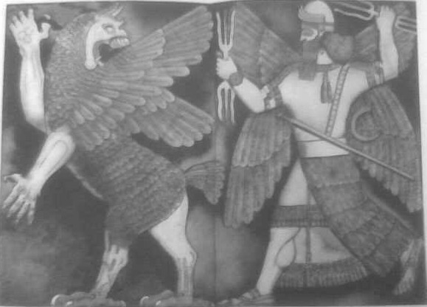
World Parent
Describes a separation or splitting of a primeval entity, the world parent or parents. Two types:
the primeval state as an eternal union of two parents, and the creation
takes place when the two are pulled apart. The two parents are
commonly identified as Sky (usually male) and Earth (usually female)
who in the primeval state were so tightly bound to each other that no
offspring could emerge.
These myths often depict creation as the result of a sexual union,
and serve as genealogical record of the deities born from it.
creation itself springs from dismembered parts of the body of the primeval being. Often in these stories the limbs, hair, blood, bones or organs of the primeval being are somehow severed or sacrificed to transform into sky, earth, animal or plant life, and other worldly features.
These myths tend to emphasize creative forces as animistic in nature
rather than sexual, and depict the sacred as the elemental and integral
component of the natural world
Examples:
Aztec Coatlicue
Babylonian Enuma Elis (precursor to Genesis)
Greek cosmogonical myth (Gaia-Uranus)

Slide 12
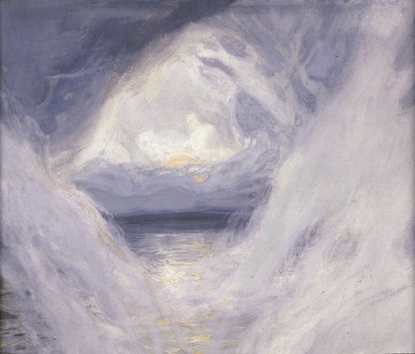
Creation Ex Nihilo
very common type of mythical creation
Ex nihilo - ex Novo - “out of nothing”
In ex nihilo creation myths the potential and the substance of creation
springs from within the creator. Such a creator may or may not be
existing in physical surroundings such as darkness or water, but does
not create the world from them.
often confused/blurred with
Out of chaos
Initially there is nothing but a formless, shapeless expanse. In these
stories the word "chaos" means "disorder", and this formless expanse,
- sometimes called a void or an abyss - contains the material with
which the created world will be made.
Chaos may be described as having the consistency of vapor or water,
dimensionless. These myths associate chaos with evil and oblivion, in
contrast to "order" (cosmos) which is the good.
The act of creation is the bringing of order from disorder, and in
many of these cultures it is believed that at some point the forces
preserving order and form will weaken and the world will once again
be engulfed into the abyss
Examples:
Ancient Egyptian creation myths
Genesis
(Christian, Islamic, Jewish)
Popol Vuh
(Maya)
Examples:
Enuma Elis
(Babylonian)
Greek cosmogonical myth
Sumerian creation myth
Leviathan/Book of Job

Slide 13
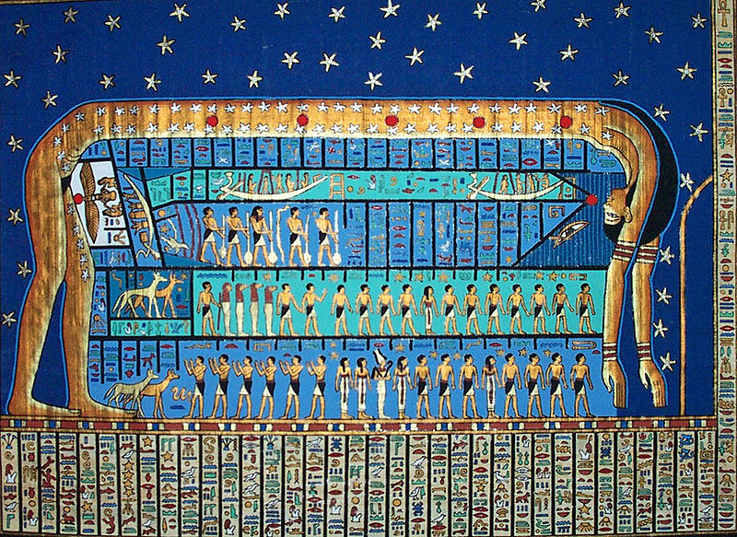
Ancient Egyptian Cosmology

Slide 14
Ancient Egyptian Cosmology
Ancient Egyptian cosmology centered on 3 key aspects:
Ma’at
Shape of the World
Time

Slide 15
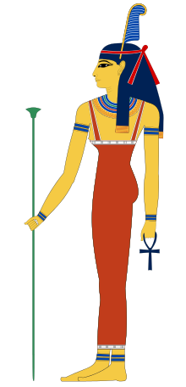
Ma’at
Ancient Egyptian cosmology centered on
Ma’at
Fundamental order of the Universe
Truth, Justice, Order, ...
Maat was also personified as a goddess regulating the stars, seasons, and
the actions of both mortals and the deities, who set the eternal order of
the universe from chaos at the moment of creation.
existed since the creation of the world, without it the world would lose
its cohesion
After her role in creation and continuously preventing the universe from
returning to chaos,
her primary role in Egyptian mythology dealt with the weighing of souls
that took place in the underworld,

Slide 16
Shape of the World
the air god Shu, assisted by other gods,
holds up Nut, the sky, as Geb, the earth, lies beneath.

Slide 17
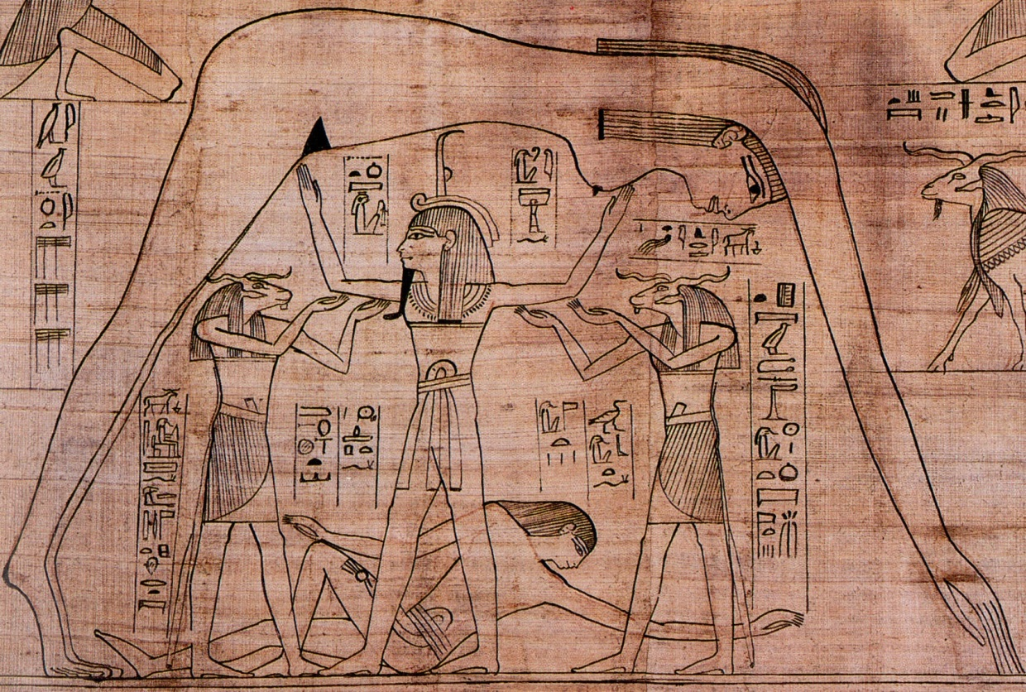
Shape of the World
Nun, disorder predating the ordered world, infinite expanse of formless water
Geb, a flat piece of land over which arches the sky
Nut, the sky
Separated by the personification of air, Shu.
Ra, the sun god Ra is said to travel through the sky, across the body of Nut, enlivening the world with his light. At night Ra passes beyond the western horizon into the Duat, a mysterious region that borders the formlessness of Nun. At dawn he emerges from the Duat in the eastern horizon.
The fertile lands of the Nile Valley (Upper Egypt) and Delta (Lower Egypt) lie at the center of the world in Egyptian cosmology. Outside them are the infertile deserts, which are associated with the chaos that lies beyond the world.
Somewhere beyond them is the horizon, the akhet. There, two mountains, in the east and the west, mark the places where the sun enters and exits the Duat.
Egypt itself is usually the scene for the action of the gods.

Slide 18
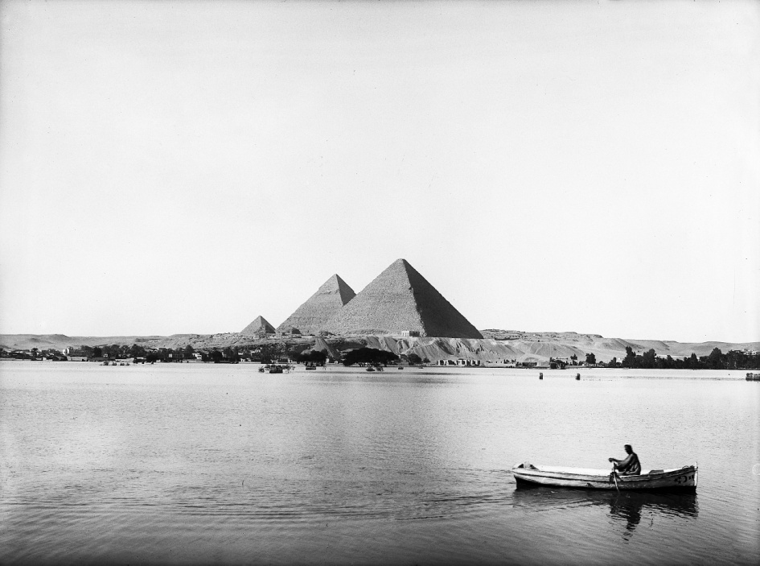
Time
annual flooding of the Nile

Slide 19
Time
The Egyptians' vision of time was influenced by their environment.
- Each day the sun rose and set, bringing light to the land and regulating human activity;
- Each year the Nile flooded, renewing the fertility of the soil and allowing the
highly productive agriculture that sustained Egyptian civilization.
These periodic events inspired the Egyptians to see all of time as a series of recurring patterns regulated by Ma’at, renewing the gods and the universe.
Although the Egyptians recognized that different historical eras differ in their particulars, mythic patterns dominate the Egyptian perception of history.
Many Egyptian stories about the gods are characterized as having taken place in a primeval time when the gods were manifest on the earth and ruled over it.
After this time, the Egyptians believed, authority on earth passed to human pharaohs.
This primeval era seems to predate the start of the sun's journey and the recurring patterns of the present world.
At the other end of time is the end of the cycles and the dissolution of the world.
Because these distant periods lend themselves to linear narrative better than the cycles of the present, they are the only periods in which true myths take place.
Yet, to some extent, the cyclical aspect of time was present in the mythic past as well.
The myths were made real every time the events to which they were related occurred.
Ritual allowed time to periodically return to the mythic past and renew life in the universe

Slide 20
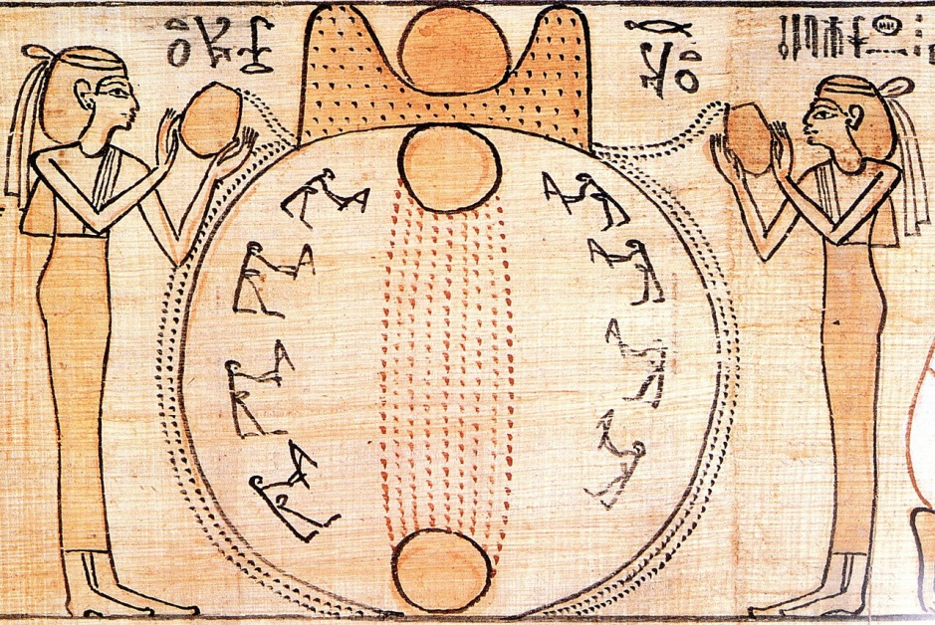
Creation Myths
Ancient Egypt had many creation myths, involving many creation gods
In all of these myths, the world was said to have emerged from an infinite, lifeless sea when the sun rose for the first time, in a distant period known as zp tpj "the first occasion".
Different myths attributed the creation to different gods:
the set of eight primordial deities called the Ogdoad:
- the self-engendered god Atum and his offspring,
- the contemplative deity Ptah,
- the mysterious, transcendent god Amun.
While these differing cosmogonies competed to some extent, in other ways they were complementary, as different aspects of the Egyptian understanding of creation
The different creation accounts were each associated with the cult of a particular god in one of the major cities of Egypt:
- Hermopolis, Heliopolis, Memphis, and Thebes.
The different creation myths have some elements in common.
They all held that the world had arisen out of the lifeless waters of chaos, called Nu.
They also included a pyramid-shaped mound, called the benben, which was the first thing to emerge from the waters.
The sun was also closely associated with creation, and it was said to have first risen from the mound, as the general sun-god Ra or as the god Khepri, who represented the newly-risen sun.[There were many versions of the sun's emergence, and it was said to have emerged directly from the mound or from a lotus flower that grew from the mound, in the form of a heron, falcon, scarab beetle, or human child.
Another common element of Egyptian cosmogonies is the familiar figure of the cosmic egg, a substitute for the primeval waters or the primeval mound.

Slide 21
Enuma Elis
Enuma Elis is the Babylonian creation mythos.
Striking similarity to Genesis
Important source for understanding Babylonian worldview, centered on the supremacy of Marduk
and the creation of humankind for the service of the gods.
The Enûma Eliš exists in various copies from Babylon and Assyria. The composition of the text probably dates to the Bronze Age, to the time of Hammurabi or perhaps the early Kassite era (roughly 18th to 16th centuries BCE), although some scholars favour a later date of c. 1100 BCE.
When the sky above was not named
And the earth beneath did not yet bear a name
And the primeval Apsu, who begat them,
And chaos, Tiamat, the mother of them both,
Their waters were mingled together,
And no field was formed, no marsh was to be seen;
When the gods none had been called into being.
Marduk and the Dragon
Marduk, chief god of Babylon, destroys – with his thunderbolt –
Tiamat the dragon of primeval chaos

Slide 22
Enuma Elis
Two primeval gods:
Apsu, representing fresh water
Tiamat, representing oceanic waters.
Several other gods are created - Ea and his brothers - who reside in Tiamat's vast body.
They make so much noise that the babel or noise annoys Tiamat and Apsû greatly. Apsû wishes to kill the young gods,
but Tiamat disagrees. The vizier, Mummu, agrees with Apsû's plan to destroy them.
Tiamat, in order to stop this from occurring, warns Ea, the most powerful of the gods. Ea uses magic to put Apsû into a coma, then kills him, and shuts Mummu out. Ea then becomes the chief god.
With his consort Damkina, he has a son, Marduk, greater still than himself.
Marduk is given wind to play with and he uses the wind to make dust storms and tornadoes. This disrupts Tiamat's great body
and causes the gods still residing inside her to be unable to sleep.They persuade Tiamat to take revenge for the death of her husband, Apsû. Her power grows, and some of the gods join her.
She creates 11 monsters to help her win the battle and elevates Kingu, her new husband, to "supreme dominion."
A lengthy description of the other gods' inability to deal with the threat follows. Marduk offers to save the gods if he is appointed
as their leader and allowed to remain so even after the threat passes. When the gods agree to Marduk's conditions he is
selected as their champion against Tiamat, and becomes very powerful.
Marduk challenges Tiamat to combat and destroys her. He then rips her corpse into two halves with which he fashions the earth and the skies. Marduk then creates the calendar, organizes the planets and stars, and regulates the moon, the sun, and weather.
The gods who have pledged their allegiance to Tiamat are initially forced into labor in the service of the gods who sided with Marduk. But they are freed from these labors when Marduk then destroys Tiamat's husband, Kingu, and uses his bloodto create humankind to do the work for the gods

Slide 23
"In the beginning God
created the heavens and the earth”
Genesis 1; 1-26

Slide 24
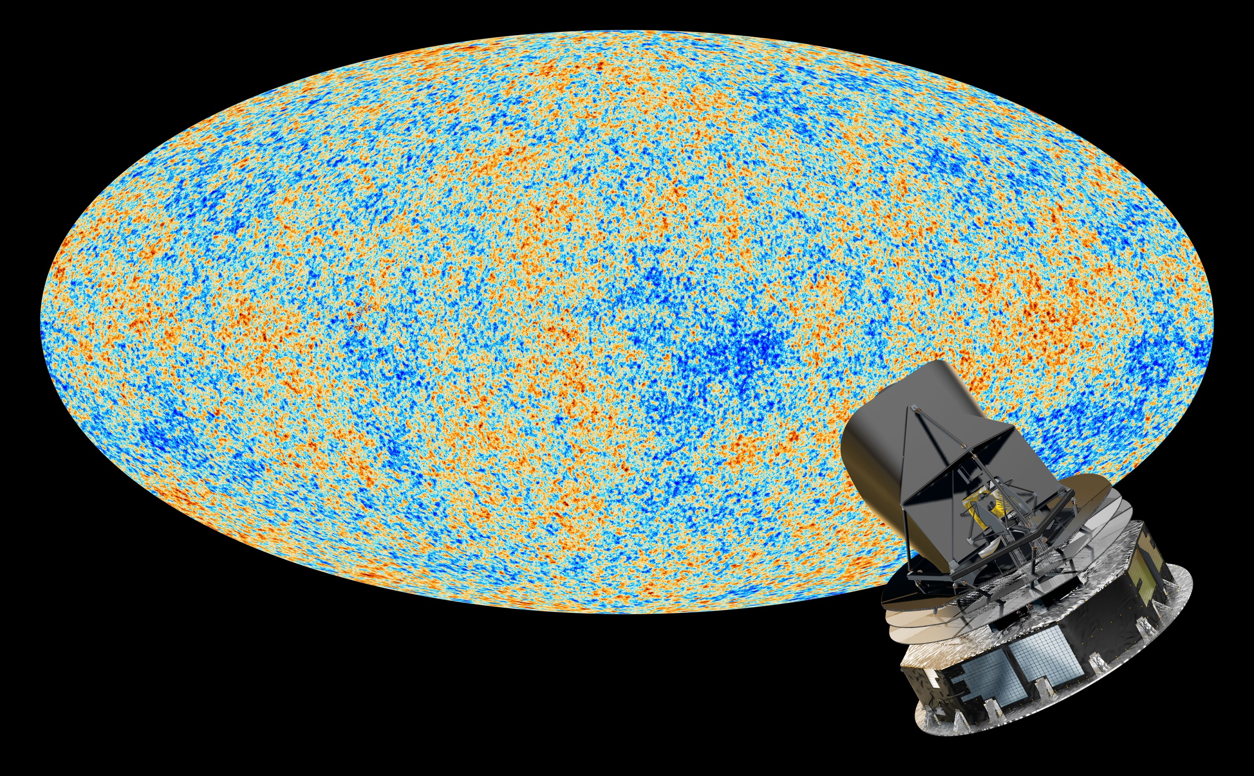
14 And God said, Let there be lights in the firmament of the heaven
to divide the day from the night; and let them be for signs, and for seasons,
and for days, and years:
15 And let them be for lights in the firmament of the heaven to give light upon the earth:
and it was so.
16 And God made two great lights;
the greater light to rule the day, and the lesser light to rule the night:
[he made] the stars also.
17 And God set them in the firmament of the heaven to give light upon the earth,
18 And to rule over the day and over the night,
and to divide the light from the darkness:
and God saw that [it was] good.
19 And the evening and the morning were the fourth day.
Genesis 1:14-1:19

Slide 25
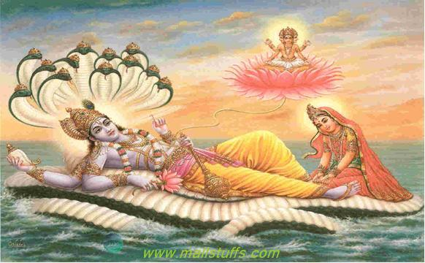
Hindu Cosmology

Slide 26
Hindu Cosmology
In Hindu cosmology, the Universe is cyclically
created and destroyed in a timespan of 8.6 billion years
Deeply rooted in Hindu literature including Vedas and Puranas,
it is believed time is divided into four epochs or Yuga, of which we
occupy the final.
In roughly 432,000 years the final Avatar Kalki will end time.
Shiva destroys all this existence while creating a new existence.
Time starts over.

Slide 27
Hindu Cosmology
Rig Veda
ancient Indian collection of Vedic Sanskrit hymns
One of the four canonical sacred texts of Hinduism (Vedas)
1028 hymns, 10600 verses, organized in 10 books (Mandelas)
“Neither being (sat) nor non-being was as yet. What was concealed? And where? And in whose protection?…Who really knows? Who can declare it? When was it born, and when came this creation? The devas were born later than this world's creation, so who knows from where it came into existence? None can know from where creation has arisen, and whether he has or has not produced it. He who surveys it in the highest heavens, He alone knows-or perhaps does not know."
(Rig Veda 10. 129)

Slide 28
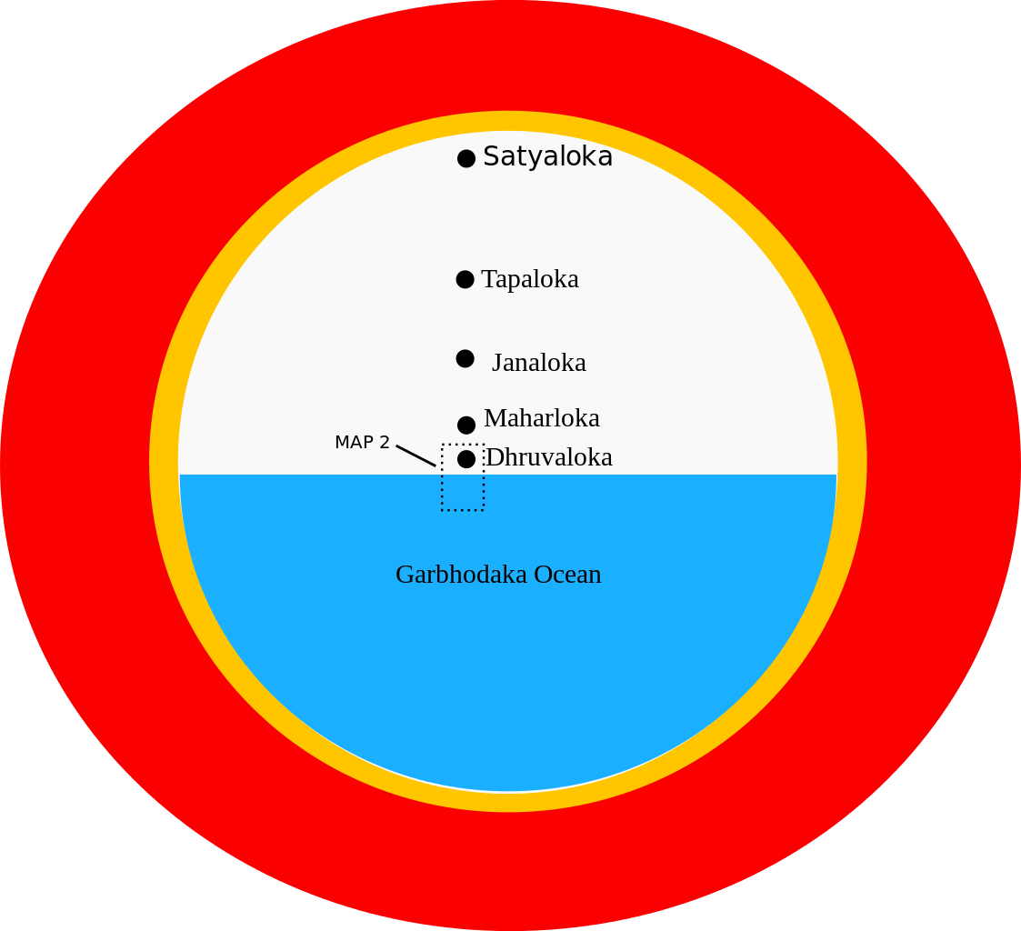
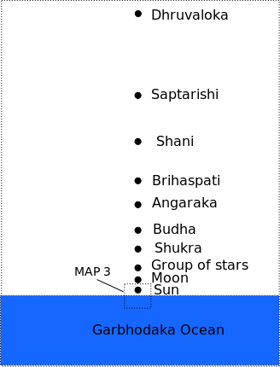
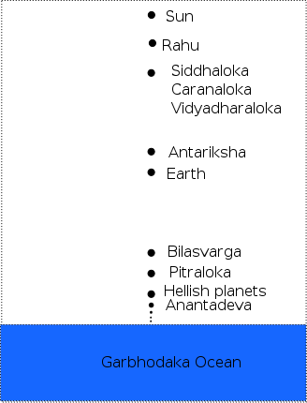
Hindu Cosmic Structure
Hindu large scale structure of the Universe

Slide 29
Hymn of Creation
The Nasadiya Sukta
(after the incipit ná ásat "not the non-existent"), also known as the
Hymn of Creation,
is the 129th hymn of the 10th Mandala of the
Rigveda (10:129).
It is concerned with cosmology and the origin of the universe

Slide 30
Nasadiya Sukta – Hymn of Creation
There was neither non-existence nor existence then; Neither the realm of space, nor the sky which is beyond; What stirred? Where? In whose protection?
There was neither death nor immortality then; No distinguishing sign of night nor of day; That One breathed, windless, by its own impulse; Other than that there was nothing beyond.
Darkness there was at first, by darkness hidden; Without distinctive marks, this all was water; That which, becoming, by the void was covered; That One by force of heat came into being;
Who really knows? Who will here proclaim it? Whence was it produced? Whence is this creation? Gods came afterwards, with the creation of this universe. Who then knows whence it has arisen?
Whether God's will created it, or whether He was mute; Perhaps it formed itself, or perhaps it did not; Only He who is its overseer in highest heaven knows, Only He knows, or perhaps He does not know.
The Rig Veda, 10.129.1–7

Slide 31
Hindu Cyclical Universe
The Rig Veda's view of the cosmos sees one true divine principle self-projecting as the divine word, Vaak, 'birthing' the cosmos that we know, from the Hiranyagarbha or Golden Egg.
Holy Trinity (Trimurti) of Hindu religion:
Brahma
Vishnu (The God of Preservation) preserves the Universe
Shiva (The God of Destruction) destroys the Universe.
Once the Universe has been destroyed by Shiva, Brahma starts the creation once again.
This creation-destruction cycle repeats itself almost endlessly

Slide 32
Hindu Cyclical Universe
The Rig Veda's view of the cosmos sees one true divine principle self-projecting as the divine word, Vaak, 'birthing' the cosmos that we know, from the Hiranyagarbha or Golden Egg.
Some Puranas describe a universe that is cyclical or oscillating and infinite in time.
The universe is described as a cosmic egg that cycles between expansion and total collapse.
It expanded from a concentrated form — a point called a Bindu. The universe, as a living entity, is bound to the perpetual cycle of birth, death, and rebirth.

Slide 33
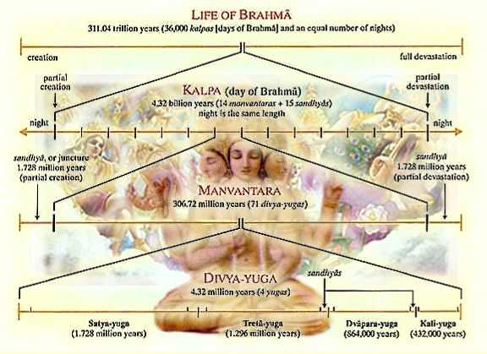
Brahma & Hindu Cyclical Universe
According to the Puranas’ view,
the universe is created, destroyed, and re-created
in an eternally repetitive series of cycles.
In Hindu cosmology, a universe endures for
- 4,320,000,000 years
- 1 day of Brahma
and is then destroyed by fire or water elements.
At this point, Brahma rests for one night,
just as long as the day.
This process, named pralaya, repeats
for 100 Brahma years
(311 Trillion, 40 Billion Human Years)
This represents Brahma's lifespan.
Brahma is regarded as a manifestation of
Brahman as the creator.
In current occurrence of Universe, we are believed to be in the 51st year of the present Brahma,about 156 trillion years have elapsed since he was born as Brahma.
fter Brahma's "death", it is necessary that another 100 Brahma years (311 Trillion, 40 Billion Years) pass until a new Brahma is born and the whole creation begins anew. This process is repeated again and again, forever.

Slide 34
Hindu Multiverse ?
The concept of multiverses is mentioned many times in Hindu Puranic literature, such as in the Bhagavata Purana (400–1000 CE):
“Every universe is covered by seven layers — earth, water, fire, air, sky, the total energy and false ego — each ten times greater than the previous one. There are innumerable universes besides this one, and although they are unlimitedly large, they move about like atoms in You. Therefore You are called unlimited “ (Bhagavata Purana 6.16.37)
“After separating the different universes, the gigantic universal form of the Lord, which came out of the causal ocean, the place of appearance for the first puruṣa-avatāra, entered into each of the separate universes, desiring to lie on the created transcendental water” (Bhagavata Purana 2.10.10)
The number of universes seems to be uncountable, immeasurable, or incalculable according to the Puranic literature:
“Even though over a period of time I might count all the atoms of the universe, I could not count all of My opulences which I manifest within innumerable universes” (Bhagavata Purana 11.16.39)

Slide 35
Jain Cosmology
Jain cosmology considers the loka, or universe, as an uncreated entity, existing since infinity, having no beginning or an end.
Jain texts describe the shape of the universe as similar to a man standing with legs apart and arm resting on his waist.
This Universe, according to Jainism, is narrow at the top, broad at the middle and once again becomes broad at the bottom.
Mahāpurāṇa of Ācārya Jinasena is famous for this quote:
"Some foolish men declare that a creator made the world. The doctrine that the world was created is ill advised and should be rejected. If God created the world, where was he before the creation? If you say he was transcendent then and needed no support, where is he now? How could God have made this world without any raw material? If you say that he made this first, and then the world, you are faced with an endless regression."

Slide 36
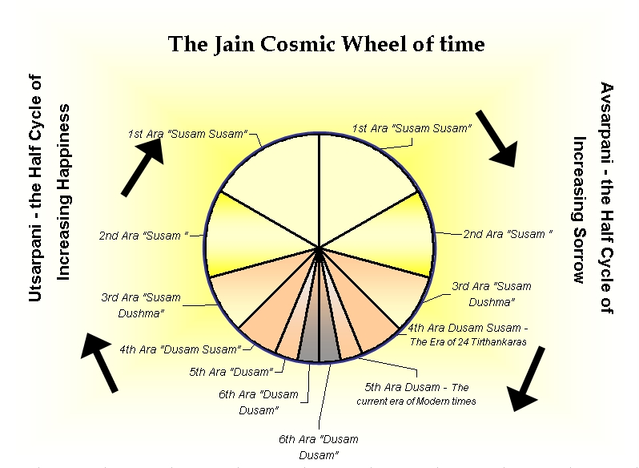
Jain Cosmology
According to Jain doctrine,
- the universe and its constituents always existed
- the universe was not created, and there is no creator

Slide 37
Ancient Greek Creation Myths
Hesiodus, Theogony
It begins with Chaos, a yawning nothingness.
Out of the void emerged Gaia (the Earth) and some other primary divine beings:
Eros (Love), the Abyss (the Tartarus), and the Erebus.
Without male assistance, Gaia gave birth to Uranus (the Sky) who then fertilized her.
From that union were born first the Titans
- six males: Coeus, Crius, Cronus, Hyperion, Iapetus, and Oceanus;
- six females: Mnemosyne, Phoebe, Rhea, Theia, Themis, and Tethys.
After Cronus was born, Gaia and Uranus decreed no more Titans were to be born.
They were followed by the one-eyed Cyclopes and the Hecatonchires or Hundred-Handed Ones, who were both thrown into Tartarus by Uranus. This made Gaia furious.
Cronus ("the wily, youngest and most terrible of Gaia's children"), was convinced by Gaia to castrate his father. He did this, and became the ruler of the Titans with his sister-wife Rhea as his consort, and the other Titans became his court.
motif of father-against-son conflict was repeated when Cronus was confronted by his son, Zeus.
Because Cronus had betrayed his father, he feared that his offspring would do the same, and so each time Rhea gave birth, he snatched up the child and ate it.
Rhea hated this and tricked him by hiding Zeus and wrapping a stone in a baby's blanket, which Cronus ate. When Zeus was full grown, he fed Cronus a drugged drink which caused him to vomit, throwing up Rhea's other children and the stone, which had been sitting in Cronus's stomach all along.
Zeus then challenged Cronus to war for the kingship of the gods. At last, with the help of the Cyclopes (whom Zeus freed from Tartarus), Zeus and his siblings were victorious, while Cronus and the Titans were hurled down to imprisonment in Tartarus.

Slide 38
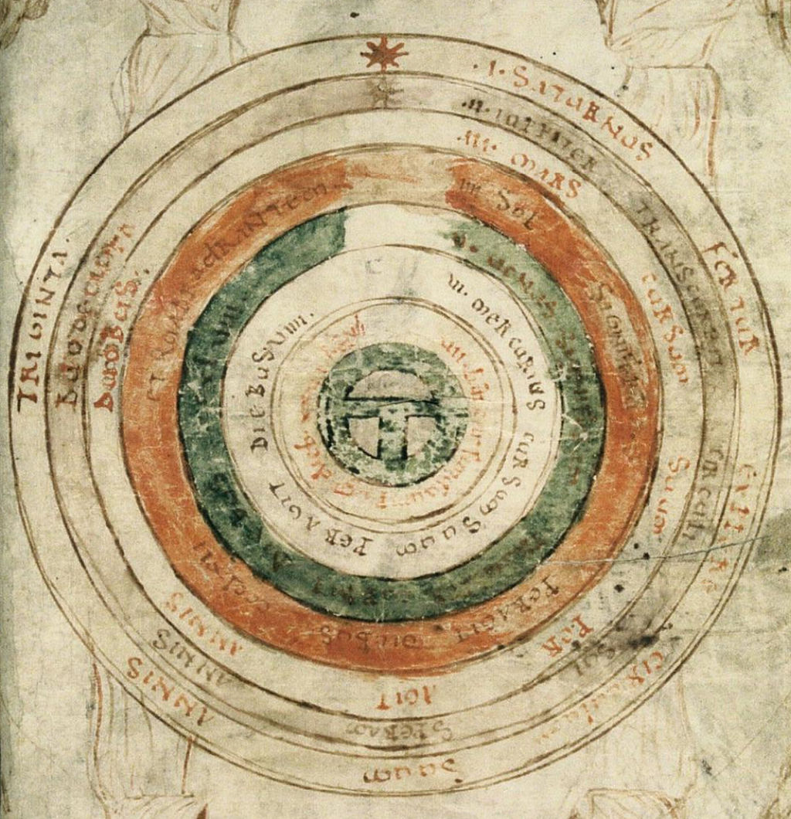
Celestial Spheres
the Earth with 7 celestial spheres, from Bede, de natura rerum (late 11th century)

Slide 39
Celestial Spheres
Celestial spheres
were the fundamental entities of the cosmological models developed by
Plato, Eudoxus, Aristotle, Ptolemy, Copernicus and others.
In these celestial models the apparent motions of the fixed stars and the planets are accounted for by treating them as embedded in rotating spheres made of an aetherial, transparent fifth element (quintessence), like jewels set in orbs.
Since it was believed that the fixed stars did not change their positions relative to one another, it was argued that they must be on the surface of a single starry sphere.^{[1]}

Slide 40
Pre-Copernican
Medieval
(Christian)
Cosmology
crystal
celestial spheres

