Slide 1
Astrophysical
Fluid Dynamics

Slide 2
Astrophysical Hydrodynamics
i Lecturer: Rien van de Weijgaert
a Room 186, phone 4086, email: weygaert@astro.rug.nl
b Office hours: You are always welcome to come to my office for short
questions. You can also make an appointment via email.
ii Teaching assistant: Patrick Bos
a Office: 189, phone: 4053, email: pbos@astro.rug.nl
iii The purpose of the course is to complete the fluid mechanics background
needed in astrophysics.
iv Attendance of a substantional fraction of course lectures is obligatory.
v Problem sets are mandatory and constitute about 25% of the final grade
vi Written exam at the end of the term

Slide 3
Bibliography
The lecture notes and handouts are the main source of material.
However, there are a number of good books that the student can use
to clarify some of the topics or for extra material.
II. Interesting Books:
■ Astrophysical Flows, J. Pringle and A. King,
Cambridge University Press, nice concise introduction
■ Fluid Mechanics, Landau and Lifshitz
exceptional book but of somewhat higher level.
■ An Introduction to Fluid Dynamics, G. K. Batchelor
historic classic, widely regarded as a “bible” for the subject.
Daunting at first sight, but lucid, thorough and reliable.
■ Gas Dynamics; Vol. II, Physics of Astrophysics, F. Shu
Univ. Science Books, very good for astrophysical perspective.
■ Album of Fluid Motion, van Dyke
Beautiful photographs showing fluid in motion
.

Slide 4
Astrophysical Fluid Mechanics
Topics
I Fluid Picture Book
II Basic fluid equations
of ideal fluids
III Inviscid Barotropic Flows:
Kelvin Circulation Theorem
Bernoulli Theorem
IV Incompressible Fluids
Compressible fluids:
V Waves
VI Hydrodynamic Instabilities
VII Shock Waves
VIII. Viscous flows:
Navier-Stokes Eqns.
IX. Similarity solutions
X. Turbulence
XI. Magnetohydrodynamics
XII. Numerical
(astro)hydrodynamics

Slide 5
Fluid Picture Book

Slide 6
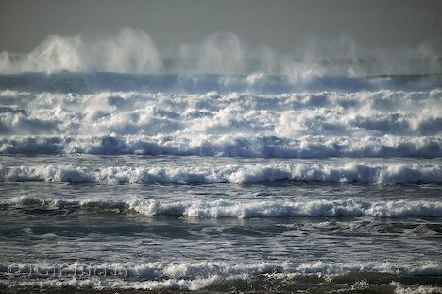
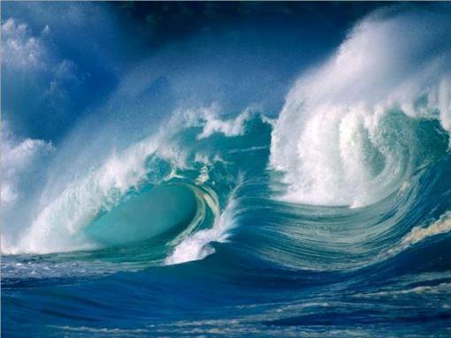
Waves:
sea & ocean waves

Slide 7
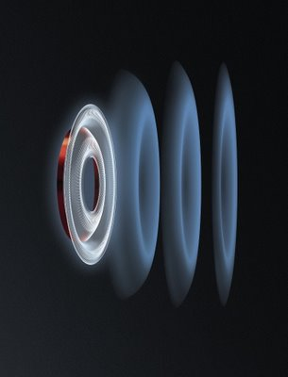
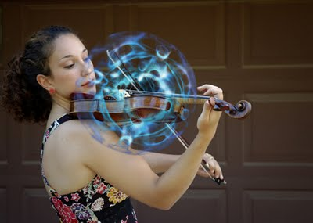
Sound Waves:

Slide 8
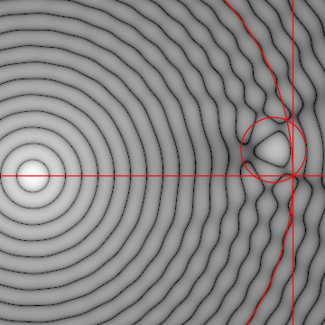
Sound Waves

Slide 9
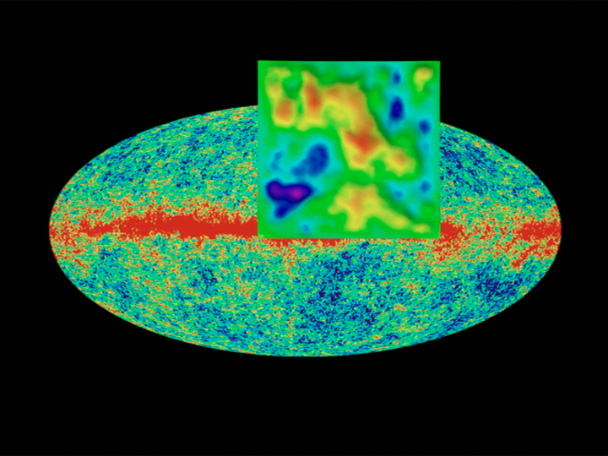
Cosmic Sound Waves
Primordial Sound Ripples seen in WMAP Cosmic Microwave Background

Slide 10
Cosmic Sound Waves

Slide 11
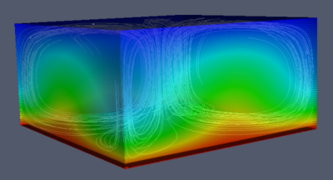
Convection:
Benard cells

Slide 12
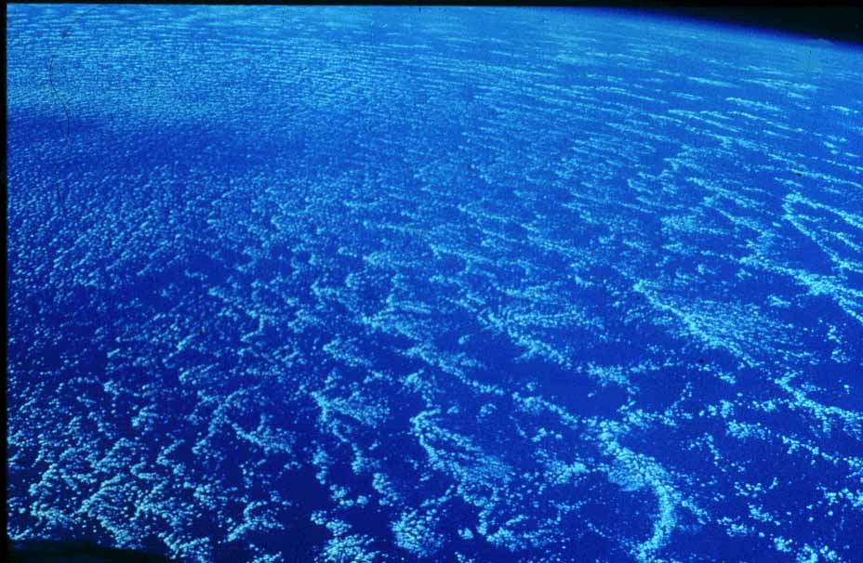
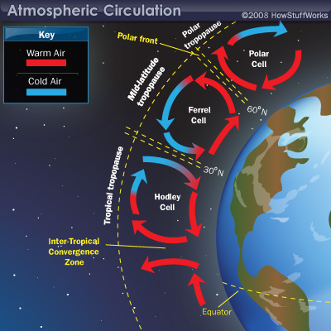
Convection:
Earth Atmosphere

Slide 13
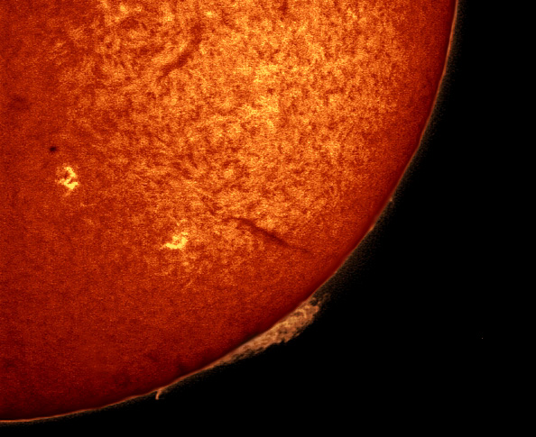
Convective cells on solar surface

Slide 14
Vortex & Vorticity

Slide 15
Vortices in Shear Flow

Slide 16
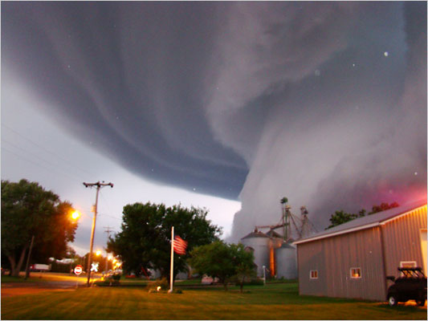
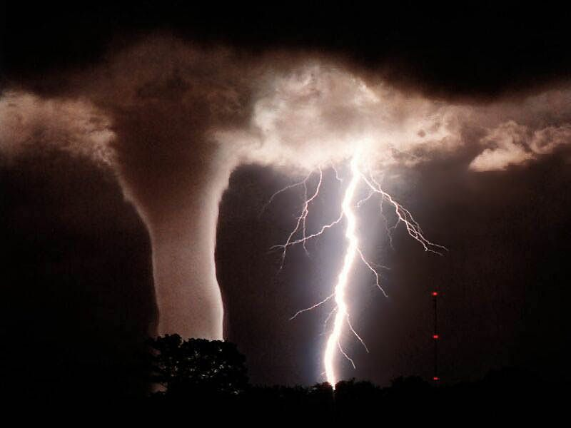
Tornados:
Atmospheric Vortices

Slide 17
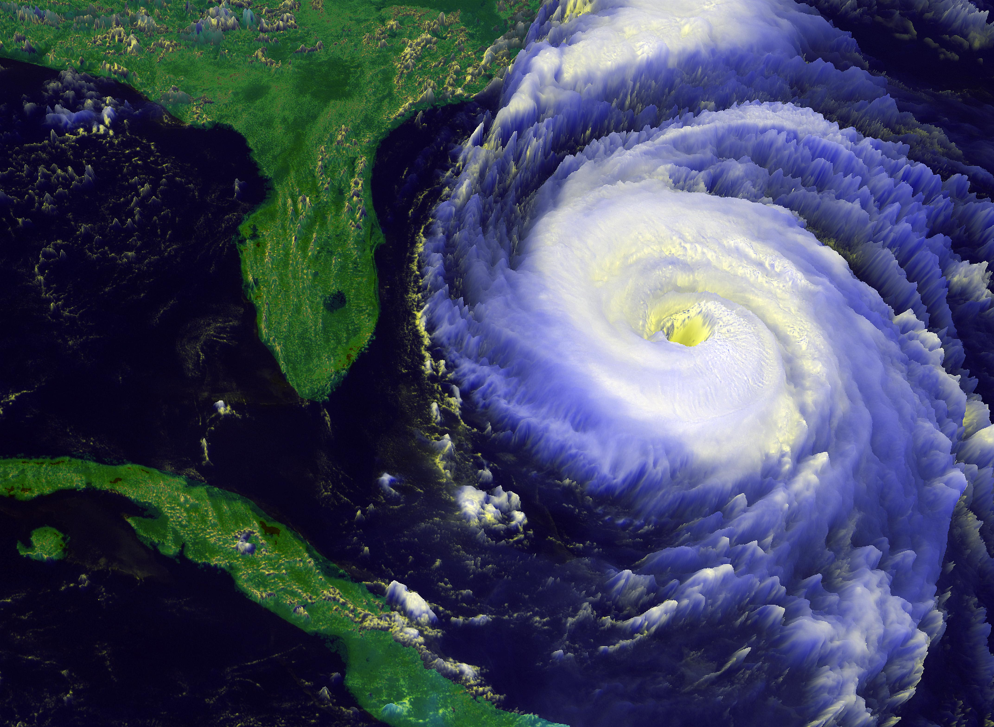
Hurricanes:
Atmospheric Vortices

Slide 18
Vortices and Eddies:
Jupiter’s turbulent atmosphere
Vortices and Eddies:
Jupiter’s turbulent atmosphere

Slide 19
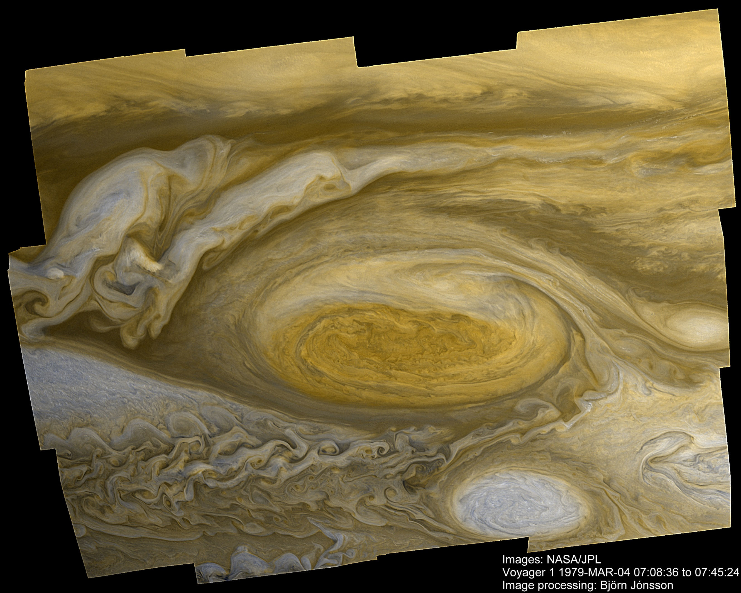
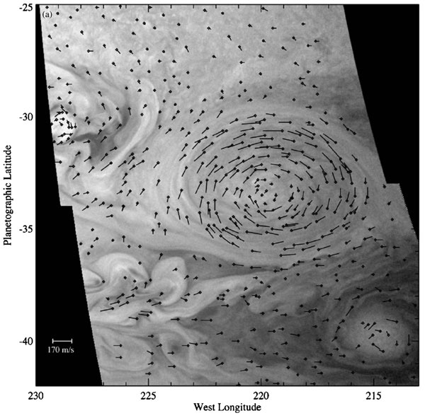
Voriticity Flow around
Jupiter’s Red Spot

Slide 20
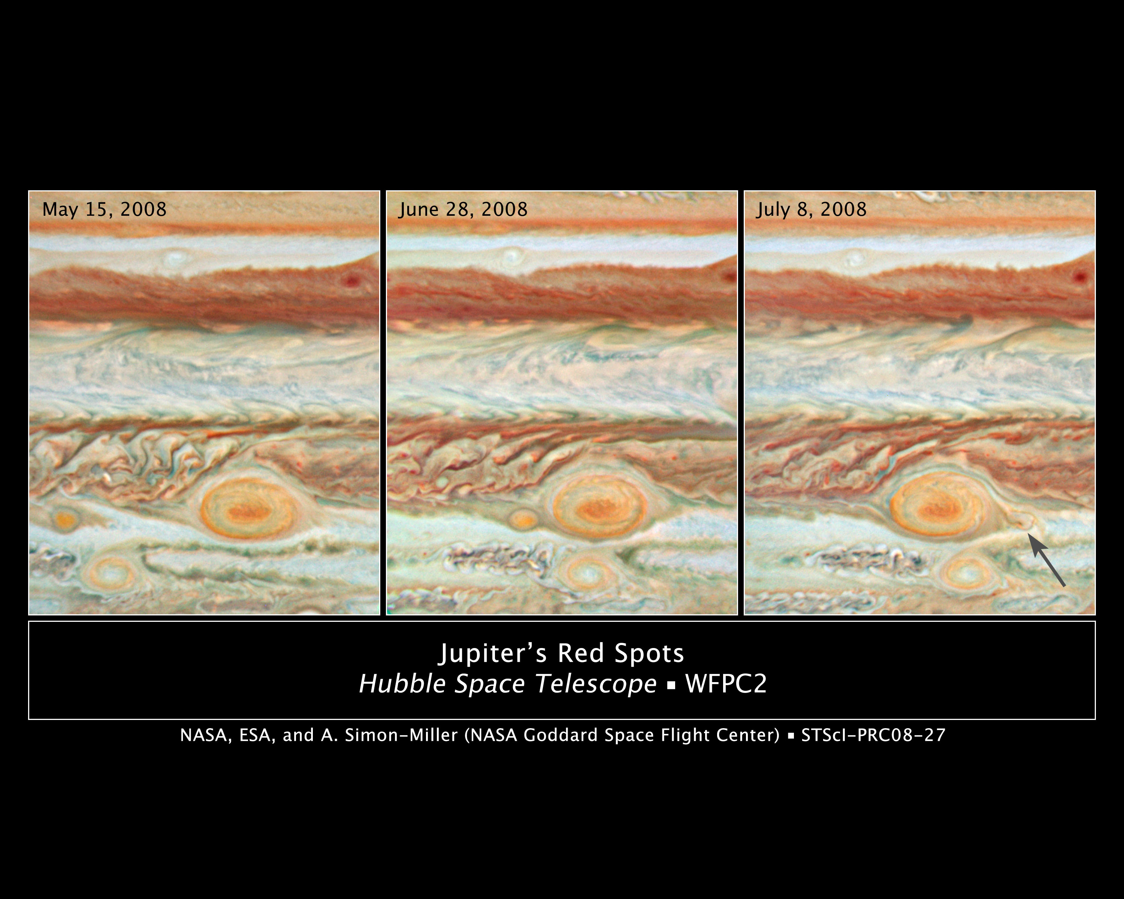

Slide 21
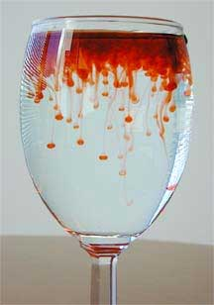
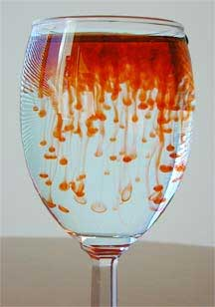
Rayleigh-Taylor Instability
2 fluids of different density

Slide 22
Rayleigh-Taylor Instability
2 fluids of different density

Slide 23
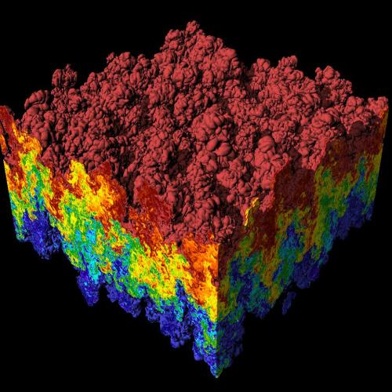
Rayleigh-Taylor Instability
fluids of different density

Slide 24
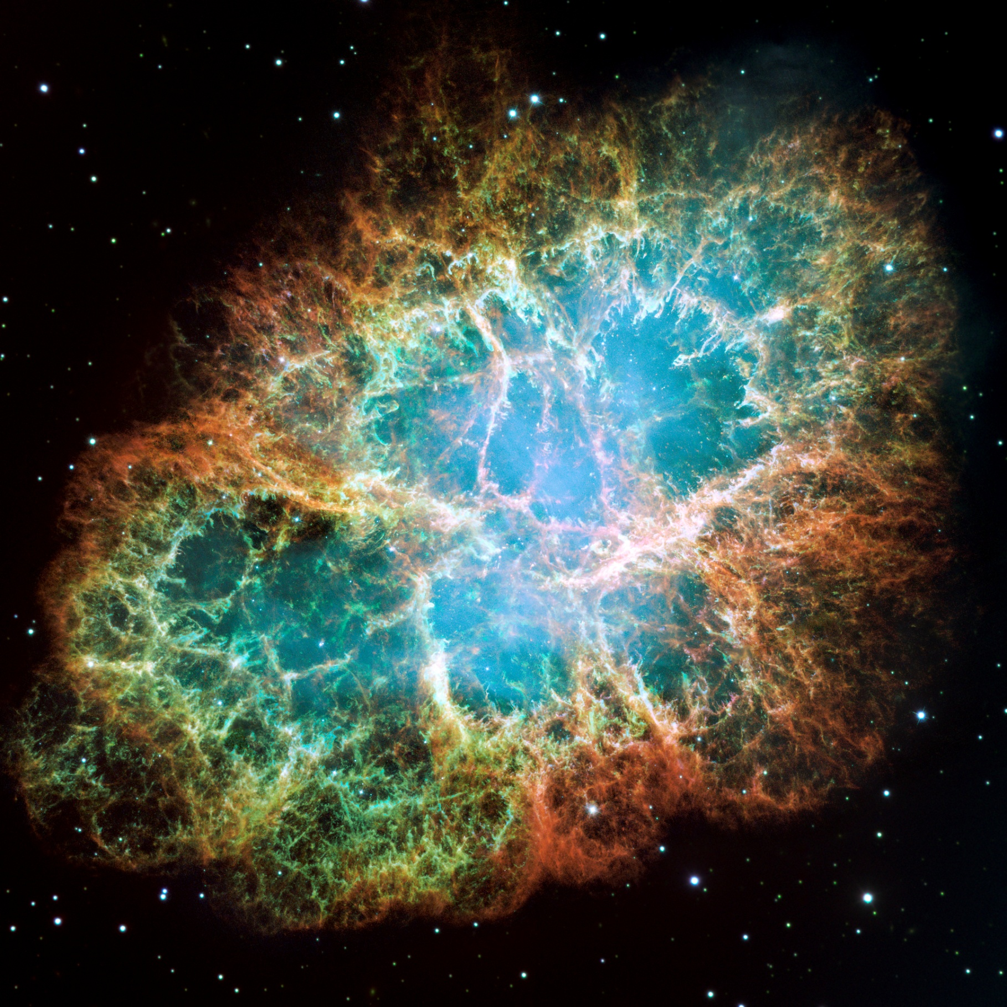
Cosmic Rayleigh-Taylor Instability
Crab Supernova Remnant

Slide 25
Kelvin-Helmholtz Instability
at the boundary of 2 shearing fluids

Slide 26
Kelvin-Helmholtz Instability
KH instability in cloud cover

Slide 27
Kelvin-Helmholtz Instability
KH instability in Saturn’s atmosphere

Slide 28
Supersonic Motion & Shockwaves

Slide 29
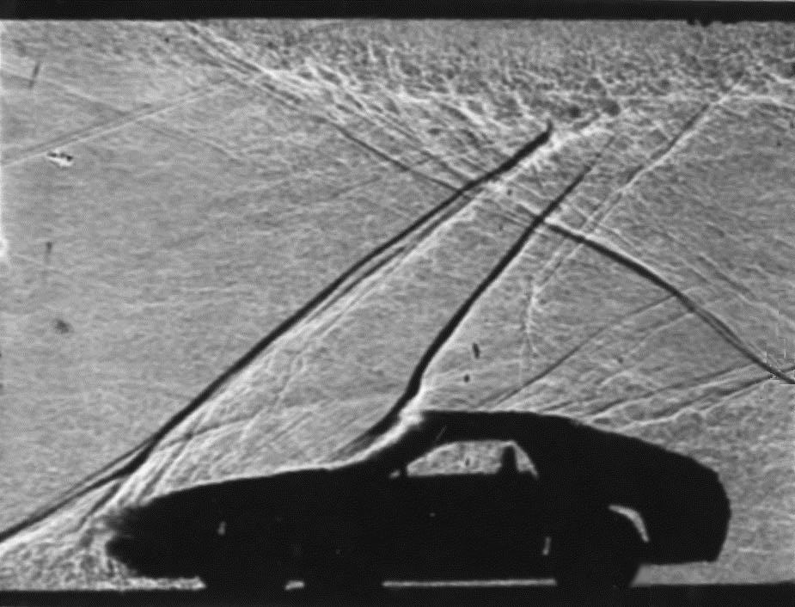
Supersonic Motion & Shockwaves

Slide 30
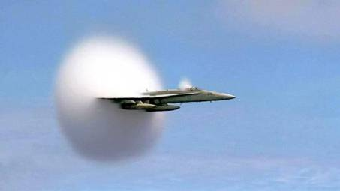
Supersonic Motion & Shockwaves

Slide 31
Cosmic Shockwave:
Supernova remnant CasA

Slide 32
Gas streams
along magnetic field lines
Solar surface
TRACE

