Slide 1
Gravity Waves

Slide 2
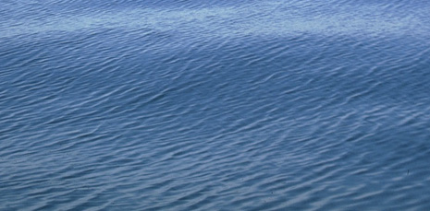
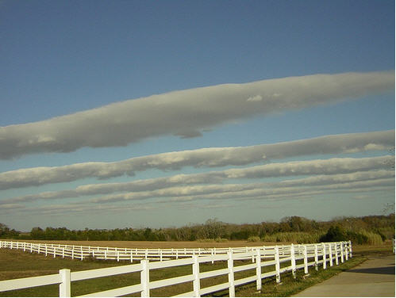
Gravity Waves

Slide 3
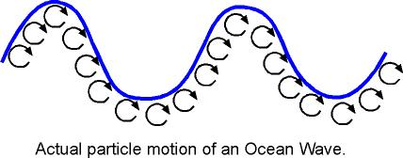
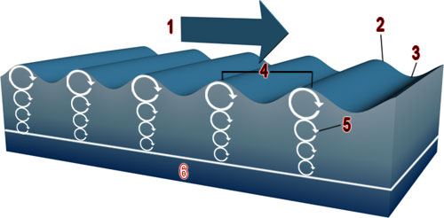
Gravity Waves

Slide 4
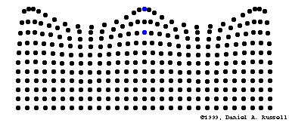
Gravity Waves

Slide 5
Kayak Surfing
on ocean gravity waves
Oregon Coast

Slide 6
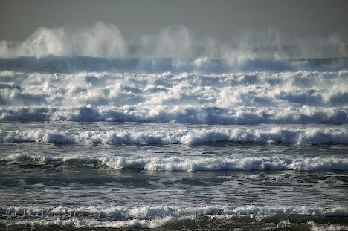
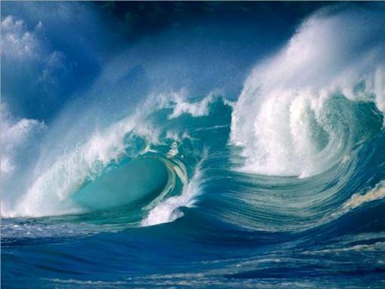
Waves:
sea & ocean waves

Slide 7
Sound Waves

Slide 8
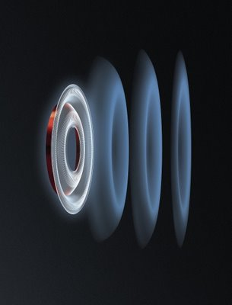
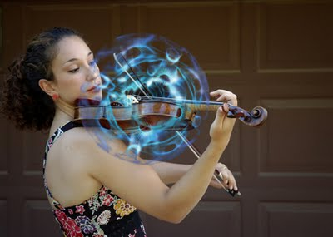
Sound Waves:

Slide 9
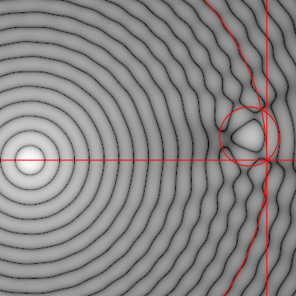
Sound Waves

Slide 10
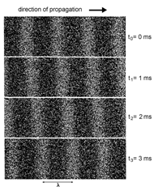
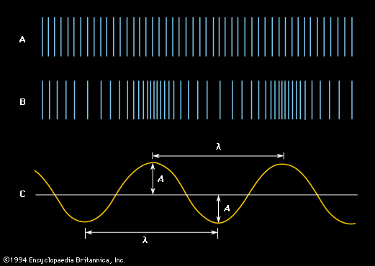
Sound Waves
Linear Waves
compression
rarefaction

Slide 11
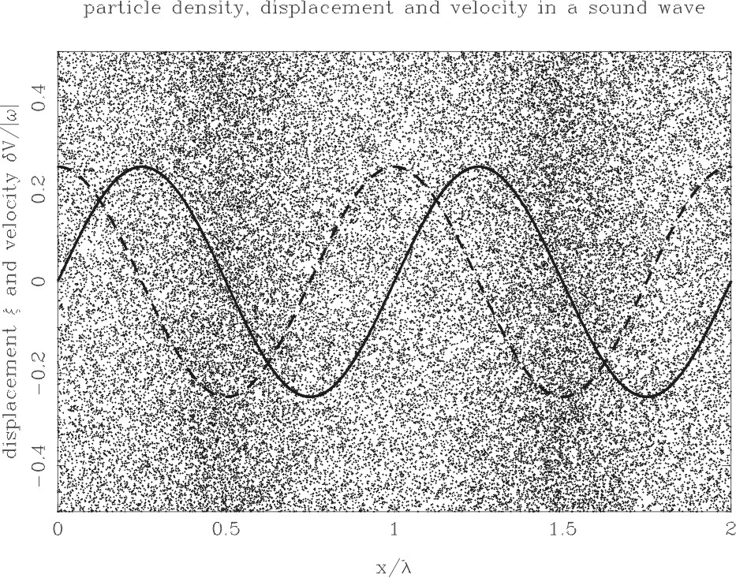
H
H
L
L
L

Slide 12
Phase & Group
Velocity

Slide 13
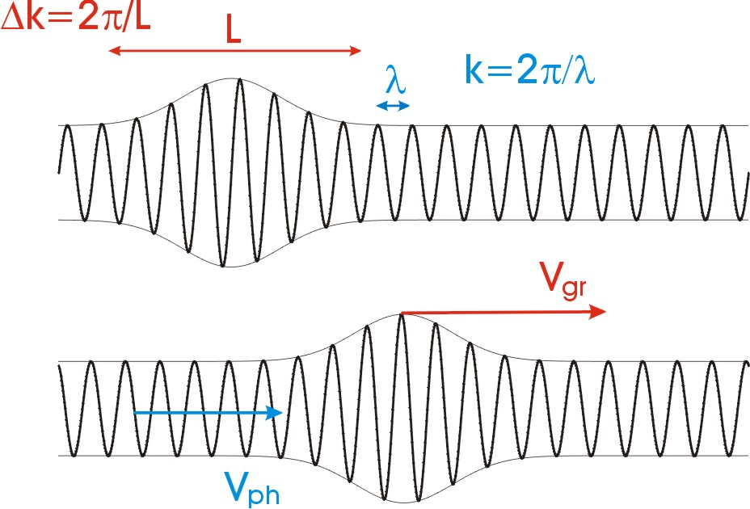

Slide 14
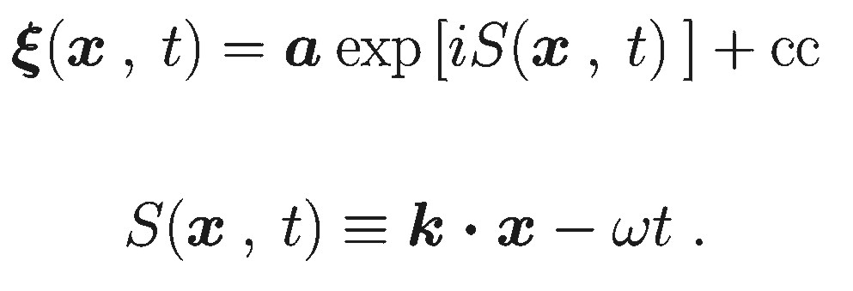
Phase velocity
Definition phase S

Slide 15
Phase velocity
Definition phase S
Definition phase-velocity

Slide 16
Phase velocity
Definition phase S
Definition phase-velocity

Slide 17
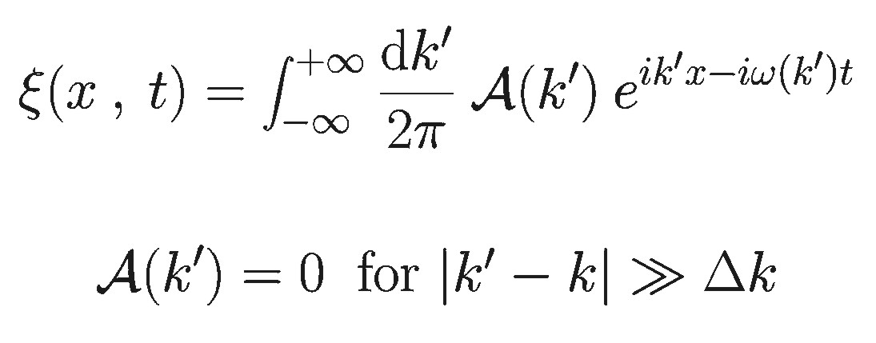
Group Velocity
Wave-packet, Fourier Integral

Slide 18
Group Velocity
Wave-packet, Fourier Integral
Phase factor x effective amplitude

Slide 19
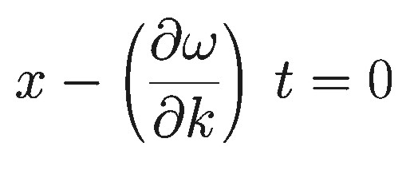
Group Velocity
Wave-packet, Fourier Integral
Phase factor x effective amplitude
Constructive
interference
in integral

Slide 20
Doppler Effect

Slide 22
Shock Waves

Slide 26
Supernova Remnants

Slide 27
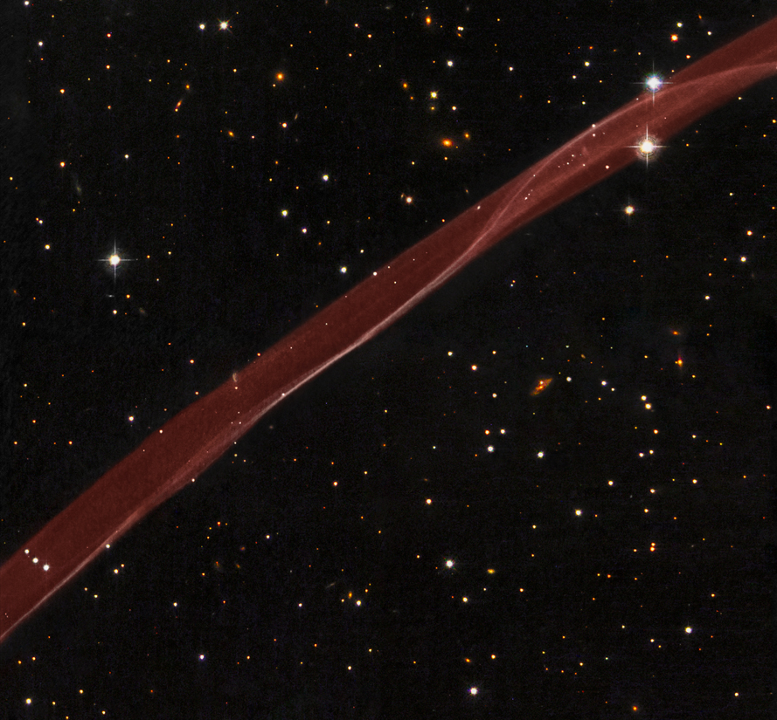
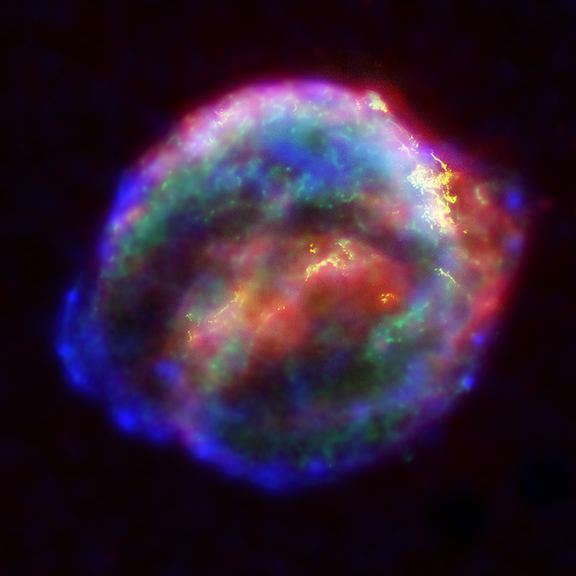
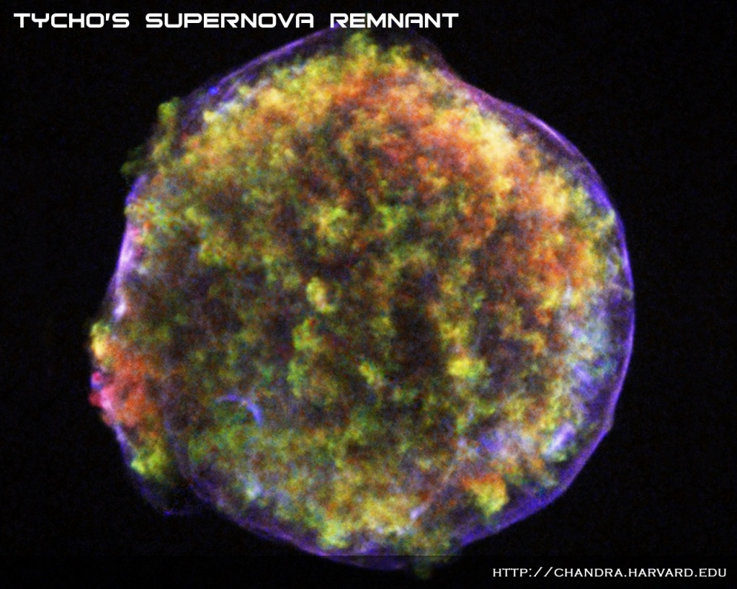
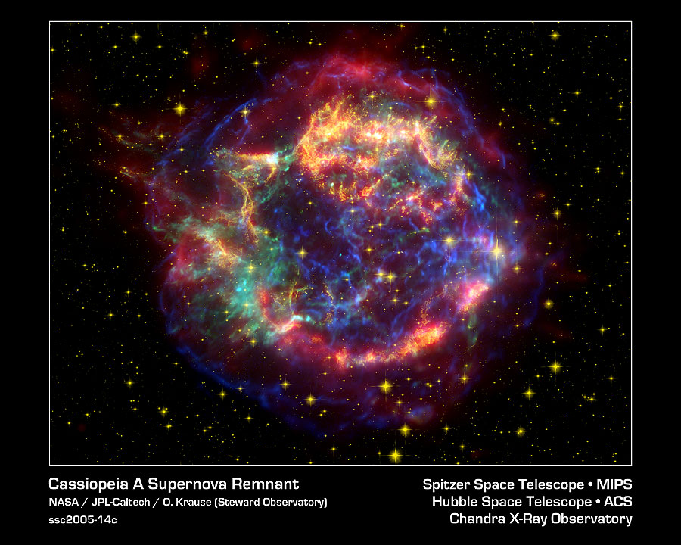
Kepler
(1604)
Tycho SNR
(1572)
SN1006 SNR
(1006)
Cas A
(1680 ?)
Cas A

Slide 28
Cas A SNR flythrough

Slide 29
Tsar Bomba Nuclear Explosion

Slide 30
Sedov-Taylor
Expansion Law

