Slide 1
Bernoulli Applications

Slide 2
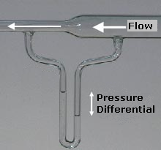
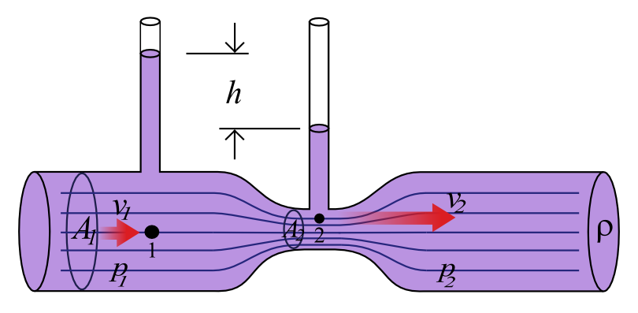
Venturi Meter
A Venturi meter is used to measure the flow rate through a tube.
It is based on the use of the Venturi effect, the reduction of fluid pressure that results when a
fluid runs through a constricted section of pipe. It is called after Giovanni Battista Venturi (1746-1822),
an Italian physicist.
Look at the construction in figure:
we assume the flow is smooth and
effectively inviscid, ie. friction is
negligible.
the fluid is incompressible, and has
density  throughout the pipe.
downstream we have a flow through
a pipe section of area A₁, with a
flow velocity v₁, and pressure p₁.
in the narrow section with area A₂,
the fluid flows with flow speed v₂,
and has accomanying pressure p₂.
as a result the two meters
indicate the difference in pressure
by means of a height difference h.

Slide 3
Venturi Meter
To find the pressure difference between the downstream flow and the pipe narrow,
we invoke 1) the Bernoulli theorem and 2) the continuity equation. The latter assures that
the rate of fluid flow through any section remains constant, ie. mass is preserved.
Bernoulli Theorem:
as the flow is horizontal, we do not have
to take into account the gravity term.
Continuity equation:
Combining both equations, we find for the
pressure difference in the two parts of
the pipe:

Slide 4
Venturi Meter
To read of the pressure difference between the two locations 1 and 2 in the fluid, we use
the height difference h between the fluid level in the vertical tubes. To connect this
height difference h to the pressure difference p1 and p2, we invoke the Euler equation:
Euler equation
(for a static medium):
With the outside atmosphere pressure being
P_{atm}, we then directly infer for the pressure
P₁ and p₂,
From this we may then infer
the flow velocity v₁
(as well as v₂):

Slide 5
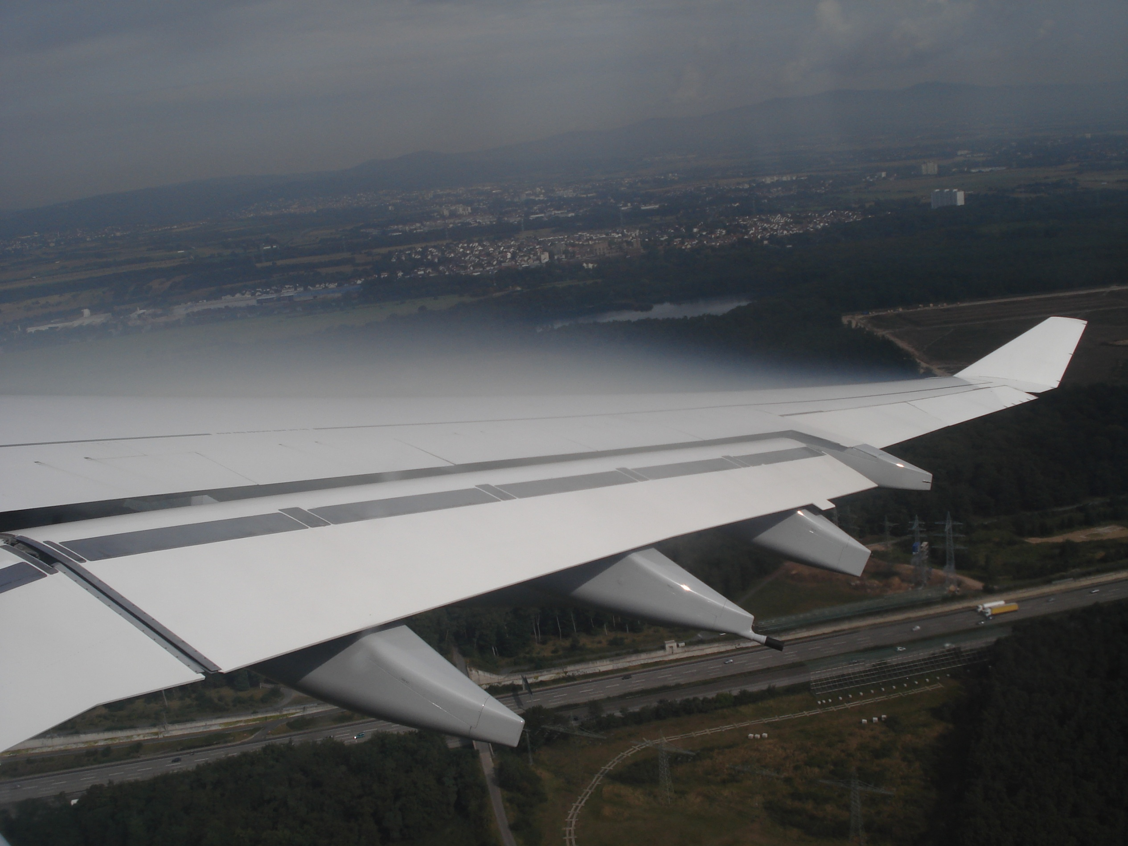
Air Flow along Wing
airflow along the wing of an airplane:
note the condensation over the upper part of the wing, where the higher flow speeds corresponds to a lower pressure and thus lower temperature.

Slide 6
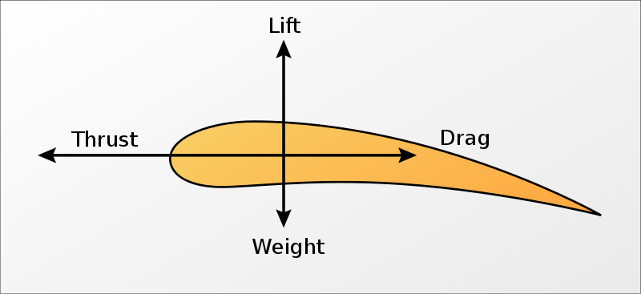
Air Flow along Wing
One of the most interesting applications of the Bernoulli equation,
is the flight of aeroplanes.
Here we will provide a simplified explanation, based on the
Bernoulli equation (reality is somewhat more complex).
Aeroplanes can fly because of the pressure difference between
the flow below the wing and the flow over the wing*. This pressure
difference results in a lift force that opposes the weight of the
aeroplane (note that similar lifting forces work on many different
objects, eg. wings of mills or wind turbines, sails on a sailboat,
propellors).
Forces working on a wing – airfoil.
Flow around an airfoil: the dots move with the flow. Note that the velocities are much higher at the upper surface than at the lower surface. The black dots are on timelines, which split into two — an upper and lower part — at the leading edge. The part of a timeline below the airfoil does not catch up with the one above ! Colors of the dots indicate streamlines.
Jet fighters often are not kept aflight by
Bernoulli. Instead, they have the thrust
of the jet motor, with vertical component,
to keep them in the air.

Slide 7
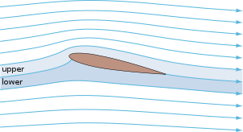
Air Flow along Wing
One of the most interesting applications of the Bernoulli equation, is the flight of aeroplanes.
Here we will provide a simplified explanation, based on the Bernoulli equation (reality is somewhat
more complex).
Aeroplanes can fly because of the pressure difference between
the flow below the wing and the flow over the wing*. This pressure
difference results in a lift force that opposes the weight of the
aeroplane (note that similar lifting forces work on many different
objects, eg. wings of mills or wind turbines, sails on a sailboat,
propellors).
According to Bernoulli,
the Bernoulli function B is constant along any streamline.
Thus, for a horizontally flying plane, we have that
1)
2) (Continuity eqn.)
C_{L} is the lift coefficient, dependent on
various factors, including the angle of wing wrt. air.
Along the wing, the flow over the
upper (longer) edge of the wing has
a (considerably) higher velocity u_{u}
than below the wing, u_{l} *.
As a result (Bernoulli), the pressure
p_{l} at the lower end of the wing is
higher than the pressure p_{u} at the
upper end.
The resulting pressure difference
generates a lift force F_{lift}
The usual assumption of equal crosstime
of upper and lower flow is not correct.

Slide 8
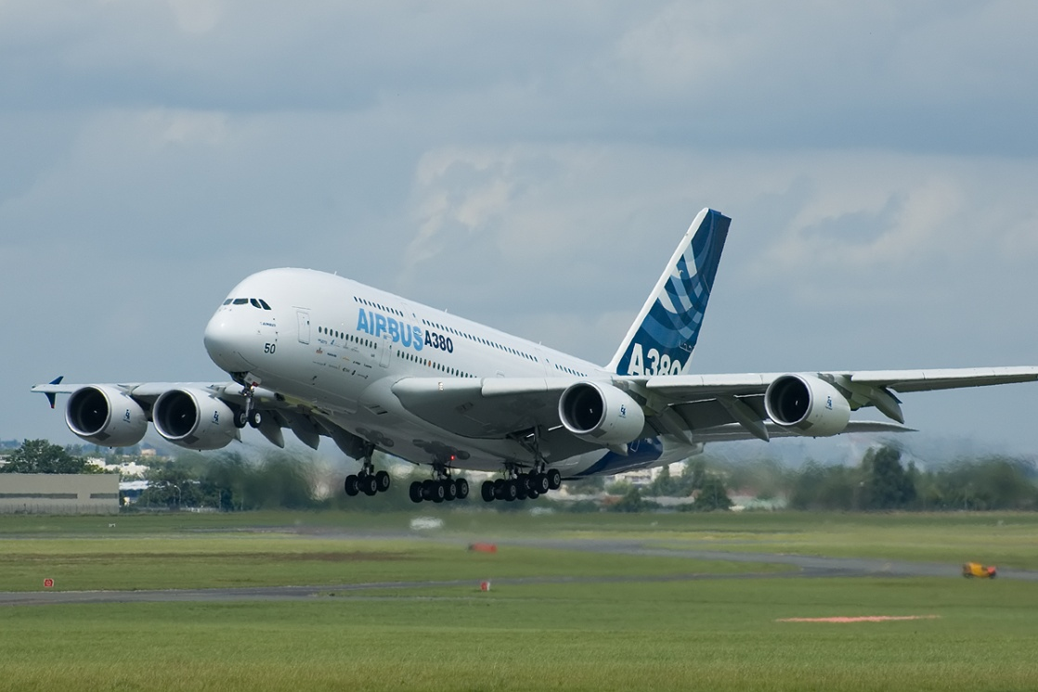
Air Flow along Wing
With the pressure difference between lower and
upper wing being
the total effective lift force
is, with A the “effective” planform area , and
C_{L} the lift coefficient,
In other words, we need a certain speed V and
planarea A to get sufficient lift force to lift
a plane into the air … (see right) …

Slide 9
Air Flow along Wing
Reality, of course, is slightly more complex.
The accompanying movie gives an impression …

Slide 10
De Laval Nozzle
Bernoulli Equation: compressible fluids.
A very interesting application of the Bernoulli equation, for compressible fluids, concerns
the de Laval nozzle.
A de Laval nozzle is a tube that is pinched in the middle, making a carefully balanced, asymmetric hourglass-shape. The nozzle was developed in 1888 by the Swedish inventor Gustaf de Laval for use on a steam turbine. The principle was first used for rocket engines by Robert Goddard.
The de Laval nozzle forms a nice platform to highlight the differences introduced by the compressibility of a gas when applying Bernoulli’s theorem.

Slide 11
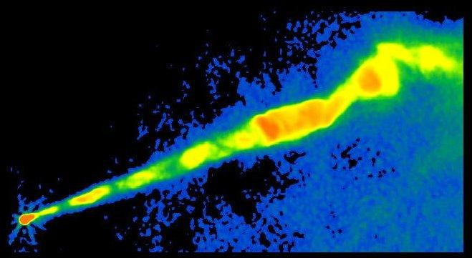
De Laval Nozzle
The de Laval nozzle is used to accelerate a hot, pressurised gas passing through it to a supersonic speed.
High-pressure gas coming from the combustion chamber enters the nozzle and flows into a region where the nozzle cross section decreases, dA/dx < 0. The thermal energy is converted into kinetic energy of the flow, and the flow goes through a sonic point at the critical point where the nozzle cross section narrows to its minimum (dA/dx=0). At that point the flow speed reaches the sound velocity. The cross section increases again after the critical point, and the gas is further accelerate to supersonic speeds.
The de Laval nozzle shapes the exhaust flow
so that the heat energy propelling the flow
is maximally converted into directed
kinetic energy.
Because of its properties, the nozzle is widely
used in some types of steam turbine, it is
an essential part of the modern rocket engine,
and it also sees use in supersonic jet engines.
Astrophysically, the flow properties of the de Laval nozzle have been applied towards
understanding jet streams, such as observed in AGNs (see figure), the outflow from
young stellar objects and likely occur in Gamma Ray Bursts (GRBs).

Slide 12
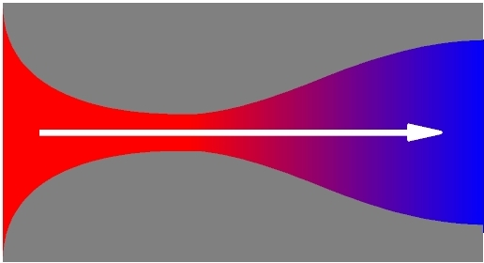
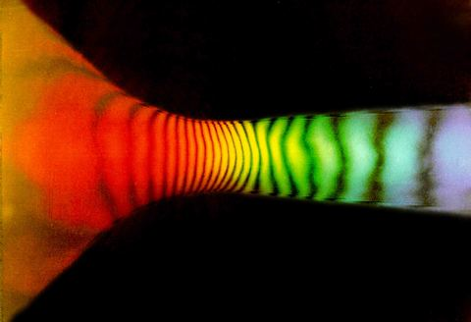
De Laval Nozzle
If we make the approximation of steady, quasi-1-D
barotropic flow, we may write Bernoulli’s theorem
and the equation of continuity as
where A is the local sectional area of the nozzle.
Note that because of the compressibility of the gas we
no longer assume a constant density, and thus have to
keep  in the integral.
Gravitational potential variations are ignored, as for terrestrial applications the fast flow of jet gases is not
relevant over the related limited spatial extent.
Two illustrations of the de Laval nozzle principle.
The 2nd figure is a measurement of the flow speed
in an experiment.

Slide 13
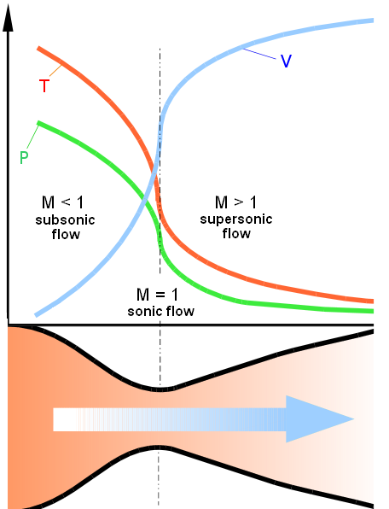
De Laval Nozzle
The variation of the area A along the axis of the nozzle
will introduce spatial variations for each of the other
quantities.
To consider the rate of such variations, take the
differential of the Bernoulli equation,
Taking into account that the sound velocity c_{s} associated
with the barotropic relation is
we find from the equations above that
We define the Mach number of the flow as the ratio of the
flow velocity to the sound velocity,
Illustration of the run of flow speed u, pressure p and temperature T, as the gas passes through the
nozzle and its sonic point.

Slide 14
De Laval Nozzle
From the relation between velocity and density,
we find that the fractional change of density  is related to the fractional change of the fluid velocity u via the equation
This equation states that the square of the Mach number
provides a measure of the importance of compressibility.
In particular, flow of air at subsonic speeds past terrestrial
obstacles can often be approximated as occurring
Incompressibility, because the fractional change of density 
is negligible in comparison with the fractional change of u if
M1.
In contrast, supersonic flight past obstacles necessarily
involves substantial compressions and expansions.
Illustration of the run of flow speed u, pressure p and temperature T, as the gas passes through the
nozzle and its sonic point.

Slide 15
De Laval Nozzle
To relate the change of velocity u to the change of
sectional area A in the nozzle, we take the logarithmic
derivative of the continuity equation,
To consider the rate of such variations, take the
differential of the Bernoulli equation,
which, taking into account the relation between density  and
flow speed u, yields the following relation between u and A:
Illustration of the run of flow speed u, pressure p and temperature T, as the gas passes through the
nozzle and its sonic point.

Slide 16
De Laval Nozzle
the relation
has the following implications:
Subsonic speeds:
this corresponds to normal experience, eg. the speeding
up of a river as the channel narrows.
Illustration of the run of flow speed u, pressure p and temperature T, as the gas passes through the
nozzle and its sonic point.

Slide 17
De Laval Nozzle
2) Supersonic speeds:
In other words, an increase in the velocity requires an
increase in the area of the nozzle, dA>0 !!!
This counterintuitive result has a simple explanation:
for M>1, the density decreases faster than the area
increases, so the velocity must increase to maintain
a constant flux of mass.
Illustration of the run of flow speed u, pressure p and temperature T, as the gas passes through the
nozzle and its sonic point.

Slide 18
De Laval Nozzle
A sonic transition , ie.
can be made smoothly, ie. With
only at the throat of the nozzle where
To obtain supersonic exhaust, therefore, we must
accelerate the reaction gases through a
converging-diverging nozzle, a fundamental feature
behind the design of jet engines and rockets.
Note that the converse does not necessarily hold:
M does not necessarily equal unity at the throat of
the nozzle, where dA=0. If M1, the fluid velocity
reaches a local extremum when the area does, i.e.
du=0 where dA=0.
Whether the extremum corresponds to a local maximum
or minimum depends on whether we have subsonic or
supersonic flow and whether the nozzle has a converging-diverging shape.
Illustration of the run of flow speed u, pressure p and temperature T, as the gas passes through the
nozzle and its sonic point.

Slide 19
De Laval Nozzle
Final Notes:
5) whether supersonic exhaust is actually achieved in
nozzle flow also depends on the boundary conditions. In particular, on the pressure of the ambient medium in
comparison with the pressure of the reaction chamber.
If a sonic transition does occur, the flow behaviour
depends sensitively on the nozzle conditions, since the
coefficient 1-M² becomes arbitrarily small near the
transition region.
When external body forces are present, we do not need
to have a throat to achieve the smooth transition of
subsonic to supersonic flow. The external forces can
provide the requisite acceleration.
Illustration of the run of flow speed u, pressure p and temperature T, as the gas passes through the
nozzle and its sonic point.

Slide 20
Potential Flow

Slide 21
Incompressible Flow
Many problems of practical importance, involving a large number of engineering and terrestrial
conditions concern incompressible flows.
For an incompressible flow, we have
which follows directly from the continuity equation on the basis of the conditions
In other words, for an incompressible fluid (a liquid) the vairation of pressure p in the
force (Euler) equation equals whatever it needs so that .
Note that for an incompressible medium, Kelvin’s circulation theorem is valid independent
of the barotropic assumption: because the vorticity equation is true independent of p,

Slide 22
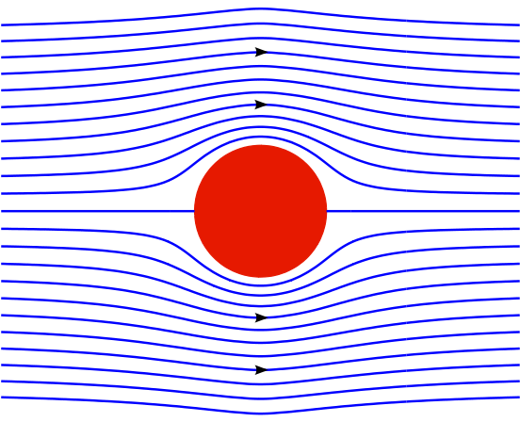
Incompressible Flow
Many problems in hydrodynamics involve the motion of a solid body (eg., a ship) through
water that is stationary at infinity.
From the point of view of an observer fixed on the ship, the water flowing past
the ship originates from a steady region of uniform conditions.
 Uniform flow has no vorticity:
Kelvin’s circulation then guarantees
that no vorticity will be generated
in the flow around the ship.
Note: this is only true as long as
the effect of viscosity can be
ignored.
If everywhere,
the flow field can be derived from
the gradient of a scalar, the
velocity potential

Slide 23
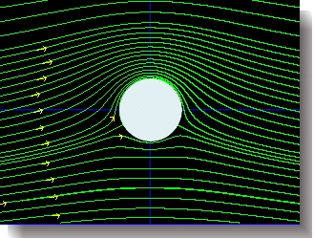
Potential Flow
If we substitute the velocity potential definition
into the continuity equation
we obtain the condition for potential flow,
This is nothing else than the Laplace equation.
Thus, the solution of many problems in hydrodynamics boils down to a solution of the
Laplace equation. The problem is well-posed , and there is a vast body of work on its solution.
To solution of the Laplace equation is dictated by the boundary (and initial) conditions that
are imposed.

Slide 24
Boundary Conditions
To solve the Laplace equation, we need to specify the boundary conditions. There are a
Variety of boundary conditions. Usually, these involve one (or more) of the following :
The value of on the bounding surface of the fluid Dirichlet boundary conditions
The value of its normal derivatives on the boundaries Neumann boundary conditions
For the problem of a flow past a solid object like
a ship or a sphere, we have the important
condition that the water should not penetrate
the object, ie. there should be no flow normal
to its surface. This translates into the
Neumann boundary condition:
for the object at rest:
if the object moves with velocity , then

Slide 25
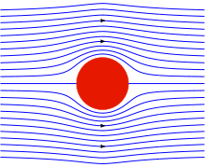
Potential Flow
To find the solutions to the Laplace equation,
one can apply the mathematical machinery of potential theory.
To provide an idea of the solutions we concentrate on solutions for
Spherical geometry (of object) and Axisymmetric flow
The general axisymmetric solution of Laplace’s equation
is obtained by the separation-of-variables method in
spherical polar coordinates, ie.
which yields
r is the spherical radius
the co-latitude (see figure):
A_{n} and B_{n} are arbitrary constants,
shose value is determined by
the boundary conditions.
P_{n} is the Legendre Polynomial of
degree n:

Slide 26
I.14 Potential flow
Potential floe is a flow in which the vorticity vanishes everywhere in the fluid,
i.e., . In such case Euler's equation could be written as:
In such case the velocity could be drawn from a potential, ψ, or v=∇ψ.
For barotropic and potential forces, Euler's equation then becomes very
simple.
or
Where φ is the force potential and T(t) is some function of time.
27

Slide 27
Hydrostatics

Slide 28
Hydrostatics
In hydrostatics no flow occurs. This reduces the fluid equations to very simple ones
In such a case the fluid equations become:
Examples:
1. Archimedes' theorem:
A fluid in hydrostatic equilibrium has a uniform density show that is a body is immersed
in it, the body experience a force equal to the gravity force exerted on the fluid that the
body displaced and opposite in direction.
The force that is experienced by the displaced fluid (prior to displacement) by the its
surroundings is
17

Slide 29
Hydrostatics
Systems where motion is absent altogether, or at least has no dynamic effects, are
in hydrostatic equilibrium:
In those situations, the fluid equations reduce to simple equilibrium equations.
Continuity equation:
Euler equation:
(the latter identity in the Euler equation is for the body force being the gravitational force).
We will shortly address four typical examples of hydrostatic equilibrium, all of major
astrophysical interest
Archimedes’ Principle, bouyancy forces
Isothermal sphere
Stellar Structure equations
4) Mass determination of clusters from their X-ray emission.
17

Slide 30
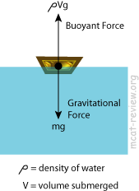
Archimedes’ Principle
In the situation where an object is (partially) immersed in a fluid (see figure),
Archimedes’ principle states, shortly, that
Buoyancy = Weight of displaced fluid
Continuity equation:
Euler equation:
(the latter identity in the Euler equation is for the body force being the gravitational force).
We will shortly address four typical examples of hydrostatic equilibrium, all of major
astrophysical interest
Archimedes’ Principle, bouyancy forces
Isothermal sphere
Stellar Structure equations
4) Mass determination of clusters from their X-ray emission.
17

Slide 31
Hydrostatics
In hydrostatics no flow occurs. This reduces the fluid equations to very simple ones
In such a case the fluid equations become:
Examples:
1. Archimedes' theorem:
A fluid in hydrostatic equilibrium has a uniform density show that is a body is immersed
in it, the body experience a force equal to the gravity force exerted on the fluid that the
body displaced and opposite in direction.
The force that is experienced by the displaced fluid (prior to displacement) by the its
surroundings is
17

Slide 32
Archimedes Principle
In hydrostatics no flow occurs. This reduces the fluid equations to very simple ones
In such a case the fluid equations become:
Examples:
1. Archimedes' theorem:
A fluid in hydrostatic equilibrium has a uniform density show that is a body is immersed
in it, the body experience a force equal to the gravity force exerted on the fluid that the
body displaced and opposite in direction.
The force that is experienced by the displaced fluid (prior to displacement) by the its
surroundings is
17

Slide 33
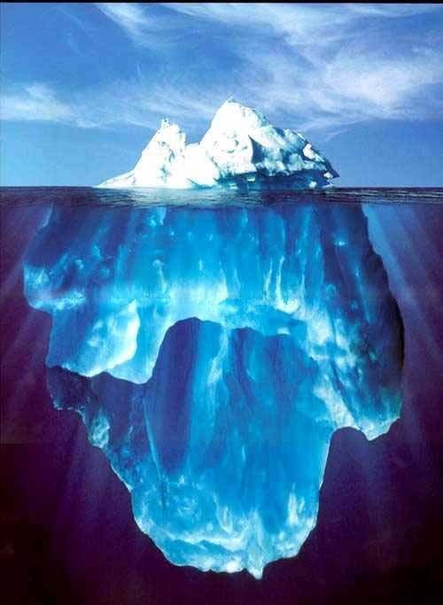
Archimedes Principle

Slide 34
Archimedes Principle

Slide 35
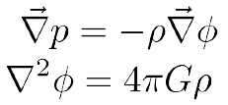
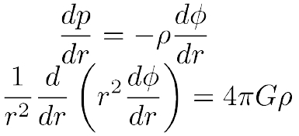
I.10 Hydrostatic equilibrium for a spherically
symmetric self gravitating Body
The two equations that govern the system are:
We'll start from the second equation, the grad and Laplacian operators in spherical
coordinates are:
Therefore, the hydrostatic and Poisson equations become:
18

Slide 36
I.10 Hydrostatic equilibrium for a spherically
symmetric self gravitating Body (cont.)
Integration of the second equation gives
where
Now we add the assumption that we have an ideal gas, namely,
We also have to decide how ∝ (the molecular weight) and T behave. Here we'll
assume they are constants. A flow that have fixed temperature is called isothermal and
c is called the isothermal sound speed. This assumption results in the equation
c2 s
2Gr 2
c4 s
2 Gr 2
Which has the solution
=
,
p=
This is the well known isothermal sphere solution. Notice that it is singular at the
center. Nevertheless it provides a useful analytic approximation for various
astronomical problems (sometime with added core).
In real stars the temperature and, with it, the pressure increase with depth which
provide enough support against self collapse without the need for the singularity at r=0.
19

Slide 37
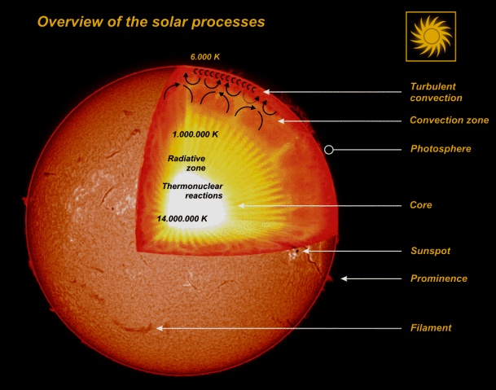
Stellar Structure

Slide 38
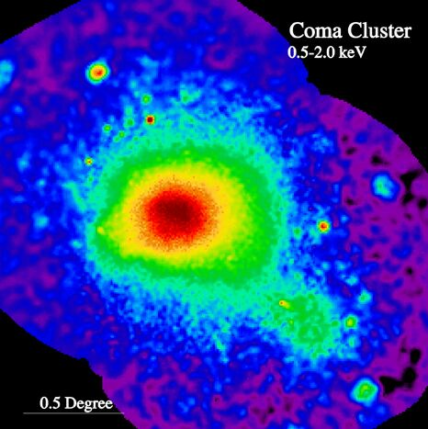
Clusters: Rontgenstralende Hete Gasbollen
Hete Gasbollen
- T ~ 10-100 miljoen Kelvin !!!
in Hydrostatisch Evenwicht:
Zwaartekracht = Gasdruk
- Straling = Bremsstrahlung
M51
ROSAT X-ray image Coma Cluster

Slide 39
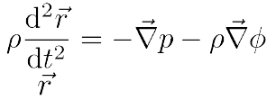
I.11 The Virial Theorem
Consider Euler equation of a self gravitating fluid and remember that the velocity
vector is given by
Hence Euler's equation can take the form:
We then multiply both sides of the equation with
volume:
The LHS of this equation could be written as:
and integrate over the whole
where
are the moment of inertia and the total kinetic energy of the fluid. The
first term in the RHS could written as:
With the first term is zero due to vanishing pressure at the boundaries.
20

Slide 40
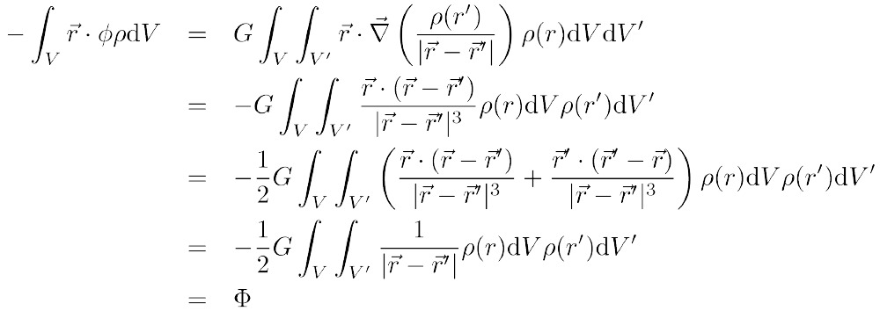
I.11 The Virial Theorem (cont.)
The last term on the RHS is the one controlled by gravity and could be written as:
Where Φ is the total gravitational energy.
21

Slide 41
I.11 The Virial Theorem (cont.)
Finally we arrive to the relation we are after, which also known as the scalar
virial theorem:
One can also derive a tensor virial theorem which could be obtained by multplying
the ith component of Euler's eq. With the jth component of the radius vector, .
This equation take the form:
where,
22

Slide 42
I.12 The energy and momentum fluxes
The Energy Flux:
Let us now consider the change of the energy per unit volume in a fluid at a
fixed point in space (Eulerian coordinate). The energy per unit volume is
composed of two components, the kinetic energy per unit volume and the
internal energy per unit volume. The rate of change in the energy per unit
volume is, , where U is the internal energy per unit mass.
The first component can be shown, using the continuity and Euler's equation,
to satisfy the equality,
Using the thermodynamic relation
one obtains
For the ρU part we use the thermodynamic relation
which leads
(where
).
23

