Slide 1
Astrophysical
Fluid Dynamics

Slide 2
What is a Fluid ?

Slide 3
I. What is a fluid ?
I.1 The Fluid approximation:
The fluid is an idealized concept in which the matter is described as a
continuous medium with certain macroscopic properties that vary as
continuous function of position (e.g., density, pressure, velocity,
entropy).
That is, one assumes that the scales l over which these
quantities are defined is much larger than the mean free path  of the
individual particles that constitute the fluid,
Where n is the number density of particles in the fluid and σ is a
typical interaction cross section.
4

Slide 4
I. What is a fluid ?
Furthermore, the concept of local fluid quantities is only useful if the
scale l on which they are defined is much smaller than the typical
macroscopic lengthscales L on which fluid properties vary. Thus to use the
equations of fluid dynamics we require
Astrophysical circumstances are often such that strictly speaking not
all criteria are fulfilled.
4

Slide 5
I. What is a fluid ?
Astrophysical circumstances are often such that strictly speaking not
all fluid criteria are fulfilled.
Mean free path astrophysical fluids (temperature T, density n):
Sun (centre):
fluid approximation very good
Solar wind:
fluid approximation does not
apply, plasma physics
3) Cluster:
fluid approximation marginal
4

Slide 6
Solid vs. Fluid
By definition, a fluid cannot withstand any tendency for applied forces
to deform it, in such a way that volume is left unchanged. Such
deformation may be resisted, but no prevented.
A
B
A
B
A
B
Solid
C
D
C
D
C
D
Before
application
of shear
After shear force
is removed
Shear force
A
B
A
B
A
B
Fluid
C
D
C
D
C
D
5

Slide 7
Mathematical
Preliminaries

Slide 8
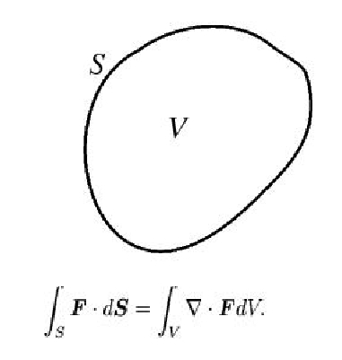
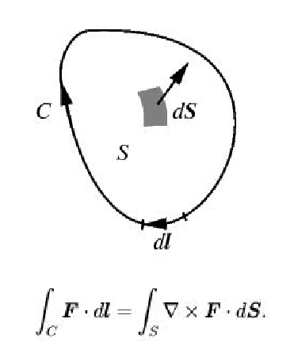
Mathematical preliminaries
Gauss's Law
Stoke's Theorem
6

Slide 9
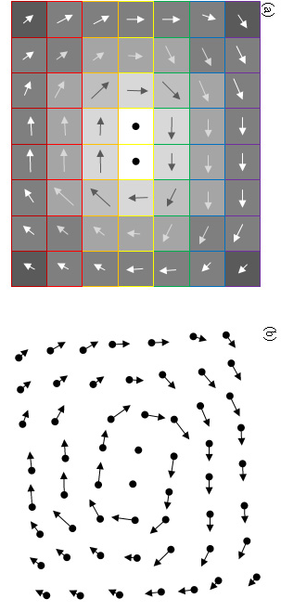
Lagrangian vs. Eulerian View
There is a range of different ways in which we can follow the evolution of
a fluid. The two most useful and best known ones are:
Eulerian view
Consider the system properties Q – density, flow velocity,
temperature, pressure – at fixed locations. The temporal
changes of these quantities is therefore followed by
partial time derivative:
2) Lagrangian view
Follow the changing system properties Q as you flow along
with a fluid element. In a way, this “particle” approach is
in the spirit of Newtonian dynamics, where you follow the
body under the action of external force(s).
The temporal change of the quantities is followed by means
of the “convective” or “Lagrangian” derivative
7

Slide 10
Lagrangian vs. Eulerian View
Consider the change of a fluid quantity at a location
Eulerian view:
change in quantity Q in interval t,
at location :
Lagrangian view:
change in quantity Q in time interval t,
while fluid element moves from
to
Convective/
Lagrangian
Derivative

Slide 11
Basic
Fluid Equations

Slide 12
Conservation Equations
To describe a continuous fluid flow field, the first step is to evaluate the development
of essential properties of the mean flow field . To this end we evaluate the first 3 moment of the phase space distribution function , corresponding to five quantities,
For a gas or fluid consisting of particles with mass m, these are
1) mass density
2) momentum density
3) (kinetic) energy density
Note that we use to denote the bulk velocity at location r, and for the particle velocity. The velocity of a particle is therefore the sum of the bulk velocity and a “random” component ,
In principle, to follow the evolution of the (moment) quantities, we have to follow the
evolution of the phase space density . The Boltzmann equation describes this
Evolution.

Slide 13
Boltzmann Equation
In principle, to follow the evolution of these (moment) quantities, we have to follow the
evolution of the phase space density . This means we should solve the
Boltzmann equation,
The righthand collisional term is given by
in which
is the angle -dependent elastic collision cross section.
On the lefthand side, we find the gravitational potential term, which according to the Poisson equation
is generated by selfgravity as well as the external mass distribution .

Slide 14
Boltzmann Equation
To follow the evolution of a fluid at a particular location x, we follow the evolution of a quantity (x,v) as described by the Boltzmann equation. To this end, we integrate over the full velocity range,
If the quantity is a conserved quantity in a collision, then the righthand side of the equation equals zero. For elastic collisions, these are mass, momentum and (kinetic) energy of a particle. Thus, for these quantities we have,
The above result expresses mathematically the simple notion that collisions can not contribute to the time rate change of any quantity whose total is conserved in the collisional process.
For elastic collisions involving short-range forces in the nonrelativistic regime, there exist exactly five independent quantities which are conserved:
mass, momentum and (kinetic) energy of a particle,

Slide 15
Boltzmann Moment Equations
When we define an average local quantity,
for a quantity Q, then on the basis of the velocity integral of the Boltzmann equation, we get the following evolution equations for the conserved quantities ,
For the five quantities
the resulting conservation equations are known as the
1) mass density continuity equation
2) momentum density Euler equation
3) energy density energy equation
In the sequel we follow – for reasons of insight – a slightly more heuristic path towards inferring the continuity equation and the Euler equation.

Slide 16
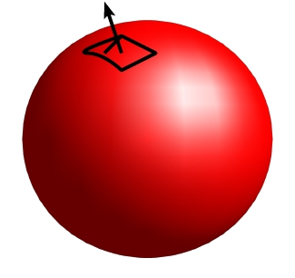
Continuity equation
n
To infer the continuity equation, we consider the
conservation of mass contained in a volume V
which is fixed in space and enclosed by a
surface S.
The mass M is
The change of mass M in the volume V is equal to
the flux of mass through the surface S,
Where is the outward pointing normal vector.
S
V
LHS:
RHS,
using the divergence theorem (Green’s formula):

Slide 17
Continuity equation
Since this holds for every volume, this
relation is equivalent to
The continuity equation expresses
- mass conservation
AND
- fluid flow occurring in a
continuous fashion !!!!!
n
S
V
One can also define the mass flux density as
which shows that eqn. I.1 is actually a
continuity equation

Slide 18
Continuity Equation & Compressibility
From the continuity equation,
we find directly that ,
Of course, the first two terms define the Lagrangian derivative, so that for a moving fluid
element we find that its density changes according to
In other words, the density of the fluid element changes as the divergence of the velocity flow.
If the density of the fluid cannot change, we call it an incompressible fluid , for which .
n

Slide 19
Momentum Conservation
When considering the fluid momentum, , via the Boltzmann moment equation,
we obtain the equation of momentum conservation,
Decomposing the velocity v_{i} into the bulk velocity u_{i} and the random component w_{i},
we have
By separating out the trace of the symmetric dyadic w_{i}w_{k}, we write

Slide 20
Momentum Conservation
By separating out the trace of the symmetric dyadic w_{i}w_{k}, we write
where
P is the “gas pressure”
_{ik} is the “viscous stress tensor”
we obtain the momentum equation, in its conservation form,

Slide 21
Momentum Conservation
Momentum Equation
Describes the change of the momentum density in the i-direction:
The flux of the i-th component of momentum in the k-th direction consists of the sum of
1) a mean part:
2) random part I, isotropic pressure part:
3) random part II, nonisotropic viscous part:

Slide 22
Force Equation
Momentum Equation
By invoking the continuity equation, we may also manipulate the momentum equation so that
it becomes the force equation

Slide 23
Viscous Stress
A note on the viscous stress term :
For Newtonian fluids:
Hooke’s Law
states that the viscous stress is linearly proportional to the rate of strain ,
where is the shear deformation tensor,
The parameters  and  are called the shear and bulk coefficients of viscosity.

Slide 24
Euler equation
In the absence of viscous terms, we may easily derive the equation for the conservation of
momentum on the basis of macroscopic considerations. This yields the Euler equation.
As in the case for mass conservation, consider an arbitrary volume V, fixed in space, and
bounded by a surface S, with an outward normal .
Inside V, the total momentum for a fluid with density and flow velocity is
The momentum inside V changes as a result of three factors:
External (volume) force,
a well known example is the gravitational force when V embedded in gravity field.
The pressure (surface) force over de surface S of the volume.
(at this stage we'll ignore other stress tensor terms that can either be caused by
viscosity, electromagnetic stress tensor, etc.):
3) The net transport of momentum by in- and outflow of fluid into and out of V
b)

Slide 25
Euler equation
External (volume) forces,:
where is the force per unit mass, known as the body force. An example is the
gravitational force when the volume V is embeddded in a gravitational field.
The pressure (surface) force is the integral of the pressure (force per unit area) over
the surface S,
The momentum transport over the surface area can be inferred by considering at each
surface point the slanted cylinder of fluid swept out by the area element S in time t,
where S starts on the surface S and moves with the fluid, ie. with velocity . The
momentum transported through the slanted cylinder is
so that the total transported monetum through the surface S is:
b)

Slide 26
Euler equation
Taking into account all three factors, the total rate of change of momentum is given by
The most convenient way to evaluate this integral is by restricting oneself to the i-component
of the velocity field,
Note that we use the Einstein summation convention for repeated indices.
Volume V is fixed, so that
Furthermore, V is arbitrary. Hence,

Slide 27
Euler equation
Reordering some terms of the lefthand side of the last equation,
leads to the following equation:
From the continuity equation, we know that the second term on the LHS is zero. Subsequently,
returning to vector notation, we find the usual exprssion for the Euler equation,
Returning to vector notation, and using the we find the usual expression for the Euler equation:

Slide 28
Euler equation
An slightly alternative expression for the Euler equation is
In this discussion we ignored energy dissipation processes which may occur as a result of
internal friction within the medium and heat exchange between its parts (conduction). This
type of fluids are called ideal fluids.
Gravity:
For gravity the force per unit mass is given by where the
Poisson equation relates the gravitational potential  to the density :

Slide 29
Euler equation
From eqn. (I.4)
we see that the LHS involves the Lagrangian derivative, so that the Euler equation can
be written as
In this form it can be recognized as a statement of Newton’s 2nd law for an inviscid
(frictionless) fluid. It says that, for an infinitesimal volume of fluid,
mass times acceleration = total force on the same volume,
namely force due to pressure gradient plus whatever body forces are being exerted.

Slide 30
Energy Conservation
In terms of bulk velocity and random velocity the (kinetic) energy of a particle is,
The Boltzmann moment equation for energy conservation
becomes
Expanding the term inside the spatial divergence, we get
 

Slide 31
Energy Conservation
Defining the following energy-related quantities:
1) specific internal energy:
“gas pressure”
conduction heat flux
viscous stress tensor
 

Slide 32
Energy Conservation
The total energy equation for energy conservation in its conservation form is
This equation states that the total fluid energy density is the sum of a part due to
bulk motion and a part due to random motions .
The flux of fluid energy in the k-th direction consists of
1) the translation of the bulk kinetic energy at the k-th component of the mean velocity,
2) plus the enthalpy – sum of internal energy and pressure – flux,
plus the viscous contribution
plus the conductive flux

Slide 33
Work Equation
Internal Energy Equation
For several purposes it is convenient to express energy conservation in a form that involves
only the internal energy and a form that only involves the global PdV work.
The work equation follows from the full energy equation by using the Euler equation,
by multiplying it by and using the continuity equation:
Subtracting the work equation from the full energy equation, yields the
internal energy equation for the internal energy
where  is the rate of viscous dissipation
evoked by the viscosity stress
.

Slide 34
Internal energy equation
If we use the continuity equation, we may also write the internal energy equation in the form of
the first law of thermodynamics,
in which we recognize
as the rate of doing PdV work, and
as the time rate of adding heat (through heat conduction and the viscous conversion of ordered
energy in differential fluid motions to disordered energy in random particle motions).
.

Slide 35
Energy Equation
On the basis of the kinetic equation for energy conservation
we may understand that the time rate of the change of the total fluid energy in
a volume V (with surface area A), i.e. the kinetic energy of fluid motion plus internal energy,
should equal the sum of
minus the surface integral of the energy flux (kinetic + internal)
plus surface integral of doing work by the internal stresses Pik
volume integral of the rate of doing work by local body forces (e.g. gravitational)
minus the heat loss by conduction across the surface A
plus volumetric gain minus volumetric losses of energy
due to local sources and sinks (e.g. radiation)
.

Slide 36
Energy Equation
The total expression for the time rate of total fluid energy is therefore
 P_{ik} is the force per unit area exerted by the outside on the inside in the i^{th}
direction across a face whose normal is oriented in the k^{th} direction.
For a dilute gas this is
 is the energy gain per volume, as a result of energy generating processes.
☹ is the energy loss per volume due to local sinks (such as e.g. radiation)
.

Slide 37
Energy Equation
By applying the divergence theorem, we obtain the total energy equation:
.

Slide 38
Heat Equation
Implicit to the fluid formulation, is the concept of local thermal equilibrium. This allows us
to identify the trace of the stress tensor P_{ik} with the thermodynamic pressure p,
Such that it is related to the internal energy per unit mass of the fluid, ,
and the specific entropy s, by the fundamental law of thermodynamics
Applying this thermodynamic equation and subtracting the work equation (see relevant slide 64),
we obtain the Heat Equation,
where  equals the rate of viscous dissipation,
.

Slide 39
Fluid Flow
Visualization

Slide 40
Flow Visualization:
Streamlines, Pathlines & Streaklines
re a
Fluid flow is characterized by a velocity vector field in 3-D space.
There are various distinct types of curves/lines commonly used when visualizing fluid motion: streamlines, pathlines and streaklines.
These only differ when the flow changes in time, ie. when the flow is not steady ! If the flow is not steady, streamlines and streaklines will change.
Streamlines
Family of curves that are instantaneously tangent to the velocity
vector . They show the direction a fluid element will travel at
any point in time.
If we parameterize one particular streamline , with ,
then streamlines are defined as

Slide 41
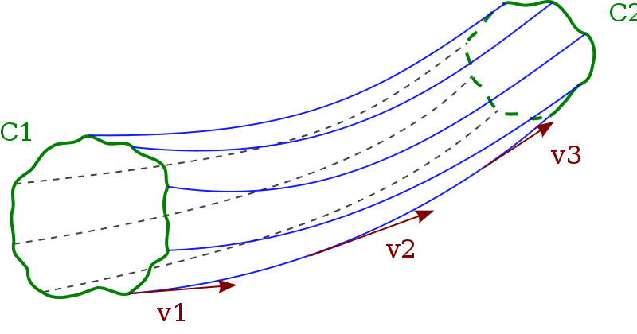
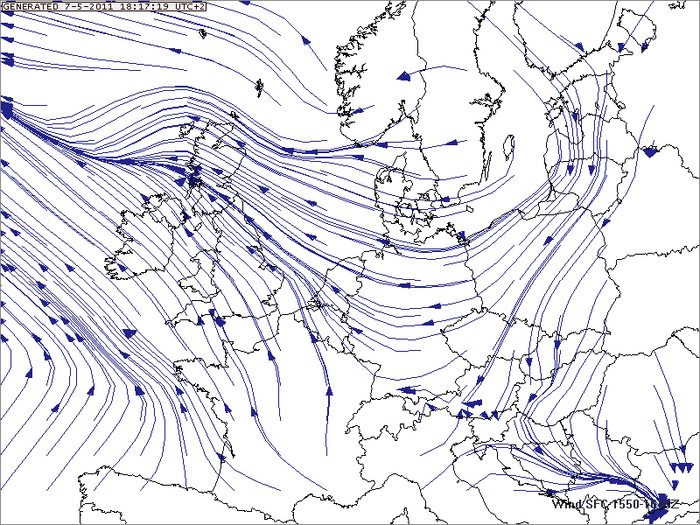
Flow Visualization:
Streamlines
re a
Definition Streamlines:
If the components of the
streamline can be written as
and
then
Illustrations of streamlines …

Slide 42
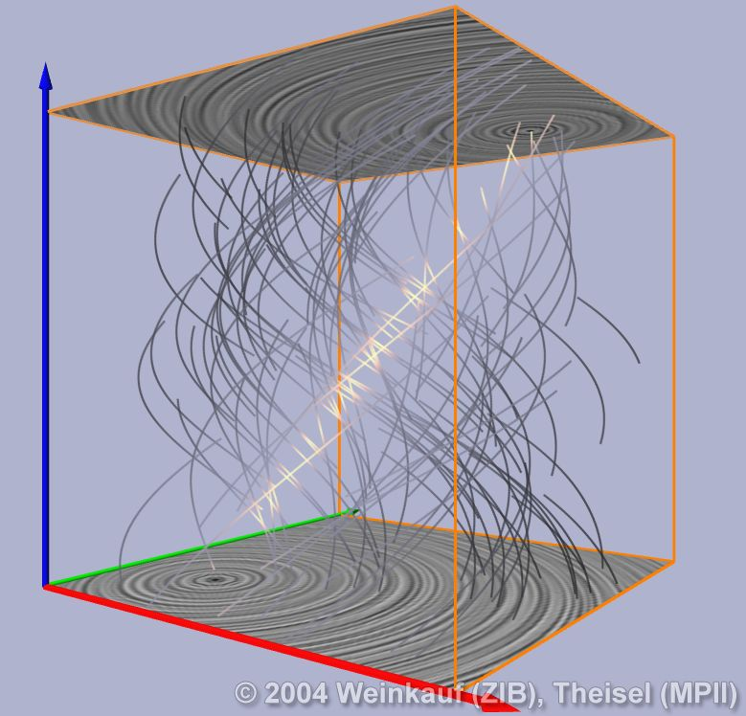
Flow Visualization:
Pathlines
2) Pathlines
Pathlines are the trajectories that individual fluid particles follow. These can be thought of as a "recording" of the path a fluid element in the flow takes over a certain period.
The direction the path takes will be
determined by the streamlines of
the fluid at each moment in time.
Pathlines are defined by
where the suffix P indicates we are following the path of particle P. Note that at location the curve is parallel to velocity vector , where the velocity vector is evaluated at location at time t.
re a

Slide 43
Flow Visualization:
Streaklines
3) Streaklines
Streaklines are are the locus of points of all the fluid particles that have passed
continuously through a particular spatial point in the past.
Dye steadily injected into the fluid
at a fixed point extends along a
streakline. In other words, it is
like the plume from a chimney.
Streaklines can be expressed as
where is the velocity at location at time t. The parameter
parameterizes the streakline and with t0 time of interest.
re a

Slide 44
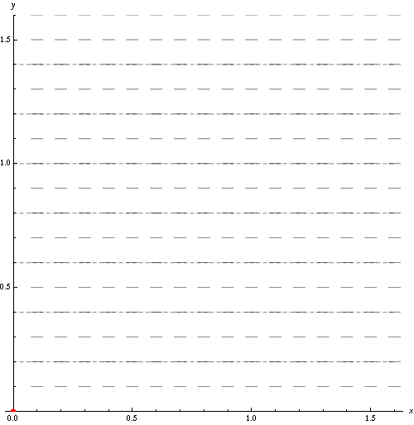
Flow Visualization:
Streamlines, Pathlines, Streaklines
The following example illustrates the different concepts of
streamlines, pathlines and streaklines:
 red: pathline
 blue: streakline
 short-dashed:
evolving streamlines
re a

Slide 45
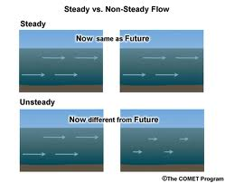
Steady flow
Steady flow is a flow in which the velocity, density and the other fields
do not depend explicitly on time, namely
In steady flow streamlines and streaklines do not vary with time and coincide with
the pathlines.

Slide 46
Kinematics
of Fluid Flow

Slide 47
Stokes’ Flow Theorem
Stokes’ flow theorem:
The most general differential motion of a fluid element corresponds to a
1) uniform translation
2) uniform expansion/contraction divergence term
3) uniform rotation vorticity term
4) distortion (without change volume) shear term
The fluid velocity at a point Q displaced by a small amount from a point P will
differ by a small amount, and includes the components listed above:
Divergence
uniform
expansion/contraction
Vorticity
uniform rotation
uniform translation
Shear term
distortion

Slide 48
Stokes’ Flow Theorem
Stokes’ flow theorem:
the terms of the relative motion wrt. point P are:
2) Divergence term:
uniform expansion/contraction
3) Shear term:
uniform distortion
: shear deformation scalar
: shear tensor
4) Vorticity Term:
uniform rotation
11

Slide 49
Stokes’ Flow Theorem
Stokes’ flow theorem:
One may easily understand the components of the fluid flow around a point P by
a simple Taylor expansion of the velocity field around the point P:
Subsequently, it is insightful to write the rate-of-strain tensor in
terms of its symmetric and antisymmetric parts:
The symmetric part of this tensor is the deformation tensor, and it is convenient
and insightful – to write it in terms of a diagonal trace part and the traceless
shear tensor ,

Slide 50
Stokes’ Flow Theorem
where
the symmetric (and traceless) shear tensor is defined as
2) the antisymmetric tensor as
3) the trace of the rate-of-strain tensor is proportional to the velocity divergence term,

Slide 51
Stokes’ Flow Theorem
Divergence Term
We know from the Lagrangian continuity equation,
that the term represents the uniform expansion or contraction of the fluid
element.

Slide 52
Stokes’ Flow Theorem
Shear Term
The traceless symmetric shear term,
represents the anisotropic deformation of the fluid element. As it concerns a
traceless deformation, it preserves the volume of the fluid element (the
volume-changing deformation is represented via the divergence term).
intention is for the volume of the sphere
and the ellipsoid to be equal

Slide 53
Stokes’ Flow Theorem
Shear Term
Note that we can associate a quadratic form – ie. an ellipsoid – with the shear
tensor, the shear deformation scalar S,
such that the corresponding shear velocity contribution is given by
We may also define a related quadratic form by incorporating the divergence term,
Evidently, this represents the irrotational part of the velocity field. For this reason,
we call the velocity potential:

Slide 54
Stokes’ Flow Theorem
Vorticity Term
The antisymmetric term,
represents the rotational component of the fluid element’s motion, the vorticity.
With the antisymmetric we can associate a (pseudo)vector, the vorticity vector
where the coordinates of the vorticity vector, , are related to
the vorticity tensor via
where is the Levi-Cevita tensor, which fulfils the useful identity

Slide 55
Stokes’ Flow Theorem
Vorticity Term
The contribution of the antisymmetric part of the differential velocity
therefore reads,
The last expression in the eqn. above equals the i-th component of the rotational
velocity
of the fluid element wrt to its center of mass, so that the vorticity vector can
be identified with one-half the angular velocity of the fluid element,

Slide 56
Linear Momentum Fluid Element
The linear momentum of a fluid element equal the fluid velocity integrated
over the mass of the element,
Substituting this into the equation for the fluid flow around P,
we obtain:
If P is the center of mass of the fluid element, then the 2nd and 3rd terms on the RHS
vanish as
Moreover, for the 4th term we can also use this fact to arrive at,
that the term represents the uniform expansion or contraction of the fluid
element.

Slide 57
Linear Momentum Fluid Element
Hence, for a fluid element, the linear momentum equals the mass times the
center-of-mass velocity,

Slide 58
Angular Momentum Fluid Element
With respect to the center-of-mass P, the instantaneous angular momentum of a
fluid element equals
We rotate the coordinate axes to the eigenvector coordinate system of the
deformation tensor (or, equivalently, the shear tensor ), in which
the symmetric deformation tensor is diagonal
and all strains are extensional,
Then

Slide 59
Angular Momentum Fluid Element
In the eigenvalue coordinate system, the angular momentum in the 1-direction is
where
with and evaluated at the center-of-mass P. After some
algebra we obtain
where is the moment of inertia tensor
Notice that is not diagonal in the primed frame unless the principal axes of
happen to coincide with those of .

Slide 60
Angular Momentum Fluid Element
Using the simple observation that the difference
since the isotropic part of does not enter in the difference,
we find for all 3 angular momentum components
with a summation over the repeated l’s.
Note that for a solid body we would have
For a fluid an extra contribution arises from the extensional strain if the principal
axes of the moment-of-inertia tensor do not coincide with those of .
Notice, in particular, that a fluid element can have angular momentum wrt. its
center of mass without possesing spinning motion, ie. even if !

Slide 61
Inviscid Barotropic
Flow

Slide 62
Inviscid Barotropic Flow
In this chapter we are going to study the flow of fluids in which we ignore
the effects of viscosity .
In addition, we suppose that the energetics of the flow processes are
such that we have a barotropic equation of state
Such a replacement considerably simplifies many dynamical discussions, and
its formal justification can arise in many ways.
One specific example is when heat transport can be ignored, so that we
have adiabatic flow,
with s the specific entropy per mass unit. Such a flow is called an isentropic flow.
However, barotropic flow is more general than isentropic flow. There are also
various other thermodynamic circumstances where the barotropic hypothesis
is valid.

Slide 63
Inviscid Barotropic Flow
For a barotropic flow, the specific enthalpy h
becomes simply
and

Slide 64
Kelvin Circulation Theorem
Assume a fluid embedded in a uniform gravitational field, i.e. with an external
force
so that – ignoring the influence of viscous stresses and radiative forces - the
flow proceeds according to the Euler equation,
To proceed, we use a relevant vector identity
which you can most easily check by working out the expressions for each of the
3 components.
The resulting expression for the Euler equation is then

Slide 65
Kelvin Circulation Theorem
If we take the curl of equation
we obtain
where is the vorticity vector,
and we have used the fact that the curl of the gradient of any function equals
zero,
Also, a classical gravitational field satisfies this property,
so that gravitational fields cannot contribute to the generation or destruction
of vorticity.
To proceed, we use a relevant vector identity
which you can most easily check by working out the expressions for each of the
3 components.
The resulting expression for the Euler equation is then

Slide 66
Vorticity Equation
In the case of barotropic flow, ie. if
so that also the 2nd term on the RHS of the vorticity equation disappears,
The resulting expression for the vorticity equation for barotropic flow
in a conservative gravitational field is therefore,
which we know as the Vorticity Equation.
To proceed, we use a relevant vector identity
which you can most easily check by working out the expressions for each of the
3 components.
The resulting expression for the Euler equation is then

Slide 67
Kelvin Circulation Theorem
Interpretation of the vorticity equation:
Compare to magnetostatics, where we may associate the value of
with a certain number of magnetic field lines per unit area.
With such a picture in mind, we may give the following geometric
interpretation of magnetic field lines per unit area. With such a
Picture, we may give the following geometric interpretation of
the vorticity equation, which will be the physical essence of the
Kelvin Circulation Theorem
The number of vortex lines that thread any element of area, that
moves with the fluid , remains unchanged in time for
inviscid barotropic flow.
To proceed, we use a relevant vector identity
which you can most easily check by working out the expressions for each of the
3 components.
The resulting expression for the Euler equation is then

Slide 68
Kelvin Circulation Theorem
To prove Kelvin’s circulation theorem, we define the circulation  around a
circuit C by the line integral,
Transforming the line integral to a surface integral over the enclosed area A
by Stokes’ theorem,
we obtain
This equation states that the circulation  of the circuit C can be calculated
as the number of vortex lines that thread the enclosed area A.
To proceed, we use a relevant vector identity
which you can most easily check by working out the expressions for each of the
3 components.
The resulting expression for the Euler equation is then

Slide 69
Kelvin Circulation Theorem
Time rate of change of 
Subsequently, we investigate the time rate of change of  if every point on
C moves at the local fluid velocity .
Take the time derivative of the surface integral in the last equation.
It has 2 contributions:
where is the unit normal vector to the surface area.
The time rate of change of area can be expressed mathematically with the help of
the figure illustrating the change of an area A moving locally with fluid velocity .
On the basis of this, we may write,
We then interchange the cross and dot in the triple scalar product
To proceed, we use a relevant vector identity
which you can most easily check by working out the expressions for each of the
3 components.
The resulting expression for the Euler equation is then

Slide 70
Kelvin Circulation Theorem
Time rate of change of 
Using Stokes’ theorem to convert the resulting line integral
to a surface integral, we obtain:
The vorticity equation tells us that the integrand on the right-hand side equals zero,
so that we have the geometric interpretation of Kelvin’s circulation theorem,
To proceed, we use a relevant vector identity
which you can most easily check by working out the expressions for each of the
3 components.
The resulting expression for the Euler equation is then

Slide 71
Kelvin Circulation Theorem
Time rate of change of 
Using Stokes’ theorem to convert the resulting line integral
to a surface integral, we obtain:
The vorticity equation tells us that the integrand on the right-hand side equals zero,
so that we have the geometric interpretation of Kelvin’s circulation theorem,
To proceed, we use a relevant vector identity
which you can most easily check by working out the expressions for each of the
3 components.
The resulting expression for the Euler equation is then

Slide 72
the Bernoulli Theorem
Closely related to Kelvin’s circulation theorem we find Bernoulli’s theorem.
It concerns a flow which is steady and barotropic, i.e.
and
Again, using the vector identity,
we may write the Euler equation for a steady flow in a gravitational field 
For barotropic steady flow the Euler equation, ignoring external forces,

Slide 73
the Bernoulli Theorem
The Euler equation thus implies that
where h is the specific enthalpy, equal to
for which
We thus find that the Euler equation implies that
For barotropic steady flow the Euler equation, ignoring external forces,

Slide 74
the Bernoulli Theorem
The Euler equation thus implies that
where h is the specific enthalpy, equal to
for which
We thus find that the Euler equation implies that
For barotropic steady flow the Euler equation, ignoring external forces,

Slide 75
the Bernoulli Theorem
Defining the Bernoulli function B
which has dimensions of energy per unit mass. The Euler equation
thus becomes
Now we consider two situations, the scalar product of the equation with and
and ,
B is constant along streamlines
this is
Bernoulli’s streamline theorem
B is constant along vortex lines
ie. along integral curves
* vortex lines are curves tangent to the vector field
For barotropic steady flow the Euler equation, ignoring external forces,

