Slide 1
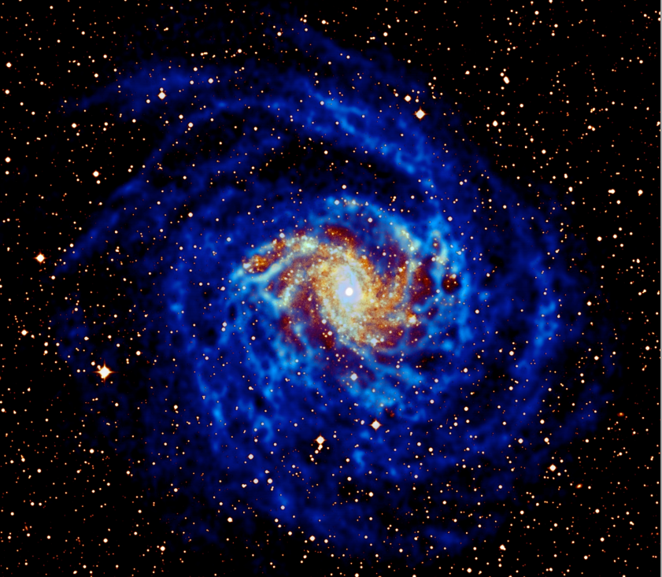
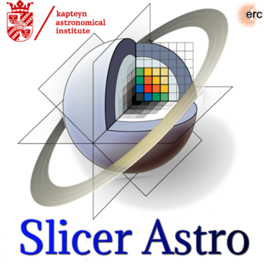
SlicerAstro: a versatile tool for linked 2D/3D visualization.
Davide Punzo*,
Thijs van der Hulst,
Jean-Christophe Fillion-Robin.
*punzodavide@hotmail.it
Image credit: T. Oosterloo

Slide 2
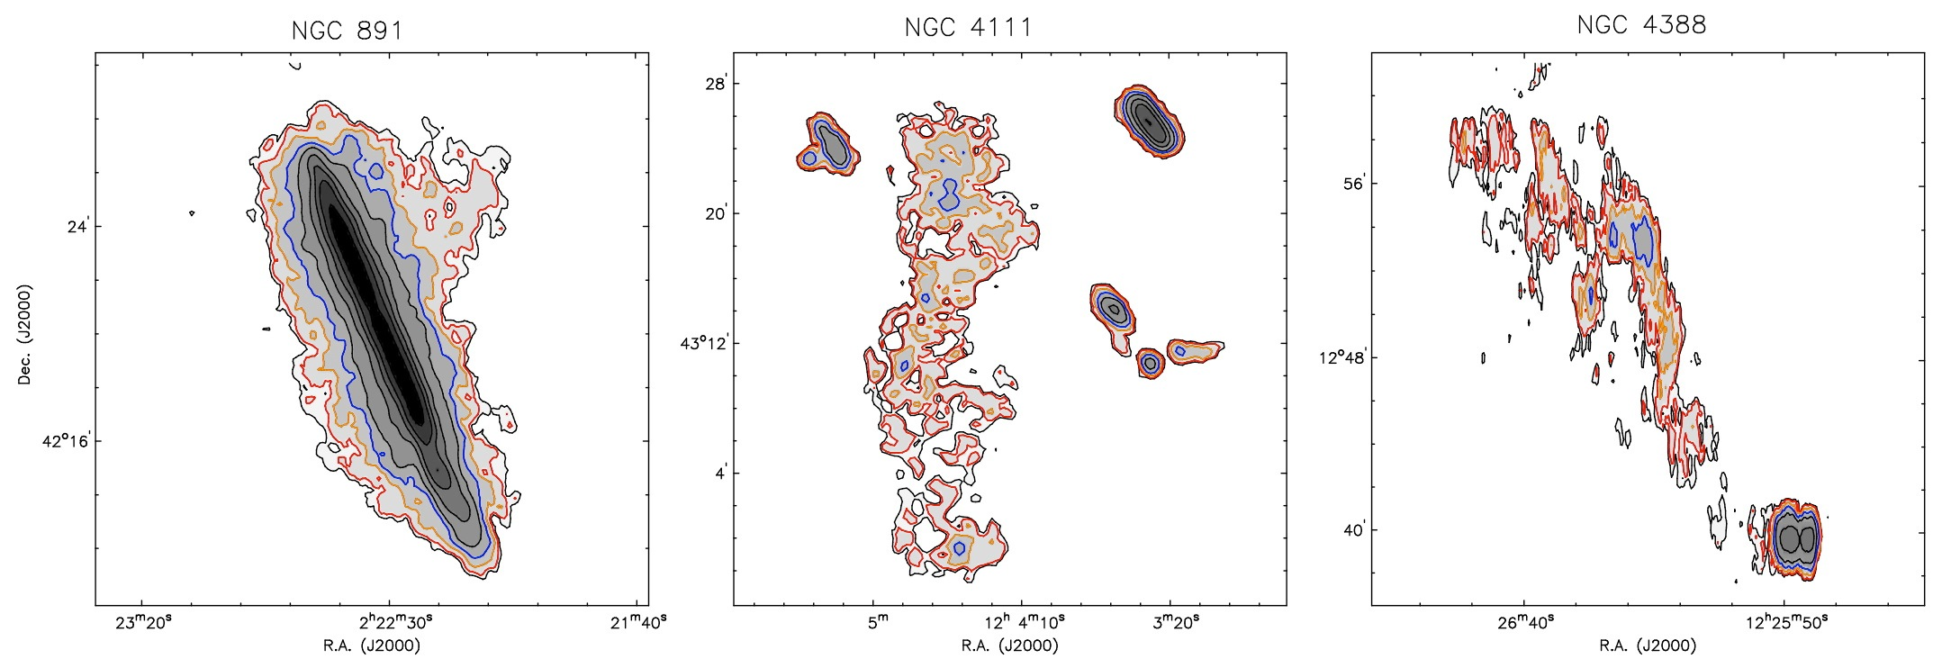
Our aim
extra-planar gas tidal filaments ram-pressure tails
Image credit: M. Verheijen
Common to these tell-tale signatures:
low column density ${\sim 10}^{19}{cm}^{−2}$
unusual kinematics
3D interactive visualization technique can help finding such features:
SlicerAstro, a 3D visual analytics tool.

Slide 3
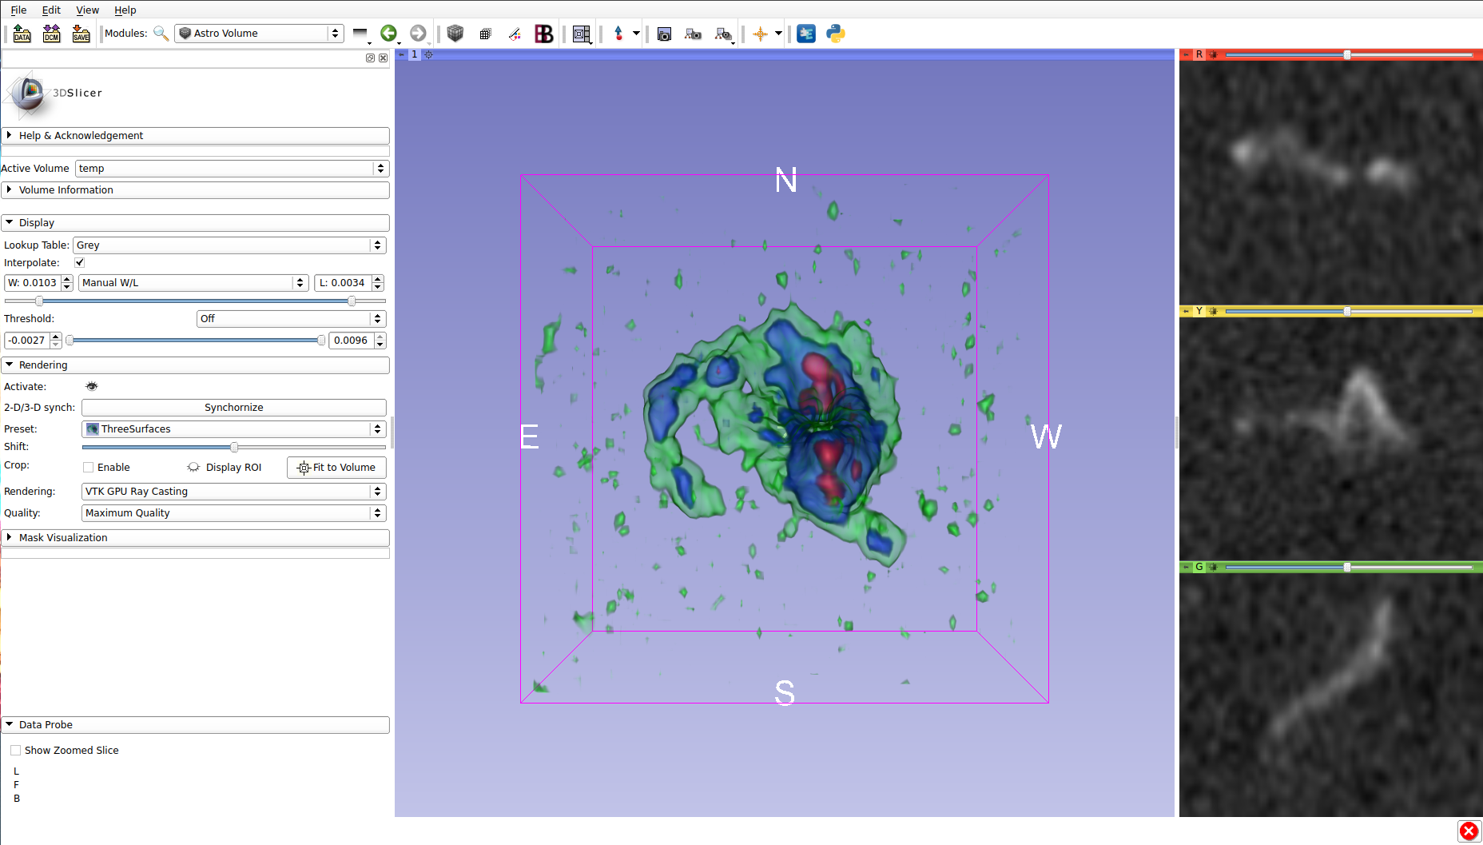
Inspecting HI in a galaxy in 3D
XY
A tidal tail
The regularly rotating disk
YZ
XZ
3D
pros:
Overview of coherent structures in space and velocity
Data:
M. Ramatsoku
See also Punzo et al., 2015, Astronomy and Computing, 12, 86.

Slide 4
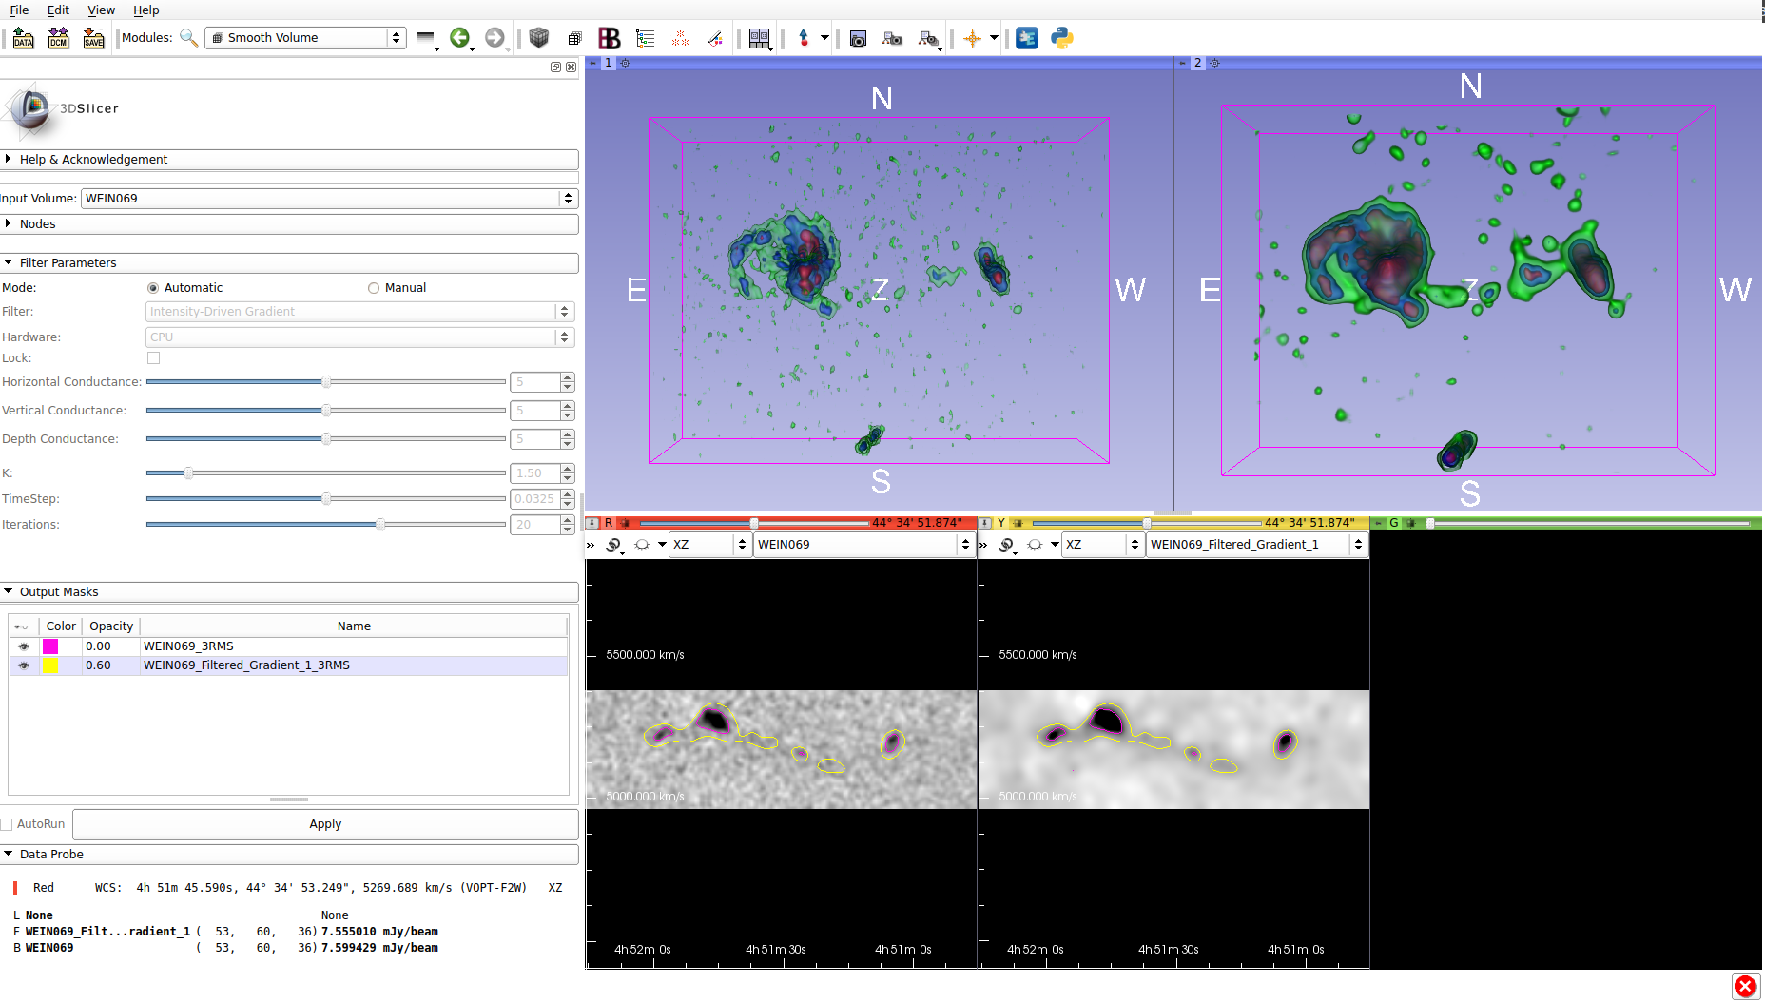
Inspecting a faint HI filament in 3D
CPU (OpenMP) / GPU(OpenGL) filtering techniques:
A
Box
B
Gaussian
HI Filament
C
Intensity-driven gradient
3D + filtering
pros:
Discovering faint structure
See also Punzo et al., 2016, Astronomy and Computing, 17, 163.

Slide 5
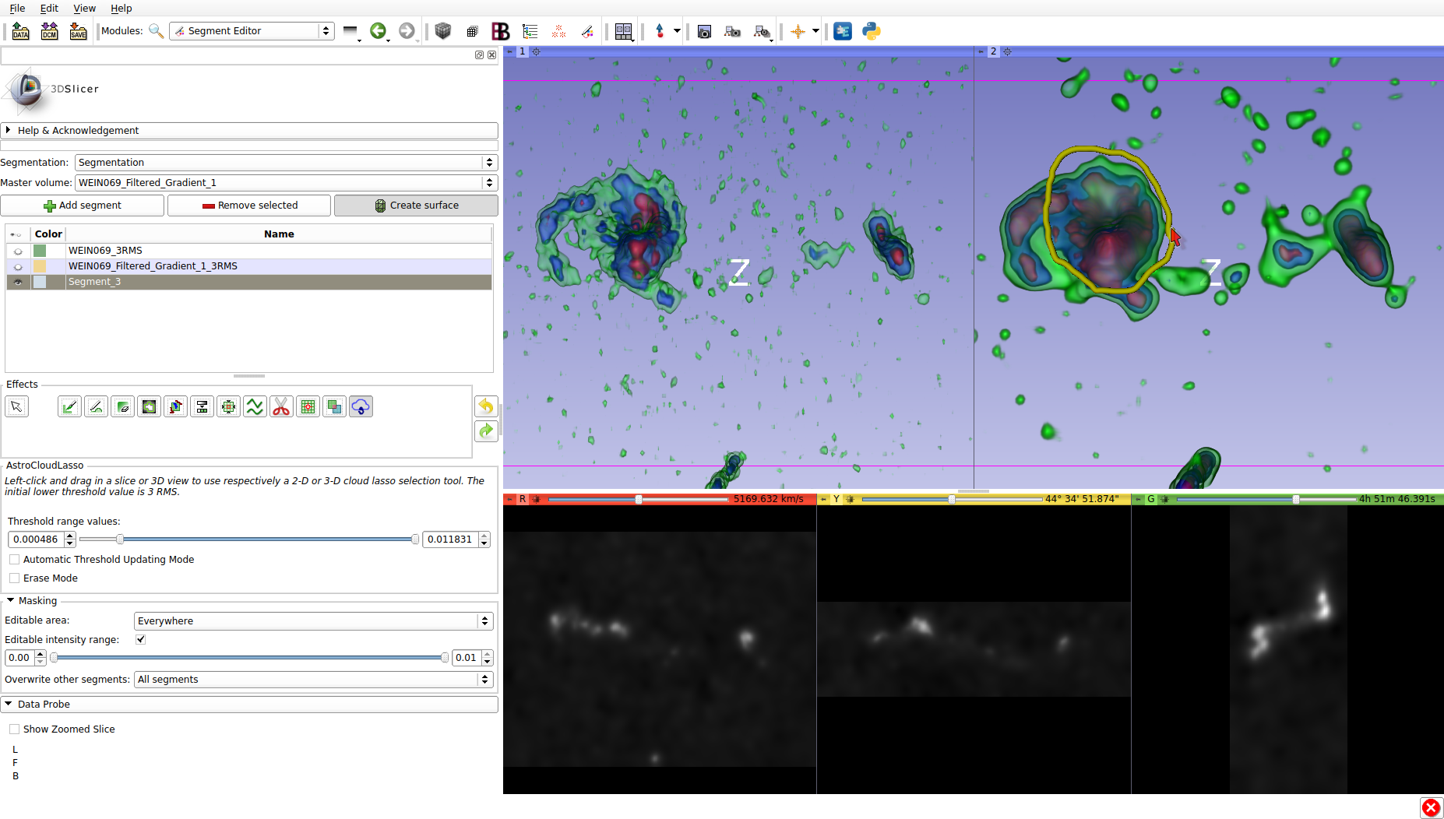
3D selection: CloudLasso
3D pros:
Selecting ROI for
further analysis
Modify interactively
the selection
See also Punzo et al., 2017, Astronomy and Computing.

Slide 6
Visual Analytics example: manual model refinement

Slide 7
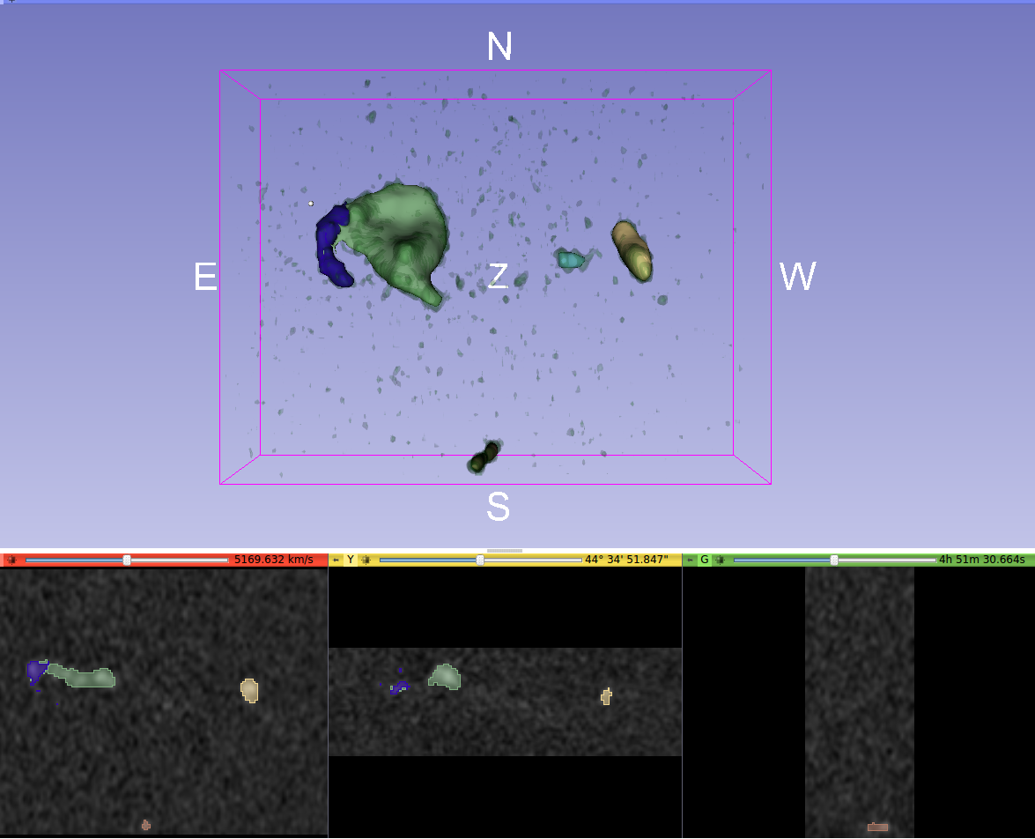
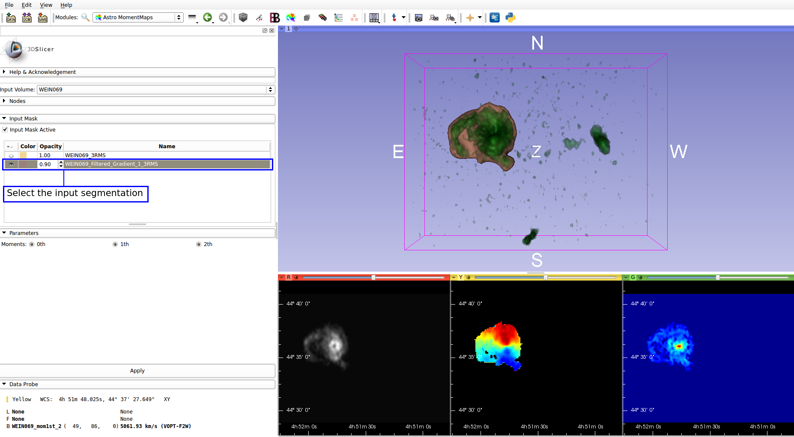
Last development: quantitative visualization
Histogram
Load and visualize masks
Interactive masking
Statistics in a selection
Generate profiles
Generate moment maps
Interactive P-V slice
Generate P-V diagram
Reprojection of data
Contours

Slide 8
Quantitative visualization: Histogram
Histogram
Load and visualize masks
Interactive masking
Statistics in a selection
Generate profiles
Generate moment maps
Interactive P-V slice
Generate P-V diagram
Reprojection of data
Contours

Slide 9
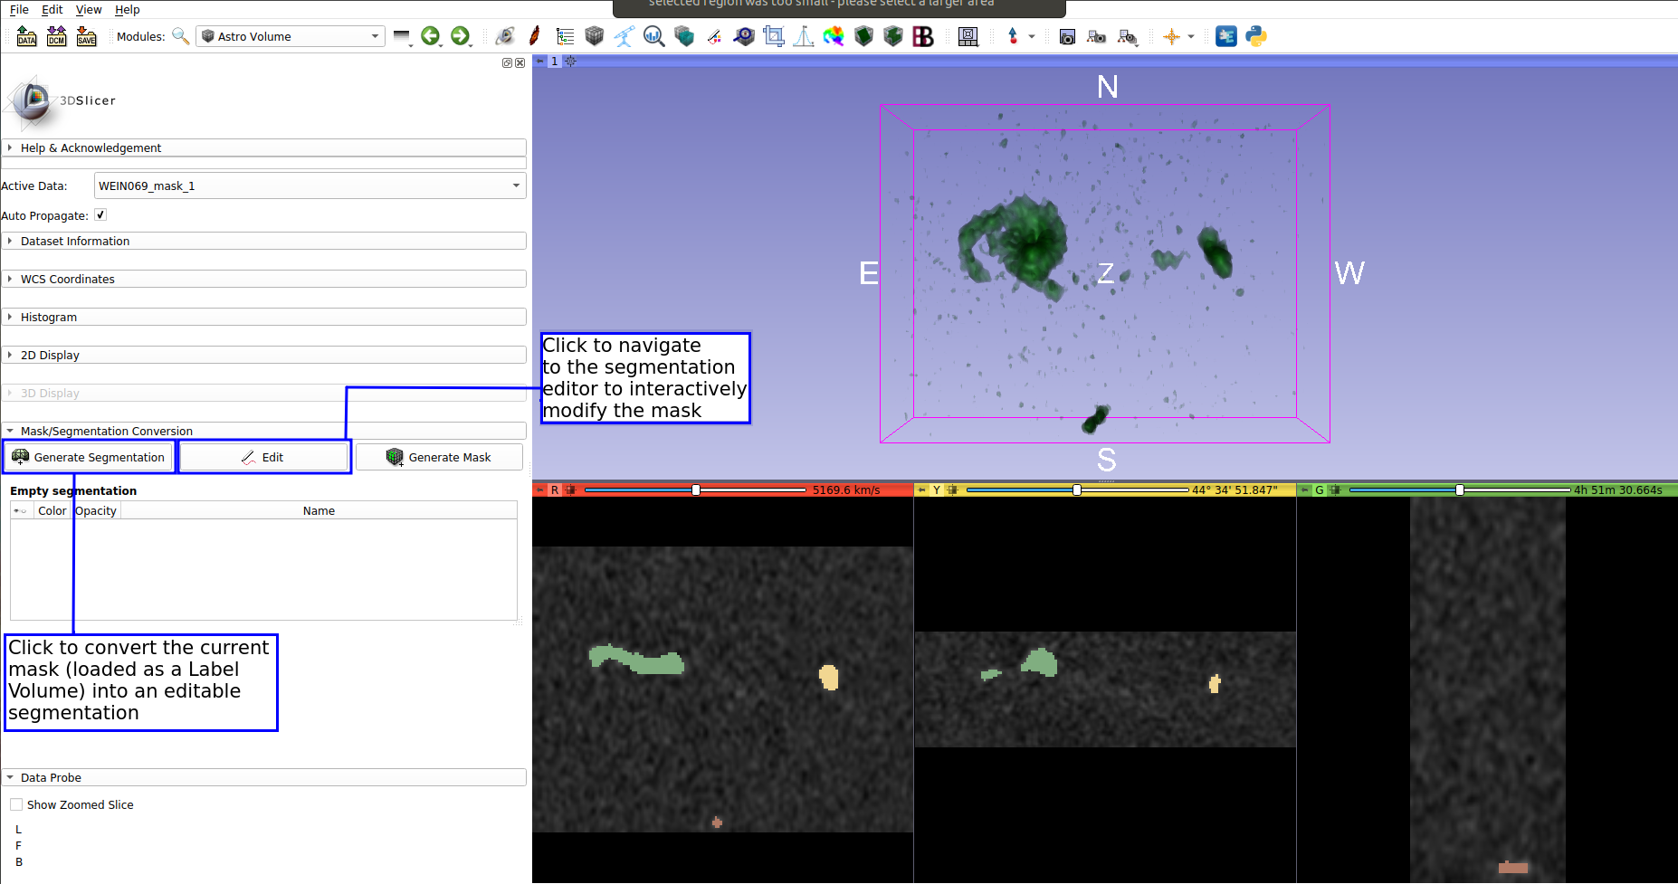
Quantitative visualization: load masks
Histogram
Load and visualize masks
Interactive masking
Statistics in a selection
Generate profiles
Generate moment maps
Interactive P-V slice
Generate P-V diagram
Reprojection of data
Contours

Slide 10
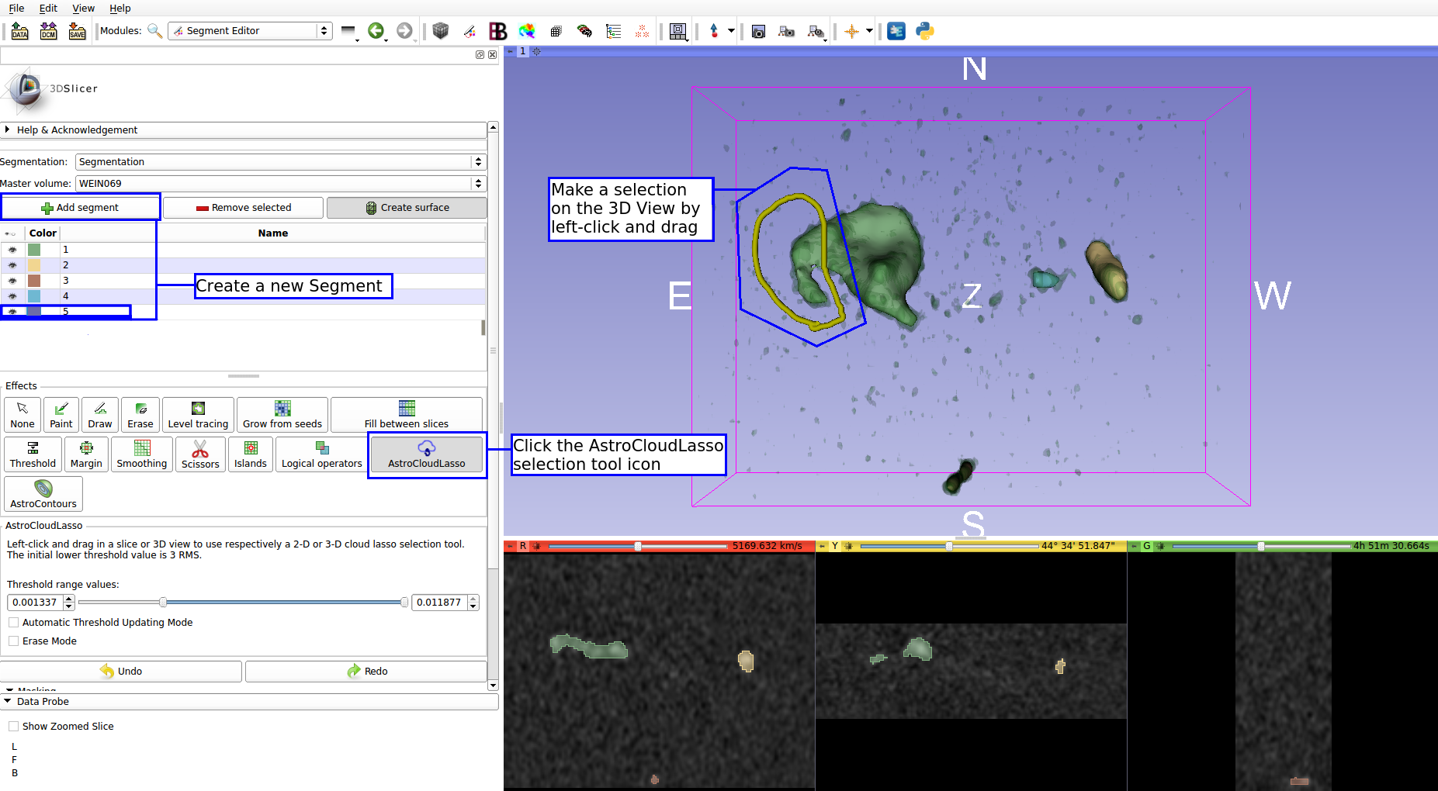
Quantitative visualization: interactive masking
Histogram
Load and visualize masks
Interactive masking
Statistics in a selection
Generate profiles
Generate moment maps
Interactive P-V slice
Generate P-V diagram
Reprojection of data
Contours

Slide 11
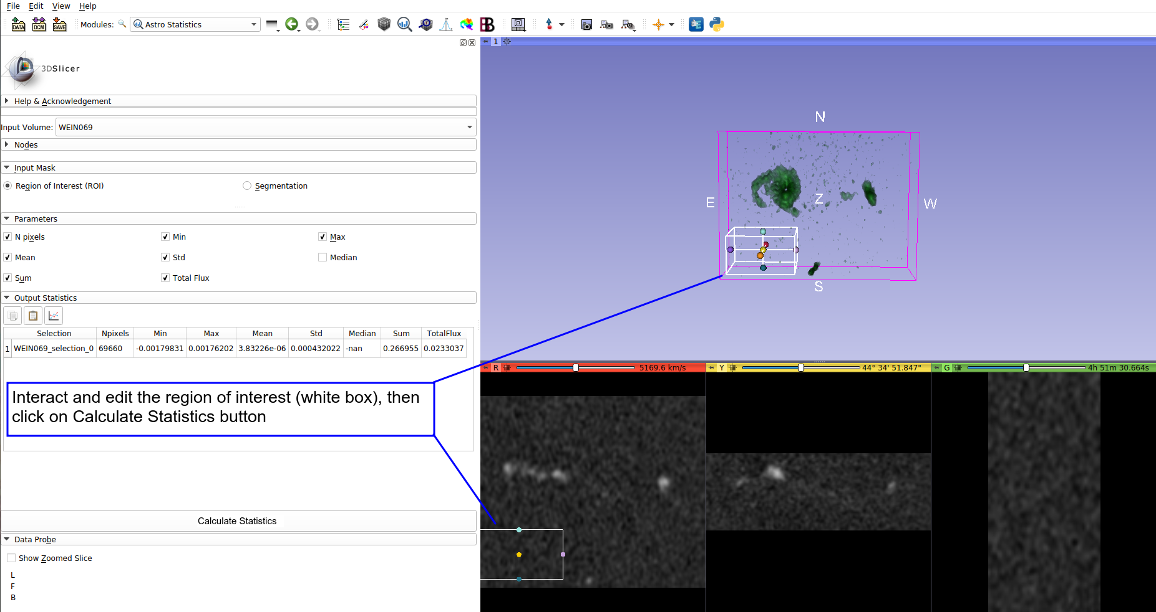
Quantitative visualization: statistics
Histogram
Load and visualize masks
Interactive masking
Statistics in a selection
Generate profiles
Generate moment maps
Interactive P-V slice
Generate P-V diagram
Reprojection of data
Contours

Slide 12
Quantitative visualization: profiles
Histogram
Load and visualize masks
Interactive masking
Statistics in a selection
Generate profiles
Generate moment maps
Interactive P-V slice
Generate P-V diagram
Reprojection of data
Contours

Slide 13
Quantitative visualization: moment maps
Histogram
Load and visualize masks
Interactive masking
Statistics in a selection
Generate profiles
Generate moment maps
Interactive P-V slice
Generate P-V diagram
Reprojection of data
Contours

Slide 14
Quantitative visualization: P-V slice
Histogram
Load and visualize masks
Interactive masking
Statistics in a selection
Generate profiles
Generate moment maps
Interactive P-V slice
Generate P-V diagram
Reprojection of data
Contours

Slide 15
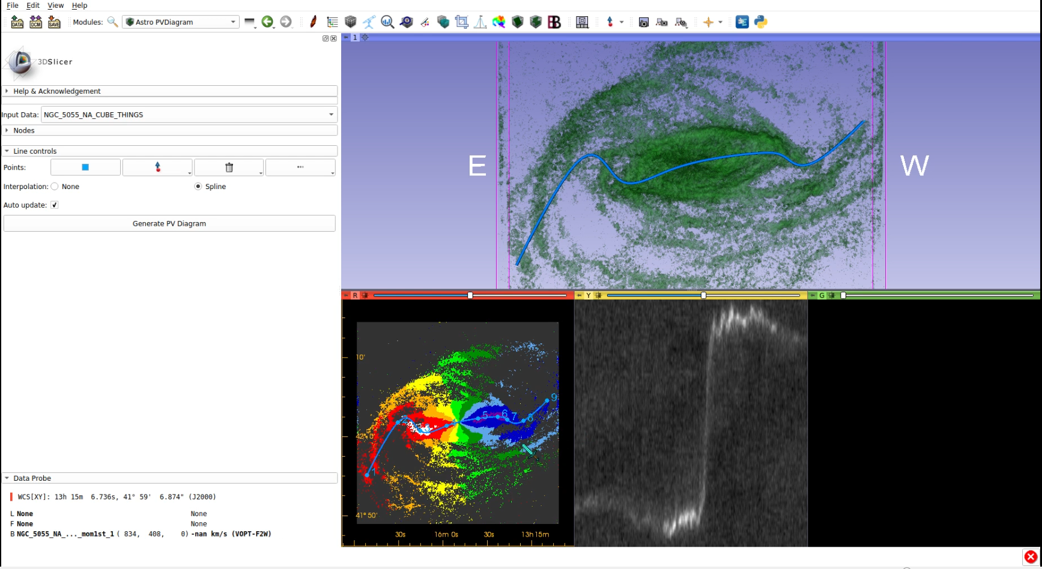
Quantitative visualization: P-V diagram
Histogram
Load and visualize masks
Interactive masking
Statistics in a selection
Generate profiles
Generate moment maps
Interactive P-V slice
Generate P-V diagram
Reprojection of data
Contours

Slide 16
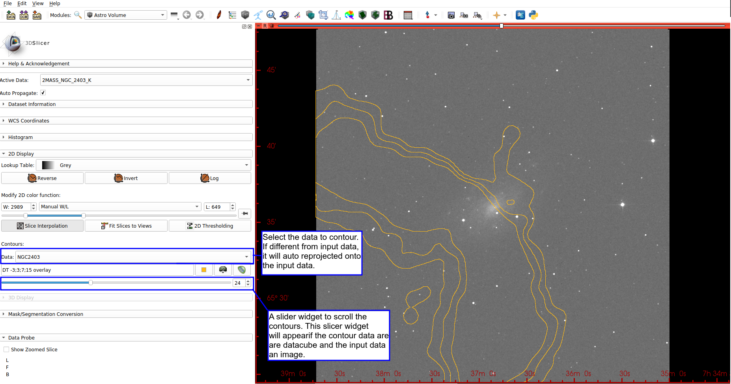
Quantitative visualization: reproject and contours
Histogram
Load and visualize masks
Interactive masking
Statistics in a selection
Generate profiles
Generate moment maps
Interactive P-V slice
Generate P-V diagram
Reprojection of data
Contours

Slide 17
VO and VR

Slide 18
Final Remarks
The main aim of SlicerAstro is to aid source inspection
and interactive analysis of spectral line data
SlicerAstro source code available at: https://github.com/Punzo/SlicerAstro
Stable Binaries (Linux and MacOS) are available at: https://github.com/Punzo/SlicerAstro/releases/tag/v1.0.0
Nigthly Binaries are available in the 3DSlicer Extension Manager: http://download.slicer.org/
We thank S. Pieper (Isomics), A. Lasso (Queen's University)
and K. Martin (Kitware) for their feedback and help.

