Slide 1
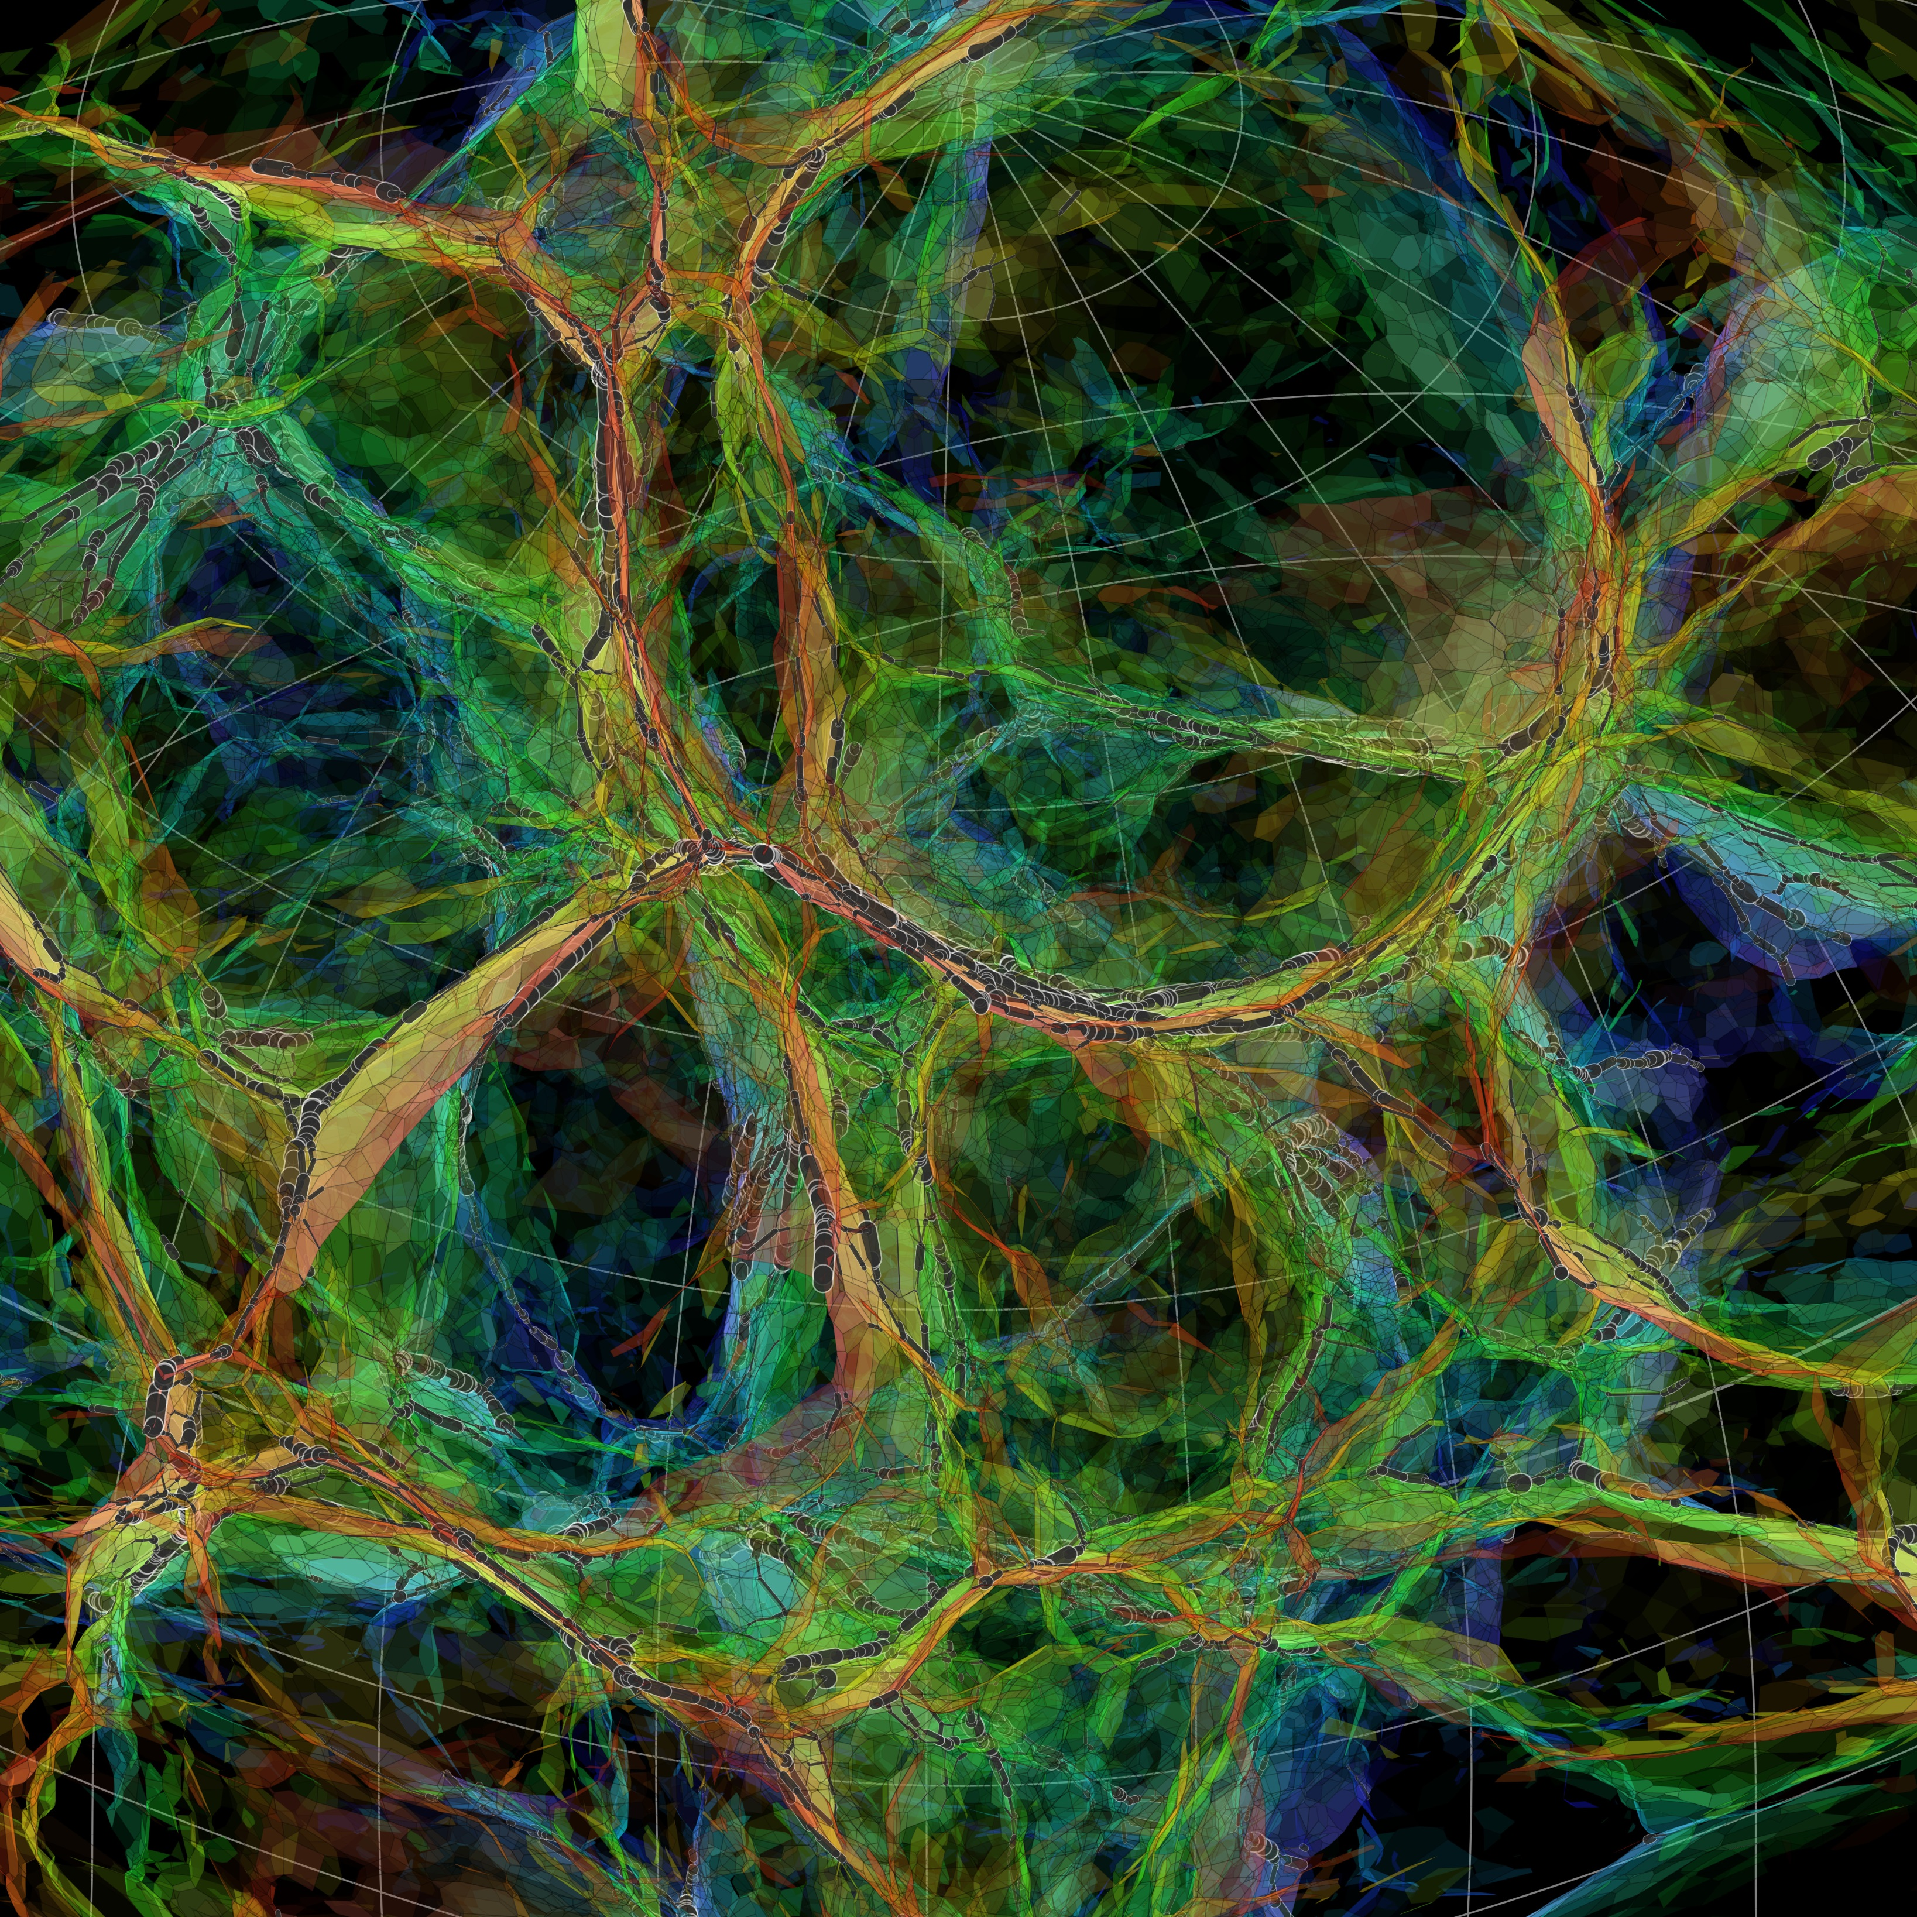
Cosmic
Structure Formation
Lecture course University of Groningen September 2018-October 2018

Slide 2
Practical Matters
Lectures: Kapteynborg
tuesday 15:00-17:00 Kapteynborg 5419 - 237
friday 13:00-15:00 Kapteynborg 5419 – 237/230/
105/103
friday 15:00-17:00 Kapteynborg 5419 - 161
Lectures: Rien van de Weygaert
rm. 186; tel. 050-3634086;
weygaert@astro.rug.nl
Tutorials: Olmo Piana
rm. 185; tel. 050-3638689
piana@astro.rug.nl
Website: www.astro.rug.nl/~weygaert/lss2018.html

Slide 3
Lecture Room Schedule
Lectures Rooms:
tuesday 15:00-17:00 Kapteynborg 5419 – 237
friday 13:00-15:00
Sept. 7 Kapteynborg 5419 - 237
Sept. 14 Kapteynborg 5419 - 105
Sept. 21 Kapteynborg 5419 - 105
Sept. 28 Kapteynborg 5419 - 105
Oct. 5 Kapteynborg 5419 - 230
Oct. 12 Kapteynborg 5419 - 103
Oct. 19 Kapteynborg 5419 - 105
Oct. 26 Kapteynborg 5419 - 237
friday 15:00-17:00 Kapteynborg 5419 –161
Exam: wed. Oct. 31 14:00-17:00 Kapteynborg 5419 - 161

Slide 4
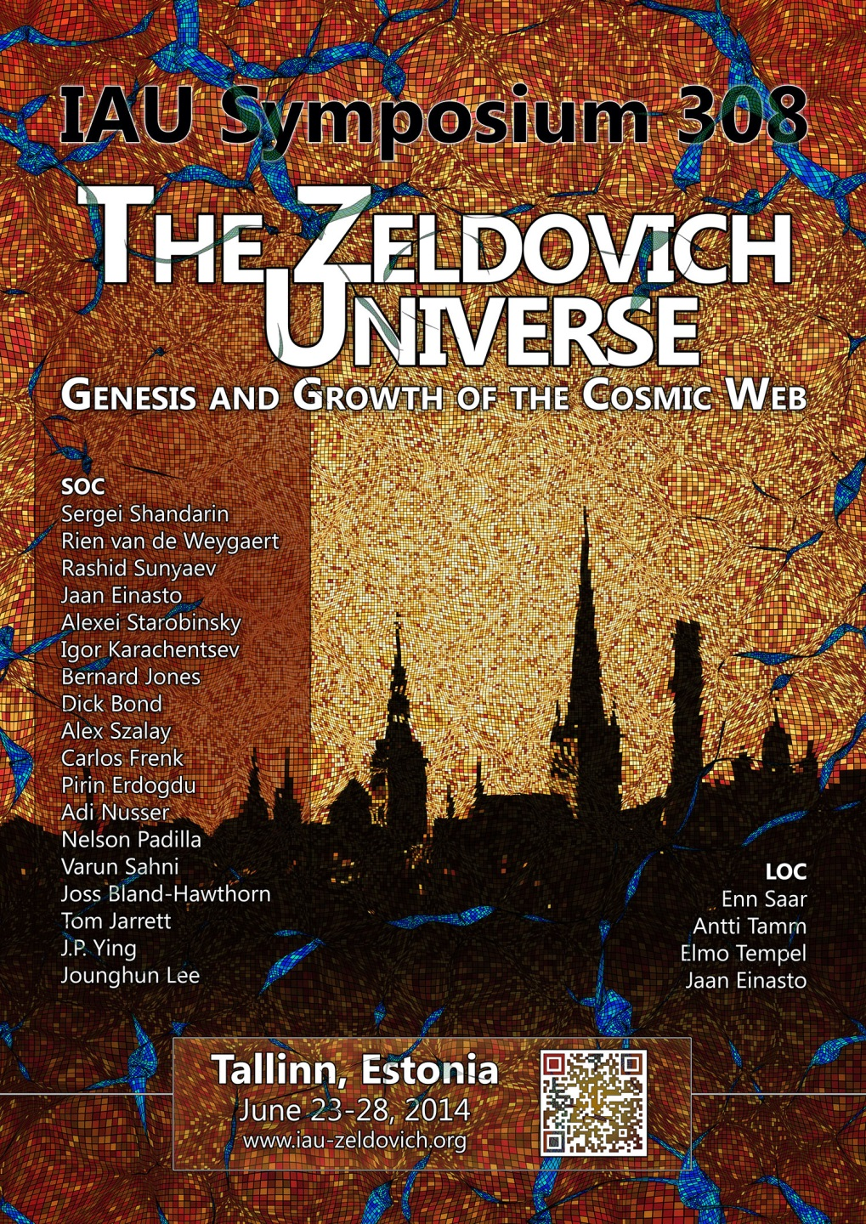

Slide 5
Exam
Three Constituents:
1. Exam (written) 65% wed. Oct 31
2.1 Tutorial Assignments (mandatory) 15%
2.2 Computer Assignments 20%
Correlation Function, CMB Dipole,
Gaussian Fields, Zeldovich …

Slide 6
Literature
Large Scale Structure of the Universe
P.J.E. Peebles, Princeton Univ. Press, 1981
The Classic Book, the Bible … defining the field !!!!!!!!!!!!
Galaxy Formation
M. Longair; Springer, A&A Library, 2nd ed., 2008
Good overview of structure and galaxy formation
Galaxy Formation and Evolution
H.J. Mo, F. van den Bosch, S.D.M. White, Cambridge Univ. Press, 2010
Most up to date book on cosmic structure formation
Structure Formation in the Universe
T. Padmanabhan, Cambridge Univ. Press, 1993
very thorough, advanced level: hard to work through
Cosmology
S. Weinberg; Oxford Univ. Press, 2008
Impressive book, covering most of relevant cosmological topics, including
structure formation, inflation theory, origin perturbations, CMB
Cosmological Physics
J. Peacock; Cambridge Univ. Press, 1998
very thorough treatment of relevant topics, advanced level
Statistics of the Galaxy Distribution
V.J. Martinez & E. Saar; Chapman & Hall/CRC, 2001
best book on statistical analysis of galaxy distribution; treats fundamentals, little bit outdated

Slide 7
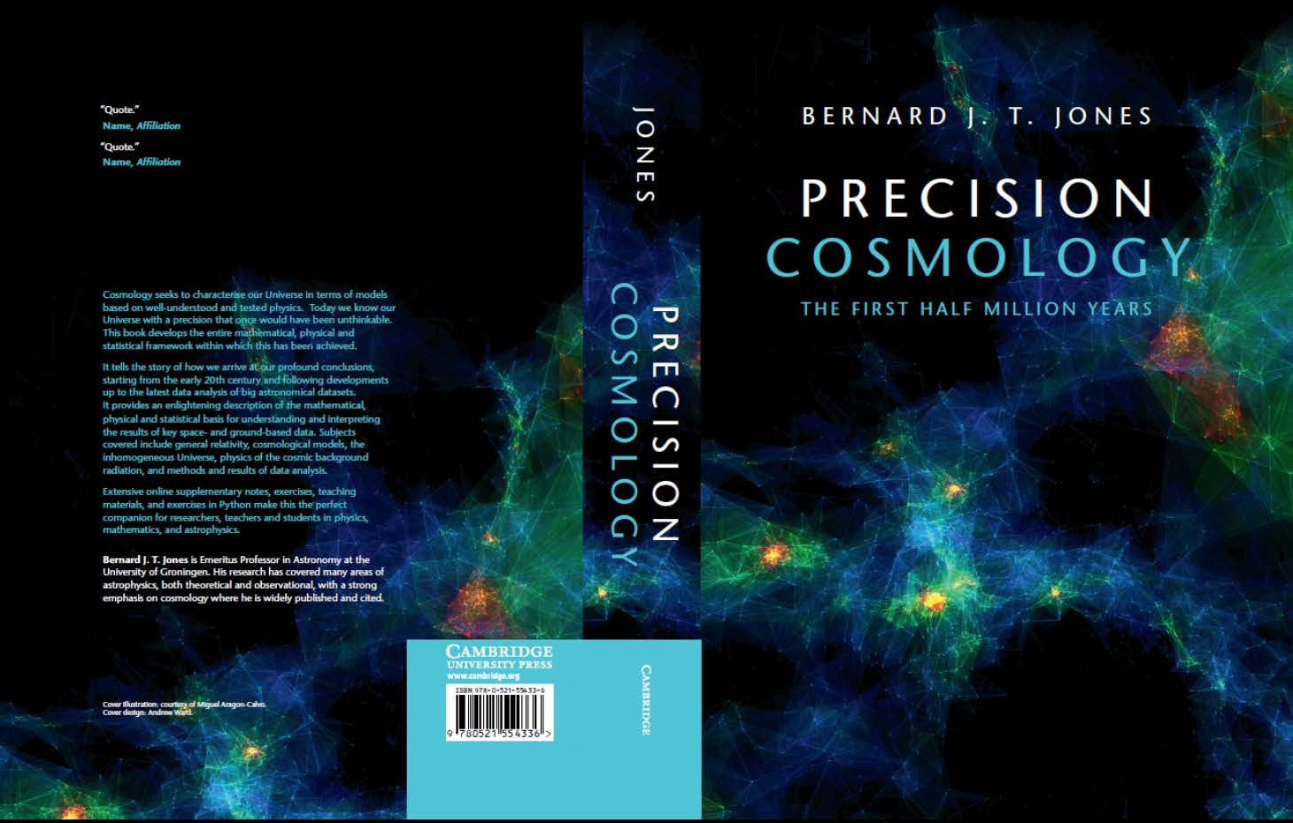
Groningen Books
The Zeldovich Universe:
Genesis and Growth of the Cosmic Web
Proc. IAU Symposium 308
R. van de Weygaert et al., eds.
Cambridge Univ. Press, £80.00
Nov. 30, 2016
Precision Cosmology
the first half million years
B.J.T. Jones
Cambridge Univ. Press, £64.99
Mar. 31, 2017

Slide 8
Literature
A Pan-Chromatic View of Clusters of Galaxies and the Large-Scale Structure
M. Plionis, O. Lopez-Cruz, D. Hughes, eds., Lect. Notes in Physics 720, Springer, 2008
Very useful reviews on in particular cluster physics.
Two chapters part of course material (Van de Weygaert & Bond 2008a, 2008b)
The Zeldovich Universe: Genesis and Growth of the Cosmic Web
R. van de Weygaert, et al., Cambridge Univ. Press, Nov. 2016
proceedings IAU Symp. 308, Tallinn, 2014
nice collection of state-of-the-art papers on cosmic structure formation
How did the First Stars and Galaxies Form
A. Loeb, Princeton Univ. Press, 2010
beautiful expose on the first stages of structure and galaxy formation
the Cosmic Microwave Background
R. Durrer, Cambridge Univ. Press, 2008
best textbook on the physics of the CMB
Introduction to Cosmology
B. Ryden, Addison-Wesley, 2003
good reference book on basic cosmology
Precision Cosmology
B.J.T. Jones, Cambridge Univ. Press, 2017
perfect advance level textbook cosmology

