Slide 1
Cosmology
In search of our Origins

Slide 3
Cosmic Origins
Universe 380.000 yrs after Big Bang
13.8 Gyrs ago (13.7980.037 Gyrs)
Temperature T = 2.725480.00057 K
temperature/density fluctuations (T/T<10⁻⁵)
Planck Baby Photo
of our Universe

Slide 4
Age of Precision Cosmology
Over the past century - in particular the last 2 decades - we have established an
amazingly accurate view of the Universe in which we live:
It was formed in the Hot Big Bang: T₀ = 13.7980.037 Gigayears ago
Space (!!!) is expanding ever since: H₀ = 67.740.46 km/s/Mpc
expansion acceleraring since: 6.7  0.4 Gigayears ago
It has an average energy density of: ₀ = 0.862  10⁻²⁹ g/cm³
The outer edge/Horizon of the visible Universe: d_{H}  41 Giga lightyears
within Horizon: # galaxies  10010⁹
# stars  20010¹⁸
On every atom (proton/neutron):   1.9  10⁹ photons
Space is almost perfectly flat: _{k}  0.000  0.005
Cosmic composition: Baryons (protons/neutrons)  4.9%
Dark Matter  26.8%
Dark Energy  68.3%

Slide 5
Cosmology,
Science of the Universe

Slide 6
Cosmology:
Science of the Universe
Van Dale
(astronomical) science or theory of
the universe as an ordered unity;
study of the structure and evolution of the universe.
Broadest Sense:
human enterprise joining science, philosophy,
theology and the arts to seek to gain understanding
of what unifies and is fundamental to our world.
Scientific:
Study of large and small structures of the Universe

Slide 7
Essential & Existential Questions
Occupying Humanity
since Dawn of Civilization
Where does the World come from ?
What is the World made of ?
How did the World begin ?
When did the World begin ?
Did it begin at all ?
How “big” is the World ? (finite, infinite …)
What is the role of humans in the cosmos ?
What is the fate of the Universe ?

Slide 8
Cosmic Time:
Origin and Fate ?
Does the Universe have an origin ?
If so, how old is it ?
Or, … did it always exist, infinitely old …
• What is the fate of the Universe ?
… will it always be there, or is there an end ?

Slide 9
Energy:
Content of the Universe
What are the components of the Universe ?
How does each influence the evolution of
the Universe ?
… and …
• How is each influenced by the evolution of
the Universe ?

Slide 10
Cosmological Riddles
Is our Universe unique, or are there many
other Universes (multiverse) … ?
What made the Universe originate ?

Slide 11
Cosmological Riddles
Why are the physical laws as they are ?
Do they need to be ?
How many dimensions does the Universe have?
More than 1timelike + 3 spacelike ?

Slide 12
Cosmological Riddles
… and …
Are our brains sufficiently equipped to
understand and answer
the ultimate questions … ?

Slide 13
A unique time …
• The past century, since 1915,
marks a special epoch
For the first time in human history,
we are able to address the
great questions of Cosmology …
• scientifically …

Slide 14
the Universe
has a
Beginning

Slide 15
Night Sky is Dark
In an infinitely large, old and unchanging
Universe each line of sight would hit a star:
Sky would be as bright as surface of star:
Night sky as bright as
Solar Surface, yet
the night sky is dark
finite age of Universe (13.8 Gyr)

Slide 16
Cosmology:
observing
the history of the Universe

Slide 17
Cosmology: exploring Space & Time
Cosmology is a unique science:
not only it looks out to the deepest realms and
largest scales of our Universe
on cosmological scales,
the finite velocity of light becomes a critical factor …
thus, it also looks back in time, to the earliest moments,
and thus is the ultimate archaeological science

Slide 18
Cosmic Depth = Cosmic Time
Light propagation through the Universe:
light has a finite velocity (c=300,000 km/s)
the further you look, the further you look in time !

Slide 19
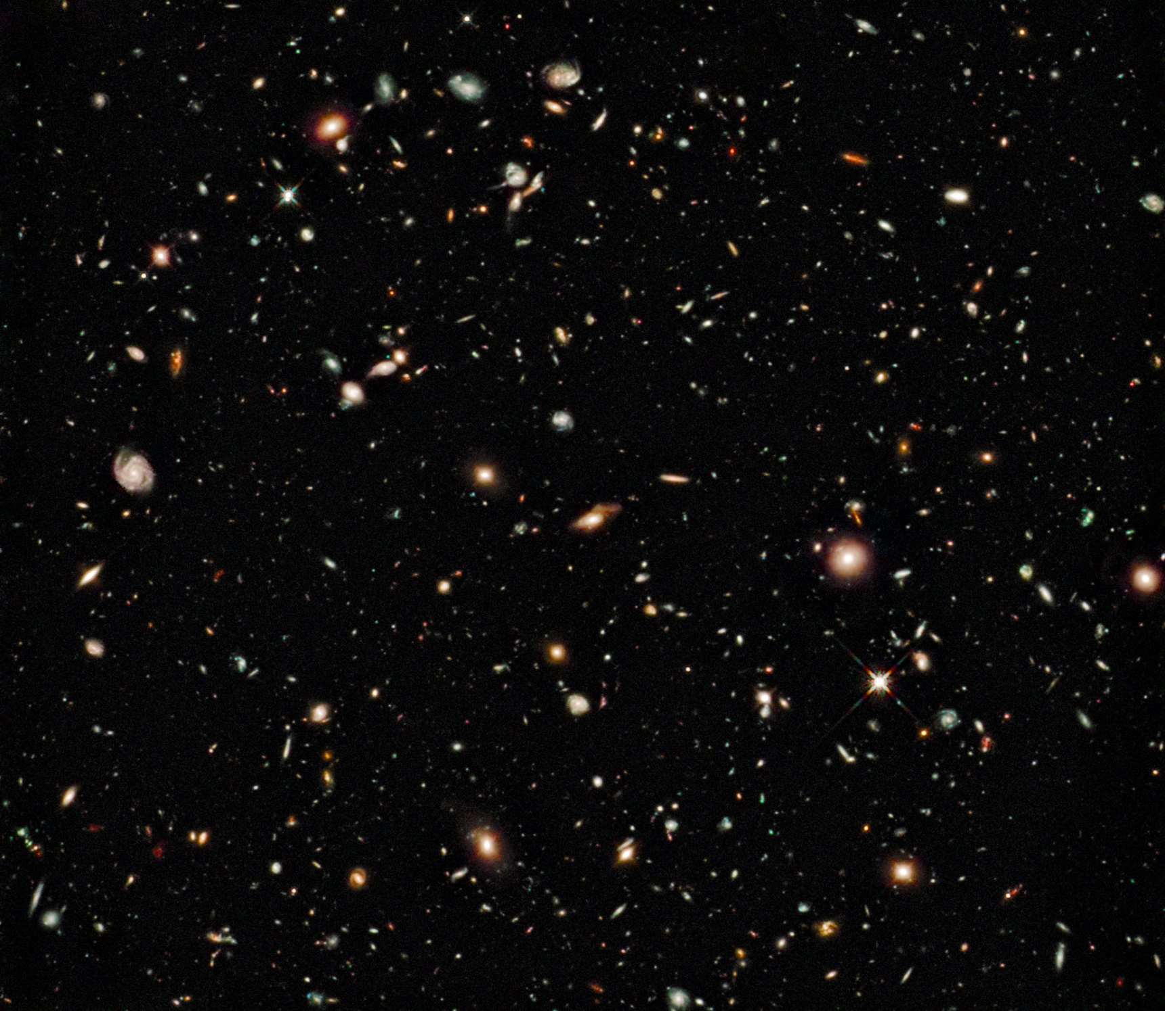

Slide 21
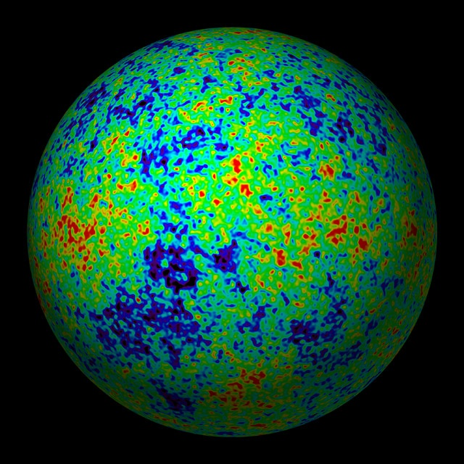
Edge of the Visible Universe
WMAP
CMB
temperature map
Earliest View
of our Cosmos:
the Universe
379,000 years
after the Big Bang
Cosmic Microwave Background

Slide 22
the Universe:
a Unique Astrophysical Object
There is only one (visible) Universe …
Finite velocity of light, c:
… a look in depth = a look back in time …
• c & implications for space-time:
observational cosmology limited to only
a minor thin “shell” of all of spacetime …

Slide 23
13.8 Gigayears
of
Cosmic History

Slide 26
Big Bang Chronology

Slide 27
Cosmic Calendar

Slide 29
Cosmic Composition

Slide 30
Cosmic Light: most abundant species
By far,
the most abundant particle species
in the Universe
to every proton/neutron
n_{γ}/n _{B} ~ 1.9 billion

Slide 31
the Cosmic TV Show
Note:
The cosmic microwave background is not an exotic phenomenon:
1% of the radiation (noise) on your (camping) tv is this CMB radiation:
!!!!! Live broadcast Big Bang !!!!!
Courtesy: W. Hu

Slide 32
Cosmic Energy Inventory
Fukugita & Peebles 2004

Slide 33
Cosmic Constituents

Slide 34
Fate
of the Universe

Slide 35
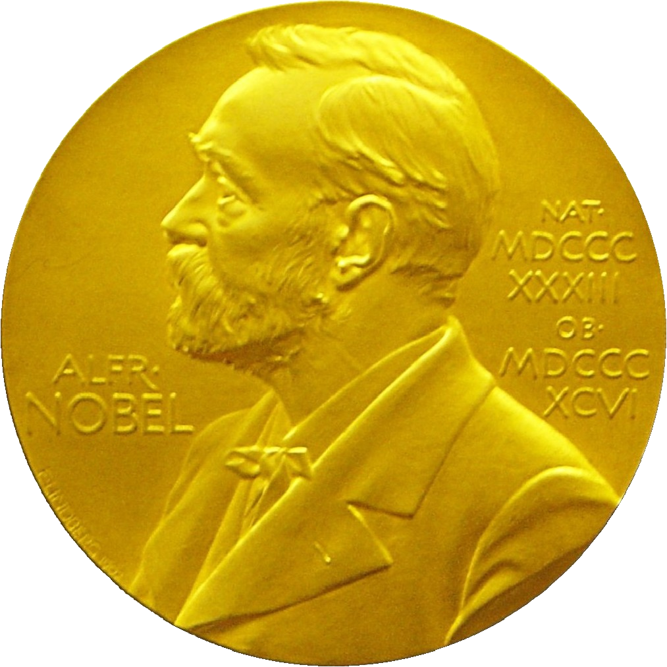
Nobel Prize Physics 2011
“the most startling discovery in physics since
I have been in the field.”
E. Witten
“I was shocked by my discovery, I just
assumed we made a mistake"
Brian Schmidt

Slide 37
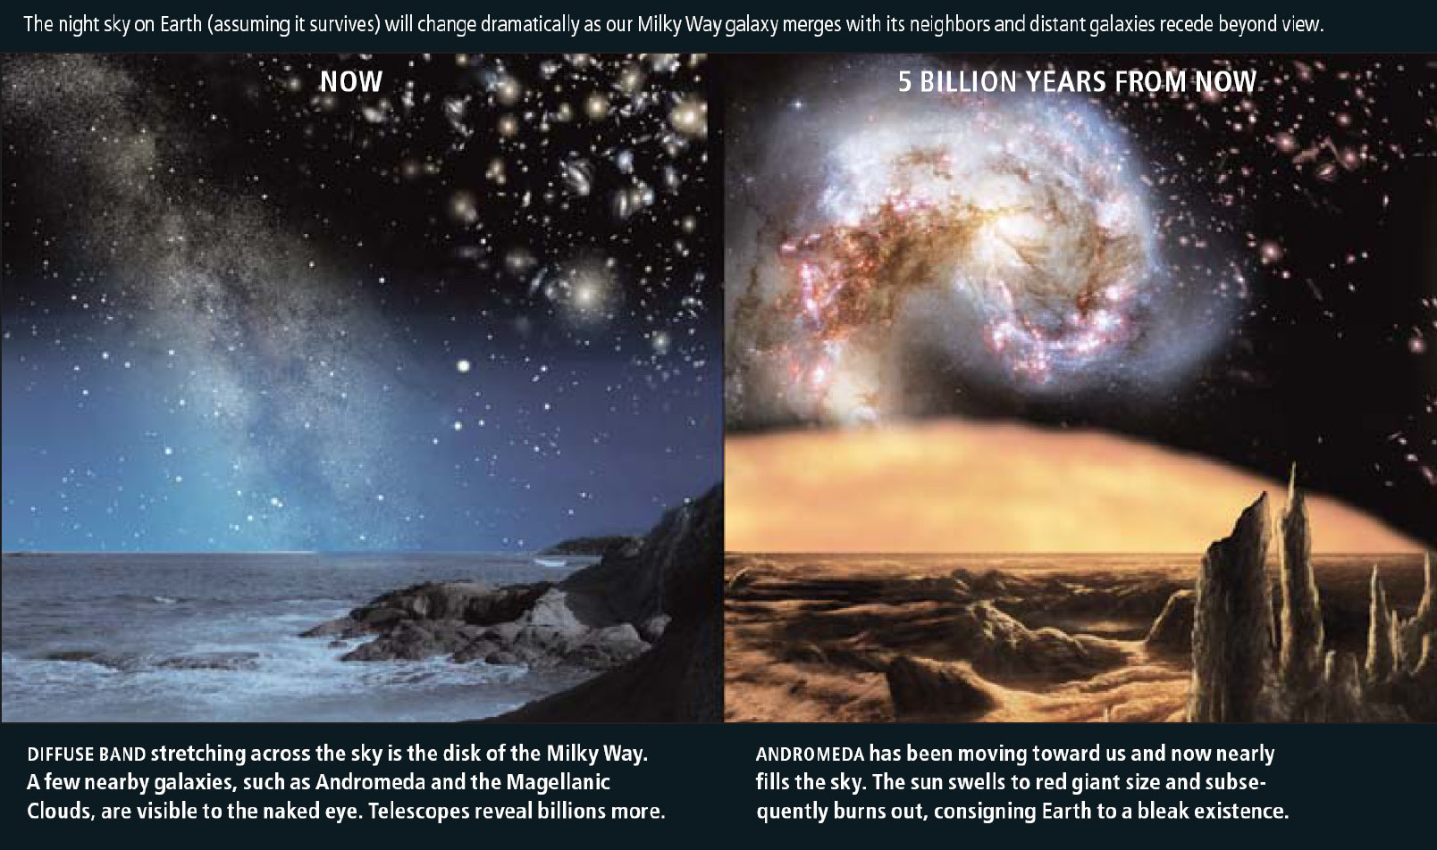
Cosmic Fate
100 Gigayears:
the end of Cosmology

Slide 38
Cosmology
Ancient Answers

Slide 39
"In the beginning God
created the heavens and the earth”
Genesis 1; 1-26

Slide 40
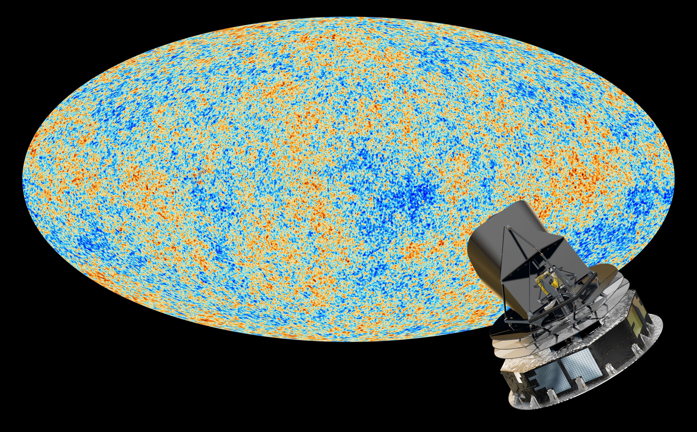
14 And God said, Let there be lights in the firmament of the heaven
to divide the day from the night; and let them be for signs, and for seasons,
and for days, and years:
15 And let them be for lights in the firmament of the heaven to give light upon the earth:
and it was so.
16 And God made two great lights;
the greater light to rule the day, and the lesser light to rule the night:
[he made] the stars also.
17 And God set them in the firmament of the heaven to give light upon the earth,
18 And to rule over the day and over the night,
and to divide the light from the darkness:
and God saw that [it was] good.
19 And the evening and the morning were the fourth day.
Genesis 1:14-1:19

Slide 41
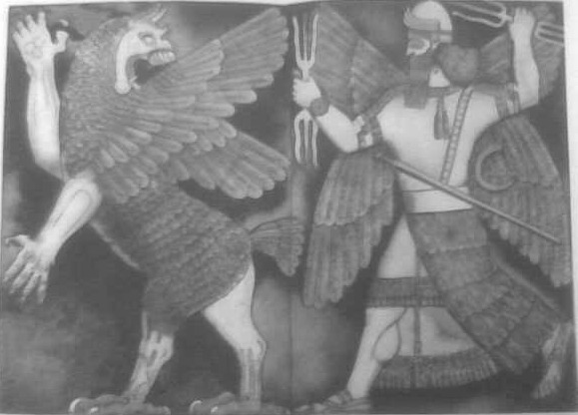
Enuma Elis
Enuma Elis is
the Babylonian creation mythos.
Striking similarity to Genesis
Important source for understanding
Babylonian worldview, centered on the
supremacy of Marduk
and the creation of humankind for the
service of the gods.
When the sky above was not named
And the earth beneath did not yet bear a name
And the primeval Apsu, who begat them,
And chaos, Tiamat, the mother of them both,
Their waters were mingled together,
And no field was formed, no marsh was to be seen;
When the gods none had been called into being.
Marduk and the Dragon
Marduk, chief god of Babylon, destroys – with his thunderbolt –
Tiamat the dragon of primeval chaos

Slide 42
Hindu Cosmology
The Nasadiya Sukta
(after the incipit ná ásat "not the non-existent"), also known as the
Hymn of Creation,
is the 129th hymn of the 10th Mandala of the
Rigveda (10:129).
It is concerned with cosmology and the origin of the universe

Slide 43
Nasadiya Sukta – Hymn of Creation
There was neither non-existence nor existence then; Neither the realm of space, nor the sky which is beyond; What stirred? Where? In whose protection?
There was neither death nor immortality then; No distinguishing sign of night nor of day; That One breathed, windless, by its own impulse; Other than that there was nothing beyond.
Darkness there was at first, by darkness hidden; Without distinctive marks, this all was water; That which, becoming, by the void was covered; That One by force of heat came into being;
Who really knows? Who will here proclaim it? Whence was it produced? Whence is this creation? Gods came afterwards, with the creation of this universe. Who then knows whence it has arisen?
Whether God's will created it, or whether He was mute; Perhaps it formed itself, or perhaps it did not; Only He who is its overseer in highest heaven knows, Only He knows, or perhaps He does not know.
The Rig Veda, 10.129.1–7

Slide 44
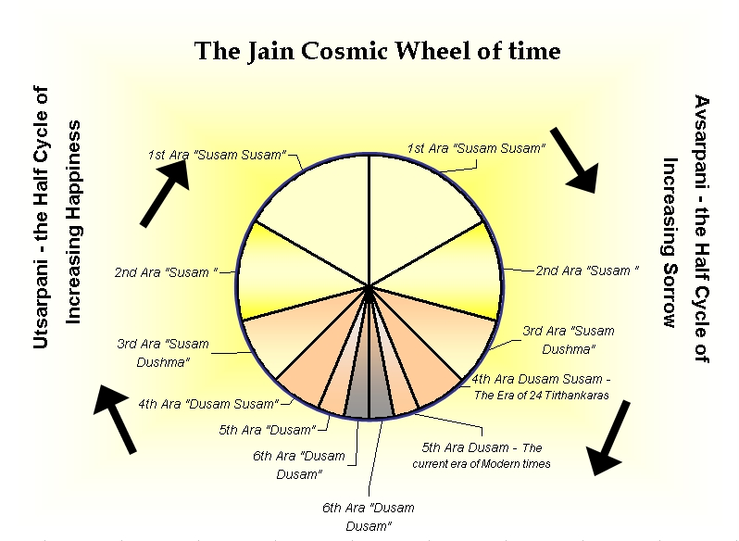
Jain Cosmology
According to Jain doctrine,
- the universe and its constituents always existed
- the universe was not created, and there is no creator

